Slide 1
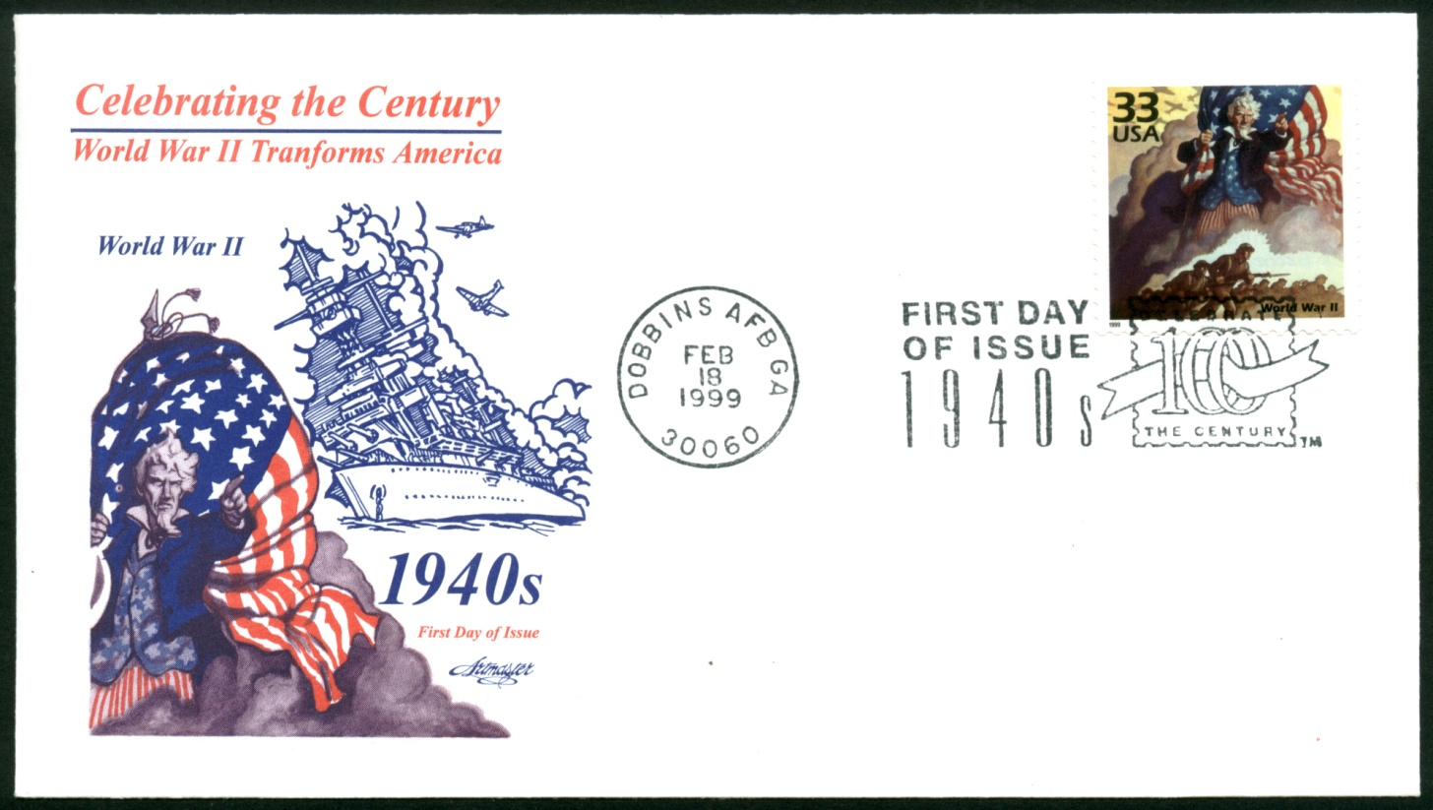
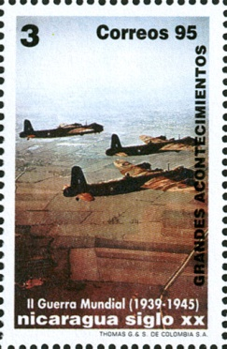
World War II on WorlDWIDE Stamps
by Luis Greiff, Jr. for the Rochester Philatelic Association
Notes:
1 – World War II on Worldwide Stamps. A presentation by Louis Greiff, Jr. for the Rochester Philatelic Association. First show on January 24 and February 14, 2013 for attending club members.

Slide 2
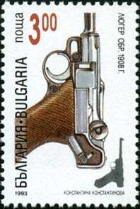
Notes:
2- Guns, perhaps the most common of weapons during World War II. This is a German Lugar, the weapon of choice for German soldiers during World War I and World War II, attaining almost legendary status with friends and foes alike.

Slide 3
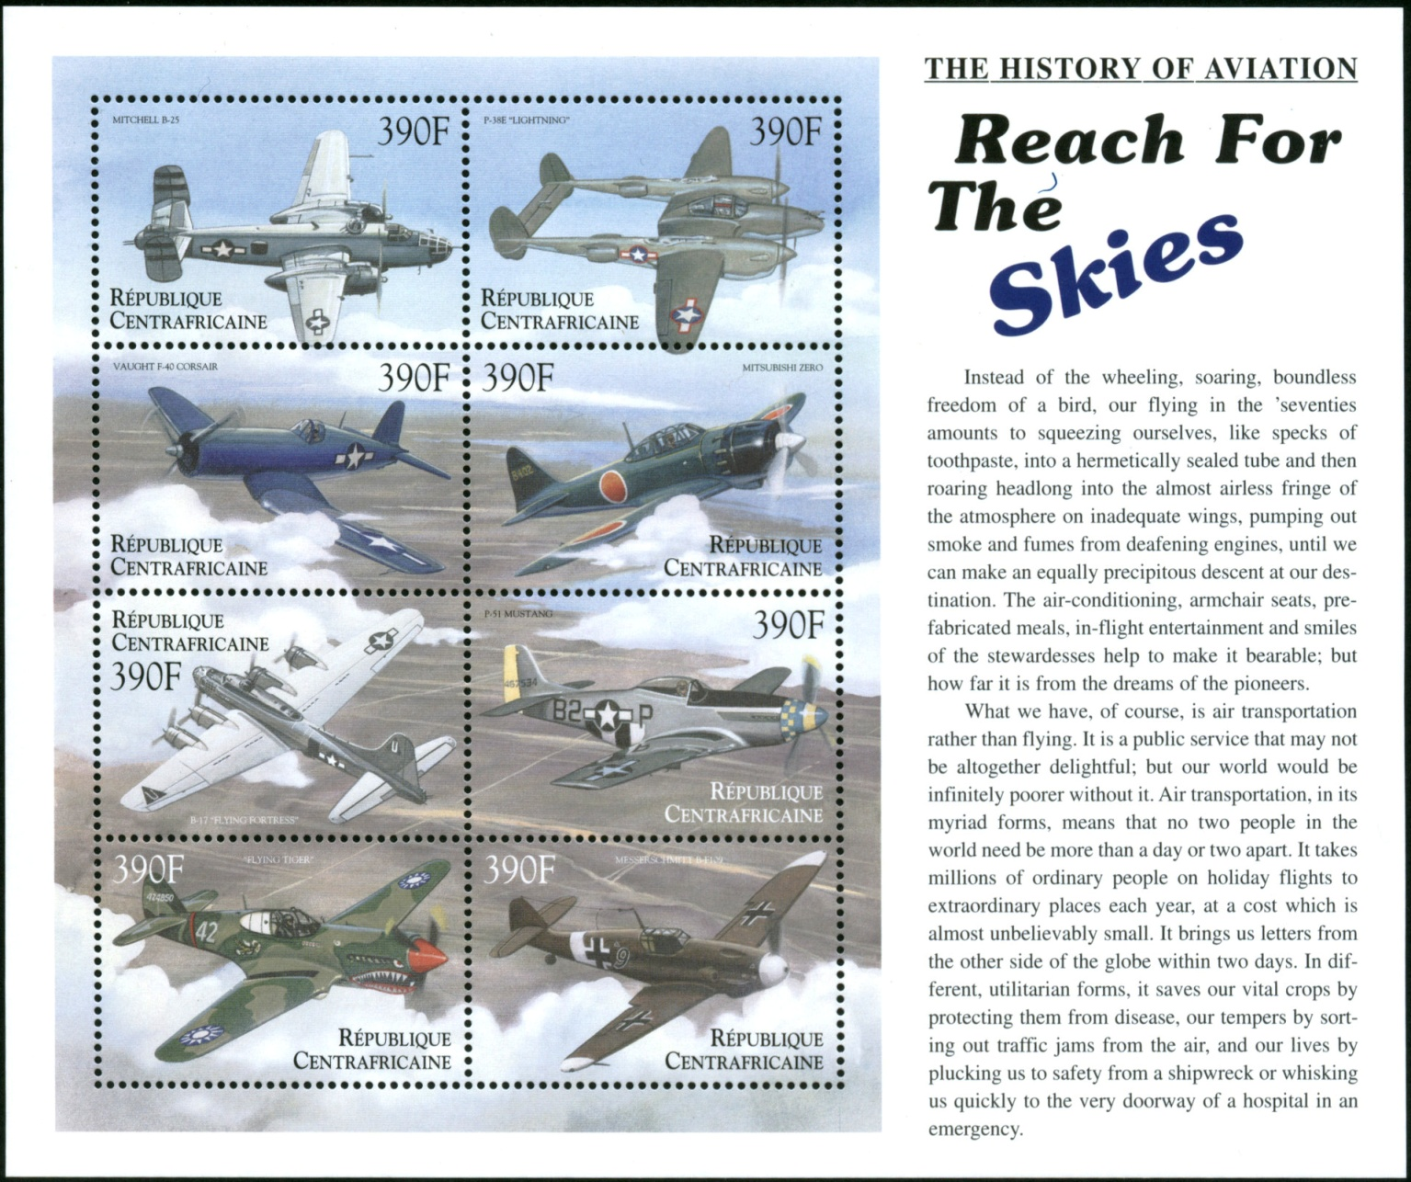
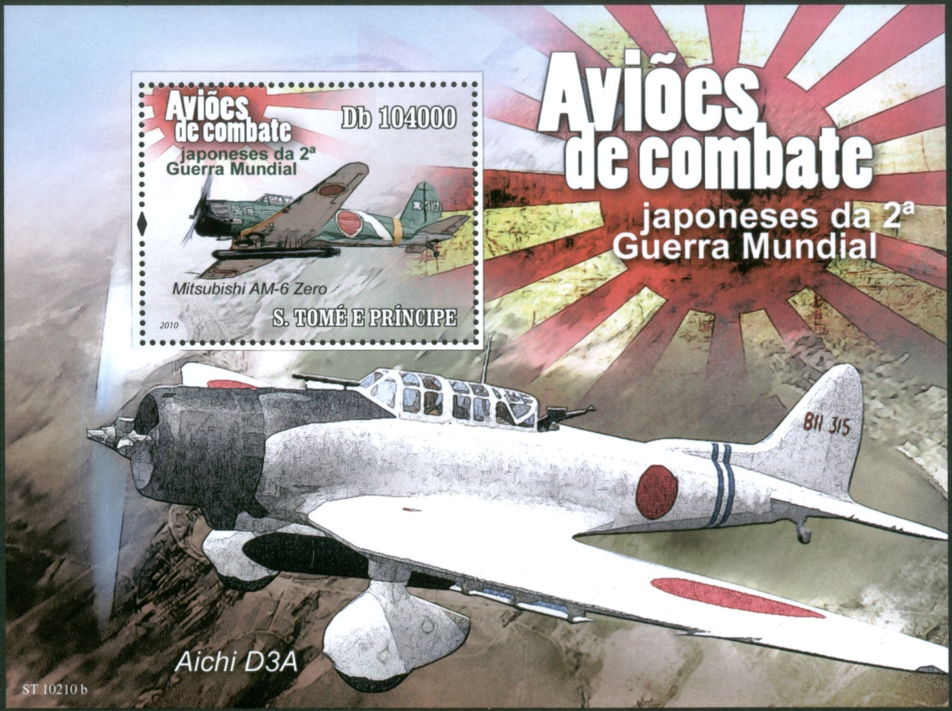
Notes:
3- The technological sophistication of military aircraft throughout World War II was one of the deciding factors in its outcome. A variety of them are shown on these two sheets. The Central African Republic sheet shows the Mitchell B-25, P-38E Lightning, Vaught F-40 Corsair, Japanese Mitsubishi Zero, B-17 Flying Fortress, P-51 Mustang, a “Flying Tiger” and German Messerschmitt B-F109. The souvenir sheet sports two Japanese planes, a Mitsubishi AM-6 Zero and Aichi D3A.

Slide 4
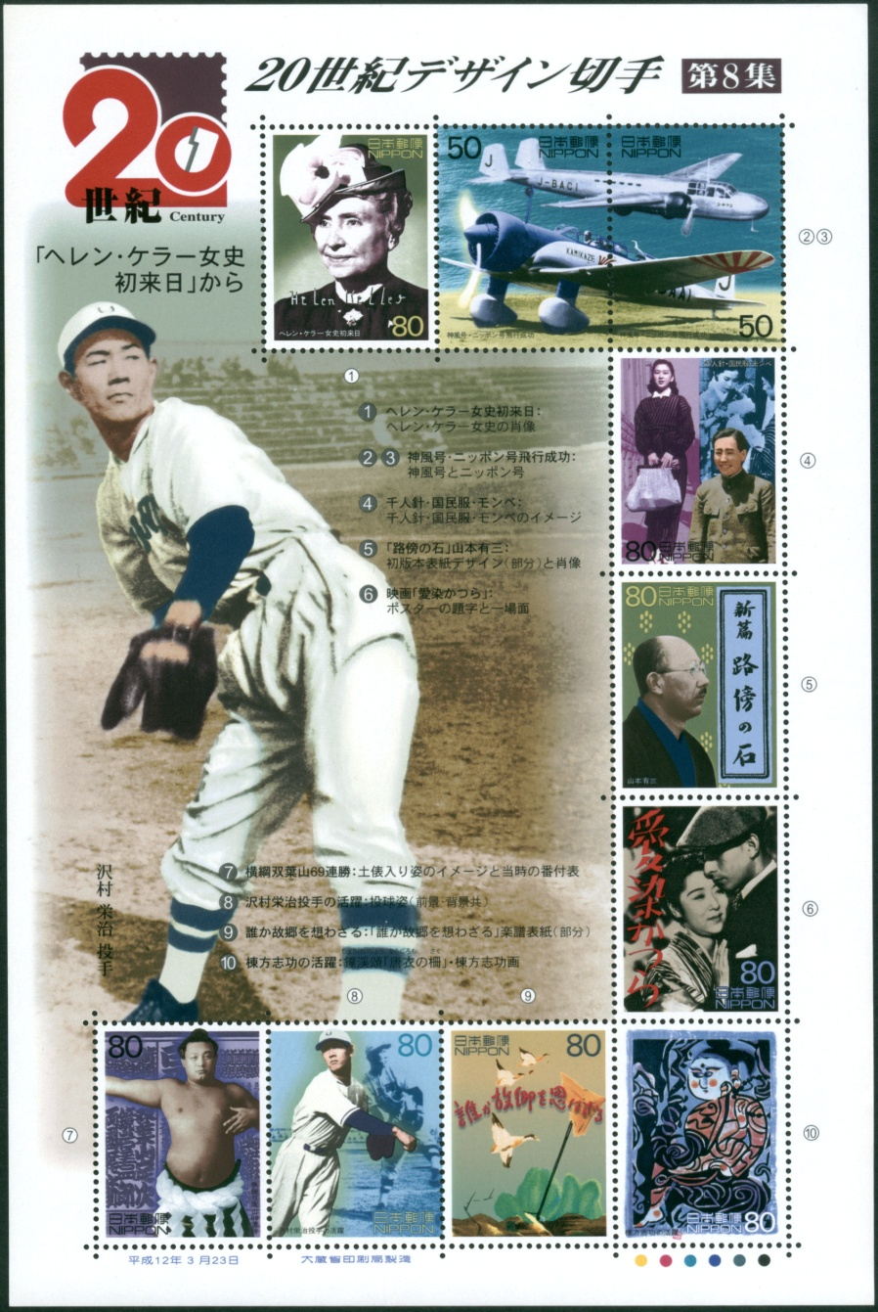
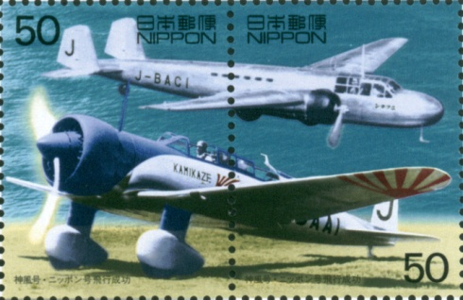
Notes:
4- Among the stamps displaying Japanese culture in the Twentieth Century is a pair of war planes. The lower plane is inscribed “Kamikaze,” the infamous Death Planes of Japanese desperation near the war’s conclusion.

Slide 5
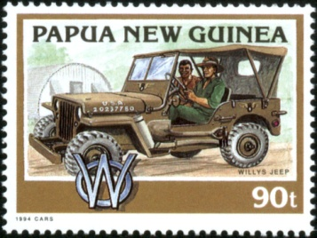
Notes:
5- These vehicles, popular even today, were the mechanized “war horses” of their World War I animal counterpart. We know them as Jeeps today, a slang name given them by WWII Army mechanics for any untested vehicle. Their manufacturer, Willys-Overland, first demonstrated its capabilities by driving up the US Capitol’s steps in February of 1941. A photo and article in the Washington Daily News showing the stunt quoted one of the test drivers as calling it a Jeep and the name stuck.

Slide 6
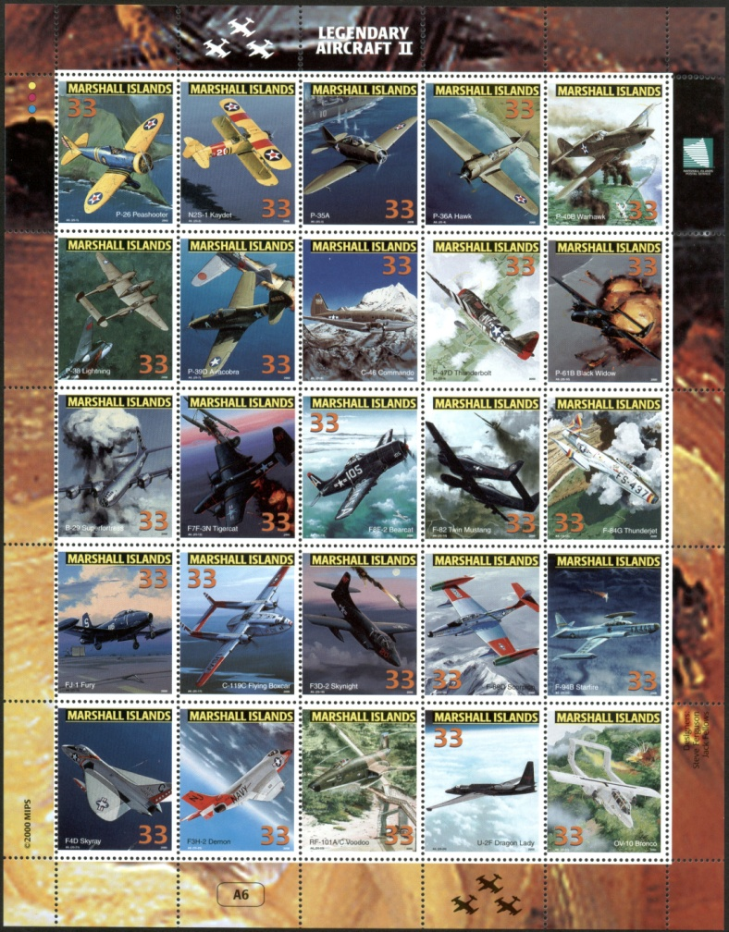
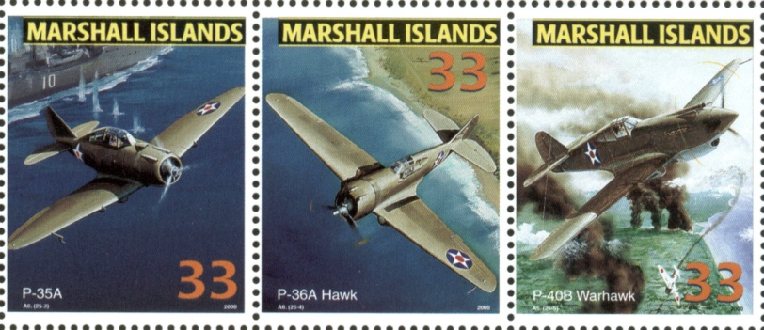
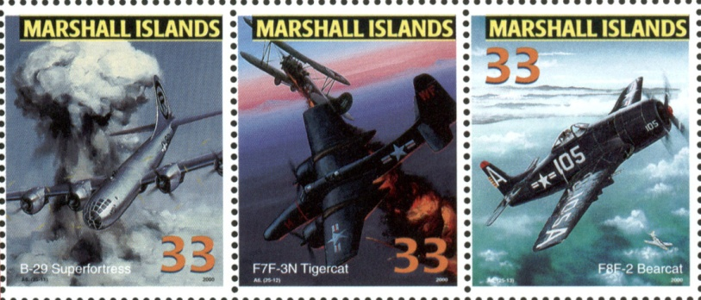
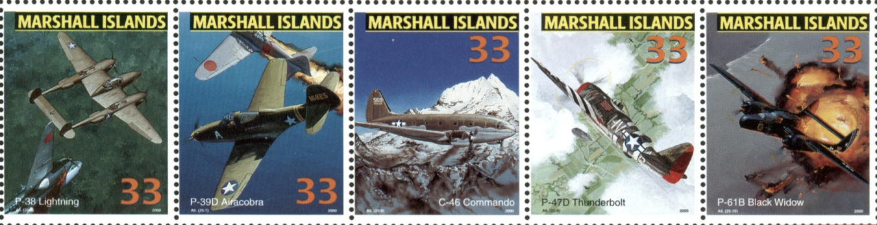
Notes:
6- A sheet of stamps from the Marshall Islands also show a variety of US aircraft from the War. Notable is the Boing B-29 Superfortress “Enola Gay” that dropped the first atomic bomb over Hiroshima.

Slide 7
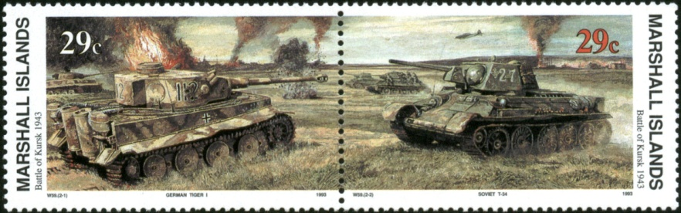
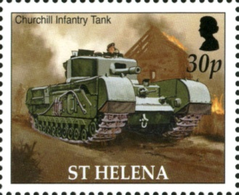
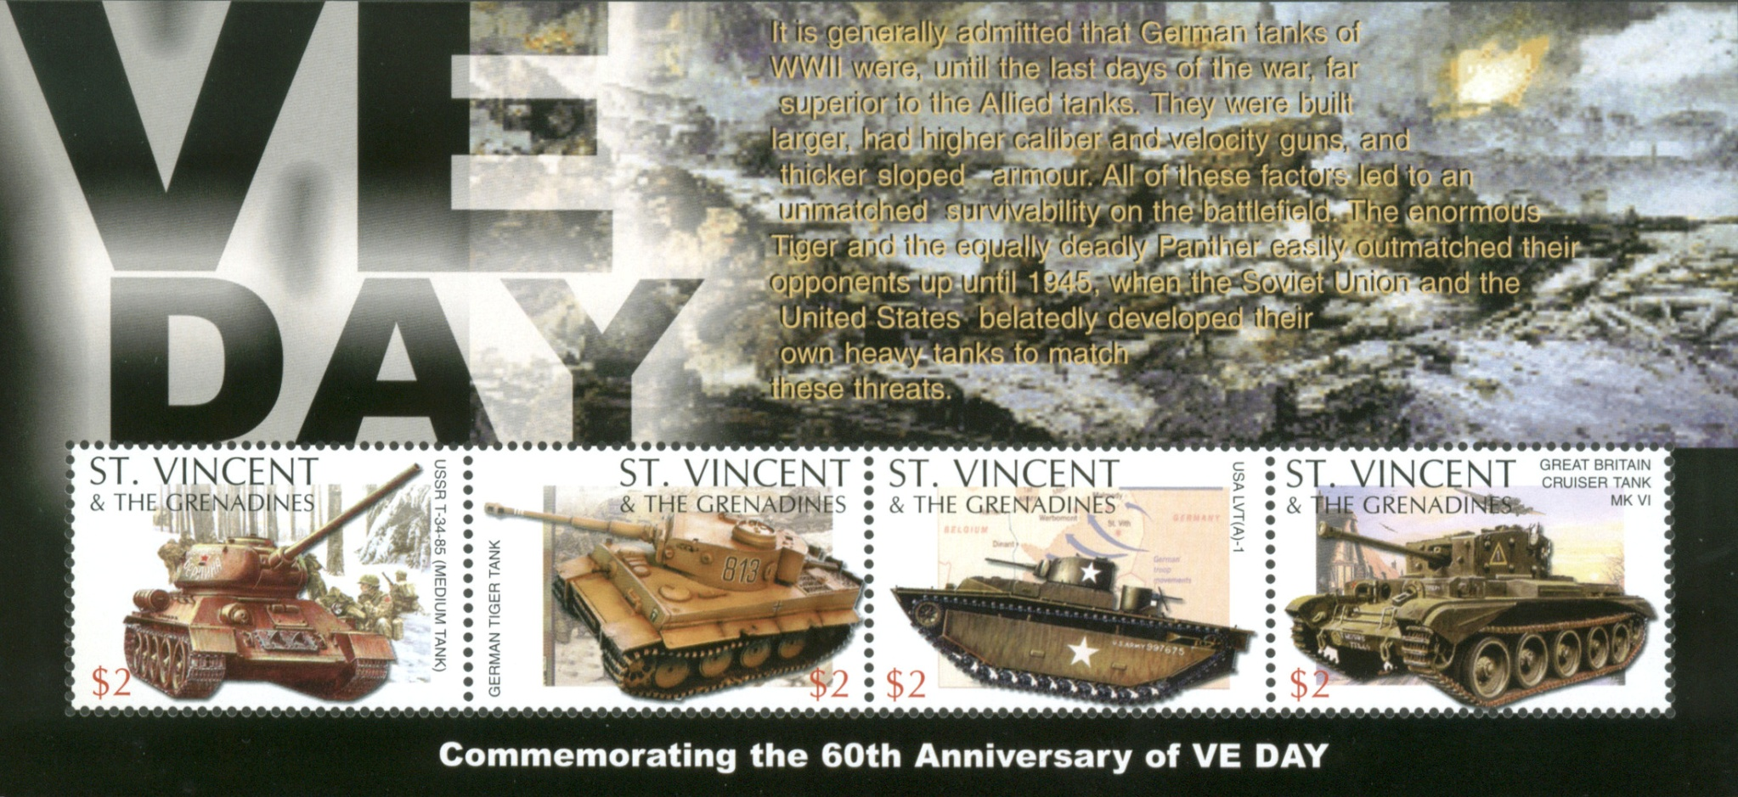
Notes:
7- Allied and Axis tanks are depicted here: On the Marshall Islands pair a German Tiger and Soviet T-34, on St. Helena’s stamp a British Churchill Tank, and others on the St. Vincent souvenir sheet. As the text on the souvenir sheet states, German tanks were considered superior to Allied tanks for their larger size, armor and firepower.

Slide 8
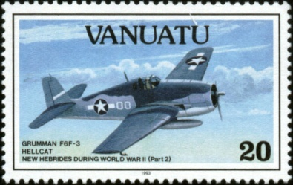
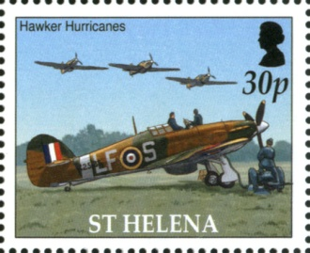
Notes:
8- The Grumman F6F Hellcat was introduced in 1943 as a carrier based fighter and could reach a speed of 380 miles per hour. 12,200 were produced for the Pacific Theater in just two years. The Royal Air Force’s Hawker Hurricane became famous in the Battle for Britain. Some were converted for use as “Hurricats,” catapult-launched convoy escorts.

Slide 9
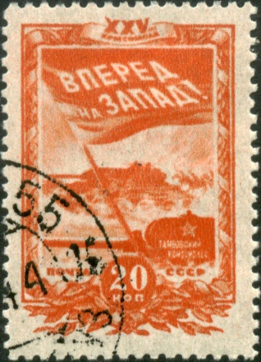
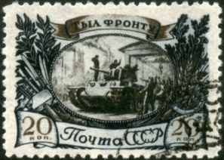
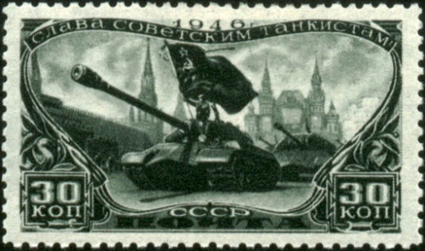
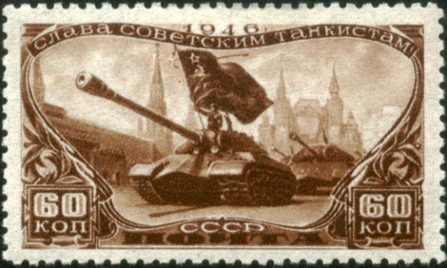
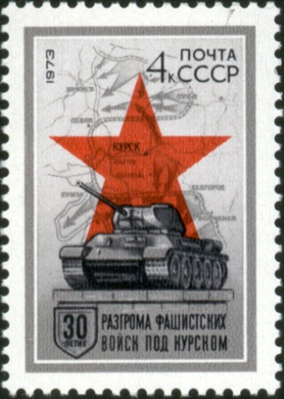
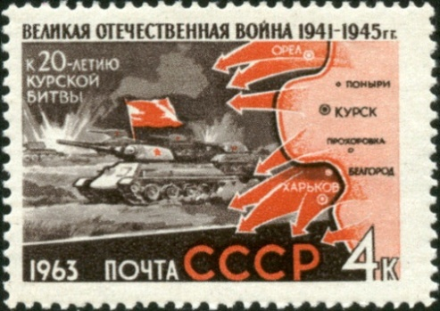
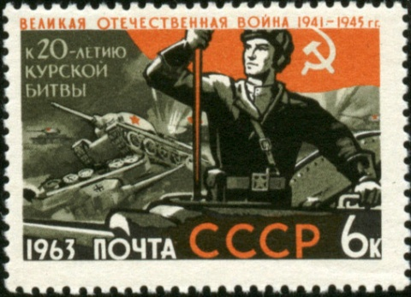
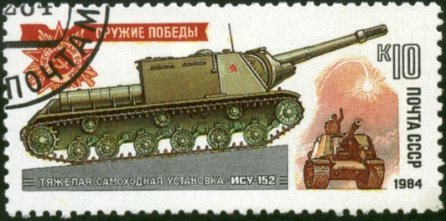
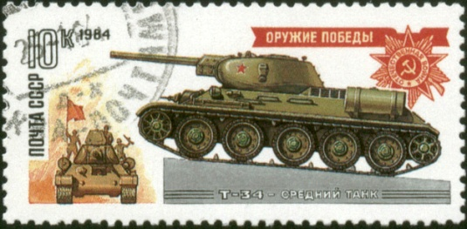
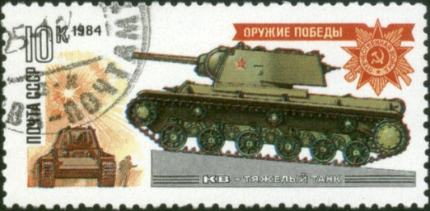
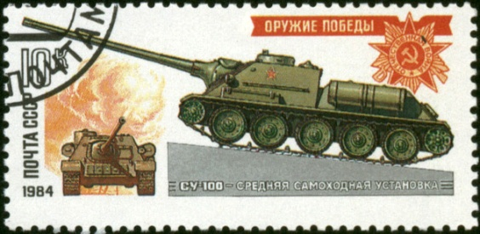
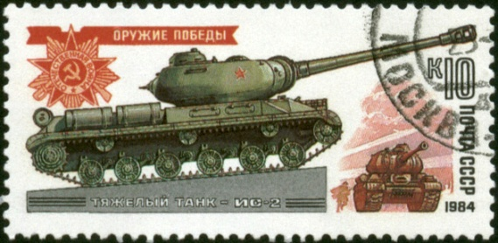
Notes:
9- Russian postal issues during and commemorating World War II could be considered patriotic propaganda. Here are several sets showing their tanks. The center stamps from 1963 and 1973 honor the role tanks played in the July-August 1943 Battle of Kursk, 280 miles south of Moscow, essentially halting the German advance on Russia.

Slide 10
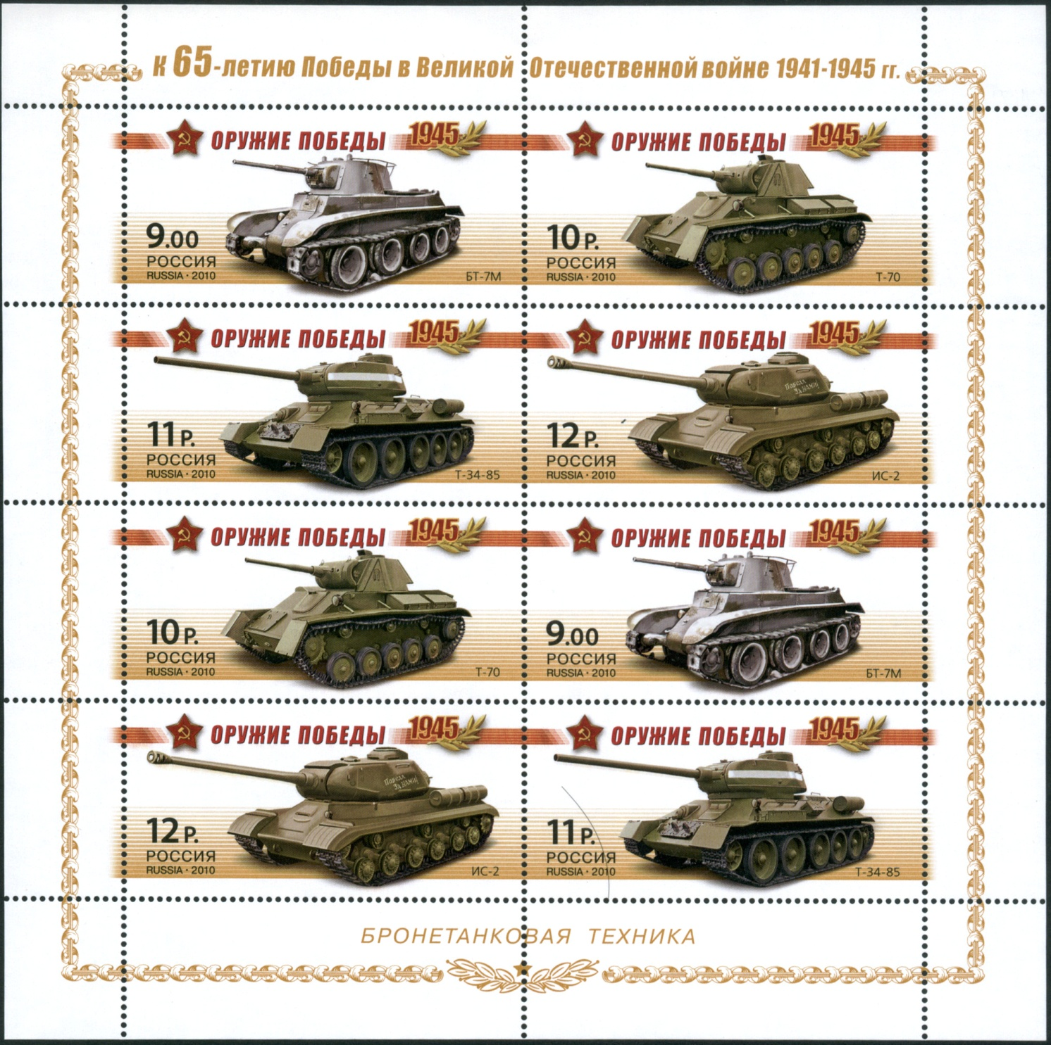
Notes:
10- A great variety of tanks were produced by the Russians throughout World War II, as seen on this sheetlet issued in 2010, the 65th anniversary of the war’s conclusion. All were named with letter and number combinations.

Slide 11
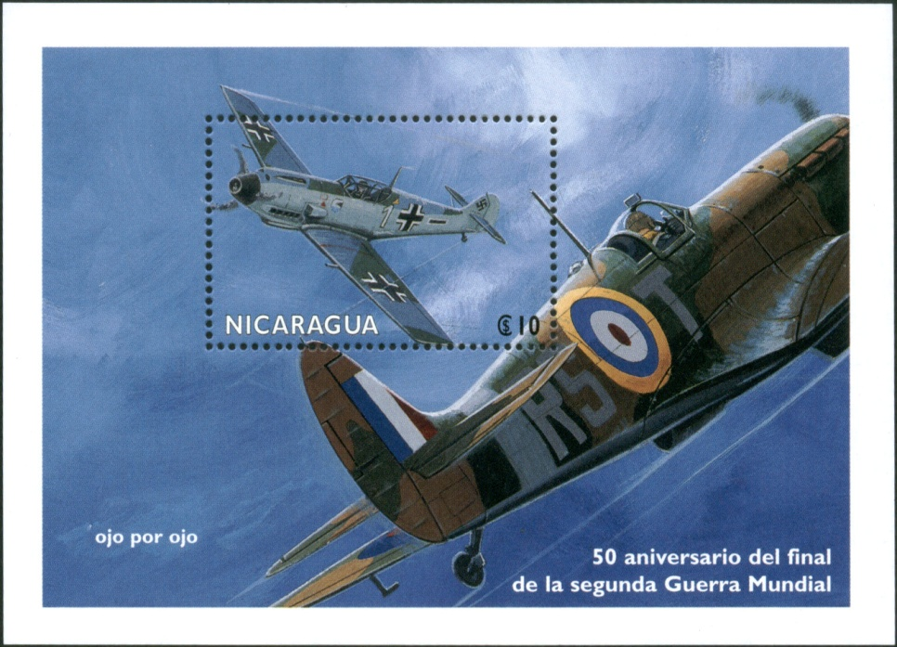
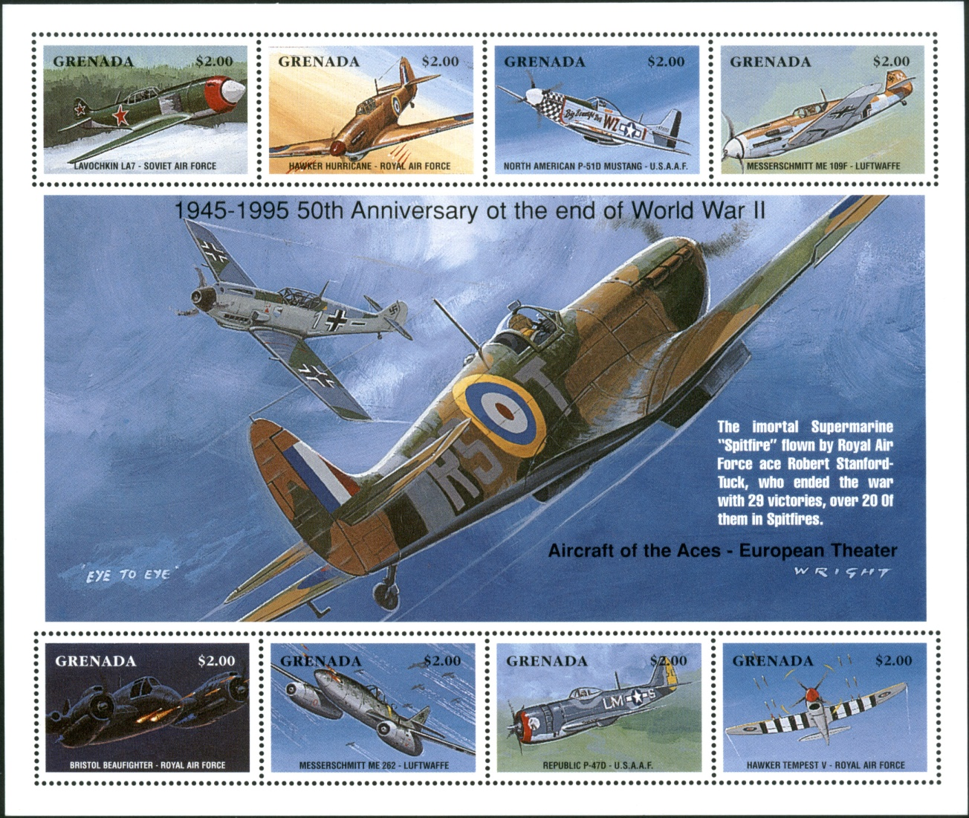
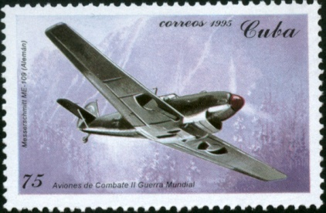
Notes:
11- You’ve probably noticed that the same artwork was used on this1995 Nicaragua souvenir sheet and the center “gutter” of the 1995 Grenada sheetlet, both issued for the 50th anniversary of the war’s end. A silver Messerschmitt ME-109 is predominant in the Cuban stamp, on the top right stamp on the Grenada sheetlet, and as the RAF Supermarine Spitfire opponent in the artwork. Between 1936, when it was first used during the Spanish Civil War, to its final version made right up to the European war’s conclusion in April 1945, 33,984 Messerschmitts were produced for the German Luftwaffe and its allies.

Slide 12
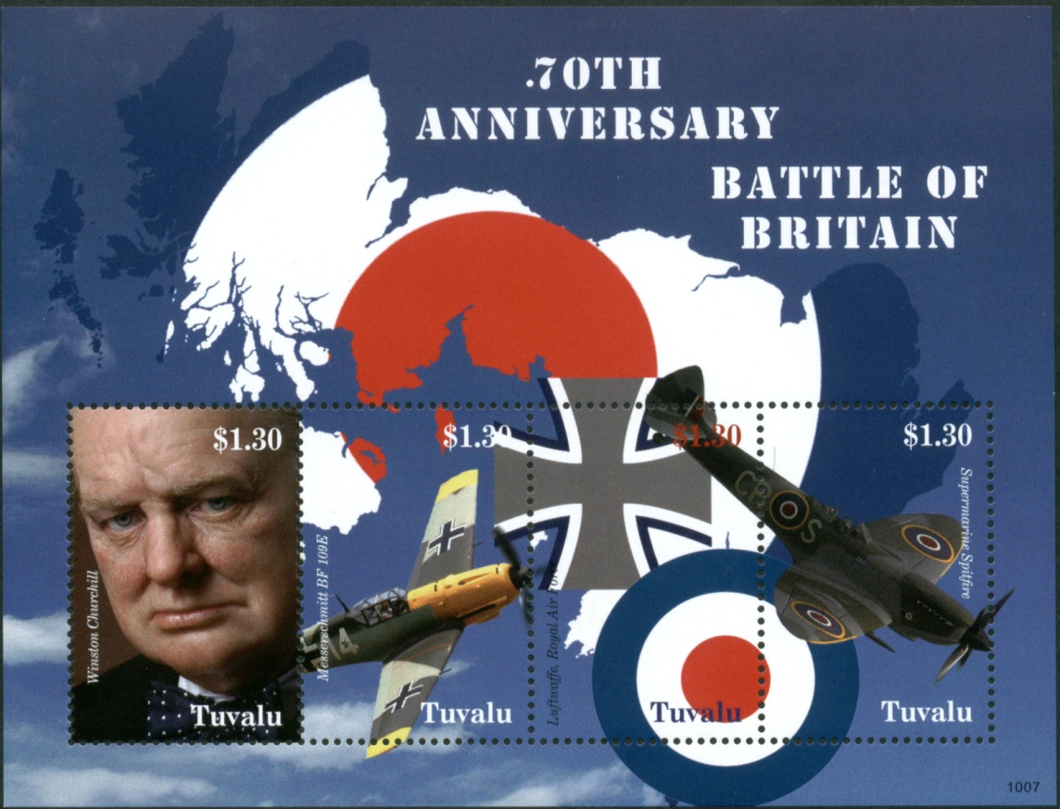
Notes:
12- This Tuvalu issue for the 50th anniversary of the Battle of Britain again depicts the epic struggle between the RAF Supermarine Spitfire and Messerschmitt ME-109. Text on the stamp gives the fighter’s alternate name designation, the Messerschmitt Bf-109 (second stamp from the left).

Slide 13
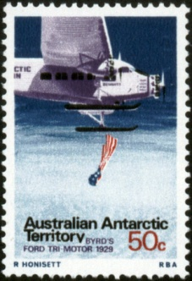
Notes:
13- What is this Australian Antarctic Territory stamp doing in a presentation about World War II? The Ford Tri-Motor passenger plane depicting Richard Byrd’s 1929 dropping of an American flag over the South Pole was a common passenger plane used throughout the war, but not necessarily with the ski feet!

Slide 14
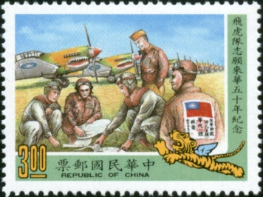
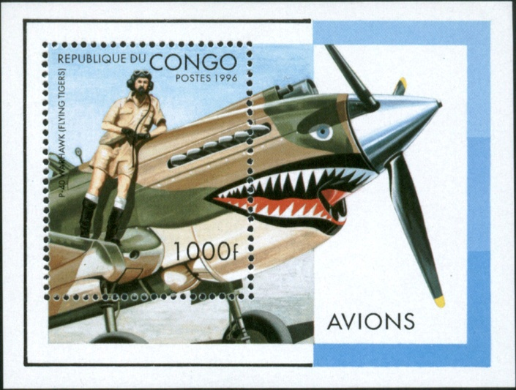
Notes:
14- The story of the 1941-42 “Flying Tigers” is a legendary one. Here, the Republic of China (Taiwan) shows P-40 Warhawks awaiting takeoff as pilots discuss final flight plans. Officially named the1st American Volunteer Group of the Chinese Air Force, the all-volunteer air corp consisted of three squadrons of 20 planes each, all distinctively painted with tiger nose art. Their initial mission was in the defense of Burma against Japanese aggressors, eventually retreating to defend China.

Slide 15
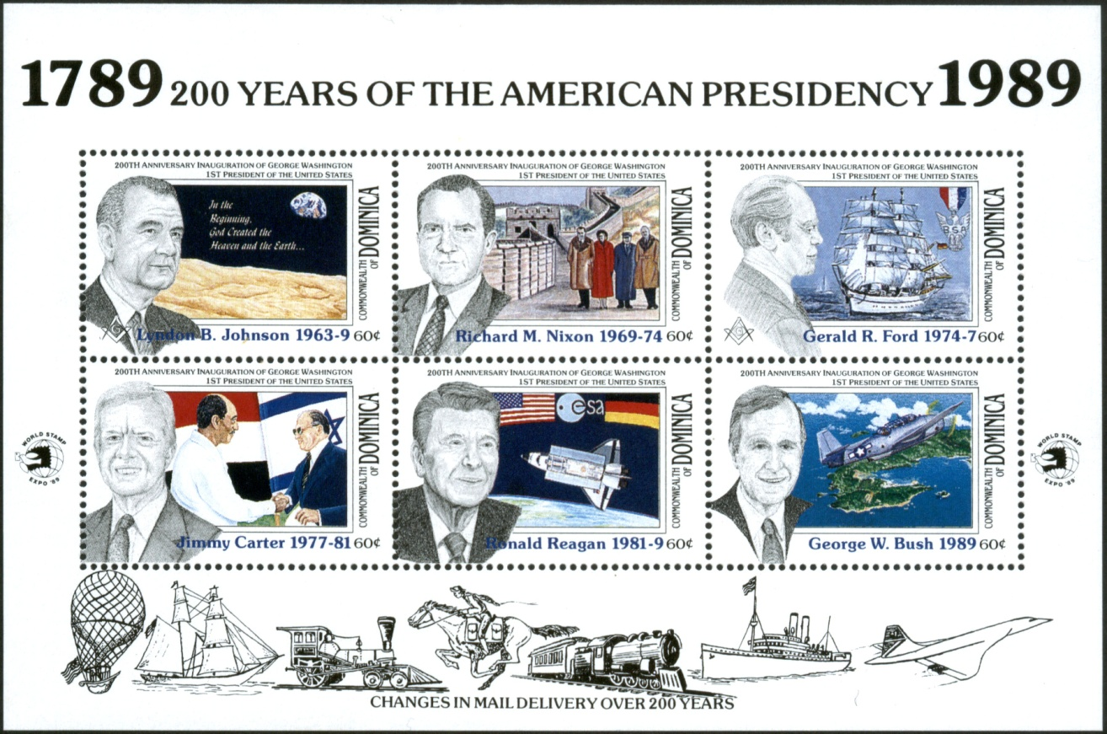
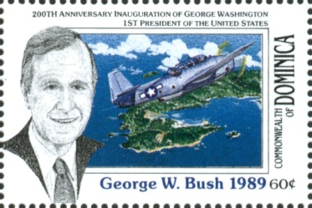
Notes:
15- Among US presidents and their accomplishments on this souvenir sheet from Dominica is one honoring World War II pilot George W. Bush and a Grumman Avenger bomber. Lieutenant Junior Grade Bush and two air crewmen were shot down on June 12, 1944 on a mission with Torpedo Squadron Fifty One as they tried to return to the USS San Jacinto about 150 miles north of Iwo Jima after dropping four 500-pound bombs on their island target. He was the only survivor.

Slide 16
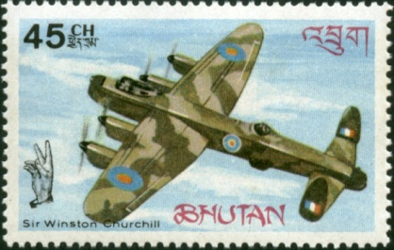
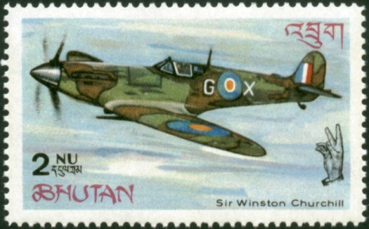
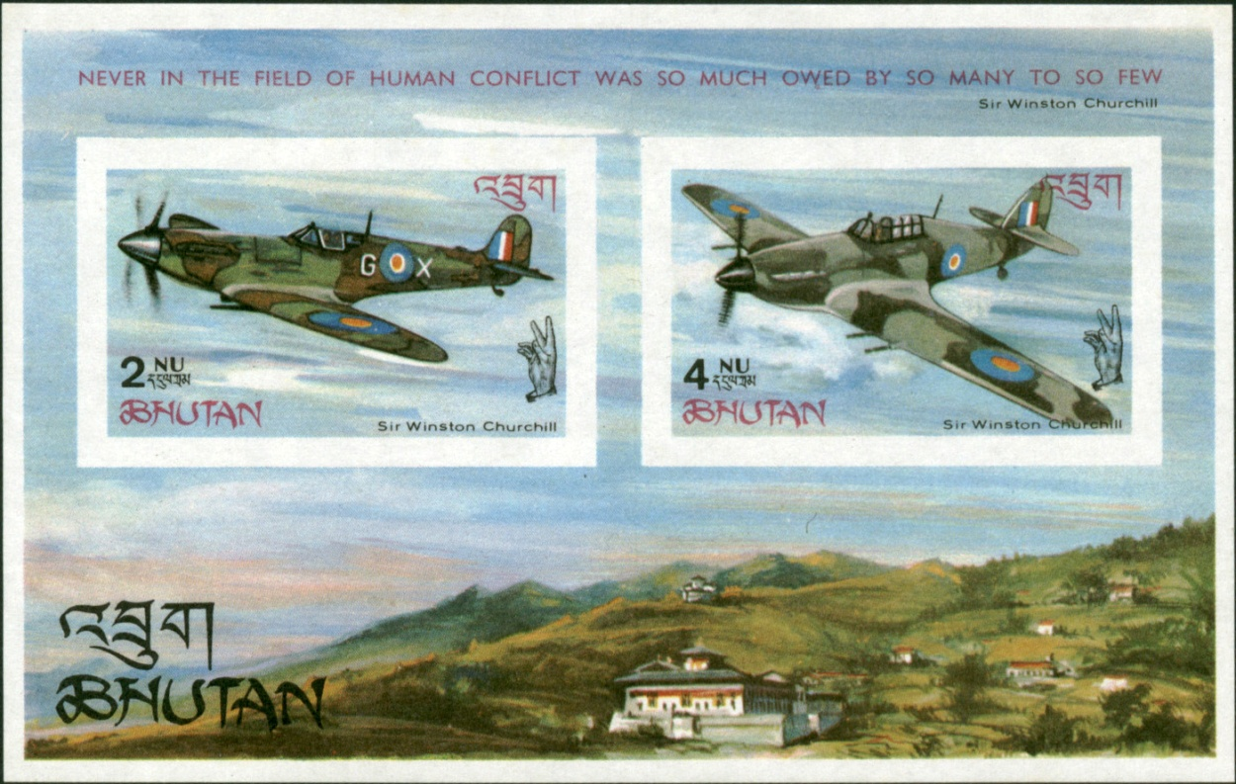
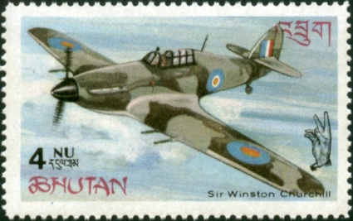
Notes:
16- Three British aircraft are shown here, a Lancaster, Spitfire and Hurricane.

Slide 17
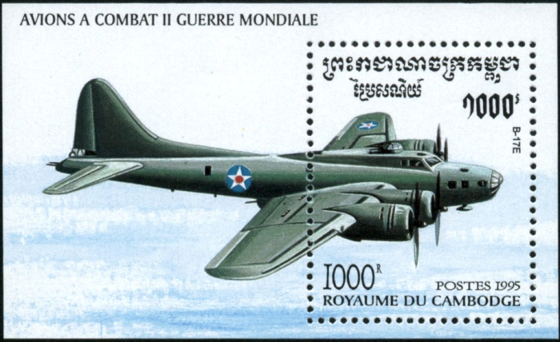
Notes:
17- A Boeing B-17 Flying Fortress four engine heavy bomber is seen here. Used primarily in the Pacific, it was the first Boeing aircraft with a flight deck instead of a cockpit. The company manufactured 6,981 on their own, with an additional 5,745 built in a collaborative effort between Douglas and Lockheed (Vega). The 103 foot craft had a range of 3,750 miles and could travel at 287 mph, weighing 65,000 pounds.

Slide 18
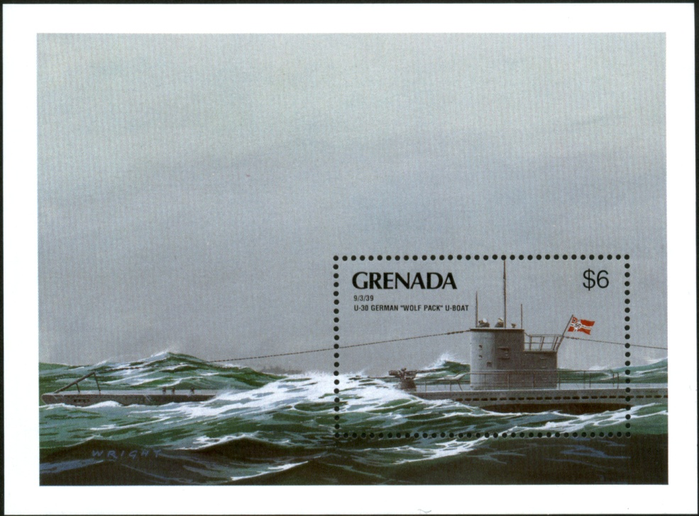
Notes:
18- This depiction of a German U-30 “Wolf Pack” U-Boat shows the sub on September 3, 1939 stalking the British passenger ship SS Athenia, which it torpedoed that day just hours after Britain declared war on Germany. A total of 118 passengers and crew died out of the 1,302 aboard the vessel. Commander Fritz Lemp believed he had sunk an armed merchant cruiser.

Slide 19
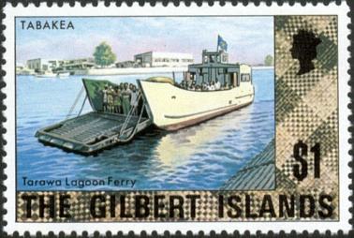
Notes:
19- The Tarawa Atoll and its main island, Betio in the Gilbert chain was the site of Operation Galvanic on November 20, 1944 involving the USS Ringgold and USS Dashiell, along with 10,000 Marines as they took control of the lagoon from the Japanese. Ferries like this one were used as troop carriers.

Slide 20
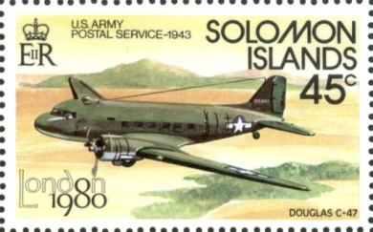
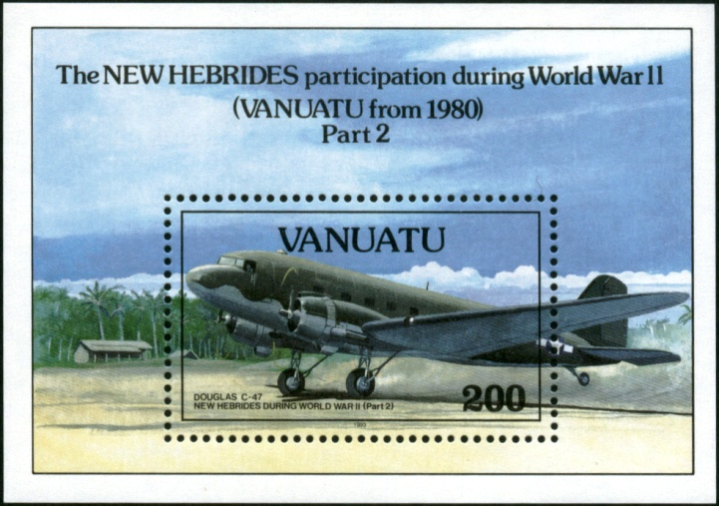
Notes:
20- The Solomon Islands just east of New Guinea were possibly the site of World War II’s lengthiest naval battles, including Guadalcanal. The New Hebrides, off the northern coast of Australia, was perhaps second in importance only to Guadalcanal, as its strategic location was necessary to keep naval lanes open for whichever side occupied the islands. Air power helped control these islands. Among other duties, the Douglas C-47 was used as a mail carrier for the US Army Postal Service.

Slide 21
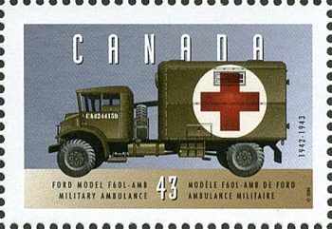
Notes:
21- Among the Canadian Military Pattern (CMP) trucks produced by the Ford Motor Company of Canada was this 3 ton 4x4 Ford F60L military ambulance. Joint collaboration between the Canadian subsidiaries of Ford and General Motors enabled generic vehicles to be easily customized for either war or commercial use, sharing interchangeable parts. According to one source, total Canadian CPM production exceeded that of all of similar vehicles of Nazi Germany.

Slide 22
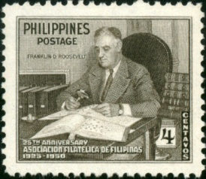





Notes:
22- Franklin Delano Roosevelt, the stamp collecting four term president. He was a fifth cousin of President Teddy Roosevelt. Harvard graduate Roosevelt studied history and economics and was conversant in German and French, having spent much time visiting Europe in his younger years. He passed the Bar Exam without finishing his law degree at Columbia University. Franklin entered politics first as a State Senator in 1910, later elected as Governor of New York State from 1929-32, then president until his death in 1945.

Slide 23

Notes:
23- First Dog “Fala,” a Scottish terrier, was at the time declared “the most photographed dog in the world.” Constant companion to the president, he is now immortalized on the FDR Memorial statue in Washington, DC, depicted at the center top of this souvenir sheet from Micronesia.

Slide 24






Notes:
24- Winston Leonard Spencer-Churchill, twice served as British Prime Minister from 1940-45 and then again from 1951-55. He served in numerous government posts for over 50 years, including Home Secretary, First Lord of the Admiralty and Chancellor of the Exchequor. Joseph Vissarionovich Stalin was elected as General Secretary of the Communist Party in 1922, in essence its ultimate leader until his death in 1953. The three Allied leaders, Roosevelt, Churchill and Stalin can be found together on numerous stamps.

Slide 25

Notes:
25- Princess Elizabeth, daughter of King George VI and Elizabeth the Queen Mother, in wartime attire when she served as a mechanic in the Auxiliary Territorial Service (ATS), the women’s branch of the British Army. All unmarried women between 20 and 30 years of age were called to military service when the British Parliament passed the National Service Act in December 1941.

Slide 26


Notes:
26- Charles André Joseph Marie de Gaulle, statesman and French General, lead the French Free Forces throughout World War II. He fled to Britain by June 1940 and organized the exiles in their resistance against the Nazis. He became President of France in 1959.

Slide 27








Notes:
27- “Two people, One War” is the slogan found on this wartime issue from Libya, then an Italian possession. Leader of the Nationalsozialistische Deutsche Arbeiterpartei (Nazi Party), Adolph Hitler became Chancellor of Germany in 1933 and lead the country until his death by suicide in 1945. “His Excellency Benito Mussolini, Head of Government, Duce of Fascism, and Founder of the Empire” is seen beside Hitler. He took power first in 1922 becoming the 27th Prime Minister of the country, consuming and consolidating other titles through 1936 as Dictator. He died in the hands of partisans in 1943.

Slide 28


Notes:
28- An unfamiliar name and face to most, Georg Elser was the sole person behind a failed assassination attempt to kill Adolph Hitler on November 8, 1938. He had managed to infiltrate Munich’s massive beer hall, the Bürgerbräukeller, planted a time bomb inside a speaker’s podium set to go off at 8:20 PM that evening and headed to the Swiss border. Hitler ended his speech earlier than expected that night to catch a train back to Munich, since the airport was fogged under, missing the explosion by 13 minutes that killed 8 and injured 63. Elser was caught before he could cross the border, was arrested, convicted and eventually sent to the Dachau Concentration Camp where he was shot and died at age 42 on April 9, 1945. A second attempt on the Führer’s life took place on July 20, 1944 at the Wolf's Lair field headquarters near Rastenburg. It was known as Operation Valkyrie, hatched by several military leaders and led to the arrest of nearly 7,000 co-conspirators, 4,980 of who were executed.

Slide 29

Notes:
29- The role of Hirohito, 124th Emperor of Japan, in World War II is controversial. While it is recorded that he approved the Japanese attack on Pearl Harbor, the failure of his military leaders to bring about a swift conclusion to war is said to have softened any personal interest the 40 year old may have had for domination of the Pacific.

Slide 30



Notes:
30- Germany’s Enigma machine was a code-breaker’s nightmare. Many on both sides of the Atlantic took on the challenge to crack the mechanism’s codes that enabled the enemy to pass messages in what was thought to be absolute security. Basically it was a typewriter like device as seen in the upper right, with 3 or 4 wheels providing 17,576 settings for each of 60 different scramble unit code combinations. That’s 159 million million million combinations. Only knowing the same wheel settings by both sender and receiver could decode a message. Alana Turing and his British colleagues built on the work of Polish predecessors in improving a decoding machine called the “bombe” as seen in the lower right. Views of the men at their headquarters at Bletchley Park, England, are seen on the souvenir sheet.

Slide 31




Notes:
31- Christmas was celebrated by the troops despite their dire circumstances. Mail was especially welcome this time of year. Seen here is a Royal New Zealand Air Force (RNZAF) Lockheed Hudson plane over Norfolk Island dropping wartime mail and supplies over the remote locale.

Slide 32




Notes:
32- Some would say that the war in the Pacific took the ultimate turn once the decision was made by President Harry Truman to use the atomic bomb twice in Hiroshima and Nagasaki on August 6 and 9, 1945, the only time such weapons have been used with devastating results. The Japanese government began surrender discussions with the Allies on August 10, accepting the terms of the Potsdam Declaration five days later. The formal surrender took place on the deck of the USS Missouri in Tokyo Bay on September 2.

Slide 33

Notes:
33- While the Nazis invaded Poland from the west in September 1939, the Russians held their own invasion of the country from the east 16 days later, taking military and civilian prisoners in their sweep. Reports claim that more than 320,000 Poles were deported to Russia, while others were sent to Prisoner of War camps. It was the Germans in 1943 who first discovered mass graves near the Katyn Forrest. The dead totaled some 22,000, made up of 8,000 Polish officers from the nearby Kozelsk Prisoner of War camp, 6,000 police officers and others arrested as being potential Russian enemies. Here, Polish military uniform buttons form a cross in commemoration of the 70th anniversary of the Katyn Forrest Massacre.

Slide 34

Notes:
34- Indian forces, part of the British Empire, were active in World War II. Their Parachute Field Ambulance Service was formed in 1941 to provide aid to their own and Allied forces, especially those in Burma, known as the 60 Para Field Ambulance. These parachute medics set up MASH (mobile army surgical hospital) units throughout the region. The unit received a citation from General Douglas MacArthur for their bravery and actions.

Slide 35

Notes:
35- The island of Bora Bora in the South Pacific island chain of French Polynesia was an important strategic supply base for the Allies known as Operation Bobcat. At its peak it was the military supply headquarters for 7,000 men supplying 9 ships with 20,000 tons of equipment. The stronghold was never attacked during the war. Its airport supported small to medium sized aircraft throughout the region.

Slide 36



Notes:
36- The diary of a Jewish Dutch girl put the human condition of war’s victims into perspective for the world. Annelies "Anne" Marie Frank’s writings have been translated into hundreds of languages, detailing her family’s experiences hiding from the Nazis in German occupied Amsterdam, Netherlands. They were betrayed, and Anne and her sister Margot were sent to the Bergen-Belsen Concentration Camp where they died of typhus in March 1945. Anne’s father Otto survived the war, learning that her diary had been saved and began efforts to get it published. It documents the 13 year old’s life from June 12, 1942 to August 1, 1944.

Slide 37



Notes:
37- Many of the athletes of the Berlin 1936 Summer Olympics aided in World War II efforts. Decathlon victor Glenn Edgar Morris was presented his gold medal from Eva Braun, Hitler’s mistress. He commanded an amphibious assault landing craft in the Pacific during the war. James Cleveland "Jesse" Owens eclipsed Morris’ fame. His story of winning four gold medals in the Berlin games is well known, especially Hitler’s disdain for the athlete’s prowess over his German opponents. During the war Jesse was asked by the Office of Civil Defense to promote its fitness program to the black community stateside. He was later hired by the Ford Motor Company in their corporate relations department to help recruit black workers for their war manufacturing needs.

Slide 38


Notes:
38- War and the movies—a combination made for Hollywood! Here are just a few movies that made it to the silver screen during and after World War II. From the upper left:
The Story of GI Joe- Burgess Meredith (1945); I Was Monty’s Double- M. E. Clifton James (1958); To Hell and Back- Audrey Murphy (as himself, 1955); The Story of Dr. Wassell- Gary Cooper (1944); The Desert Fox, James Mason (1951); Mission to Moscow- Manart Kippen (1943); Above and Beyond- Robert Taylor (1952); The Gallant Hour- James Cagney (1960); Pride of the Marines- John Garfield (1945); and finally Patton- George C. Scott (1970).

Slide 39









Notes:
39- Here’s a minute by minute account of the attack on Pearl Harbor:
6:00 AM- First wave of Japanese aircraft leave the Carrier Akagi
6:40 AM- Destroyer Ward and a PBY attack unidentified midget submarine
7:00 AM- Second wave of Japanese aircraft leave carriers
7:48 AM- Japanese zeros begin attack on Kaneohe Naval Air Station
7:55 AM- Pearl Harbor attack begins
8:10 AM- The torpedoed Battleship Arizona explodes killing 1,177 of her crew
8:30 AM- Destroyers Breeze, Medusa and Curtiss sink another Japanese midget submarine
8:45 AM- Although damaged and on fire, Battleship Nevada bravely makes dash for the open sea
9:45 AM- Japanese attack is over

Slide 40

Notes:
40- Before and after images of the Pearl Harbor attack on this souvenir sheet from Antigua and Barbuda on its 50th anniversary.

Slide 41

Notes:
41- The USS Arizona Memorial in Pearl Harbor is operated by the US National Park Service. Dedicated in 1962, this National Historic Landmark is typically visited by over a million visitors annually. Some of the funds to build the $500,000 Memorial were raised privately, including a 1961 benefit concert by Elvis Presley ($64,000) and the sale of plastic models of the Arizona by the Revell Model Company ($40,000).

Slide 42



Notes:
42- Three key Americans who played an important role in the war, all of whom became sequential Presidents of the United States: Franklin Delano Roosevelt (32nd President), Harry S. Truman (final Vice President of FDR, 33rd President), and Dwight David Eisenhower (General, Allied Forces European Commander, 34th President).

Slide 43








Notes:
43- Stamps from Iran commemorate their war efforts and famous personalities. The docks at Bandar Shapur near the border with Iraq and Kuwait was an important gulf seaport supply hub that also was the terminus of the railway that stretched from the Persian Gulf to the Caspian Sea. Eleanor Roosevelt was an accomplished First Lady in her own right, appointed as US Ambassador to the United Nations after the war and advocate for human rights around the globe. Charles de Gaulle’s visit to Iran is seen on this 1963 stamp set.

Slide 44

Notes:
44- Vanuatu’s Million Dollar Point on the island of Espiritu Santo is best described as the US’s World War II junk yard. The archipelago was another important Pacific military base and at war’s end acted as a depository of all things left over—jeeps, trucks, bulldozers—and much more. These scraps were eventually just dumped offshore that eventually turned into an artificial reef attracting fish, coral and divers observing them.

Slide 45




Notes:
45- This Omnibus common design issued by many British Empire crown colonies celebrated one year of victory and peace. Parliament and the River Thames are featured in the background alongside a portrait of King George VI.

Slide 46





Notes:
46- The Omnibus issue for the 50th anniversary of the end of World War II displays some of the hardware that added to its victorious conclusion for the Allies. The common souvenir sheet in the center features a field of poppies, Remembrance Day symbols for veterans of all wars and the War Medal 1939-1945, a decoration given to all British Empire veterans that served in the armed forces Army, Navy or Merchant Marines for at least 28 days from September 3, 1939 to September 2, 1945. The reverse here shows a lion over the body of a double headed dragon, representing the enemies of the east and west.

Slide 47


Notes:
47- Adolphe-Félix-Sylvestre Éboué was born in French Guiana and became a French colonial administrator, the equivalent of a governor, serving in Ubangi-Chari, Martinique, Guadeloupe and then Chad at the outbreak of World War II. He was the first colonial administrator to support the Free French resistance and assisted their efforts throughout French Equatorial Africa. Numerous French colonies issued this Omnibus design in his honor in 1945, a year after his death.

Slide 48

Notes:
48- Like the British Empire, the French colonies also issued an Omnibus issue showing an angel over the Arc de Triumph flanked by tanks in 1946 honoring the European Allies’ victory.

Slide 49






Notes:
49- The French colonies’ Chad to Rhine Omnibus issue of 1946 depicts scenes of French African Forces as they traversed from the sands of Chad to the doorstep of the German enemy.

Slide 50

Notes:
50- French colonies also issued an Omnibus issue for the 50th anniversary for the Liberation of France.

Slide 51

Notes:
51- Pablo Picasso’s mural masterpiece “Guernica” showing his interpretation of German aerial bombings that hit that city during the Spanish Civil War of 1937. Hitler supported Franco in the rebellion against Republican loyalists and used Spain as a proving ground as the German war machine revved up. The mural was the centerpiece of the Spanish Pavilion at Paris’ 1937 World’s Fair.

Slide 52

Notes:
52- There are several World War II themed albums available for collectors. Here is a part of a page from the White Ace Sir Winston Churchill Album.

Slide 53

Notes:
53- Here is the second page of the White Ace Sir Winston Churchill Album.

Slide 54

Notes:
54- These next three pages are from the J. V. Bond “World at War” Album. Here is the outline of the 127+ page album.

Slide 55

Notes:
55- A sample page from the J. V. Bond “World at War” Album.

Slide 56

Notes:
56- Another sample page from the J. V. Bond “World at War” Album.

Slide 57

Notes:
57- These next two pages are from the Scott 50th Anniversary of World War II Album.

Slide 58

Notes:
58- Another page from the Scott 50th Anniversary of World War II Album.

Slide 59


Notes:
59- Belarus’ two philatelic tributes to the 60th anniversary of the war’s end. The Mound of Glory Monument on the hilltop at Minsk, Belarus is shown. The mound contains dirt from the nine “Hero Cites” of the Soviet Union that resisted the Nazi aggression. A symbolic representation of four bayonets soar into the sky.

Slide 60



Notes:
60- The Warsaw Ghetto uprising was commemorated on a joint issue between Poland and Israel in 1993 marking its 50th anniversary. It was an attempt by the remaining residents in that segregated Jewish neighborhood to resist the last effort of the Nazis to clear the area and transport the occupants to the Treblinka camp where 800,000 were put to death. The familiar motto “Arbiet Macht Frei,” or “Work Shall Set You Free” on the gates of the Auschwitz Concentration Camp in Poland are seen on the stamp from Dominica. The camp was liberated by Soviet troops on January 27, 1945, but not before upwards of one million men, women and children were exterminated.

Slide 61


Notes:
61- German rocket technology advancements by Werhner von Braun and other Axis scientists led to a variety of weapons throughout the war. Some 3,000 liquid propelled V-2 ballistic missiles fired from German occupied territories terrorized London, Antwerp and Liege in 1944. They were manufactured by prisoners of war from the Mittlebau-Dora concentration camp. Each 28,000 pound rocket was 46 feet high, had a 5 foot diameter and carried a 2,200 pound warhead. von Braun later came to America and developed the US manned space program and Apollo rocket.

Slide 62


Notes:
62- The end of the war in the Pacific also brought about Korean liberation from the Japanese. But tensions continued there just a few years later as the Soviet supported North clashed with American supported South. Although still honoring the country’s liberation, the 1961 souvenir sheet above clearly shows the demarcation between North and South in a still divided Korea.

Slide 63


Notes:
63- Antarctic waters were not immune from the war nearly half-way around the world from them. Concerned that some in the pro-German Argentinian government might allow Axis ships to hide out in nearby waters, British “Occupation Tabirin” began in 1943. It was the first ever effort to build a base in the Antarctica. The British Admiralty sent a 14 man force in two ships from the Falklands, the vessel Fitzroy and HMS William Scoresby, a minesweeping trawler, to establish a base on Deception Island, off the South Shetland Islands and Antarctic Peninsula.

Slide 64


Notes:
64- Lt. junior grade John F. Kennedy and PT-109 was another war story of legend. The future president’s motor patrol torpedo boat was not small, being 80foot long, weighed around 56 tons and had a total crew of 16. Idling in the waters off one of the Solomon Islands at 2 AM on August 2, 1943, Kennedy and crew found themselves in the path of the Japanese destroyer Amagri, which eventually was able to ram their patrol boat. Two were killed and two were severely wounded. The survivors made it to Plum Pudding Island 3.5 miles away, then on to Olasana Island that had fresh water and coconut trees. The survivors were found by native islanders, who carried a coconut inscribed by Kennedy with note about their location 35 miles to the nearest Allied base and were eventually rescued.

Slide 65

Notes:
65- Events of the 1940’s are highlighted on stamps on this sheet from Dominica, some of which have already been seen in this presentation.

Slide 66


Notes:
66- Among the “First Century of Flight” commemoratives on this sheet from Micronesia are aircraft from Japan (the Mitsubishi A6M Zero), the US (B-29 heavy bomber) and Germany (Messerschmitt 262A jet fighter).

Slide 67


Notes:
67- World War II events also take center stage on this sheet from Nicaragua pointing out notable events of the 20th century.

Slide 68

Notes:
68- The iconic image of pure joy felt on VE Day is this one of a US sailor kissing a woman in a white dress just south of 45th Street overlooking the intersection of Broadway and 7th Avenue in New York City that day at 7 PM on August 14, 1945. Photographer Alfred Eisenstaedt was in the right place at the right time, taking four images in a row of the kiss between strangers with his Leica camera, never getting their names. One of the four photos was appeared in LIFE Magazine a week later and gained worldwide acclaim. Their absolute identities remain a mystery. At least 3 women and 11 men have claimed to be the pair over the years.

Slide 69



Notes:
69- Joseph Aloisius Ratzinger, aka Pope Benedict XVI, grew up in a small town in Bavaria, Germany. At age 14 in 1941 he was conscripted into the Hitler Youth, as was the law. One of his cousins of the same age with Downs Syndrome was taken away and murdered under orders of the Action T4 euthanasia campaign that exterminated those who were judged to be incurably sick. He was drafted while in the seminary at age 16 as an Air Force child soldier. He was briefly put into a POW camp at the war’s end before returning to the seminary with his older brother.

Slide 70
The End
Scanning/Page Arrangement by Tom Fortunato

