Slide 1


Withdrawn Stamps of the 21st Century
by
Tom Fortunato
A Presentation for the Rochester Philatelic Association

Slide 2
From time to time postal administrations uncover a reason to withdraw a stamp due to a design error or controversy of what is depicted. Most interesting to collectors are those that have already been printed and, in many cases, put on sale to the public in the normal course of business or by mistake.
Once identified, the issuing administration has several options:
Recall all remaining stamps and destroy or modify them, possibly creating philatelic rarities of those already sold
Leave them on sale, with or without opting to print and release a corrected version days, weeks or years later

Slide 3
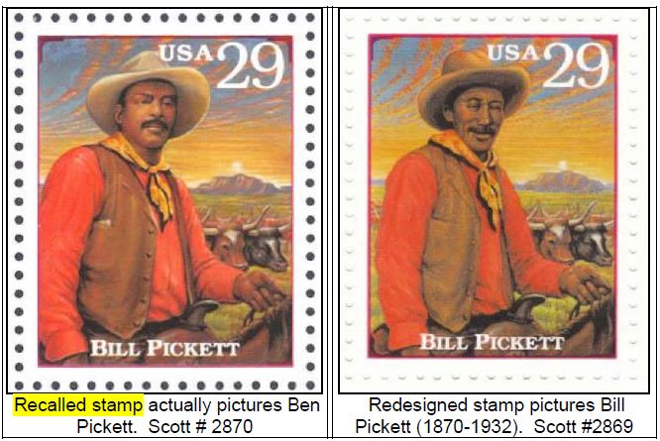
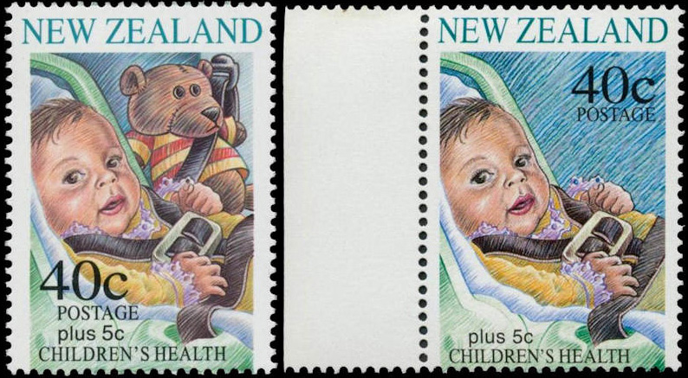
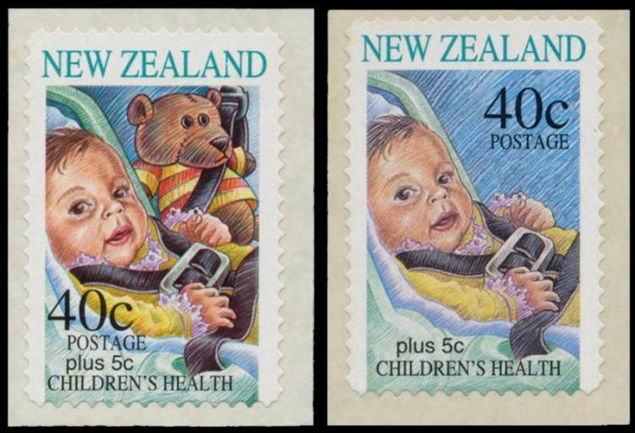
Two such recalls and their reissues made big news in the 1990s.
1993 USA- Legends of the West
1996 New Zealand- Health Semi-Postals
Wrong “Bill Pickett” image printed, error discovered before release and recalled, but 183 sheets were sold before the issue date. USPS held a lottery with 150,000 error sheets sold. The sheet of 20 was reissued in 1994 with the corrected image.
Child and teddy positioned wrong, as NZ law required seat to be facing to the rear of the car, not forward. Water activated and self-stick stamps recalled and supposedly destroyed before release, with non-teddy revisions printed. But two post offices inadvertently retained the older versions, selling a few hundred of them. The self-sticks are the rarer of the two formats.

Slide 4
It was hoped that the twenty-first century would usher in an era of far fewer such withdrawn (or recalled) stamps, but just the opposite is happening. This presentation shows just a small sampling of those issued from 2000 through 2023!
Supply and demand dictate the value of a withdrawn issue. Prices here are from offerings on ebay, Delcampe and HipStamp. The numbers released is a factor, as is the subject matter. Those from lesser popular collecting countries may not demand the premium of a more popular one. Nations notorious for poor quality control of their stamp issues are also less desirable.

Slide 5
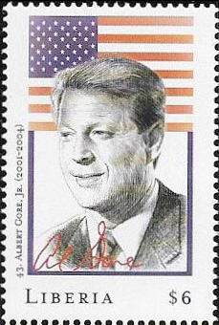
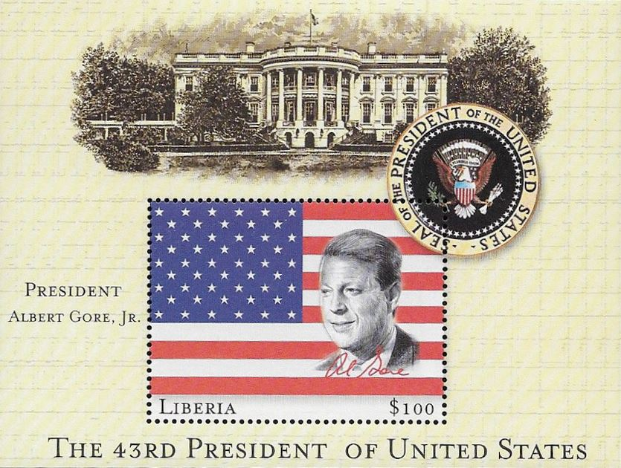
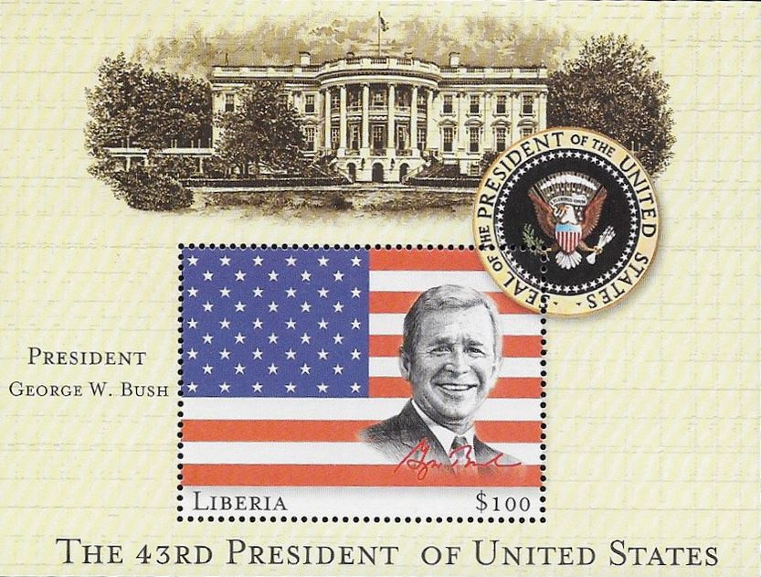
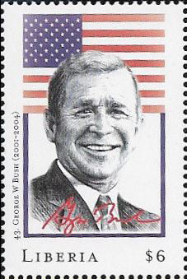
November 17, 2000 Liberia redundancy
Liberia issued a set of stamps and souvenir sheets Oct. 2 for every US president ahead of the US November election. Prepared in advance were similar items for both candidates with only the winner’s items to be released, wanting to be the first to honor him. In the election result confusion, they released everything, withdrawing Gore items knowing the final outcome.

Slide 6
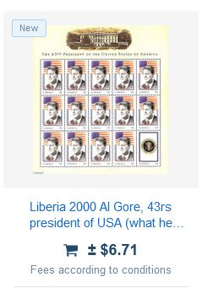
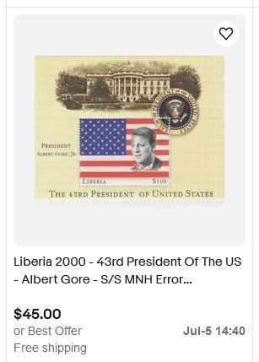
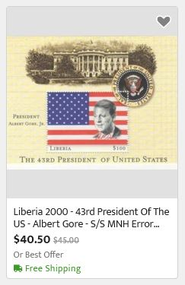
November 17, 2000 Liberia redundancy

Slide 7
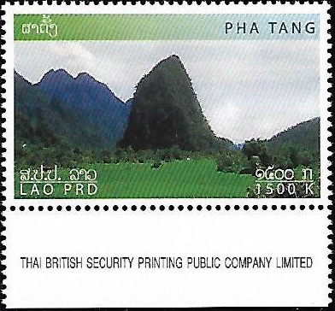
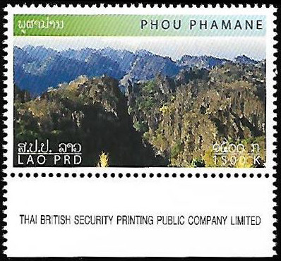

March 30, 2002 Laos text error
original
corrected, issue date unknown
The Laos “People’s Democratic Republic” (Laos PDR) had the letters D and R mixed up (Laos PRD) on the original release on this “Year of the Mountain” set that were withdrawn. A corrected version was later released.

Slide 8
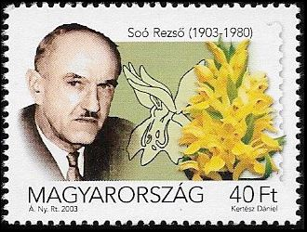
February 12, 2003 Hungary image error
Withdrawn on March 31, 47 days after being issued, this stamp was one of a set of three honoring famous Hungarians meant to depict botanist Rezső Soó. However the stamp shows another Hungarian botanist, Ujvárosi Miklós.

Slide 9
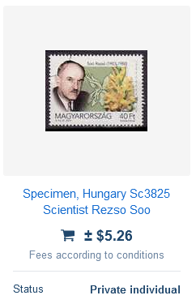
February 12, 2003 Hungary image error

Slide 10
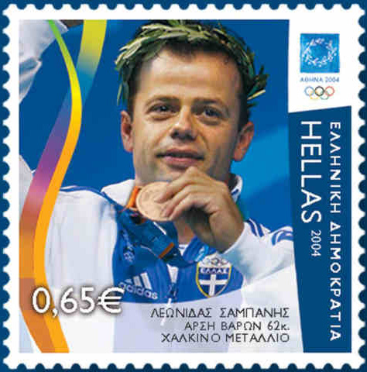
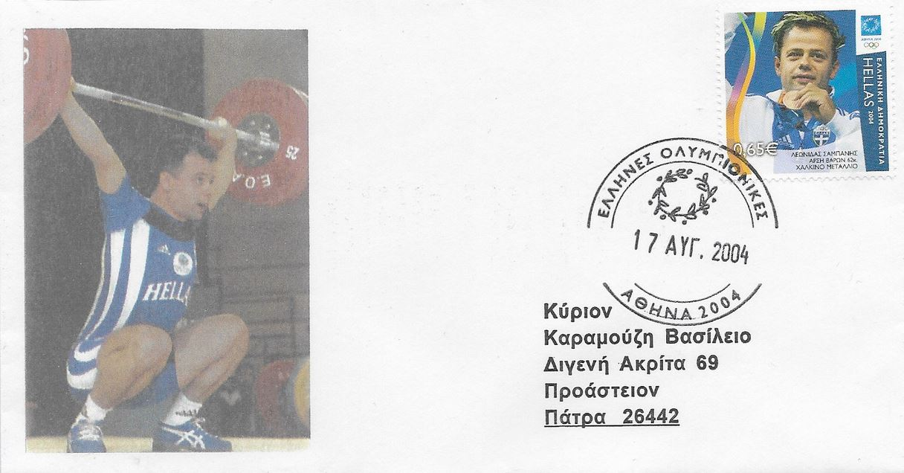
August 17, 2004 Greece doping scandal
Greek 2004 Olympic medalists were honored on a stamp the next day, including 62 kilo weight class bronze winner weightlifter Leonidas Sampanis. He failed two drug tests days later and was stripped of his medal on August 22 by the IOC. ELTA, the Greek Post, ordered all post offices to stop selling his stamps and return all those remaining.

Slide 11
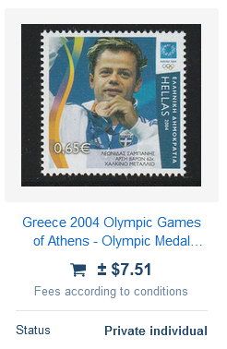
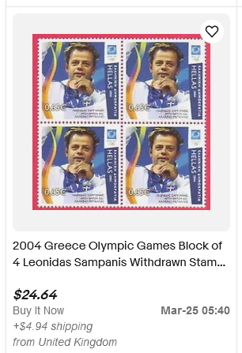
August 17, 2004 Greece doping scandal

Slide 12
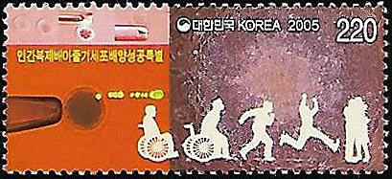
February 12, 2005 Korea (South) fraud
Officially released under the title "Successful Establishment of Human Cloned Embryonic Stem Cells," this stamp honored the scientific breakthrough by scientist Hwang Woo-suk. By January 2006 enough evidence was collected to prove the data was falsified and the stamp was withdrawn later that month.

Slide 13
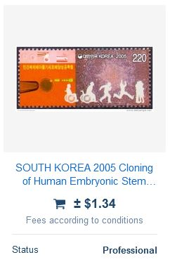
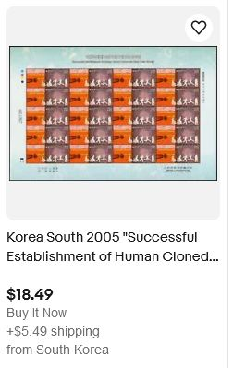
February 12, 2005 Korea (South) fraud

Slide 14

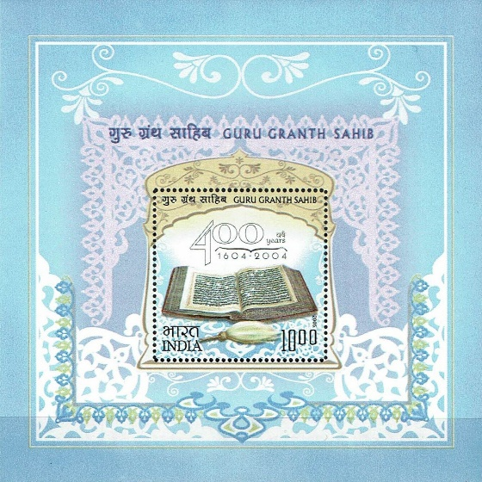
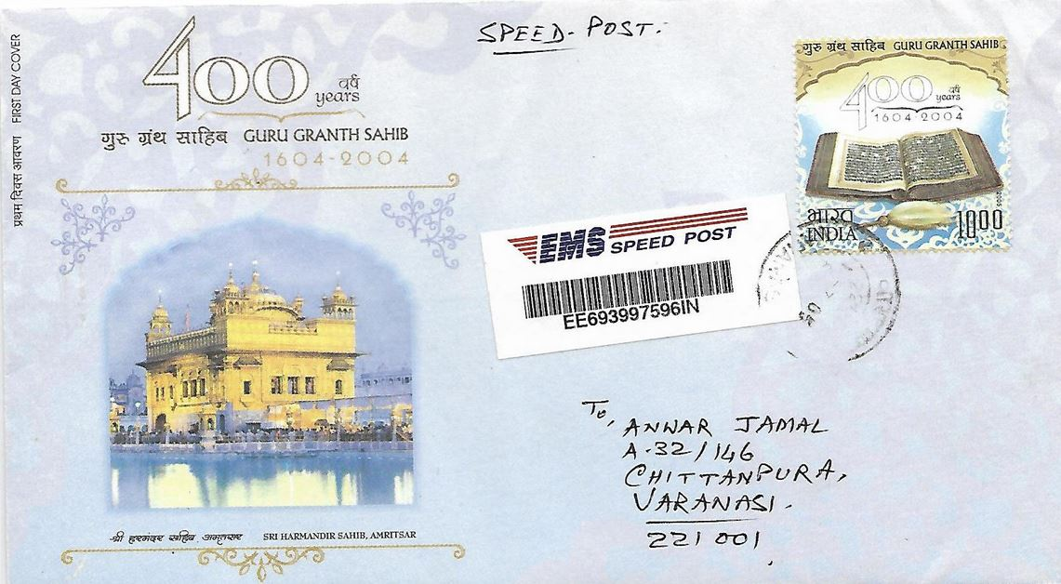
June 16, 2005 India image error
The Sikh sacred text, the Guru Granth Sahib, celebrated its 400th anniversary in 2004, commemorated here. The religion forbids imagery of the book, which is also lacking its “rumala” cloth covering on the stamp. These were distributed to post offices and recalled before issuing, however some leaked out.

Slide 15
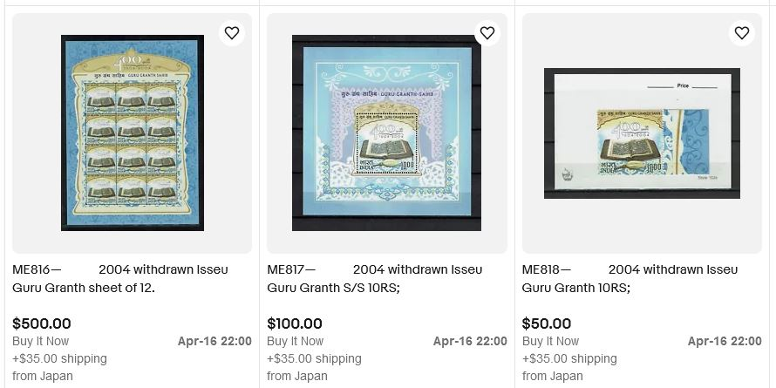
June 16, 2005 India image error

Slide 16
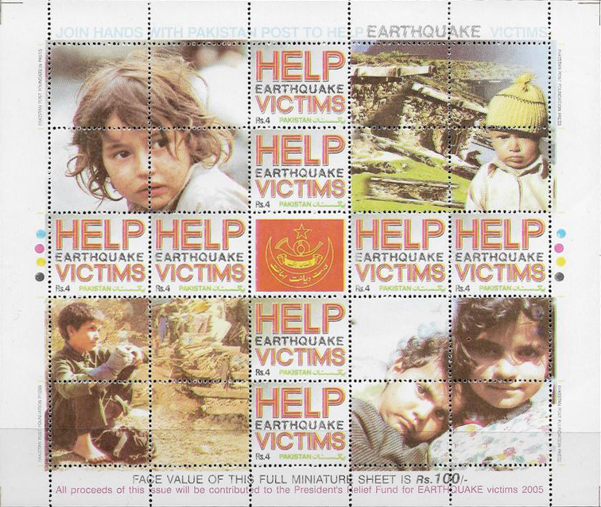

October 27, 2005 Pakistan legal issues
An earthquake hit the Kashmir region of Pakistan on October 8 and this sheet was released as a fund raiser. Intended that all Rs 100 go to the fund, the law required the face value of Rs 32 go to the Post. It was withdrawn over the controversy.

Slide 17
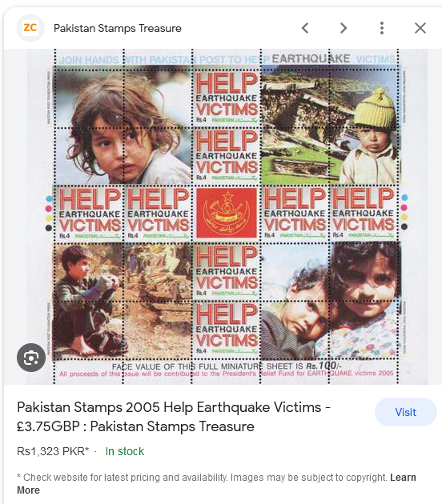
October 27, 2005 Pakistan legal issues

Slide 18
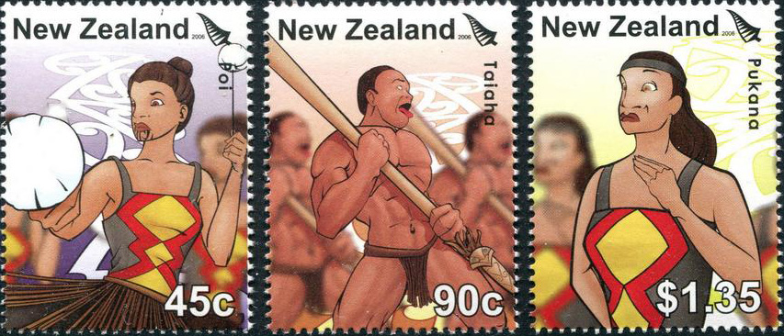
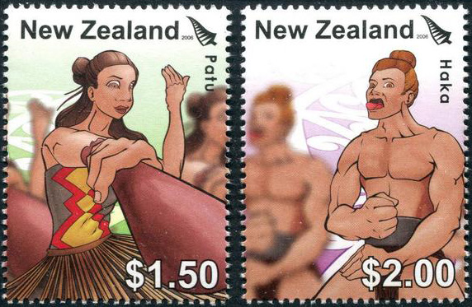
June 7, 2006 New Zealand image controversy
A set of 5 depicting native Maori “Kapa Haka” performing arts was to be issued in New Zealand but were deemed too cartoonish by the public. NZ Post decided to recall all the stamps June 2, five days before the release date, back from post offices. Eight advance orders had already been mailed out and paid for by customers, creating rarities.

Slide 19
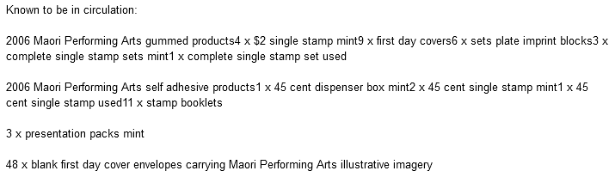
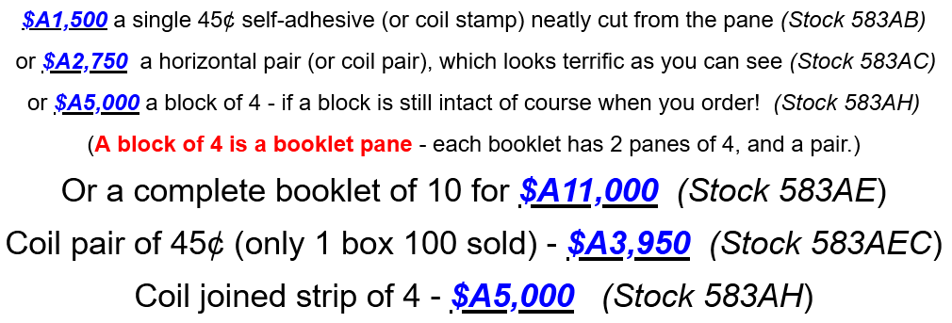
June 7, 2006 New Zealand image controversy
prices from https://www.glenstephens.com/kapa_haka.html

Slide 20
September 15, 2006 Kazakhstan text error
The meeting place of the 3rd ECO (Economic Cooperation Organisation) postal authorities took place in Ankara (Анкара), Turkey, not Istanbul (Ыстамбұл) as seen on the original issue.
original
corrected, issued Sept. 22

Slide 21
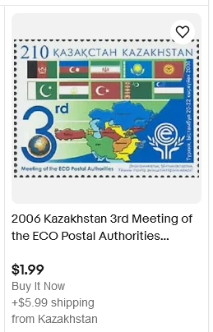
September 15, 2006 Kazakhstan text error

Slide 22
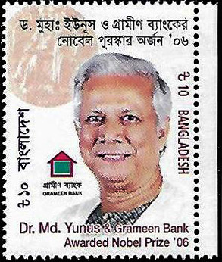
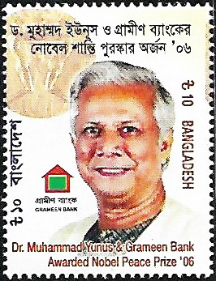
August 29, 2007 Bangladesh text and image error
Dr. Yunus was honored for winning the Nobel Peace Prize for pioneering the concepts of microcredit and microfinance. The original stamp was withdrawn Sept. 2, as the wrong Nobel medal is shown, his first name was wrongly abbreviated and “Peace” was omitted.
original
corrected, issued Sept. 9

Slide 23
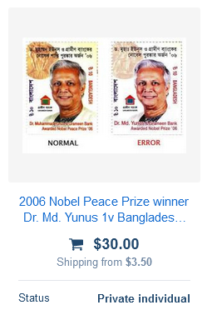
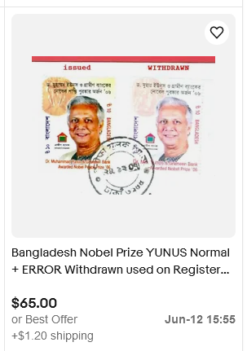
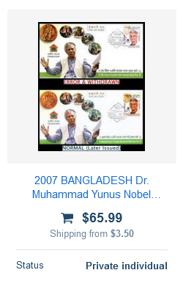
August 29, 2007 Bangladesh text and image error

Slide 24
December 4, 2007 Mauritius image and text errors
The 50th Anniversary of the Ministerial System was commemorated here, but had several errors. The lower right image is not that of A.M. Osman but his brother, A. H. Osman. Incorrect captions include "Dr. G. Millien" instead of "Dr. E. Millien", and "R. Vaghjee" instead of "H.R. Vaghjee". The stamp was withdrawn and reissued, but without the two text names being corrected.
original
corrected, issued Dec. 27

Slide 25
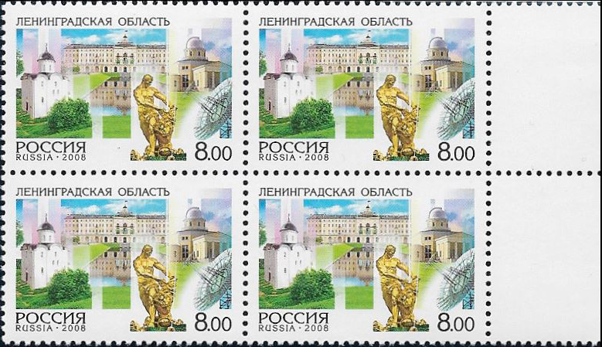
September 17, 2008 Russia text error
Caught before its scheduled release, this Russian stamp depicts scenes from St. Petersburg, including the famous Samson Fountain in Peterhof Palace. However the stamp bore the city’s former name by mistake, Leningrad. While none reached post offices, some were sold through the state philatelic agency.

Slide 26
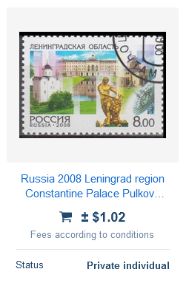
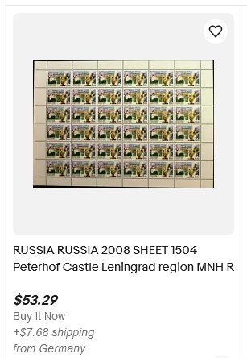
September 17, 2008 Russia image error

Slide 27
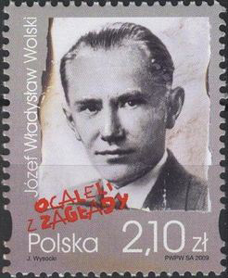
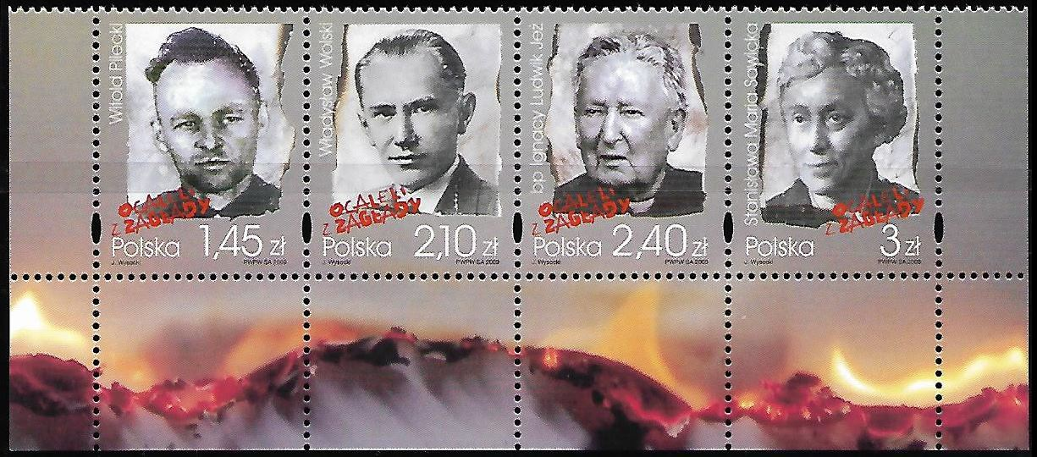
January 30, 2009 Poland text error
Poland released a set of stamps honoring concentration camp survivors. One of those was Józef Wladyslaw Wolski, a distinguished Polish historian. His first name was missing on the first issue that was recalled, but added on the second version.
original
corrected, issued April 3

Slide 28
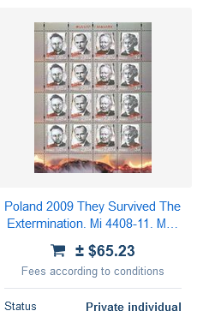
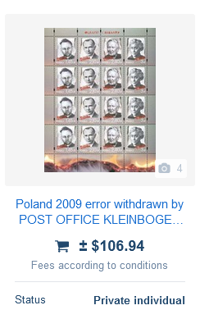
January 30, 2009 Poland text error

Slide 29
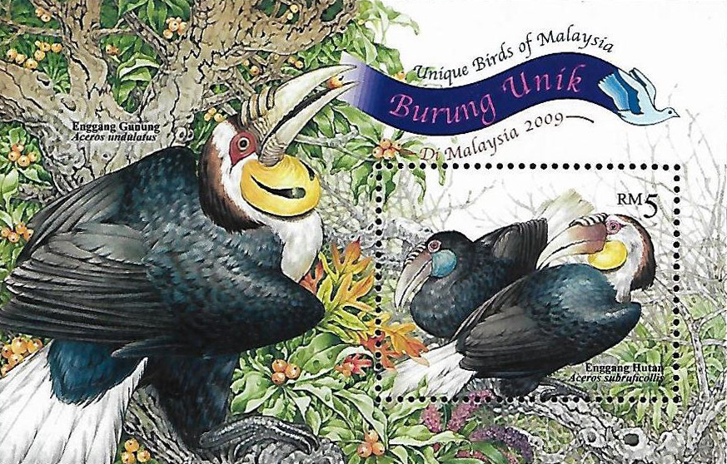
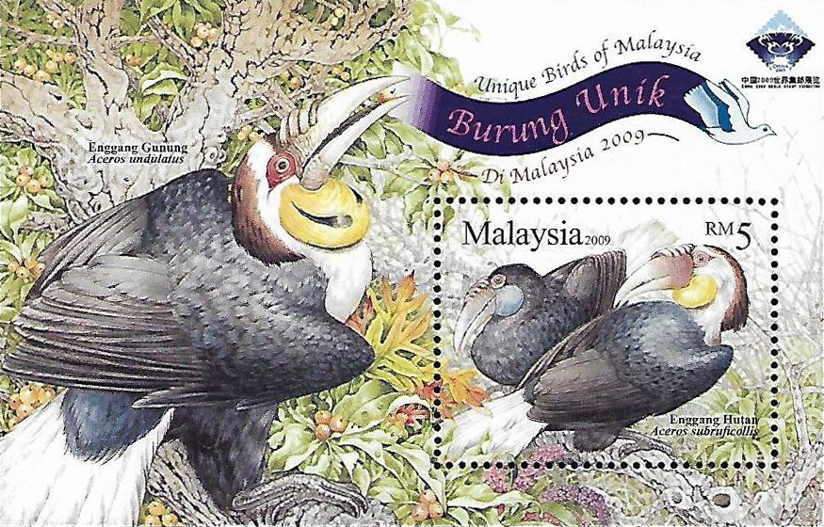
January 21, 2009 Malaysia missing text
original
corrected, issued April 10
Malaysia’s “Unique Birds of Malaysia” set of stamps included a souvenir sheet. While on the selvage, the country’s name was missing from the stamp itself. Withdrawn after a few days, it was reissued with the name and the logo of a Chinese stamp show.

Slide 30
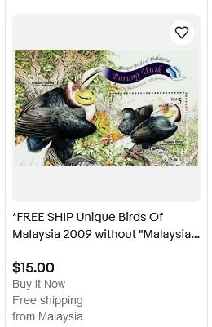
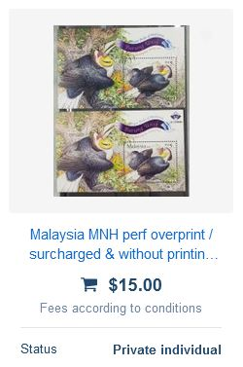
January 21, 2009 Malaysia missing text

Slide 31
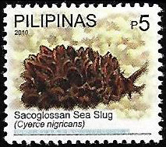
April 16, 2010 Philippines text error
Issued as part of a set featuring “Philippine Biodiversity” the 5 peso stamp accurately depicts a “cyerce nigricans,” but was incorrectly labeled as a sea hare and quickly withdrawn. A replacement was issued six months later.
original
corrected, issued October 22

Slide 32


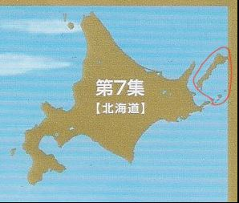
June 1, 2010 Japan map controversy
The seventh edition of Japan’s Hometown Scenes sheet series had a map of Hokkaido in the upper right corner showing the controversial South Kurils Islands as well, disputed land with Russia. The sheet was withdrawn the next day to avoid a political clash with its neighbor.
original
corrected, issued Sept. 10

Slide 33
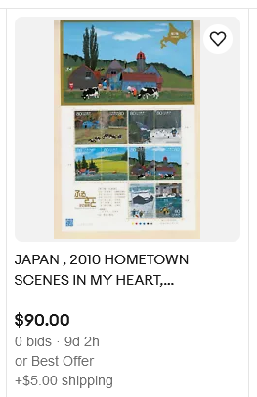
June 1, 2010 Japan map controversy

Slide 34




May 9, 2011 Greenland poor quality
Two definitives featuring Queen Margarethe II did not meet quality standards after being made and were withdrawn on May 26. It was found that the printing plate used suffered from inconsistent steel engravings. Replacements of a new design were released 19 months later in differing colors.
original
replacements, issued Dec. 22, 2012

Slide 35

May 9, 2011 Greenland poor quality

Slide 36


May 14, 2011 Sri Lanka image controversy
Celebrating the Buddhist Vesak festival, four holy sites are shown within a map of India. However one of them shows the Maya Devi Temple in Buddha's birthplace, Lumbini, Nepal. Nepalese political and religious groups protested and the stamp and souvenir sheet were withdrawn.

Slide 37


May 14, 2011 Sri Lanka image controversy

Slide 38



November, 23, 2011 Croatia missing logo
A miniature sheet of 9 stamps with a vignette at the top left honoring Ivica Kostelić was withdrawn two days later under protest of the Croatian Ski Federation, as the label was missing the sponsor’s logo, Raiffeisen Grupa. (200,000 sheets printed)

Slide 39



November, 23, 2011 Croatia missing logo

Slide 40


December 10, 2011 Srpske (Serbian Bosnia) missing text
Withdrawn on the day of issue, this stamp honors poet Ivo Andrić on the 50th anniversary of winning the Nobel Prize for Literature. Despite bearing “Поштe Српскe” (Serbian Post), it was missing the actual name of the country. Supposedly between 400-2,951 were sold out of the print run of 15,000. A new version was issued ten weeks later, with “Босна и Херцеговина - Република Српска” (Bosnia Herzegovina – Republic Srpska).
original
corrected, issued Feb. 27

Slide 41



December 10, 2011 Srpske (Serbian Bosnia) missing text

Slide 42





April 9, 2012 Macedonia text error
On its acceptance into the European Union Macedonia released a set of two stamps featuring capitols of two nations, Cyprus and Denmark. However, the country’s name was spelled incorrectly as МАКДОНИЈА (missing an “E”) instead of МАКEДОНИЈА. The set was withdrawn and reissued on the same day a year later.
original
corrected, issued April 9, 2013

Slide 43



April 9, 2012 Macedonia text error

Slide 44




January 4, 2013 France denomination change
This French 0.60€ “Chinese Year of the Snake” stamp was printed before a last minute 20 gm domestic rate change to 0.63€ was announced. All copies were to be destroyed without being released, but a few post offices received them in error.

Slide 45




June 12, 2014 Turkey image error
Turkey’s 2014 World Cup set was withdrawn after being on sale for two weeks after 15,000 were sold as the cup logo and lettering did not meet FIFA copyright size standards. Two totally different stamps came out two months later.
Ú
Ú
Ú
Ú
original
revisions, issued Aug. 8

Slide 46



June 12, 2014 Turkey image error

Slide 47


August 5, 2014 Egypt image error
Egypt’s original intent to depict scenes from the recently widened Suez Canal project, costing £2.4 billion, mistakenly showed views of the Panama Canal instead. According to the online edition of Cairo Post, Egypt’s postal authority ordered sales of the error stamps ended on Saturday, September 13. The revised version added “The New Suez Canal” in English.
original with photo the middle stamp’s design was based
corrected, issued Sept. 16

Slide 48



August 5, 2014 Egypt image error

Slide 49




July 6, 2015 Canada image error
Alberta’s Dinosaur Park was one of several UNESCO World Heritage sites to be shown on a set of booklet stamps and souvenir sheet. Three days after release they were withdrawn, as a site 200 km away was used in error, including on the cover. A corrected version in both formats was released 45 days later.
booklet cover, self-stick stamps and souvenir sheet
corrected image, issued Aug. 21, 2015

Slide 50

July 6, 2015 Canada image error

Slide 51



May 4, 2016 Czech Republic text error
This souvenir sheet honoring the 700th anniversary of Charles IV (1316-1378) was recalled after a few days and re-issued for a Latin spelling error, “KAROLUS QUATRUS” (Charles the 4 sided) instead of “KAROLUS QUARTUS” (Charles IV).
original
corrected, issued May 14 (?)

Slide 52


November 14, 2017 Canada design change
Shortly before being issued Canada Post changed this self- stick booklet’s Star of David cover design for one showing a Menorah with four candlesticks, more representative of the Jewish holiday. A few dealers who had standing orders were sent the original design booklets in advance and refused to return them back at Canada Post’s request.
original cover design
revised design as issued Nov. 22

Slide 53


November 14, 2017 Canada design change

Slide 54
August 14, 2019 Pakistan image error
Issued to honor the 70th Anniversary of the Commonwealth of Nations, Pakistan depicted a newly planted tree. However the tree did not match the original picture, which had less foliage, and it was withdrawn. It was replaced shortly after.
original
corrected, date unknown

Slide 55



August 14, 2019 Pakistan image error

Slide 56


September 26, 2019 Bosnia-Herzegovina image error
original
corrected, issued Oct. 2019
The Travnik fortress was built around the turn of the 15th century, but its minaret was added later under the Ottomans after 1463. The original release omits the minaret, which still stands today.

Slide 57

September 26, 2019 Bosnia-Herzegovina image error

Slide 58


May 8, 2020 North Macedonia map error
A set of two stamps were issued by Macedonia to mark its presidency of the European Union, each in a sheetlet of 8 stamps and central label. The Zagreb stamp was withdrawn the next day due to protests by its neighbors Bosnia, Serbia and Montenegro as it showed a map of what was “Greater Croatia” during World War II instead of its border of today. The set had a print run of 6,000 stamps.
Ú
original
Ú

Slide 59


May 8, 2020 North Macedonia map error

Slide 60


January 24, 2021 Moldova missing text
Valeriu Gafencu (1921-1952), died at the age of 31 after spending 11 years in a Romanian communist prison for his Christian beliefs. This stamp notes his 100th birth year, but was lacking the country’s name and recalled on April 21. A new version was issued later on June 6.
original
corrected, issued June 6

Slide 61


January 24, 2021 Moldova missing text

Slide 62

May 25, 2021 Spain image controversy
Good intentions went awry with this “Racial Equality” set issued on the one year anniversary of the George Floyd murder. The four stamps vary in face value based on skin tone, with darkest skin having the least value: pale 1.60€, slightly darker 1.50€, brown 0.80€, and black 0.70€. Their release was to 'reflect an unfair and painful reality that shouldn't be allowed‘. They were withdrawn on May 28 after worldwide condemnation.

Slide 63


May 25, 2021 Spain image controversy

Slide 64



July 28, 2021 Bangladesh misleading text
original
corrected, issued Dec. 2021
original on cover
Issued for the 50th birthday of Sajeeb Ahmed Wazed Joy, the son of the Prime Minister. Withdrawn in a week, as the years looked as though they refer to a birth/death memoriam (1971-2021).

Slide 65



July 28, 2021 Bangladesh misleading text

Slide 66



November 16, 2021 Bangladesh missing text
Souvenir sheet for “Contribution of Foreigners in the Liberation War.” Withdrawn shortly after release, missing country name.
original
corrected, issued February 13, 2022

Slide 67



November 16, 2021 Bangladesh missing text

Slide 68





November 22, 2022 Argentina text error
Available 1 day with wrong price, reissued with a label over area.
was to be sold at $1200, not $1040 face value as printed
corrected

Slide 69

November 22, 2022 Argentina text error

Slide 70

May 16, 2023 Vatican City image controversy
World Youth Day was celebrated with this Vatican stamp for only three days before it was withdrawn. The Pope is shown leading children around Lisbon, Portugal’s famous Henry the Navigator statue. Opposition came from those who believe it was pro- colonialism and others who thought it gave tacit approval to the country’s dictator at the time it was built, Antonio Salazar.

Slide 71



May 16, 2023 Vatican City image controversy

Slide 72
Whether you call it withdrawn, recalled or use other words to describe the phenomenon, the pace of stamps being taken off sale due to a design flaw or “hullabaloo” of some kind is not slowing. Be prepared for many more coming our way!
By the way, when searching for these on the Internet and auction sites “withdrawn” brings many more hits than “recalled,” which mostly is associated with the U.S. Legends of the West issue.
Much of the material here came from an excellent web site that deals with withdrawn, controversial and exceptional stamps with 318+ examples at https://withdrawn-english.jimdofree.com.

Slide 73
Far from…
THE END

