Slide 1

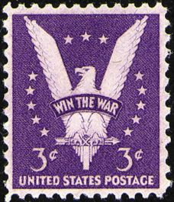

The 3c Win the War Stamp -
Common Stamp,
Uncommon Usage
by Jeff Shapiro
for the Rochester Philatelic Association
March 23, 2023

Slide 2
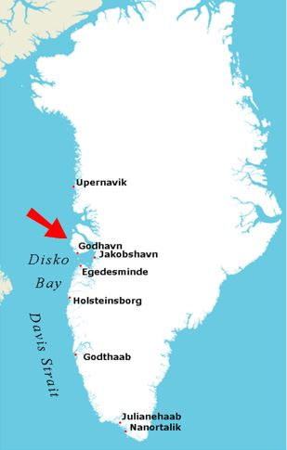
Censored “Win the War” first day cover mailed to Greenland.
2

Slide 3
Mail from one Japanese Internment camp to another.
3

Slide 4
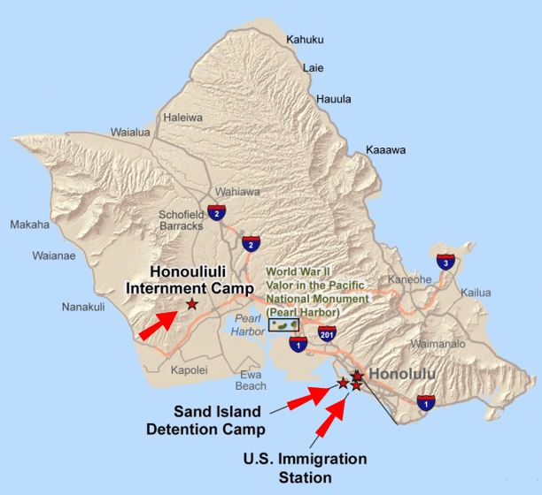
Re-addressed mail to Honolulu Immigration Station 8.
4

Slide 5
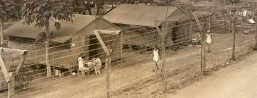
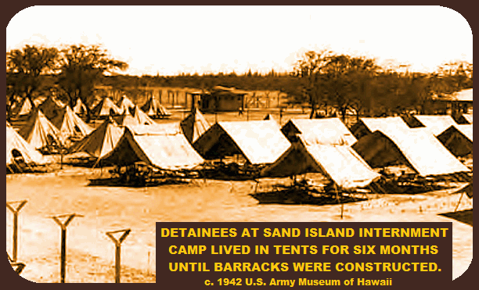
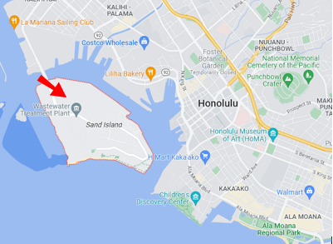
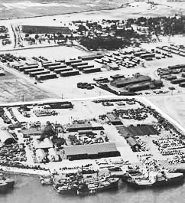
Location of Hawaii’s 15 month WW2 internment camp.
5

Slide 6
Censored cover sent to Alien Enemy Internment camp.
6

Slide 7
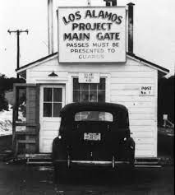
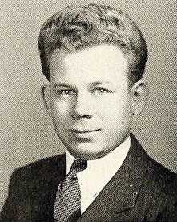
P.O. Box 1663 - used by Civilian technical personnel
P.O. Box 180 - used by Military technical personnel (until the end of 1944, P.O. Box 1663 was used for both types of technical personnel)
Two covers mailed to secret “atomic” PO box addresses.
7

Slide 8
Sent to Jewish Internment Camp. Note “German Written.”
8

Slide 9
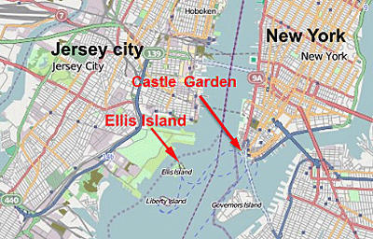
One of several temporary detention camps run by the Department of Justice for mostly German and Italian national POWs and enemies of the state.
Ellis Island cover - lawyer to a detained immigrant.
9

Slide 10
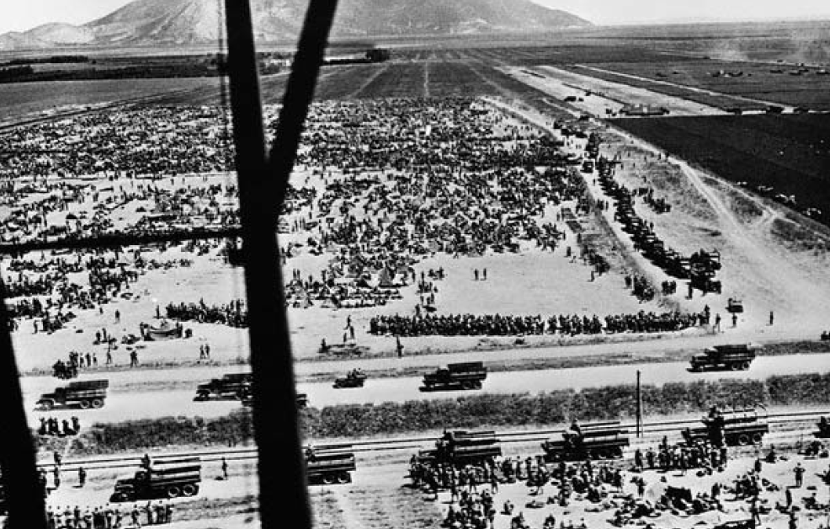
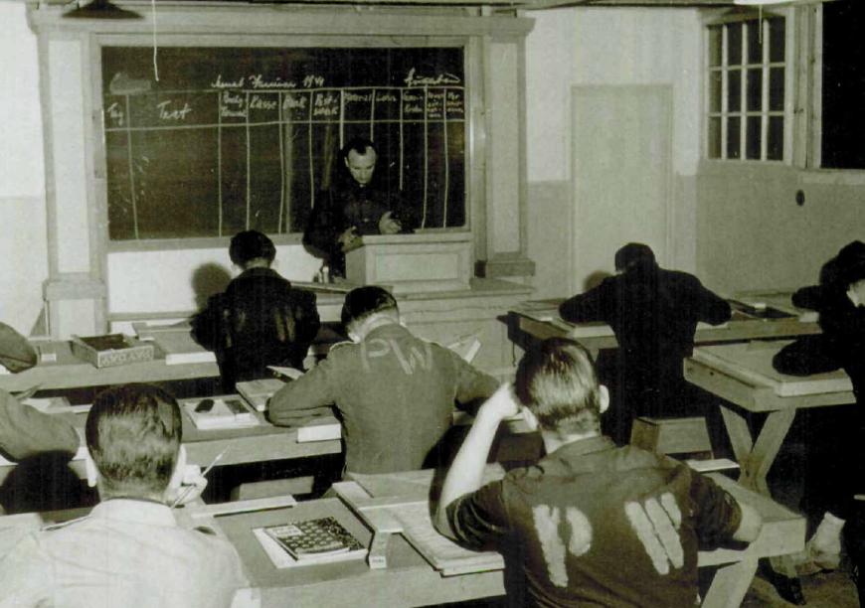
Mailed to a German POW housed at the Huntsville, TX camp.
10

Slide 11
To a prisoner at the Federal Penitentiary in Lewisburg, PA.
11

Slide 12
Military deserter and “accidentally killed” covers.
12

Slide 13
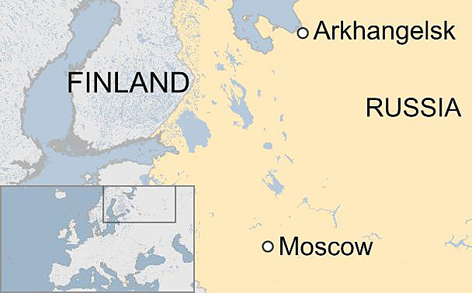
Brooklyn, NY transit mark
Archangel, Russia censor
Merchant Marine mail, Russian Arctic.
13

Slide 14
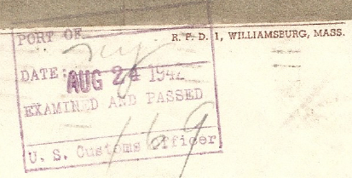
U.S. Customs censor on reverse
To a passenger on the S.S. Gripsholm, Swedish American Line, repatriation voyage *. Former U.S. counsel to Kobe, Japan.
14

Slide 15

Mailed from Free French Forces Destroyer, “Le Terrible.”
15

Slide 16
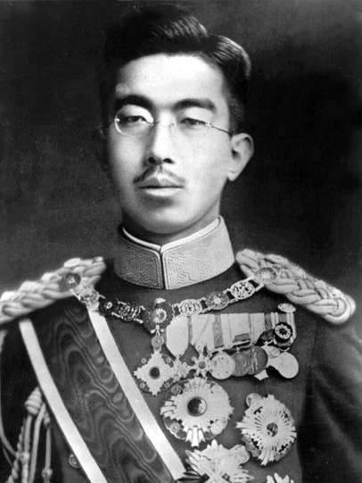
Returned censored “Peace” letter written to the Emperor.
16

Slide 17
Thanks for Watching!

