Slide 1


Queen Victoria Era Stamps of St. Lucia
Scott Martz 1/2013
Updated March 2026 by Tom Fortunato

Slide 2
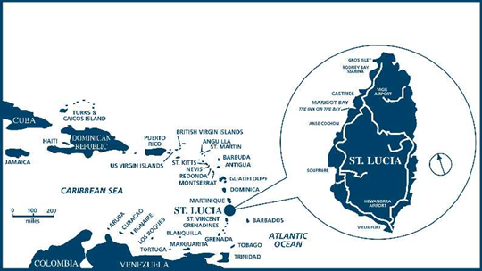
Saint Lucia was inhabited by the Arawak and Kalinago Caribs before European contact in the early 16th century. It was colonized by the British and French in the 17th century and was the subject of several possession changes until 1814, when it was ceded to the British by France for the final time. Wikipedia

Slide 3
Here’s an 1849 cover mailed from St. Lucia sent to London in the days before stamps were used with a crowned circle “Paid at St. Lucia” mark. Postage was one shilling.

Slide 4
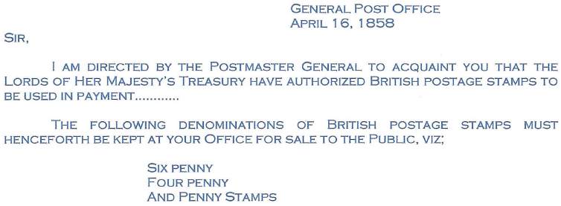
The colony of St. Lucia began using British stamps in 1858, when it was mandated that all mail leaving the island must be prepaid and have affixed stamps as proof.
Fifty pounds in face value stamps were dispatched to the island, thought to be a two-month supply. The 4d paid the western hemisphere rate, the 6d paid the single rate to Great Britain, and the 1d paid any make-up rate. They were authorized for use through May 1860 by which time specific St. Lucia stamps were expected to be ready for use.

Slide 5
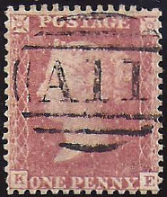
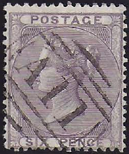
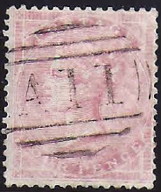
A cancellation device was sent to the colony with the stamps, with the unique colony identifier, A 11. Its first recorded use was August 28, 1858.

Slide 6
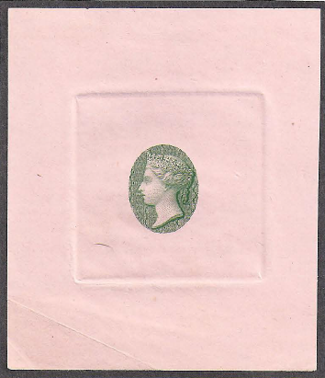
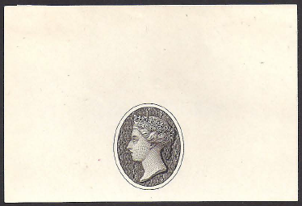
The head of Queen Victoria was engraved by C.H. Jeens in May of 1860 for use on the 9 pence stamp for South Australia. That engraving was placed in a vertical oval large enough for the head, surrounded by a plain band with the words St. Lucia and Postage, and an engraved background in the corners.
Jeens was paid £2 12s 6p for the drawing, and £9 9s for the engraving. This design was considered by many as one of Perkins Bacon’s most elegant.
handwritten “Specimen”

Slide 7
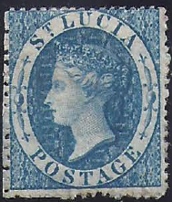
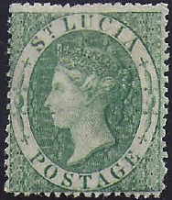
rose-red 1d blue 4d green 6d
The stamps were printed using a line engraved process. To save money for the colony one plate was made with only the ink’s color differentiating its denomination.
With fewer than 200 people on the island being able read or write, this may have been another reason to forego inscribing values on each.
Scott #1-3

Slide 8

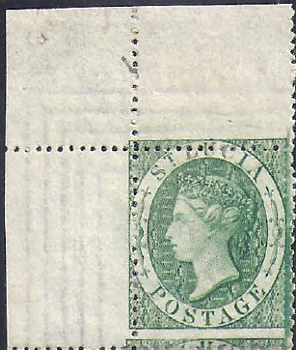
The final plates consisted of of 240 stamps per sheet.
Stamps from the first run were reportedly printed by a Mr. Dix on October 10. The total number of stamps from the printing runs by denomination were:
36 sheets of the 1p rose-red (8,640 stamps)
13 sheets of the 4p blue (3,120 stamps)
17 Sheets of the 6p green (4,080 stamps)
The first issue was printed on paper produced by Rush Mills in Northampton on watermarked paper with small six-pointed stars and “POSTAGE” repeated twice along the sheet’s sides and once on the top and bottom edge with 5 parallel lines between the wording.

Slide 9
Three days later on October 14 the stamps were documented as being perforated by a Miss Stewart.
The perforation needles were set to 14-16, but they often became clogged resulting in rough perforations.
rough rough cut free clear
The first issue was shipped from Perkins Bacon in Great Britain by island packet on November 17 and placed on sale December 18.
Castries, St. Lucia street scene, 1860

Slide 10
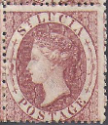
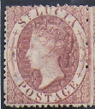
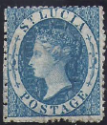
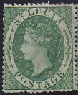
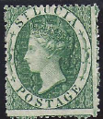
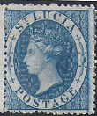
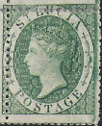
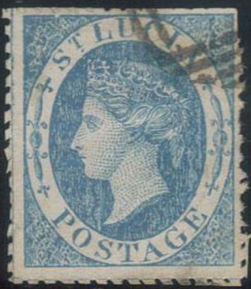
Stamps with perforations clear on all sides free of the design are extremely rare. This example has perforations clear of the design on all sides.
Stamp shades of all three abound due to ink batches with slight differences in the mix and exposure over time.
Scott #2

Slide 11
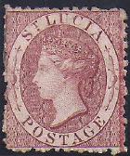
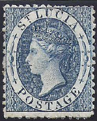

In 1863 another printing of these stamps took place using the same printing plate but through De La Rue printers. Their results were not as clear as the first printing, mostly due to the wear of the plate. While the ink mixes used were different, causing slightly different coloration and smearing, they are easily identified because of the change of watermark to the Crown and CC type.
lake red indigo emerald green
42 sheets 13 sheets 23 sheets
10,080 stamps 3,120 stamps 5,520 stamps
All perf 12 ½. Known with watermark reversed.
Scott #4-6

Slide 12
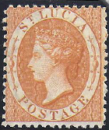
In 1864 another printing took place using the same plate, watermark design and 12.5 perforation, but with changed colors and the addition of a 1 shilling denomination.
black 1d light yellow 4d lilac 6d orange red 1 sh
Their second printing were perf 14, all else similar.
Scott #7-10
Scott #11-14

Slide 13
January 27, 1882 folded letter from St. Lucia to London, paid at the correct 4d postage rate, also noted in red crayon. Still, the shade of the 4d yellow is very close to that of the 1-shilling orange, potentially causing confusion.
reverse

Slide 14
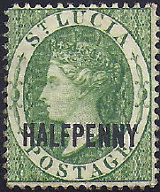

In 1881 stamps were surcharged with denominations. The first was a ½ d in green, and 2 ½ d in scarlet. Perforated 14.
In 1883 five additional stamps were prepared with surcharged denominations on new paper, which had the Crown and CA watermark. These were also perforated 14.
Scott #15, #17
Scott #19-23

Slide 15
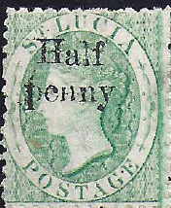
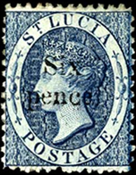
In 1884 the 4 pence in yellow was reprinted, and this time it was perforated 12.
In 1885 2 additional values were prepared, but never put into use, a half penny, and 6 pence. The 6 pence is extremely rare.
Scott #24
Scott #25
Scott #26

Slide 16
The 1883 stamp issues followed the trend of the rest of the empire by releasing the first large scale key type design used by multiple colonies and territories. The first 6 values were done in single colors.
De La Rue essay
Scott #27//36

Slide 17
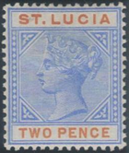
The second group was done in 2 colors, highlighting the country and denomination, except for the 1d color change.
Scott #29//39

Slide 18
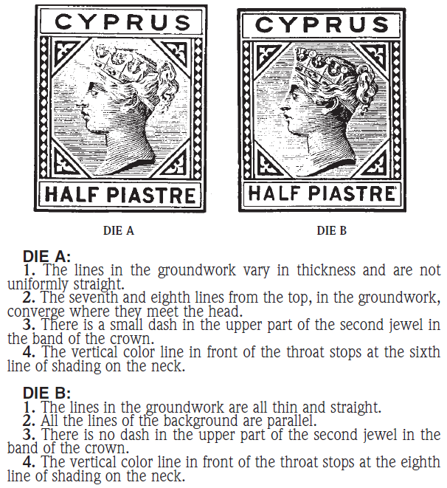
Two different dies were used to produce these key types,
Die 1 or A, Die 2 or B.
Here is the guide from the Scott Catalogue.

Slide 19
And here is the guide from the Stanley Gibbons Catalogue.

Slide 20
In 1892 the were three overprints done, one of which was bisected.
Scott #40 Scott #41 Scott #42
Several varieties are known, including varieties to individual lettering and double surcharges.

Slide 21
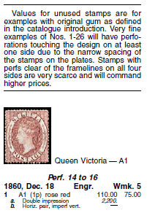
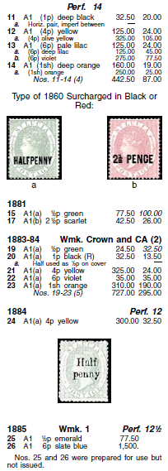
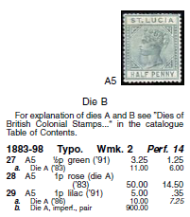
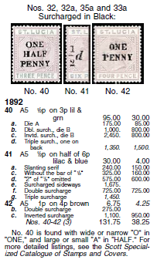
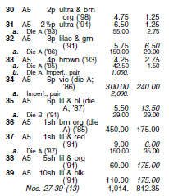
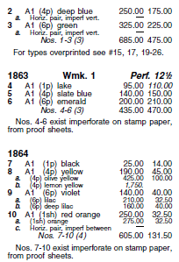
In case you were wondering… from the 2008 Scott catalog…

Slide 22
From the 2016 Gibbons Commonwealth & Emp. Catalogue.
Although difficult to read here, it’s much more detailed than Scott’s, listing shades and varieties of most issues.

Slide 23
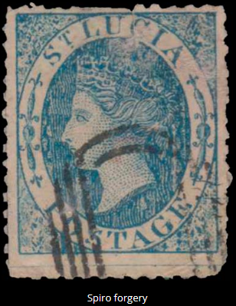
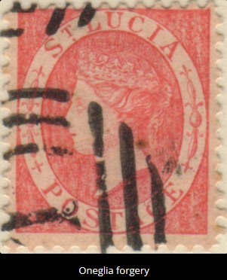
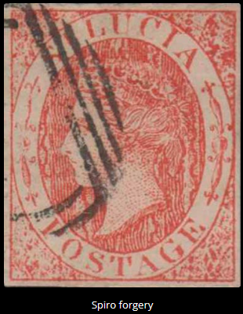
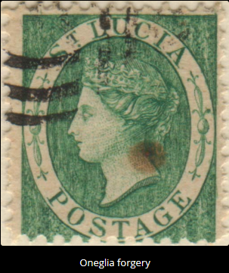
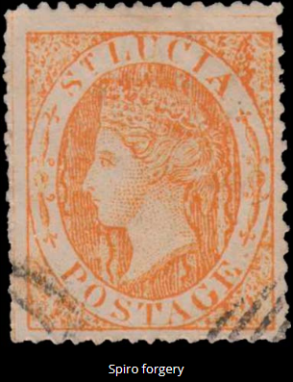
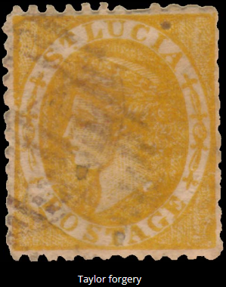
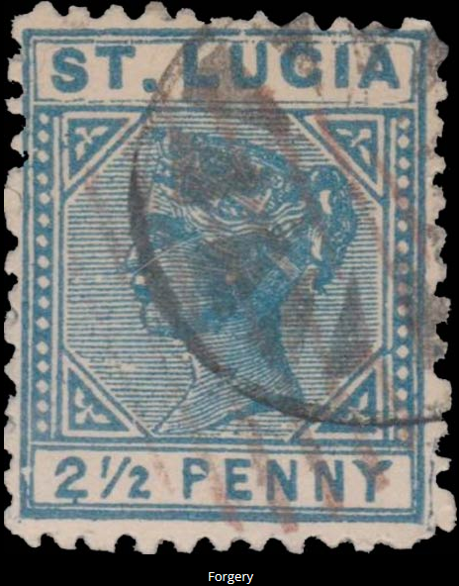
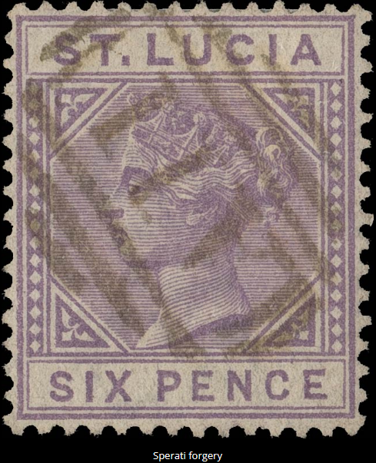
Beware of fakes and forgeries of classic St. Lucia stamps.

Slide 24
A total of 40 stamps were issued under Queen Victoria’s reign for the colony of St. Lucia, all of which carried her portrait. Classic designs never go out of style!
The End
Much information and several images used came from the November 2014 Royan Philatelic Society London presentation PDF on St. Lucia by John Keegan here.

