Slide 1
The Parcel Post System (January 1, 1913)
Outline:
1. Historical Development: Parcel Post System
2. Parcel Post Stamps Q1 to Q12
Illustrations of Postal Personnel, Q1 to Q4
Illustrations of Postal Transportation, Q5 to Q8
Illustrations of Industry and Agriculture, Q9 to Q12
3. Parcel Post Postage Due Stamps, JQ1 to JQ5
4. Few example of Use
                M .Savka, RPA, Oct. 2026

Slide 2
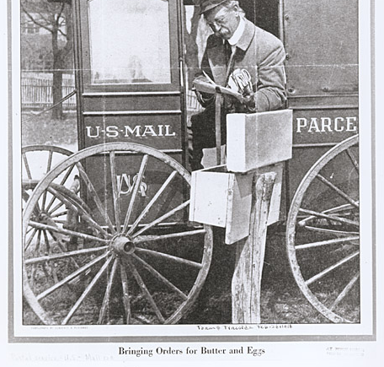
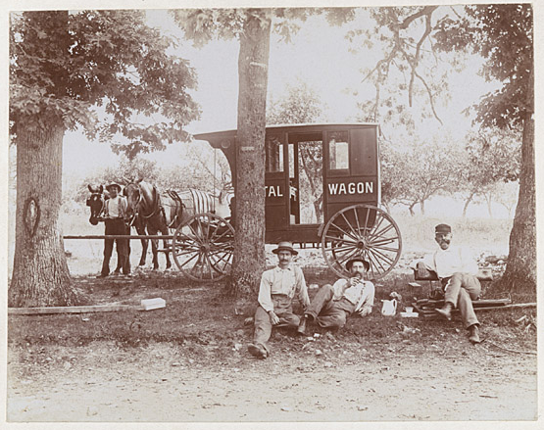
The Parcel Post System (January 1, 1913): an extension of the postal system and the birth of a beautiful series of short-lived stamps
The Parcel Post System: A U.S. Gov. Business Venture: develop city delivery of farm products, rural package delivery, and aimed to spur economic growth
M .Savka, RPA, Oct. 2026

Slide 3
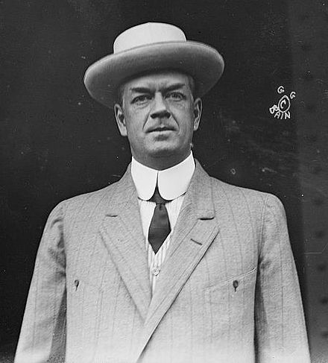
An extension of the 4th class mail category
Renamed 4th class mail as parcel post began in 1913, by an Act of Congress, August 24, 1912, the Parcel Post System was established.
Frank Harris Hitchcock was then the Postmaster General of US from 1909 to 1913. Hitchcock and his staff oversaw production of the 17 new stamps for the Parcel Post System, 12 regular parcel post (Q series) and 5 parcel post postage due (JQ series) stamps.
His team wrote the regulations for the
establishment of the Parcel Post System,
Order No. 6685, Nov. 20, 1912.
He is also credited with establishing: 1, the
first U.S. Airmail Service and 2, establishing
the U.S.P.S. Operation Santa in 1912
(Children’s Letter To Santa Claus).

Slide 4
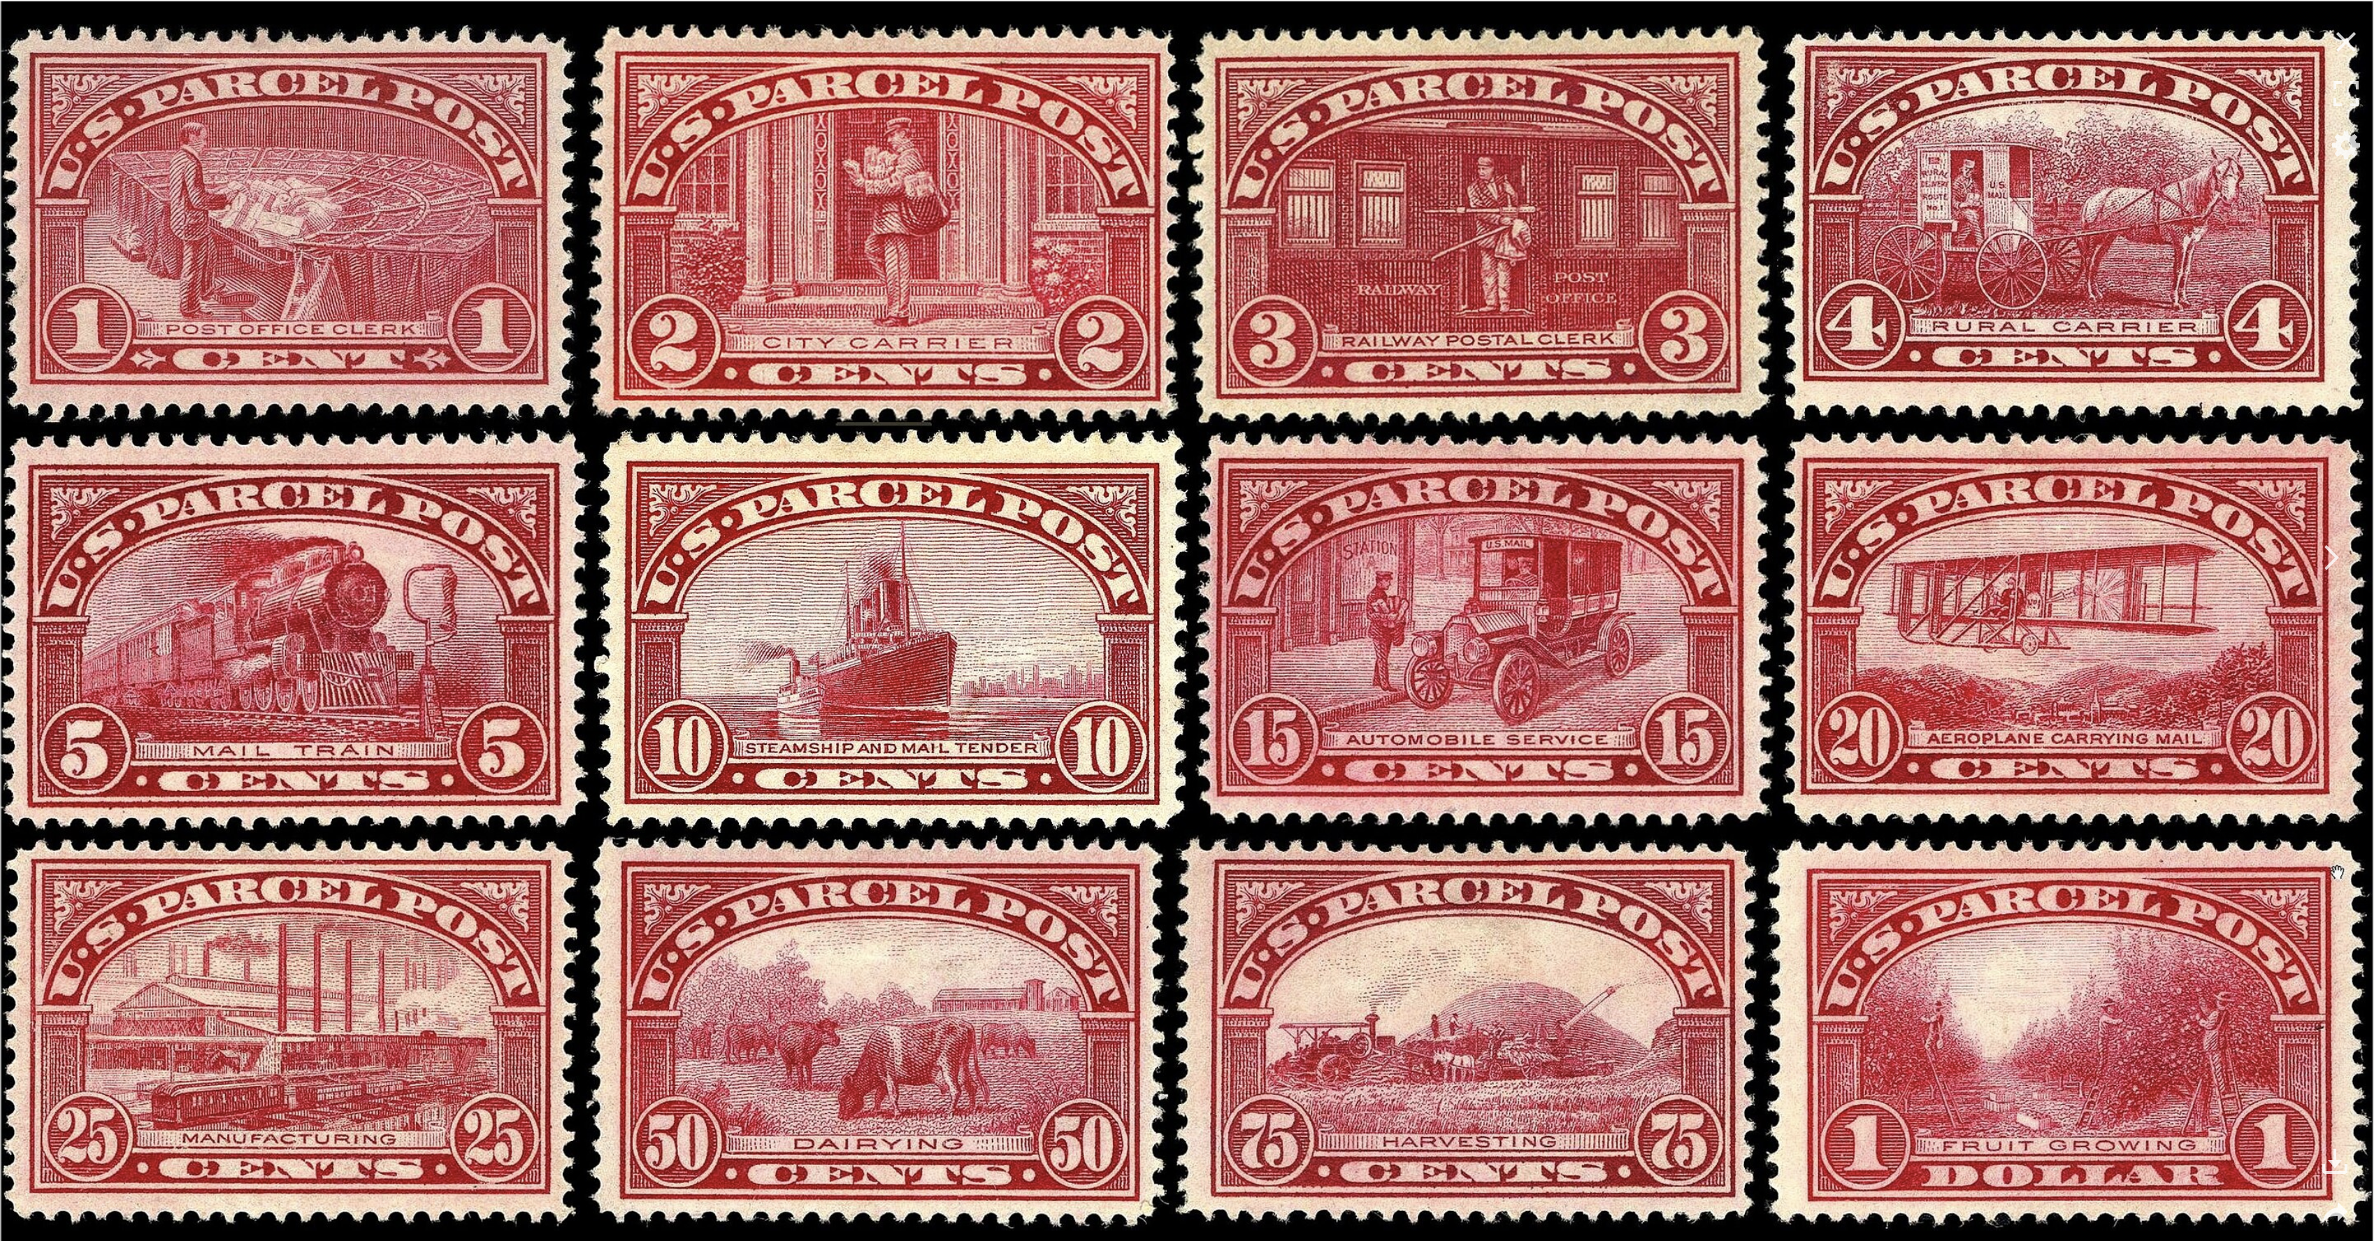
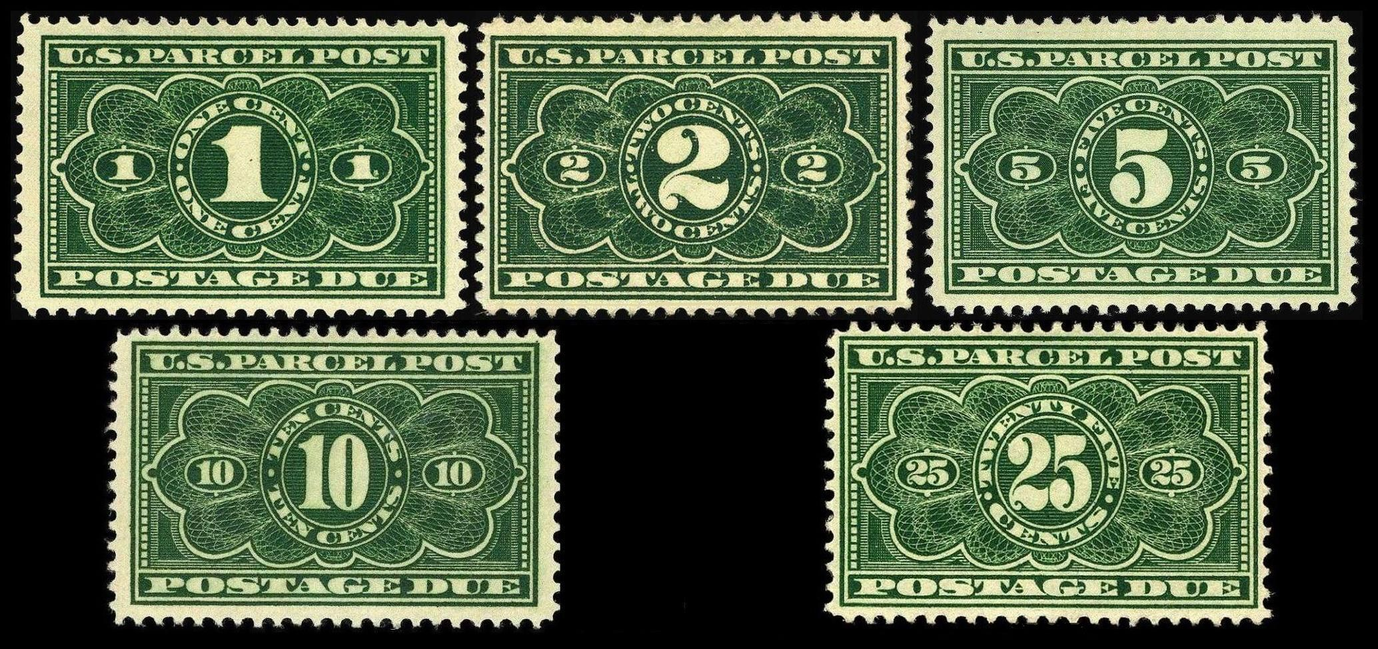
Mail materials of 3rd class became 4th class to support the New Parcel Post System
Included printed matter other than regular newspapers and periodicals. Merchandise and other mailable matter became 4th class mail to support the Parcel Post system (e.g., mail orders via Sears Roebuck and Montgomery Ward companies).
The Parcel Post System went into effect on Jan. 1, 1913, and brought forth the production of twelve (9) stamps, 1 cent to 1-dollar, all in one color and size. The 3-, 50-cent and 1-dollar issues not available until after Jan 1, production delays.
The Postmaster general issued an order that only the special Parcel Post Postage stamps (Q) could be used in this new service (accounting reasons). If 4th class mail was mailed with regular stamps it would be “held for postage” and this was the function / place to use the Parcel Post Postage Due, JQ issue(s).
Q Issues
JQ Issues

Slide 5
Parcel Post Rates and Rate Changes: Designed for Low Cost of Transport of Packages
Increased package for mailing from 4 to 11 pounds and retained old rate of 1 cent for up to 4 ounces.
Provided a rate stepped structure based on both weight in pounds or fraction of pounds AND distance sent (zones – next slide).
Was a separate system within the mail system.
Jan 1913, 1st pound = 5 cents, then increased by zone to 12 cents in the most remote zones. Added pounds were 1 cent locally and to 12 cents for the furthest zones with a maximum rate of $1.32. Can add insurance for up to $50.00 for 10 cents.
August 13, 1913, increased limit to 20 pounds for nearest two zones.
Jan, 1, 1914, increased limit to 50 pounds for nearest two zones and to 20 pounds for for the furthest zones.
1918, Rates were reduced and weight limits now accepted to 50 pounds in all zones including the furtherest zones.

Slide 6
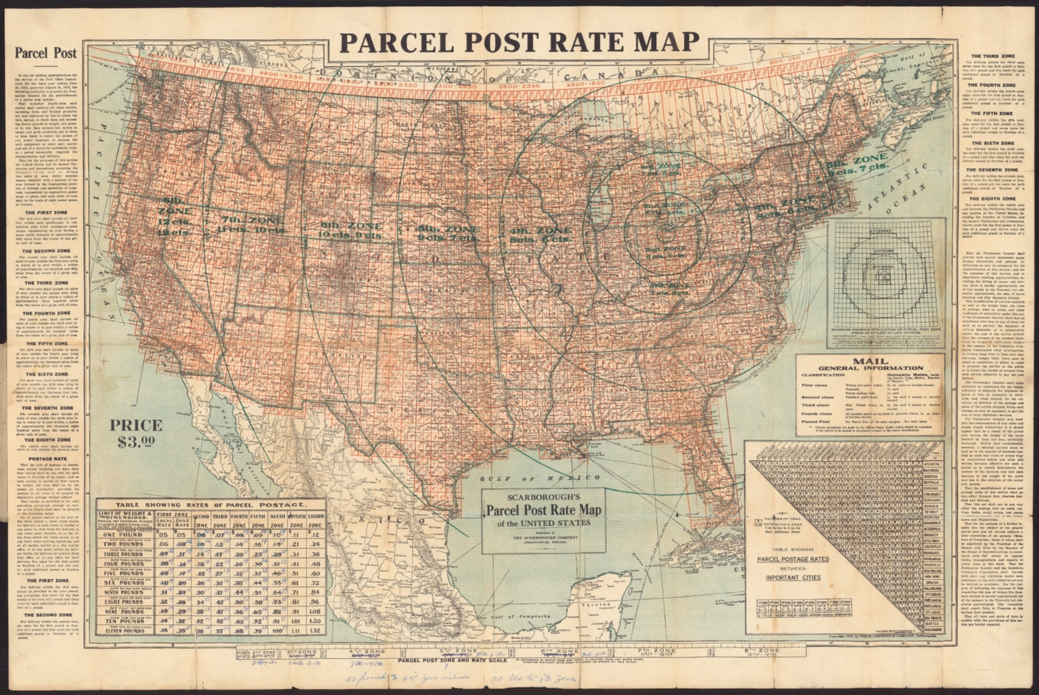

Slide 7
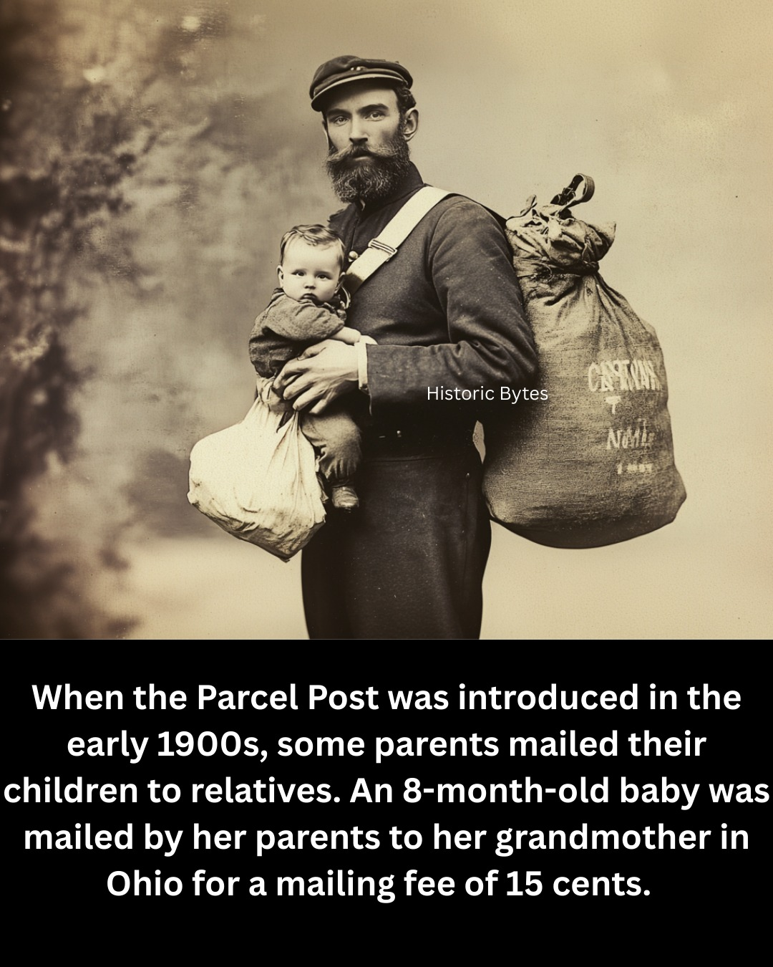

Slide 8
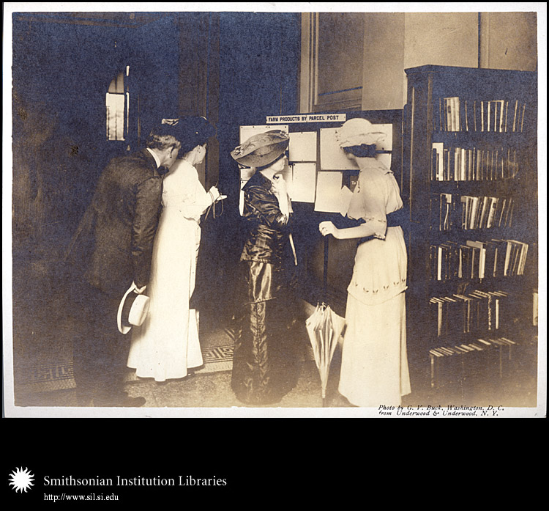
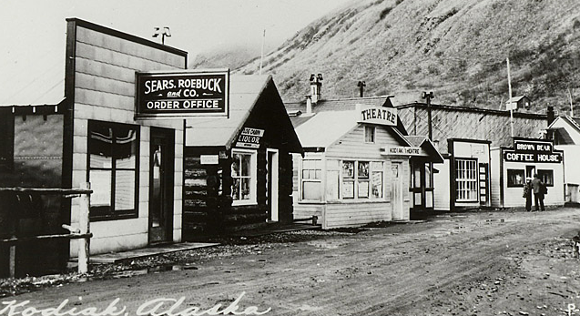
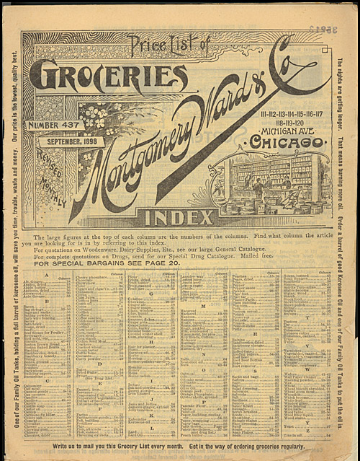
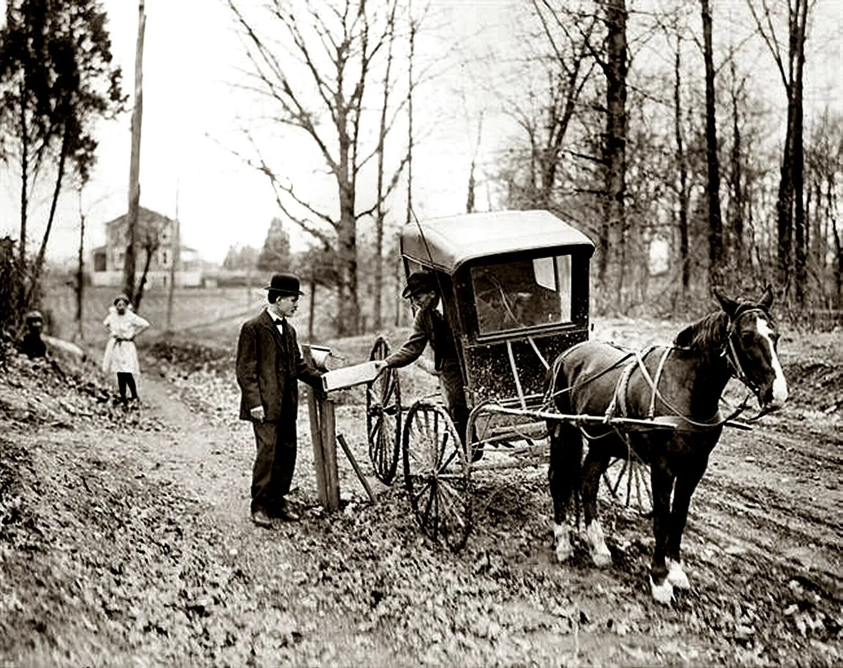

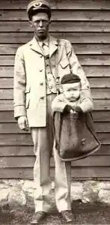
Farm products by parcel post,
Sears Roebuck order house in Kodiak Alaska,
Montgomery Wards Co. order advertisement,
Rural delivery, Two children sent via Parcel Post.

Slide 9
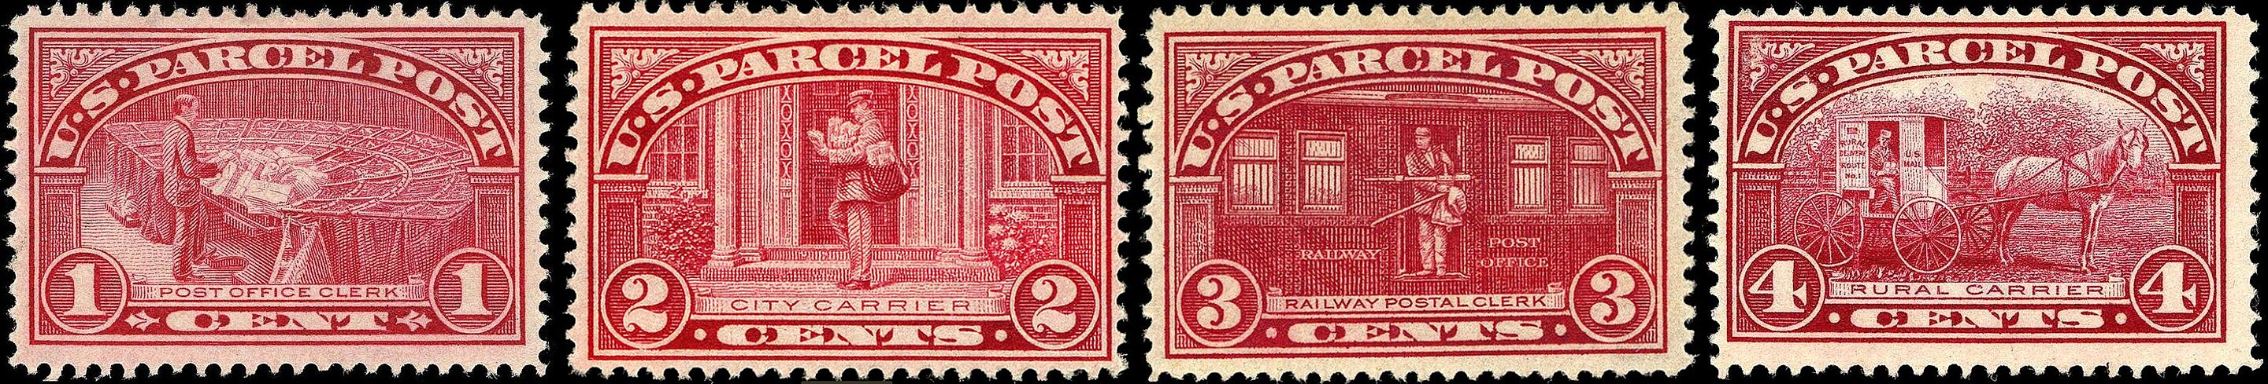

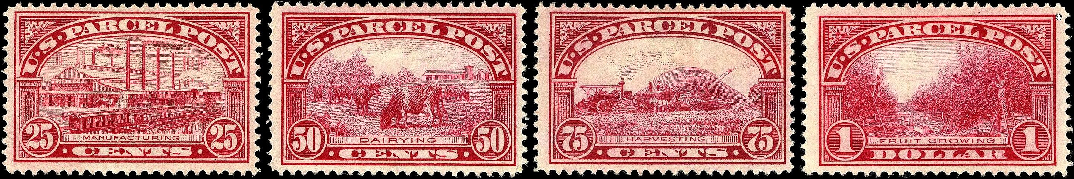
Parcel Post Stamps: Q1 to Q12
Q1 to Q4, Postal Personnel: Post office clerk, City carrier, Railway
postal clerk, Rural carrier.
Q5 to Q8, Postal Transportation: Mail train, Steamship and mail tender,
Automobile service, Aeroplane carrying mail.
Q9 to Q12, Industry and Agriculture: Manufacturing, Dairying, Harvesting,
Fruit growing.

Slide 10
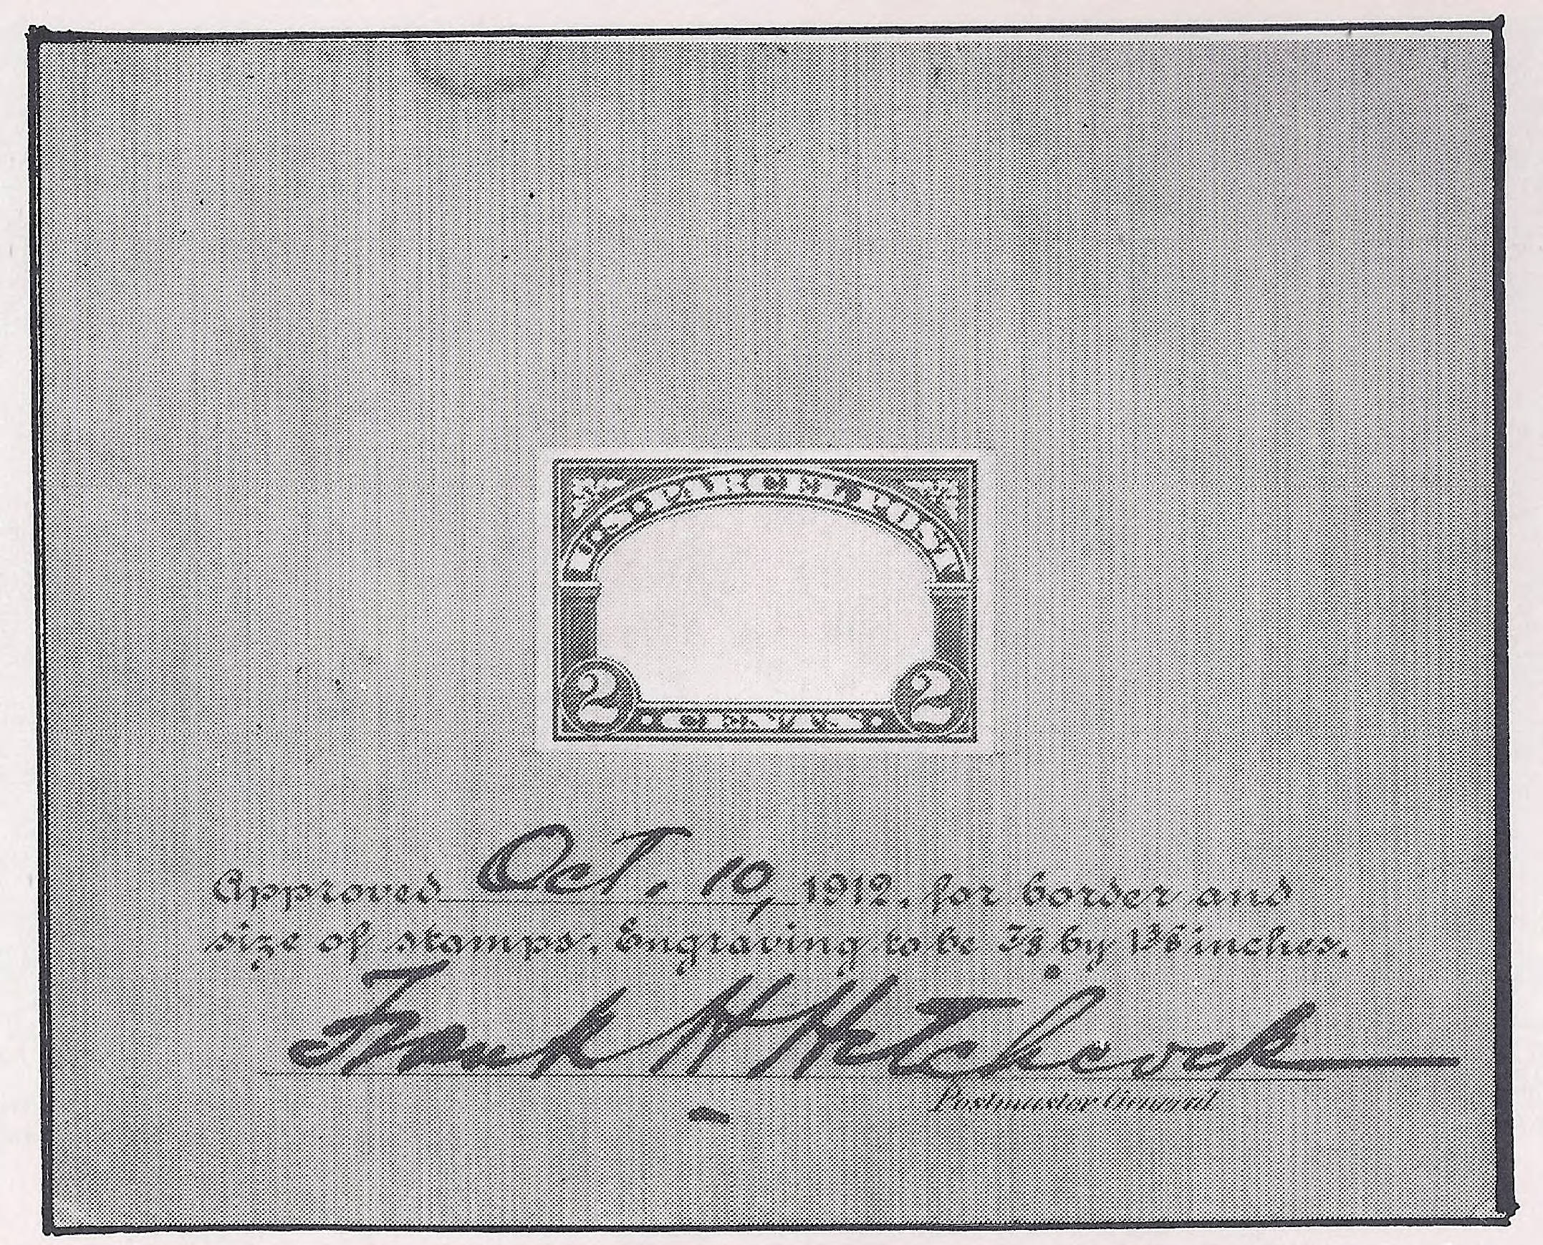
Postmaster General Hitchcock approved on Oct 10, 1912, the model below in black and white, for Parcel Post Postage (Q-series), the stamp size and the common border design
Q series:
1. Same size
2. Same border design
3. Same color “red” for all 12 issues
(previous approved)
4. Vignette tailored for each denomination.

Slide 11
JQ Series: The Parcel Post Postage Due
Issues of 1, 2, 5, 10 and 25 cents, Geometric Lathe Design, Same Size as Parcel Post Postage Stamps, the Q issues
Parcel Post Postage Due Usage: added to parcels lacking the correct prepaid amount with regular Parcel Post series issues (Q) or regular postage. The amount due was paid by the recipient, not the sender.

Slide 12
The five issues of the Parcel Post Postage Due Stamps: JQ1 to JQ5, same size as the Parcel Post Postage stamps
Dates of issue were: 1- and 3-cent Nov. 12, 1912, and the 2-. 10- and 25- cent on Dec. 9, 12 and 16, 1912, respectively. All issued before the Parcel Post System started (Jan 1,1913).

Slide 13
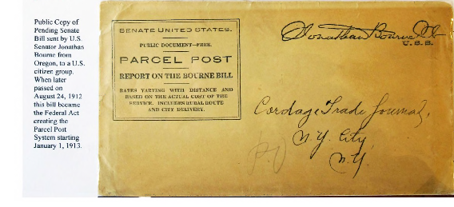
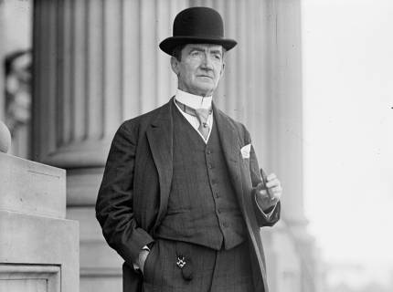
Parcel Post System: J. Bourne Bill, Restricted use period
The restricted use period from January 1 until June 30,1913 and the unrestricted use period from July 1,1913 forward, regulated on which class of materials shipped, on which the seventeen stamps could be used.
During the restricted use period, all domestic Parcel Post matter was to be prepaid exclusively by the distinctive Parcel Post Stamps. The purpose for the exclusive use of Parcel Post and Parcel Postage Due Stamps was to track revenue generated.

Slide 14
Parcel Post System: Unrestricted use period
Unrestricted use period began on July 1,1913, when the original regulations were rescinded, all regular postage and postage due stamps were permitted for use on Parcel Post matter. Parcel Post and Parcel Post Due stamps, likewise, were valid on all classes of mail becoming interchangeable with ordinary postage due stamps.
The production of the 17 stamps was discontinued, but existing stamps continued to be used until all remaining supplies were exhausted.
The Post Office Department knew that the Parcel Post System was a success, revenue had an increase and PPS no longer needed exclusive service specific stamps to provide revenue statistics.
By 1926, most Post Offices had used up the majority of the Parcel Post and Parcel Post Postage Due stamps, e.g. Q1 to Q8, 1914; Q9, 1915; Q10, 1916; Q11, 1922; Q12, 1917.

Slide 15
Effective July 1, 1913
Before this same time (Jan 1 to July 1, 1913) and as the Q issues were in the post offices, the single-color “red” scheme for the Q series was considered a mistake and many complaints from postal clerks, who noted it was difficult to keep the denominations distinct and that lead to mixing them-up during sales (sold them for the wrong value and this turned out to be gripes in having to handle and manage the (12 + 5) 17 new issues by the postal window clerks).
Frauds of the one cent issue were reported (this added to the rejection storm…). This was by replacing the cent panel with a cut-out dollar panel from revenue stamps; however, examples of these frauds were not forthcoming or ever found…

Slide 16
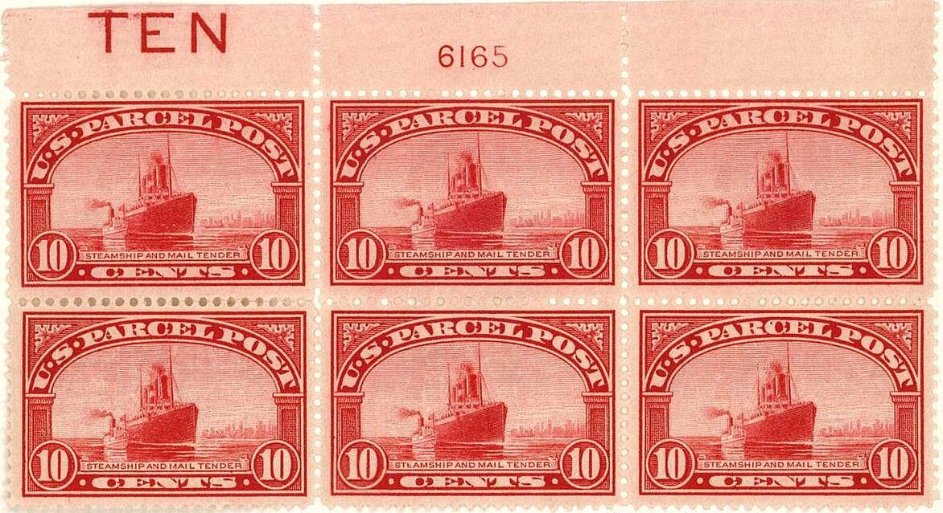
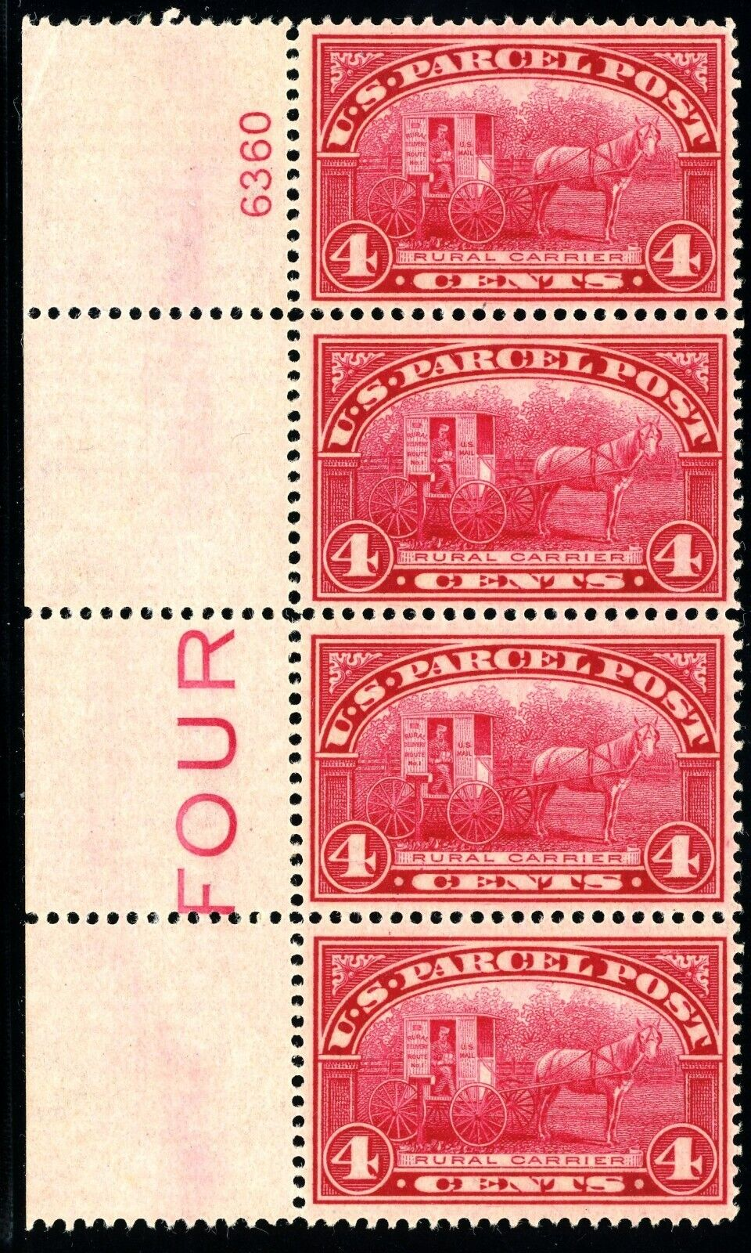
The ruckus raised by the window clerks about the difficulty of the new stamps…
To address this ruckus, on Jan. 27, 1913, the post office department added an inscription of the values onto the printing dies. Values were added in plain capital letters in the sheet selvage of each denomination and before the 3 and 50 cent stamps were issued. This was done to help quell the complaints from the postal clerks. This changed occurred only 26 days after the parcel post system was implemented.

Slide 17
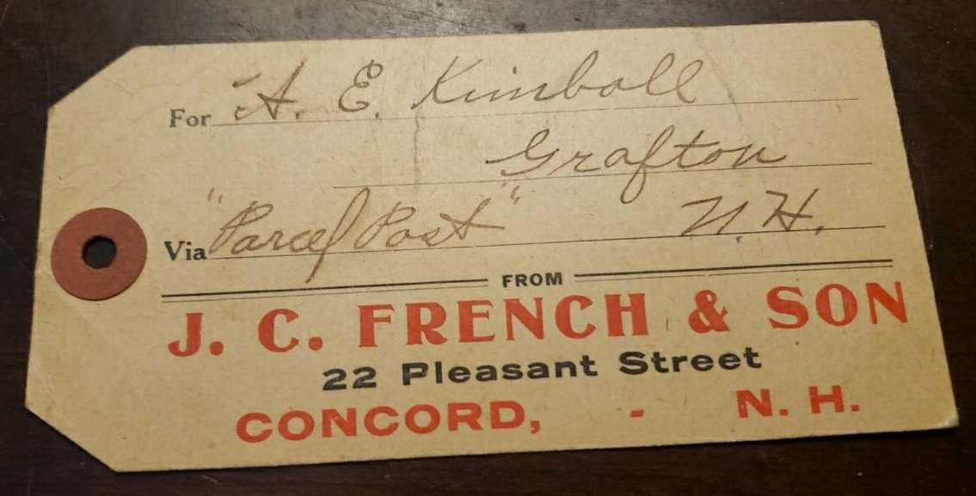
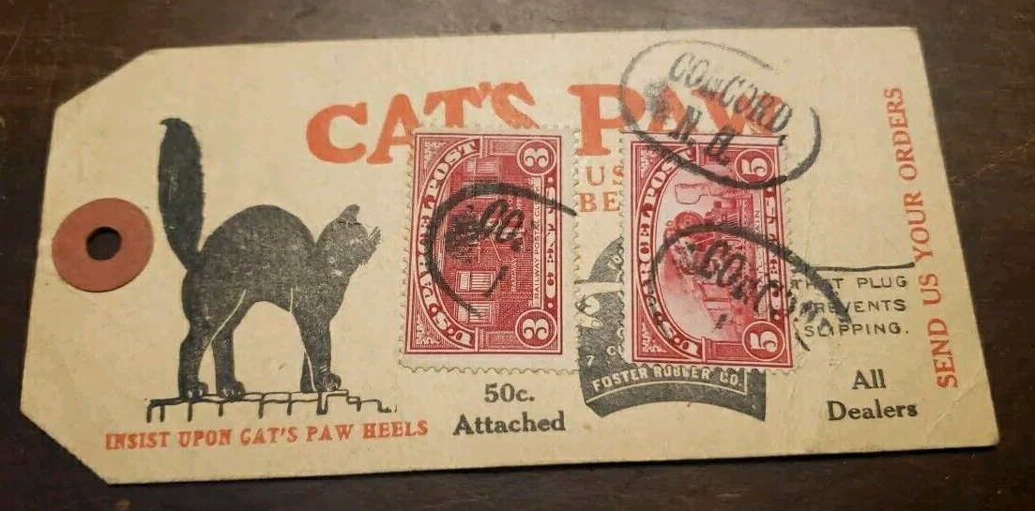
This ruckus occurred in the light of serious problems with the issues, other than color, were authentic
The Real or Authentic Problems Included:
Stamps were too large for use, since many times used in multiple combinations on packages, on a small parcels or tags, there was just not enough room on the face of the parcel for multiple stamps.
Another problem that made handling / managing difficult was the panel size (working sheet size) was 45 stamps, when, at that time, the postal clerks were familiar with sheet panels of 50 or 100 stamps.
Finally, the most loathsome factor was the increase in total additional stamp stock that each window clerk was forced to managed and this led to a dislike of the twelve new red parcel post and five green parcel post postage due issues.

Slide 18
Parcel Post Essays / Proposals of Stamp Design
Many unissued designs were considered in the form of:
1) wash drawings and 2) sketches in black and white.
Of unissued designs, three preliminary designs with dies engraved with only one of them, the Q10 (50 cent issue) four die plates were made and stamps printed, but no stamps issued (destroyed).
Three of the four essays were originally in the Frank Hollowbush collection included:
the 3-cent, Q3;
the 20-cent, Q8;
the 50-cent Q10;
with a fourth essay recently surfacing, the 15-cent, Q7 issue.

Slide 19
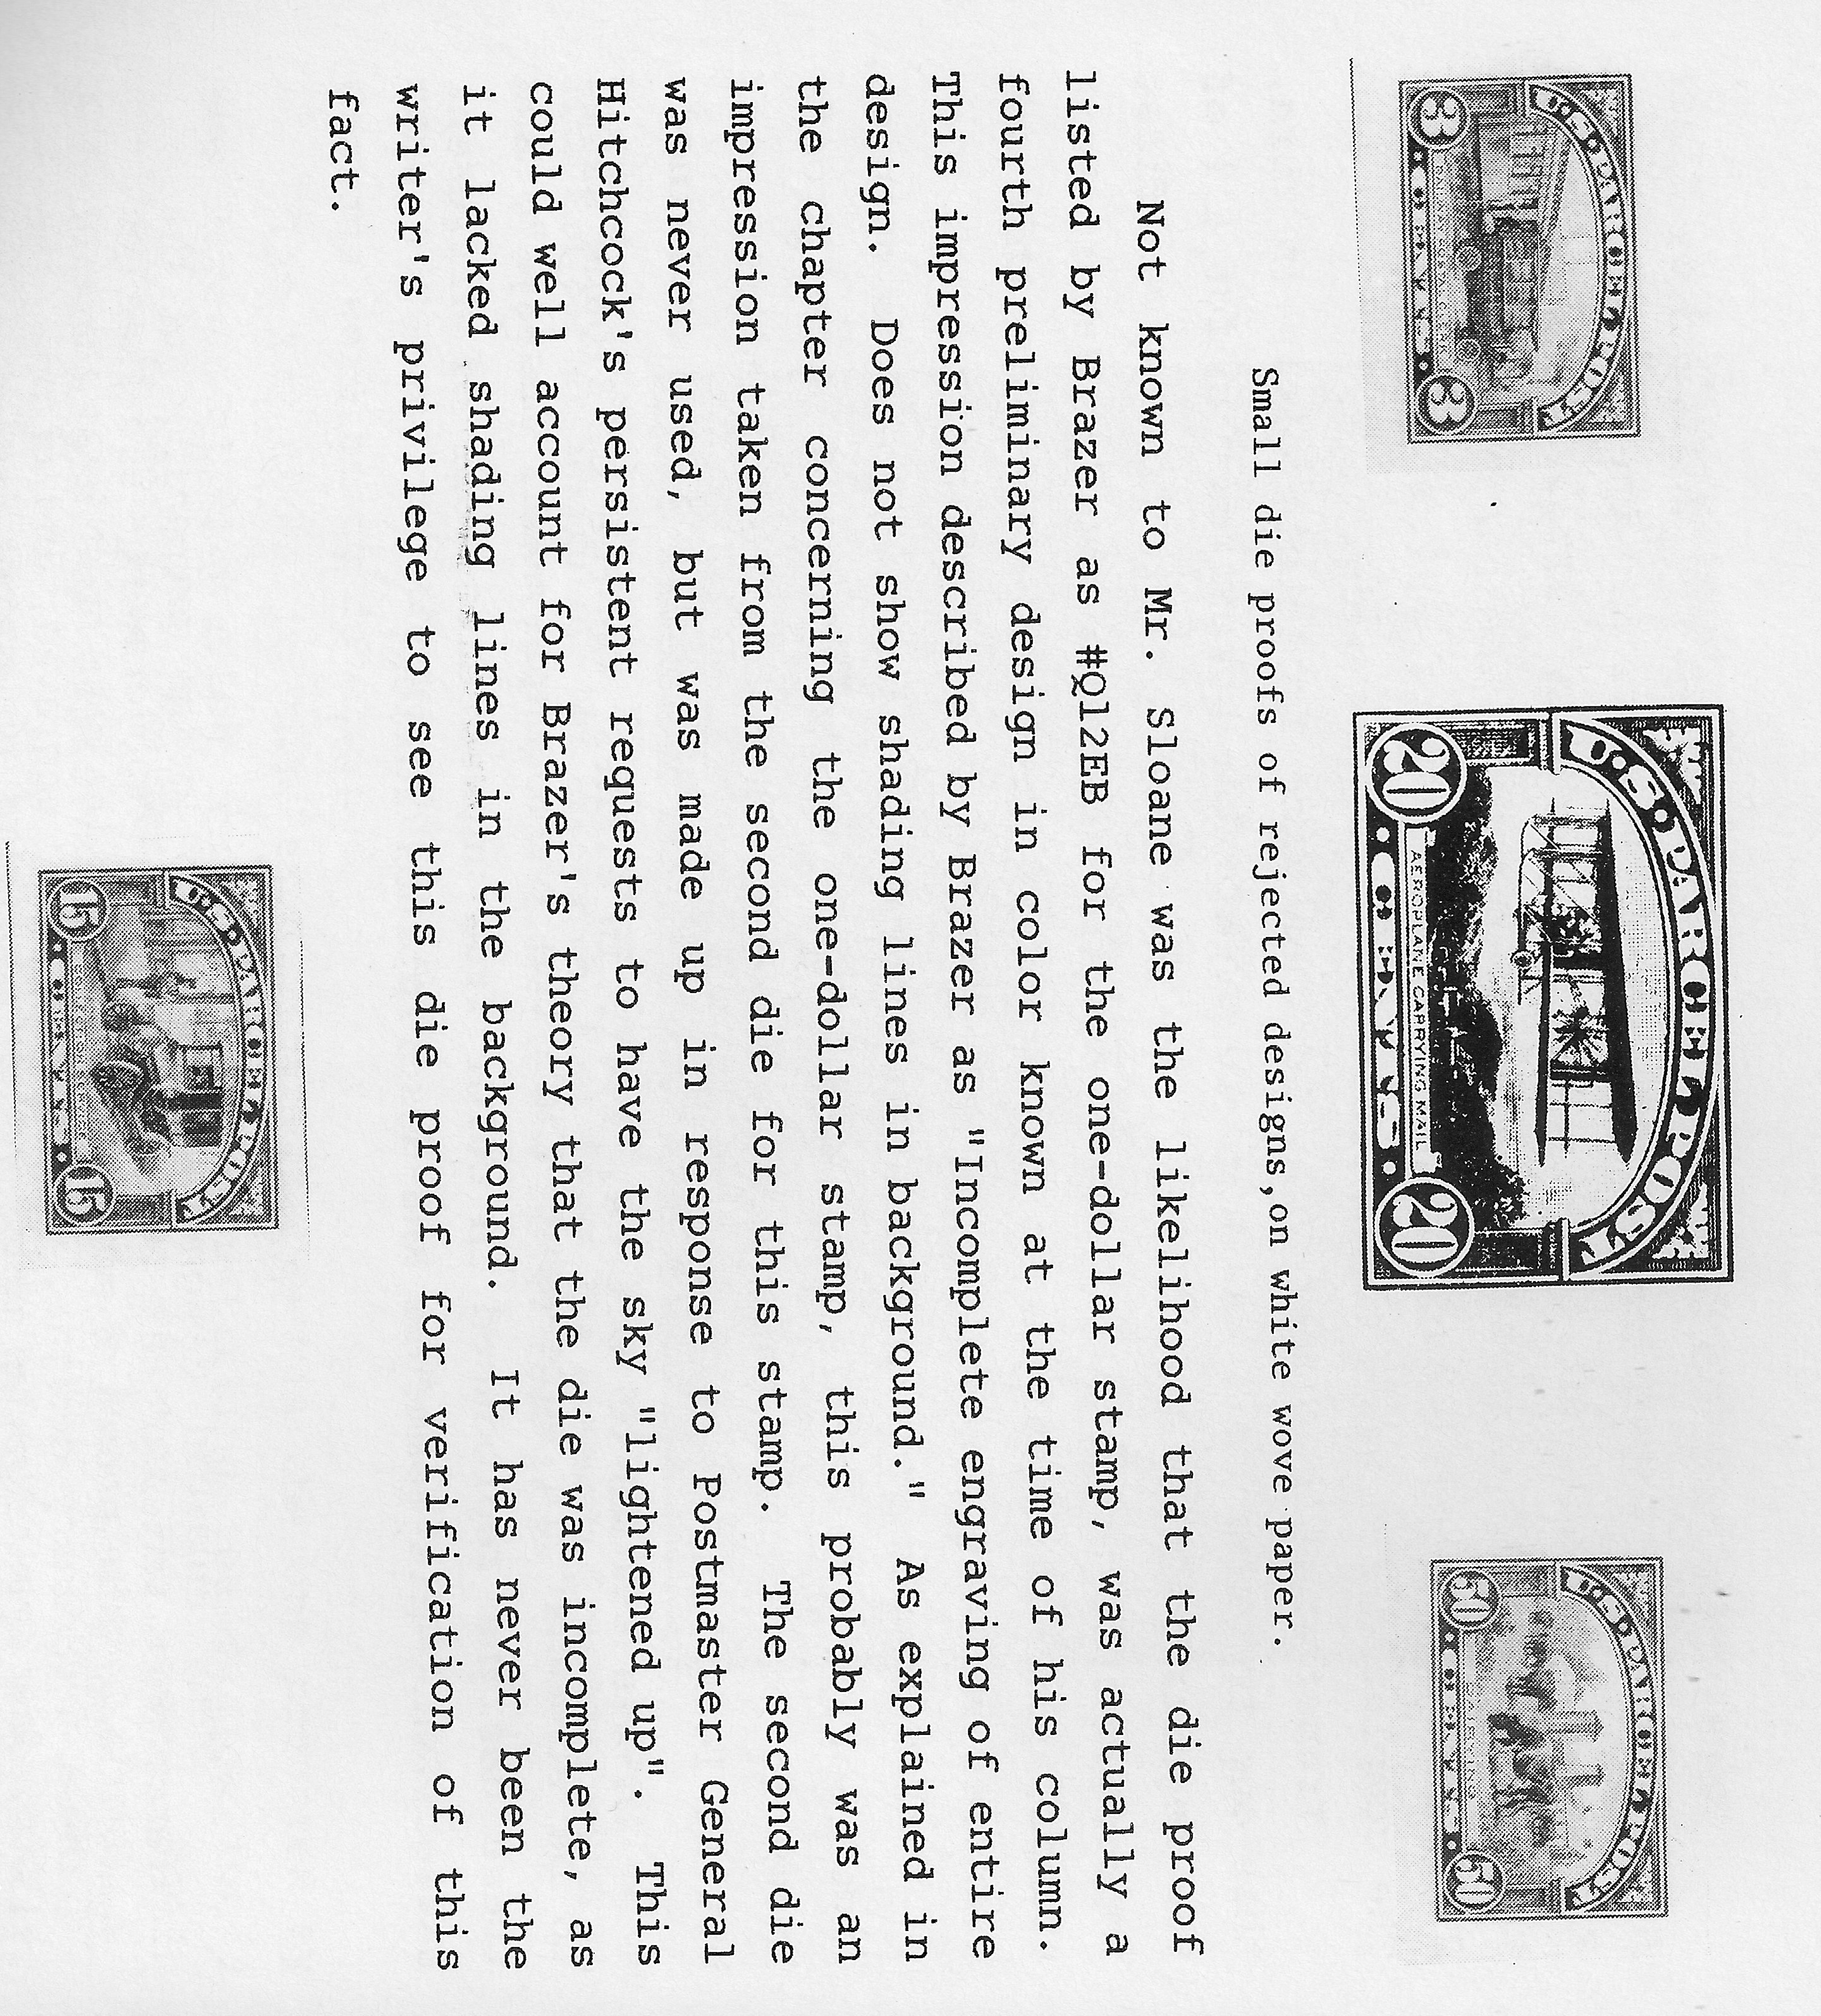
Four Die Proofs Not Approved (in black & white):
Differences: next slide

Slide 20
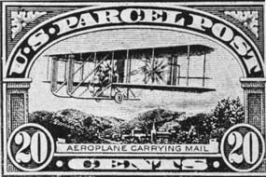
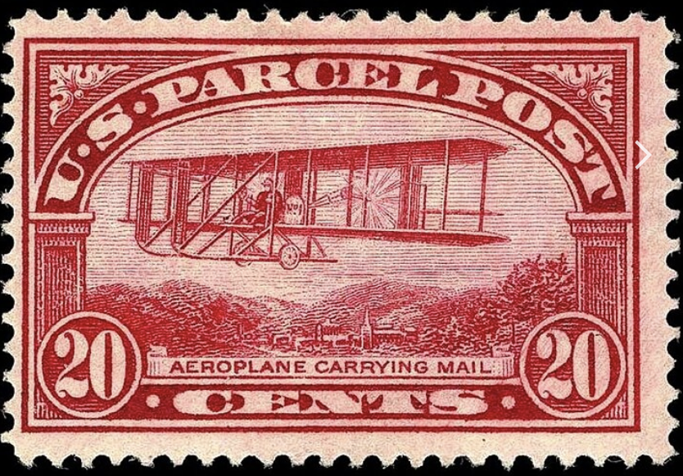
Q8 essay / proposal:
Actual Q8 Issue
A Wrong Airplane Design: This essay (left image) was engraved from a photograph of an airplane taken on the ground, so it has the aviator's feet in a strange position and mail pouch dangling perilously near his head. The mail bag “No 1” is at his right (blue arrow) while another sack hangs loosely out of the plane (green arrow; all these features are difficult to discern in the essay due to half-tone illustration). Mail bag in Q8 issue evident, right stamp, (yellow arrow).

Slide 21
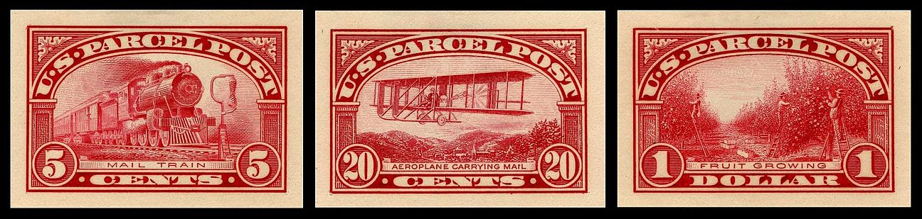
Some Parcel Post (Q5, Q8 and Q12 Die Proofs)
“Carmine” or “carmine rose” color of the parcel post issues found in catalogs, also some “lake” color issues of Q2 have been documented.
Full size paper sheets carried 180 stamps, with 10 wide by 18 high. Then cut into four quadrant sheets: down the middle, both vertically and horizontally, to give four panes of 45 stamps. Paper used for all issues was USPS single line watermark with a 12-gauge perforation.

Slide 22
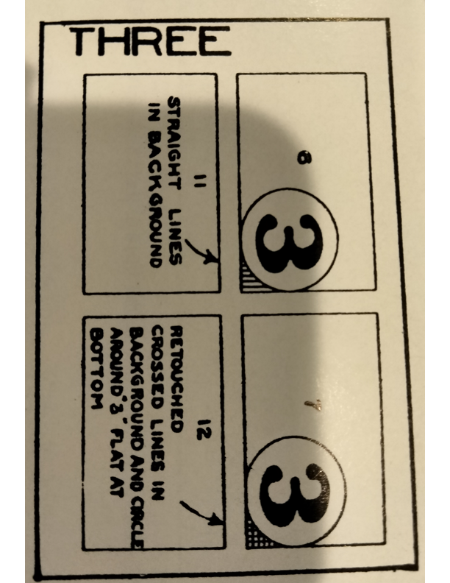
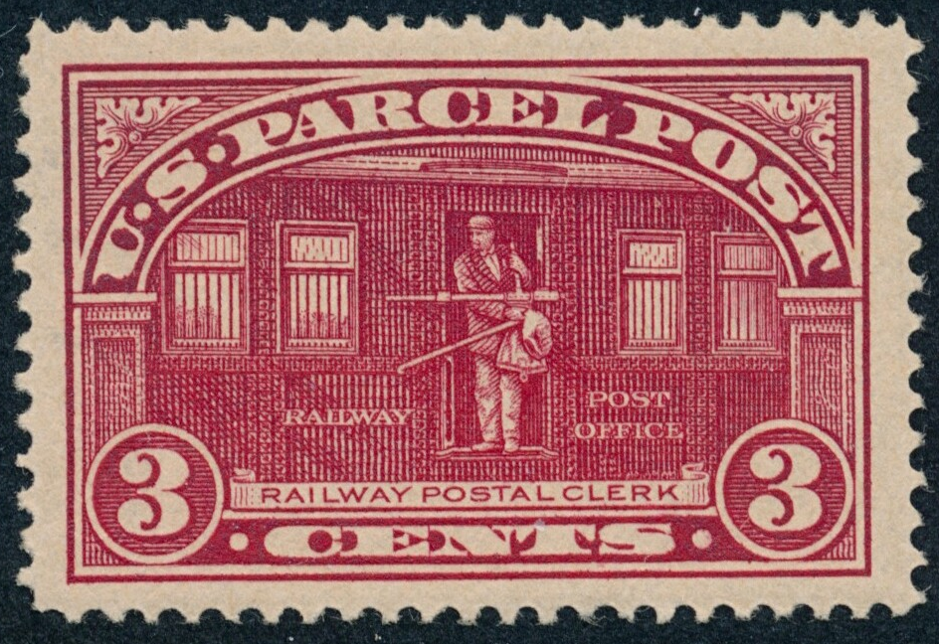
A retouched die plate for Q3 issue
Die retouched

Slide 23
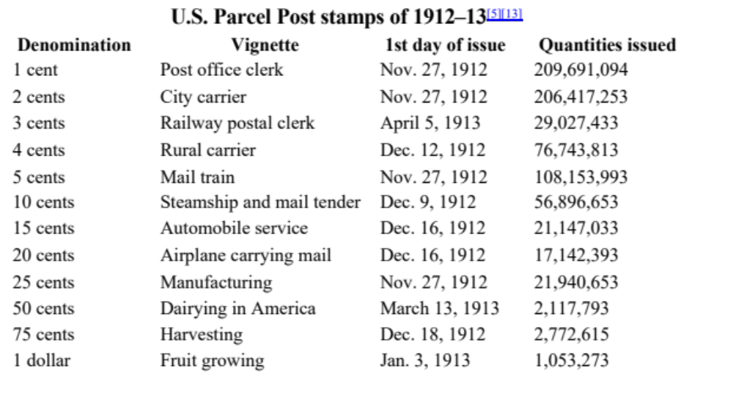
PP Stamps Illustrated Themes of Early Mail Delivery:
Working Personnel of the Postal Service
Ways of Transportation of Mail
U.S. Manufacturing and Agriculture Interests
Issue release after program began Jan 1, 1913, issue release delayed into 1913 year
1.
2.
3.

Slide 24
Parcel Post Stamps: Q1 to Q12
Q1 to Q4, Postal Personnel: Post office clerk, City carrier, Railway
postal clerk, Rural carrier.
Q5 to Q8, Postal Transportation: Mail train, Steamship and mail tender,
Automobile service, Aeroplane carrying mail.
Q9 to Q12, Industry and Agriculture: Manufacturing, Dairying, Harvesting,
Fruit growing.

Slide 25
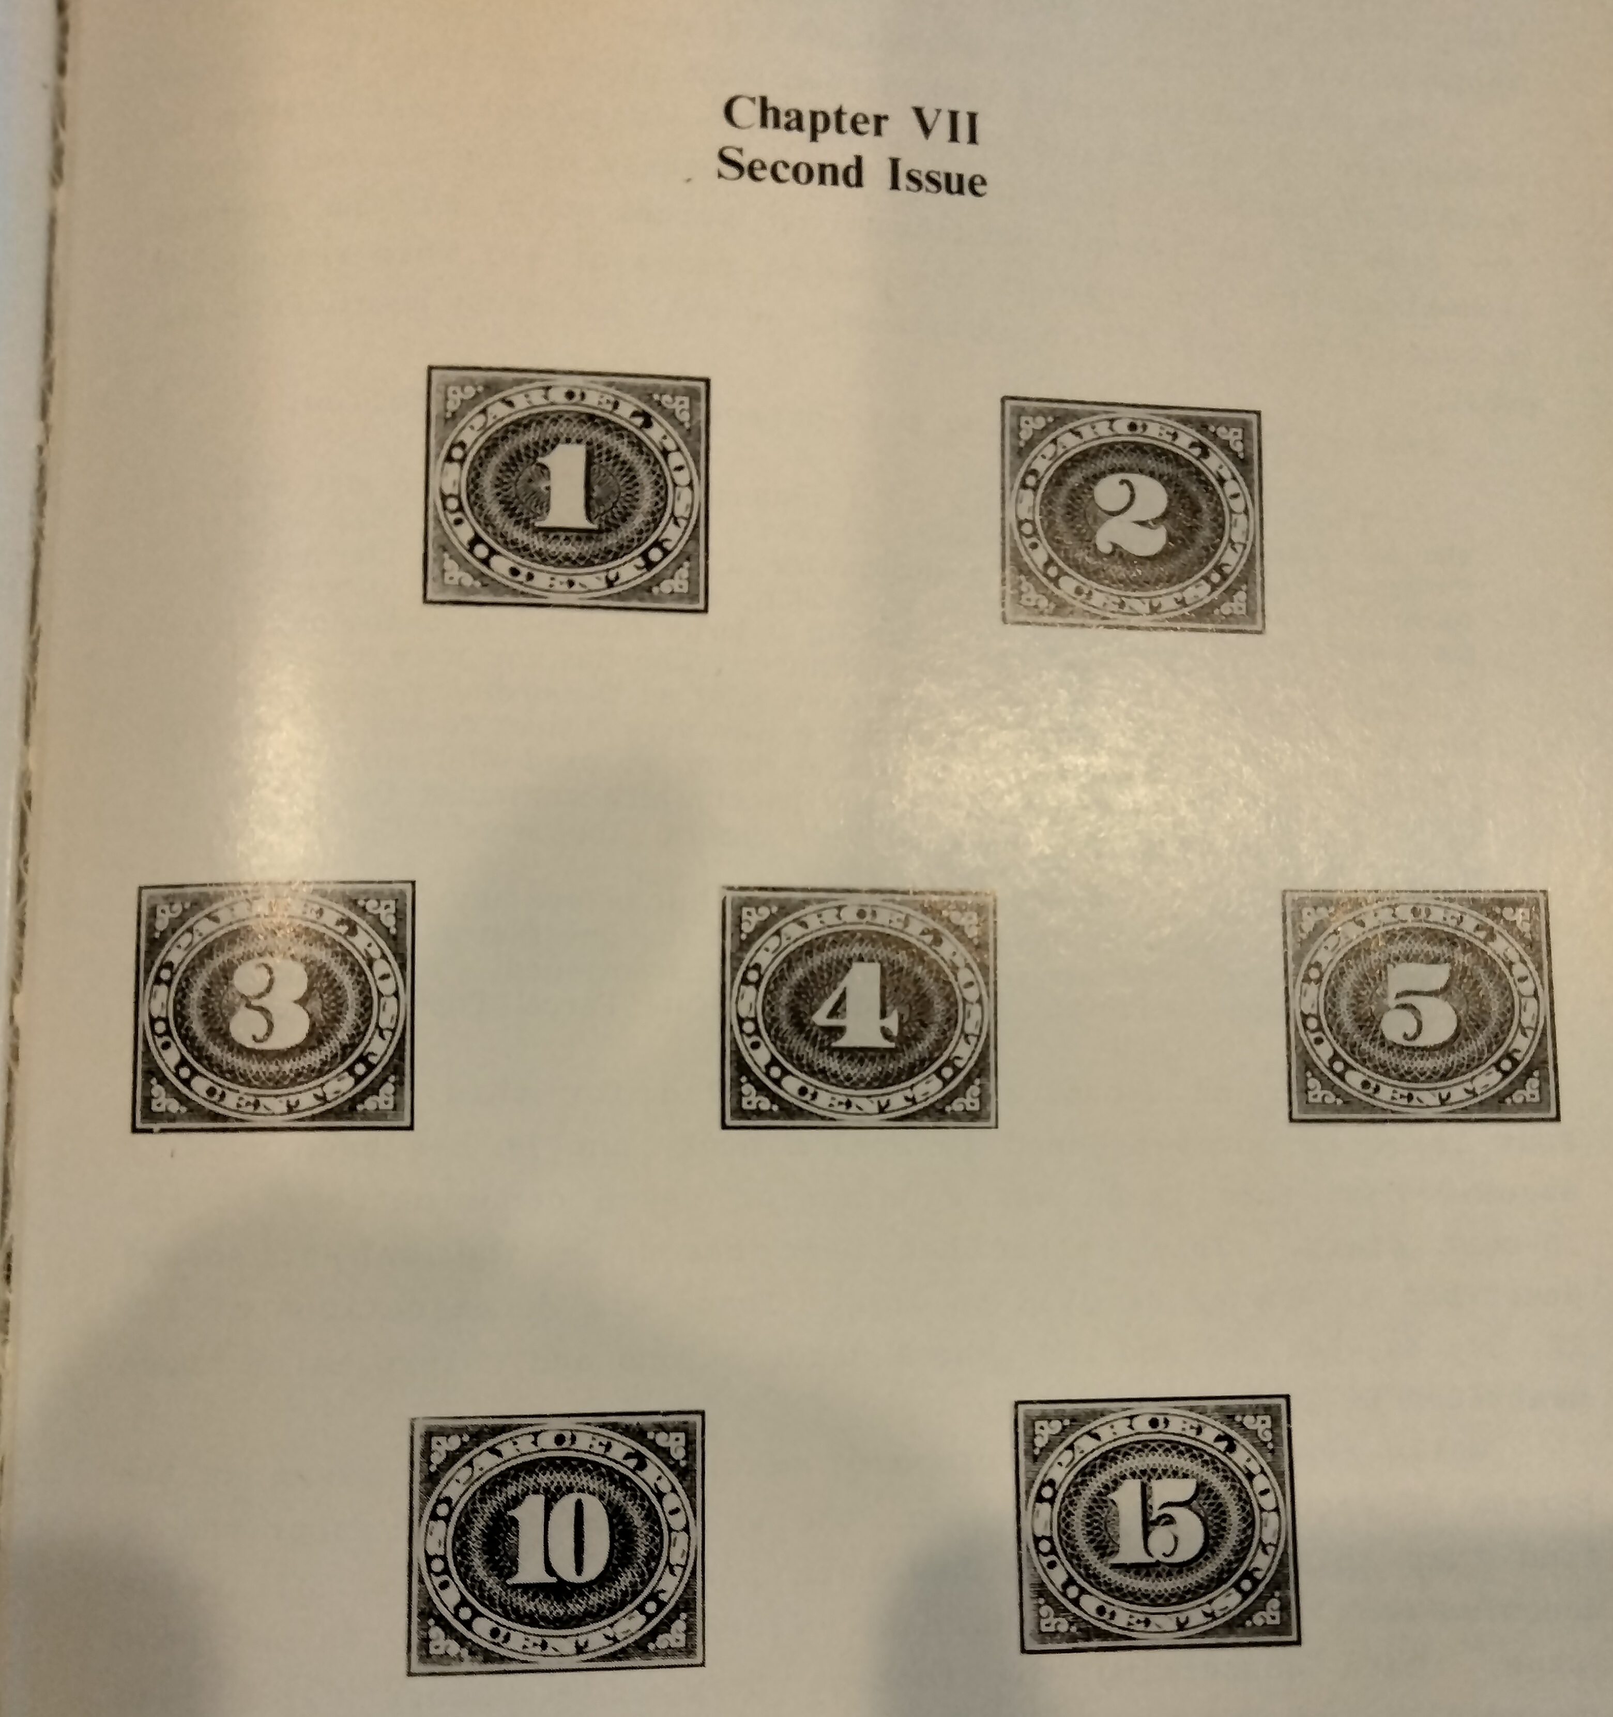
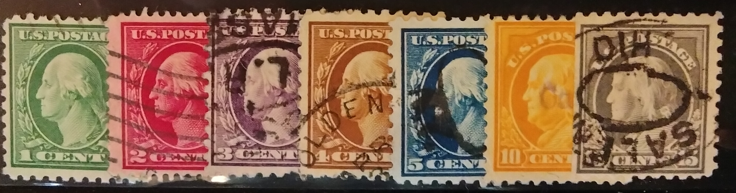
Proposed Second Issues of the Parcel Post Stamps: Smaller in size, change in design and colors to matching those of regular postage in use at time
In March 1913, the new President Woodrow Wilson administration and new Postmaster General, Burleson, gave approval for a new series of parcel post stamps. A new series, with a reduced stamp size and change in designs and color scheme, was approved. After 20 plates had been prepared, but before any printing of stamps occurred, the P. O. Department considered if they could be discontinued. The discontinue of use was approved based on the only need for the second issue was to measure revenue. Ordinary stamps and existing stocks of the 17 issues would be used for all purposes except postage due (Q11 delivered to postmaster until 1922).
# 374, 375, 376, 377, 378 (1910-11 SLW, Perf. 12 issues), 416, 418 (1912-14 SLW, Perf. 12 issues) of green, carmine, violet, brown, blue, orange, and gray, respectively.

Slide 26
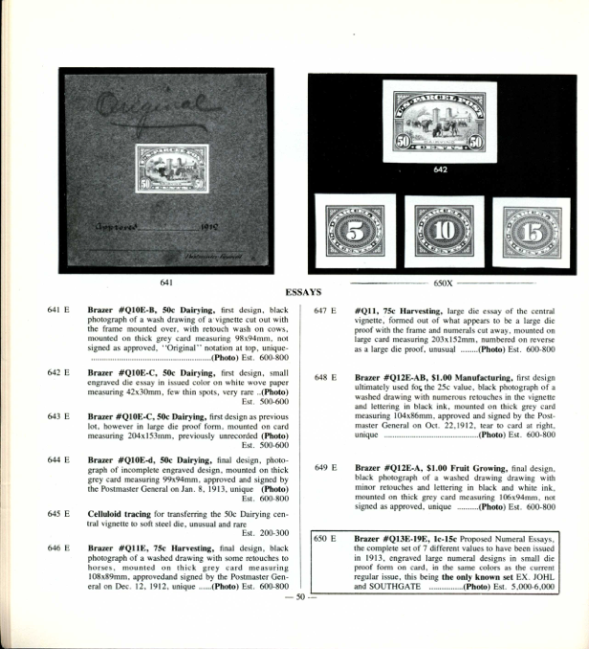
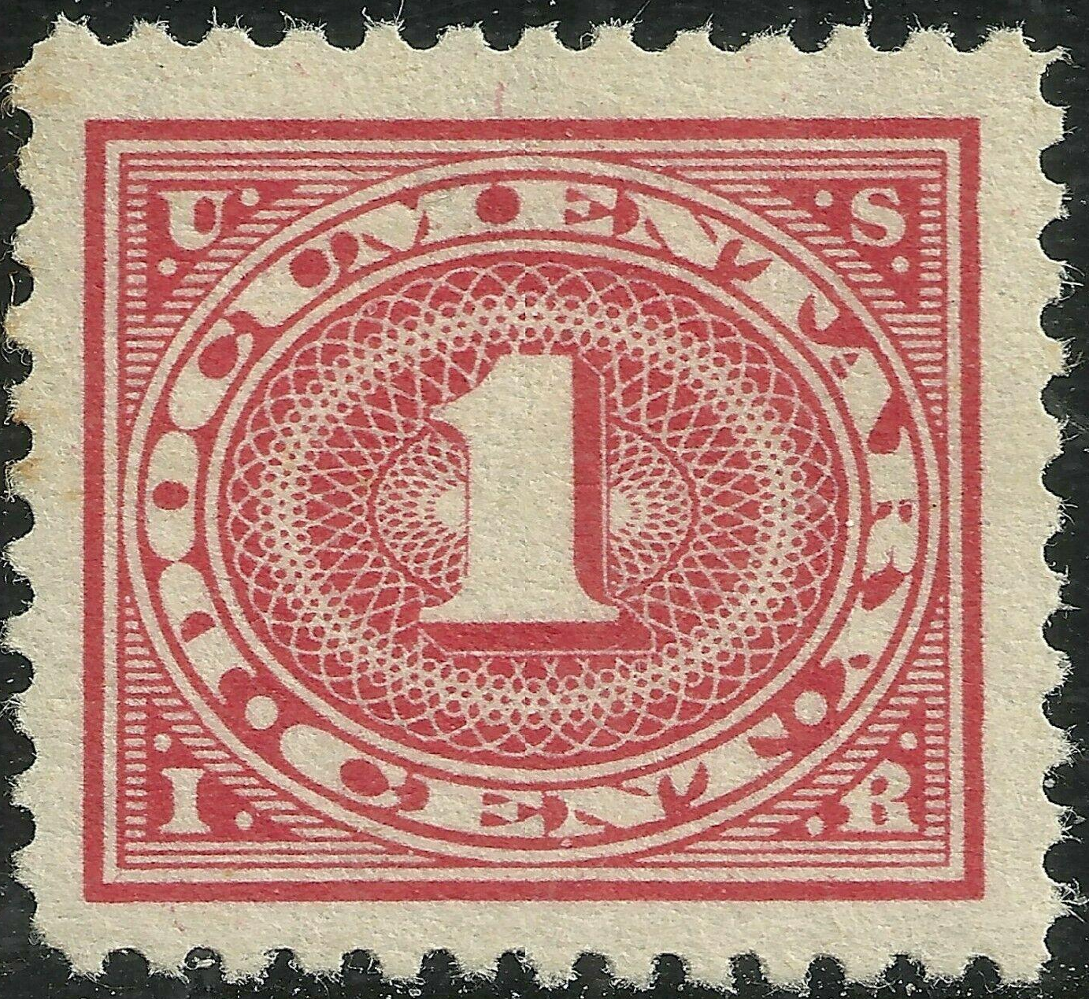
Essays of Proposed Second Issues of the
Parcel Post Stamps: Auction Listing
Sotheby, Parke, Bernet in NYC on October 3, 1978, Auction Listing
The proposed second series were drafted from the documentary taxes issue, the low values, 1, 10, 80 cents (Scott’s R228, etc…). The same oval remains in the proposed second issues parcel post stamps.
R228

Slide 27
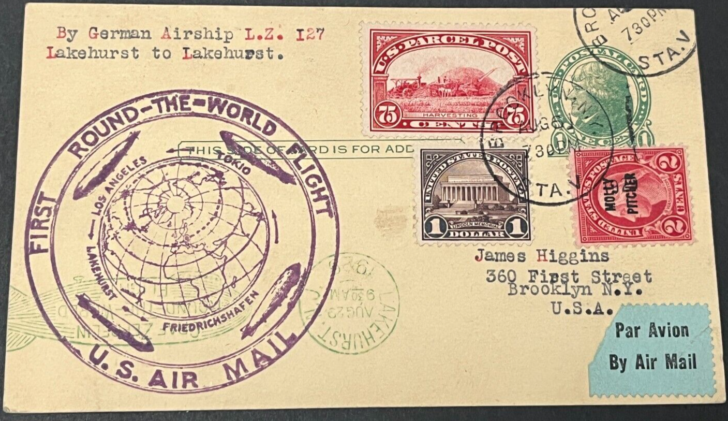
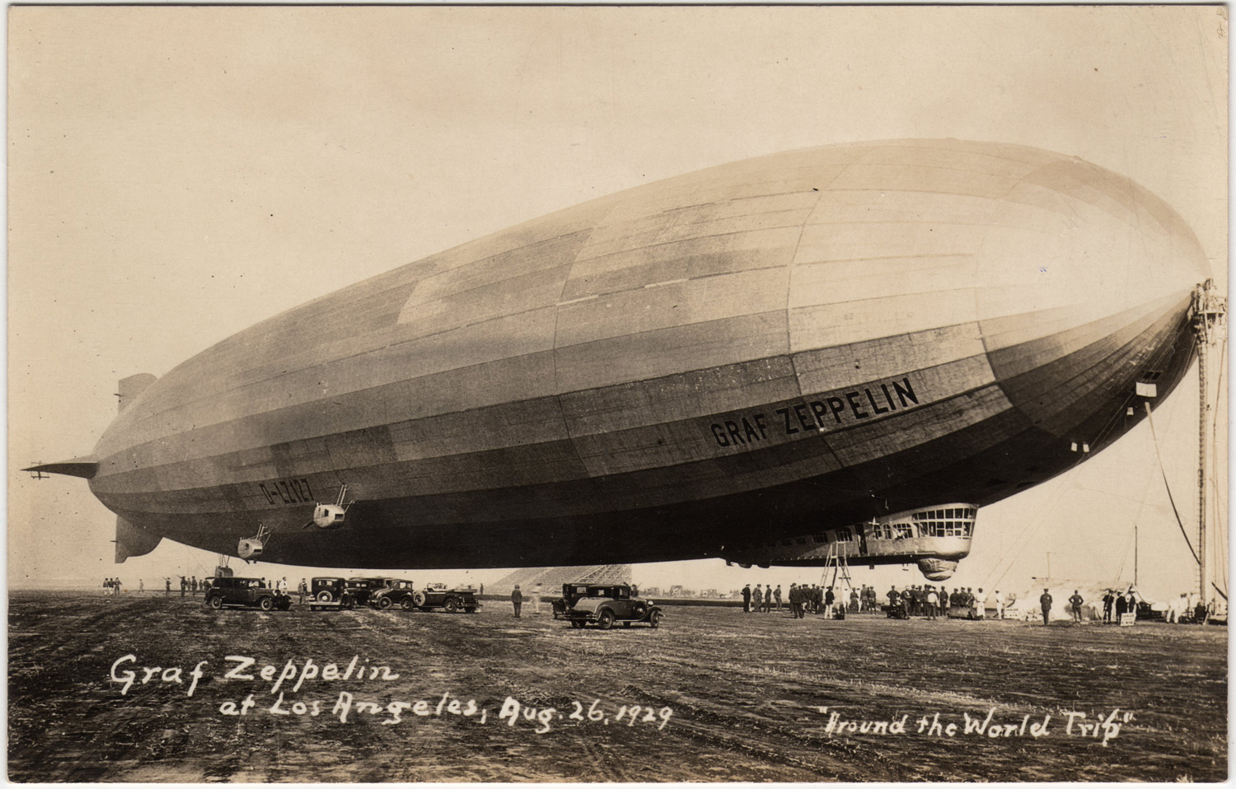
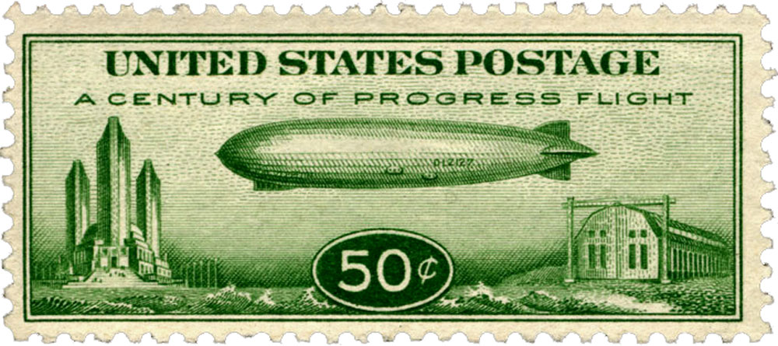
Usage, Parcel Post Postage Stamp: Use of Q11 on card of first around the world trip of the Graf Zeppelin, 1929 (late as).
The most successful zeppelin ever built, D LZ I 27 Graf Zeppelin flew more than a million miles on 590 flights, carrying over 34,000 passengers without a single injury. Airship’s image on the C18, Baby Zeppelin stamp shown below (red arrow points to D LZ I 27).

Slide 28
Five issues of the Parcel Post Postage Due Stamps: JQ1 to JQ5, same size as the Parcel Post Postage stamps
Dates of issue were: 1- and 3-cent Nov. 12, 1912, and the 2-. 10- and 25- cent on Dec. 9, 12 and 16, 1912, respectively. All issued before the Parcel Post System started (Jan 1,1913), no delays as in the three Q issues.

Slide 29
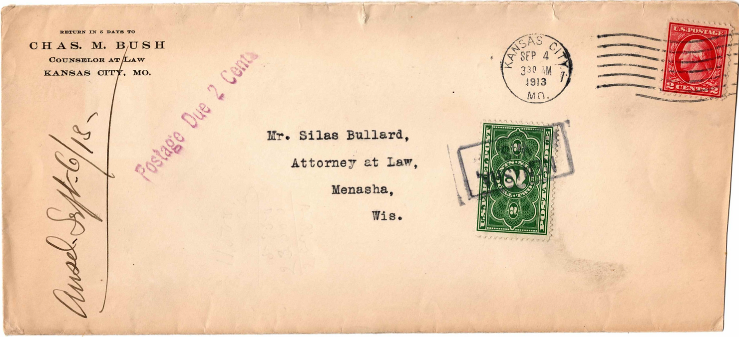
Authorization and Usages:
In conjunction with Parcel Post stamps, Congress approved an act on August 24, 1912, for unrestricted use for parcel post postage due stamps which were issued at the same time the parcel post postage stamps.
This cover used in unrestricted time after July 1, 1913.
Postmarked: Sept. 4, 1913.
In the restricted time, Jan 1 to July 1, 1913, the parcel post postage due stamps were to be used when inadequate postage was affixed to a parcel. Postage-due stamps were affixed by the Postmaster and the amount was supposed to be paid by the addressee or parcel recipient.

Slide 30
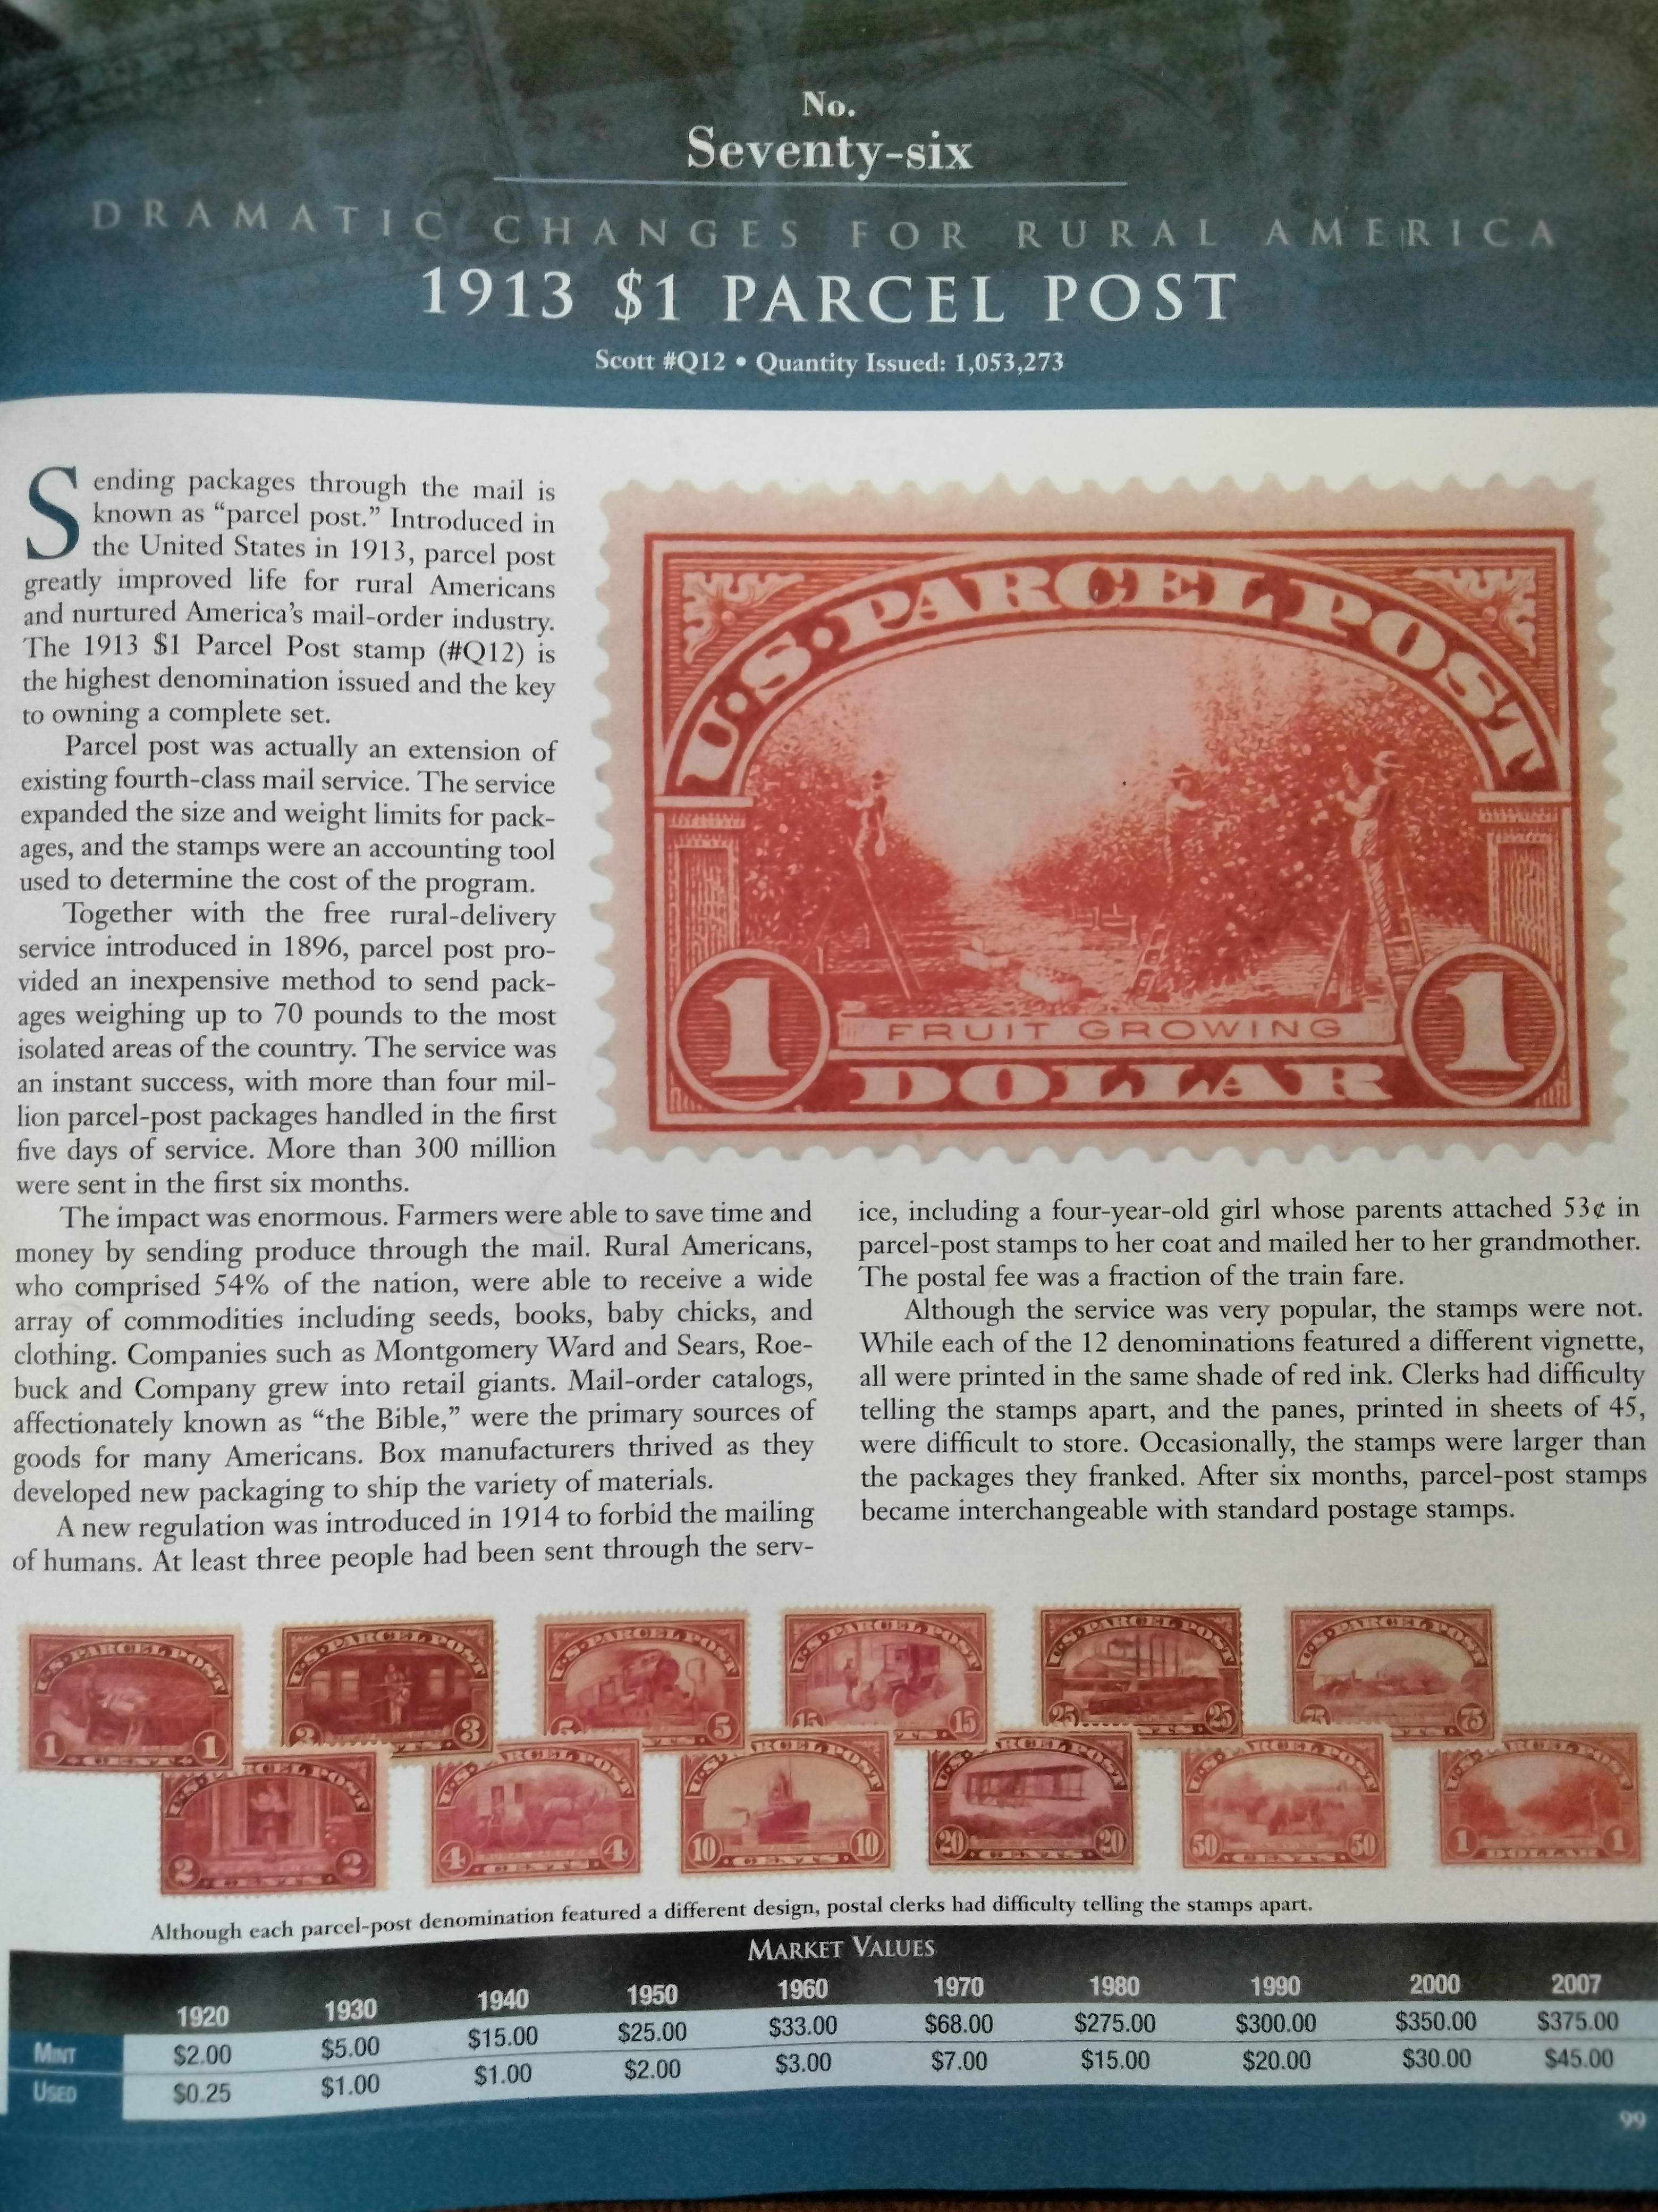
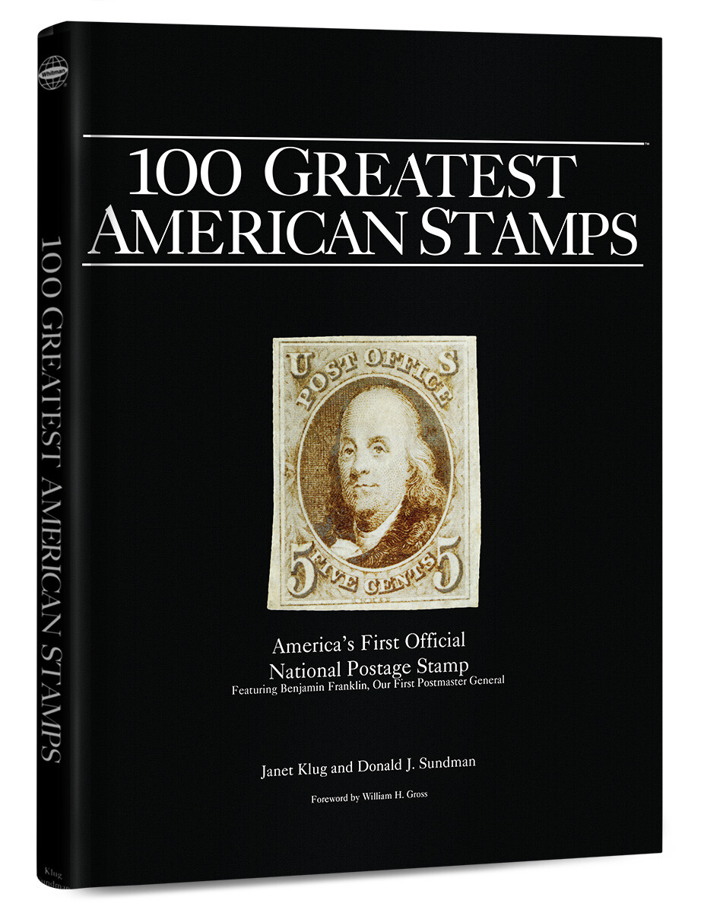
76th of 100 Greatest American Stamps: The Q12 issue of the Parcel Post Series, Fruit Growing

Slide 31
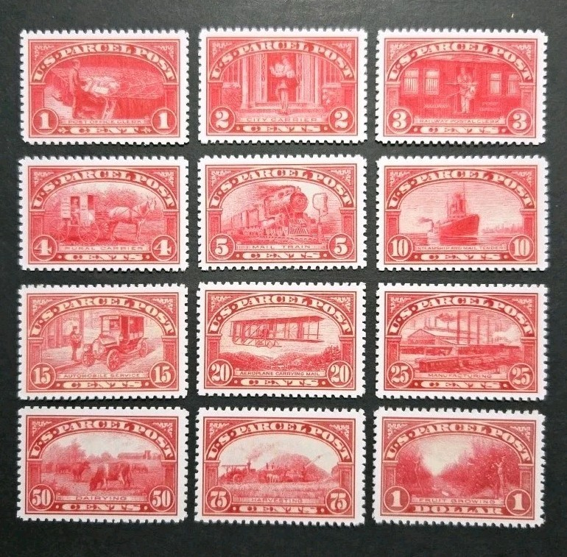
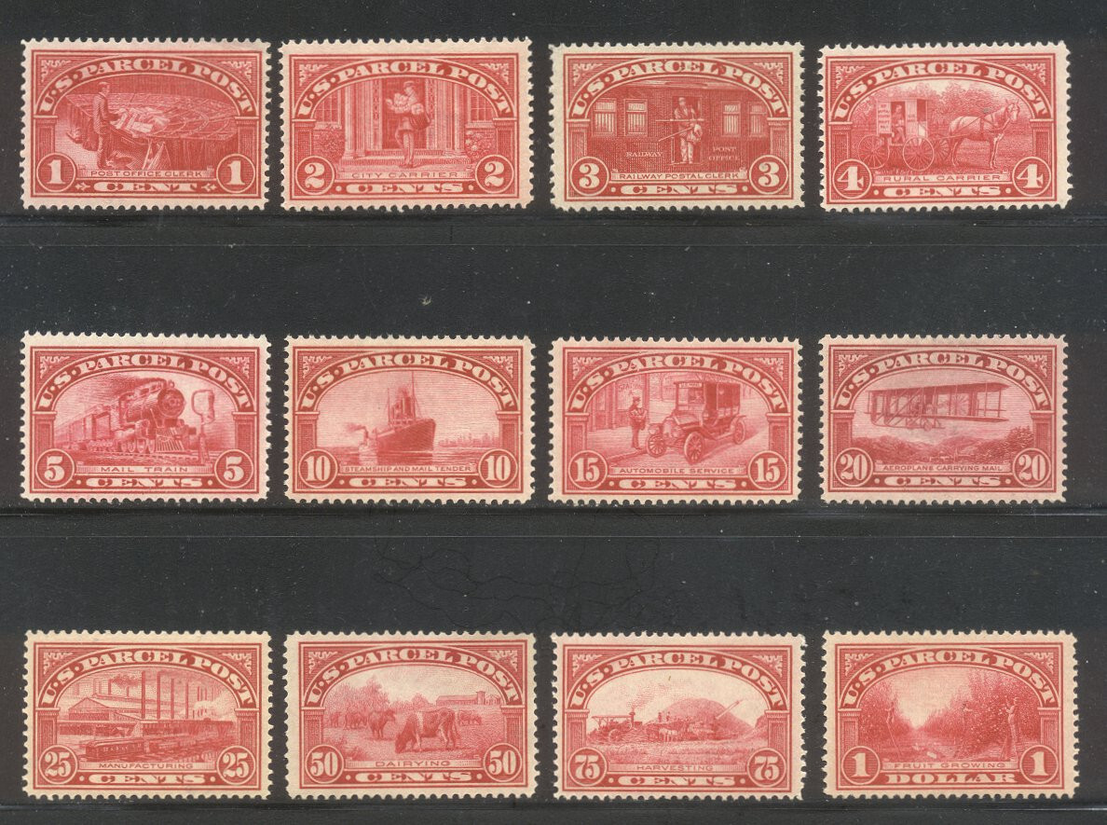
Which Parcel Post set (A or B) would you buy and why? (or neither!?)
A B

Slide 32
Summary
Federal U.S. Gov’t Business venture, to increase movement of matter/ goods from rural areas to cities and from cities to rural locations, 4th class mail.
Created 17 stamp issue to track revenues of venture.
A short six-month life of the Parcel Post system as originally authorized, to track and inventory revenue.
Created a set of 12 Parcel Post stamps and 5 Parcel Post Postage Due stamps.
Made well defined and easily identified sets for the stamp collector but not for postal clerks of the time.
Lack of robust acceptance of 17 stamp issues, proposed and developed second issues of the Parcel Post issues but these were never issued for use.

Slide 33
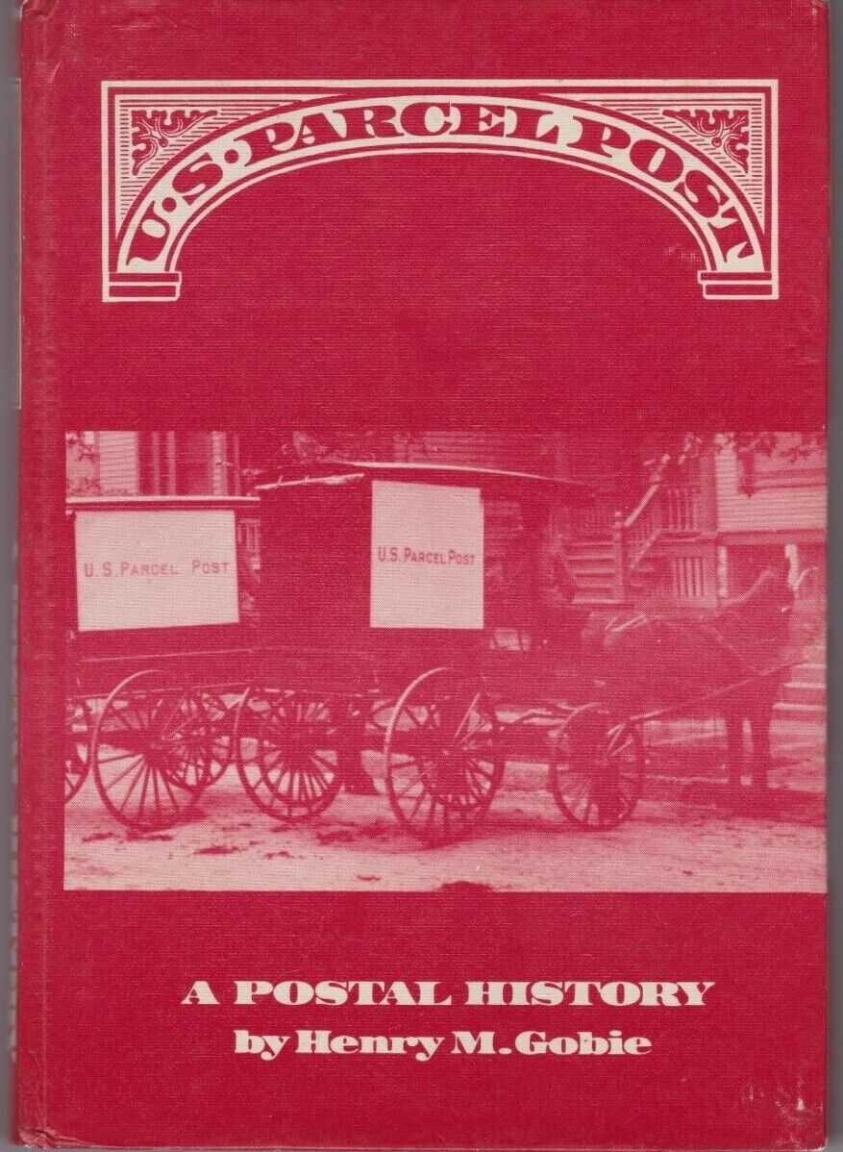
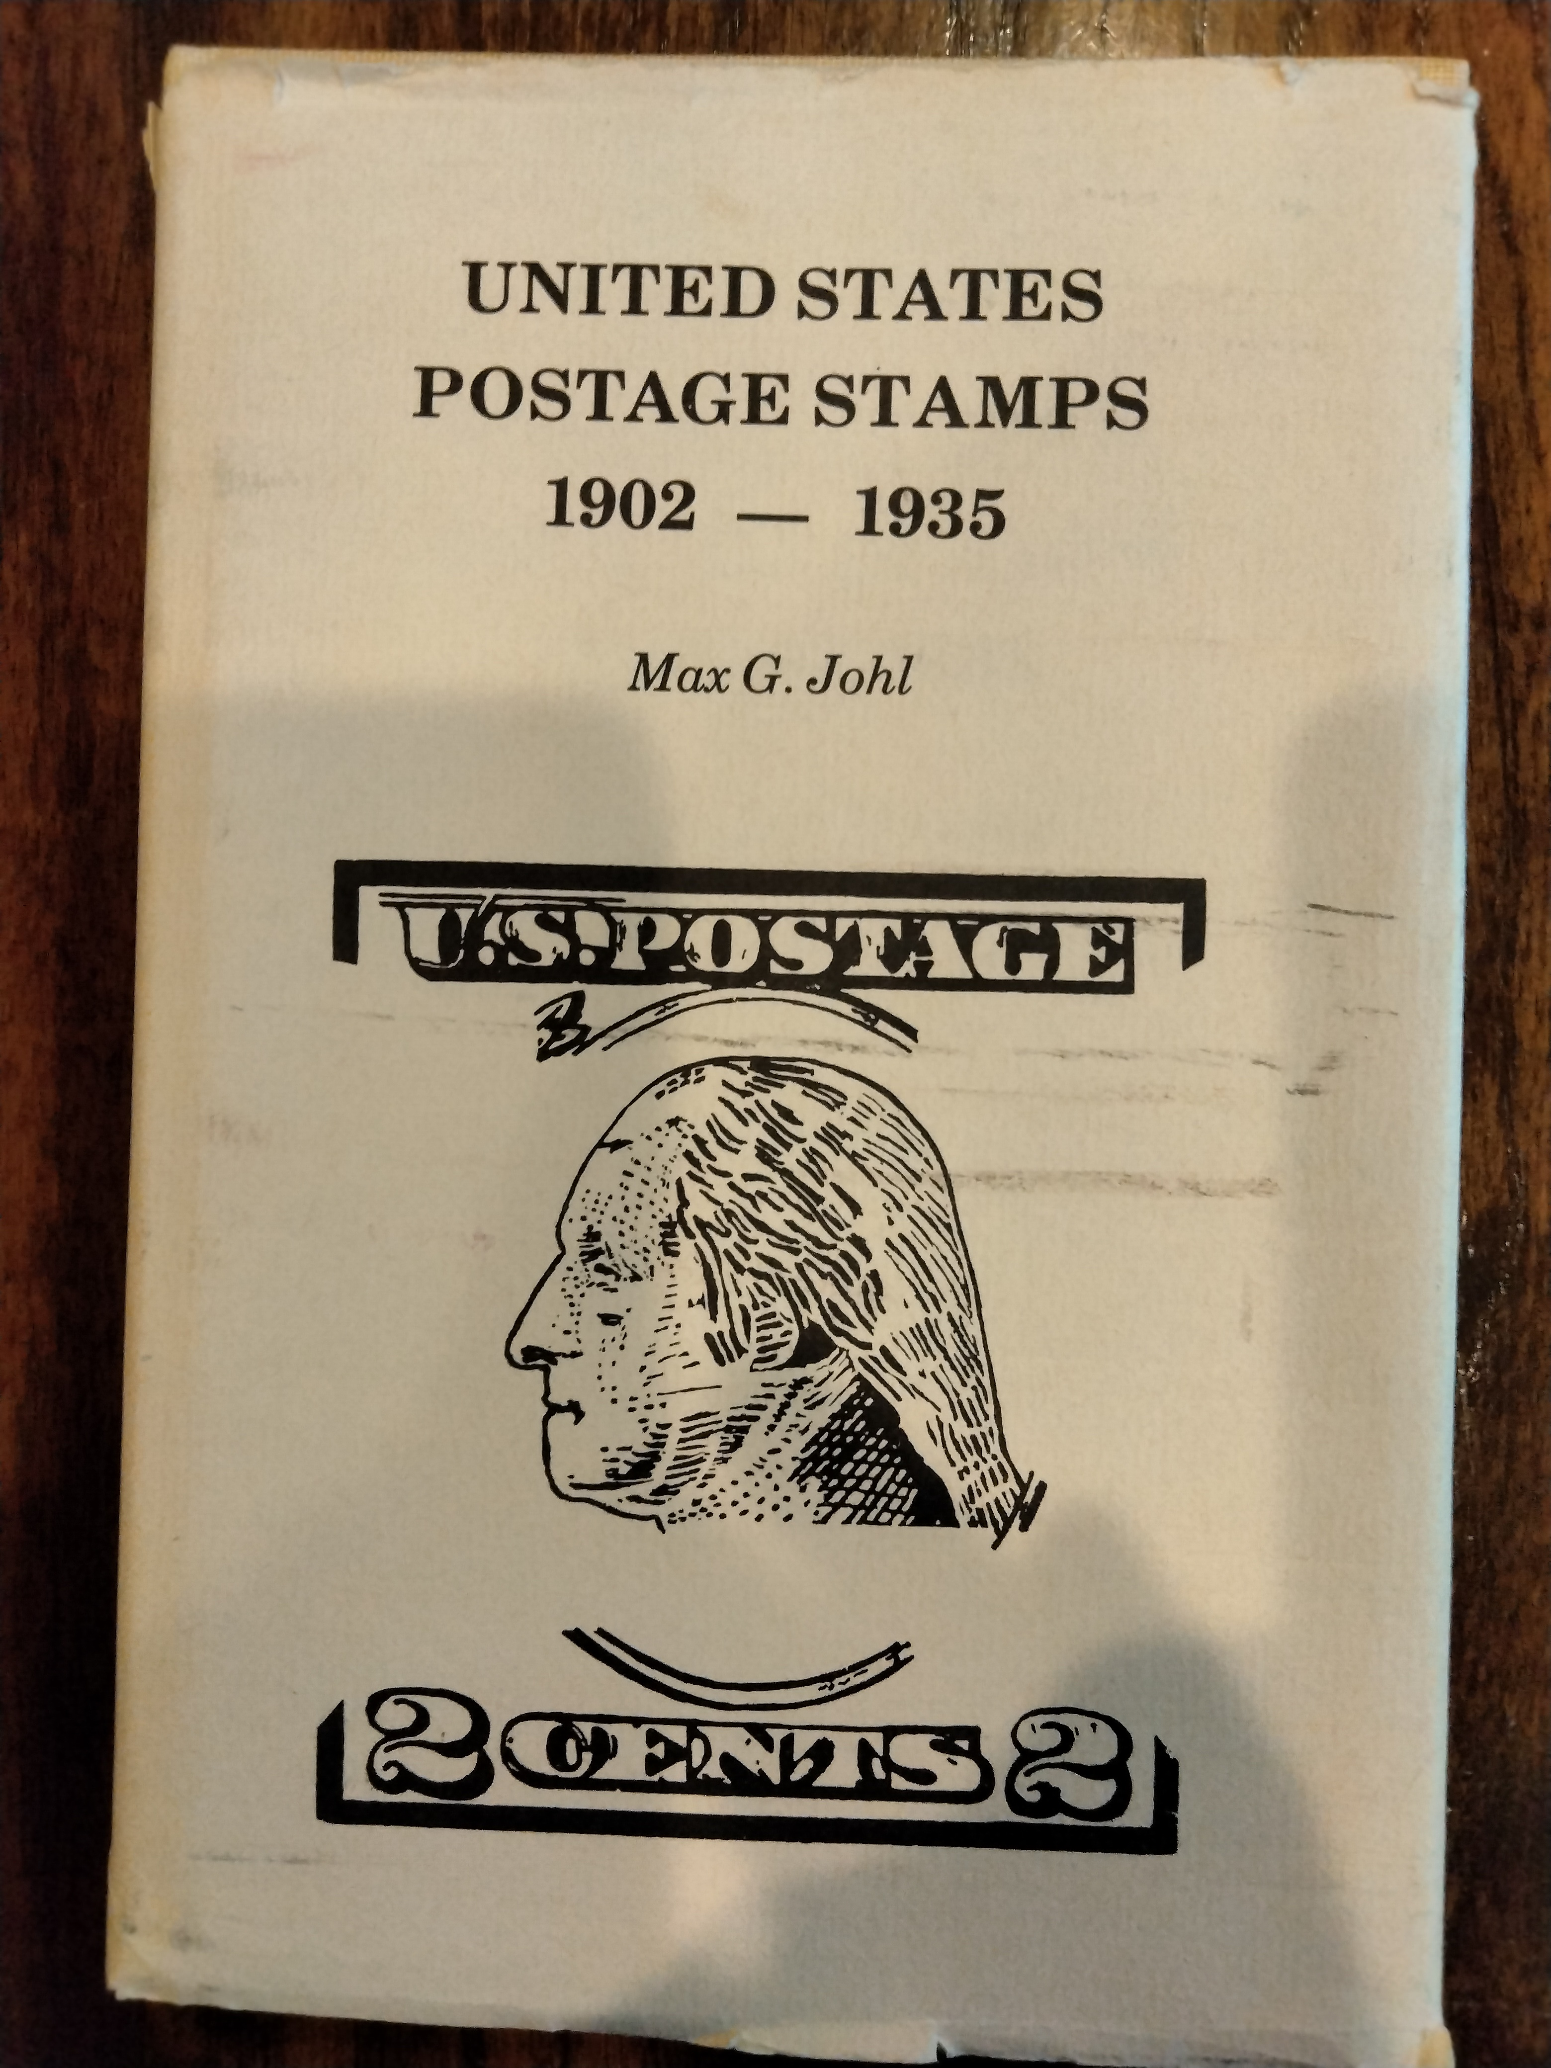
Some References
Gobie, Henry M. U.S. Parcel Post: A Postal History. 1979. Published by Wilhelmina M. Gobie, 241 pages (A).
Johl, Max G. United Stages Postage Stamps: Regular Issues, Parcel Post, and Airmails. 1935, 566 pages (B).
    A B
Graham, Richard, B., 1991. Parcel Post began in 1913 and thrived. Linn’s Stamp News, June 3, 1991, via APS service.
Mystic Stamp Company, This Day in History… January 1, 1913, Parcel Post Service Begins. https://info.mysticstamp.com/parcel-post-service-begins_tdih/
Smithsonian National Postal Museum, Reaching Rural America (Past Exhibits). https://postalmuseum.si.edu/exhibition/reaching-rural-america-past-exhi
Tomalei Vess and Nathaniel Fenush, APS, Bellefonte, PA 16823, 2025 email correspondence, Provided image Essays of proposed 2nd Series of Parcel Post Issues that were held in auction at Sotheby, Parke, Bernet in NYC on October 3, 1978.

Slide 34
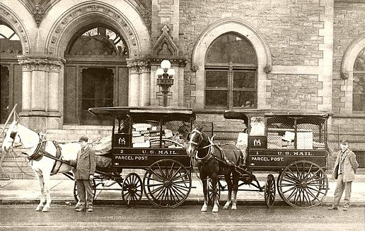
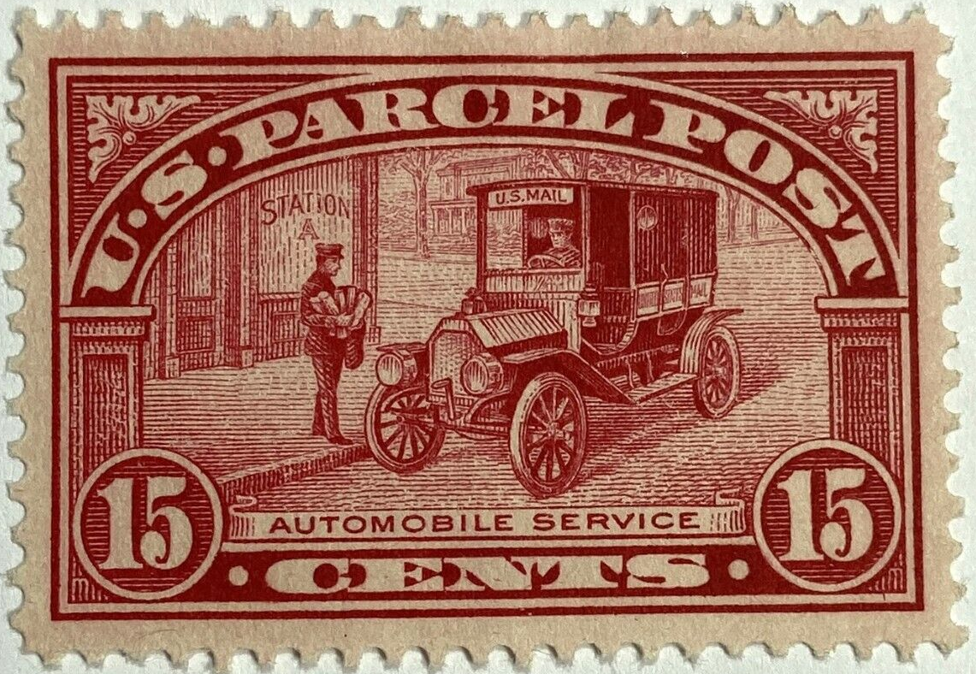
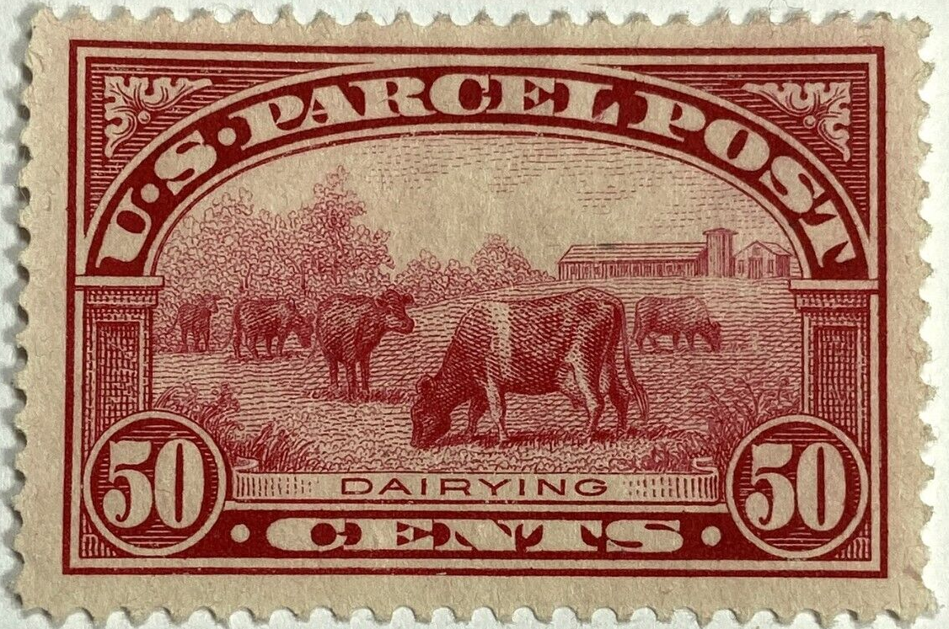
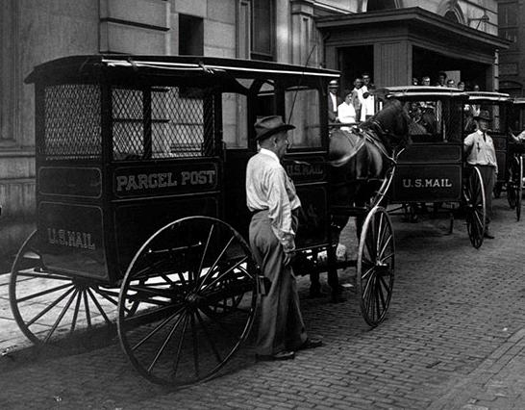
Thank you, comments and questions?

