Slide 1
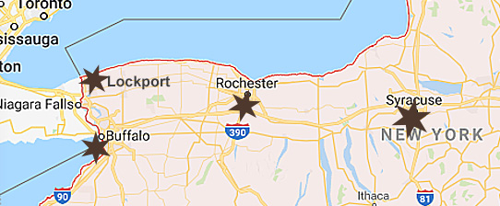
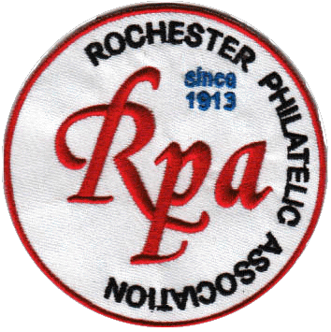
U.S. Match & Medicine Stamps from Western New York
Adapted from an RPA presentation by
Mark Scheuer, March 10, 2011
by Tom Fortunato

Slide 2
What are “Match & Medicine” Stamps?
To pay for the Civil War and its aftermath, the U.S. federal government collected excise tax using stamps on:
documents: deeds, insurance policies, checks
consumer goods: matches, medicine, playing cards
services: telegrams
luxury items: liquor, beer, tobacco, perfume, photos
Not counting checks and stamped paper, over 7.8 billion revenue stamps were printed between 1862 and 1883.

Slide 3
What are “Match & Medicine” Stamps?
The Revenue Act of 1862’s Schedule C (amended in 1864) included specific proprietary consumer goods to be taxed in advance and paid for by the manufacturer:
Matches: friction matches, wax tapers, and cigar lights taxed based on quantity
Patent medicines: taxed based on retail price
Perfumery and cosmetics: hair oil, tooth powder, and colognes taxed on a flat, per‑item basis
Playing cards: taxed per pack
Photographs: taxed based on retail price, repealed on August 1, 1866 due to pressure from photographers
Stamps had to be destroyed on opening the package or item to prevent reuse. Denominations were between 1-5¢.

Slide 4

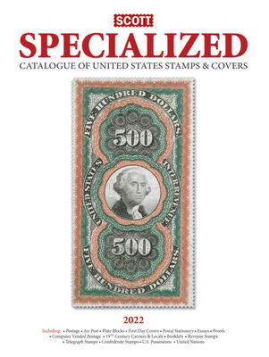


What are “Match & Medicine” Stamps?
In 1864 manufacturers were allowed to create their own stamp designs to replace federal ones showing the tax paid on their items. “Match and Medicine” refers collectively to these 'private die' tax stamps created for these goods:
matches (RO) – 183 varieties
medicines (RS) – 350 varieties
perfumes (RT) – 33 varieties
playing cards (RU) – 16 varieties
canned fruit (RP) – one stamp
They are listed in the Scott Specialized
Catalogue of U.S. Stamps and Covers
using the two letter prefixes above.

Slide 5
What are “Match & Medicine” Stamps?
Over two thirds of these stamps were privately printed under the authority of the government. They did this to save engraving and printing costs. Most were engraved to the high standards of postage stamps and bank notes on as many as five different paper types: old, double line watermarked (USIR), pink, silk and experimental.
Firms using the stamps also saved money. A private company received $11 in revenue stamps for every $10 spent. Not only was it free advertising, but their clever designs implied government approval of their item’s beneficial claims, compulsorily bearing “U.S. Int’l Revenue.”
With an average face value of about 1.25 cents, nearly $65 million was raised.

Slide 6
The Stamp Printers
The private stamps were first engraved and printed by Butler & Carpenter in Philadelphia.
John Butler died in 1868 and Joseph Carpenter continued until 1875.
The contract passed to the National Bank Note Company, the Continental Bank Note Company, and the American Bank Note Company; the same firms that printed regularly issued postage stamps.
The Bureau of Printing and Engraving took over in 1881.

Slide 7
Why Many of the Stamps are Rare
M&M stamps were never sold to the public.
M&M stamps were not cancelled.
They were placed on the items intentionally to be destroyed when the packaging was opened.
The only saved stamps were remainders and those that were carefully removed by the buyer.
Few buyers were stamp collectors.
Faulty stamps are the norm. Perfect stamps are the exception.

Slide 8
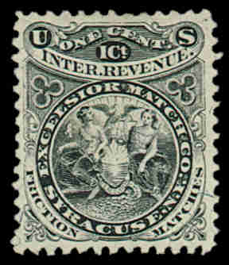
Syracuse Excelsior Match Company
1875-1882 silk, pink and watermarked paper
(RO82 b, c, d)
Identical design to Watertown Company (RO81), but no connection (Syracuse Co. probably bought the die).
Stamps are relatively common.
(15 million, evenly divided)
Company bought out by the Diamond Match Co in 1881.

Slide 9
Syracuse Ryder, Crouse & Welch
1881-1882 all on watermarked paper (RO164d)
Relatively rare due to small printing (2 million) and limited life.
Shield reminiscent of 10c and 30c 1869 postage stamps, but with a small bird on top.

Slide 10
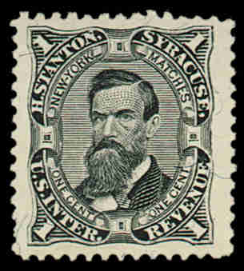
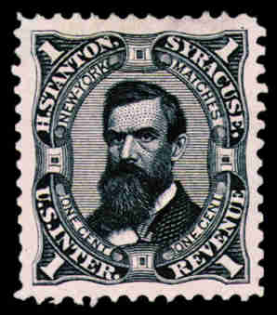
Syracuse Henry Stanton 1866-1880
1866-1880 on old, silk, pink, watermarked and experimental paper (RO171 a,b,c,d,e)
All are common except experimental silk paper.
Over 50 million printed – about half on silk.
Bought out by the Diamond Match Company.

Slide 11
Syracuse Dr. E. L. Soule & Company
1867-1876 on old, silk, and experimental silk paper
(RS227 a,b,e,u)
Printed on wrapper of sugar-coated laxative pills.
Only 440,000 stamps issued in light blue.

Slide 12

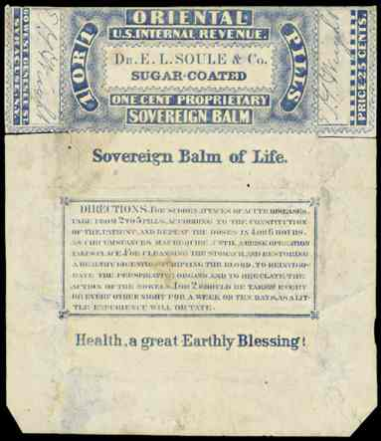
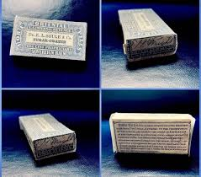
Syracuse Dr. E. L. Soule & Company
Less than 10,500 printed in ultramarine by mistake. Only 26 now known.

Slide 13
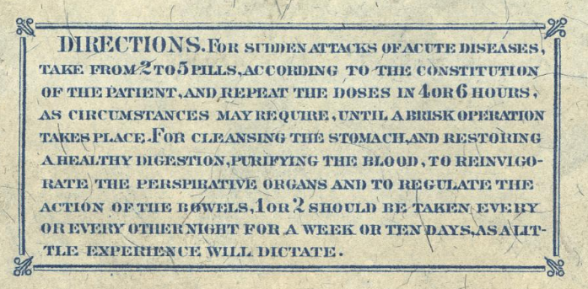
Syracuse Dr. E. L. Soule & Company

Slide 14
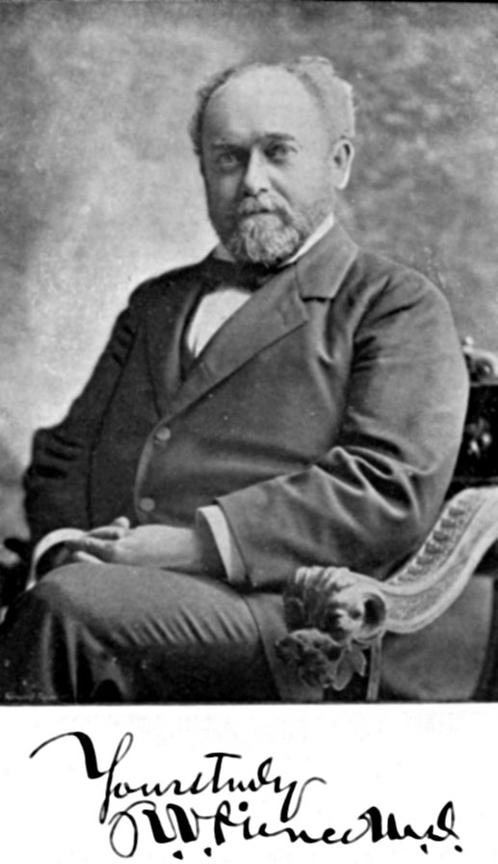
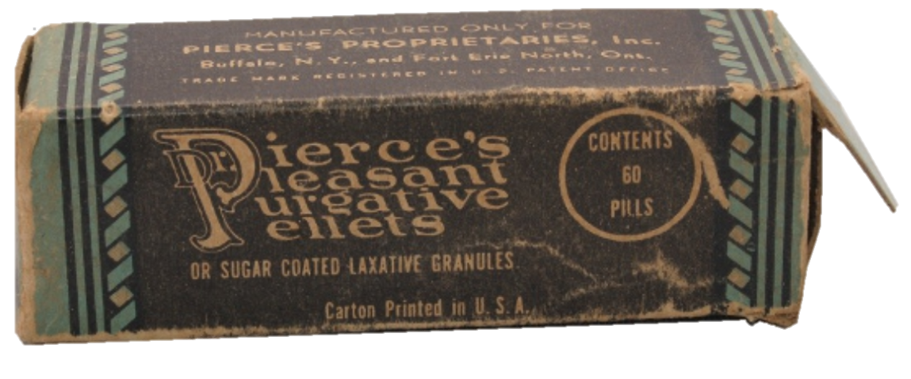
Buffalo R. V. Pierce
Dr. Ray Pierce was born in Stark New York on August 6, 1840. Graduating with a doctorate from the Eclectic Medical College in 1865, he moved to Buffalo New York in 1867 where he started The World’s Dispensary, a mail-order patent medicine business.

Slide 15
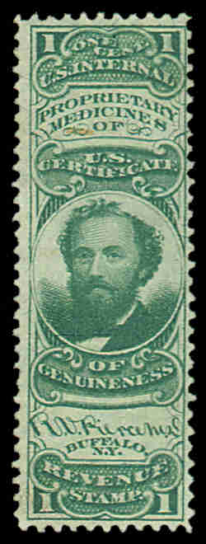
Buffalo R. V. Pierce
1 cent 1872-1879 silk, pink, and watermarked paper (RS189 b,c,d)
The pink paper is somewhat rare. The others are common.
Used on Dr. Pierce’s Pleasant Purgative Pellets & Extract of Smart-Weed, made from the “best French Brandy” . . . A magical remedy for pain, bowel complaints and a liniment for humans and horse flesh.

Slide 16
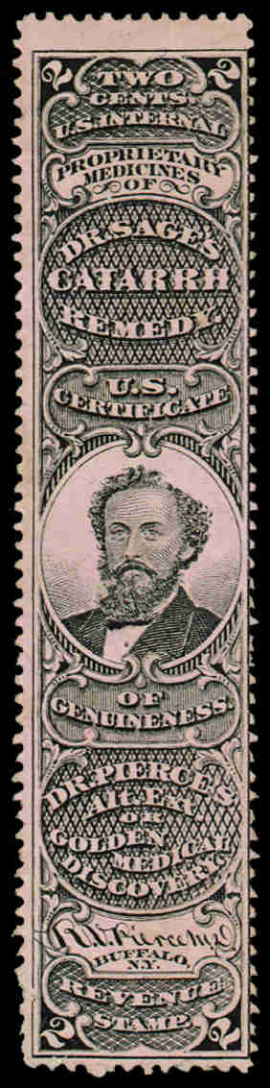
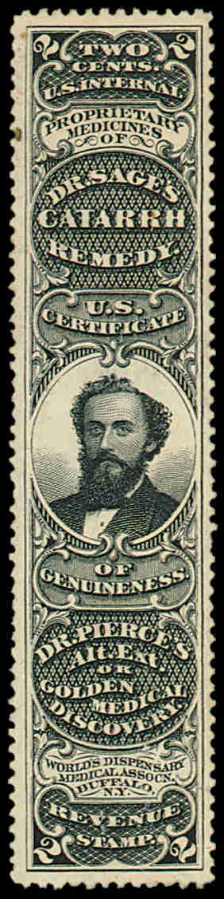
Buffalo R. V. Pierce
2 cent 1870-1879 on old, silk, pink, watermarked and experimental silk paper (RS190 a,b,c,d,e)
Mostly common stamps.
Used on Dr. Sage’s Catarrh Remedy (for head colds), Dr. Pierce’s Golden Medical Discovery (for bronchitis & coughs) and Dr. Pierce’s Favorite Prescription (a restorative tonic for chronic weaknesses and complaints particular to females).

Slide 17
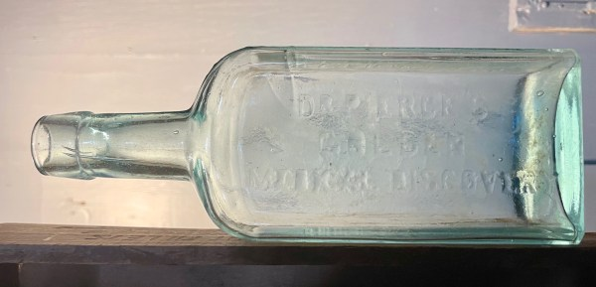
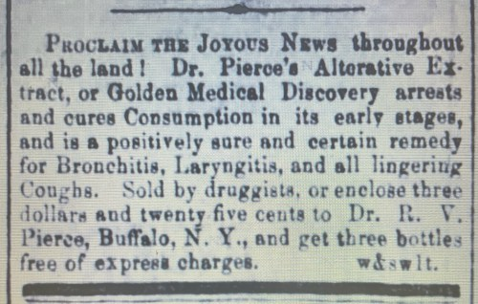
Buffalo R. V. Pierce

Slide 18
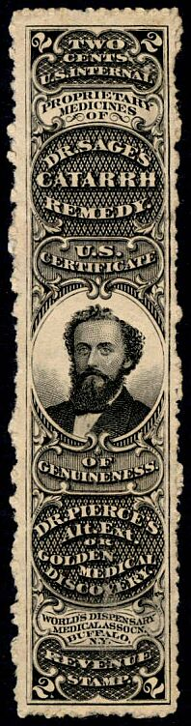
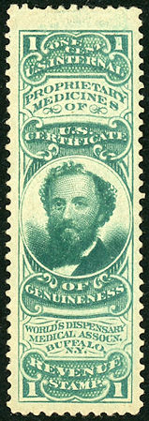
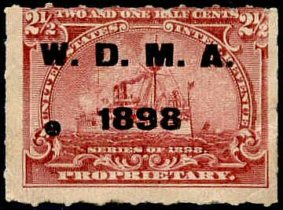
Buffalo R. V. Pierce
World’s Dispensary Medical Association
(1879-1883)
Expansion and incorporation of Dr. Pierce’s business in 1879 founded this company. It was still running in 1898.
RS272 and RS273 are on
watermarked paper. Common.

Slide 19
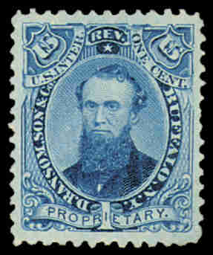
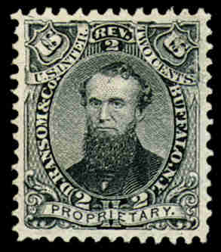
Buffalo D. Ransom & Company
1865-1875 on old, silk, and experimental silk paper (RS194 b,c,d – 4 million; RS195 a,b,e – 2 million)
Relatively common stamps.

Slide 20
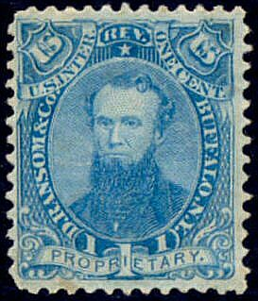
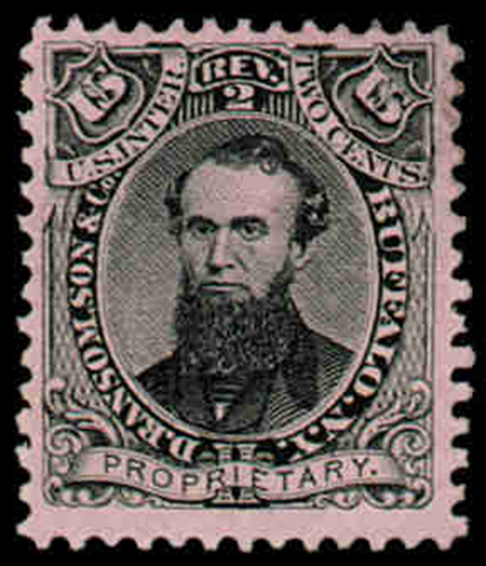
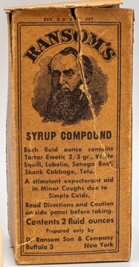
Buffalo D. Ransom & Company
1876-1883 on old, silk, and watermarked paper (RS196 b,c,d – 2.3 million; RS197 b,c,d – 1.1 million). Relatively common stamps except for 2c pink which cats for $82.

Slide 21
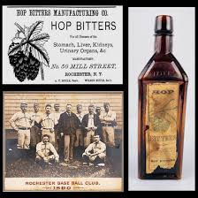
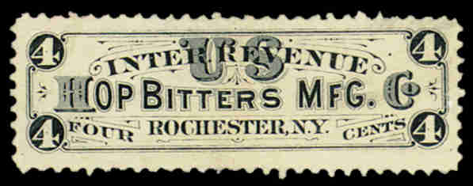
Rochester Hop Bitters Manufacturing Company
1879-1883 (RS131d on watermarked paper)
Hop Bitters contained hops, water and alcohol and was sold by the pint. It claimed to cure drunkenness. The stamp is common.

Slide 22
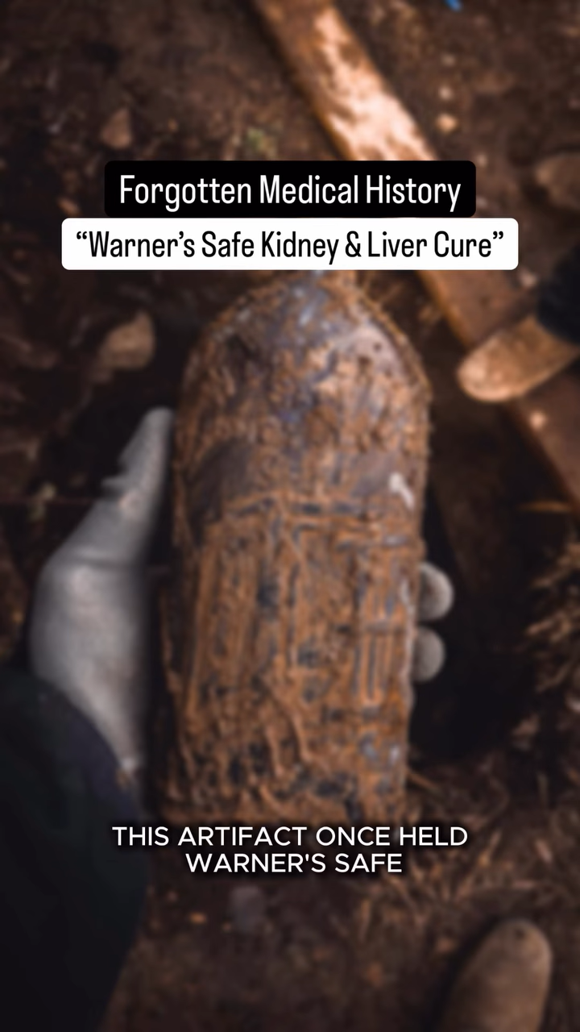
Rochester H. H. Warner & Company

Slide 23
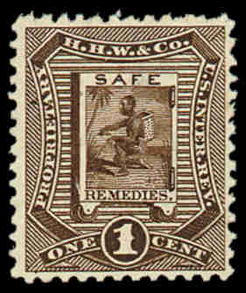
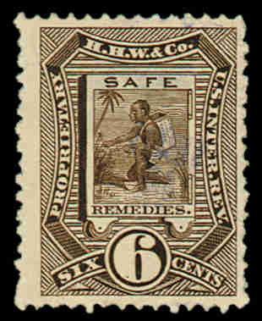
Rochester H. H. Warner & Company
(RS254-258 all on watermarked paper)
Located on St. Paul Street, this company made remedies for kidney and liver disease, gout, rheumatism, headaches, nervousness, asthma, colds, etc.
The 6c stamp did not fit well on bottles and was replaced.
Catalog- $90. The others are common.

Slide 24
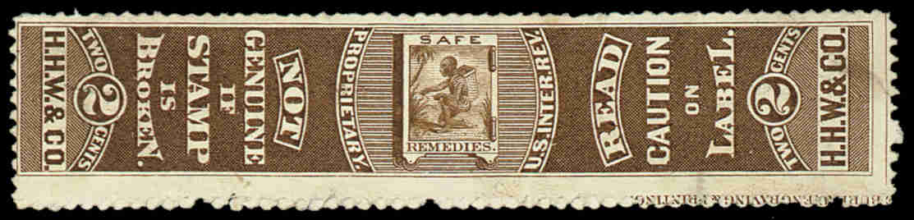
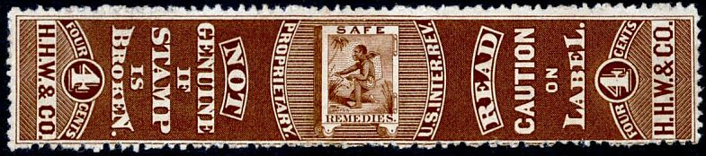
Rochester H. H. Warner & Company

Slide 25
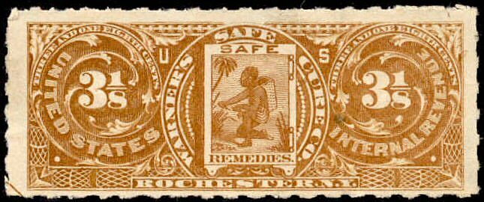
Rochester Warner’s Safe Cure Company
(RS305)
This stamp was made after the tax was reinstated during the Spanish American War.
Warner was selling products in 1898 and beyond, although no longer able to claim being “cures” for diseases.

Slide 26
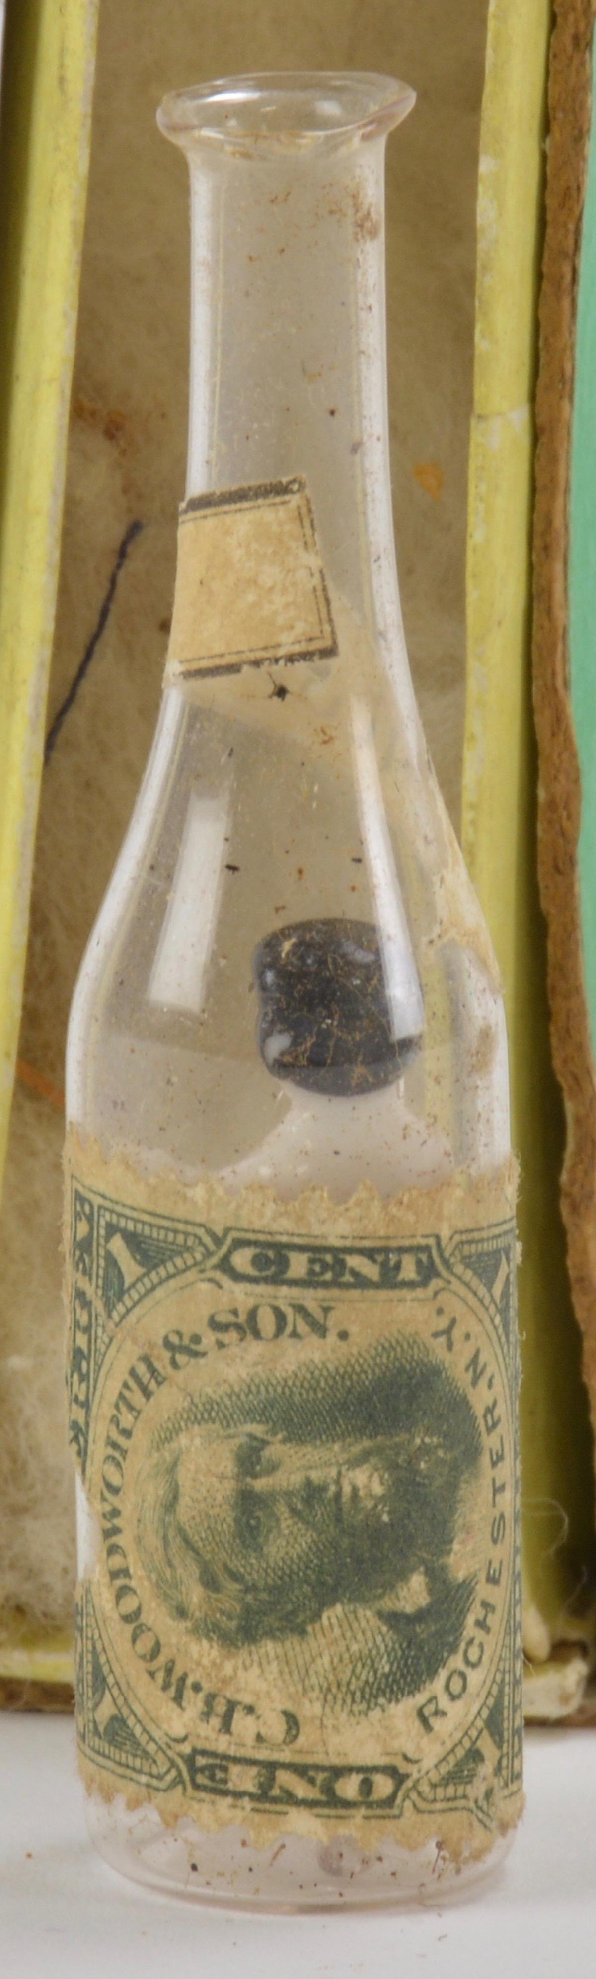
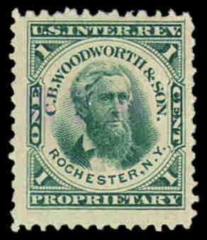
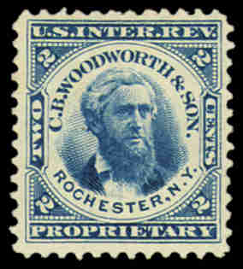
Rochester C. B. Woodworth & Son
1872-1883
(RT20 on silk, pink*, and watermarked papers) (RT21 on silk*, pink***, and watermarked papers)
(* = somewhat rare, *** = very scarce – 9 copies)

Slide 27
Lockport Merchant’s Gargling Oil
Founded by Dr. George Merchant in 1833, the product sold locally until … He was bought out by M. H. Tucker in 1855 for $50,000. Tucker expanded the sales nation-wide.
John Hodge, of Lockport, NY, married one of Tucker’s daughters and took over the company when Tucker died in 1865.
Hodge believed in the power of advertising and turned the company into a multi-million-dollar enterprise.

Slide 28
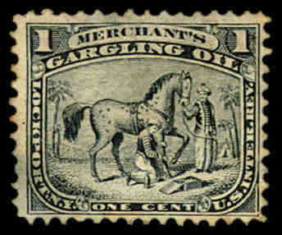
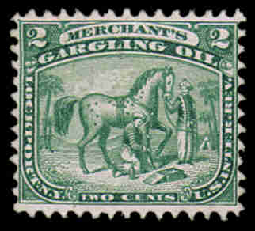
Lockport Merchant’s Gargling Oil
1869-1883 on all papers (RS178 a,b,c,d,e; RS179 a,b,c,d,e)
Most are common except 178e (12), 179c (20),
and 179e (8)

Slide 29
Lockport Merchant’s Gargling Oil
What was Merchant’s Gargling Oil?
Initially a liniment for horses and other animals, claimed to cure almost all ailments. Eventually, a formula for humans was developed.
Linseed oil (2.5 gal) Turpentine (2.5 gal) Petroleum (1 gal) Liquor Potass (8 oz) Sap Green (1 oz) mix
From Mrs. Owen’s Cook Book and Other Useful Hints (1884)
Also contained alcohol (44%) and a grain of opium.

Slide 30
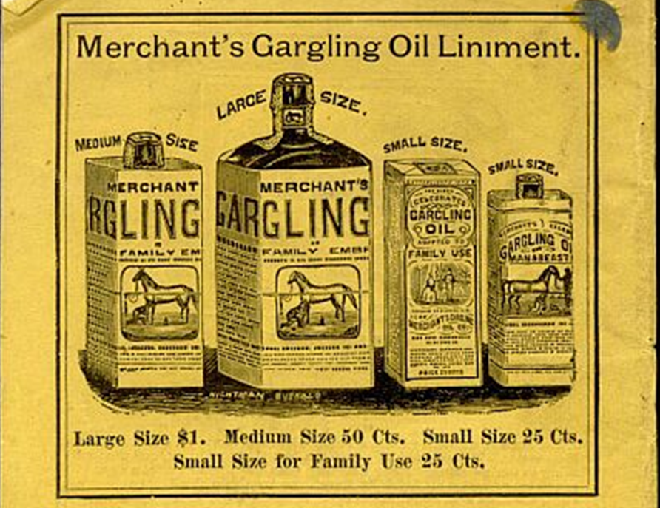
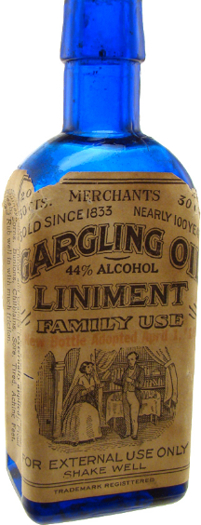
Lockport Merchant’s Gargling Oil
1c tax on the small size (package seal)
2c on the medium (stamp on cork)
2x2c on large (stamp on cork + stamp on bottle neck.

Slide 31
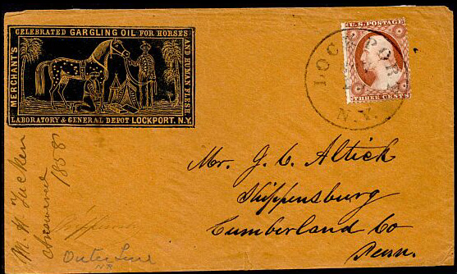
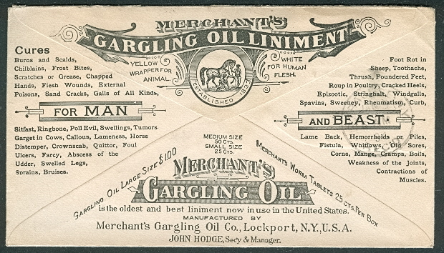
Lockport Merchant’s Gargling Oil

Slide 32
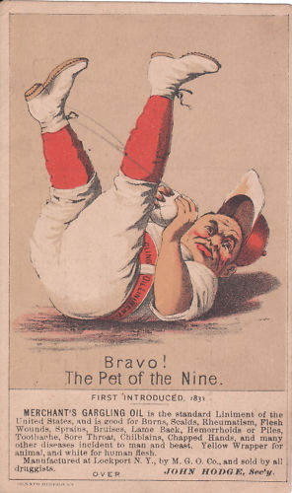
Lockport Merchant’s Gargling Oil
Advertising Trade Cards

Slide 33
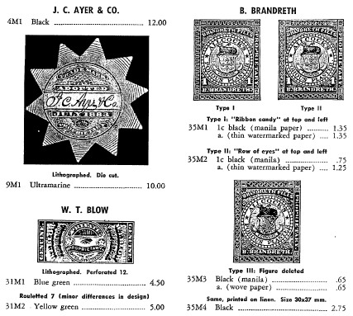
The 1883 Repeal of the Proprietary Tax…
icons: Flaticon.com

