Slide 1

More Unusual Worldwide Stamps
Issued between 2019-2021
By Tom Fortunato
A presentation for the Rochester Philatelic Association

Slide 2
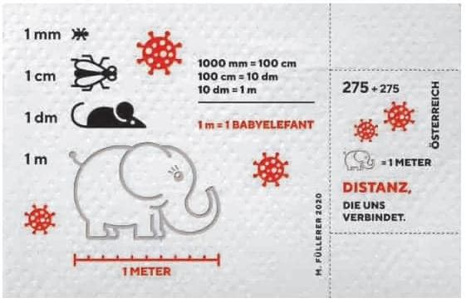
The Covid pandemic has not stopped postal administrations around the world from continuing to issue out-of-the-ordinary and unusual postage stamps. Here’s a sampling of some of them. Enjoy!
10/20/2020
Austria semi-postal 3-ply “toilet paper” stamp drawing attention to “distance” and the relative sizes of recognizable objects. Ten of these side-by side make 1 meter, the recommended safe length to stay apart from others.

Slide 3
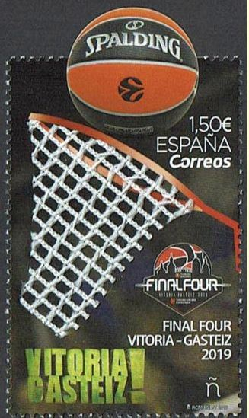
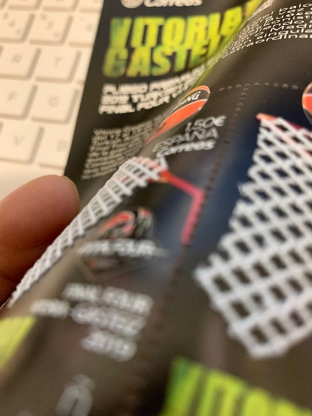
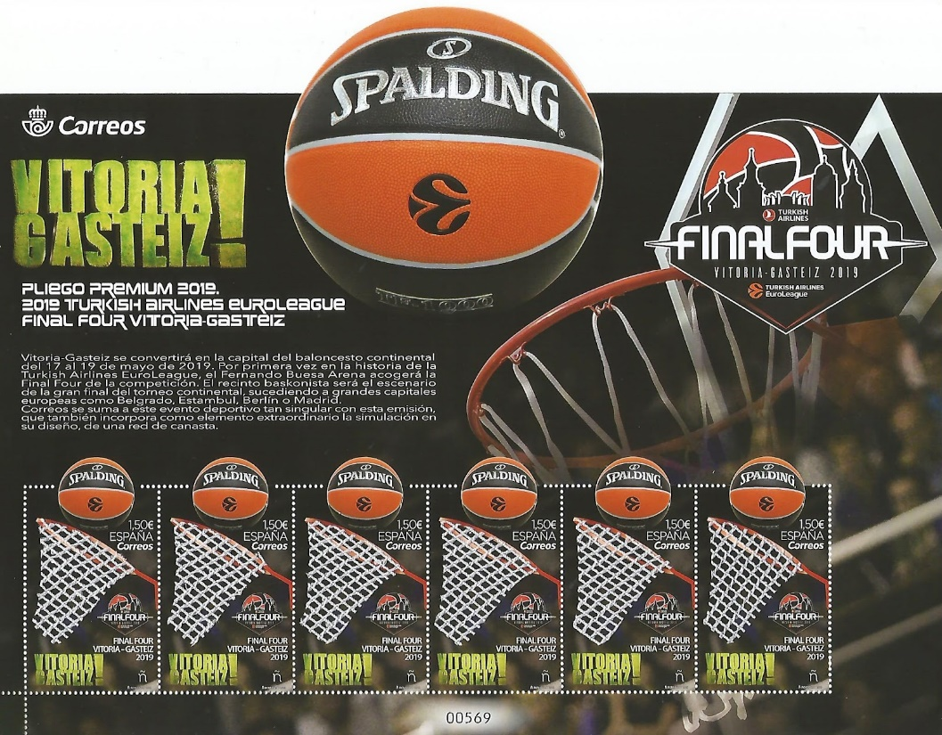
05/17/2019
Spain
Host to the final four of the Basketball 2019 EuroLeague in Vitoria Gastiez. Spalding made the official game ball. Real basketball netting was used on the stamps, seen rising above the paper.

Slide 4
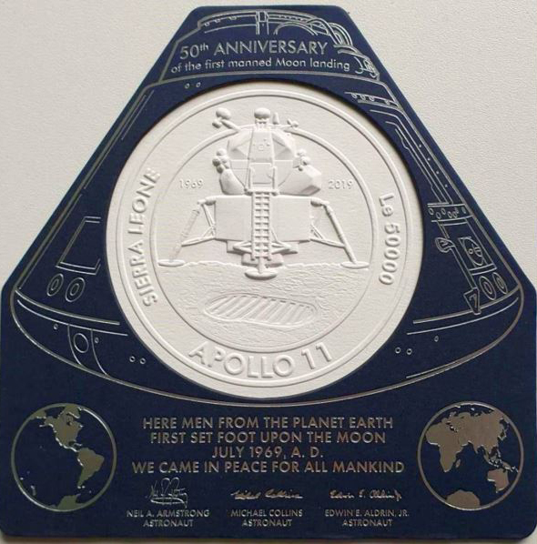
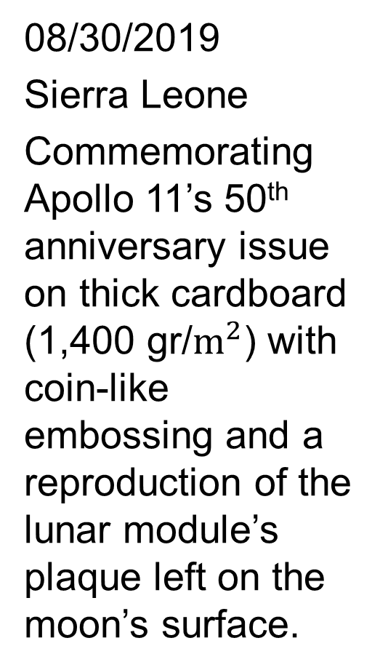
08/30/2019
Sierra Leone
Commemorating Apollo 11’s 50th anniversary issue on thick cardboard (1,400 gr/$m^{2}$) with coin-like embossing and a reproduction of the lunar module’s plaque left on the moon’s surface.

Slide 5

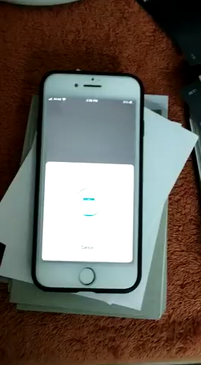
10/22/2019
Portugal
This Christmas issue has a small LED light within the Bethlehem star that is activated through NFC (near field communication) technology by touching it with a smartphone, causing it to flash.
(click image above in a .pptx to view animation)

Slide 6
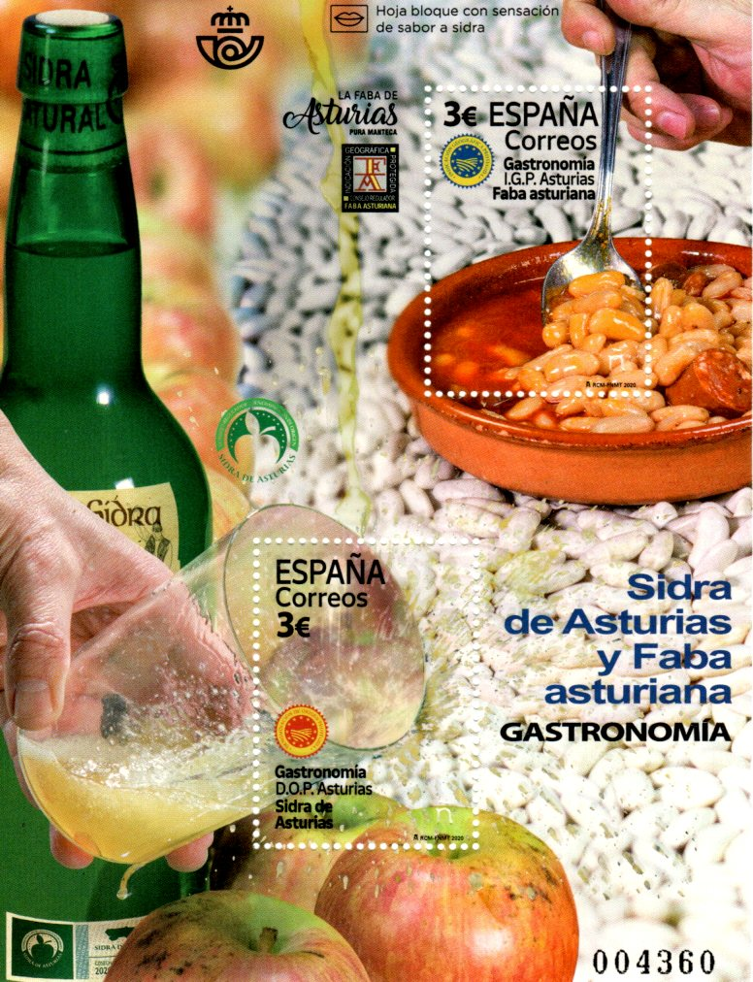
03/20/2020
Spain
Two traditional foods from Spain’s northern coastal Austuria region are featured here, faba beans and apple cider. Licking the yellowish dripping pouring into the glass will taste like the drink. Afterwards, is it still a “mint” stamp?

Slide 7

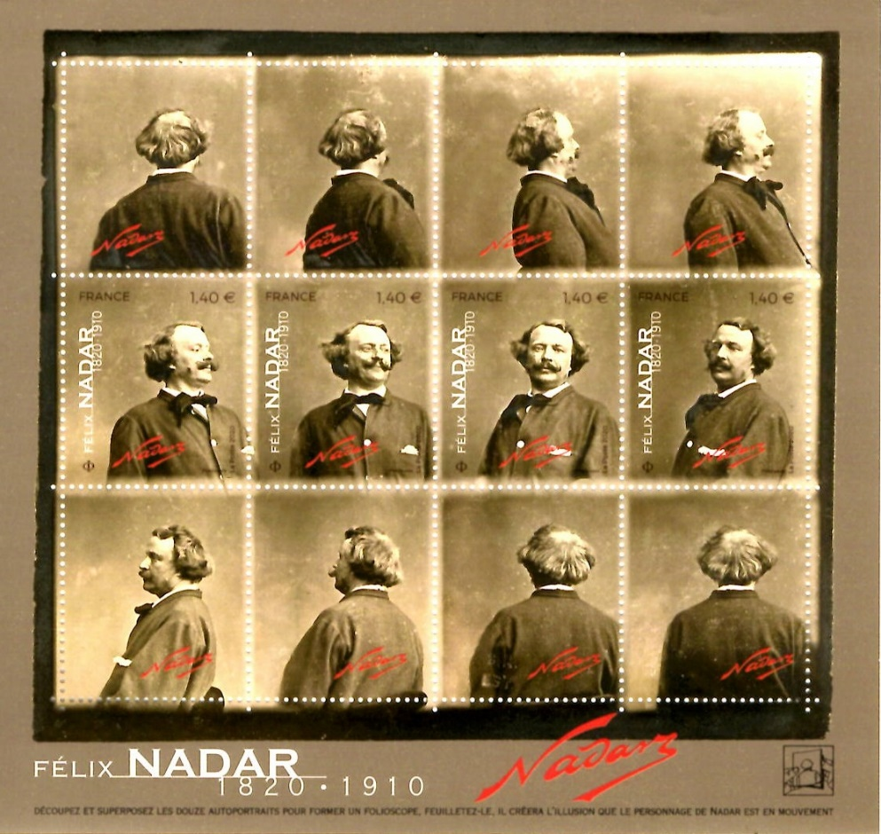
04/03/2020
France
Four stamps (center row of stamps in the sheet) and eight labels (top and bottom rows) of sequential photographs combine to make a flip book showing self-portraits of Felix Nadar (1820-1910) turning in a 360 degree circle.
(click image at right in a .pptx to view animation)

Slide 8
05/20/2020
Spain
This translucent polyester stamp replicates Spain’s national identity document, established in 1944, consisting of a unique ID number, signature, fingerprint, and photograph.
Issue of 160,000

Slide 9
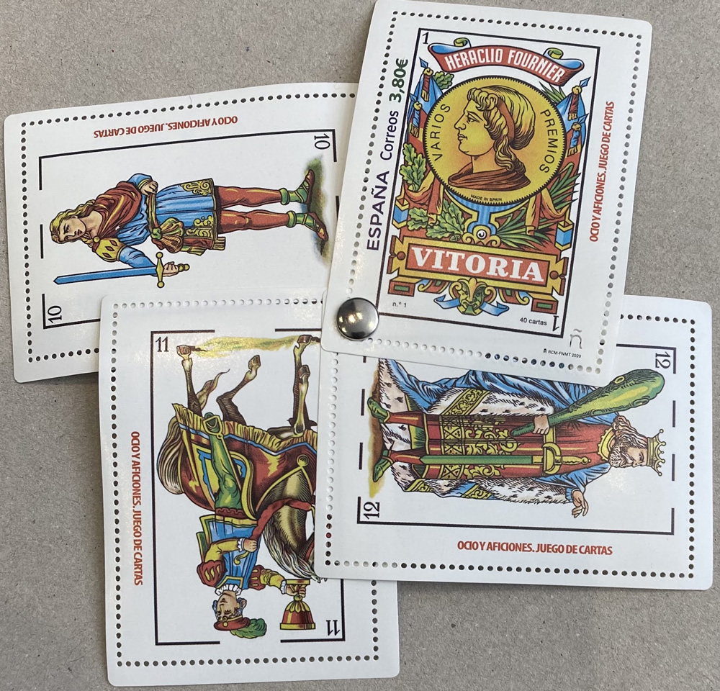
06/11/2020
Spain
The Jack of Spades, Knight of Cups, King of Wands and Ace of Pentacles are on this set honoring the Naipas Heraclius Fournier card manufacturer founded in 1870.

Slide 10

09/07/2020
Liechtenstein
Promoting an eco-friendly environment is this stamp made of polyester yarn thread originating from 3,100 600 ml. (about 20 ounce) recycled PET lightweight polyester bottles.
Issue of 40,000

Slide 11

10/23/2020
Austria
Forming an alpine ski tip, this stamp is made from the same plastic composite and aluminum as the real thing, given its shape, edging and 3 mm thickness by means of a CNC-controlled milling machine. Issue of 150,000

Slide 12
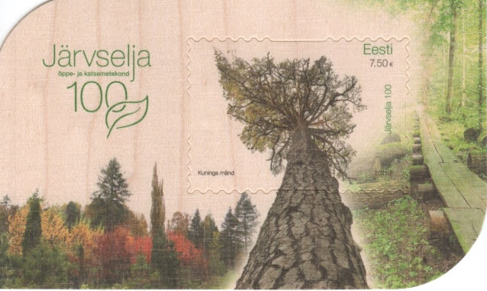
04/13/2021 Estonia
Estonia Post has issued a special wooden souvenir sheet to commemorate the 100th Anniversary of the country’s Järvselja Nature Reserve.

Slide 13
05/20/2021
Estonia
This stamp featuring the common poppy has seeds affixed with a transparent circular plastic sticker in the center of each flower that can be planted to grow poppy plants.

Slide 14

06/05/2021
Turkey
World Environment Day stamp promoting recycling and printed on recycled paper.

Slide 15
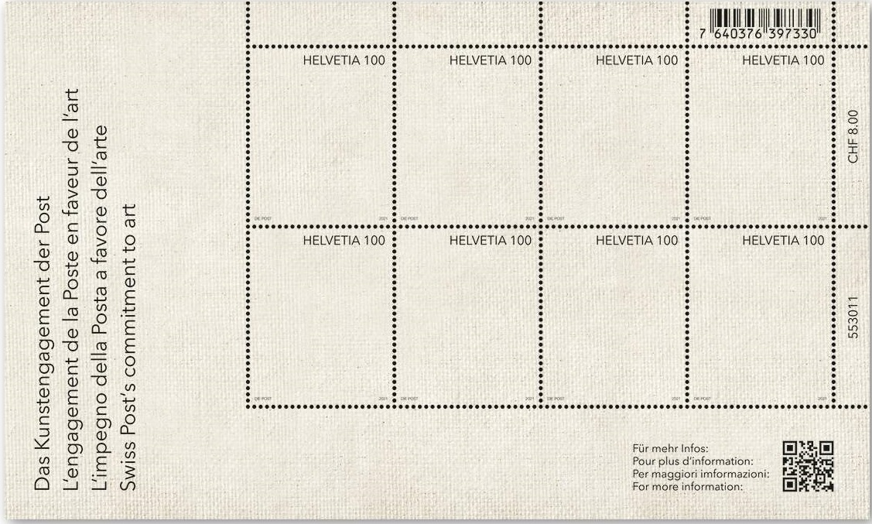
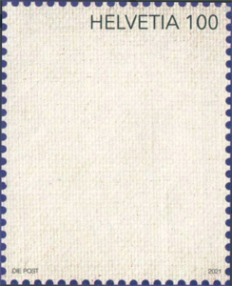
09/02/2021 Switzerland
What else other than plain linen canvas could Swiss Post have used to promote the country’s commitment to art? If a picture is worth 1,000 words, do you see a polar bear in a snow storm?

Slide 16
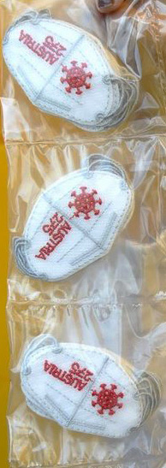
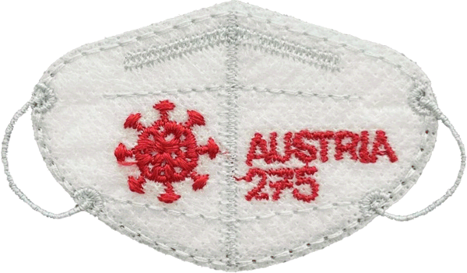
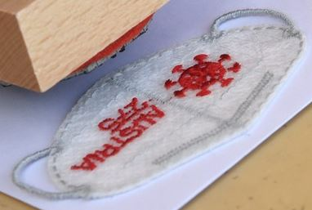
09/17/2021
Austria
A stamp made from the same materials as a pandemic mask: two layers of non-woven fiber were embroidered, laser cut to shape and finished with two stitched ear loops.

Slide 17
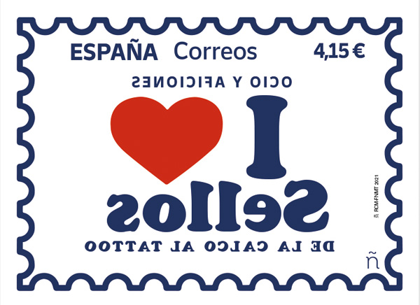
09/20/2021
Spain
An homage to the 1970’s youngster decalcomania fad. These tattoo stamps on cardboard are removable when moistened and stick to skin (or anything) by a turpentine layer on the stamp’s face. [I ¤ Stamps]

Slide 18

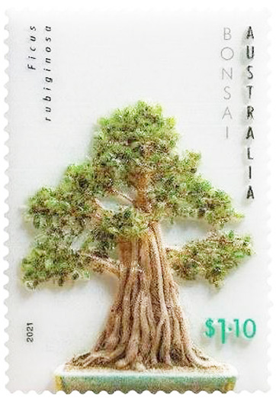
11/01/2021 Australia
Another in a limited edition “Impression Series” of 3D UV-curable resin stamps is this bonsai stamped first day cover. Still available as of August 2022, the FDC retails for A$119.95 from Australia Post. Issue of 150

Slide 19
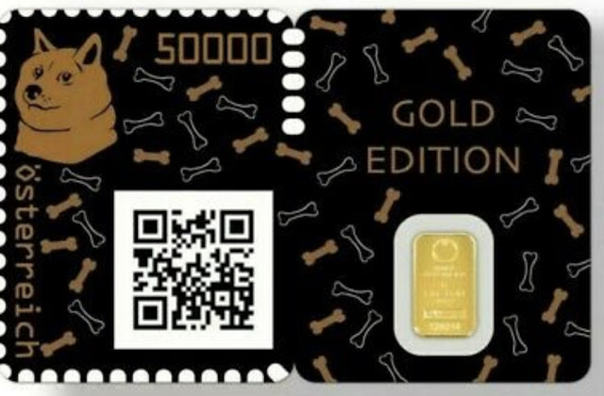

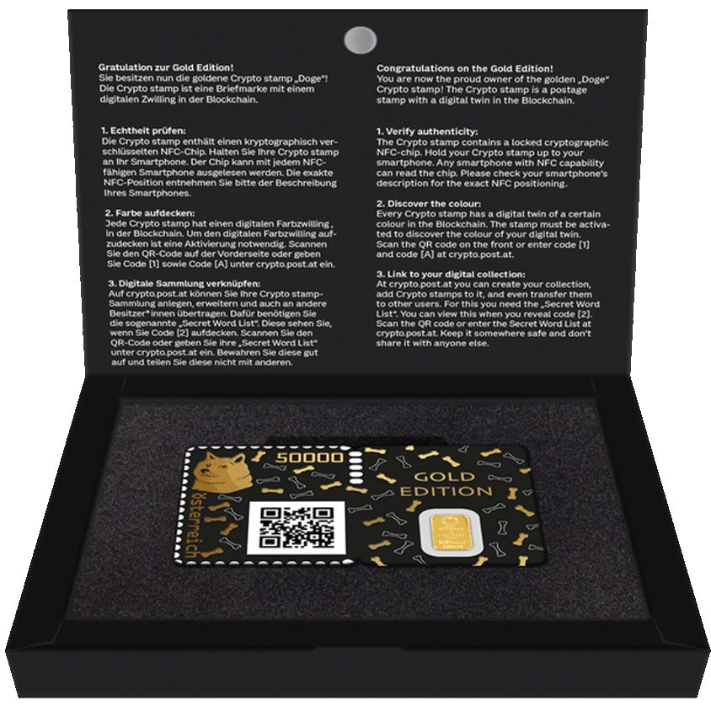
11/02/2021
Austria
A sold out limited edition Gold Doge semi-official item selling for €500 (about $600) when released is this 50,000 Euro cent crypto stamp and a one Kinegram gold bar with Lipizzaner security mark released at the NFT Art Fair in New York. (read more)
Issue of 1,000

Slide 20
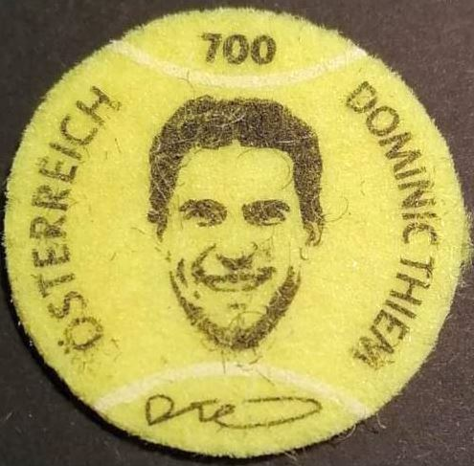
10/25/2021
Austria
Tennis ball felt highlights this stamp honoring Austrian tennis great Dominic Thiem, ranked #3 in the world and winner of the 2020 Grand Slam US Open.
Issue of 150,000

Slide 21
11/04/2021
Switzerland
Depicting plasters (a.k.a. bandages), including their air holes, this issue honors 50 years of the humanitarian organization “Doctors Without Borders.”

Slide 22

11/12/2021
Austria
Continues its series of woven stamp designs with this mitten shaped stamp combining cloth, cotton and polyester preparing for the upcoming winter chill. The textile material was pre-heated before printing to prevent shrinkage. It untypically bears its country’s name in English instead of the native German “Österreich.”

Slide 23
11/14/2021 Luxembourg
Shaped like a Mobius, Luxembourg issued a stamp in the shape of its pavilion at the United Arab Emirates Expo in Dubai. It was sold in a strip of stamps that replicated the same shape within a clear Plexiglas souvenir container as seen below using 5 €0.80 real stamps on one side, 7 non-denominated images of the design on the other.
Issue of 2,500

Slide 24
Thanks for watching!
There are plenty more unusual stamps from this time period you can see. Here are a few online resources to explore further…
Blog: http://philaquelymoi.blogspot.com/
Web site: http://www.eryx.it/dentelli/index.htm
Exhibit: https://www.ottawaphilatelicsociety.org/resources/exhibits/different-and-unusual-stamps/
Exhibit: https://sites.google.com/site/seloshow/concept
Singapore Philatelic Museum Exhibition: https://www.nhb.gov.sg/spm/exhibitions/seeing_is_believing_unusual_stamps_2013

