Slide 1
Stamps of Unique Materials
by
Kelly Armstrong
A 2023 Presentation for the Rochester Philatelic Association.

Slide 2
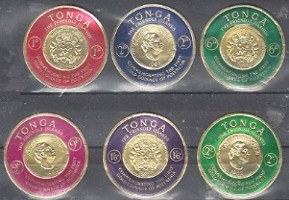
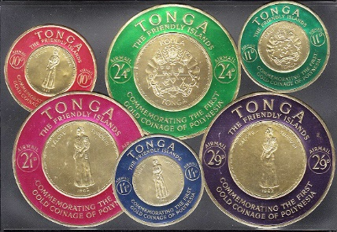
Introduction
For more than a century postage stamps were, for the most part, all the same being printed on paper. But things changed in the 1960s when countries started experimenting by using other materials as substrates and/or embellishing paper in ways never before seen. Such creations have exploded onto the philatelic marketplace and continue into today. Here is a small sample of them.

Slide 3
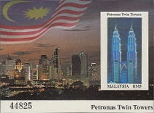
2- Malaysia
1- Thailand
3- Malaysia

Slide 4
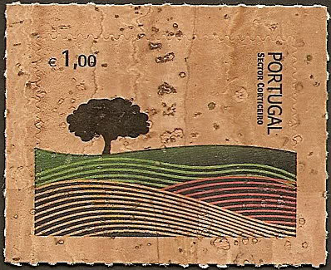
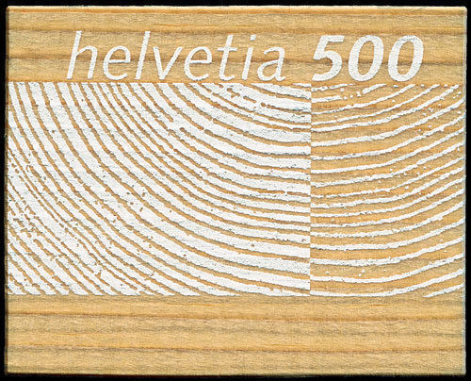
4- Portugal
5- Switzerland
6- Switzerland
7- China

Slide 5
8- Spain
9- Singapore
10- Hong Kong

Slide 6
11- Thailand
12- China
13- North Korea
14- Bhutan

Slide 7
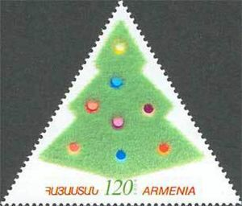
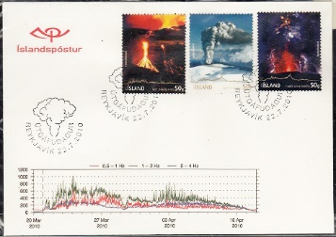
16- Thailand
17- Armenia
15- Austria
18- Iceland

Slide 8
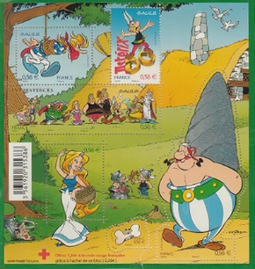
19- France
20- Thailand
21- Gibraltar
22- Spain

Slide 9
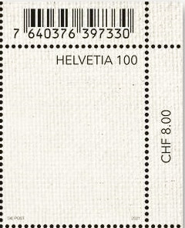
23- Austria
24- Switzerland
25- Austria
26- Austria

Slide 10
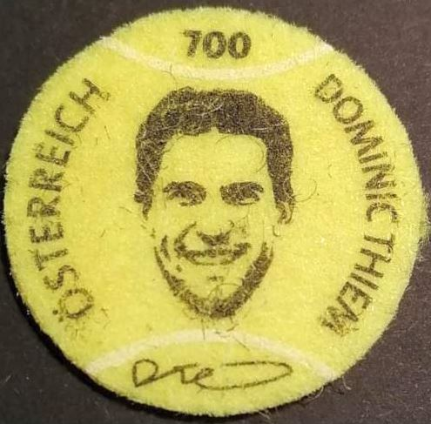
27A- Austria
27B- Hong Kong
28- Austria
29- Austria

Slide 11
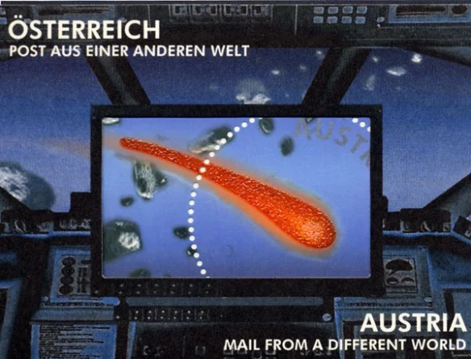
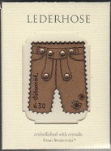
30- Austria
31- Austria
32- Austria
33- Austria
34- Austria
35- Austria

Slide 12
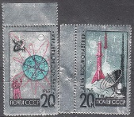
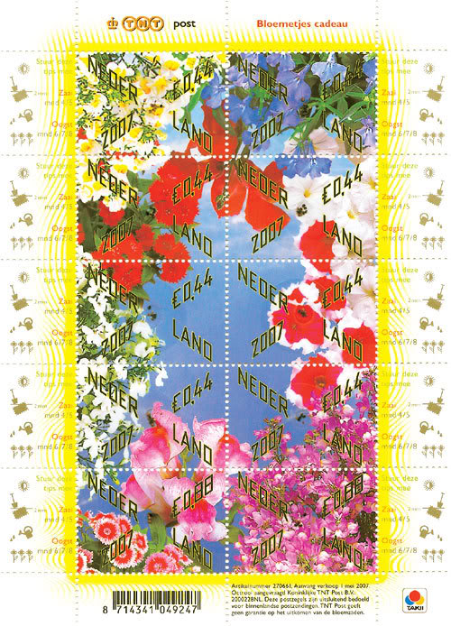
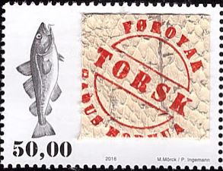
36- Austria
37- Austria
38- Faroe Islands
39- Netherlands

Slide 13
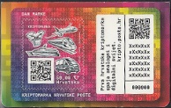
40- Spain
41- Bhutan
42- Croatia
43- Austria

Slide 14
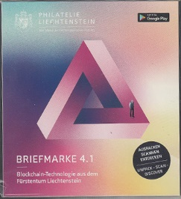
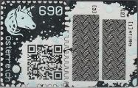
44- Liechtenstein
45- Austria
46- Gibraltar
47- Croatia
48- Austria

Slide 15
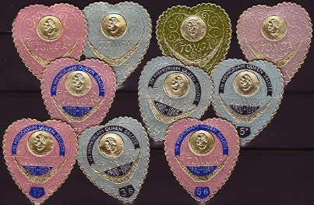
49- Belgium
50- Tonga

Slide 16
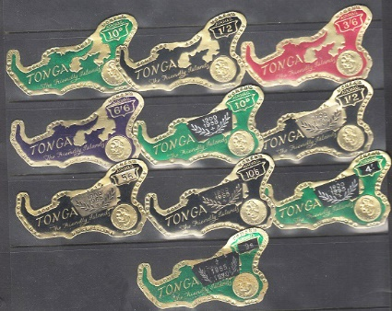
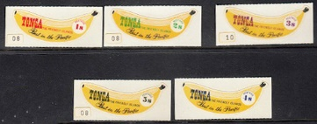
51- Tonga
52- Tonga
53- Tonga
54- Tonga

Slide 17
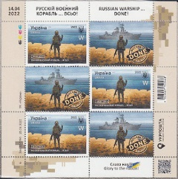
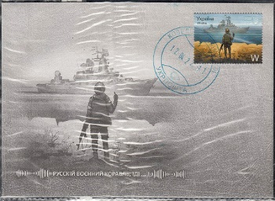
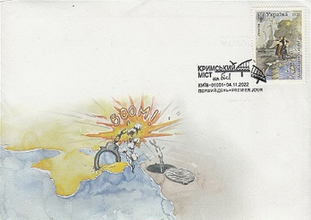
55- Ukraine Issues

Slide 18
Much more to come!
Background by Vecteezy.com

