Slide 1
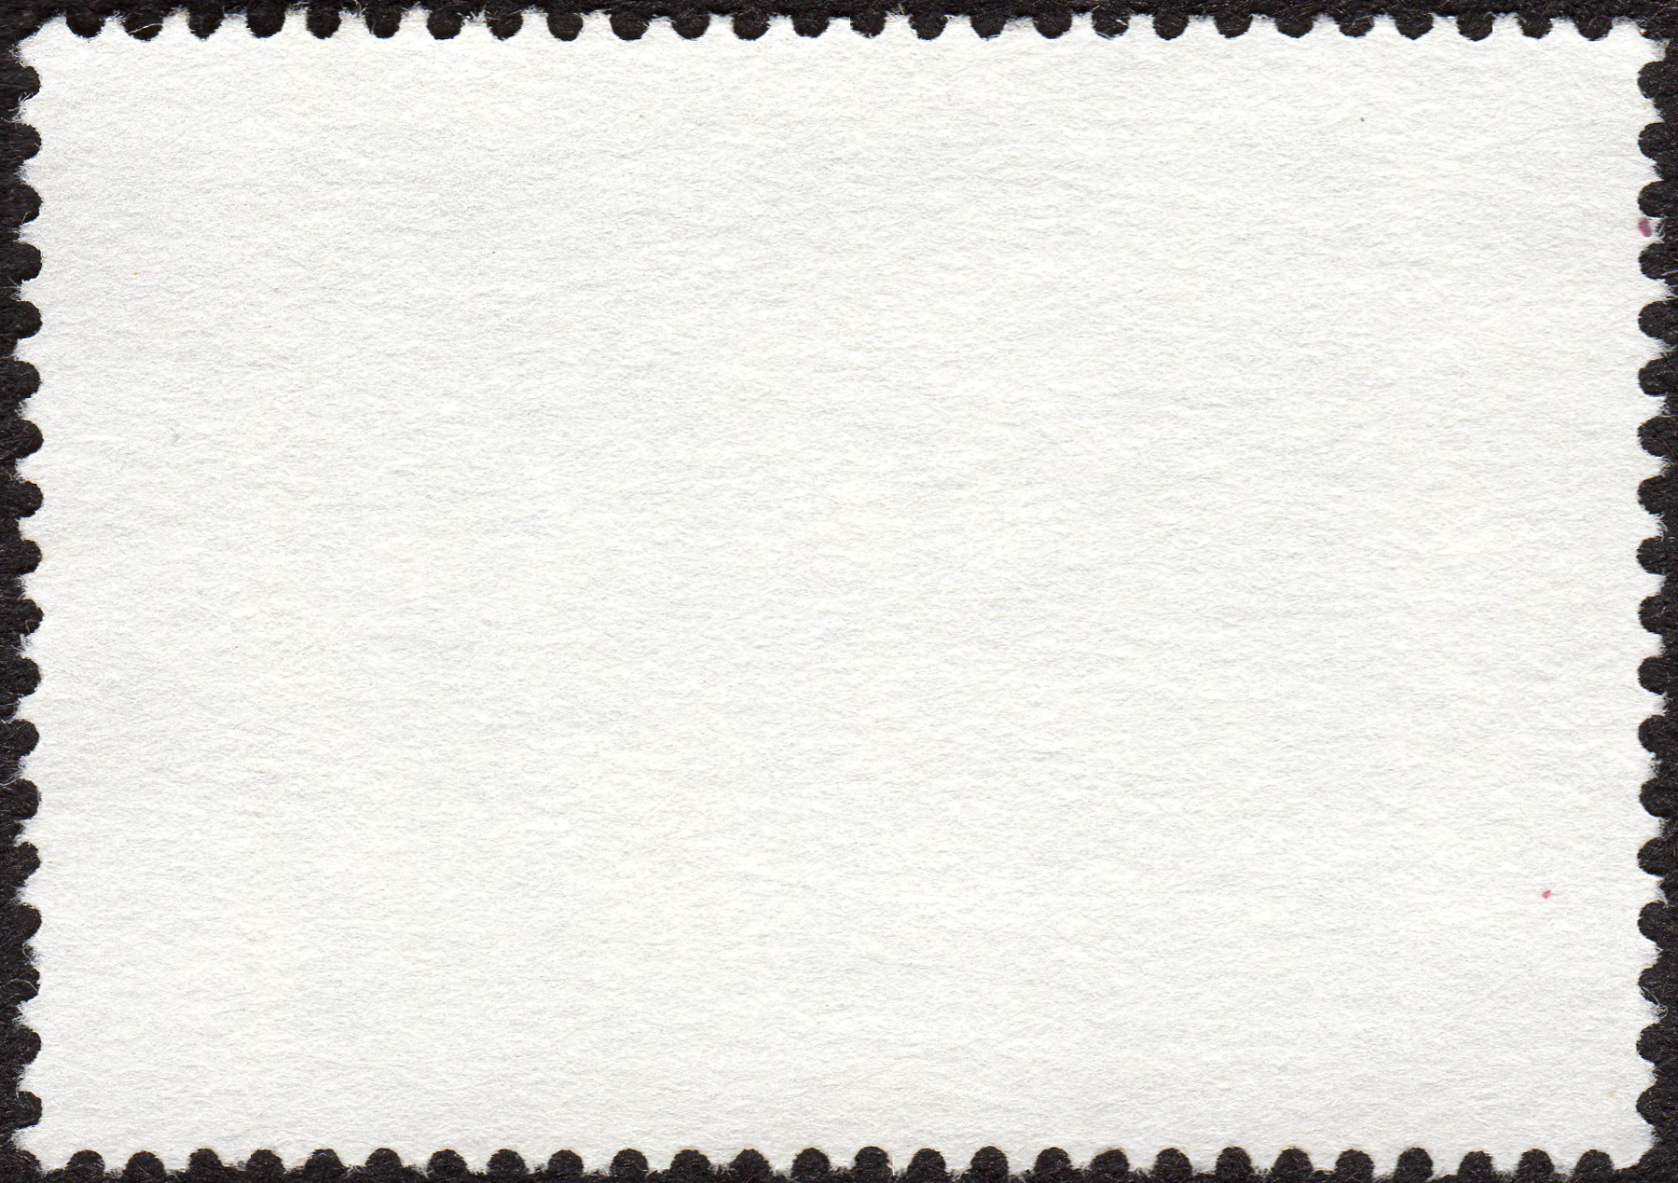
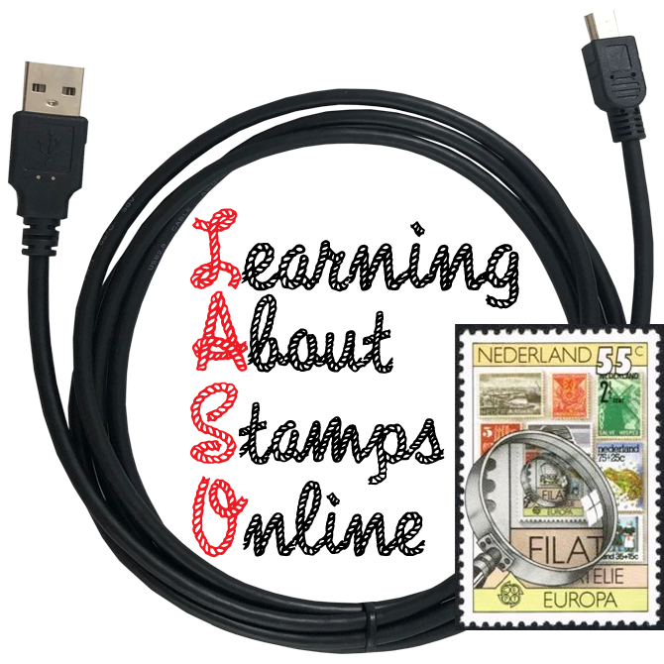

Stamp Collecting Basics
Your Questions Answered
by Tom Fortunato
August 18, 2026
A LASO presentation.
https://learningaboutstamps.org/
= link to related information

Slide 2
Beginner stamp collectors have lots of questions. We have been keeping track of these from among the LASO membership and have put together this presentation to help answer many of them.
Presentation Outline
Collecting Basics
> Focus, Handling Stamps, Identifying Stamps, Stamp Storage, Hinges and Mounts
Stamp Characteristics and Tools
> Perforations, Watermarks, Color and Shades, Putting it All Together
Buying/Selling/Trading
> Sources, Reliability, Swapping, Open Questions

Slide 3
Collecting Basics Focus
How do I decide what to collect, especially if I’m on a budget?
How does one put together a collection?
The bottom line for any hobby is to collect what you like and makes you happy. How big a challenge are you looking for? Philately offers many options and the choice of what to collect and how to collect is totally yours! You make a great collection! Many beginners start with something relatable.
> Select a country of interest. Collecting one of every stamp is a great goal, but beyond most wallets. So, narrow your focus:
• select a time period (like 1960-1980 or your birth year)
• start by buying only stamps under a specific dollar amount, increase when possible
> Picking a subject of interest (known as topical or thematic collecting) such as animals, sports or trains from one or multiple countries is another option.

Slide 4
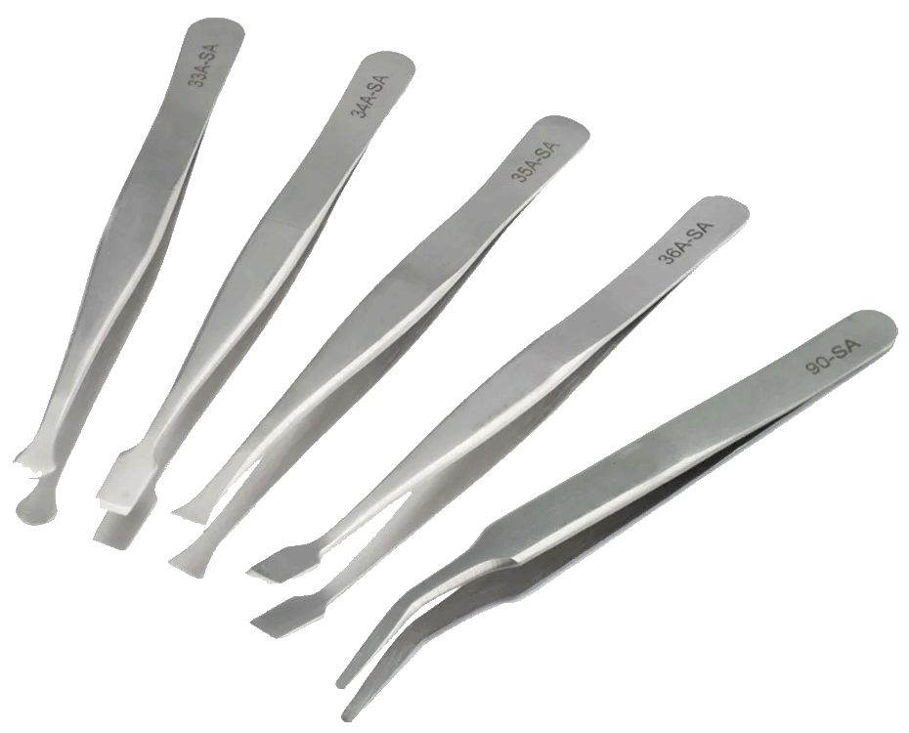
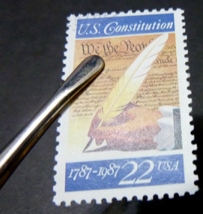

Collecting Basics Handling Stamps
How should I handle loose stamps?
Mint (unused) stamps with full gum or any stamp of value are best handled using tongs. Also known as “tweezers” in the UK and abroad, they come in a variety of end tips as shown. Those with a flat or rounded end are easiest to maneuver compared to a pointed tip more for seasoned collectors.
But it is fine to handle stamps with clean hands, otherwise oils and dirt may transfer unintentionally to the stamps.

Slide 5
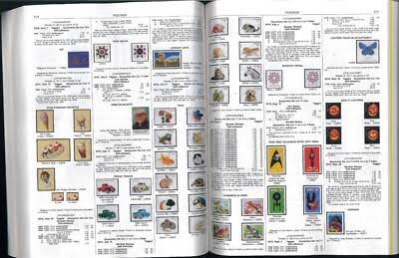
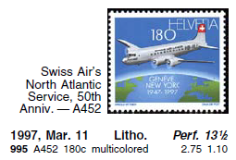
Collecting Basics Identifying Stamps
How do I identify the stamps I need or have?
The “bible” used by stamp collectors in North America is called the Scott’s Standard Catalogue published yearly, available in most libraries. The worldwide version has 6 sections in 12 volumes. Its proprietary reference number system is used by sellers and buyers alike to identify stamps and gives retail values for mint and used copies.
Caution- While dealer selling prices may be close to these values, buy-backs will be at a great discount.

Slide 6
Collecting Basics Identifying Stamps
Are online stamp identification resources available?
Yes! Worldwide stamps can especially frustrate beginner collectors in determining what country a stamp is from and in some cases, additional helpful details.
Try one or more of these:
• ISWSC World Wide Stamp Identifier (text based to determine country)
• Kenmore Stamp U.S. Stamp Identifier (visual guide listing Scott numbers)
• Colnect Stamp Image Identifier (upload images, comprehensive data base)
There are also phone apps that can help:
• Colnect Stamp Image Identifier Android iOS
• iCollect Stamps Android iOS
These apps are free, and may offer paid Pro versions with added features.

Slide 7
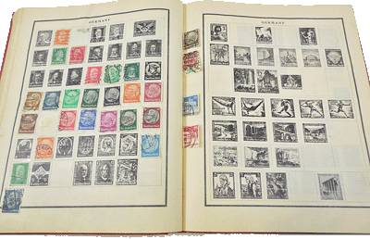
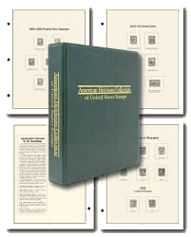
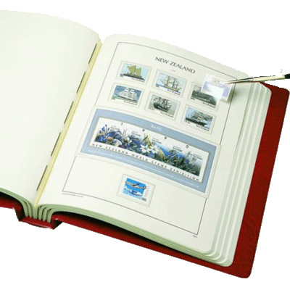
Collecting Basics Stamp Storage
How should I store and “house” my collection?
Collectors have several storage options depending on your goals. Traditionalists collecting single or multiple countries should easily find preprinted albums. Pages will have images and/or spaces to place each stamp using hinges or special mounts that protect any gum on the back. Hingeless albums are also made. Albums can be bound or have loose-leaf pages to allow for additional pages to be inserted.

Slide 8
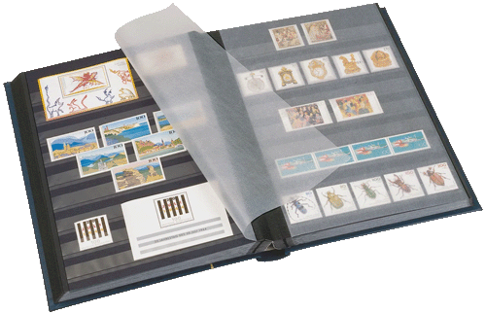
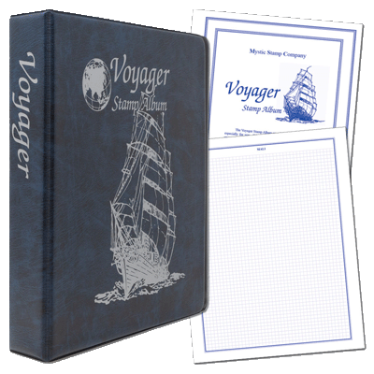
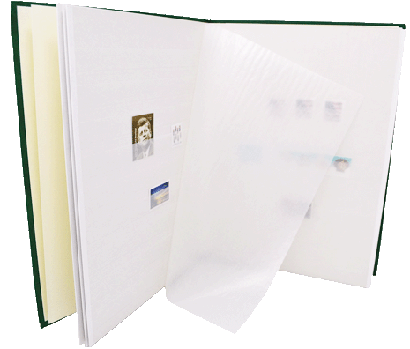
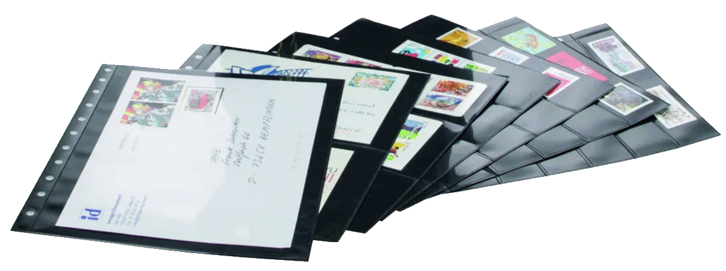
Collecting Basics Stamp Storage
For subjects without their own album already produced, make your own pages up in a three-ring binder using a heavy stock grade paper, preferably acid free. As before, place stamps using hinges or mounts. Another option is to buy bound stockbooks or loose stock pages that have clear or glassine strips in rows. You decide organization.

Slide 9
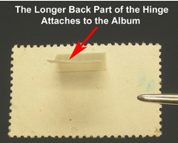
Collecting Basics Hinges and Mounts
If you opt for an album rather than stockbook, you’ll need to find a safe way to attach your stamps to the page. Do not use cellophane tape! Stamp hinges are folded small strips gummed on one side. Moisten the smaller part, attach it to the top of a stamp, then wet the larger portion and attach it to the album page. Clear or black-backed protective mounts are best for mint (unused) stamps still with gum. Long strips of various heights can be cut to the width of the stamp. Adhering the top hinge to the page secures it in place.

Slide 10
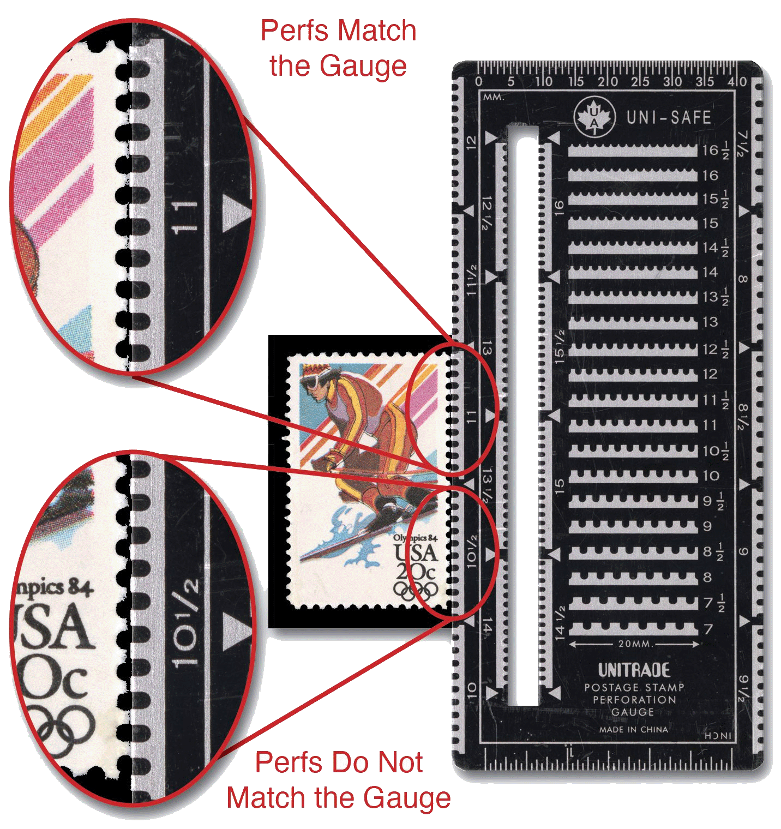
Stamp Characteristics and Tools Perforations
How do you use a stamp gauge?
Stamp perforations refer to the holes and bridges (aka “teeth”) that appear when separating stamps from a sheet. They are measured using a perf gauge counting the teeth of various separations over a 20 mm span. Simply match the holes and teeth with the gauge line closest matching them.
The stamp shown here is Perf 10½ on the horizontal edges and Perf 11 on the vertical, identified as a Perf 10½ x 11 stamp. If both edges were identical in measurement as 11, for example, it would be considered a Perf 11 stamp.

Slide 11
Stamp Characteristics and Tools Perforations
What is a compound perf?
When the perforation measurements of the horizontal and vertical sides are not identical, the stamps is considered having compound perfs.
What is a mixed perf?
Mixed perfs are when the top and bottom (or left and right) measurements are different. They are very uncommon, created when a perforation production error occurs and a different gauge of row punching pins is used compared to the original.
What is a re-perfed stamp, and how can you detect one?
Stamps with one or more straight edges have been doctored to make them appear as originally having proper perfs, done to enhance their appearance or fake a more valuable stamp variety. These are known as re-perfed stamps. How to tell? Uneven hole distances, non-uniform horizontal and vertical hole alignment, different shaped holes are some of the indicators of a re-perfed stamp.

Slide 12
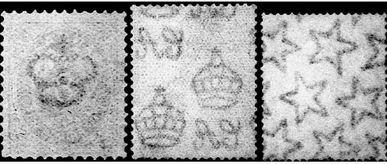
Stamp Characteristics and Tools Watermarks
What is a watermark?
Watermarks are impressions in the paper some stamps are printed on, acting as a security measure against counterfeits and can also identify a specific paper manufacturer. They are produced during the paper making process by impressing a series of designs into the firming pulp slurry, creating a slight thinning indentation when dried. Holding a stamp to a light makes the impression appear lighter than its surrounding area, but darker when up against a black surface.
watermarks can appear over multiple stamps

Slide 13
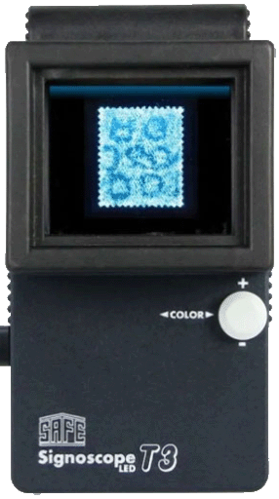
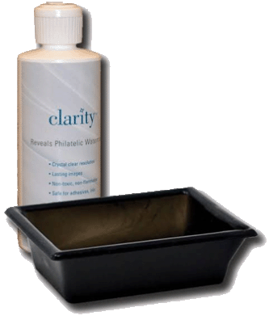
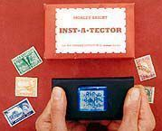
Stamp Characteristics and Tools Watermarks
What methods detect watermarks?
Detecting a watermark can be tricky. Always view the stamp from the reverse unprinted side and hold it to the light or place it on a dark surface. Orange, yellow and other light-colored inks make the watermark harder to see with the naked eye. Most reliable is using a black tray and a few drops of watermark fluid, which will not harm mint or used stamps and evaporates quickly. Pay particular attention for the moment when the fluid evaporates when the design is easiest to view. Various pressure and electronic scopes can also be used with limited success.

Slide 14
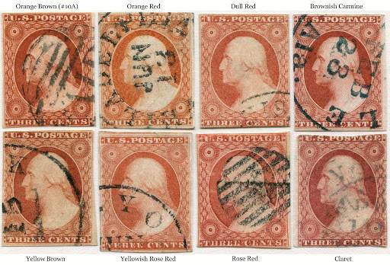
Stamp Characteristics and Tools Color and Shades
How do I determine a specific color or shade?
There are no absolute answers when it comes to identifying stamp color shades. This is especially true of stamps from 1840-1920 or so. Ink raw material components and formulations were not always consistent between batches, manufacturers changed, printing processes and aging oxidation all effected resulting stamp colors. Stamp catalog editors even can name the same color differently. Experts of specific stamp
issues have standardized color shades among specialists. One would need examples of each to compare with a questionable stamp to determine a particular shade, or submit that stamp to an expertizing firm to confirm the shade. Slight variances could mean differences of thousands of dollars in a stamp’s value.

Slide 15
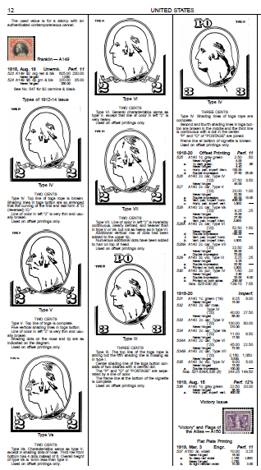
Stamp Characteristics and Tools Putting it All together
Perforations, watermarks and color shades can all help identify look-alikes as listed in stamp catalogs. The Washington-Franklin series running from 1908-1922 adds even more complexity to these, as different plates, printing techniques and papers were utilized over the years, creating additional varieties to the extreme.

Slide 16
Buying/Selling/Trading Sources
How can I obtain stamps?
Collectors have lots of options when it comes to building their collections—mainly through buying and trading stamps—in person, online and by mail. Don’t forget to ask relatives, friends and neighbors to save them for you!
Buying and Selling Sources
• Fellow collectors/stamp clubs • Dealers • Stamp shows • Garage/rummage sales • Thrift stores • Online (eBay, APS StampStore Hip Stamp, Delcampe, Colnect, etc.) • Craig’s List • Facebook Marketplace • Auctions
Sorry to say the days of stamp corners in department stores, stamp dollar bags at Woolworth’s and stamp approvals by mail have all gone passé. The “action” today is mostly at stamp clubs, stamp shows and especially online.

Slide 17

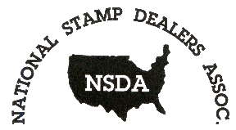



Buying/Selling/Trading Reliability
How do I know if the stamp business I’m dealing with is reliable/trustworthy?
Identifying as a member of an established professional trade association can relieve your concern. The American Stamp Dealer’s Association, National Stamp Dealers Association, Canadian Stamp Dealers Association, Philatelic Traders’ Society and the Internet Philatelic Dealers Association are highly reputable organizations that have vetted their membership and can intervene if an interaction problem develops. Their websites list member contact information to easily find them along with their specialties. Look at their online reviews.

Slide 18




Buying/Selling/Trading Reliability
How do I know the individual I’m dealing with is reliable/trustworthy?
Is he/she a member of a local/regional/ national stamp club or organization? Ask for references. If online, look for transaction ratings. Is there a returns policy? Like businesses, larger groups have disciplinary boards that will review disagreements with members to resolve any outstanding issues. Look for memberships in the American Philatelic Society, American Topical Association, Royal Philatelic Society of Canada, British North America Philatelic Society and other major societies.

Slide 19
Buying/Selling/Trading Swapping
How can I trade stamps and how do I find others interested in doing so?
Swapping stamps is one of the fun parts of collecting. The two most popular exchange types are one-for-one and catalog-value based. One-for-one is easiest for most collectors. Otherwise, both collectors must use the same catalog and publishing edition, then identify and price the stamp(s) being exchanged. Retail prices listed can change from year to year. Keep records of the values both ways.
Start first by finding collectors in your area. Try a local stamp club first. The APS has a listing of U.S. and Canadian clubs . A Google search of “online stamp exchanges” reveals many possibilities. TradeOnlyStamps.com is frequently referenced with the more familiar sites of Colnect and Hip Stamps. Read any requirements and guidelines they offer thoroughly. Several organizations run multiple exchanges for members only, like the International Society of Worldwide Stamp Collectors, which are worth investigating.

Slide 20
Buying/Selling/Trading Open Questions
Up for discussion…
What’s the best way to buy or sell stamps--individually, in sets or whole collections?
Other then organizational references, what additional criteria do collectors have before doing business with sales listings on the internet?
What sources are out there for purchasing modern issues from the last 20-30 years, especially used U.S. (or for that matter, worldwide) rather than mint stamps?
What should be done with older stamp albums no longer needed?
What do you do when you inherit a stamp collection?

Slide 21
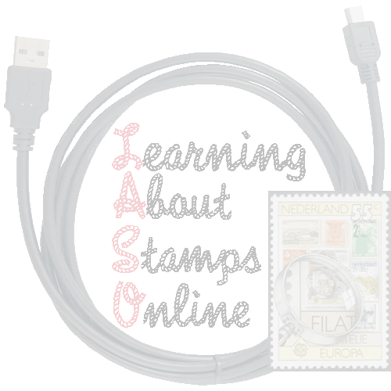
Wrapping it Up
All this can be very overwhelming to a beginner collector. Don’t let it scare you! We all started out knowing very little, but through time, patience and the innate desire to study and learn new things are sharing our knowledge with you.
And LASO is here to help.
Our web site is full of information and links to assist beginning, intermediate, and advanced collectors. The Resources page has links to hundreds of web sites covering a wide range of subjects. Learn more by viewing links to stamp presentations. Over 20 LASO members act as subject specialists to assist anyone with questions or are seeking mentors to guide on the Philatelic Guides page. All you need to do is ask!
Thanks for watching!
https://learningaboutstamps.org

