Slide 1

PUNderful Cover Cachets
by Kelly Armstrong
for the Rochester Philatelic Association

Slide 2
Pun - A joke exploiting the different possible meanings of a word or the fact that there are words which sound alike but have different meanings.
Introduction
Puns are the type of humor that can be enjoyed by all ages.
They make us cringe, but they do bring laughter.
Puns are typically spontaneous “at the moment” type of humor.
They do require a good comprehension of the English language to deliver the pun successfully.

Slide 3
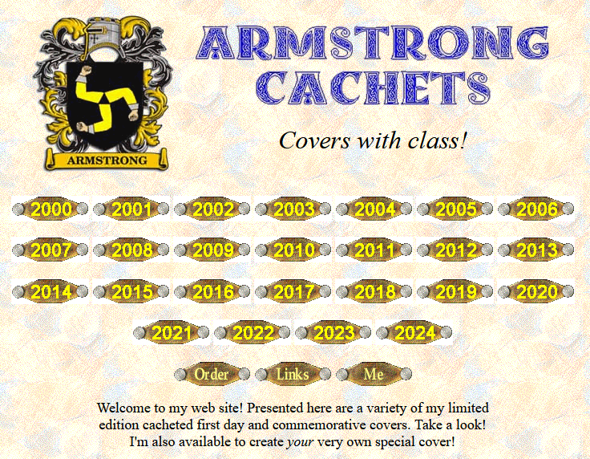
My “standard” FDC and commemorative covers can be viewed on my web site.
http://www.armstrongcachets.com

Slide 4
Florida has so many iconic symbols. I used several of them in the stamps and cachet to highlight the unique Miami cancel’s design.
The term “barefoot mailman” refers to the carriers on the first U.S. Mail route (1885-1892) between Palm Beach and the settlements around the body of water known as Lake Worth on the north, and Miami, Coconut Grove, and Lemon City to the south. Mail was delivered on foot or by boat!
Commemorative cancel – February 5, 2023

Slide 5

This set of 5 stamps features images taken by the 320 mile high Hubble telescope of interestingly named nebulae and galaxies.
2000 Hubble Space Telescope 10th Anniversary

Slide 6
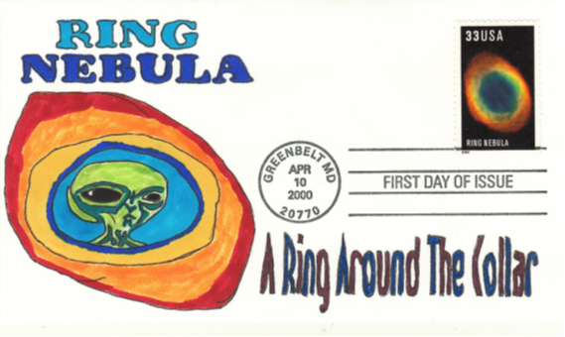
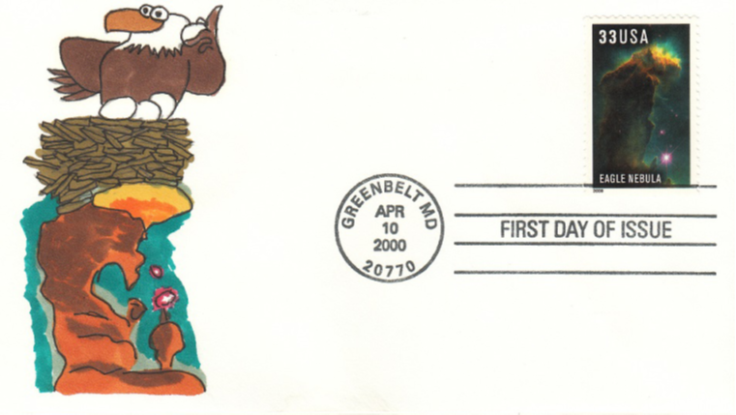
As you can see I decided to interject a little humor in these covers. Austin Powers and Dr. Evil must be out there somewhere!
2000 Hubble Space Telescope 10th Anniversary

Slide 7
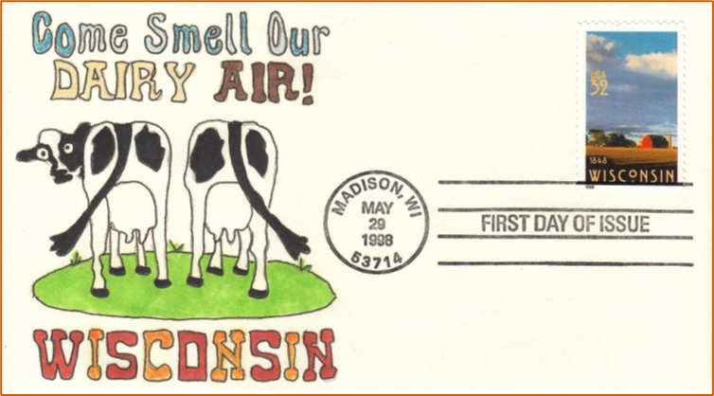
These two stamp issues are not necessarily related, except for an X-Files TV series episode I somehow subconsciously remembered...
Using the special USPS Stamp Decoder on the stamp reveals the state’s animal, a badger, among the clouds!
1998 Wisconsin Statehood and 1964 Robert Goddard

Slide 8


Here is the 2020 Fruits and Vegetables set of 10 stamps using their color cancel versions.
2020 Fruits and Vegetables

Slide 9



They celebrate the tradition of using fruits and vegetables as subjects for still life paintings. I think Picasso would “relish” my artwork.
2020 Fruits and Vegetables

Slide 10

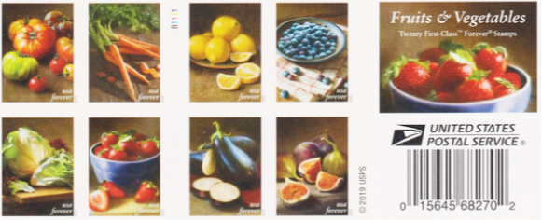

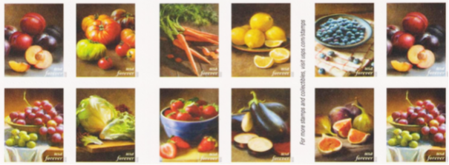
Popular books, movies and songs make great sources for puns!
2020 Fruits and Vegetables

Slide 11
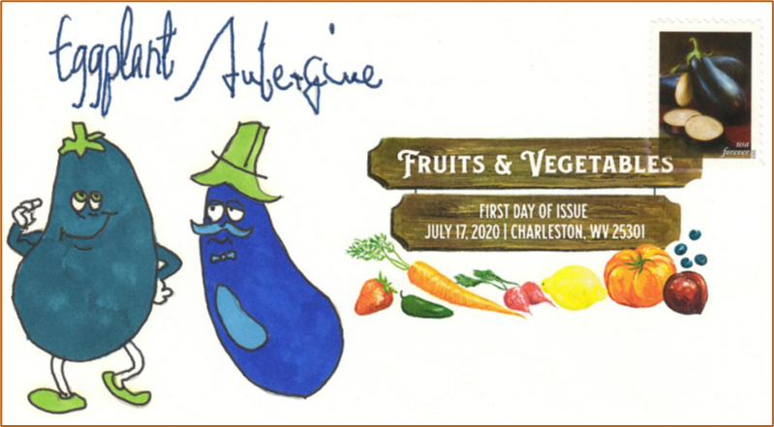

And you thought an “aubergine” (actually considered as a berry fruit by botanical definition) only referred to the emoji!
2020 Fruits and Vegetables

Slide 12
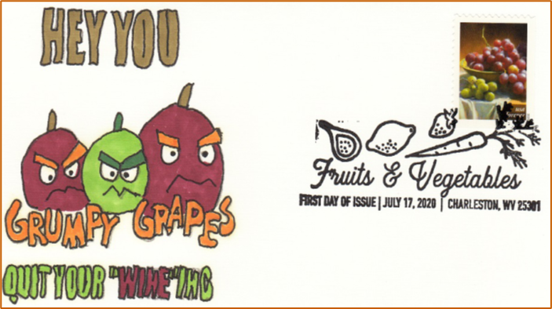
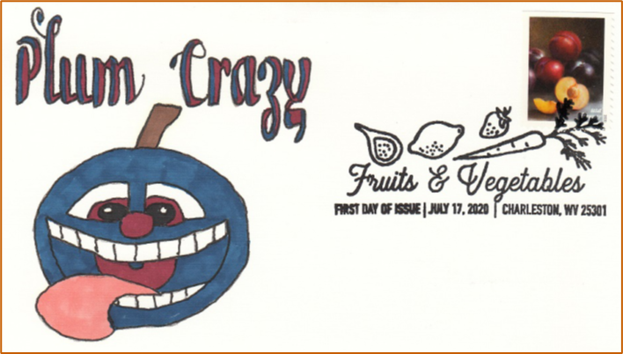
Here’s the same set of 10 stamps using the standard black first day cancels with different cachets.
2020 Fruits and Vegetables

Slide 13


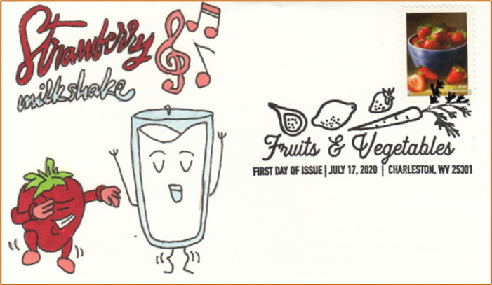
Vitamix these!
2020 Fruits and Vegetables

Slide 14
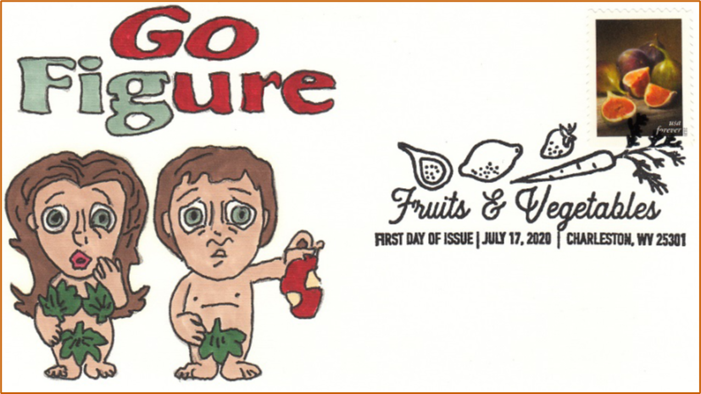

Don’t Vitamix these!
2020 Fruits and Vegetables

Slide 15
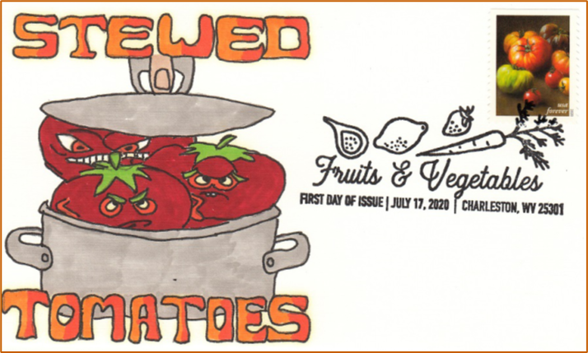
I already discussed eggplant, but is a tomato a fruit or vegetable?
Answer: It’s a fruit eaten as a vegetable.
2020 Fruits and Vegetables

Slide 16
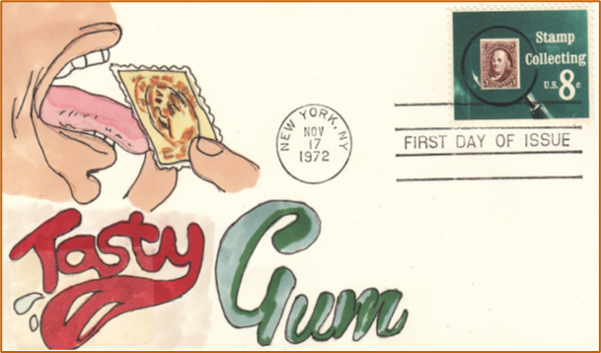

My questionable humor at work again. Just watch where you stick your tongue!
1989 Inauguration Day cancel 1972 Stamp Collecting 2021 Year of the Ox

Slide 17
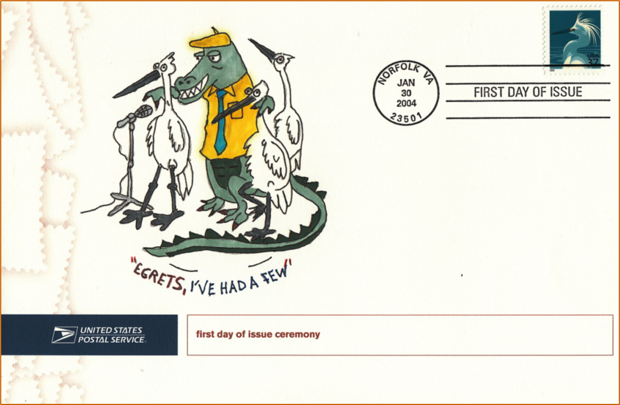
I “did it my way” and couldn’t wait to add this image to the ceremony’s program— and it had nothing to do with Florida.
2004 Snowy Egret

Slide 18
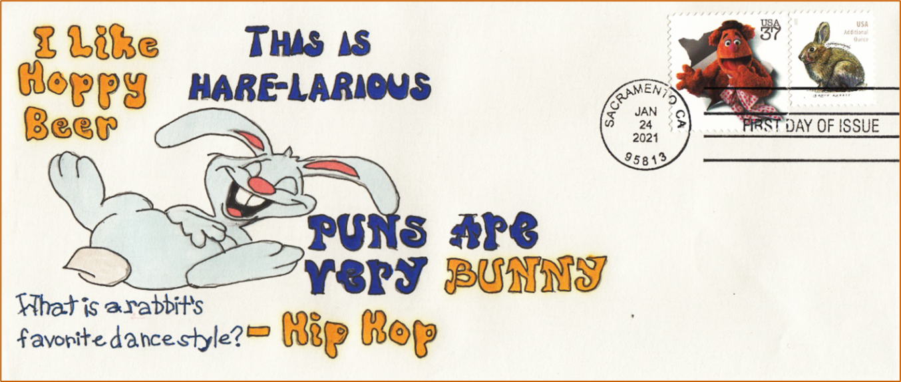
I had a lot of fun making this cachet for the 2021 Brush Rabbit additional ounce stamp, worth 20 cents at the time. Hare-Larious, no?
2021 Brush Rabbit

Slide 19



I could not resist creating cachets for the 2021 Heritage Breed set of 10 animal stamps.
2021 Heritage Breeds

Slide 20
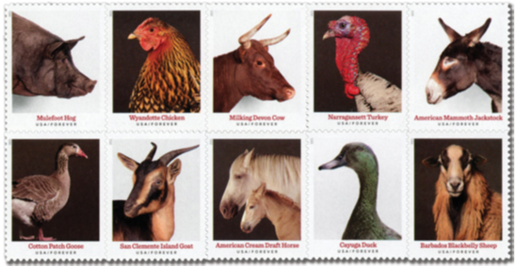


Animals and kids (as well as the goat kind) have lots of pun-potential.
2021 Heritage Breeds

Slide 21
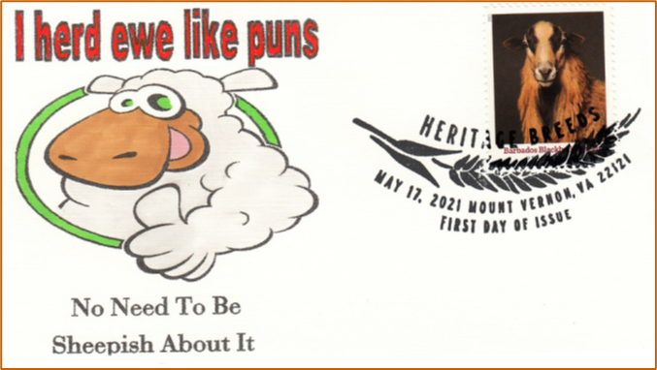
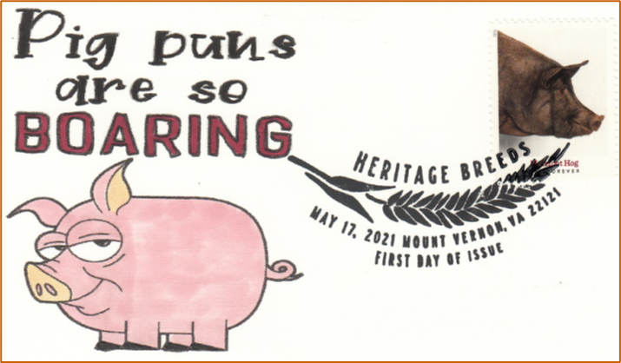

Ewe like these?
2021 Heritage Breeds

Slide 22


You should have realized I like to add plenty of references about beer in my puns.
Homer Simpson, “drink” your heart out!
2021 Heritage Breeds

Slide 23
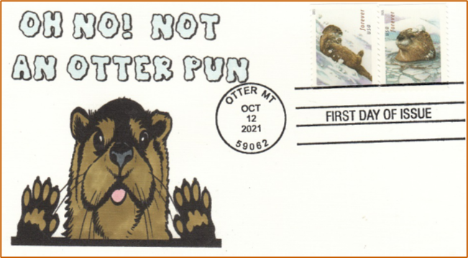
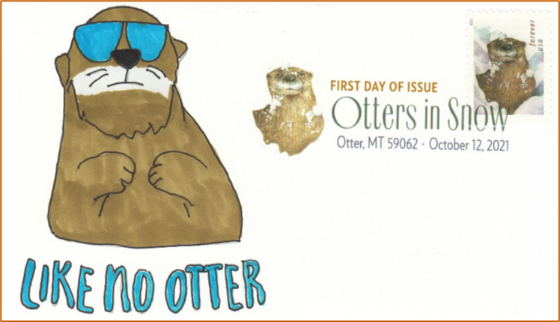
Later in 2021 the 4 stamp “Otters in the Snow” issue was released for Christmas. I put together 2 combo-covers and 4 singles.
2021 Otters in the Snow

Slide 24
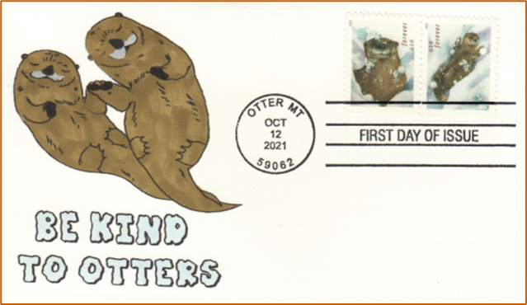
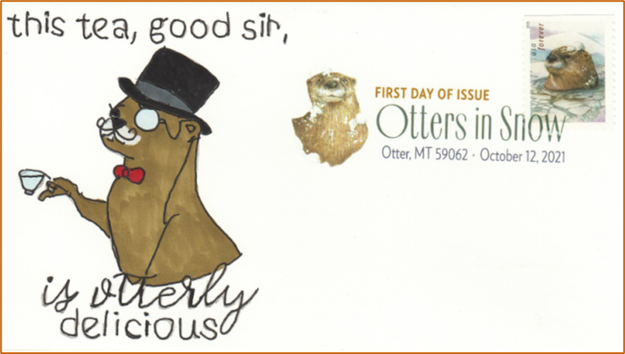
It was fun to work with these stamps.
2021 Otters in the Snow

Slide 25

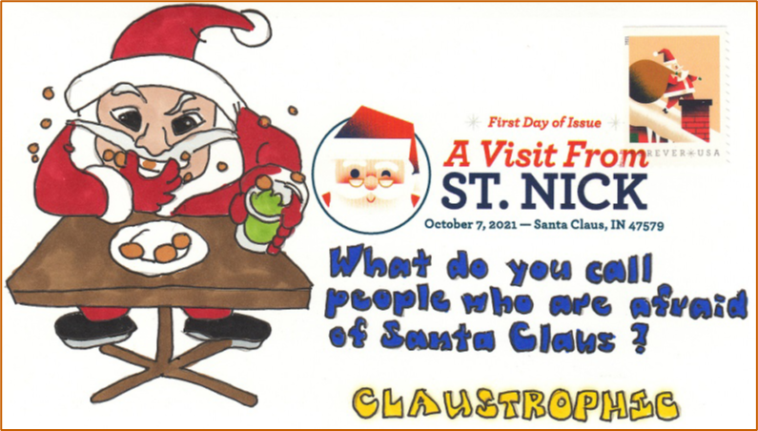
Christmas and Santa Clause—
So many possibilities for this 4 stamp set…
2021 A Visit from St. Nick

Slide 26
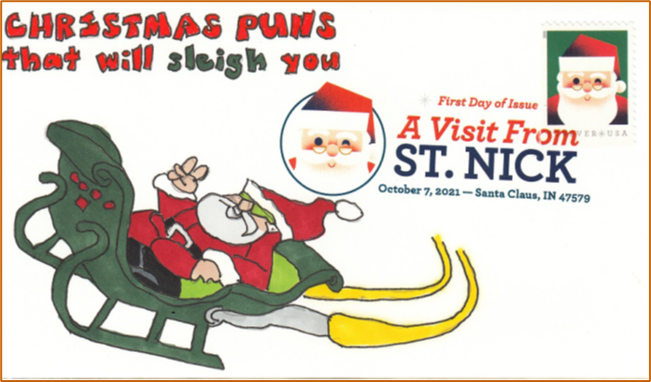
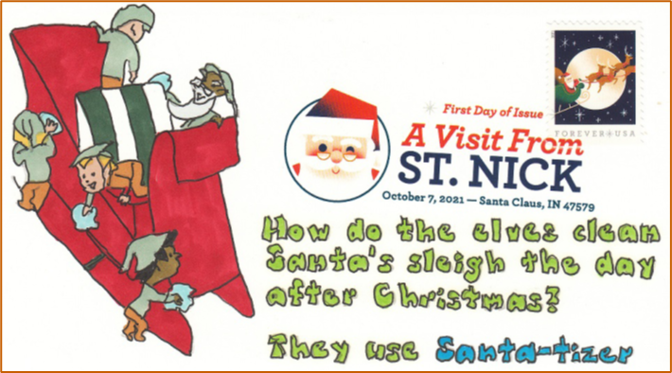
Note Santa stuck in the chimney and the reindeer laughing and shouting Ho Ho Ho.
2021 A Visit from St. Nick

Slide 27
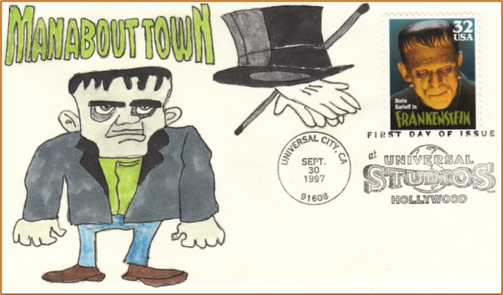
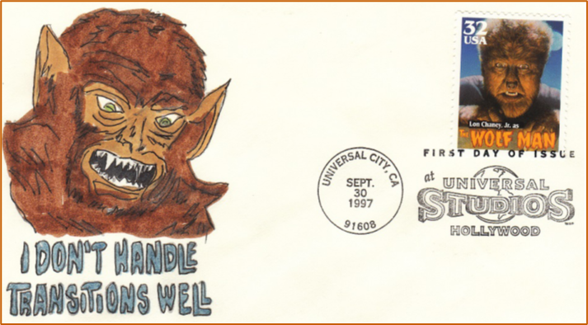
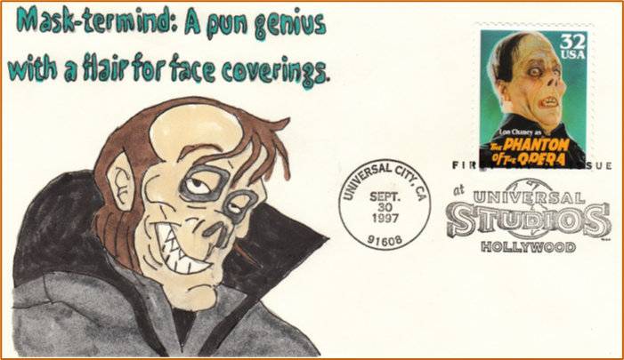
Who doesn’t like a monster movie? This 1997 set of 5 was released for Stamp Collecting Month—now a dead USPS ‘celebration.’
All five stamps also display secret images when used with the USPS Stamp Decoder referenced earlier- opera masks, bats, lightning bolts, Egyptian deities and howling wolves.
1997 Classic Movie Monsters

Slide 28



That’s a wrap – like a director says when a movie is finished. Did you get that one?
1997 Classic Movie Monsters

Slide 29
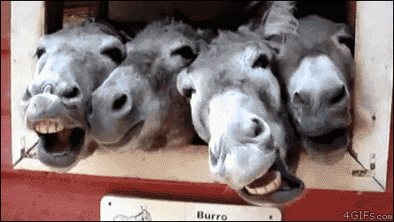
By now you should
be laughing your…
off!
Thanks for Watching!
Background template by poweredtemplate.com

