Slide 1
Precancel Stamps
Millions of Varieties
A presentation by Charles Adrion and Jim Sands for the Rochester Philatelic Association, April 2016

Slide 2
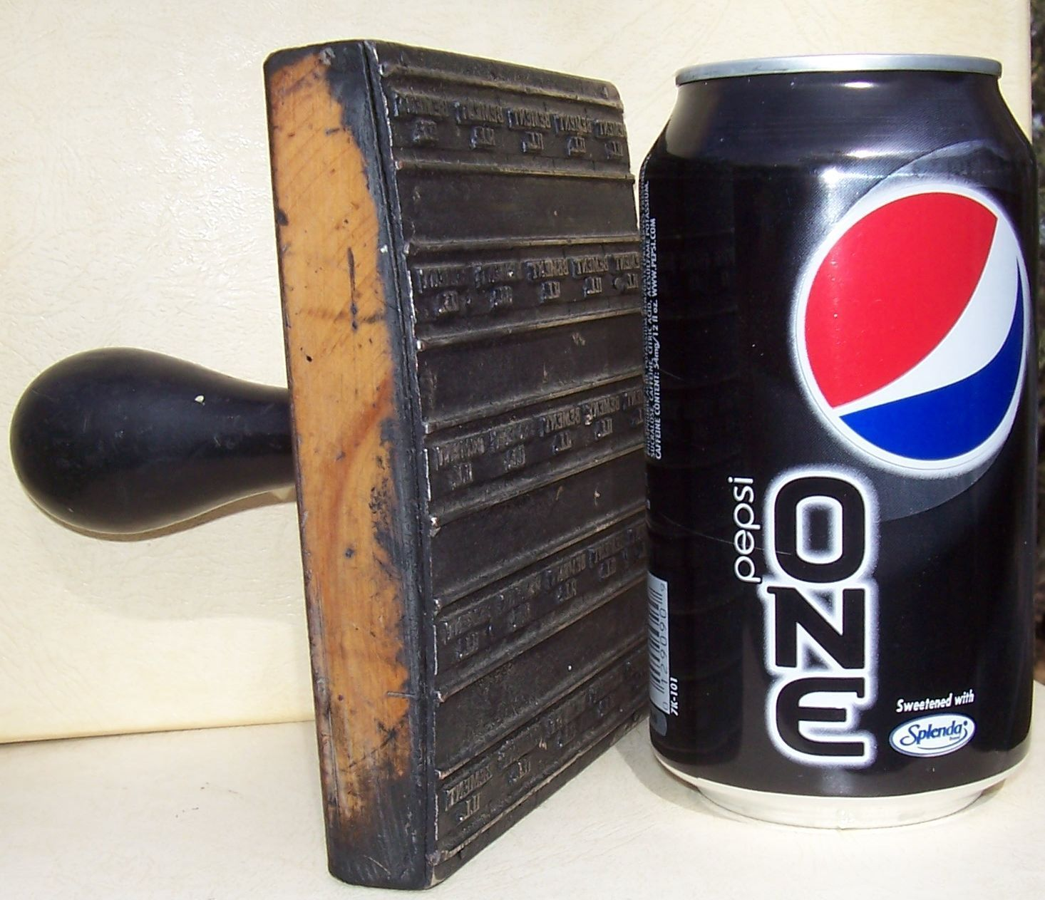

Slide 3
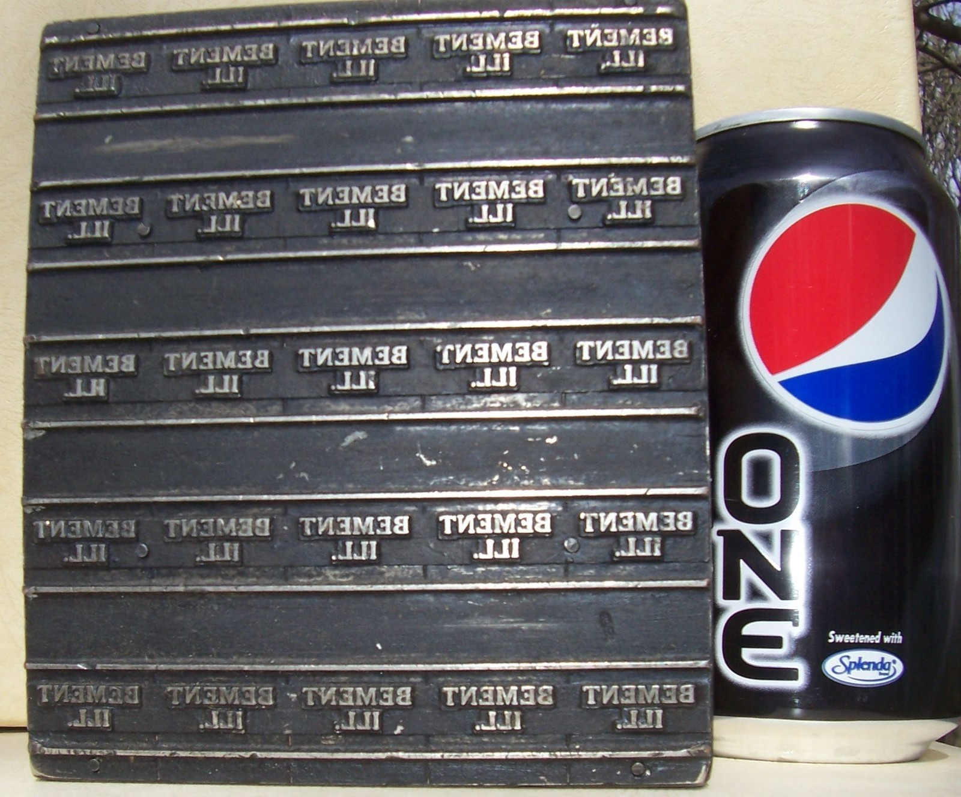

Slide 7
Bureau Precancels
Style Chart

Slide 8
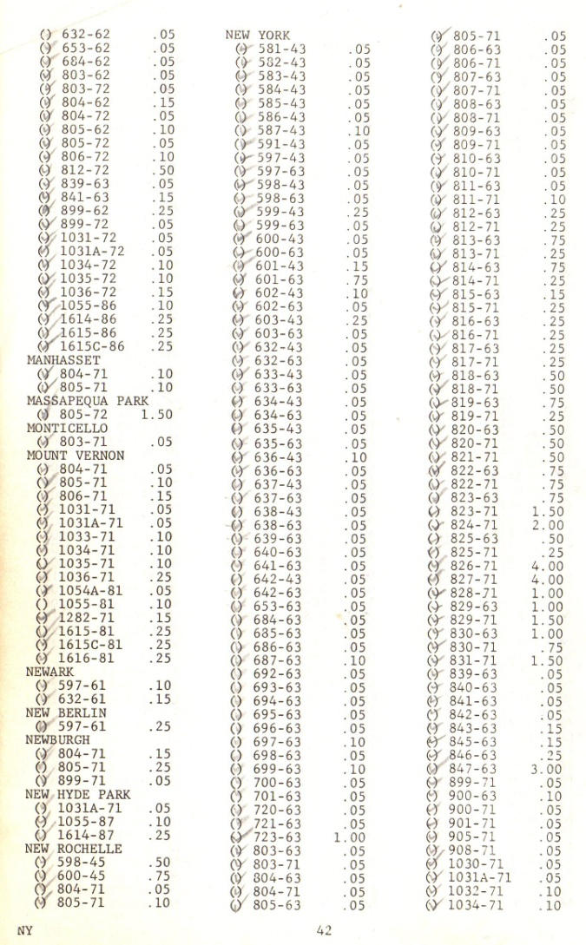
Sample Catalog Page

Slide 9
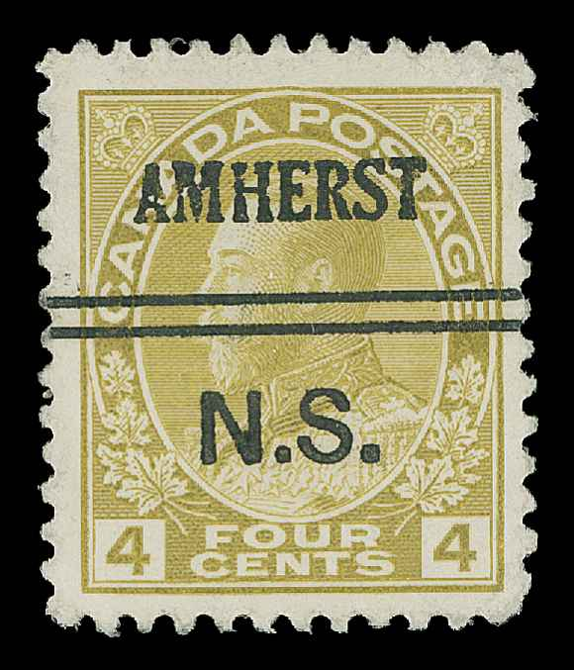
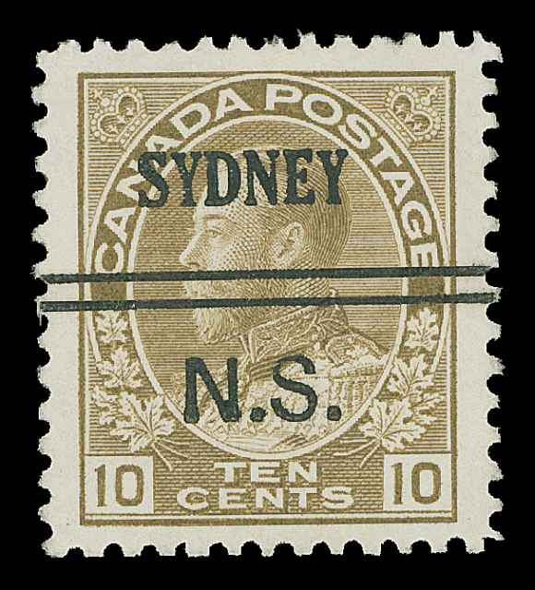
Canada Rarities

Slide 10
Canada

Slide 11
Philippine Rarities

Slide 12
Few Precancels Span Stamps

Slide 13
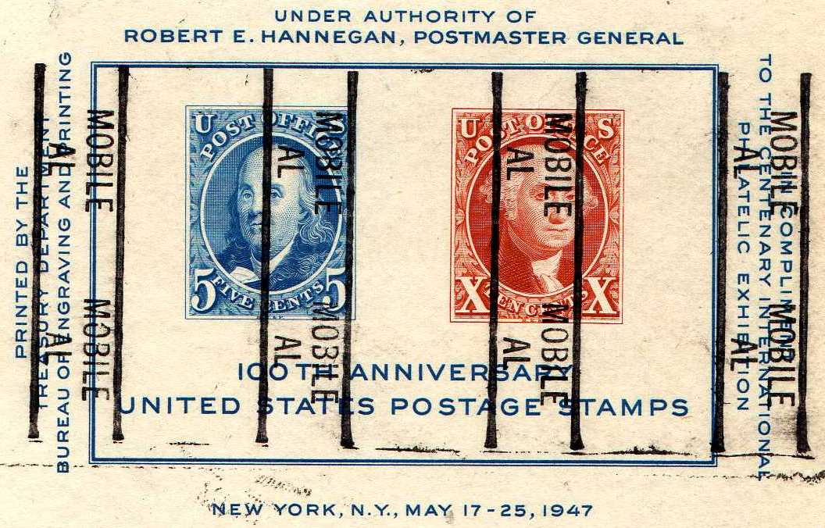
Made by and for collectors

Slide 14
High value souvenirs

Slide 15
More collector inspired

Slide 16
Classic Era Inspired

Slide 17
Errors and Careless Printing

Slide 18
Errors on Bureau Prints

Slide 19
Subtle Varieties

Slide 20
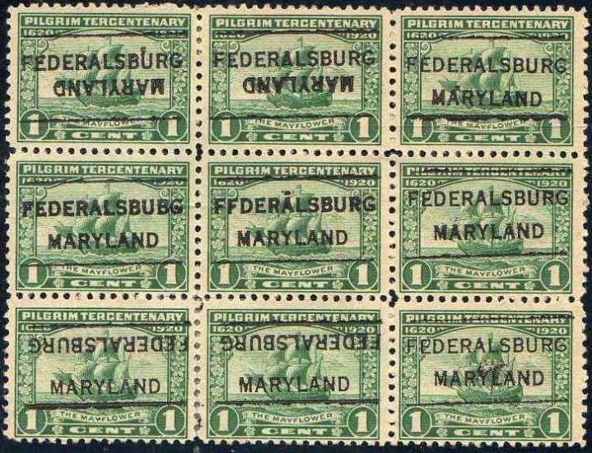
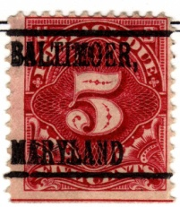
Subtle Errors

Slide 21
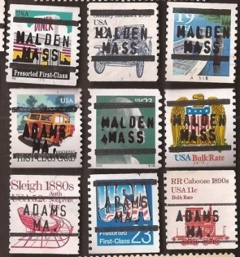
Fakes

Slide 22
Mysteries and Humor

Slide 23
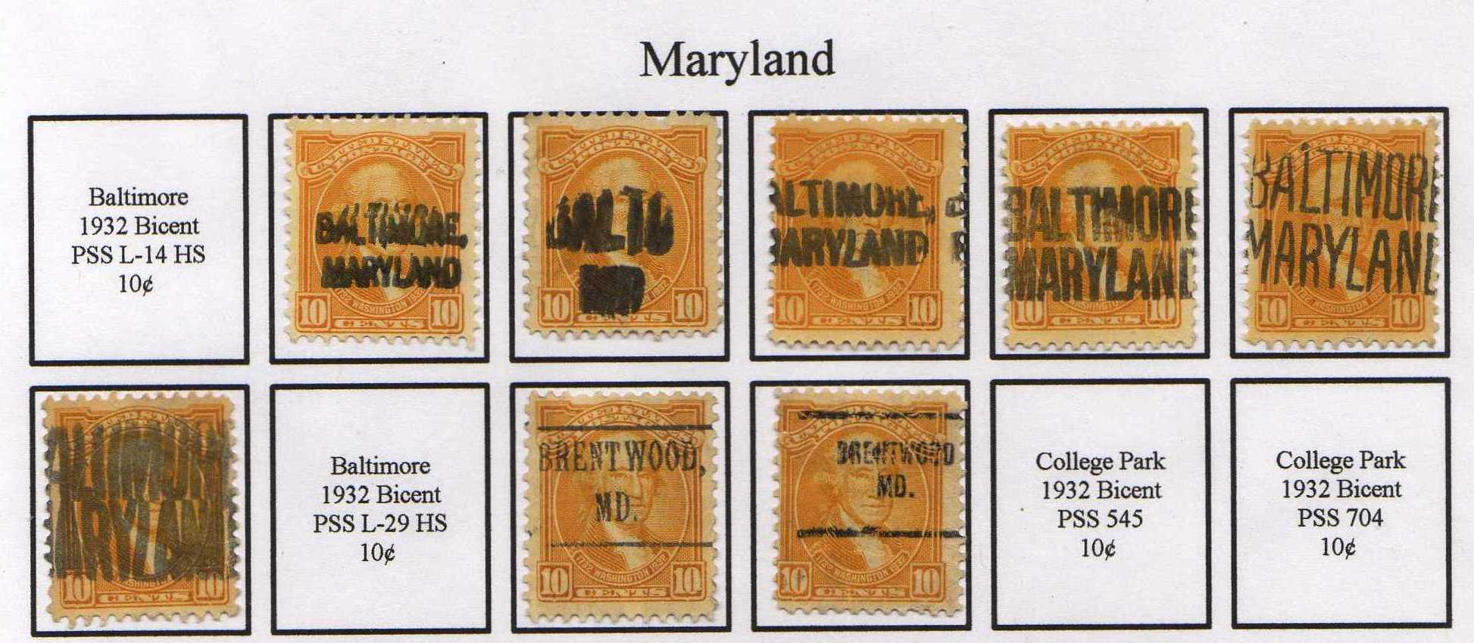
Collecting a Denomination

Slide 24
Collecting Bicentennials

Slide 25
Collecting Sets

Slide 26
Using Traditional Albums

Slide 27
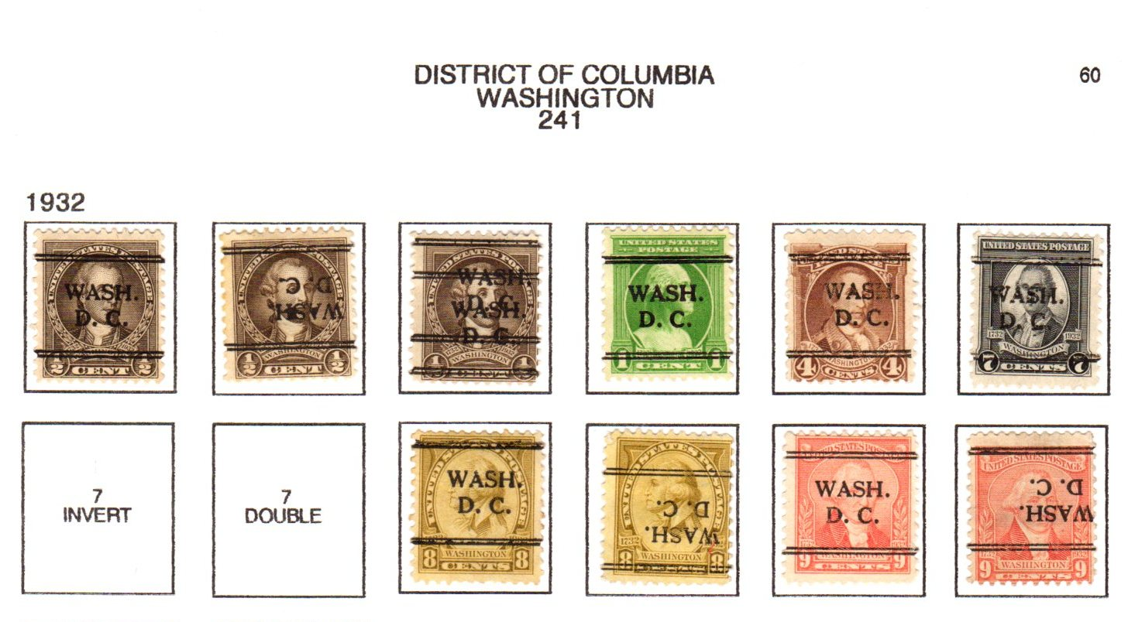
Collecting DLE’s

Slide 28
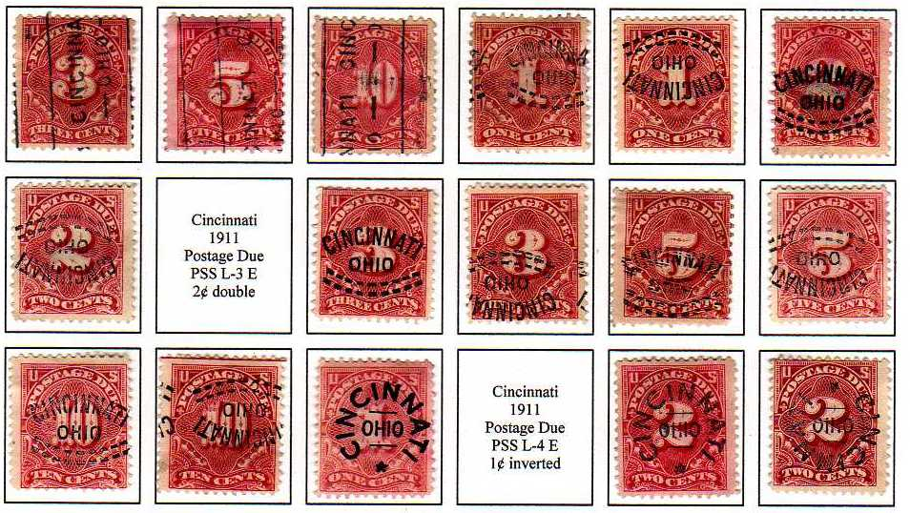
Classic Postage Dues

Slide 29
From the PSS Album Maker

Slide 30

Collecting a State

Slide 31
Organizing before Mounting

Slide 32
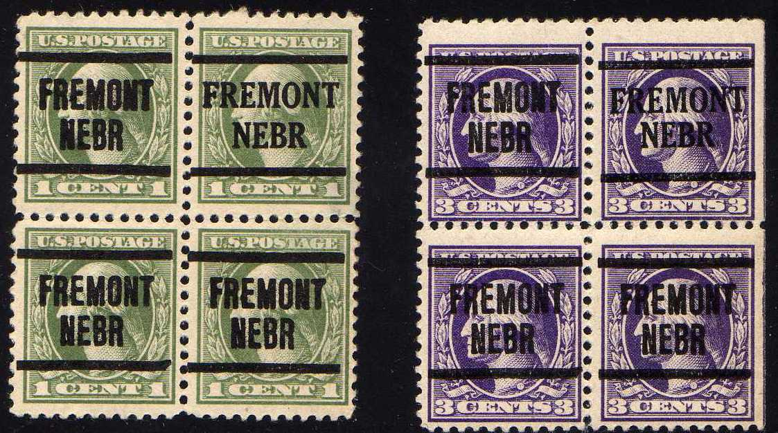
Dated , Repairs

Slide 33
Hometown Collecting

Slide 34
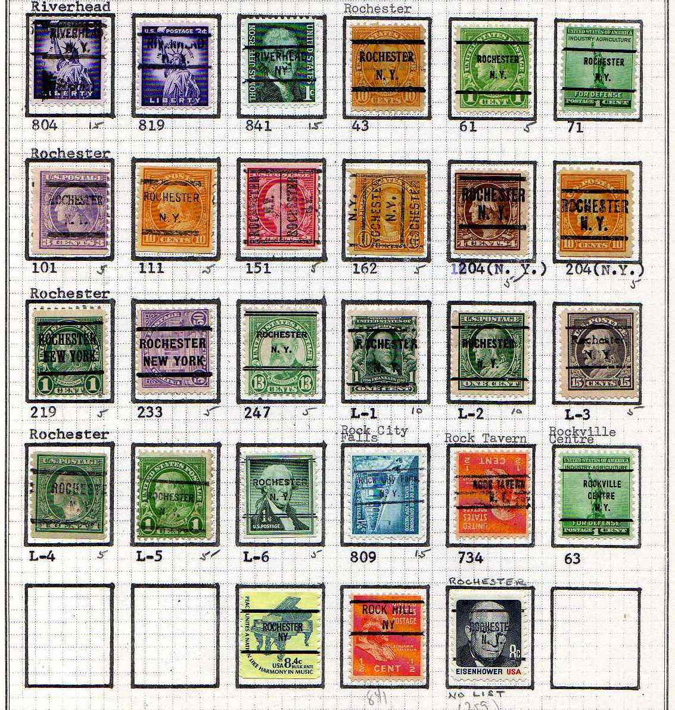
Precancels of Rochester

Slide 35
Stationery and Playing Cards

Slide 36
Genuine Coil Stamps

