Slide 1
Pre-adhesive mail
By Gabriel Foltz

Slide 2
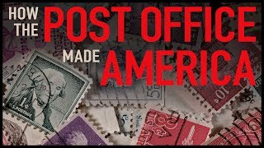

Slide 3
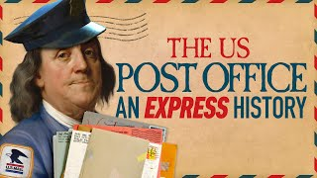

Slide 4
Pre-adhesive mail: Introduction
Most Americans did not exchange mail at this time
    Was seen as an event
Delivered along networks of personal acquaintance
In 1799: delivery to Canandaigua from New York City took twenty days
Majority of stampless mail sent “collect”
  Recipient paid the postage
Recipient and sender could also share the cost

Slide 5
Introduction Cont.
1790-1845: Incremental pricing system
    Seen as confusing
    Assessed on distance and number of sheets
Starting in 1845: Charged on the basis of weight
    5 cents per half ounce
    10 cents per half ounce for distance greater than 300 miles
Postal act of 1851: Eliminated distance as determinant of cost

Slide 6
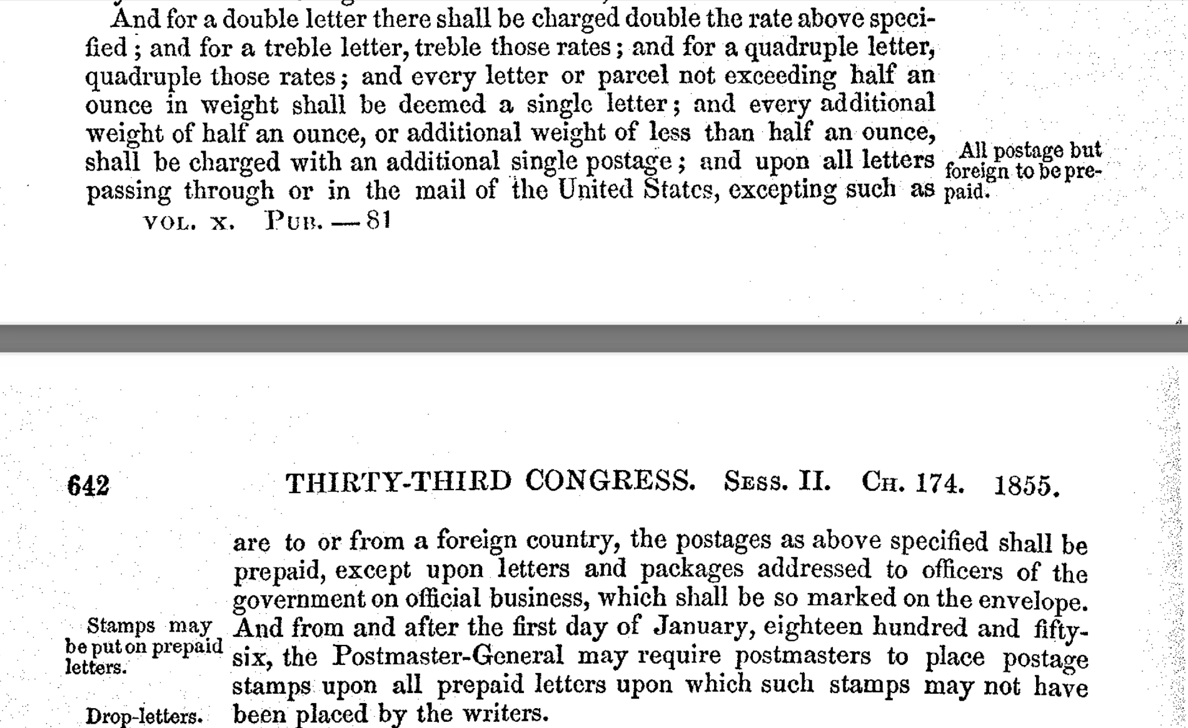

Slide 7
Introduction Cont.
Act of March 3, 1855
    Made paying Pre-postage mandatory
    Led to a significant increase in stamp usage
      Stamp use doubled over next two years
1856: Mailers required to prepay postage only using postage stamps

Slide 8
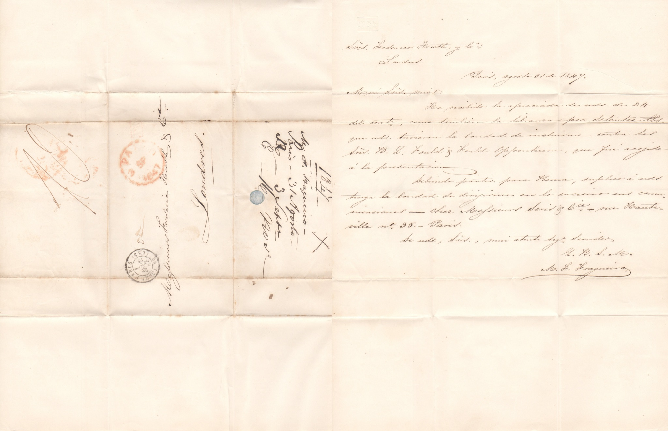
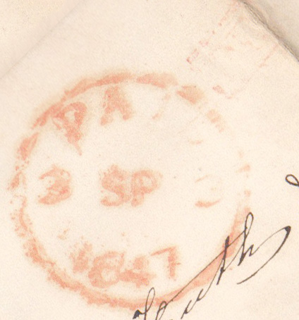
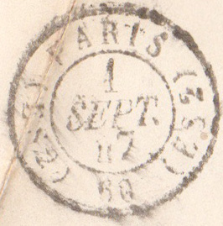
Paris to London: August 31 1847
The next three detail information about Frederick Huth & Company which was one of the leading merchant banks in Britain in the 19th century. Red British paid mark.

Slide 9
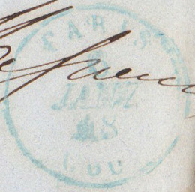
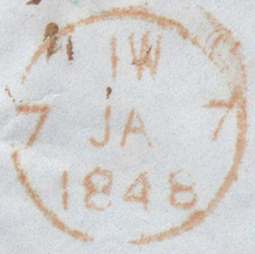
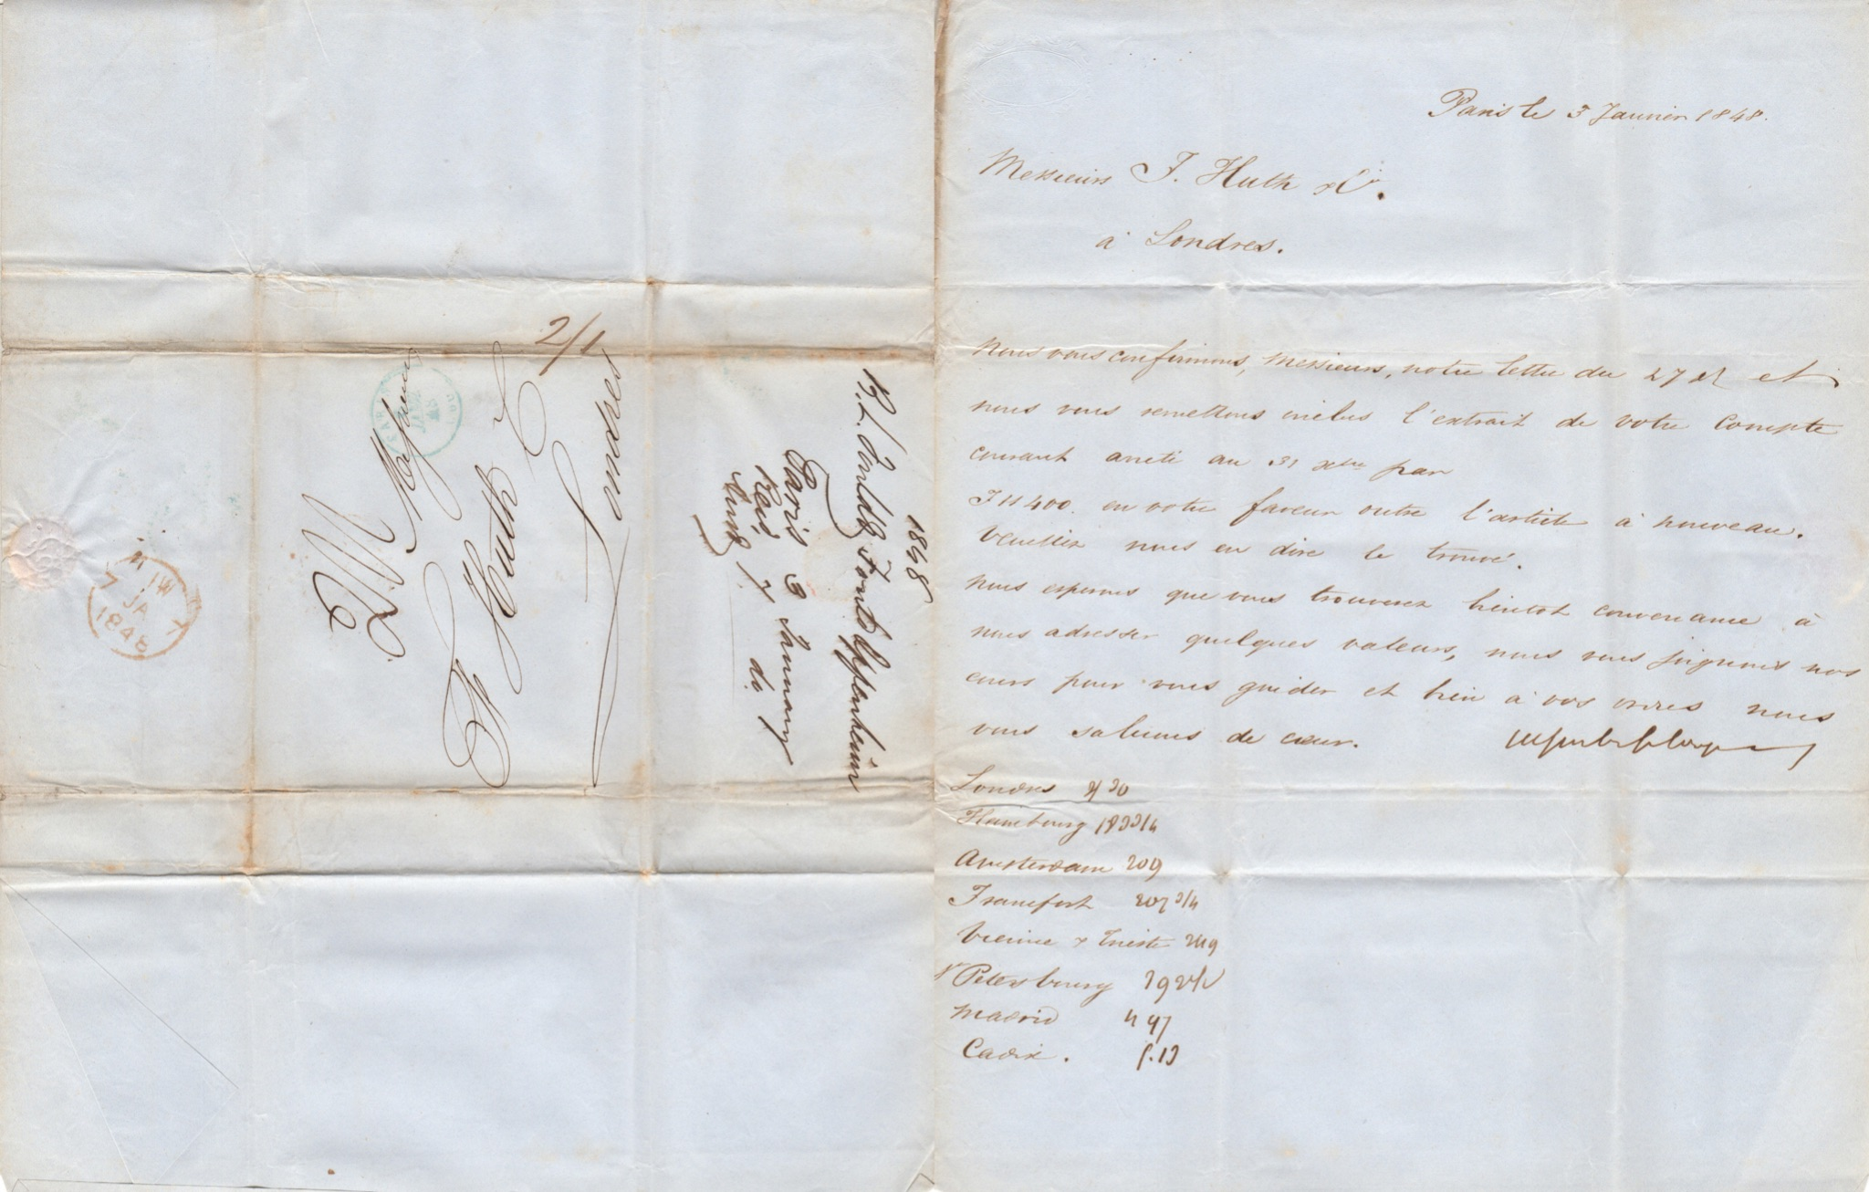
Paris to London: January 3, 1848
The French Revolution in 1848 (February Revolution) where King Louis Philippe abdicated the throne was caused by economic factors like currency outflows, bank runs, and credit market failure. Green Paris postmark and red London receiving stamp.

Slide 10
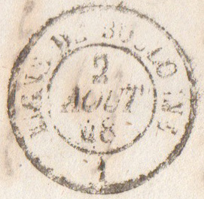
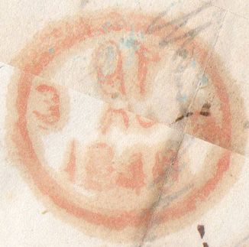
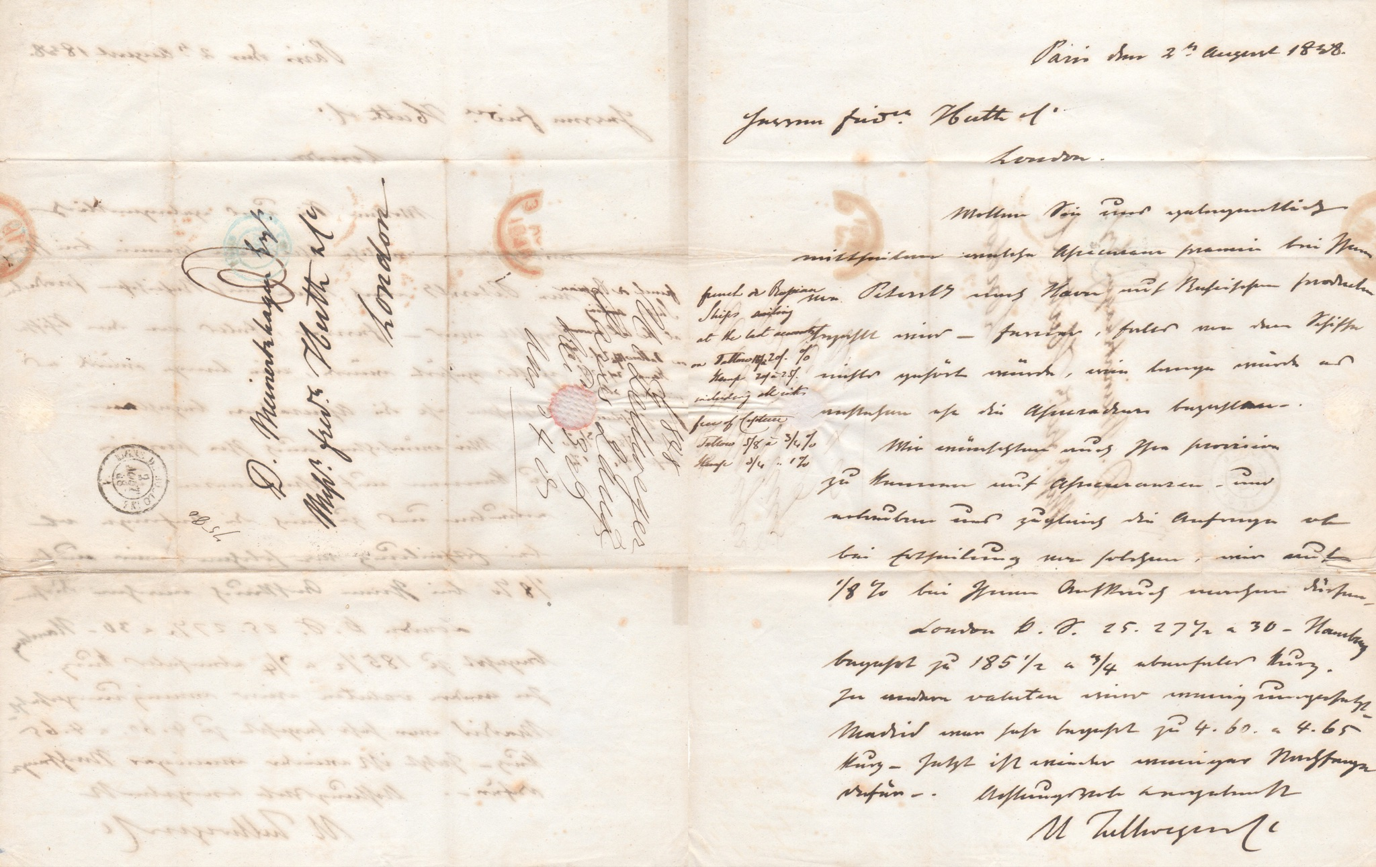
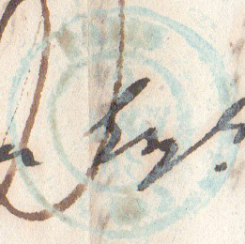
Paris to London August 2, 1848
The recipient was Daniel Meinertzhagen who managed Frederick Huth & Co. His son is the controversial Colonel Richard Meinertzhagen who played a role in the Haversack Ruse in WWI. Green Paris postmark and black backstamp August 2. Red London receiving stamp.

Slide 11
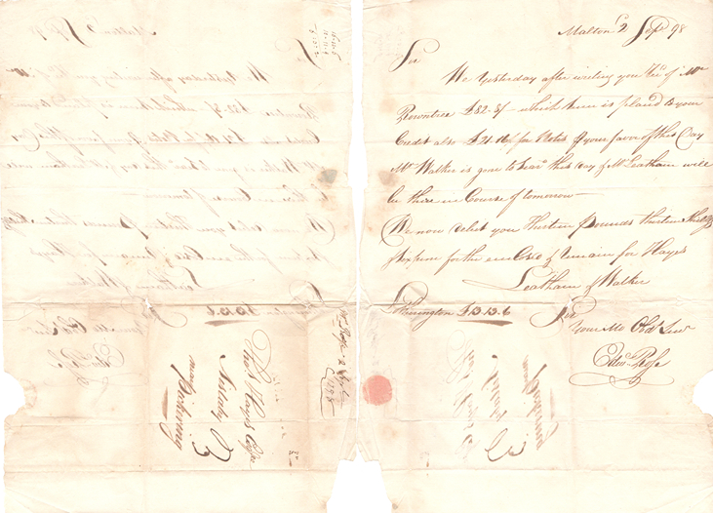
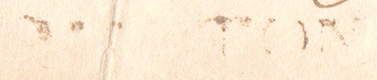
Malton to Aislaby September 2, 1798
The Hayes cafe where this cover is addressed to, is run by the Hayes family, who are the subject of a book and other literature. Below is a Malton straightline mark. Straightline marks are hand stamped and indicate origin town.

Slide 12
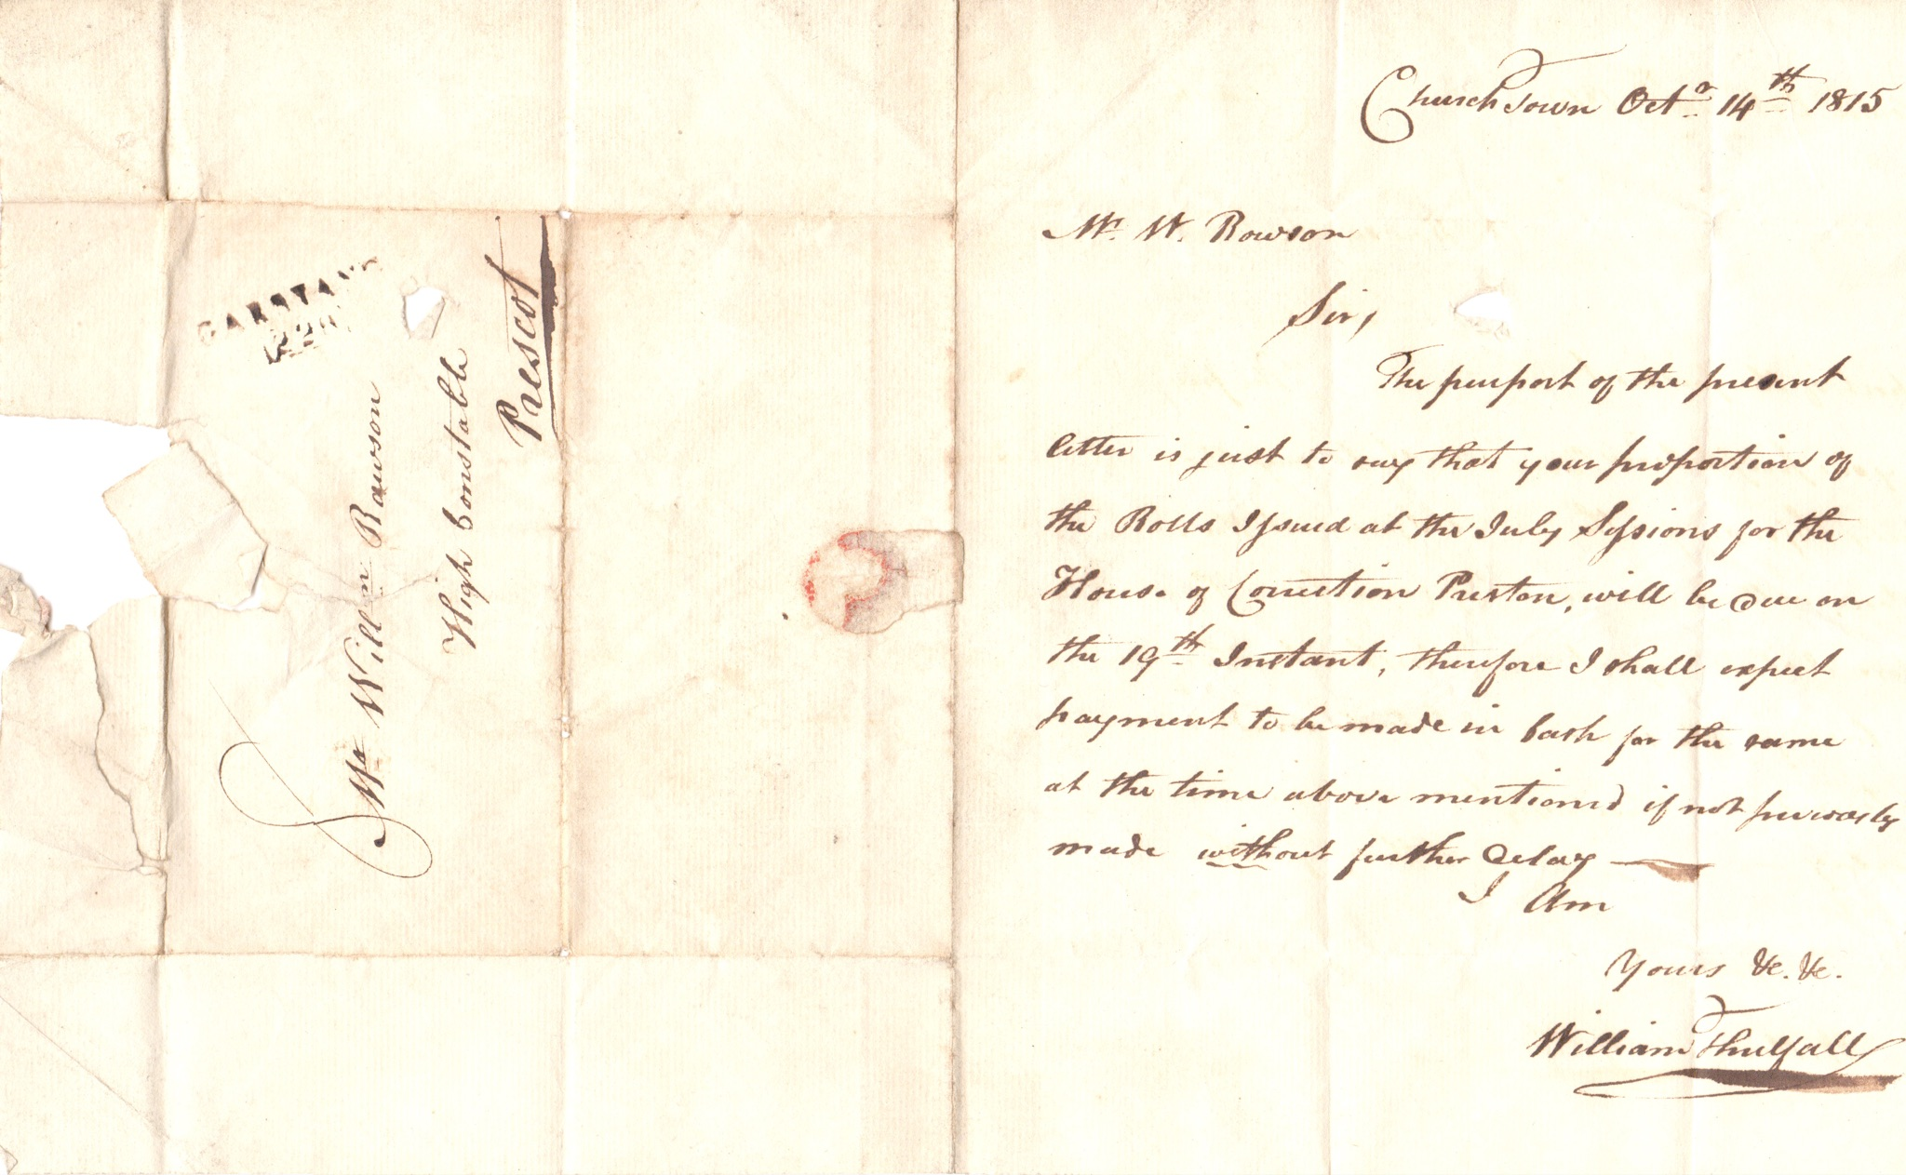
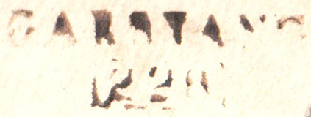
Garstang to Prescot October, 14 1815
Garstang 228 mileage mark from London. Provincial postal marks issued with the mileage from London so the receiving clerk was able to check the charge.

Slide 13
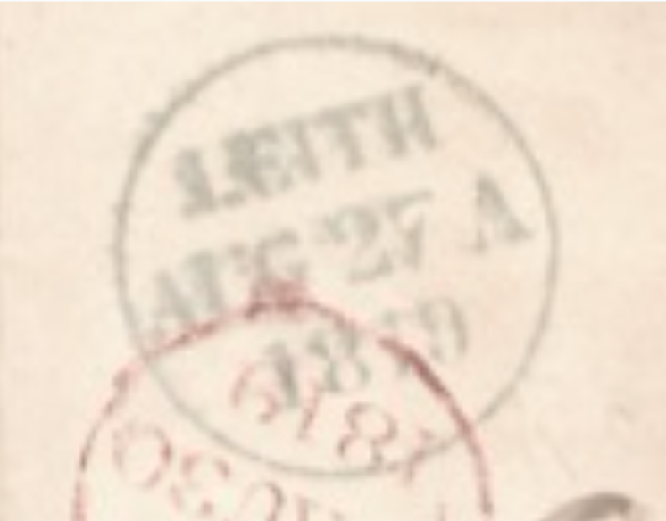
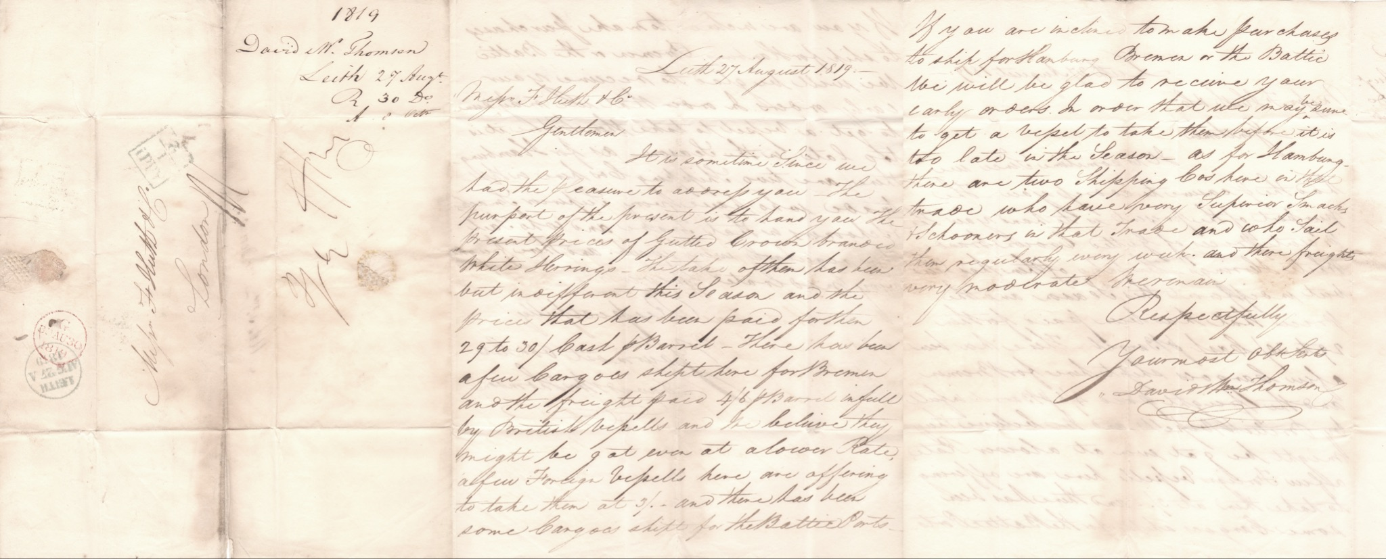
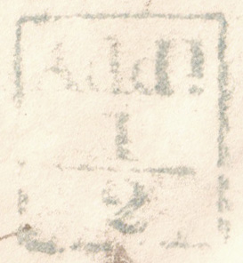
Leith Scotland to London England August 27, 1819
Leith Scotland became a separate burgh of Edinburgh in 1833 but Leith was in possession of a regular date-stamp prior to this. The marks were impressed with a distinct blueish ink.
Add! Halfpenny surcharge to mail going over toll roads in Scotland.

Slide 14
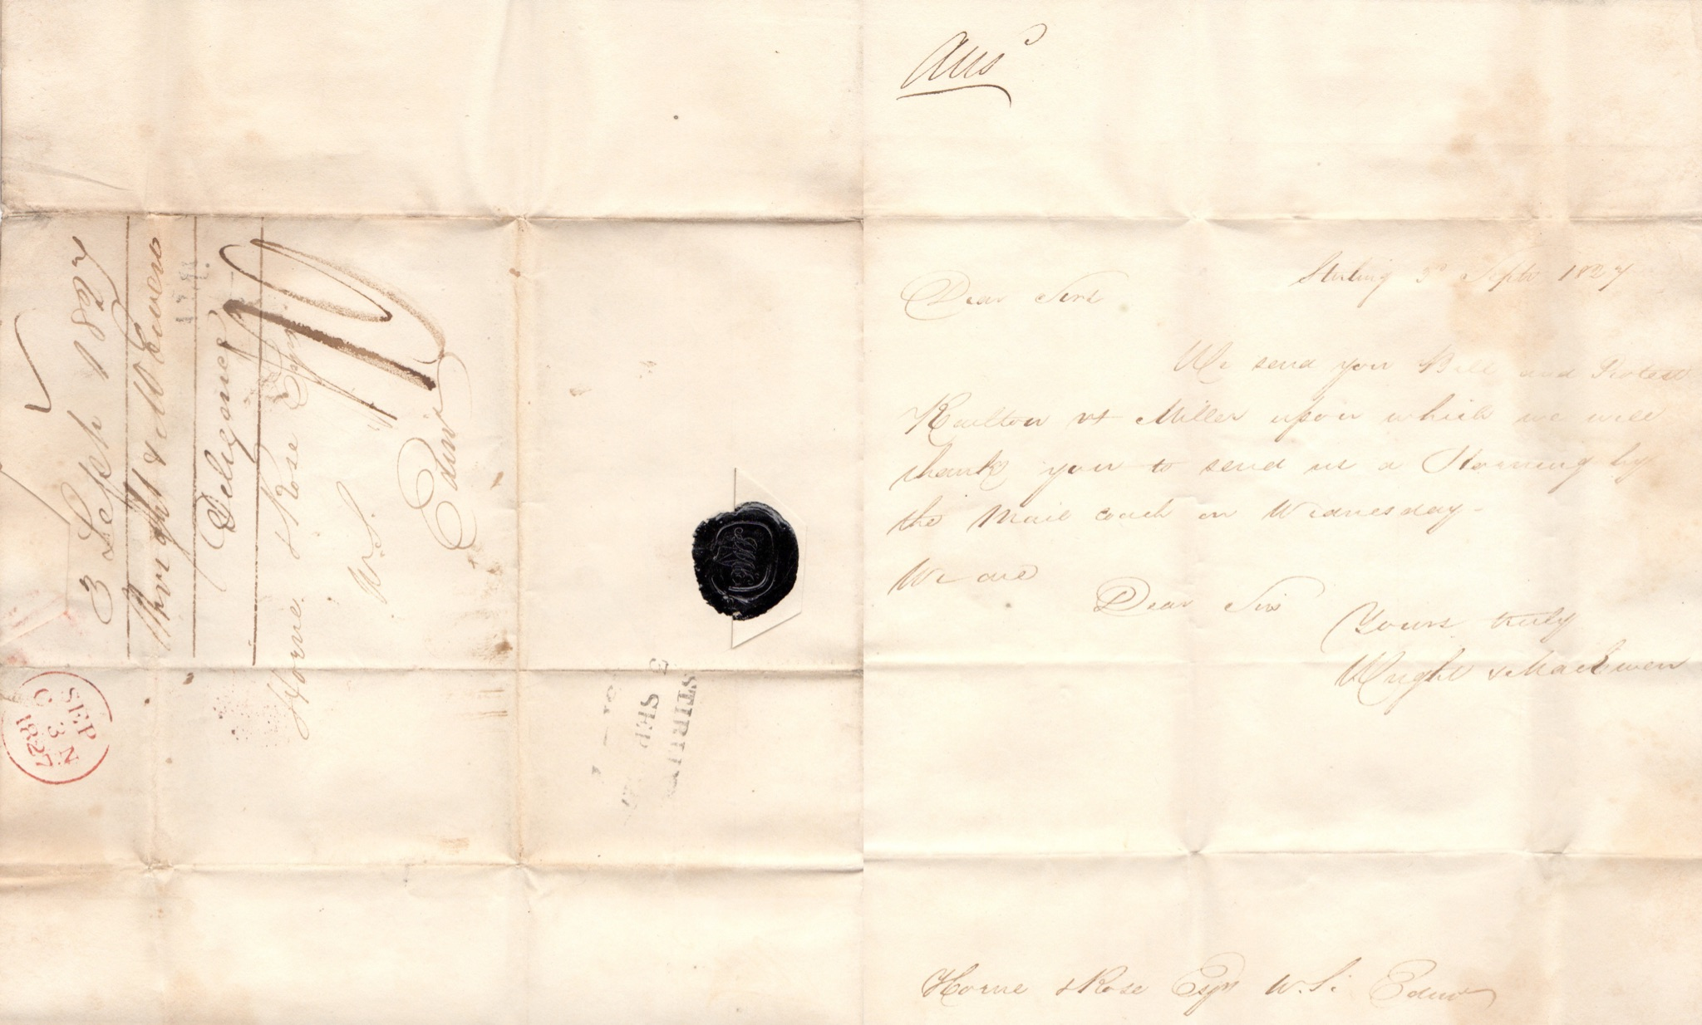
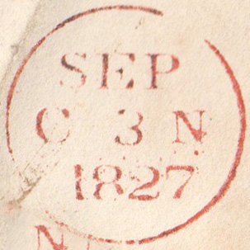
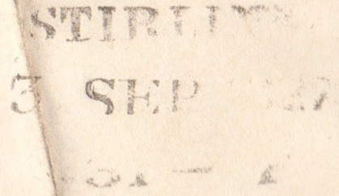
Stirling Scotland to Edinburgh September 3, 1827
Stirling 3 Sep 1827 postmark and red receiving
mark.

Slide 15
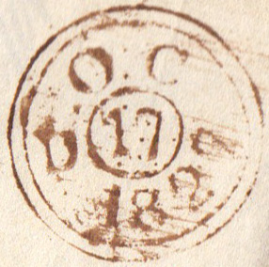
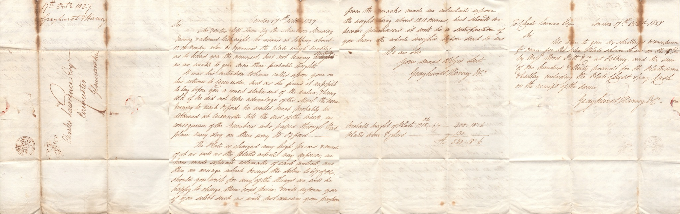
London to Cirencester October 7, 1827
Grayhurst & Harvey is a watchmaker based in London. Their watches have been displayed in the Metropolitan Museum of Art. The company is still in business to this day now under the name of Harvey and Gore Jewellers. The recipient Charles Lawrence was one of the founders of the Royal Agricultural College at Cirencester and brother to Sir William Lawrence, baronet, Serjeant surgeon to
the queen
Victoria.
London
evening
double ring
backstamp.

Slide 16
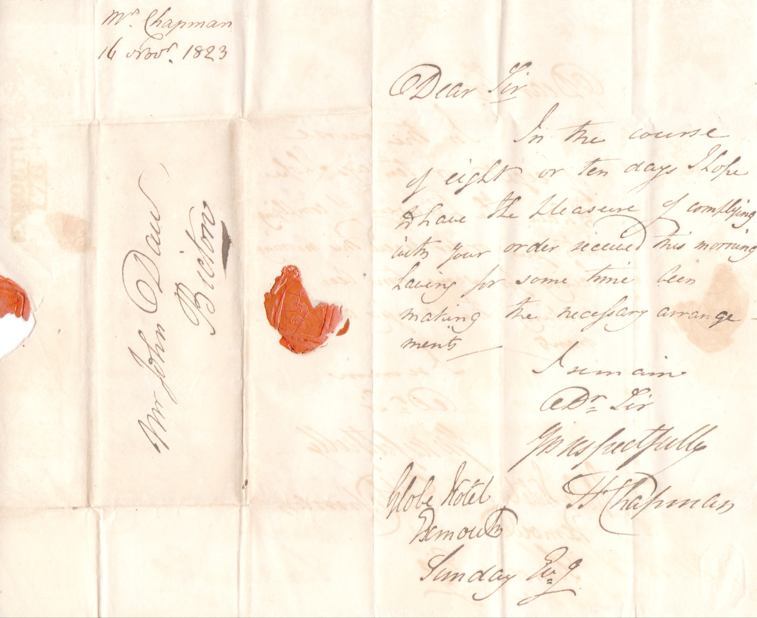
Exmouth to Bicton November 16, 1823
The next 13 letters revolve around three people. Baron John Rolle who was a Member of Parliament and a member of the House of Lords. Rolle was a advocate for William Pitt the Younger and had significant landholdings, but was most known for falling during the coronation of Queen Victoria. The two people in the letter are John Rolle’s second wife Louisa Trefusis and his solicitor John Daw.

Slide 17
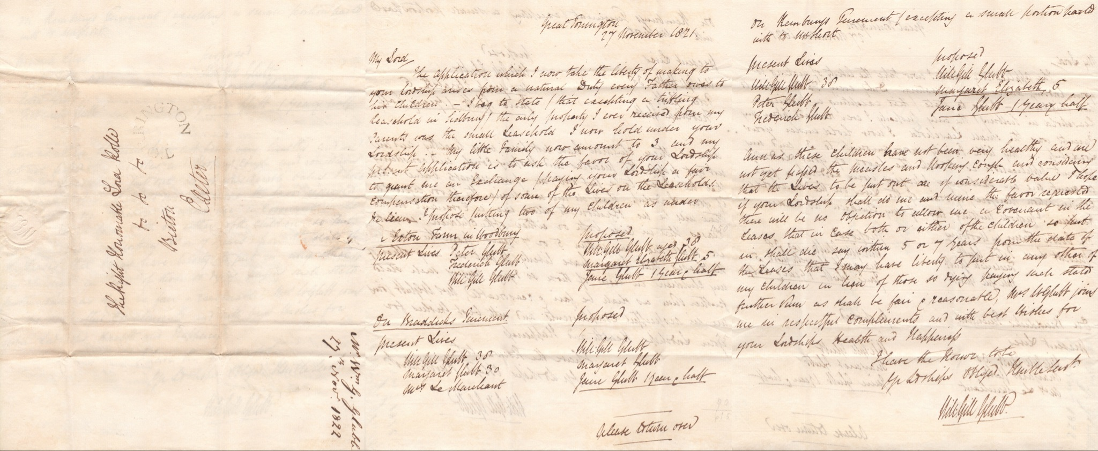
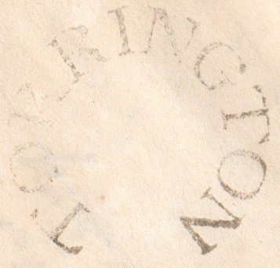
Torrington to Exeter November 27, 1821
Undated Torrington Postmark.

Slide 18
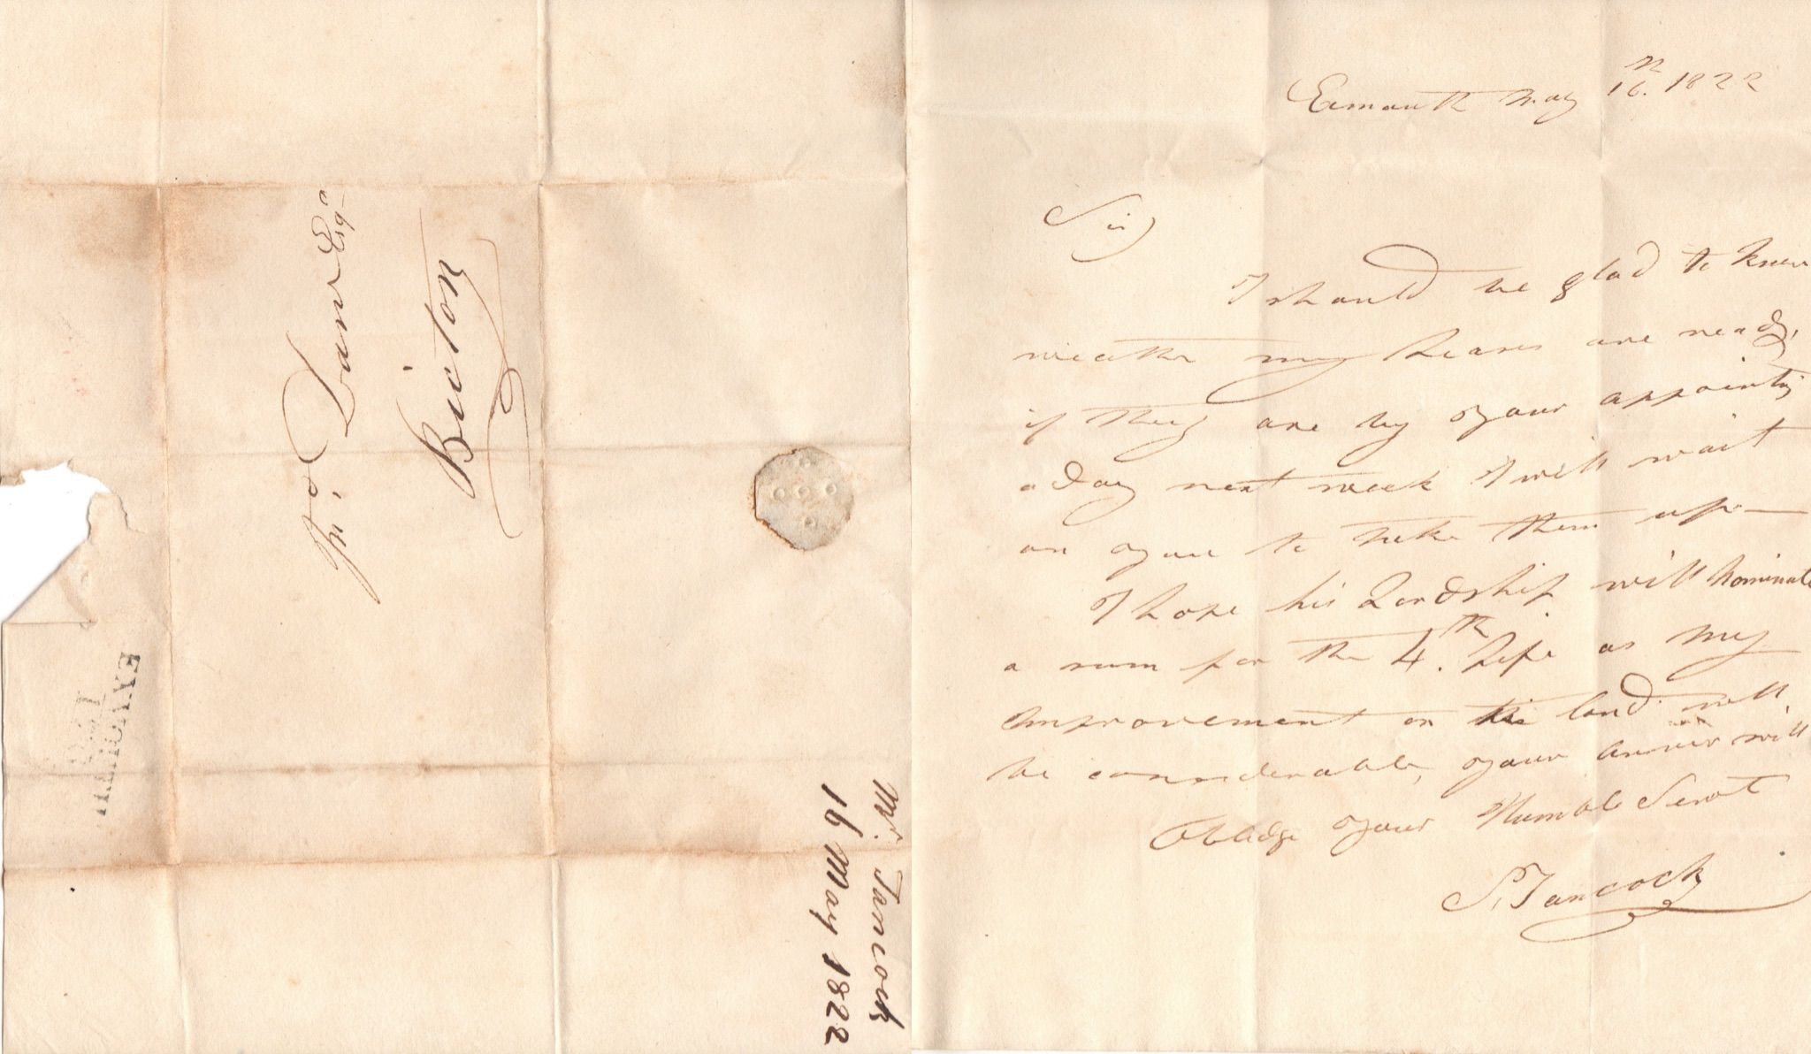
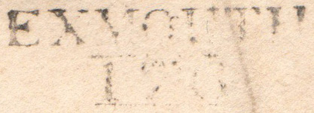
Exmouth to Bicton May 16, 1822
Exmouth 176 mileage mark from London.

Slide 19
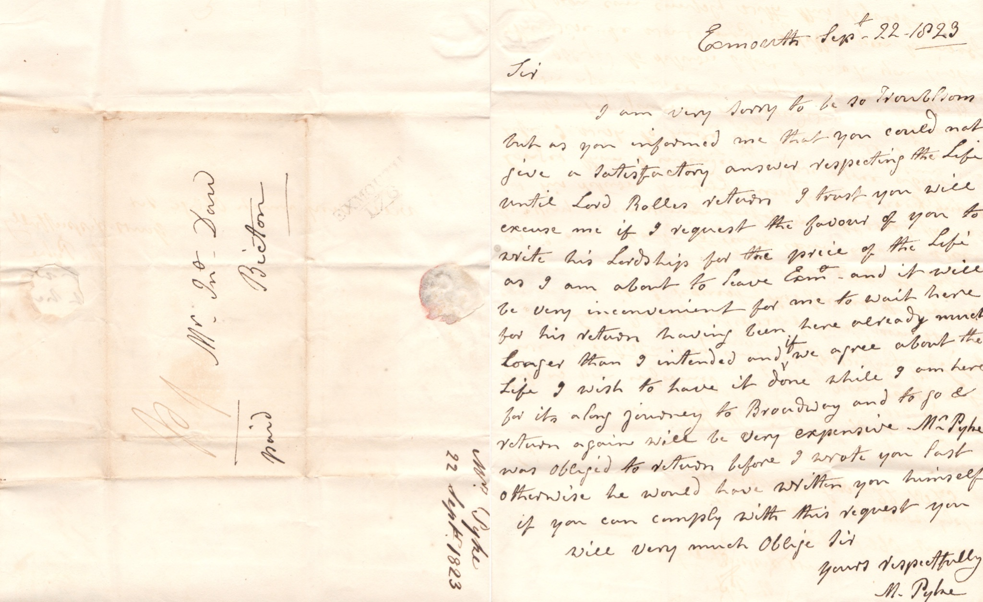
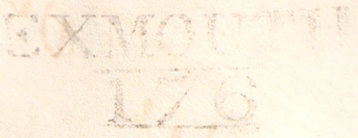
Exmouth to Bicton September 22, 1823
Another Exmouth 176 mileage mark from London.

Slide 20
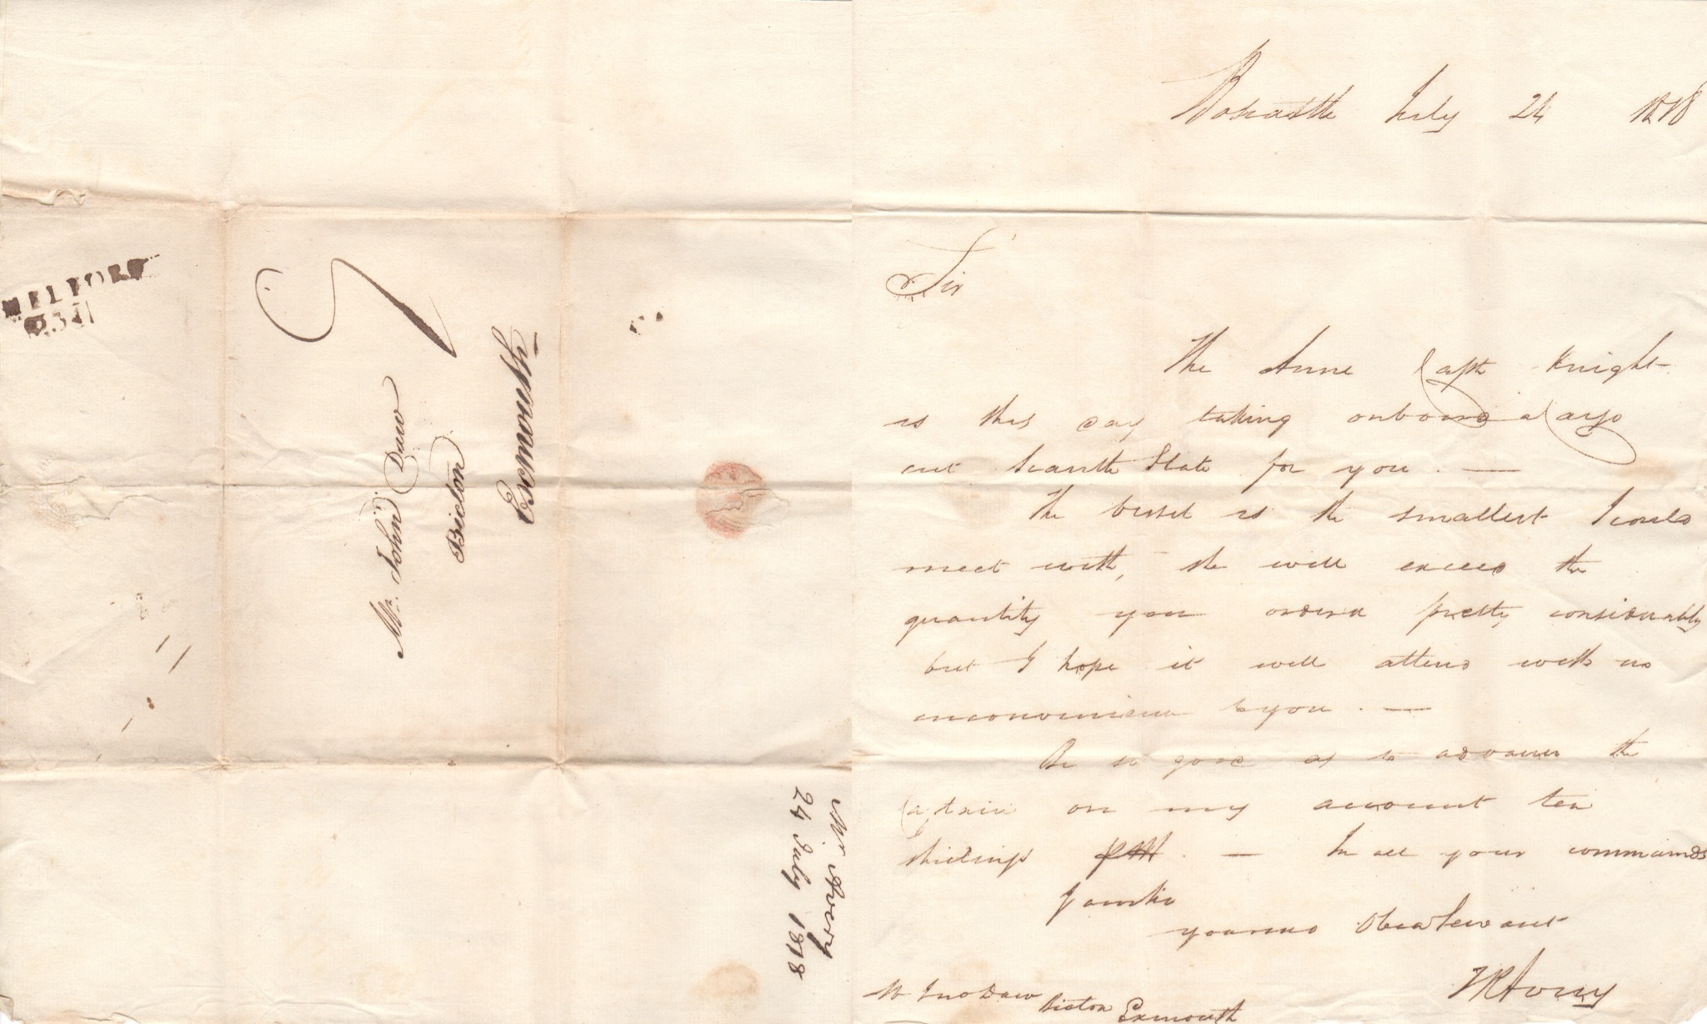
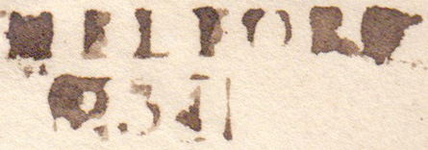
Long Melford to Bicton July 24, 1828
Melford 23 mileage mark (from London).

Slide 21
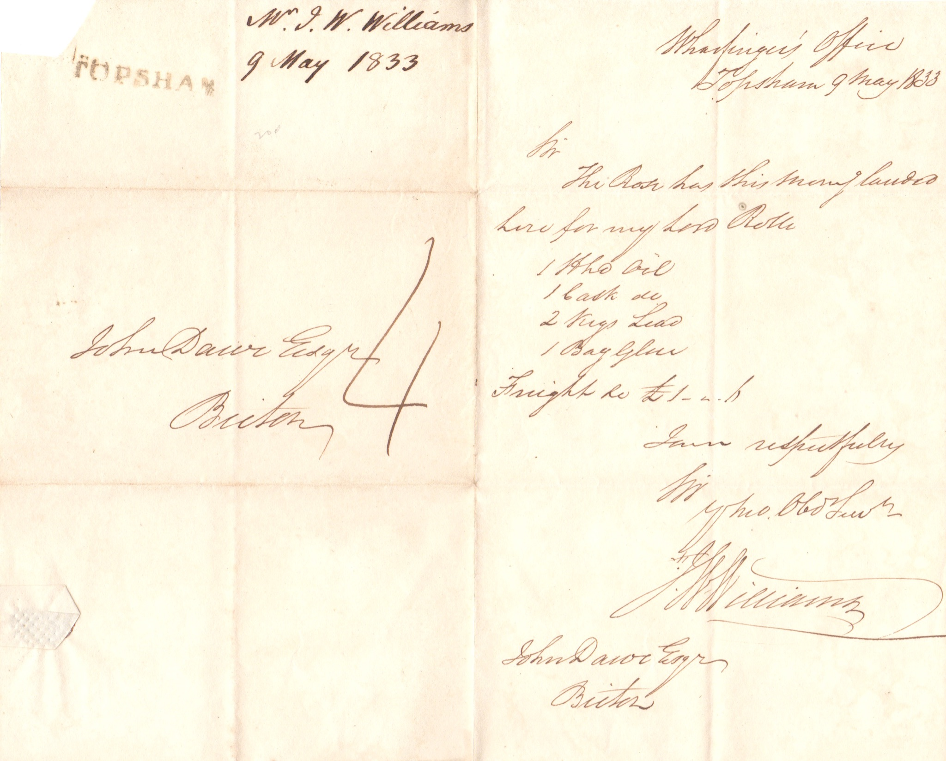

Topsham to Bicton May 9, 1833
Topsham straightline mark.

Slide 22
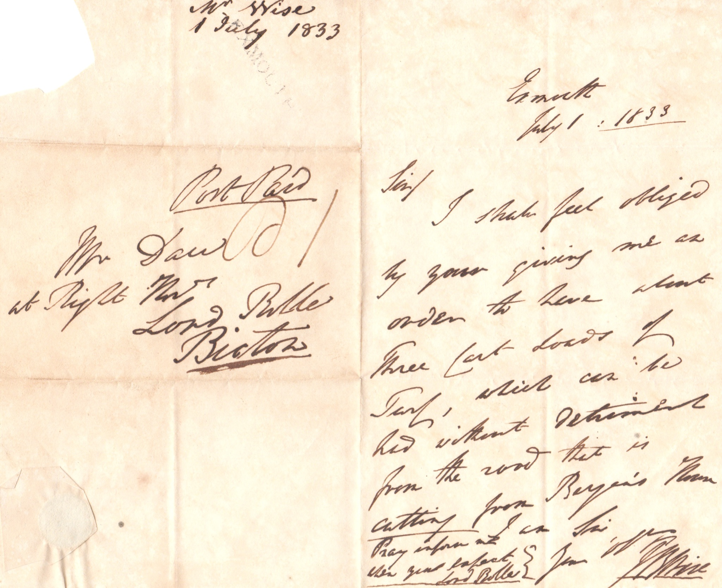

Exmouth to Bicton July 1, 1833
Exmouth straightline mark.

Slide 23
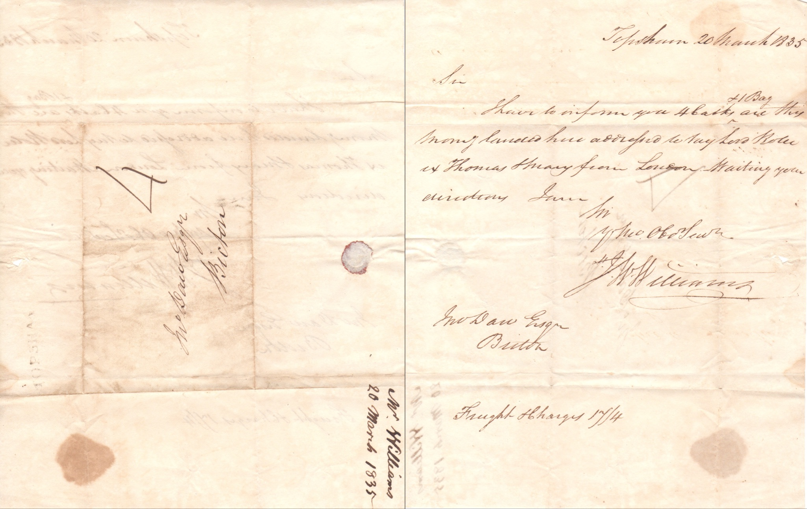

Topsham to Bicton March 20, 1835
Another Topsham straightline mark.

Slide 24

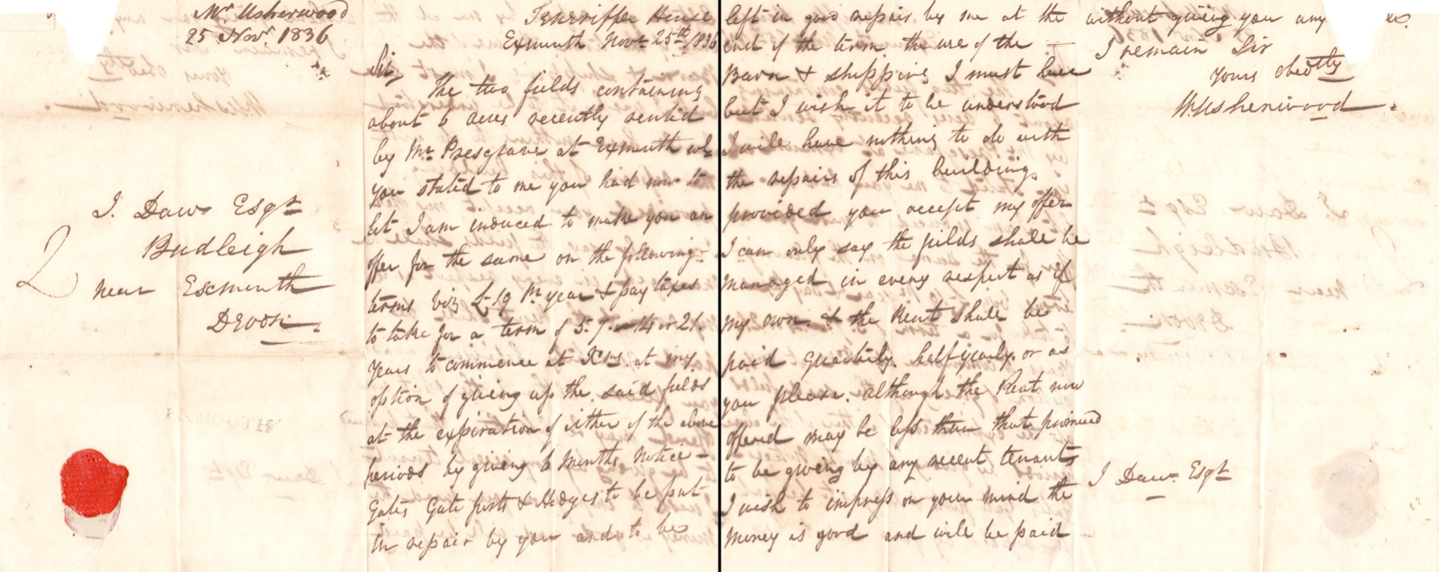
Exmouth to Budleigh November 25, 1836
Another Exmouth straightline mark.

Slide 25
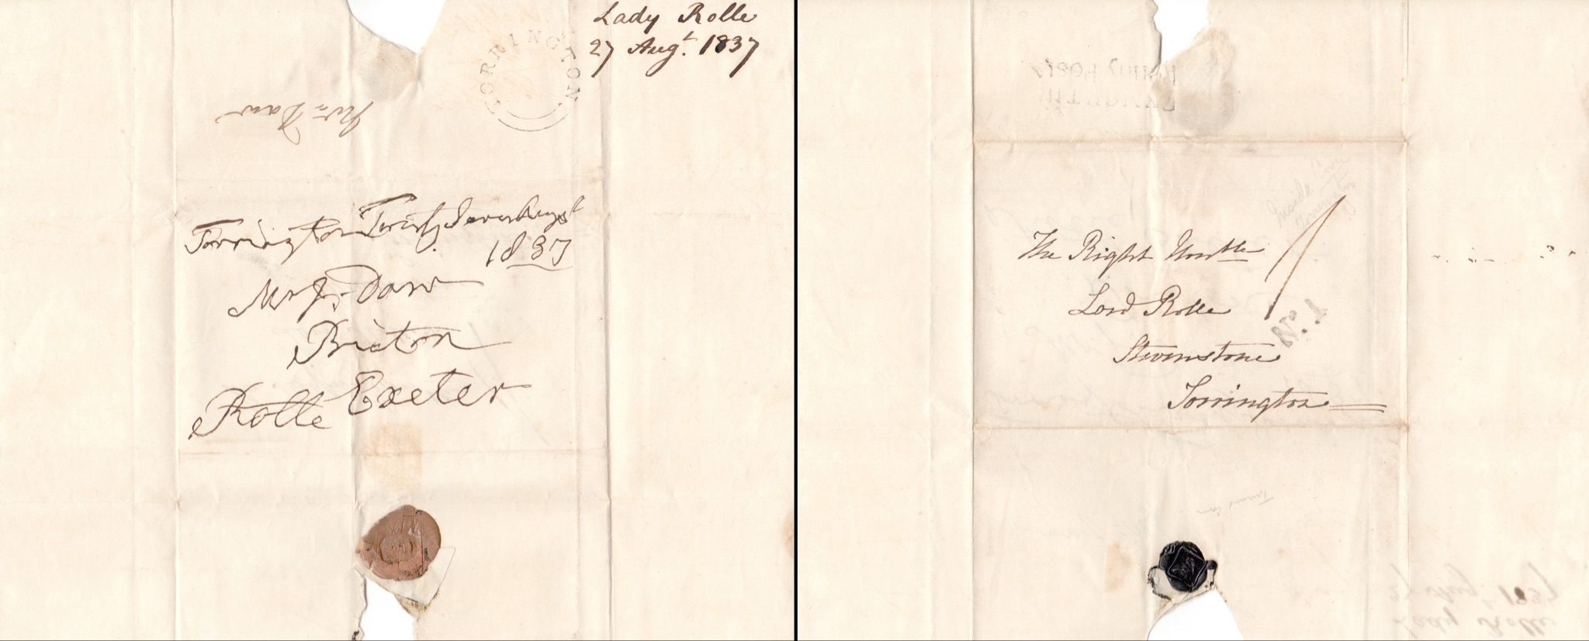
August 27, 1837 Turned Cover: cover reused for second letter after being turned inside out.

Slide 26
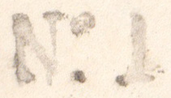
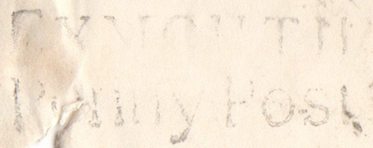
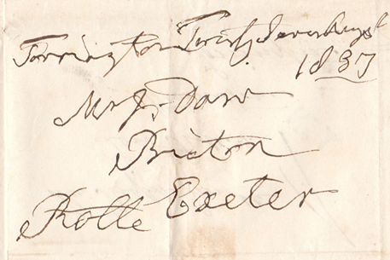
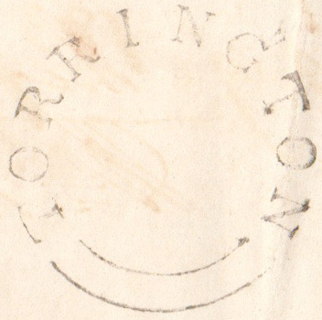
Turned Cover Cont.
The early mail service revolved around delivering and receiving mail to and from the Post town. If you lived outside the post town, no door-to-door service was available. The fifth clause of the postal act of 1801 allowed private arrangements to be made between the postmaster
of local British towns and the
inhabitants. The charges agreed by
the inhabitants tended to be one
penny (Penny Posts namesake).
Torrington undated postmark.

Slide 27
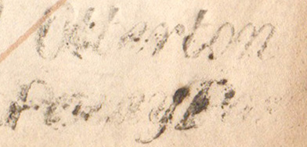
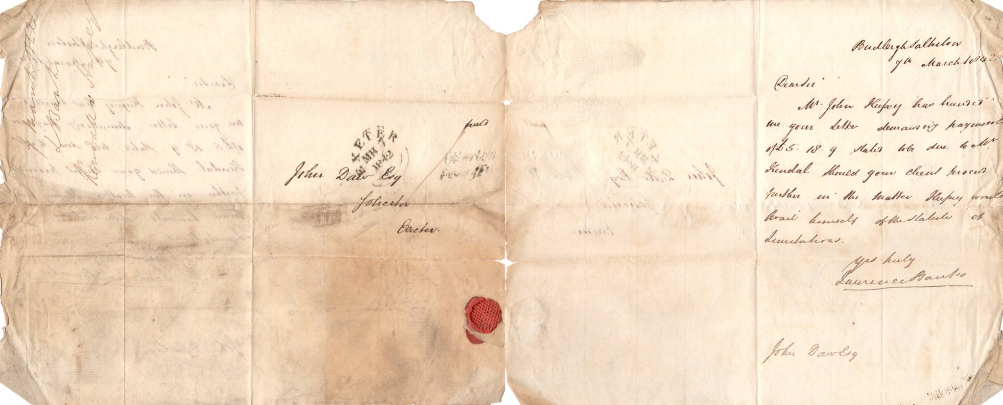
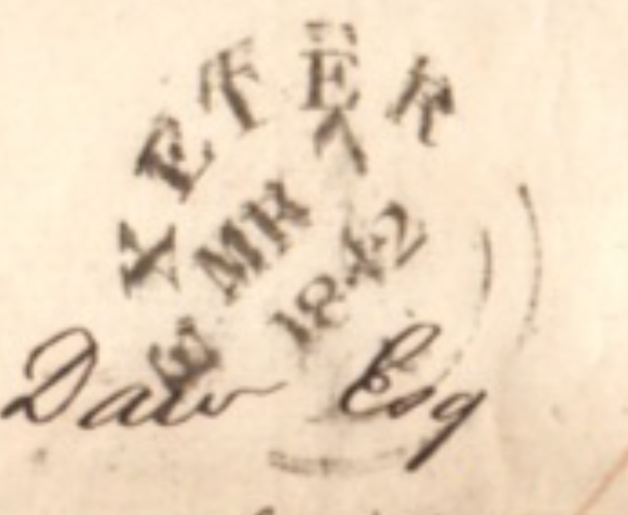
Budleigh to Exeter March, 7 1842
These stamps were employed starting in 1822 for provincial post offices. It is claimed by the inventor that a bad impression was impossible and they were made by a “mathematical engine”.
Otterton Penny Post (Budleigh Salterton drop off).

Slide 28
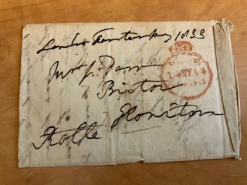
Free Frank: allows specific government officials to send mail for free without paying postage.
In Britain, it was hand stamped to parliamentary mail and taxpayers took on the cost of this mail. The system was eliminated in 1840 by Rowland Hill because of various abuses and such abuses included companies appointing MPs to boards in order to take advantage of the free franking privilege. In the United States, the President did not have a free frank privilege; however, the Vice President and members of Congress were able to use it.

Slide 29
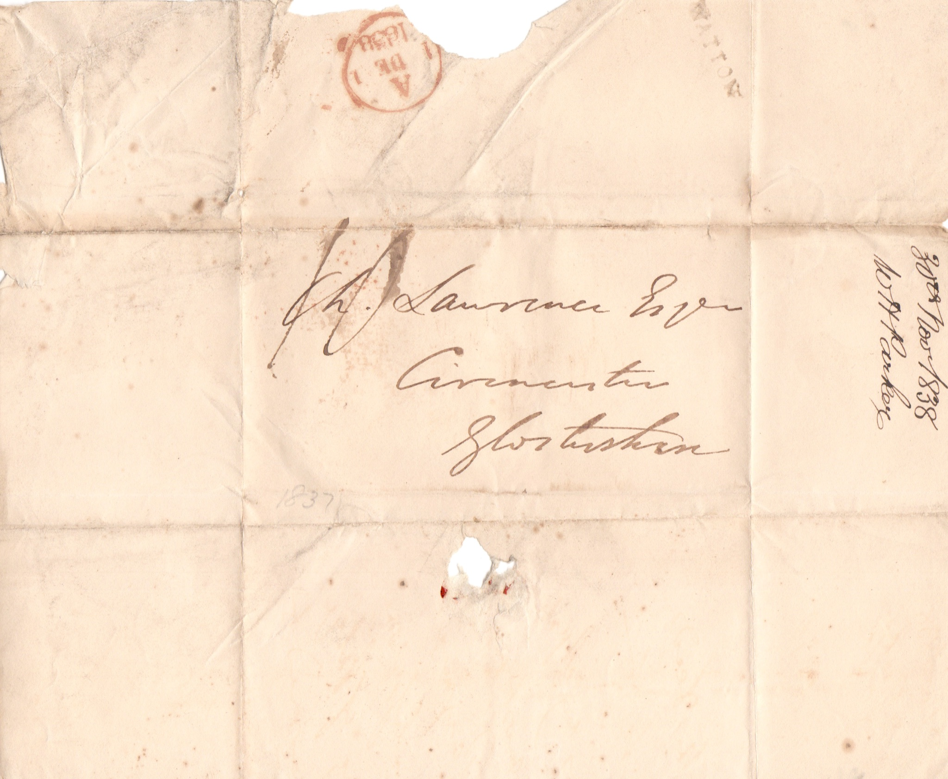
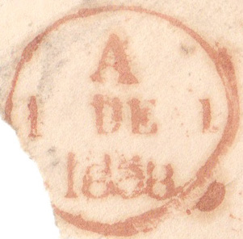

Watton to Cirencester November 30, 1838
Watton straightline mark and December 1 receiving backstamp.

Slide 30
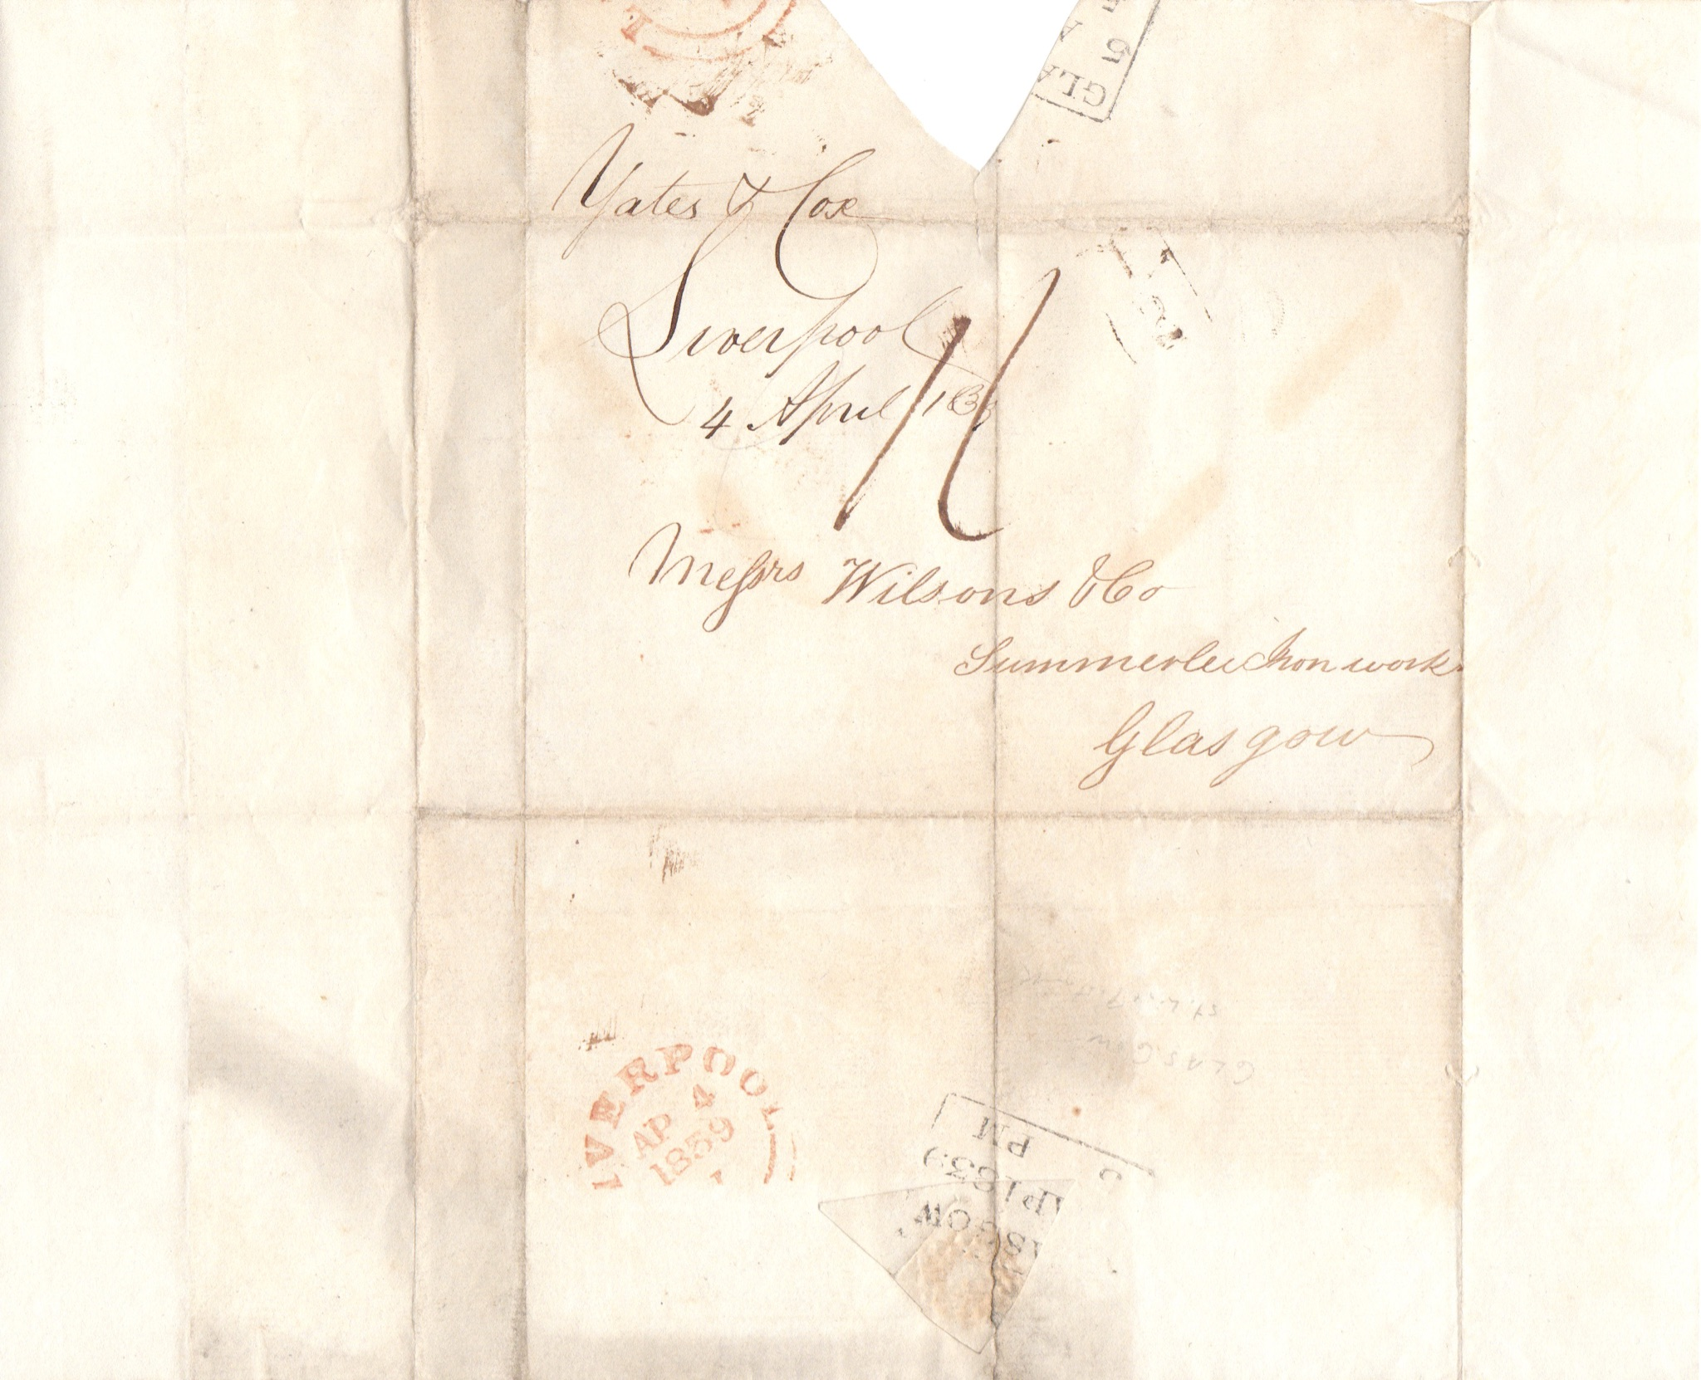



Liverpool to Glasgow April 4, 1839
Certain Glasgow receiving backstamps bore the hour along with the date. The flat rate Halfpenny surcharge was imposed by the Scots on the letter.

Slide 31




Liverpool to Prescot August 2, 1842
Low Hill Liverpool post office mark.

Slide 32


Demerara “Dutch Guiana” to Liverpool June, 17 1811
Demerara (present day Guyana) was a colony of the Netherlands from 1648 to 1815. Demerara was occupied by the British in 1803 during the Napoleonic Wars and Demerara was combined with the colony Essequibo April 28, 1812. Has a London evening
backstamp.
The letter is addressed to Samuel Sandbach mayor of Liverpool who made his fortune off the slave trade and owned plantations in the colony of Demerara.

Slide 33




Burgos Spain to London via Paris June 1839
Spain June 26 postmark and a Paris June 30 transit backstamp. Two Spanish pesos paid.

Slide 34



Baltimore Maryland to Hood(s) Mill Maryland
Descendants of an early colonist Edward Dorsey who is a subject of many genealogical literature.

Slide 35



Massillon Ohio to Mapleton Ohio March 11, 1850
Charity School of Kendall: one of the first vocational schools in Ohio.The school is loaning a person
$238.05 (~$9000)
at 7% interest. Below
is Massillon Ohio’s
postmark.

Slide 36


Owl Creek Ohio to Clear Spring Maryland February 20, 1854
Looks like it was stamped free first by mistake and then restamped paid.

Slide 37


Owl Creek Ohio to Clear Spring Maryland
September 14, 1853
Paid 3 cents mark.

