Slide 1
Philatelic Treasures from the Dollar Box – 3 Richard Spinelli President, Rochester Philatelic Association January 2016
My definition of a “Philatelic Treasure” is a collectable postal item usually found in a dealer’s unsorted lot (a box of inexpensive items), which has an historical significance and interest.

Slide 2
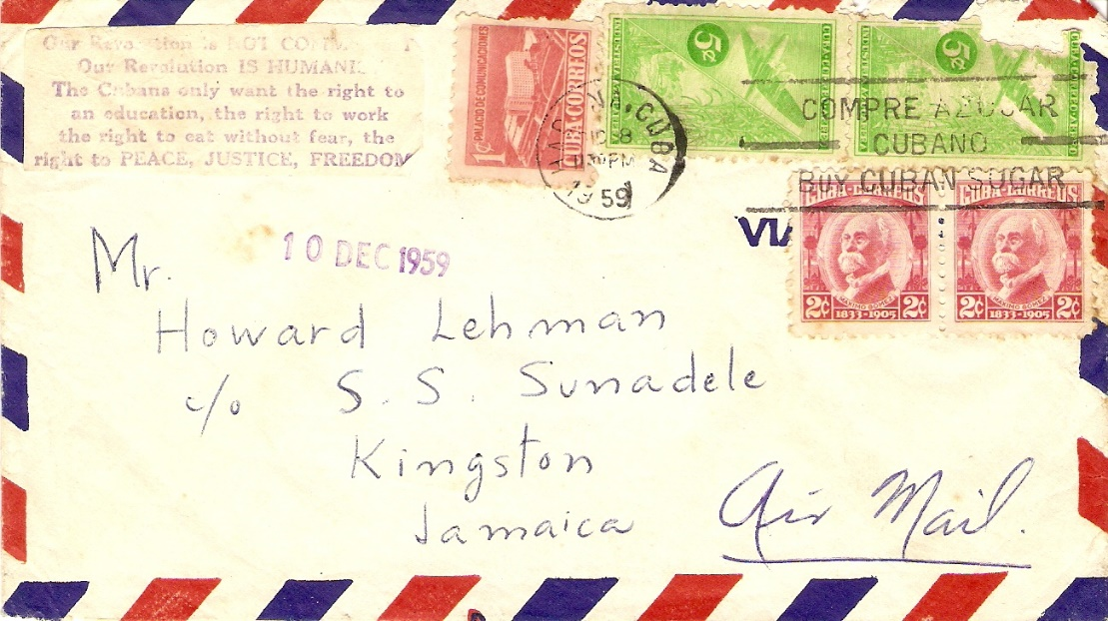
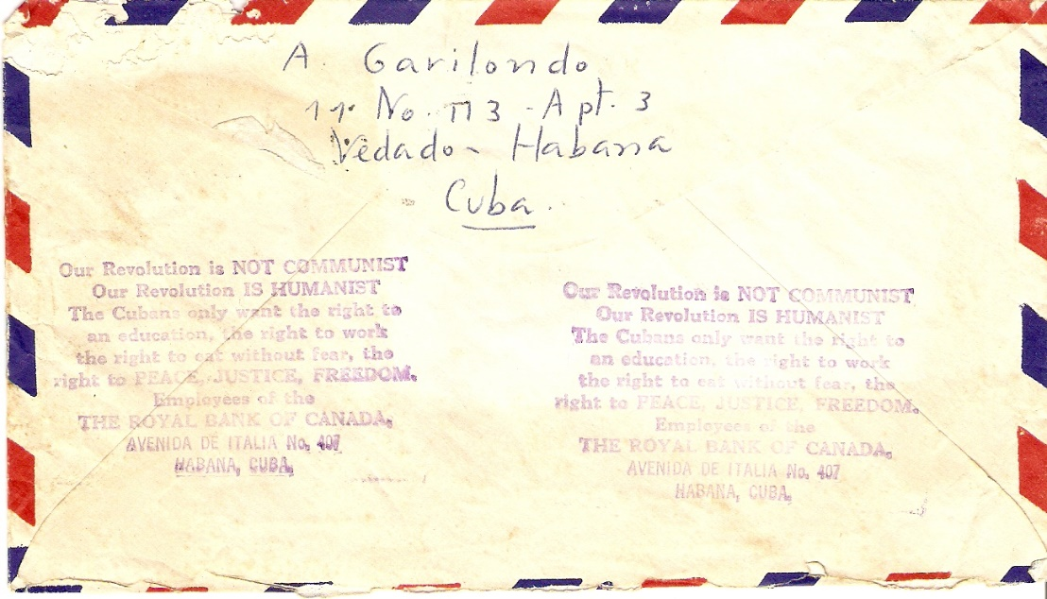
1959 Cuban Airmail Letter with Fidel Castro Propaganda Message
Before assuming the presidency of the Island of Cuba, Fidel Castro stressed that the pillars of the future administration – “the right to peace, justice and freedom” - do not communicate with Communist ideas.
In 1959, the year Castro took power from the fallen Bastista regime, he introduced a stamp which said: “Our Revolution is not Communist. Our revolution is Humanistic. Cubans only want the right to education, the right to work, the right to eat without fear, the right to peace, justice and freedom”.
The Royal Bank of Canada, the only bank in Cuba not nationalized by Castro since he needed financial contact with the West, released this cover with Castro’s message imprinted twice on the back and once on the front. It is believed Castro’s message disappeared forever on airmail covers after it’s 1959 usage.

Slide 3
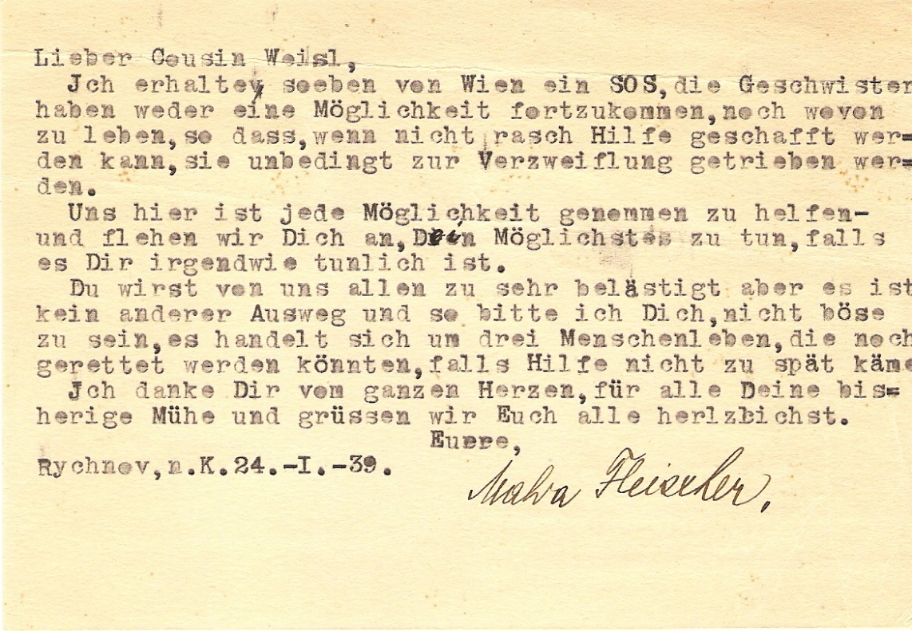
This Slovak letter was written in German on January 24, 1939 by Malva Fleischer, resident of Rychnov Nad Kneznow, Bohemia, to cousin Edwin Weisl, New York City, requesting urgent help in emigrating three Fleisher siblings away from potential Nazi Germany atrocities.
“Dear cousin Weisl, I received an SOS note from Vienna; the siblings have found neither a way yet to get away or in which to live, so if rapid assistance cannot be provided, they are necessarily driven to despair.
We have taken every possibility to help and we beseech you to do your supreme effort, if it is somehow feasible. You all may be too bothered by us but there is no way out and so I beg you not to be angry; there are three lives that could be saved if aid does not come too late.
I thank you with all my heart for your previous troubles and we all (unknown) greet you.
Yours, cousin Malva Fleischer, Rychnev, N. K., 24 - 1- 39”
(Translated by R. Spinelli and Google Translator in 2015)
Unfortunately, help came too late for sibling Hugo Fleischer, born February 26, 1878. He was transported by the Germans in a cattle train from the Bohemian City of Hradec-Kralove to the Nazi Concentration Camp at Theresienstadt (in what is now Czechoslovakia) on December 12, 1942 and killed on April 14, 1943, one of more than 30,000 who died in Theresienstadt.

Slide 4
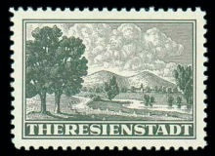
The Nazi Germany Theresienstadt “Settlement”
Located within Bohemia and Moravia
A military fortress and nearby walled garrison.
Built by Austrian Emperor Joseph II (1741-1790) during the late 18th Century
Named after his mother, Austrian Empress Maria Theresa (1717-1780).
During World War II, Used by the Gestapo as a ghetto / concentration camp for Jews from Czechoslovakia, Germany, Austria, the Netherlands, and Denmark and as a RED Cross showcase.
Although not an extermination camp, about 33,000 died in the ghetto, due to the appalling conditions caused by overcrowding
More than 150,000 Jews were sent there
About 88,000 inhabitants were deported to Auschwitz and other extermination camps
At the end of the war, there were a little over 17,000 survivors
The non-denominated stamp was issued in Bohemia and Moravia in July 1943 for use on parcels being sent from Theresienstadt
Design depicts a rather pleasing looking pastoral landscape -- kind of sad and ironic, considering the incredibly horrible reality of the place that it was supposed to represent.
Theresienstadt was liberated on May 9, 1945 by the Soviet Army.
The stamps were printed in dark green on white paper, perforate 10½ and imperforate. They were initially issued in miniature sheets of four stamps, but later on, they were printed in sheets of 25 (5x5) stamps. Only 76,000 of these stamps were printed, of which I own one. This is not a “Dollar Box” find.

Slide 5
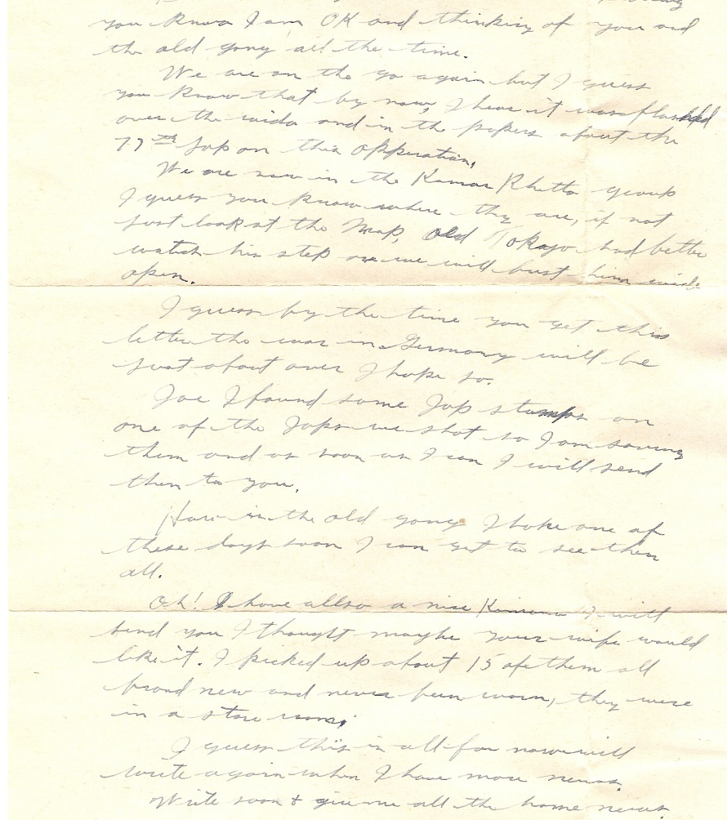
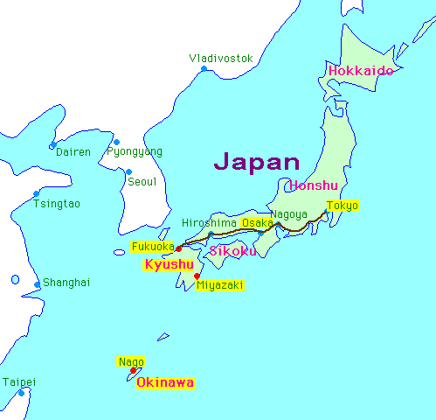
World War II US Soldier Letter From Japan
April 6, 1945
“……… Joe, I found some Jap stamps on one of the Japs we shot. So, I am saving them and as soon as I can, I will send them to you.
………..Oh, I also have a nice Kimono I will send you. I thought maybe your wife would like it. I picked up about 15 of them. All brand new and never been worn. They were in a store room”.
This US soldier was probably on the island of Okinawa on April 6, 1945 when he captured the spoils of war and wrote this letter to a friend back home. Okinawa is 340 miles off the coast of Japan and was being prepared as an air base for the planned US invasion of Japan.

Slide 6
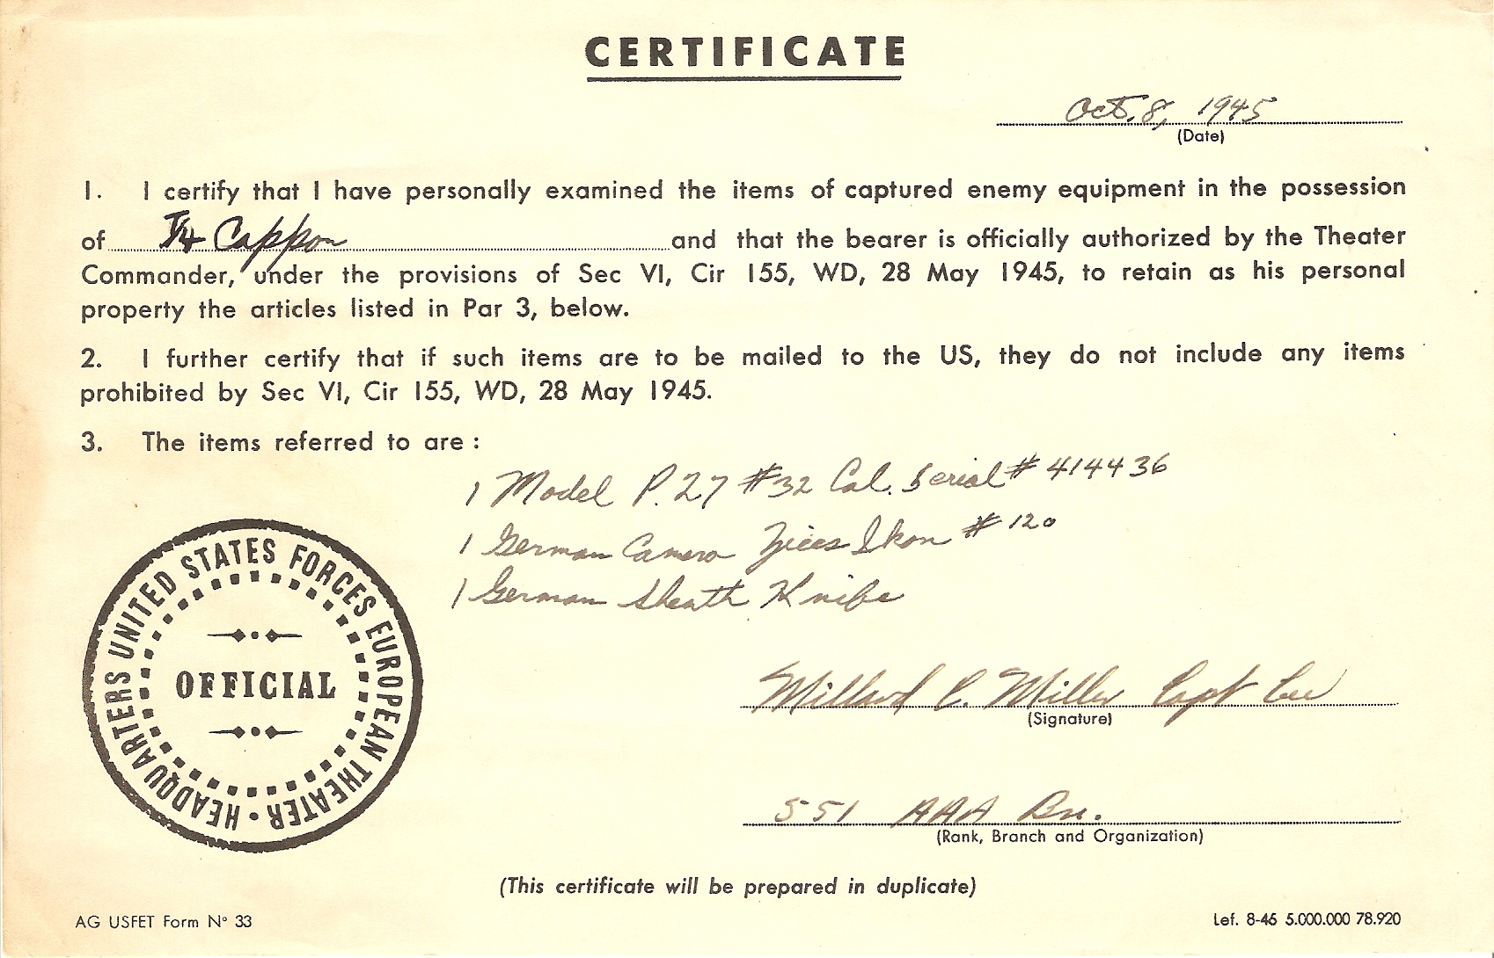
World War II Spoils of War. Soldiers were allowed to return to the US with captured items, as long as they were properly registered. This 1945 certificate allowed a soldier to return with a German p27 pistol, a Zeiss camera and a souvenir dagger. Daggers were not used in combat by Germany, but only as decoration.

Slide 7
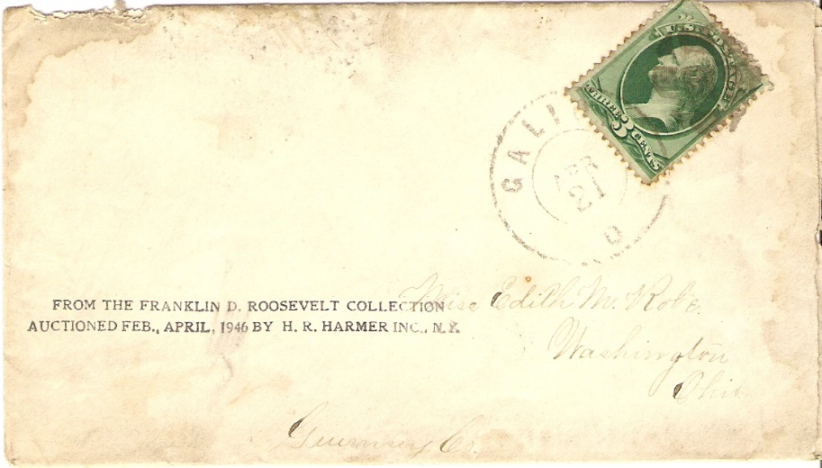
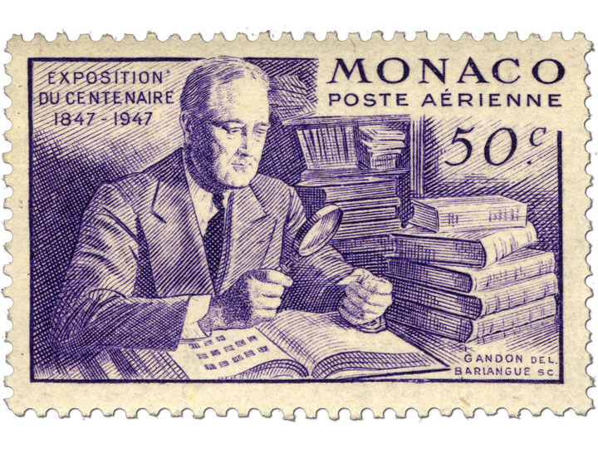
Postal Cover from the Collection of President Franklin Roosevelt, from Galion, Ohio, April 21, 1875,
Auctioned by H. H. Harmer, April, 1946
FDR started collecting stamps in 1890 at the age of 8
Life long philatelist
Became world’s most famous stamp collector and elevated stamp collecting
Took his stamp collection to prep school, Harvard, the White House, and WWII conferences such as Casablanca and Yalta.
Credits stamp collecting with helping his recovery from Polio: “I owe my life to my hobbies, especially stamp collecting”
As president, he helped design or held influence over every stamp issued by the United States (1933 – 1945).

Slide 8
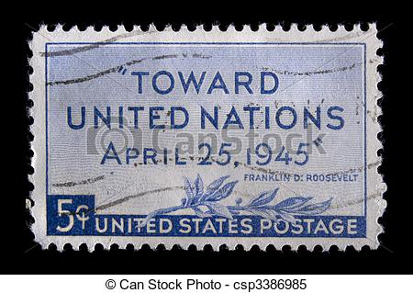
On the morning of April 12, 1945, FDR approved the design for the new “Toward the United Nations” commemorative stamp, then spent an hour with his stamps. Shortly thereafter, while posing for a portrait, he collapsed and died from a massive cerebral hemorrhage.

Slide 9
In 1946, following FDR’s death, his family sold his philatelic estate through Harmer Auction. The four FDR stamp sales brought high prices and controversy.
Most philatelists wanted to own a piece of the nation’s most famous stamp collection, but some argued that the U.S. government actually owned the fabulous holdings of U.S. essays and proofs.
Winning bidders in Harmer’s FDR auctions could have their purchases marked with a rubber stamp to verify that they came from the president’s collection.
Stamp dealers bought many large lots of common stamps and mounted them on cards for sale as inexpensive souvenirs. Today, collectors still eagerly seek these ex-FDR philatelic items for their own collections.

Slide 10
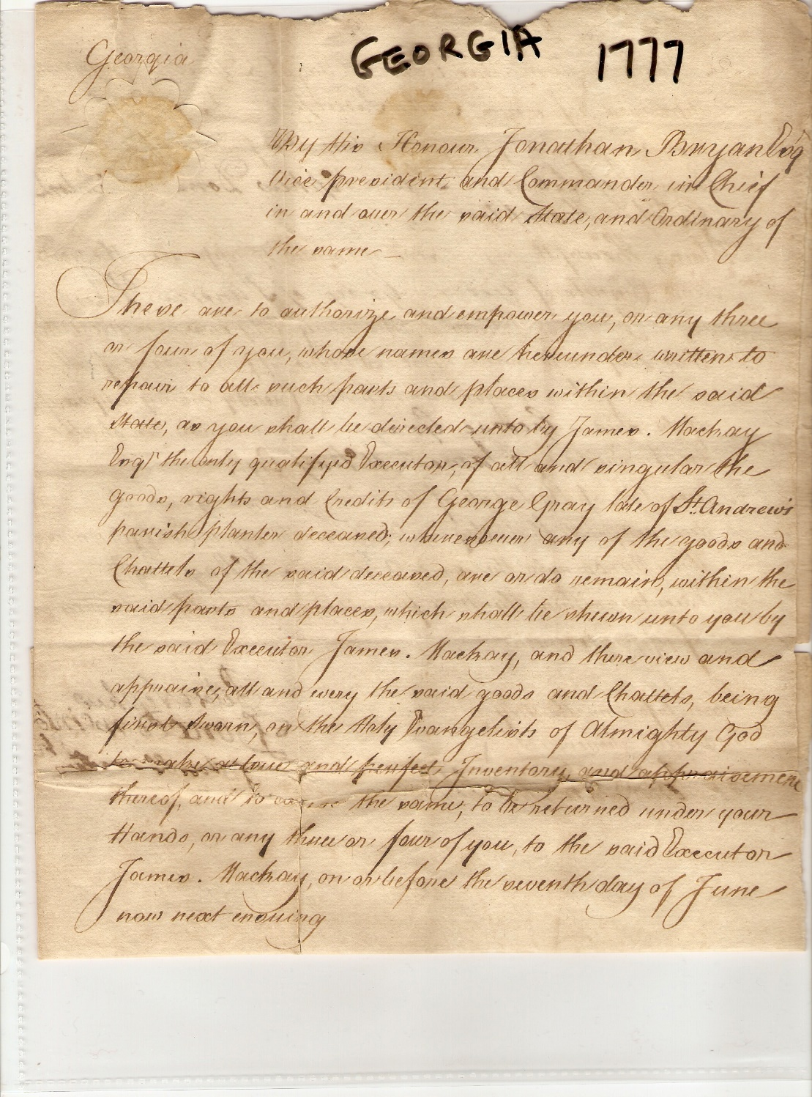
Hand Written December 7, 1777 Revolutionary War Era “Warrant of Appraisement” Document (disposition of a deceased’s assets). Signed by Ten (10) Founders of the State of Georgia, United States of America
Oglethorpe proposed that the area be colonized with the “worthy poor” of England to provide an alternative to overcrowded Debtor’s Prisons. He initially did not support slavery but capitulated since there was not a way to get enough labor
The area of Georgia was inhabited by Native Americans before English Settlers arrived in the 1730’s led by James Oglethorpe, a member of British Parliament.

Slide 11
Signers of this Document
Jonathan Bryan: American born, friend of Oglethorpe, supporter of independence, financier of Continental troops, captured and held prisoner for two years by British
James McKay: Planter, captained George Militia, pillaged and sunk British boats, killed 10-25 King’s Rangers who refused to support the Patriots
George Gray: An original receiver of British Plantation Land grants, whose last will demanded that his “Negroes and chattels be sold to pay debts”
Hugh Morrison: Scottish immigrant granted Georgia lands between 1757 and 1769
Roderick McIntosh: British Army Officer who turned sides against the British, part of Continental garrison which attacked Savannah, received wound to face

Slide 12
Signers of this Document
Peter Nephew: Immigrated to Georgia by 1756, received an early 100 acre British Land Grant, ultimately received 1250 acres in 27 years in Georgia
Donald Bain McIntosh: Land Grant recipient, rice grower and neighbor and probably relative of Roderick McIntosh
John Hampton: First mentioned in Georgia in 1747 as selling cattle to a neighbor.
Thomas Whitefield: Probable son of George Whitefield, noted British Preacher, co-founder of Methodism and early leader of evangelical movement in Georgia and America. Anti-slavery in 1740, but by 1770 convinced Georgia needed slaves. Co-founder with his father of the first and oldest child-caring institution in the Country
John Sandiford: Georgia conservator of the peace, his father left him “one half of tract mentioned above, Negro girl named Beck, eleven cows and calves”

Slide 13
By the late 1770’s, two facts are believed: (1) James McKay and the other “Worthy Poor” were slave holders, but their sentiments were anti slavery. (2) The political emotions of these men were with the Patriots.
In 1775, residents of St. Andrews Parish, including these men, met in convention and adopted six resolutions:
Approval for” the decent, but firm and manly conduct of the loyal and brave people of Boston and Massachusetts Bay to preserve their liberty”.
Approved three resolutions against specific British colonial practices
…Confirmed “our disapprobation and abhorrence of the unnatural practice of slavery in America…”
Named delegates to an upcoming provincial congress in Georgia and requested that Georgia appoint delegates to the upcoming Continental Congress

Slide 14
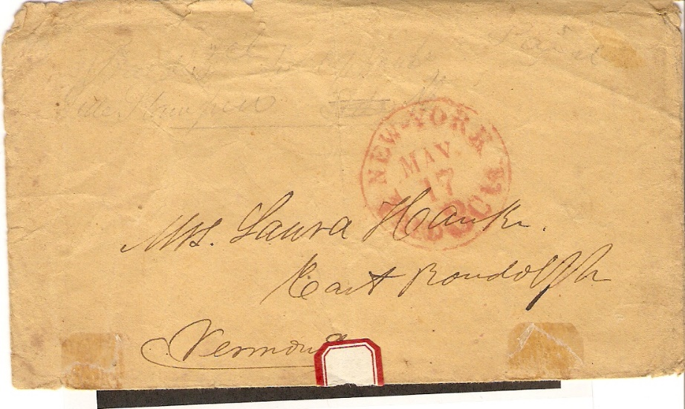
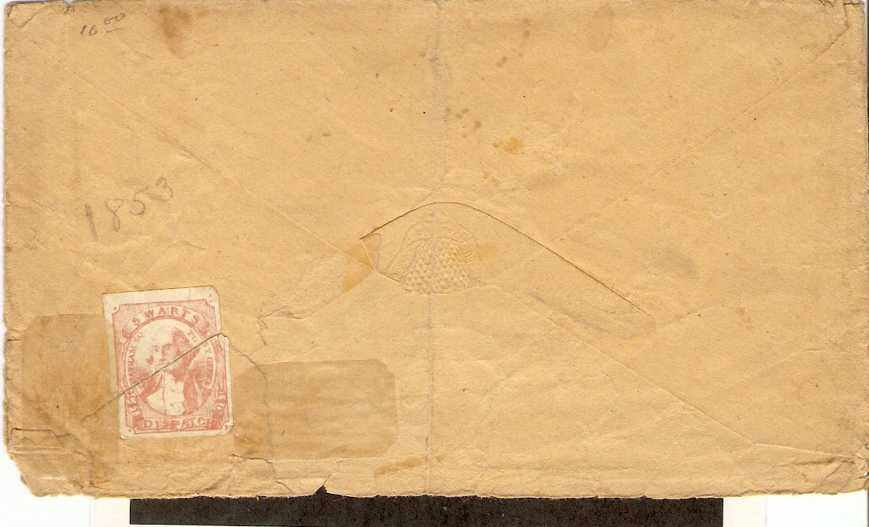
1853 Stampless Cover from New York City Addressed to Mrs. Laura Hawke, East Randolph, Vermont
Swarts City post Dispatch Local Stamp on Reverse
Aaron Swarts was employed by the Post Office Department at Chatham Square (NYC) in 1845 and 1846. On January 5, 1847 the Chatham Square branch was discontinued leaving area residents and businesses without a convenient nearby post office. Swarts saw an opportunity and on January 15th announced the opening of his local branch, advertising it as the Branch Post Office, although there was no official connection to the government Post Office. The Company lasted until 1863.
Robert Siegel recently auctioned three similar Swarts covers at an average price of $400 each.

Slide 15
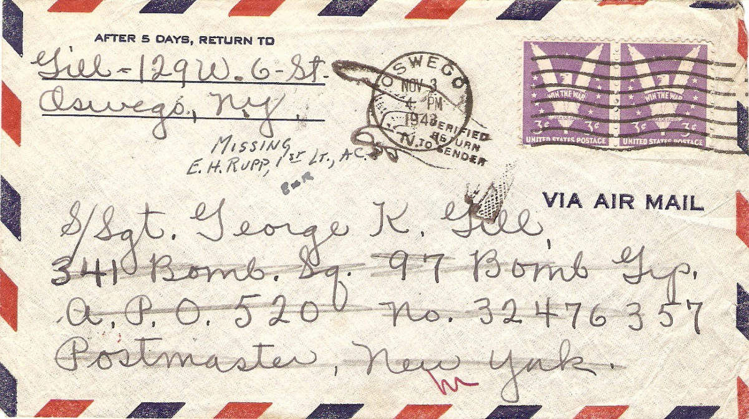
1943 World War II “Return to Sender” Cover Without Letter
From the John M. Gill Family , 129W. Sixth Street Oswego, New York
To S/Sgt. George K. Gill
341st Bomb Squadron, 97th Bomb Group
APO 520, no. 32476357, Postmaster, New York
This envelope with letter left Oswego, New York on November 3, 1943 and was returned to sender on December 21, 1943 with a notation by 1st Lieutenant E. H. Rupp that S/Sgt. Gill was Missing In Action.
S/Sgt. George K. Gill was born about 1920 and enlisted in the US Army on September 16, 1942. He was assigned to the 341st Bombardment Squadron, 97th Bombardment Group, XII Air Force as a tail gunner in a B-17 Heavy Bomber.
On November 8, 1943, 81 B-17’s bombed the Turin, Italy ball bearing works, marshalling yard, motor and aircraft engine works. S/Sgt. Gill was shot down in his B-17 and declared lost on November 8, five days after the posting of his family’s letter. His remains were never found. The letter was returned to the family.

Slide 16
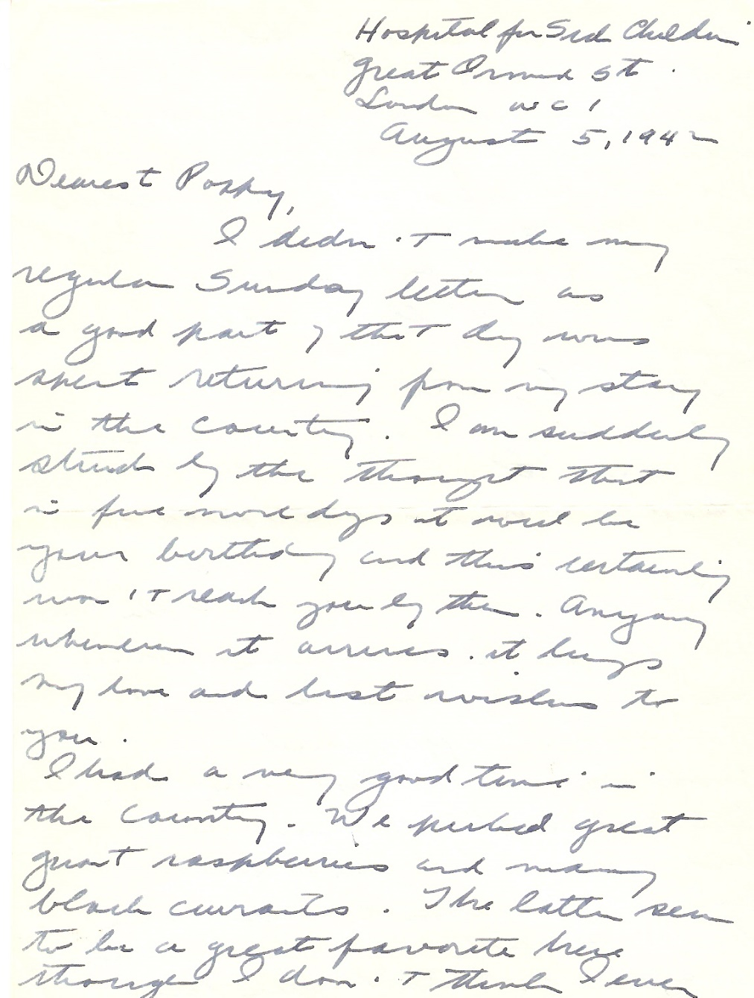
1942 Censored Letter From One of First Seven American Women Doctors in WWII, Eleanor K. Peck
Women doctors in the United states sought to use their medical skills in support of the American war effort during WWII. Commissions in the Army and Navy, however, did not become available to them until 1943. In the summer of 1941, the American Red Cross sought women doctors for the British Emergency Medical Services. Seven medical doctors responded to this call, including Eleanor K. Peck.
Dr. Peck served as a pediatrician in London in 1941 and 1942. In 1943, she transferred from the Red Cross to the US Army.
In her letters, Dr. Peck describes her trip overseas, air raids, the hospital, rationing, commissioning of female doctors and her reaction to the bombing of Pearl Harbor.
Fifteen of Dr. Peck’s letters home to her aunt and uncle are contained in the Library of the University of North Carolina. Three of Dr. Peck’s letters are contained in my personal collection.

Slide 17
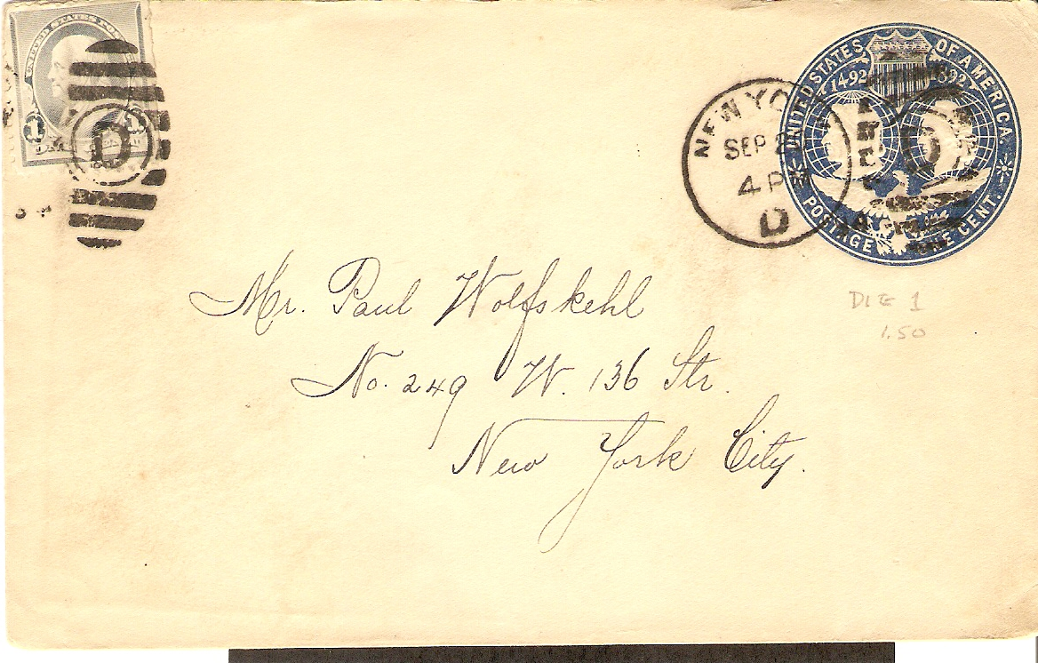
1901 Cover Addressed to Paul Friedrich Wolfskehl, Industrialist and Mathematician
Wolfskehl bequeathed 100,000 Marks (1,000,000 pounds today) to the first person to prove Fermat’s last theorem.
Fermat's Last Theorem states that no three positive integers a, b, and c satisfy the equation a^{n} + b^{n} = c^{n} for any integer value of n greater than two.
The cases n = 1 and n = 2 were known to have infinitely many solutions, including:
a² + b² = c²
a = 3, b = 4, c = 5
3² + 4² = 5²
9 + 16 = 25
This theorem was first conjectured by Pierre de Fermat in 1637 in the margin of a copy of Arithmetica where he claimed he had a proof that was too large to fit in the margin. The first successful proof was released in 1994 by Andrew Wile, and formally published in 1995, after 358 years of effort by mathematicians.
Why the prize? Theory one is that Wolfskehl was spurned by a young lady and decided to commit suicide, but was distracted by an error in a paper on Fermat’s famous problem. This rekindled his will to live, and in thanks, he established his prize. Theory two is that he missed his suicide time because he was in a library studying Fermat’s theorem.

Slide 18
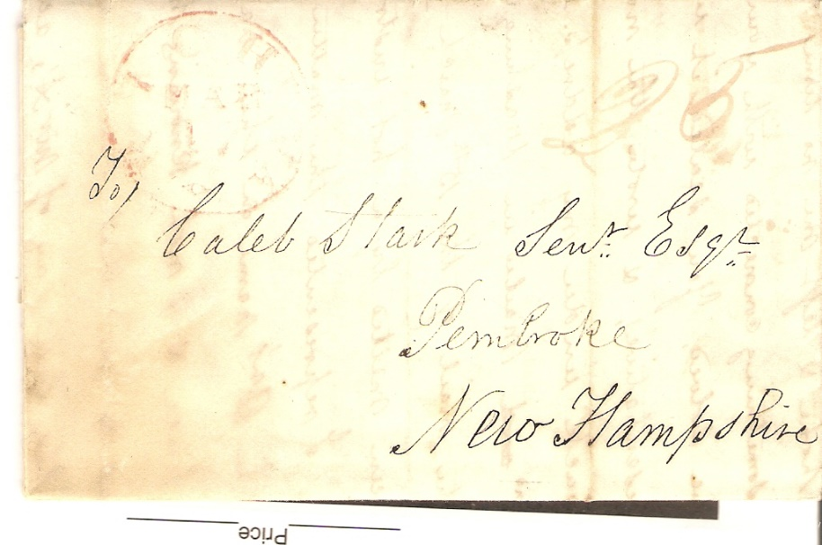
Letter to Caleb Stark (1759 – 1838), Revolutionary War Veteran and
Eldest Son of Revolutionary War Hero General John Stark
During the Revolutionary War, Caleb served with his father in the 1st New Hampshire Regiment at the Battles of Bunker Hill, Trenton and Princeton. General John Stark is credited with “Live free or die: Death is not the worst of evils”, the phrase which ultimately became New Hampshire’s state motto. John was personally thanked for his War efforts by George Washington and was the last surviving General of the War.
After his father resigned his commission Caleb remained in the Continental Army, serving the rest of the war and rising to the rank of major. He was the youngest survivor of the Battle of Bunker Hill. In 1811, Caleb Stark started the first cotton mill in Suncook, New Hampshire. He also practiced law and became a historian, and a member of the New Hampshire State Senate.
1829 – 25 cents
Richmond Va. To Pembroke, New Hampshire

Slide 19
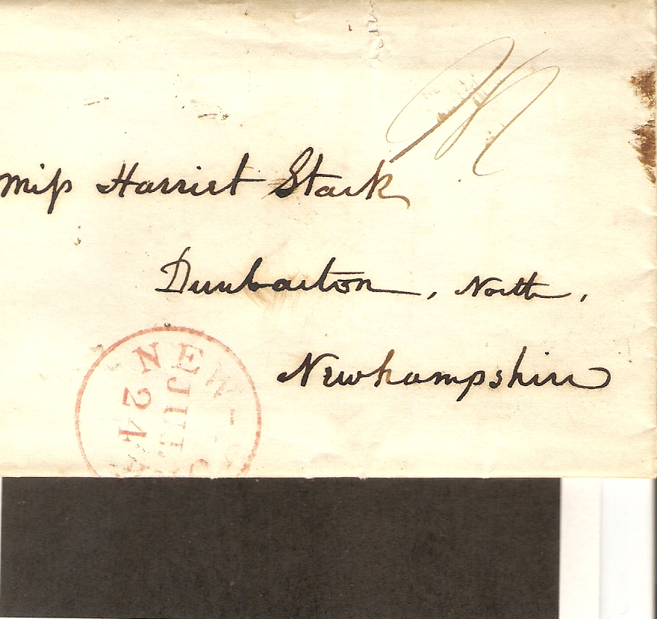
Stamples Cover to Miss Harriet Stark, Dumbarton, New Hampshire
Harriet was the daughter of Caleb Stark and granddaughter of General John Stark. She lived to be 85 years old and “left a big estate”.

Slide 20
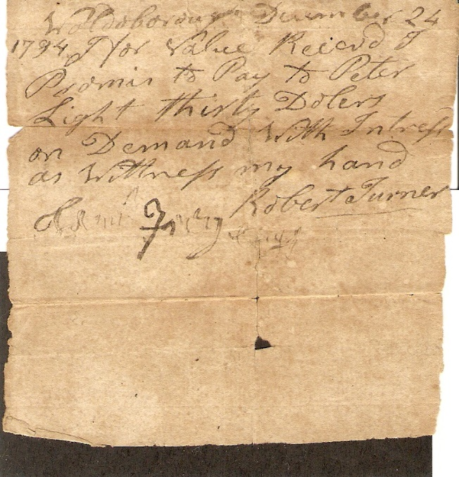
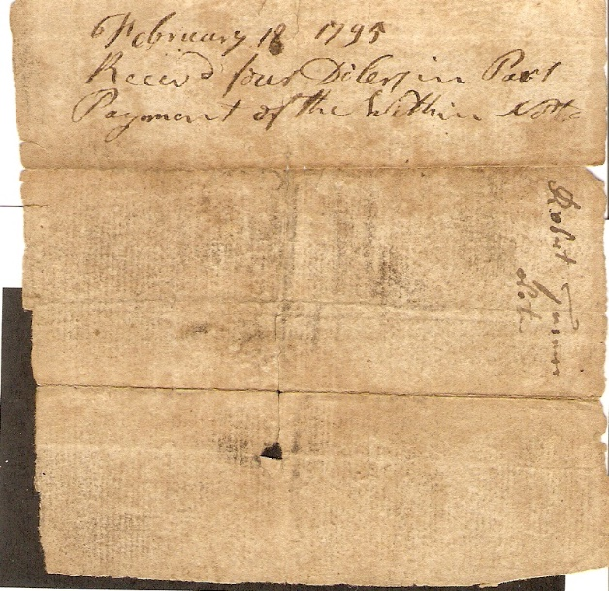
1794 Promissory Note from Robert Turner to Peter Light with Connection to War of 1812
Obverse Content
Woldoboro, Maine
For value received, I promise to pay Peter Light thirty dolars on demand with interest as witnessed my hand.
(Signed) Robert Turner
Reverse Content
February 18, 1795
Rec’d four dollars in part payment of this note.
Peter Light
During the war of 1812, Peter Light, a fisherman, was captured by a British privateer and carried to Halifax, NS. The crew, having gone ashore for a holiday, left Light and the cook on-board the vessel. Light and the cook cut the cable, stole the ship and steered for the New England coast. As they sailed up the Waldoboro River, they fired several guns which alarmed the people in the vicinity.

Slide 21
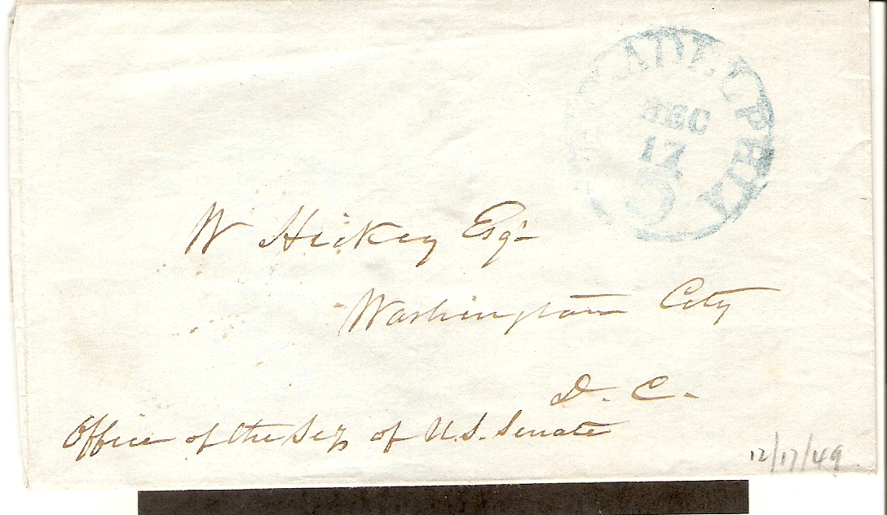
1849 Stampless Cover to William Hickey
Office of the Secretary of the US Senate
William Hickey – 1798 – 1866
Assistant Secretary of the United States Senate. 42 Years in Service of the Senate. Author of works on the Senate. Edited an official printed version of the Constitution used by the Government and certified by then Secretary of State James Buchanan (corrected several words and 65 punctuation errors). Ordered survey map of land tracts in Washington DC. Was involved in the creation of the official Vice Presidential Seal of the day. Only one impression - on – cover (1850 - Millard Fillmore), is known today
1849 Philadelphia to Washington – 6 cents

Slide 22
Other Friends I Have Met Through Stampless Covers
James Smith Bush (1800 – 1867) – Great-Great Grandfather of President George W. Bush and a Rochester resident
Virgil Douglas Parris (1807 – 1874) - US Congressional Representative from Maine
Jonathon Tarbell (1830 – 1888) - US Civil War Brigadier General
Amy Kirby Post (1818 – 1914) – 19th Century US Women’s rights suffragette and her abolitionist friends Frederick Douglas, William L. Chapman, Issac Post (her husband), J. C. Hathaway, J. C. Jackson plus six run-away underground railway slaves; this is my most prized stampless cover; Amy’s papers reside at U of Rochester
Charles P. Leverich (1803 – 1876) – New Orleans cotton broker and business partner of Confederate President Jefferson Davis
Gouverneur Morris Jr. (1813 – 1883) - Son of a US founding father and a New York railroad tycoon
Judge Augustus Seymour Porter – The first white settler of what is now Niagara Falls, New York; promoter of the power of the Niagara River and a pioneer of Great Lakes transportation
Royal Chapin Taft (1823 – 1912) – Member of the political Taft family (shared a great-great-great-great grandfather with President William Howard Taft), Governor of Rhode Island, banker and railroad executive. His extensive art collection resides at RI School of Design
Lewis Bradley (1815 – 1900) – Noted American landscape painter, lithographer and drawing master

Slide 23
Other Friends I Have Met Through Stampless Covers
John Savin (1820 - ?) – White slave holder great grandfather of American writer and poetess Maya Angelou
Edgar Ketchum (1811 – 1882) – Appointer by President Abraham Lincoln as Collector of Internal Revenue. Wife’s grandfather delivered the welcoming speech to George Washington upon his entry to New York for his inauguration address
John H. Swift – Last member of the New York State Assembly who served in the Civil War (1900 – 1901)
David Rittenhouse Porter – Governor of Pennsylvania, 1838 – 1845
Silas Wright (1795 – 1847) – New York Senator, Brigadier General New York State Militia, 20th US Congress (1827 – 1829), New York State Comptroller, US Senator from New York (1833 – 1844)
Azariah Cutting Flagg (1790 – 1873) – New York Secretary of State, State Comptroller and NYC Comptroller. Political crony of President Martin Van Buren
Job Mann – Pennsylvania State Treasurer and three term US congressman from PA
Albert Sands Southworth (1811 – 1894) – Operator of Southworth and Hawes Daguerrotype studio and student of Samuel F. B. Morse.
Myron H. Clark (1806 – 1892) – Governor of New York (1855 – 1857), State Senator and Ontario County Sheriff

Slide 24
George E. Paine – New Orleans cotton broker for Southern growers, including Confederate States President Jefferson Davis. Arranged for transport and sale of black slaves and Chinese coolies as labor for cotton trade
David Elder – Builder of the only Wire Suspension Bride (1866) still standing in America (Carrabassett River, Maine)
Lorenzo Lorraine Langstroth – Invented the modern Beehive in 1851 (US Patent 9,300) enabling greater production of honey

Slide 25
The end

