Slide 1
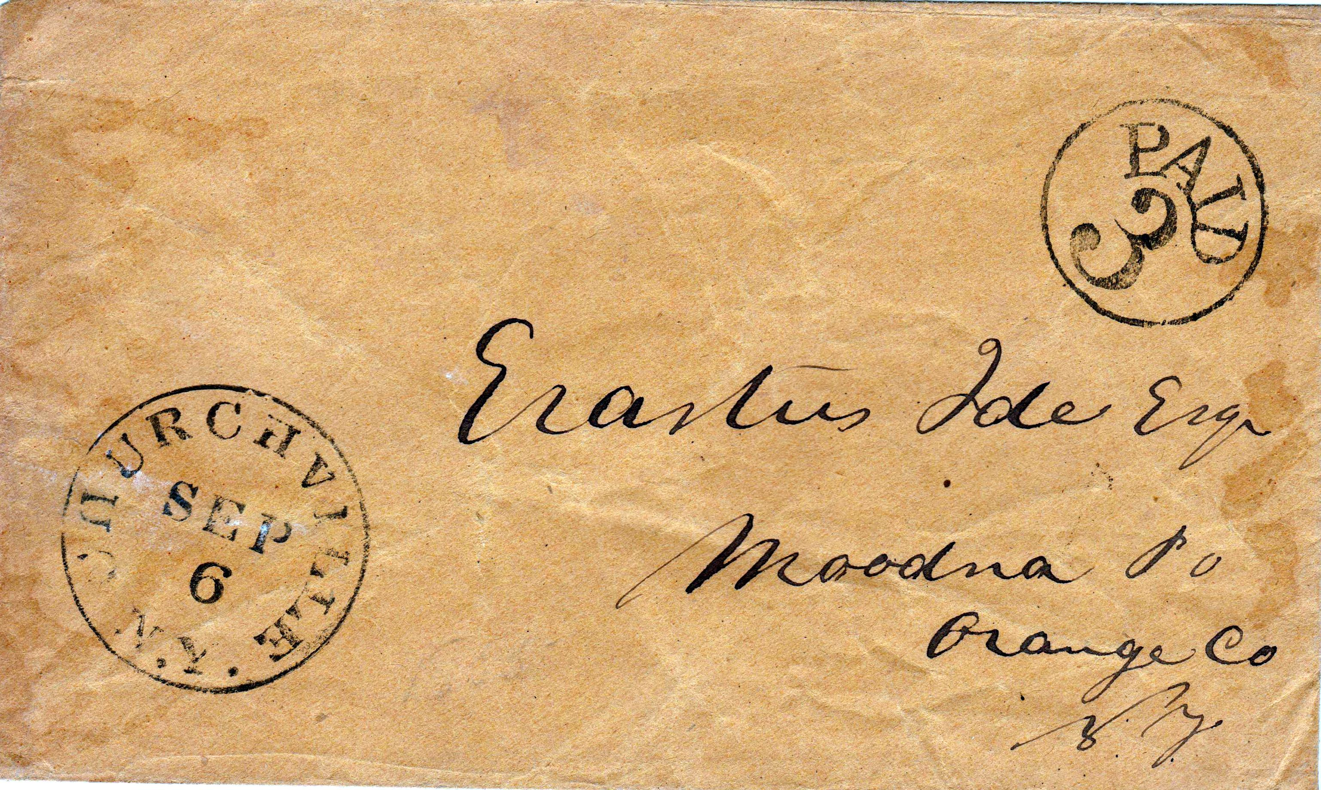
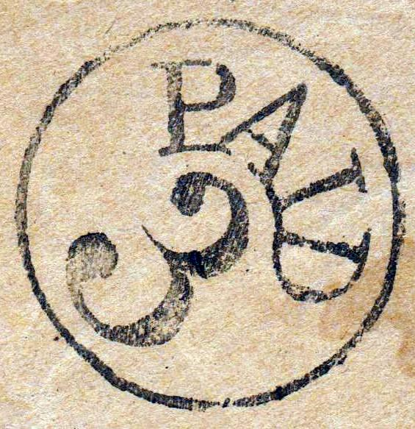
New York State
Paid 3

Slide 2
History
Postal Stamp Act of 1845
-Postage 5 cents delivery less then 300 miles
-Postage 10 cents greater then 300 miles
Postal Stamp Act of 1851
-Postage reduced to 3 cents for -delivery less then 3,000 miles if
Paid in advance---created PAID 3
-Postage 5 cents if paid upon delivery

Slide 4
New York State Totals Paid 3
910 Total
806 Towns
104 Town Multiples
597 Larry Collection
207 No Image
25 New not in references

Slide 5
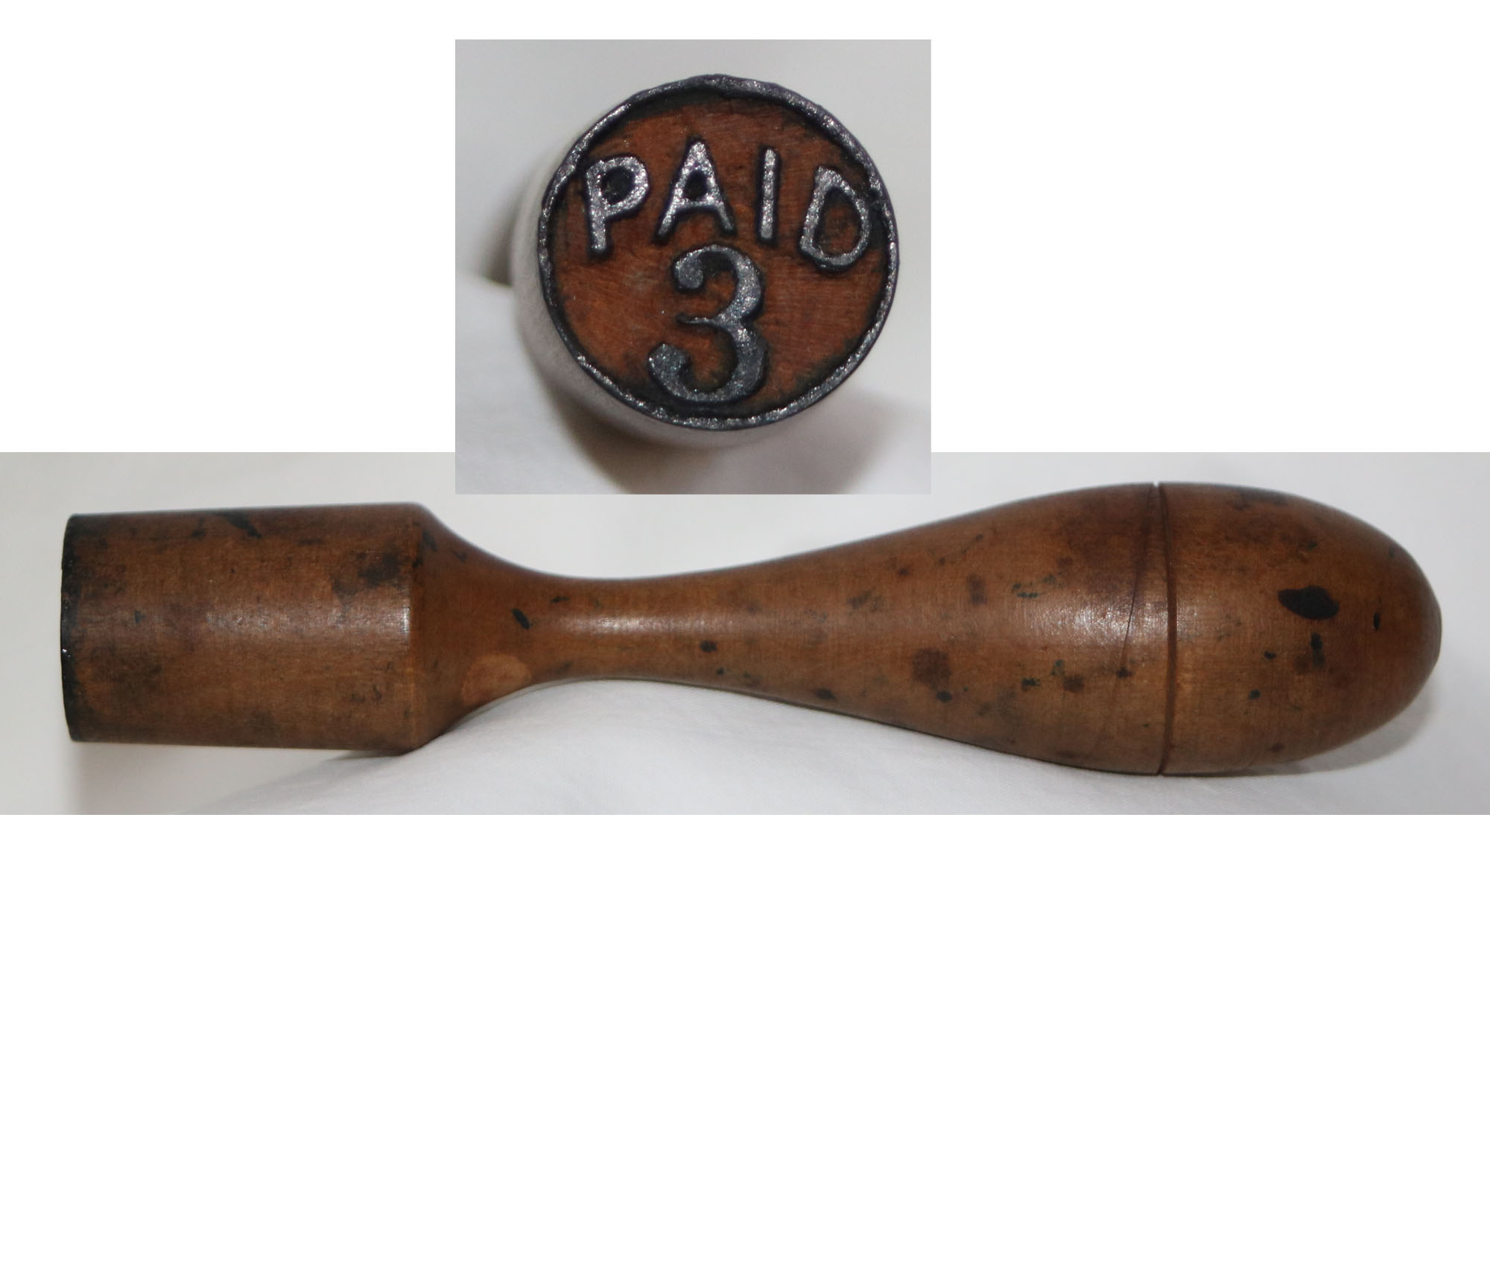
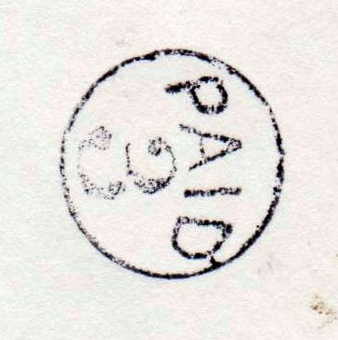
Hand Cancel-Wood Carved Paid 3

Slide 6
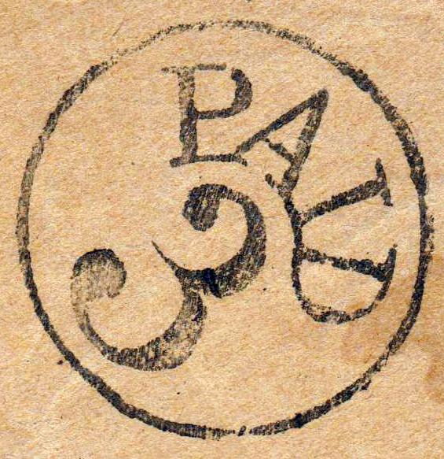

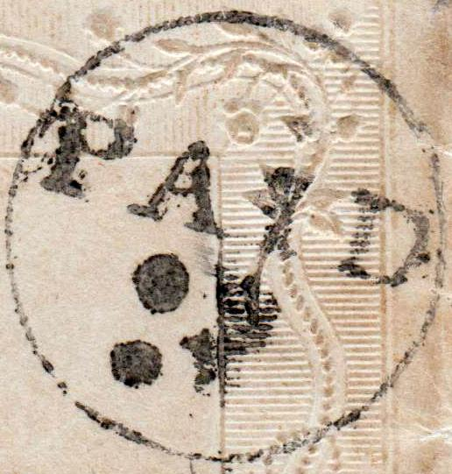
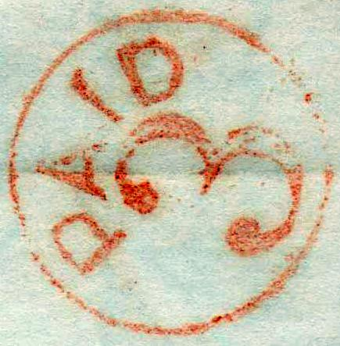
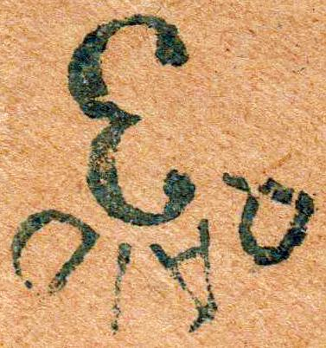
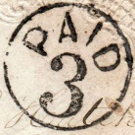
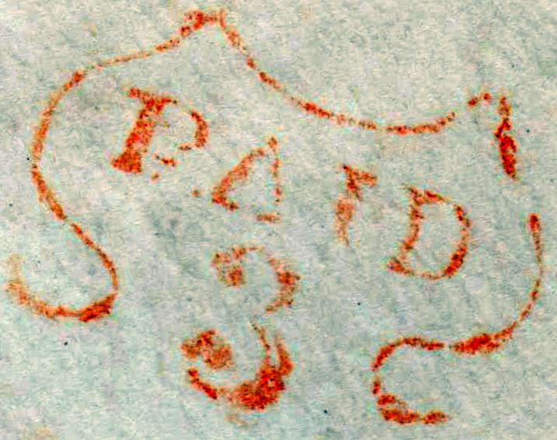

Monroe County
112 Post Offices in Monroe County
48 Post Offices Open During 1851 to 1855
13 Identified with Paid 3 Only 8 found
Churchville
Fairport
Honeoye Falls
North Chili
Penfield 1
Penfield 2
Scottsville
Spencerport

Slide 7
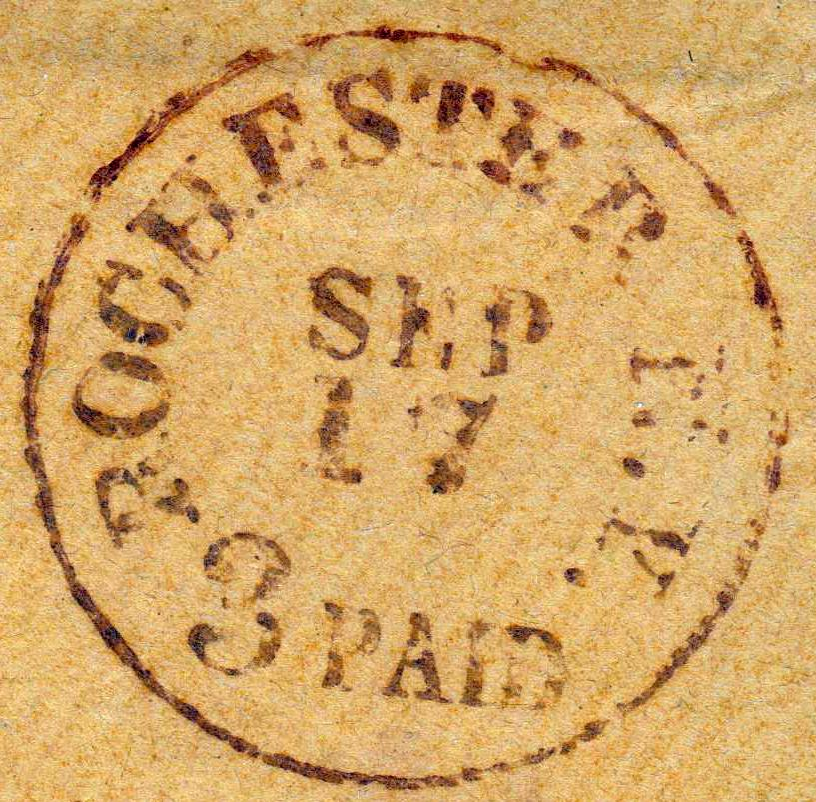
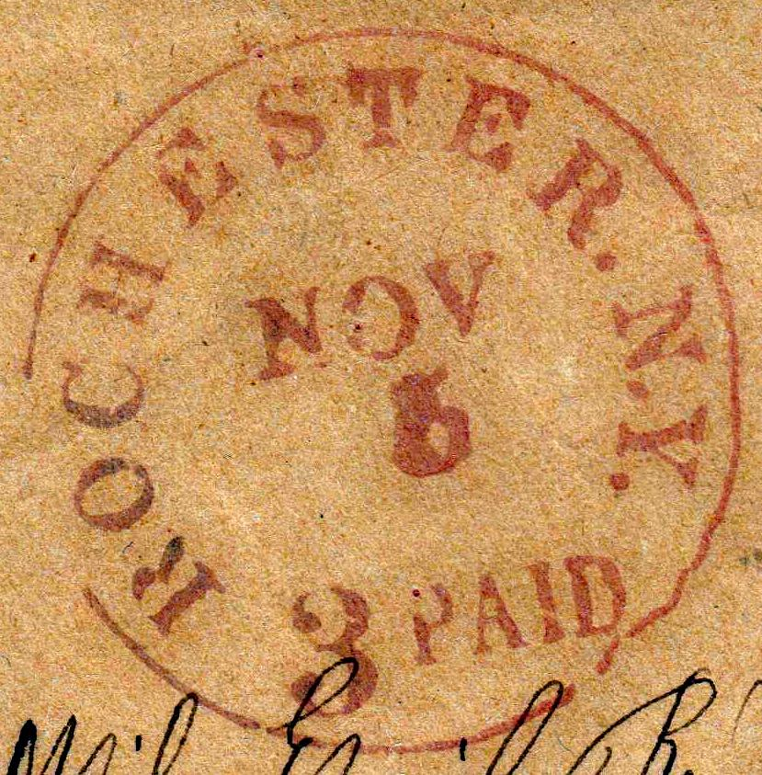
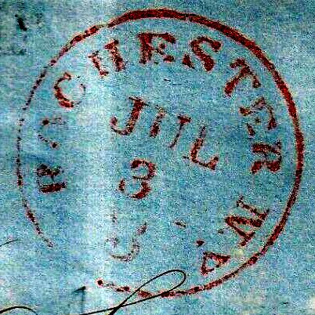
Monroe County
Rochester 1
Rochester 2
Rochester 3

Slide 8
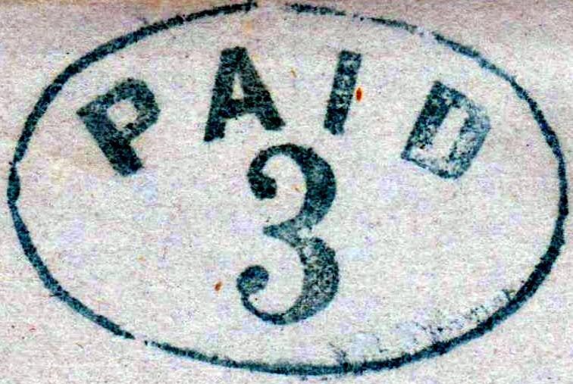
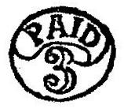
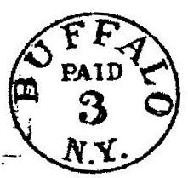
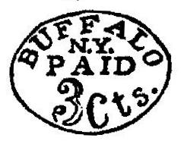
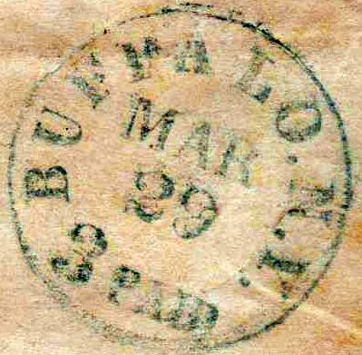
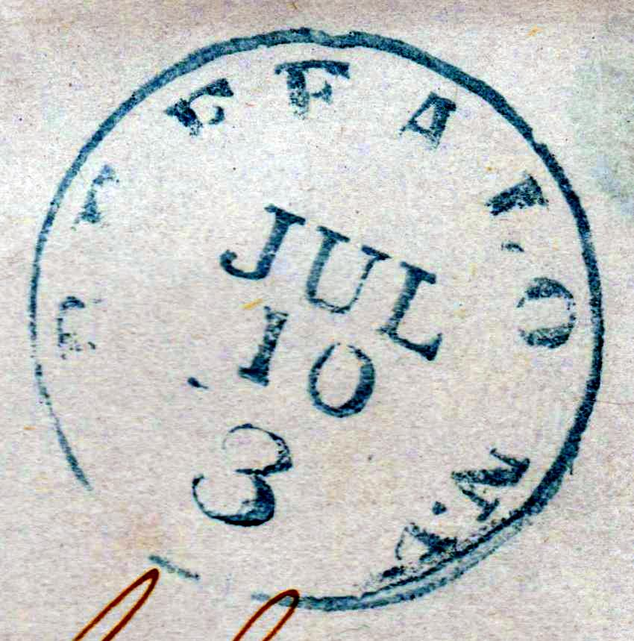
Buffalo

Slide 9
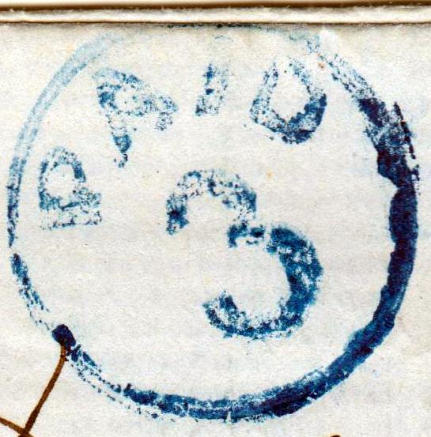
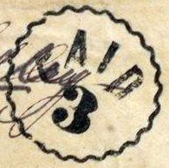
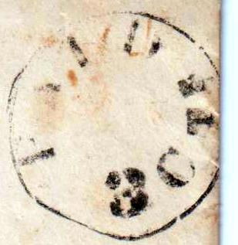
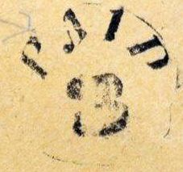
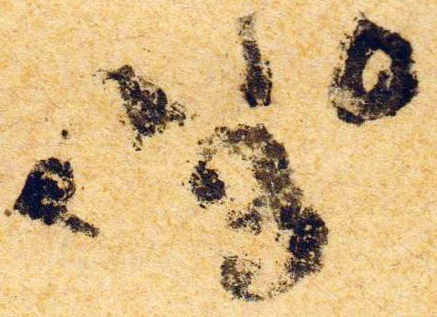
Lyons Wayne County
Population 3989
3 CTS

Slide 10
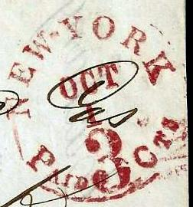
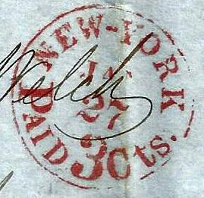
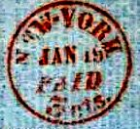
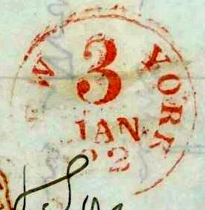
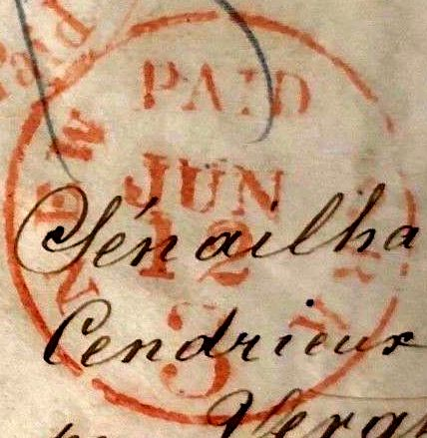
New York

Slide 11
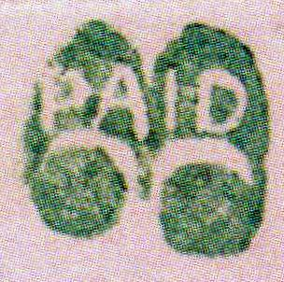
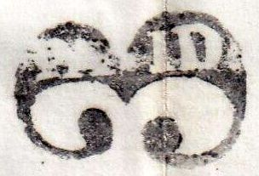
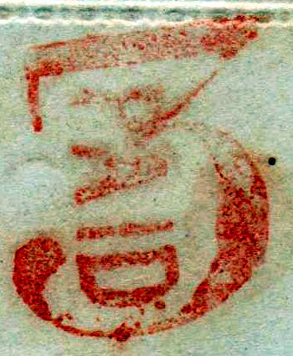
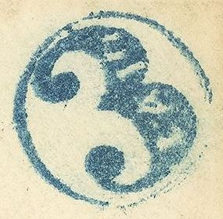
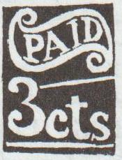
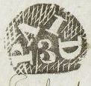
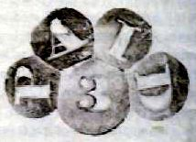
Fancy
Shushan
Schaghticoke
Sandy Hill
Honeoye Falls
North Easton
Aurora
Aurora

Slide 12
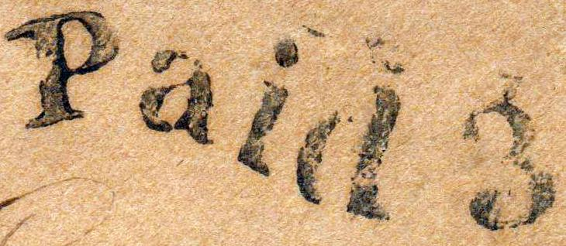
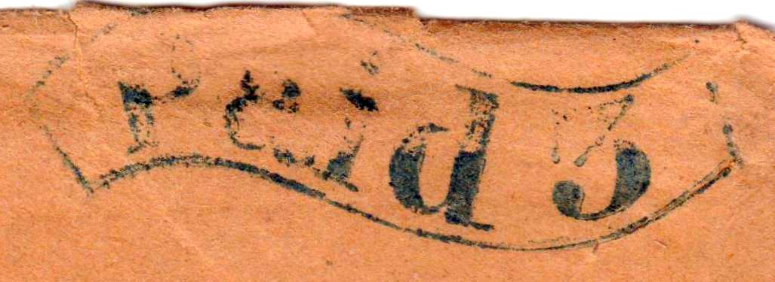
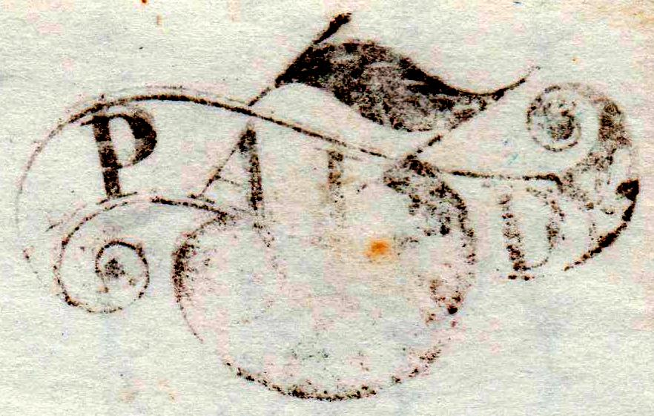
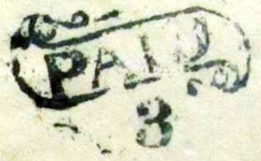
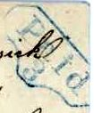
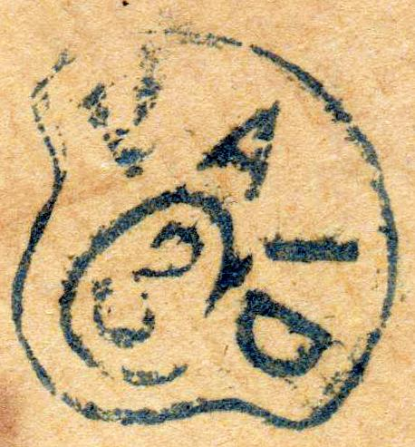
Fancy
Hancock
Boonville
Richfield Springs
Niagara Falls
Scottsville
Ovid
Farmer

Slide 13
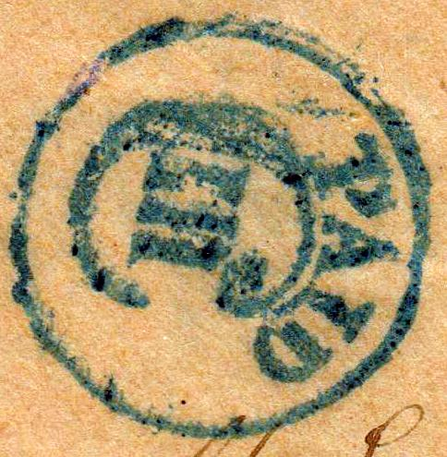



Roman Numeral
Auburn
Watertown
Johnstown
Niagara Falls

Slide 14
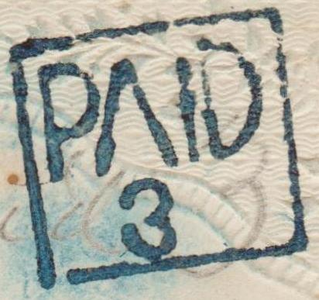
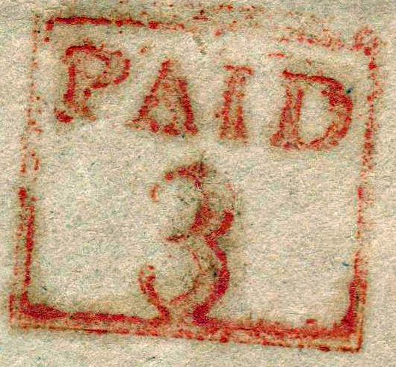
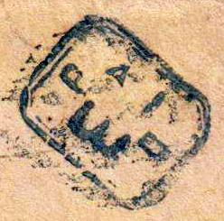
Boxed Paid 3
Branchport
Friendship
Fairport
Horseheads

Slide 15
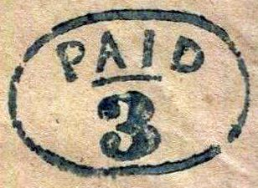
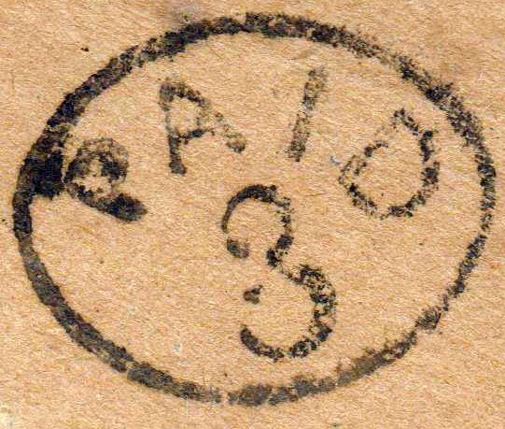
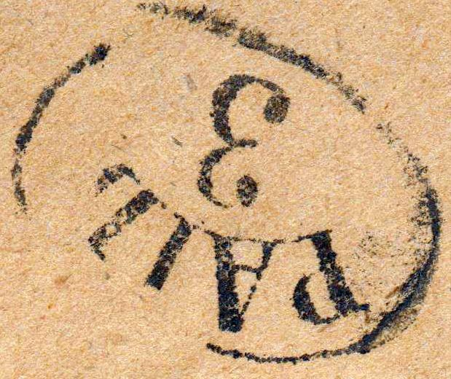
Oval
Deposit
Buffalo
Gerry
Owego

Slide 16
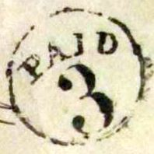






Circle
Lyons
Fayettville
Clifton Springs
Glasco
Dunkirk
Constantia
Bloomingburgh
North Haverstraw

Slide 17







Circle
Northville
Rensselaerville
Wales Centre
Prattsburgh
Canandaigua
Attica
Montgomery

Slide 18





Circle
West Dresden
So Kortright
Triangle
Mexico
Colia

Slide 19







Circle
Quaker Street
New Lebanon Centre
Keeseville
Clinton
Fabius
Marcellus Falls
Waterville

Slide 20






Circle part of CDS
Canton
Ogdensburgh
Malone
Islip
Utica
Troy

Slide 21








Arc
East Bethany
Gouverneur
Rose
Rhinebeck
Lyons
Locust Valley
Canoga
Champain
Washington Heights

Slide 22









Straight
Fort Plain
Addison
Gloversville
Albany
Portville
Westmoreland
Albany
Buskirks Bridge
Pierrepoint

Slide 23






Manuscript
Gardnersville
Otisco
Sempronius
South Glenn Falls
Warrensburgh
White Creek

Slide 24




Used After 1855
Factoryville
Greenville
Hudson
Lake Ridge
Rochester 1
Rochester 2
Rochester 3

Slide 25

Classic Society 1997

Slide 26




Slide 27

Paid Markings George W Linn 1955

Slide 28


