Slide 1
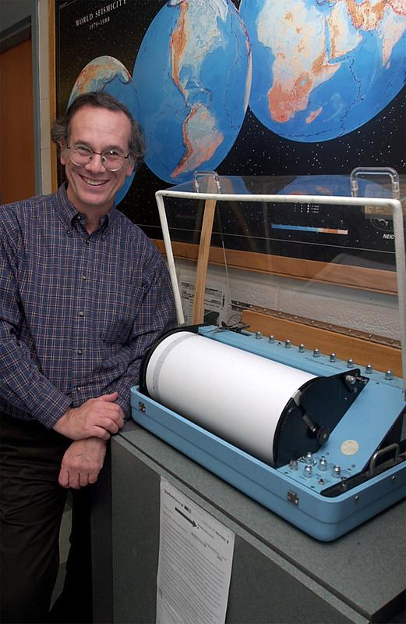


North American Earthquakes on Stamps, Postcards, and Letters
Rob Sternberg
Professor emeritus, Earth and
Environmental Science
Franklin & Marshall College
rs_sternberg@yahoo.com
member: APS, ATA, AFDCS, USCS, PSLC
Presentation for:
Rochester Philatelic Association
24 April 2025
link to this presentation: https://docs.google.com/presentation/d/1gH7sTcDUCnBxJrePSK4stHU6rfMWcdxrGARNvkoh9dc/edit?usp=sharing

Slide 2
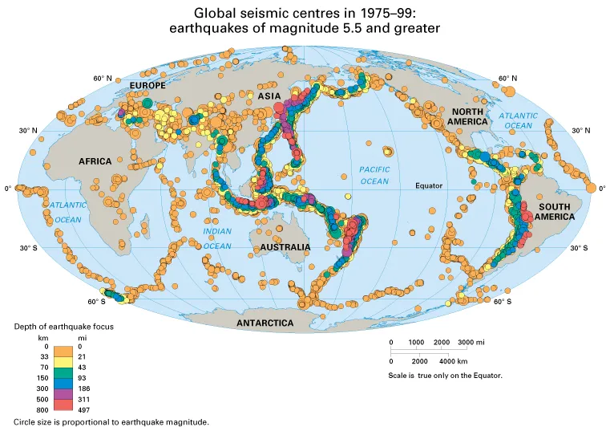
Earthquake geography (1) - seismicity patterns

Slide 3
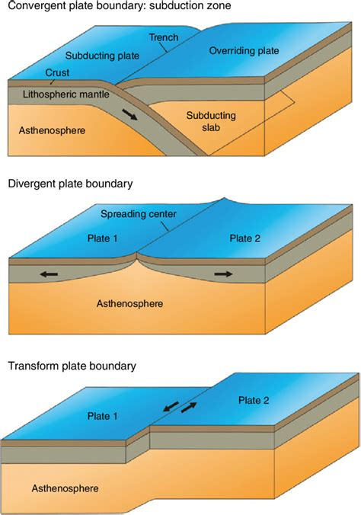
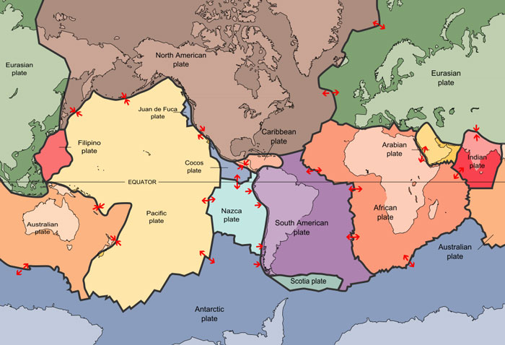
Earthquake geography (2) - plate tectonics
Most earthquakes occur near the boundaries of tectonic plates

Slide 4
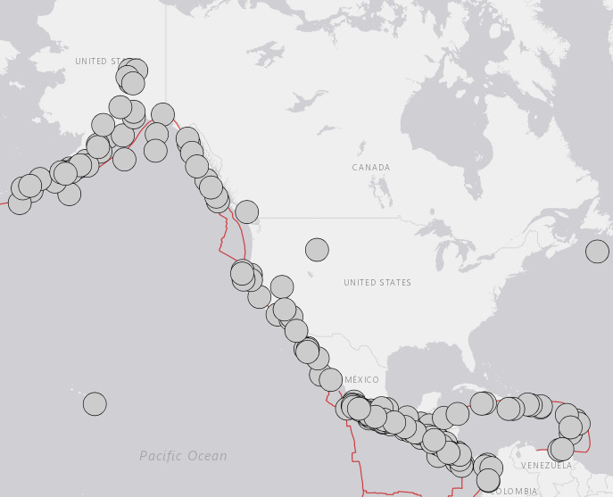
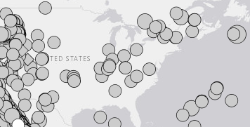
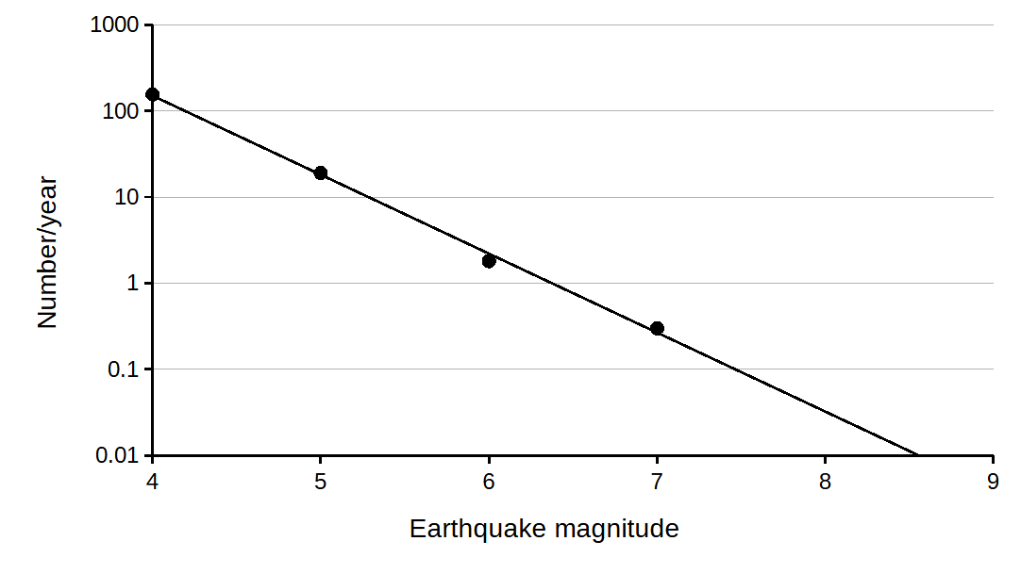
Earthquake geography (3) - North American earthquakes
M>7, 1900-present
U.S., last 10 years
M>5, 1900-present
Notes:
https://earthquake.usgs.gov/earthquakes/search/

Slide 5
Outline of this presentation
Earthquake geography
Earthquakes in my collection
Earthquake stamps
San Francisco earthquake, 1906
Long Beach earthquake, 1933
Loma Prieta earthquake, 1989

Slide 6
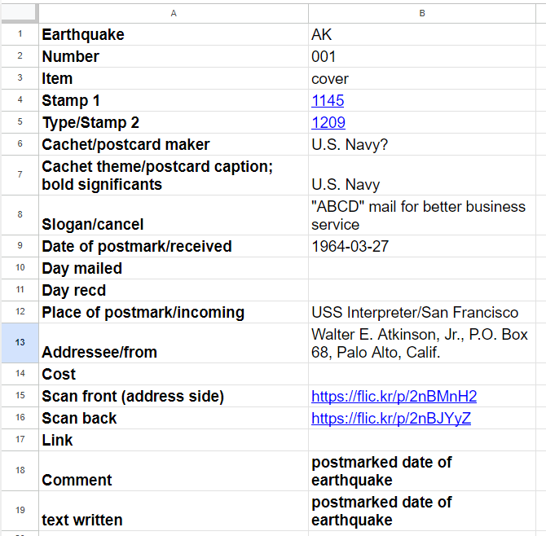
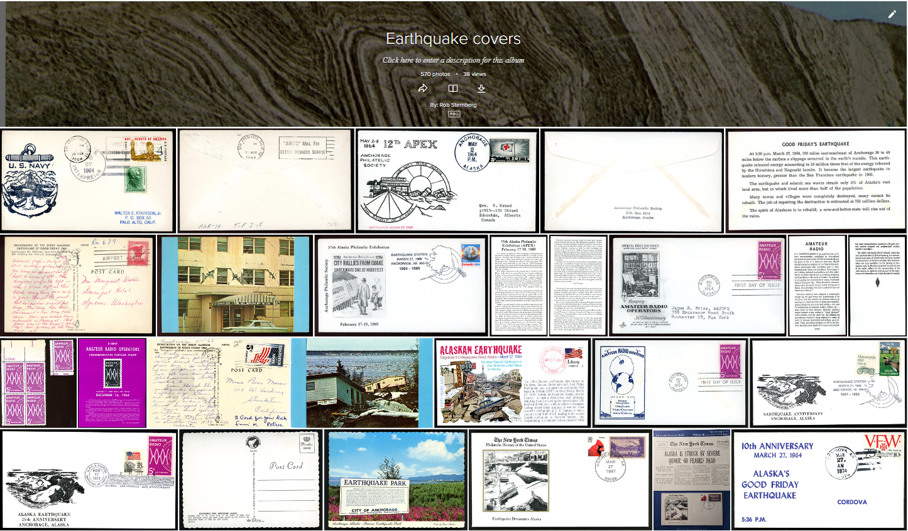
Earthquakes in my collection (1)
Spreadsheet list
https://docs.google.com/spreadsheets/d/1TVzudKaRLIAihXQ28Ujs1_YhFEdWjDbuveGUsEq5v_E/edit?usp=sharing
Flickr images
covers and postcards - https://flic.kr/s/aHsmUGrr3p
stamps - https://flic.kr/s/aHBqjAneq4
Notes:
stamps from outside the U.S. not integrated into all the statistics to follow

Slide 7
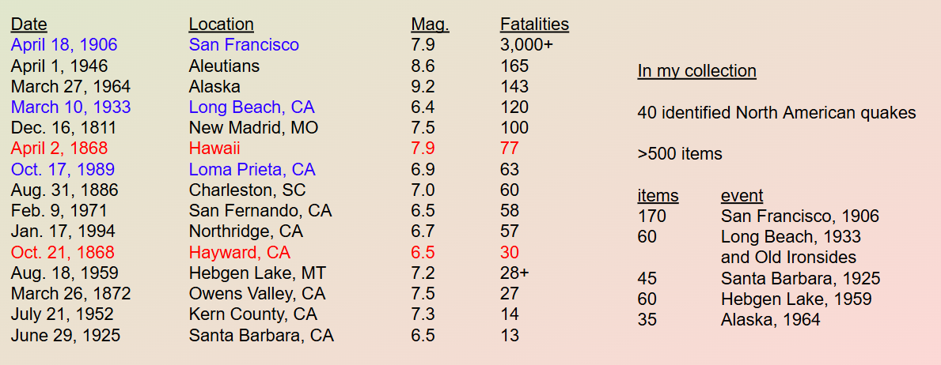
Earthquakes in my collection (2)
U.S. earthquakes with >10 Fatalities
Red - events not represented in my collection
Blue - shown in this presentation
Notes:
https://en.wikipedia.org/wiki/List_of_earthquakes_in_the_United_States

Slide 8
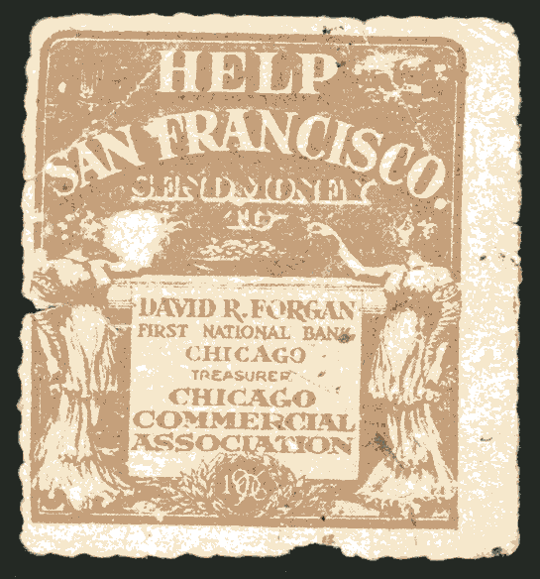
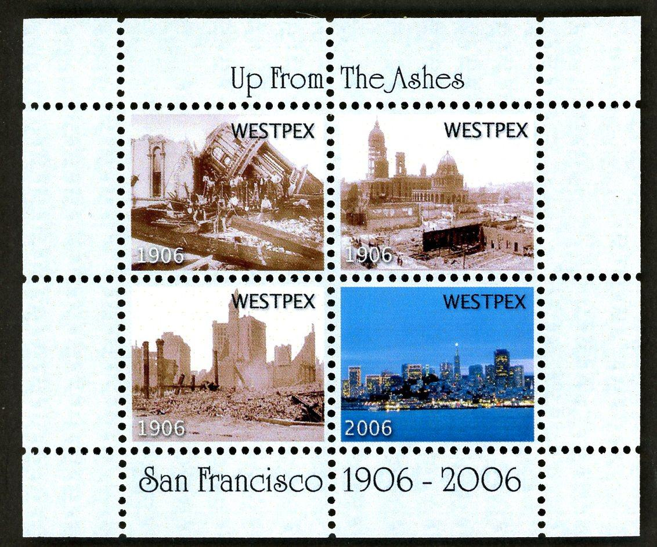
Earthquake stamps (1) - U.S. stamps (not)
“Help San Francisco; send money; David R. Forgan, First National Bank, Chicago, treasurer, Chicago Commercial Association" and author of The Golfer’s Creed
SF001 in my collection
No postage stamps
Citizens Stamp Advisory Committee
2019 criteria for stamps
https://about.usps.com/who/csac/#criteria
“The stamp program commemorates positive contributions to American life, history, culture and environment; therefore, negative occurrences and disasters will not be commemorated on U.S. postage stamps or stationery.”
A few cinderellas (labels, not for postage)
The show theme for WESTPEX 2006 was commemorating the 100th anniversary of the 1906 San Francisco earthquake.
SF011 in my collection

Slide 9
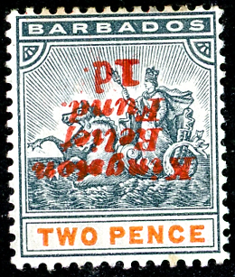


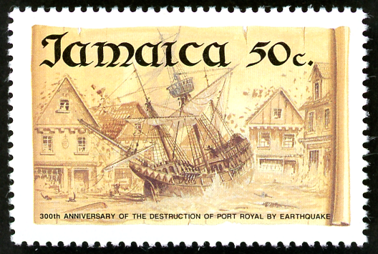
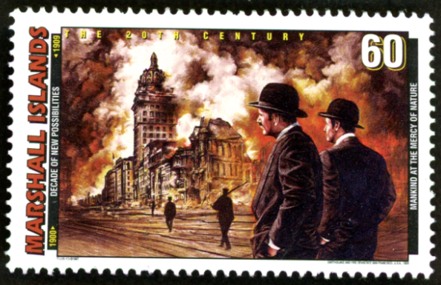
Earthquake stamps (3) - Central America, Caribbean
Earthquake stamps can
use surcharges to aid relief work
honor rescue workers and rebuilding
commemorate a historical event
Barbados B1e (1907), semi-postal,
inverted overprint
Kingston (1907) relief fund
Nicaragua C447 (1960), airmail, overprinted
Red Cross aid for victims in Chile (1960)
Jamaica 772 (1992)
300th anniv. of Port Royal (1692)
Marshall Islands 627k (1997)
20th Century, 1900-1909
Mankind at the Mercy of Nature
San Francisco (1906)
Nicaragua 2247 (1998), souv. sheet
25th anniv. Managua (1972)
Notes:
Old English Money
Please note: We have mainly written about England, as that is the country within the UK where our students live. We would be very happy for schools and visitors to send us information we can add to our website on Wales and Scotland.
After the Norman Conquest in 1066, the pound was divided into twenty shillings or 240 pennies. It remained so until decimalization on 15 February 1971, when the pound was divided up as it is still done today.
Before 1971 money was divided into:
pounds (£ or l )
shillings (s. or /-) and
pennies (d.)
Nicaragua souvenir sheet
Overprint of Nic. 1959 stamp for 150th Lincoln birthday

Slide 10
Earthquake stamps (3) - postcards and letters
Some of my U.S. collection consists of covers and letters
But a large number are postcards (deltiology)
Also books and ephemera like contemporary newspapers
Preferred criteria:
mailed, stamp not removed
postmarked soon after earthquake
postmarked from near the epicenter
includes a message about the event
legible with clear markings
good condition
not too expensive

Slide 11
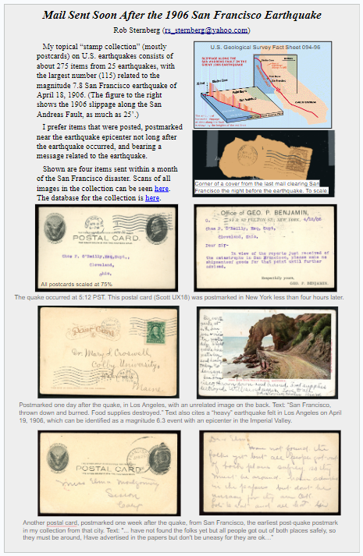
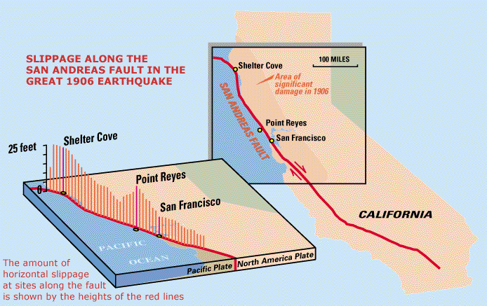
San Francisco earthquake, 1906 (1)
San Francisco earthquake, April 18, 1906, 5:12 am
magnitude = 7.8
3000+ fatalities
80% of the city destroyed
Its importance comes more from the wealth of scientific knowledge derived from it than from its sheer size.
U.S. Geological Survey Fact Sheet 094-96
ATA 1-page exhibits, 2024 (offline)
Notes:
https://pubs.usgs.gov/fs/1996/fs094-96/fs094-96.pdf

Slide 12
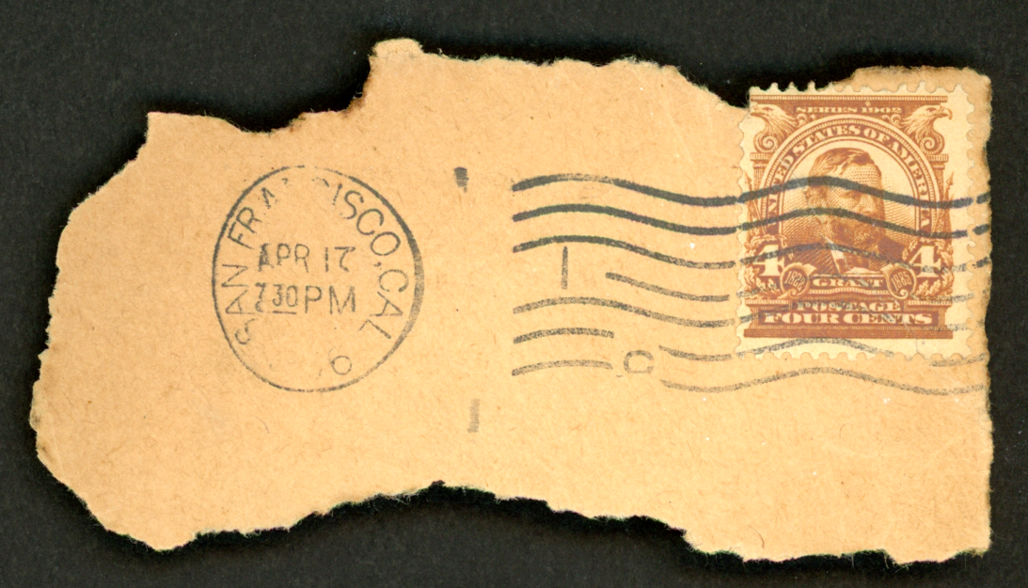
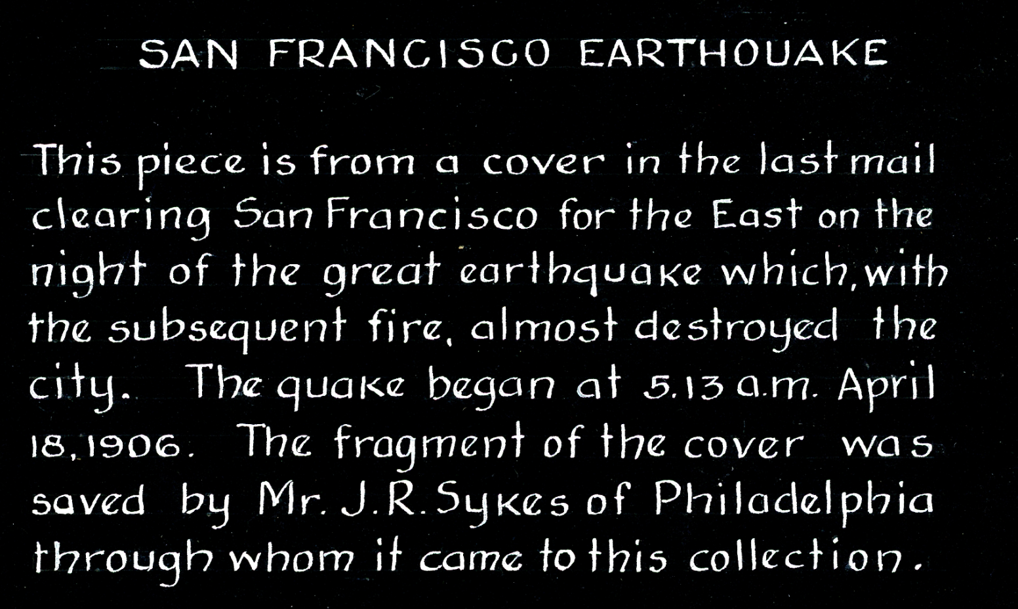
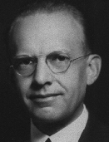
San Francisco earthquake, 1906 (2)
San Francisco - 4/17/1906, 7:30 pm
stamp - Scott 303 (1903), Grant
SF002 in my collection
SF quake, 4/18/1906, 5:12 am local time
Postmarked 10 hours before the quake.
Addressee(?): Clifton Pool Mayfield, born Sept. 5, 1887, Washington. D.C.
Notes:
https://userpages.cs.umbc.edu/mayfield/genealogy/093CliftonPoolMayfield.html

Slide 13
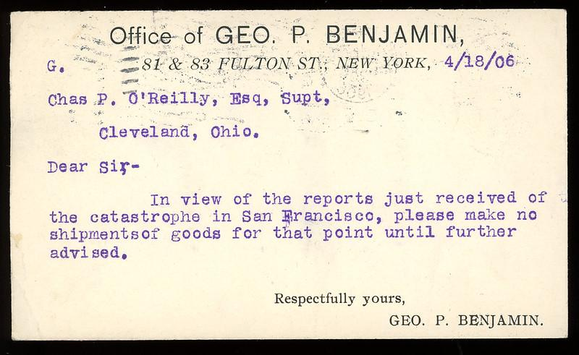
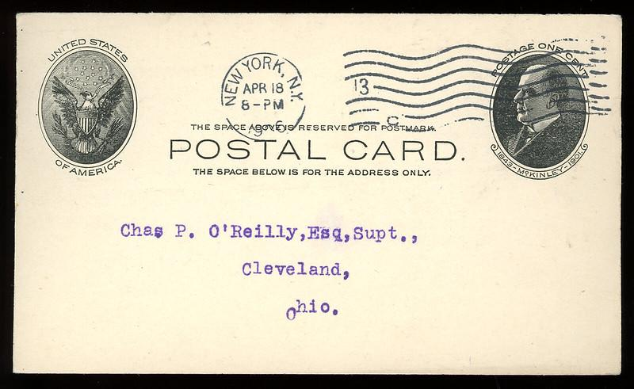
San Francisco earthquake, 1906 (3)
Postal card
NY to Cleveland, 4/18/1906
stamp - Scott UX18 (1902), McKinley
SF050 in my collection
It’s typed!
postal rate for postcard is 1¢
SF quake, 4/18/1906, 5:12 am local time
Postmarked same day, just 12 hours after the quake.
Contacted the reference staffs of The New York Public Library and the Cleveland Public Library. “O’Reilly might have been the superintendent of a city prison/workhouse.”
Notes:
quake at 5:12 am Pacific

Slide 14
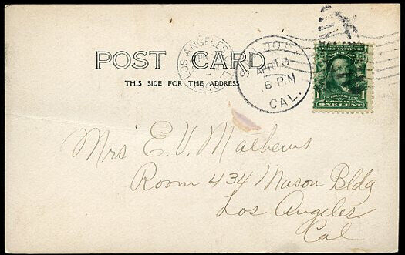
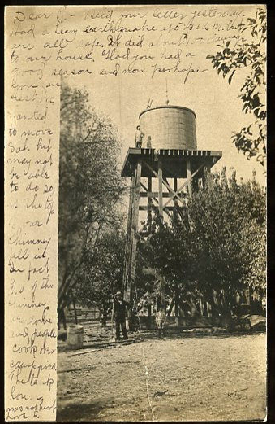
San Francisco earthquake, 1906 (4)
Earliest SF area cancel, 13 hours after quake.
About 80 miles from epicenter.
"Dear R, Recd your letter yesterday. Had a heavy earthquake at 5:30 am. but are all safe. It did about $400 damage to our house. Had you had a good season and now perhaps you can rest. We wanted to move Sal [?] but may not be able to do so as the top of our chimney fell in. In fact [?] of the chimneys are down and people cook over camp fires. The tank house was not hurt. Love K"
real photo postcard (RPPC), undivided
San Jose - Los Angeles, 4/18/1906, 6 pm
stamp - Scott 300 (1903), Franklin
SF125 in my collection
Text on front (picture) side

Slide 15
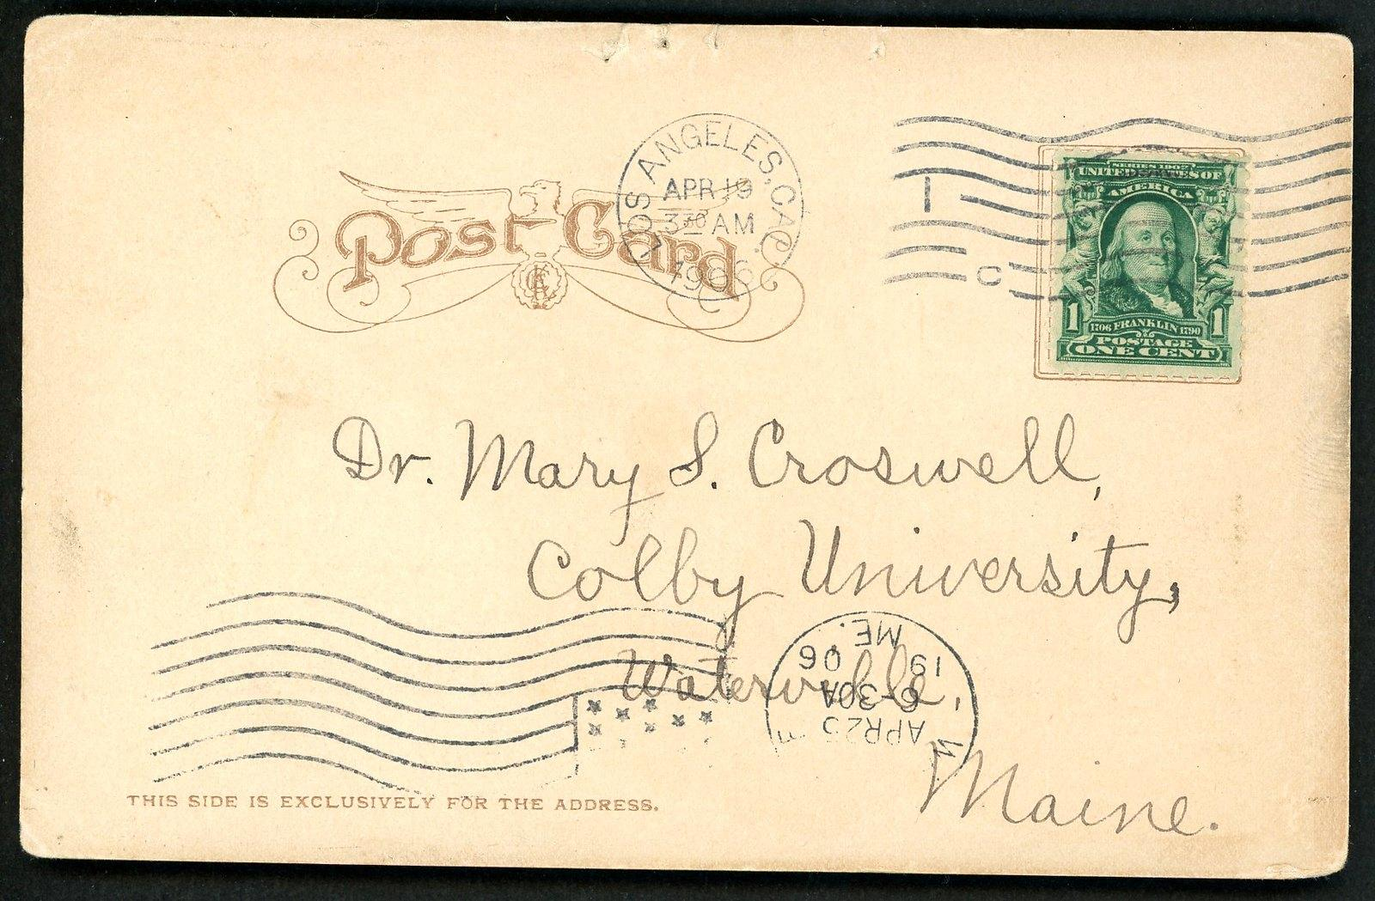
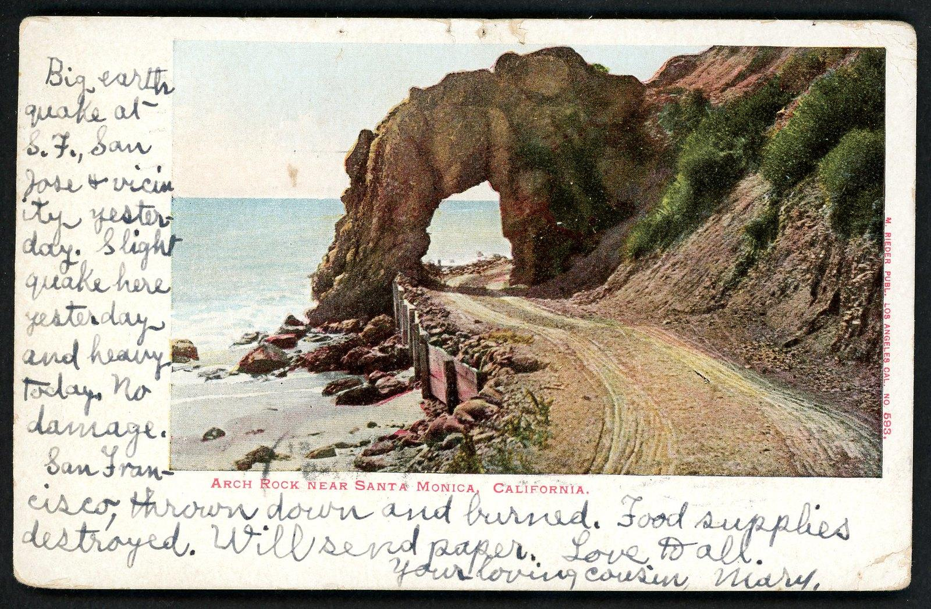
San Francisco earthquake, 1906 (5)
Postcard (undivided), color
Los Angeles - Waterville, ME, 4/19/1906
stamp - Scott 300 (1903), Franklin
SF003 in my collection
‘Arch Rock near Santa Monica, CA’
Postmarked one day after the quake, in Los Angeles, with an unrelated image on the back.
“Big earthquake at S.F., San Jose & vicinity yesterday. Slight quake here yesterday and heavy today [can be identified as a magnitude 6.3 event with an epicenter in the Imperial Valley]. No damage.
“San Francisco, thrown down and burned. Food supplies destroyed. Will send paper. Love to all. Your loving cousin, Mary.”
Notes:
Dr. Mary was an osteopathic physician, mainly in the Farmington area of Maine, plus a few years in Los Angeles, CA, when many Croswells relocated West. She was a Colby College grad (1896) and earned medical degrees from Tufts Univ. School of Medicine, Boston (1903) with a dozen other female physicians, and from the Pacific College of Osteopathy in Calif.
She was highly educated and professional, the only daughter of a prominent, successful businessman. She specialized in treating women & children, and diseases of the eye, ear, nose & throat. Sadly, she committed suicide at age 57. Her obit. reflects the esteem with which patients regarded her: "She was very much devoted to her profession, and took a most self-sacrificing interest in her patients."

Slide 16
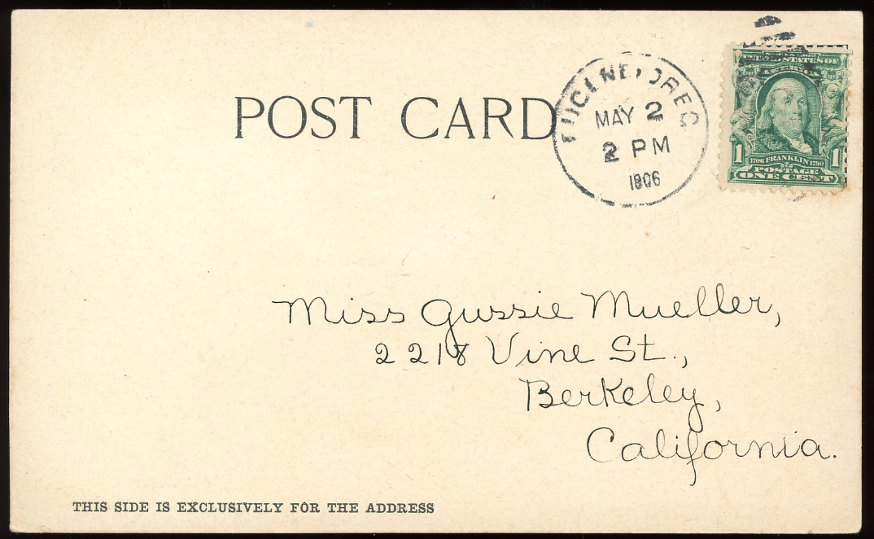
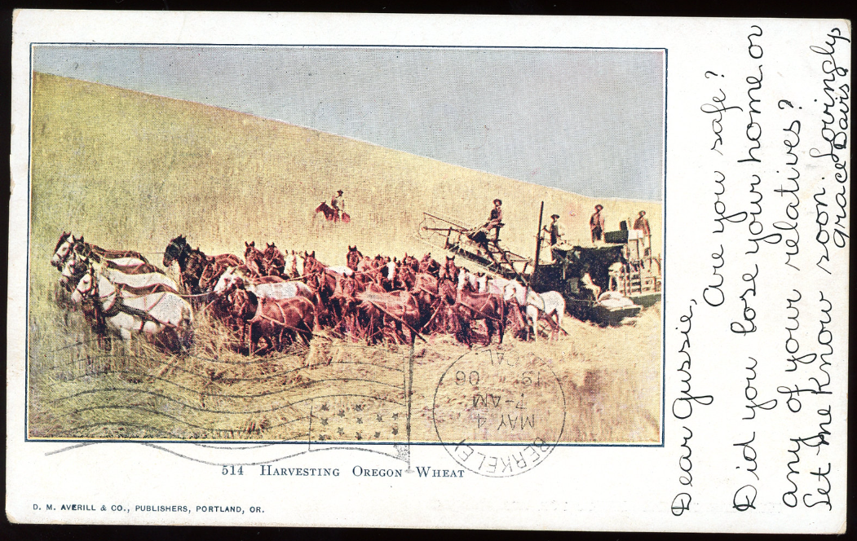
San Francisco earthquake, 1906 (6)
Postcard (undivided), color
Eugene, OR - Berkeley, 5/2/1906
stamp - Scott 300 (1903), Franklin
SF019 in my collection
‘Harvesting Oregon wheat’
Earliest card to Bay Area, two weeks after quake.
"Dear Gussie, Are you safe? Did you lose your home or any of your relatives? Let me know soon. Lovingly, Grace Davis"

Slide 17
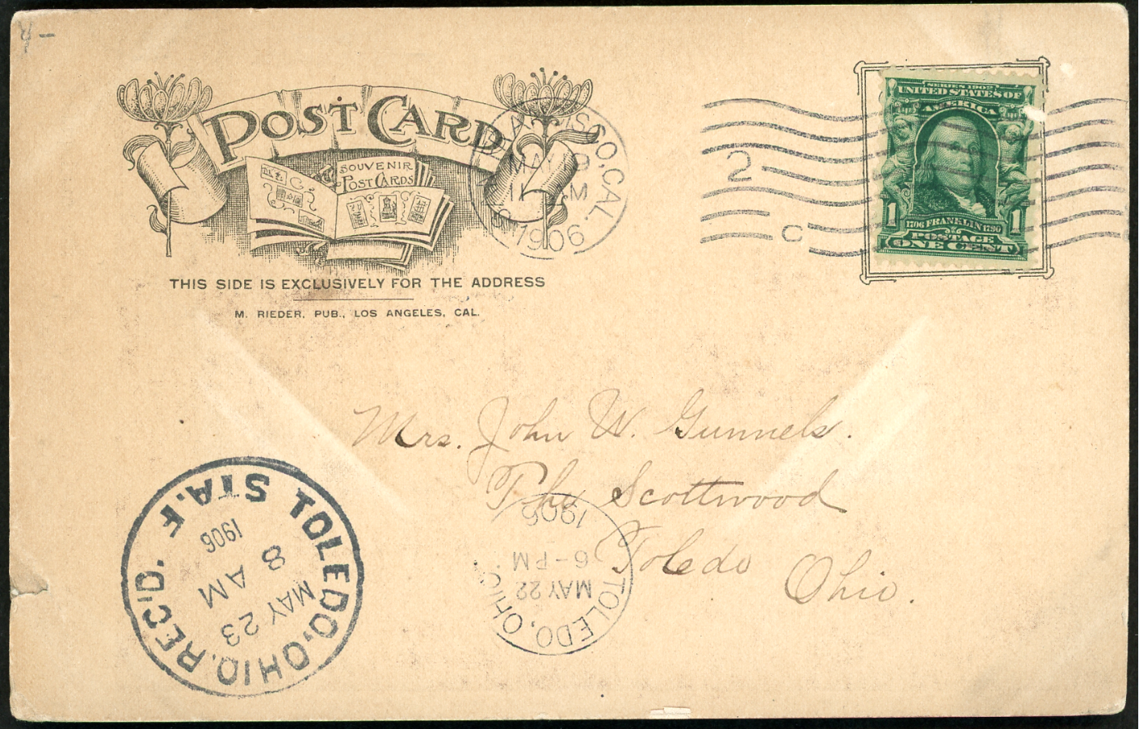
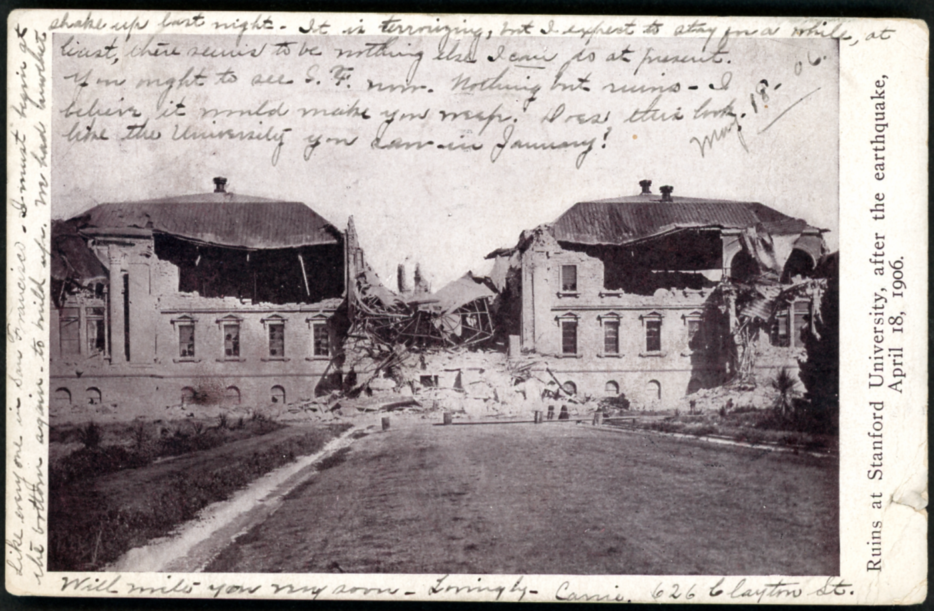
San Francisco earthquake, 1906 (7)
Postcard (undivided), color
San Francisco - Toledo, ME, 5/19/1906
stamp - Scott 300 (1903), Franklin
SF135 in my collection
‘Ruins at Stanford University, after the earthquake. April 18, 1906.’
Two Toledo cancellation on 5/22 and 5/23
"Like everyone in San Francisco, I must begin at the bottom again, to build up. We had another shake up just might. It is terrorizing, but I expect to stay for a while at least. there seems to be nothing else I can do at present. You ought to see S.F. now. Nothing but ruins. I believe it would make you [?]. Does this look like the university you saw in January! Will write you more soon. Lovingly, Carrie 626 Clayton St., May 18 06."

Slide 18
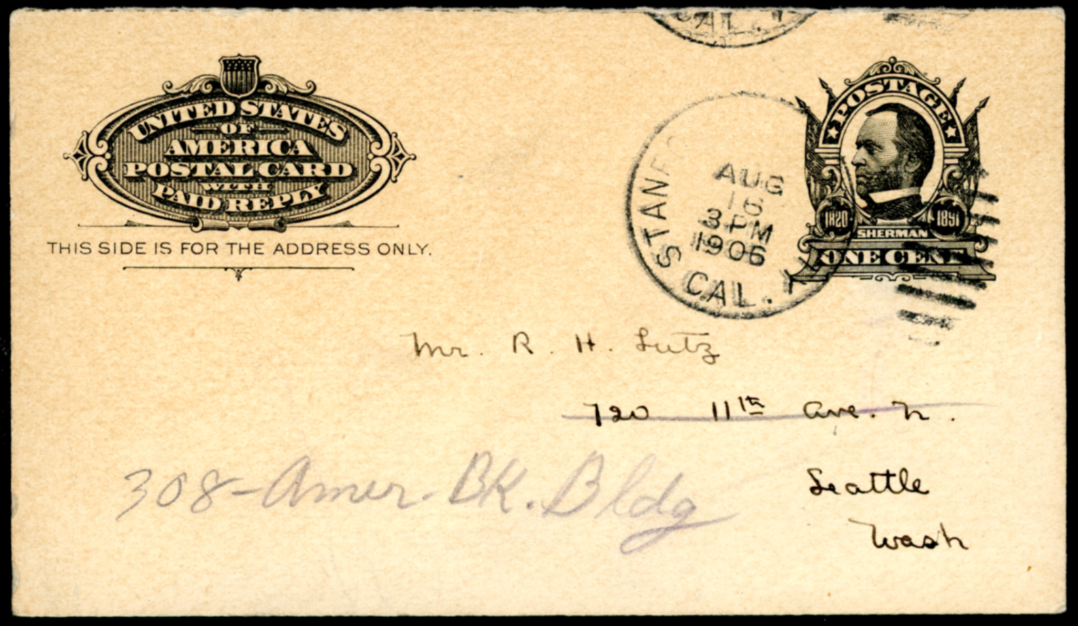
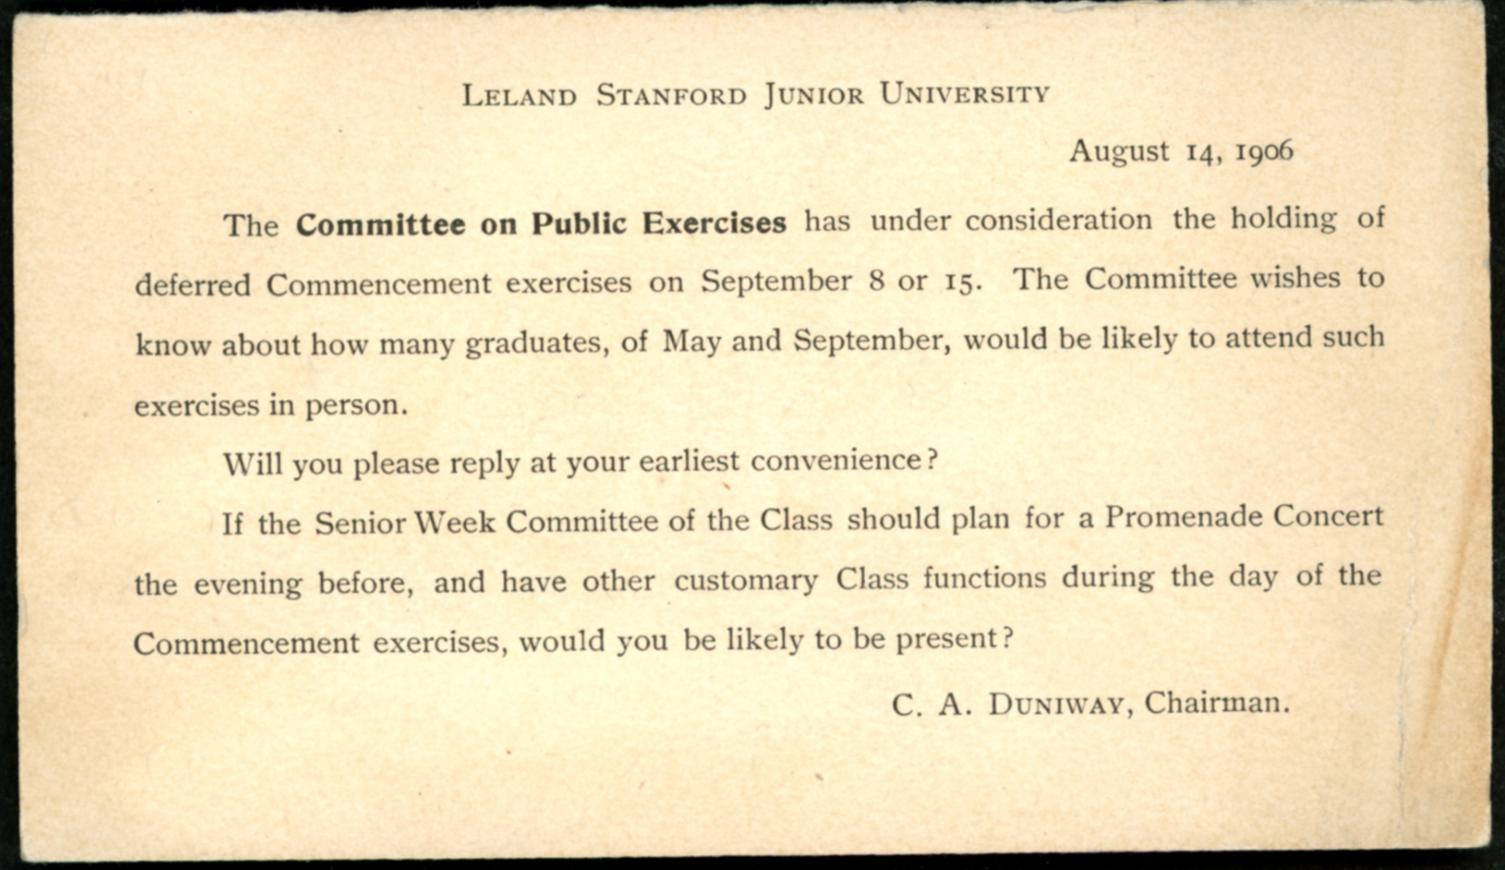
San Francisco earthquake, 1906 (8)
Postal card with reply (reply missing)
Stanford - Seattle, 8/16/1906
stamp - Scott UY4 (1904), Sherman
SF179 in my collection
‘Leland Stanford Junior University August 14, 1906
The Committee on Public Exercises has under consideration the holding of deferred Commencement exercises on September 8 or 15. The Committee wishes to know about how many graduates, of May and September, would be likely to attend such exercises in person.
Will you please reply at your earliest convenience?
If the Senior Week Committee of the Class should plan for a Promenade Concert the evening before, and have other customary Class function during the day of the Commencement exercises, would you be likely to be present?
C. A. DUNIWAY, Chairman.’

Slide 19
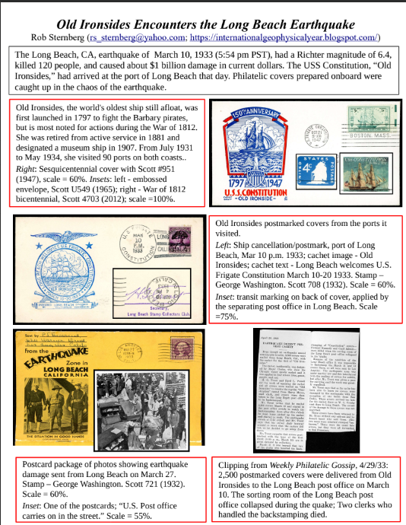
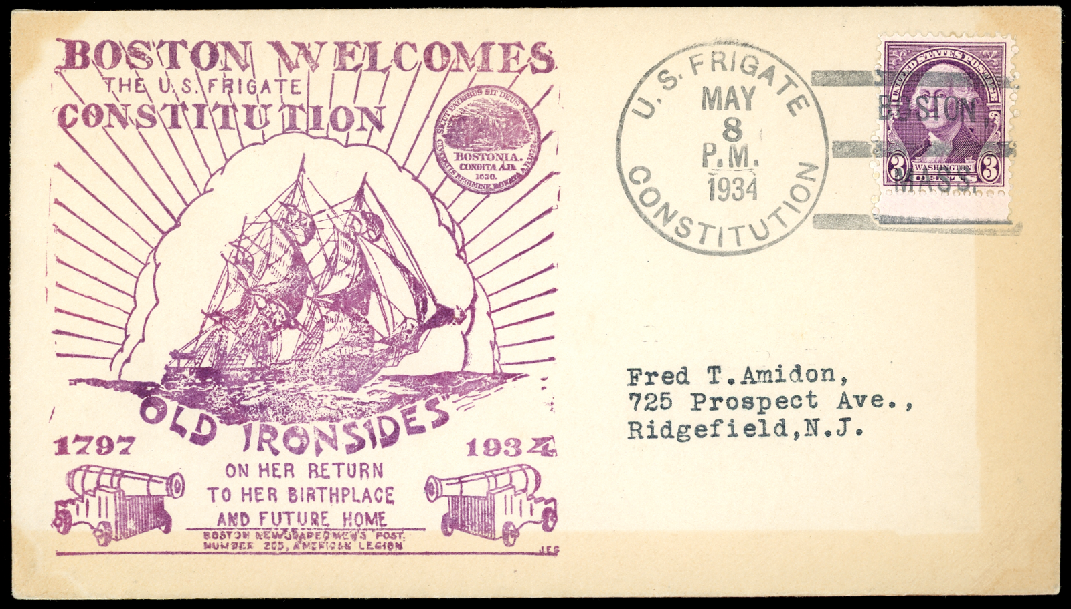
Long Beach earthquake, 1933 (1)
Long Beach earthquake, March 10, 1933, 5:54 pm
magnitude =6.4 120 fatalities
Led to the passage of California’s Field Act, mandating earthquake-resistant construction for public school buildings.
USS Constitution (aka Old Ironsides) - from 1931-1934, it toured 76 cities along the Atlantic, Gulf, and Pacific coasts of the United States during the National Cruise
It docked in Long Beach on the morning of March 10, 1933, and encountered the earthquake.
cover
cachet - ‘Boston welcomes The U.S. Frigate Constitution’
4/8/1934, onboard
Scott 720 (1932)
OI004
ATA 1-page exhibits, 2022 (offline)

Slide 20
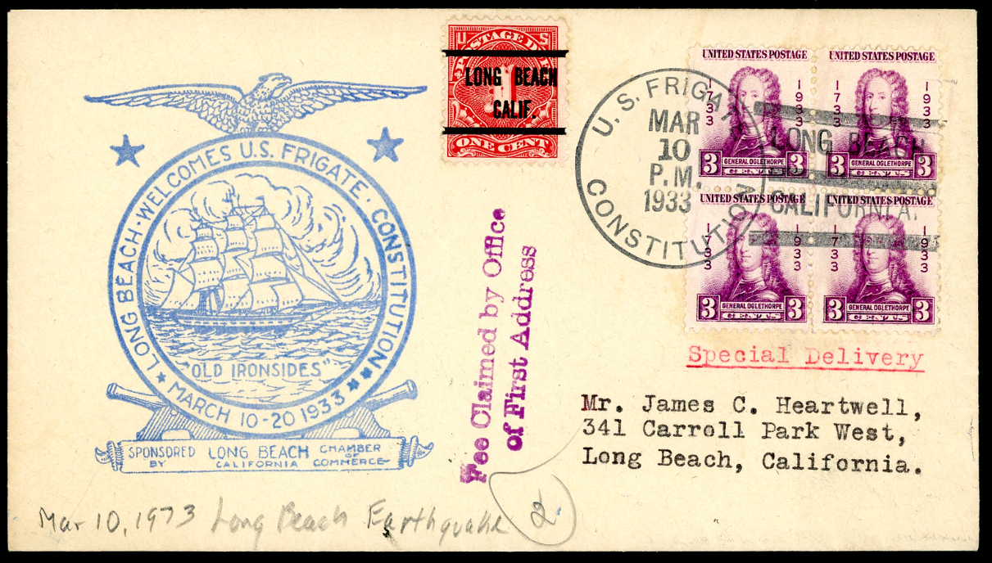
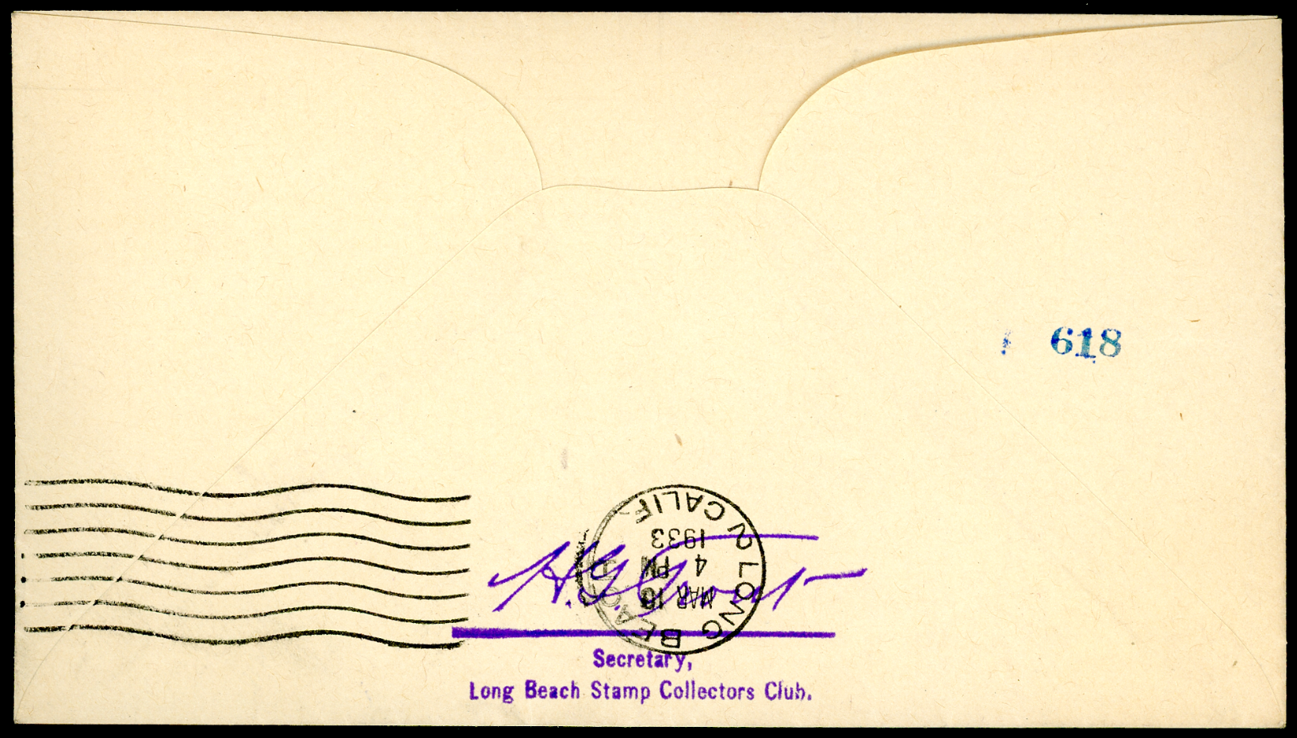
Long Beach earthquake,1933 (2)
cover
Long Beach - Long Beach, 3/10/1933, in the p.m.
front: ship cancellation/postmark
backstamp: Long Beach transit marking, 3/10/33, 4pm
signed by H.G. Trout
cachet image - Old Ironsides
cachet text - Long Beach welcomes U.S. frigate Constitution March 10-20 1933
stamp - Scott 726 (block), James Oglethorpe
postage due - Scott J5? (1910s)
markings - Fee Claimed; Special Delivery
LB026 in my collection
Long Beach, CA, m=6.4 earthquake was March 10, 1933 (5:54 pm PST).
The USS Constitution, “Old
Ironsides,” arrived at the port of Long Beach earlier that day as part of a three-year tour of 90 ports on both coasts.
Old Ironsides processed covers from the ports it visited.

Slide 21
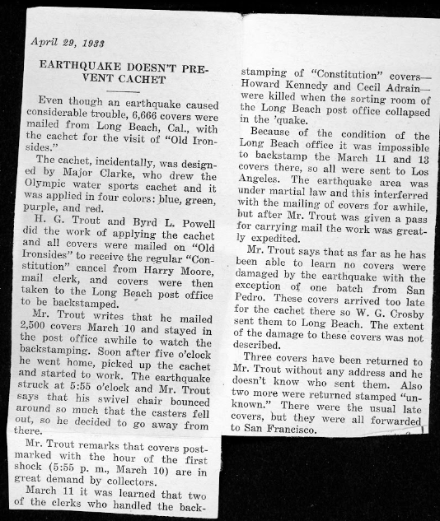
Long Beach earthquake,1933 (3)
Weekly Philatelic Gossip
April 29, 1933
EARTHQUAKE DOESN'T PRE-
VENT CACHET
Even though an earthquake caused considerable trouble, 6,666 covers were mailed from Long Beach, Cal., with the cachet for the visit of “Old Ironsides.”
The cachet, incidentally, was designed by Major Clarke, who drew the Olympic water sports cachet and it was applied in four colors; blue, green, purple, and red.
H. G. Trout and Byrd L. Powell did the work of applying the cachet and all covers were mailed on “Old Ironsides” to receive the regular “Constitution” cancel from Harry Moore, mail clerk, and covers were then taken to the Long Beach post office to be backstamped.
Mr. Trout writes that he mailed 2,600 covers March 10 and stayed in the post office awhile to watch the backstamping. Soon after five o’clock he went home, picked up the cachet and started to work. The earthquake struck at 5:55 o'clock and Mr. Trout says that his swivel chair bounced around so much that the casters fell out, so he decided to go away from there.
Mr. Trout remarks that covers postmarked with the hour of the first shock (5:55 p. m., March 10) are in great demand by collectors.
March 11 it was learned that two of the clerks who handled the backstamping of “Constitution” covers—Howard Kennedy and Cecil Adrain—were killed when the sorting room of the Long Beach post office collapsed in the quake.
Because of the condition of the Long Beach office it was impossible to backstamp the March 11 and 13 covers there, so all were sent to Los Angeles. The earthquake area was under martial law and this interferred [sic] with the mailing of covers for awhile, but after Mr. Trout was given a pass for carrying mail the work was greatly expedited.
Mr. Trout says that as far as he has been able to learn no covers were damaged by the earthquake with the exception of one batch from San Pedro. These covers arrived too late for the cachet there so W. G. Crosby sent them to Long Beach. The extent of the damage to these covers was not described.
Three covers have been returned to Mr. Trout without any address and he doesn’t know who sent them. Also two more were returned stamped “unknown.” There were the usual late covers, but they were all forwarded to
San Francisco.
LB001 insert
Notes:
Two of the clerks who handled the back-stamping of "Constitution" covers were killed when the sorting room of the Long Beach post office collapsed in the 'quake
https://www.ataexhibits.com/old-ironsides-encounters-the-long-beach-earthquake/

Slide 22
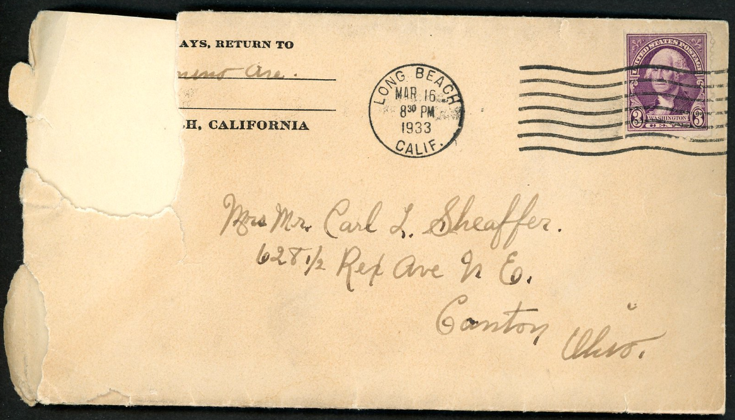
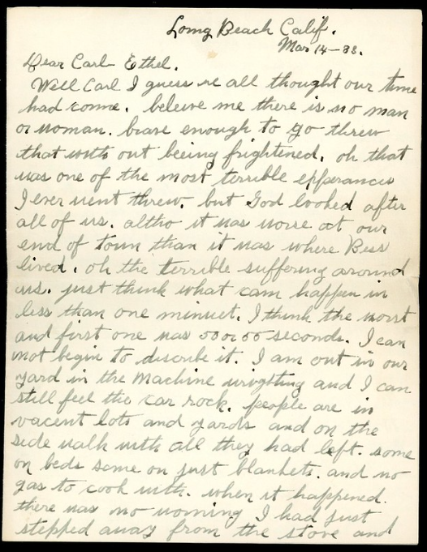
Long Beach earthquake, 1933 (4)
written March 14, four days after quake
Letter
Long Beach - Canton, OH, 3/16/1933
Scott 720 (1932), Washington
LB008 in my collection
postal rate for letter is 3¢
p. 1
Notes:
“Well Carl I guess we all thought our time had come. believe me there is no man or woman brave enough to go threw [sic] that with out being frightened. oh that was one of the most terrible experiences I ever went threw. but God looked after all of us altho it was worse at our end of town than it was where Bess lived. oh the terrible suffering around us just think what can happen in less than one minuet [sic]. I think the worst and first one was 50 or 55 seconds. I can not begin to describe it.”

Slide 23
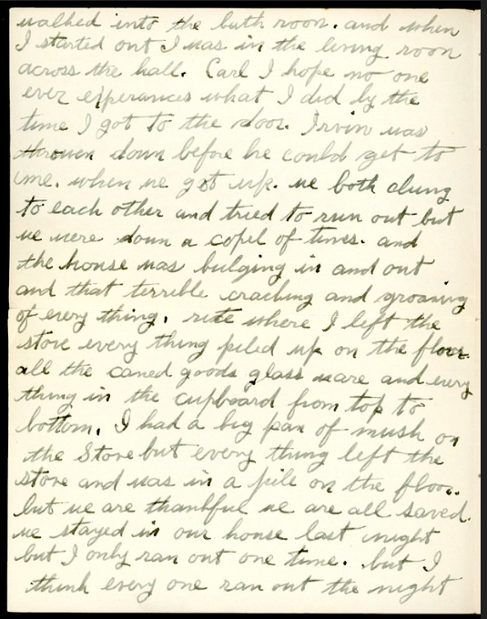
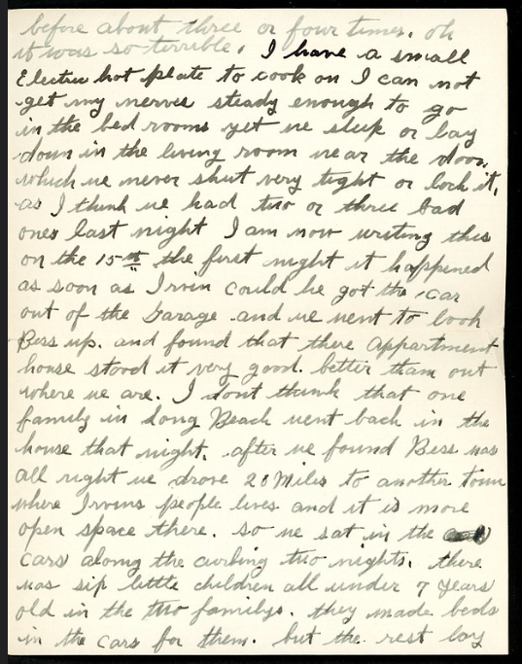
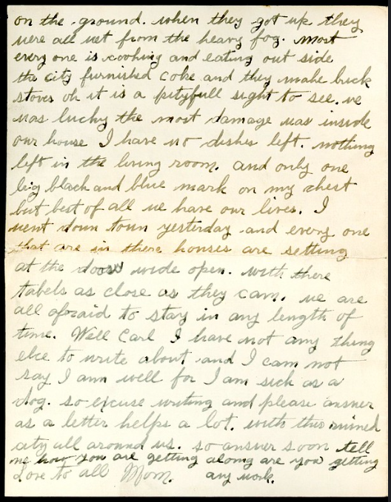
Long Beach earthquake, 1933 (5)
p. 2
p. 3
p. 4
LB008 in my collection
Notes:
“Well Carl I guess we all thought our time had come. believe me there is no man or woman brave enough to go threw [sic] that with out being frightened. oh that was one of the most terrible experiences I ever went threw. but God looked after all of us altho it was worse at our end of town than it was where Bess lived. oh the terrible suffering around us just think what can happen in less than one minuet [sic]. I think the worst and first one was 50 or 55 seconds. I can not begin to describe it.”

Slide 24
Long Beach earthquake, 1933 (6)
Long Beach Calif. Mar 14 - 33.
Dear Carl Ethel.
Well Carl I guess we all thought our time had come. believe me there is no man or woman brave enough to go threw [sic] that with out being frightened. oh that was one of the most terrible experiences I ever went threw. but God looked after all of us altho it was worse at our end of town than it was where Bess lived. oh the terrible suffering around us just think what can happen in less than one minuet [sic]. I think the worst and first one was 50 or 55 seconds. I can not begin to describe it. I am out in our yard in the machine (?) and I can still feel the car rock. people are in vacant lots and yards and on the side walk with all they had left. some on beds, some on just blankets. and no gas to cook with. when it happened there was no warning. I had just stepped away from the stove and walked into the bath room. and when I started out I was in the living room across the hall. Carl I hope no one ever experiences what I did. by the time I got to the door, Irvin was thrown down before he could get to me. when he got up we both clung to each other and tried to run out but we were down a cople [sic] of times. and the house was bulging in and out and that terrible cracking and groaning of every thing. rite [sic] where I left the stove every thing piled up on the floor. all the caned [sic] goods glass are and every thing in the cupboard from top to bottom. I had a big pan of mush on the Stove but every thing left the stove and was in a pile on the floor. but we are thankful we are all saved. we stayed in our house last night but I only ran out one time. but I think every one ran out the night before about three or four times. oh it was so terrible. I have a small Electric hot plate to cook on[.] I can not get my nerves steady enough to go in the bed rooms yet we sleep or lay down in the living room near the door which we never shut very tight or lock it, as i think we had two or three bad ones last night[.] I am now writing this on the 15th. the first night it happened as soon as Irwin could he got the car out of the Garage and we went to look Bess up and found that there [sic] appartment [sic] house stood it very good, better than out where we are. I don't think that one family in Long Beach went back in the house that might. after we found Bess was all right we drove 20 miles to another town where Irvins people lives and it is more open space there. so we sat in the cars along the curbing two nights. there was six little children all under 7 years old in the two familys [sic]. they made beds in the cars for them. but the rest lay on the ground. when they got up there were all wet from the heavy fog. most every one is cooking and eating out side[.] the city furnished coke and they make brick stoves. oh it is a pityfull [sic] sight to see. we was lucky the most damage was inside our house. I have no dishes left, nothing left in the living room, and only one big black and blue mark on my chest but best of all we have our lives. I went down town yesterday and every one that are in there [sic] houses are setting at the doors wide open with there [sic] tabels [sic] as close as they can. we are all afraid to stay in any length of time. Well Carl I have not any thing else to write about and I can not say I am well for I am sick as a dog. so excuse writing and please answer as a letter helps a lot with this ruined city all around us.
so answer soon tell me how you are getting along. are you getting any work.
Love to all Mom
LB008
Notes:
“Well Carl I guess we all thought our time had come. believe me there is no man or woman brave enough to go threw [sic] that with out being frightened. oh that was one of the most terrible experiences I ever went threw. but God looked after all of us altho it was worse at our end of town than it was where Bess lived. oh the terrible suffering around us just think what can happen in less than one minuet [sic]. I think the worst and first one was 50 or 55 seconds. I can not begin to describe it.”

Slide 25
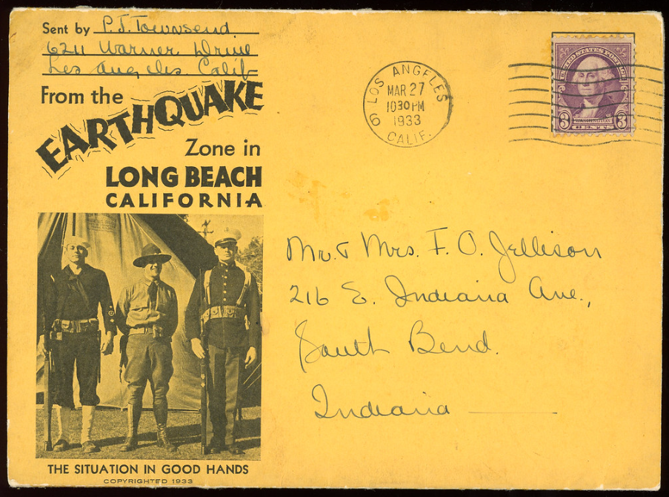
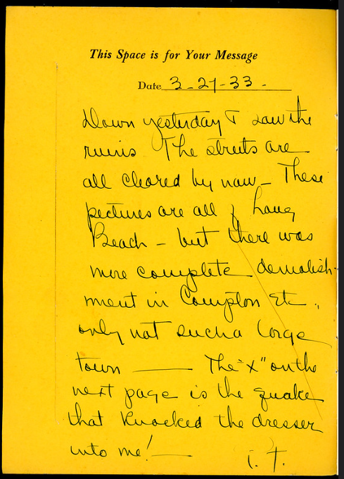
Long Beach earthquake, 1933 (7)
"3-27-33 Dawn yesterday I saw the ruins. The streets are all cleared by now. These pictures are all of Long Beach - but there was more complete demolish- ment in Compton etc. only not such a large town. The "x" on the next page is the quake that knocked the dresser into me! i.t."
Postcard folder - 17 p.
Los Angeles - South Bend, IN, 3/27/1933
stamp - Scott 720 (1932), Washington
LB011 in my collection
17 folders in my collection, 7 from Long Beach

Slide 26
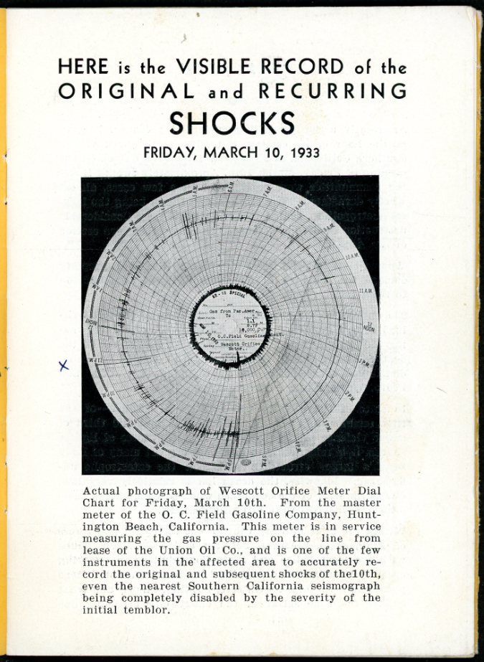
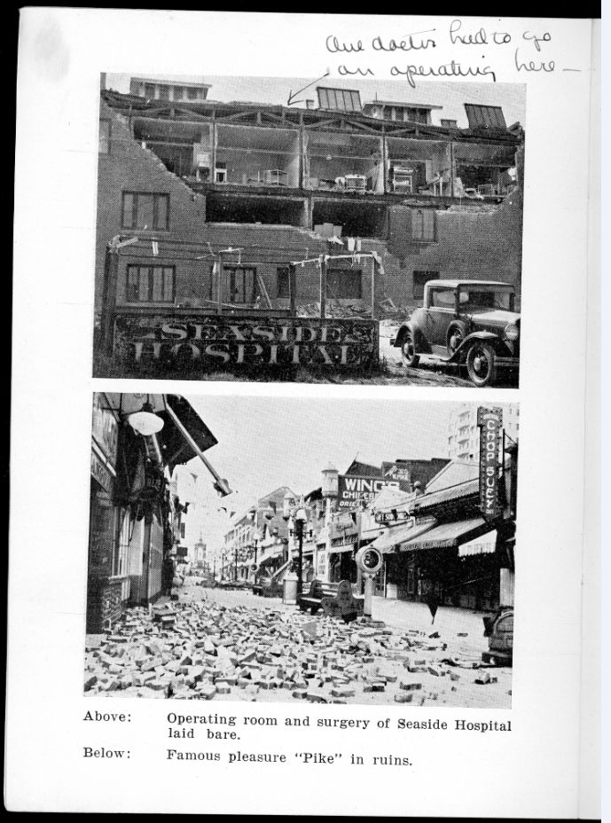
Long Beach earthquake, 1933 (8)
‘Operating room and surgery at Seaside Hospital laid bare.’
“Our doctor had to go on operating here.”
‘Famous pleasure “Pike” [historic amusement zone] in ruins.’
x marks the spot!
Seismogram from a gas pressure meter.
Actual seismo- graphs were still sparse. The Richter magnitude scale not developed until 1935.
6 pm
LB011 in my collection

Slide 27
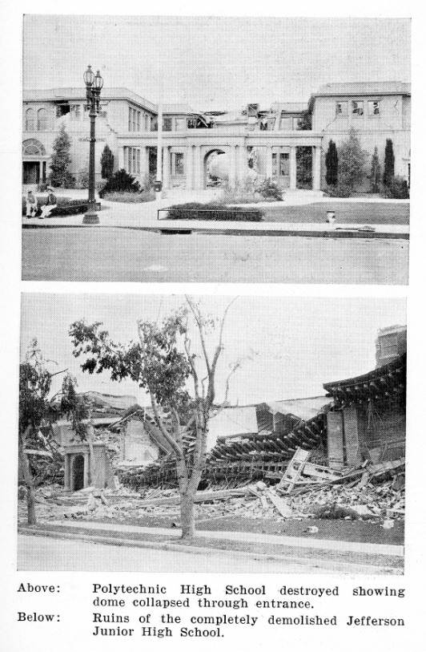
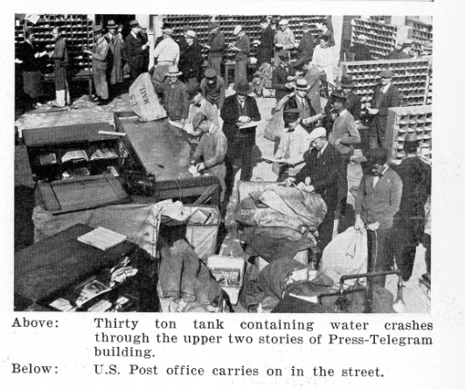
Long Beach earthquake, 1933 (9)
Two of the seventy schools destroyed and 120 damaged.
‘Polytechnic High School destroyed showing dome collapsed through entrance.’
‘Ruins of the completely demolished Jefferson Junior High School.’
Led to passage of California Field Act mandating quake-resistant schools in California.
‘U.S. Post Office carries on in the street.’
Post office destroyed.
LB011 in my collection

Slide 28
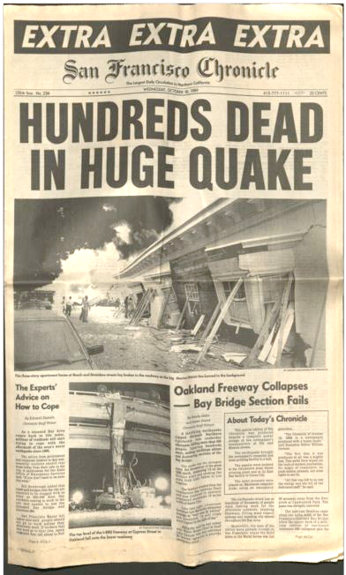
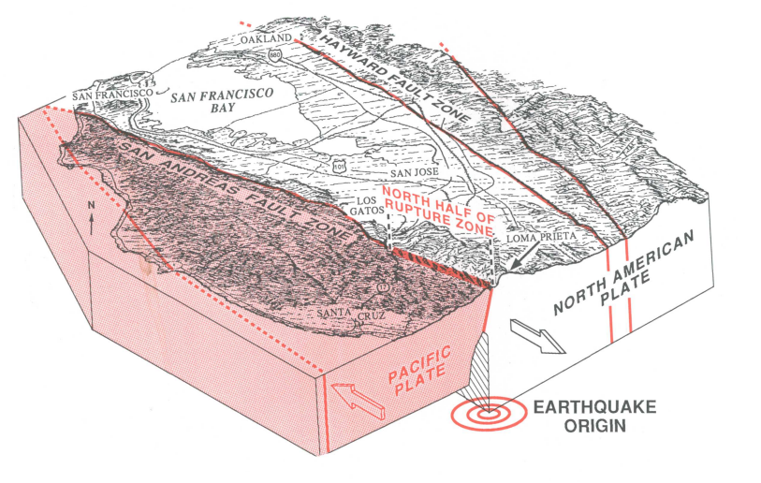
Loma Prieta earthquake, 1989 (1)
PSLC 1-page exhibits, 2024
Loma Prieta earthquake, Oct. 17, 1989, 5:04 pm
m = 6.9
The World Series earthquake!
Ephemera in my collection:
The SF Chronicle from the day after the quake reported on the damages.
T
Ward and Page (USGS, 1989)

Slide 29




Loma Prieta earthquake, 1989 (2)
cover
cachet - World Series quake
stamp - Scott 2417 (1989),
Lou Gehrig
Signed - Roger Craig
Giants manager
former NY Mets pitcher
‘Game three of the 1989 World Series was postponed…’
LP003 in my collection
ephemera - Topps 744 baseball card (1989),
Roger Craig, signed
LP008 in my collection
Signed - Roger Craig, Giants manager
ephemera - Score #702 baseball card (1990). ‘Bashers blast Giants. After an 11-day delay, Game 3 of the 1989 World Series resumed on October 28. The Athletic' Bay Bombers, hitting as if they had played just yesterday, responded with an awesome display of earth-shaking slugging to knock out the Giants 13-7…’ LP010 in my collection
Notes:
"San Francisco Bay Area Earthquake. The earth shook at exactly 5:04 p.m. on October 17, 1989 just before the start of the third game of the World Series between the Giants and the A’s. The earthquake measured 7.1 on the Richter scale. While 95% of The City escaped serious damage, the Marina District, on landfill, suffered the most destruction. Also shown are the collapsed 880 Freeway and the 50-foot section of the Bay Bridge that collapsed. The bridge was repaired in record time, and reopened one month later."
Bashers blast Giants.
After an 11-day delay, Game 3 of the 1989 World Series resumed on October 28. The Athletic' Bay Bombers, hitting as if they had played just yesterday, responded with an awesome display of earth-shaking slugging to knock out the Giants 13-7. Dave Henderson, Jose Canseco and Carney Lansford each had three hits, and totalled four runs and nine RBIs among them. Henderson almost had three homers, but his first inning drive bounced off the top of the right field fence for a two-run double. With Tony Phillips also adding a home run, the A's equalled the record of five in one game set by the mighty 1928 New York Yankees. Throw in the Giants' two homers and the two teams set a mark for home runs in one game.
Dave Stewart, the Series MVP, became the first pitcher to win two playoff games and two World Series games in the same year when he held the Giants to five hits and three runs in seven innings, striking out eight. After he left, the Giants scored four runs in the ninth as Bill Bathe tied a record with a three-run pinch-hit homer in his first World Series at bat.

Slide 30


Loma Prieta earthquake, 1989 (3)
"Jan. 5, 1990.
Dear Jim,
In answer to your letter about Mrs. [Tony] Lazzeri, I have no idea where she is living as I haven’t seen or heard from anybody about her. I will continue to put my "feelers" out. Should I hear I will let you know. J."
letter with envelope
San Francisco - Fort Lauderdale
Jim Ogle was Yankees alumni director
1/6/90, 2½ months after quake
stamp - Scott 2278 (1988), flag
slogan - Give to the March of Dimes
LP012 in my collection
My house is still being worked on and can’t do any traveling until at least another week or ten days.
In regards to your letter to me asking if I could be interested to proposal, my answer is ‘No.’ "

Slide 31


Loma Prieta earthquake, 1989 (4)
postcard, color chrome
Long Beach - Clinton, IA, 4/21/90
stamp - Scott 2111 (1985), D-rate eagle
LP003 in my collection
‘...While 95% of The City escaped serious damage, the Marina District, on landfill, suffered the most destruction. Also shown are the collapsed 880 Freeway and the 50-foot section of the Bay Bridge that collapsed. The bridge was repaired in record time, and reopened one month later.’
"Friday. Arrived safely. I experienced earthquake tremors next morning [aftershocks of main quake]. Dazed over so far. Beautiful wedding reception dinner and party last nite. Have seen quite a few people I know. See you next wk, Mary"

