Slide 1
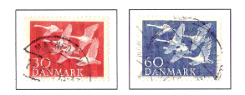
Norden Stamp Series
1953-2020
Fred Haynes
Rochester Philatelic Society
April 13, 2013

Slide 2
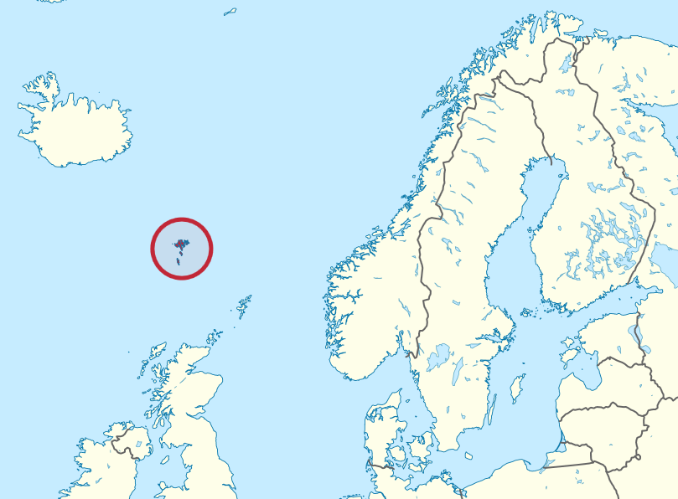
Original Nordic Group Countries
The five major Scandinavian nations initiated a postal service cooperation union in 1869. Some 87 years later, the five nations decided to issue a joint a pair of postage stamps to commemorate their long standing cooperation and their shared heritages.
Denmark:
Population 5,580,000
Capital - Copenhagen
Finland:
Population 5,400,000
Capital - Helsinki
Iceland
Iceland:
Population 320,000
Capital - Reykjavik
Finland
Norway:
Population 5,030,000
Capital - Oslo
Norway
Sweden
Sweden:
Population 9,540,000
Capital - Sweden
Denmark
Total Population:
16,330, 000

Slide 3
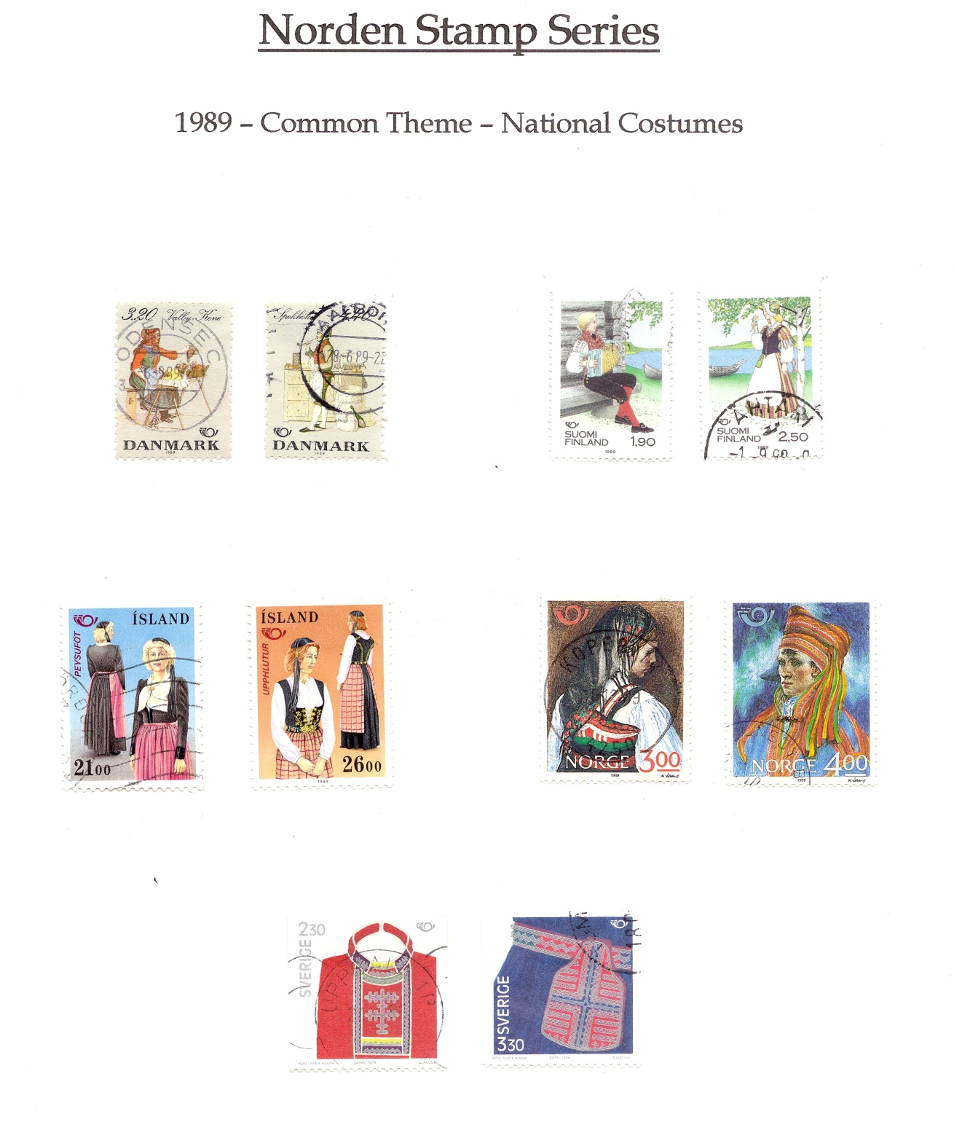
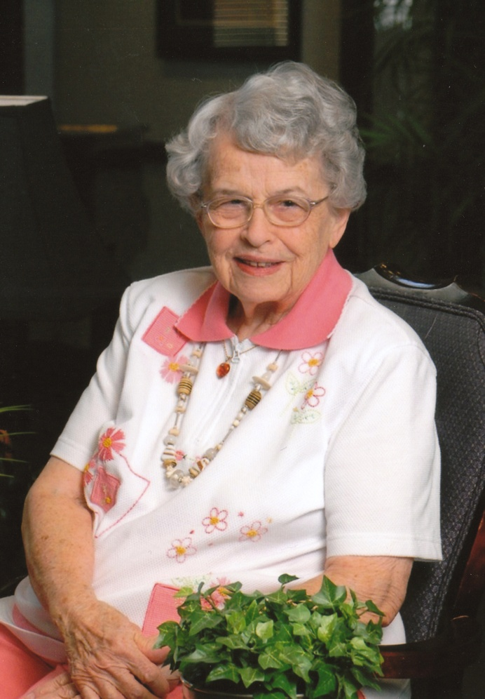
Lois M. Haynes
(1923-2011)

Slide 4
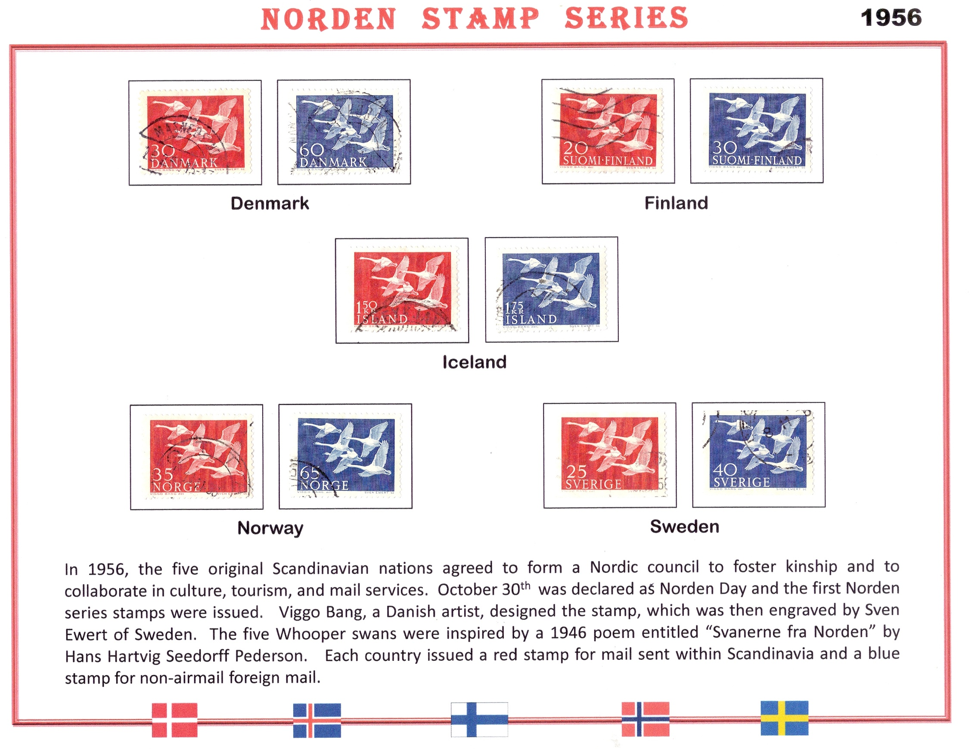

Slide 5
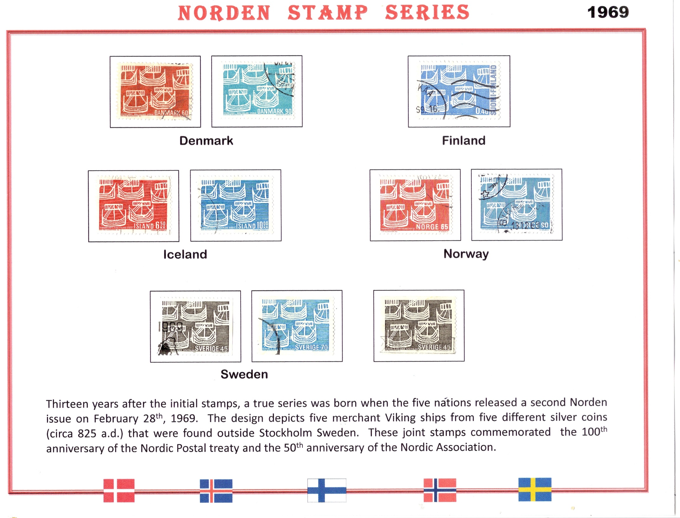

Slide 6
Norden Stamp Series
1969
Sweden First Day Cover

Slide 7
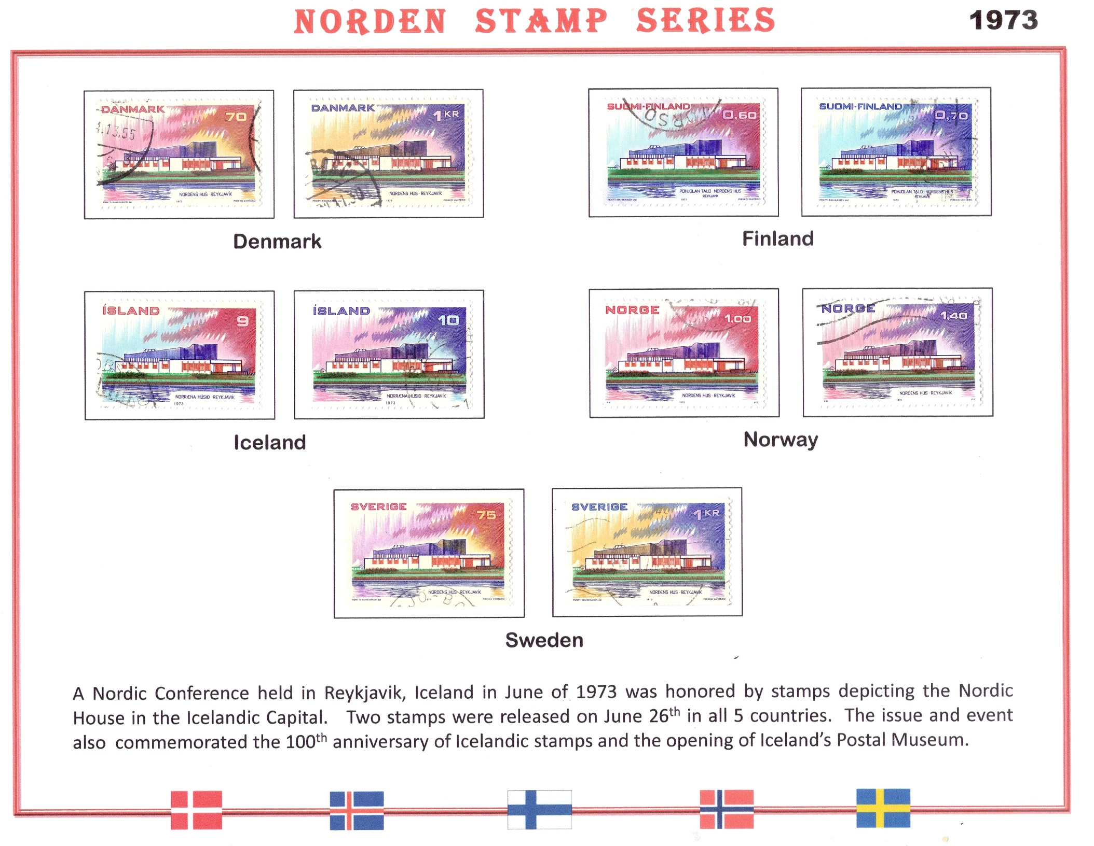

Slide 8
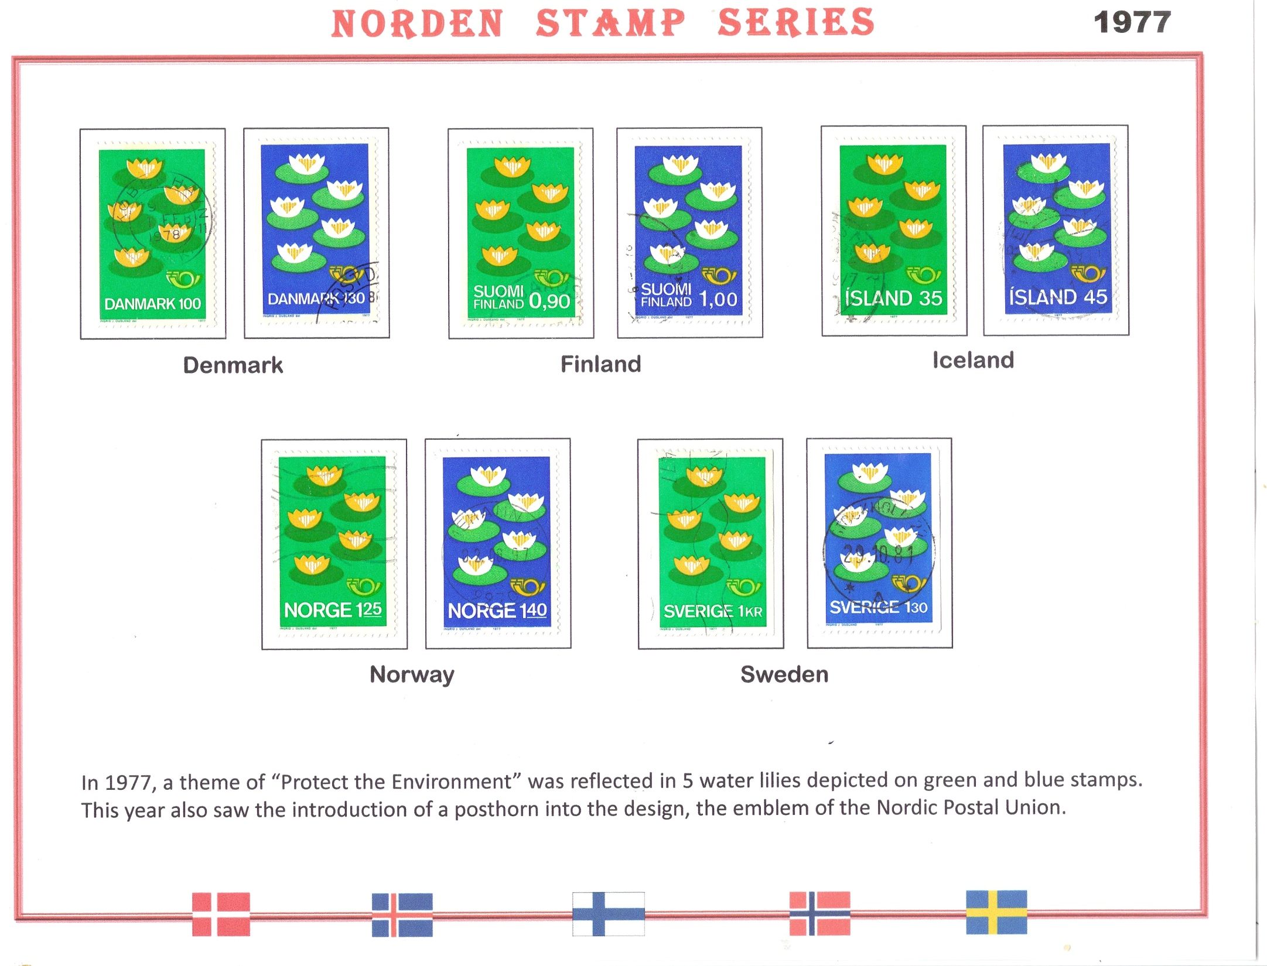

Slide 9
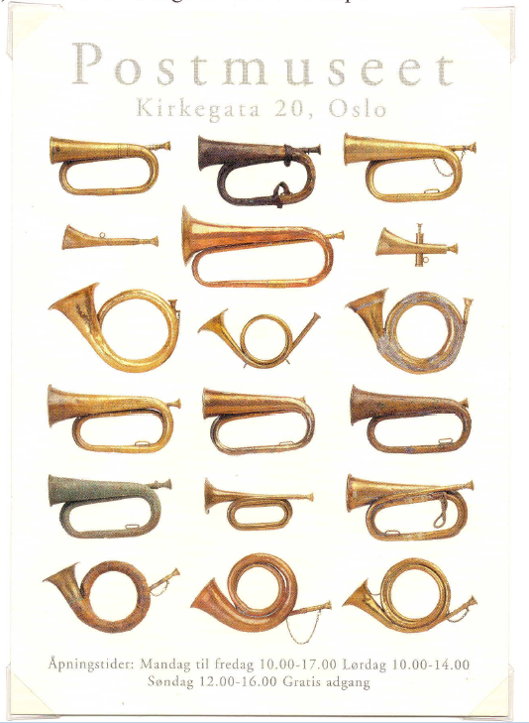
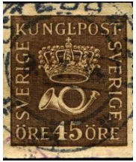
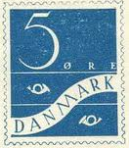
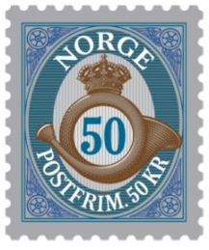
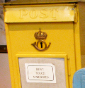
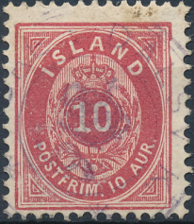
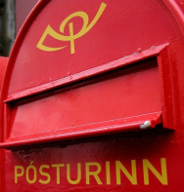
The Posthorn: A symbol for mail delivery
Denmark
Sweden
Finland
Norway
Iceland
Norwegian postcard depicting a number of posthorns found in the Norway Postal Museum in Oslo
First stamp to include the Posthorn:
Kingdom of Hanover Scott #18, released in 1860

Slide 11
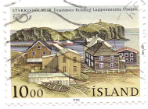
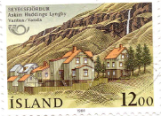
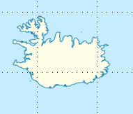
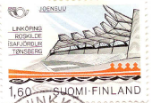
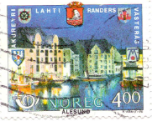
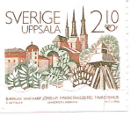
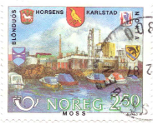
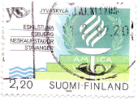
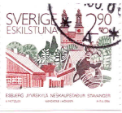
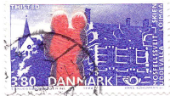
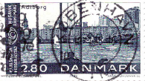
1986 Issue honored sister cities
Finland
Sweden
Stykkisholmur
Seydisfjordur
Joensuu
Iceland
Alesund
Jyaskyla
Uppsala
Norway
Moss
Thisted
Åalborg
Eskilstuna
Denmark

Slide 14
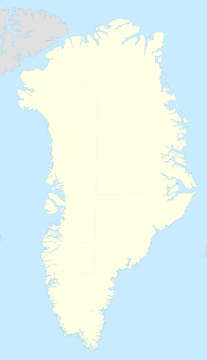
Åland Islands, Faroe Islands, and Greenland join in 1991
Greenland
Iceland
Sweden
Faroe Islands (Føroyar)
Finland
Greenland:
Population 57,700
Capital - Godthåb
Territory of Denmark
Norway
Faroe Islands:
Population 49,500
Capital - Tórshavn
Territory of Denmark
Åland
Åland Islands:
Population 28,300
Capital –Mariehamn
Territory of Finland
Denmark

Slide 17
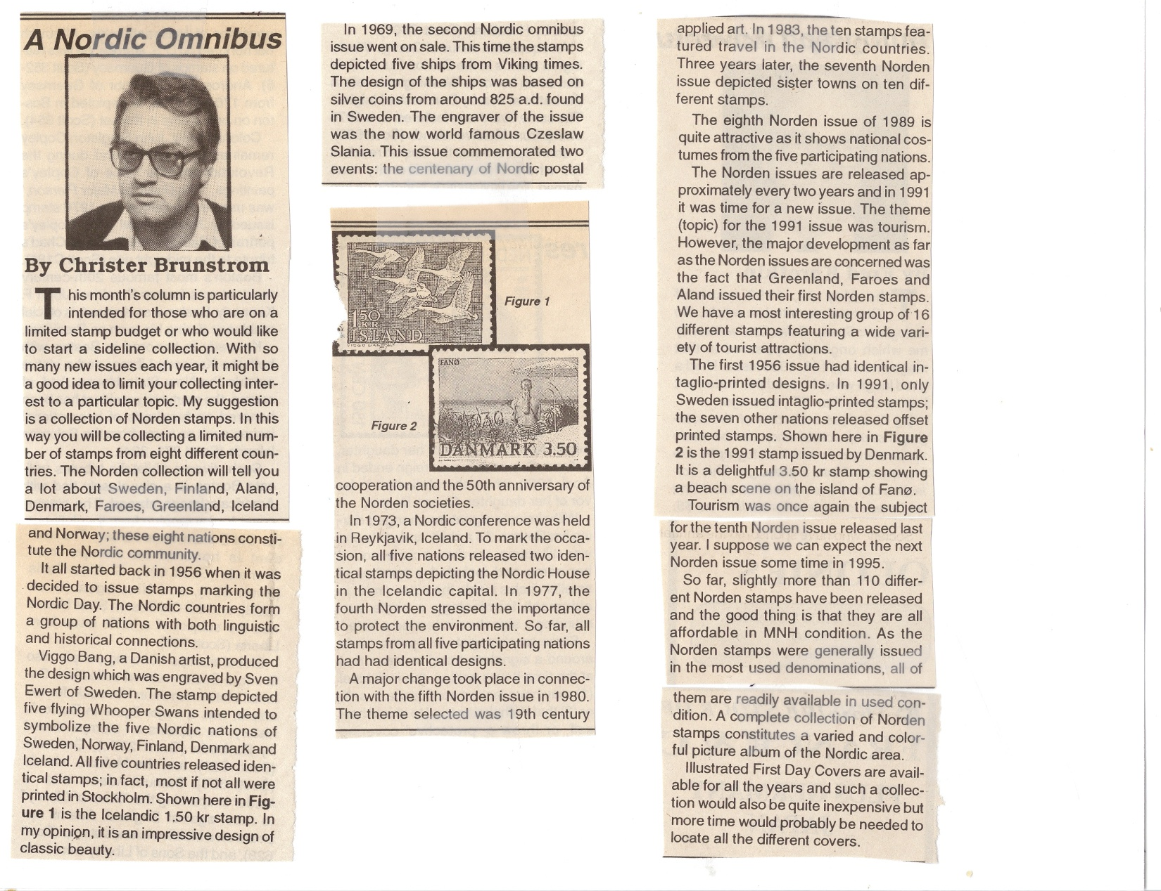
Global Stamp News, 1994

Slide 20
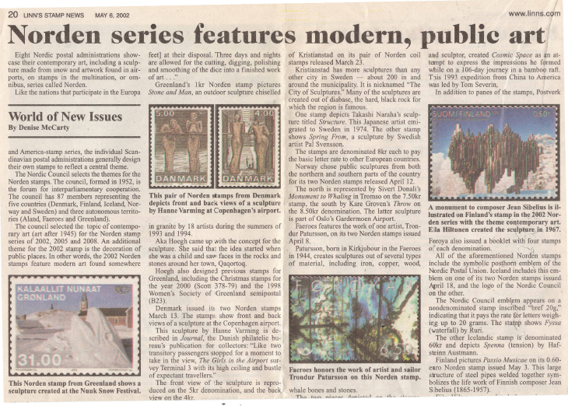
LINNS, May 6, 2002

Slide 21
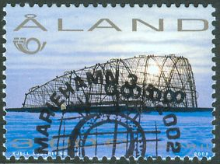
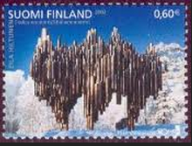
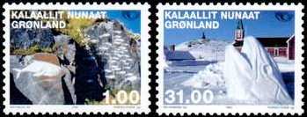
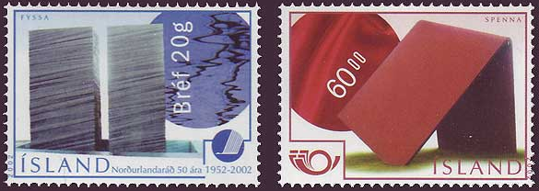
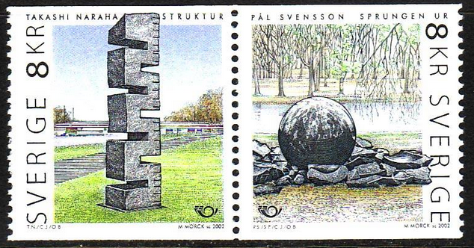
Norden Stamp Series
2002
Åland
Denmark
Faroe Islands
#145
#1099
Finland
Greenland
#854
Iceland
Norway
Sweden
#1189
The official theme for 2002 was “Ornamentation of the Public Space”, the unofficial translation (public art). And the nations sure showed their diversity in their use of sculptures and other art work. The Faroe Islands rejoined the group after missing the previous issue.

Slide 22
2004-2008 Norden Stamps : “Top of the world”
Three series featuring mythology and legends

Slide 23
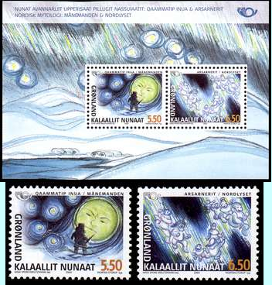
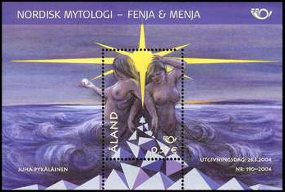
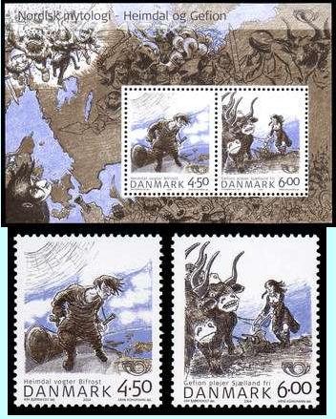
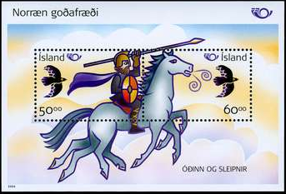
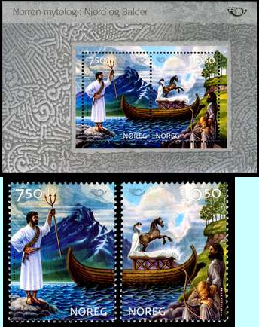
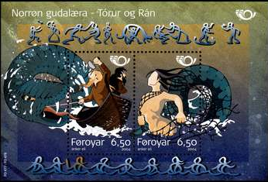
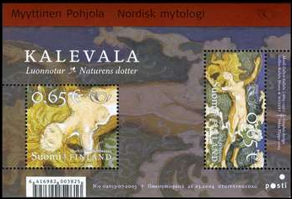
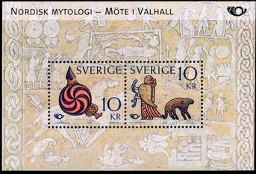
Norden Stamp Series
2004

Slide 24
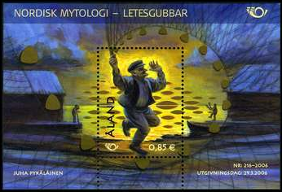
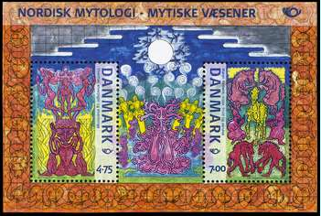
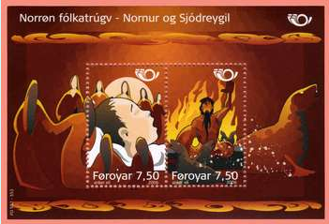
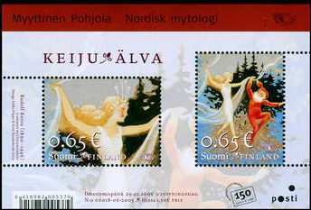
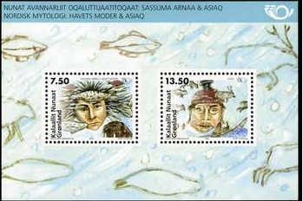
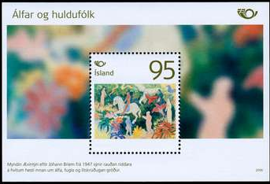
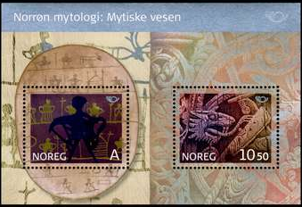
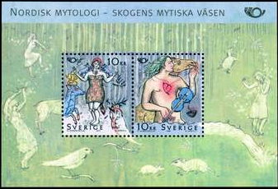
Norden Stamp Series
2006
Åland Islands
Denmark
Faroe Islands
Finland
Greenland
Iceland
Norway
Sweden

Slide 25
Norden Stamp Series – Mythology III
2008
Aland Islands
Denmark
Iceland
Faroe Islands
Finland

Slide 26
Norden Stamp Series – Mythology III
2008
Greenland
Iceland
Norway
Sweden

Slide 27
Norden Stamp Series – Life by the coast
2010

Slide 28
Norden Stamp Series – Life by the coast
2010

Slide 29
Norden Stamp Series - 2012
Life by the Coast II (Search and Rescue)
Denmark
6 Kr stamp depicts one of three Air Force rescue helicopters at work in the North Sea.
11 Kr stamp shows the helicopter landing atop the Copenhagen hospital.
2012 Sweden – First Day Cover
both issued March 21, 2013
Sweden
Pair of 12 kroner stamps:
Dash Q-300 surveillance aircrafts. One of 3 that patrols the Swedish coastline and is available for environmental and rescue assistance at sea.
Pilot boat Arko 833 is used to maintain/repair lighthouses such as the Häradskär lighthouse near Östergötland.

Slide 30
Norden Stamp Series - 2012
Life by the Coast II (Search and Rescue)
Norway
A single “Europe” denomination (A) stamp depicts a Sea King rescue helicopter.
The souvenir sheet depicts a rescue boat addressing a boat fire in the North Sea.
The Norwegian Search and Rescue Service was established after a several serious accidents in the late 1960’s. Centers were established and staffed in the north (BodØ
and in the south (Stavanger).
Iceland
This single Icelandic offering is based on an award winning photograph by Jonas Erlendssson. On March 9th, 2004 the TF Lif Coast Guard helicopter successfully rescued 16 crew members from the fishing vessel Baldwin Thorsteinsson which was grounded when it’s capelin net was caught in the ship’s propeller.
both issued March 21, 2013

Slide 31
Norden Stamp Series - 2012
Life by the Coast II (Search and Rescue)

Slide 32
Norden Stamp Series - 2014
Life by the Coast III (Ships)
Åland
Denmark
Faroe Islands
Finland

Slide 33
Norden Stamp Series - 2014
Life by the Coast III (Ships)
Greenland
Iceland
Norway
Sweden

Slide 34
Norden Stamp Series - 2016
Nordic Food Culture
Åland
Denmark
Faroe Islands
Finland

Slide 35
Norden Stamp Series - 2016
Nordic Food Culture
Iceland
Greenland
Sweden
Norway

Slide 36
Norden Stamp Series - 2018
Nordic Fishes
Åland
Denmark
Finland
Faroe Islands

Slide 37
Norden Stamp Series - 2018
Nordic Fishes
Greenland
Iceland
Norway
Sweden

Slide 38
Norden Stamp Series - 2020
Nordic Mammals
Åland
Denmark
Faroe Islands
Finland

Slide 39
Norden Stamp Series - 2020
Nordic Mammals
Iceland
Greenland
Sweden
Norway

Slide 40
Norden Stamp Series - 2022
Birds
100 years of baseball in Finland !!
Norway – Europa (2022)
Troll Forest Nymph

Slide 41
Thank You !!

