Slide 1
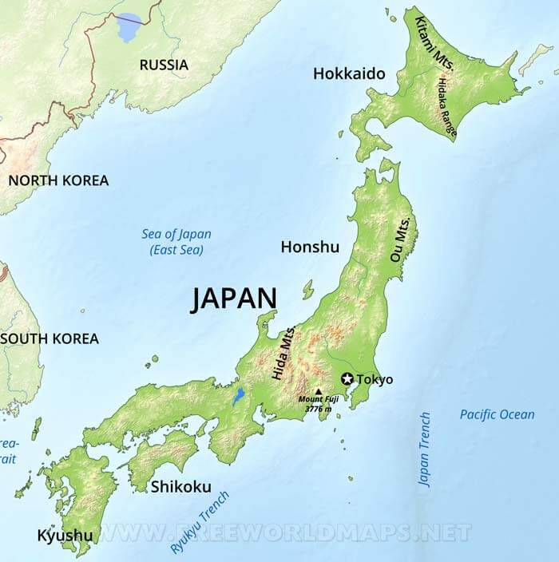
日本郵便のキャンセル by Richard Spinelli
Rochester philatelic Association
April 10, 2025

Slide 2
リチャード・スピネ
リによる日本郵便の
キャンセルに関する
プレゼンテーション、
ロチェスター切手協会
2025年.
Presentation by Richard Spinelli on Japan Post's Cancellation, Rochester Philatelic Society, 2025.
Richādo supine Ri ni yoru nippon'yūbin no kyanseru ni kansuru purezentēshon, rochesutā kitte kyōkai 2025-nen.

Slide 3
日本郵便のキャンセル
Anyone try translating this phrase?

Slide 4
日本郵便のキャンセル
Nippon'yūbin no kyanseru
“Japan Post Cancellation”
The Japanese word for "Japan" in kanji is 日本 (Nihon or Nippon), where 日 means "sun" or "day" and 本 means "origin" or "root". (Land of the Rising Sun).

Slide 5
日本郵便のキャンセル
In the 1850’s, Japan had been largely isolated from the West for over two centuries, with limited trade allowed only with a few nations.
The United States, with growing trade interests in the Pacific and a burgeoning whaling industry, sought access to Japanese ports for supplies, refueling, and trade.
under orders from President Millard Fillmore, Commodore Matthew Perry's expedition to Japan in 1853-1854 aimed to force Japan to open its ports to American trade after centuries of self-imposed isolation, using gunboat diplomacy, if necessary.

Slide 6
日本郵便のキャンセル
Japan's opening to the Western world was a pivotal event, leading to the end of Japan's 200-year isolation policy and the subsequent Meiji Restoration, which modernized and Westernized the country.
On July 8, 1853, Commodore Perry led his four ships into the harbor at Tokyo Bay, seeking to re-establish regular trade and discourse between Japan and the western world.
I had the privilege to travel to Japan Three Times on Business FOR XEROX CORPORATION DURING THE Late 1980’S AND Early 1990’S.
I AM BY NO MEANS AN EXPERT IN JAPAN, Japanese stamps and cancels or Japanese culture. I do have a curiosity in a particular Japanese stamp cancel.

Slide 7
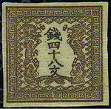
日本郵便のキャンセル
In 1870, Japan sent A Baron Maeshima to London to study the British postal system, which led to the founding of Japan's postal system in 1871.
In September 1870, Japan’s Finance Office was requested to design Japan’s first stamps. The stamps were made in four denominations: 48-mon (Brown), 100-mon (Blue), 200-mon (vermilion), and 500-mon (Blue-Green). They were hand-engraved and had no perforation on the edges nor any gummed back.

Slide 8
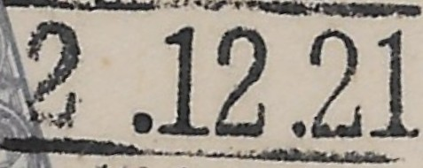
日本郵便のキャンセル
Issued in April 1871, the stamps were used by Japan’s Postal Service which was established in March 1871. When Japan’s monetary system changed in February 1872, the denominations of these first four stamps were changed to half sen, 1 sen, 2 sen, and 5 sen and issued in April 1872. Later in September the same year, stamps with 10-sen, 20-sen, and 30-sen denominations were added.
The Japanese postal service began using a "machine cancels" system, which included Western-style cancel numbers, around 1920. (Before this, Japanese cancellations were primarily hand-stamped).
So, is this cancel February 12, 1921 or February 12, 2021?
Neither!!!!

Slide 9
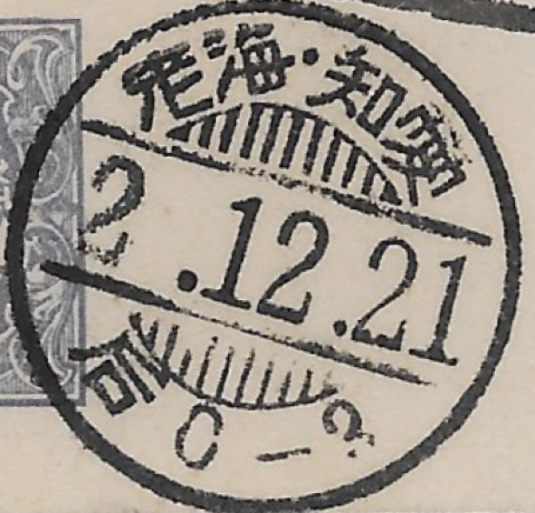
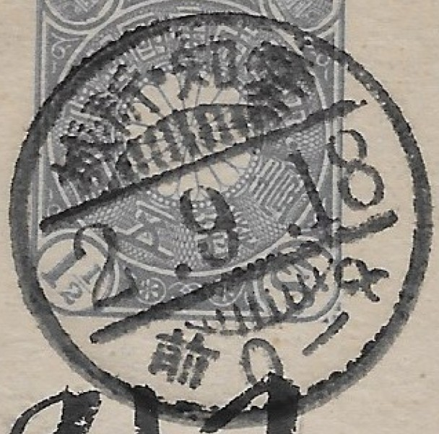
日本郵便のキャンセル
besides using the Western world’s Gregorian calendar, Japan bases its years on the Emperor’s reign. Thus, the year of A postmark could refer to the Meiji Era (1868-1912), Taisho Era (1912-1926), Showa Era (1926-1989), Heisei Era (1989-2019), Reiwa Era (2019- Present. So if you see “2” as the year, it could be Year 2 of any of these eras (1868, 1912, 1926, 1989 or 2019.

Slide 10
日本郵便のキャンセル
Year of the Emperor
Month of the Year
Day of the Month

Slide 11
日本郵便のキャンセル
This, and the previous stamp, are personnel Postal Card Stamps. It is difficult to find nice “Sock On Nose” Western date cancels on stamps because of the date size. As you see here, the date is off the stamp face.
Date off stamp face.

Slide 12
日本郵便のキャンセル
Traditionally, the Japanese imperial throne is passed down through agnatic primo-geniture, meaning succession is limited to male descendants in the male line, with preference given to the Emperor's eldest son, then his eldest son's eldest son, and so on.

Slide 13
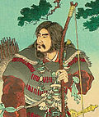
The Japanese Emperor Dynasty Began in 660 BC.
Emperor Jimmu (Born: Hikohohodem) was the
legendary first emperor of Japan.
according to the Nihon Shoki and Kojiki, (“The Chronicles of Japan”, the second-oldest book of classical Japanese, 740 BC) .His ascension is traditionally dated as 660 BC.
In Japanese mythology, he was a descendant of the sun goddess Amaterasu, through her grandson Ninigi, as well as a descendant of the storm god Susanoo.

Slide 14
日本郵便のキャンセル
Jimmu launched a military expedition from Hyūga near the Seto Inland Sea, captured Yamato, and established this as his center of power.
In modern Japan, Emperor Jimmu's legendary ascension is marked as National Foundation Day on February 11.
Since the Japanese Post Office was formed in 1870, we are only interested in Emperors from this date and beyond.

Slide 15
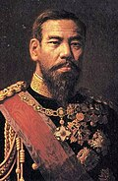
.
Meiji 1868-1912
Mutsuhito (3 November 1852 – 29 July 1912), posthumously honored as Emperor Meiji, was the 122nd emperor of Japan according to the traditional order of succession, reigning from 1867 until his death in 1912. His reign is associated with the Meiji Restoration of 1868, which ended the Tokugawa shogunate and began rapid changes that transformed Japan from an isolationist, feudal state to an industrialized world power. Emperor Meiji was the first monarch of the Empire of Japan, and presided over the Meiji era.

Slide 16
Meiji Calendar
Meiji 1 = 1868.10.23
Meiji 2 = 1869
Meiji 3 = 1870
Meiji 4 = 1871
Meiji 5 = 1872
Meiji 6 = 1873
Meiji 7 = 1874
Meiji 8 = 1875
Meiji 9 = 1876
Meiji 10 = 1877
Meiji 11 = 1878
Meiji 12 = 1879
Meiji 13 = 1880
Meiji 14 = 1881
Meiji 15 = 1882
Meiji 16 = 1883
Meiji 17 = 1884
Meiji 18 = 1885
Meiji 19 = 1886
Meiji 20 = 1887
Meiji 21 = 1888
Meiji 22 = 1889
Meiji 23 = 1890
Meiji 24 = 1891
Meiji 25 = 1892
Meiji 26 = 1893
Meiji 27 = 1894
Meiji 28 = 1895
Meiji 29 = 1896
Meiji 30 = 1897
Meiji 31 = 1898
Meiji 32 = 1899
Meiji 33 = 1900
Meiji 34 = 1901
Meiji 35 = 1902
Meiji 36 = 1903
Meiji 37 = 1904
Meiji 38 = 1905
Meiji 39 = 1906
Meiji 40 = 1907
Meiji 41 = 1908
Meiji 42 = 1909
Meiji 43 = 1910
Meiji 44 = 1911
Meiji 45 = 1912.7.30

Slide 17
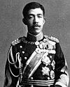
Taisho 1912-1926
Yoshihito (31 August 1879 – 25 December 1926), posthumously honored as Emperor Taishō, was the 123rd emperor of Japan according to the traditional order of succession, reigning from 1912 until his death in 1926. His reign, known as the Taishō era, was characterized by a liberal and democratic shift in domestic political power, known as Taishō Democracy. Yoshihito also oversaw Japan's participation in the First World War from 1914 to 1918, the Spanish flu pandemic, and the Great Kantō earthquake of 1923.

Slide 18
TasHio 1912 - 1926
Taisho 1 = 1912.7.30
Taisho 2 = 1913
Taisho 3 = 1914
Taisho 4 = 1915
Taisho 5 = 1916
Taisho 6 = 1917
Taisho 7 = 1918
Taisho 8 = 1919
Taisho 9 = 1920
Taisho 10 = 1921
Taisho 11 = 1922
Taisho 12 = 1923
Taisho 13 = 1924
Taisho 14 = 1925
Taisho 15 =1926.12.25

Slide 19
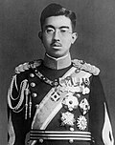
Shōwa 1926-1989
Hirohito (29 April 1901 – 7 January 1989), posthumously honored as Emperor Shōwa, was the 124th emperor of Japan according to the traditional order of succession, from 25 December 1926 until his death in 1989. He remains Japan's longest-reigning emperor as well as one of the world's longest-reigning monarchs. As emperor during the Shōwa era, Hirohito oversaw the rise of Japanese militarism, Japan's expansionism in Asia, the outbreak of the Second Sino-Japanese War and World War II, and the postwar Japanese economic miracle.

Slide 20
Showa 1926-1989
Showa 43 = 1968
Showa 44 = 1969
Showa 45 = 1970
Showa 46 = 1971
Showa 47 = 1972
Showa 48 = 1973
Showa 49 = 1974
Showa 50 = 1975
Showa 51 = 1976
Showa 52 = 1977
Showa 53 = 1978
Showa 54 = 1979
Showa 55 = 1980
Showa 56 = 1981
Showa 57 = 1982
Showa 58 = 1883
Showa 59 = 1984
Showa 60 = 1985
Showa 61 = 1986
Showa 62 = 1987
Showa 63 = 1988
Showa 64 = 1989
Showa 1 = 1926.12.25
Showa 2 = 1927
Showa 3 = 1928
Showa 4 = 1929
Showa 5 = 1930
Showa 6 = 1931
Showa 7 = 1932
Showa 8 = 1933
Showa 9 = 1934
Showa 10 = 1935
Showa 11 = 1936
Showa 12 = 1937
Showa 13 = 1938
Showa 14 = 1939
Showa 15 = 1940
Showa 16 = 1941
Showa 17 = 1942
Showa 18 = 1943
Showa 19 = 1944
Showa 20 = 1945
Showa 21 = 1946
Showa 22 = 1947
Showa 23 = 1948
Showa 24 = 1949
Showa 25 = 1950
Showa 26 = 1951
Showa 27 = 1952
Showa 28 = 1953
Showa 29 = 1954
Showa 30 = 1955
Showa 31 = 1956
Showa 32 = 1957
Showa 33 = 1958
Showa 34 = 1959
Showa 35 = 1960
Showa 36 = 1961
Showa 37 = 1962
Showa 38 = 1963
Showa 39 = 1964
Showa 40 = 1965
Showa 41 = 1966
Showa 42 = 1967

Slide 21
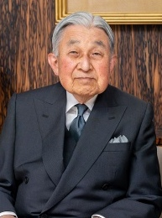
Heisi
1989-2019
Akihito (born 23 December 1933) is a member of the Imperial House of Japan who reigned as the 125th emperor of Japan from 1989 until his abdication in 2019. The era of his rule was named the Heisei era, Heisei being an expression of achieving peace worldwide. He made efforts to bring the imperial family closer to the Japanese people, and made official visits to all forty-seven prefectures of Japan and to many of the remote islands of Japan. He has a keen interest in natural life and conservation, as well as Japanese and world history. He abdicated due to his advancing age and declining health, feeling he could no longer fully fulfill his duties as the "symbol of the State“.

Slide 22
HeisEI
1989 - 2019
Heisei 1 = 1989.1.8
Heisei 2 = 1990
Heisei 3 = 1991
Heisei 4 = 1992
Heisei 5 = 1993
Heisei 6 = 1994
Heisei 7 = 1995
Heisei 8 = 1996
Heisei 9 = 1997
Heisei 10 = 1998
Heisei 11 = 1999
Heisei 12 = 2000
Heisei 13 = 2001
Heisei 14 = 2002
Heisei 15 = 2003
Heisei 16 = 2004
Heisei 17 = 2005
Heisei 18 = 2006
Heisei 19 = 2007
Heisei 20 = 2008
Heisei 21 = 2009
Heisei 22 = 2010
Heisei 23 = 2011
Heisei 24 = 2012
Heisei 25 = 2013
Heisei 26 = 2014
Heisei 27 = 2015
Heisei 28 = 2016
Heisei 29 = 2017
Heisei 30 = 2018
Heisei 31 = 2019.4.3

Slide 23
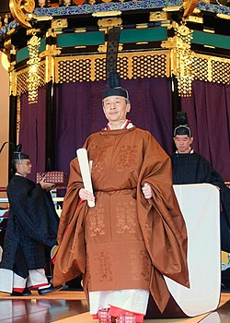
Reiwa 2019 -Present
Reiwa is the current Emperor of the official calendar of Japan. It began on 1 May 2019, the day on which Emperor Akihito's eldest son, Naruhito, ascended the throne as the 126th Emperor of Japan.
The day before, Emperor Akihito abdicated the Chrysanthemum Throne, marking the end of the Heisei era. The year 2019 corresponds with Heisei 31 from 1 January to 30 April, and with Reiwa 1, ('the base year of Reiwa') from 1 May. The Ministry of Foreign Affairs of Japan explained the meaning of Reiwa to be "beautiful harmony".

Slide 24
Reiwa 2019 -Present
Reiwa 1 = 2019.5.1
Reiwa 2 = 2020
Reiwa 3 = 2021
Reiwa 4 = 2022
Reiwa 5 = 2023
Reiwa 6 = 2024
Reiwa 7 = 2025

Slide 25
日本郵便のキャンセル
An Easy Short Cut to Determining the actual date of cancelation:
ADD:
1867 to a date in Meiji
1911 to a date in Taisho
1925 to a date in Showa
1988 to a date in Heisei
2019 to a date in Reiwa

Slide 26
Meiji Calendar
Meiji 1 = 1868.10.23
Meiji 2 = 1869
Meiji 3 = 1870
Meiji 4 = 1871
Meiji 5 = 1872
Meiji 6 = 1873
Meiji 7 = 1874
Meiji 8 = 1875
Meiji 9 = 1876
Meiji 10 = 1877
Meiji 11 = 1878
Meiji 12 = 1879
Meiji 13 = 1880
Meiji 14 = 1881
Meiji 15 = 1882
Meiji 16 = 1883
Meiji 17 = 1884
Meiji 18 = 1885
Meiji 19 = 1886
Meiji 20 = 1887
Meiji 21 = 1888
Meiji 22 = 1889
Meiji 23 = 1890
Meiji 24 = 1891
Meiji 25 = 1892
Meiji 26 = 1893
Meiji 27 = 1894
Meiji 28 = 1895
Meiji 29 = 1896
Meiji 30 = 1897
Meiji 31 = 1898
Meiji 32 = 1899
Meiji 33 = 1900
Meiji 34 = 1901
Meiji 35 = 1902
Meiji 36 = 1903
Meiji 37 = 1904
Meiji 38 = 1905
Meiji 39 = 1906
Meiji 40 = 1907
Meiji 41 = 1908
Meiji 42 = 1909
Meiji 43 = 1910
Meiji 44 = 1911
Meiji 45 = 1912.7.30
December 21, 1869

Slide 27
日本郵便のキャンセル
In the early years until 1879, postmarks were used to indicate the date of collection and the date of receipt from out of town.
Early Japanese postmarks, particularly those preceding 1879, were diverse with each postal district having its own style.
In 1879, the Communications Office issued official recommendations, and by 1909, postmarks became standardized nationwide.
In September 1888, the name of the local area was included in the postmark.

Slide 28
日本郵便のキャンセル
Until 1911, postmarks were imprinted by hand (at a rate of 100 pieces per minute).
Automatic postmarking machines were introduced in 1919.
At the end of 1919, the latest postmarking machines were imported from America and used in Tokyo.

Slide 29
日本郵便のキャンセル
Up to September 1912, postcards and letters had two postmarks (except for special mail). One was imprinted when the postcard was mailed (canceling the stamp), and another was imprinted when the postcard was received.
Stamp cancellation marks were also separate from postmarks. They could be a series of dotted lines or text like “Postage Paid” (in Japanese).
Some postmarks were square in shape. Each postal district had their own postmark system and style.

Slide 30
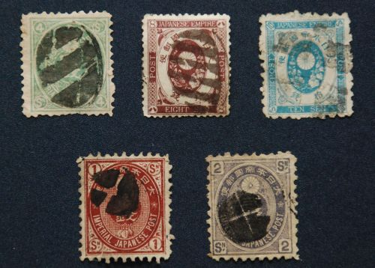
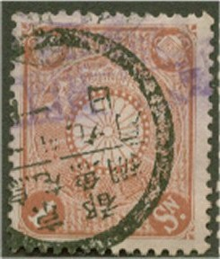
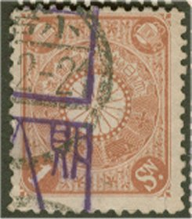
日本郵便のキャンセル
Early 1880 Japanese Cancels

Slide 31
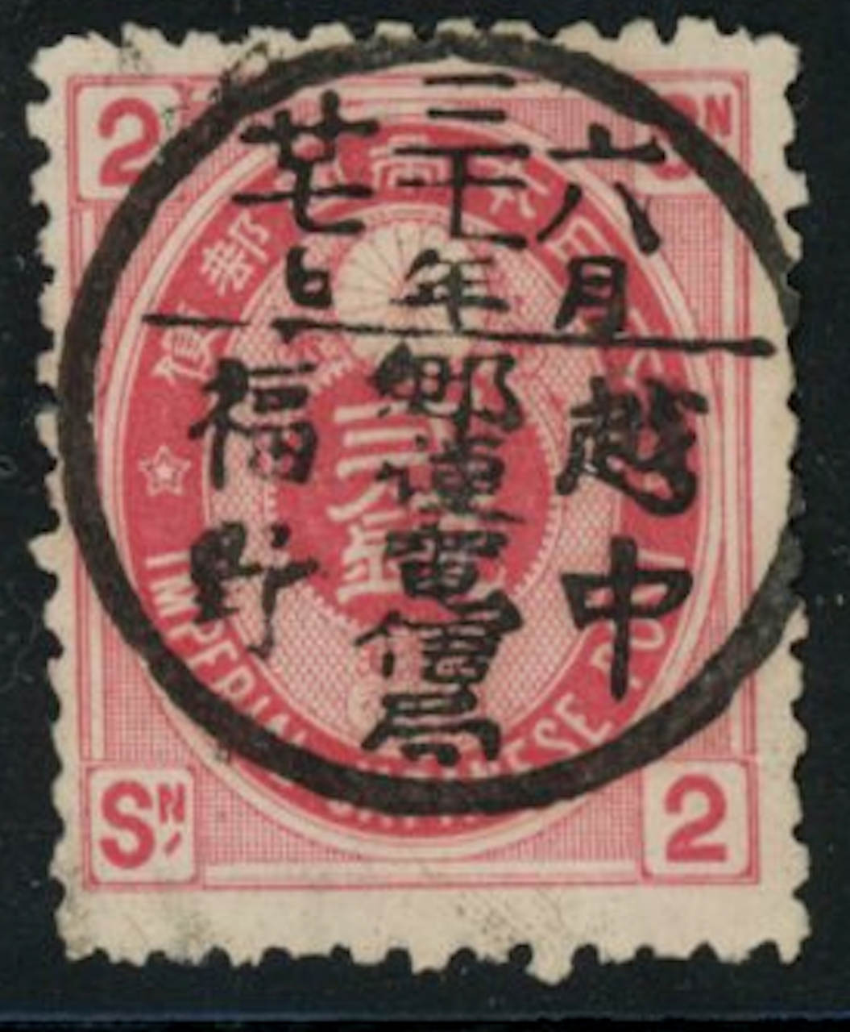
日本郵便のキャンセル
This is a telegraph, money order or telephone cancel. All text in the postmark is read from right to left. In the first line is the province name. In the second line is the town name. The part below the bisect will indicate if the cancel is postal or a non-postal service offered by the post office (telegraph, telephone, money order, or whatever)

Slide 32
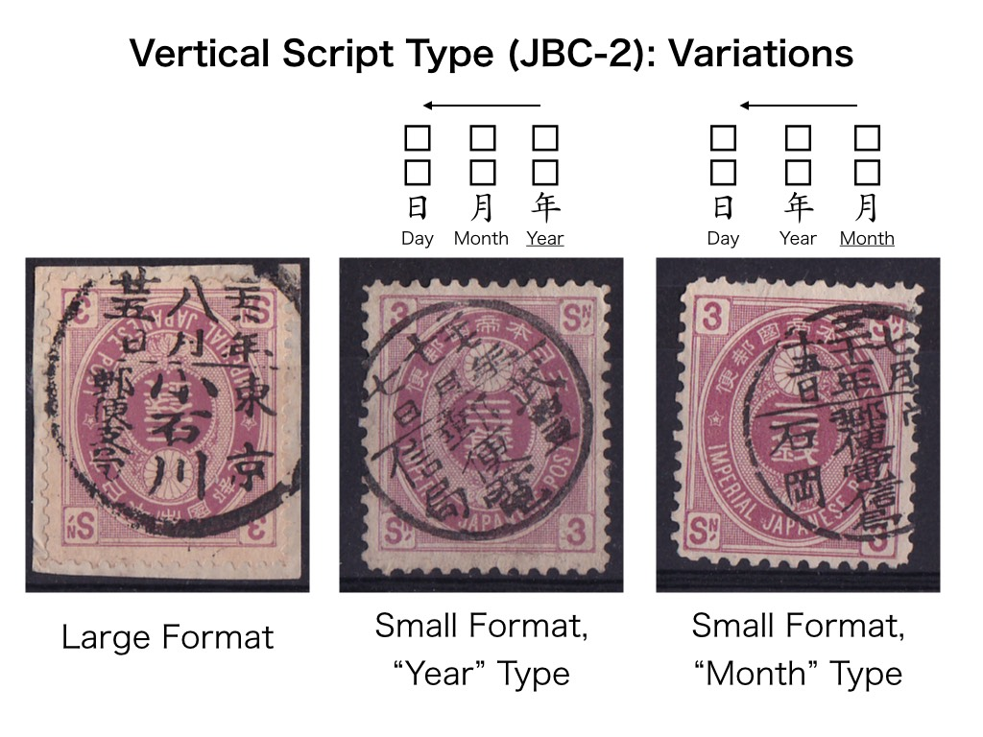
日本郵便のキャンセル

Slide 33
日本郵便のキャンセル
You Will Now learn about the Japanese writing system how to count to 100 in Japanese before you leave tonight – Guaranteed!

Slide 34
日本郵便のキャンセル
The Japanese writing system doesn't have a single alphabet like English; instead, it uses a combination of three systems: Hiragana, Katakana, and Kanji, each serving different purposes.
Hiragana:
A phonetic script used primarily for native Japanese words and grammatical elements.
Katakana:
Another phonetic script, primarily used for foreign words, names, onomatopoeia (the formation of a word from a sound associated with what is named (e.g. cuckoo, sizzle ). "a relatively large number of bird names arise by onomatopoeia."
and sometimes for emphasis.

Slide 35
日本郵便のキャンセル
Kanji are characters borrowed from Chinese that represent words or ideas.
The Japanese word for "Japan" in kanji is 日本 (Nihon or Nippon), where 日 means "sun" or "day" and 本 means "origin" or "root". (Land of the Rising Sun).

Slide 36
日本郵便のキャンセル
There are two different counting systems in Japan: the Sino-Japanese and the Native Japanese number systems.
Sino-Japanese comes from Chinese origins, while Native Japanese originates from Japan.
native Japanese numbers are used up to 10.
From then on, you’ll only see Sino-Japanese numerals. This makes learning how to count in Japanese much easier.

Slide 37
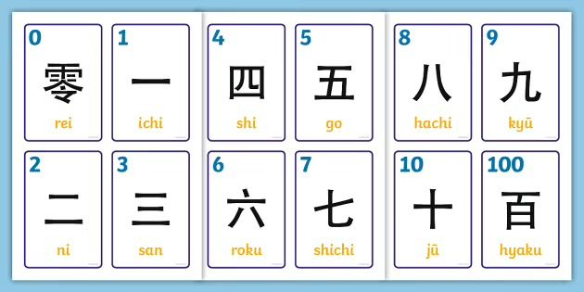
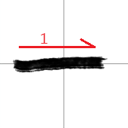
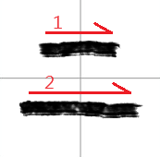
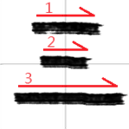
日本郵便のキャンセル

Slide 38
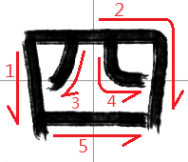
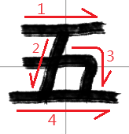
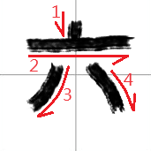
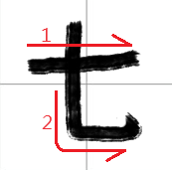
日本郵便のキャンセル

Slide 39
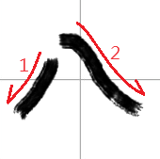
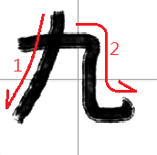
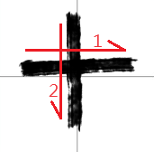
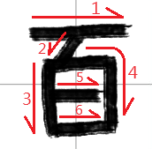
日本郵便のキャンセル

Slide 40
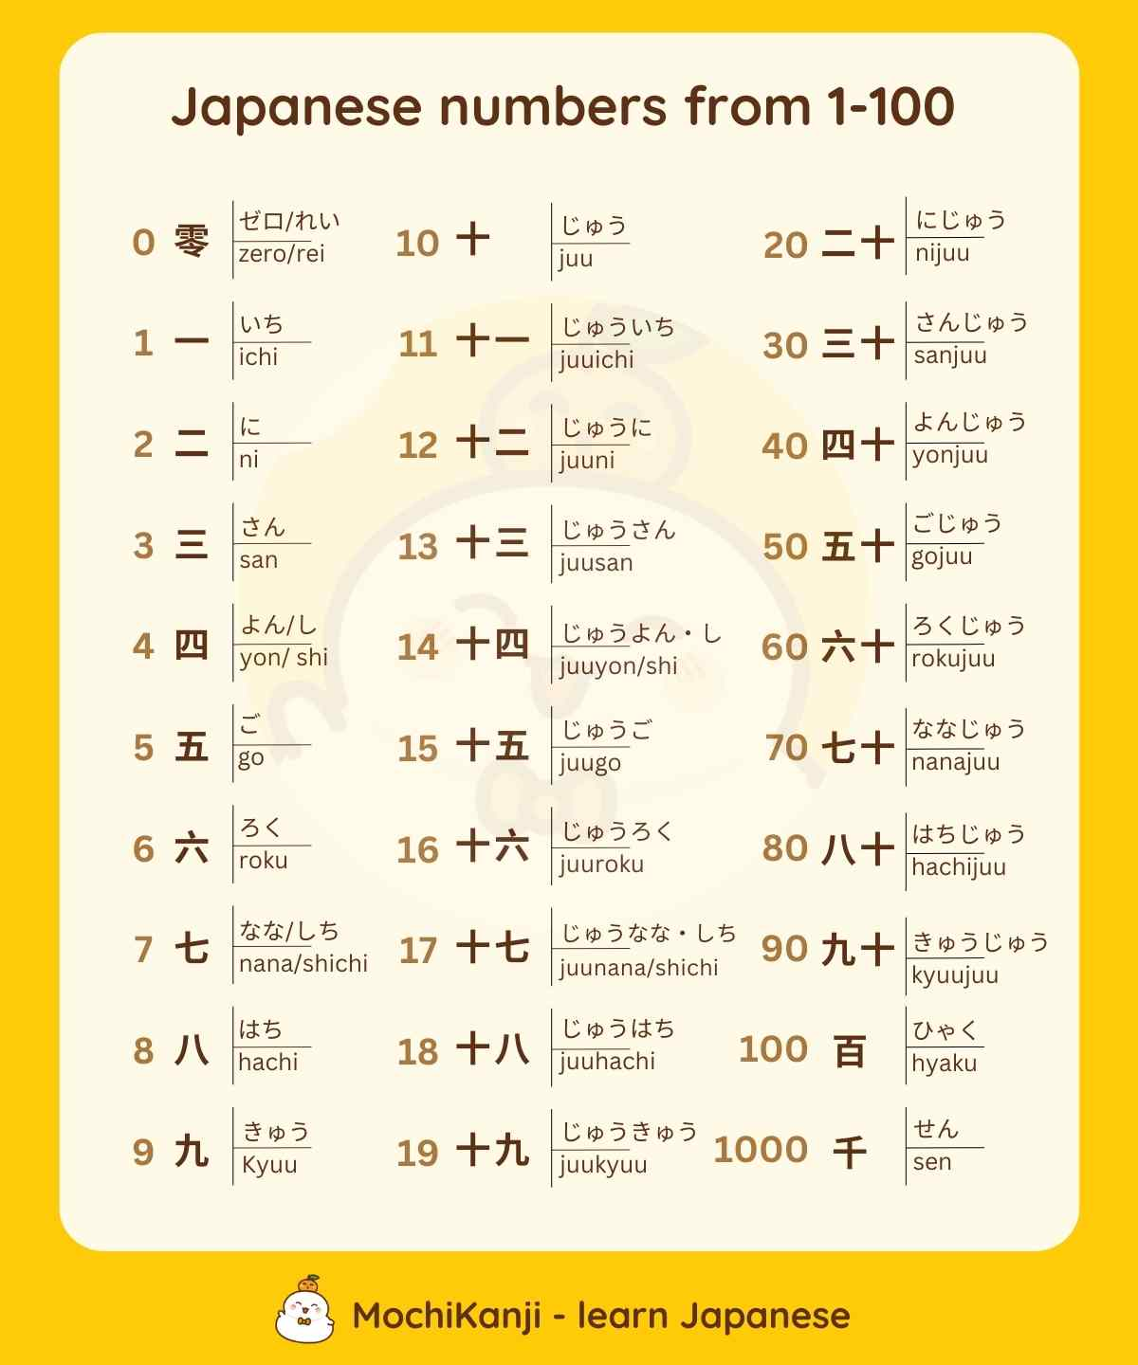

Slide 41
日本郵便のキャンセル
Now, Go Home and Practice your Japanese. I have it from a good source that Emperor Trump (#127, A Descendent of the Sun and storm gods), is contemplating annexing Japan as the 52nd American state.
The end.
Good Night.

