Slide 1
The Postal History And Early Stamps Of India
June 26th 2025

Slide 2
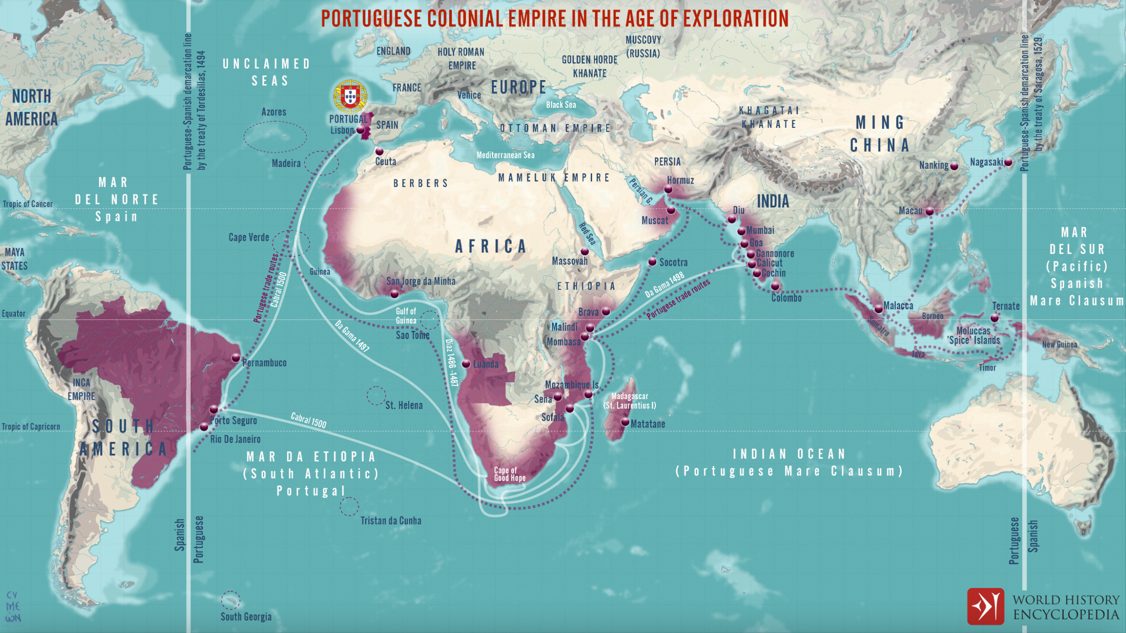
The Portuguese Colonial Empire

Slide 3
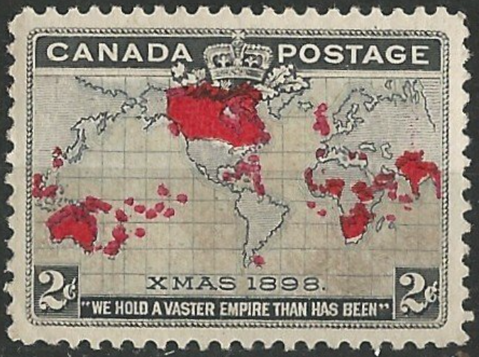
The British Colonial Empire
Canada # 85 British Empire map 1898

Slide 4
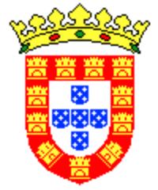
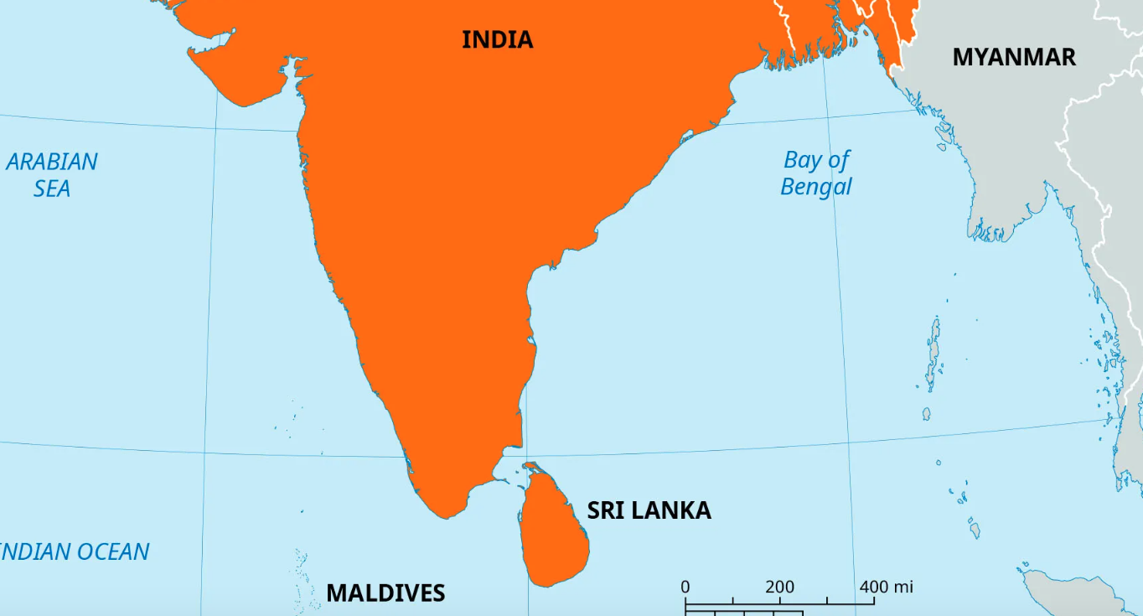
Portuguese Settlements In India And Sri Lanka 1498-1600
Hughli 1537
Diu 1535
Daman 1558
Bassein 1533
Bombay 1533
Goa 1510
Cannanore 1501
Madras 1522
Calicut 1498
Portugal
Nagapatnam 1507
Cochin 1500
Trincomalee 1522
Colombo 1505
Matara 1507
Calle 1507

Slide 5
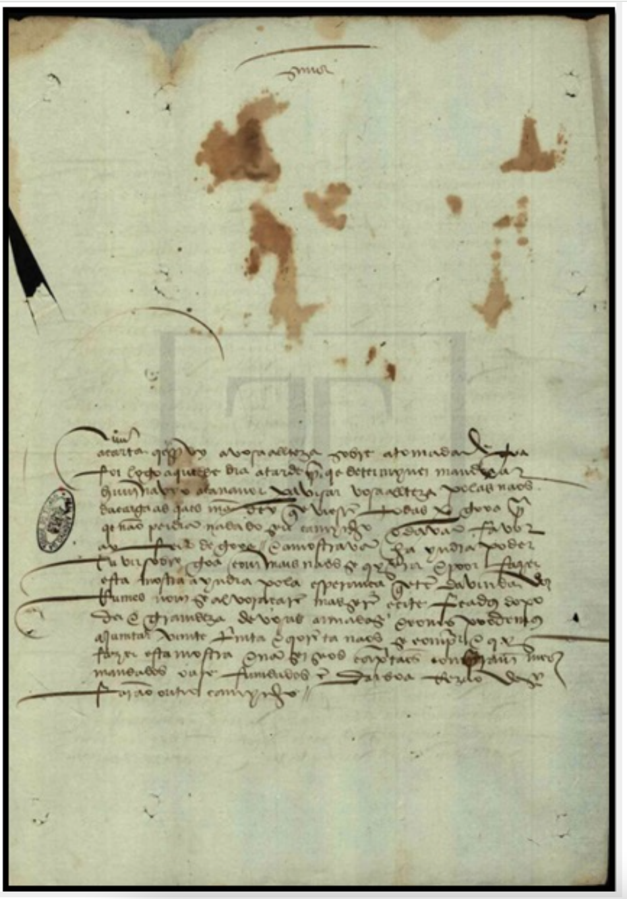
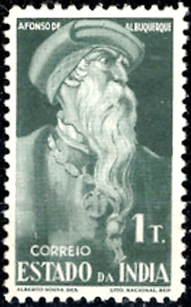
First Known Letter From India To Europe
Letter from Afonso de Albuquerque to D. Manuel I
about the conquest of Goa. 1510-12-22. Portugal, Torre do Tombo Chronological Body, Part I, mç. 9, no. 109 .

Slide 6
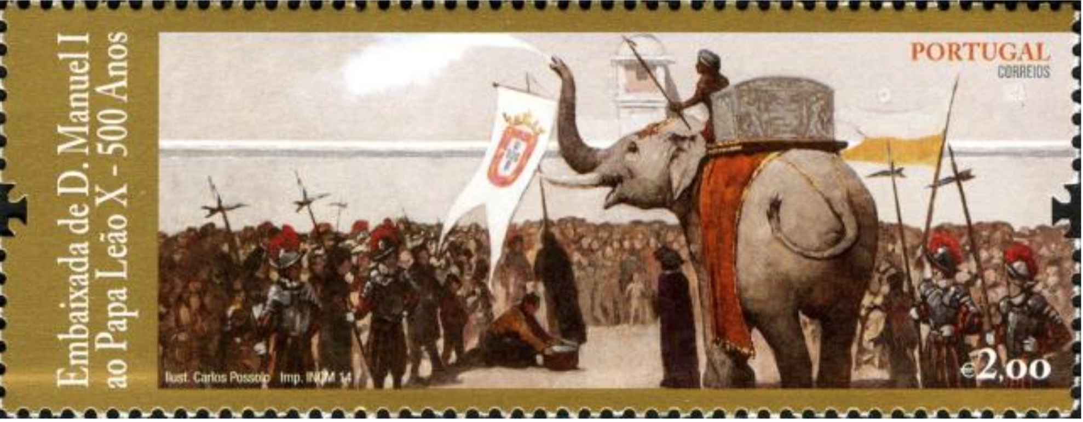
Transport By Sea Mail
Hanno was the pet white elephant given by King Manuel of Portugal to Pope Leo X at his coronation.
He was named Annon and Hanno after the Malayalam word Aana meaning elephant.
Hanno, an Asian elephant came to Rome in 1514 with the Portuguese ambassador Tristo Da Cunha and quickly became the Pope's favorite animal.
Hanno died two years later from complications of a treatment for constipation with a gold-enriched laxative.

Slide 7
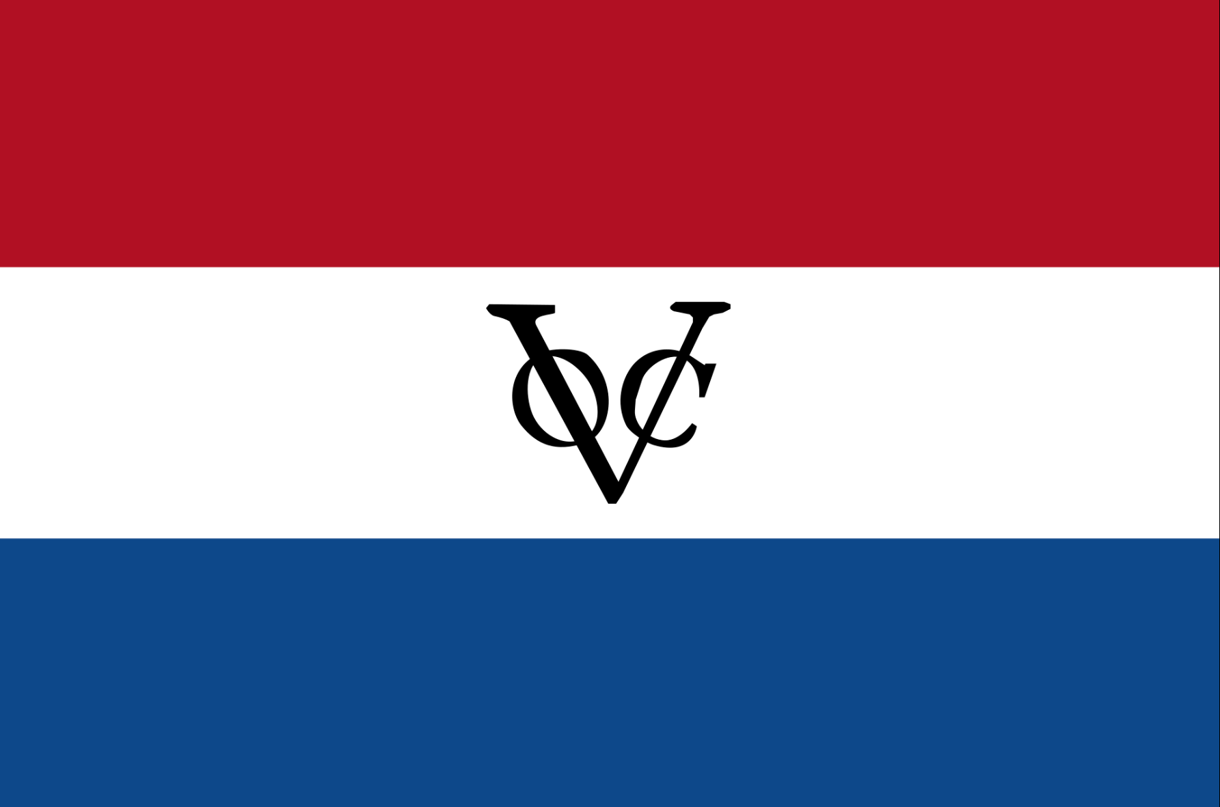
Dutch East India Company (VOC) Settlements In India And Sri Lanka 1610-1795
Hughli 1537
Chinsurah 1635, 1653
Diu 1535
Sura1616
Daman 1558
Bassein 1533
Bombay 1533
Masulipatnam 1616
Goa 1510
Vereenigde Oostindische Compagnie
Pulicat 1610
Cannanore 1501
Madras 1522
Calicut 1492
Portuguese settlements
1658
Nagapatnam 1507
Cochin 1500
1637, 1674
Trincomalee 1522
Colombo 1505
1656
Matara 1507
Calle 1507
1656
Notes:
Jan Huygen van Linschoten (1563 – 8 February 1611) was a Dutch spy, merchant, traveller and writer.
He travelled extensively along the East Indies regions under Portuguese influence and served as the archbishop's secretary in Goa between 1583 and 1588. He is credited with publishing in Europe important classified information about Asian trade and navigation that was hidden by the Portuguese. In 1596, he published a book, Itinerario (later translated as Discours of Voyages into Ye East & West Indies), which graphically displayed for the first time in Europe detailed maps of voyages to the East Indies, particularly India.
During his stay in Goa, he meticulously copied the secret charts page by page. Even more crucially, he provided nautical data like currents, deeps, islands and sandbanks that were vital for safe navigation, along with coastal depictions to guide the way. The publication of the navigational routes enabled the passage to the East Indies to be opened to trading by the Dutch, French and the English. As a consequence, the Dutch East India Company and the British East India Company would break the 16th-century monopoly enjoyed by the Portuguese on trade with the East Indies.

Slide 8
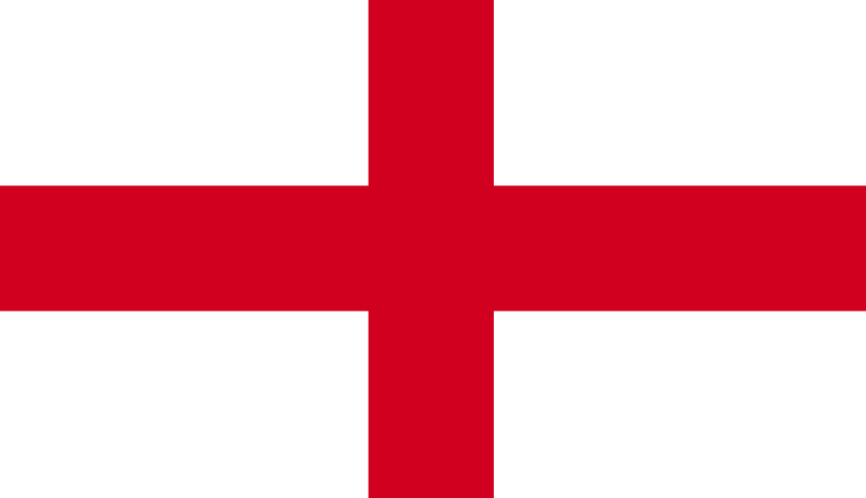
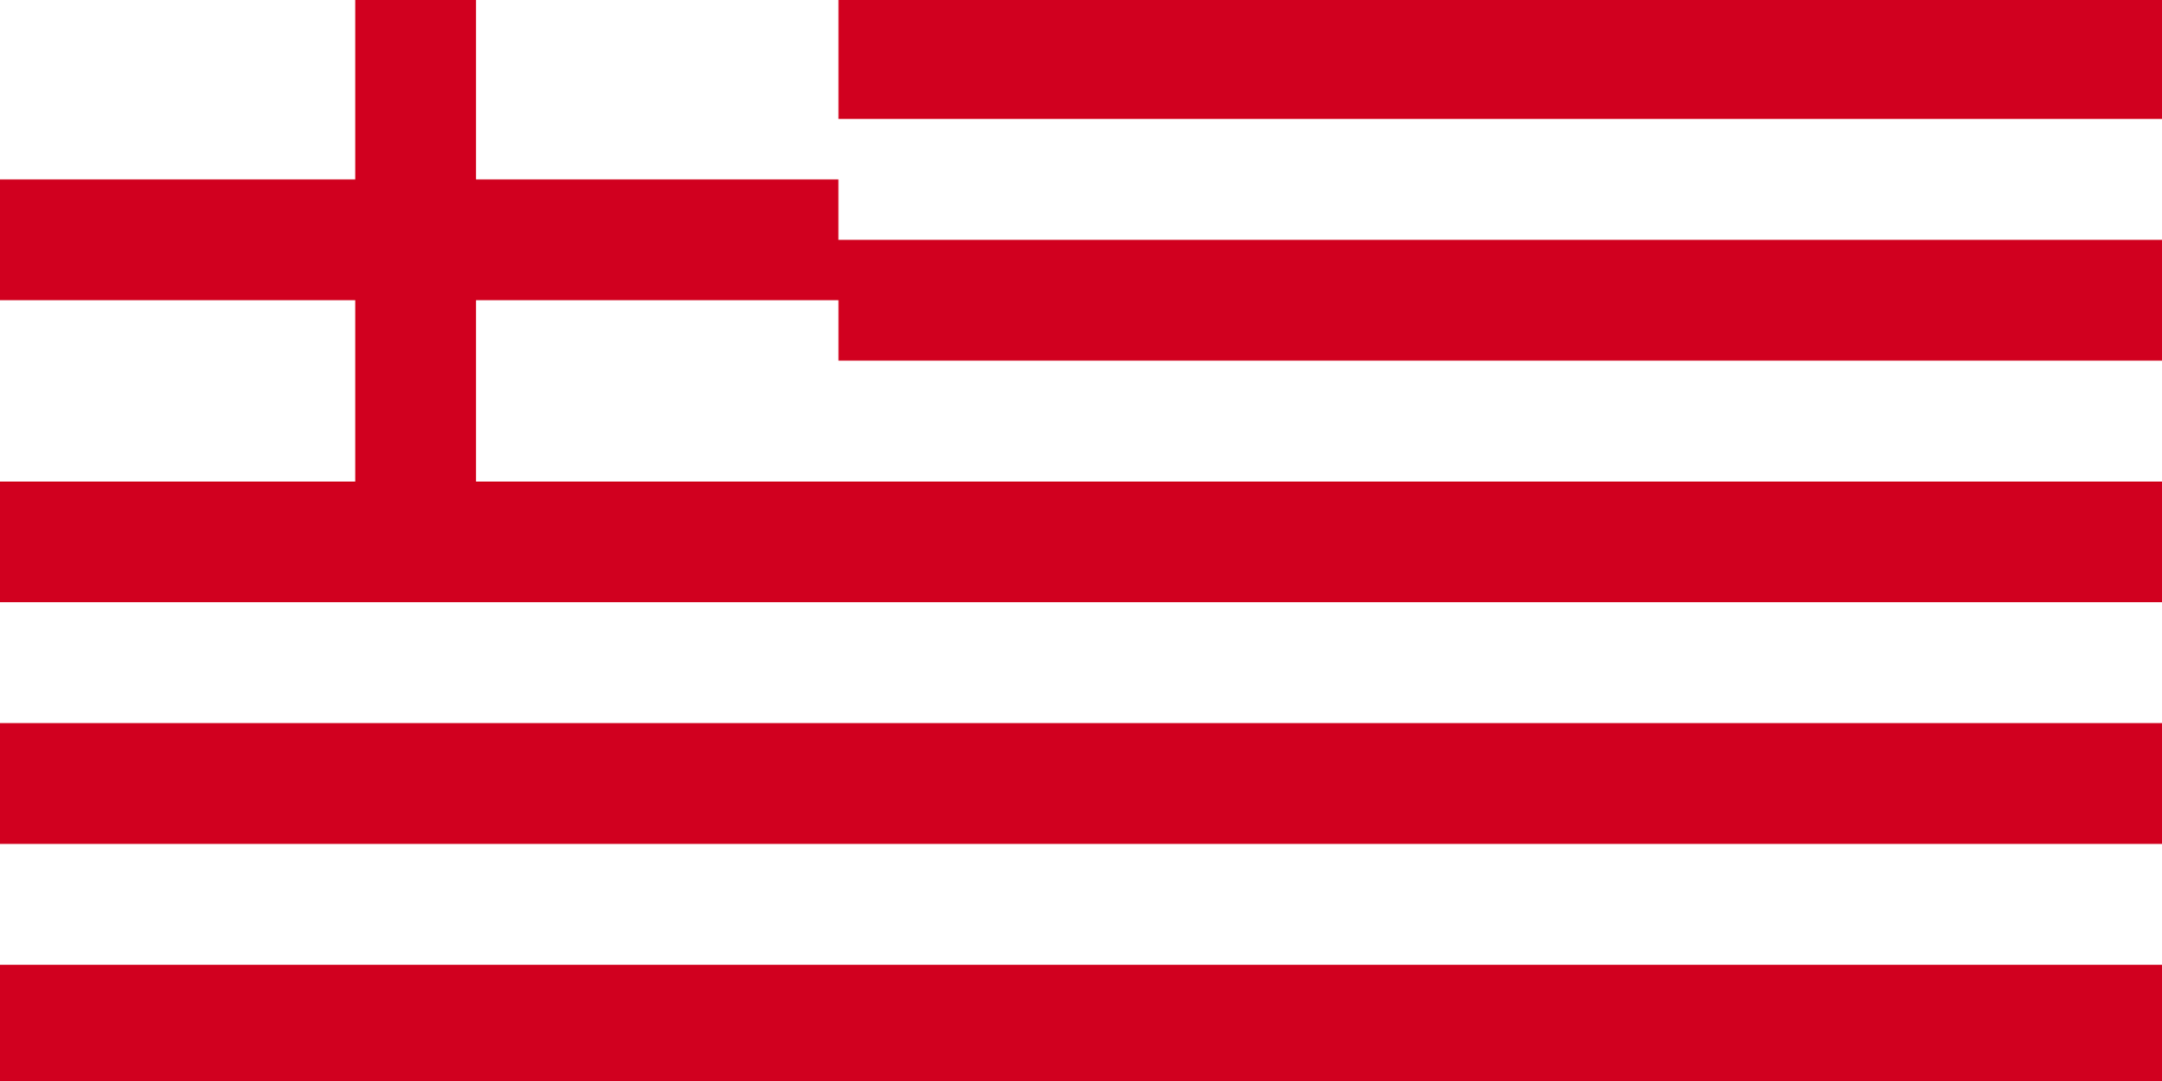
English Settlements In India And Sri Lanka 1612-1739
Hughli 1537
1658
Chinsurah 1635, 1653
1616
Diu 1535
Surat 1612
Calcutta 1690
Daman 1558
Bassein 1533
Bombay 1533
Visagapatnam 1682
1638
Masulipatnam 1616
Goa 1510
English East India Company
Pulicat 1600
Cannanore 1501
Madras 1522
1639
Calicut 1492
Portuguese settlements
1658
VOC settlements
Nagapatnam 1507
Cochin 1500
1637, 1674
Trincomalee 1522
Colombo 1505
1656
Matara 1507
Calle 1507
1656

Slide 9
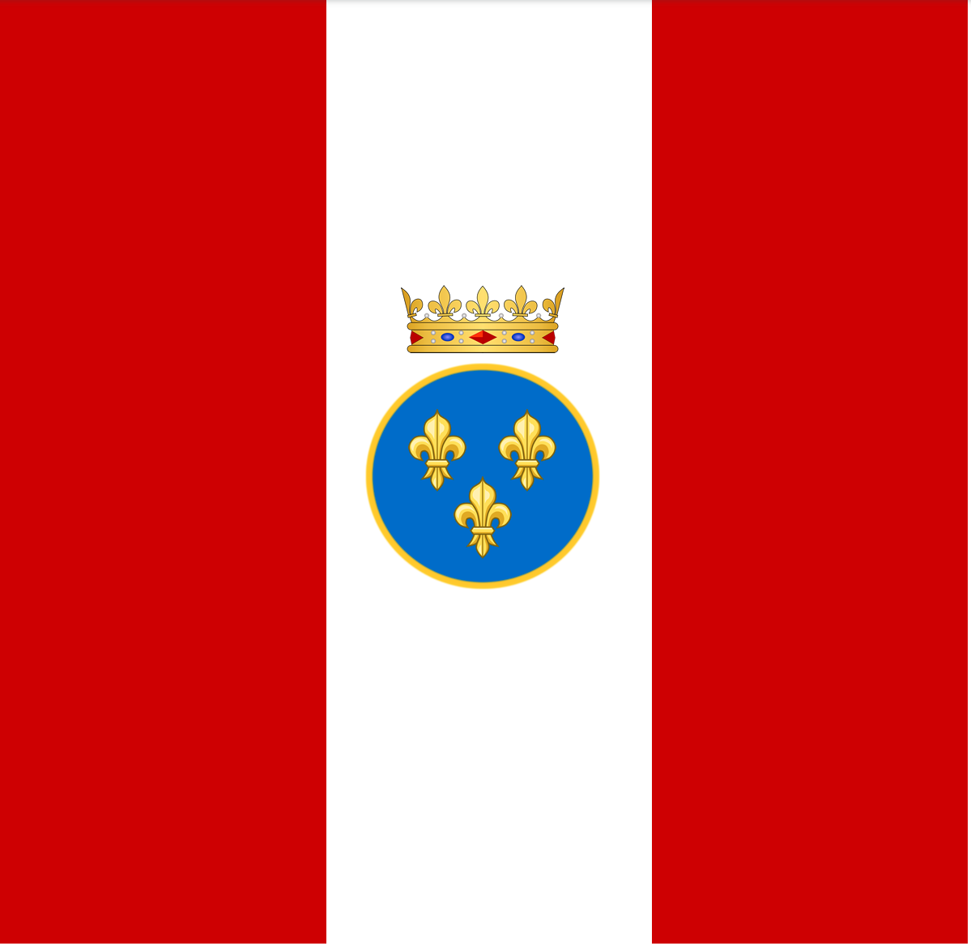
French Settlements In India And Sri Lanka 1674-1739
Hughli 1537
1658
Chinsurah 1635, 1653
Chandarnagar 1675
Diu 1535
Surat 1612
Calcutta 1690
Daman 1558
Bassein 1533
Bombay 1533
Visagapatnam 1682
1638
Masulipatnam 1616
Goa 1510
Pulicat 1600
French East India Company
Cannanore 1501
Madras 1522
Mahe 1725
1639
Calicut 1492
Pondicherry 1674
Portuguese settlements
1658
VOC settlements
Nagapatnam 1507
English settlements
Cochin 1500
1637, 1674
Trincomalee 1522
Colombo 1505
1656
Matara 1507
Calle 1507
1656

Slide 10
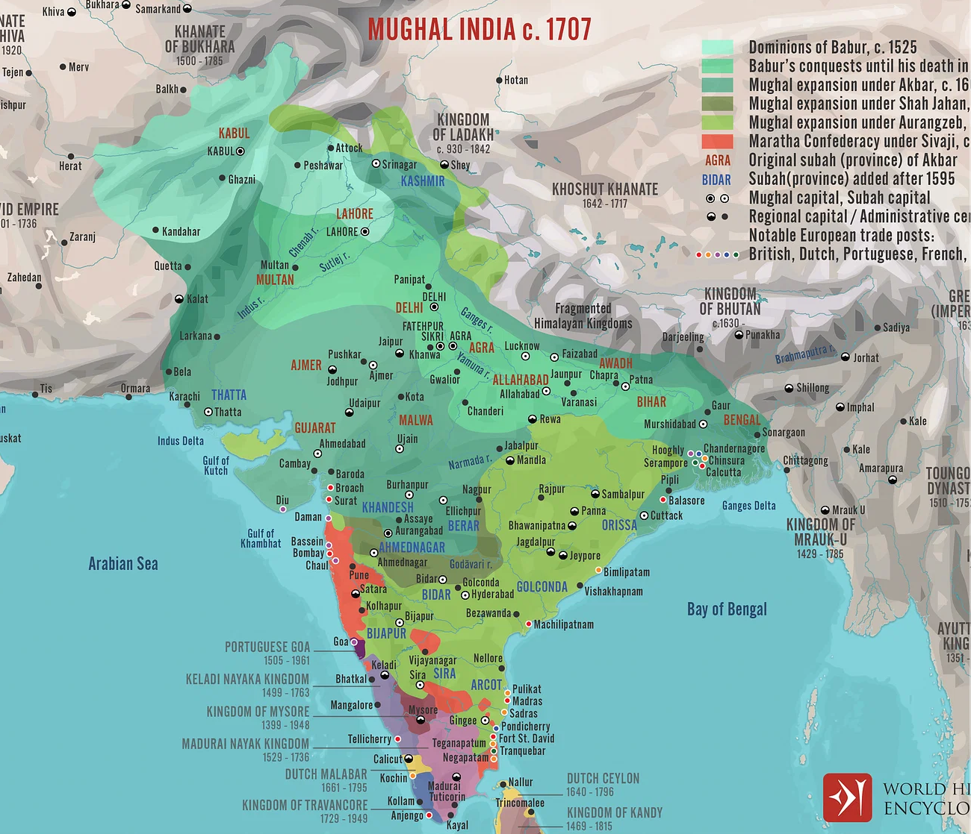
Mughal India

Slide 11
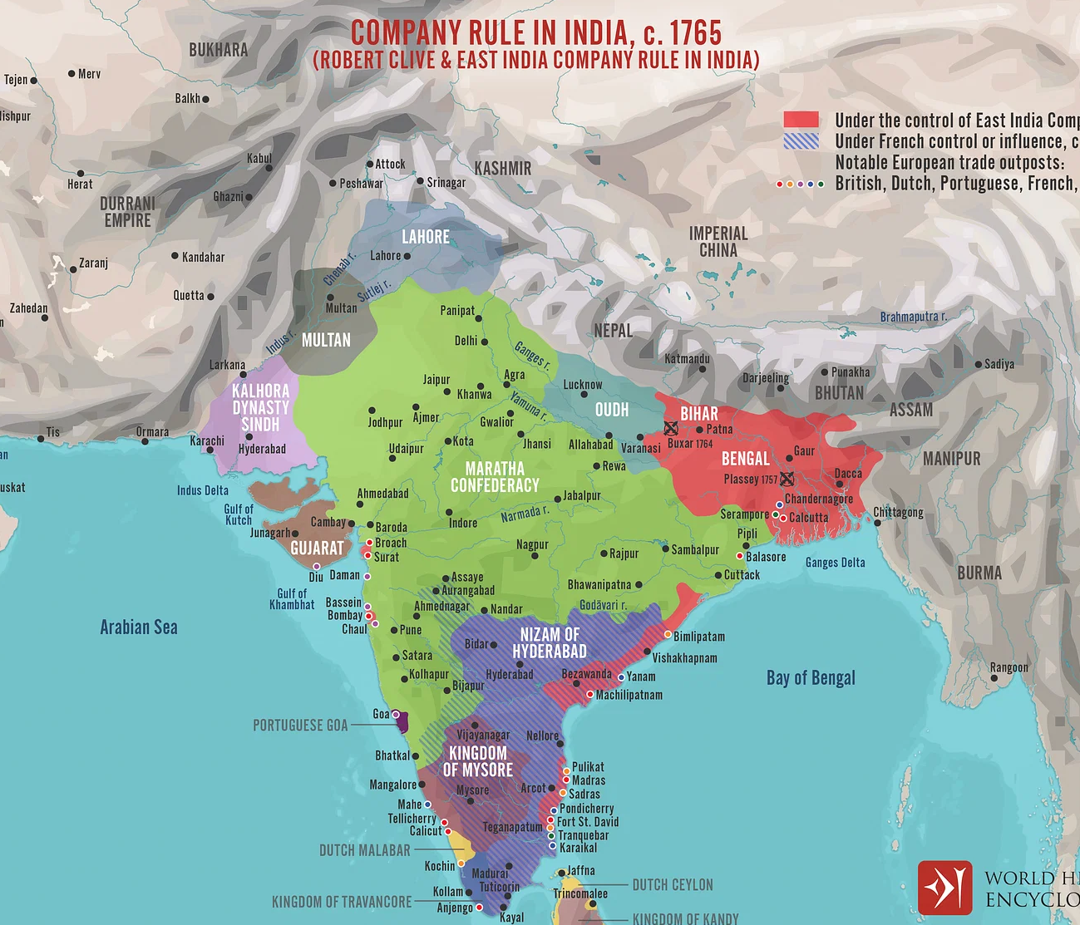
East India Company Rule c. 1765

Slide 12
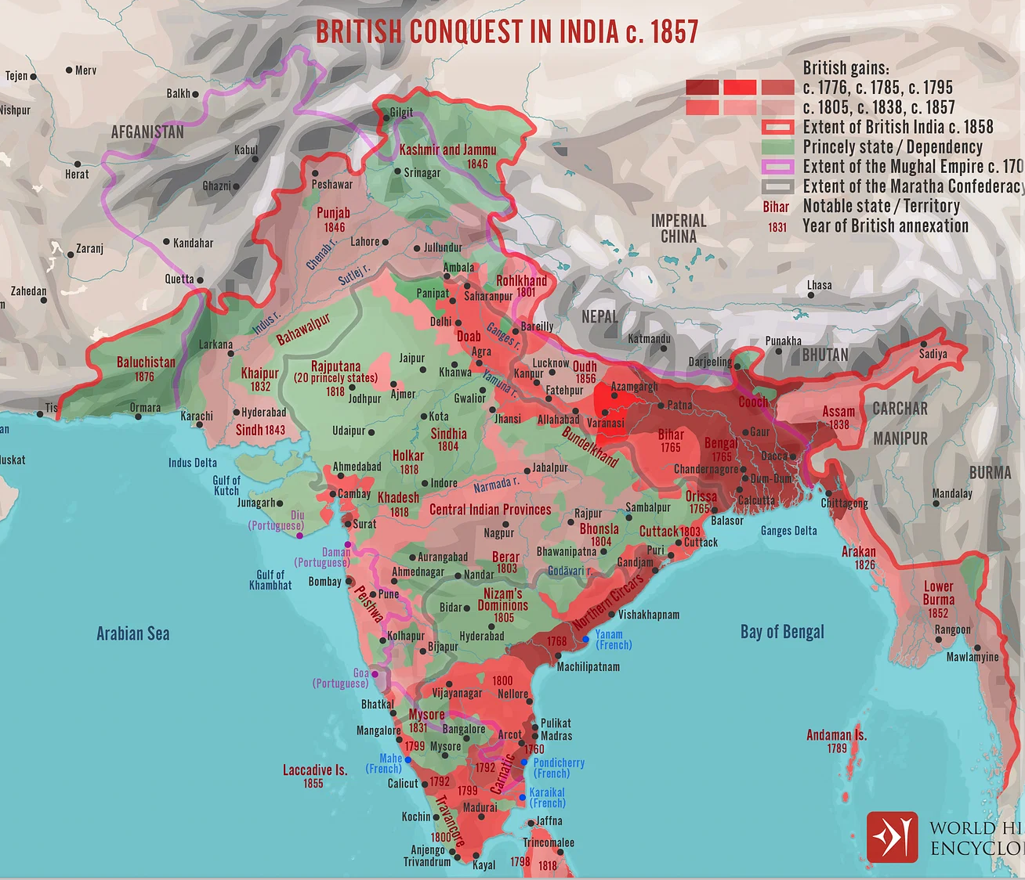
British Conquest Of India c. 1857

Slide 13
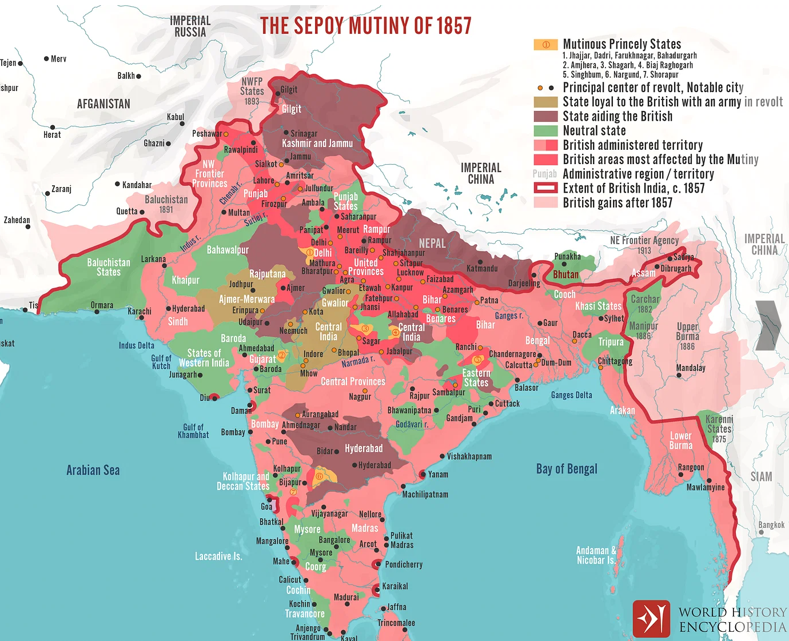
The Sepoy Mutiny aka The Indian Rebellion Of 1857

Slide 14
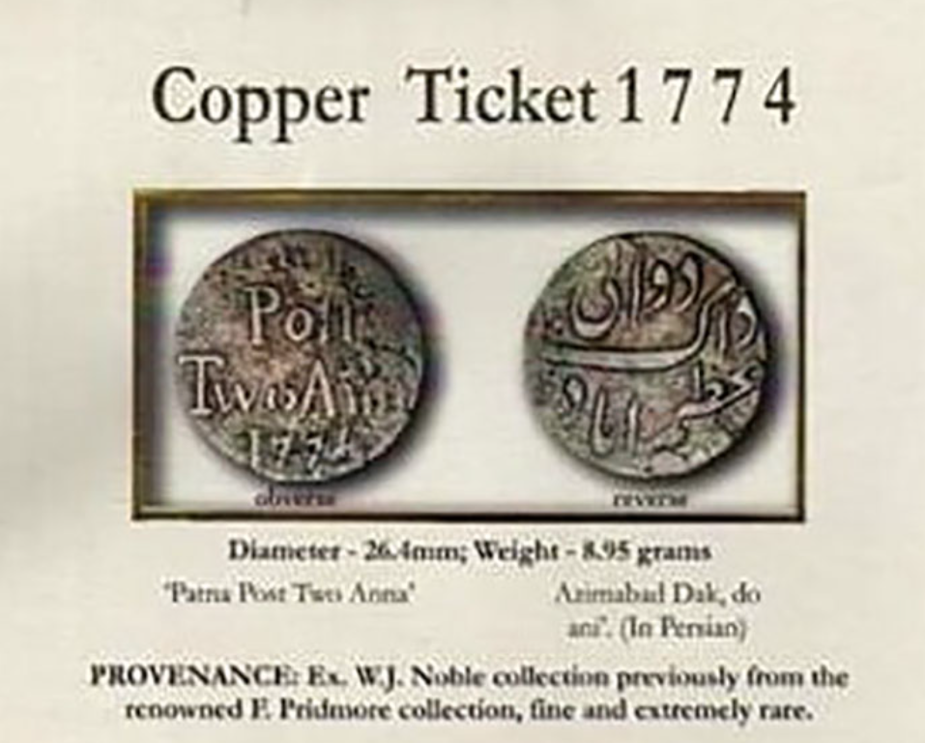
The Patna Copper Ticket
In January 1774, India’s first Governor General, Warren Hastings, began to make arrangements for the establishment of India’s first Post Office Department.
One reform introduced was the prepayment for postage of letters.
Small Copper Tickets of 2 Annas each (being the single rate for every 100 miles) were introduced exclusively for postal purposes.
These rare copper tickets thus became one of the first recorded instruments for the prepayment of postage, even before the Penny Black of 1840.

Slide 15
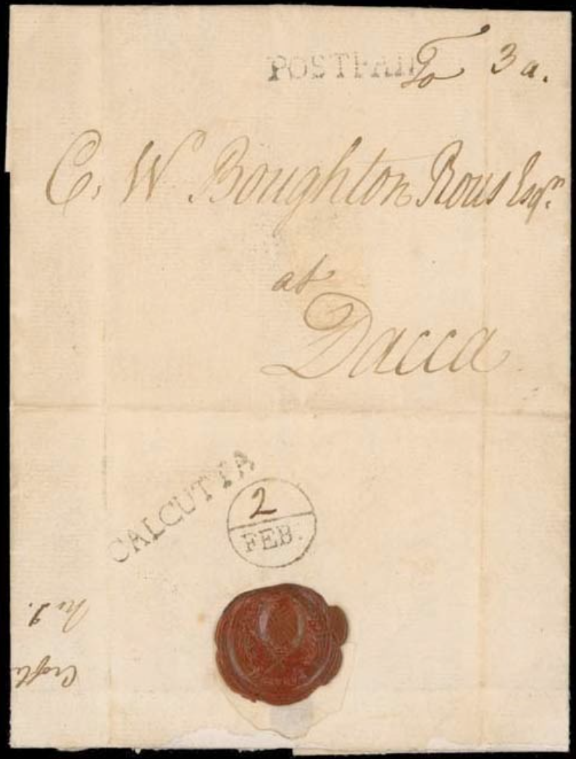
Bishop Marks
He also introduced a requirement, “That all letters shall be stamped with the day of the month on which they are delivered into any chief office.”
Cover 1775 (2 Feb.) entire letter from Croftes and Johnson to William Boughton Rous, Chief of the Provincial Council of Revenue at Dacca, showing "POSTPAID" (HG 2) and, on reverse, a superb strike of the India Bishop mark for "2/FEB" (HG X2) alongside equally fine "CALCUTTA" (HG 1). A remarkable cover, being the earliest of the four India Bishop marks recorded in private hands.
Image from Christie’s Auction 10/25/2000. Price realized: GBP 32,000.00

Slide 16
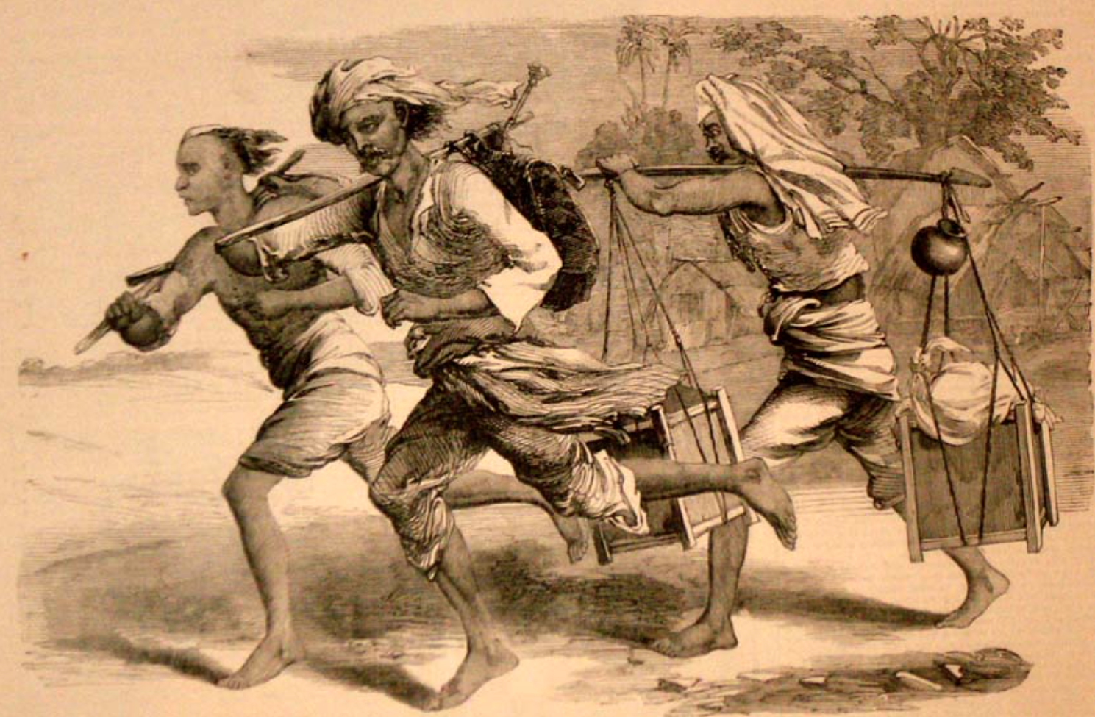
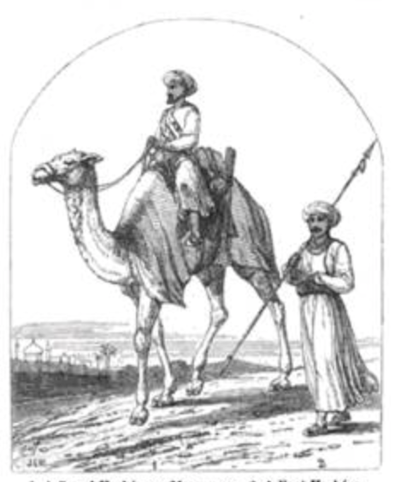
Messenger Postal System: Dak Harkara
Camel Harkara and Foot Harkara
Postcard showing two Dawk-Wallahs transporting the mail, around 1850
Source: http://oldphotosbombay.blogspot.com.es/

Slide 17
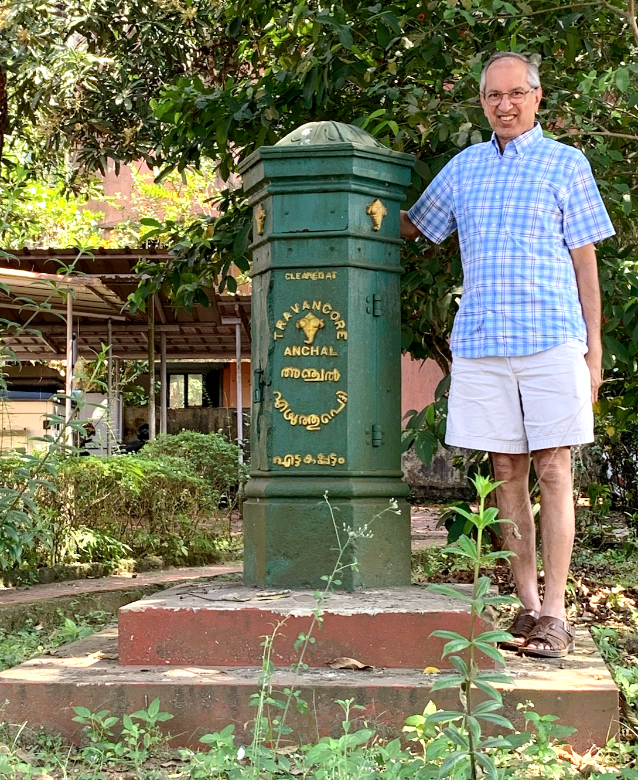
The Mysore Anche And Travancore/Cochin Anchal
Anche may derive from the Urdu word unjal meaning message.
Chikka Devaraja Wodeyar II ruled the state of Mysore from 1673-1704 and started an Anche Post.
In the neighboring Travancore kingdom, Maharaja Marthanda Varma started the Travancore Anchal post.

Slide 18
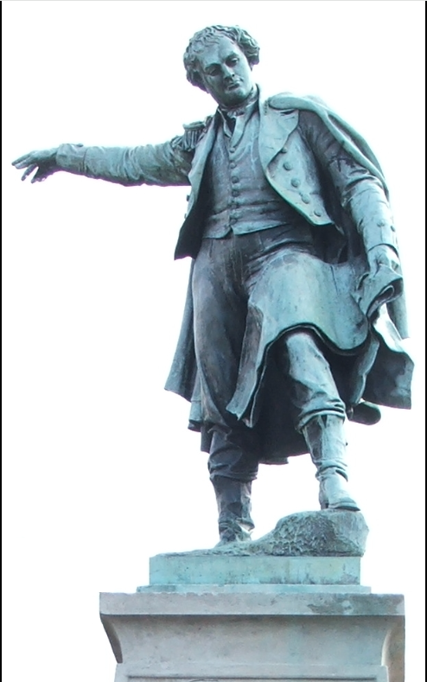
Thomas Waghorn
Waghorn promoted and claimed the idea of a new route from England to India overland through Egypt connecting the Mediterranean and Red Seas prior to the development of the Suez Canal.
Waghorn claimed to have demonstrated the route for the first time in 1829-30 and that it reduced the journey from over 11,000 miles (18,000 km) to 6,000 miles (9,700 km) and while steamships around the Cape of Good Hope took about three months, his route took between 35 and 45 days.
Thomas Waghorn's statue in Chatham

Slide 19
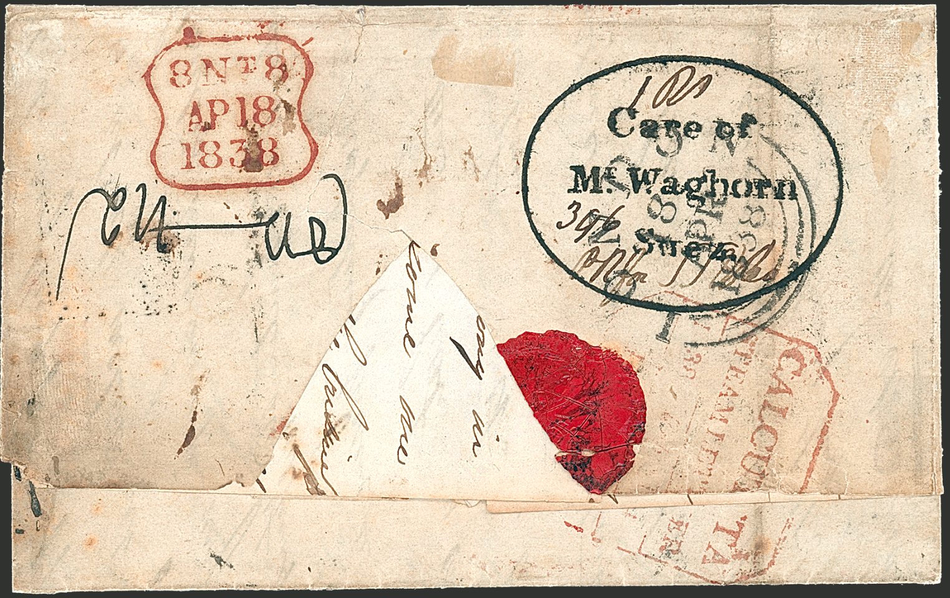
Care of Mr. Waghorn

Slide 20
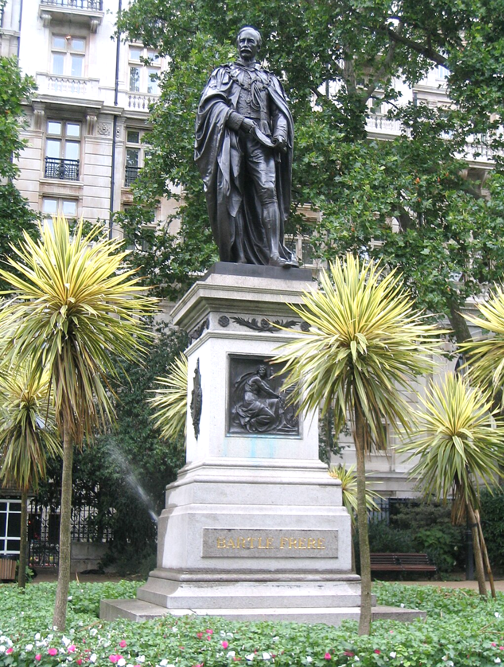
Sir Bartle Frere and the Scinde Dawk
The first postage stamps of India were not issued for the whole of the country, but for a small province – Sindh.
Sir Bartle Frere introduced stamps that were required for the prepayment of postage, a basic feature of the new system.
These stamps were first issued on 1 July 1852.
On 30th September 1854 the British postal administration stopped issuing Scinde Dawk stamps.
The name derives from the words "Scinde”, the British spelling of the name of the province of Sindh, and "Dawk", the anglicized spelling of the Hindi word "Ḍāka" or Post.

Slide 21
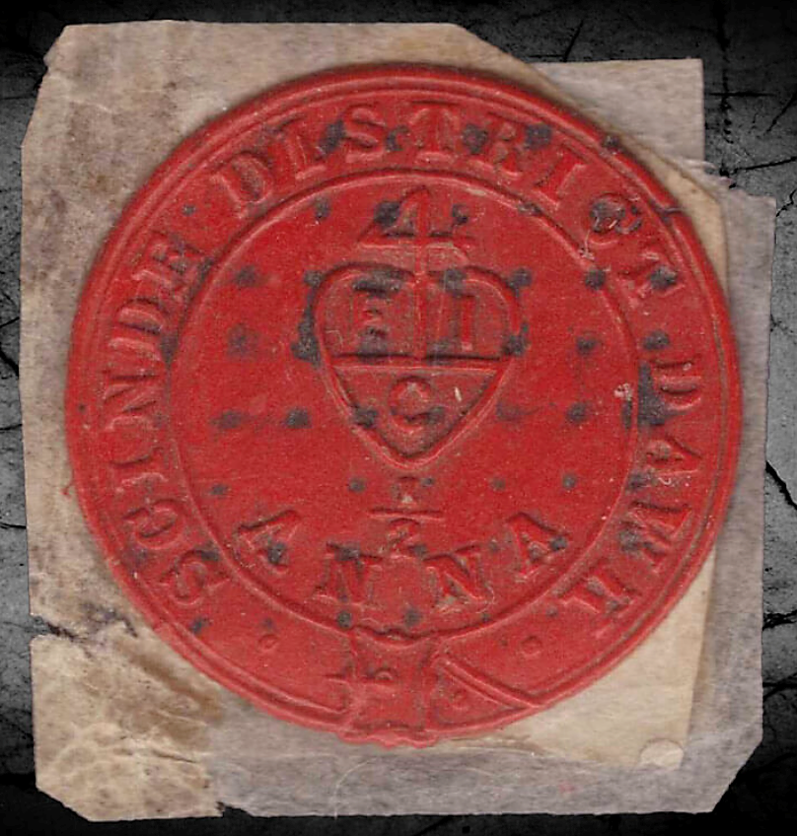
Red Scinde Dawk
The Red Scinde Dawk was the first stamp issued in all of Asia.
Because it was embossed on a wax wafer it had a tendency to crack (and often disintegrate).
It was deemed unacceptable and quickly replaced with the white and blue stamps embossed on paper.
Examples completely free of these cracks and splits are quite exceptional.
Very few examples at this level of condition are believed to exist.
Provenance: Ex Hedergott

Slide 22
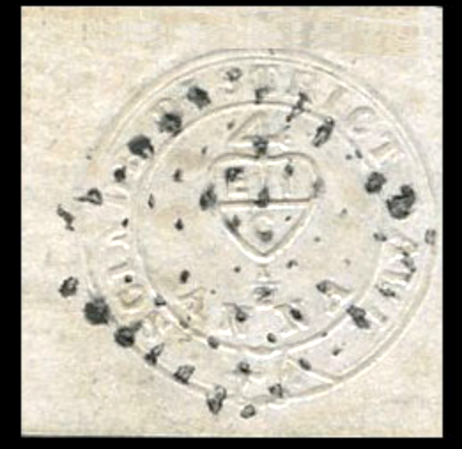
White Scinde Dawk
The original red wafer stamps proved fragile, leading to the creation of the white paper version to improve durability.
The white stamp was also found unsatisfactory, because when used on a white cover, it was diﬃcult to distinguish it and its design in candle light from the white cover.
The white Scinde Dawk stamps are also collected for the easily viewed cancellations used at that time.

Slide 23
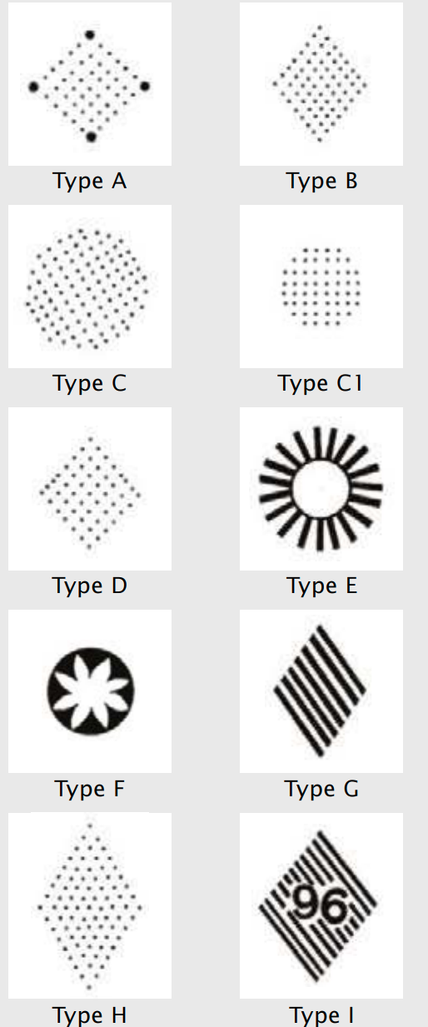
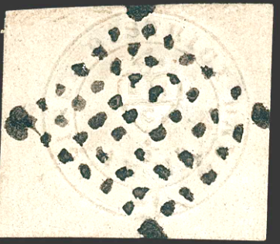
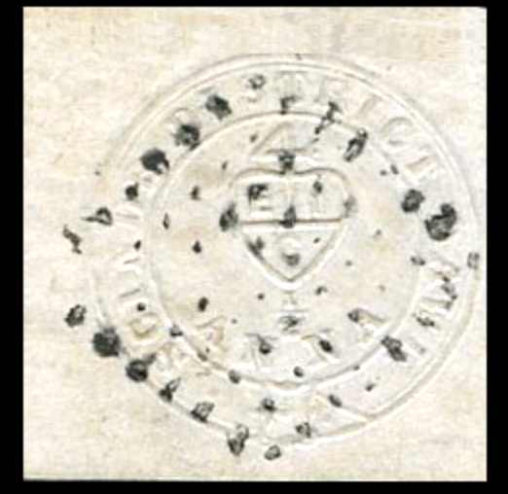
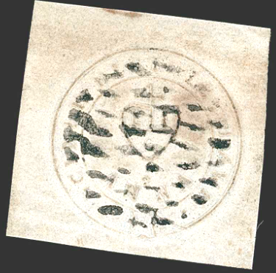
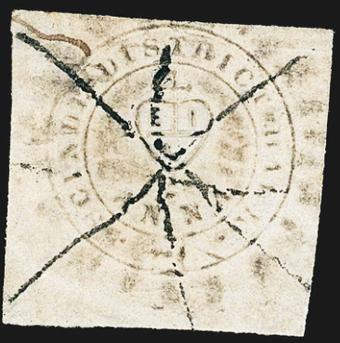
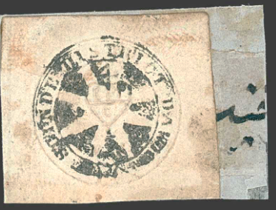
Scinde Dawk Cancellations
There are 9 types of Scinde Dawk Cancellations recorded
The cancellation types B, G, H and I were intended for use on India’s first national stamps, which were introduced on 1 October 1854.
Their use on the Scinde Dawk stamps proves that the order for the destruction of the Scinde Dawk stamps by that date was not fully carried out.

Slide 24
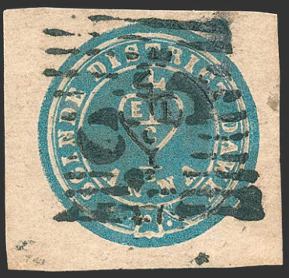
Blue Scinde Dawk
A new embossed stamp, which was also surface-printed in blue, was introduced to replace the White Scinde Dawk.
An extra ring around the circumference of the design was added.

Slide 25
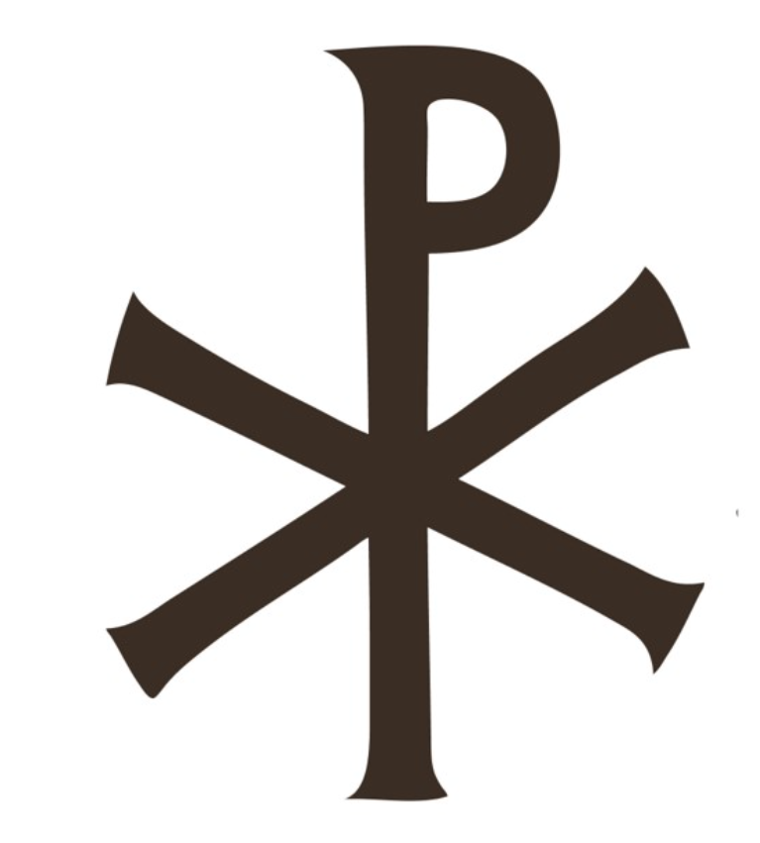
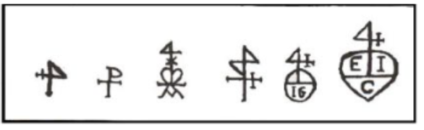
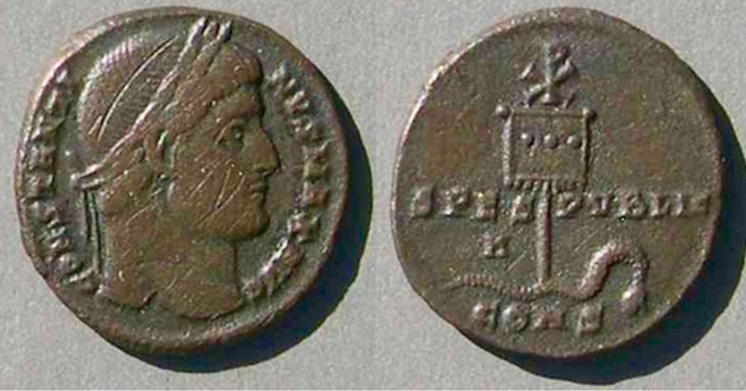
Scinde Dawk Design
Progress of the East India Company Emblem adopted in the design of Scinde Dawk
Tails side of a Constantine coin that is dated to 317 AD. Snake being conquered, vanquished, under the Chi-Rho

Slide 26
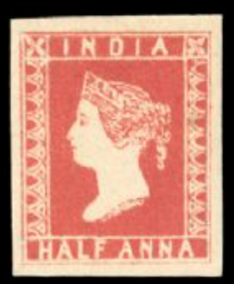
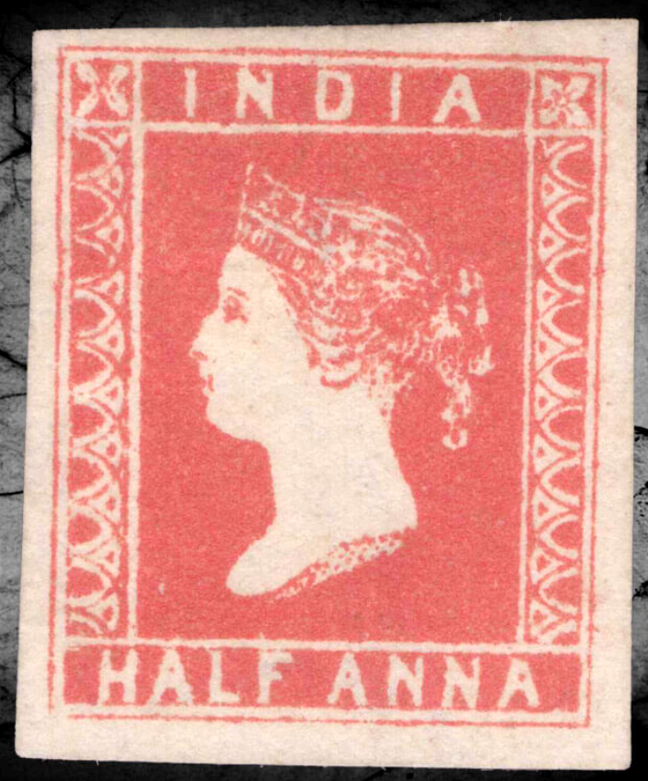
“9 ½ Arches” The Lithographed Stamps
Named "9 1/2 Arches" for the number of arches in the side panel, this issue was printed and prepared for use with a supply sent to Bombay, although it was never officially released for sale.
The printing of the shipment sent by Capt. Thuillier (The Deputy Surveyor General in charge of the Lithographic Department of the Survey Office, Calcutta), had exhausted the vermilion ink supplies on hand. Ink believed to be of similar quality and color was sourced, but it was quickly realized that this ink had a severe corrosive effect on the plates.
The chemical reaction destroyed the printing plates.
Officials in Bombay were telegraphically informed that supplies were to be destroyed, but evidently some of the sheets were released.
India, 1854, ½ anna Vermilion
India, 1854, ½ anna Deep Vermilion

Slide 27
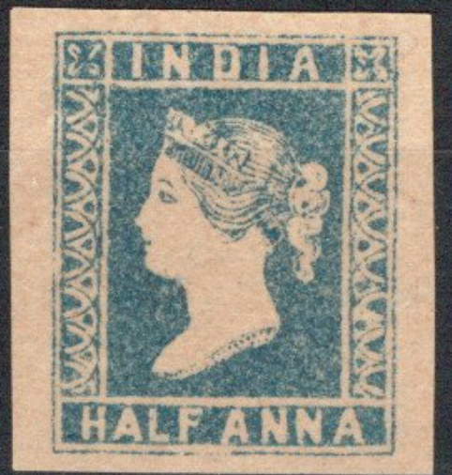
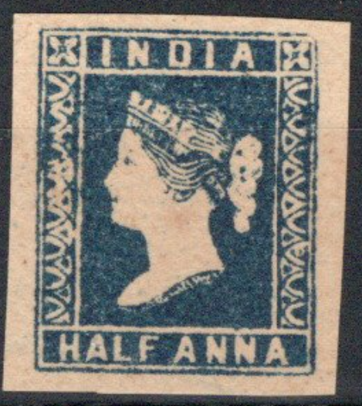
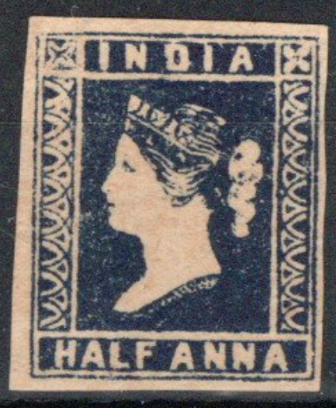
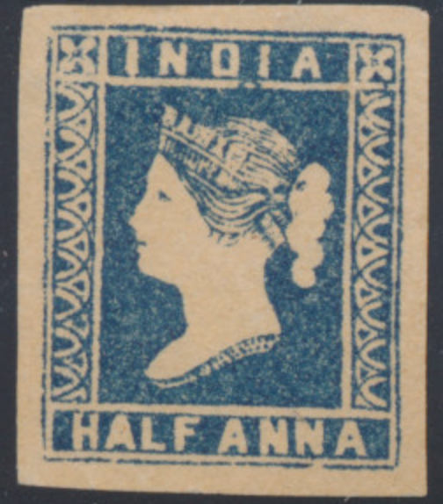
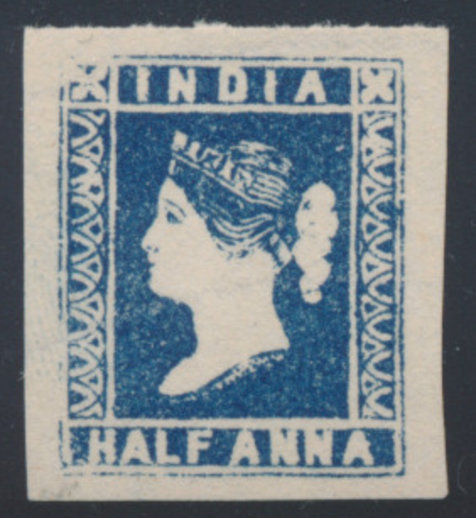
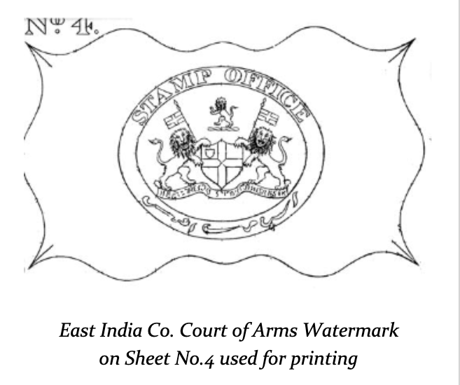
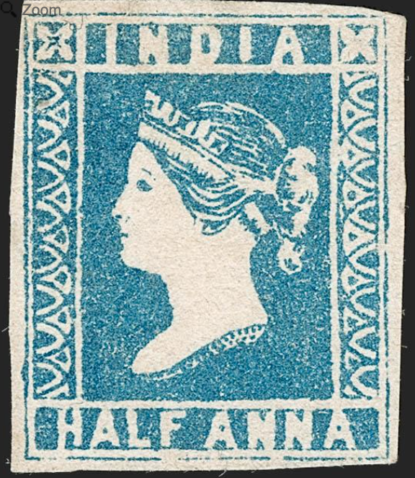
The Half Anna Blue
Die | Printing Date | No Of Stamps
Die I | April - July 1854 | 3,000,000
Die II | Aug-Sept 1854 | 2.006,034
Die III | July-Nov 1855 | 4,687,776
Die I
Light Blue
Dark Blue
Indigo
Design engraved on a copper plate by Indian artist Numerodeen
Die II
Blue
Indigo
Die III
Pale Blue
Blue
Greenish Blue
Deep Blue

Slide 28
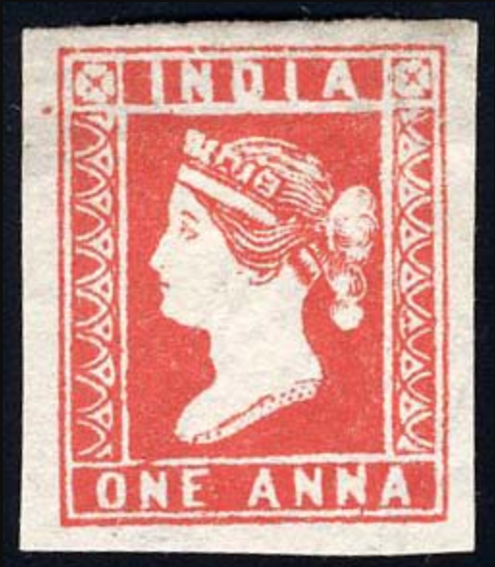
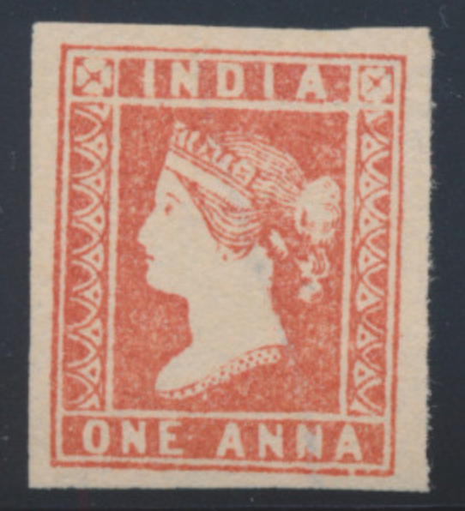
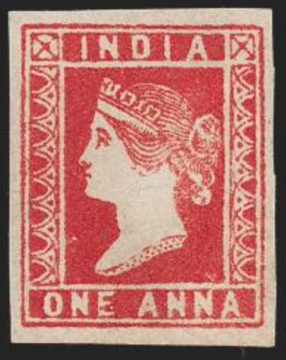
The One Anna Red
Die I
Die | Printing Date | No Of Stamps
Die I | July 1854 | 4,250,000
Die II | Aug-Sept 1854 | 3,500,000
Die III | July-Aug 1855 | 1,520,000
Deep Red
Red
Die II
Deep Red
Dull Red
Die III
Red
Dull Red

Slide 29
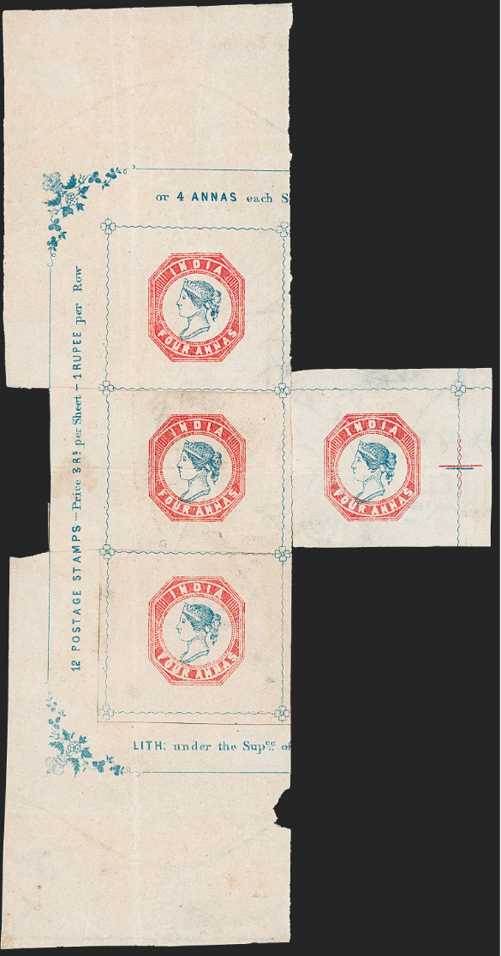
Adding a Second Color: 1854
The authorities gave the Survey Office a new challenge.
The 4 anna stamp was to be printed in two colors, with a red frame surrounding an indigo Queen’s head.
At this time, the only stamps to have been issued in more than one color anywhere in the world were from Zürich and Basel, printed using sophisticated techniques in Europe.
Reconstructed irregular unused block of four of the 1854 4 annas lithograph

Slide 30
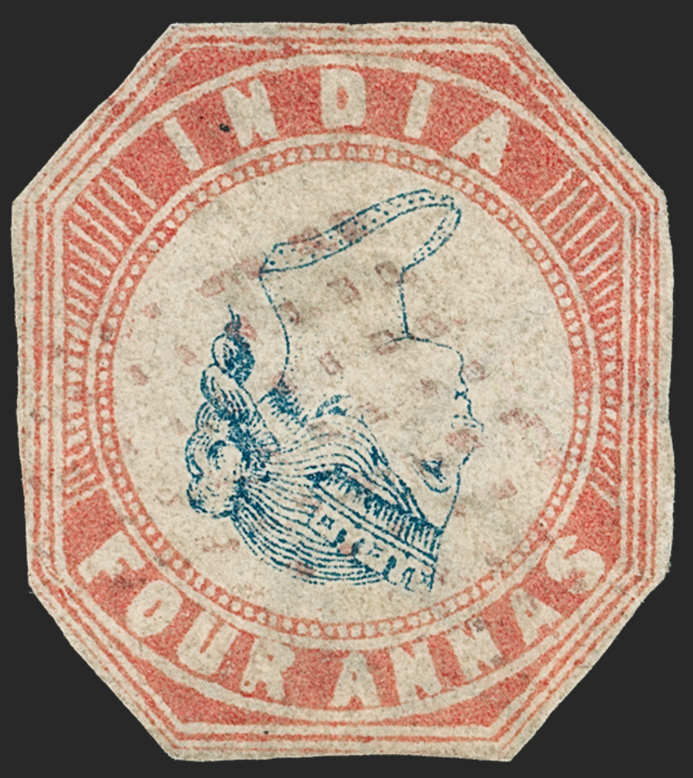
The Inverted Head 4 Annas: 1854
Surprisingly, no mention of this error was made until 1874, two decades after issue, when an example was exhibited at a meeting of The Royal Philatelic Society London.
Of the 28 verified examples of this error, three are cut square.
This example has a red "hollow" diamond of dots cancel of the Straits Settlements (Singapore).

Slide 31
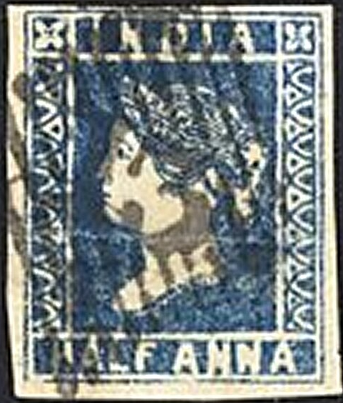
The Postal History Of Portuguese India
The postal history of Portuguese India goes back to the earlier days of the colony.
The postal history begins with communication between the Viceroy and the Court at Lisbon soon after the conquest of Old Goa by Afonso de Albuquerque in 1510.
In those days, correspondence was normally sent in triplicate so as to offset any losses caused by monsoons or pirate attacks. One copy would be sent on the flag ship and the other two would be handed over to the captains of the other vessels.
Portuguese Indian postmarks are known from 1854, when a post office opened in Goa.
A stamp of the British East India Company, cancelled with the Damaun postmark in Portuguese India

Slide 32





The “Native Stamps” Of Portuguese India
The first postage stamps of Portuguese India were issued 1 October 1871.
These were issued for local use within the colony. Stamps of British India were required for overseas mail.
The design of these first stamps simply consisted of a denomination in the center, with an oval band containing the inscriptions "SERVIÇO POSTAL" and "INDIA PORT.".
1871 - 10 reis. Ex. Admiral Bridges. Only unused multiple known
Value | Color | Number Issued
10 Reis | Black | 10,000
20 Reis | Dark Carmine | 20,000
40 Reis | Blue | 5,000
100 Reis | Green | 3,000
200 Reis | Ochre | 2,000
First printing on thin paper

Slide 33






The Last Outposts Of Portuguese India: 1956
In 1661, the Portuguese ceded the island of Bombay to the English as part of the dowry for Catherine of Braganza's marriage to King Charles II of England.
This transfer was formalized in a marriage treaty signed on June 23, 1661, which also included other assets like Tangier and a cash dowry of £300,000.
The Liberation of Goa on December 19, 1961, marked the end of 451 years of Portuguese rule in the region.
Following a brief military operation India annexed the territories of Goa, Daman, and Diu.

