Slide 1
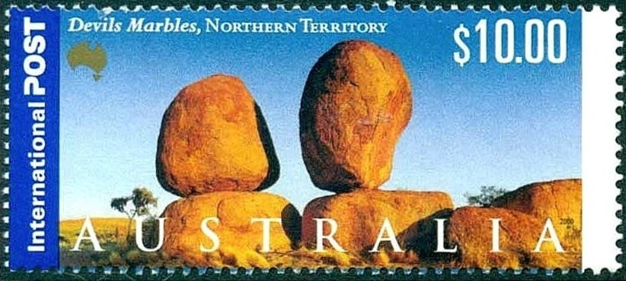

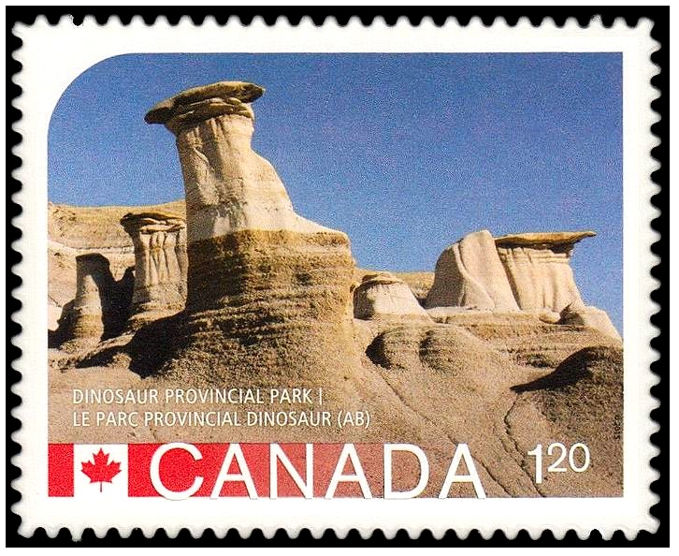
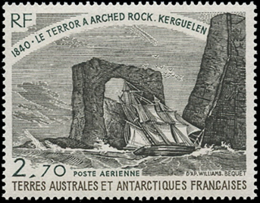
Geomorphology on Postage Stamps
Fred Haynes February 27, 2025

Slide 2
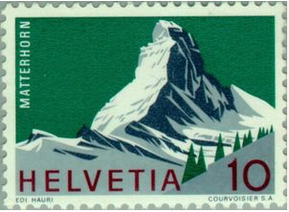
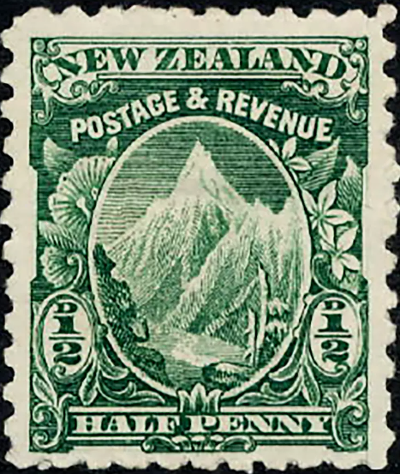
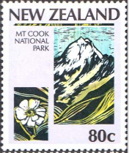
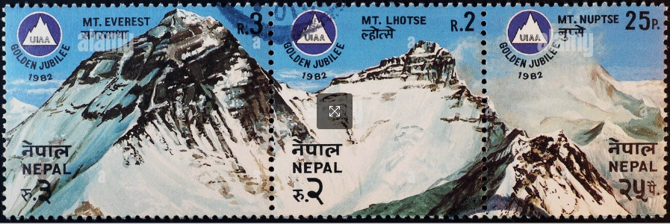

Mountains
1900
1987
highest mountain in New Zealand (12,218’)
Matterhorn (1965) - Switzerland
Nepal
(1982)
Mountains – 4182 entries
Volcanoes – 633 entries

Slide 3
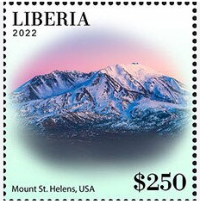
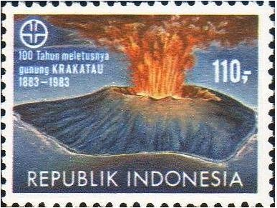
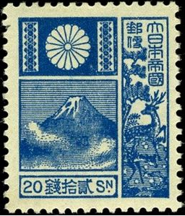
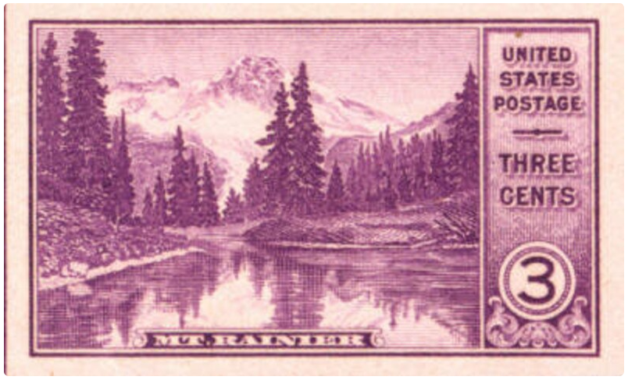
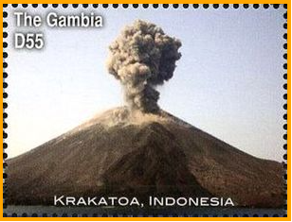
Volcanoes
Mt. Fuji
Japan (1929)
artist depiction of August, 1883
2016, photo of a recent eruption
Mt. Ranier (1935 NP set) - imperf

Slide 4
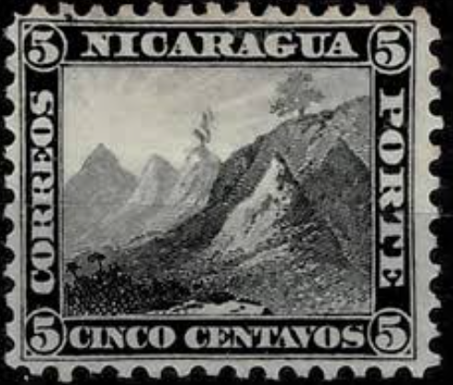

There are approximately 1350 potentially active volcanoes, about 500 have erupted in recorded history (last ~5000 years). About 50 erupt every year.
In the US there are 170 potentially active volcanoes, 130 of them are in Alaska, 54 of which have erupted in recorded history. Don’t worry, there are none in New York.
1862 first volcano stamp
In the fall of 1902 American politicians were actively debating whether to support a canal bridging the Atlantic and Pacific Oceans through Panama or Nicaragua. .
Two years earlier, Nicaragua had issued this stamp depicting Mt. Momotombo, a stratovolcano in Nicaragua, and added smoke coming from its top.
The leaders of Panama sent copies of this stamp to all US senators and also reminded them of the May 8, 1902 eruption of Mt. Pelee on the Caribbean island of Martinique that killed 30,000.
Mt. Momotombo (1900)

Slide 5
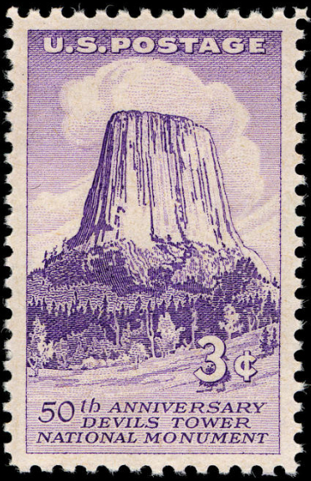
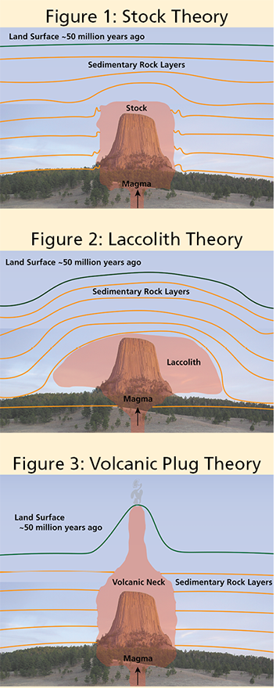
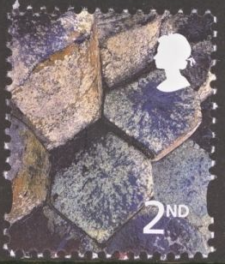
Giant’s Causeway
Northern Ireland
Great Britain 2001
September, 1956
First US National Monument
columnar jointing caused by cooling as magma solidifies within the crustal stress regime
National Park Services webpage

Slide 6
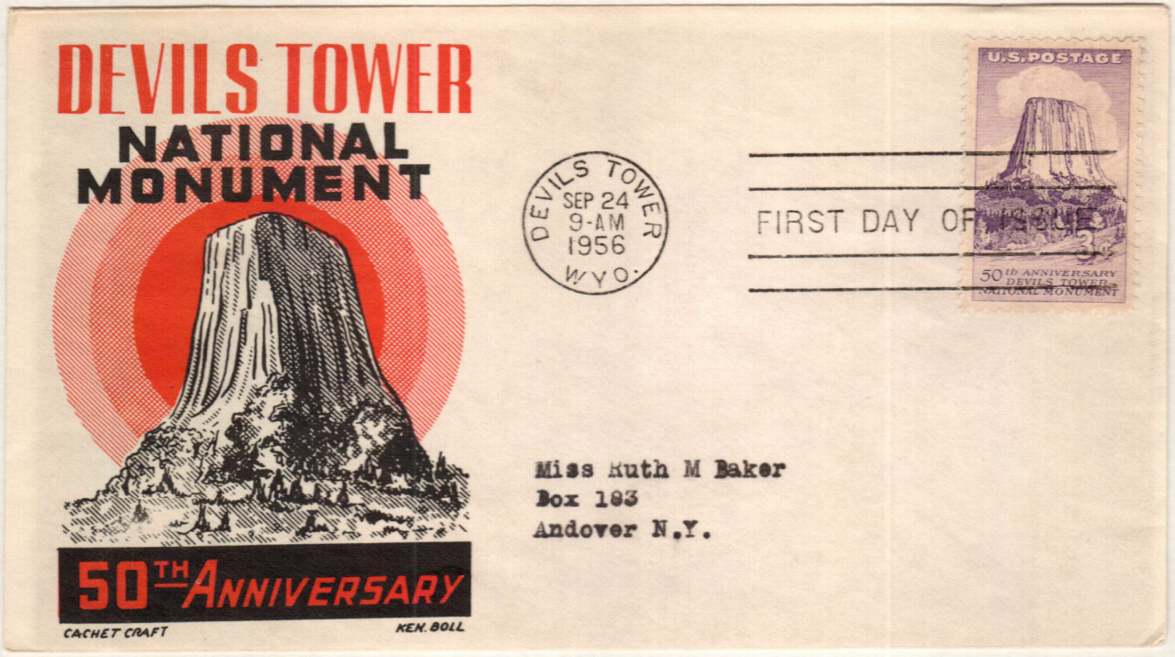
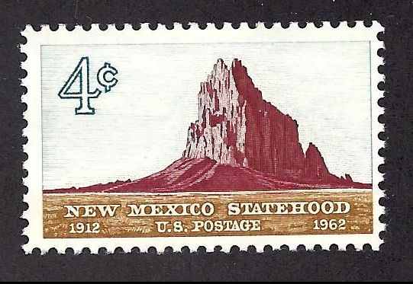
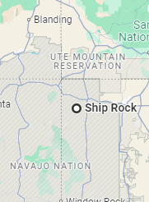
A first day cover or FDC featuring the Devils Tower stamp, a first day cancel from the site when the stamp was first issued and a cachet image, here a line drawing of the feature.
What is the rock type?
Phonolite porphyry with nepheline
Ship Rock or Tse Bitai “winged rock” in Navaho is a volcanic neck where less resistant volcanic rock surrounding the central stock has eroded away.
UT
CO
AZ
NM

Slide 7
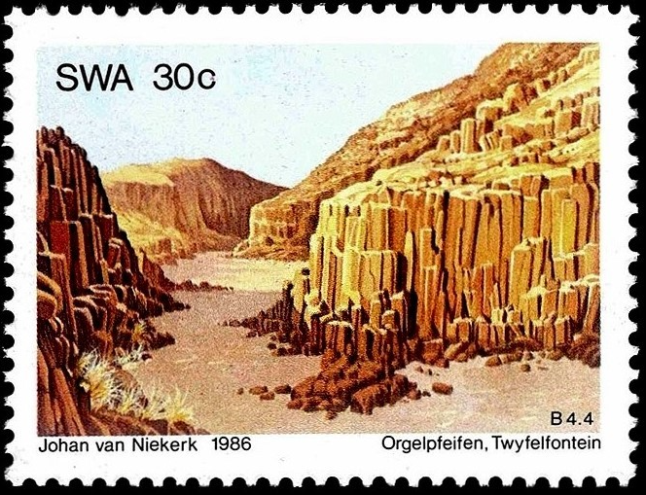
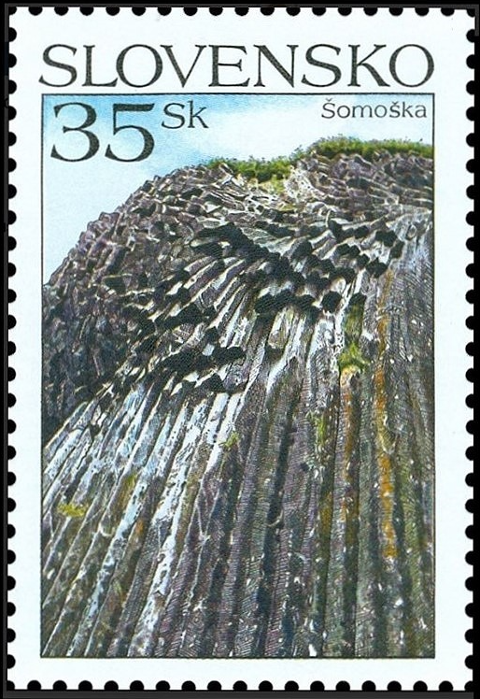
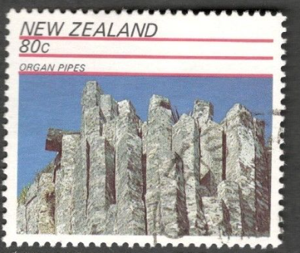
120-140 million year old basalt
Slovakia, 2006: Stone waterfall of Somaska
just 4 million year old basalt
10 my old basalt

Slide 8
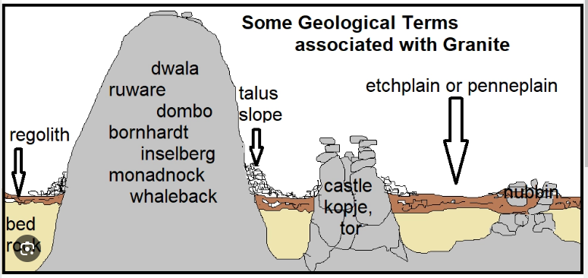
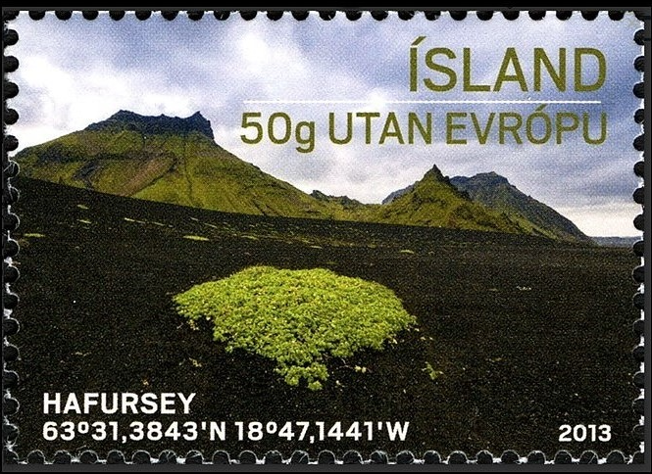
Some Geologic Features
associated with Continental Weathering
Hafursey: an inselberg (isolated mountain) made up of palagonite, an alteration product between volcanic glass and seawater.
generally kaolinite, illite, other clays and zeolites

Slide 9

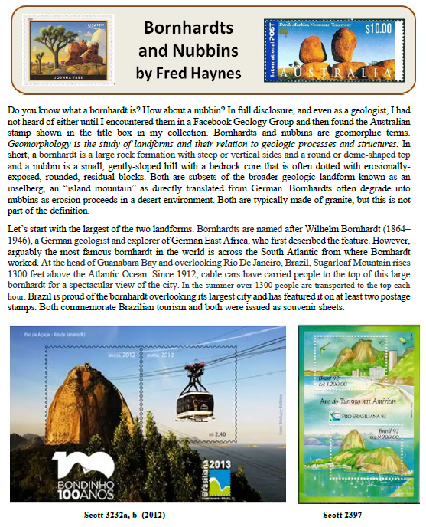

Slide 10

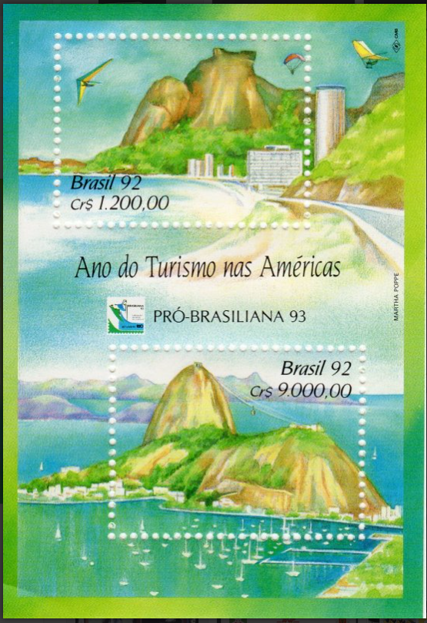
A bornhardt is a dome-shaped rock formation with steep sides at least 50m tall and hundreds of meters wide. [Named afer German geologist Wilhelm Bornhardt]
Sugarloaf Mountain, at the head of Guanabara Bay in Rio De Janeiro may be the world’s most famous bornhardt, rising 1300’ above the bay.
Brazil has featured Sugarloaf Mountain on postage stamps twice (in 1992 and 2013). In both cases a pair of stamps are set into what is called a souvenir sheet.

Slide 11
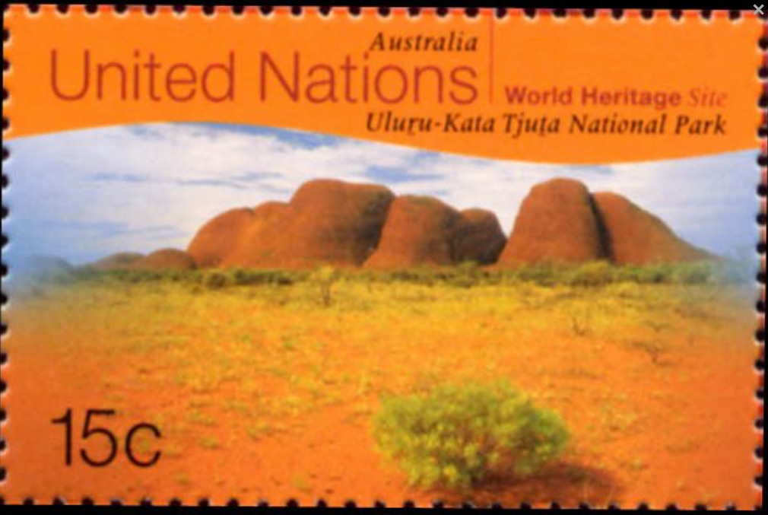
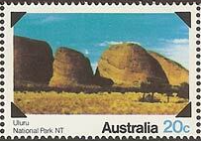
1999
1979
Australians are likely to disagree with the assignment of Sugarloaf Mountain as the world’s most famous bornhardt. There are many noteworthy bornhardts in central Australia, particularly in Uluru-Kata Tjuta National Park.
Although many bornhardts are intrusive igneous rocks that is not a strict part of the definition. These hills are arkosic sandstone and conglomerate, remnants of Cambrian alluvial fans.

Slide 12
These are nubbins: rounded residual blocks exposed by weathering, typically composed of intrusive igneous rock.
Australian explorer, John Ross, who is created with mapping the region in 1910, is said to have stated that it appears that the “devil himself emptied his bag of marbles”.
Geologists, however offer a different explanation.

Slide 13
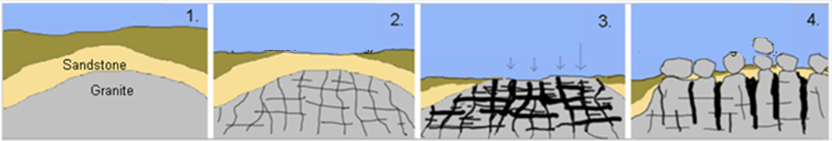
~1700 million years ago, a granitic magma intruded older sedimentary rocks.
As the granite cooled, pressures and stresses within the Australian continental plate caused cracks (joints) to develop at right angles.
Over hundreds of millions of years the overlying rocks were eroded and the granite came closer to the surface. Groundwater filtered down the joints, converting some of the feldspars in the granite to clay. The weathering process was helped by the warm, humid climate. Weathering was greatest at the corners of the blocks where surfaces were exposed.
Eventually, the overlying rocks were eroded away and the granite was exposed. The softer weathered granite at the edges of the blocks was washed away leaving boulders perched on one another and strewn across the rock platform.
Devil’s Marbles were born!

Slide 14
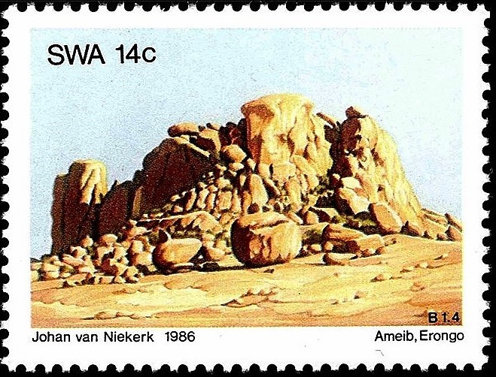
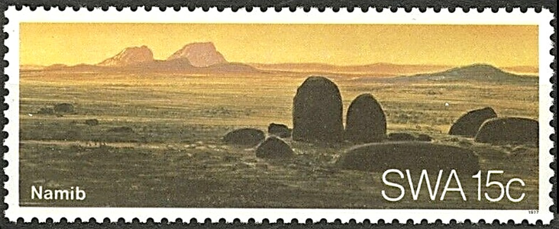
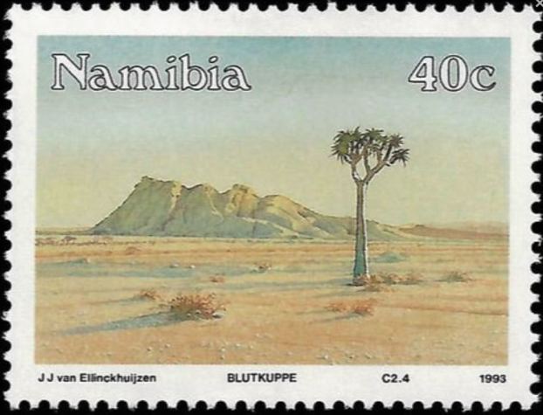
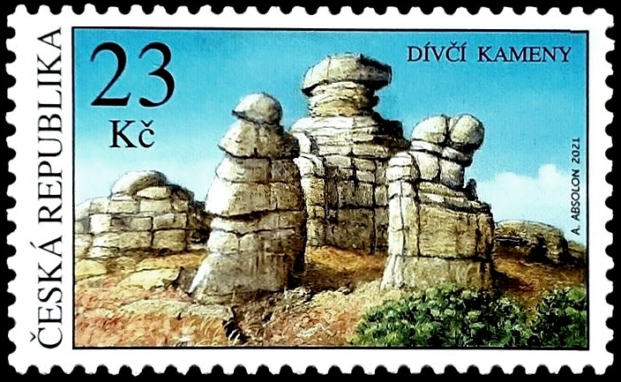
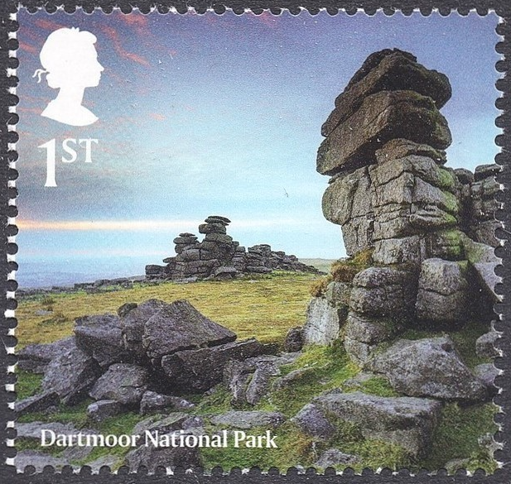
kopje-small rocky hill in a flat area
Tor
Czech Republic (2021) – fractured Paleozoic granite carved by erosion and weathering in the Giant Mountains . So what are these?
Granite outcrops on moorland , often found atop inselbergs or pediments.
They provide evidence that glaciers did not cover the areas on which they are
Believe it or not, Wikipedia describes it as a combination of a kopje and a tor

Slide 15
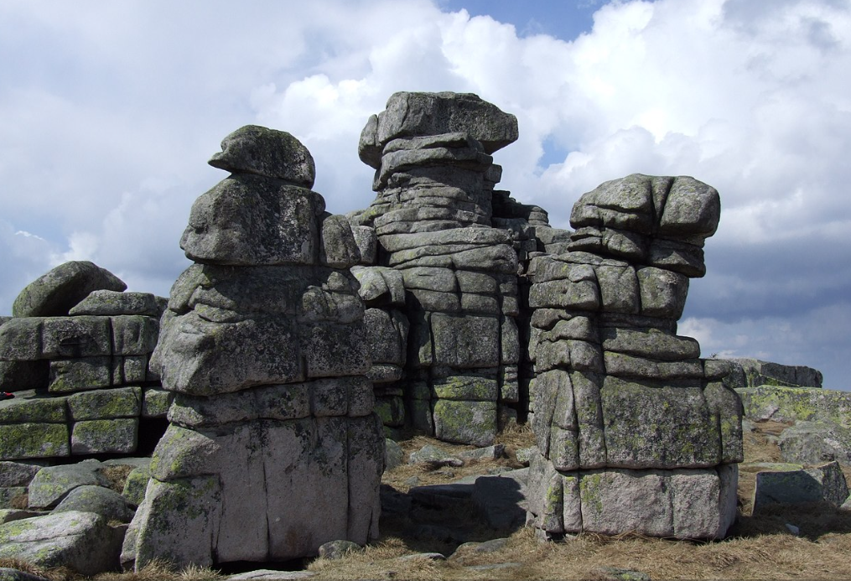

Slide 16

Too small to be a bornhardt, perhaps a kopje, perhaps with continued weathering the rocks will separate and they will be nubbins.

Slide 17
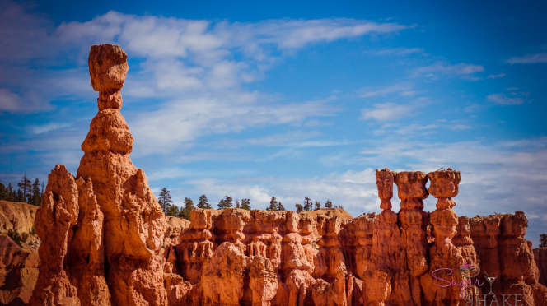
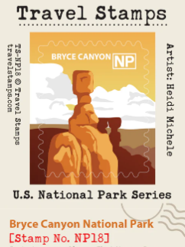
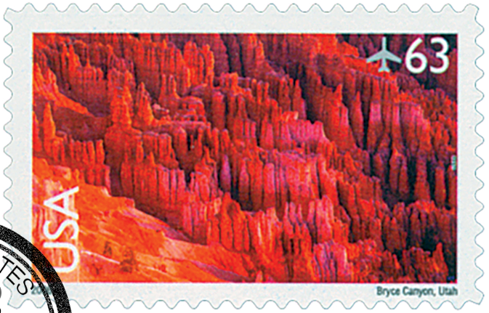
Hoodoos are thin spires or columns of rock with a harder cap rock
2006 United States
International Postal rate (63 cents)
Domestic 1 oz. rate was 39 cents

Slide 18
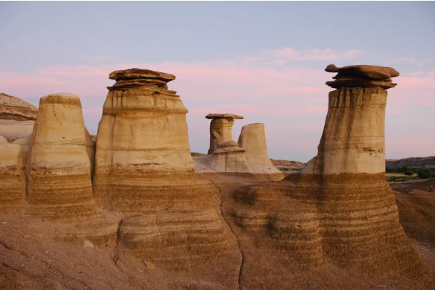
Canada 2015 World Heritage Site Stamp Issue
Drumheller hoodoos,
Alberta, Canada
(Cretaceous shale/silt capped by calcite-cemented sandstone)

Slide 19
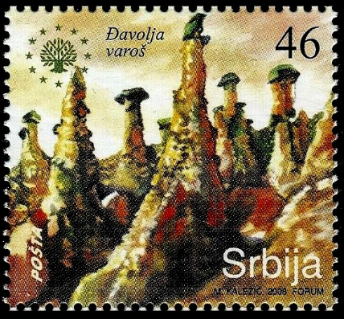
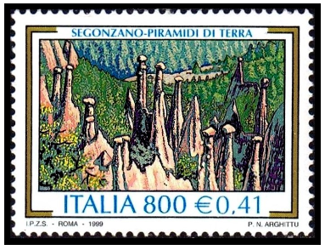
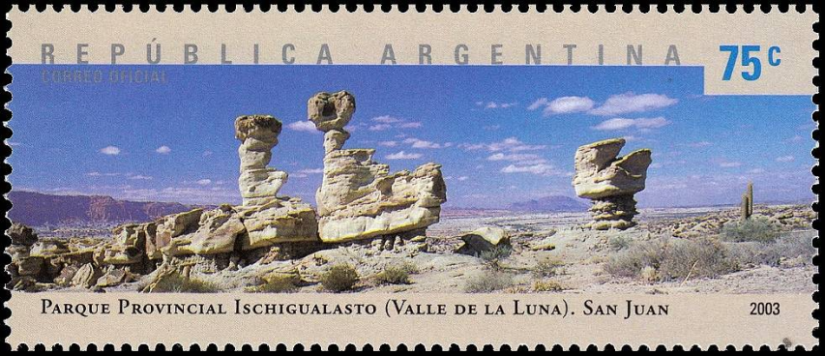
More Hoodoos
Italy (1999) – “earth pyramids” of Segonzano, erosional remnants of moraines from Quaternary glaciation, cemented caprock
Serbia (2008) – Djavolja Varos in the Radan Mountains, Neogene volcanic tuffs capped by a resistant dark andesitic lava flow
Argentina (2003)
Ischigualasto Provincial Park, San Juan
Triassic badlands and sculpted rocks know for their dinosaur fossils

Slide 20
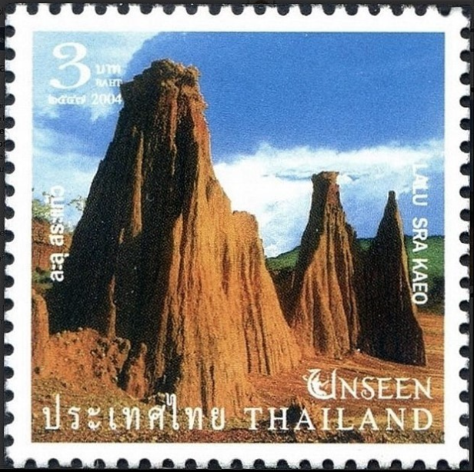
Yup, one more hoodoo
Thailand (2004) – Laku is a natural canyon located in Sa kaeo Province. The hoodoos here are created by erosion of weakly consolidated laterite formation beneath a more cemented, resitive unit.

Slide 21
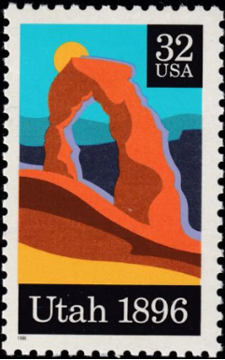
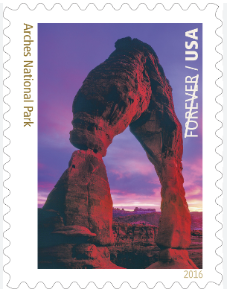
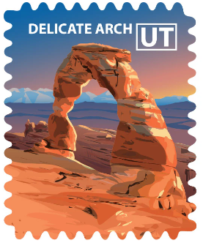
Arches National Park, Moab, Utah
Arches form when erosive forces work on each side of cliff or fin under a more resistive cap rock
Delicate Arch – Jurassic Entrada Formation
The opening is 16 meters high and 10 m wide
There are a reported 2000 natural stone arches in the 120 square mile park, but to my knowledge this is the only one that has been rewarded with a postage stamp.
1996 – 100 year anniversary of statehood

Slide 22
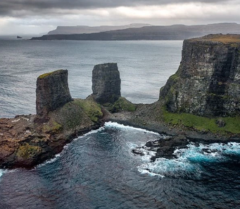
There are no pictures of this arch, only this line drawing from the expedition because it collapsed in a storm in 1910.
French Southern and Antarctic Territories
Kerguelen Islands, ~3000 equidistant kilometers from Madagascar, Australia (Perth), and Antarctica in the southern Indian Ocean.
Explored in 1840 by James Clark Ross on a two sailboat expedition to the isolated stratavolcano comprised of Tertiary flood basalts and a central core of plutonic rocks.
The sea stacks that remain are now part of L’Arche des Kerguelen National Monument within the French Southern and Antarctic Lands after leaving the jurisdiction of Madagascar in 1955.

Slide 23
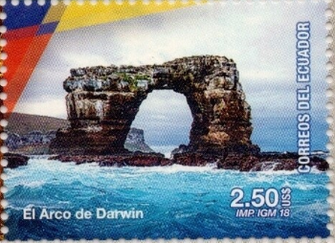
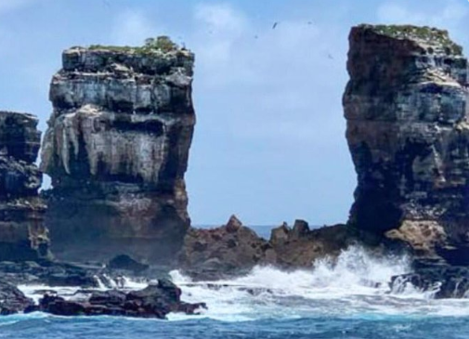
Darwin’s Arch, Galapagos Island
The arch collapsed at 11:20 AM on May 17, 2021, an event witnessed by a group of divers who were nearby.
Located 60 miles north of the main Galapagos Island Group, Darwin’s Arch was featured on an Ecuador stamp in 2018.
The two columns of interbedded volanic lava flows have now been appropriately christened the “The Pillars of Evolution”

Slide 24
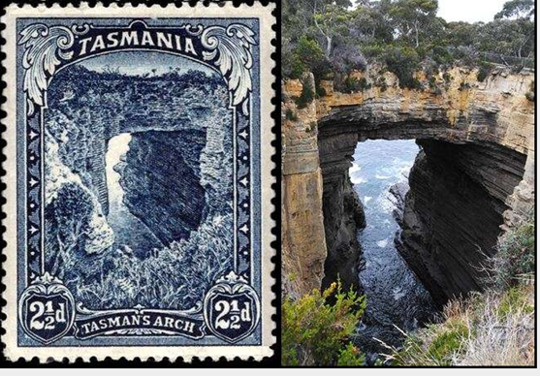

Natural Bridges
a subset of arches where the overlying resistant unit is accessible and level enough for a trail or road.
Tasman’s Arch was featured on a Tasmania stamp in 1899. Tasmania issued its own postage stamps from 1852 until it was incorporated into Australia in 1901.
Jurassic dolerite (i.e. diabase)
Burdah Rock Bridge
(arch or natural bridge?)
is a full day’s ride in a 4x4 to a protected desert wilderness Area called Wadi Rum.
It made it onto a Jordan stamp in 2016

Slide 25



Fenster
When arch or natural bridge just don’t seem to apply to a hole through a geologic formation, the word fenster is used. Fenster is the German word for window.
Perce Rock, Gaspe Bay Peninsula, Quebec
Bogenfel’s Arch, Namibia 1931

Slide 26





More arches, bridges and fensters on stamps
on Puerto Rico’s
Atlantic Coast
arch in recent lava, north coast of Iceland
Green Bridge of Wales, Pembrokeshire Coast NP (Great Britain, 2021)
Faroe Islands
Czech Republic

Slide 27



Drumlins

Slide 28




roche moutonnee
(or sheepback)
rock formation caused by glacial ice passing over bedrock with abrasion on the upstream side and plucking on the downstream side
boulder field
glacial eratic

Slide 29



Esker Finland 1969

Slide 30

A Karling ?
The Matterhorn’s pyramidal shape was caused by the glacial erosion of three separate glaciers which carved cirques into the massive resistant gneiss. The rocks at the peak are remnants of Africa from continental collision 50-60 million years ago. Paleozoic gneissic rocks have been thrust over Mesozoic marine rocks at the base.
Although generally referred to as a “horn”, hence the popular name , the Matterhorn is actually a karling
“an angular peak with steep walls and sharp ridges undercut on all sides by glaciers.”
1962

Slide 31

Sand Dunes

Slide 32



Beach dunes immediately adjacent to Lake Michigan reach 110’ tall in central Michigan.
Perched dunes are thinner blankets of wind-blown sand sitting atop glacial deposits a bit further inland and their collective height exceeds 460’ above Lake Michigan
Issued on January 21, 2018 this was the highest denomination U.S. regular stamp in history. Priority Mail Express Rate
2020 stamp
January 22, 2024
Athabasca Sand Dunes, extreme NW corner of Saskatchewan on Lake Athabasca

Slide 33





Spanish Sahara
Saudia Arabia

Slide 34


Slide 36





Moeraki Boulders – Septarian Nodules
calcite-cemented marine mudstone, similar compositon to host rock, spherical shape suggests mass diffusion, suspected millions of years to grow
1969
2014

Slide 37



May 3, 2003
in New Hampshire
1955 1988
Chatsky Head on the Teterev River near Zhytomyr, Ukraine
(Precambrian granite)

Slide 38

A makhtesh is formed through a sequence of geological events, starting with tectonic uplift, which pushes layers of rock upward. Millions of years of erosion, driven by wind and water, strip away the softer sedimentary rock, exposing older, more resilient formations. The result is a steep-walled, bowl-shaped valley open at one end.
Makhtesh
Makhtesh Ramon, located in Israel’s Negev Desert is the largest erosion crater or “makhtesh in the world. The rocks exposed at Makhtesh Ramon are Triassic, ~200 million years old. Israel featured three makhteshs on stamps in 2014.

Slide 39


Slide 40









The end
Thank you

