Slide 1
The Eagle on United States Covers
O162 - 25¢ official
June 25, 2007 Kansas City, MO (FDC)
by Luis Greiff, Jr.
A presentation for the Rochester Philatelic Association

Slide 2
This presentation is a mostly chronological look
at U.S. covers featuring America’s iconic
symbol, the eagle.
It all started when I purchased a small collection
of them at the American Philatelic Society’s
Stampshow a few years back.
The eagle is also the national symbol of
many other countries around the world,
so I’m preparing a follow-up titled,
“Eagles on Worldwide Covers.”
.

Slide 3
.
(#2) #121b - 30¢ Eagle and Flags invert
May 15, 1869 7 unused and 37 used examples exist

Slide 4
.
(#3) #116 - 10¢ Shield & Eagle with “NEW YORK PAID ALL" exchange postmark
April 9, 1870 New York, NY (via England) to Genoa, Italy

Slide 5
(#4) #654 - 2¢ Edison's first lamp
July 4, 1932 Henton, IL illegal use of registry cancel on 1st class letter

Slide 6
.
(#5) #UXC1 - 4¢ first airmail postal card
January 10, 1949 Washington, DC (FDC 236,620)

Slide 7
.
(#6) #1094 - 4¢ 48 star Old Glory (eagle atop flag pole)
July 4, 1957 Washington, DC (FDC 523,879)

Slide 8
.
(#7) #UXC3 - 5¢ airmail eagle in flight postal card
June 18, 1960 Minneapolis, MN (FDC 228,500)

Slide 9
.
(#8) #UXC9 - 8¢ stylized eagle
March 1, 1968 New York, NY (FDC 179,923)

Slide 10
.
(#9) #1387 - 6¢ American Bald Eagle
May 29, 1970 USS John F. Kennedy-CVA 67 (JFK’s posthumous 53rd birthday)

Slide 11
.
(#10) #1396 - 8¢ US Postal Service Emblem
July 1, 1971 Omaha, NE (FDC multi-city 16,300,000)

Slide 12
(#11) #1489/1498 - 10¢ Postal Service Employees (eagle on mailbox)
April 30, 1973 Jackson, MI (FDC multi-city, quantity unrecorded)

Slide 13
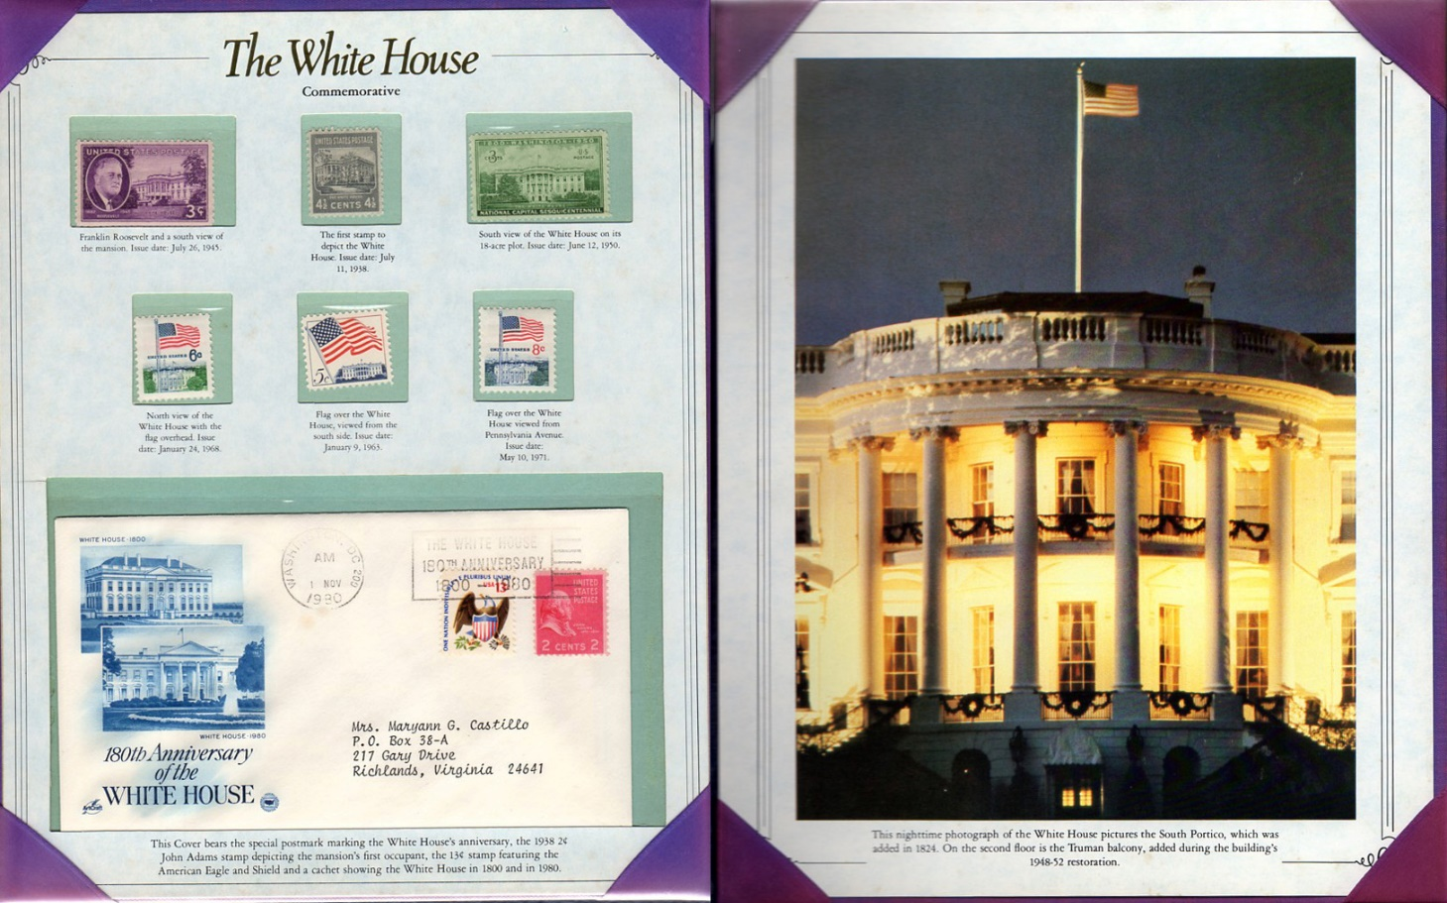
.
(#12) #1596 - 13¢ Eagle and Shield + #806 - 2¢ John Adams
November 1, 1980 Washington, DC (180th White House Anniversary cancel)

Slide 14
.
(#13) #2370 - 22¢ Australia Bicentennial (koala and eagle country symbols) January 26, 1988 Washington, DC (joint issue FDC 523,465)

Slide 15
.
(#14) #2394 - $8.75 Express Mail Eagle and Moon
October 4, 1988 Terre Haute, IN (Friedman hand-painted FDC 66,558)

Slide 16
.
(#15) #2421 - 25¢ Bill of Rights/Constitution Bicentennial
September 25, 1989 Philadelphia, PA (FDC 900,384)

Slide 17
.
(#16) #2431 - 25¢ Eagle and Shield
November 10, 1989 Virginia Beach, VA (FDC quantity unrecorded)

Slide 18
.
(#17) #U079 - 45¢ Official Great Seal envelope
March 17, 1990 Springfield, VA (FDC 5,956)

Slide 19
.
(# 18) #2540 - $2.90 Priority USPS 1992 Barcelona Olympic Sponsor
July 7, 1992 San Diego, CA (FDC 79,555)

Slide 20
.
(#19) #1831 - 29¢ Organized Labor
September 1, 1980 Washington, DC (cover postmarked February 21, 1994)

Slide 21
.
(#20) #3183B - 32¢ 1910’s Celebrate the Century/Federal Reserve System 1913
February 3, 1998 Washington, DC (FDC 3,896,387)

Slide 22
(#21) #3185E - 32¢ 1930’s Celebrate the Century/FDR’s New Deal/Work Progress Administration/Civilian Conservation Corps/NRA Eagle/Eagle w/painters board September 10, 1998 Cleveland, Ohio (FDC 999,017)

Slide 23
.
(#22) #3188C - 33¢ 1960s Celebrate the Century/Man Walks on the Moon
September 17, 1999 Green Bay, WI (Fred Collins FDC 1,252,243)

Slide 24
(#23) #U646 - 34¢ Blue gray & gray Eagle stamped envelope (recycled paper)
January 7, 2001 Washington, DC (FDC quantity unrecorded)

Slide 25
(#24) #3471 - 55¢ Eagle
February 22, 2001 Wall, SD (Fred Collins FDC quantity unrecorded)

Slide 26
(#25) #U650 - 10¢ Presort Graphic Eagle envelope + #2480 - 30¢ Cardinal
August 8, 2002 Washington, DC (FDC quantity unrecorded)

Slide 27
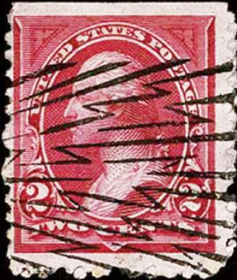
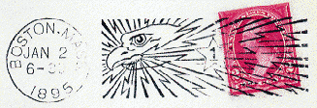
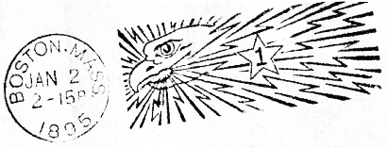
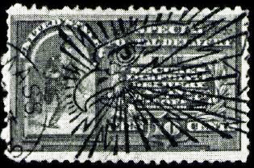
.
proof strike
Among the rarest eagles in US philately – Boston’s “Eagle and Thunderbolt” experimental American Company machine cancel. Less than 10,000 covers were postmarked on only one day, January 2, 1895, between 2-5 PM.
(read details: http://machinecancel.org/forum/eagle/eagle.html)

Slide 28

Thank you for watching!
July 4 postcard
Scanning and Layout by Tom Fortunato

