Slide 1

A Look at
Cover
Clubs
by Tom Fortunato
for the
Rochester Philatelic Association

Slide 2
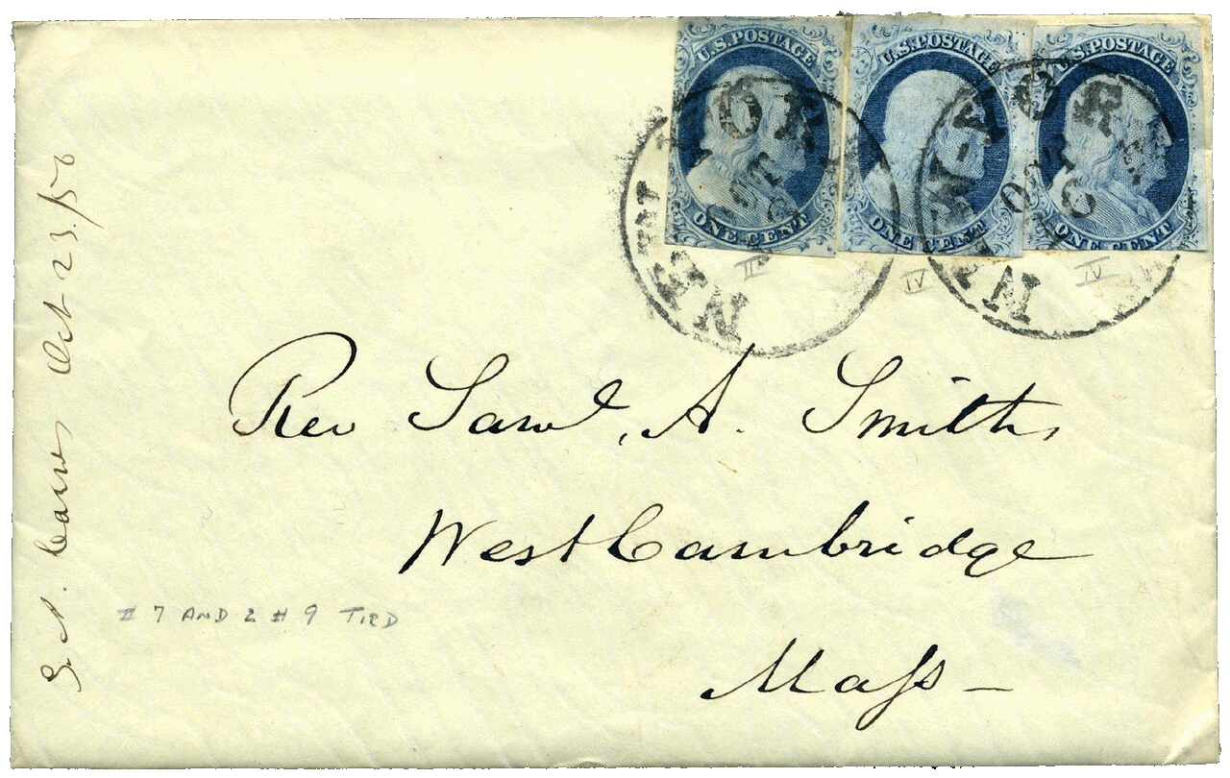
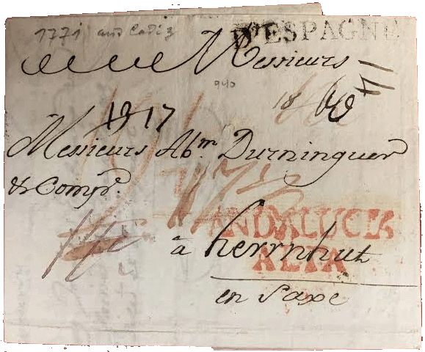
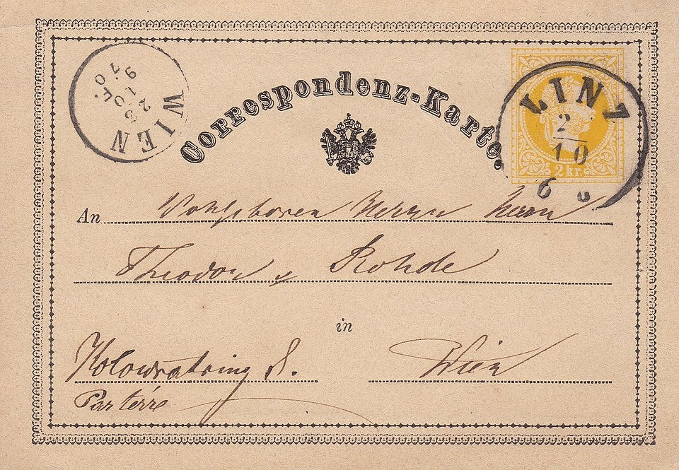
To Begin… What exactly is a “cover”?
In philatelic terms, a cover is best defined as a mail piece of some kind. In olden days this was simply folded paper. Then came the use of envelopes and post cards.
Austria issued the first postcard in 1869 as a way of reducing costs for mailers.

Slide 3
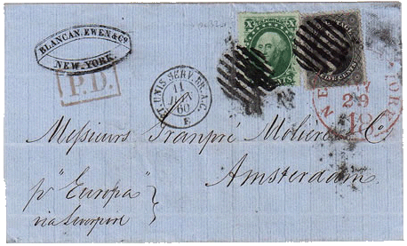
At the introduction of stamps in 1840, only the stamps found on mailings were of interest to collectors. The thought of saving the entire mail piece came later, when interest in the cancels and related markings, routes and rates (now known as postal history) came into being.

Slide 4
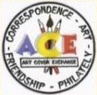

This presentation will introduce you to three active cover collecting groups, two in operation today. They exist encouraging friendship and collaboration through a shared interest in collecting and exchanging philatelic items with one another on an international scale. All believe covers can easily become works of art.
Art Cover Exchange (ACE)
https://artcoverexchange.org
Cover Collectors Circuit Club
https://www.covercollectors.club
Postcrossing
https://www.postcrossing.com

Slide 5
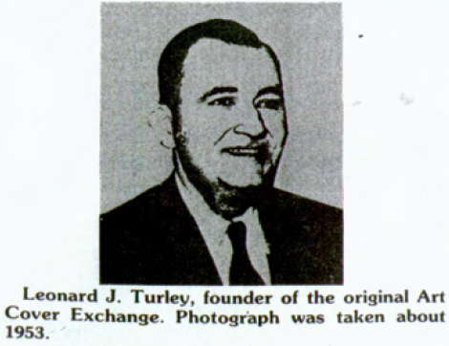
Art Cover Exchange (ACE)
Leonard J. Turley (January 27, 1893 – June 14, 1980) of Louisville, Kentucky, founded the Art Cover Exchange (ACE) in 1934. It was formed for the purpose of using covers to exchange art work, sometimes accompanied by a letter. The Art Cover Exchange combined his interest in art, correspondence, and philately.
“Members who are interested in other hobbies, such as stamp collecting, coin collecting, collecting of Indian relics, postcards, etc., may exchange material with each other,” per the ACE Handbook.

Slide 6
Art Cover Exchange (ACE)
From the ACE web site:
Turley’s concept was simple: “Send a cover with a handmade cachet to a member and receive one in return.”
“Most important was the cover and the exchange. Everyone was welcome to draw or paint in their own style, write a friendly message, affix postage and send a cover to another member.”
“Today, in addition to hand-drawn or painted art, members use a variety of artistic methods for decorating their covers, including computer art, stickers, rubber stamps, collage and just about anything else that will adhere to a cover and go through the mails.”

Slide 7
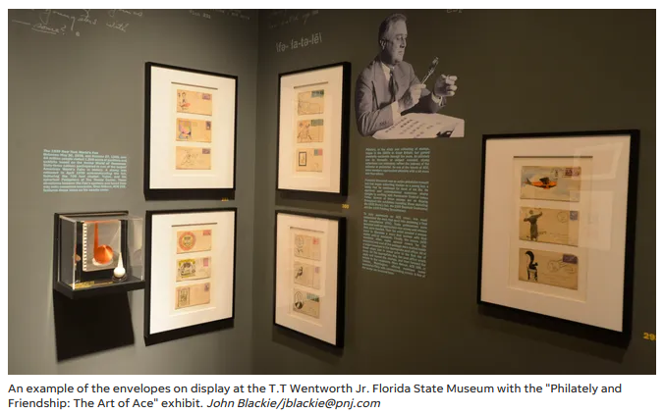
Art Cover Exchange (ACE)
Yes, philately is art! The 2018 Pensacola News Journal article titled, “T.T. Wentworth Museum's 'Art of ACE' exhibit recalls the lost craft of mail art,” [link] describes an exhibit of material donated to the museum by ACE #299,
Manuel Runyan. Born in 1872, he was an active Pensacola artist, often seen riding a bike by locals with an easel strapped to his back. Most of the covers in the display were sent to him from other early ACE members.
From an earlier 2013 web site…

Slide 8
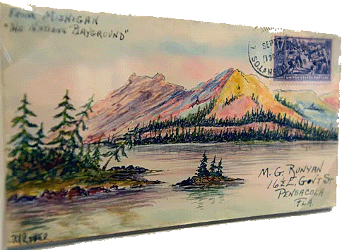
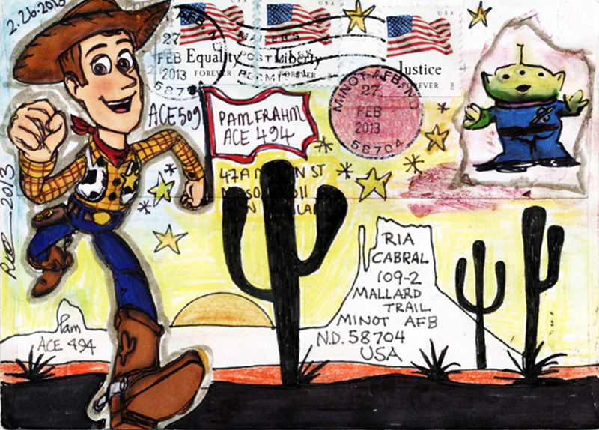
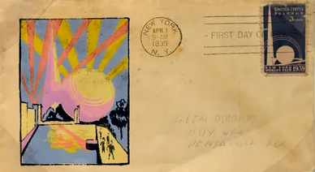
Art Cover Exchange (ACE)
a multi-mailed collaborative cover from 2013
two more covers from the collection

Slide 9
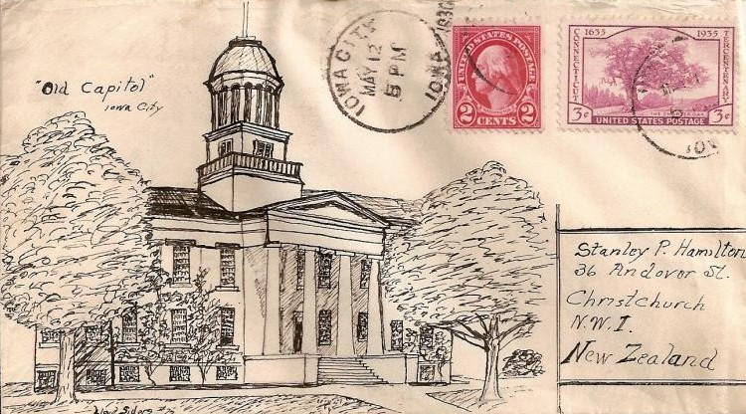
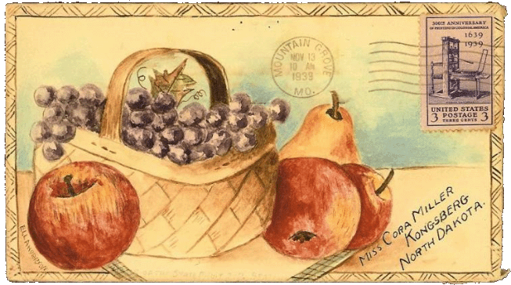
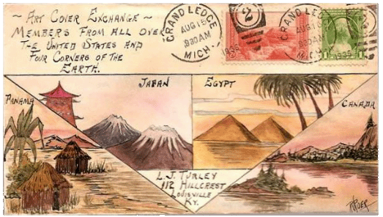
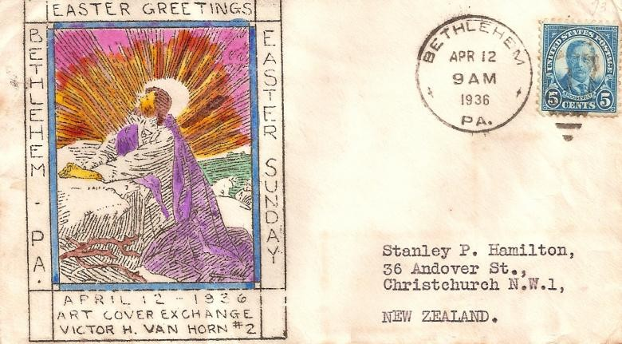
Art Cover Exchange (ACE)

Slide 10
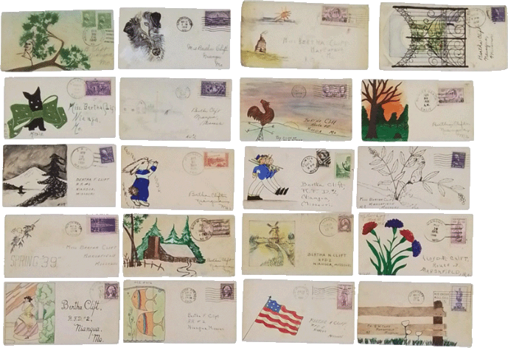
Art Cover Exchange (ACE)
The Art Cover Exchange went inactive shortly after the end of World War II, but was started up again by Leonard Turley’s grand-daughter in 1985, remaining strong ever since.

Slide 11
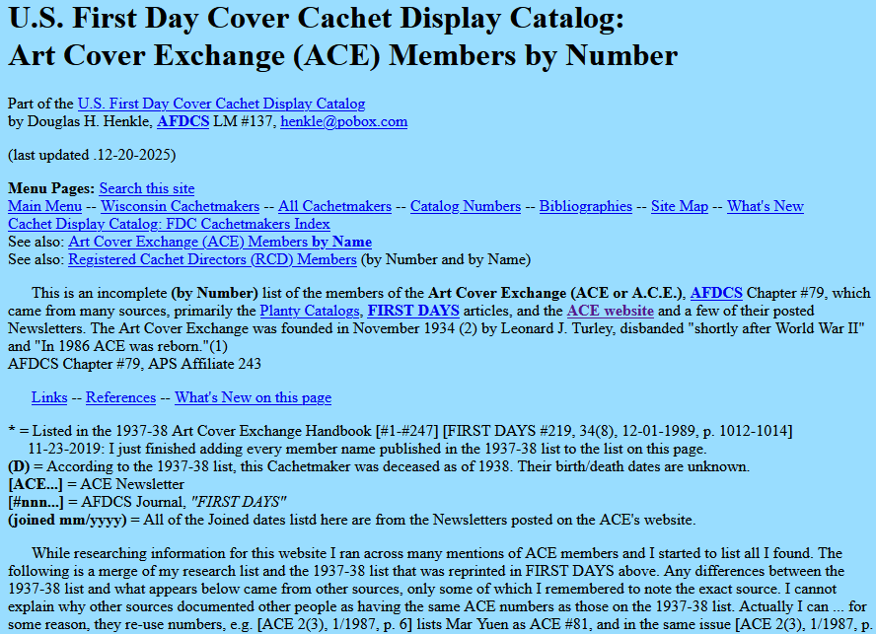
Art Cover Exchange (ACE)
An extensive membership list of former and current ACE members is maintained on a web site by Douglas H. Henkle at www.folklib.net/fdc/ace-members.shtml, especially useful in determining the creator using his or her identification number found on a cover.

Slide 12
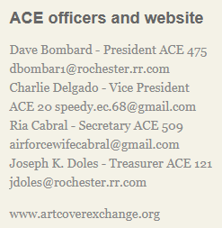
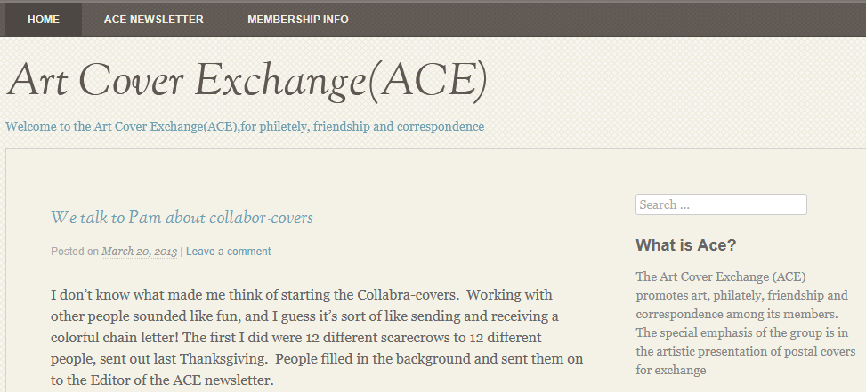
Art Cover Exchange (ACE)
From an earlier 2013 web site. Rochester collectors were active in its leadership for many years.

Slide 13
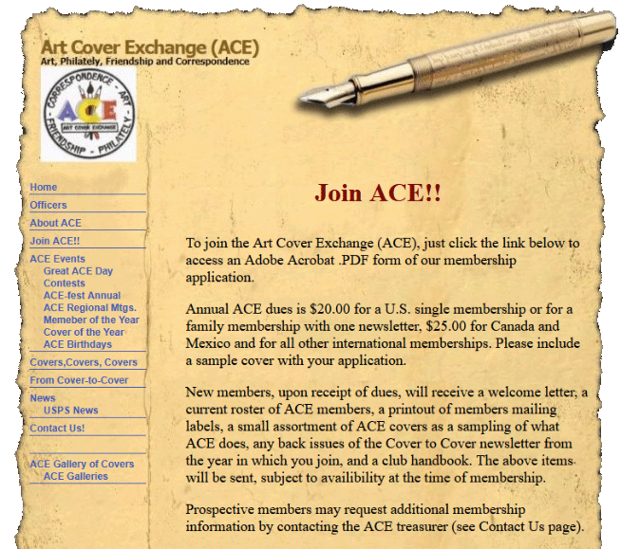
Art Cover Exchange (ACE)

Slide 14
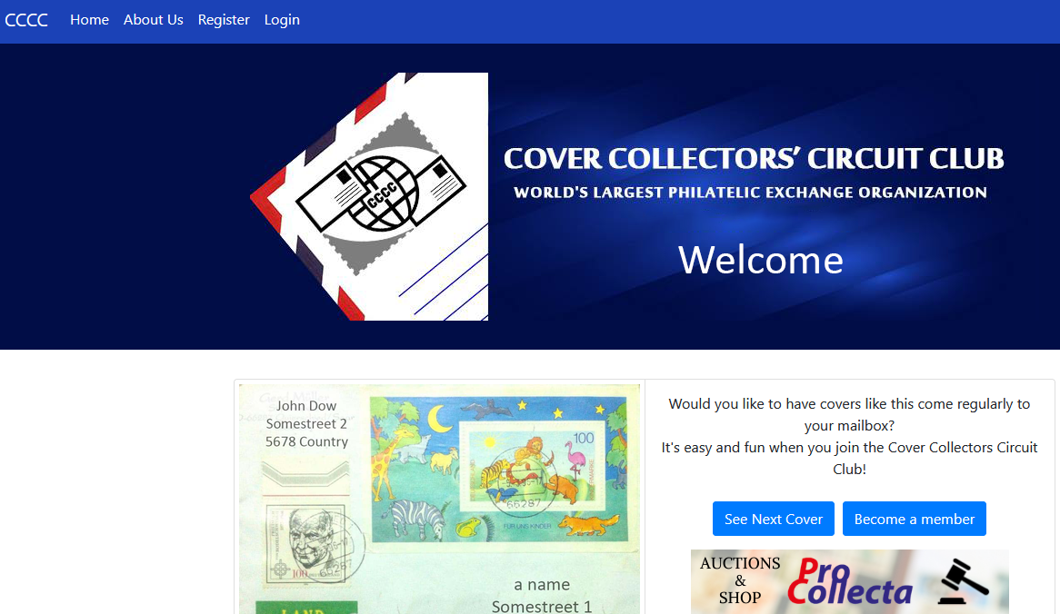
Cover Collector Circuit Club (CCCC)

Slide 15
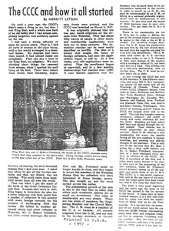
Cover Collector Circuit Club (CCCC)
Founded March 5, 1947, shortly after World War II, the CCCC’s purpose was to assist stamp and cover collectors find contacts and promote international friendships.
King Beal of Waterloo, Iowa, had the idea in 1947 of forming a worldwide organization that would help people connect through the use of a circuit form. It would pass among several members and then return back to the person who originated it. Along the way everyone was encouraged to list their specialties and make exchange offers.

Slide 16
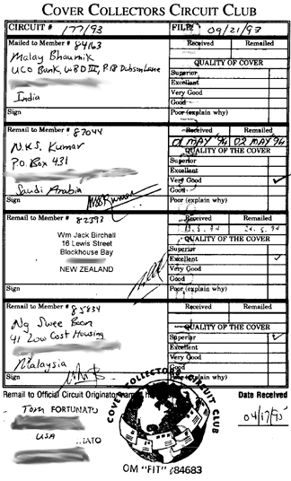
Cover Collector Circuit Club (CCCC)
Contacts are made through use of an official circuit form. CCCC members from the USA are known in the club as OMs (originating members). Members from other countries are CMs (circuit members). Canadians may sign up as either OMs or CMs. The OM's role is to create the path of each circuit, mailing it to CMs whose names and addresses appeared in regularly updated membership lists supplied every few weeks from the Managing Director. The OM then mails the form to the first CM on each circuit, passing from one to the next, until it returns back to the originator. (older examples are shown throughout to protect addresses)

Slide 17
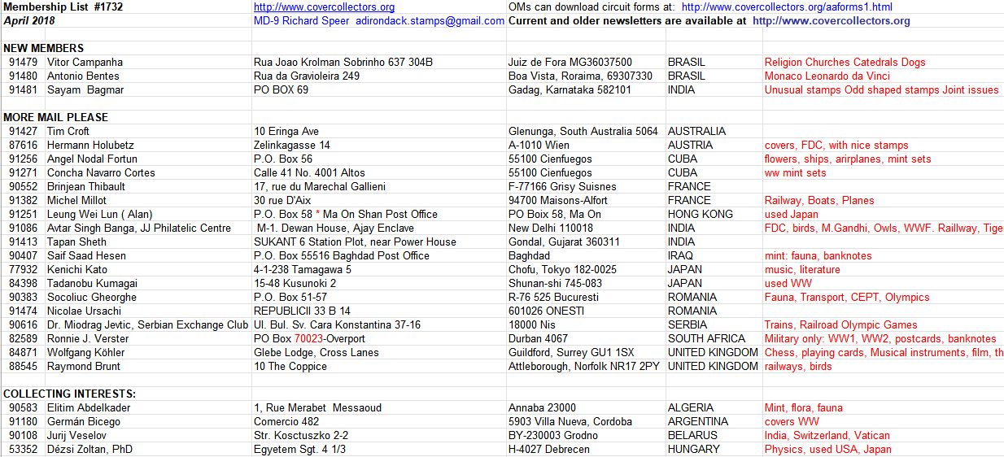
Cover Collector Circuit Club (CCCC)
Regular emails to OMs list members and report address changes.

Slide 18
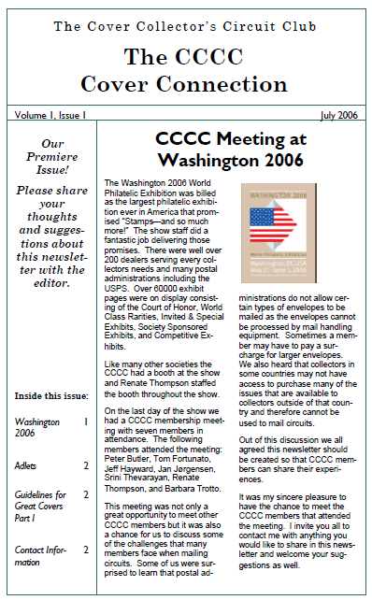
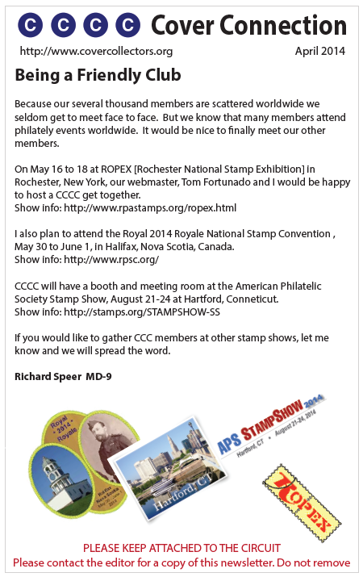
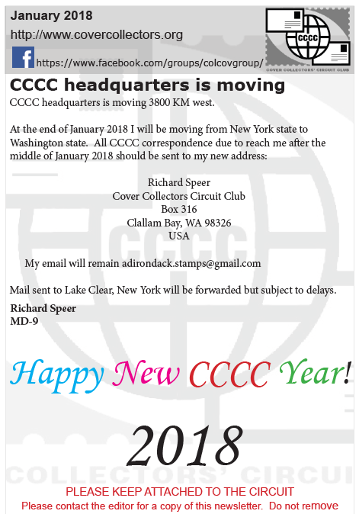
Cover Collector Circuit Club (CCCC)
Newsletters attached to each circuit update members of club activities.

Slide 19
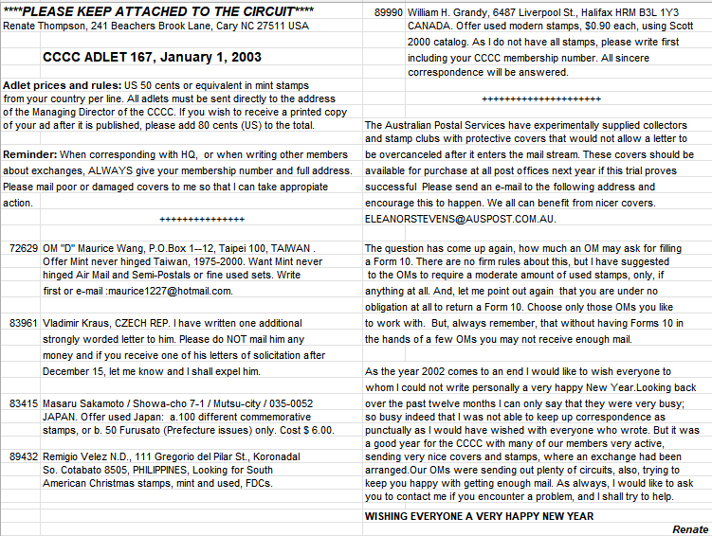
Cover Collector Circuit Club (CCCC)
Adlets are also attached, listing member offerings of exchanges.

Slide 20
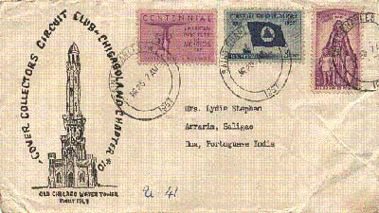
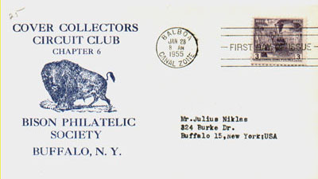
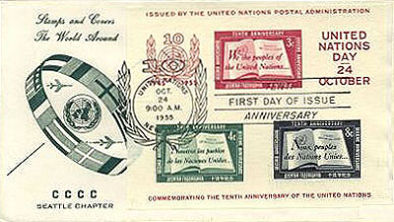
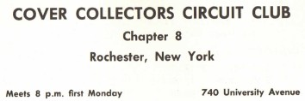
Cover Collector Circuit Club (CCCC)
It proved to be a popular concept with collectors and the club grew to thousands in a matter of just a few years. Several sub-groups sprung from the main CCCC membership, especially in the United States. Established local stamp clubs formed CCCC chapters.
1963 ad in RPA show program

Slide 21
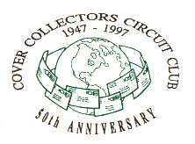
Cover Collector Circuit Club (CCCC)
A variety of anniversary cachet envelopes used by members.

Slide 22
Cover Collector Circuit Club (CCCC)

Slide 23
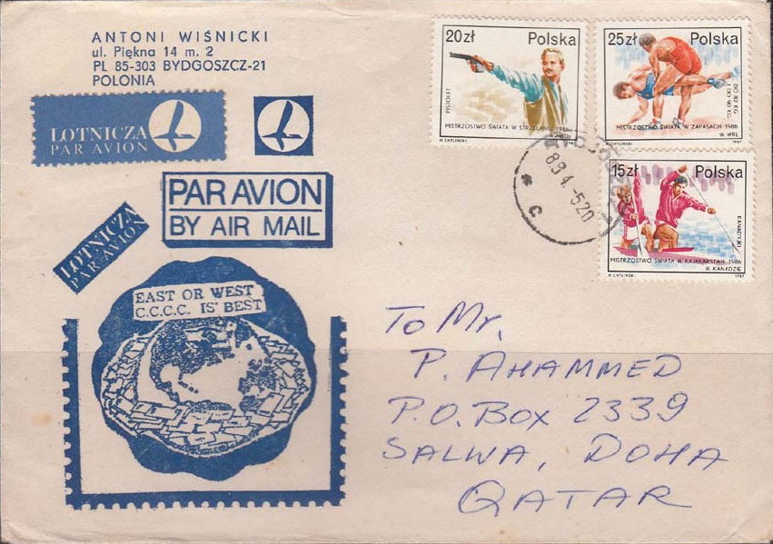
Cover Collector Circuit Club (CCCC)

Slide 24
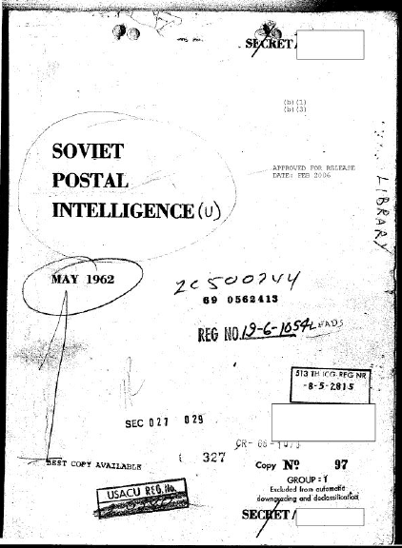
Cover Collector Circuit Club (CCCC)
Interestingly, the CCCC’s activities even caught the attention of the Central Intelligence Agency, as expressed in this passage of a recently released secret document on Soviet postal spying:
“Letters containing orders or requests for stamps by catalogue numbers may lend themselves to clandestine transmittal of coded Information. It should be noted that these letters are not in violation of Soviet postal regulations. The RIS [Russian Intelligence Service] has used international stamp collectors' letters for agent communication outside the USSR to the USSR. "Cover" exchanges to and from the Soviet Union are not as prevalent as in other countries but there have been exchanges with the Western world. Probably the most widely circulated cover club in the USSR is the Cover Collectors Circuit Club with headquarters in Waterloo, Iowa.”
Soviet Postal Intelligence, CIA, May, 1962

Slide 25

Postcrossing
Gaining popularity today is Postcrossing, an organization on the fringe (the term being used in a nice way!) of philately. Founded by a Portuguese student in 2005, Paulo Magalhaes and his friend, Ana Campos, never could have imagined that their idea could blossom to involve more than 800,000 participants in over 200 countries around the world as of 2026.
Their concept is simple and rewarding, especially to an “online generation” looking for tactile gratification: Send a postcard, get a postcard. Who wouldn’t want to be surprised to receive colorful postcards from exotic lands from total strangers on a regular basis?
Sound somewhat familiar to the last two groups mentioned already?

Slide 26
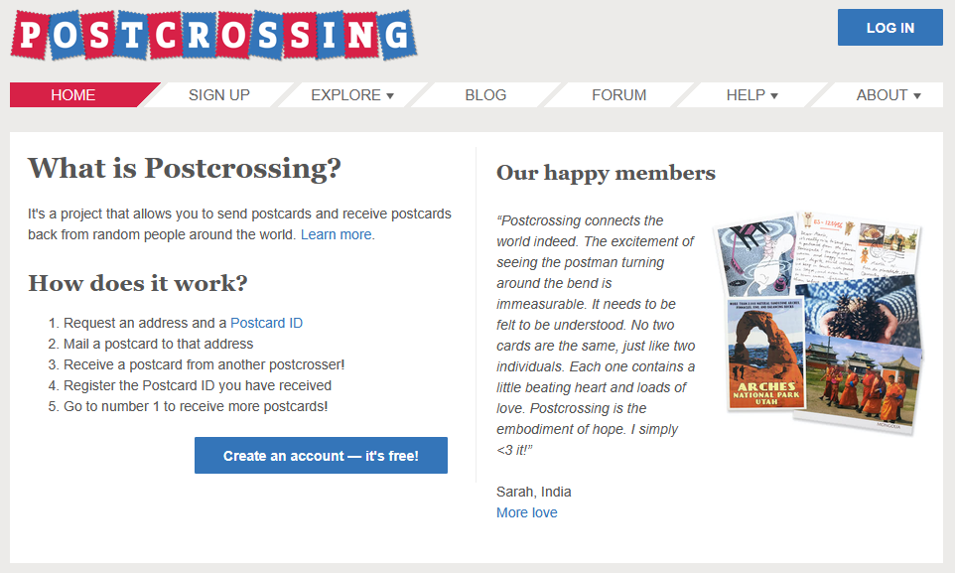
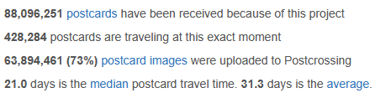

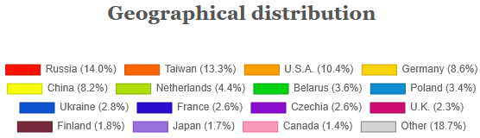
Postcrossing
Their extensive web site is very detailed and well structured, making it very easy to find anything needed--including a Blog and Forum.
Stats as of Sept. 1, 2026

Slide 27
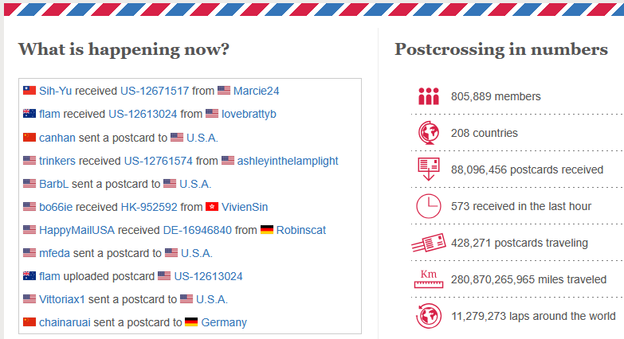
Postcrossing
Up to the minute stats about postcards in motion.

Slide 28
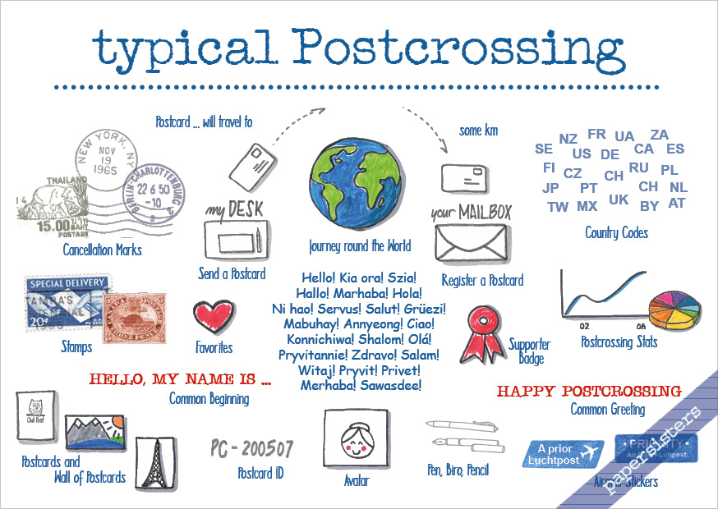
Postcrossing
This creative postcard depicts the process. The sender goes online and requests an ID, name and address to send a postcard to. A message is written, the postcard embellished, stamped, postmarked and mailed. The receiver goes online to confirm its receipt. Receive one in return.

Slide 29
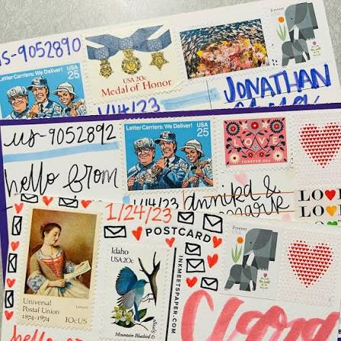
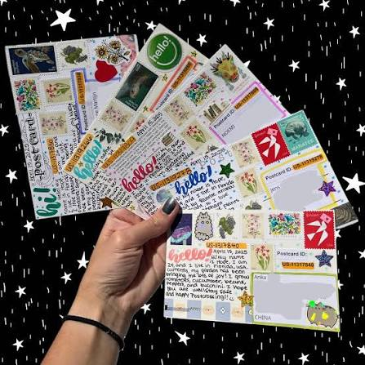
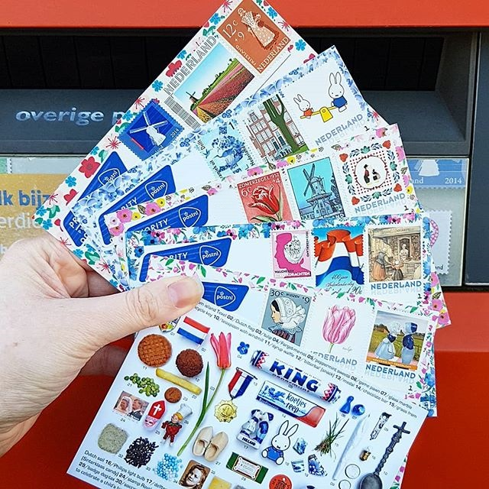
Postcrossing
Postcrossers are interested in the postcard image, the decorations used on it, and the stamp(s) and cancel used, especially if they connect in some way. Those mailed from exotic locales are especially prized.

Slide 30
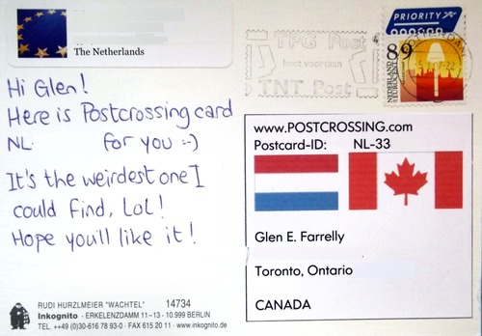
Postcrossing
The message starts with something like, “Hello, my name is…,” followed by whatever the writer wishes to mention, short or long.

Slide 31
Postcrossing
Members are encouraged to describe their topical interests so the sender can make his or her postcard more relatable to the receiver.

Slide 32
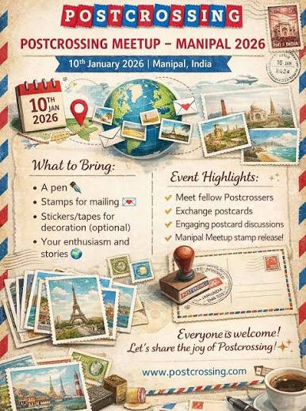
Postcrossing
Postcrossing members organize regional meetings called “Meetups” that allow members to meet face to face. Manufacturers and members have taken advantage of such opportunities to produce related postcards.

Slide 33
Postcrossing
Over 200 Postcrossers met at the Boston 2026 World Expo in May.

Slide 34
Postcrossing

Slide 35
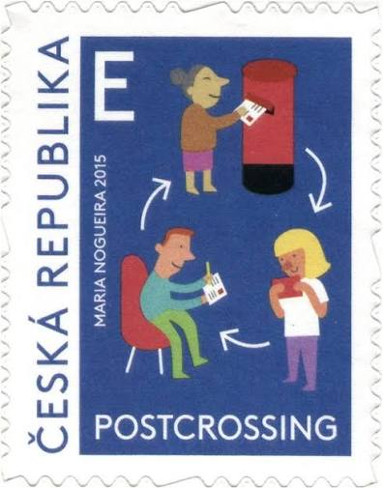
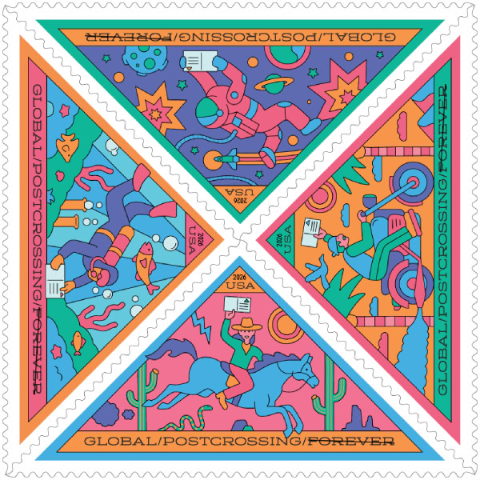

Postcrossing
Postal administrations from around the world have issued stamps honoring Postcrossing, with the United States being among the latest.
2026 U.S. issue

Slide 36
Postcrossing
Commemorative postmarks are numerous.

Slide 37
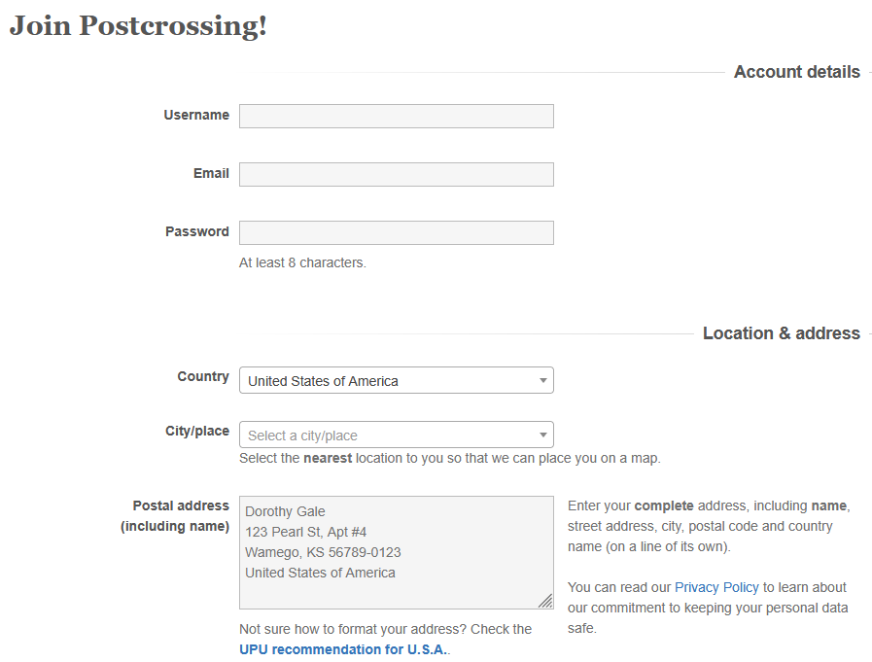
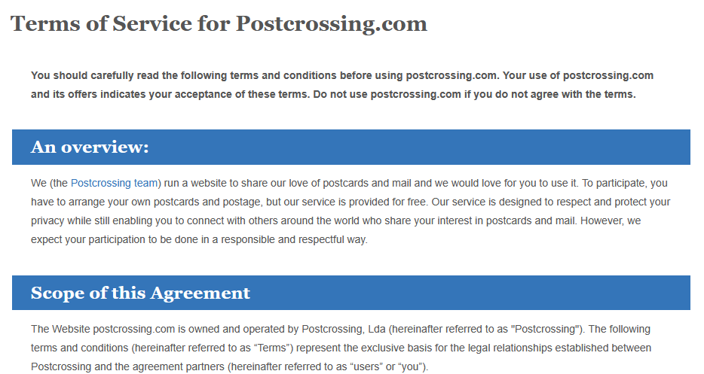
Postcrossing
Membership is free to anyone 13 years or older.

Slide 38
In Conclusion…
These are just three of the most active cover groups.
So, which of these three clubs would you be most likely to join?
All offer collectors the opportunity to connect
with like-minded colleagues, adding to their
collections and philatelic knowledge.

