Slide 1
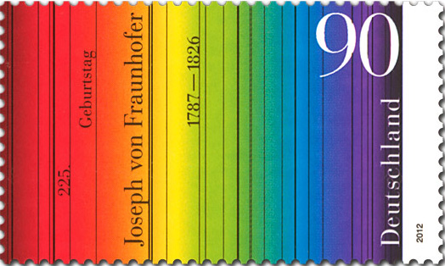
Stamps and Color
By Tom Fortunato
A 2020 presentation for the Rochester Philatelic Association

Slide 2
Introduction
There are two different approaches one can take to tackle the subject of stamps and color…
The Scientific- discussing colorimetry, colloidal systems of fine pigment particles dispersed in a solvent (otherwise known as ink!), additive and subtractive color systems, X-ray diffraction to determine composition, spectral analysis, etc. For something like that, do a Google search and have fun.
or…
The Relatable- something understandable by everyone. If that’s you, continue on!
A good site to start… http://inventorartist.com/primary-colors/

Slide 3
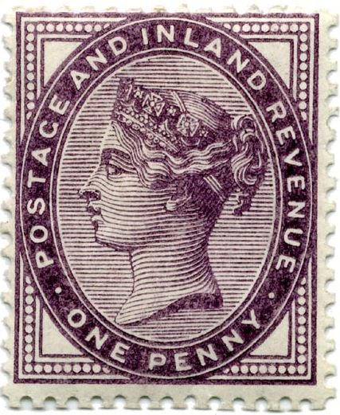
Introduction
Take a good look at this stamp. What color is it? Purple, dark purple, lilac, grape? Are you sure? How did you decide? How do stamp printers and catalogs describe its color? This brief presentation explores the role color plays in our philatelic hobby.
What is Color?
Describing Color
Stamp Inks
Printer Samples
Stamp Color Guides
Comparing Catalog Colors
Fun with Stamp Color

Slide 4
What is Color?
As defined on the Crayola crayon web site, “Color is the aspect of things that is caused by differing qualities of light being reflected or emitted by them. To see color, you have to have light. When light shines on an object some colors bounce off the object and others are absorbed by it. Our eyes only see the colors that are bounced off or reflected.”
https://www.crayola.com

Slide 5
What is Color?
Start with the primary colors of blue, red and yellow. Mixing these make others- blue and red make purple, red and yellow make orange, yellow and blue make green, and so on. Back in grade school you probably learned the acronym “ROYGBIV” to help remember the order of the color spectrum.

Slide 6
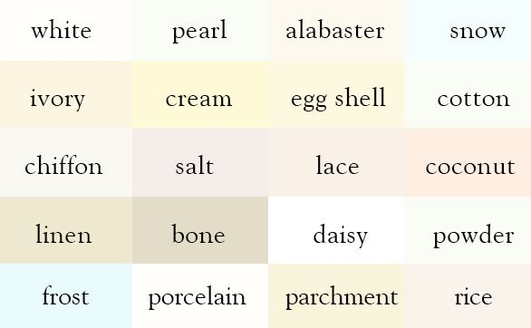
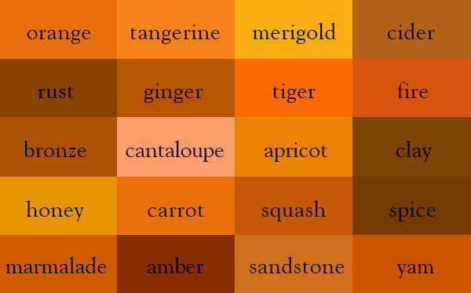
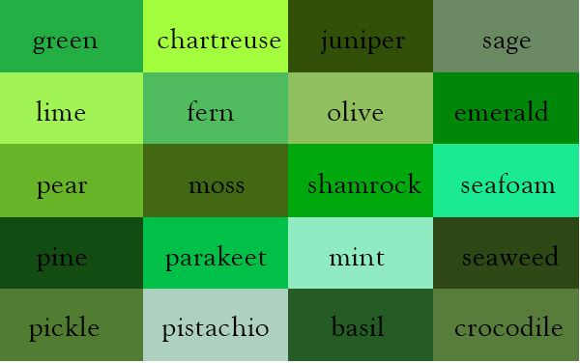
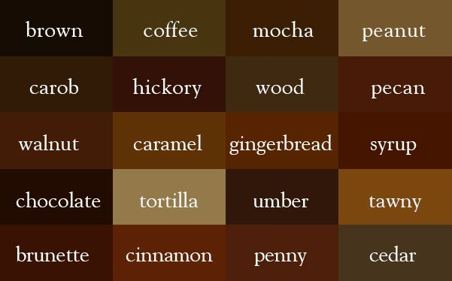
Describing Color
So, how can one describe a color? Think about it. While there are basic color names whose origins are perhaps lost to history, like “white,” many color shade and tone names come from flora, fauna and other natural things around us, like…

Slide 7
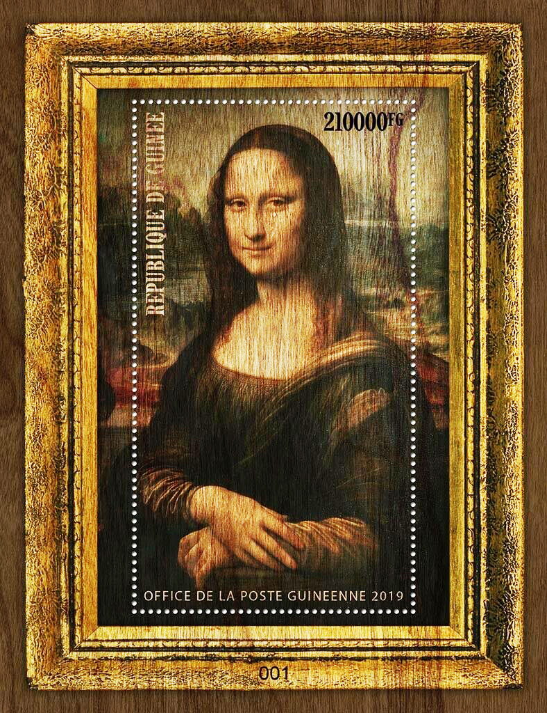
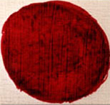
Describing Color
The color pallet of Renaissance artists was created by mixing oils and natural ingredients from plants and animals. One of the red pigments was made from cochineal beetles found on oak twigs. The color "Carmine lake" comes from the Latin word carminium from Sanskrit krmija (red dye) produced by a worm krmi=worm and from Latin minium=cinnabar/red lead.

Slide 8
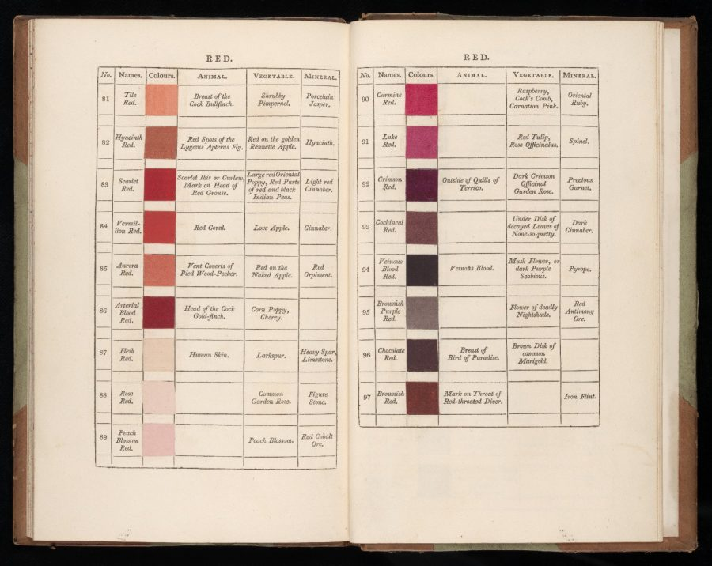
Describing Color
Page through the English 1821 edition of the book online at: https://archive.org/stream/gri_c00033125012743312?ui=embed and additional info at http://www.openculture.com/2018/09/an-interactive-online-version-of-werners-nomenclature-of-colours.html
An early effort to standardize the nomenclature of color was by German mineralogist Abraham Gottlob who wrote, “Werner’s Nomenclature of Colours.” In 1814 it was updated by Scottish painter Patrick Syme who added color swatches using Gottlob’s specs. It was used by scientists and naturalists to describe the world around them. Printers used it to help identify ink colors.

Slide 9
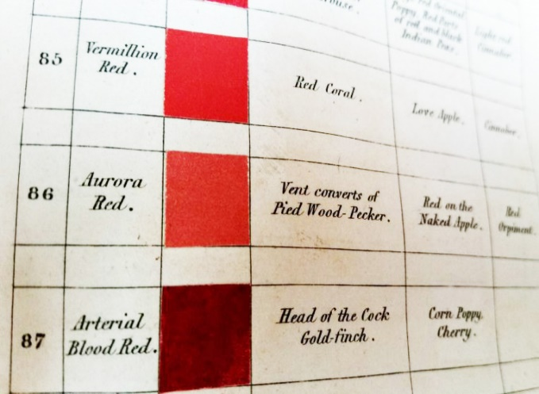
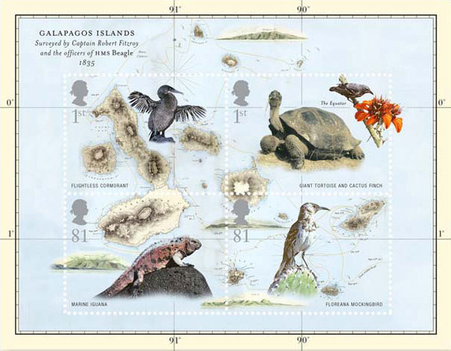
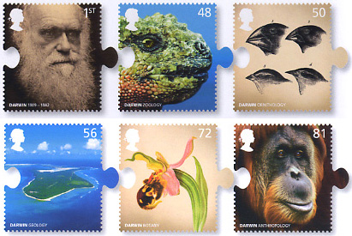
Describing Color
The book had color tiles to compare the item in question with. It was found so useful that Charles Darwin referred to his second edition copy to describe the flora and fauna he found on his various expeditions around the world. Some of
these color names found their way into stamp printer vernacular.

Slide 10
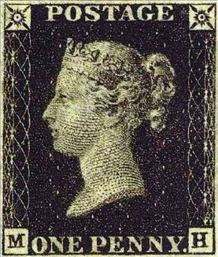
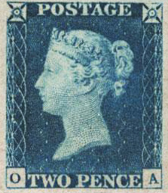
Stamp Inks
Fast forward to 1840 and the production of the world’s first postage stamps. The consideration of their color was secondary only to the design itself. Black and blue were eventually decided on in part to best display the engraving artistry of the design and make them readily noticeable on an envelope.
The Line Engraved Postage Stamps of Great Britain, Bacon, 1920 http://www.gbps.org.uk/information/downloads/files/postage-stamps/The%20Line-Engraved%20Postage%20Stamps%20of%20Great%20Britain,%20Vol%201%20-%20Edward%20Denny%20Bacon%20(1920).pdf

Slide 11
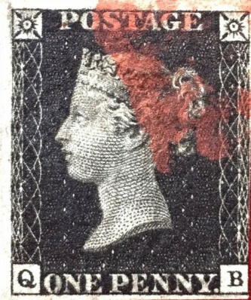
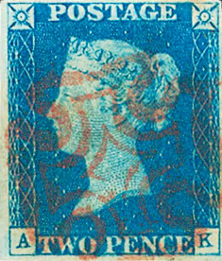
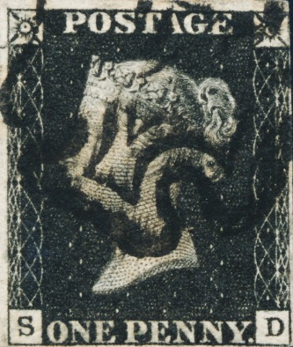
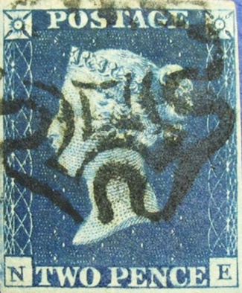
Stamp Inks
Within a month of their May release, a problem developed. Powder of creosote was being used to remove the red ink used to cancel the stamps. A black colored ink formula was then tried, again without success. On June 27 Rowland Hill wrote, “I shall prepare a report on the subject of obliteration, and propose to adapt (sic) a light colour for the penny stamps.”
* “The Line Engraved Postage Stamps of Great Britain, vol. 1,” Bacon, pp 90-91
Red cancel ink formula: 1 pound printer’s red ink, 1 pint linseed oil, 1/2 pint sweet oil droppings, all mixed well*
Black cancel ink formula: black letterpress printer’s ink*

Slide 12
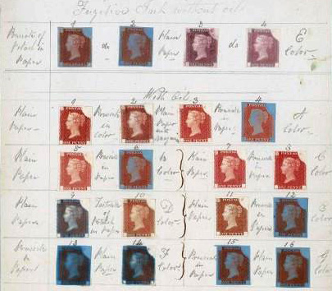
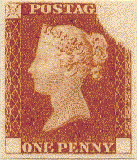
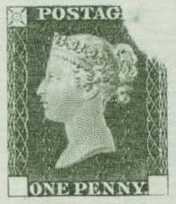
Stamp Inks
Thus was born the “Rainbow Trials,” a series of experiments using different stamp ink formulations on different papers tested against various cancellation inks to determine the best combination to prevent stamp re-use.

Slide 13
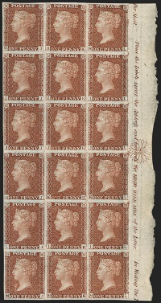
Stamp Inks
The eventual “winner” of the trials was, as Hill expected, a lighter colored stamp that could become well cancelled with black ink, the 1d “penny red.” The initial printing came from the same seven penny black plates, numbers 1A, 2, 5, 8, 9, 10, and 11. Plates 12 to 177 were used to print further imperf penny reds with corner alphabet sets I and II.
Later printed block from plate 132 onward based on the margin star

Slide 14
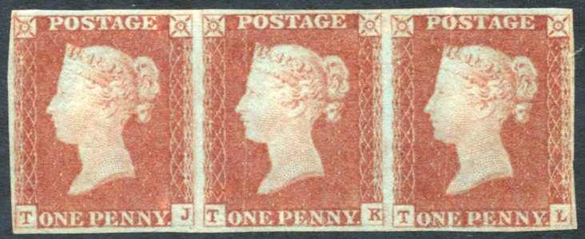
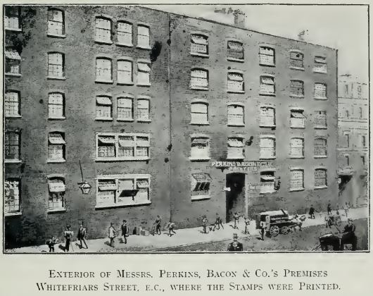
Stamp Inks
But what color was it?
Like its predecessors, these were printed by Perkins, Bacon and Company. Claimed to be “pink” by J. B. Bacon, he said it was made from “rose-pink, prussiate of potash, cochineal, carbonate of potash, and oil.“ The result was red-brown, but the nickname “penny red” stuck and is used to this day.

Slide 15
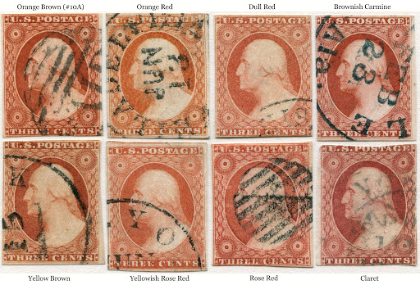
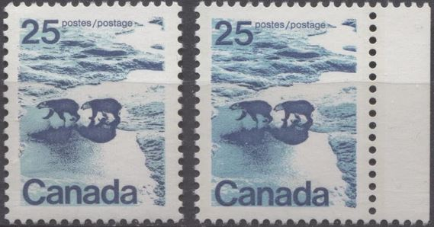
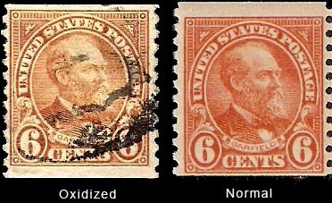
Stamp Inks
Color shades have several causes…
inks and oils used obtained from different sources
wrong ink formulations mixed
absorbency of the paper
viscosity of the ink when applied
temperature and humidity of the printing room
oxidation of ink over time
chemical alteration after printing

Slide 16
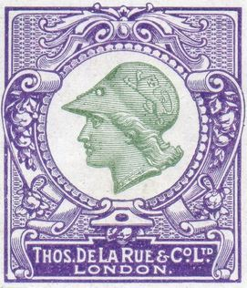
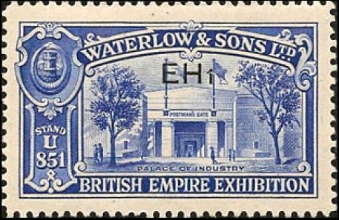
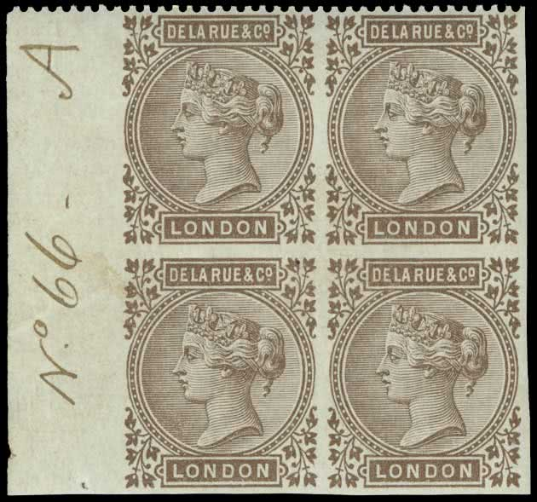
Printer Samples
Put yourself in the shoes of a stamp printer a century ago and even today. How could you best display your work to prospective clients and standardize specific colors by combining inks to be used in their various issues?
… By creating sample books and “dummy stamps.” The following pages give a representative look at these from several British and US printing firms.

Slide 17
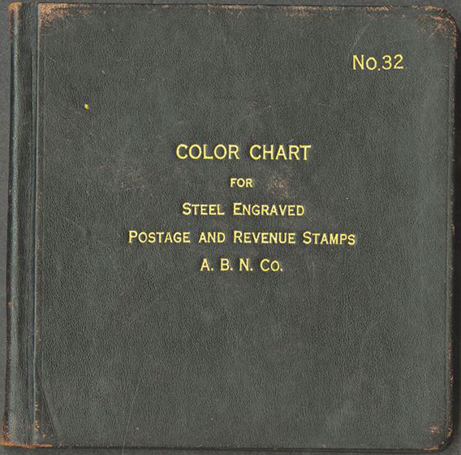
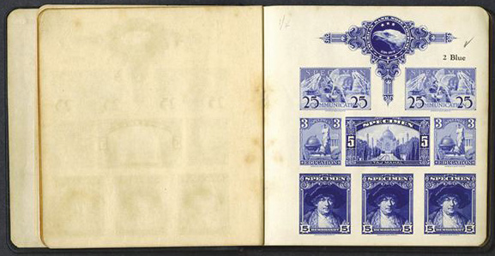
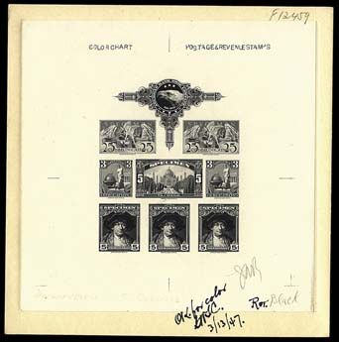
Printer Samples
American Bank Note Company (USA)

Slide 18

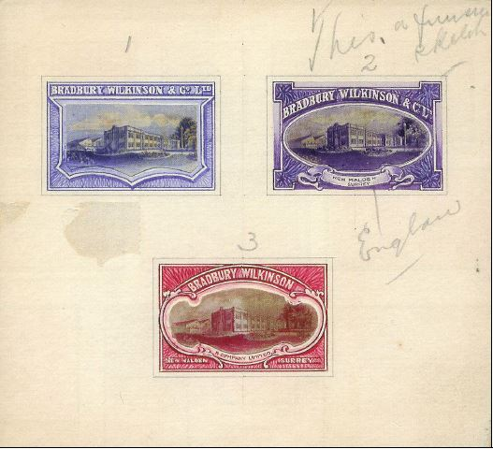
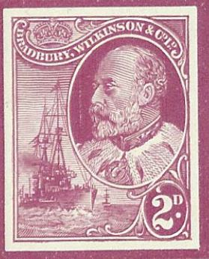
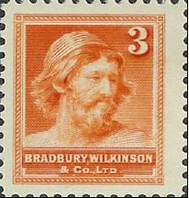
Printer Samples
Bradbury Wilkinson (Great Britain)

Slide 19
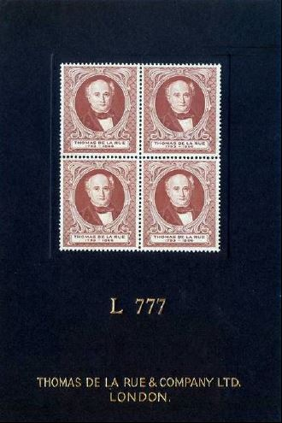
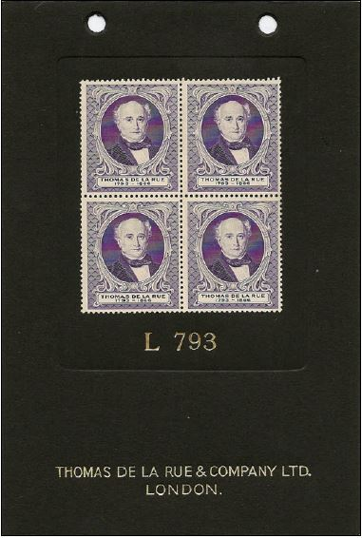
Printer Samples
Thomas De La Rue (Great Britain)

Slide 20
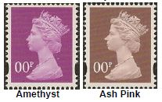
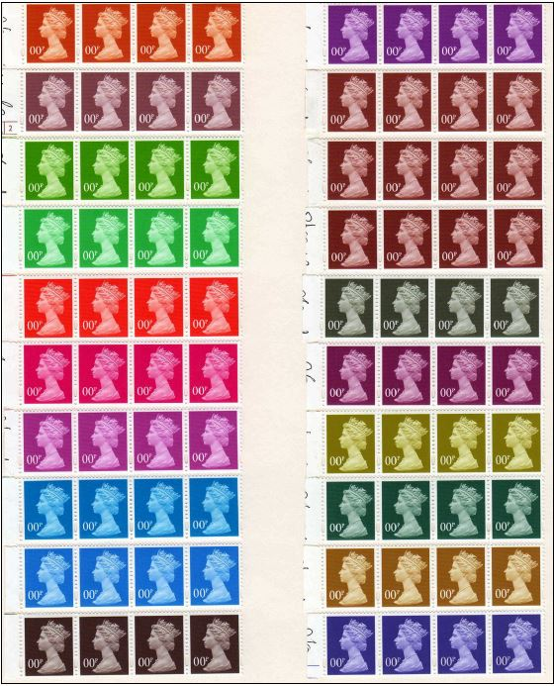
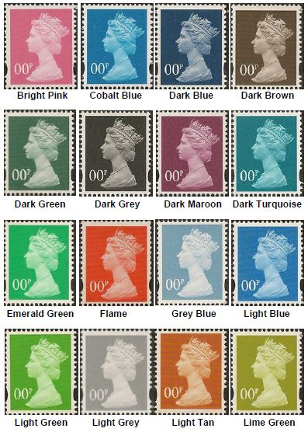
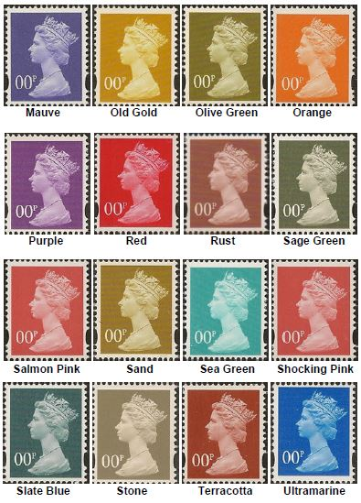
Printer Samples
Thomas De La Rue (Great Britain)
Samples made to distribute to printers taking over the Machin De La Rue production contract.

Slide 21
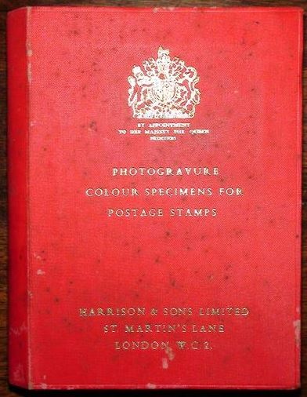
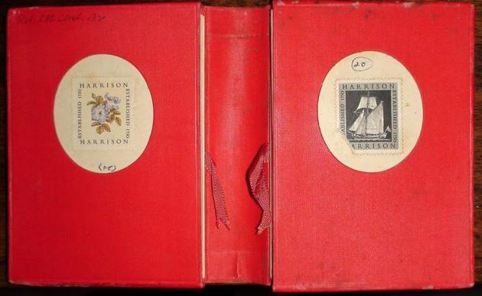
Printer Samples
Harrison and Son (Great Britain)
Twenty color variation cards of both designs in each pocket.

Slide 22
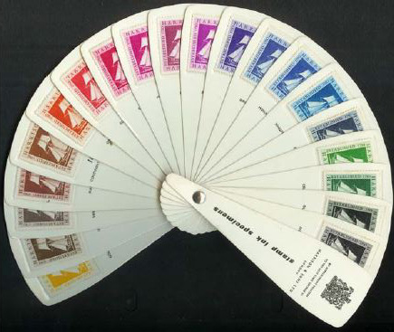
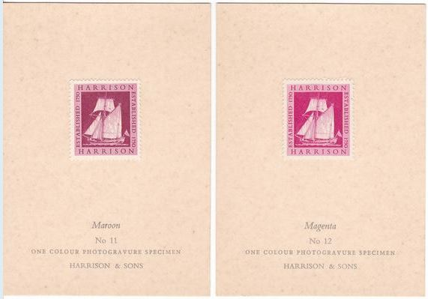
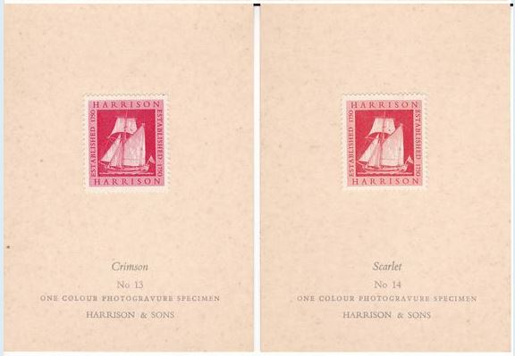
Printer Samples
Harrison and Son (Great Britain)

Slide 23


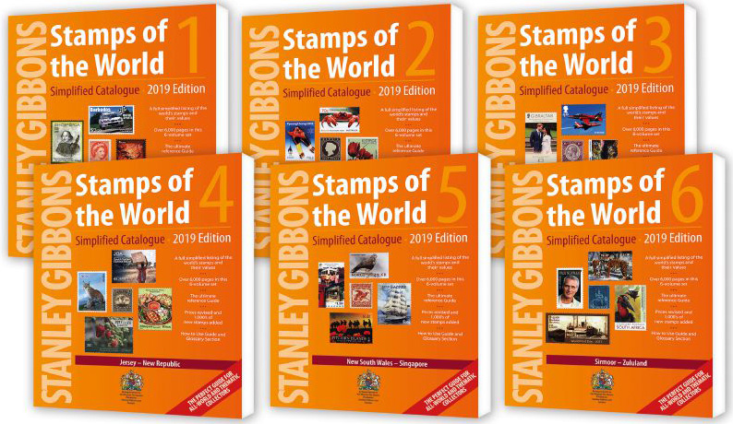
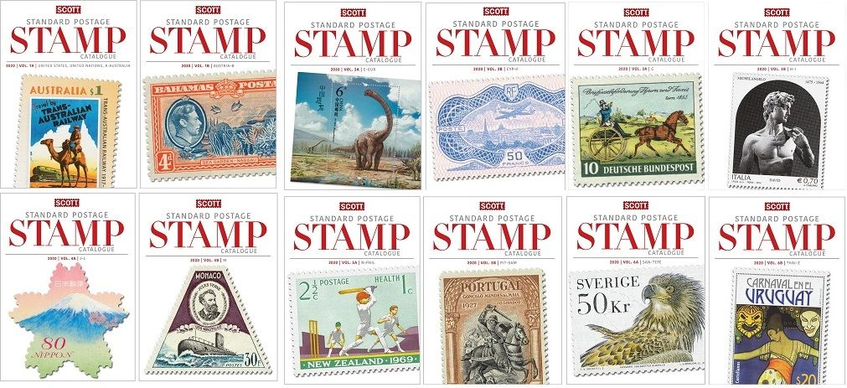
Stamp Color Guides
So how do stamp catalog publishers determine a stamp’s color for their listings and how do you tell what color your stamp is? Unfortunately, there are no easy answers to these basic questions!

Slide 24
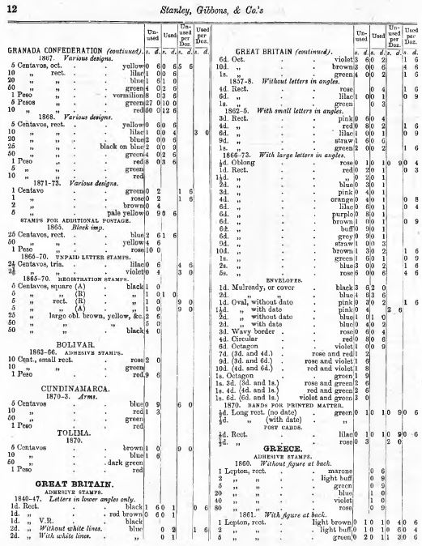

Stamp Color Guides – Stanley Gibbons
Here’s a page from the 1874 Stanley Gibbon’s Stamp Catalogue describing worldwide issues, their denominations, colors and pricing. The colors listed seem rather basic, including those of Great Britain’s earliest issues.

Slide 25

Stamp Color Guides – Stanley Gibbons
As time went on, color names for stamps and shades became more descriptive, especially when identifying more pricey varieties and newer issues. Stanley Gibbons took the lead by publishing “A Colour Dictionary” in 1899 as a listing naming 200 colors and reproducing 56 color images in concordance with catalog listings. This booklet underwent two revisions published in 1908 and 1913.

Slide 26


Stamp Color Guides – Stanley Gibbons
Pages from Stanley Gibbon’s 1899 “A Colour Dictionary.”

Slide 27

Stamp Color Guides – Stanley Gibbons
Stanley Gibbons teamed up with two stamp printers to produce an updated “Colour Guide for Stamp Collectors” in the 1920s. Perkins, Bacons & Co., Ltd. printed 100 color reference labels found in the booklet. Attaching the labels was very labor intensive. Interestingly the back cover refers to Harrisons and Sons, Ltd. as the manufacturer of the guide. Colors were matched by Perkins to Gibbons’, “actual stamps chosen by us as samples.”

Slide 28



Stamp Color Guides – Stanley Gibbons
Pages from the 1920s “Colour Guide for Stamp Collectors”

Slide 29




Stamp Color Guides – Stanley Gibbons
Pages from the 1920s “Colour Guide for Stamp Collectors”

Slide 30



Stamp Color Guides – Stanley Gibbons
Gibbons’ circa 1960 guide (Publication 3333) listed 75 “most useful” colors for stamp descriptions using labeled color blocks.

Slide 31

Stamp Color Guides – Stanley Gibbons
Publication 3333’s 1966 edition increased to 100 color tiles.

Slide 32





Stamp Color Guides – Stanley Gibbons
Later Gibbons’ guides are much smaller and user friendly with holes in the 200 color tiles to allow better comparison viewing.
2020 Listing of Stanley Gibbons Stamp Colour Key shades: http://www.acsc-history.info/Dshades.aspx

Slide 33

Stamp Color Guides – Others
Of course Stanley Gibbons was not the only firm producing color guides for collectors. Here is an unidentified German guide dated from 1917 with French and English translations.

Slide 34


Stamp Color Guides – Others
Amos Hobby Publishing, parent company of both Scott Publishing Company and Linn's Stamp News, released a 39 page book in 2005, “Specialized Color Guides for United States Stamps” with Munsell color system chips covering four early US definitive issues.
Munsell color system: https://munsell.com/about-munsell-color/how-color-notation-works/

Slide 35

Stamp Color Guides – Others
The masterwork of US color guides is, “Encyclopedia of the Colors of United States Postage Stamps,” five volumes in four binders. It covers 1847 to 1918 issues complete with Scott color shades for most issues. When available the 1981 set can sell for $500+.

Slide 36


Stamp Color Guides – Others
Sample reduced sized pages from the loose-leaf, “Encyclopedia of the Colors of United States Postage Stamps.”

Slide 37


Stamp Color Guides – Others
German catalog publisher Michel has their own color guide, “Farbenführer,” that coordinates 600+ shades with those used in their worldwide catalogs.

Slide 38

Stamp Color Guides – Others
Michel also utilizes color code numbers that can be used to identify shades.

Slide 39



Comparing Catalog Colors
Stamp catalog color listings continue to be more divergent as additional varieties and shades come to light for older and newer issues. Do a quick color comparison among them for a few issues.
Australia 1914 KGV definitive, 4d denomination
Stanley Gibbons Commonwealth and British Empire catalogue, 2004 edition
Scott’s Catalogue, Volume A-B, 2009 edition
Yvert & Tellier Overseas Volume III, 1972 edition
yellow-orange
a. yellow

Slide 40



Comparing Catalog Colors
Germany 1922-23 Airmails
Scott’s Catalogue, Volume I A-B, 2009 edition
Yvert & Tellier Europe Volume II,
1972 edition
violet and rose
brown and yellow
olive and rose
Michel Germany Specialized 1998 edition
dark red lilac and carmine
sienna brown and pale yellow
dark olive and pale orange-red

Slide 41






Comparing Catalog Colors
Italy 1965 Commemoratives
Yvert & Tellier Europe Volume II,
1972 edition
slate and red
multicolored
Michel Europe West 1997/98 edition
dark grey blue and red
multicolored
Sassone Italy Spec., 2007 edition
blue black and red
multicolored
Stanley Gibbons Stamps of the World, Volume I A-J, 1999 edition
Scott’s Catalogue, Vol 3 G-I,
2009 edition

Slide 42
Comparing Catalog Colors
When asked to comment about his role in listing stamp colors, Martin J. Frankevicz, New Issues Editor for Scott’s at Amos Media wrote,
“We do have a color guide that we use in the office. It’s a notebook full of stock pages that have older stamps on them along with the color names they were assigned. I don’t use it all that often, however. For the most part, I don’t really have to because 99% of the stamps that I list are multicolored. I will give colors for engraved stamps of one color, and some stamps produced by other methods having one or two colors, provided they are not produced with a mixture of colors. And yes, when I use our color book, I go compare the stamp I have to the stamps on the stock pages and generally find that the shade of the new stamp doesn’t totally match anything on the stock page.”

Slide 43


Fun with Stamp Color
Yes, stamps in a catalog with the same color name also show shade differences. Here are pages using Scott stamp colors.

Slide 44

Fun with Stamp Color
The previous slide showed pages from “Filacolor,” a loose leaf thematic stamp album by color created by Donald M. Harper of Evanston, IL in 1959 who also copyrighted a list of worldwide Scott stamp catalogue numbers sorted by different shades.

Slide 45



Fun with Stamp Color
Collectors and non-collectors have found artistic and clever ways to use stamps in a non-traditional ways. Here are a few!
https://www.tanglecrafts.com

Slide 46



Fun with Stamp Color
https://www.pinterest.com/pin/552183604287038377/

Slide 47


Fun with Stamp Color
https://colormethrifty.com/2020/01/decoupaged-table-makeover.html
https://colormethrifty.com/2020/01/decoupaged-bracelets-with-postage-stamps.html

Slide 48



Fun with Stamp Color
Works by Peter R. Mason
https://thepostpopartman.co.uk
https://artgallery.co.uk/artist/peter-mason

Slide 49
Conclusion
All in all, a stamp’s color is a difficult subject to tackle. Noted philatelic writer Kathleen Wunderly probably summarized it best in a Linn’s Stamp News article from July 22, 2002:
“Color naming is an issue that required some sort of resolution prior to the publication of the first stamp catalog. I doubt that anyone now living knows the rationale for many of the choices. Not surprisingly, catalog publishers today continue to use whatever names were decided by their predecessors, even though some names may be confusing. Trying to change to new color names would likely result in catalog color chaos.”*
* https://www.linns.com/news/postal-updates-page/stamp-collecting-basics/2002/july/color-presents-challenge-for-stamp-collectors.html

Slide 50
Stamps and Color
Thanks for visiting!

