Slide 2
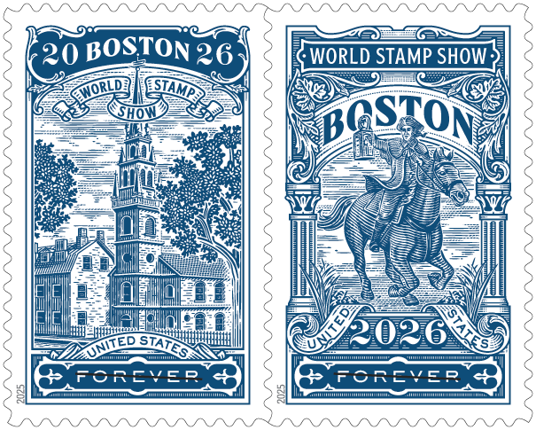
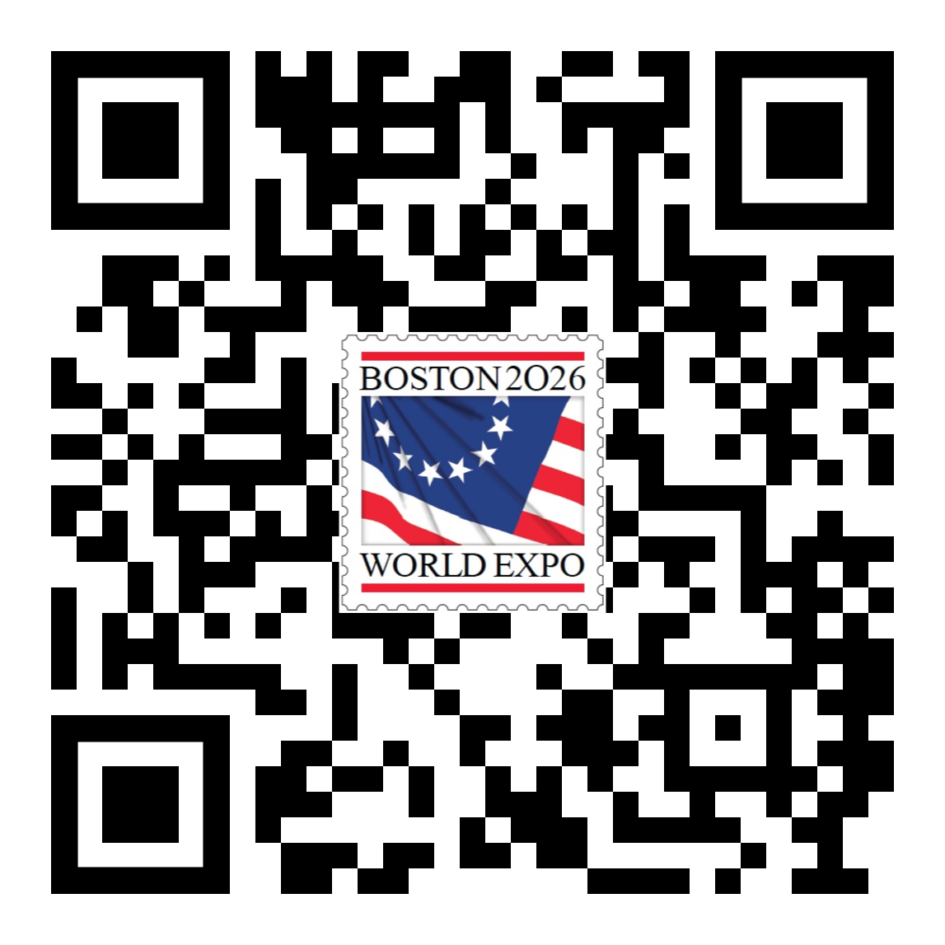
The Twelfth International Philatelic Exhibition in the United States
Saturday-Saturday,
May 23-30, 2026
Boston Convention
& Exhibition Center
Boston 2026 World Stamp Show, Inc.
Boston2026.org

Slide 3


Who is Arranging this Event?
Boston 2026 World Stamp Show, Inc.
- Organizing Committee, in partnership
with:
United States Postal Service
American Philatelic Society
Smithsonian National Postal Museum
Spellman Museum of Stamps and Postal History
Countless Philatelic Organizations, Supporters and Volunteers
-- A Collector-Supported Exhibition --

Slide 4
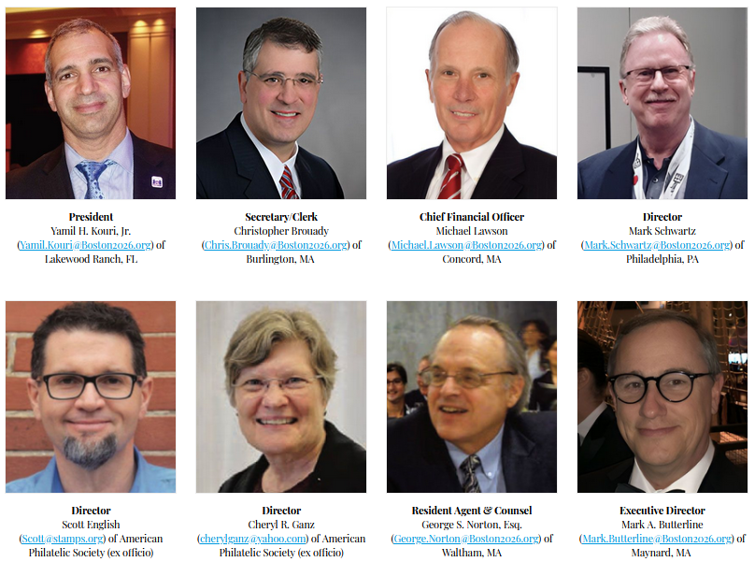
Boston 2026 Corporate Officers

Slide 5
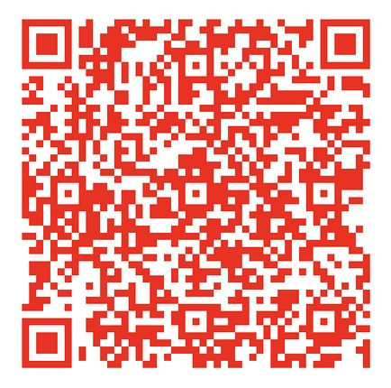
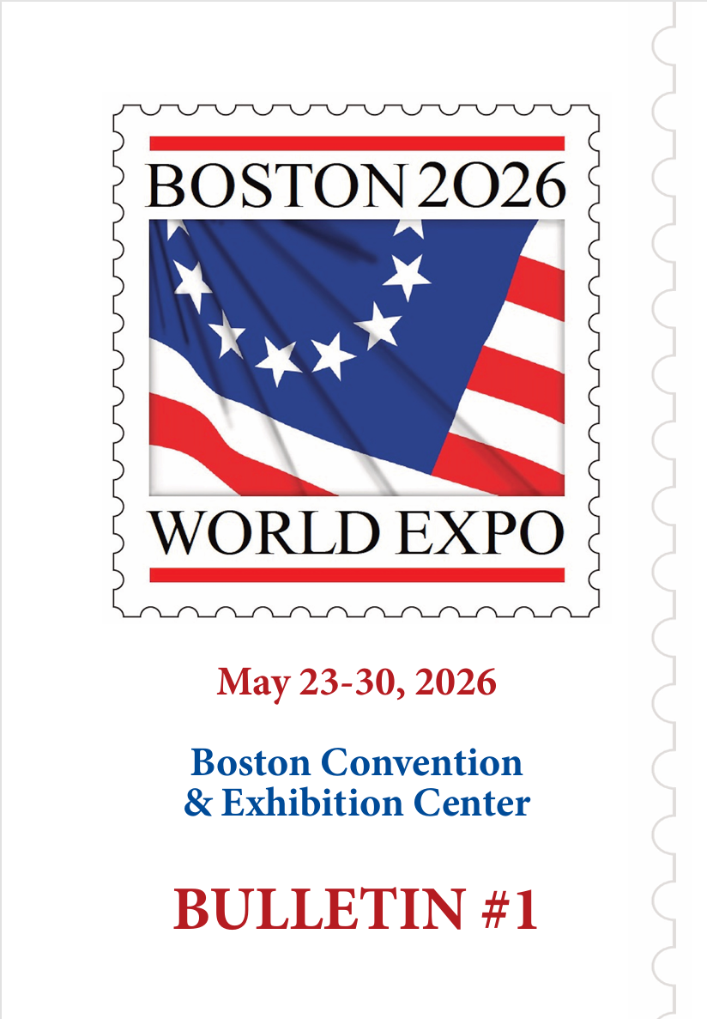
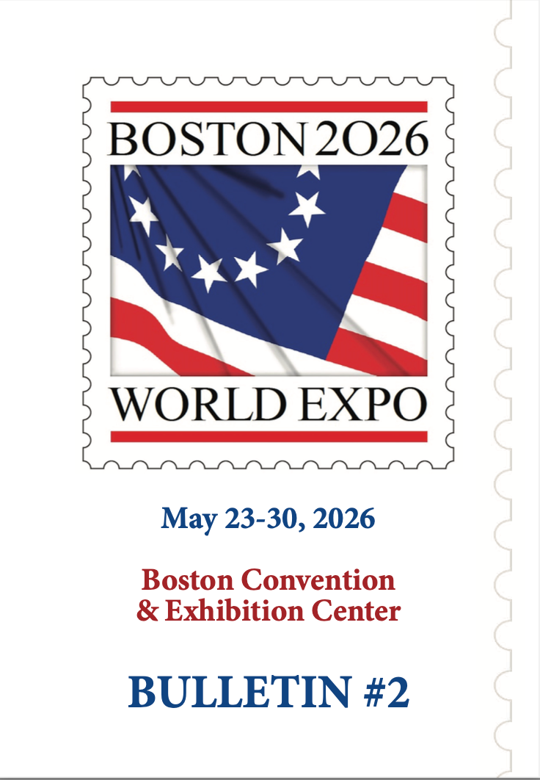
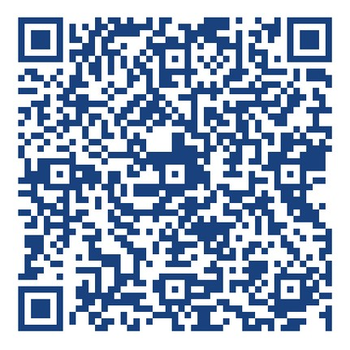
Bulletins
Bulletins 1 and 2 have already been issued and contain basic details about the show, specific information regarding rules and regulations dealing with exhibiting and a number of articles about philatelic and historical connections to the greater Boston area. Both PDFs may be downloaded from the Boston 2026 web site or scan the QR codes here.
1
2

Slide 6

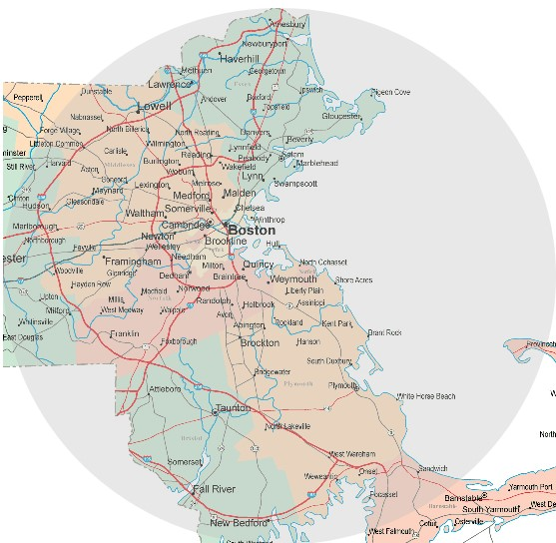
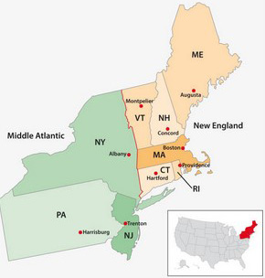
Easily reach Boston…
by plane, train, bus, boat or car!

Slide 7
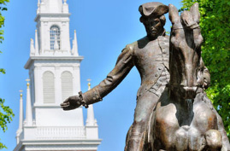
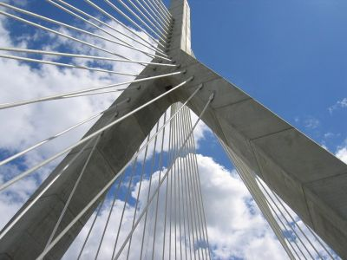
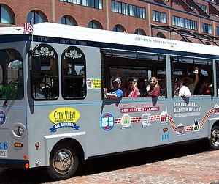
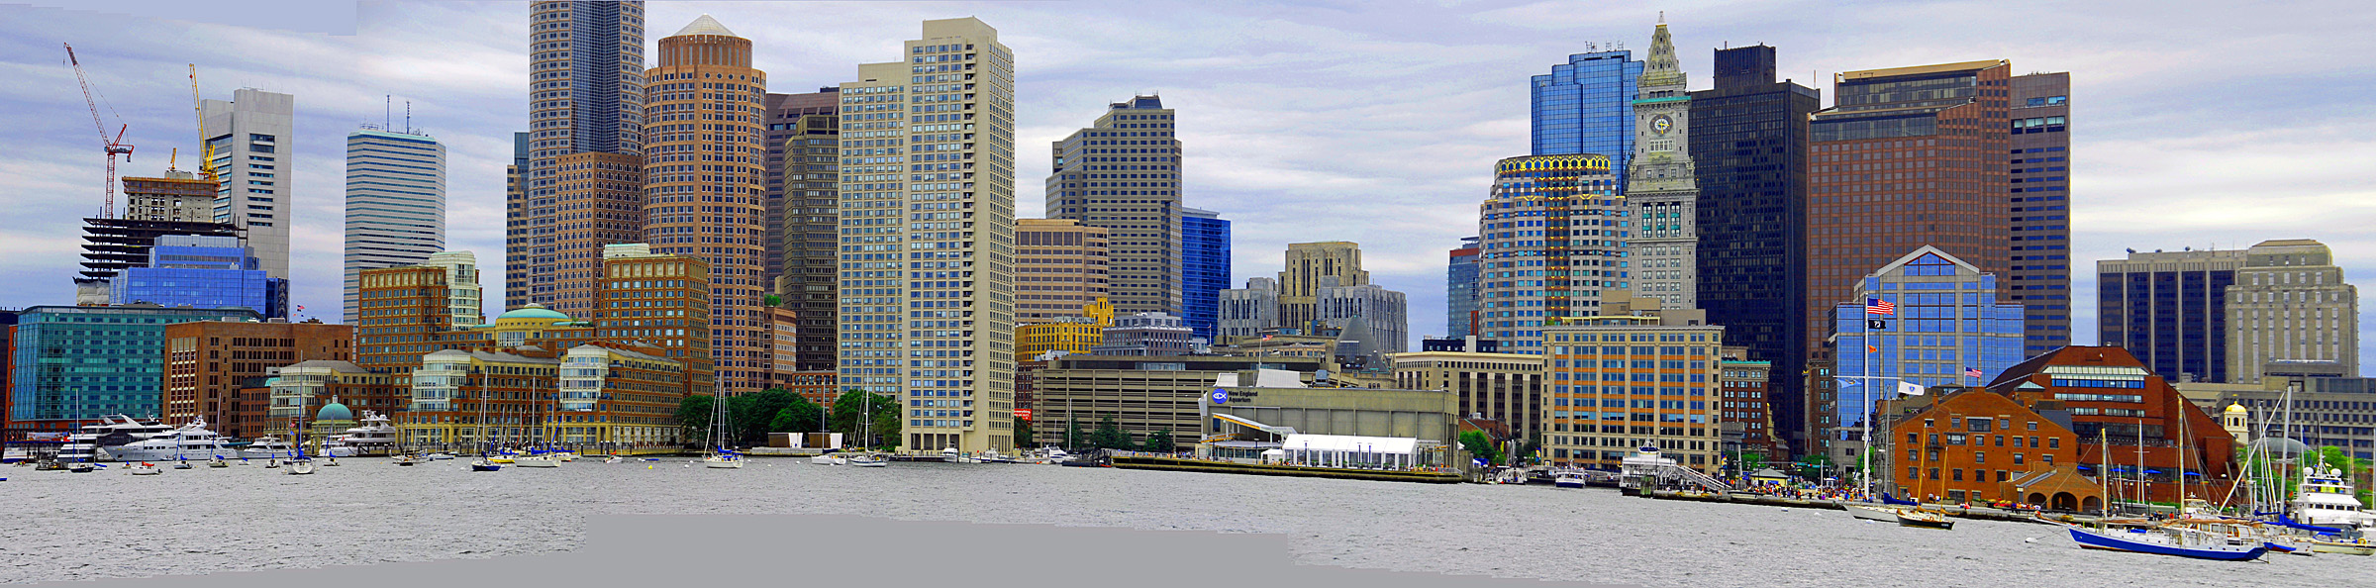
Boston has Much to Offer Visitors
History
Museums and culture
Compact and walkable
Family-friendly
Harbor activities
Chinatown and Little Italy
Education center
Major league sports, including hosting FIFA World Cup 26 matches

Slide 8
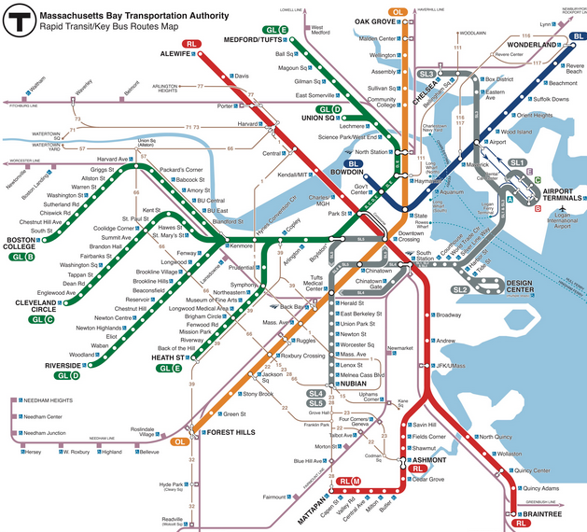
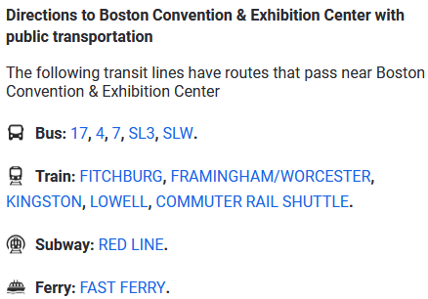
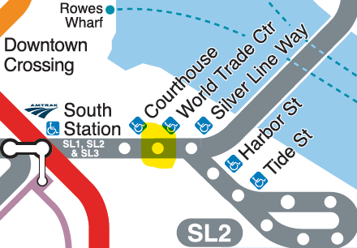
Easily get around Boston…
by bus, train/rail, subway, ferry or car!

Slide 9
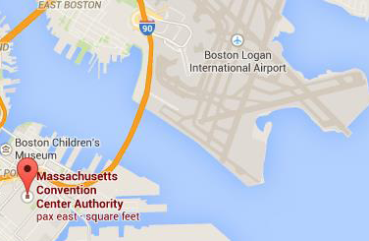
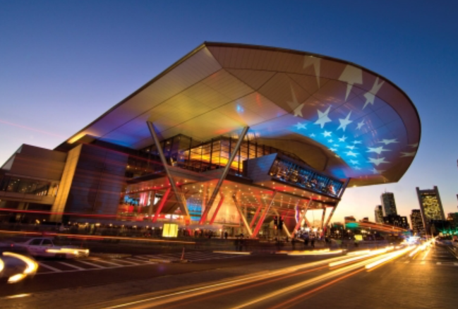
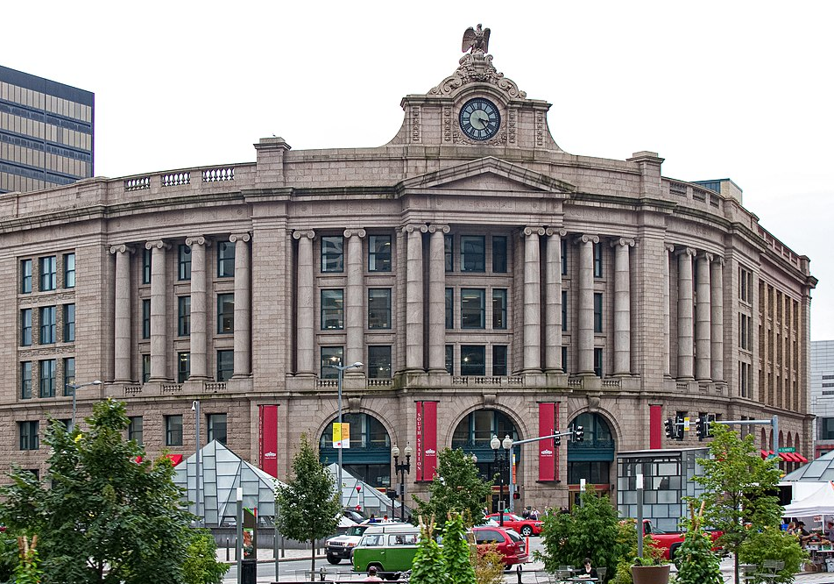
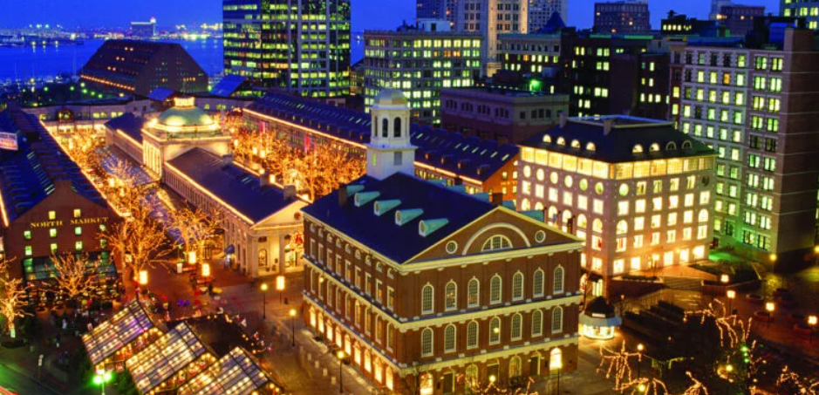
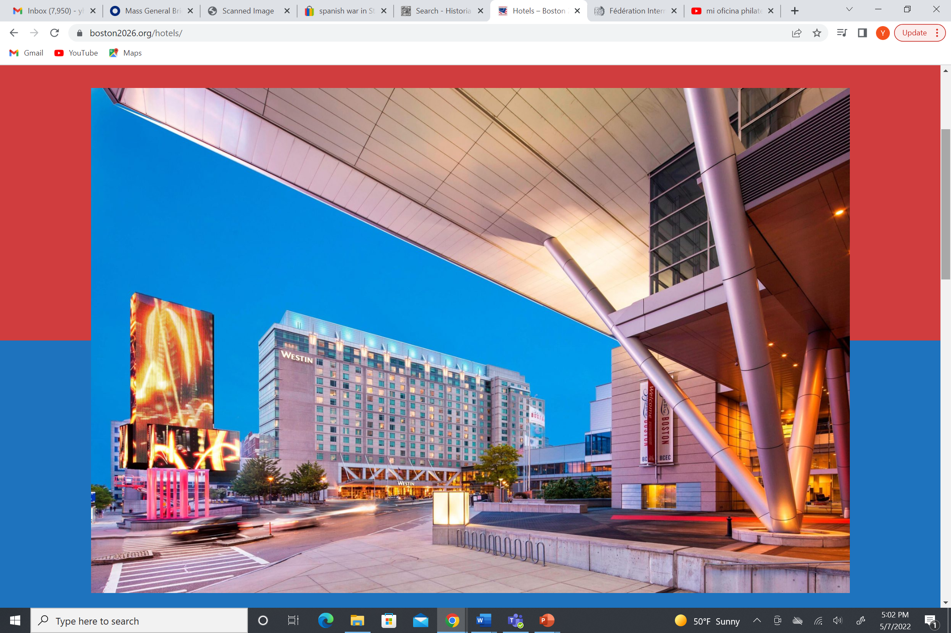
Location, Location, Location …
Less than 2 miles
0.6 miles
Boston Logan Airport
Next to or very close to the show venue
Boston Convention and Exhibition Center
South Station
About a mile
Faneuil Hall and Quincy Market
Show Hotels

Slide 10
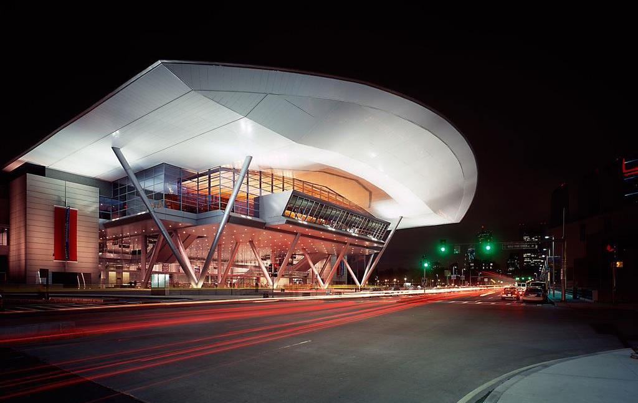
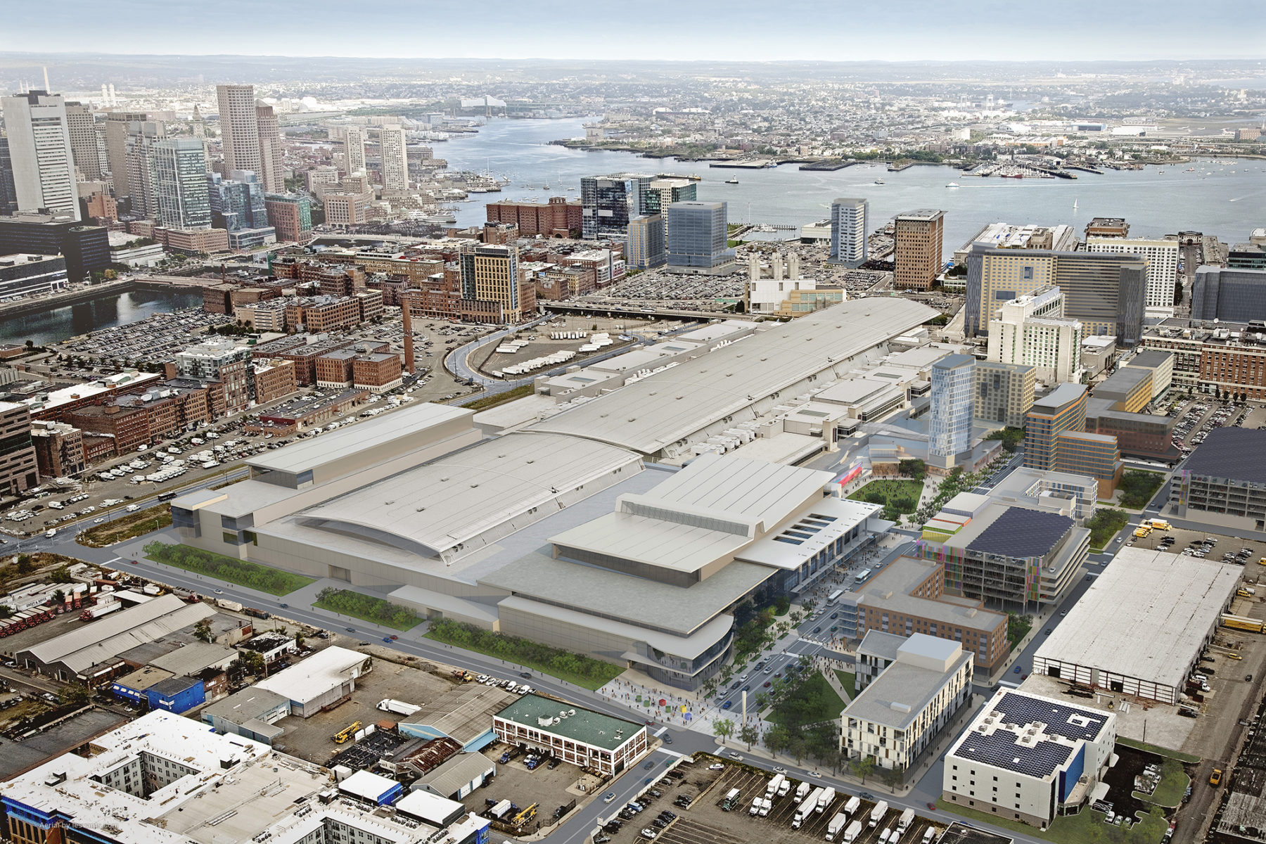
Boston Convention and Exhibition Center

Slide 11
Boston Convention and Exhibition Center
352,000 sq ft of contiguous exhibit space (Halls A & B)
Minimal column obstruction
19,000 sq ft of registration area
State of the art technology and climate control (free Wi-Fi)
42 meeting rooms of various sizes
20,000 sq ft ballroom with capacity for 1,500 diners
Food court
Wheel chair accessible, in-hall mini-carts available
62 covered loading bays
Ample onsite parking (~2,000 spaces)
Easy to reach by public transportation or driving

Slide 12
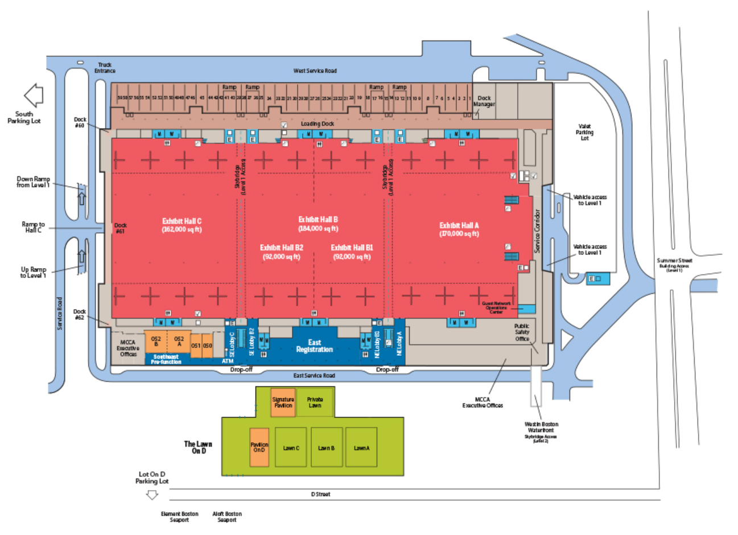
Boston Convention and Exhibition Center
Lower Level (Show Floor)

Slide 13
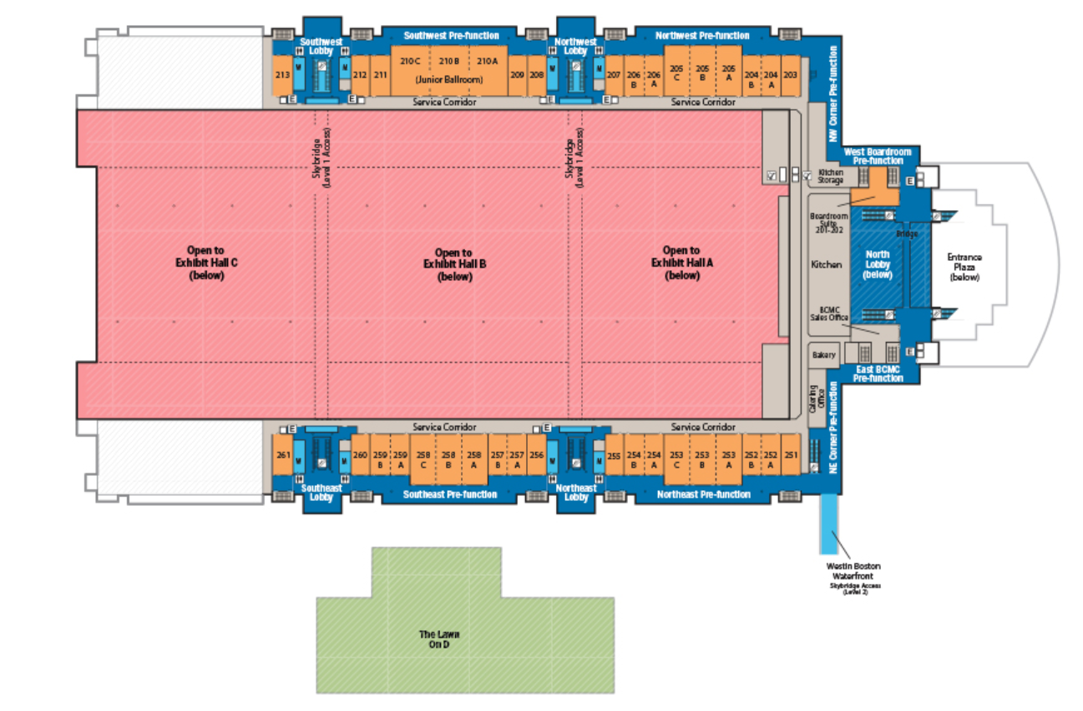
Boston Convention and Exhibition Center
Upper Level (Meeting Rooms and Lobby)

Slide 14
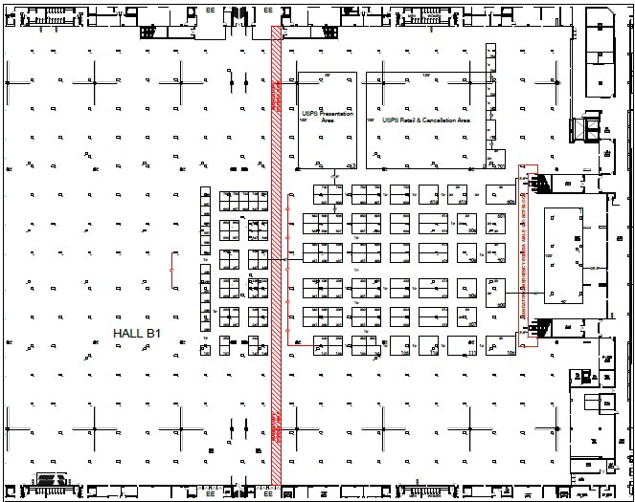
Boston Convention and Exhibition Center
Lower Level (Show Floor)
Major Society Booths
USPS Retail and Cancellation Area (125’x100’)
USPS Presentation Stage (60’x100’)
Welcome to Stamp Collecting Pavilion Youth and Adult sections (70’x120’)
Minuteman Club
(100’x25’)
Escalator
Exhibits, Continental and Polar Pavilions (throughout the remaining area)
Registration Area
(upper level)
Escalator
Court of Honor and Invited Exhibits
(100’x40’)
Main Bourse Area

Slide 15
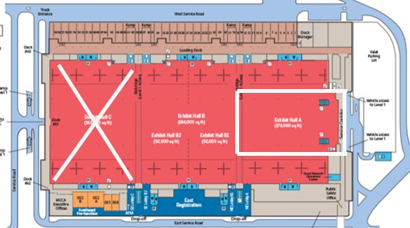

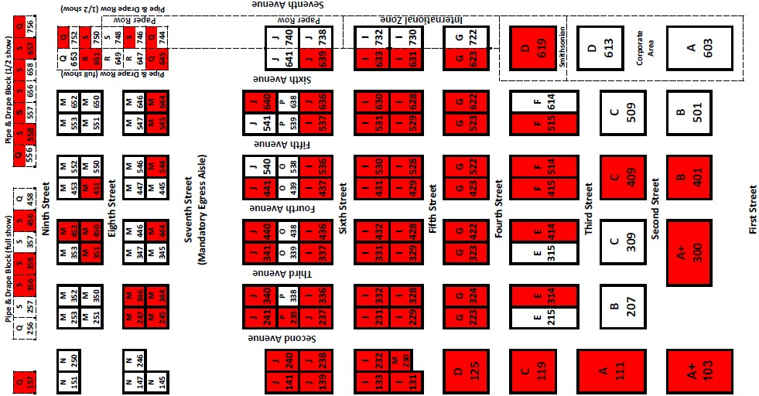
Boston Convention and Exhibition Center
Dealer and Major Society Booth Area
as of mid-May 2025
White- Available Dealer Booths Red- Sold Dealer Booths
North Lobby
Street
Hotels

Slide 16
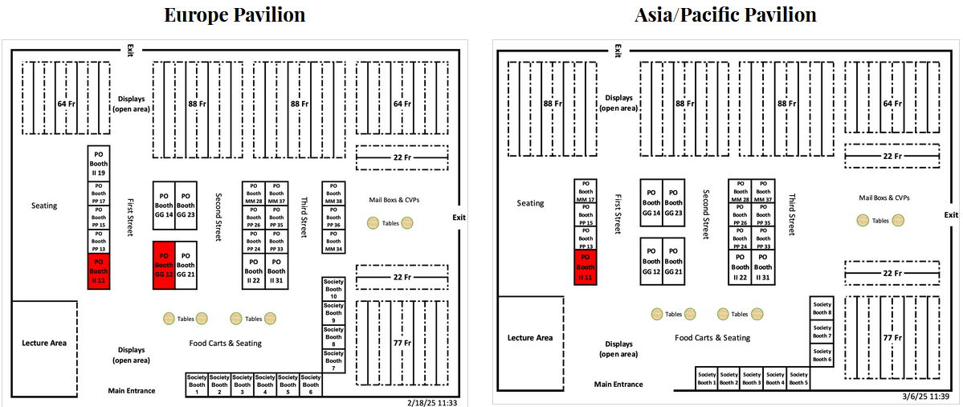
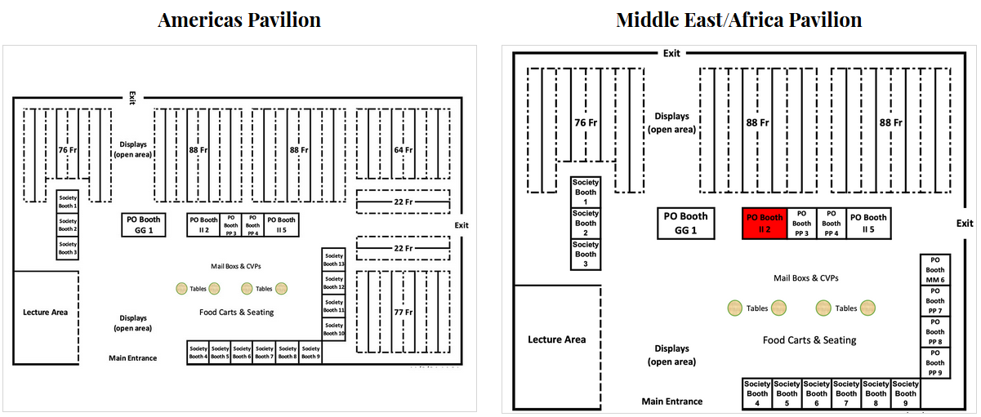
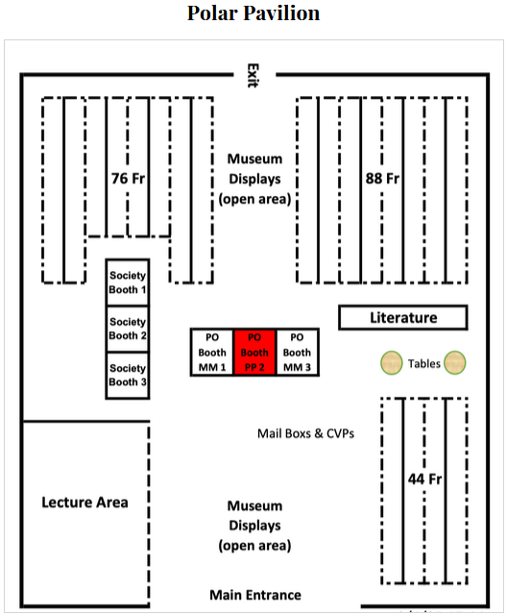
Boston Convention and Exhibition Center
Five different pavilions will be located across the hall showcasing postal administrations selling stamps, competitive and non-competitive exhibits, and displays of all kinds.

Slide 17
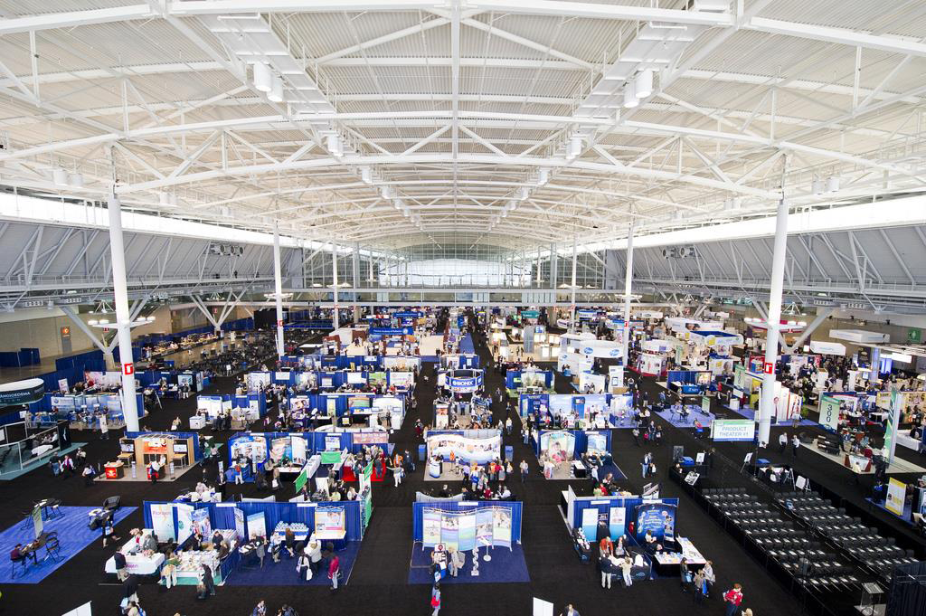
Boston Convention and Exhibition Center

Slide 18
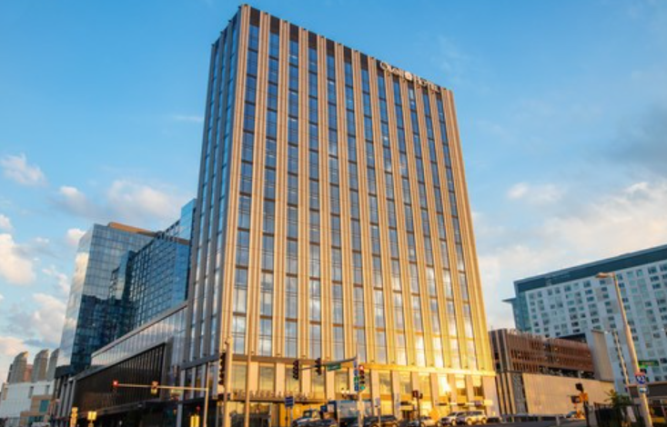
Two Show Hotels Directly Connect to the Convention Center
Westin Boston Seaport District
Show Headquarters
Contracted in 2015
Omni Boston Hotel at the Seaport
Opened September 2021
Contracted in 2021

Slide 19
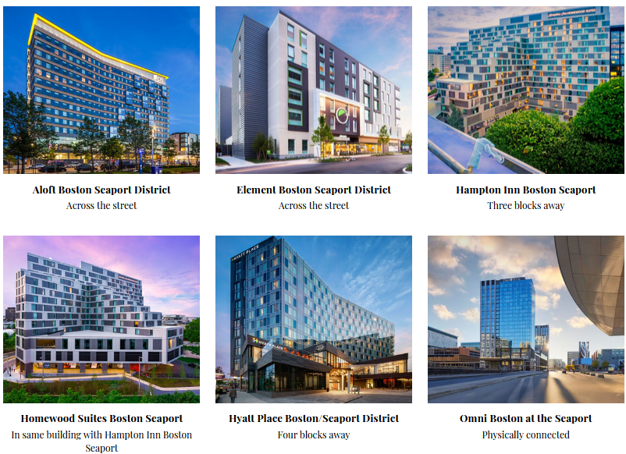
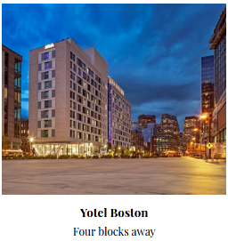
Six Other Nearby Show Hotels

Slide 20
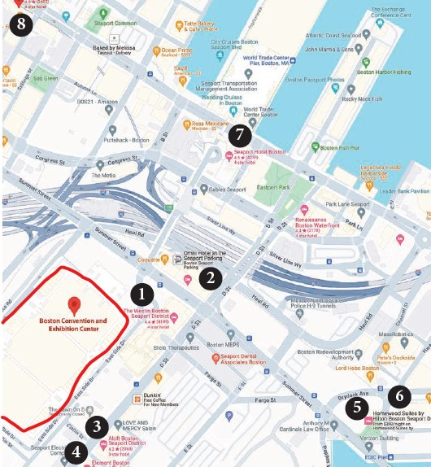
Contracted Nearby Show Hotels (per night+tax)
1 - Westin Boston Seaport District ($333)
2 - Omni Boston ($280)
3 - Aloft Boston Seaport District ($270)
4 - Element Boston Seaport District
($279)
5 - Hampton Inn Boston Seaport ($248)
6 - Homewood Suites Boston
Seaport ($280)
7 - Hyatt Place Boston Seaport
District ($276)
8 - Yotel Boston ($249)
Booking Manager: OnPeak, reservations started March 17, 2025

Slide 21
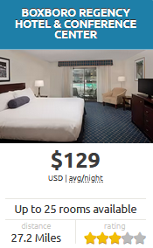
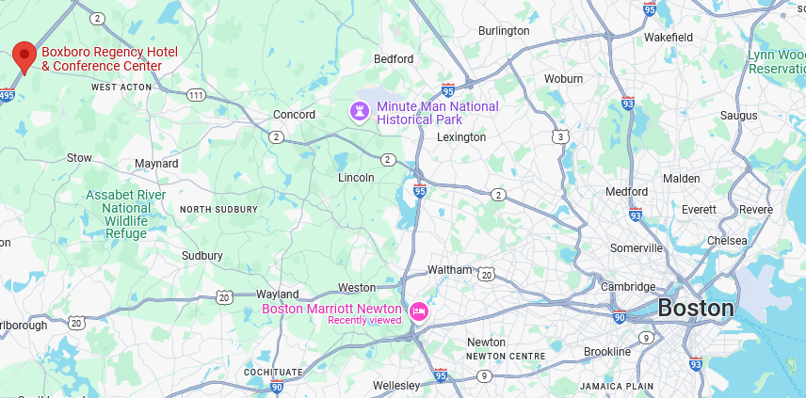
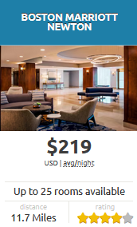
Two Contracted Suburban Show Hotels
These two official show hotels are also available, most convenient for visitors planning to drive to the area. Both offer free parking. Train and light rail line stations offer reasonably priced daily parking for commuters to the city.
Convention Center

Slide 22
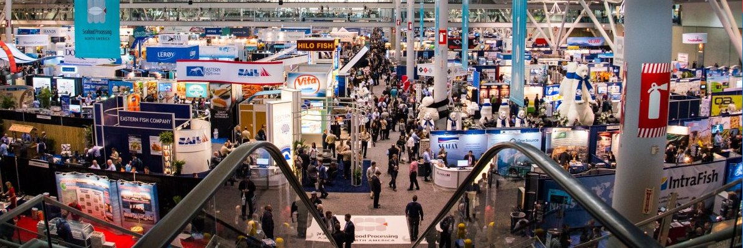
Dealer Options
More than a dozen types of booths to choose from.
Booth sharing allowed (two businesses maximum).
Half-show option (4 days with pipe & drape booths).
Booth and hotel packages.
Customs broker arrangements for non-U.S. dealers.

Slide 23
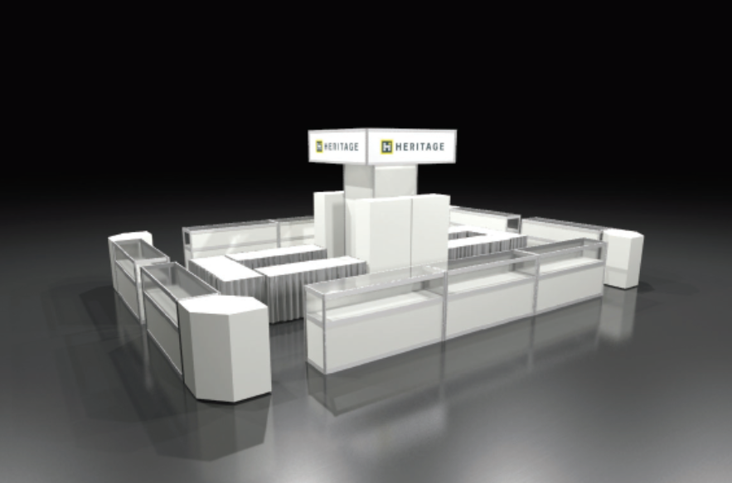
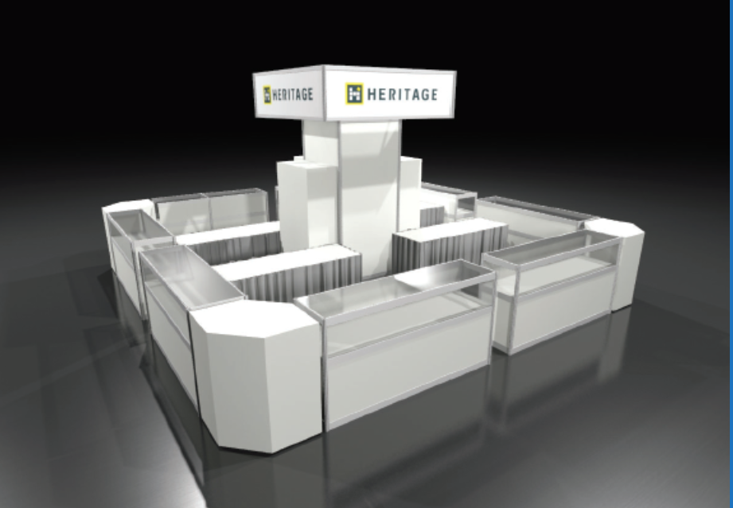

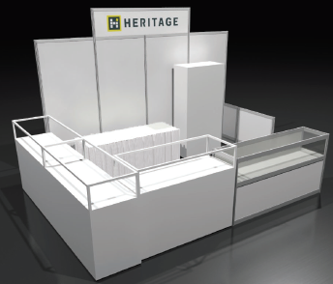

Dealer Counter Style Booths
Five of twelve configurations offered by Heritage Decorators.
30 x 20 Super Booth
20 x 20 Super Booth

Slide 24
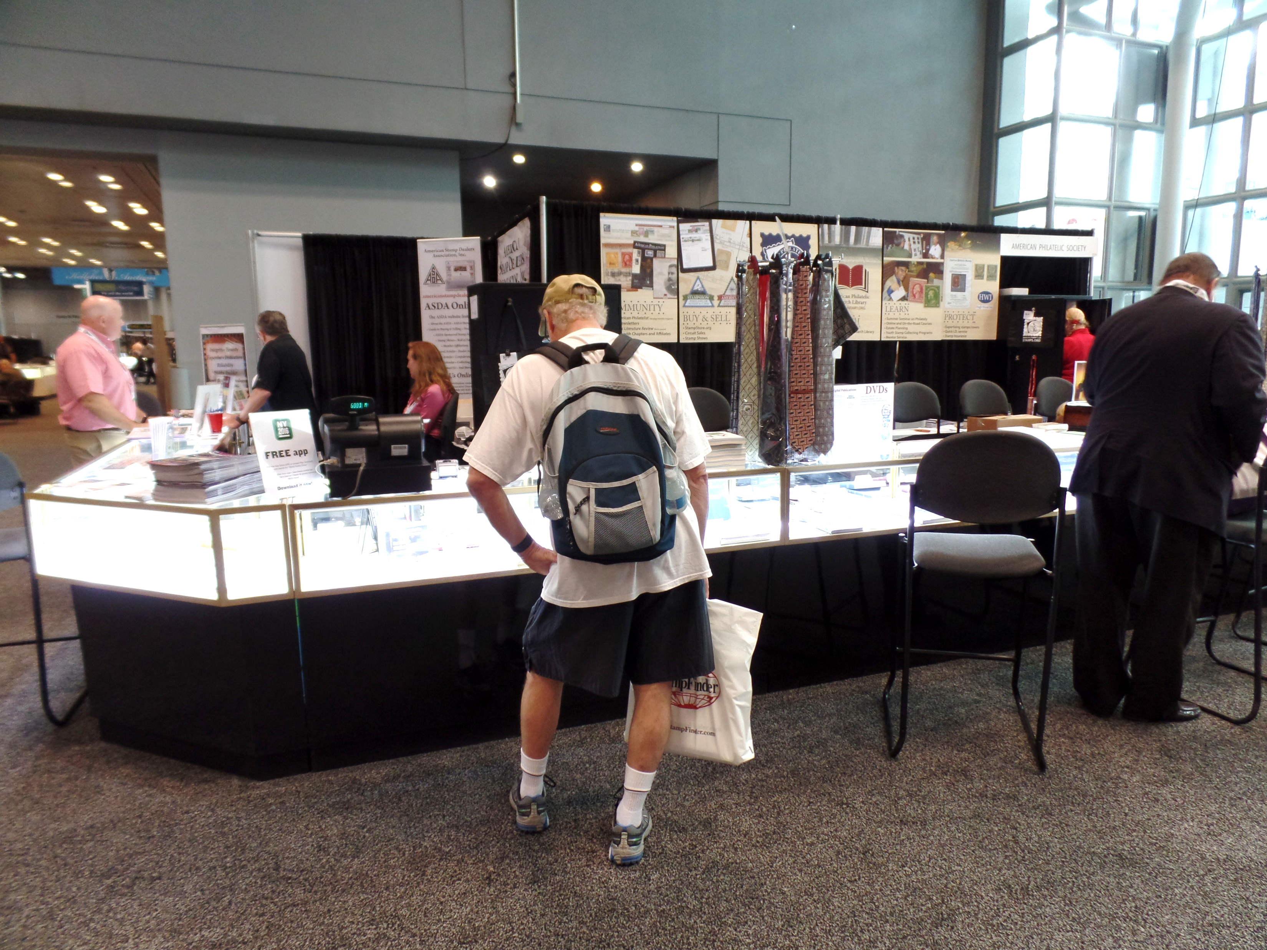
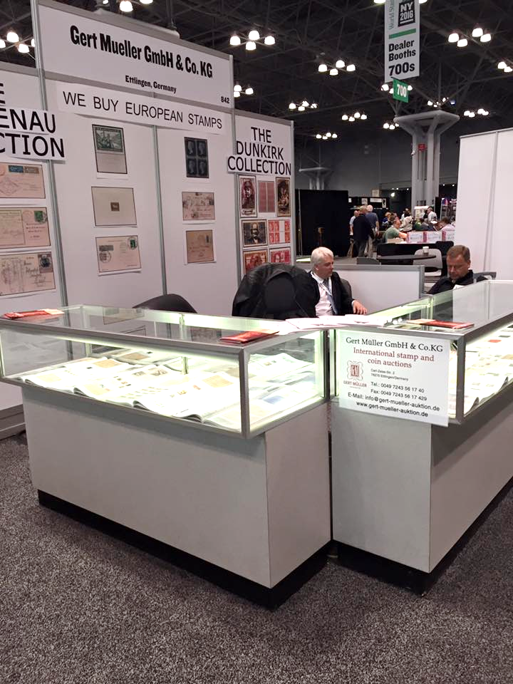
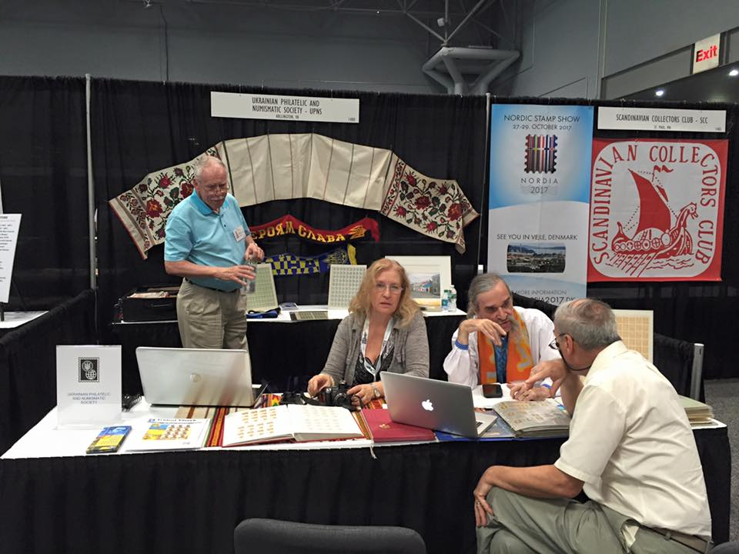
Dealer Booths
Dealer counter booths typically have no or few chairs,
but pipe and drape booths towards the back of the hall will.

Slide 25
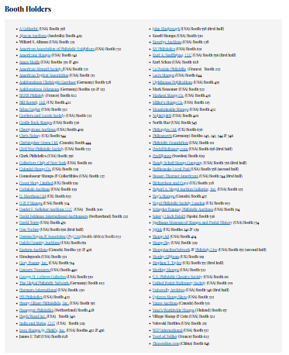
Attending Dealers
The updated list of attending booth holders, their hall locations and web links is located on the Boston 2026 web site.
We anticipate around 150 dealers will be coming from across the globe bringing material worth millions of dollars.
Bring your “want” list!

Slide 26










Auctioneers
Several major auction houses will have booths at Boston 2026, including those listed here.
Arrangements are being made to hold several live auctions over the eight days of the show.

Slide 27
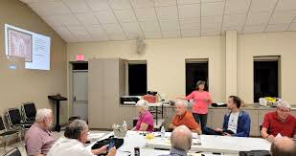
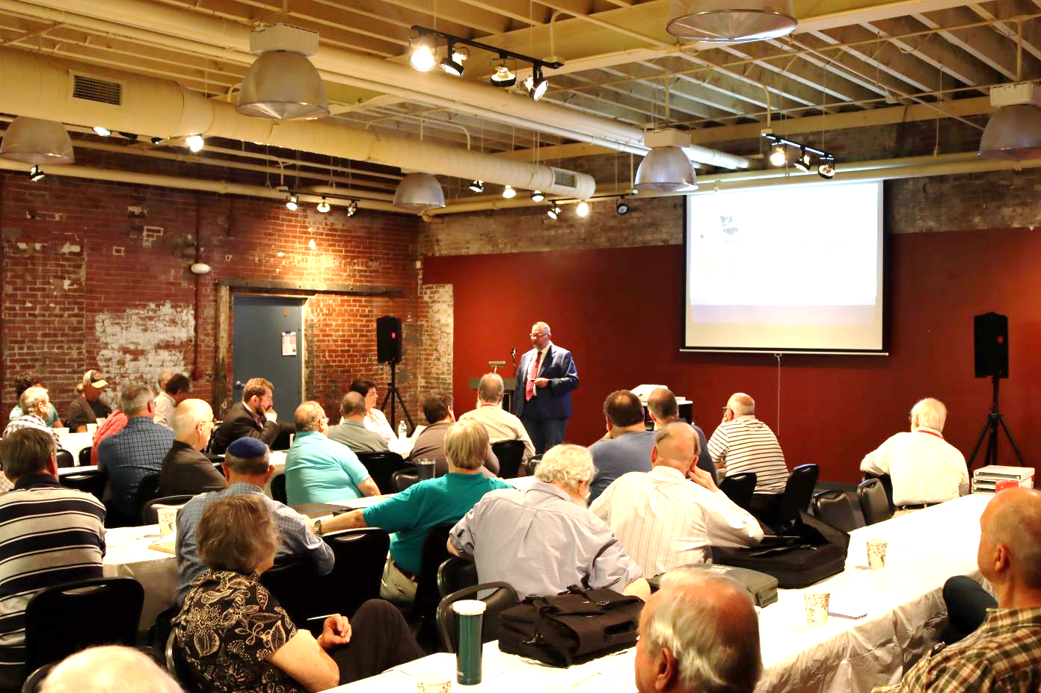
Societies, Meetings and Presentations
Meeting rooms are provided by Boston 2026 free of charge for any philatelic organization or presentation. Societies of varied size and collecting specialties are taking this opportunity to schedule their annual convention. Individuals looking to promote their interests or announce new discoveries are also taking advantage of this opportunity.

Slide 28

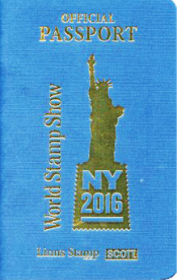


Philatelic Passports
Come visit the world in one day! The popular philatelic passports will be available at Boston 2026. Stop by the various philatelic booths, buy a stamp and have it postmarked with their special commemorative cancel. Filling the book is a souvenir keepsake you’ll always treasure.

Slide 29



First Day Ceremonies
Every day of Boston 2026 will feature at least one first day ceremony by a leading postal administration followed by an autograph signing session by dignitaries related to the issue.
Photos courtesy of USPS of the March 23, 2018 Mister Rogers stamp ceremony in Pittsburgh.

Slide 30





The Exhibitions
Fédération Internationale de Philatélie (FIP) Patronage
APS 2026 Champion of Champions
Federación Interamericana de Filatelia Recognition
Federation of European Philatelic Associations Recognition
Kraus Polar Salon

Slide 31

Competitive Exhibits
• FIP Competition (about 3,500 frames)
Classes: Aerophilately/Astrophilately, First Day Covers (experimental), Open, Picture Post Cards, Postal History, Postal Stationery, Revenue, Thematic, Traditional, Youth and Championship multi-frame exhibits; Single Frame exhibits; and Literature (incl. digital and web sites). [1, 5 or 8 frames per exhibit]
• APS annual Champion of Champions 2026 (about 250 frames)
Grand award winners from the 23 U.S. and Canadian national World Series of Philately shows vie for being selected the best among them. [up to 10 frames per exhibit]
• Kraus Polar Salon (200 frames)
Exhibits dealing with polar exploration, polar-themed and/or polar region stamp issues.
[up to 10 frames per exhibit]

Slide 32
FIP Competitive Exhibit Criteria
Four areas are scrutinized by the judging teams in scoring most classes of FIP exhibits, awarding points in these categories:
• Treatment and Philatelic Importance (up to 30 points)
The completeness and correctness of the selected material made by the exhibitor to illustrate the subject and the philatelic significance of the subject being displayed.
• Philatelic and related Knowledge, Personal Study and Research (up to 35 points)
The degree of knowledge of the exhibitor through the items chosen, their proper analysis and revelation of new info about the items and/or subject.
• Condition and Rarity of material exhibited (up to 30 points)
The quality, rarity and difficulty of acquisition of the selected material.
• Presentation (up to 5 points)
The overall aesthetic appearance of the exhibit.

Slide 33


FIP Competitive Exhibit Awards
FIP medal levels are awarded based on the total points given:
Large Gold 95-100
Gold 90-94
Large Vermeil 85-89
Vermeil 80-84
Large Silver 75-79
Silver 70-74
Silver Bronze 65-69
Bronze 60-64
Certificate < 60
Special donated prizes are awarded for merit, typically objet d’art.
medals and special prizes awarded during the last U.S. international exhibition in 2016

Slide 34





Non-Competitive Exhibits
• Court of Honor (World Rarities)
• Invited Exhibits
• German American Salon (50 frames)
Sponsored by the Bund Deutscher Philatelisten of Germany (BDPh) and the Germany Philatelic Society of the United States (GPS)
• Ephemera Exhibits
Sponsored by the Ephemera Society of America
• Cinderella Exhibits
Part of the World Cinderella Philately Congress
• Museum Exhibits

Slide 35


Other Events during Boston 2026
Signing of the Roll of Distinguished Philatelists Ceremony
Inter American Federation of Philately (FIAF) Annual Assembly
World Cinderella Philately Congress - signing of the Roll of NCP
UPU Philatelic Marketing Conference
Lego Displays
Iconic Baseball Memorabilia
Paper making, printing and engraving
Historical artifacts
Book presentations and signing
Plus…
United States Semiquincentennial Celebrations in Boston
Revolutionary War re-enactments

Slide 36
Some of the Milestones Ahead
(not in any particular order)
Exhibit frame design, manufacturing and unveiling
Appointment of national commissioners of participating nations by their philatelic bodies
Exhibit application and acceptance processes
Invitations sent to postal administrations
Request for and receipt of exhibit special prize donations
Design and manufacturing of exhibition medals
Layout of the Continental Pavilions, Polar and German Salons
Selection of the exhibition’s theme day subjects
Finalization of auction plans
Scheduling of 100+ society meetings, seminars and talks
Collection of donated stamps for Beginner/Youth show use
Announcement of side trips to Boston area attractions

Slide 37




Boston 2026 World Expo Summary
Free admission!
About 4,000 exhibit frames
United States Postal Service
American Philatelic Society
Participation of Several Museums
Daily First Day Ceremonies by USPS, UNPA and others
150 Dealers and Auction Houses
135 Societies and Organizations
50 Postal Administrations
Hundreds of meetings, seminars and events
yearly promotional labels
2021
2022
2023
2024

Slide 38

Donations
Boston 2026 World Stamp Show, Inc. has 501(c)(3) recognition by the IRS.
Donations continue to be received by individuals, societies and organizations.
US donations are tax deductible to those who itemize.
See the Donor page on the Boston 2026 web site.

Slide 39



After the Show…
Greater Boston offers much to visitors, whether it be historic, cultural or sports-minded in nature. Stick around!
Looking for adventure? Logan Airport services 52 airlines from its four terminals with 106 gates to almost any domestic or international destination imaginable.
Ready for a vacation after your Boston 2026 trip? Norwegian Cruise Lines offers a 7-night Halifax and Bermuda cruise leaving Sunday, May 31, from its Boston dock on the 3,963 passenger Norwegian Breakaway!

Slide 40



Thanks for watching.
Join us May 23-30, 2026.

