Slide 1
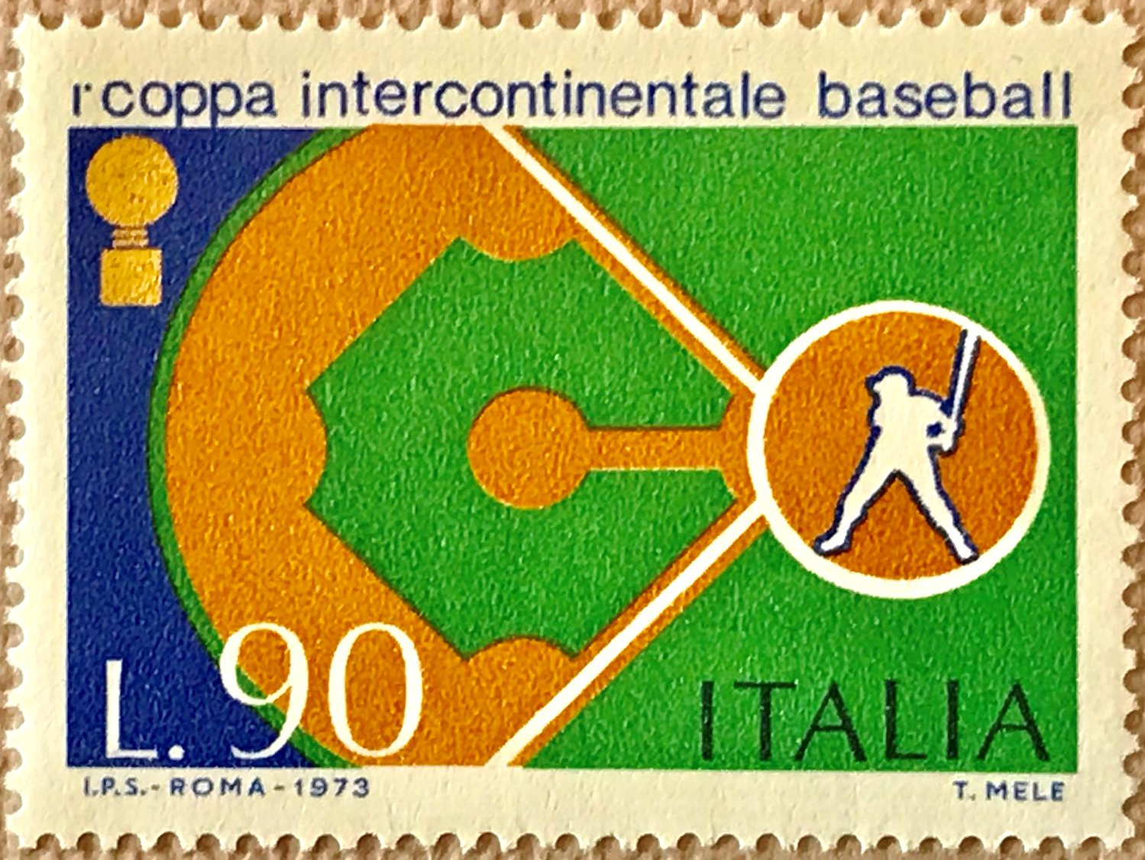
History of Baseball
As Depicted In Postage Stamps
David Schulz
Canadian Baseball History Conference
November 2018
Notes:
Good morning. And now for something completely different!
My name is David Schulz and I’m going to talk about a number of historical baseball events and people that have been depicted and honoured in commemorative postage stamps from around the world. I hope you enjoy the presentation and learn something new.

Slide 2
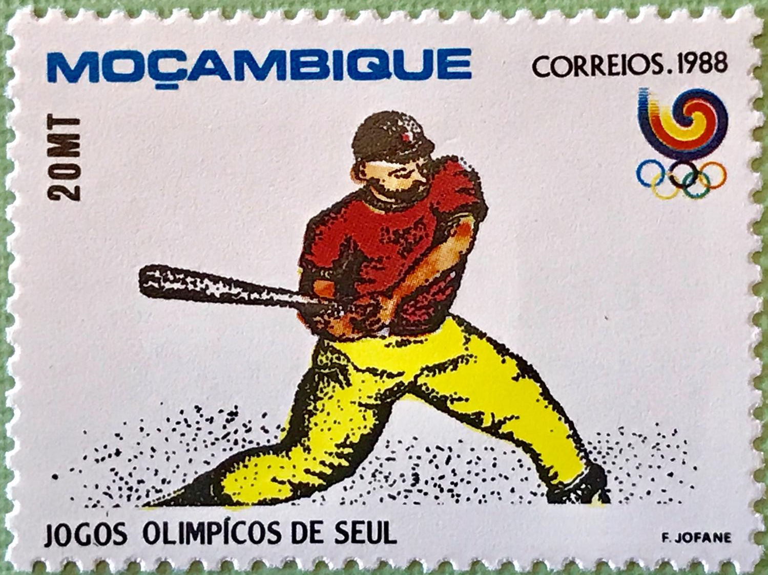
Thanks
Swing Time Philately
  Rob Van Tuyl (Netherlands)
  Leon Vanverre (Belgium)
National Baseball Hall of Fame and Museum Reference Library
  James Gates, Cassidy Lent
Several internet references
Heather Schulz – Powerpoint Guru
Notes:
I want to start off with thanks to two key sources for the presentation material
First, there’s a great stamp collecting group called Swing Time Philately based in the Netherlands and Belgium
Rob Van Tuyl and Leon Venverre research baseball and golf postage stamps around the world and maintain a detailed catalogue for its membership
They also put together a newsletter with articles on both sports and their related postage stamps
Thanks as well to the reference library at the National Baseball Hall of Fame and Museum in Cooperstown
Both Cassidy Lent and James Gate were both very interested in this project and helpful in providing all that the library had to offer

Slide 3
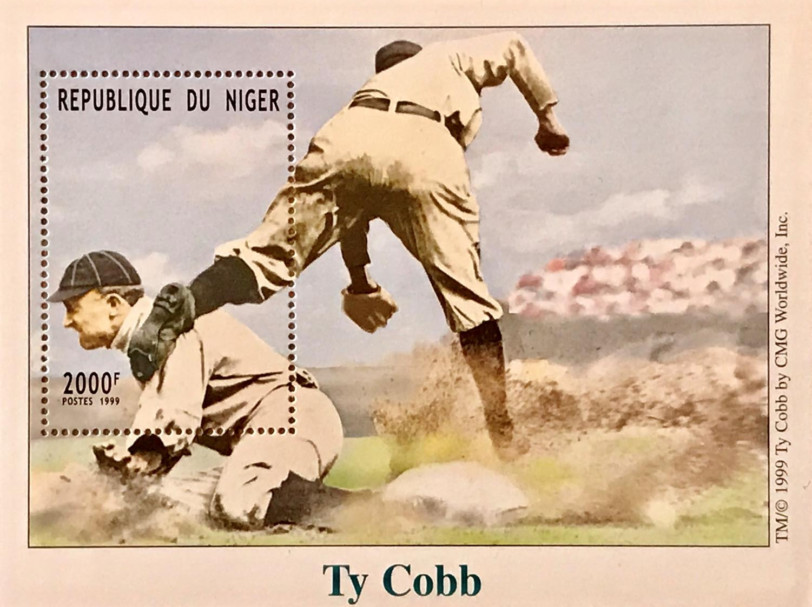
Notes:
As I mentioned, my goal in this presentation is to share stories about baseball that you might not be aware of that have been honoured or celebrated in postage stamps
I’ve selected several stamps with hopefully a good cross section from just a few of the countries and the various topics covered in these issues. I’ve also picked some that have a Canadian connection
I’ll also focus on the 6 stamps that Canada has issued
It is not my intent to talk about the hobby of baseball stamp collecting, but I will share some interesting data about the stamps that have been issued on this topic
Before I get to that data, I want to talk about the very first baseball stamp ever issued….

Slide 4
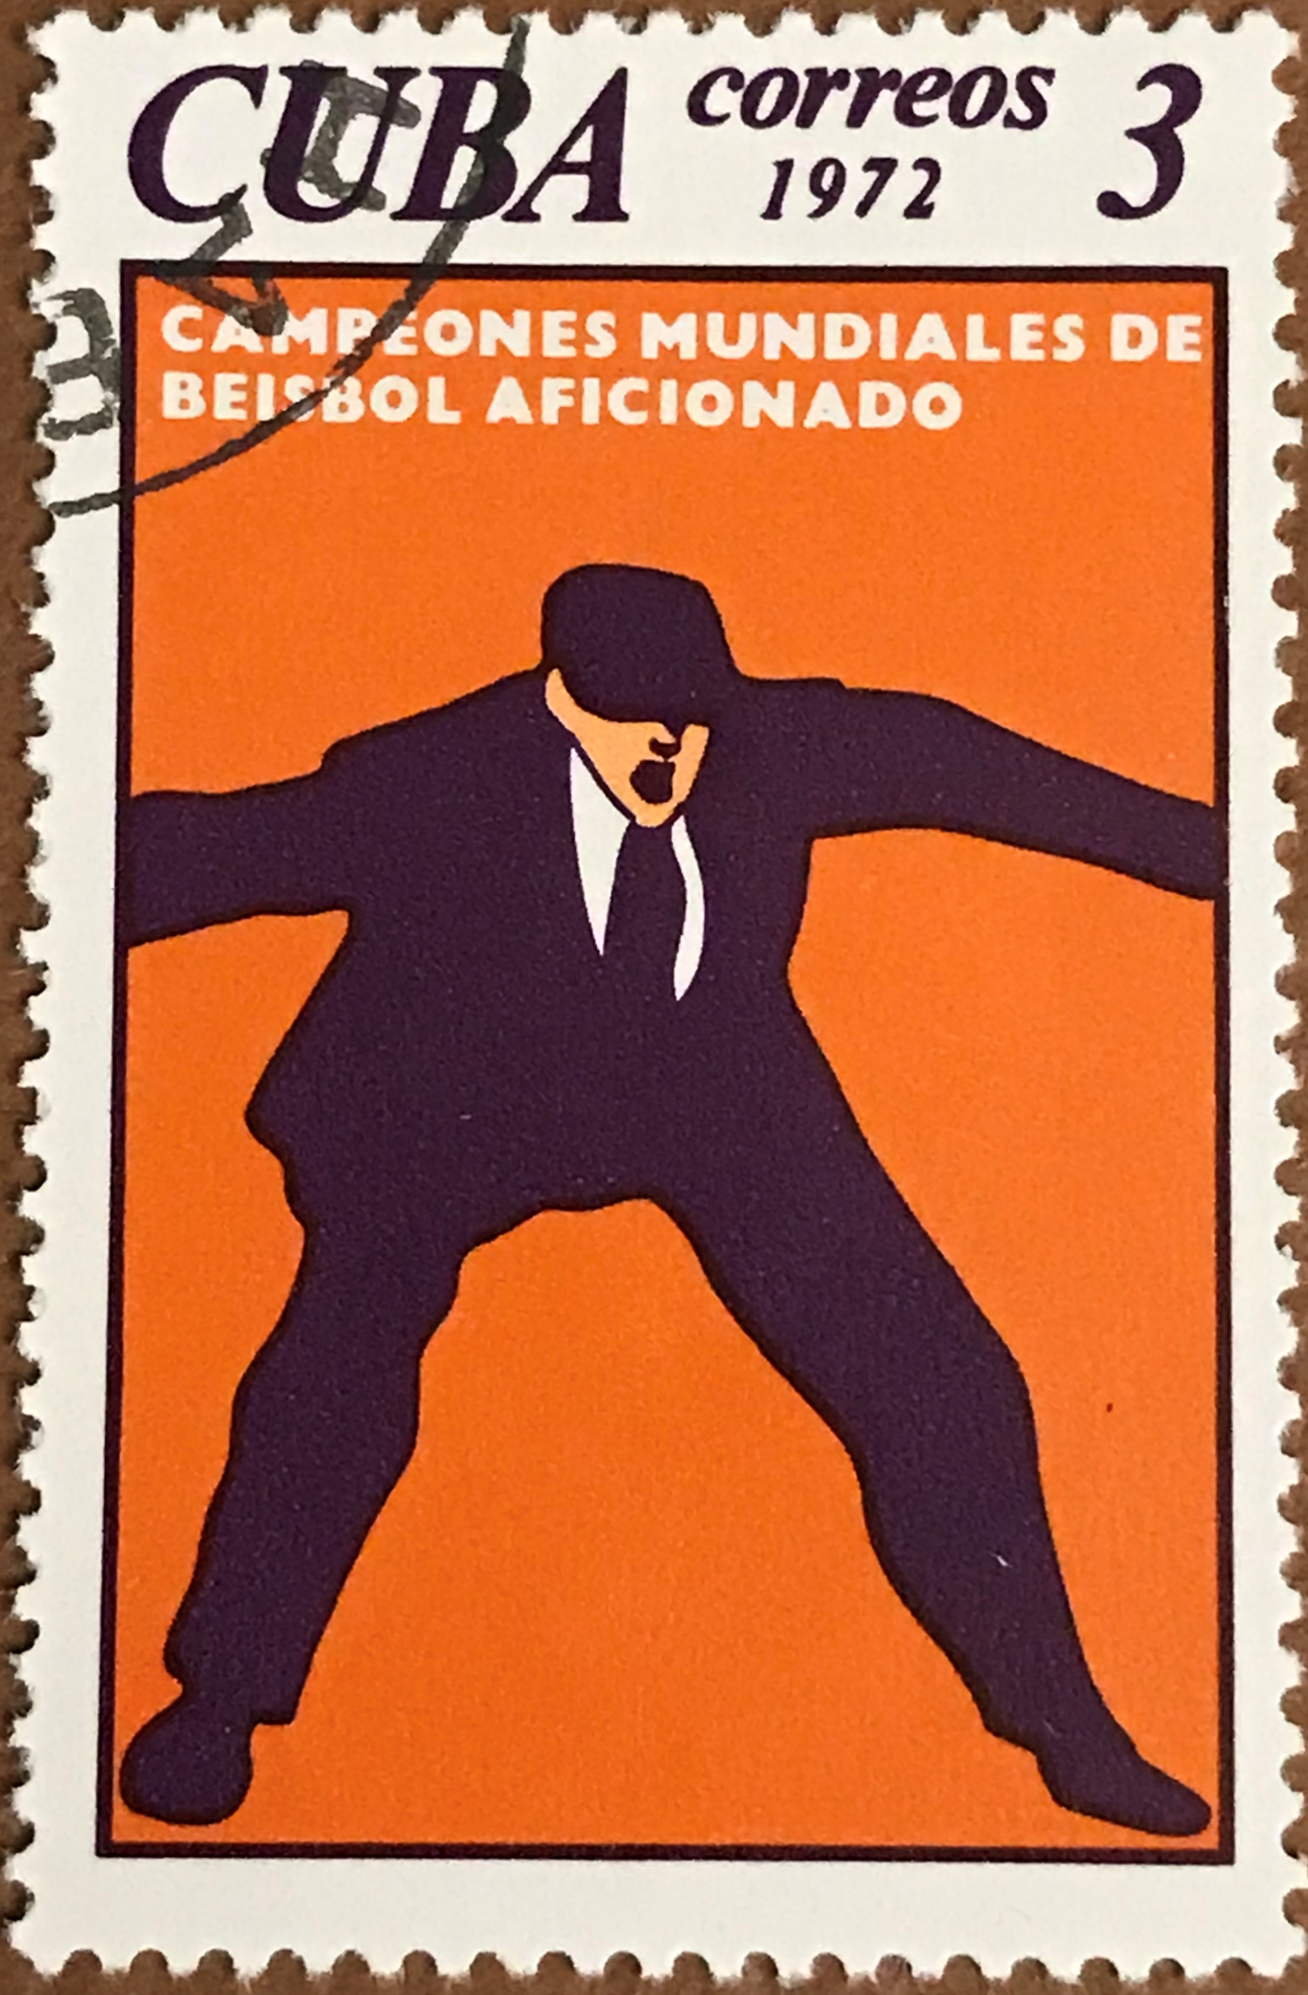
First Baseball Stamp
Where?
When?
Why?
Notes:
Any guesses on where, when and why the first baseball stamp was issued?
Anyone?
I’ll give you a hint, it’s not the stamp on the screen

Slide 5
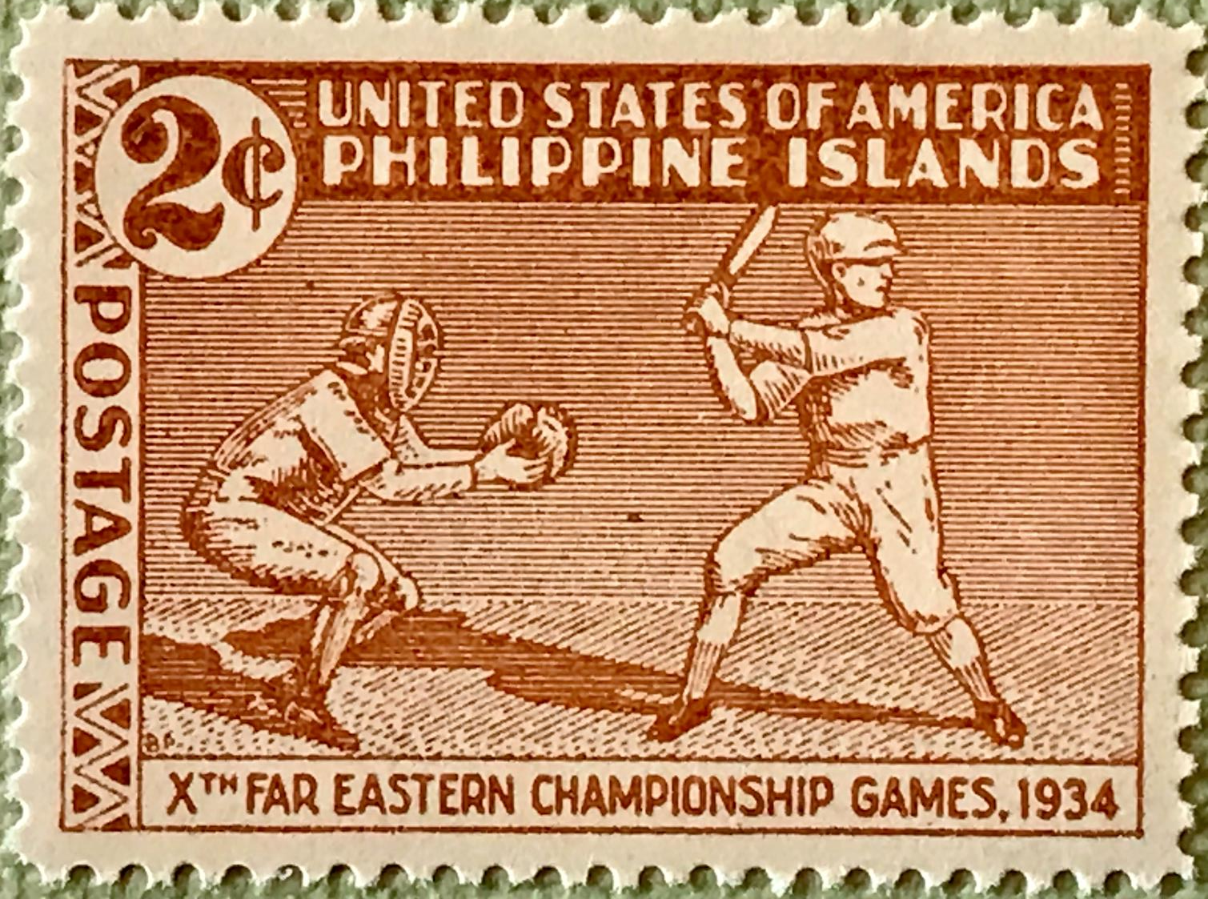
Notes:
Very first baseball stamp was issued in the Philippines on April 4, 1934
The three stamp set also included basketball and tennis
- Commemorates the 10th Far Eastern Championship Games, a sort of regional Olympics, which were held in Manila that year
These games included eight sports contested over four days generally between China, Japan and the Philippines. These particular set of games also included the Dutch East Indies (now Indonesia).
Philippines won the medal for baseball
The 10th edition was the final time these games were held due to poor relations between China and Japan
Some debate as to who really owns the ‘rights’ to claiming the first baseball stamp --- the Philippines or the United States --- because the Philippines were under American Rule following the Treaty of Paris in which Spain ceded it’s colony to the States following the Spanish-American War of 1898.
The Philippines were granted full independence from the States in 1946
There was probably some influence from the United States for this stamp but most collectors give the honour to the Philippines.

Slide 6
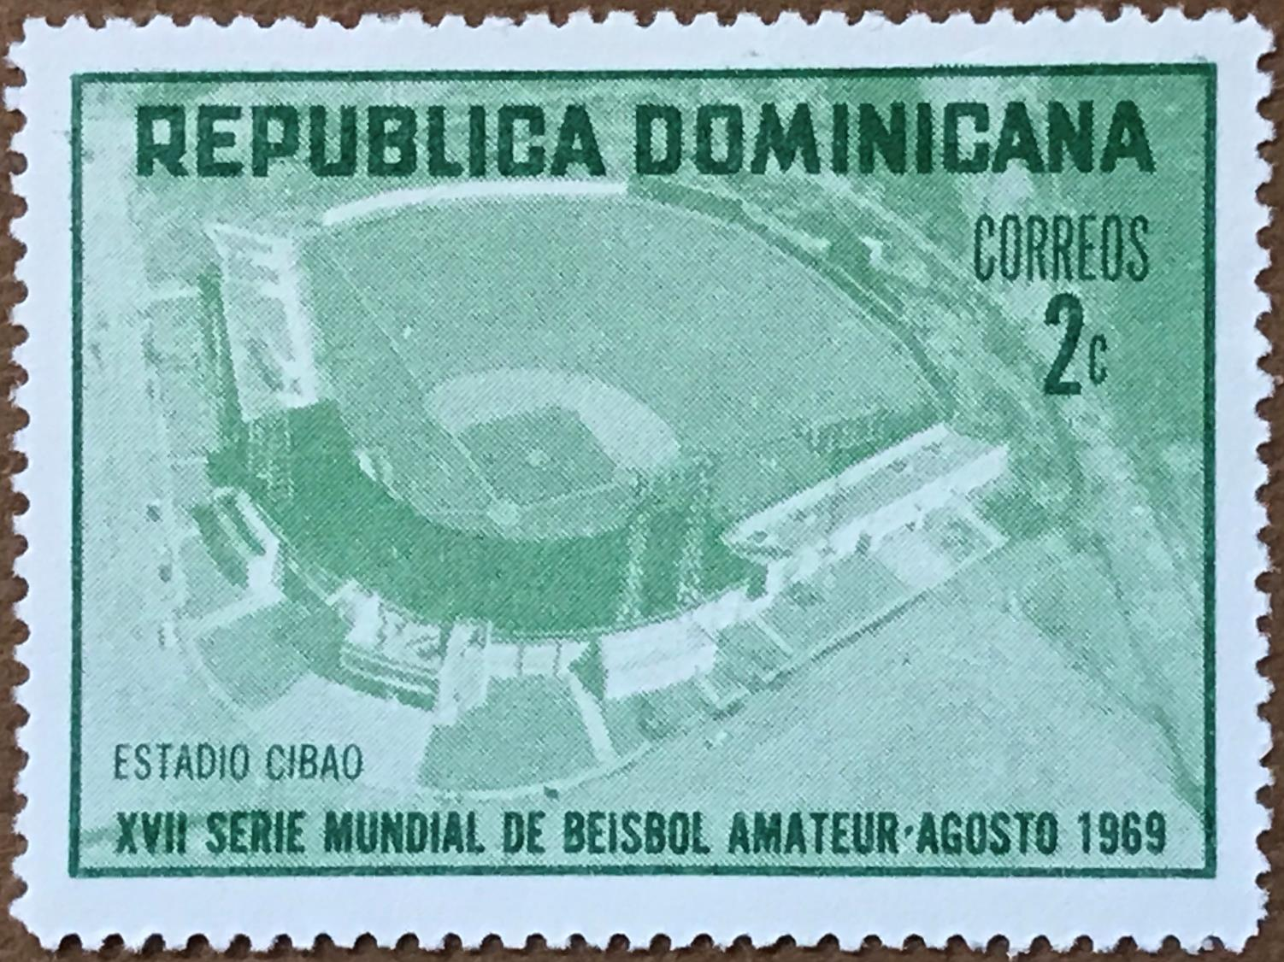
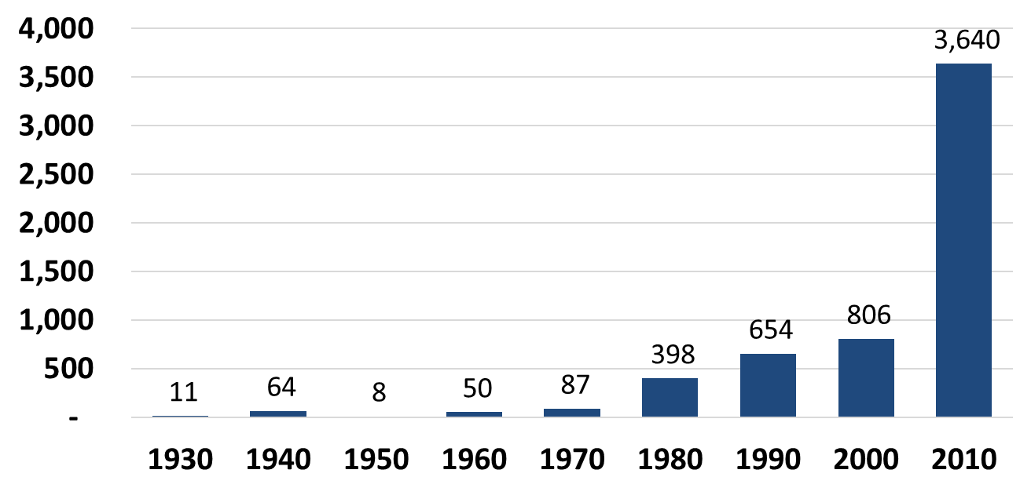
Stamps Issued by Decade
Notes:
So that was stamp #1. Now I just want to touch on that data regarding baseball postage stamps that I talked about
As of December 2017, the last update to the STP (Swing Time Philately) catalogue, there are 5,718 postage stamps related to baseball in the world
To be considered ‘related to baseball’, it can have any reference to baseball including such a small thing as a baseball in a picture, even if the intent of the picture has nothing to do with baseball. We’ll actually see three Canadian stamps that fall into this loose category. 170 countries have issued at least one baseball stamp.
This bar chart shows the number of stamps issued per decade since 1934. As you can see, it is growing in leaps and bounds

Slide 7
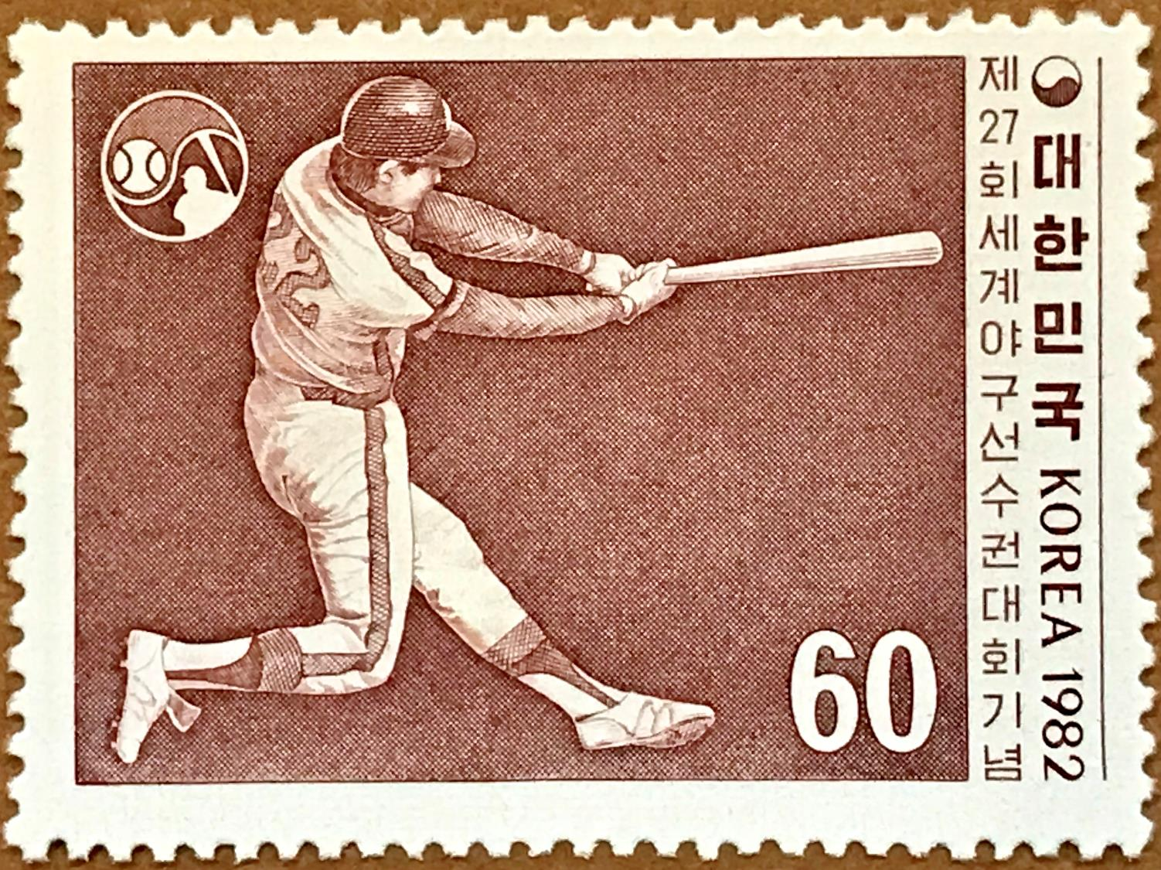
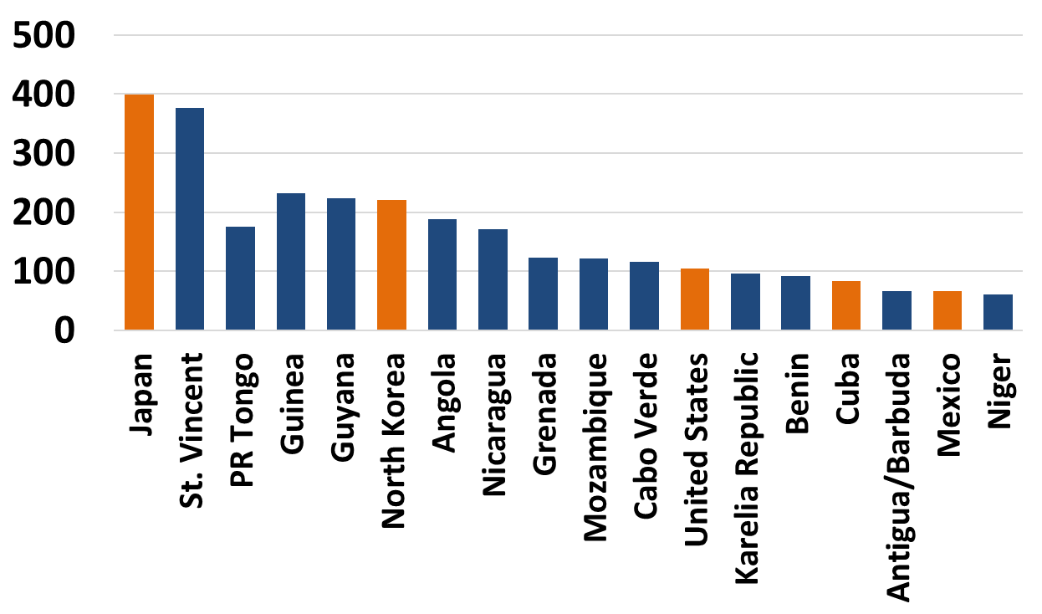
Stamps Issued by Country
Notes:
This next chart shows which countries are the biggest contributors to the baseball stamp production. These 19 countries produce just over 50% of all baseball stamps with the other 151 countries providing the rest. Most of the countries in this top 19 produce stamps merely for the sake of feeding the stamp collecting hobby. Many of them do not even print the stamps in their own country and those stamps never see the light of day in their ‘home’ country. They may not even be legal stamps for use in any postal system
These stamps are often referred to as ‘collector’ or ‘Cinderella’ stamps. It’s simply a money maker for these countries because they’ve all figured out that:
The world is full of stamp collectors
The world is full of baseball fans
A lot of stamp collectors are baseball fans and will pay money for stamps depicting baseball
The legitimate countries in this chart are Japan, North Korea, USA, Cuba and Mexico. Of all the 170 countries, I would guess that about 50 are legitimate countries and they’ve produced just under 1,200 stamps

Slide 8
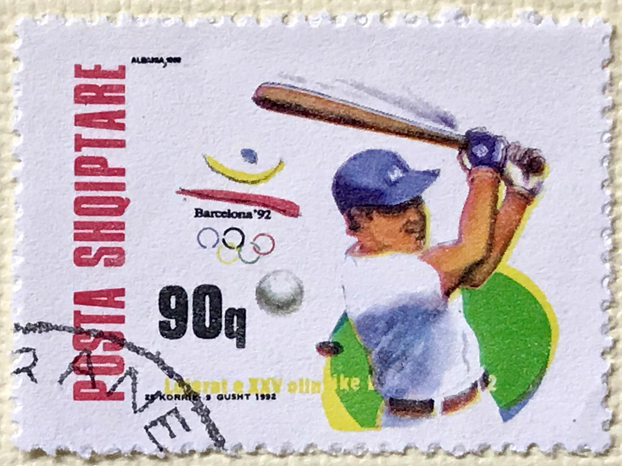
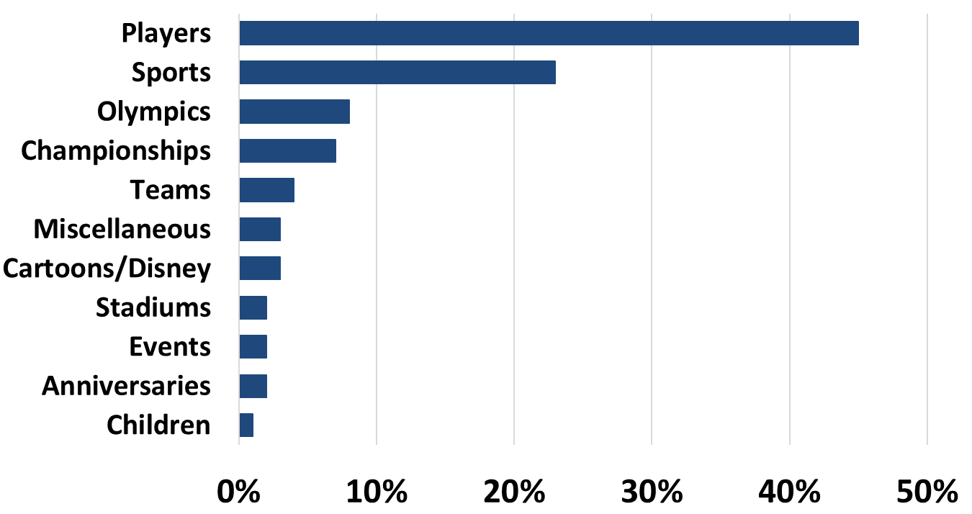
Stamp Topics
Notes:
Lastly, I went through the STP catalogue to see what the common topics are within baseball stamps
You can see here that almost 50% of stamps issued are about a specific player.
Next is sports in general of which baseball is included
The Olympics and various World Championships follow
The miscellaneous section includes women in baseball, softball, movies, baseball art and more.

Slide 9
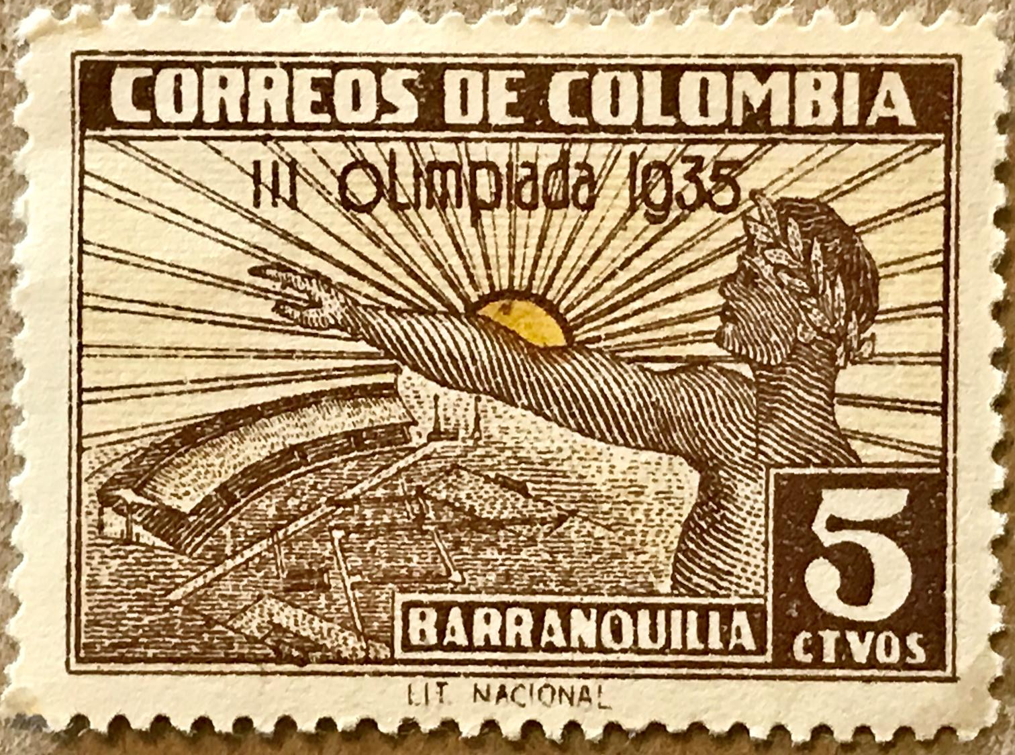
Notes:
Alright, back to baseball stories.
I’ll go through these roughly in chronological order but might bounce around a bit
The most difficult baseball stamp to find is this 1935 Colombia stamp
Unfortunately, there is very little information on the 3rd Olympics that are referenced on the stamp. It could have been a pre-Olympics games for qualification to the 1936 Olympics or just some regional games
In this stamp, you can see the baseball diamond and stadium stands

Slide 10
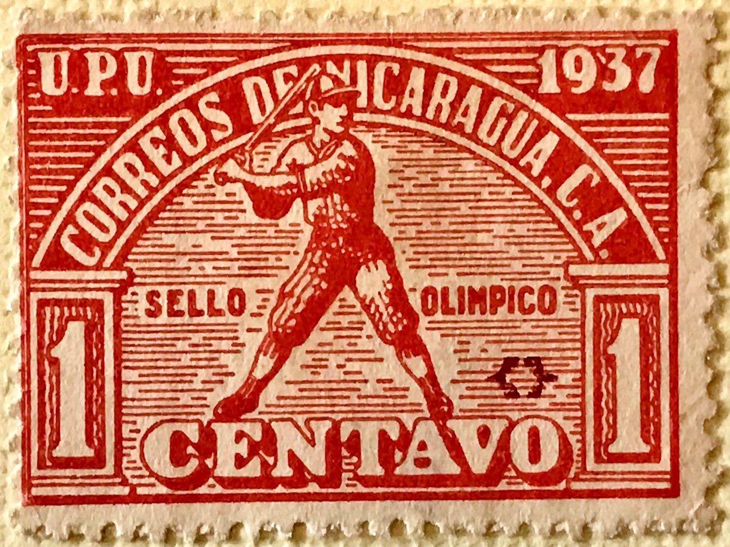
Notes:
This 1-centavo postal tax stamp produced in 1937 by Nicaragua celebrating the 4th Central American games was actually issued with the specific purpose to raise money for the Central American Caribbean Games
Again, unfortunately, very little information available on these Games which were held in Managua but baseball was a central theme in the Games.
A generic batter is shown on four different stamps. Each stamp has the same pose, but four different colors were used.

Slide 11
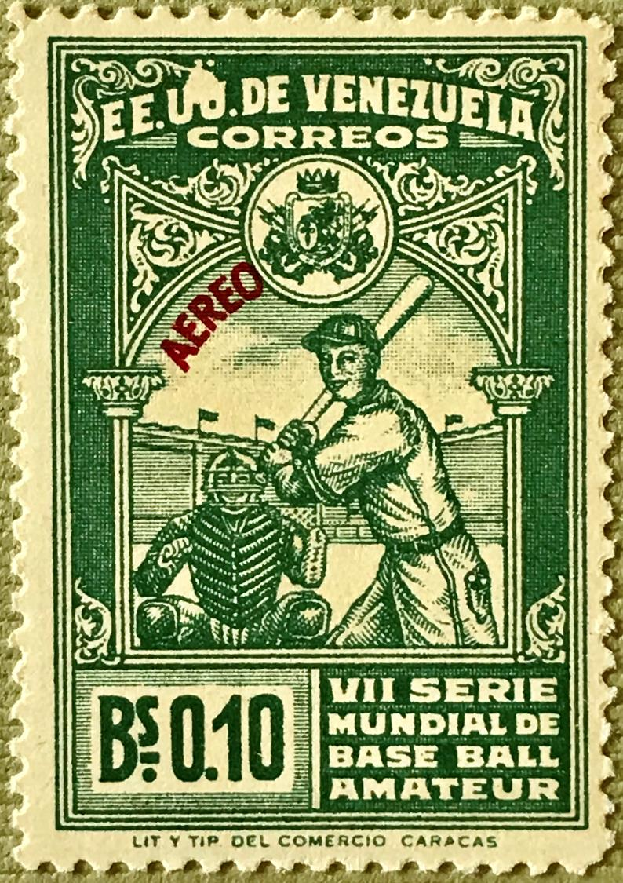
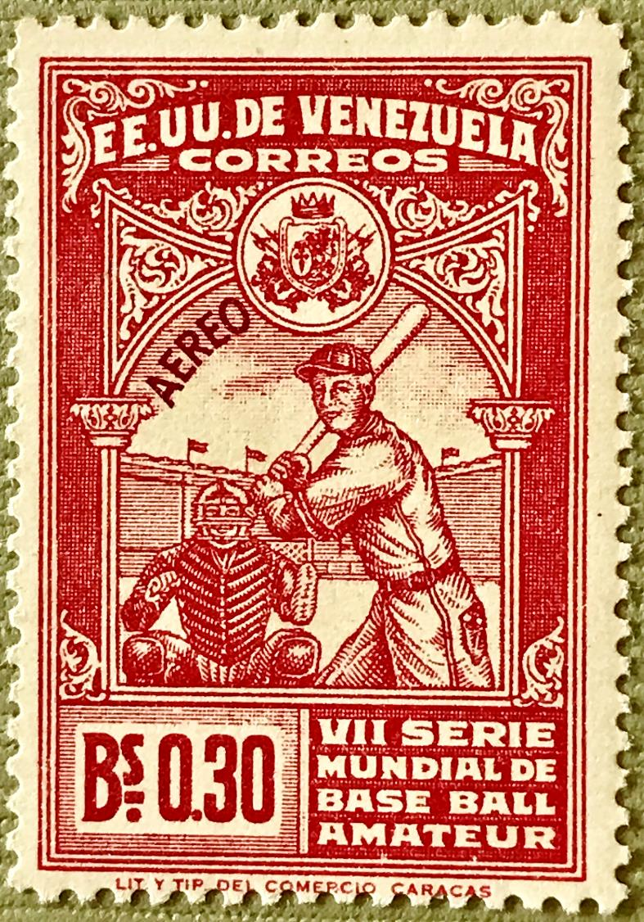
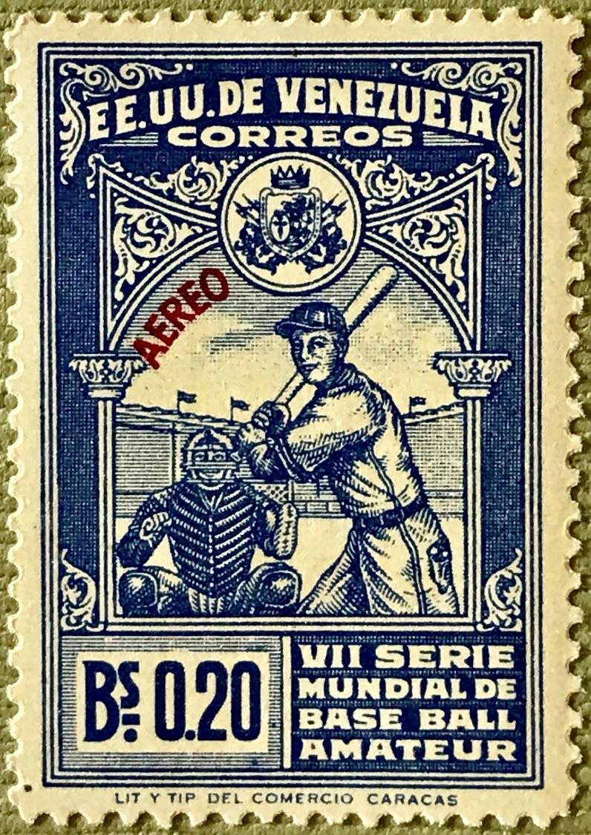
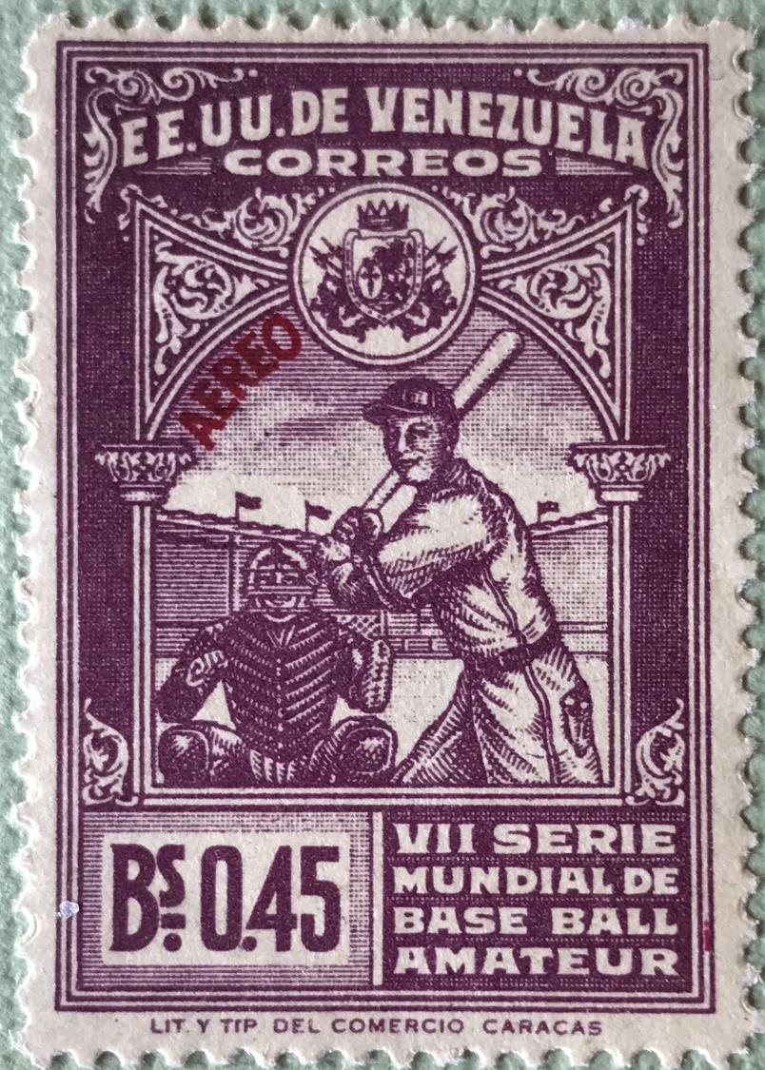
Notes:
In 1944, Venezuela heralded the 7th World Amateur Baseball Championship with nine airmail stamps, four of which are shown on this slide. These games have continued over the years and have led to the current Baseball World Cup.
Held in Caracas in October and November that year, there were 8 teams from 2 continents at these games. Venezuela won the tournament with Mexico, Cuba and Panama following in the standings. This tournament is remembered for a number of controversial umpiring calls.
The most remembered bad call took place in a Cuba–Venezuela game in the final phase of the event. After a Venezuelan player made an error during a close play at first, a photographer came over and threw the ball to one of the Venezuelan players, which led to an out. The Cuban manager protested the call and was told by the umpires that photographers were allowed to intervene in the play. Due to this, Cuba withdrew from the Cup and their remaining game was forfeited but they were credited with a third-place finish nonetheless.

Slide 12
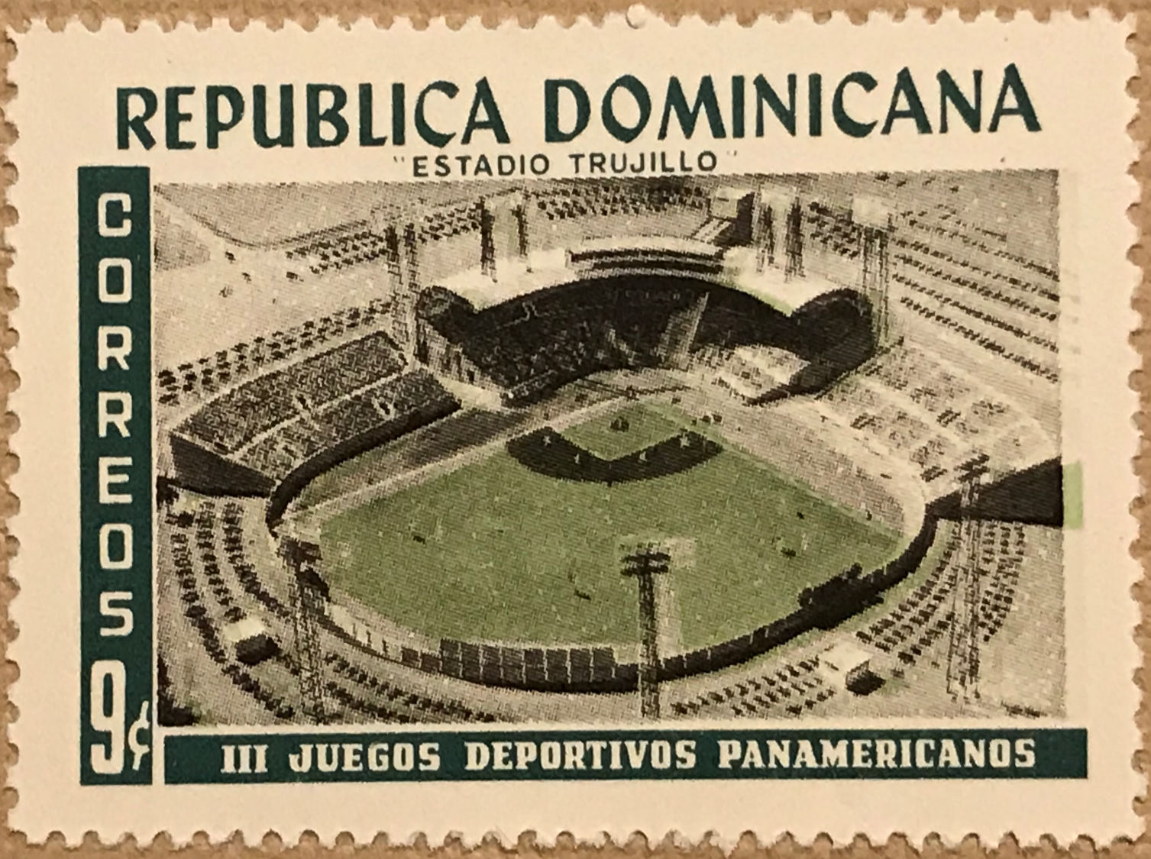
Notes:
The 3rd Pan American Games were held in Chicago in the months of August and September in 1959, the first Pan Am Games to be held in the northern hemisphere. Chicago stepped in after Cleveland had to back out for financial reasons and backup host Guatemala had also stepped away.
25 countries competed in 18 sports. Canada placed 5th in the medal count. Venezuela won it’s first and only baseball gold medal at these games
Although baseball games were played in Wrigley Field and Comiskey Park, this 1959 Dominican Republic stamp shows Estadio Trujillo named after their 30-year ruler and dictator Rafael Trujillo. The stadium was renamed Estadio Juan Marichal in 2009 after the Hall of Famer, the first Dominican player to be inducted

Slide 13
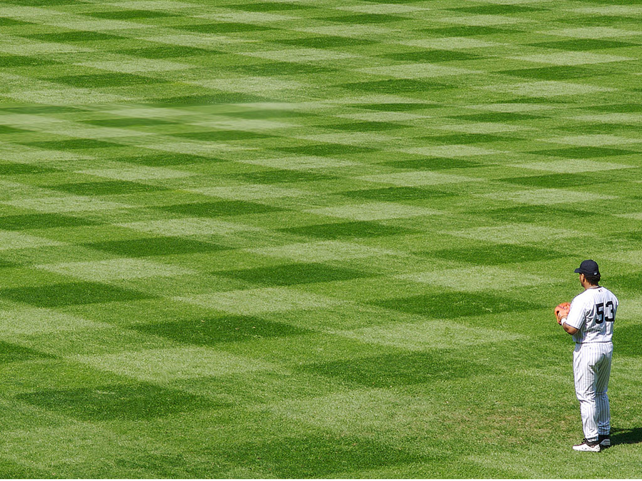
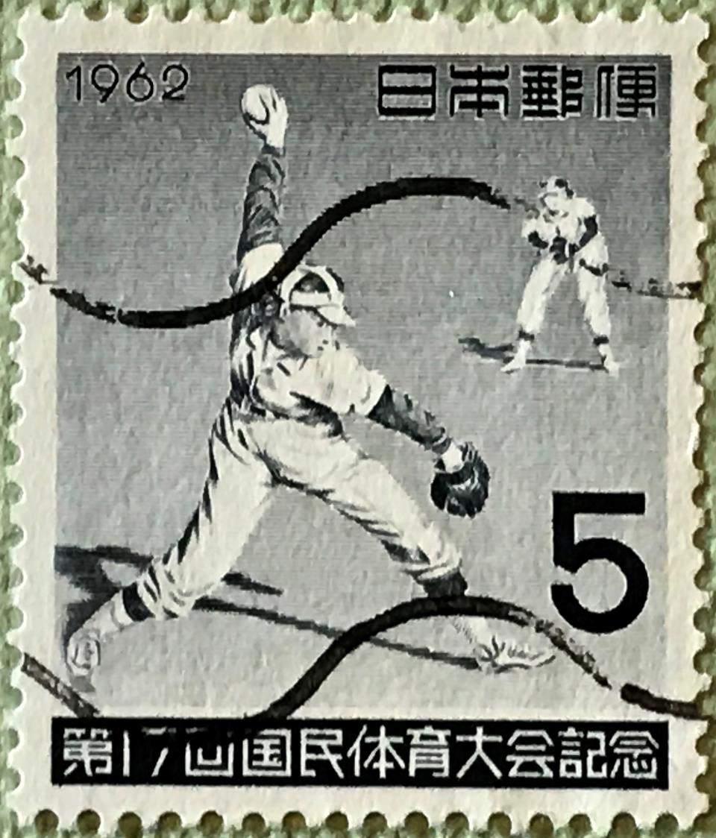
Notes:
I wanted to include this stamp, issued in 1962 by Japan, because it is one of the few baseball topical stamps that commemorates softball
The National Sports Festival of Japan is the national premier sports event in that country for youths and adults. It was started in 1946 and is held annually
As you can read on the bottom of the stamp, it is also referred to as the National Athletic Meeting and in 1962 they held the 17th edition of these games in Okayama
Softball and high school baseball are regular events but, depending on the region where the games are played, other types of baseball events may include mini softball, tee ball, senior softball, boys and girls softball and disabled softball

Slide 14
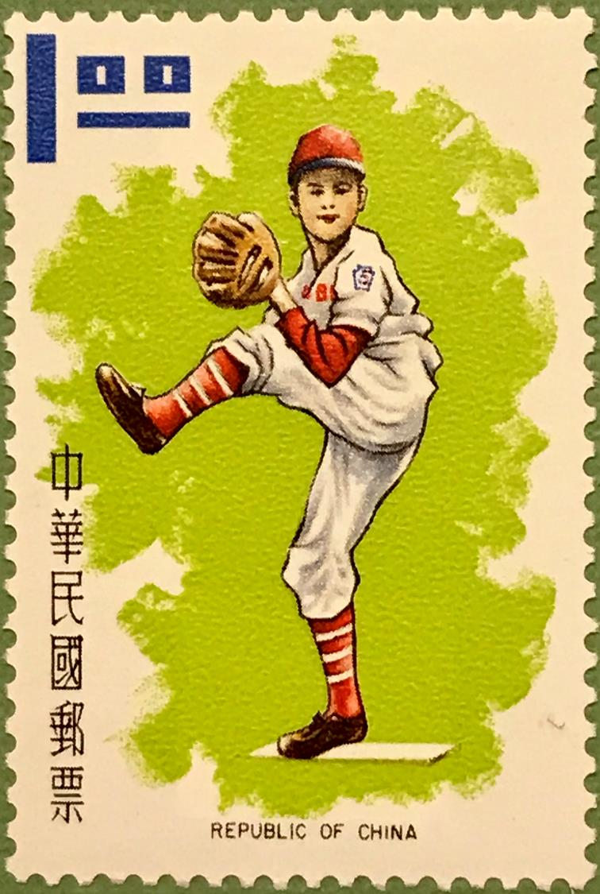
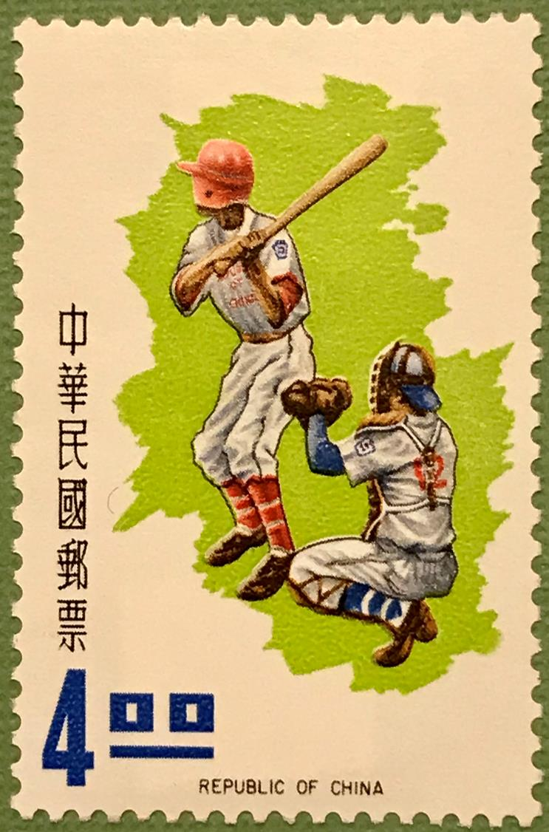
Notes:
TWO SLIDES - SLIDE #1
Taiwan, also known as the Republic of China (as opposed to the People’s Republic of China, who claims sovereignty over Taiwan) celebrated the 1971 Little League World Series which takes place in, of course, Williamsport, Pennsylvania.
The Tainan Little League of Tainan City, Taiwan, defeated the Anderson Little League of Gary, Indiana, in the championship game of the 25th Little League World Series.
Canada made it to the quarter finals to lose to Hawaii who eventually took third place over Spain.
TO SLIDE TWO

Slide 15
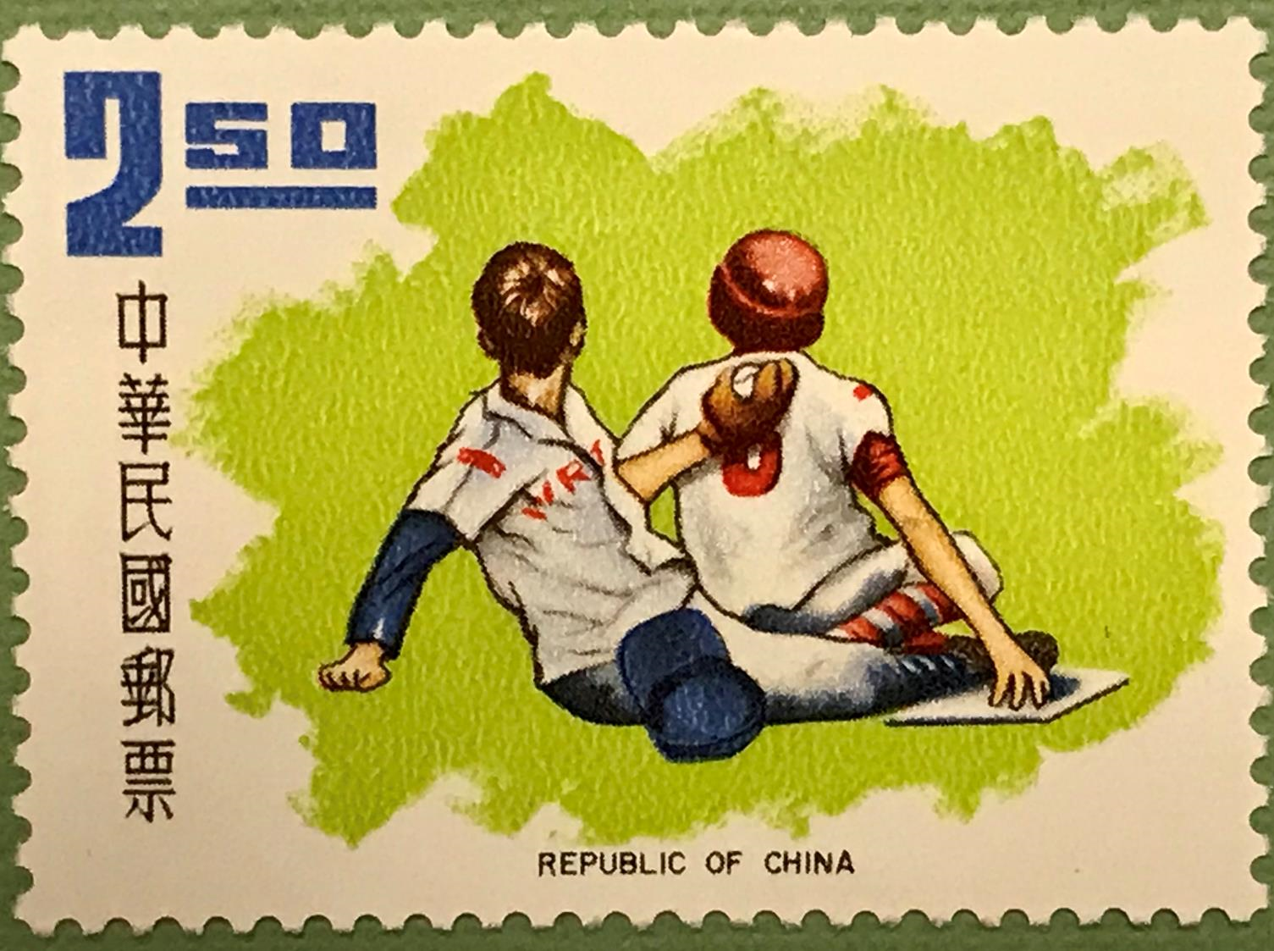
Notes:
SLIDE #2
This was the first championship game that was decided in extra innings. The game is the longest championship game in Little League World Series history.
Lloyd McClendon played for the Gary, Indiana team and hit 5 consecutive home runs in his 5 official at-bats. He was inducted to the Little League Hall of Excellence in 2006.
He played in the major leagues for 4 teams over 7 years and is currently the batting coach for the Detroit Tigers.

Slide 16
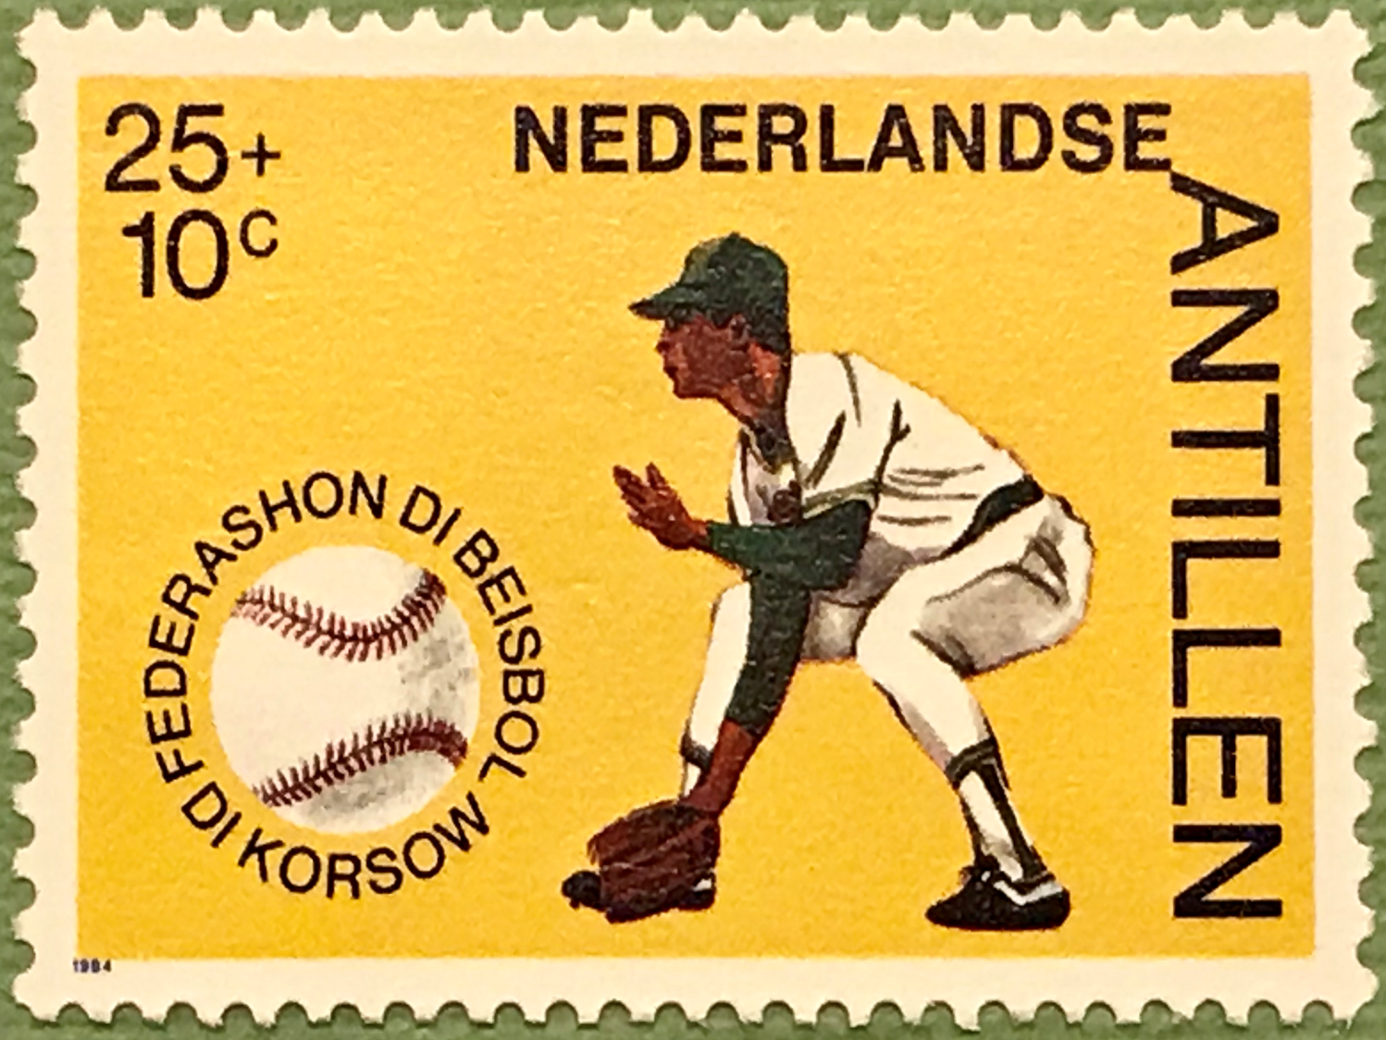
Netherlands Antilles, 1984
Notes:
FOUR SLIDES SLIDE #1
These next four stamps, issued in 1984, celebrate 50 years of the Curacao Baseball Federation.
Curacao can be found in the Caribbean just north of Venezuela and, back in 1984, Curacao was part of a group of islands called the Netherland Antilles or Dutch Antilles.
After the dissolution of the Netherland Antilles, it became an autonomous country within the Kingdom of the Netherlands in 2010.

Slide 17
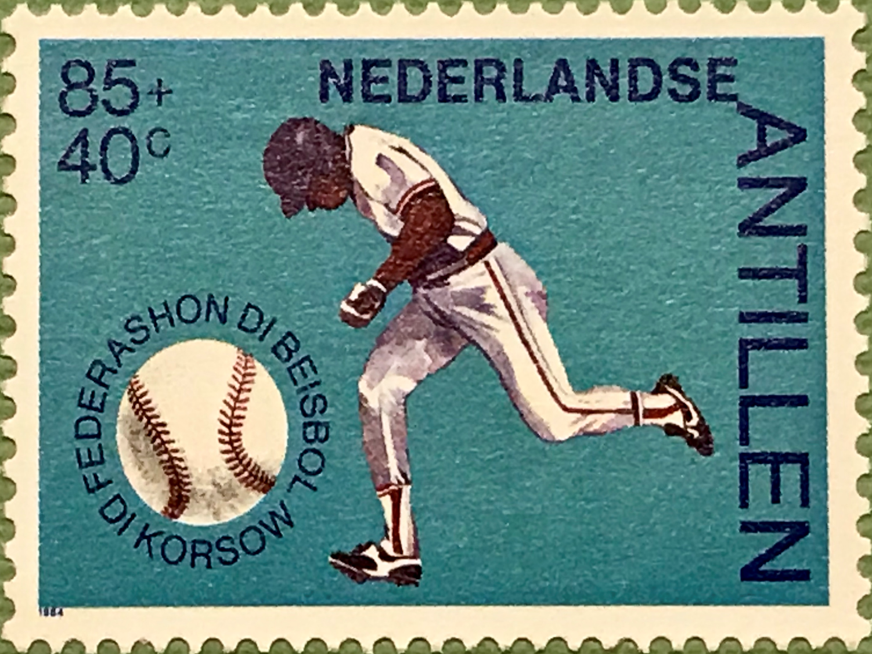
Netherlands Antilles, 1984
Notes:
SLIDE #2
Baseball has been played on Curacao for more than 80 years, reportedly dating to a game between Dominican labourers and Venezuelan fruit sellers.
But the island didn't send anyone to the big leagues until 1989, when the New York Yankees called up Hensley “Bam Bam” Meulens. Meulens played 12 seasons in the majors and also played in Japan and Korea. He is currently a bench coach for the San Francisco Giants

Slide 18
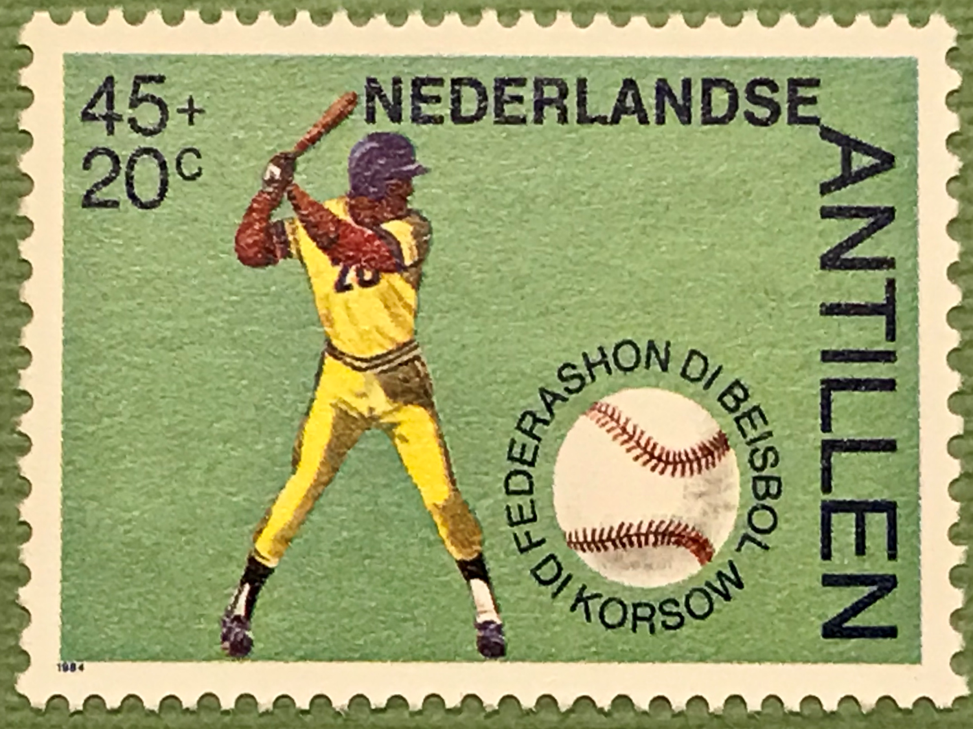
Netherlands Antilles, 1984
Notes:
SLIDE #3
Meulens helped open the way for Andruw Jones, who debuted as a teenager with the Atlanta Braves in 1996 and went on to hit 434 home runs, win 10 Gold Gloves and make five All-Star teams. Jones’ success led to a baseball boom on the island.
Interest further exploded after a team from Willemstad, which included Texas Rangers infielder Jurickson Profar, won the Little League World Series in 2004.

Slide 19
Notes:
SLIDE #4
Despite a population of just 160,000, Curacao has sent 14 players to the big leagues since 2000, the most per capita of any country.
Another interesting note is that baseball has its highest worldwide per-capita television viewership in Curacao.

Slide 20
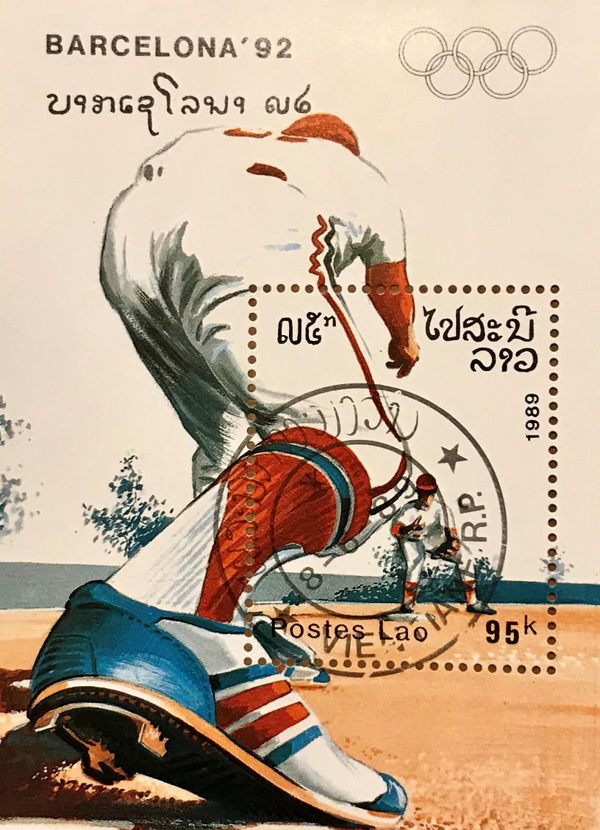
Notes:
Laos, officially the Lao People's Democratic Republic, is the only landlocked country in Southeast Asia at the heart of the Indochinese peninsula, bordered by Myanmar (also known as Burma) and China, Vietnam, Cambodia and Thailand. This stamp from Laos is one of many stamps celebrating the 25th Olympic Games held in Barcelona in 1992.
These Summer Olympics were the last to be staged in the same year as the Winter Olympics
Baseball had its debut as an official medal sport at the 1992 Olympics. Eight nations competed, with the preliminary phase consisting of a full round robin of all teams. Baseball was an event open only to male amateurs.
Cuba gold, Taiwan silver, Japan bronze
Canada did not participate in baseball Olympics that year.

Slide 21
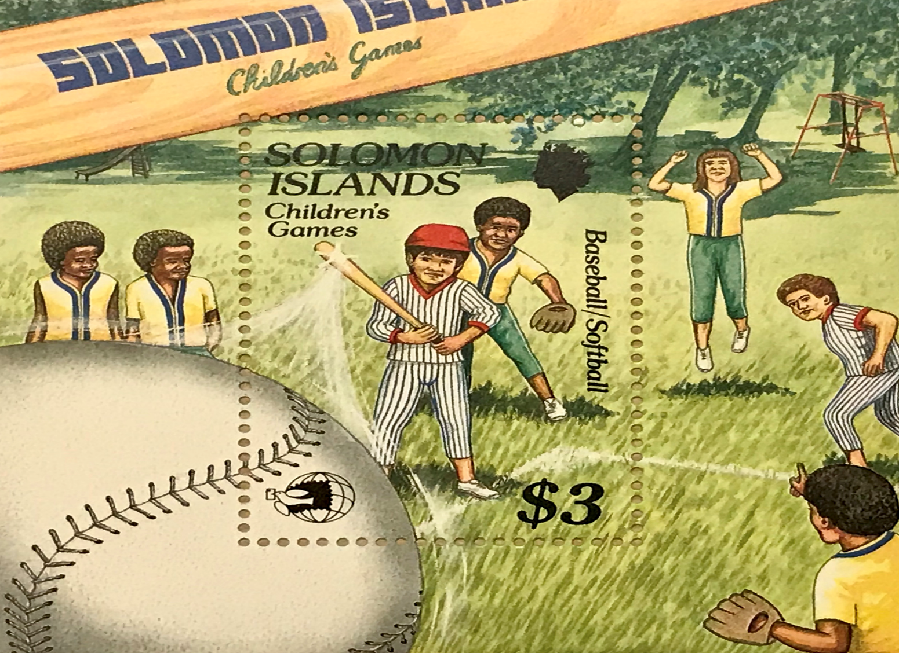
Notes:
The Solomon Islands is a 6 islands grouping east of Papua New Guinea. It is best known as the site of the Battle of Guadalcanal, a fierce battle between Japan and the USA during World War 2
The stamp is one of a group that focuses on children’s games.

Slide 22
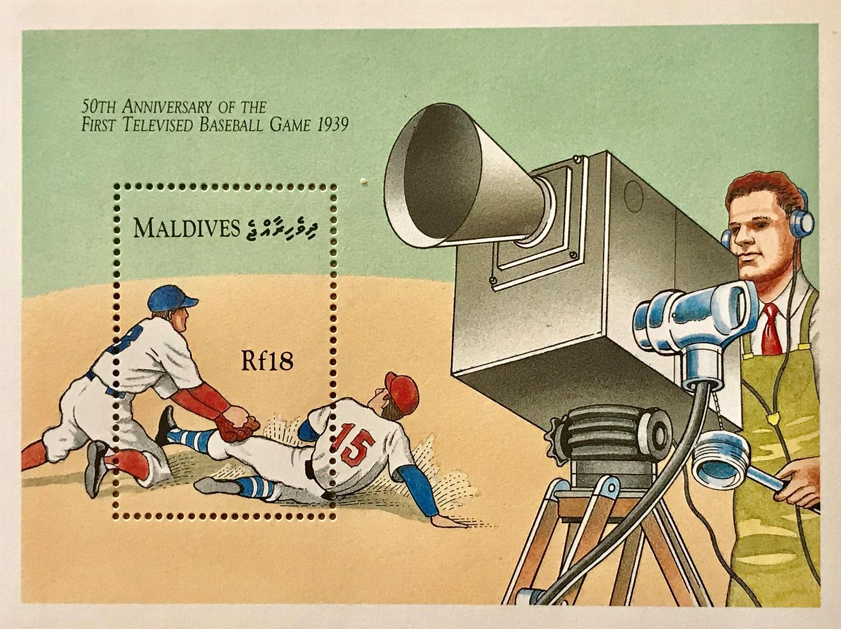
Notes:
The Maldive Islands are located in the Indian Ocean, situated in the Arabian Sea. It lies southwest of Sri Lanka and India and consists of a chain of 26 atolls
This is a fun stamp issued in 1989 that remembers the first televised baseball game on May 17, 1939. The game was held between U.S. universities Princeton and Columbia. Princeton beat Columbia 2–1 at Columbia's Baker Field. The contest was aired on NBC station W2XBS, an experimental station in New York City. The game was announced by Bill Stern. On August 26 of the same year, the first ever Major League Baseball game was televised (once again on W2XBS).
With Red Barber announcing, the Brooklyn Dodgers and the Cincinnati Reds played a doubleheader at Ebbets Field. The Reds won the first game, 5–2, while the Dodgers won the second, 6–1.
Barber called the game without the benefit of a monitor and there were only two cameras capturing the game. One camera was placed behind home plate, in the second tier of seating, while another was positioned near the visitors' dugout on the third-base side.

Slide 23
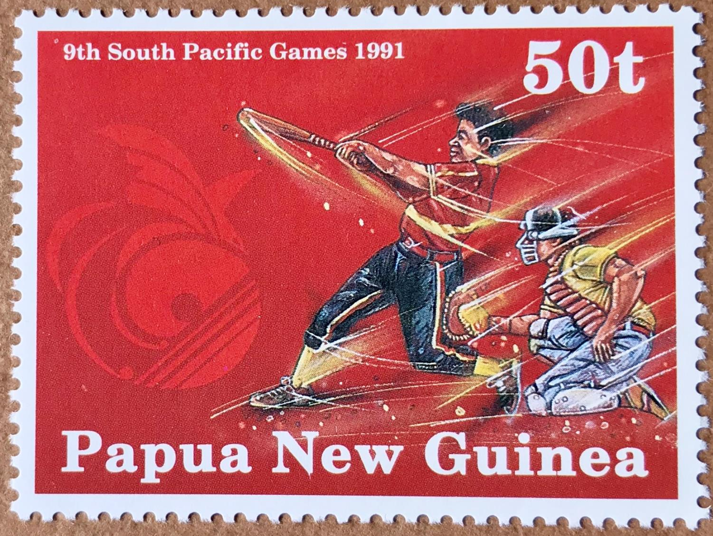
Notes:
The 1991 South Pacific Games, held in September of that year at Port Moresby and Lae in Papua New Guinea, was the ninth edition of the games
This was the first time that events at one games had been held in two cities. The decision to do so was to allow both locations to benefit from the construction of new facilities.
Sixteen Pacific nations participated in 17 sports and 164 medal events in these Games
Papua New Guinea won the gold medal in softball
They also won most medals in the games followed by French Polynesia and New Caledonia

Slide 24
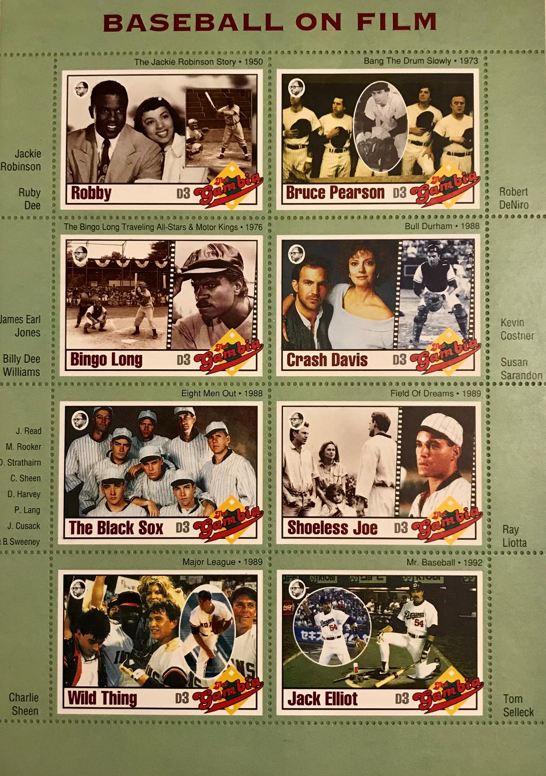
The Gambia, 1993
Notes:
THREE SLIDES SLIDE #1
Officially the Republic of The Gambia, this is a country in West Africa that is almost entirely surrounded by Senegal with the exception of its western coastline along the Atlantic Ocean. It is the smallest country within mainland Africa.
Gambia is one of the big producers of cinderella or collector stamps.
They have produced a few souvenir sheets remembering many of the great baseball movies that have been made over the years…

Slide 25
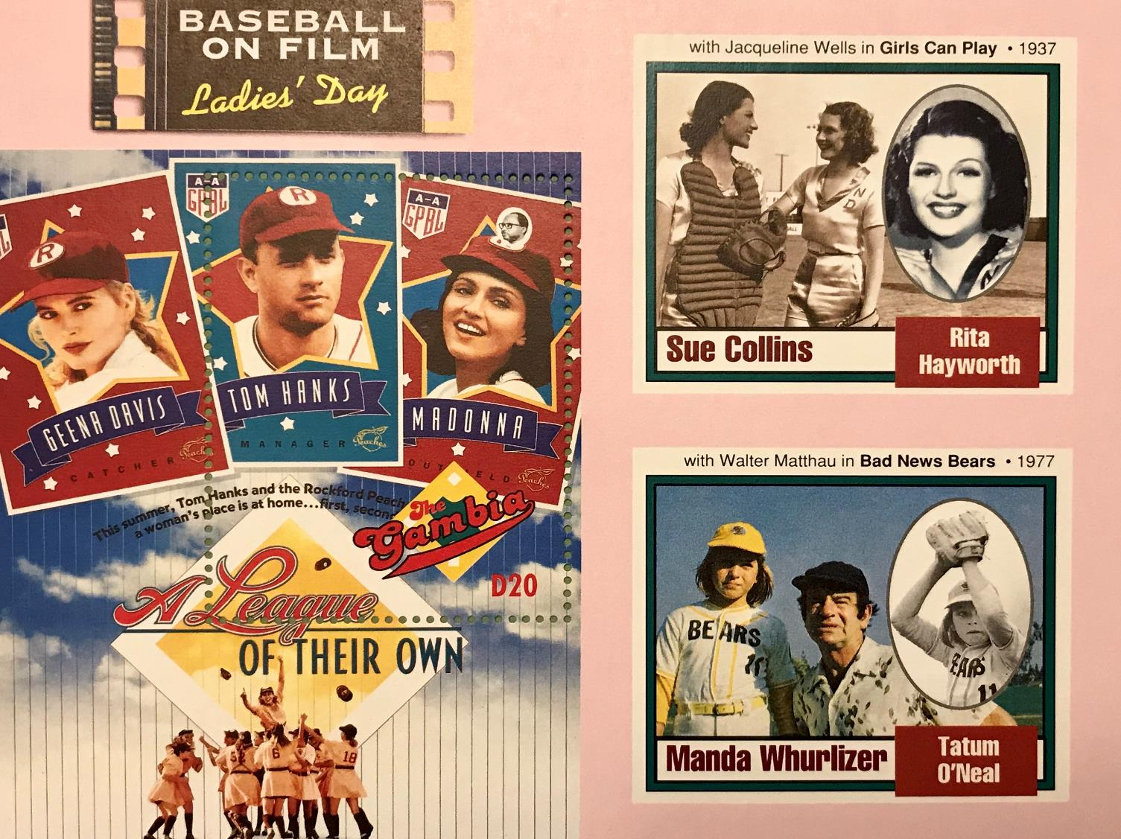
The Gambia, 1993
Show two sheets
Notes:
SLIDE #2
….. the actors that performed in these movies and in some cases, …..

Slide 26
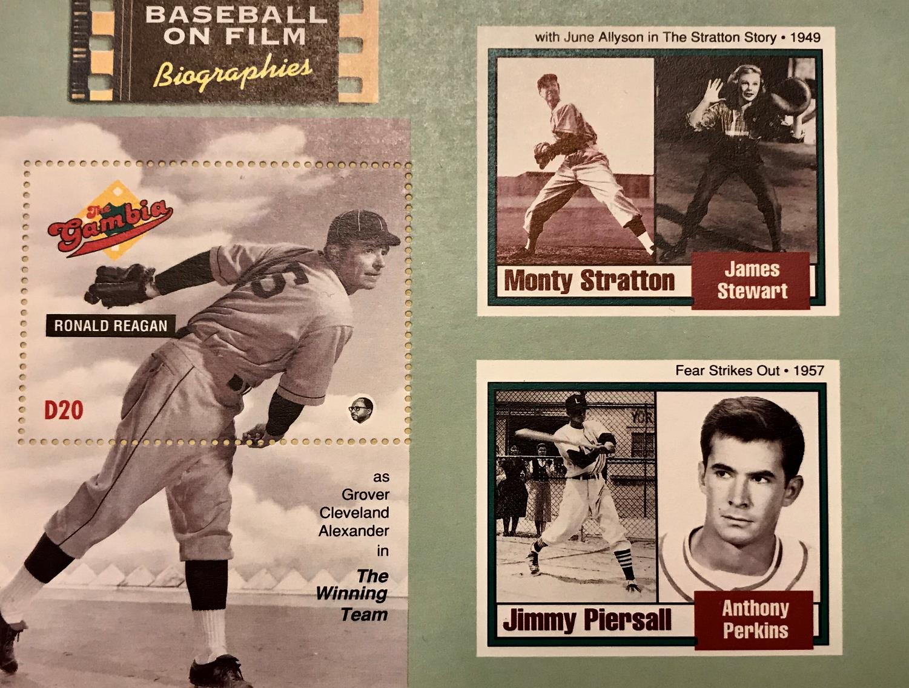
The Gambia, 1993
Show two sheets
Notes:
SLIDE #3
….. and in some cases, the events and the real people and players in the history of the game.

Slide 27
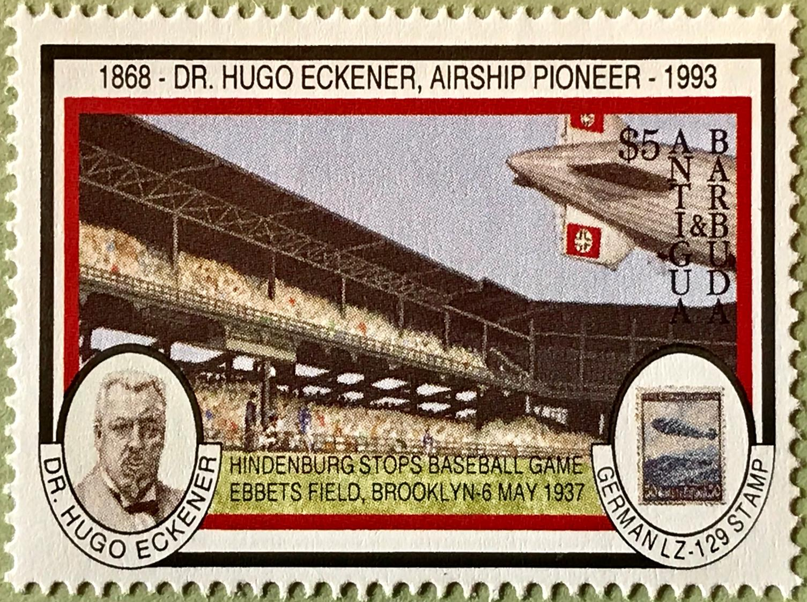
Notes:
Antigua and Barbuda is a sovereign state in the West Indies lying between the Caribbean Sea and the Atlantic Ocean. It consists of these two major islands, Antigua and Barbuda, and a number of smaller islands.
This is an interesting stamp issued in 1993 noting an Ebbets Field game in Brooklyn on May 6, 1937. It’s called the Hindenburg Game. It also recognizes Dr. Hugo Eckener, an important designer, builder and commander of rigid airships such as the Zeppelin and the Hindenburg. The game at Ebbets Field in 1937 began as a pitcher’s duel. The Pirates couldn’t post a hit off of Van Lingle Mungo through the first five innings. Likewise, Red Lucas was taming the Dodgers.
As the two teams battled on the field, the players and fans suddenly gazed skyward. Several fans began to rise and point to the sky as the mammoth Hindenburg came into view. Its silvery color showed the reflection of the sun peeking through the clouds. The bright red and black swastikas on its tail end gleamed as it hovered less than 1,000 feet over the field. And then the ship headed south for its destination in Lakehurst, New Jersey. The excitement that had carried the day turned to shock and disbelief with the news that the famous Hindenburg exploded and crashed to the field in Lakehurst taking the lives of 35 of its 97 passengers and crew and one member of the ground crew and basically ending the era of passenger airship travel.

Slide 28
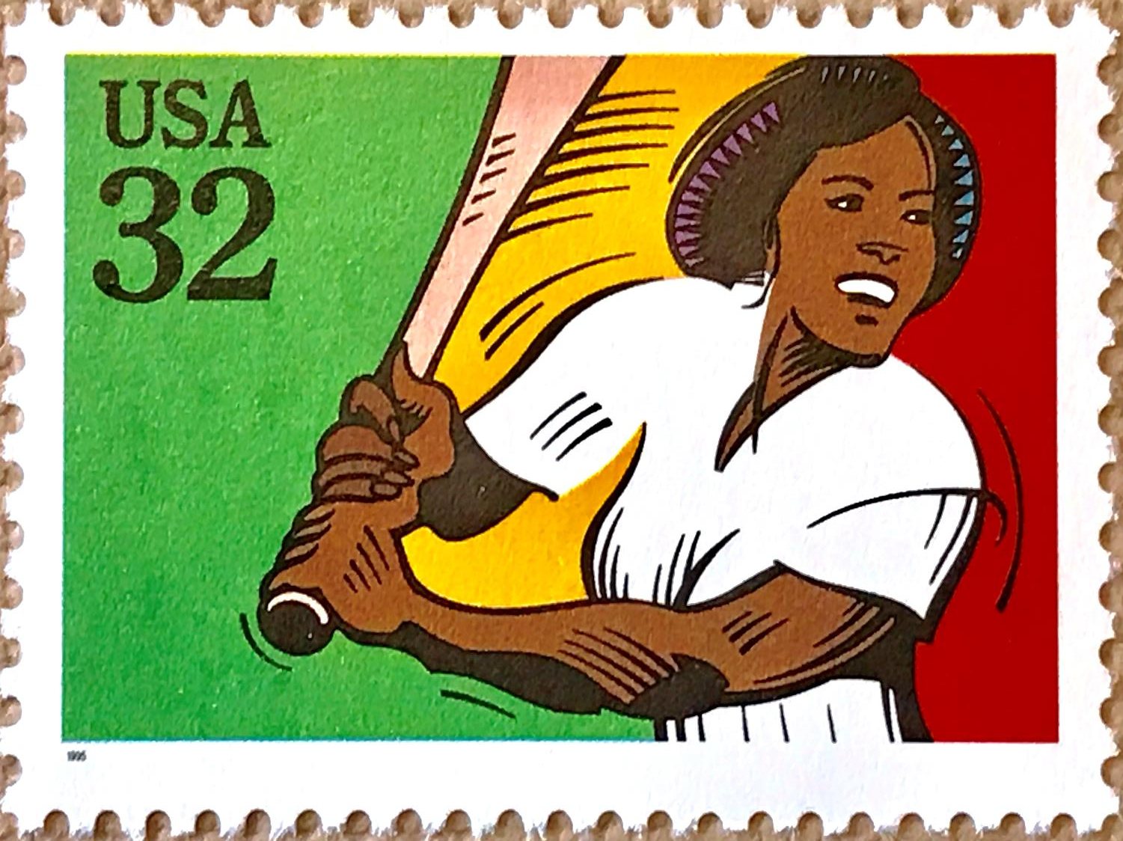
Notes:
These next three stamps will focus on depictions of women in baseball and including them has scored me big points with my two daughters who still play the game.
This stamp from the United States in 1995 doesn’t have much of a story but recognizes women’s softball in a stamp called ‘Recreational Sports’

Slide 29
Notes:
Another United States stamp is this 1996 issue for the 1996 Olympic Games in Atlanta.
Women’s softball made its debut at these Games. It stayed around for three more Olympic Games but was removed in the 2012 and 2016 games. It will be added, along with baseball, in the 2020 games.
The softball games were held in Columbus, Georgia (approximately 100 miles from Atlanta). Countries competing included the Canada, China, Australia, Japan, the United States, Taiwan, the Netherlands and Puerto Rico. The United States finished first, China second and Australia third. Canada placed 5th with a 3 and 4 record in round robin play.

Slide 30
Notes:
The 1998 ISF (International Softball Federation) Women's World Softball Championship was held in July of 1998 in Fujinomiya, Japan and is noted in this Japanese stamp.
A fourth straight title was won by the team from the United States, which avenged its only loss of the tournament to Australia by a 1-0 margin in the final.
Canada was 6-0 after the round robin portion of the tournament but went 1-2 after that and did not qualify for the medal round.
17 teams competed.

Slide 31
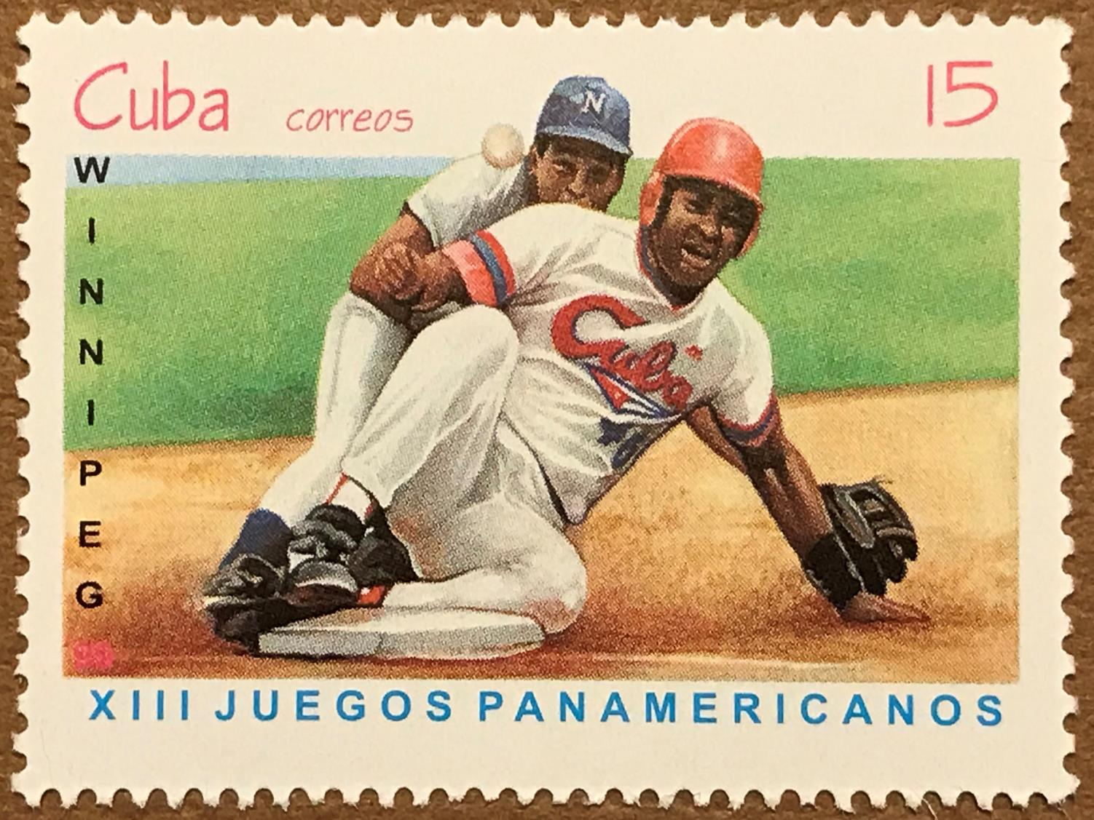
Cuba, 1999
Notes:
2 SLIDES - SLIDE #1
These next two stamps from Cuba and the Dominican Republic celebrate the 13th Pan American Games held in Winnipeg, Manitoba in 1999. The games were held in July and August with approximately 5,000 athletes from 42 nations participating in 34 sports. The 1999 Games were the second Pan Am Games hosted by Canada and Winnipeg. Previously, Winnipeg had hosted the 1967 Pan American Games.
Both baseball and softball were played in these games. The 1999 Games were the first time professional baseball players were allowed to participate. The primary venue for the baseball competition was CanWest Global Park. Stonewall Quarry Park was used a secondary venue.
Cuba gold, USA silver, Canada bronze

Slide 32
Notes:
SLIDE #2
Men’s and Women’s softball was played at the John Blumberg Softball Complex.
Canada’s men won gold over USA and Cuba
Canada’s women’s team won silver behind USA and ahead of Cuba

Slide 33
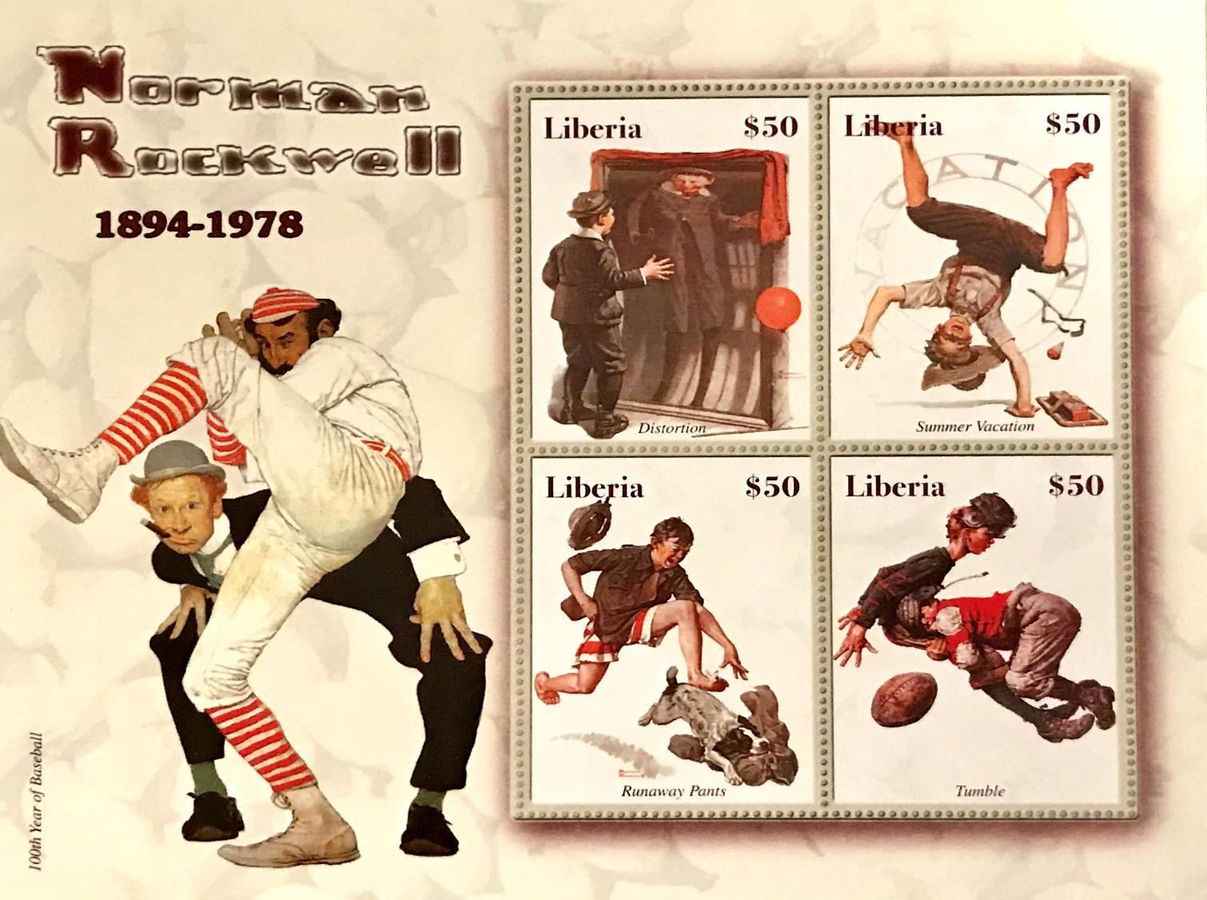
Liberia, 2005
Notes:
This stamp was mentioned in the programme notes for this presentation with the question: “Was Liberia celebrating Norman Rockwell or baseball (or both) in their 2005 stamp?”
As it turns out, the answer is “both”.
There are five Rockwell paintings in this souvenir sheet --- four in the stamps and one in the large border. The stamp in the border is entitled “100 years of baseball” as noted in the bottom left corner. Rockwell was commissioned to create this painting in honour of that anniversary.
The other stamps are called Distortion, Summer Vacation, Runaway Pants and Tumble.
Liberia, a country on the West African coast bordered by Sierra Leone, Guinea, Ivory Coast and the Atlantic Ocean, has issued 15 stamps pertaining to baseball over the years.

Slide 34
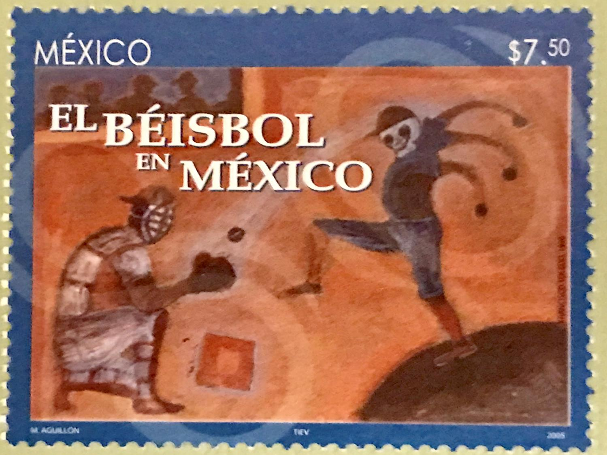
Notes:
2 SLIDES SLIDE #1
No real story to this stamp called “El Beisbol en Mexico”. I just had never seen a painting of a 3-armed, skull-headed pitcher before.

Slide 35
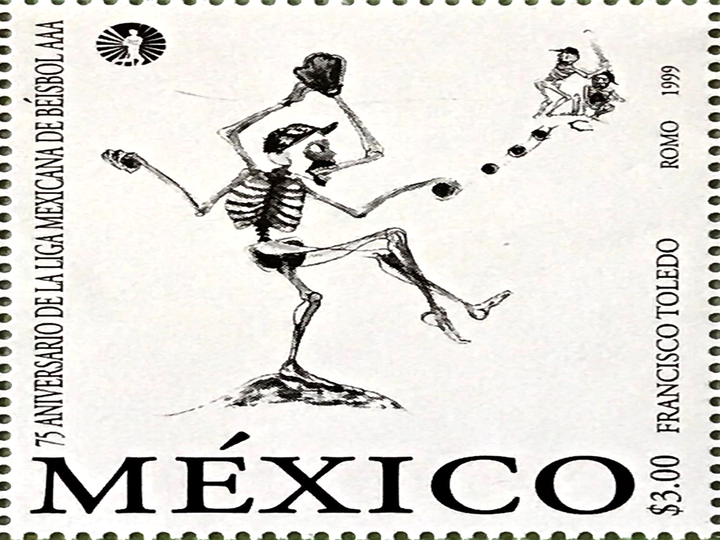
Notes:
SLIDE #2
Also not sure about this picture also from Mexico, but there seems to be a theme of skulls and bones

Slide 36
Notes:
The United States postal service did some good in 2010 by issuing two stamps remembering Negro Leagues Baseball.
The baseball league that helped spark integration of American professional sports was honoured on a 44-cent U.S. postage stamp first issued at the Negro Leagues Baseball Museum in Kansas City, Missouri.
The stamp pays tribute to the all-black professional baseball leagues that operated from 1920 to about 1960.
From part of a speech at the unveiling ceremony in Kansas City, it was noted that “In 1920, the first of several black leagues of the modern era was formed right here in Kansas City. It was called the Negro National League. With the issuance of these stamps, the rich legacy of the Negro Leagues will travel far and wide.”
A second commemorative stamp features the league’s founder, Andrew “Rube” Foster, who is considered the “father” of Negro Leagues Baseball. In 1981, Foster was honoured by the National Baseball Hall of Fame as the “foremost manager and executive” of Negro Leagues baseball.
Artist Kadir Nelson designed the stamps. A book of his artistry called “We Are The Ship, The Story of Negro Leagues Baseball” was also released at the same time as the stamps. A copy of the book can be seen on the table.

Slide 37
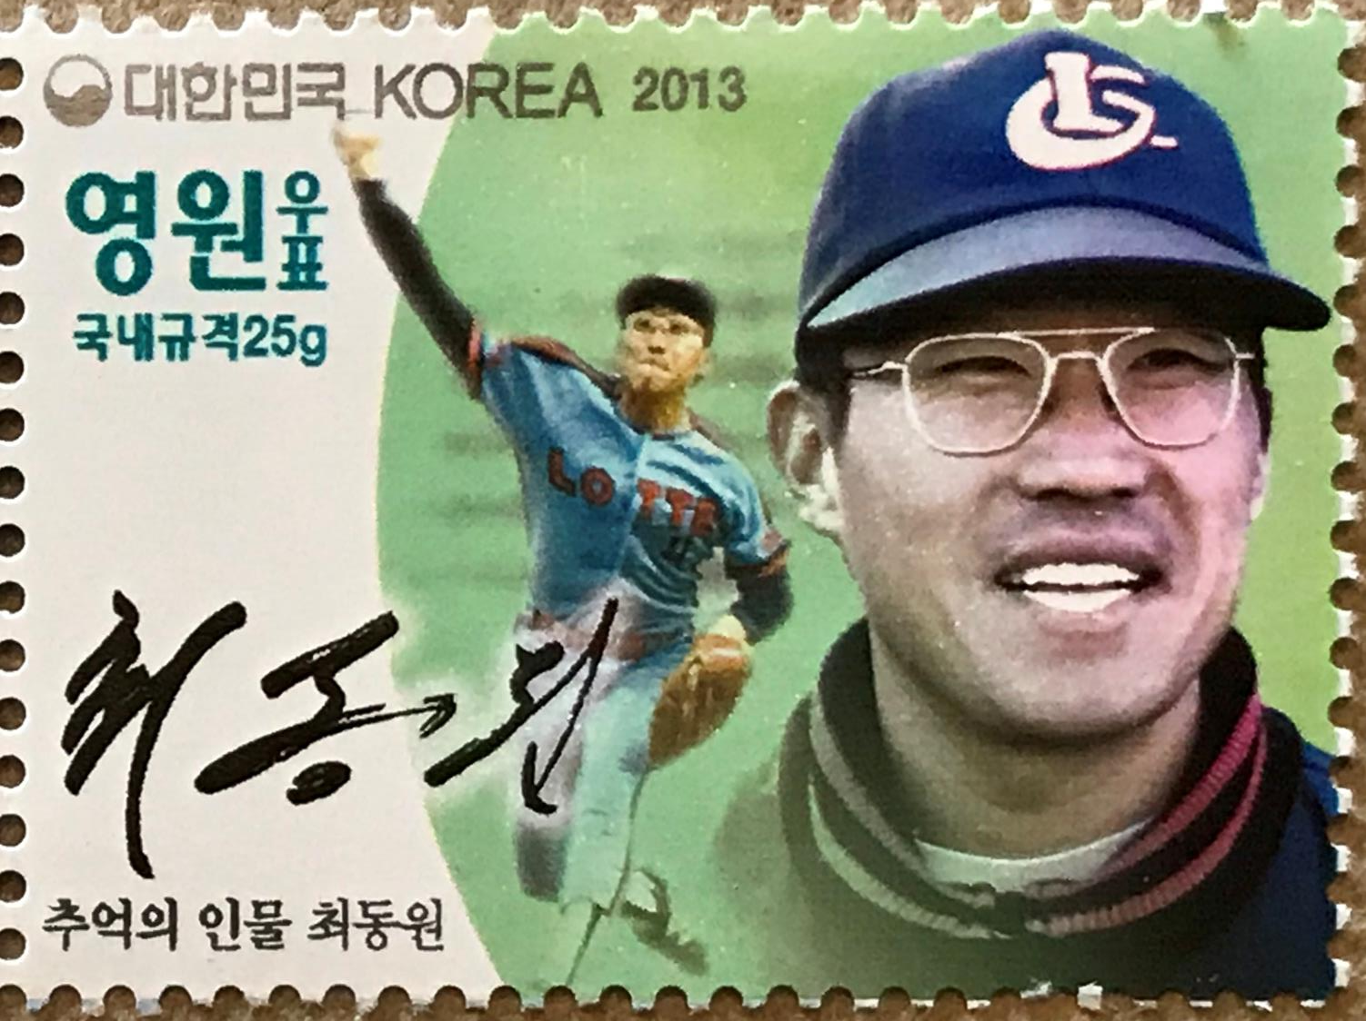
Notes:
South Korea issued two stamps in 2013 for two of their baseball stars --- Choi Dong Won and Jang Hyo-Jo. Choi Dong Won was a South Korean pitcher in the Korean Baseball Organization (KBO) League who played for the Lotte Giants and Samsung Lions. Choi batted and threw right-handed.
After impressive performances at the 1981 Intercontinental Cup in Canada, the Toronto Blue Jays showed a strong interest in Choi, regarding him as having the potential to play in the big leagues immediately. The Blue Jays' scouts went to see Choi in South Korea six times before signing him to a major league contract reportedly worth around $250,000.
Meanwhile, South Korea was in the process of forming its own professional baseball league. When the government discovered Choi was heading to Toronto, it threatened to jail the scouts if they tried to leave the country with the contract. The Blue Jays planned on bringing Choi to their spring training for the 1983 season, but the government intervened again.
Choi was given a choice: serve a mandatory military commitment before going to Canada, or pitch in the Korean professional league and have his military service waived. Choi eventually opted for the latter, after playing in the 1982 Amateur World Series. Choi was selected by the Lotte Giants in the first round of the 1983 draft and was later traded to the Samsung Lions. He retired in 1990.

Slide 38
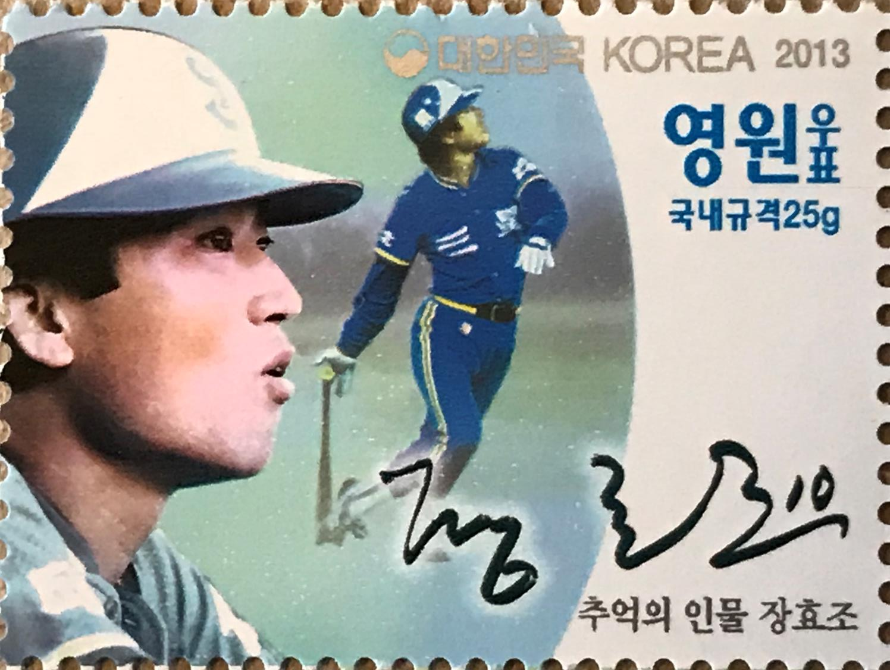
Notes:
The other South Korean honouree was Jang Hyo-Jo, a South Korean outfielder in the Korean professional baseball league who played for the Samsung Lions and Lotte Giants. Jang batted and threw left-handed.
Jang is widely regarded as one of the best KBO hitters for average of all time. He still holds several records including the highest career batting average (.331) and most career batting titles with 4. He played for the Samsung Lions starting in 1983 but was traded to Lotte Giants for Choi Dong Won, the player on the other stamp. He played until 1992
Unfortunately, both men died of cancer in September of 2011 while both in their 50’s.

Slide 39
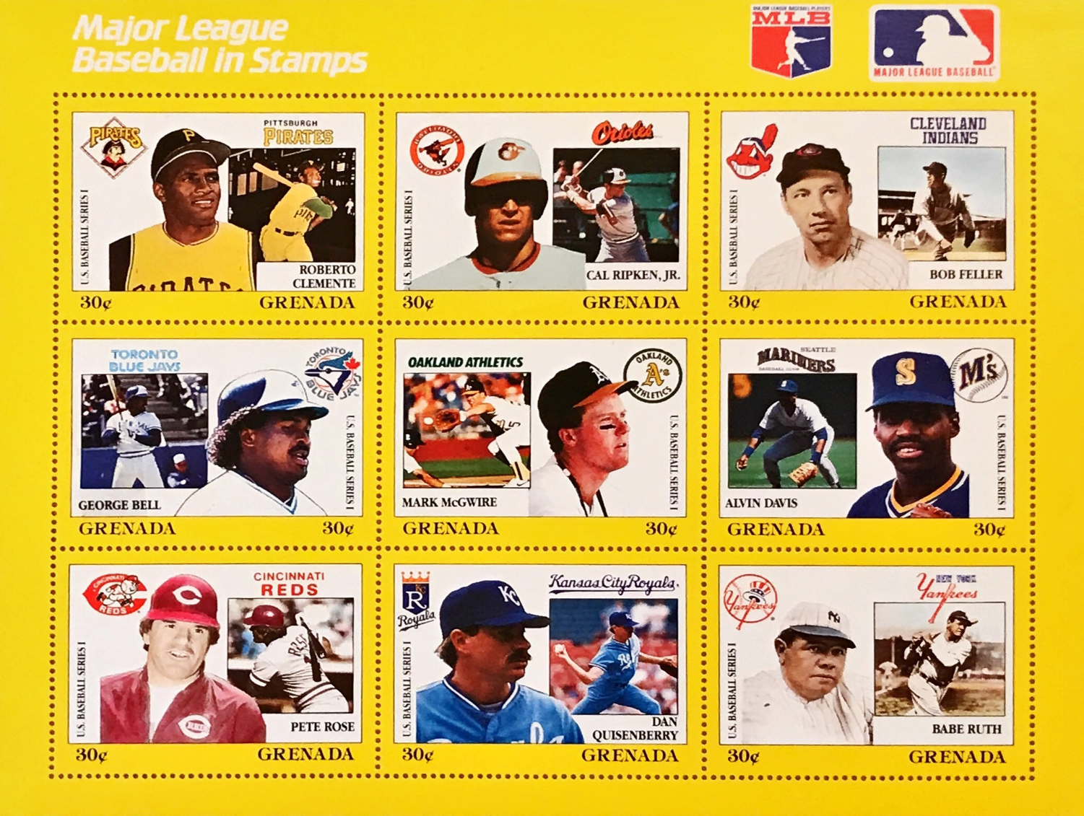
Grenada, 1990
Notes:
2 SLIDES SLIDE #1
And now we get into some baseball politics and postage stamp hand slapping. In November 1988, Grenada, a very big contributor to Cinderella baseball stamps, issued 81 stamps picturing United States baseball players, in nine souvenir sheets of nine stamps each. Pete Rose was pictured on one stamp, in the lower left-hand corner of one of the sheets as shown here.
Major League Baseball, who had given permission to the stamp development company, Philatelic International, to use their MLB logo, asked the company to remove Rose, who was banned from baseball after the major league investigation concluded that he had bet on baseball games. This stamp was issued just a few months after the MLB decision, so it was an even more sensitive subject at the time than it remains to be today.
So Grenada and Philatelic International created a very subtle solution for this problem.

Slide 40
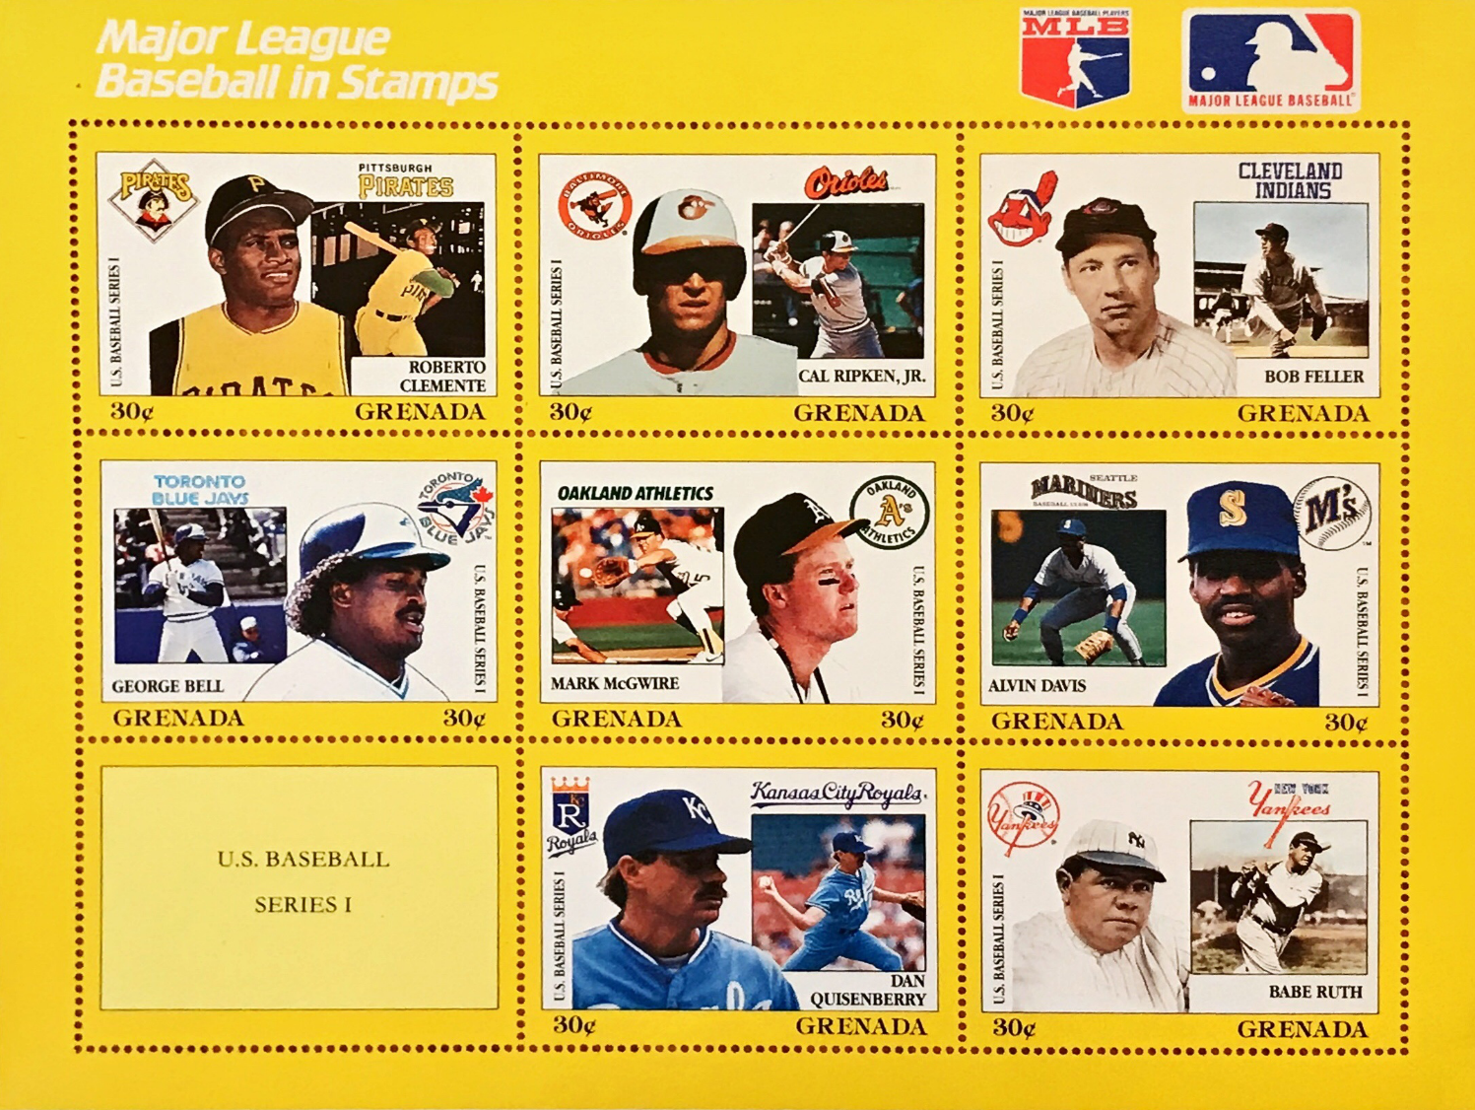
Grenada, 1990
Notes:
SLIDE #2
They made new a souvenir sheet. The new sheet has a yellow space where the Rose stamp was, with the words ''U.S. Baseball Series 1'’ entered in the middle of the space. Problem solved!!
As you can imagine, baseball postage stamp collectors clamoured for copies of the original sheet for their collections.

Slide 41
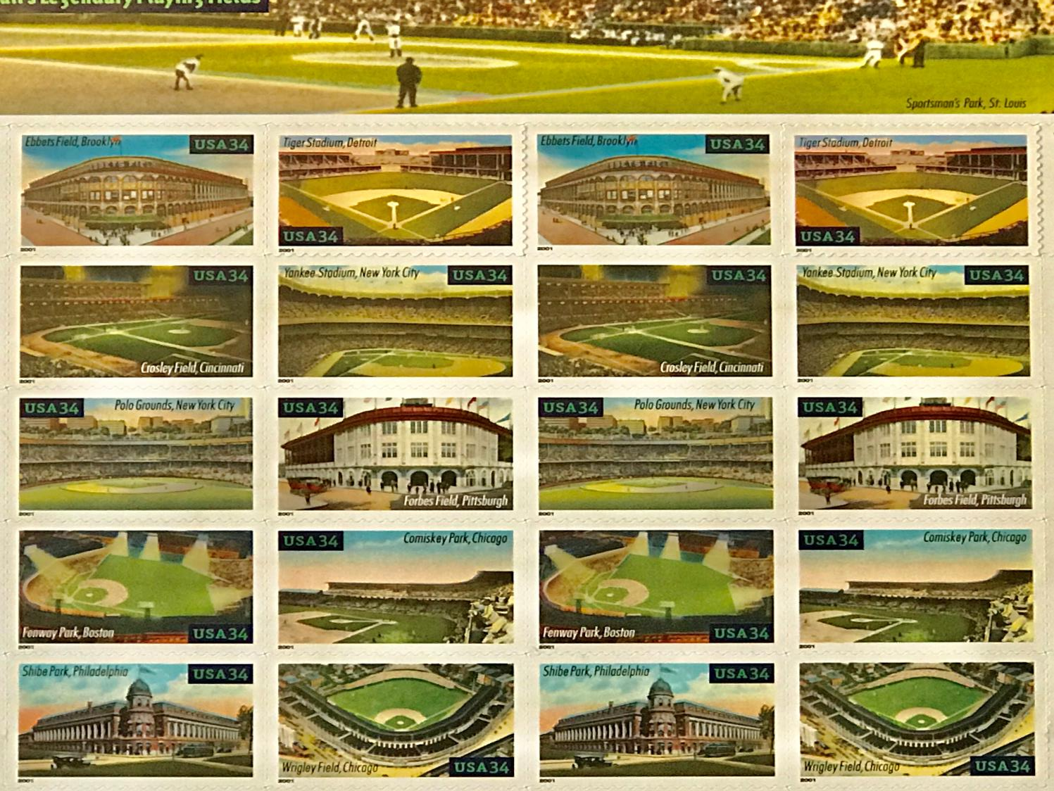
Notes:
2 SLIDES SLIDE #1
I’ve had the good fortune to watch games at almost 50 major league ballparks over the years so I had to include this souvenir sheet called Baseball’s Legendary Playing Fields.
The US Postal Service issued ten 34-cent commemorative stamps in 2001 with images of some of the classic ballparks built in the early 1900’s. There were official unveiling ceremonies at each of the 10 cities with the first ceremonies held at each “still standing” stadium on the same day. Tiger Stadium, Fenway Park, Wrigley Field, Yankee Stadium.
The stamps were unveiled at Fenway, Wrigley and Yankee in pre-game ceremonies.

Slide 42
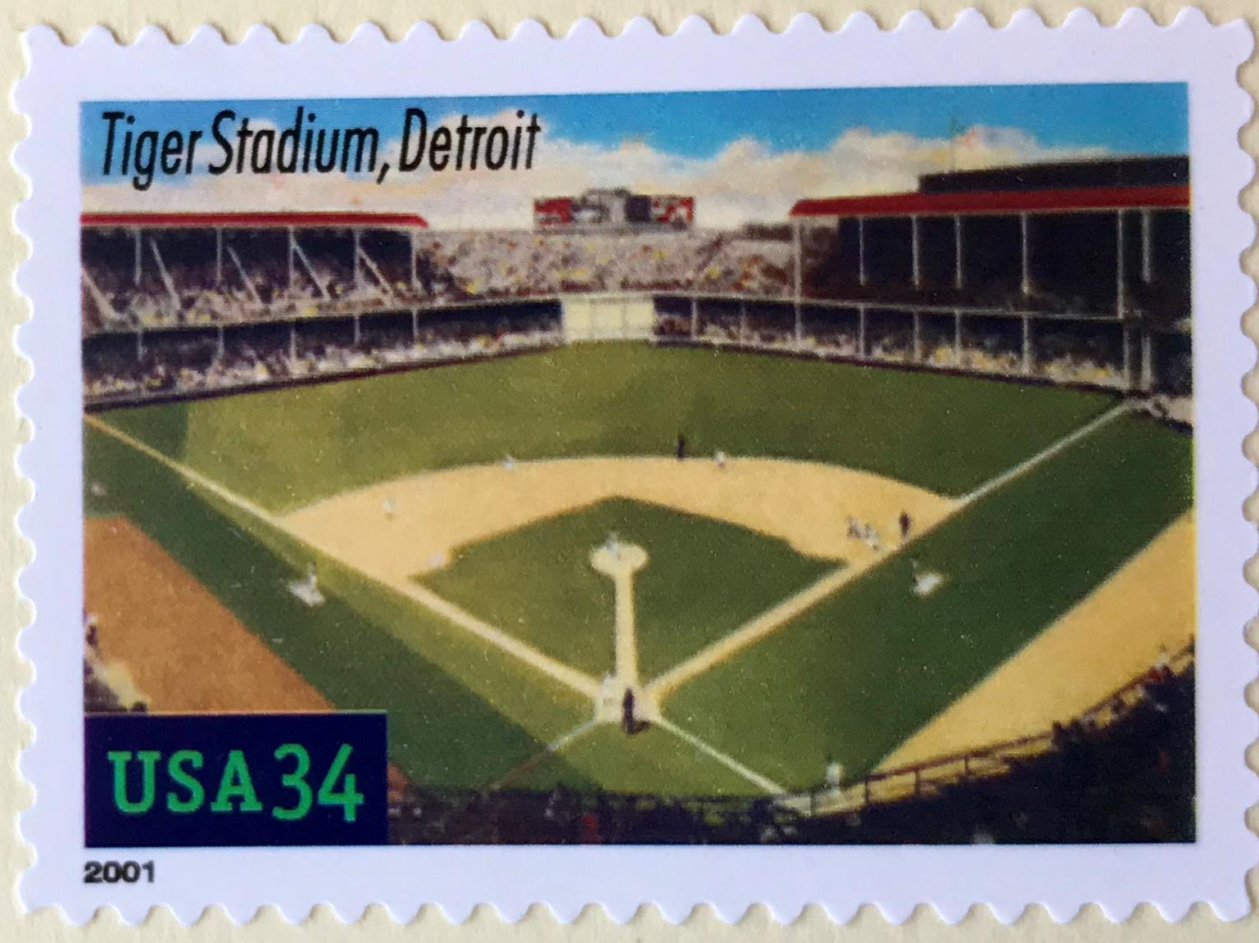
Notes:
SLIDE #2
Since Tiger Stadium was no longer in use in 2001, the unveiling took place at the park in the morning of the same day.
The ceremony, for some reason, was not open to the public. Maybe for safety reasons at the closed stadium. Attending were former Detroit Tiger greats Gates Brown, Mickey Lolich, and my favourite Tiger, Willie Horton.

Slide 43
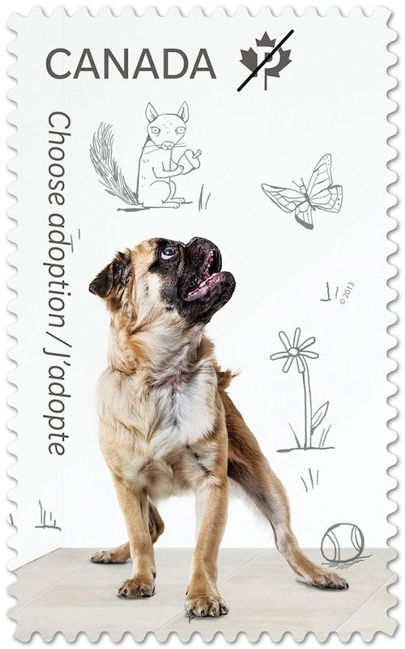
Notes:
I’ll now focus on the 6 baseball postage stamps issued here in Canada.
I’m going to get one very minor example out of the way first because it is barely a “baseball stamp” and secondly, it’s all about dogs and I’m not a dog lover.
Canada issued an “Adopt A Pet” stamp on April 22, 2013.
Note the baseball on the floor.
That’s all I want to say about that.

Slide 44
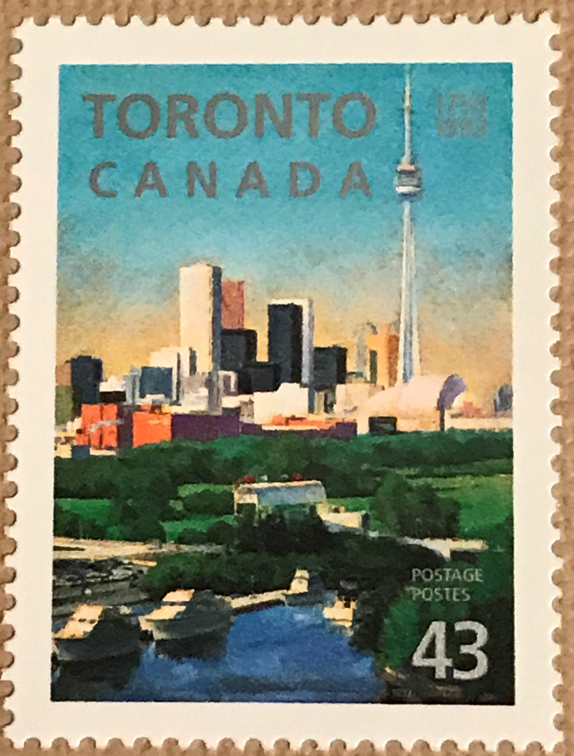
Notes:
Canada issued a commemorative stamp on August 6, 1993 to recognize the 200th anniversary of the City of Toronto.
Included in the picture is Skydome (now named Rogers Centre) , the home of the Toronto Blue Jays.

Slide 45
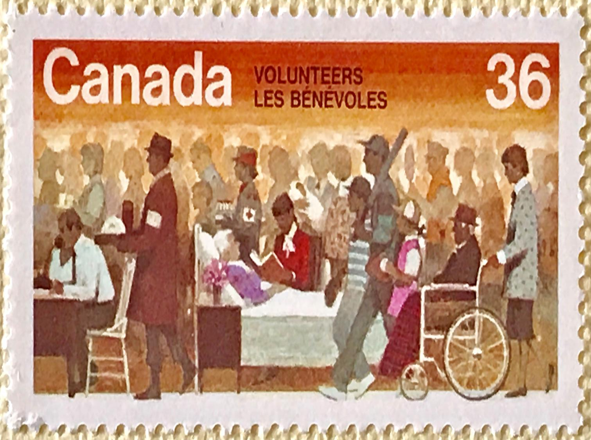
Notes:
Every year some 3,000,000 Canadians do volunteer work.
Canada applauded these great people during National Volunteer Week in May 1987.
Volunteer baseball coaches and league organizers and Moms and Dads who all help out kids baseball leagues all over the country are included in the stamp picture with the man carrying a bat walking with the girl holding a ball and glove.
So, as mentioned near the start of this presentation, these are three examples of stamps that are not meant to be about baseball, but there is something related to baseball in the stamp picture so it is included in the baseball ‘topical’ category.

Slide 46
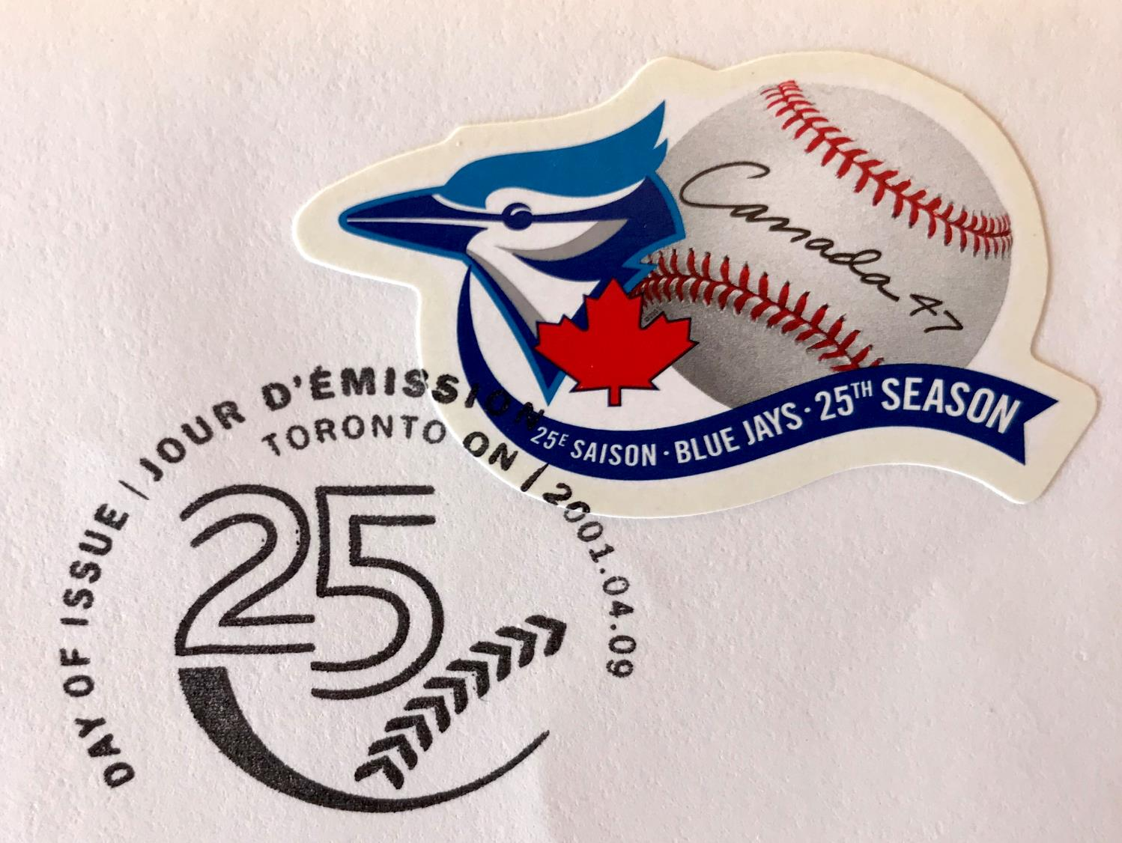
Notes:
To commemorate 25 years of Toronto Blue Jays baseball and outstanding team spirit, Canada Post commissioned renowned designer Paul Haslip to produce a stamp that is a celebration of the team's accomplishments.
Paul's design combines several elements of baseball tradition, including a photographic rendition of a ball, as well as the Blue Jays' 25th anniversary logo. "This led to the idea of having the "Canada 47" in the same style as a player's signature”.

Slide 47
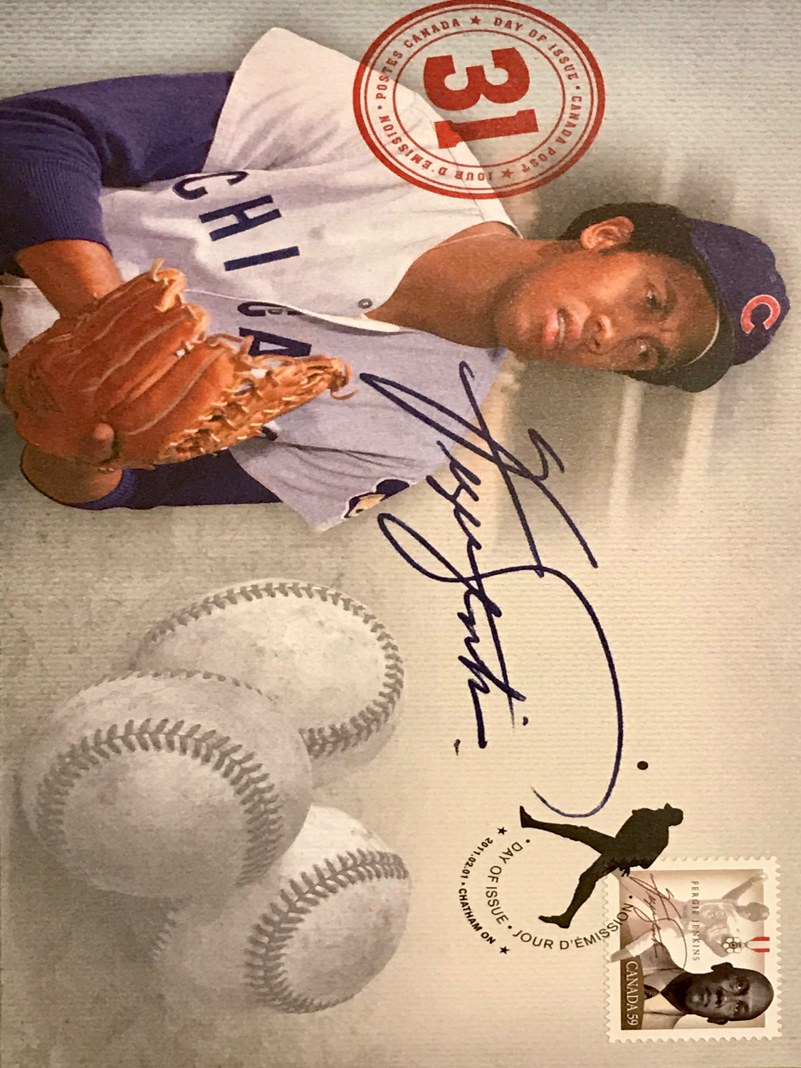
Notes:
2 SLIDES SLIDE #1
Everyone knows Fergie Jenkins and his story, and Canada honoured him as part of Canada Post’s Black History Month issue.
Ferguson “Fergie” Jenkins was born on December 13, 1942, in Chatham, Ontario. He excelled at sports in school and played bantam baseball as a teenager and was eventually signed by the Philadelphia Phillies in 1962.
Fergie would go on to pitch for the Phillies, Cubs, Rangers and Red Sox between 1965 and 1977.

Slide 48

Canada, 2011
Notes:
SLIDE #2
He was inducted into the Canadian Baseball Hall of Fame in 1987 and is the only Canadian honoured so far in the National Baseball Hall of Fame in Cooperstown (1991).
Stamp designer Lara Minja notes “The determination, strength, integrity and pride of Fergie Jenkins are the attributes I aspired to bring to this stamp. The design balances a more recent depiction with an image from the past. A photograph of a more mature Jenkins is overlapped by an image of him on the pitcher’s mound. The stamp incorporates the Order of Canada icon, as well as the name and signature of Jenkins to personalize the design.”

Slide 49

Notes:
What baseball event was honoured in the Czech Republic?
Stamp issued in 2005 to celebrate the European Baseball Championship which was held in the Czech Republic (Praque)
12 teams participated including Czech.
Won by Netherlands over Italy

Slide 50

Notes:
What’s with Marty Cordova’s face on a 1999 Rwanda issue? 1999 collective sheet called Sports Stars of the 20th Century included two baseball players --- Derek Jeter and Marty Cordova. I can maybe see Jeter on this (although not a fan of him) but never heard of Marty Cordova.
He was an American former professional baseball left fielder, who played in Major League Baseball (MLB) for the Minnesota Twins, Toronto Blue Jays (played 62 games in 2000), Cleveland Indians, and Baltimore Orioles.
He was the American League Rookie of the Year in 1995, and mostly injured between 1997 and 2000, so why was he selected to be on a stamp in 1999?

Slide 51

Notes:
Why did Ajman create a stamp for George Sisler in 1969?
Ajman: the emirate of Ajman in the United Arab Emirates, located along the Persian Gulf.
Ajman honoured baseball greats in a 6 stamp set called the Champions of Sport, including Ty Cobb, Babe Ruth, Honus Wagner, Stan Musial, Joe DiMaggio and George Sisler.
Sisler played 15 seasons (1915-30) mostly with the St. Louis Browns, batting .340 lifetime with 2812 total hits. He held the record for most hits in a single season (257) in 1920 until that record was broken by Ichiro Suzuki (262) in 2004.

Slide 52

Notes:
The final Canadian baseball stamp is called Baseball In Canada, 1838 – 1988. As has been presented and discussed in previous conference presentations, the first recorded baseball game was played in Beachville, Ontario, on June 4, 1838. The Beachville game was played a year earlier than the more publicized American game held at Cooperstown, New York.
The stamp was introduced on September 14, 1988 at Olympic Stadium in Montreal. Canada Post Chairman Sylvain Cloutier said “over the past century and a half, baseball has become part of the Canadian heritage, part of the way we live and the way we play”. Cloutier presented a special replica of the stamp to Expos Manager Buck Rogers and Allan Lewis of the Canadian Baseball Hall of Fame which was then located at Ontario Place in Toronto.
On field presentations were also made at Exhibition Stadium in Toronto by Donald Lander, Canada Post President to Jays Manager Jimy Williams and Randy Eckland of the Hall of Fame.

Slide 53

Notes:
So back to the line “played a year earlier”. The United States issued a stamp called “Centennial of Baseball” in 1939. The stamp features a painting of kids playing a sandlot game of baseball. This stamp, the 3-cent Baseball Centennial Issue, commemorated the 100th anniversary of the creation of baseball by Abner Doubleday in Cooperstown, New York.
We all know there’s lots of research to prove that Abner Doubleday did not invent baseball, but I will state here, probably for the first time ever, that the real proof of where baseball started lies in the issuance of these two stamps --- the Canadian 150 years stamp and the US centennial stamp and a scene at the end of the movie “Miracle on 34th Street”.

Slide 54

Notes:
If you recall, a man, Kris Kringle, is up for trial claiming to be Santa Claus ……

Slide 55

Notes:
…. when all of a sudden the US Postal Service decided to deliver bags and bags of letters…

Slide 56

Notes:
… addressed Santa to the defendant right there in the courtroom.

Slide 57

Notes:
The defendant’s lawyer says to the judge:
“The Post Office has delivered these letters to Santa Claus. Therefore the Post Office Department, a branch of the Federal Government, recognizes this man Kris Kringle to be the one and only Santa Claus.”
The judge sees an easy out of a very delicate situation and declares that:
“Since the United States Government declares this man to be Santa Claus, this court will not dispute it. Case dismissed.”

Slide 58


Notes:
So, since BOTH the Canadian and US Postal Services, which are BOTH branches of their respective federal governments, have stated when baseball started in their respective countries, I think it’s “case dismissed” that it all happened here first.

Slide 59

Thank you!
Notes:
Thank you all very much for your attention. I have my baseball stamp collection on a table if you’d like to take a few minutes to look at it as well as the Swing Time Philately stamp catalogue.
Thanks for your time and have a great rest of your day.

Slide 60

Internet References
filipiknow.net
articles.chicagotribune.com
en.wikipedia.org
mlb.com
uspsblog.com/mlb-star-stamps
artsandculture.google.com
canadianpostagestamps.ca
philatelicdatabase.com
canadapost.ca
canadianstampnews.com
collectiblestampsgallery.com
mufi.org.mx
stampselector.blogspot.com
picclick.co.uk
latimes.com
Baseball on Stamps, Ed Stephan

