Slide 1
Baseball, The Babe and Philatelics
By Richard Spinelli
April 14, 2022
Rochester Philatelic Association
For Permission to Use, Contact Rspinell@Rochester.rr.com
* web links to more information

Slide 2
Baseball, The Babe and Philatelics
Little Rich Spinelli, age 5 years, at J. P. Riley Playground, the Home of Champions in Rochester, New York, preparing for one of the great days of his life. (Thanks, Rochester ACE!)
Hand-drawn by a member of the Art Cover Exchange.

Slide 3
Baseball, The Babe and Philatelics
So, you think you know all about America’s Past time?
Well, consider this:
The earliest reference to a baseball-like game occurred in Russia in the 1300’s.
The Russian Game, Lapta, consisted of two teams (5 to 10 members), with a pitcher and batter. The ball would be thrown to a batter, who would attempt to hit it with a short stick and then run to the opposite field side and back before being hit by the ball. *
The first published terms about baseball appeared in 1744 in a British book entitled “A Little Pretty Pocket Book” written by John Newbury. The book contained some wood cut pictures of boys playing a game very similar to modern baseball, and a rhyme called “Base-ball”. This is considered the first know instance of the word “baseball” in print.

Slide 4
Baseball, The Babe and Philatelics
The book was very popular in England and was later published in Colonial America in 1762. *
A second reference to “baseball” played in England on Easter Monday in 1755 was contained in a diary by English Lawyer William Bray. *
Jane Austin’s novel, “Northanger Abbey,” written in 1798, described her young heroine as preferring “cricket, baseball, riding on horseback, and running about the country.. to books.” *

Slide 5
Baseball, The Babe and Philatelics
A 1791 bylaw in Pittsfield, Mass. prohibited playing “baseball” within 80 feet of the town meeting house because of the potential for breaking windows. *
The French book, Les Jeux des Jeunes Garcons (Paris, 1810), is the first book known to contain printed rules for a game of two teams of 8 to 10 players, four bases (one called home), a pitcher, a batter and flyball outs. *
An 1823 letter in the National Advocate, a New York Newspaper, refers to the “manly and athletic game of Base ball” 16 years before its supposed invention by Abner Doubleday. *

Slide 6
Baseball, The Babe and Philatelics
An article published in a Haggerstown, Maryland newspaper in 1828 describes a young girl: “Her longing eyes fixed on a game of baseball at the corner of the green”. *
In 1845, Alexander Joe Cartwright (1820-1892) of New York invented the modern baseball field. (90 feet base-to-base, 60 feet 6 inches pitchers mound to home plate). *
In 1846, the first recorded competitive baseball game took place at Elysian Fields in Hoboken, New Jersey between Cartwright’s Knickerbocker Baseball Club (losers) and the New York Baseball Club (winners). *

Slide 7
Baseball, The Babe and Philatelics
In 1858, The National Association of Baseball Players, the first organized baseball league, was formed. *
In 1869, the first professional game was played. The Cincinnati Red Stockings became the first openly salaried team and are considered the first professional team. *
In 1871, the First Professional League, the National Association of Professional Base Ball Players, was formed. *
In 1876, the first major league, The National League, was formed. *
In 1947, Rich Spinelli threw his first baseball pitch and swung his first baseball bat.
1n 2005, Rich Spinelli swung at his last baseball pitch and hung up his gear for the last time. Along the way were many games and many friends.

Slide 8
Baseball, The Babe and Philatelics

Slide 9
Baseball, The Babe and Philatelics
George Herman “Babe” Ruth.
February 6, 1895 to
August 16, 1948
“Never Let the Fear of Striking Out Get in Your Way”.

Slide 10
Baseball, The Babe and Philatelics
George Herman "Babe" Ruth Jr. (February 6, 1895 – August 16, 1948) was an American professional baseball player whose career in Major League baseball (MLB) spanned 22 seasons, from 1914 through 1935. Nicknamed "The Bambino" and "The Sultan of Swat", he began his MLB career as a star left-handed pitcher for the Boston Red Sox, but achieved his greatest fame as a slugging outfielder for the New York Yankees. Ruth is regarded as one of the greatest sports heroes in American culture and is considered by many to be the greatest baseball player of all time. In 1936, Ruth was elected into the Baseball Hall of Fame as one of its ”First Five” inaugural members.

Slide 11
Baseball, The Babe and Philatelics

Slide 12
Baseball, The Babe and Philatelics
As a child, Ruth spoke German. His father had a saloon with an upstairs apartment. Because George Sr. was a saloon owner in Baltimore and had given Ruth little supervision growing up, he became a delinquent. Ruth was sent to St. Mary's Industrial School for Boys because George Sr. ran out of ideas to discipline and mentor his son. Ruth admitted that as a youth he ran the streets, rarely attended school, and drank beer when his father was not looking. Ruth entered St. Mary's on June 13, 1902. He was recorded as "incorrigible" and spent much of the next 12 years there.

Slide 13
Baseball, The Babe and Philatelics
Ruth was sent to St. Mary’s Industrial School for Boys at age seven, a reformatory where he was mentored by Brother Matthias Boutlier of the Xaverian Brothers, the school's disciplinarian and a capable baseball player. In 1914, Ruth was signed to play minor league baseball for the Baltimore Orioles but was soon sold to the Red Sox.

Slide 14
Baseball, The Babe and Philatelics

Slide 15
Baseball, The Babe and Philatelics
Gill Craft cachet

Slide 16
Baseball, The Babe and Philatelics

Slide 17
Baseball, The Babe and Philatelics

Slide 18
Baseball, The Babe and Philatelics
By 1916, Ruth had built a reputation as an outstanding pitcher who sometimes hit long home runs, a feat unusual for any player in the pre-1920 dead-ball era. Although Ruth twice won 23 games in a season as a pitcher and was a member of three World Series championship teams with the Red Sox, he wanted to play every day and was allowed to convert to an outfielder. With regular playing time, he broke the MLB single-season homerun record in 1919. *

Slide 19
Baseball, The Babe and Philatelics

Slide 20
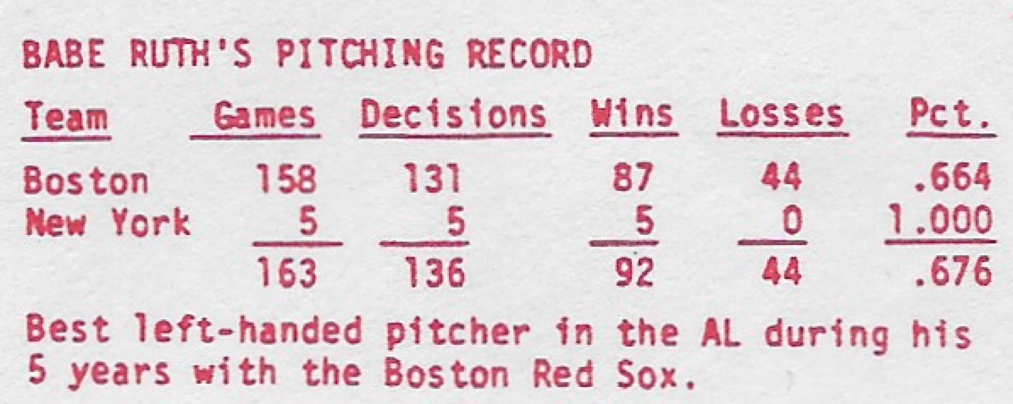
Baseball, The Babe and Philatelics

Slide 21
Baseball, The Babe and Philatelics

Slide 22
Baseball, The Babe and Philatelics

Slide 23
Baseball, The Babe and Philatelics
Although Ruth twice won 23 games in a season as a pitcher and was a member of three World Series championship teams with the Red Sox, he wanted to play every day and was allowed to convert to an outfielder. With regular playing time, he broke the MLB single-season home run record in 1919. After that season, Red Sox owner Harry Frezee sold Ruth to the Yankees amid controversy. The trade fueled Boston's subsequent 86-year championship drought and popularized the “Curse of the Bambino" superstition. *

Slide 24
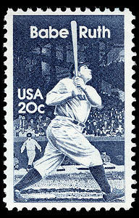
Baseball, The Babe and Philatelics
A 20-cent commemorative stamp honoring baseball great Babe Ruth was issued July 6, 1983, in Chicago, Illinois, in conjunction with the 50th anniversary year of the All-Star Game in which Ruth hit the first home run, scoring two runs and winning the game. It was the third stamp in the American Sports Series which begun in 1981 with stamps honoring golfer Bobby Jones and all-around athlete Babe Didrikson Zaharias before Ruth.

Slide 25
Baseball, The Babe and Philatelics
The dedication ceremony for the stamp was held on July 5, during the Old Timers Game at Comiskey Park, site of the first All-Star Game in 1933. The Babe Ruth Stamp design, by Richard Gangel of Weston, Connecticut, was based on a classic photograph of Ruth with feet spread apart and bat pointed almost straight up. He is looking toward the fences following a home run swing. Esther Porter modeled the stamp. A total of 184,950,000 stamps were issued at a value of 20¢ each for a total value of $36,990,000. (Stamp ID# Scott 2046). *

Slide 26
Baseball, The Babe and Philatelics

Slide 27
Baseball, The Babe and Philatelics
Aristocrat cachet

Slide 28
Baseball, The Babe and Philatelics

Slide 29
Baseball, The Babe and Philatelics

Slide 30
Baseball, The Babe and Philatelics
Zaso cachet

Slide 31
Baseball, The Babe and Philatelics
TCMA Ltd Robert Steven Simon painting cachet

Slide 32
Baseball, The Babe and Philatelics

Slide 33
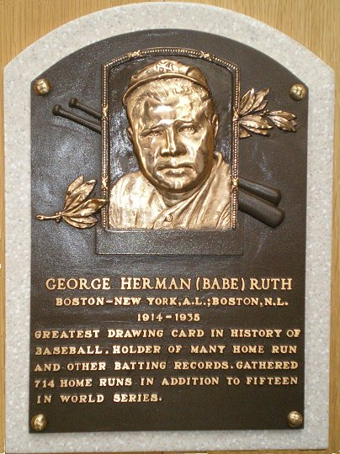
Baseball, The Babe and Philatelics
Note the starting year in each

Slide 34
Baseball, The Babe and Philatelics

Slide 35
Baseball, The Babe and Philatelics

Slide 36
Baseball, The Babe and Philatelics
Panda cachet

Slide 37
Baseball, The Babe and Philatelics
TCMA Ltd Robert Steven Simon painting cachet

Slide 38
Baseball, The Babe and Philatelics
TCMA Ltd Robert Steven Simon painting cachet

Slide 39
Baseball, The Babe and Philatelics
Hersh cachet

Slide 40
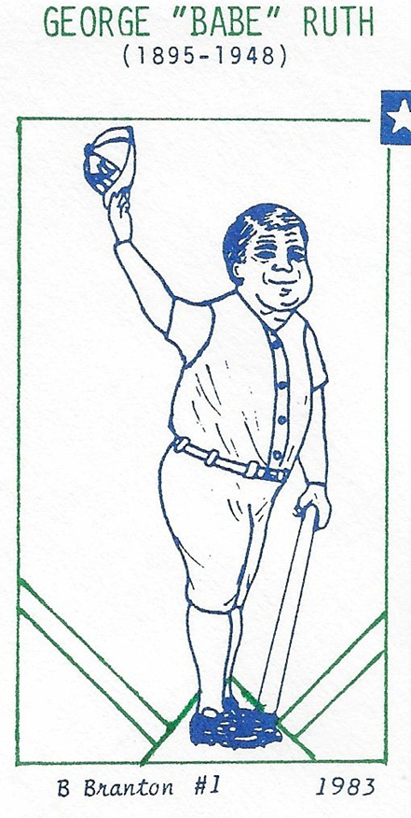
Baseball, The Babe and Philatelics
No one told George Herman “Babe” Ruth he had cancer, but his death changed the way cancer is fought. It all started with a searing pain behind his left eye. Then he could not swallow. Then the pain seeped down his body. He was treated at Memorial Sloan Kettering Hospital, just a short train ride from Yankee Stadium.
A tumor had grown from behind his nose to the base of his skull. Ruth lived at a time when Cancer rates were increasing markedly from smoking and pollution. But no one really knew what caused it or how to treat it. Because Ruth was Ruth, he received many trial and error radiation and chemotherapy applications in hopes of finding a cure.

Slide 41
Baseball, The Babe and Philatelics
Ruth was the first to receive a “Chemo Beamo” combination at Sloan. Doctor’s confirmed this coordinated effort extended Ruth’s life so that he could say goodbye to Yankee Stadium on June 13, 1948, just two months before his death.
For years, doctors thought Ruth died from cancer in his larynx. Years later it was determined that Ruth died from nasopharyngeal cancer, a rare illness that starts behind the nose, and the “Chemo Beamo” treatment he received was the beginning of today’s approach to nasopharyngeal cancer.

Slide 42
Baseball, The Babe and Philatelics
LEB cachet

Slide 43
Baseball, The Babe and Philatelics
First Rank cachet

Slide 44
Baseball, The Babe and Philatelics

Slide 45
Baseball, The Babe and Philatelics
YKL cachet

Slide 46
Baseball, The Babe and Philatelics

Slide 47
Baseball, The Babe and Philatelics
TCMA Ltd Robert Steven Simon painting cachet

Slide 48
Baseball, The Babe and Philatelics
H&M cachet

Slide 49
Baseball, The Babe and Philatelics

Slide 50
Baseball, The Babe and Philatelics
Artcraft cachet

Slide 51
Baseball, The Babe and Philatelics

Slide 52
Baseball, The Babe and Philatelics

Slide 53
Baseball, The Babe and Philatelics
JM cachet
(first design)

Slide 54
Baseball, The Babe and Philatelics
DRC cachet

Slide 55
Baseball, The Babe and Philatelics
Babe Ruth’s Original 1919 transfer contract from the Boston Red Sox to the New York Yankees sold at auction in 2005 for $996,000. * *
It is reputed to be again on the auction block in 2022.
My framed, authenticated copy of the contract, which I purchased about six or seven years ago at a Ronald MacDonald House Fund Raiser and which you see here now, is not for sale at any price.

Slide 56
Baseball, The Babe and Philatelics
MWO cachet

Slide 57
Baseball, The Babe and Philatelics
Lou Gehrig, another MLB Hall of Famer, who died at age 37, is a story for another time.
Van cachet

Slide 58
Baseball, The Babe and Philatelics
The End

