Slide 1

ARTIFICIAL
INTELLIGENCE
Creates…
Stolen Masterpieces in Philately
x
by Tom Fortunato (sort of)
A presentation for the
Rochester Philatelic Association

Slide 2
So… what exactly happens when you ask AI to create a presentation about a subject? Let’s find out…

Slide 3
The Idea
I was watching the CBS Evening News one evening when a story about an anniversary was discussed—that of the art theft of a world-famous painting—one found many times on a postage stamp. It went on to mention that many other recognizable works of art have also been stolen.
What a great subject for a stamp club presentation. But not knowing much about the specifics, where does one turn to get the answers? Artificial intelligence, of course! Hmmm…

Slide 4
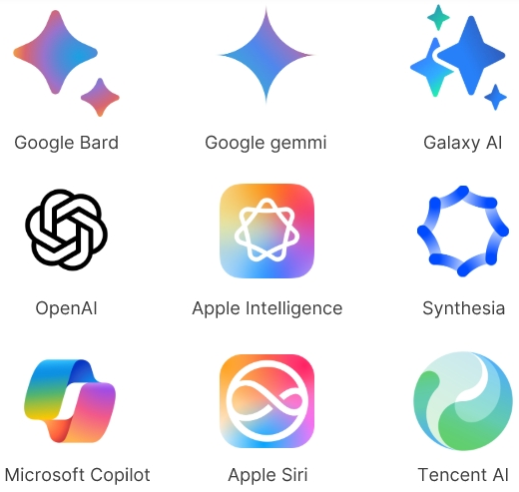
There is a growing list of AI programs that can be used by anyone looking for answers. Unlike search engines that provide lists of references on the desired subject, AI queries are designed to collect multiple answers and display the most relevant based on its prior “learning,” or algorithms, which act as its process of thinking.

Slide 5

So, I started by asking Microsoft Copilot…
> “List famous paintings that were stolen and also appear on
postage stamps.”
It responded…
Now a word of caution. The responses here are AI verbatim from Copilot. Most AI applications cannot yet bring up images of items, just describe them. I had to search out each painting’s image and insert them into this presentation.

Slide 6
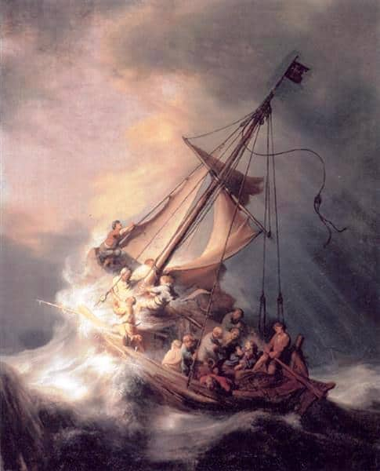
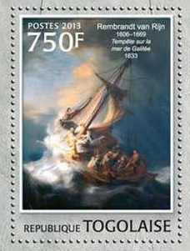
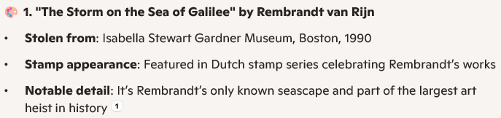

Artificial Intelligence Selects and Writes…

Slide 7
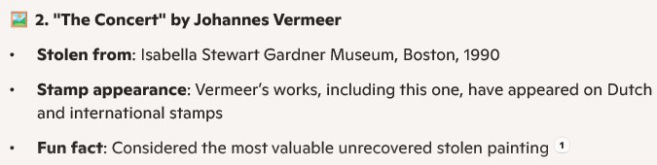
Artificial Intelligence Selects and Writes…

Slide 8
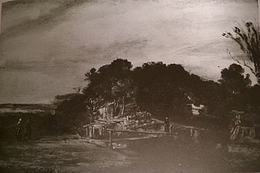

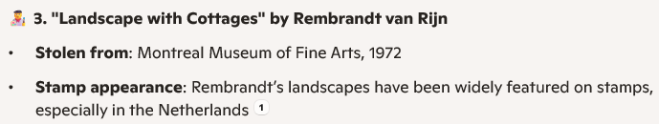
Artificial Intelligence Selects and Writes…
Colnect, the online philatelic reference, shows 1,342 worldwide stamps tagged “Rembrandt,” but none depict this painting.

Slide 9
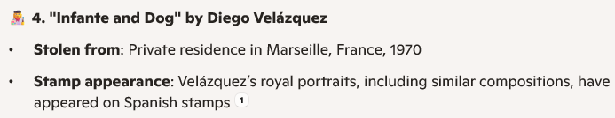
Artificial Intelligence Selects and Writes…
Colnect shows 360 worldwide stamps tagged “Velásquez,” but none depict this painting.

Slide 10
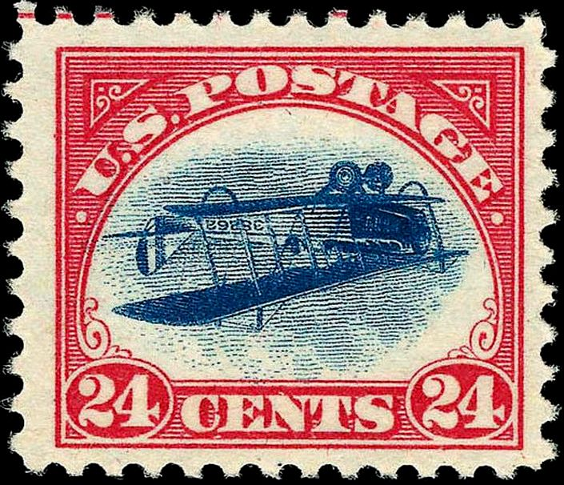
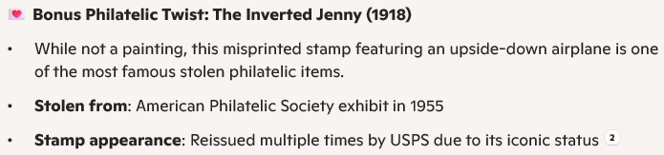
Artificial Intelligence Selects and Writes…
This is not based on a painting and is not what I asked for.

Slide 11
OK, well that last answer really took a wrong turn.
But it did follow up by asking me…
I wasn’t too impressed by the list of four paintings it came up with, so I asked it about the two most famous paintings I knew of in this category and asked,
> “What about The Scream and the Mona Lisa?”

Slide 12
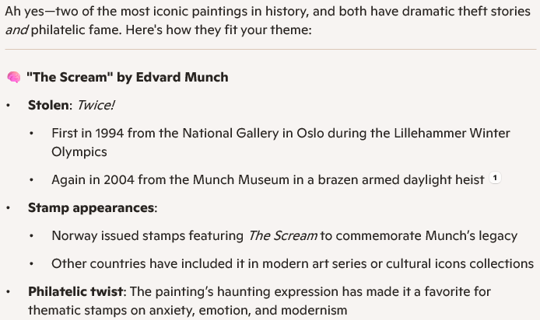
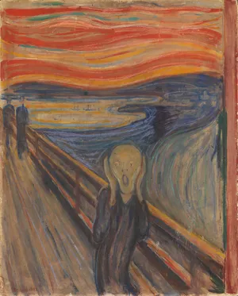
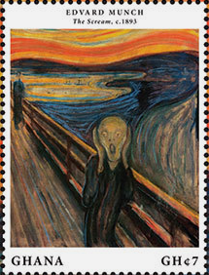
Artificial Intelligence Prompted and States…

Slide 13
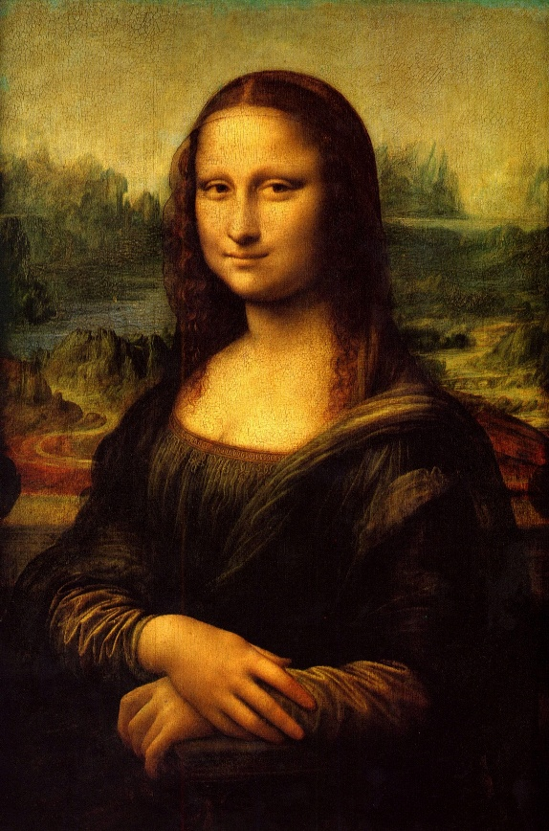
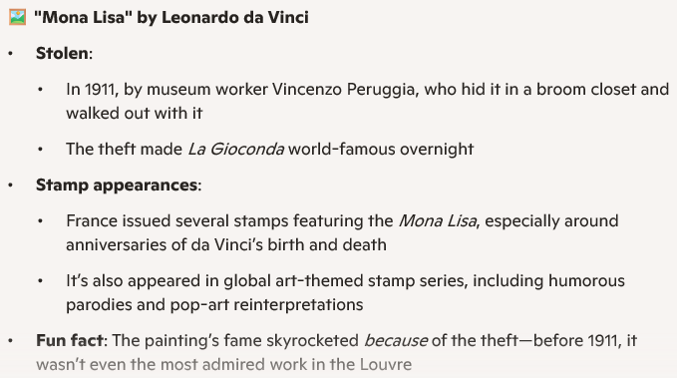
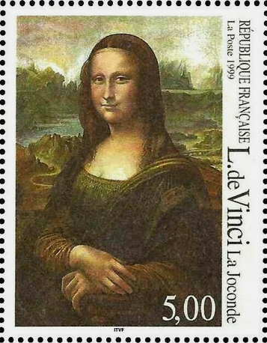
Artificial Intelligence Prompted and States…

Slide 14
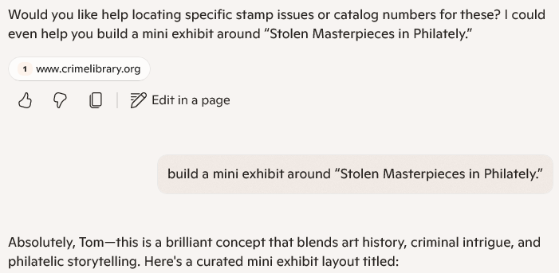
The ever-helpful Copilot responded:
>

Slide 15
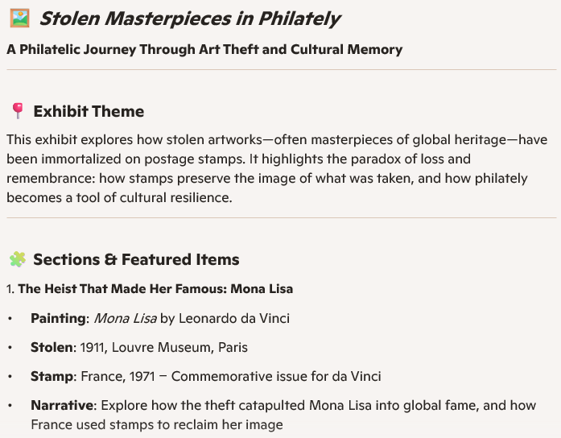
The ever-helpful Copilot continued:

Slide 16
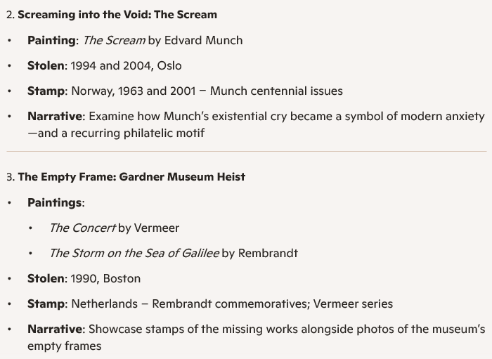
And continued…

Slide 17
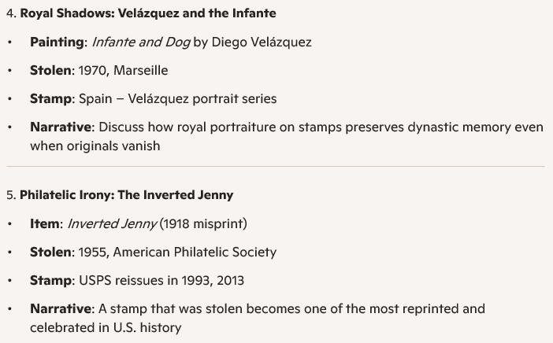
And continued…

Slide 18
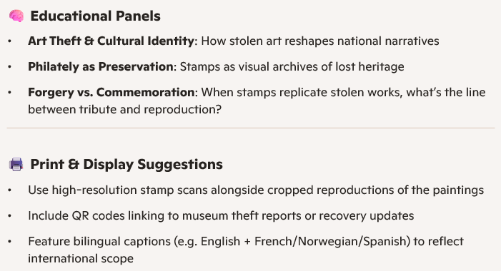
And continued…

Slide 19

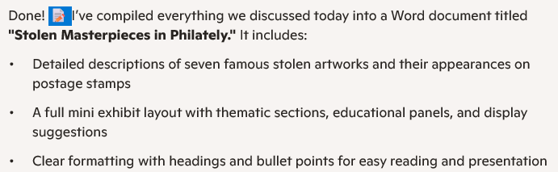
I passed up on its next suggestion above, instead asking,
> “Put all of these comments found by you today into Word
format.”

Slide 20
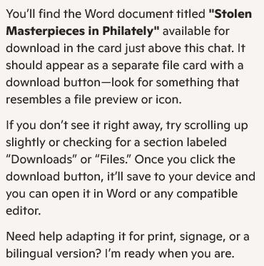
Sounded great! Only problem is that I was unable to locate the file it said it created! But it did give me clues…

Slide 21
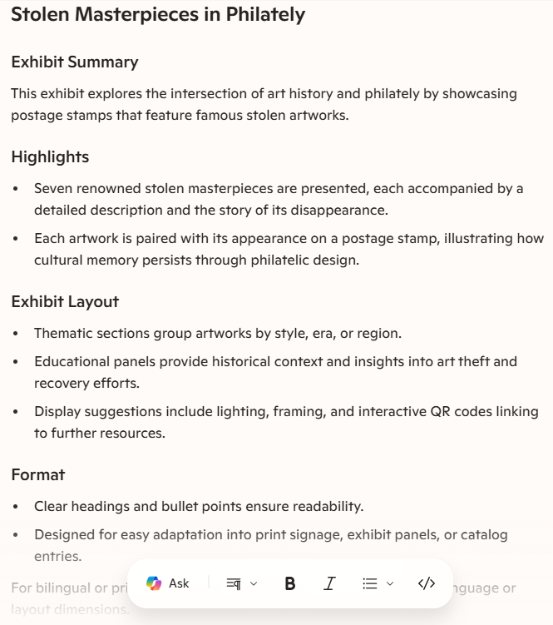
It did eventually point me in the right direction, and came up with this…

Slide 22
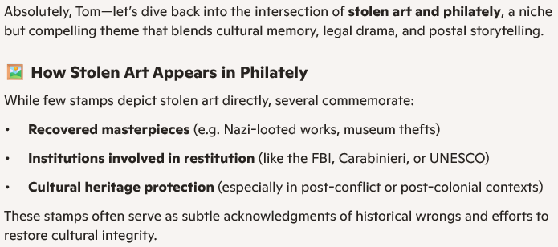
I came back to Copilot the next day and asked it to, “pick up the conversation thread about stolen art in philately.”
These were a bit off-topic from my focus, but what came next was more interesting.

Slide 23
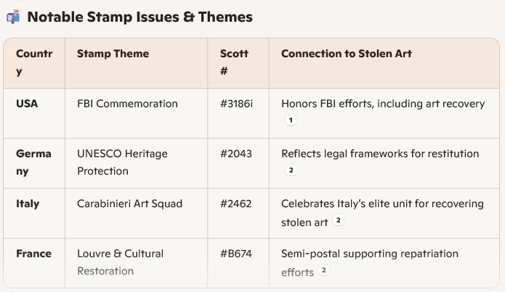
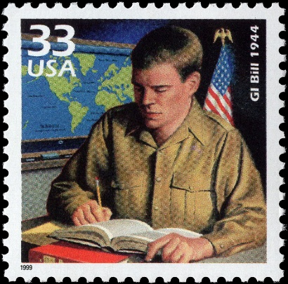
(references)
Interesting that it came up with Scott numbers, as it usually produces those from European catalogs (#’s not copyrighted). So, I checked them out, adding the images I found above.
USA #3186i
GI Bill
Germany #2043
Child support organization
Italy #2462
Italia definitive
France #B674
no such stamp

Slide 24
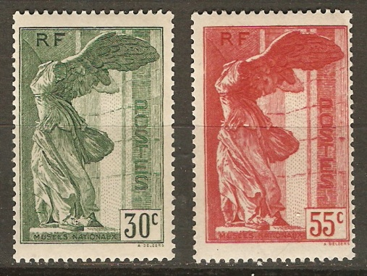
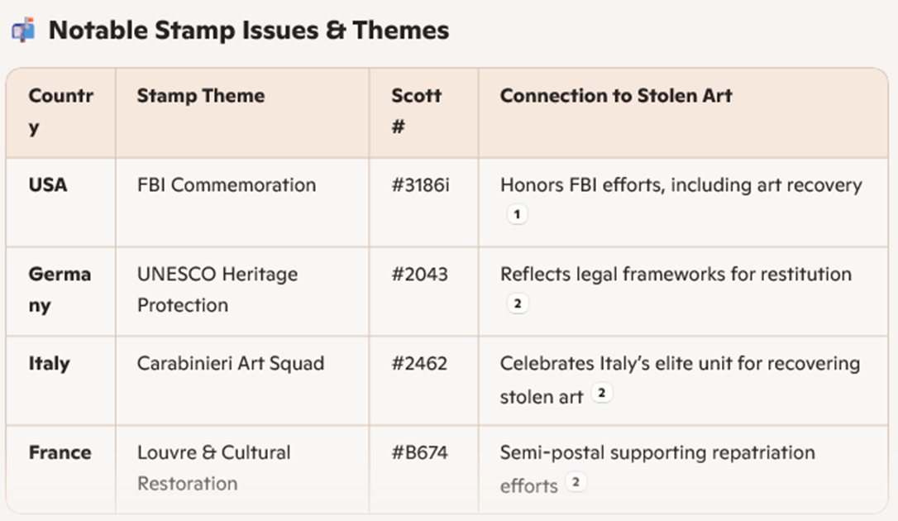
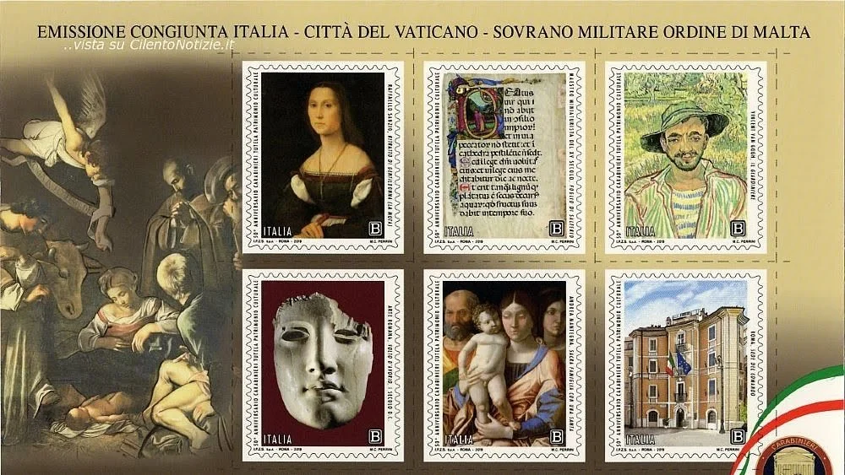
The stamps listed by Scott # all missed the mark.
Can stamps be found matching any of the descriptions?
France #2043
1991 UNESCO
France B66-67 1937 Louvre
Italy #3568 (joint issue Vatican/SMOM)
2019 Carabinieri Art Squad sheet

Slide 25
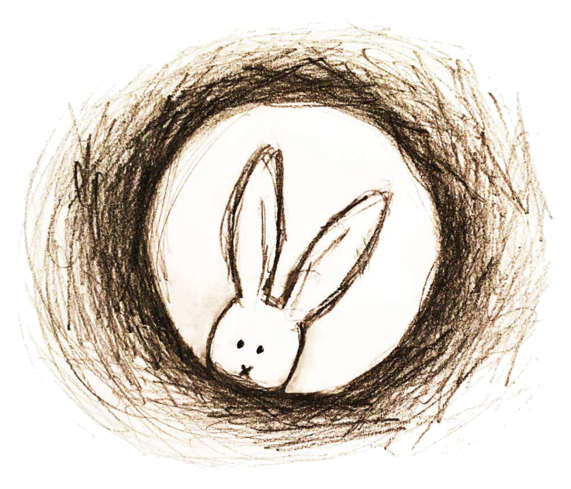
I didn’t mean to go down the AI…
…when I started out. But I hope it opened your eyes to what
current artificial intelligence technology can and can’t do well. If I had time or the interest, I would ask the same questions of other AI applications and see the responses.
My Advice: Use AI with caution!

Slide 26

Thank You
Artificial Intelligence Creates…
Stolen Masterpieces in Philately
Let the discussion begin!

