Slide 1
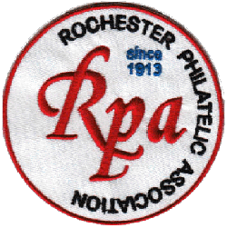
2025 US First Day Ceremonies Photos and Souvenirs
by Roy Michael Roush

Slide 2
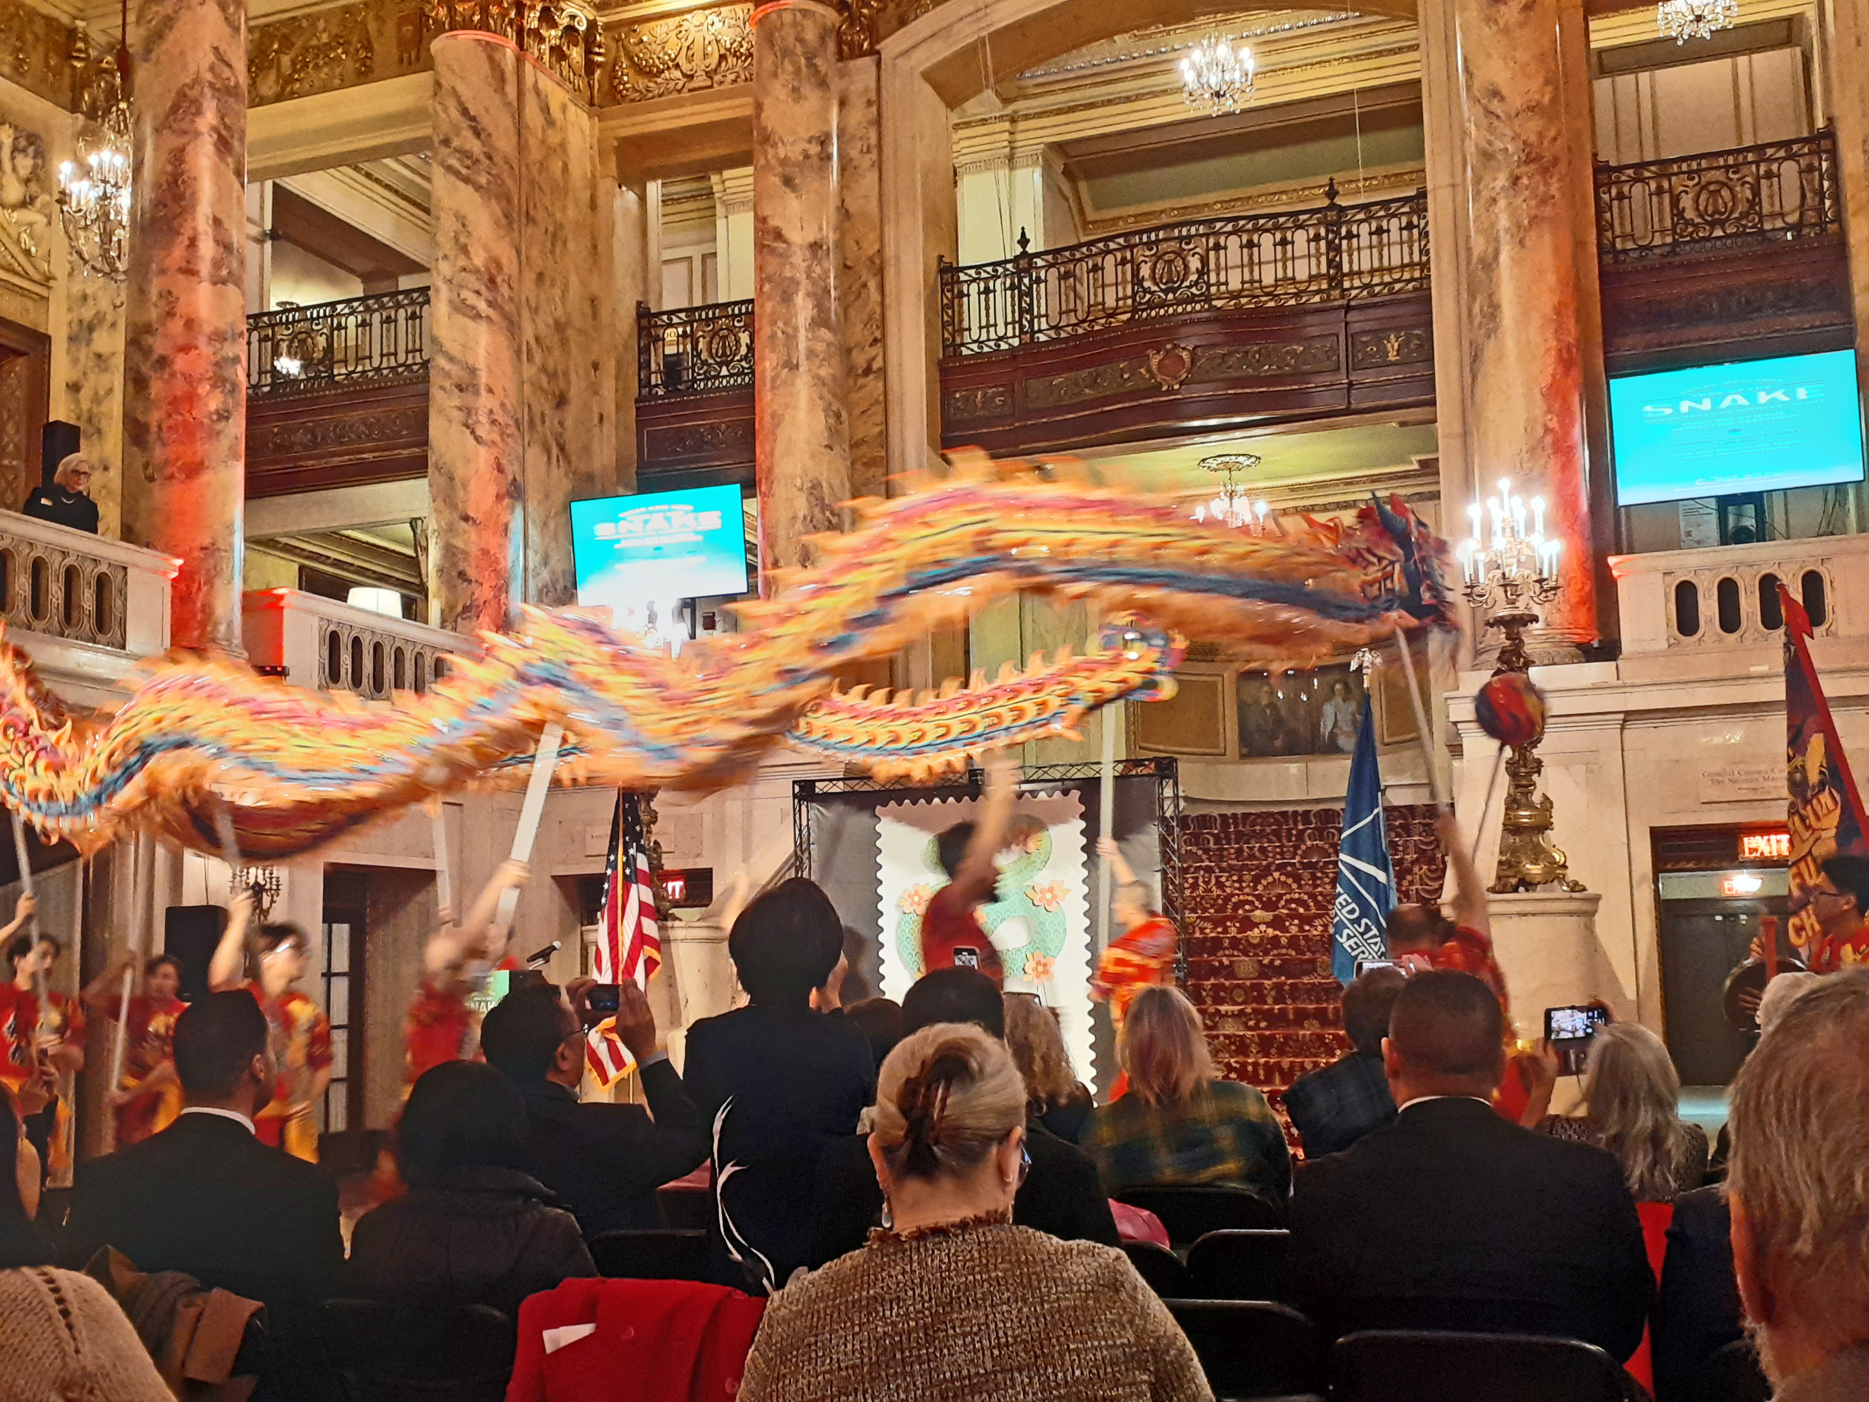
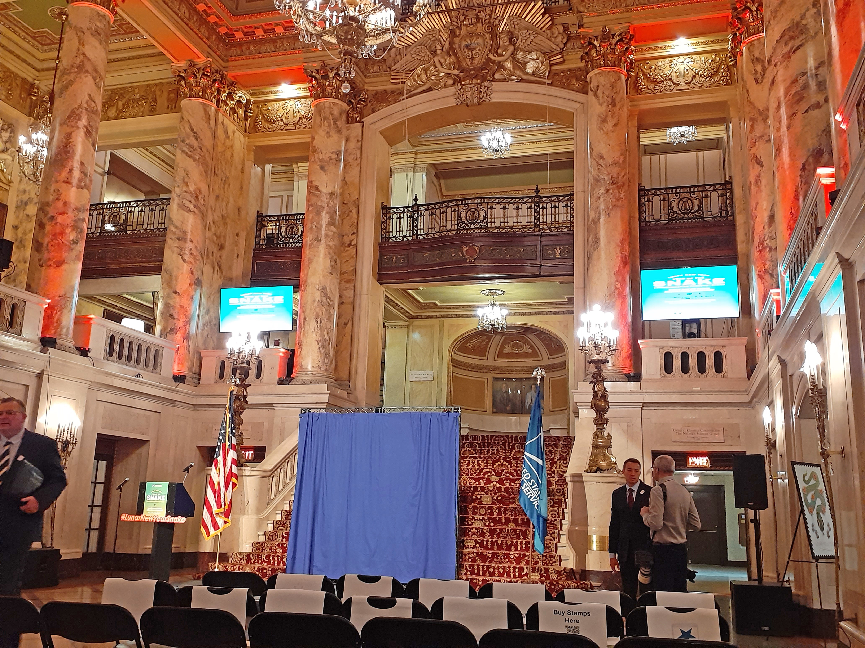
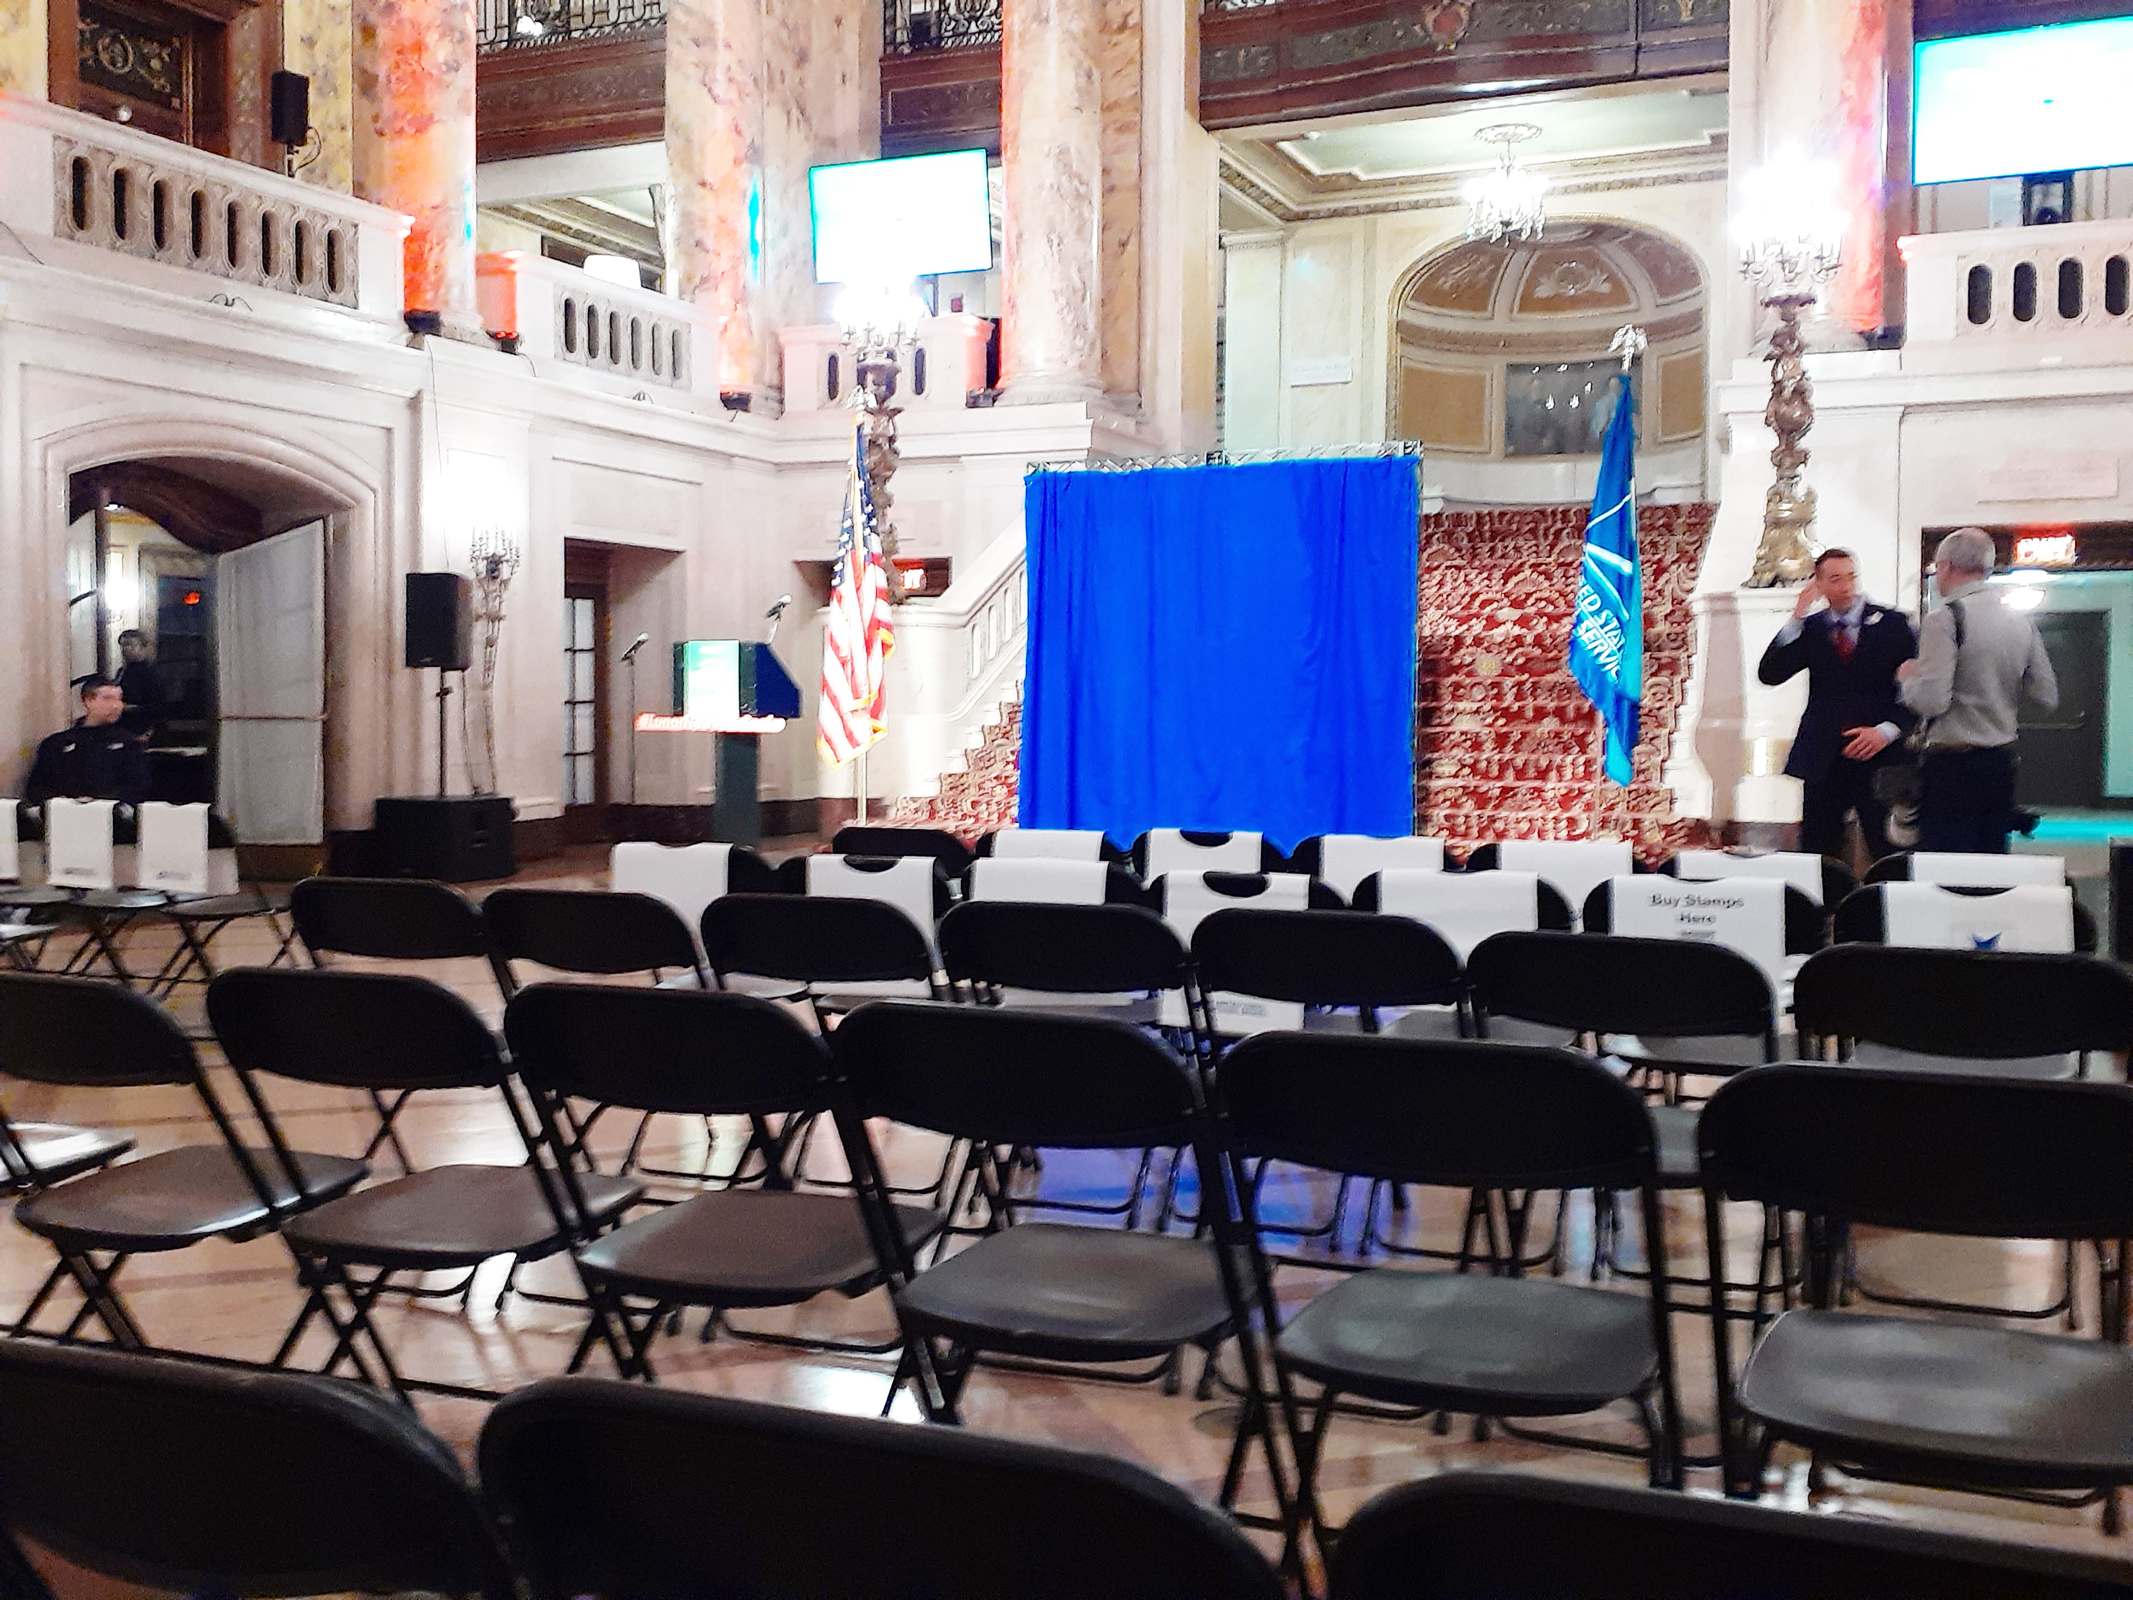
Jan. 14 Boston, MA Lunar New Year
National ceremony held at the Boch Center Wang Theater. The facility complimented the subject with local community members, national USPS representatives and special dance troupe entertainment.

Slide 3
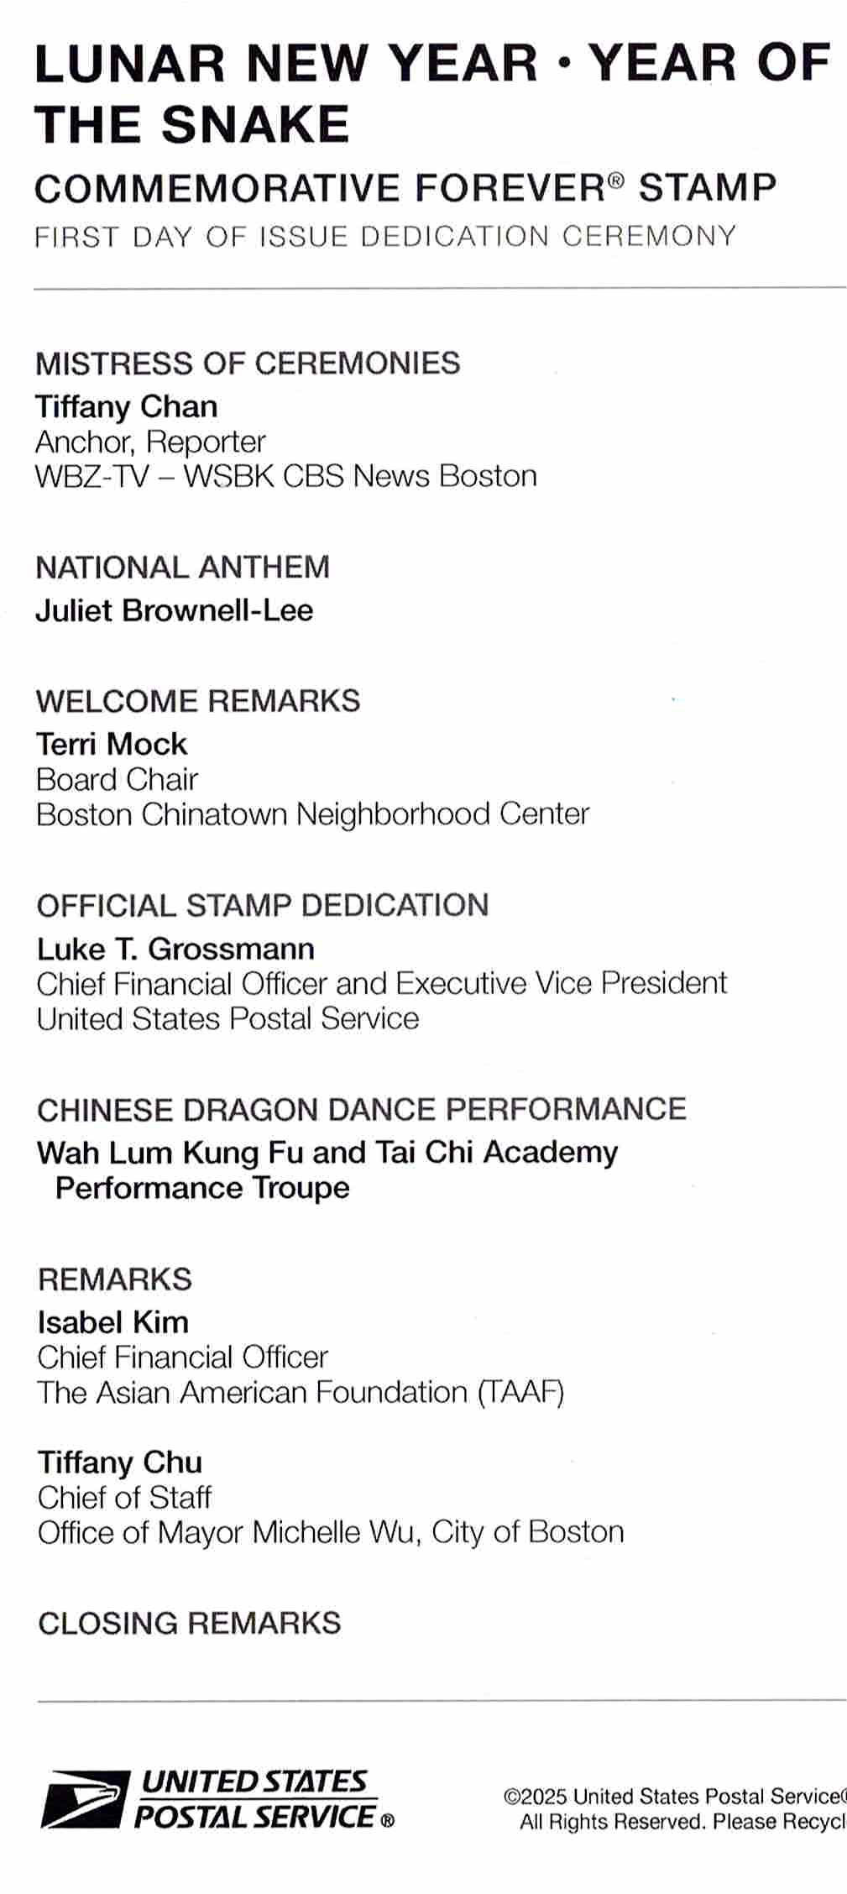
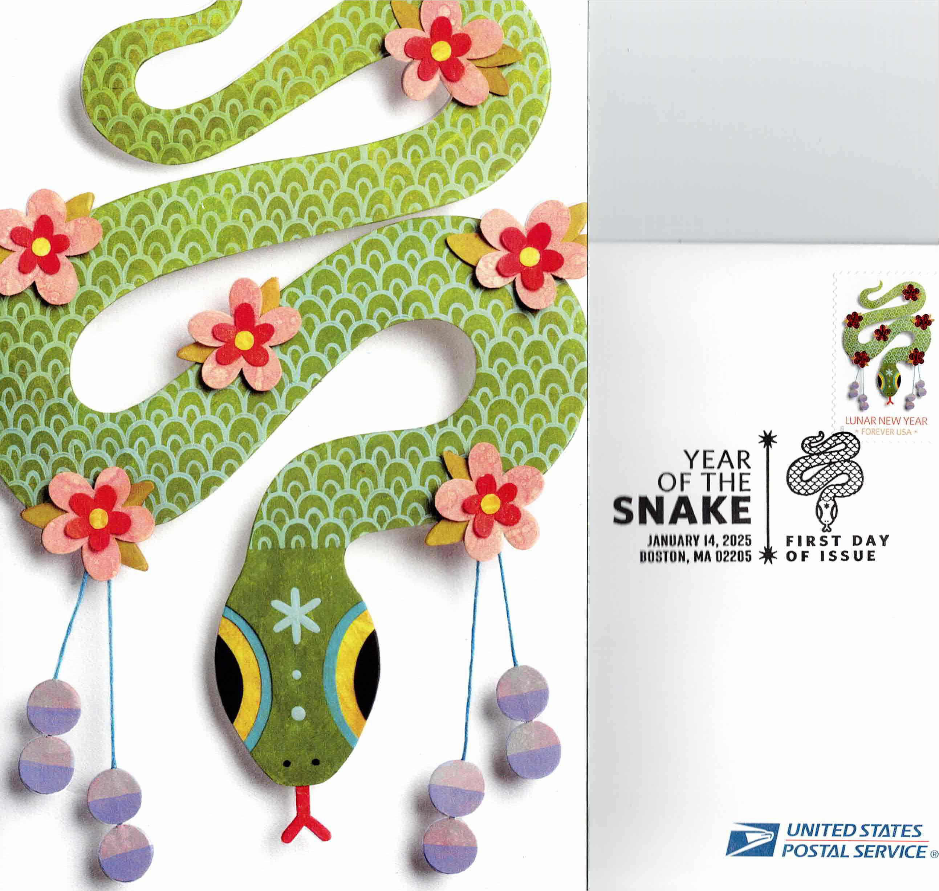
Jan. 14 Boston, MA Lunar New Year

Slide 4
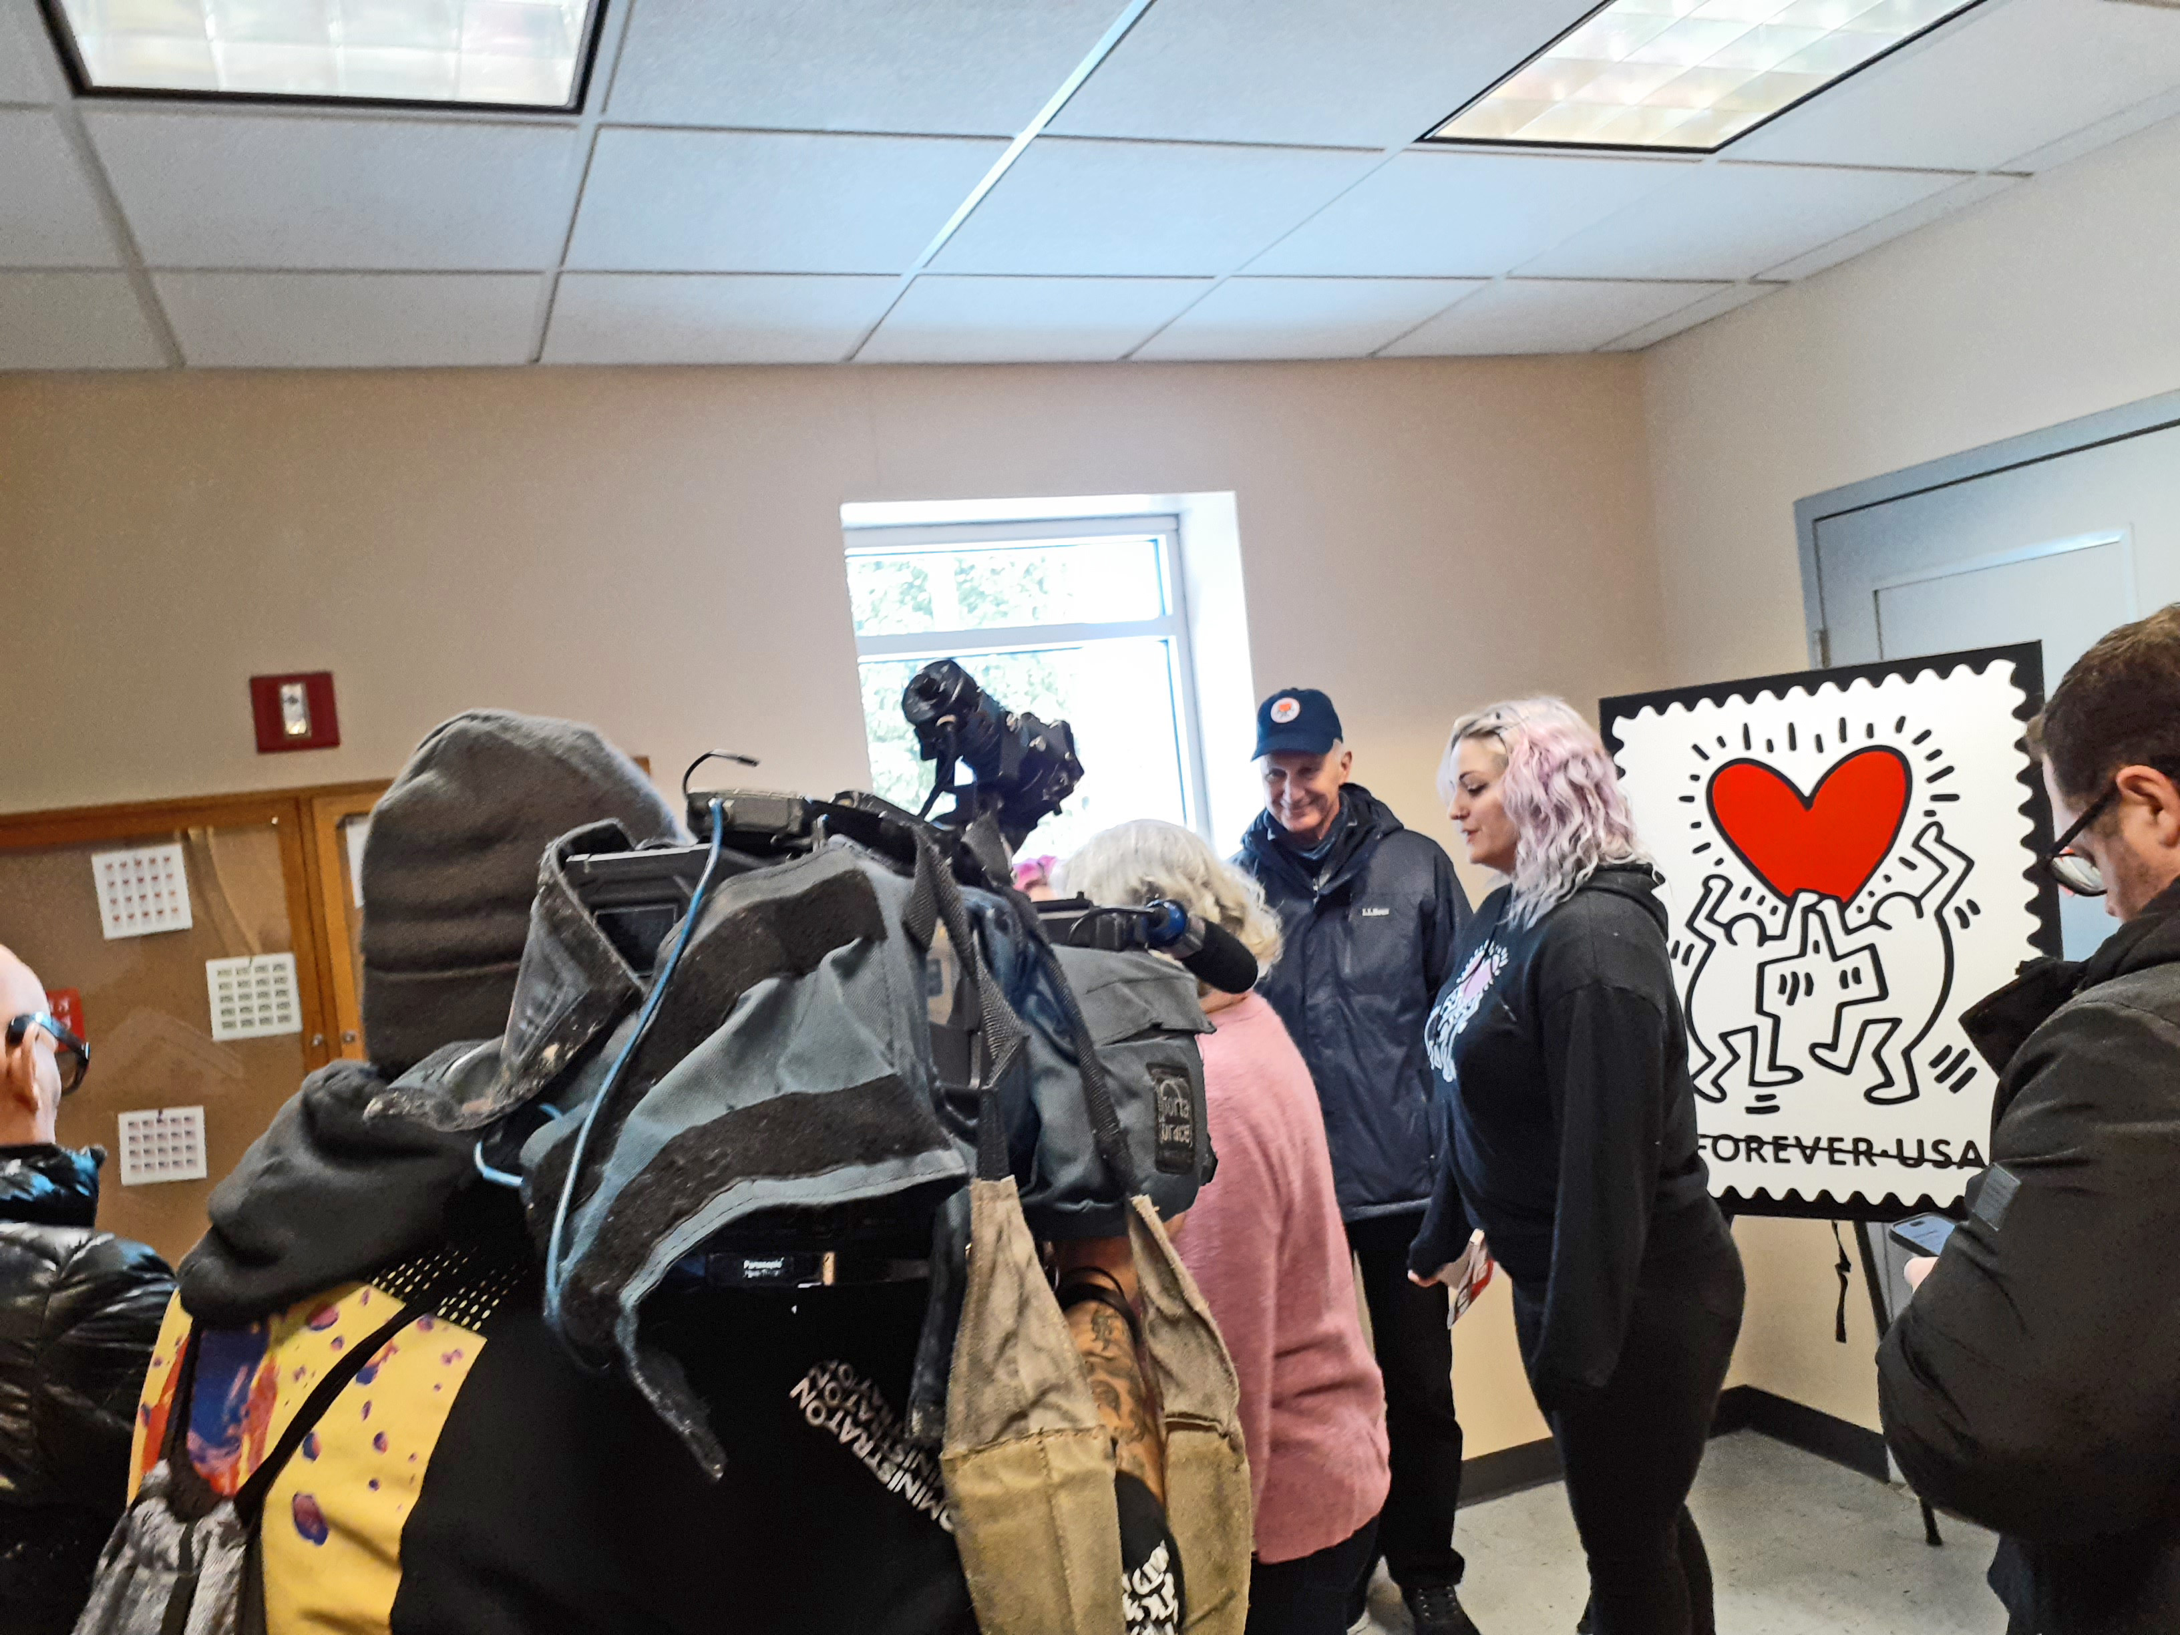
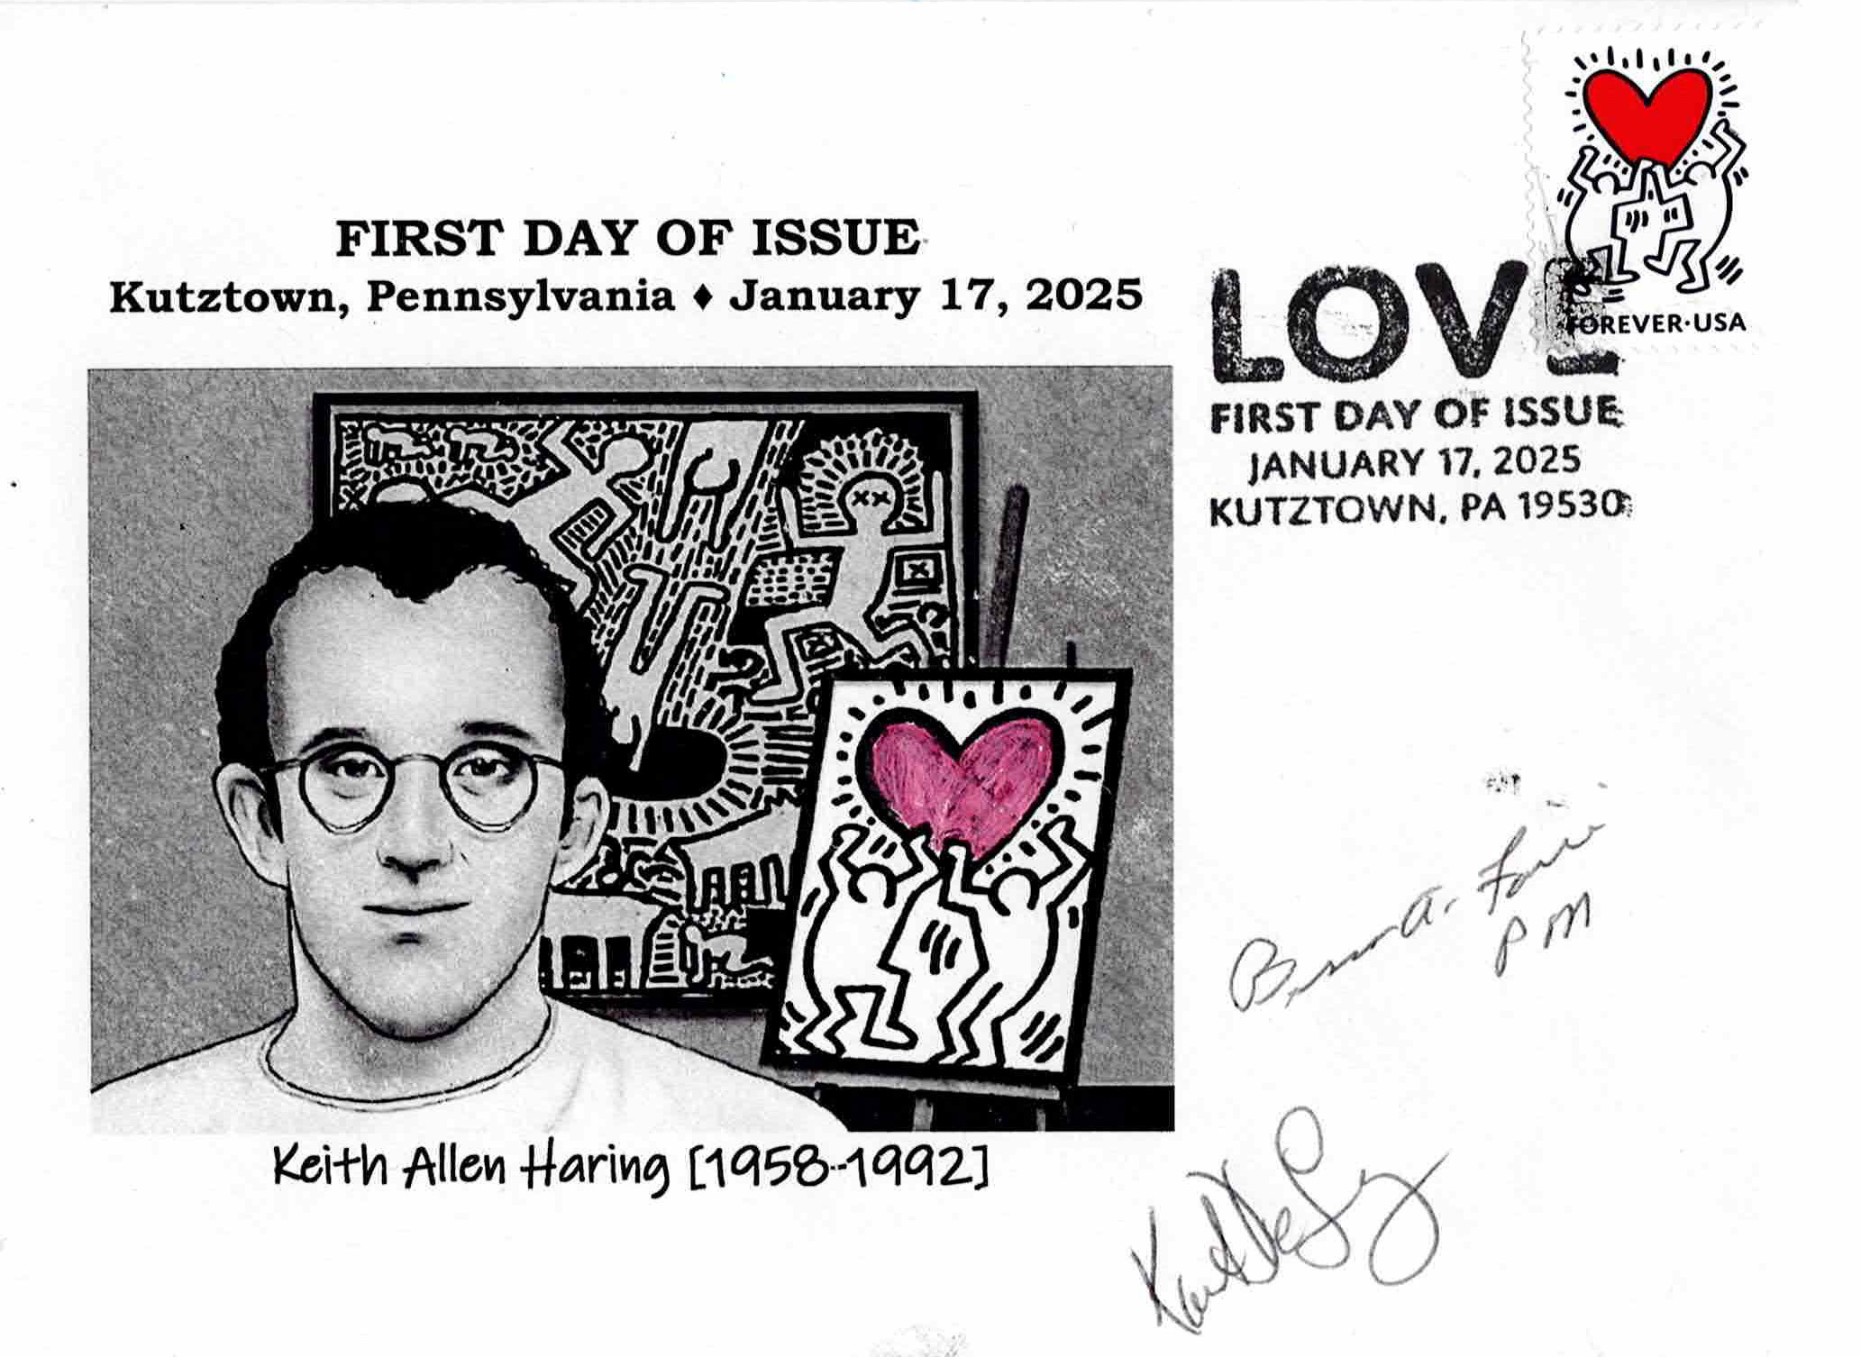
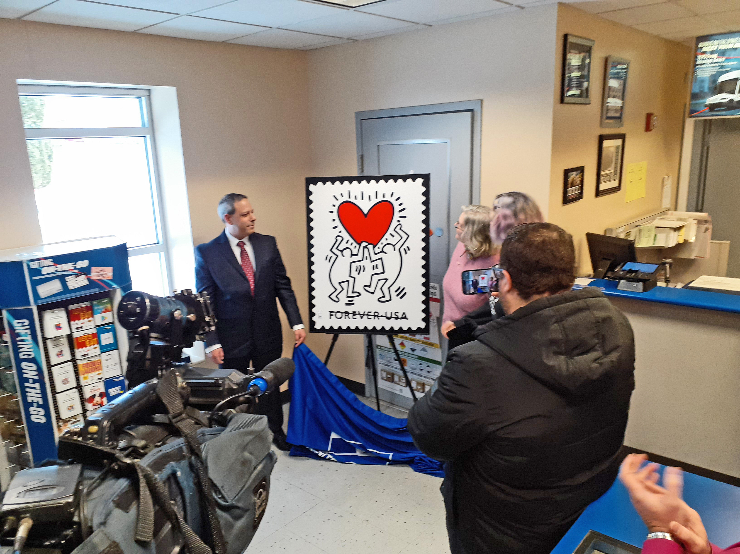
Jan. 17 Kutztown, PA Love
Local, low-key event. Held in a post office lobby; local postmaster led show and family members present.

Slide 5
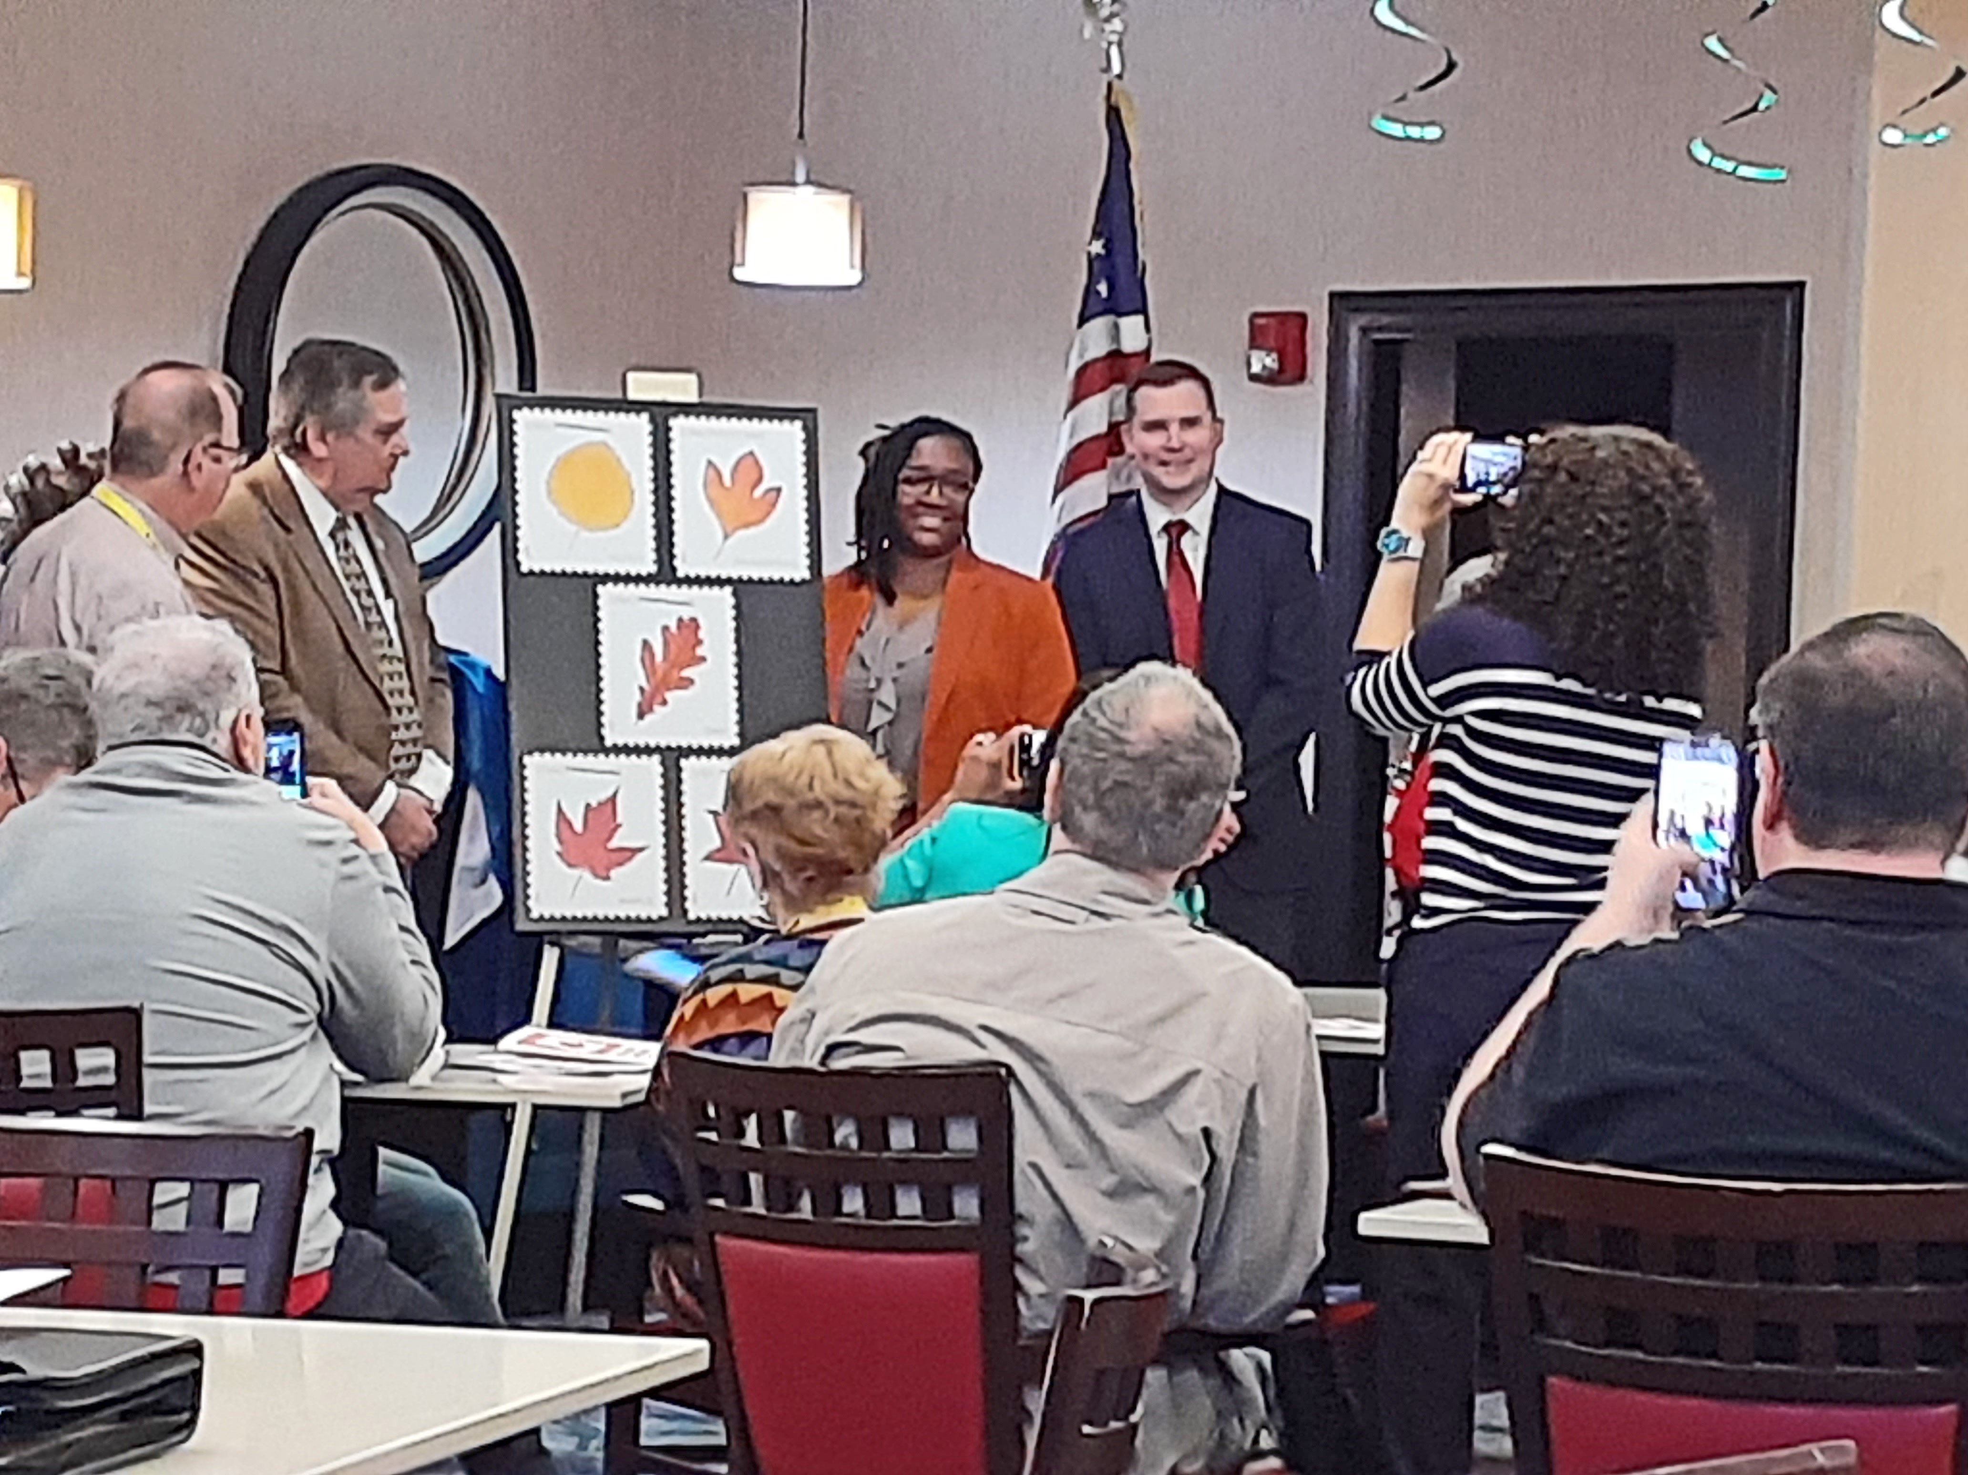
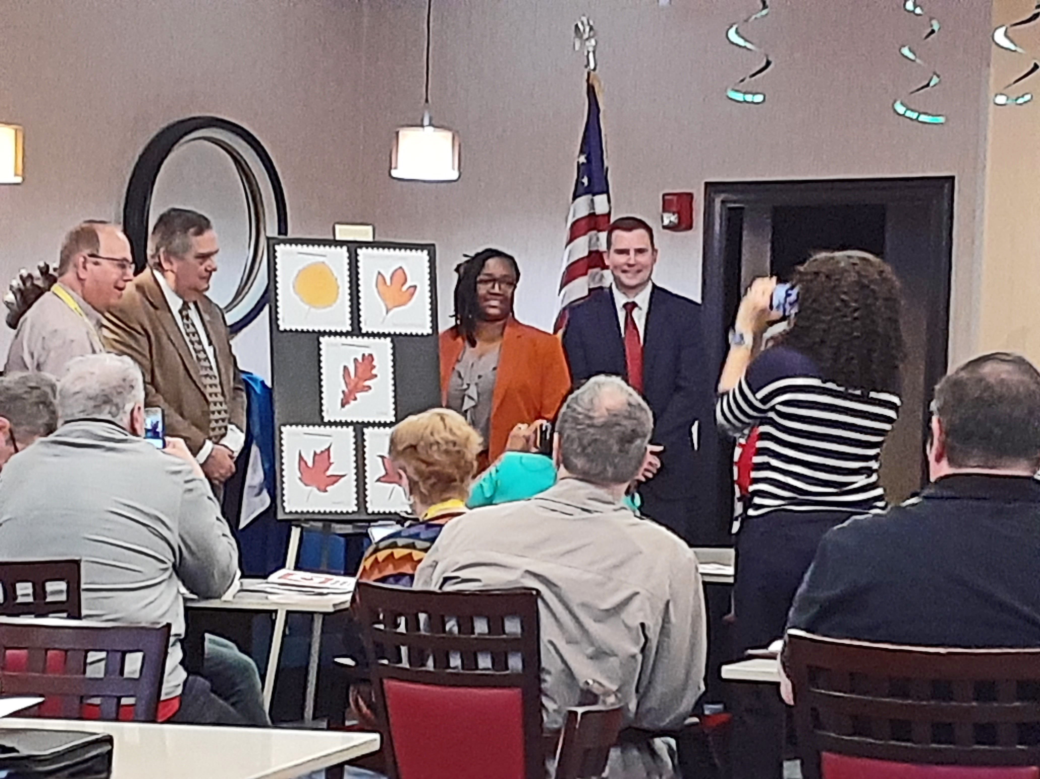
Mar. 14 Strongsville, OH Vibrant Leaves
Regional ceremony held during the annual March Party stamp show by the Garfield-Perry Stamp Club.

Slide 6
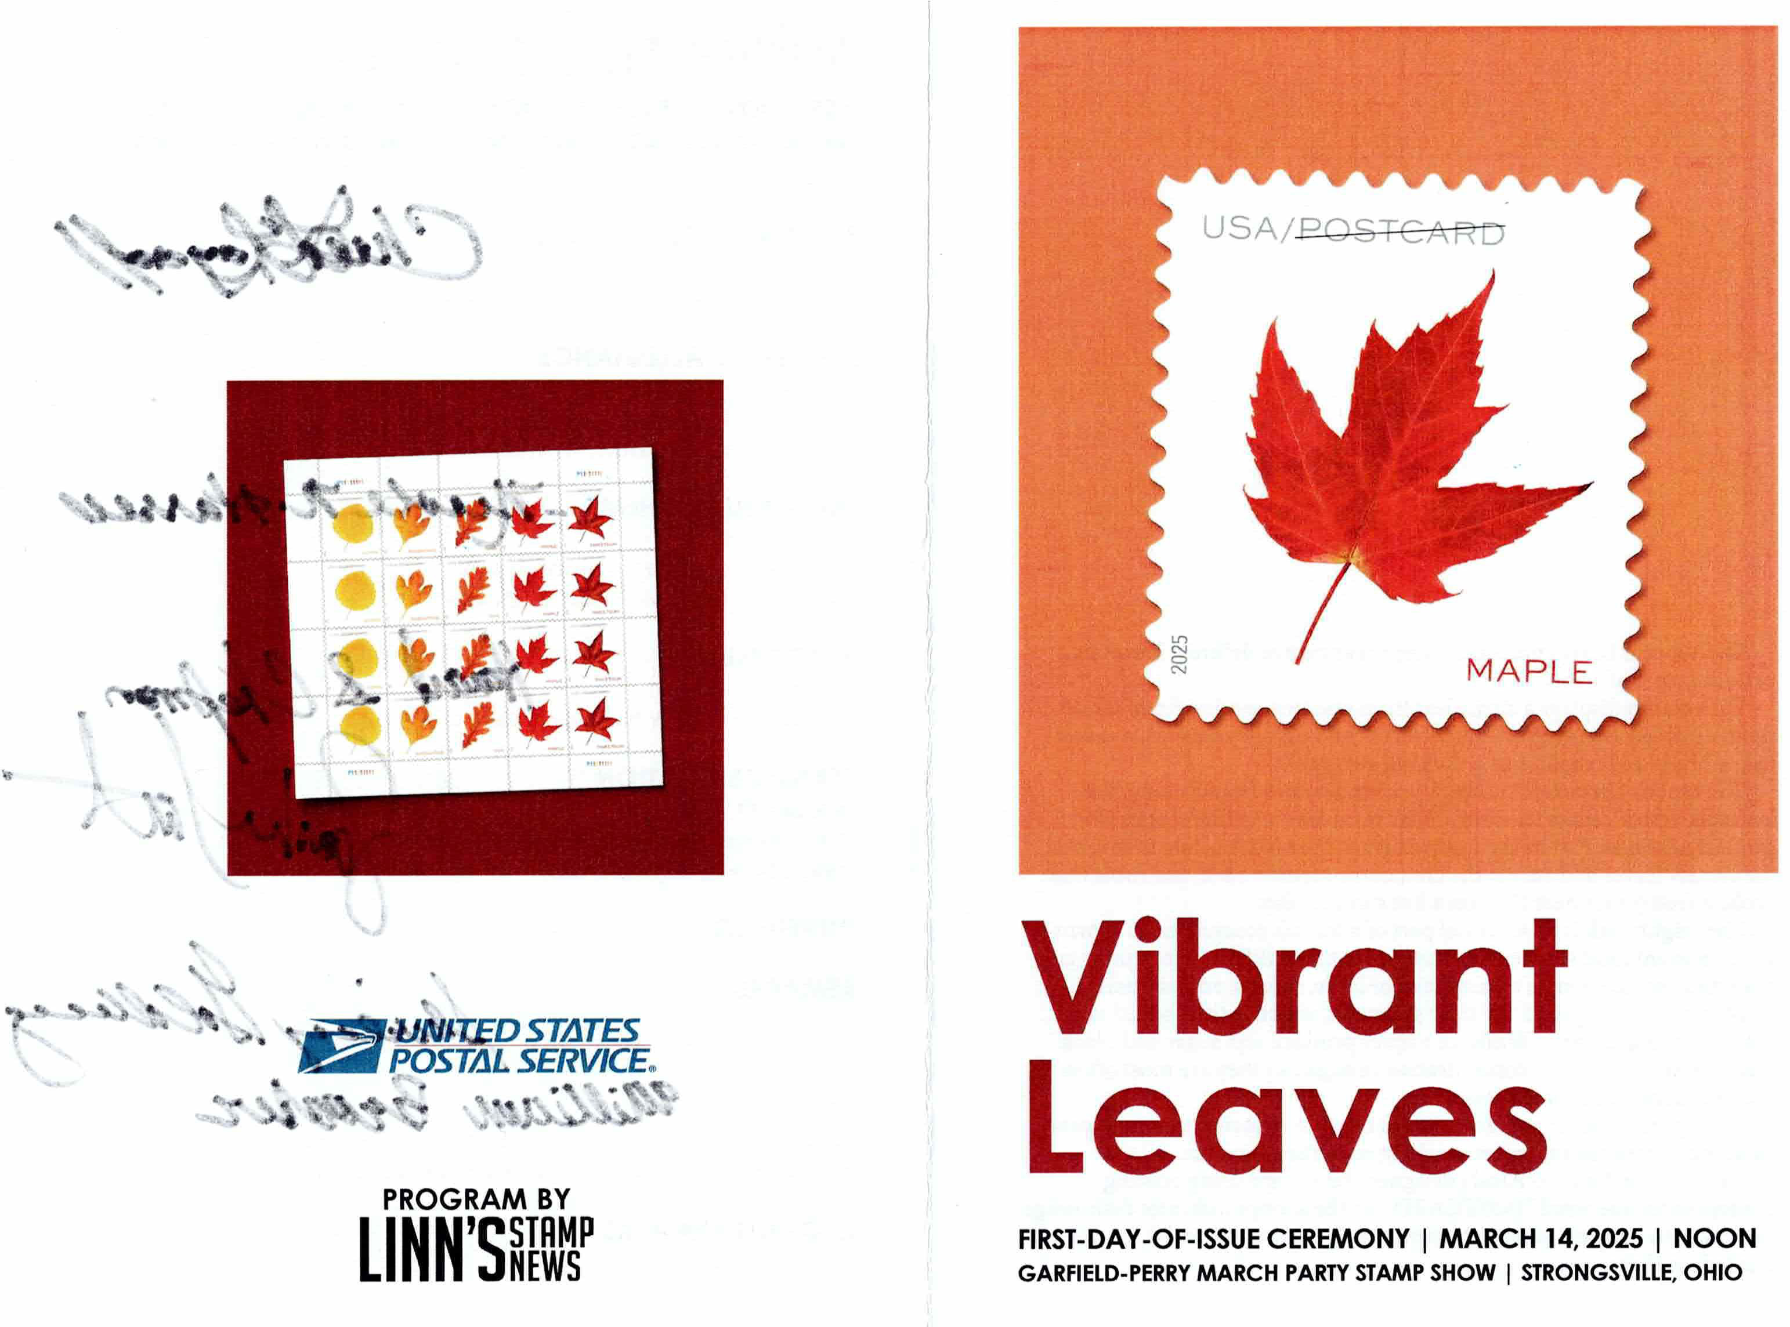

Mar. 14 Strongsville, OH Vibrant Leaves

Slide 7
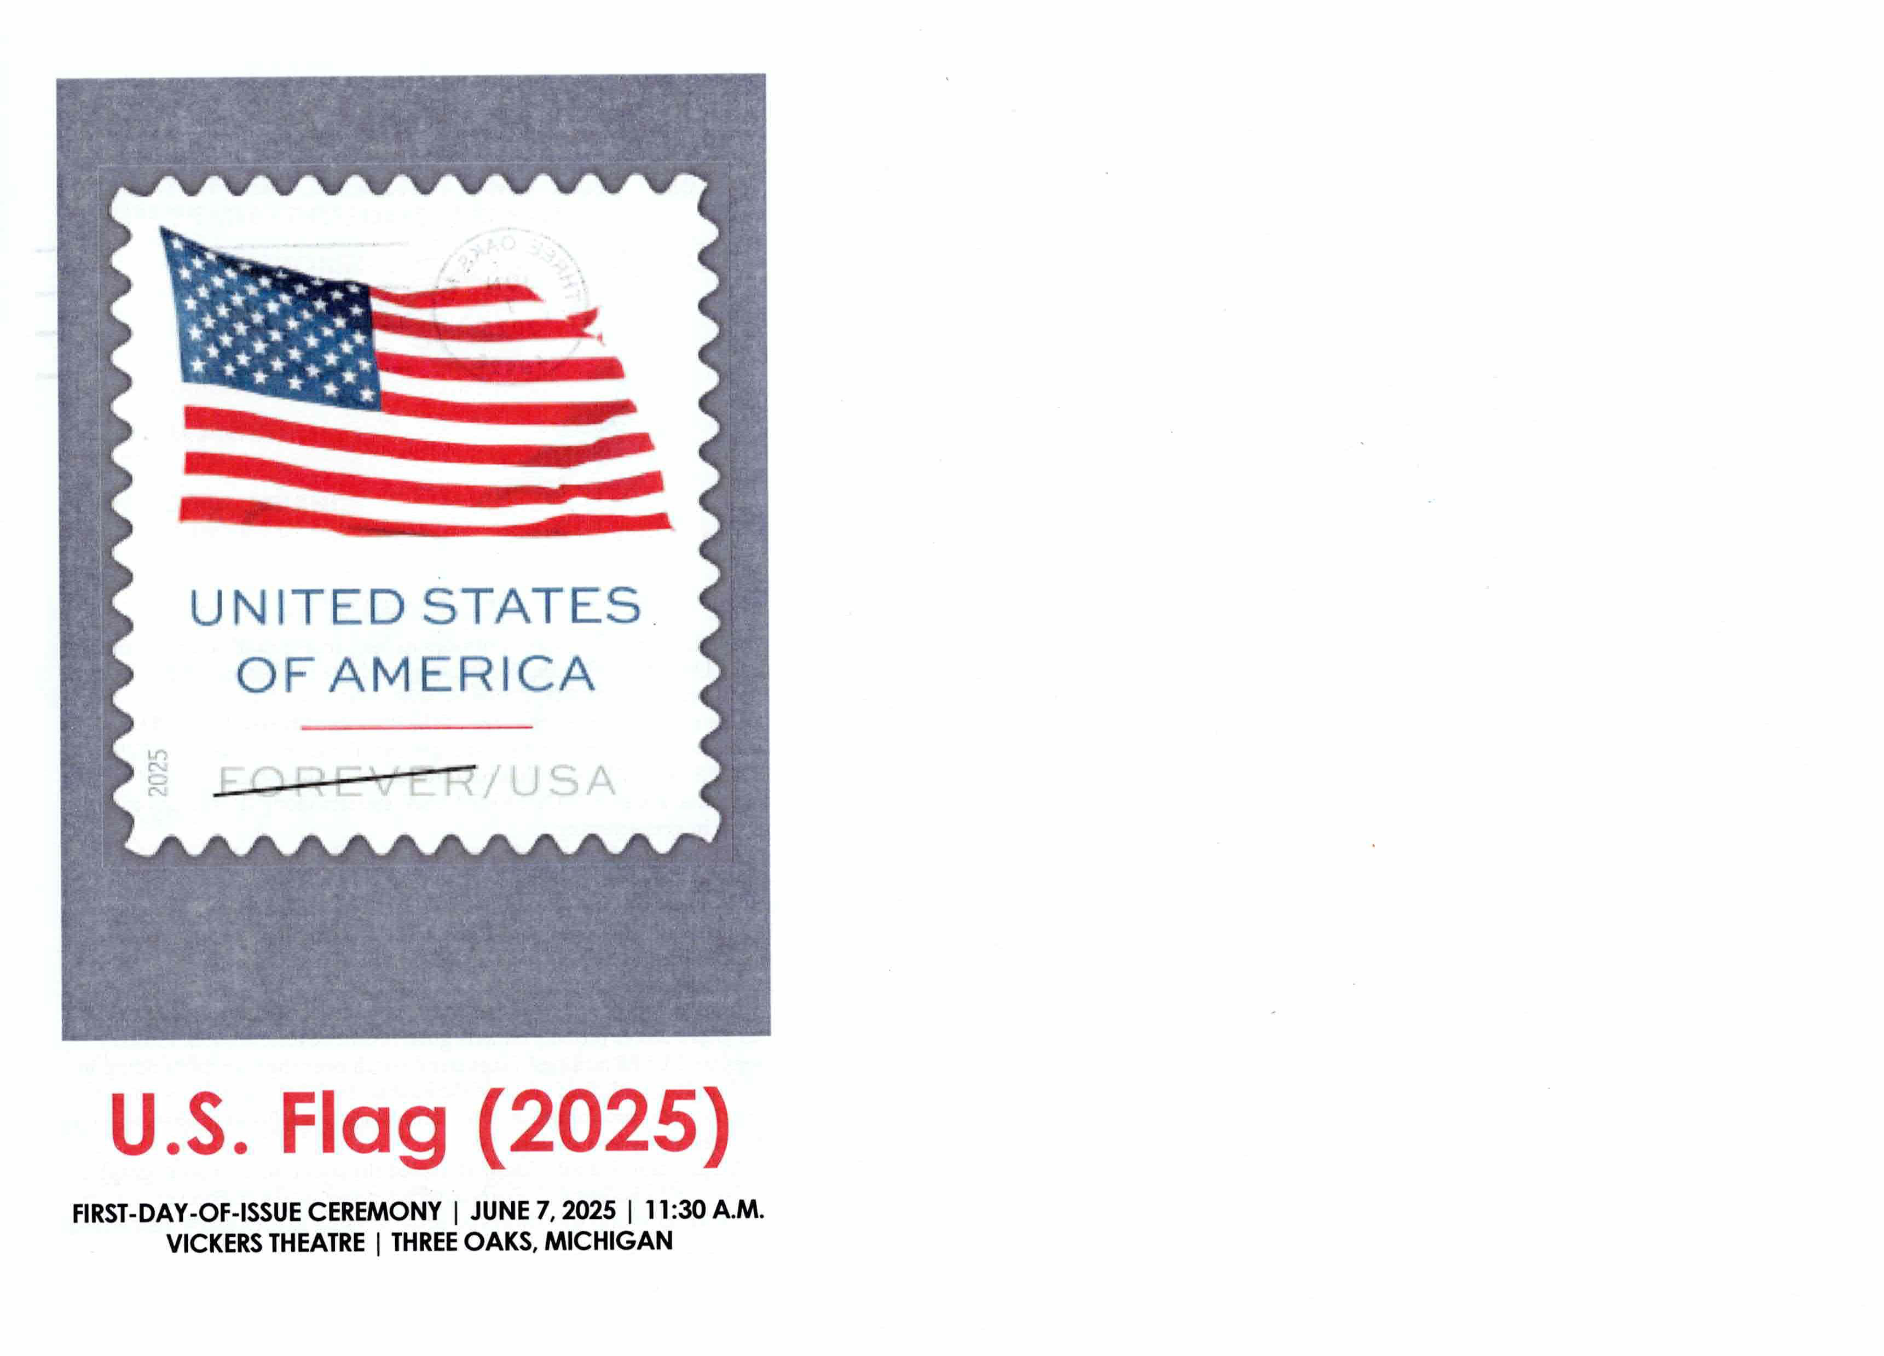
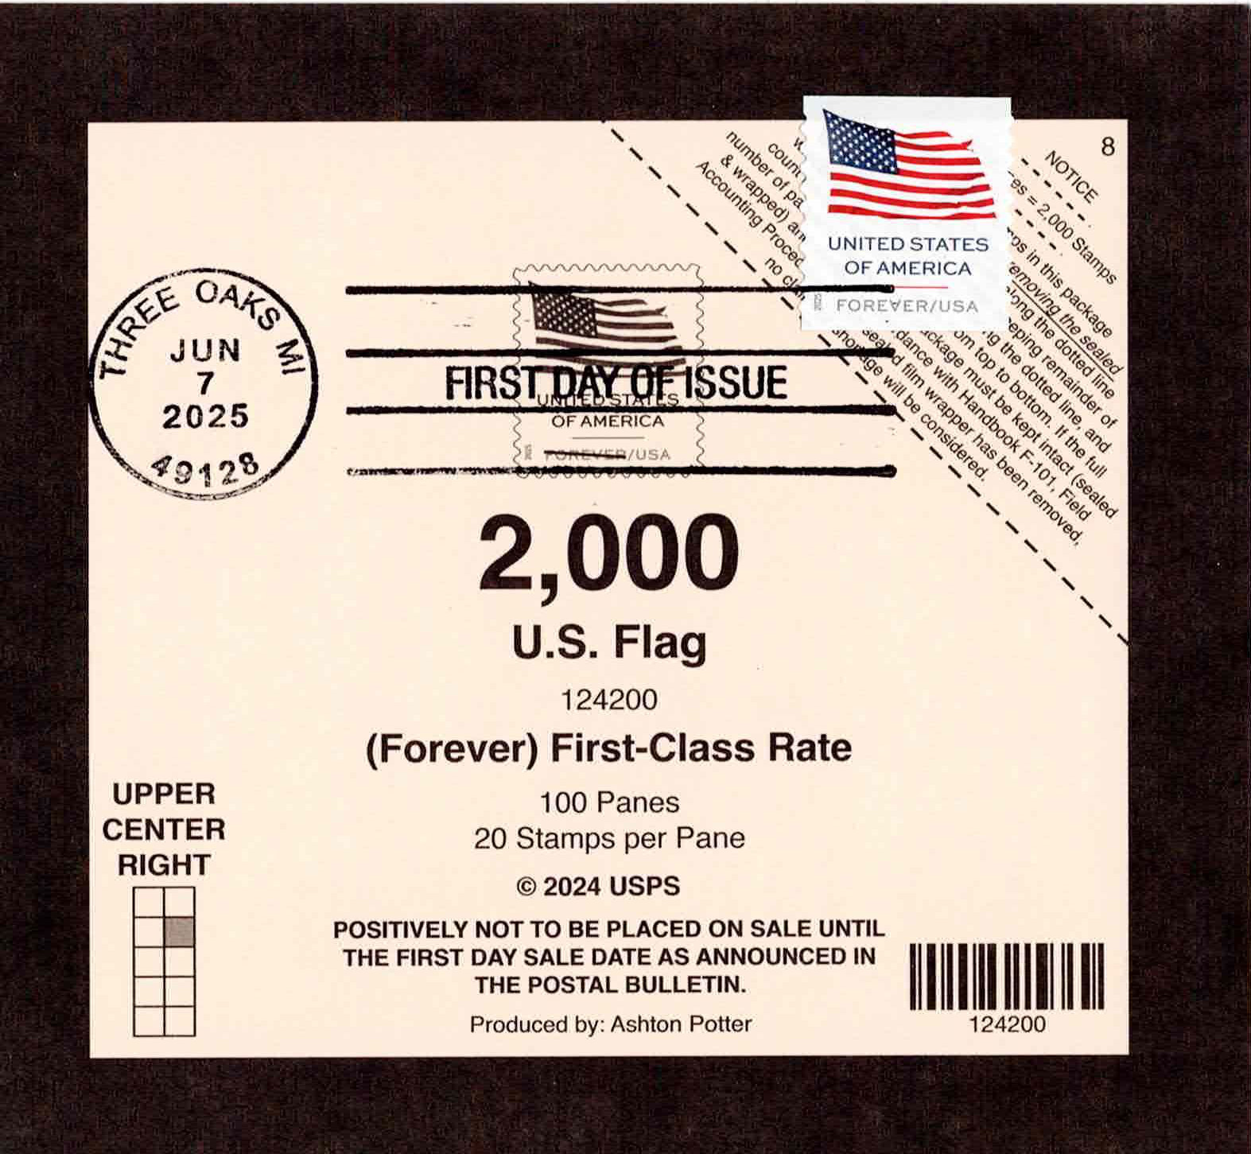
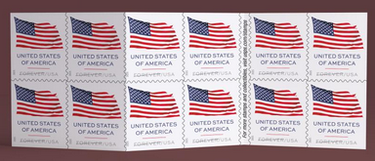
Jun. 7 Three Oaks, Michigan US Flag
Regional event held during the annual local Flag Day festival and parade.

Slide 8
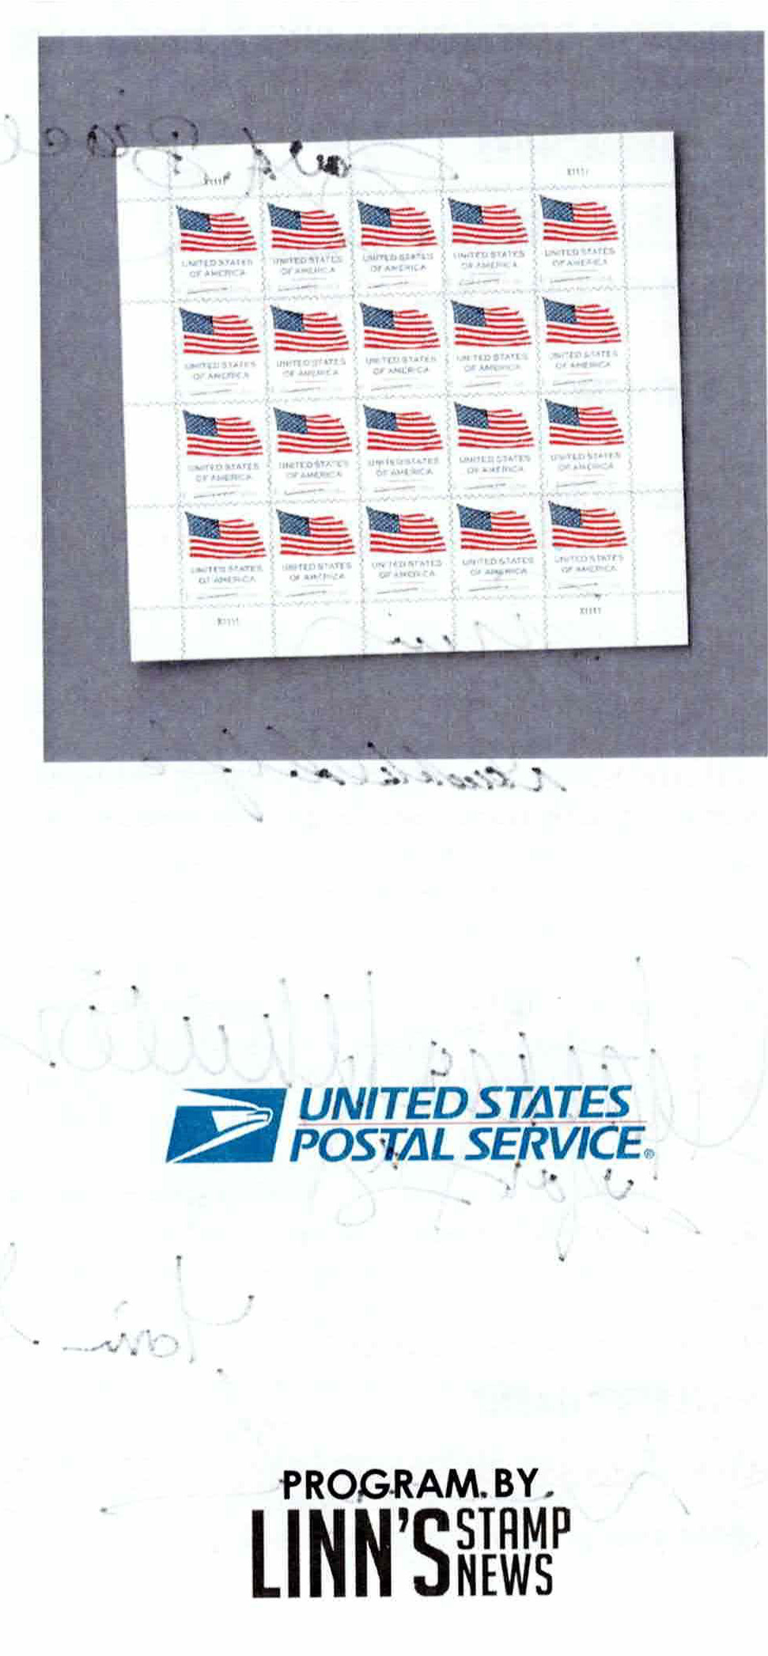
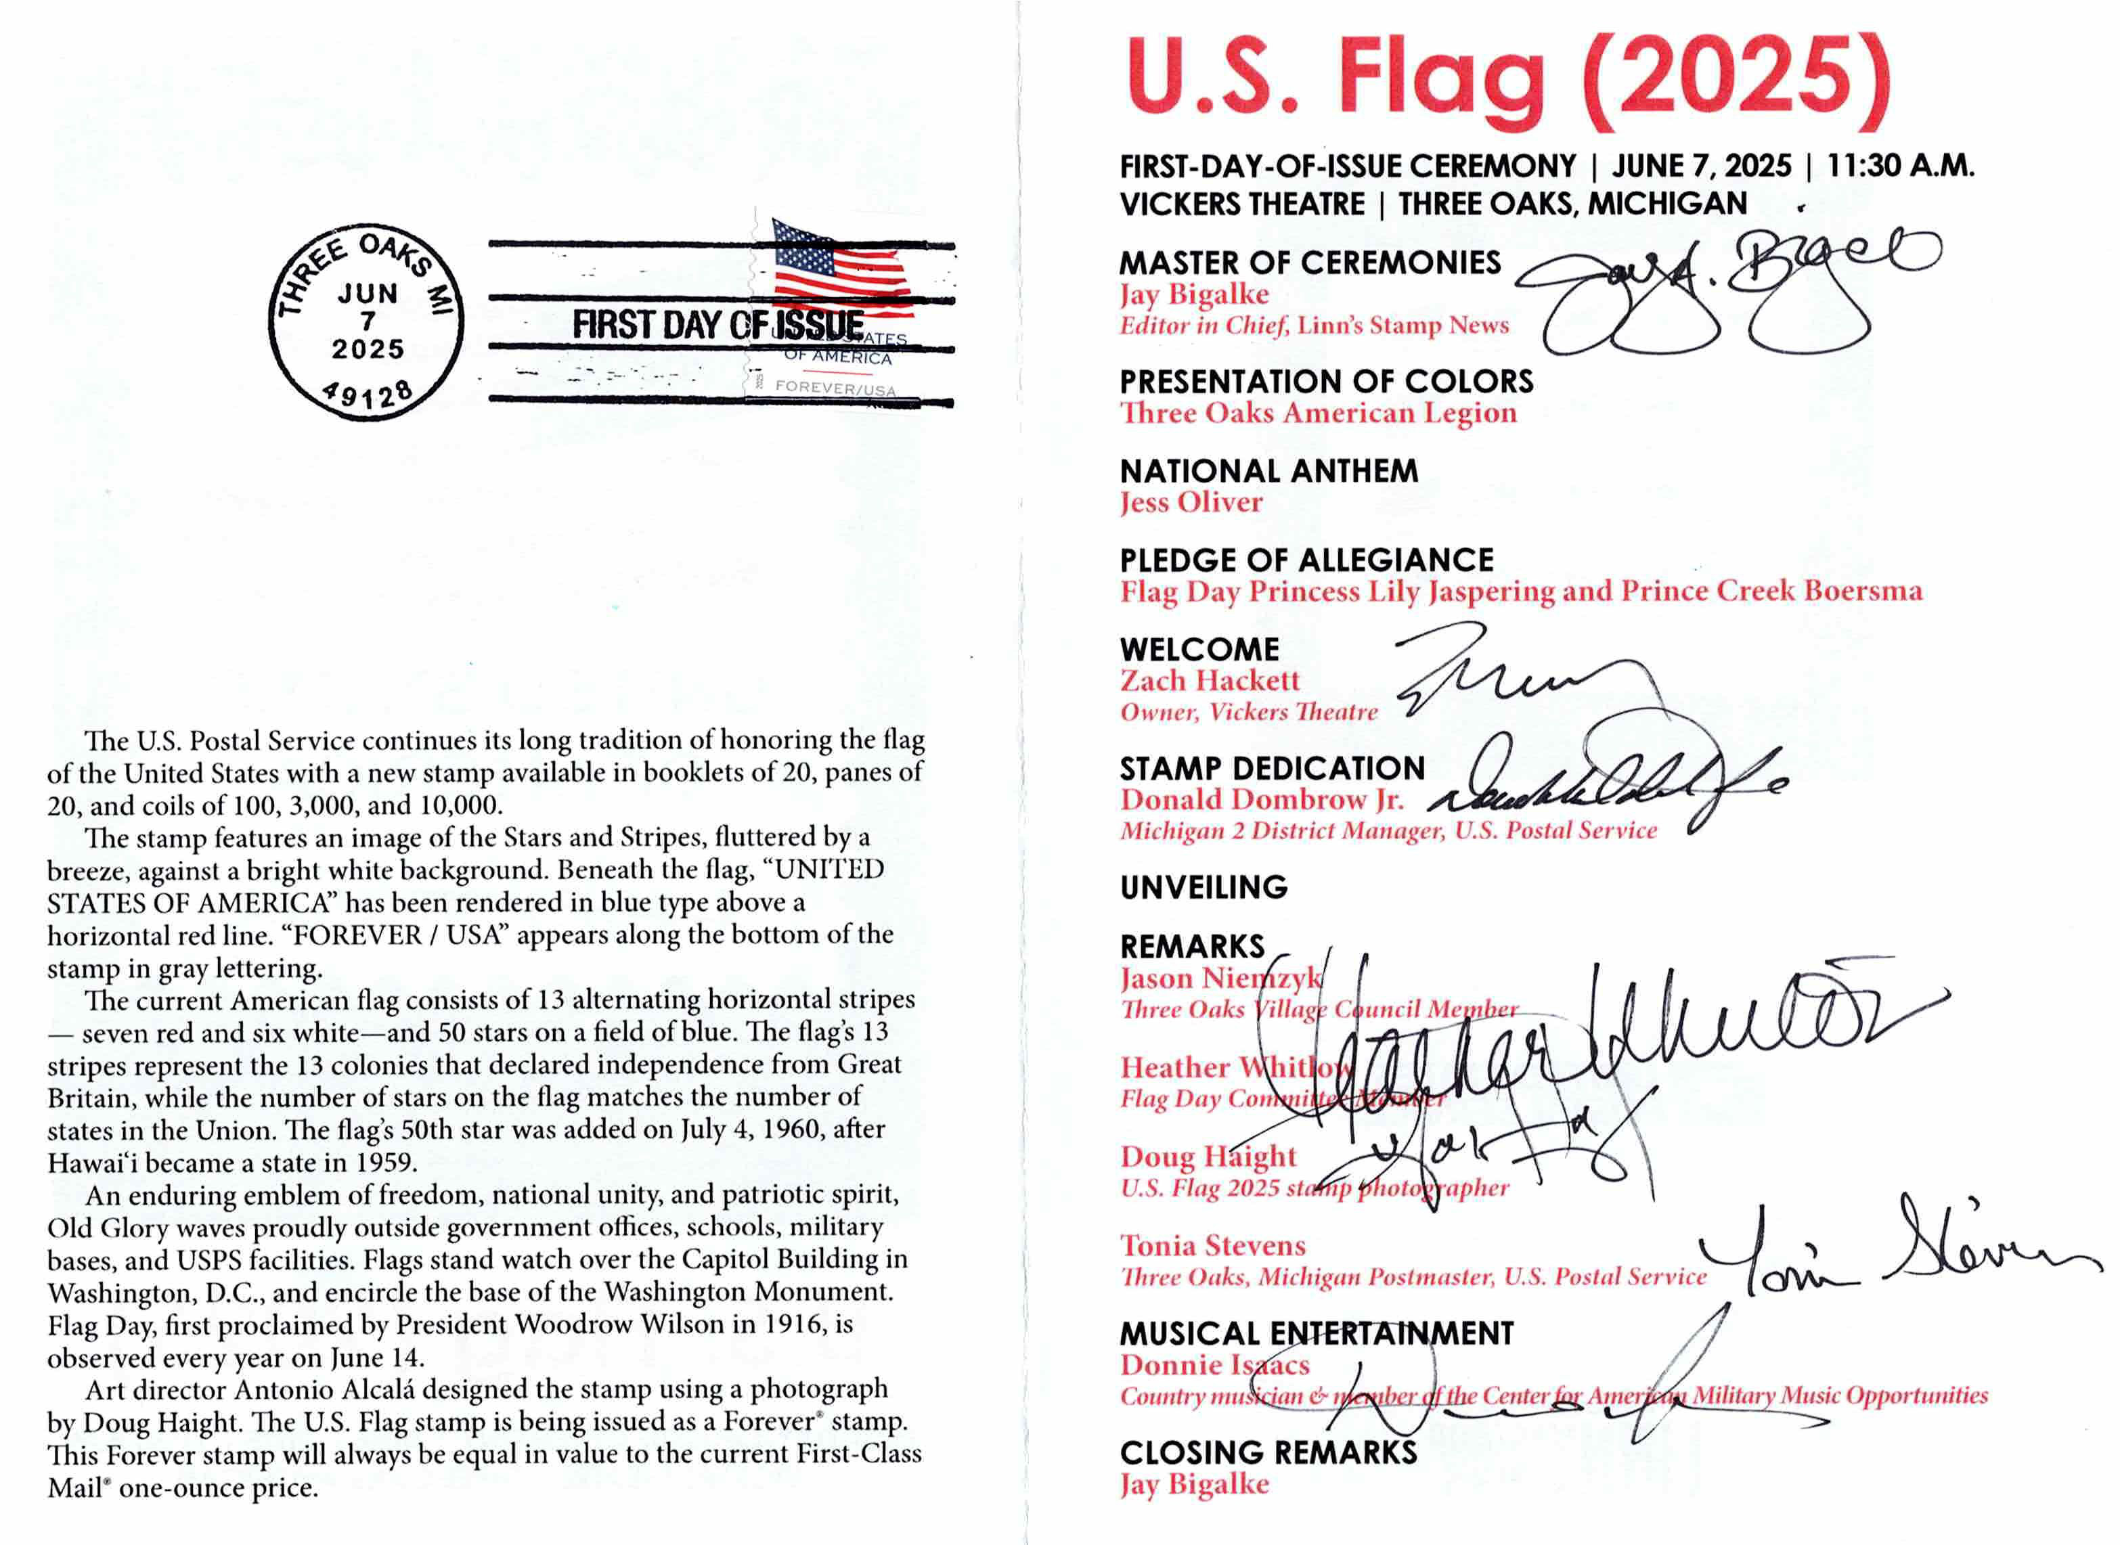
Jun. 7 Three Oaks, Michigan US Flag

Slide 9
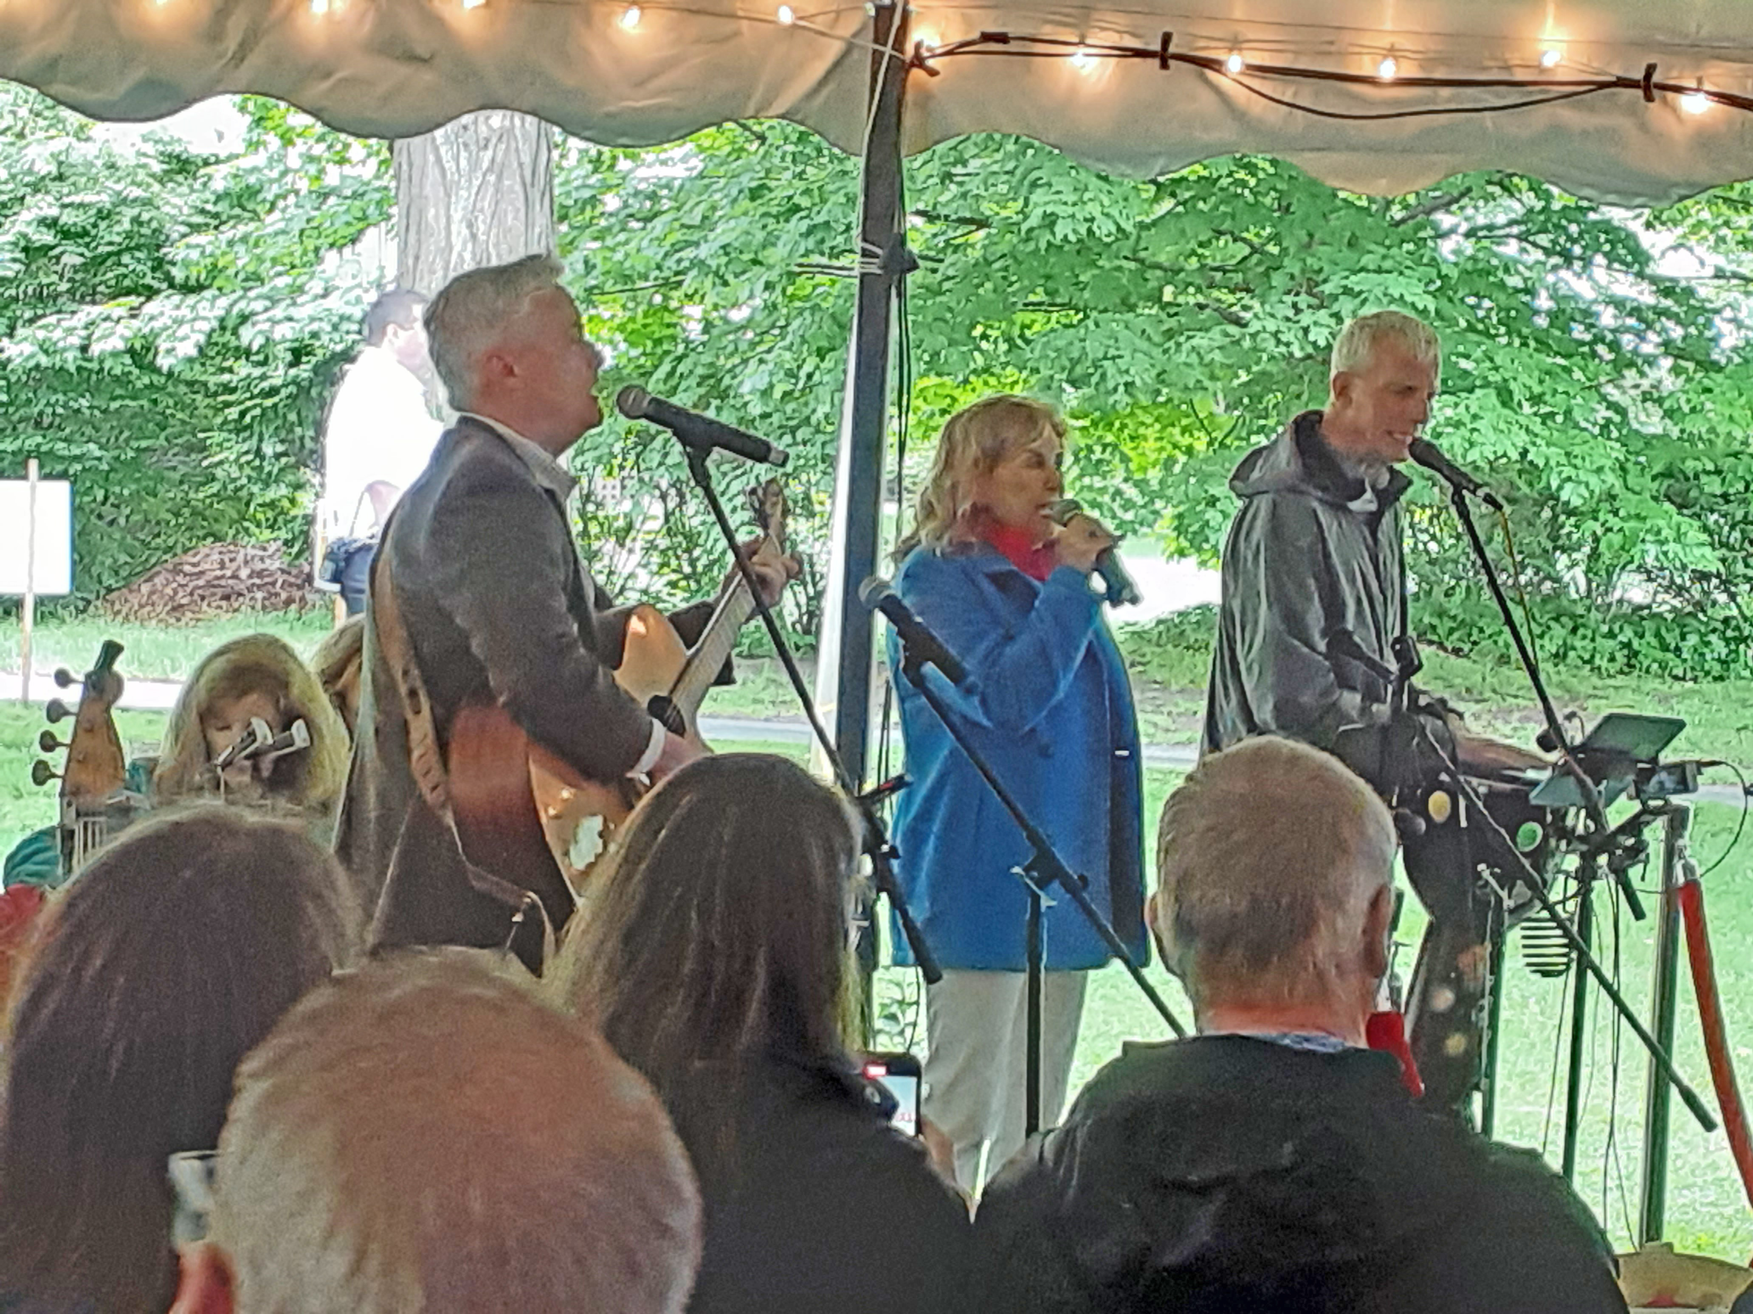
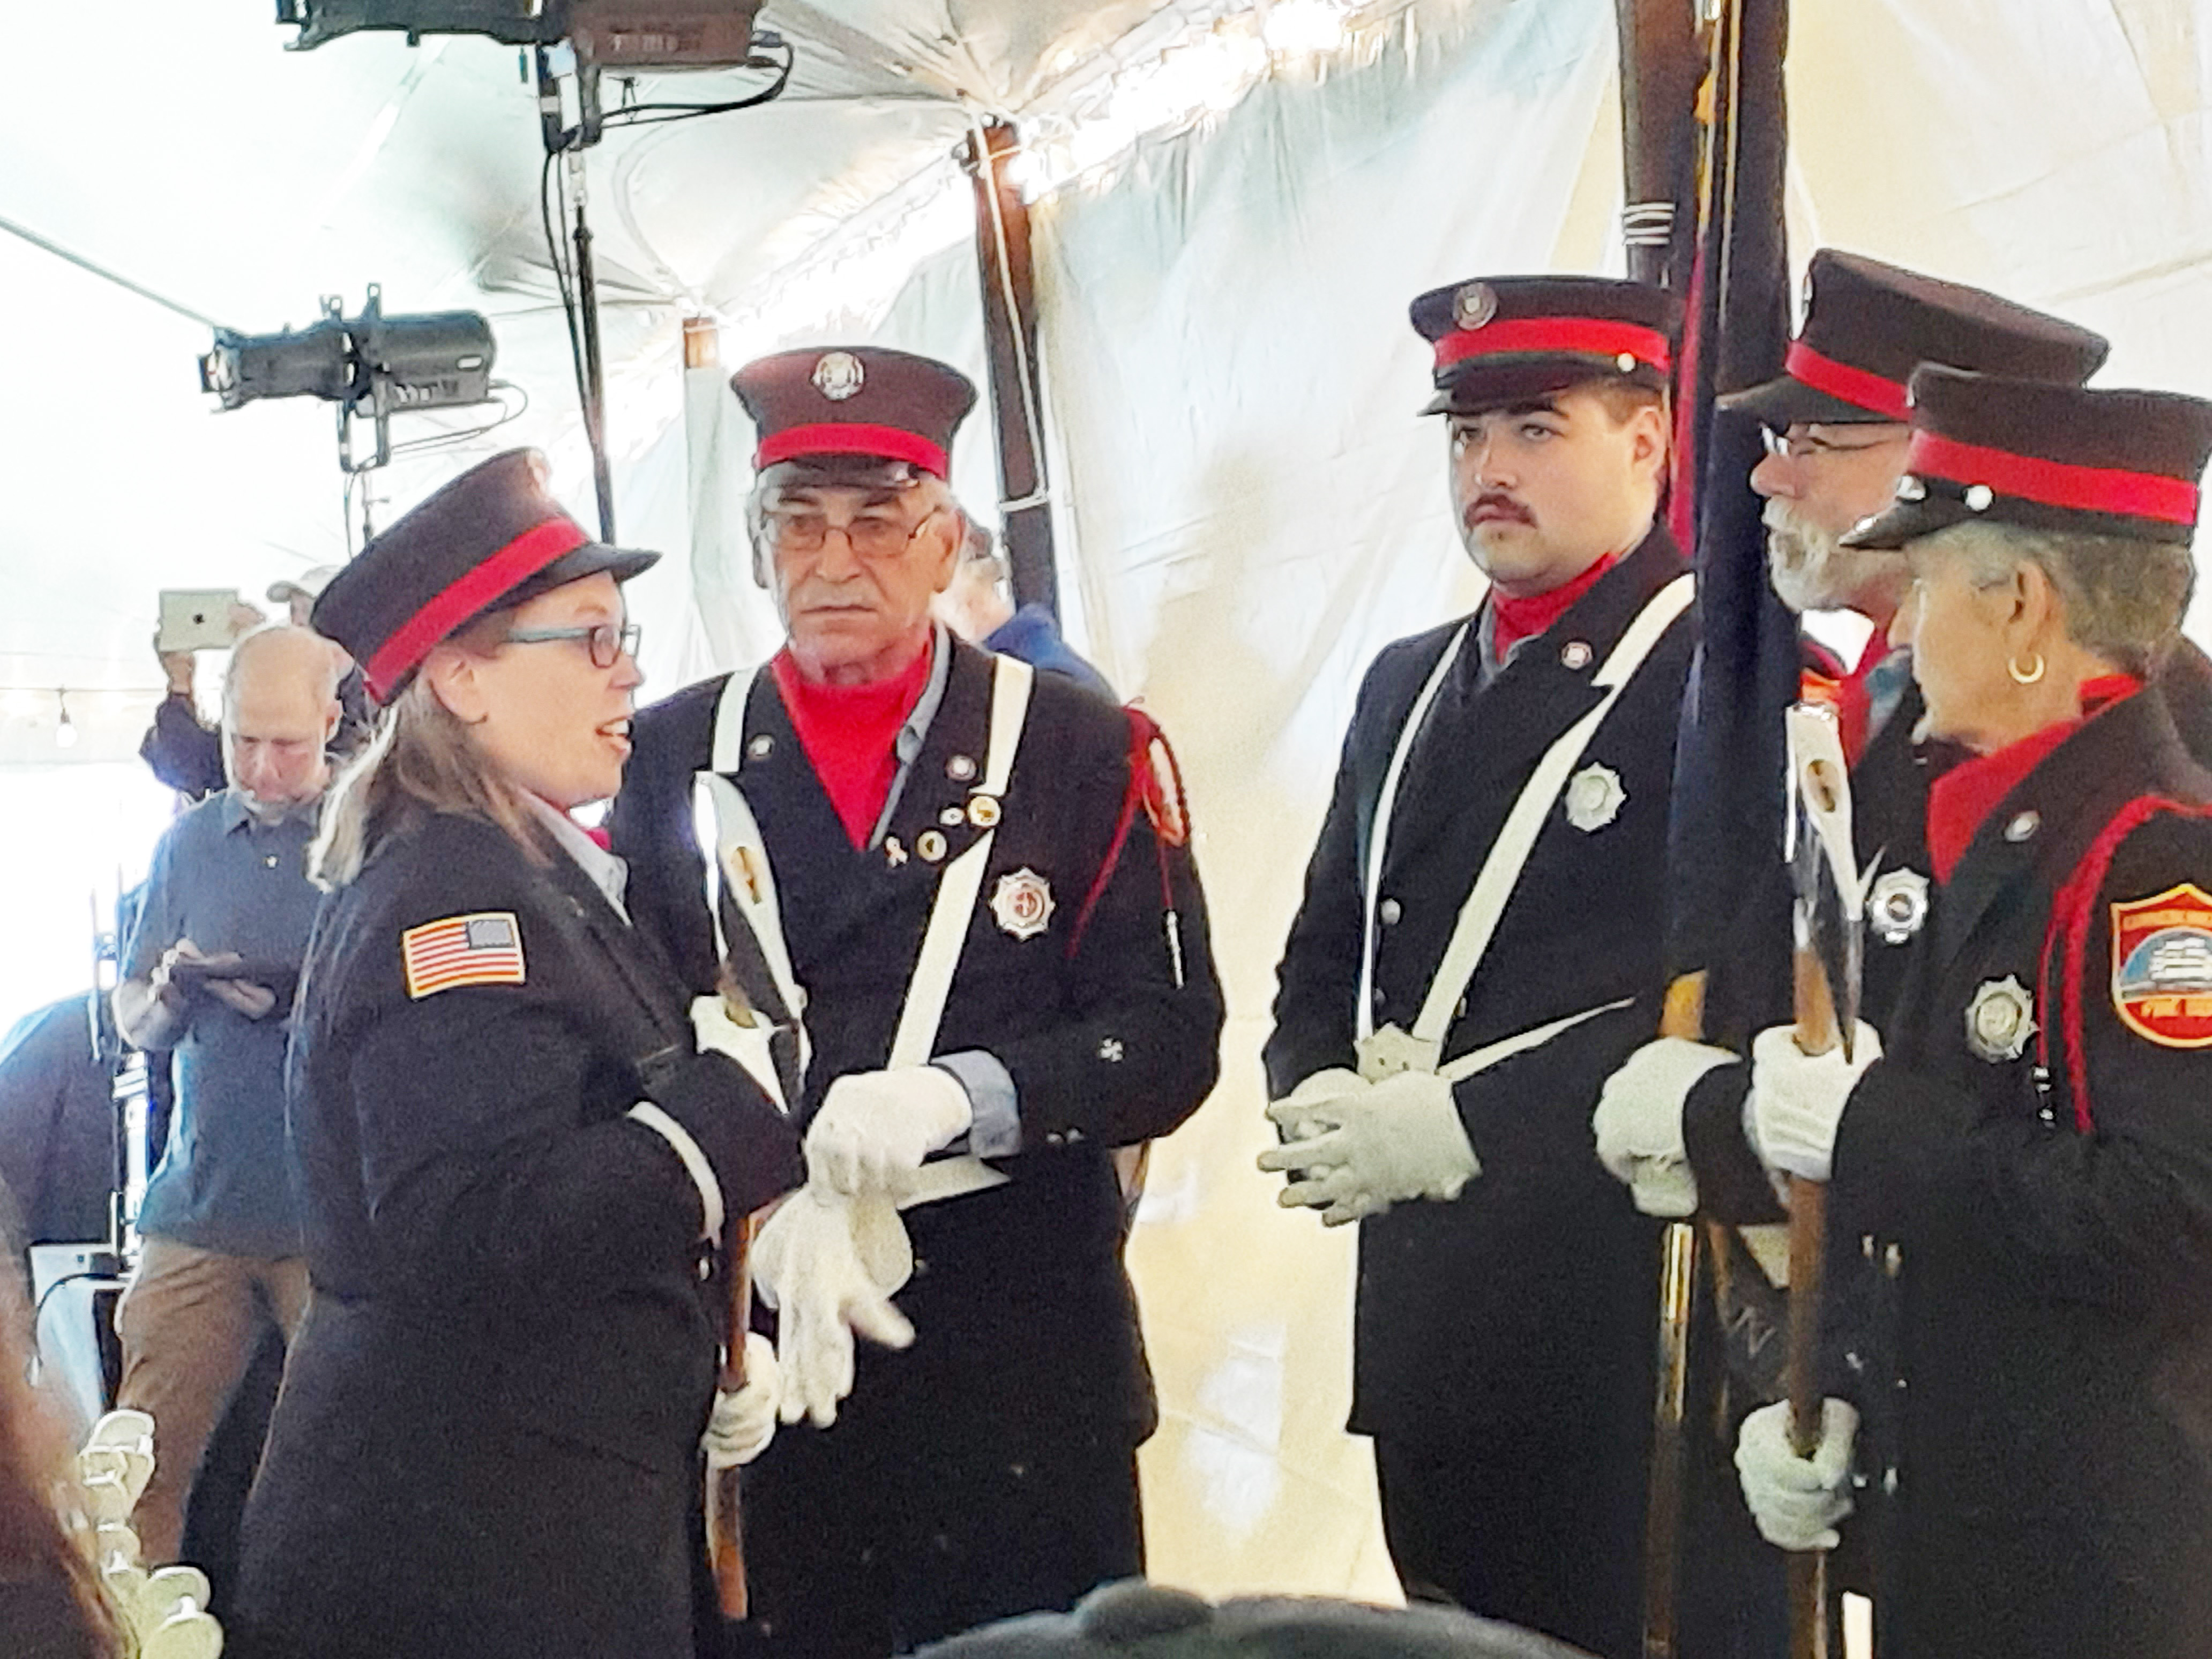
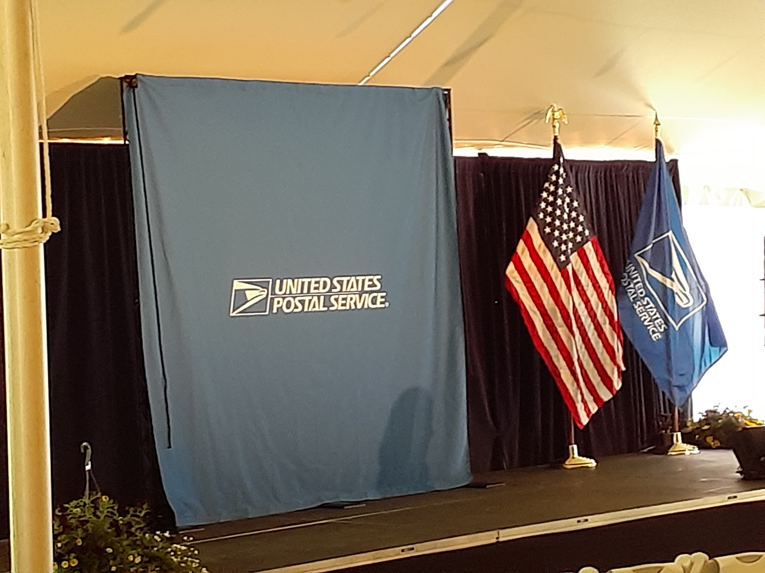
Jun. 10 Kennebunkport, ME Barbara Bush
National ceremony. Fire department honor guard.
Music by Lisa, Jim and Byran Band.
Held under a tent in Ganny’s Garden, a site visited and supported by Mrs. Bush.

Slide 10
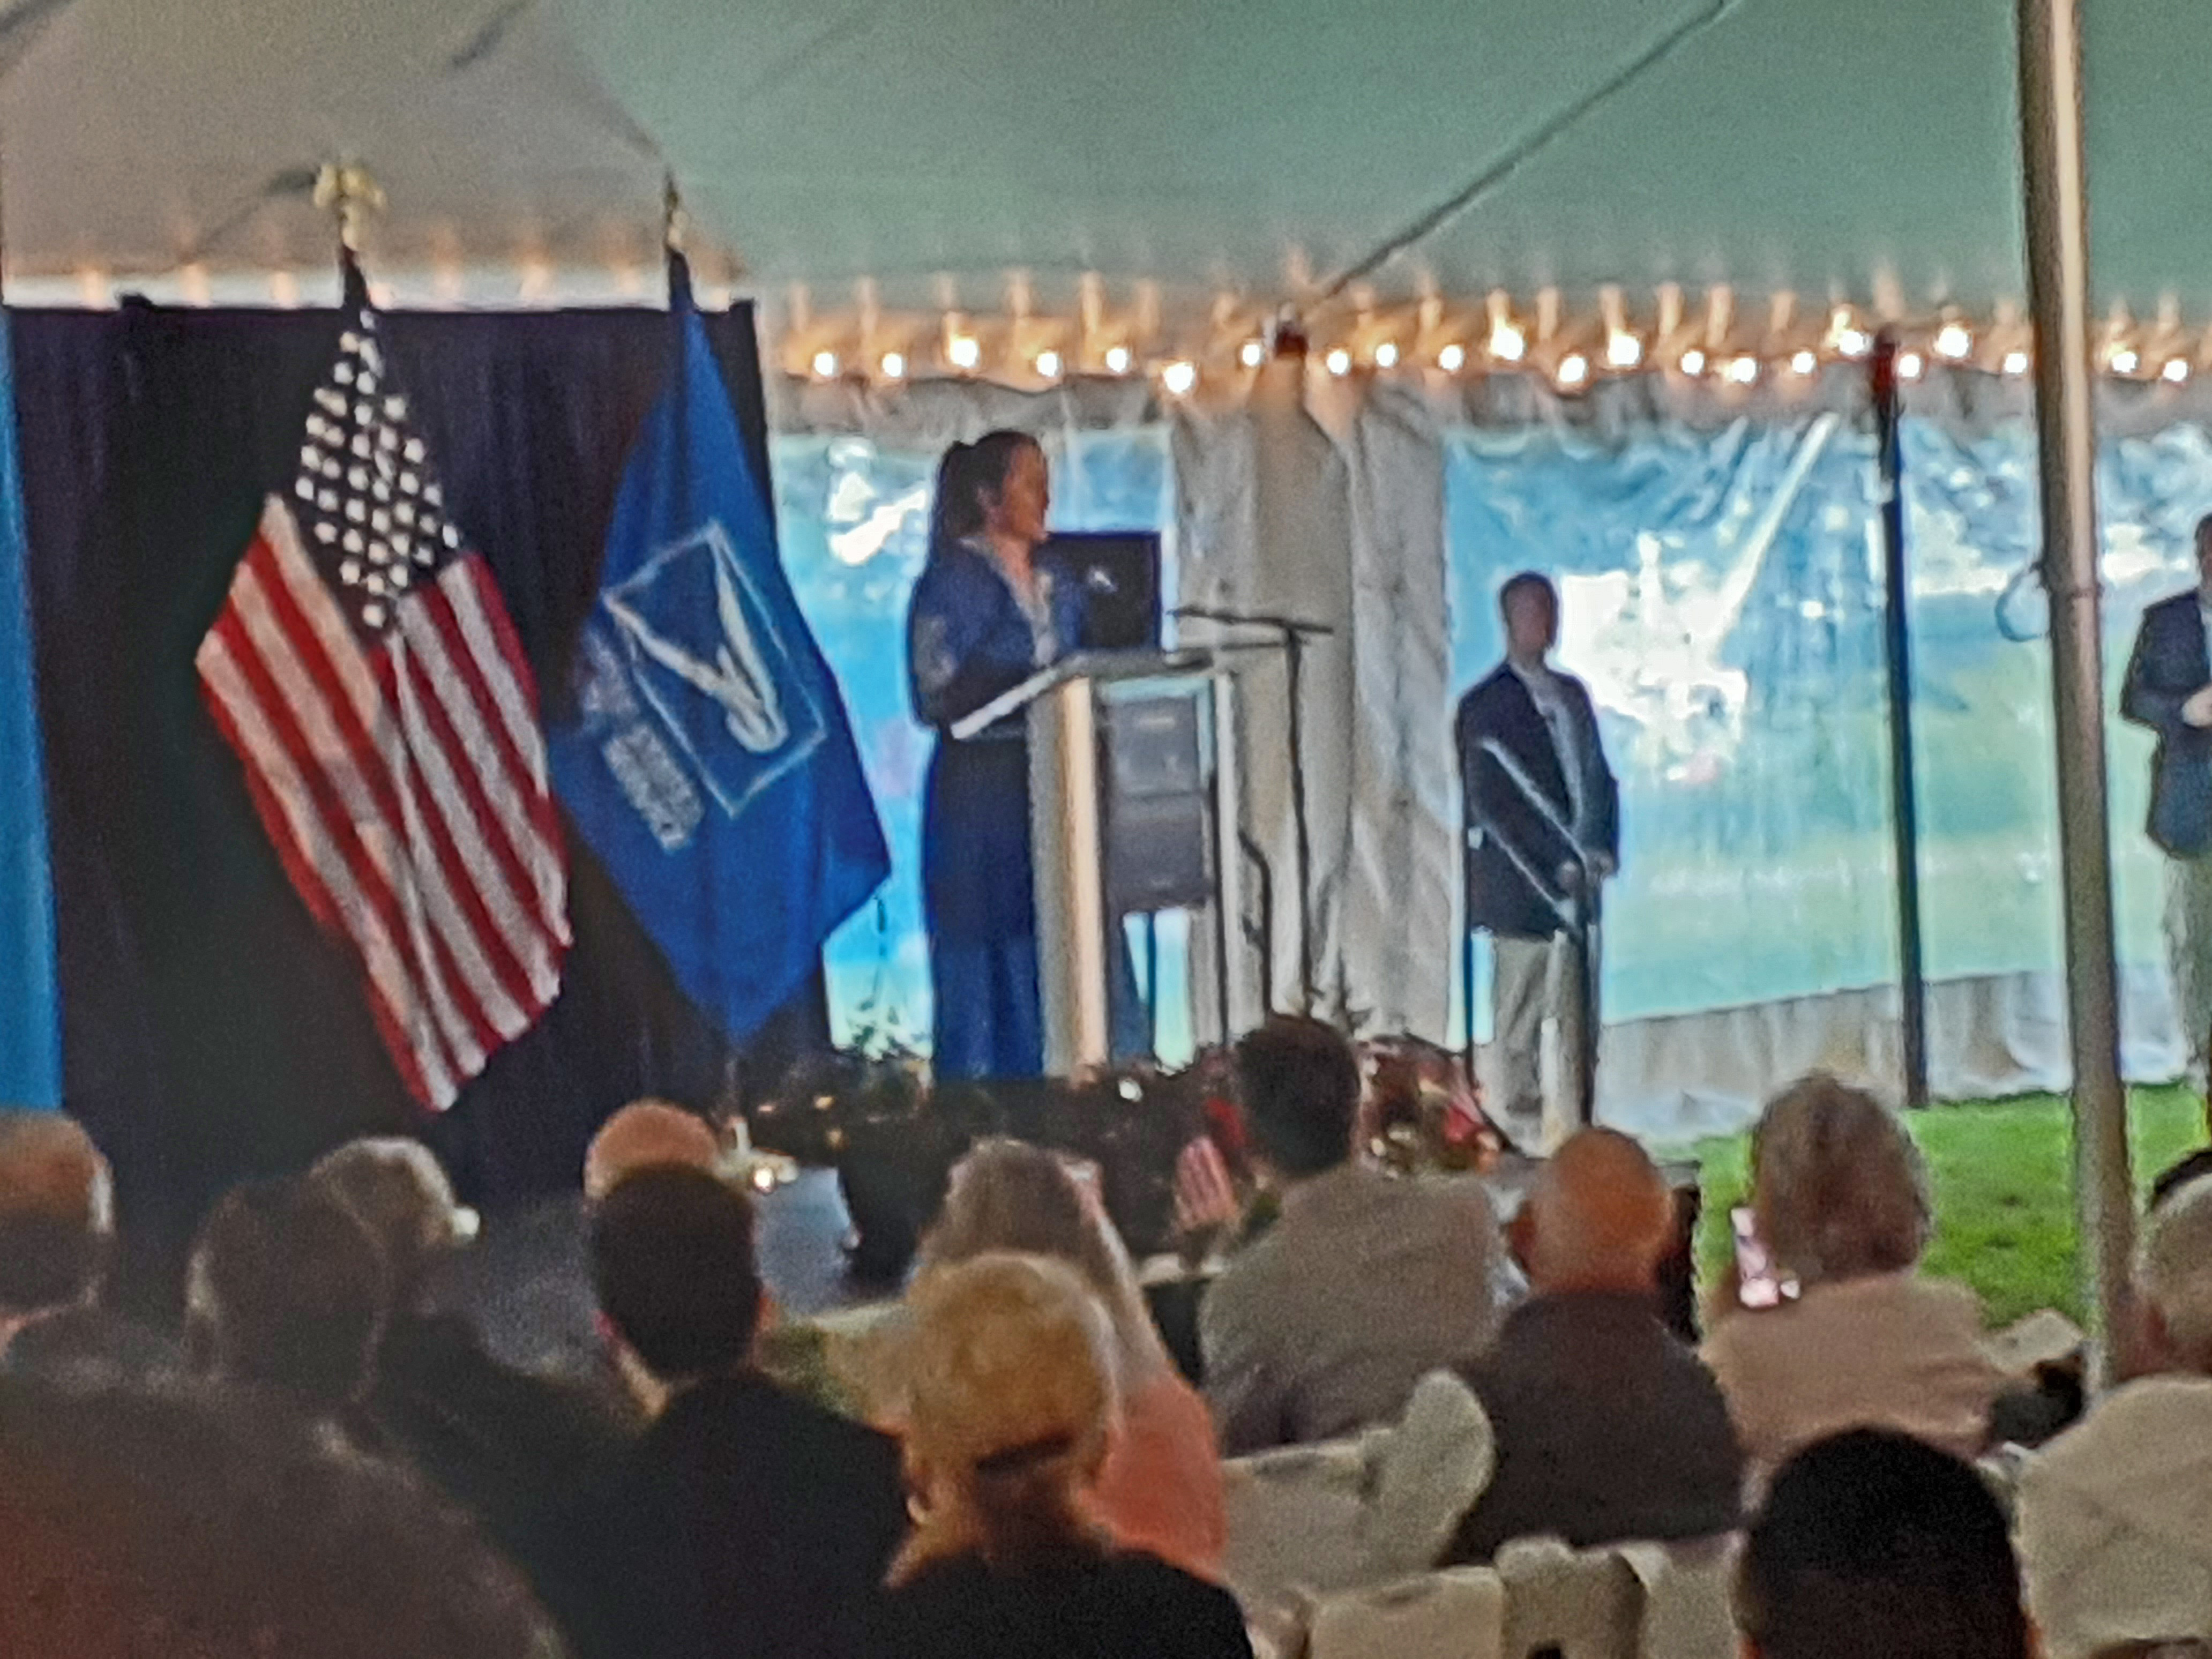
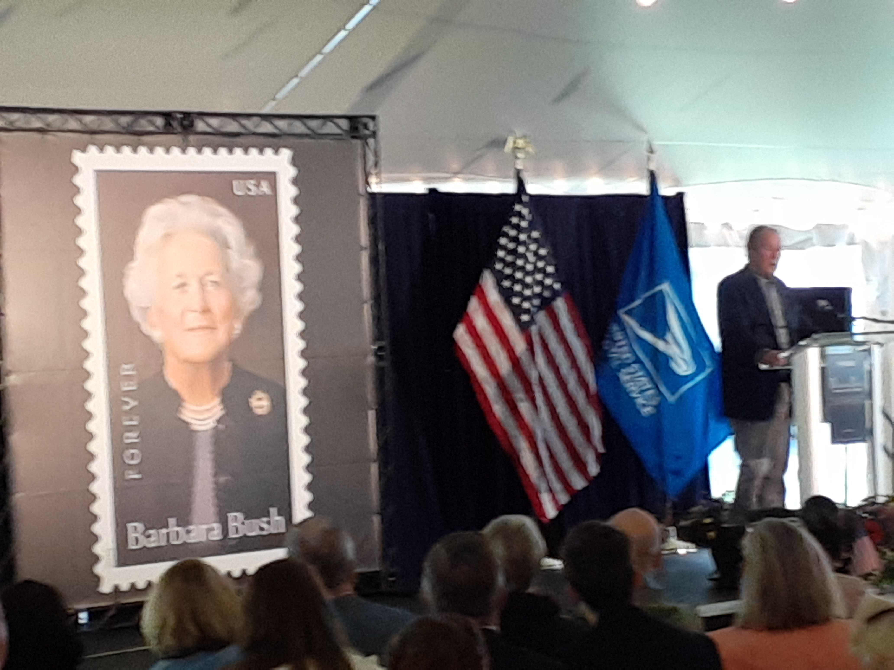
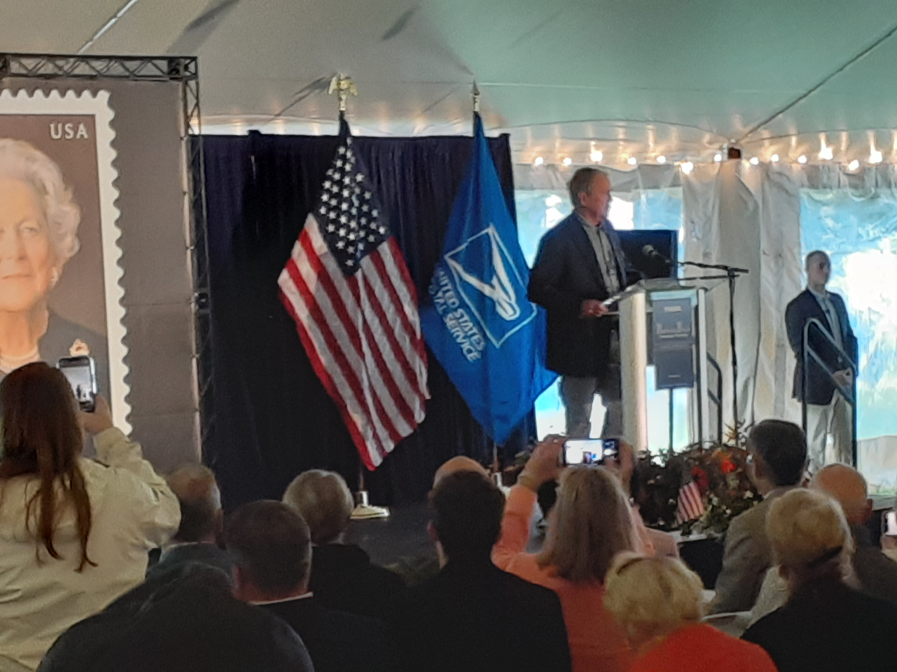
Jun. 10 Kennebunkport, ME Barbara Bush
Alice Gonzalez Yates, Master of Ceremonies, CEO of George and Barbara Bush Foundation.
Featured speaker was George W. Bush, 43rd President, son of Barbara.

Slide 11
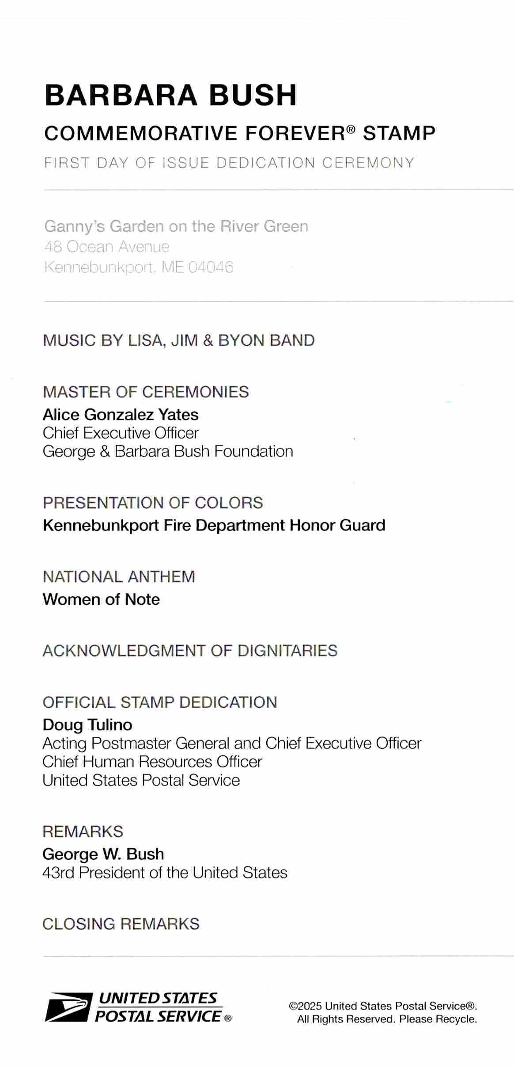
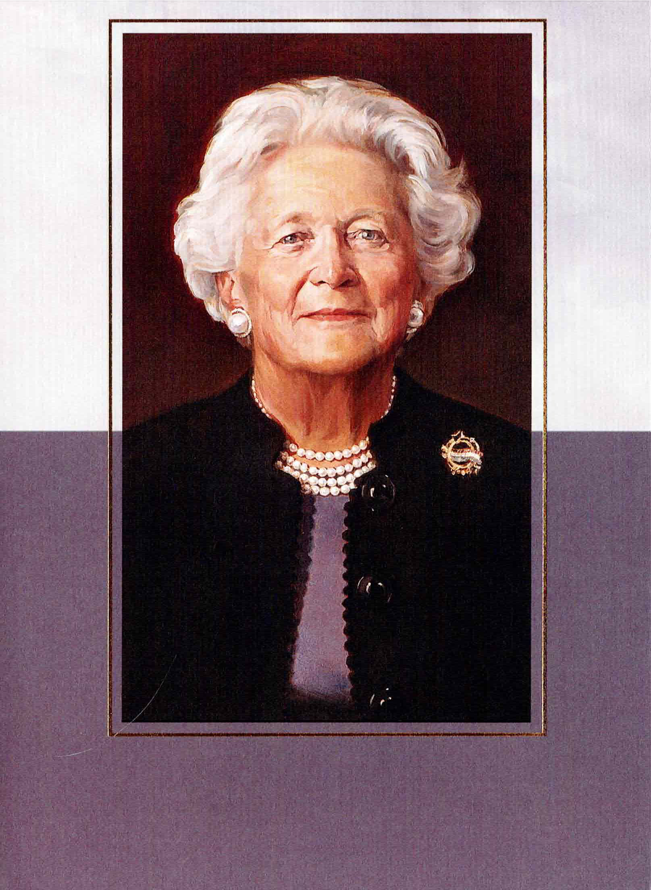
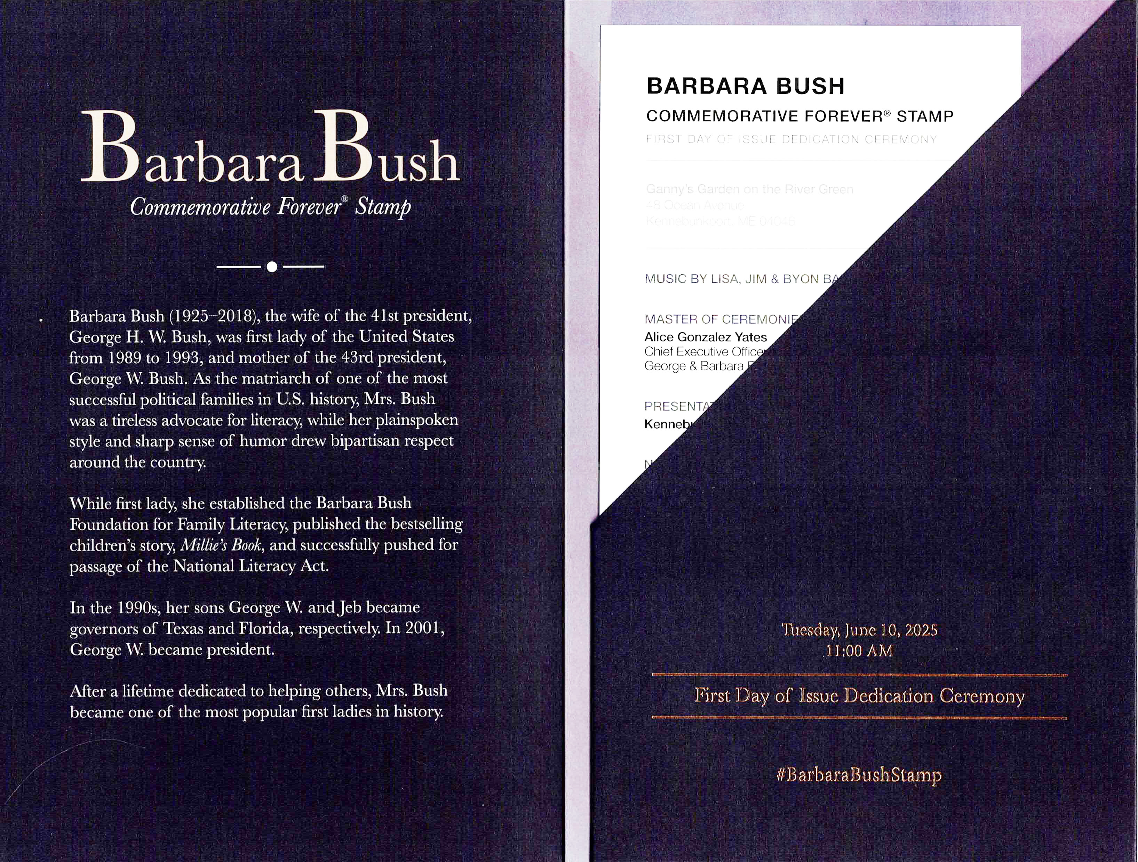
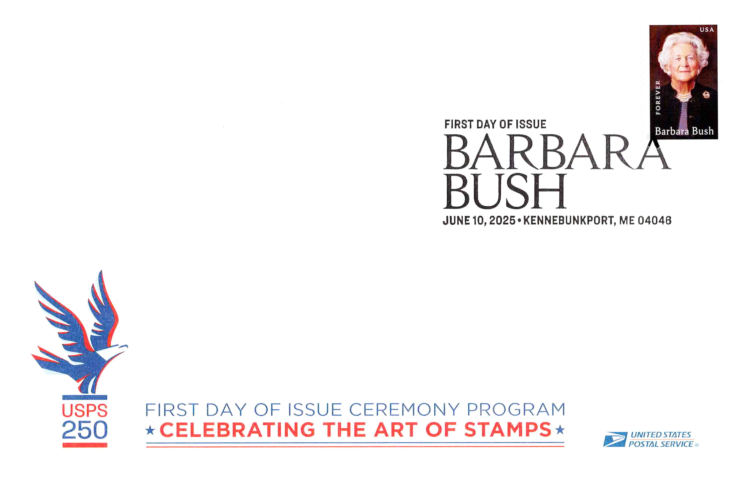
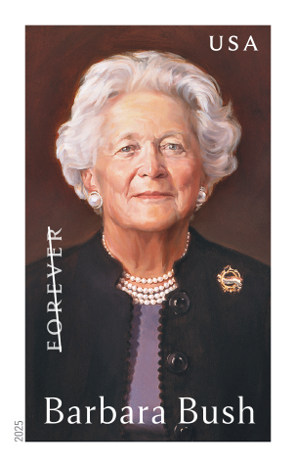
Jun. 10 Kennebunkport, ME Barbara Bush

Slide 12
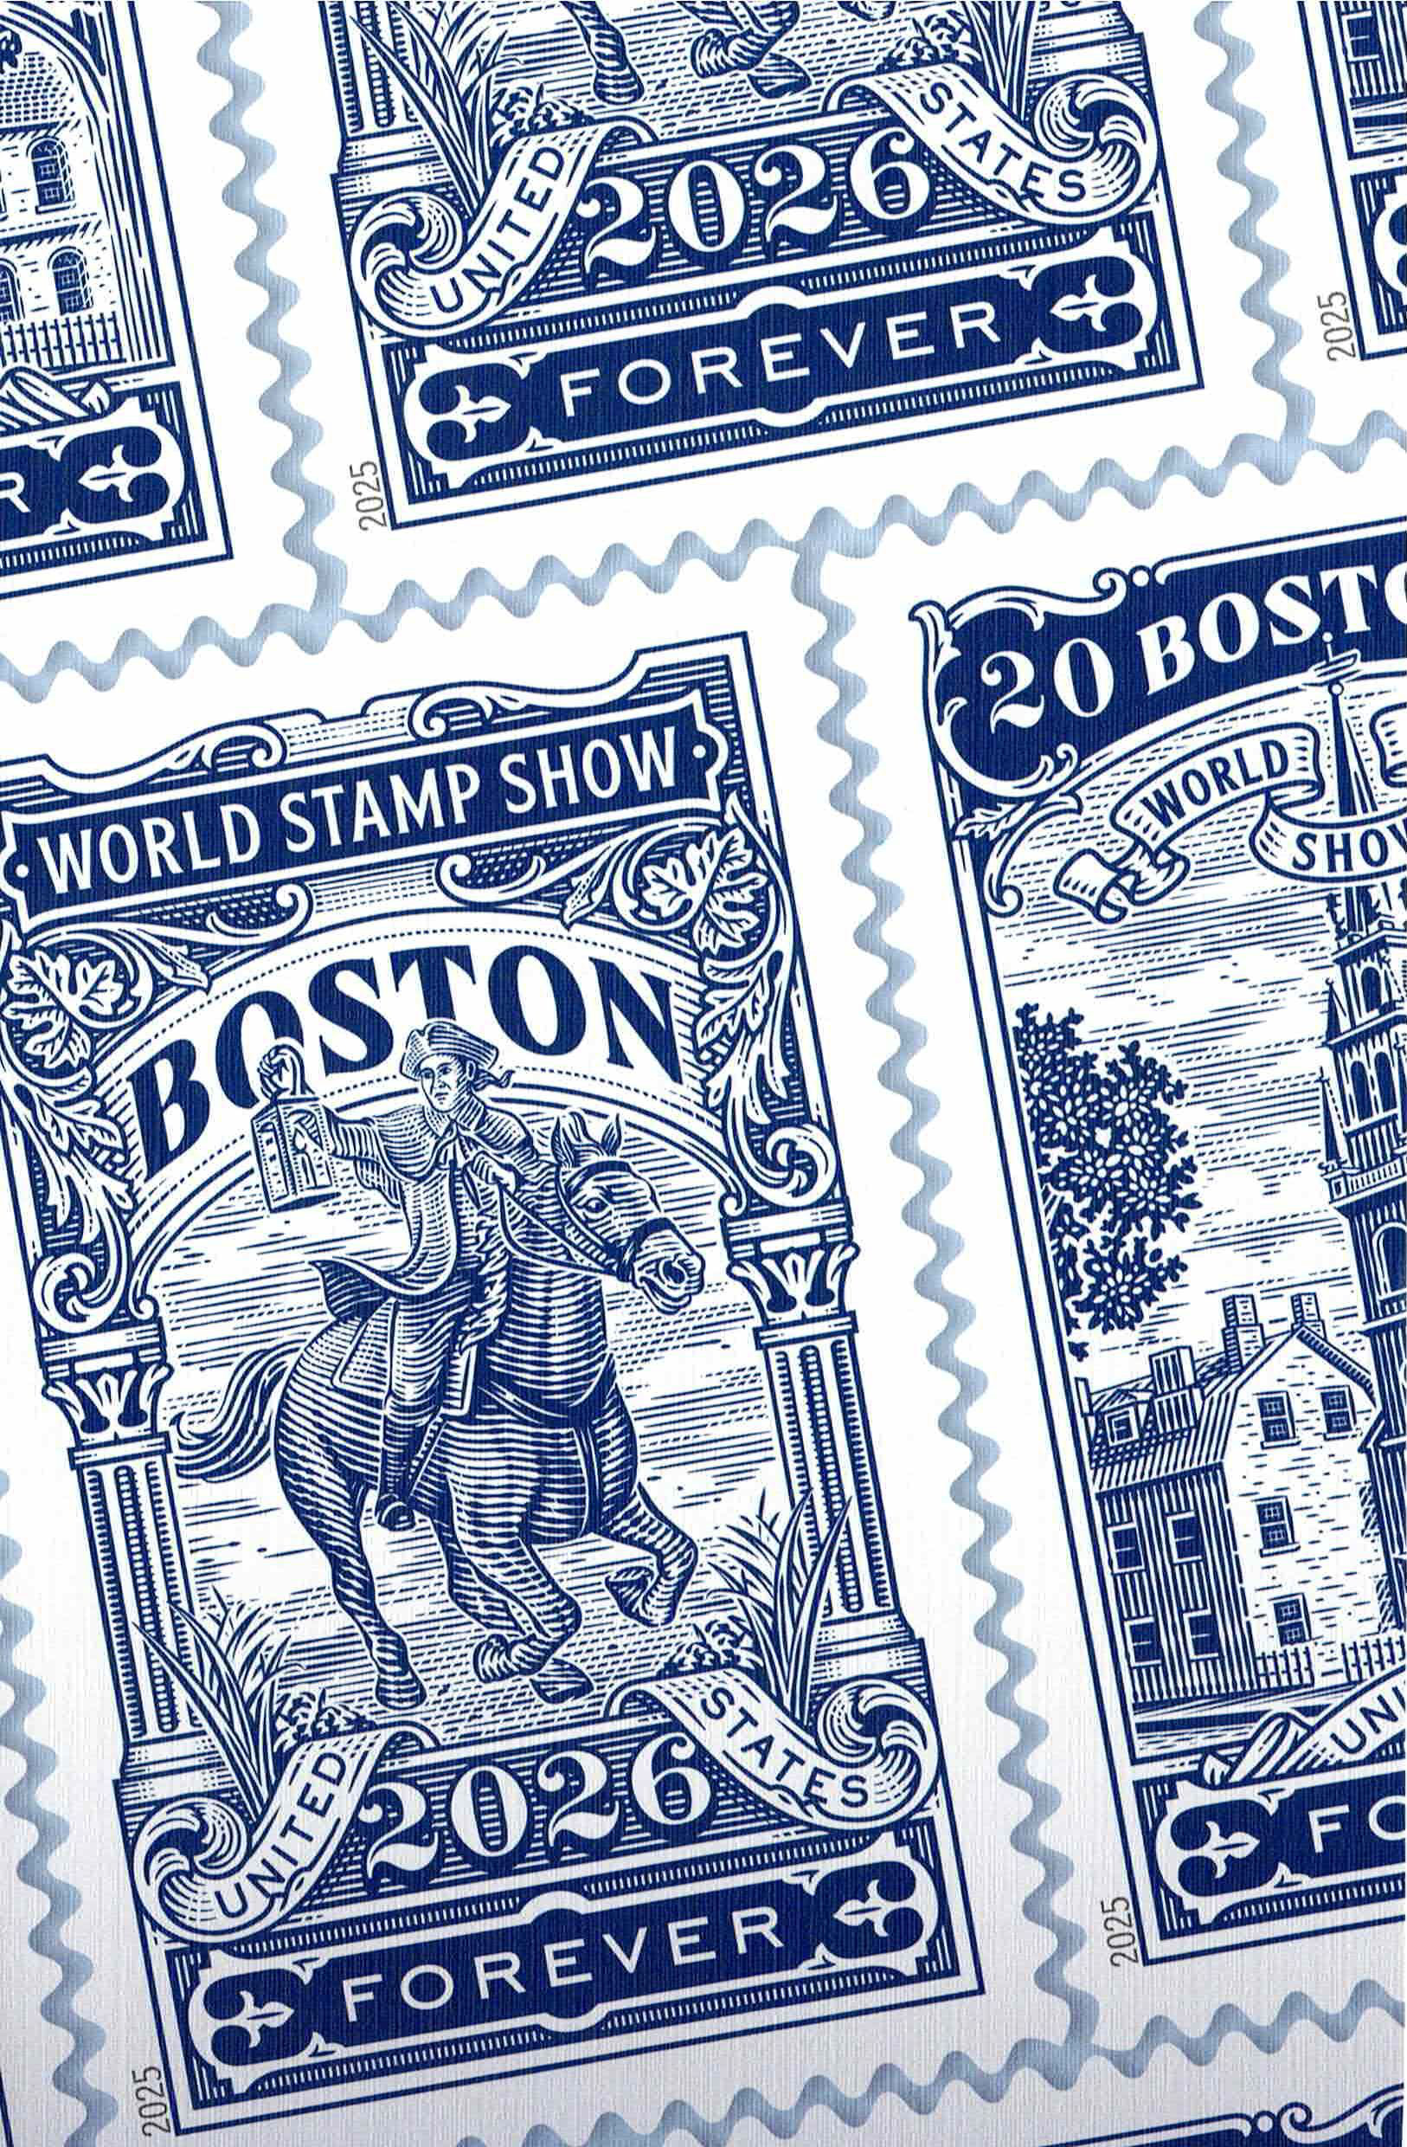
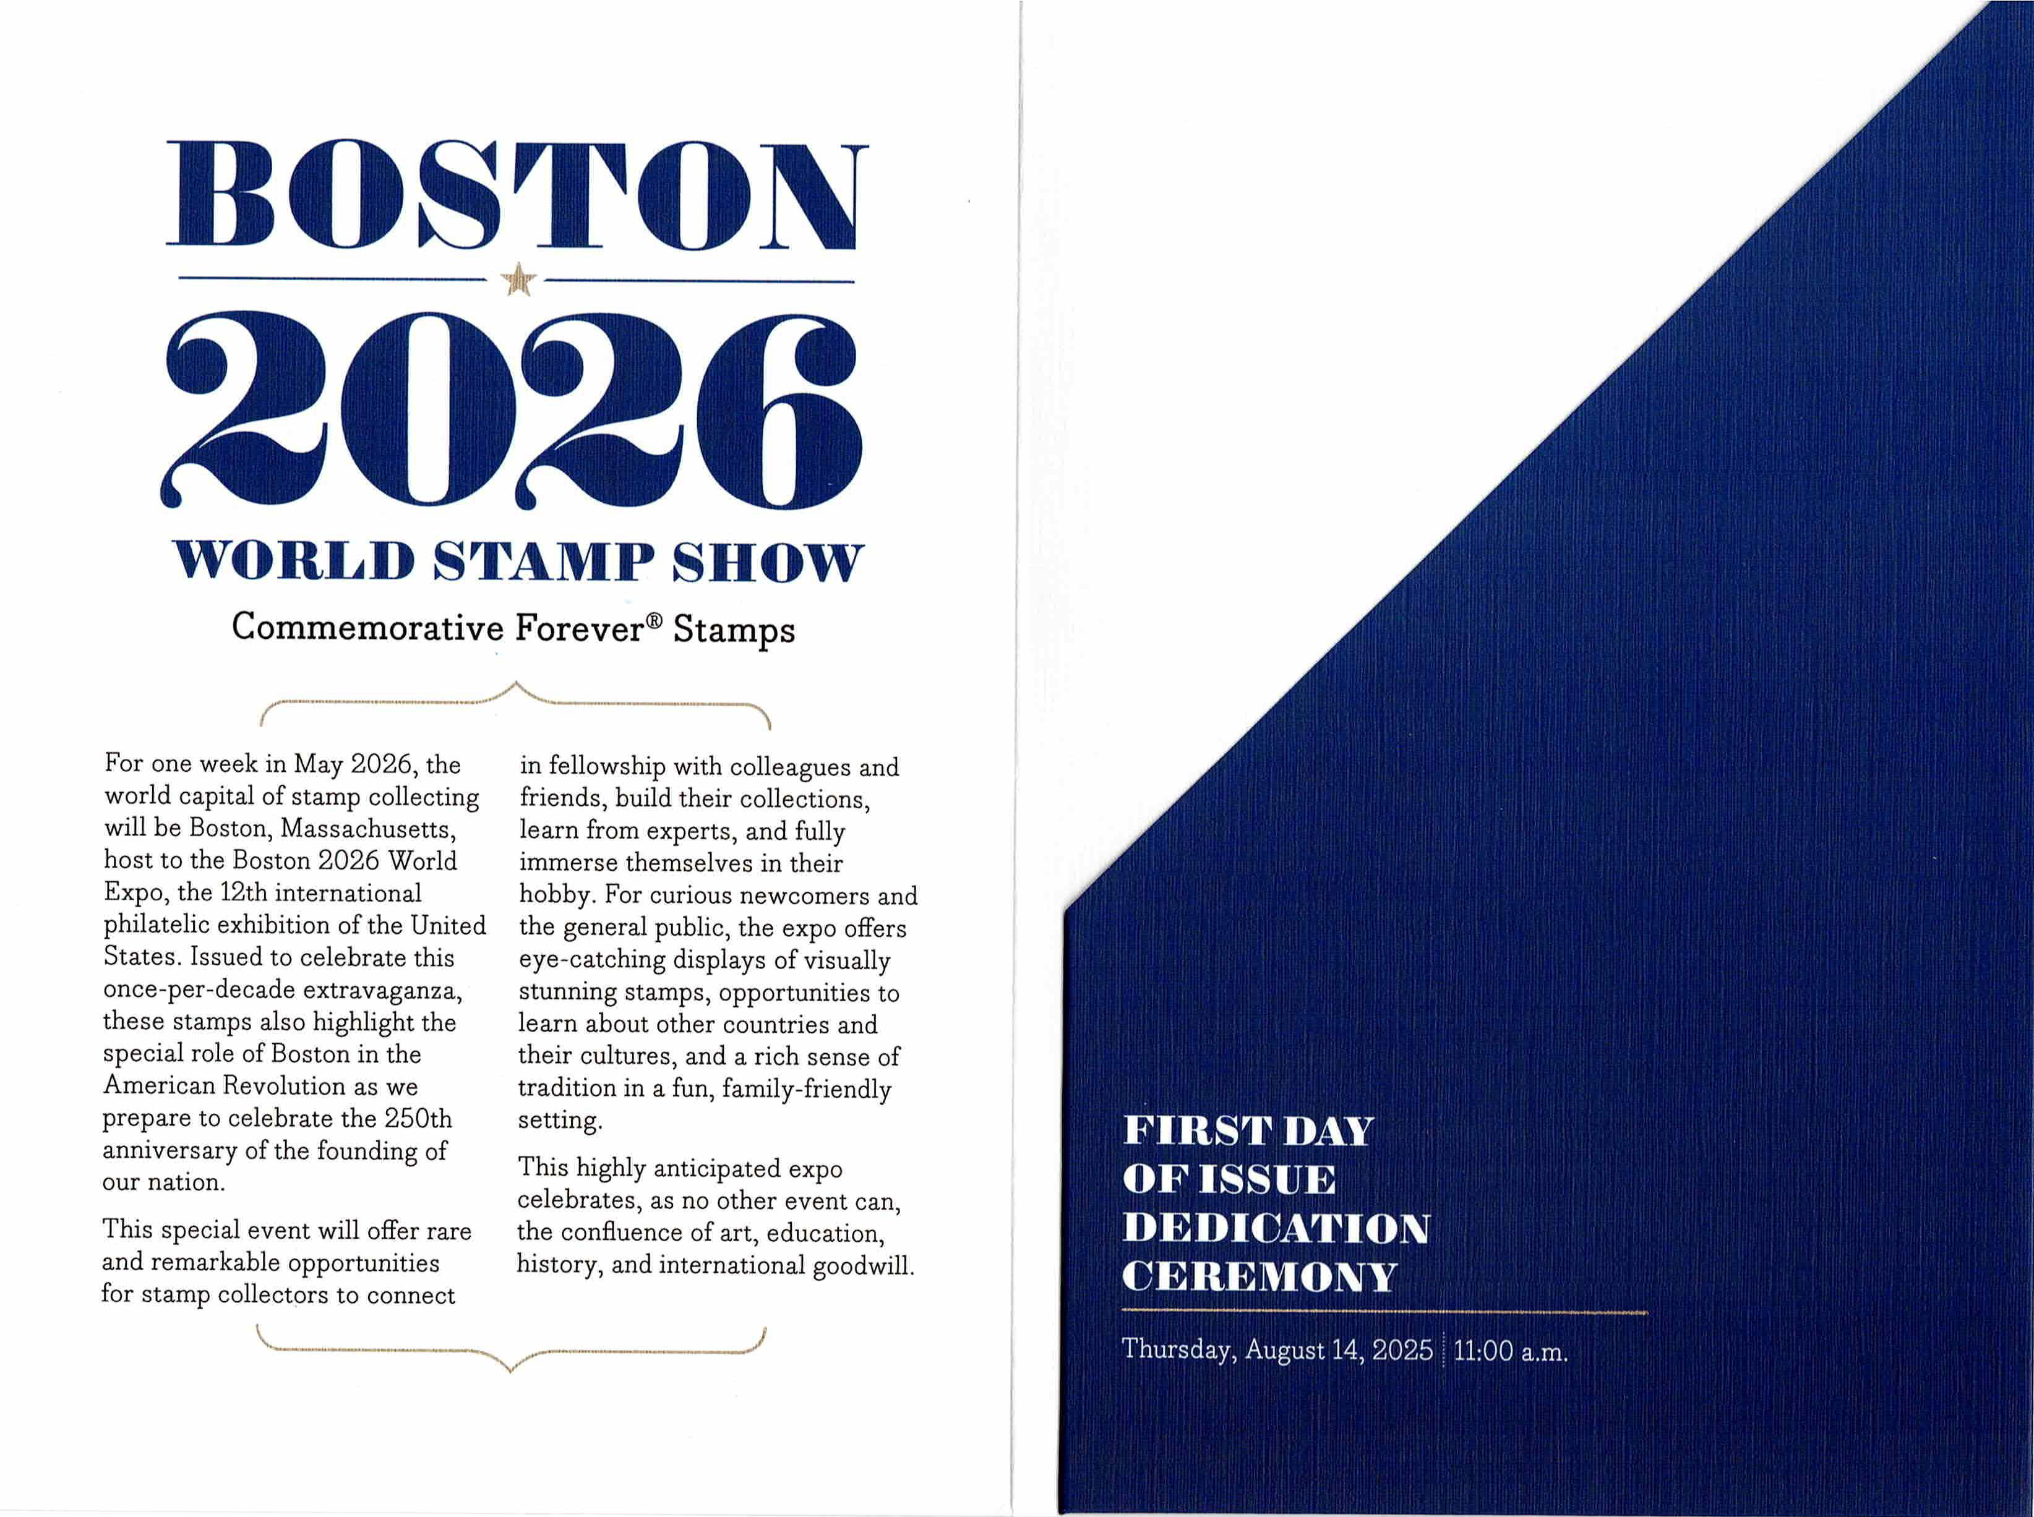
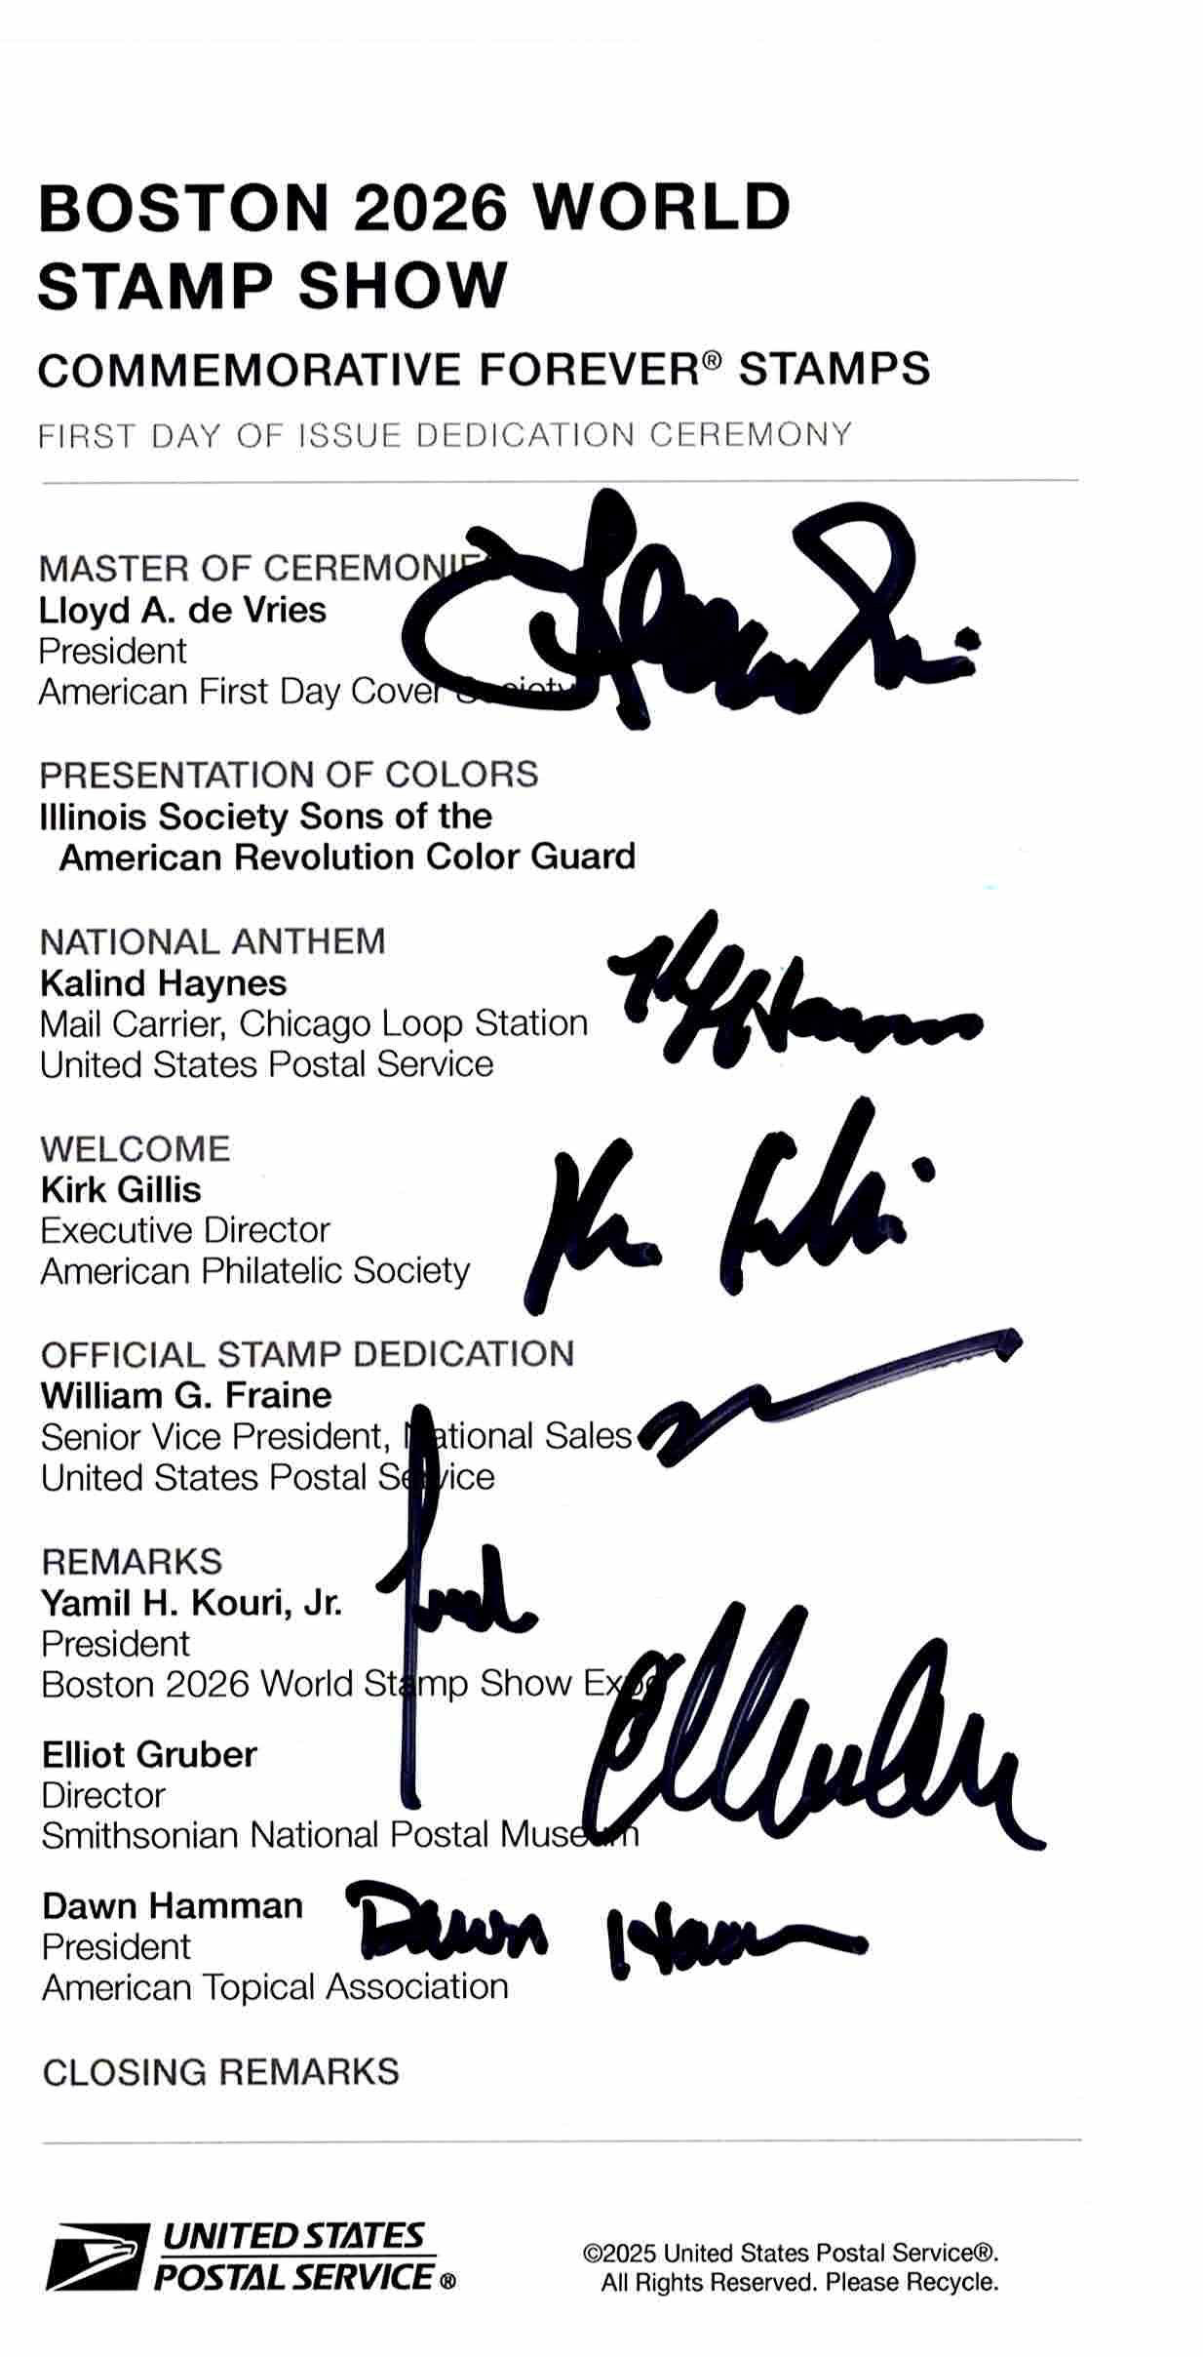
Aug. 14 Schaumberg, IL Boston 2026 Commemoratives
Held at the APS/ATA/AFDCS Great American Stamp Show in the Chicago suburbs.

Slide 13
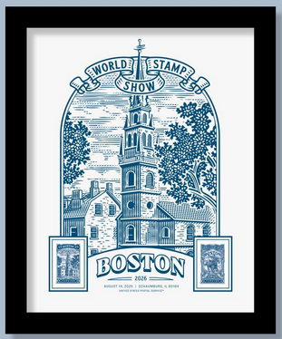
Aug. 14 Schaumberg, IL Boston 2026

Slide 14
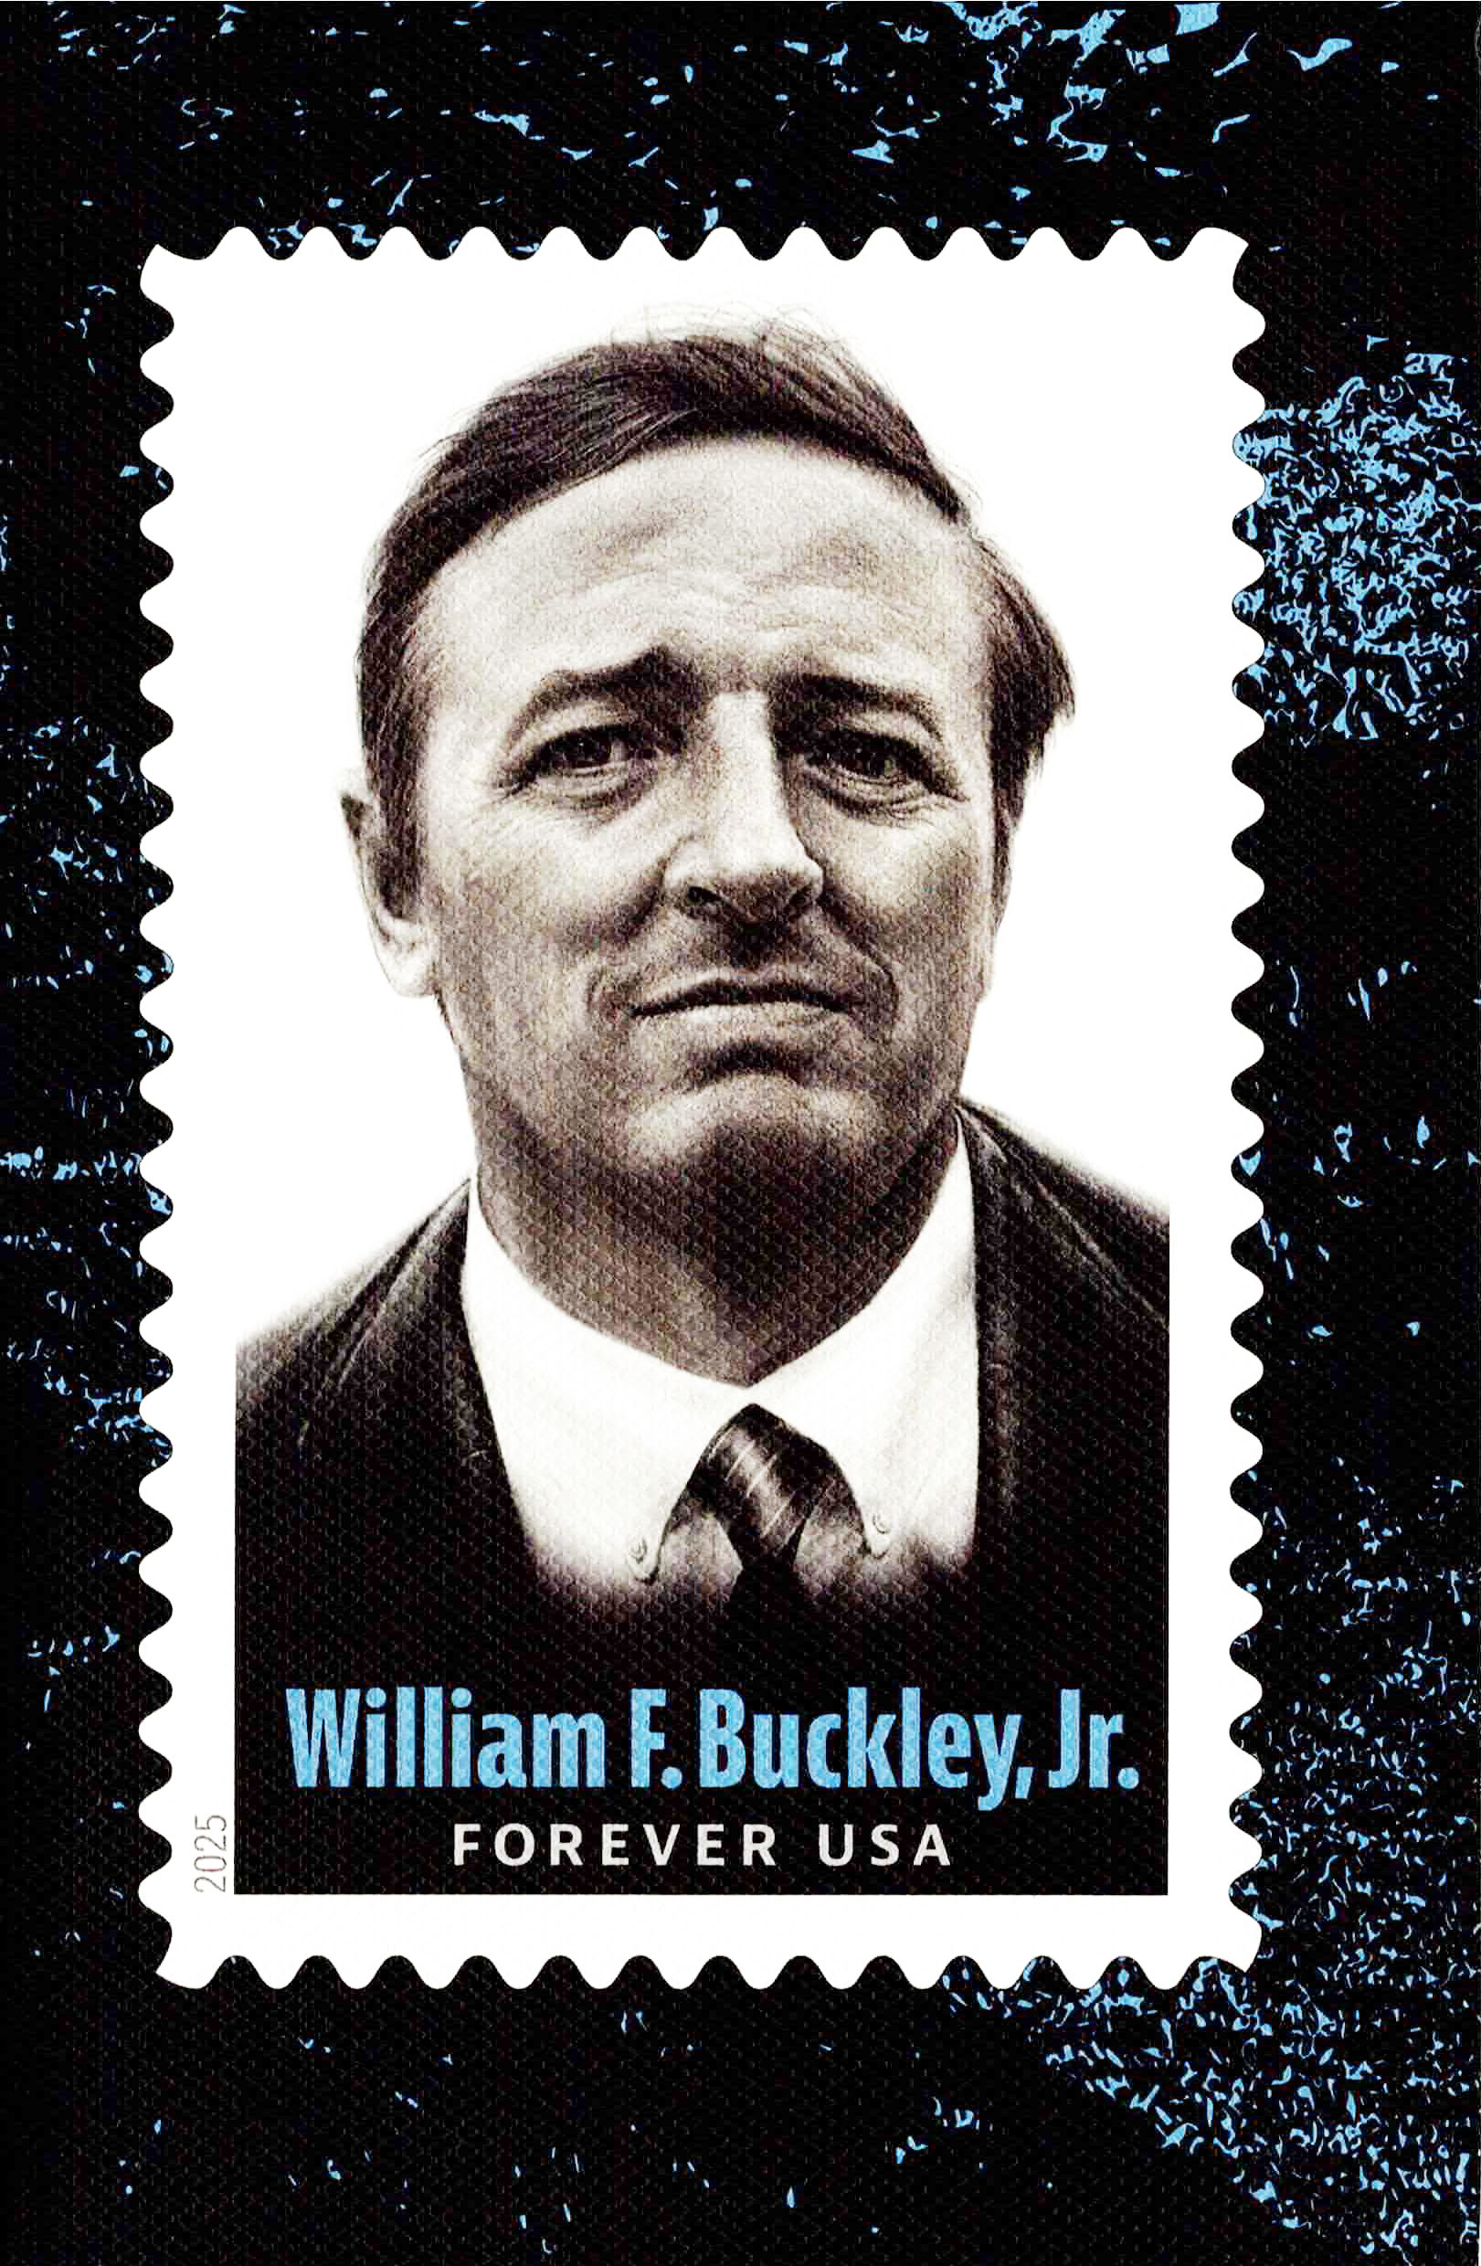
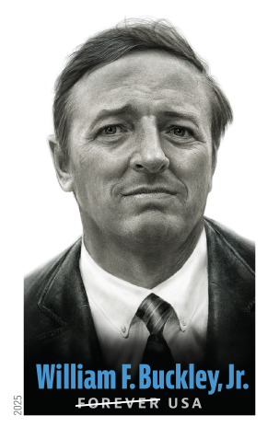
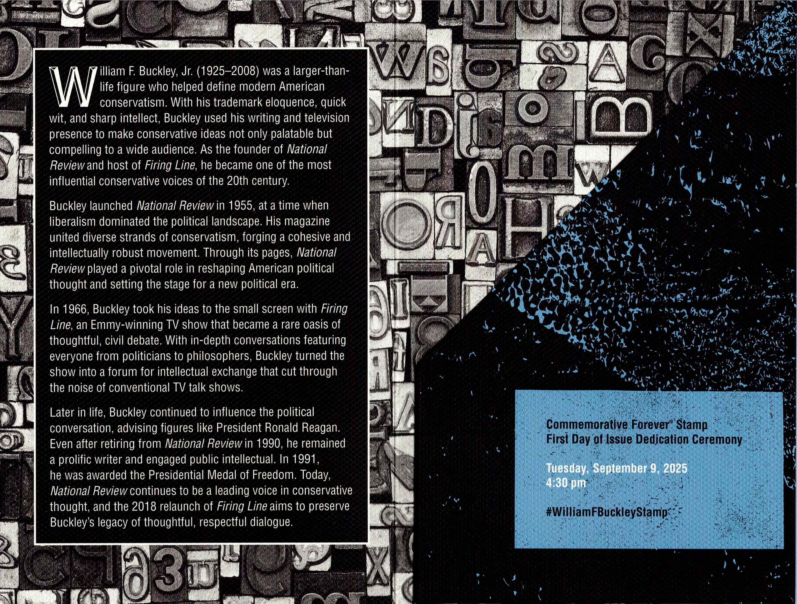
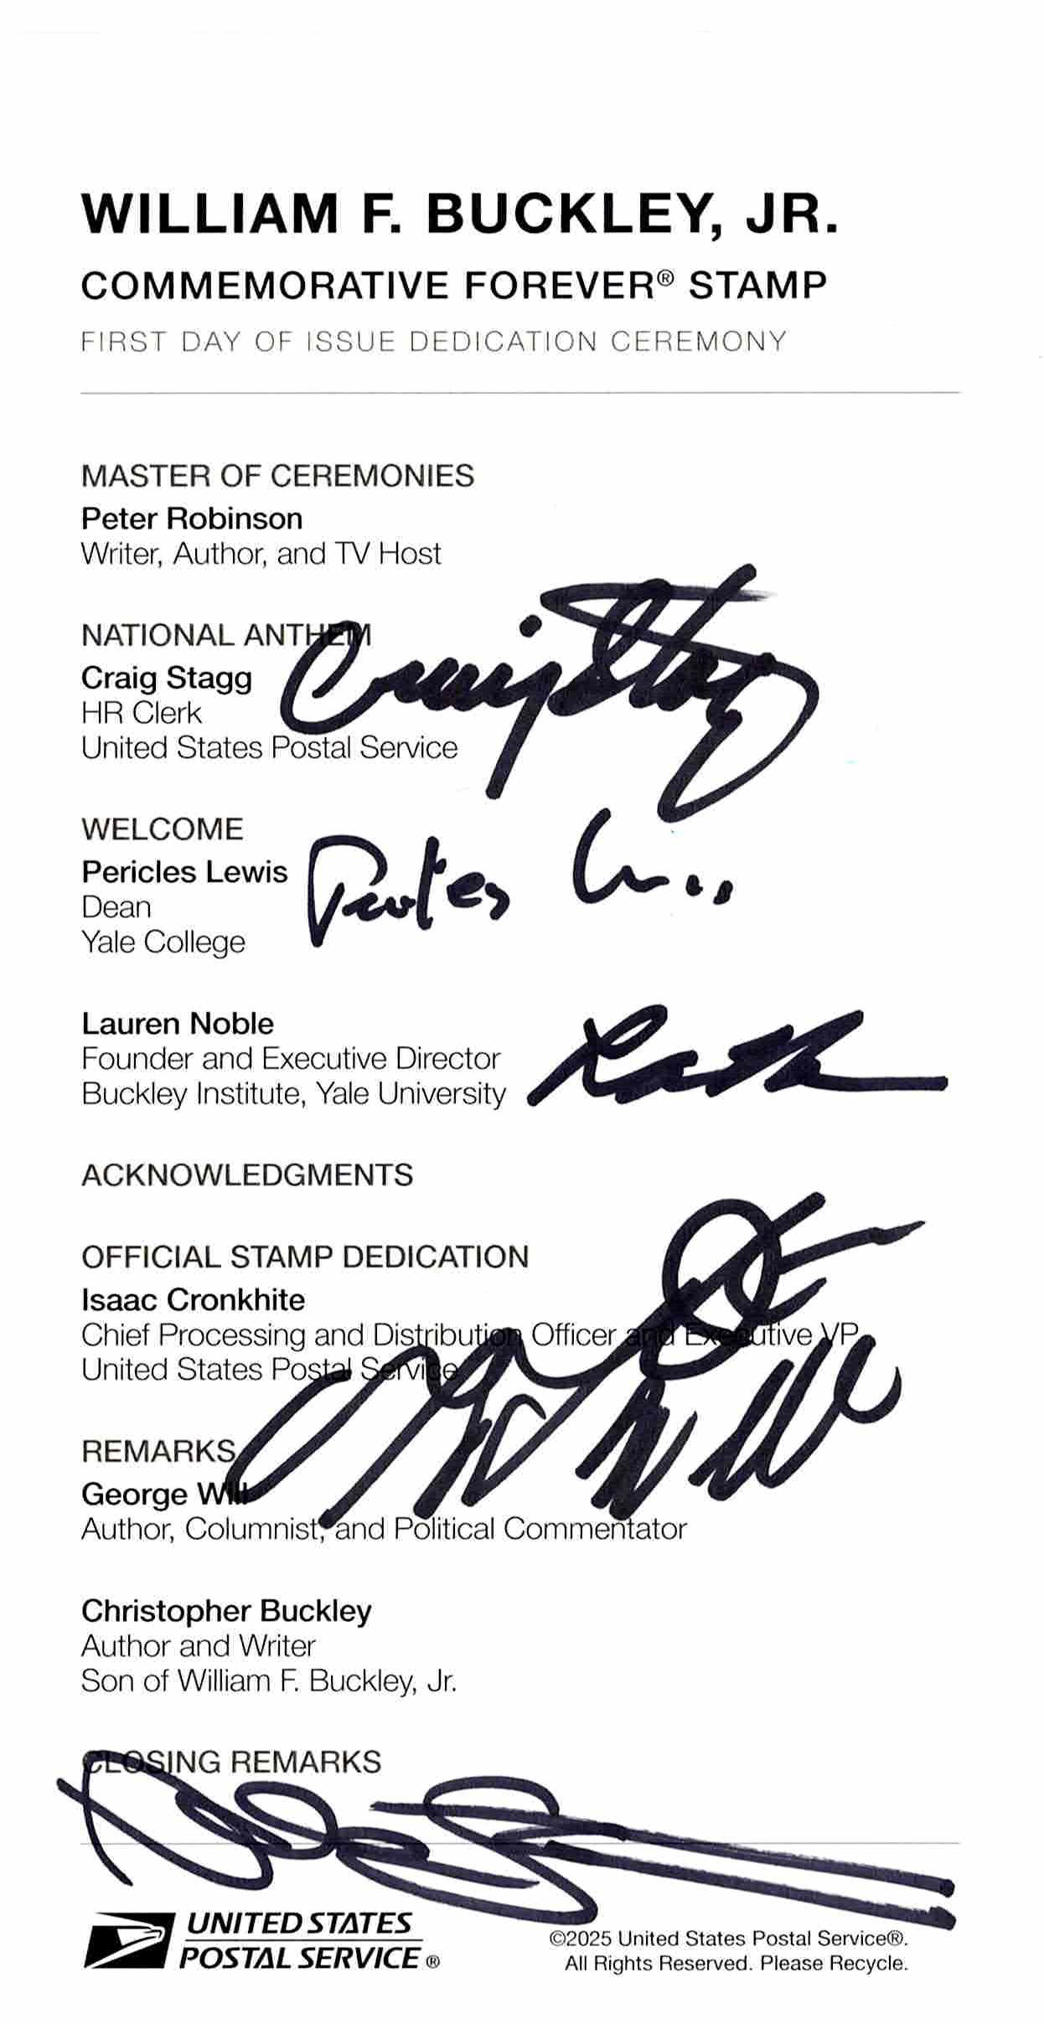
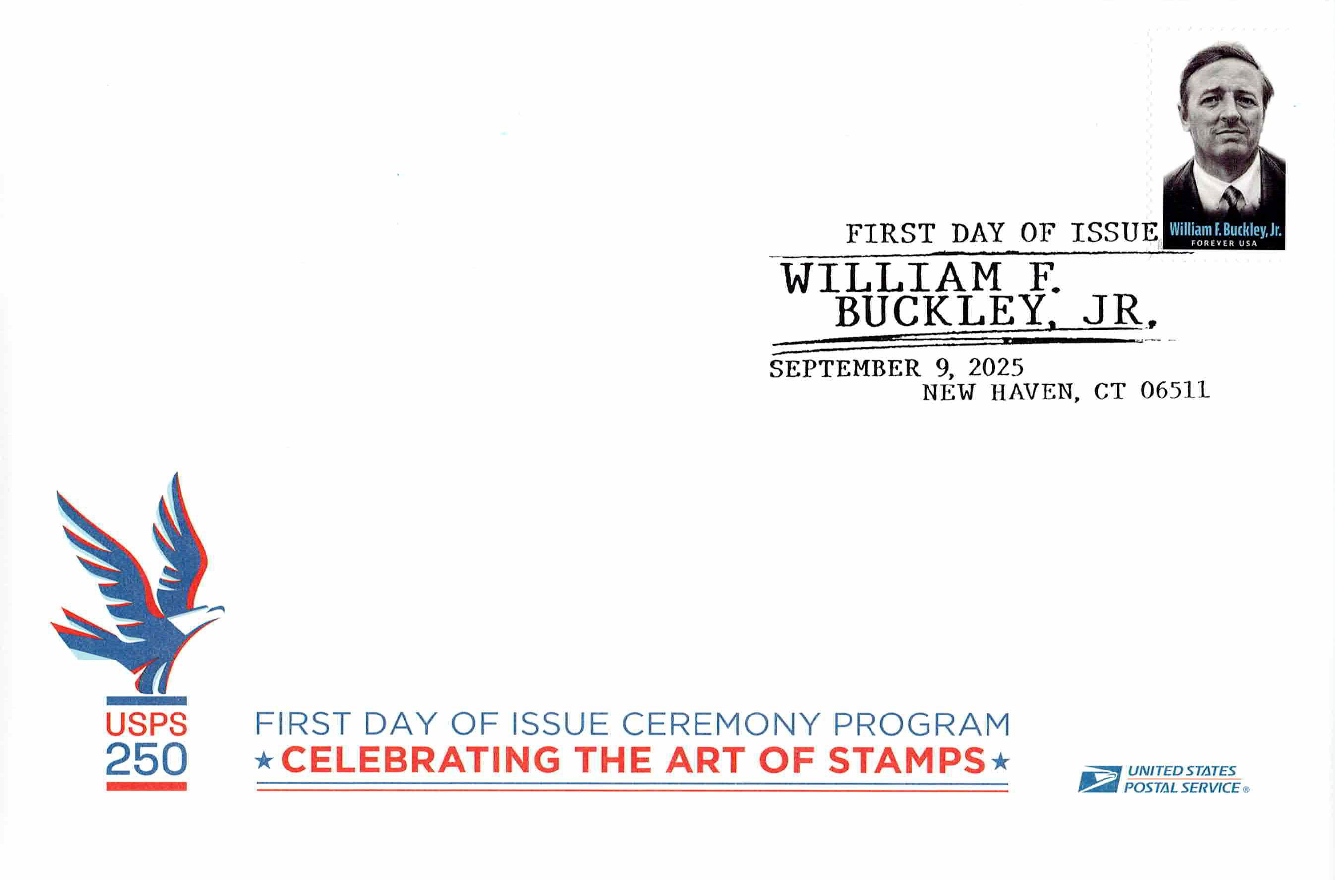
Sep. 9 New Haven, CT William F. Buckley, Jr.
Unusual afternoon national ceremony held at Beinecke Plaza on the campus of Yale University.

Slide 15
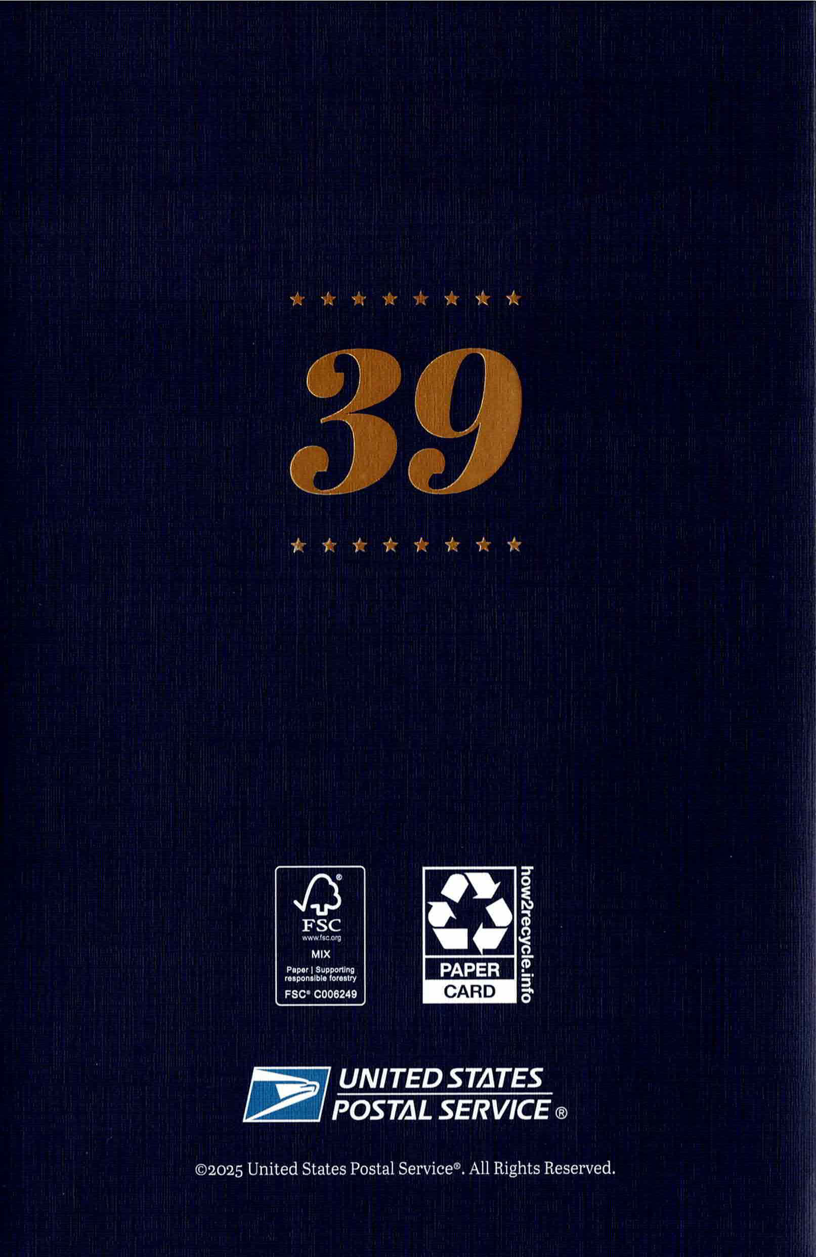
Oct. 1 Atlanta, GA Jimmy Carter
National ceremony held at The Carter Center in Atlanta on what would have been the 39th President’s 101st birthday.

Slide 16
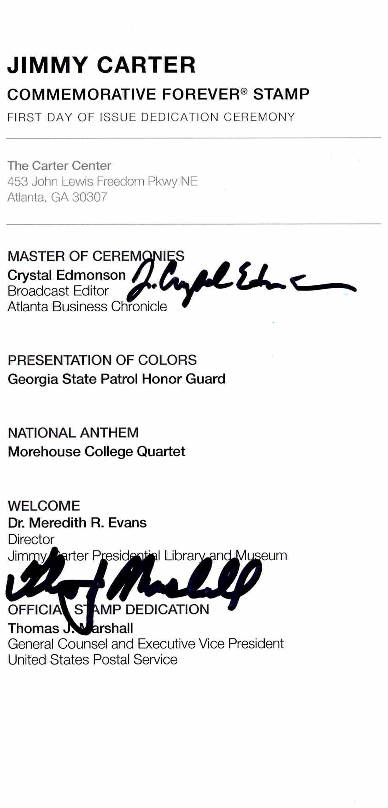
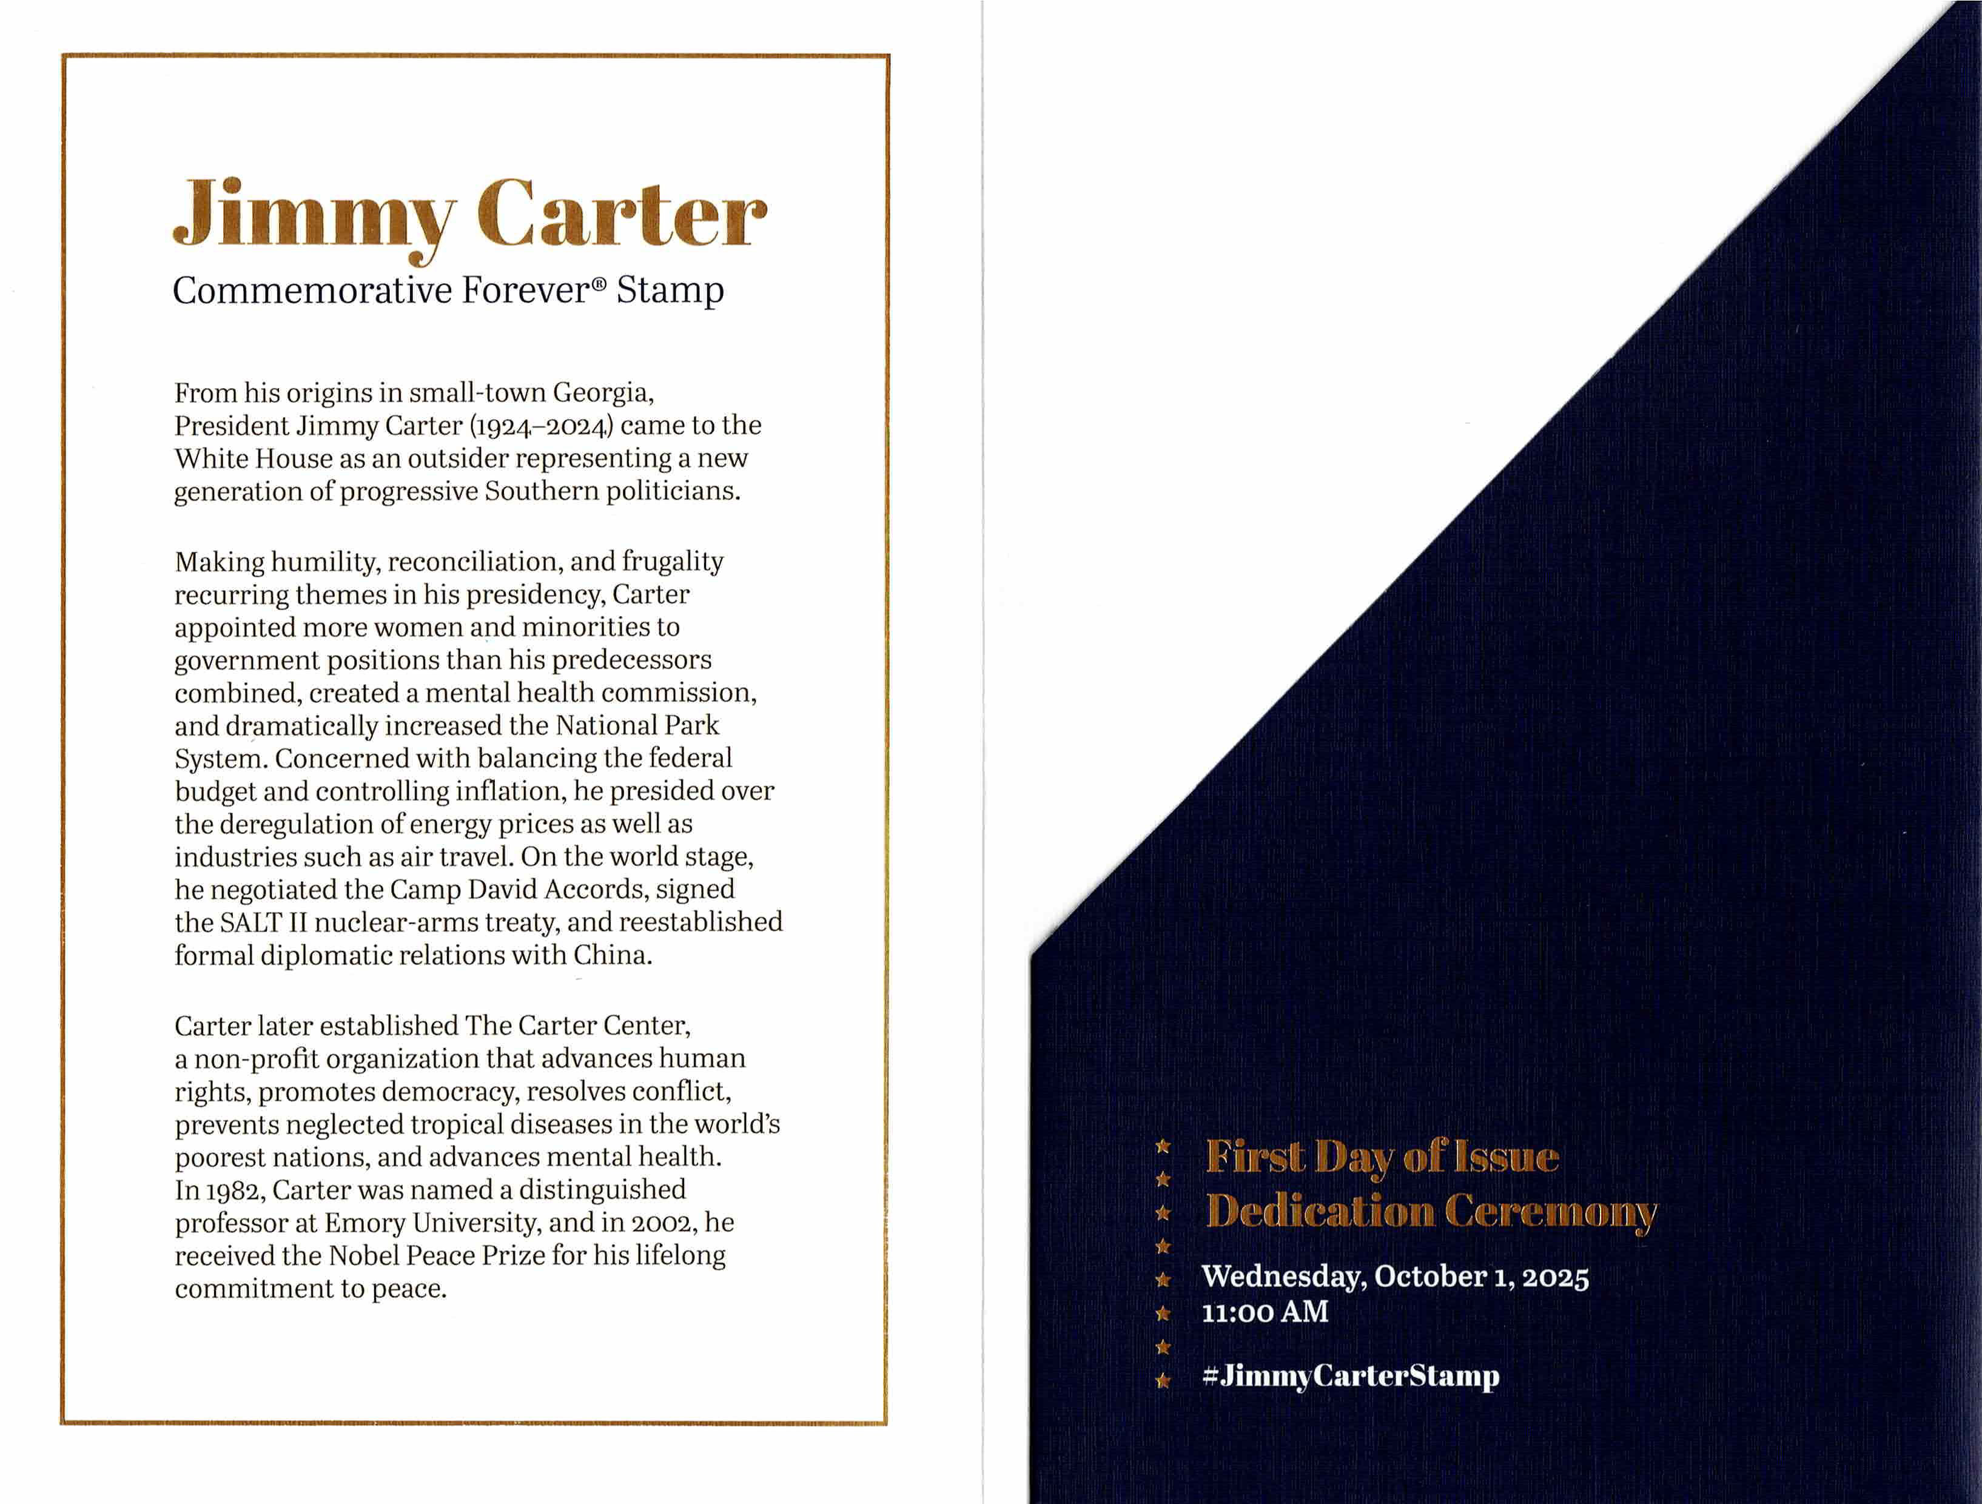
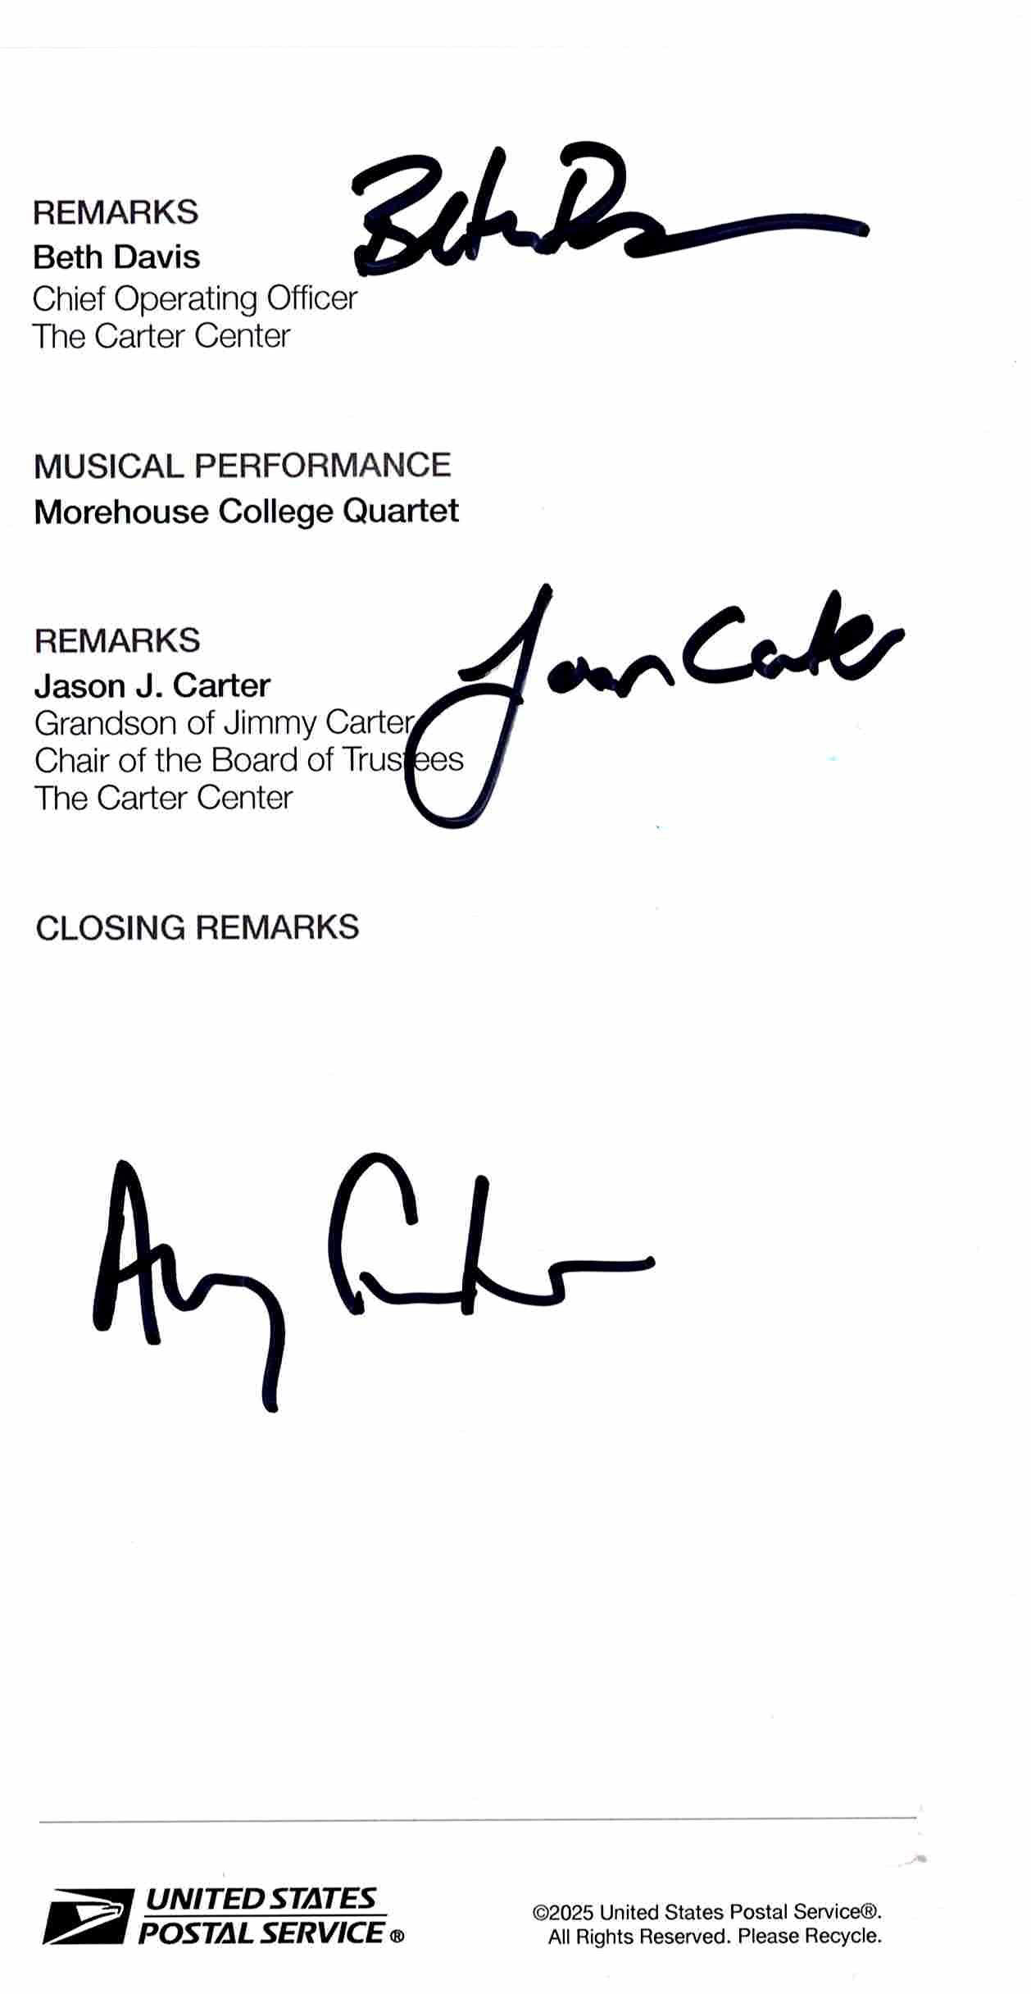
Oct. 1 Atlanta, GA Jimmy Carter

