Slide 1
2015 RPA STAMP OLYMPIAD MARCH 26, 2015
Yearly stamp quiz by Fred Haynes of 20 philatelic questions. Guess the answer and “click” to see if you were right!

Slide 3
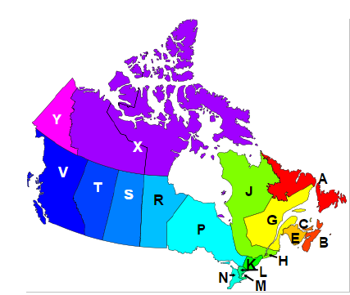
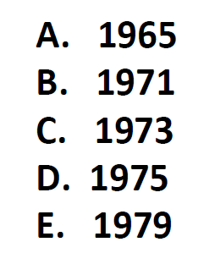

Slide 4
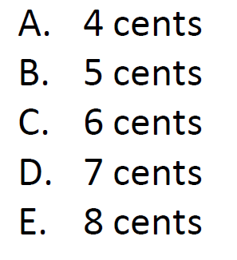

Slide 5
April 1, 1965

Slide 6
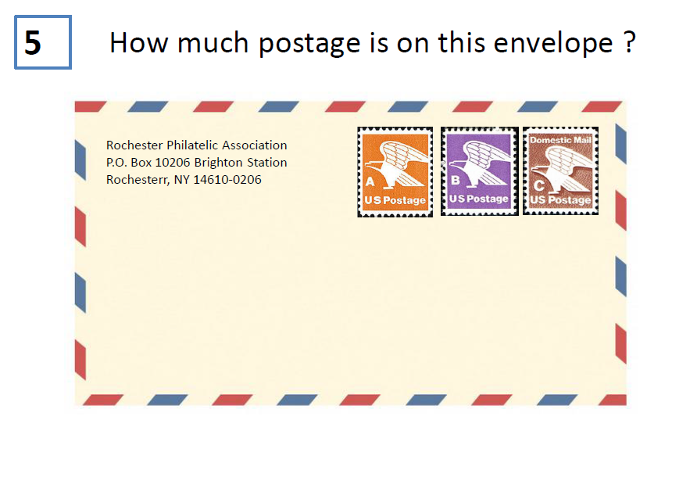
15 cts
18 cts
20 cts
President Barack Obama
The White House
1600 Pennsylvania Avenue NW
Washington DC 20500
46 cents B. 49 cents C. 51 cents
D. 53 cents E. 56 cents

Slide 7
6
Who was the first U.S. Postmaster General ?
Thomas Stone
Ben Franklin
John Hancock
Richard Bache
Thomas Jefferson
July 26, 1776
Second – Nov. 7, 1776

Slide 8
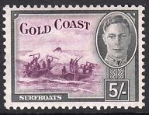
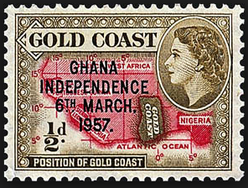
7
The Gold Coast in no longer. What is the name of this country now?
Liberia
Sierra Leone
Nigeria
Namibia
Ghana

Slide 9
1872-present

Slide 10
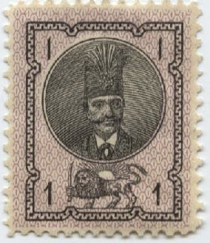
9
Which Islamic country was the first to portray a person on their stamp?
Persia
Egypt
Turkey
Eritrea
Tunisia
Persia - 1876

Slide 11
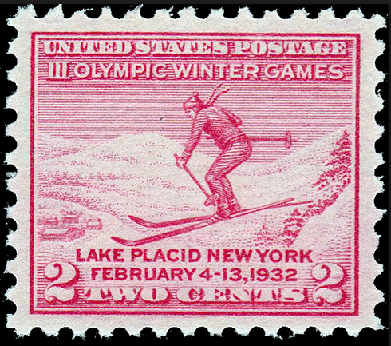
10
The first U.S. stamp issued to honor the Olympics commemorated the 3rd Winter Games. Where were they held ?
Chamonix, France
Squaw Valley, CA
Bavaria, Germany
Lake Placid, NY
St. Moritz, Switzerland

Slide 12
11
How many different postage stamps did the U.S. issue in 2014?
87
94
102
109
116

Slide 13
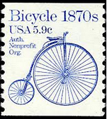
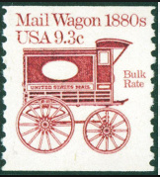
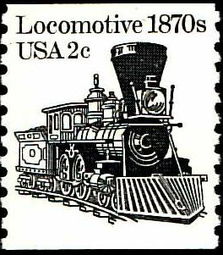
What is the sum of the postage in these three transportation coil stamps?

Slide 15
14

Slide 16
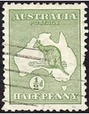
15
Which of these countries has a country map on its first stamp ?
Democratic Republic of Congo
Australia
Djbouti
Greenland
Kenya

Slide 17
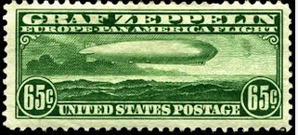
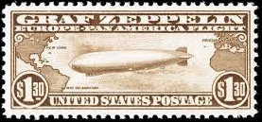
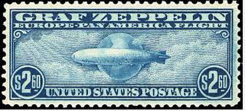
16
We all can visualize the 1930 Graf Zeppelin air mail series. But, can we recall the denomination of the highest value stamp in the set?
$1.30
$2.20
$2.40
$2.60
$3.20

Slide 18
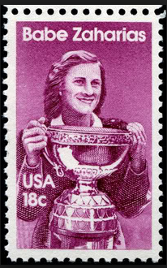
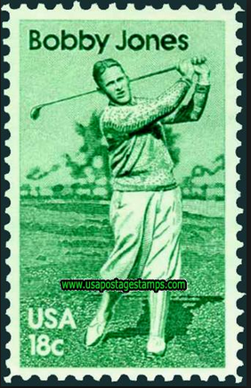
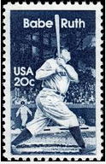
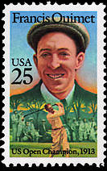
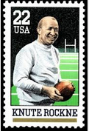
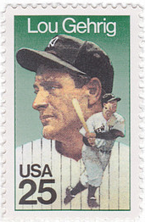
17
Individual American Sports Heroes were not honored with stamps until 1981. Which two champions were honored on U.S. stamps in 1981.
Jim Thorpe and Babe Ruth
Babe Ruth and Lou Gehrig
Babe Zaharias and Bobby Jones
Knute Rockne and Francis Ouimet
Jackie Robinson and Bobby Jones
1983
1988
1988
1989

Slide 19
18
Which country issued the first Christmas Seal ?
Denmark
Belgium
France
Sweden
Great Britain

Slide 20
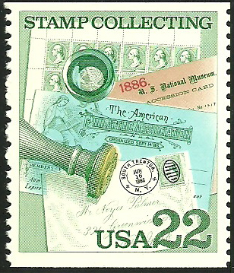
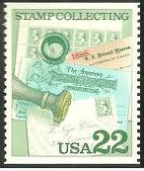
19
This 1986 stamp has two errors associated with its printing. The most common of these two errors is:
black cancel is inverted
red 1886 date is missing
black cancel is missing
blue color is missing
Stamp Collecting printed
in blue

Slide 21
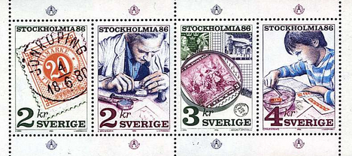
20
The Stamp Collecting Booklet issue of 1986 was a Joint Issue with what country ?
Belgium
Great Britain
Canada
Sweden
Spain

Slide 22
Thanks for playing along! Happy Stamping!

