Slide 1
U.S.
Philatelic
Trivia
By Larry Rausch
For the RPA July, 2018

Slide 2
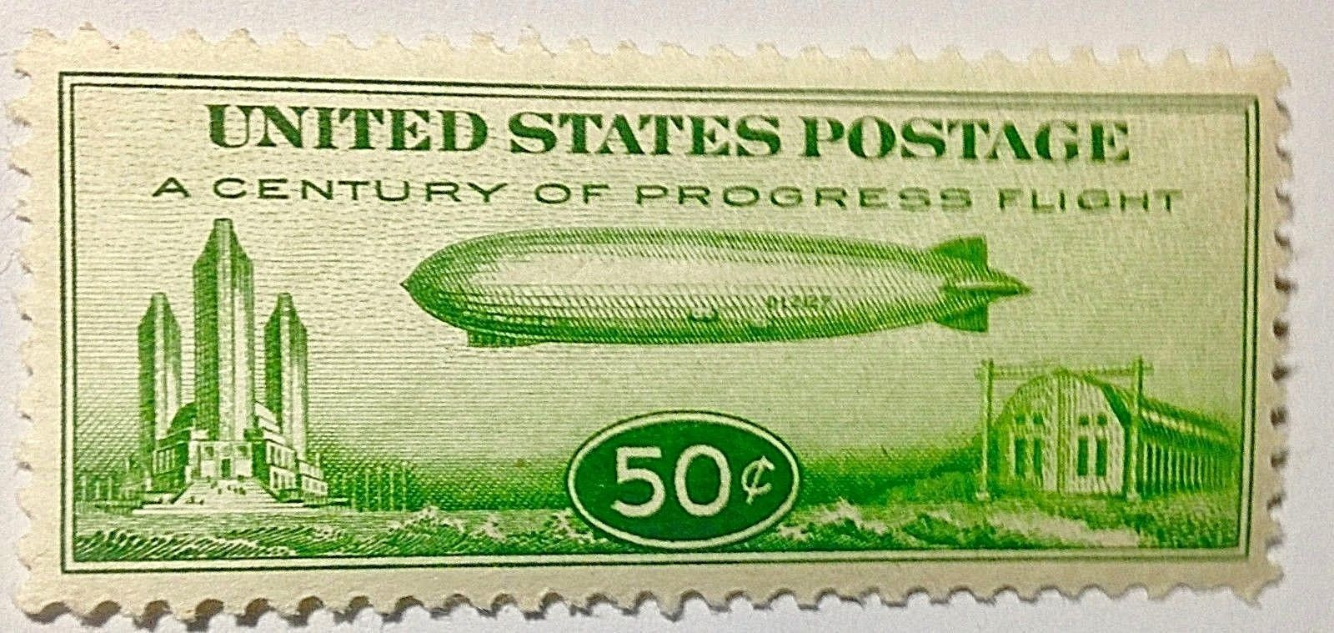
What is the denomination of the “Baby Zeppelin” stamp.
A. 60 cents
B. 40 cents
C. 50 cents
D. 30 cents

Slide 3
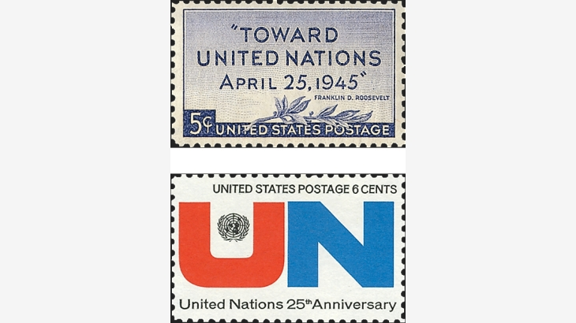
2.In what year did the United Nations celebrate its 25th anniversary
A. 1970
B. 1968
C. 1971
D. 1969

Slide 4
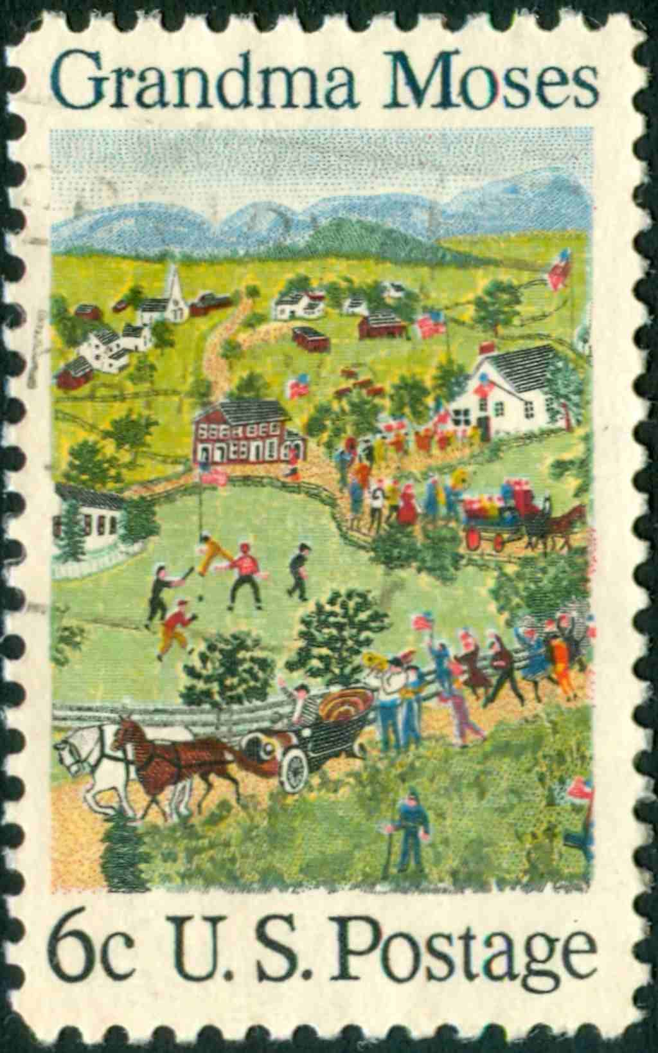
3. In which year was the Grandma Moses stamp issued?
A. 1972
B. 1969
C. 1974
D. 1968

Slide 5
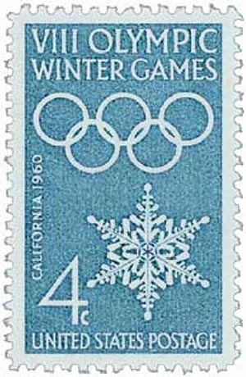
4. In what year was the 8th Winter Olympics held?
A. 1960
B. 1956
C. 1964
D. 1968

Slide 6
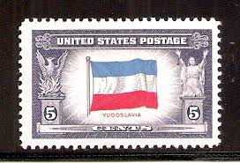
5. How many stamps are in the 1943-44 Overrun Countries issue?
A. 12
B. 11
C. 14
D. 13

Slide 7
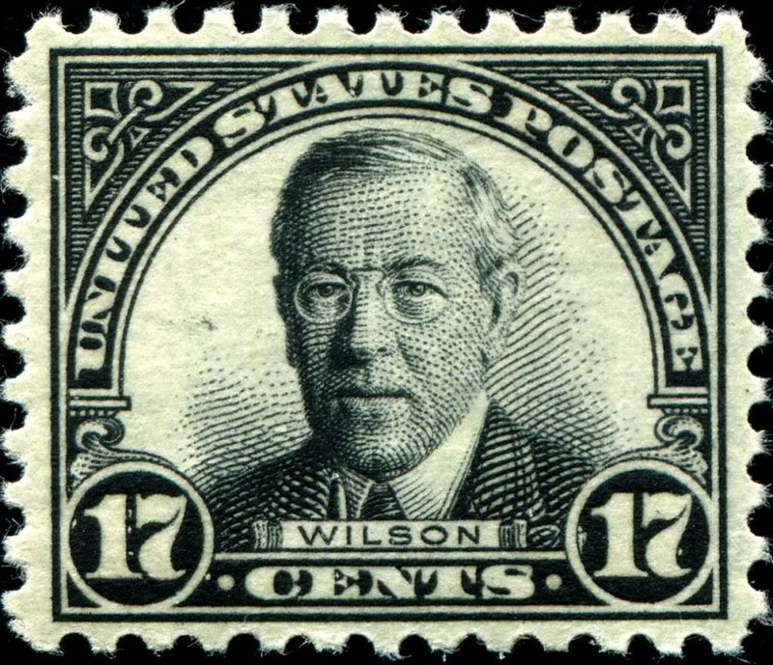
6. What is the denomination of the 1925 Woodrow Wilson stamp?
A. 15 cent
B. 18 cent
C. 17 cent
D. 19 cent

Slide 8
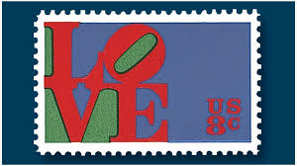
7. In what year was the first Love stamp issued?
A. 1968
B. 1972
C. 1969
D. 1970

Slide 9
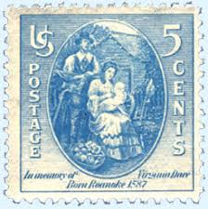
8. In what year was the Virginia Dare stamp issued?
A. 1934
B. 1939
C. 1938
D. 1937

Slide 10
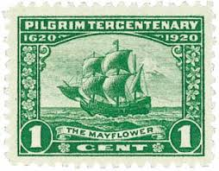
9. In the 1920 Pilgrim Tercentenary issue, what
denomination bears the picture of the Mayflower?
A. 1 cent
B. 2 cent
C. 5 cent

Slide 11
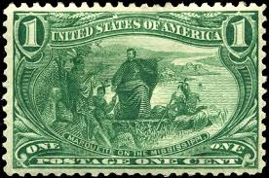
10. What town held the 1898 Trans-Mississippi fair?
A. Saint Louis, Missouri
B. Cincinnati, Ohio
C. Chicago, Illinois
D. Omaha, Nebraska

Slide 12
11. What color is the 1934 “Whistler’s Mother stamp
A. Green
B. Purple
C. Red
D. Blue

Slide 13
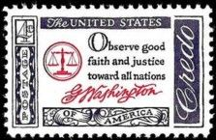
12. How many stamps are in the 1961 Credo issue?
A. 4
B. 6
C. 5
D. 3

Slide 14
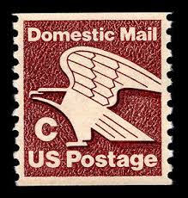
13. What is the denomination of the 1981 “C” stamp
A. 15 cents
B. 22 cents
C. 20 cents
D. 17 cents

Slide 15
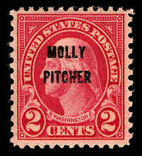
14. In what year did the “Molly Pitcher” overprint occur?
A. 1928
B. 1926
C. 1930
D. 1932

Slide 16
15. On what type of US stamp was an airplane first depicted?
A. Postage Due
B. Air Mail
C. Parcel Post
D. Special Delivery

Slide 17
16. What type of Bird is on a 1970 Natural History Issue Stamp?
A. Turkey
B. Condor
C. Cardinal
D. Eagle

Slide 18
17. What type of car was the first to appear on a 1901 U.S. stamp
A. Steam
B. Electric
C. Gasoline

Slide 19
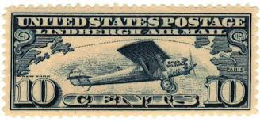
18. In what year was Lindbergh's transatlantic flight?
A. 1927
B. 1925
C. 1931
D. 1928

Slide 20
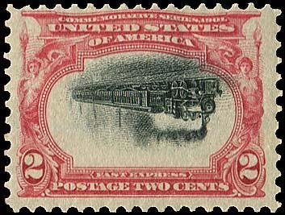
What town was the 1901 Pan-American Expo held?
A. Philadelphia, Pennsylvania
B. Chicago, Illinois
C. Saint Louis, Missouri
D. Buffalo, New York

Slide 21
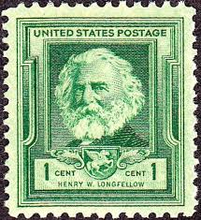
How many stamps are in the 1939 Famous American issue?
A. 28
B. 30
C. 35
D. 32

Slide 22
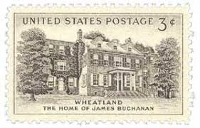
In what state is Wheatland, President Buchanan’s home?
A. Vermont
B. Pennsylvania
C. North Carolina
D. New York

Slide 23
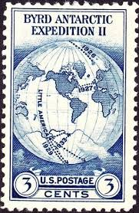
How many stamps are in the 1934 Byrd souvenir sheet?
A. 6
B. 10
C. 8
D. 25

Slide 24
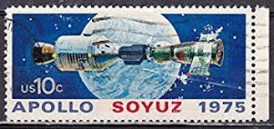
23. The Apollo-Soyuz space mission took place in what year
A. 1975
B. 1976
C. 1970
D. 1972

Slide 25
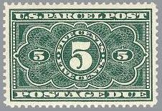
24. How many denominations of the 1913 Parcel Post
postage due stamps were issued?
A. 6
B. 3
C. 5
D. 4

Slide 26
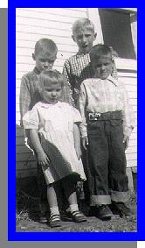
25. Bonus question what state was I, Larry Rausch, born in?
A. Illinois
B. Wisconsin
C. Minnesota
D. Iowa

Slide 27
What is the denomination of the “Baby Zeppelin” stamp.
A. 60 cents
B. 40 cents
C. 50 cents
D. 30 cents

Slide 28
2.In what year did the United Nations celebrate its 25th anniversary
A. 1970
B. 1968
C. 1971
D. 1969

Slide 29
3. In which year was the Grandma Moses stamp issued?
A. 1972
B. 1969
C. 1974
D. 1968

Slide 30
4. In what year was the 8th Winter Olympics held?
A. 1960
B. 1956
C. 1964
D. 1968

Slide 31
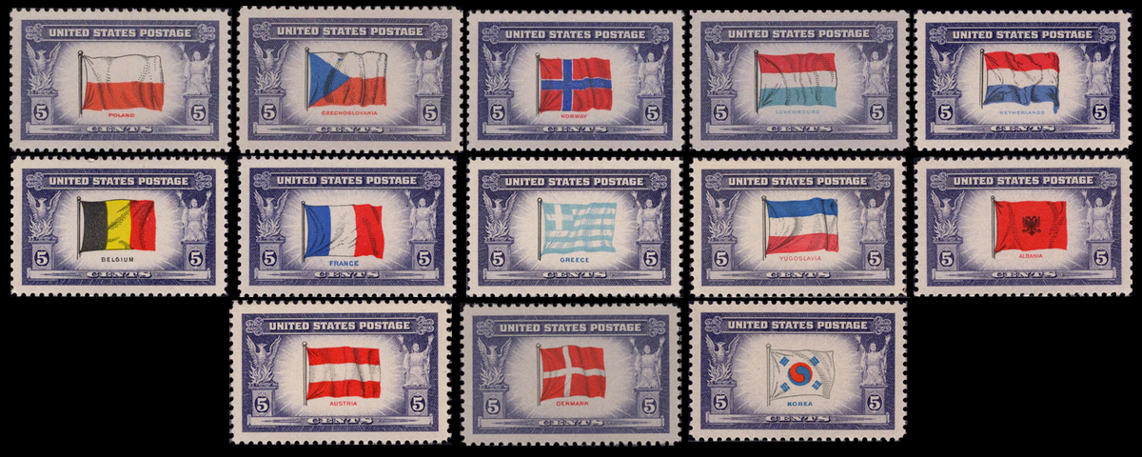
5. How many stamps are in the 1943-44 Overrun Countries issue?
A. 12
B. 11
C. 14
D. 13

Slide 32
6. What is the denomination of the 1925 Woodrow Wilson stamp?
A. 15 cent
B. 18 cent
C. 17 cent
D. 19 cent

Slide 33
7. In what year was the first Love stamp issued?
A.1968
B. 1972
C.1969
D.1970

Slide 34
8. In what year was the Virginia Dare stamp issued?
A. 1934
B. 1939
C. 1938
D. 1937

Slide 35
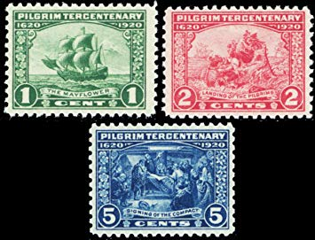
9. In the 1920 Pilgrim Tercentenary issue, what
denomination bears the picture of the Mayflower?
A. 1 cent
B. 2 cent
C. 5 cent

Slide 36
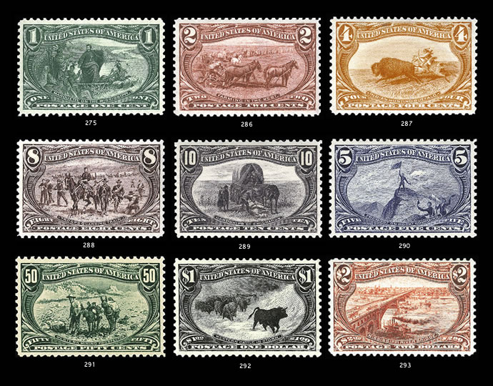
10. What town held the 1898 Trans-Mississippi fair?
A. Saint Louis, Missouri
B. Cincinnati, Ohio
C. Chicago, Illinois
D. Omaha, Nebraska

Slide 37
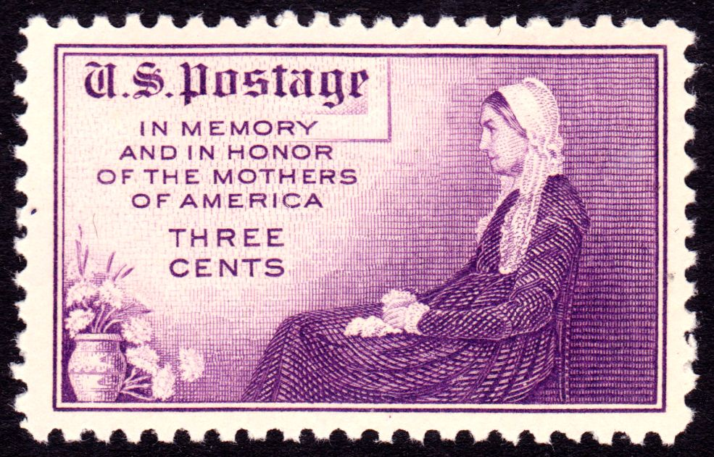
11. What color is the 1934 “Whistler’s Mother stamp
A. Green
B. Purple
C. Red
D. Blue

Slide 38
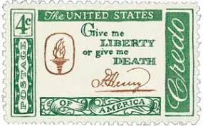
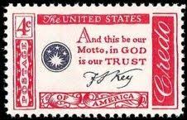
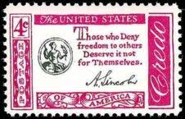
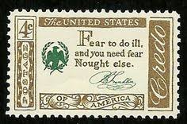
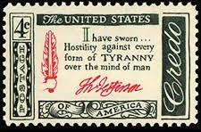
12. How many stamps are in the 1961 Credo issue?
A. 4
B. 6
C. 5
D. 3

Slide 39
13. What is the denomination of the 1981 “C” stamp
A. 15 cents
B. 22 cents
C. 20 cents
D. 17 cents

Slide 40
14. In what year did the “Molly Pitcher” overprint occur?
A. 1928
B. 1926
C. 1930
D. 1932

Slide 41
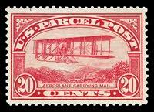
15. On what type of US stamp was an airplane first depicted?
A. Postage Due
B. Air Mail
C. Parcel Post
D. Special Delivery

Slide 42
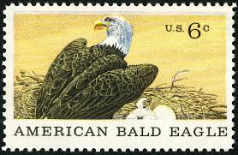
16. What type of Bird is on a 1970 Natural History Issue Stamp?
A. Turkey
B. Condor
C. Cardinal
D. Eagle

Slide 43
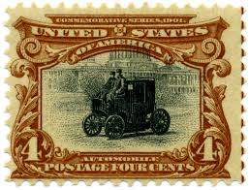
17. What type of car was the first to appear on a 1901 U.S. stamp
A. Steam
B. Electric
C. Gasoline

Slide 44
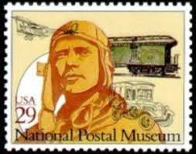
18. In what year was Lindbergh's transatlantic flight?
A. 1927
B. 1925
C. 1931
D. 1928

Slide 45
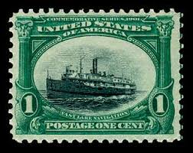
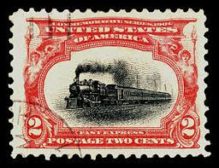
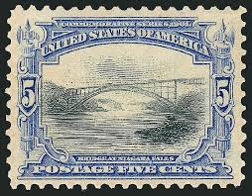
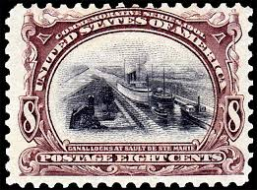
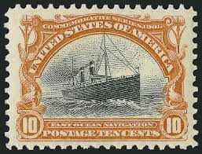
What town was the 1901 Pan-American Expo held?
A. Philadelphia, Pennsylvania
B. Chicago, Illinois
C. Saint Louis, Missouri
D. Buffalo, New York

Slide 46
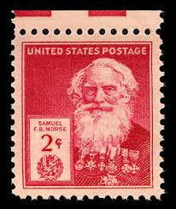
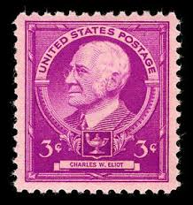
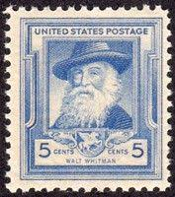
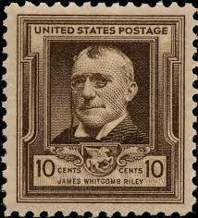
How many stamps are in the 1939 Famous American issue?
A. 28
B. 30
C. 35
D. 32

Slide 47
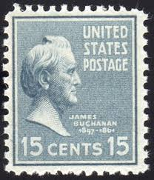
In what state is Wheatland, President Buchanan’s home?
A. Vermont
B. Pennsylvania
C. North Carolina
D. New York

Slide 48
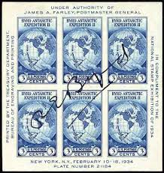
How many stamps are in the 1934 Byrd souvenir sheet?
A. 6
B. 10
C. 8
D. 25

Slide 49
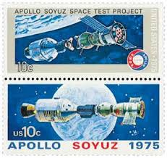
23. The Apollo-Soyuz space mission took place in what year
A. 1975
B. 1976
C. 1970
D. 1972

Slide 50
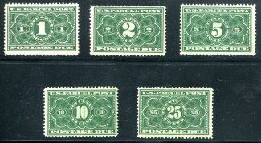
24. How many denominations of the 1913 Parcel Post
postage due stamps were issued?
A. 6
B. 3
C. 5
D. 4

Slide 51
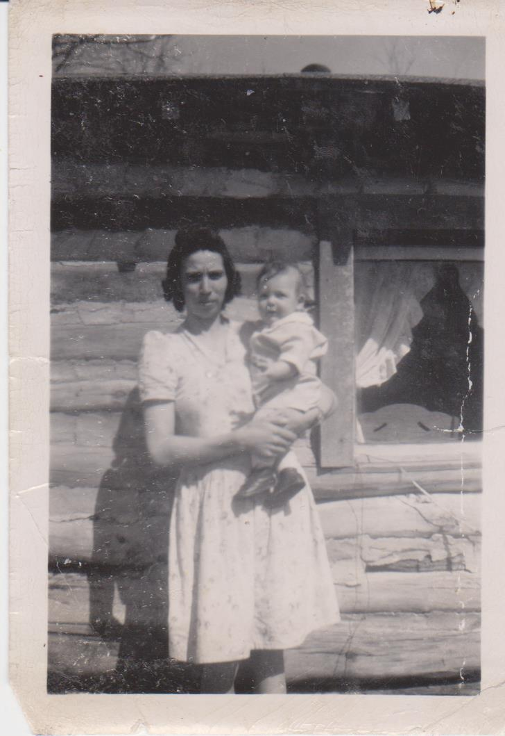
25. Bonus question what state was I, Larry Rausch, born in?
A. Illinois
B. Wisconsin
C. Minnesota
D. Iowa

