Slide 1
US Fancy Cancels -
and a Bit of Postal History
to Explain Them
Presented by Rich Spinelli
for the RPA, Nov. 10, 2016.
(but blatantly ripped-off from an internet
presentation published by Bruce Dangremond,
15th of January, 2012--thanks, Bruce.)

Slide 2
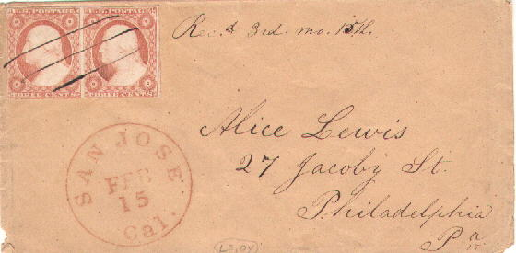
1847: First US postage stamps sold to customers at post offices. Why?
  US Post Office Department wanted to encourage customers to prepay their letters
  Stamps made bookkeeping at the post office easier
  Customers could just drop off letters bearing postage stamps
Early problem: Receiver of a letter can remove the stamp and re-use it on another letter without paying the post office
Solution: “Cancel” or “kill” postage stamps
at the sending post office thereby rendering
them useless as future postage
One of the first methods of cancellation was
with pen and ink (Manuscript Cancel)
However, manuscript cancels were time consuming to apply.

Slide 3
Why not use the hand stamps already in use to cancel stamps and save time?
The other hand stamps most prevalent in post offices where those used to indicate postal rates. Stamps canceled with rate hand stamps are, therefore, very common on early postage stamps
The rate hand stamp used to obliterate the postage stamp had no numerical significance whatsoever. It was merely the result of whichever hand stamp the postal clerk chose as his canceling device.

Slide 4
There were other hand stamps also used as canceling devices, whose original purpose was not to cancel postage stamps. These would include: “FREE”, “STEAMBOAT”, “ALL PAID”, “OVERLAND”, and “WAY”.
Local post offices eventually began acquiring and using hand stamps
specifically designed to cancel or “kill” postage stamps.
One very common hand stamp intended to be a “killer” produced what is now known as a “target cancel”, a series of concentric rings.
Most of these hand stamps where professionally made by local engravers and sold to post offices.

Slide 5
Another very common and diverse category of fancy cancellations is known as the “grid” cancels - closely spaced lines, dots, squares, diamonds, or other shapes that form a grid-like pattern
The first two cancels on the left are known as "bar-grid" cancels and were most likely commercially produced for post office use
The next three grid cancels were produced by postal employees; carved from wood (Notice the sharp well-defined edges).
The last two stamps are referred to as "cork cancels“ probably fashioned by inventive postal clerks and postmasters from cork bottle stoppers

Slide 6
Eventually, postal clerks took great pride in making and using distinctive cancellations. They were responsible for producing the fancy cancels that are most prized by collectors today
The images below are stamps with letter cancels. Often these represented attempts by postal employees to uniquely identify their post office.
The first three stamps are the “H” cancel used in Hudsonville, Michigan, the “L” cancel of Lockport, New York, and the fancy “T” cancel of Titusville, Pennsylvania. The last stamp is the Saratoga Springs cancel.

Slide 7
The geometric type cancellation is a large category that includes many designs not otherwise easily described.
The leftmost stamp below is a circular design cancellation used in the South Framingham post office of Massachusetts.
The second stamp cancel is the “pinwheel” design from Cambridge, Massachusetts.
The third stamp shows the “stovepipe” cancel used in Leominster, Massachusetts.

Slide 8
The fourth stamp is a radial type cancellation used in the post office of Irwin Station, Pennsylvania.
The last stamp has a cancel that is similar to many other radial designs of the period. This one is believed to be the cancel used in Bridgeport, Connecticut.
Some of the most elaborate geometric cancels were used to cancel high value stamps on foreign mail going from the New York City post office to overseas destinations.

Slide 9
The star cancellation is also a large category of fancy cancels used in many post offices.
In the image below, the leftmost stamp cancellation is a negative five-point star in a solid disk and was used in the Boston post office.
The second cancel is a smaller solid five-point star inside a ring used in Londonderry, Vermont.
The third star cancel is on a Scott #88 stamp (see grill in star) used in Osceola Mills, Pennsylvania.

Slide 10
The fourth stamp shows a negative five-point star in a solid blue ink pentagon.
The post office is unknown.
The last stamp shows a beautiful large negative five-point star in a solid disk with additional small negative dots. It was a cancellation used in the post office of Brookline, Massachusetts.

Slide 11
The civil war was responsible for the series of stamps issued in 1861, of which the 3-cent Scott #65 is its most profuse member.
To express allegiance with the union, many patriotic symbols were used as cancellation designs on letters bearing this stamp in northern post offices.
The first stamp has a cancel showing “US” inside a simple shield from the post office in Albany, New York.

Slide 12
The second stamp has a cancellation with a “US” and stars in a shield used in Boston, Massachusetts.
The third stamp sports the much sought after fancy shield of Medalia, New York.
The last stamp shows another large shield cancel. This one is from the post office in Taunton, Massachusetts.

Slide 13
There are many other categories of fancy cancels.
The first stamp shows the fancy “R” cancellation of Rockville, Connecticut.
The second is the “spearhead” cancel of Lewisburg, Pennsylvania.
The middle stamp is the very sought after “open book” cancel of Rutland, Vermont.
Fourth, is known as the “prison bar” cancel of Columbus, Ohio.
The fifth stamp above shows one of the most desirable fancy cancels in our hobby. It is the “devil and pitchfork” cancel of West Meriden, Connecticut.

Slide 14
The first stamp above shows the “skull and crossbones” cancel of Elizabethtown, Kentucky.
Second is the “shield in heart” cancel of New York, New York.
The third stamp shows an almost perfect strike of the “clover” cancel of Boston, which some collectors believe may be an early “precancel”, a cancellation applied to stamps at the post office prior to being sold. This was done for mass mailings, like circulars & newspapers, so postal employees would not have to cancel each piece individually when they were delivered to the post office.

Slide 15
The fourth stamp illustrates a beautiful blue strike of a Masonic “square and compass” thought to be from the post office in Louisville, Kentucky. This is one of many fraternal organizations promoted on fancy cancellations of the period.
Finally shown is a stamp whose cancel is of unknown origin. This is what makes collecting fancy cancels so interesting. Is this a bull inside a ring? Or is it a bird, bat, flower or insect in a ring? Or is it simply a killer whose blob of ink represents nothing at all?
Or, is it a fake?

Slide 16
Two references to help identify fancy cancels are:
United States Cancellations 1845-1869 by Hubert C, Skinner and Amos Eno
Billig’s Philatelic Handbook Volume 33, The Century United States Fancy Cancellations.

Slide 18
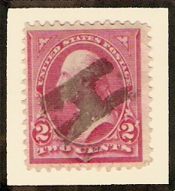
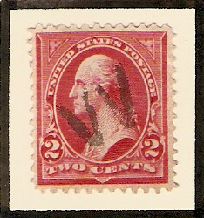
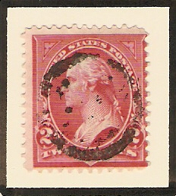
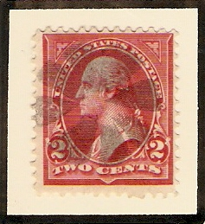
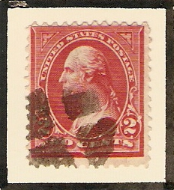
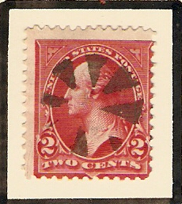
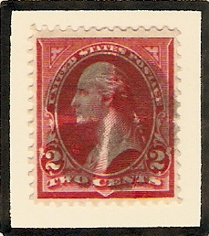
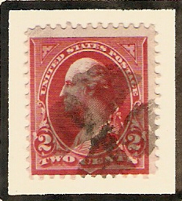

Slide 19
