Slide 1
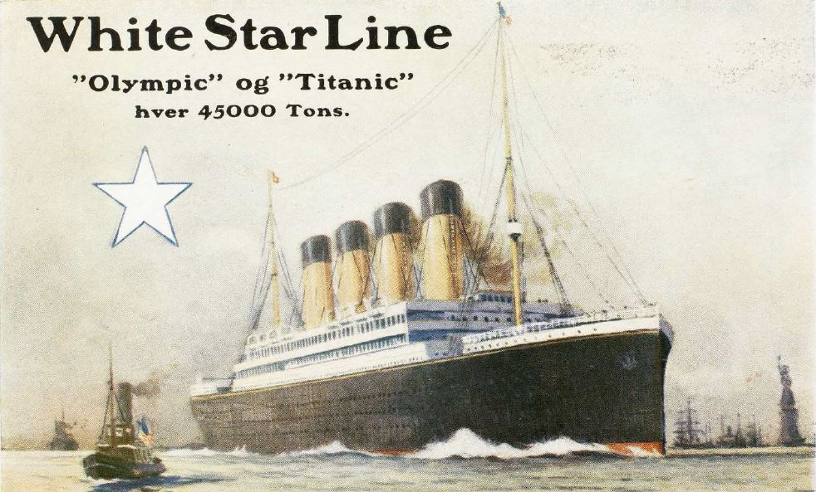
My Titanic Cover that Missed the Boat
by Tom Fortunato
A 2022 Presentation for the Rochester Philatelic Association

Slide 2

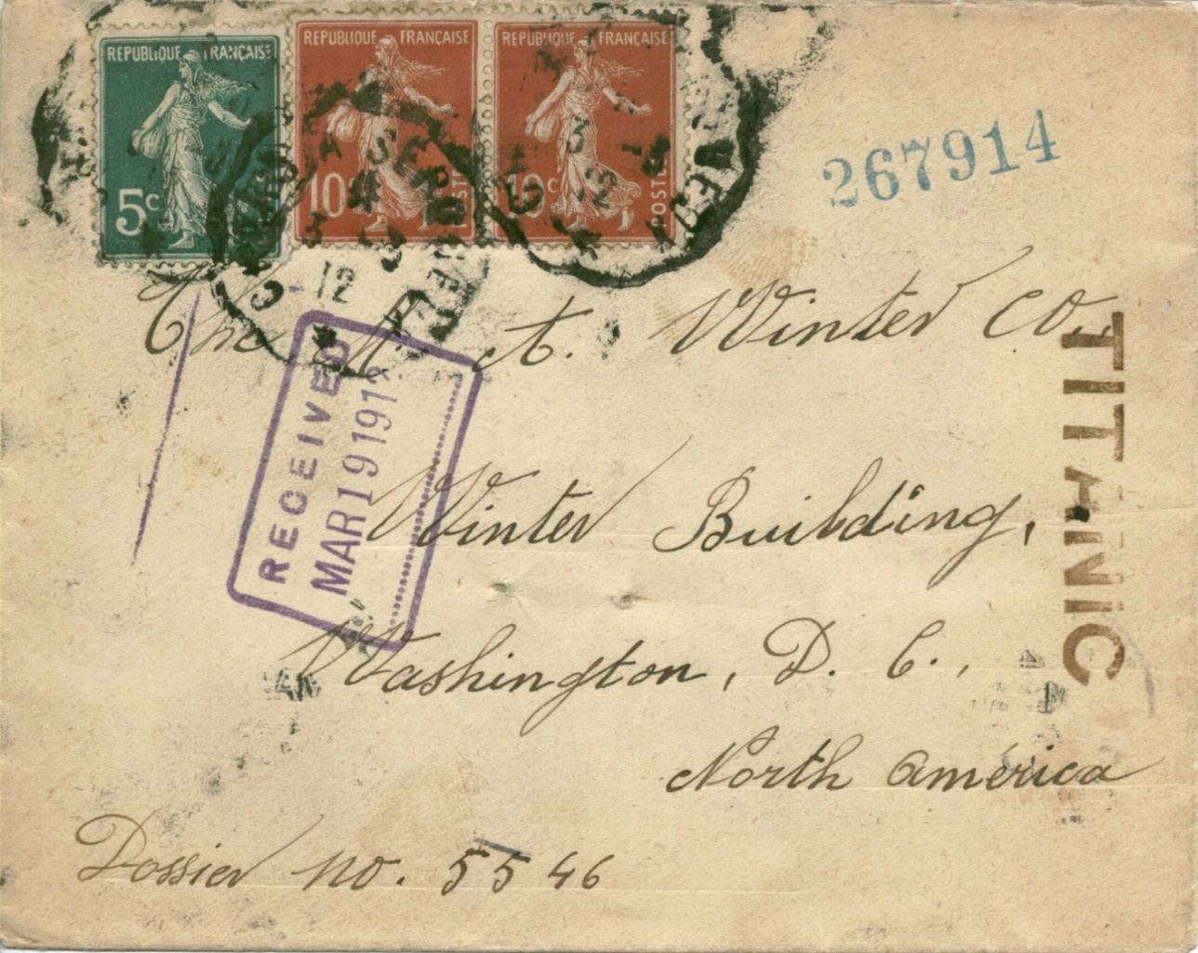
This story began back in 1986 when I attended the annual STEPEX Stamp Show near Elmira, NY. A sign on a dealer’s box caught my eye—“Better Junk-$10 Each.” I started looking over the covers and the one below definitely got my attention.
It was the “TITANIC” mark that got my attention. But why was this cover postmarked in March of 1912, one month before the ship actually set sail? Yes, RMS (Royal Mail Steamship) Titanic was built primarily to transport mail across the Atlantic, but no mail survived its only voyage. The investigation began once I brought it home!

Slide 3
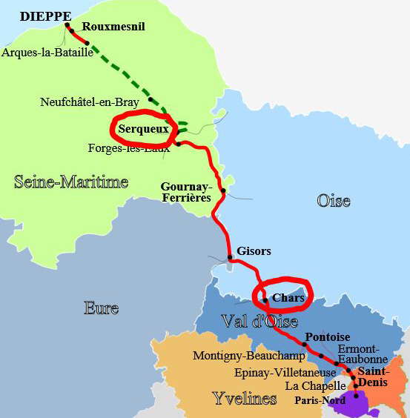
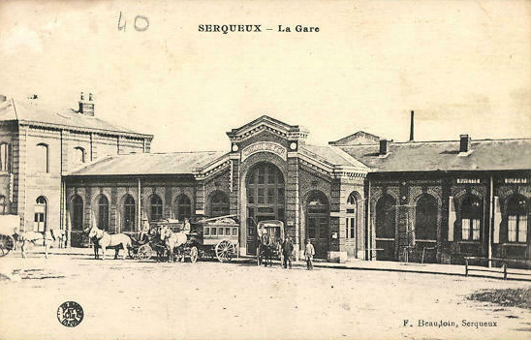

The cover was rather ratty, but surprisingly full of dated post, transit and receiving marks.
The French scalloped cancellations dated 3/3/12 were used on train mail of that era, these from the short 40 mile Chars to Serqueux line running northwest of Paris.

Slide 4
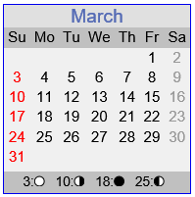
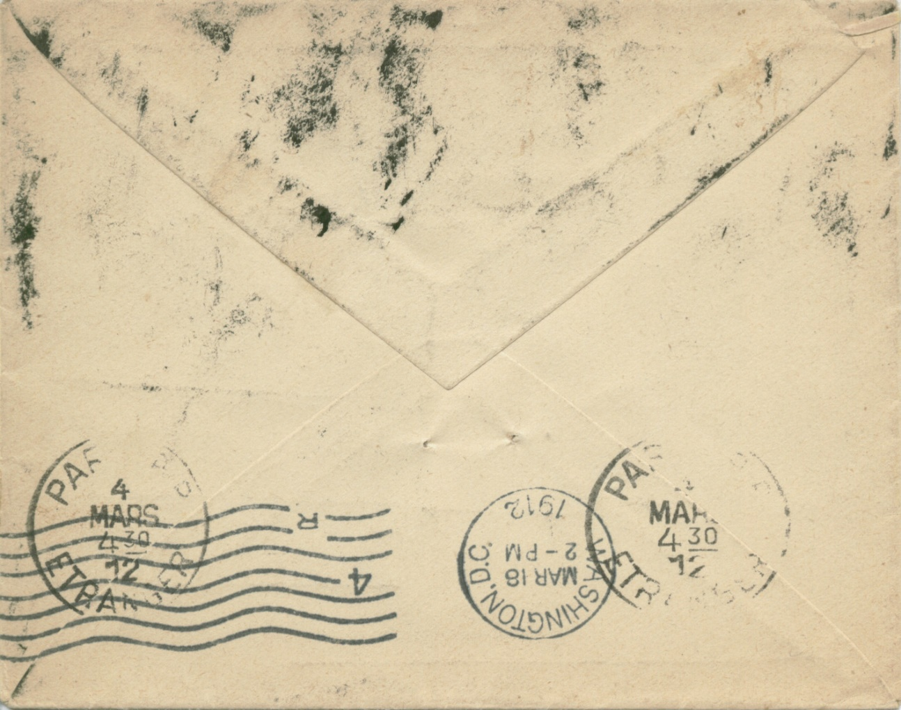
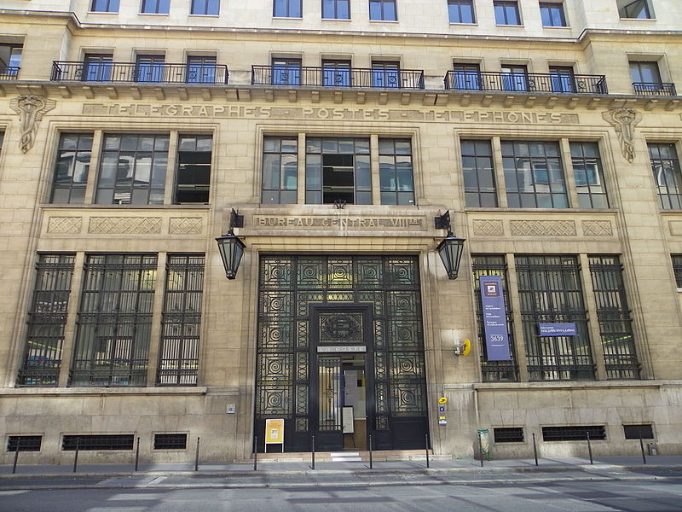
The back-stamped receiving marks show that this letter ended up in a Paris post office at 4:30 AM the following day, Monday, 3/4/12.

Slide 5
What happened between March 4-18 when it arrived in Washington, DC is supposition, uncovered through 30+ years of detective work!
The letter was franked with 25 centimes, enough for the standard surface letter rate to America. Overseas-bound mail from throughout France was brought to Paris where it was prepared and bagged for transit.
It was common practice to write or stamp the name of the ship a letter was to be carried on somewhere on the envelope. The san-serif TITANIC violet marking was proven to be of the same font and size as that used on letters posted on its sister ship, White Star Line’s RMS Olympic, by Dutch typographer David van Dalen. It is not certain whether the ship’s name was applied to mail at the central Paris collecting station or later at the ship’s port of departure.

Slide 6
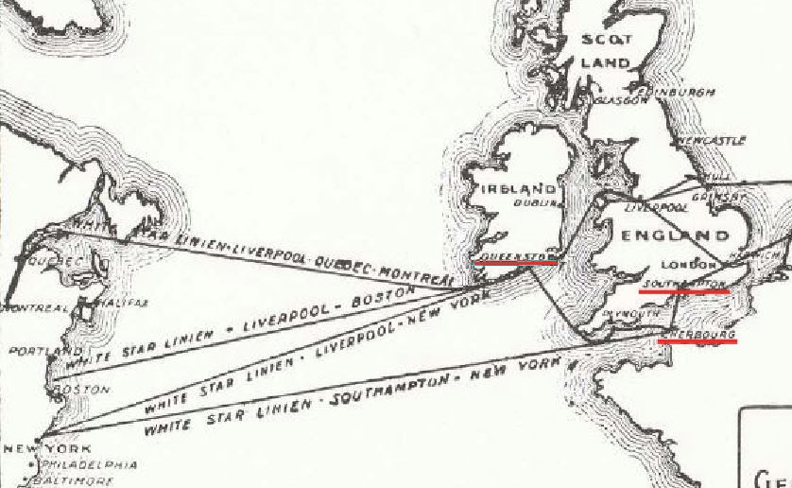
Various shipping lines had specific ports they docked at. The letter would have left France at Cherbourg if it departed on the White Star Line.
From a Danish travel brochure of 1912 White Star planned sailings.

Slide 7
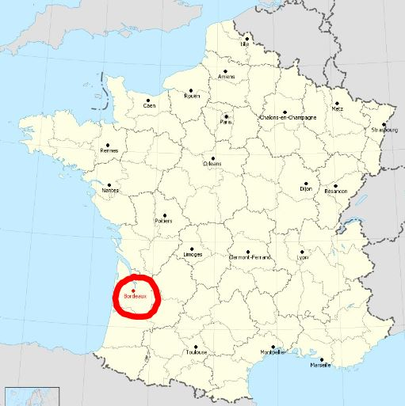
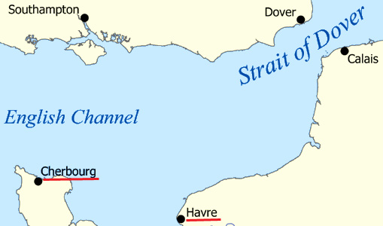
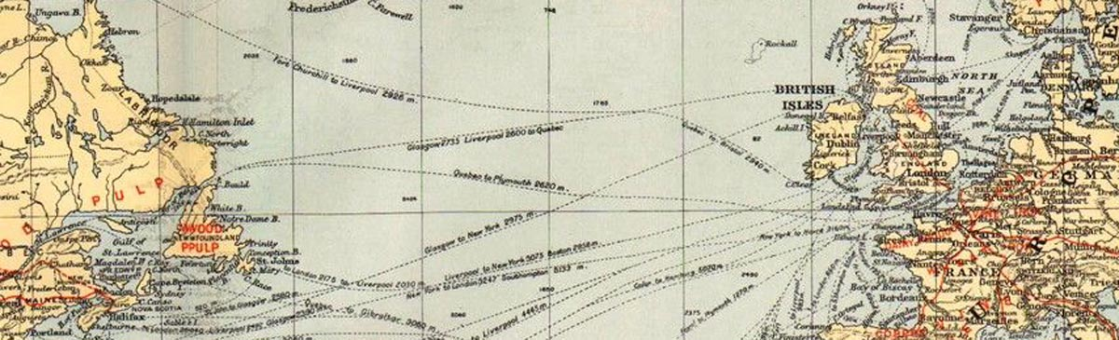
Other trans-Atlantic lines favored other French ports. The North German Lloyd and Hamburg-American Lines preferred Cherbourg; the French CTG line docked at La Havre and Bordeaux.

Slide 8
A typical trans-Atlantic crossing to New York City would have taken 5 days from these major ports, assuming no stopovers. So the cover’s DC arrival mark provides a clue. The ship it travelled on probably arrived in New York City on Sunday, March 17, the day before it reached the Washington post office by train per the back-stamp.
From that information we know the ship should have left its last European port on or before Tuesday, March 12.

Slide 9
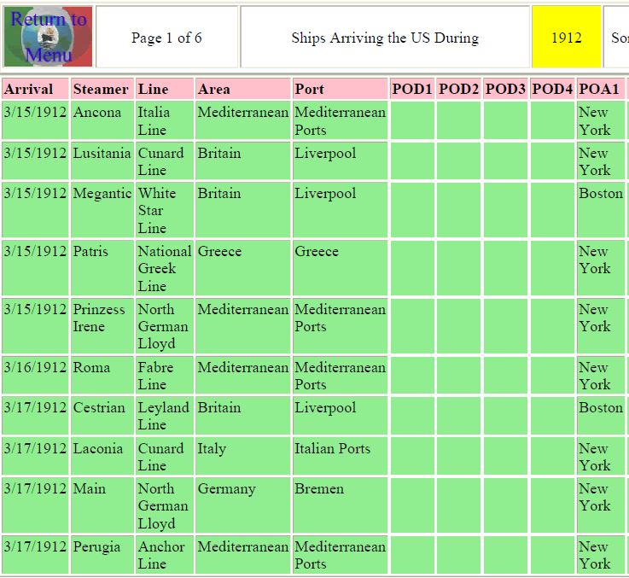
Ship arrivals were very well documented in the newspapers of the day. An online search of the “Morton Allan Directory of European Passenger Steamship Arrivals” book covering 1904-1926 resulted in the chart seen here. Most likely the cover departed via Cherbourg: North German Lloyd’s “Main,” Bremen-Southampton- Cherbourg-New York City. http://www.cimorelli.com/safe/shipmenu.htm

Slide 10
So to summarize the probable timeline of this cover…
Mailed Sunday, March 3
Arrived Paris, Sunday, March 4 at 4:30 AM
Sent to Cherbourg port
Left on North German Lloyd’s “Main” (approximately Tuesday, March 12)
Arrival NYC, Sunday, March 17
Arrival Washington, DC Monday, March 18 at 2 PM
Delivered Tuesday, March 19

Slide 11
But that’s far from the whole story, as questions remained…
Why was the Titanic marking on the cover?
Are there similar covers?
What kind of business was this letter sent to?
Why was this TITANIC cover saved?
Here are some answers!

Slide 12
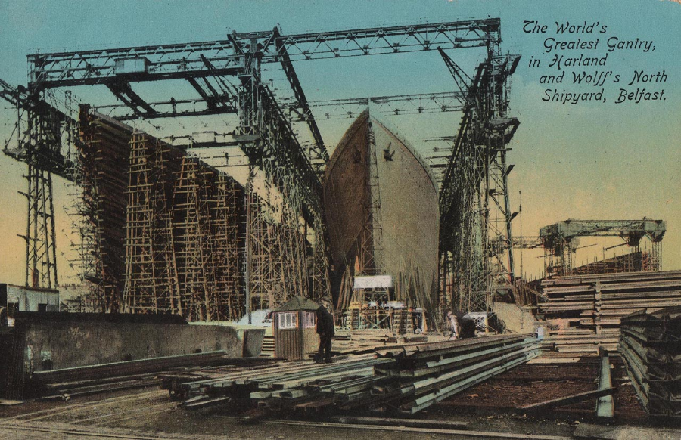
White Star’s Olympic and Titanic were built at the Harland and Wolff’s North Shipyard in Belfast, Northern Ireland. As no attempt had ever been made to build ships of their size before, it was a learning process.
Titanic’s keel was laid on March 31, 1909, three months after that of the slightly smaller Olympic. Over 15,000 men worked on the two ships built side by side. Eight were killed over the three year process, half the expected total.

Slide 13
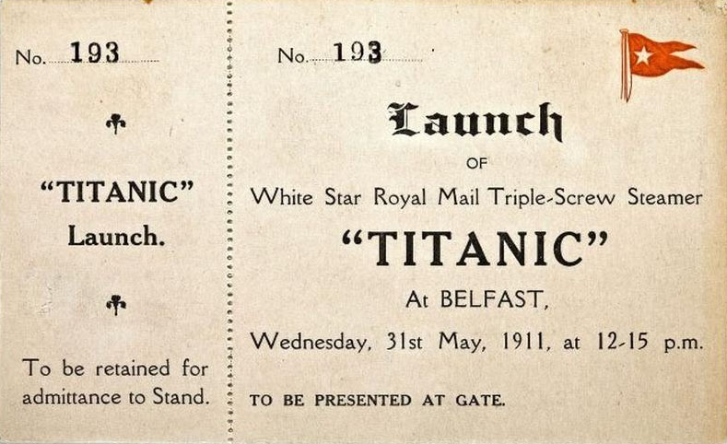
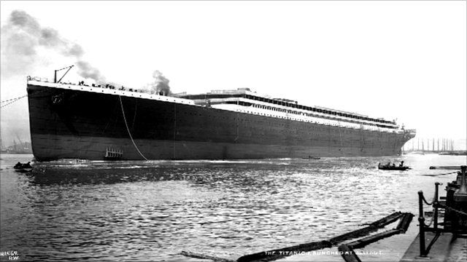
Two years later the Titanic was launched, stretching 882.5 feet long and 92.5 feet wide. Official VIP tickets were highly prized as 100,000 people were in attendance.
The 46,328-ton steamship was far from complete, with its internal fittings and famous four smoke stacks yet to be added.

Slide 14
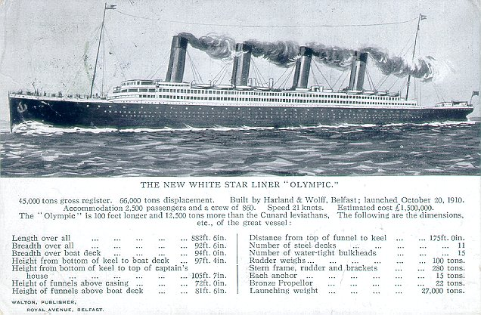
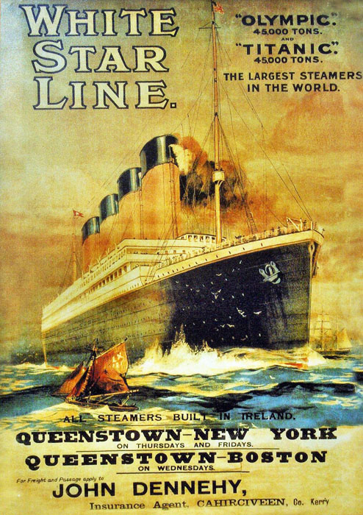
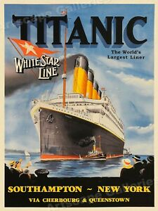
The Olympic was placed into service shortly after Titanic’s launch. The maiden voyage began June 11, 1911 from Southampton with stops in Cherbourg, France and Queenstown, Ireland before arriving in New York on June 21.
The White Star Line announced its 1912 sailing schedule on September 25 for both the Olympic and Titanic, whose maiden voyage was set on March 20 following the same route as its sister ship.

Slide 15
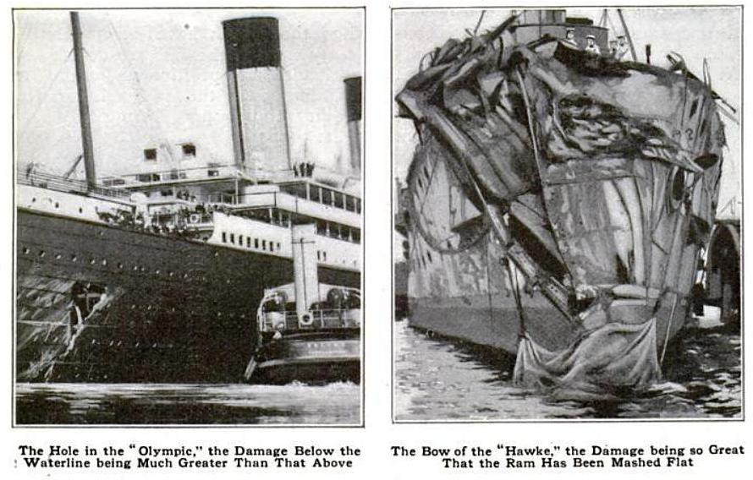
Olympic was about to start its fourth trans-Atlantic crossing to NYC when it collided with HMS Hawke in the Southampton Channel on September 20. The ship returned to the Belfast shipyards for repairs to its propeller shaft, cannibalizing Titanic parts.
A second Olympic collision took place on February 24, 1912 off the coast of Newfoundland. On March 6 Titanic was moved out of dry dock again, seen here, to allow Olympic in. Once again Titanic parts were used.

Slide 16
Titanic’s maiden voyage date of March 20 was changed to April 10 presumably because of delays due to the Olympic’s troubles.
Why was the Titanic marking on the cover?
One possible explanation is that French postal officials simply missed the date change, assuming it was scheduled to leave March 20. Although marked in error, mail would have been sent on the next available trans-Atlantic ship.

Slide 17
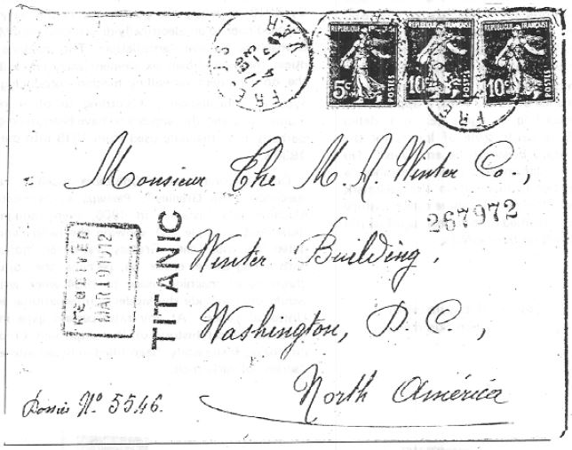
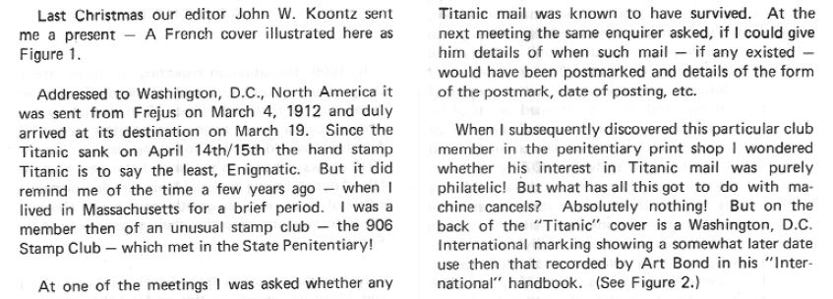
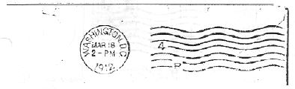
Are there similar covers?
I began to look for other covers with a similar TITANIC mark on them. These were the days before the Internet, so it was slow at first, but a literature search turned up this article by Reg Morris in the 1978 Machine Cancel Society Forum p. 517 titled, “The Sinking of the Titanic.”

Slide 18

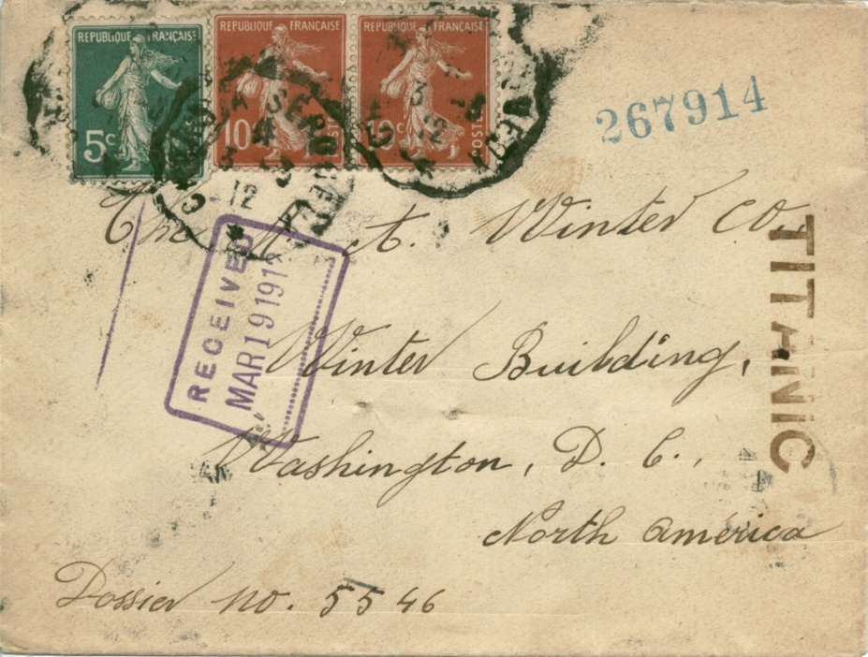
I was floored! There seemed almost too much in common between the two covers:
Mailed a day apart, March 4 instead of 3, but from Frejus between Cannes and St. Tropez on the southern Mediterranean
Franked with 25 centimes postage
Written to the same business and address
Same Titanic mark in font and size
Same handwritten Dossier number
Six-digit number stamped on both, same first 4 digits
Same Washington, DC receiving mark by type, date and time on the reverse
Same MAR 19 1912 receiving mark

Slide 19
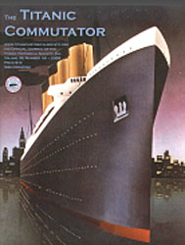
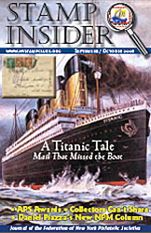

So there clearly were more covers like mine, but how many? The Internet very much changed everything as it slowly uncovered more information about known covers in publications and auction catalogs. I started writing articles about these in an effort to flush out more. Info was updated or corrected as needed in follow-ups as it became known.

Slide 20
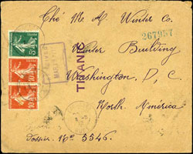
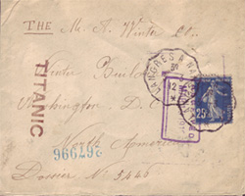
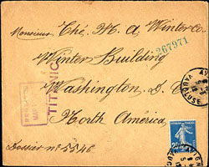
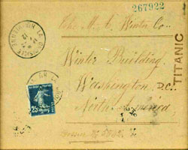
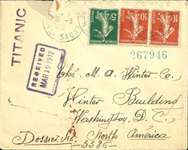
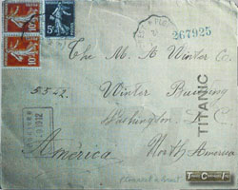
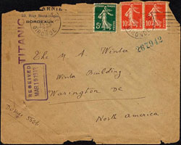
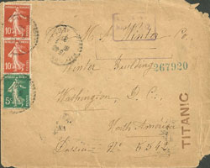
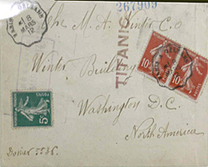
As of September 2022 twenty one similar covers have been documented. Here are some of them. All can be viewed online on a website dedicated to them at www.titaniccovers.com. Also there you’ll find articles, auction lots with prices realized when known, research materials and a cover summary table.

Slide 21
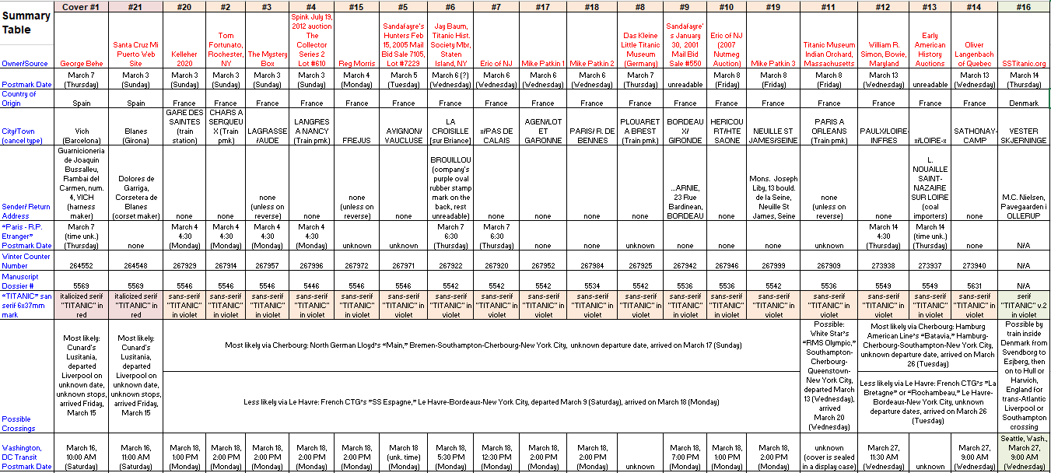
Part of the current cover Summary Table…

Slide 22
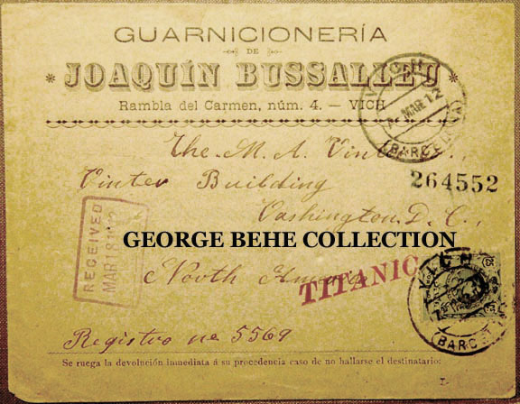
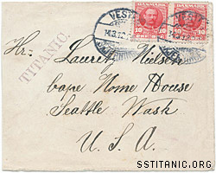
Two non-French covers bear unique TITANIC serif font handstamps.
Mailed from Vich (Barcelona), Spain on Thursday, March 7, 1912
Sent to the M A Winter Company as the others
Arrived in Washington, DC on Sat., March 16
Mailed from Vester Skjerninge, Denmark on Thursday, March 14, 1912
Sent to a lodging house in Seattle, Washington
Arrived in Seattle on Wednesday, March 27

Slide 23
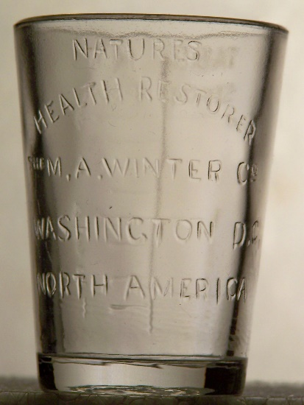
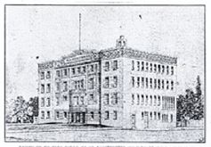

What kind of business was this letter sent to?
All but one cover was mailed to the M. A. Winter Company at what is now 1438 U Street in Washington, DC. It was built in 1908 for $50,000 by Mahlon Adolphus Winter and his partner, George W. Faris, to house Winter’s large patent medicine business. The British medical publication “The Lancet” proclaimed, “both the M. A. Winter Co. and its wonderful medicines are unworthy of serious consideration,” otherwise as snake oil salesmen!

Slide 24
Earlier mail sent to the company gave clues to the six digit numbers seen stamped on the Titanic covers. These docket numbers were applied by the company on receipt to identify each correspondence and its contents and apparently kept filed should they be needed for later use. This apparently changed from manuscript to a handstamp between 1910-11. The Winter’s purple “RECEIVED” handstamp is also found on every mail piece before, during and after 1912.

Slide 25
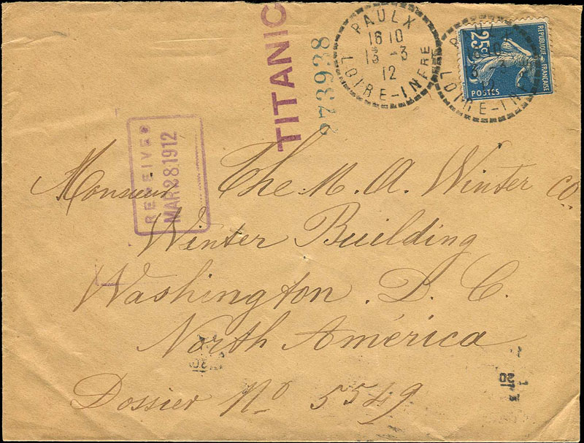
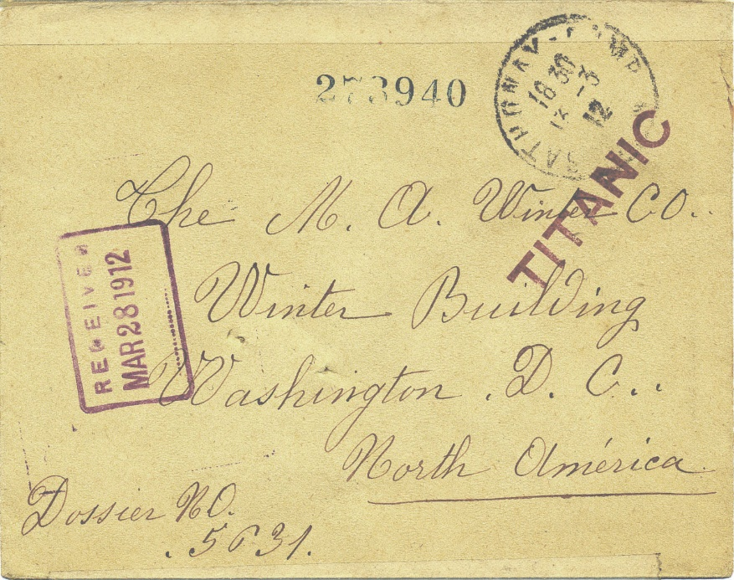
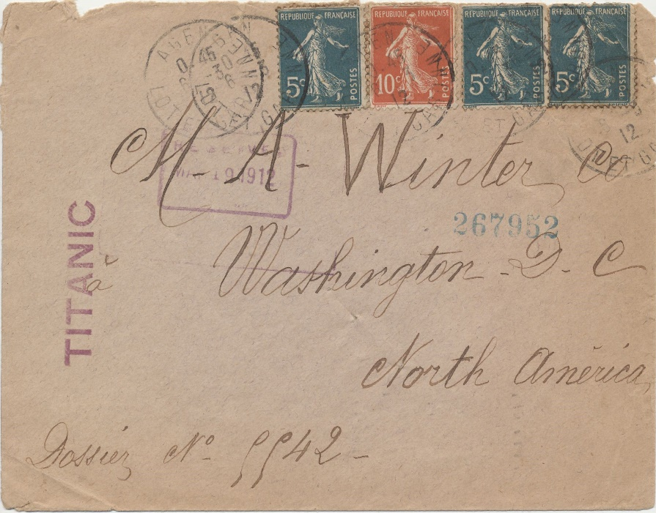
Why was this TITANIC cover saved?
The novelty of the TITANIC markings on some covers may have saved them from destruction when the company disposed of their envelope files. By that time the world knew of the fate of its maiden voyage and its passengers. Perhaps they were horded by Winter employees and kept as souvenirs or sold through philatelic channels.

Slide 26

The mystery of the dossier numbers found on all Winter mail was solved by Jerry N. J. Vondeling of the Netherlands in an article that appeared in the Summer 2017 edition of “The Titanic Commutator” that I collaborated on. He found an ad in a 1911 Dutch American paper recruiting sales people for their “remedies.”

Slide 27
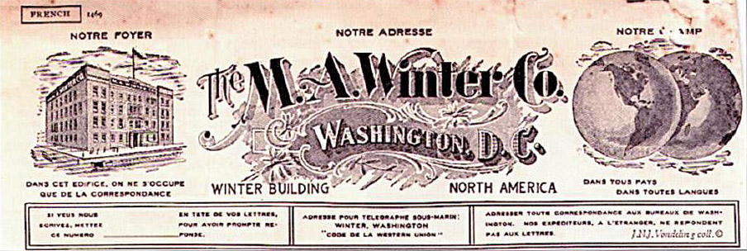
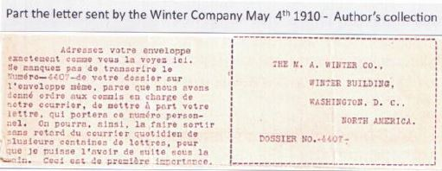
The French were especially prone to this recruitment scheme, as found by Vondeling in this letter excerpt clearly showing how to address a response to the company about a job by referencing the dossier number:
“Address your letter exactly as you see here. Be sure to write Number-4407-from your folder on the same envelope, because we instruct the clerk in charge of our mail to look for your number that will carry this personal number. We can, thus, find it without delay from the hundreds of letters received daily so that I can have it at hand.”

Slide 28
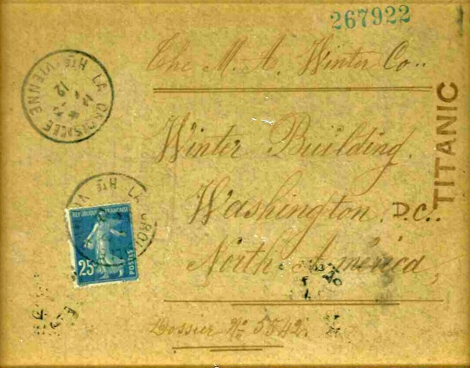
Most of the 20 covers were mailed in plain envelopes, however a few are on business advertising covers.
on reverse of cover
(unreadable)
Harness Maker
Joaquin Bussalleu
Rambia del Carmen,
Number 4,
Vich (Spain)
Importers of Coal
Briquettes and Anthracite
L. Nouaille – Saint Nazaire sur Loire
(port near Nances in NW France)

Slide 29
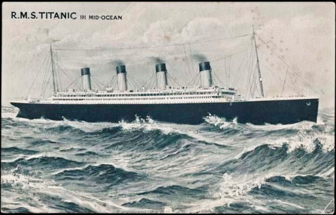
So to summarize…
Multiple “Titanic” covers have been found, putting initial rebuttals to rest that they were intentionally “manufactured”
A theory exists why the “Titanic” marking was used before the ship actually sailed
Probable ship crossings for all 21 known covers have been researched and documented based on cover markings and New York City trans-Atlantic arrival dates
All Winter Company markings have been explained
There is a plausible reason why so many Winter covers have been found

Slide 30
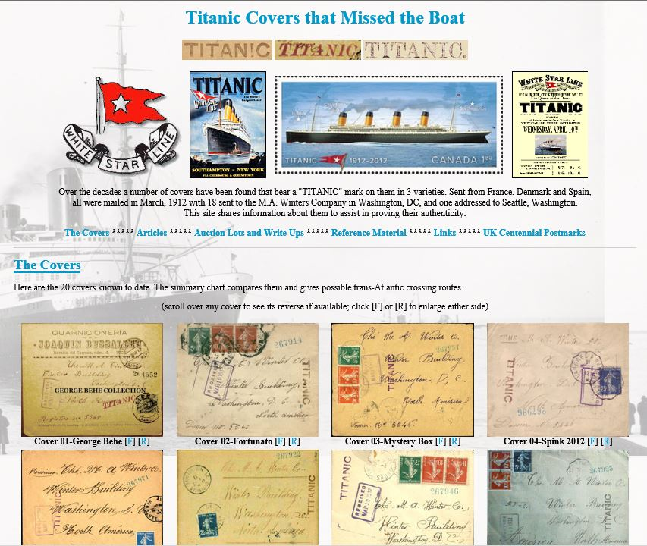
I hope you enjoyed this brief look at Titanic covers that “missed the boat.”
For those interested, I would encourage you to visit my web site dedicated to the background and census of these covers. www.titaniccovers.com
There is definitely more to learn about these fascinating pieces of postal history.

