Slide 1
Small Stamps by Paul Brach for the Rochester Philatelic Association May, 2018
Note: Stamps are not to scale with each other!

Slide 2
U.S. 2476 21 x 25 mm = 525 sq. mm

Slide 3
U.S. 1449 25 x 21 mm = 525 sq. mm

Slide 4
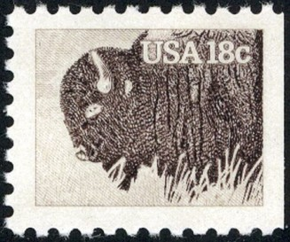
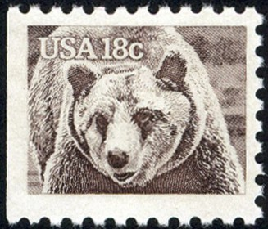
U.S. Mammals Booklet Stamps
1884
22 x 19 = 420 sq. mm
1883
22 x 18 = 400 sq. mm

Slide 5
U.S. 1822 18 x 20 = 360 sq. mm

Slide 6
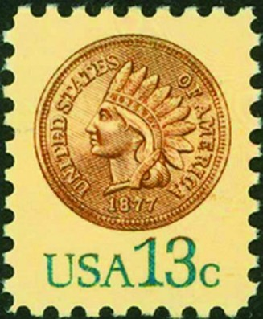
U.S. 1734 16 x 20 = 320 sq. mm

Slide 7
U.S. RS119b 40 x 12 = 480 sq. mm

Slide 8
U.S. 26L1 and 26L2 25 x 19 = 475 sq. mm

Slide 9
U.S. TF443 42 x 9 = 380 sq. mm

Slide 10
U.S. 137L1 18 x 15 = 270 sq. mm

Slide 11
U.S. RJA42d 38 x 6.5 = 250 sq. mm

Slide 12
U.S. 15L14 16 x 11 = 175 sq. mm

Slide 13
Russia 2292 19 x 26 mm = 494 sq. mm

Slide 14
Russia 12 18 x 25 = 450 sq. mm

Slide 15
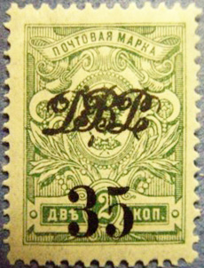
18 x 25 mm = 450 sq. mm
Far Eastern Republic 30
Finland 74

Slide 16
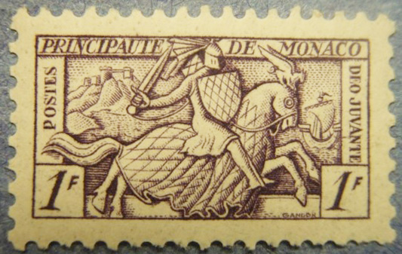
Monaco B5 26 x 16 = 416 sq. mm

Slide 17
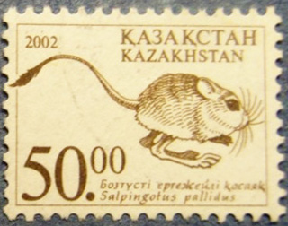
Kazakhstan 360, 375 = 408 sq. mm 17 x 24 mm 24 x 17 mm

Slide 18
Spain 174 20 x 20 = 400 sq. mm

Slide 19
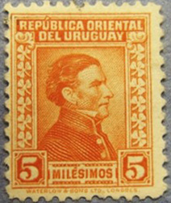
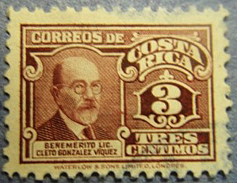
396 sq. mm
Costa Rica 210A
22 x18 mm
Uruguay 61a
18 x 22 mm

Slide 20
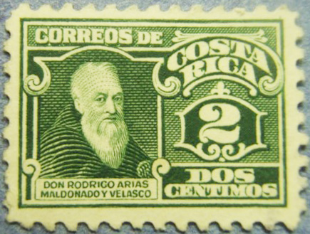
Costa Rica 128 22 x17 = 374 sq. mm

Slide 21
Bergdorf 3 20 x 18 = 360 sq. mm

Slide 22
360 sq. mm
Brazil RA9
19 x 19 mm
Nicaragua RA62
24 x 15 mm

Slide 23
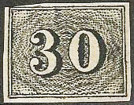
Brazil 23 22 x 16 = 350 sq. mm

Slide 24
Victoria 184 13 x 22 = 286 sq. mm

Slide 25
Shanghai 152 10 x 24 = 240 sq. mm (per half)

Slide 26
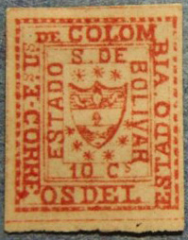
Bolivar 2 and 3 11 x 14 = 154 sq. mm

Slide 27
Columbia 601 18 x 8 = 144 sq. mm

Slide 28
Alberta AP1 10 x 11 = 110 sq. mm

Slide 29
Perspective

Slide 30
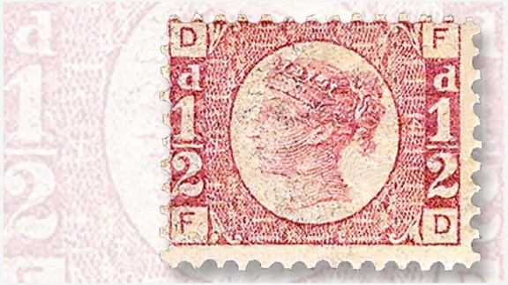
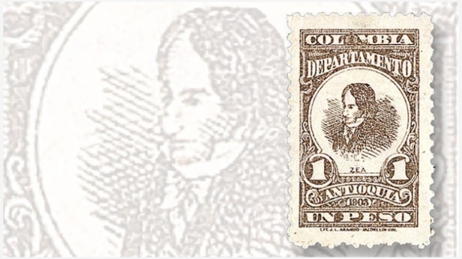
There are plenty more… …if you look close!
Great Britain
Germany
Columbia-Antioquia
Italy

Slide 31
Thanks for watching!
Design and Layout by Tom Fortunato

