Slide 1
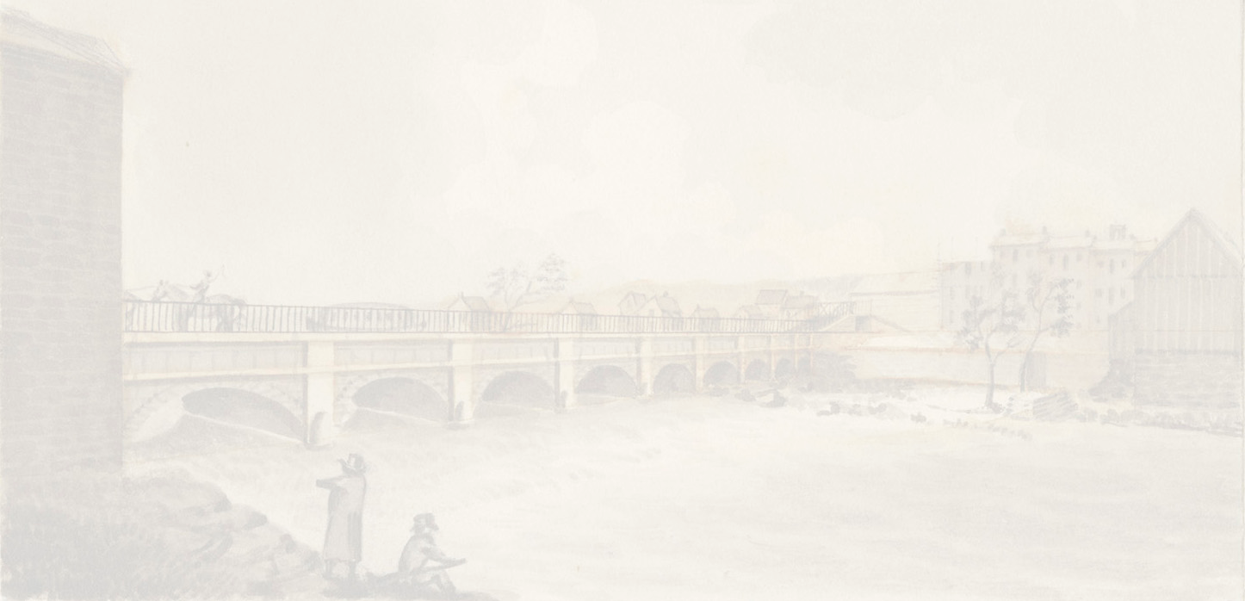
Rochester Trivia
Using
Advertising Covers
A 2022 presentation for the
Rochester Philatelic Association
By Tom Fortunato

Slide 2
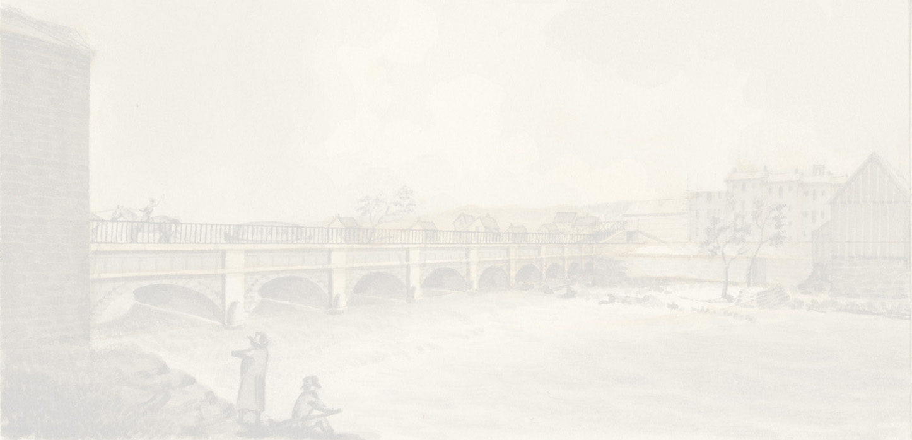
Rochester, NY was first settled in 1789 by Ebenezer Allen whose grist mill on the Genesee River supported the area’s Seneca Indians. His 100 acre tract was sold to three Maryland entrepreneurs who later offered lots for sale in 1811. The village of Rochesterville was established in 1817, renamed Rochester in 1822 and incorporated as a city in 1834. The population grew because of the area’s abundant flour mills and the transportation resources of the Erie Canal and railroads moving those goods to markets across the country. The latter half of the century saw growth in the shoe and clothing industries, as well as nursery and mail-order seed companies. Engineering and industrial production of all kinds highlighted the early twentieth century, especially in cameras and optics.
This presentation highlights a few of those businesses, the people and interesting stories about them that perhaps you never knew.

Slide 3
Highlighting the following people and companies from Rochester past…
American Chemical Manufacturing and Mining Company
Ward’s Natural Science
Pure Gold Manufacturing Company
Cutler Manufacturing Company
William S. Kimball and Company/American Tobacco Company
Vacuum Oil Company
Buffalo, Rochester and Pittsburgh Railroad Company
Henry R. Selden
Western Union Telegraph & Hiram Sibley and Company
Randolph Huntington
S. F. Hess and Company
Selden Motor Vehicle Company
US Standard Voting Machine Company
William W. Osgoodby

Slide 4
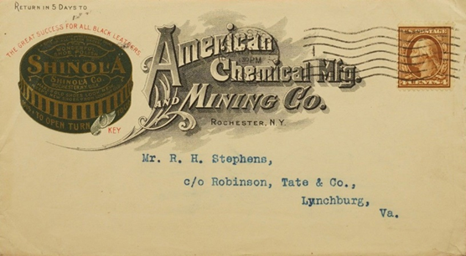
American Chemical Manufacturing and Mining Company
What is this company’s connection to the expression,
“You don’t know ‘$&!+’ from shinola”?

Slide 5
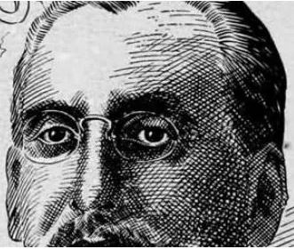
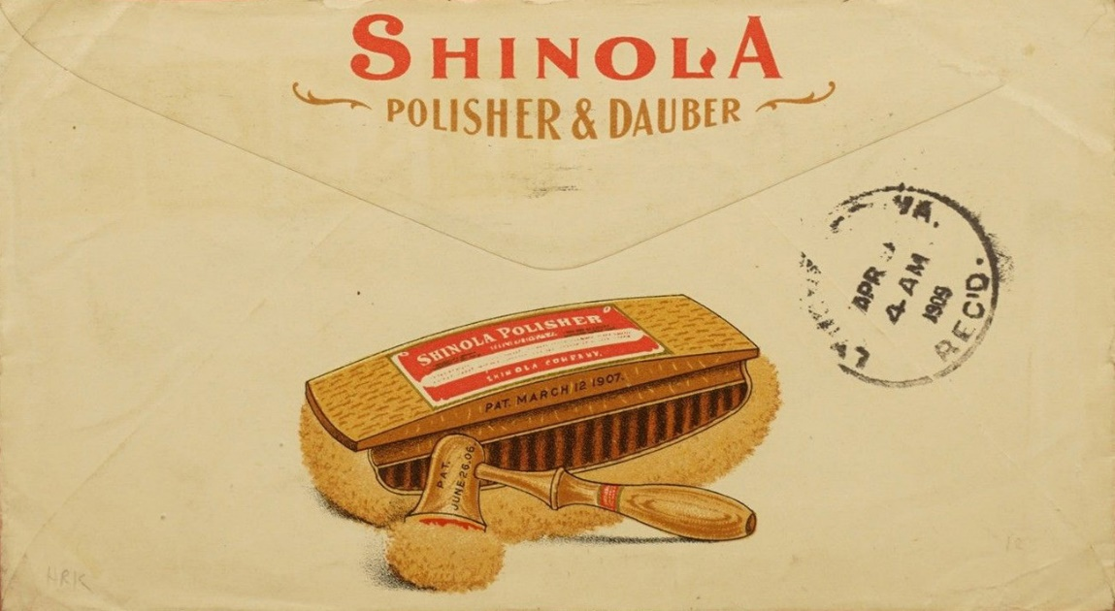
Located on 6 Jay Street the American Chemical Manufacturing and Mining Company produced a variety of items, but its most famous product was a black wax polish first made around 1880 created by employee George Melancthon Wetmore. Shinola became a worldwide success. He later became its president in 1917 and renamed the business The Shinola Company. He died in 1923 and the company was sold off and moved away. WWII soldiers made the “shinola” phrase popular, having been forced to use it often during their service tour.
Interesting fact: Comedian George Carlin used the phrase in his banned shtick, "Filthy Words," aka "Seven Dirty Words," source of the 1978 broadcasting free speech case FCC v. Pacifica Foundation, a 1st Amendment constitutional decision by the Supreme Court of the United States.

Slide 6
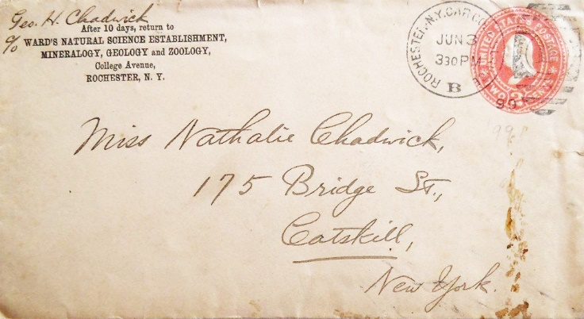
Ward’s Natural Science
What “act” linked Ward’s with the Barnum and Bailey Circus?

Slide 7
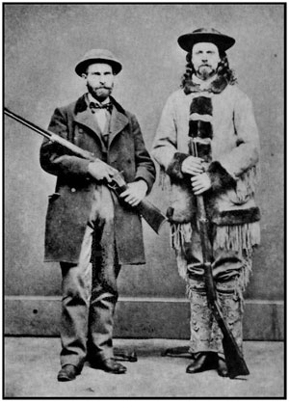
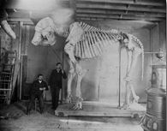
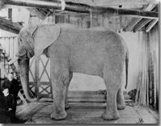
Founded by Henry Augustus Ward in 1862 and still around today, this company supplies the worldwide scientific community and educational institutions with specimens and kits dealing with biology, chemistry, earth science and much more. Ward travelled the world collecting specimens of all kinds, especially meteorites. When friend P. T. Barnum’s elephant Jumbo died after being hit by a train, Ward was commissioned to mount its skeleton and skin so that it might continue to be part of the circus for years to come. It took two years to finish.
Interesting fact: Henry Ward was the first automobile casualty in Buffalo, NY having been hit by a car on July 4, 1906, dying later that day. His brain was donated to the Wilder Brain Collection at Cornell University.
Henry Ward (left) with Buffalo Bill Cody

Slide 8
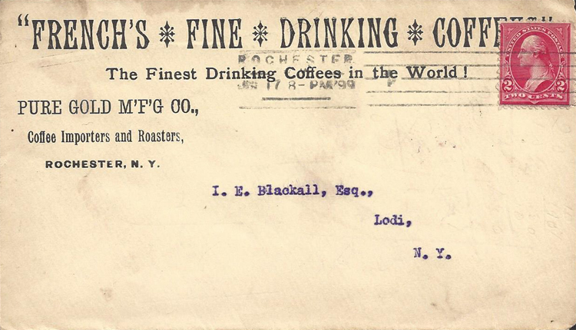
Pure Gold Manufacturing Company
Are you familiar with this company’s renowned sister product?

Slide 9
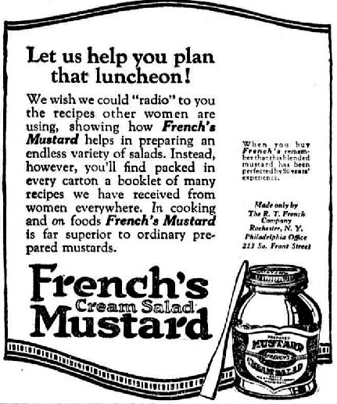
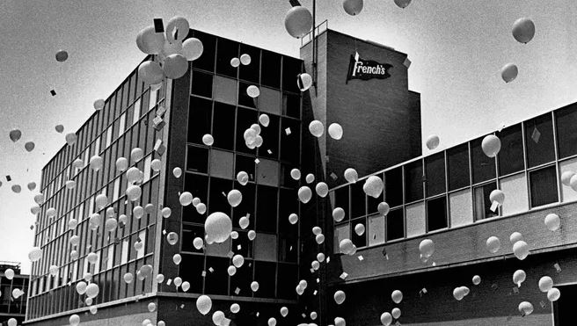
The Pure Gold Manufacturing Company was owned the R. T. French Company. French's Cream Salad Brand Mustard debuted as a salad garnish at the 1904 St. Louis World’s Fair, which also hosted the Olympics. The French family sold the business to the British firm Reckitt & Colman in 1926, but the French’s headquarters remained in Rochester until 1987 when it moved along with its test kitchens to Chester, New Jersey. McCormick's spice company currently owns the brand after having undergone several corporate buyouts.
Interesting fact: While the Brits invented a process for making instant mashed potatoes in WWII, it was the R T French company that mass produced it for the first time starting in 1946.

Slide 10
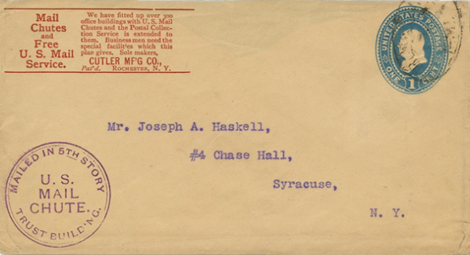
Cutler Manufacturing Company
Shoot, no, chute!

Slide 11
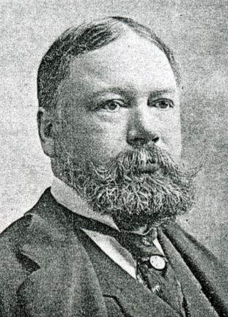
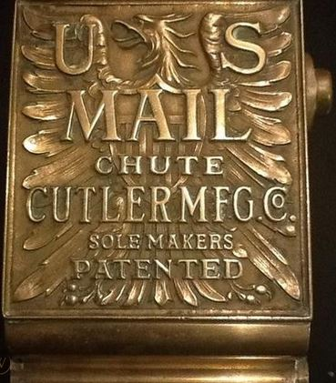
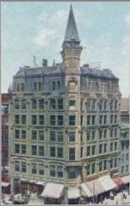
Vintage decorative bronze plaques can still be found around the country on walls that used Cutler Mail Chutes. The concept was patented by James Goold Cutler in 1884 as a way to collect mail from multi-floor buildings. He had formerly designed several structures, including the Elwood Building at Four Corners in 1879 and Kimball Tobacco Factory on Court St in 1880. The National Fire Protection Association banned the use of mail chutes for buildings built after 1997.
Interesting facts: James Goold Cutler was the mayor of Rochester from 1904-1907. He was eulogized by former President Taft and former NY Governor/Secretary of State Charles Hughes when he died in 1927.
Elwood Building

Slide 12
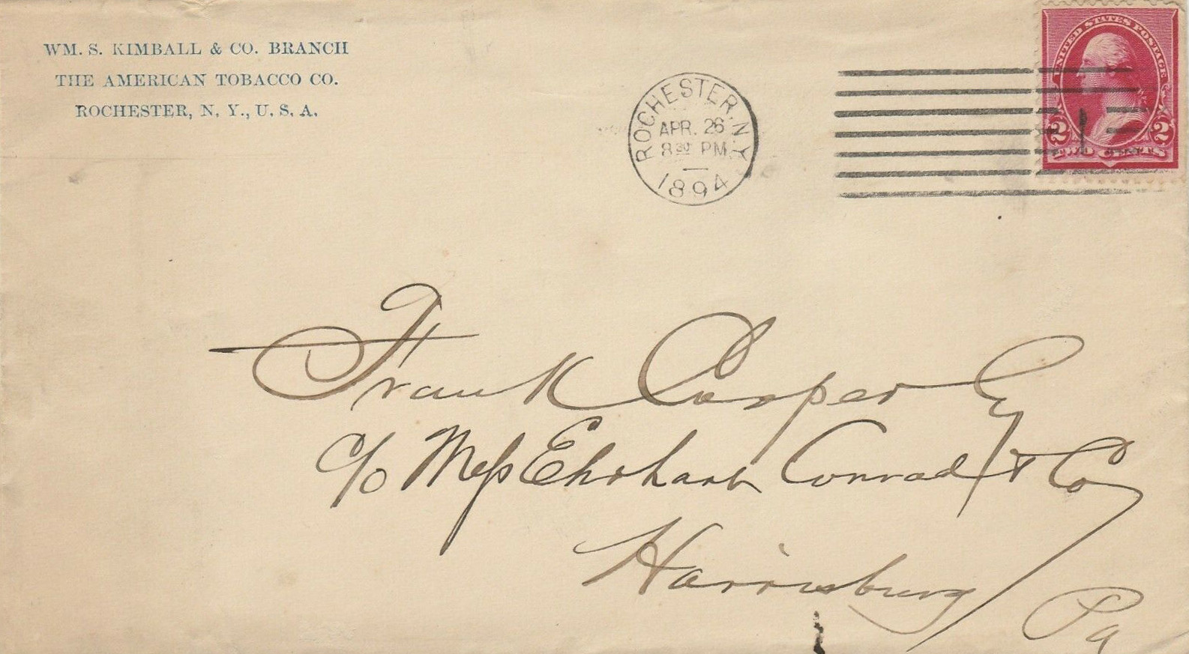
William S. Kimball and Company/American Tobacco Company
What is the connection of tobacco and the god of commerce?

Slide 13
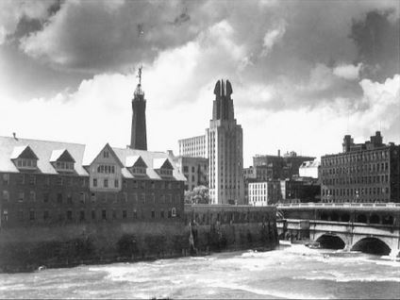
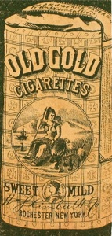
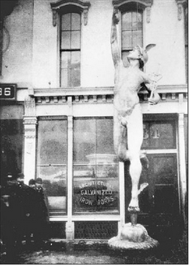
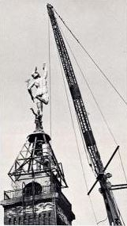
One of the country’s largest cigarette manufacturers was here in Rochester. The William S. Kimball and Company’s Peerless Tobacco Company began in 1867. Use of a mechanized cigarette-cutting machine helped the firm produce over 750 million Peerless cigarettes per year, which had over 1,000 employees. In 1890 Kimball merged with four major tobacco producers forming the American Tobacco Company, later disbanded for anti-trust measures in 1911. Peerless was sold off to F. F. Adams in Milwaukee and continued the brand.
Interesting fact: Kimball’s brother-in-law, Guernsey S. Mitchell, designed the 21 foot 700 pound copper statue of Mercury, God of Commerce. Placed atop a company smokestack in January 1881, it stood for 70 years.

Slide 14
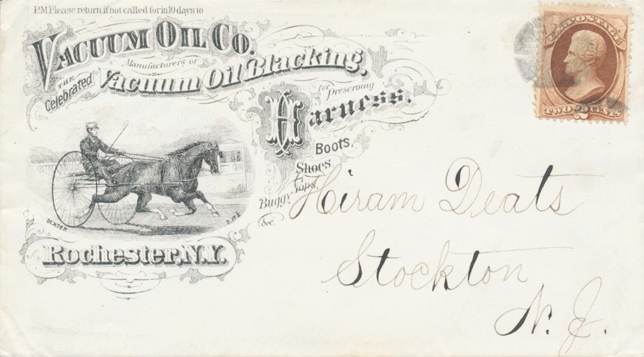
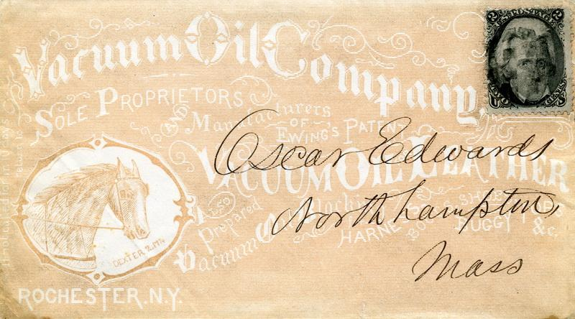
Vacuum Oil Company
What famous oil company did this firm become?

Slide 15
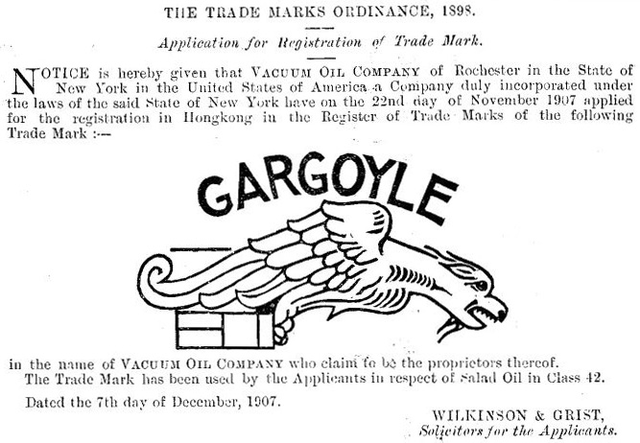
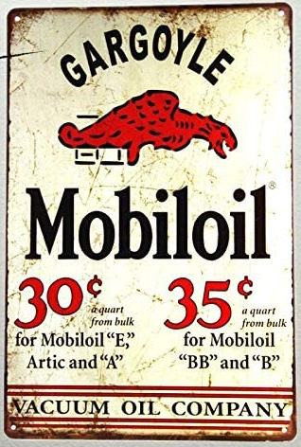
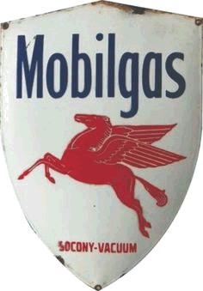
Matthew Ewing patented a process converting crude oil into kerosene, with the residual oil usable as a leather refinisher (saddle harnesses, shoes, etc.) and lubricant (machines, trains and eventually cars), creating Vacuum Oil Works in 1866. John D. Rockefeller’s Standard Oil bought controlling interest in the firm in 1879, keeping the refining factory on Flint and Exchange Street operational until 1935. The two companies eventually merged. Initial environmental cleanup of 7 of the site’s 40 acres was estimated at $17 million in 2015.
Interesting fact: Vacuum Oil’s gargoyle symbol of 1907 morphed into the well known Mobile gas Pegasus.

Slide 16
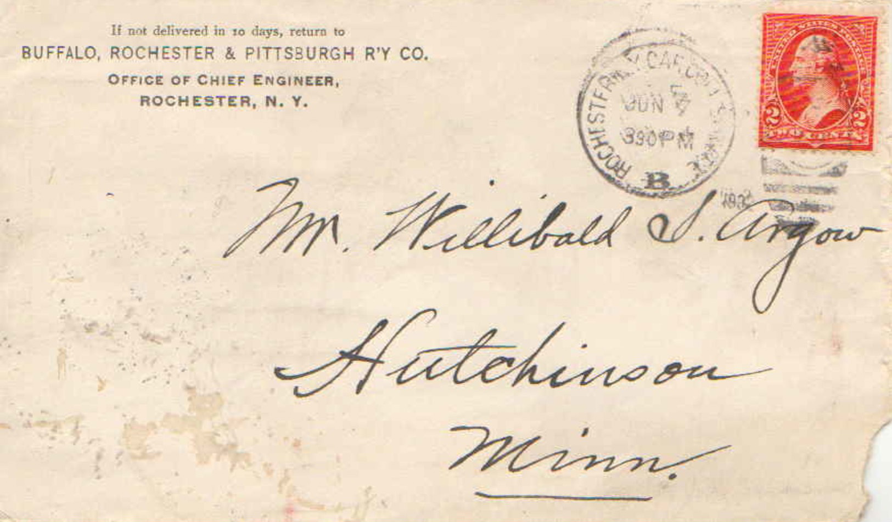
Buffalo, Rochester and Pittsburgh Railroad Company
It remains a Rochester landmark.

Slide 17
Railroads played a major part in Rochester’s growth. The Buffalo, Rochester and Pittsburgh Railroad had lines from Pennsylvania all the way to Charlotte, primarily as a way of transporting coal to the cities of Rochester, Buffalo and via ferry to Cobourg, Ontario. It formed in 1885 by taking possession of the failed Rochester & State Line Railroad. By the time BR&P was bought out by the B&O Line in 1932 its coal, freight and passenger system had expanded into Indiana and throughout western and central Pennsylvania.
Interesting fact: Next time you dine at Nick Tahou’s on 320 West Main Street, remember that you’re in BR&P’s former headquarters!

Slide 18
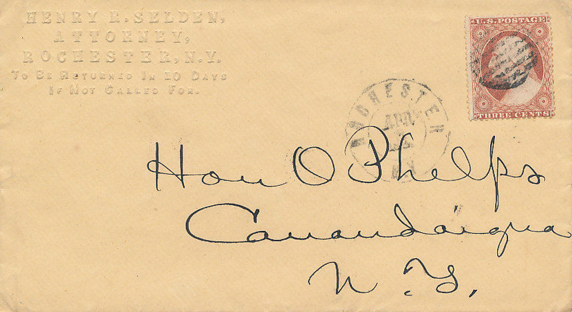
Henry R. Selden
A prominent lawyer, judge and politician involved in Rochester affairs.

Slide 19
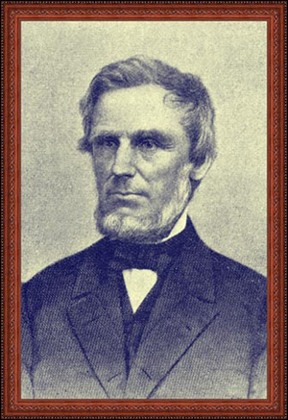
Twenty year old Henry R. Selden moved to Rochester in 1825 to join relatives where he entered the Bar in 1830 and became very involved in the Abolitionist Movement. He ran for Lt. Governor and won a 2 year term from 1857-58. In 1859 Selden advised Frederick Douglass to flee to Canada, getting tipped that the governor planned to extradite him to Virginia. He had a short term as a judge with the NYS Court of Appeals, then was elected as a state Assemblyman for Monroe County. His most famous legal case defending Susan B. Anthony who had voted
in the recent national election under his advice. Anthony had been arrested for not having the right to vote. Her case took place in the Canandaigua Court House June 17-18, 1873 and eventually sentenced to pay a fine of $100 plus costs. No appeal was allowed.
Interesting fact: Selden was offered the Republican VP nomination slot with Abraham Lincoln in the 1860 campaign, but turned it down due to worsening health issues.

Slide 20
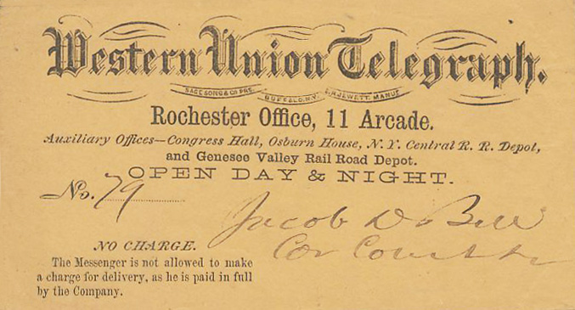
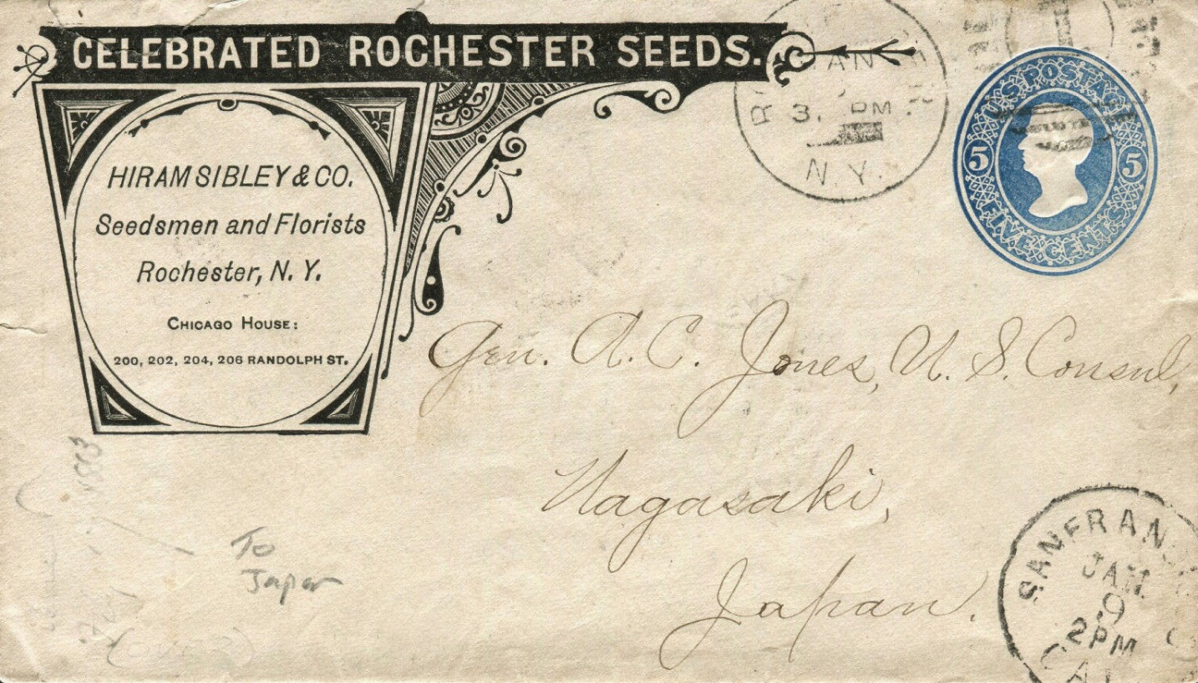
Western Union Telegraph Hiram Sibley and Company
How are these two companies linked?

Slide 21
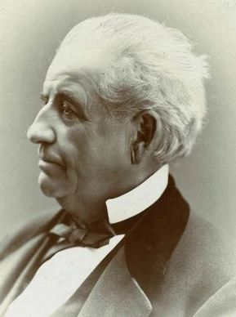
A visit with Samuel Morse sparked Hiram Sibley’s interest in the telegraph. With his encouragement Congress funded the first telegraph line in 1844. He and other Rochesterians purchased 11 small telegraph firms in 1851, forming the New York and Mississippi Valley Printing Telegraph Company with a line running from Buffalo to St. Louis. It was renamed Western Union Telegraph Company in 1856 with Sibley as president. Their transcontinental line was completed in 1861, making the firm the leader in the industry. He left in 1869.
Sibley moved on to other interests after WU, notably farm seed development and nurseries, owning farmlands across the globe.
Interesting facts: Sibley was elected sheriff of Monroe County in 1843. At one point Sibley was the county’s richest citizen. On his death his fortune was estimated to be over $10 million.

Slide 22
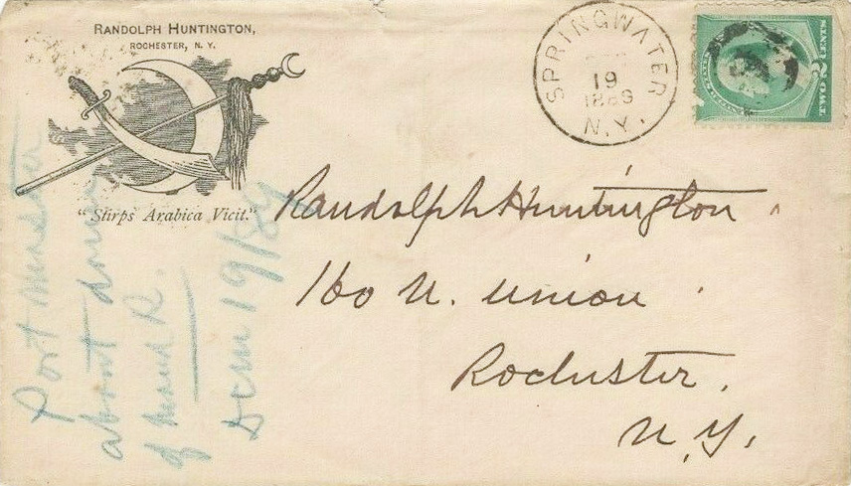
Randolph Huntington
How’s your Latin? “Stirps Arabica Vicit”

Slide 23
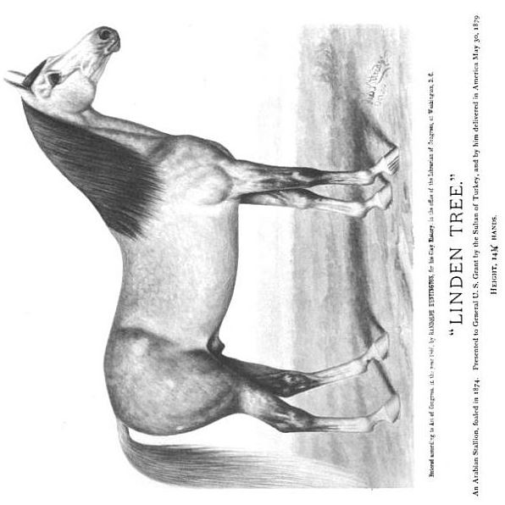
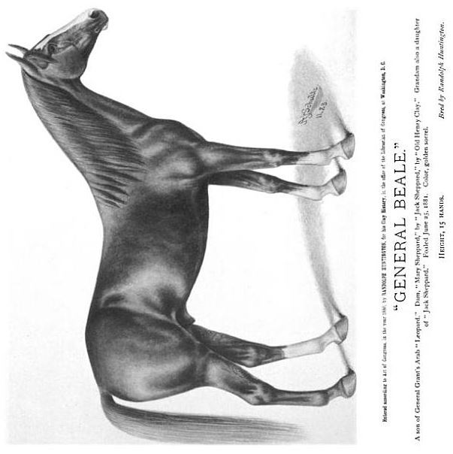
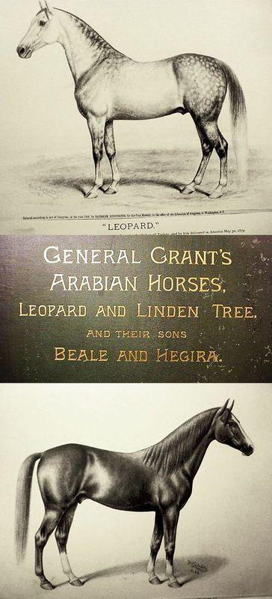
“An Arabic wins.” Ralph Huntington, a druggist by trade, was considered the world’s leading expert of Arabian horses in his day. His specialty from 1877-1893 was in breeding Arabic horses with descendants of the American trotting horse “Henry Clay” to create a better lineage of saddle and road horse. He was married in Bloomfield in 1865 and resided in Rochester from 1876-1891, leaving for Oyster Bay, Long Island. His treasurer, Francis Weeks, embezzled over $100,000 shortly there after, forcing Huntington into bankruptcy in 1893 with his remaining 84 horses auctioned off the following year.
Interesting fact: Read his 1885 book, “History in Brief of Leopard and Linden, General Grant’s Arabian Stallions” online at Google Play: https://play.google.com/books/reader?id=Z7lCAAAAYAAJ&hl=en&pg=GBS.PP7

Slide 24
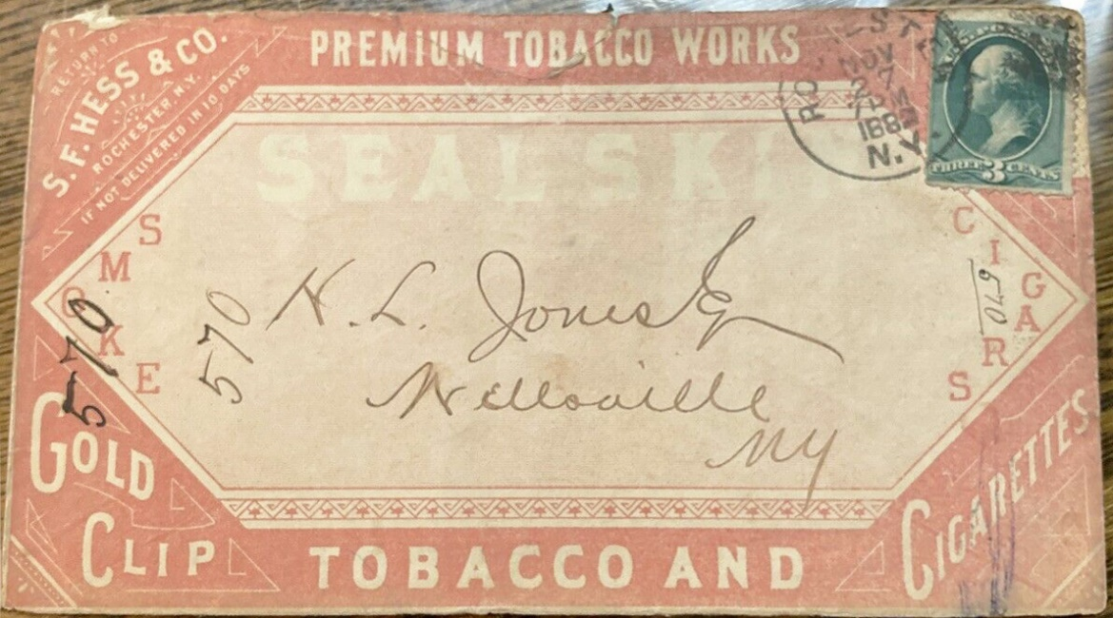
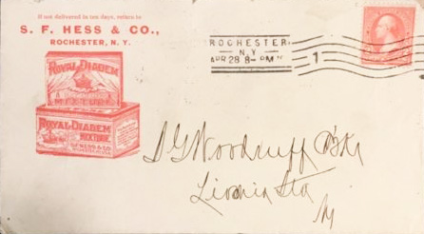
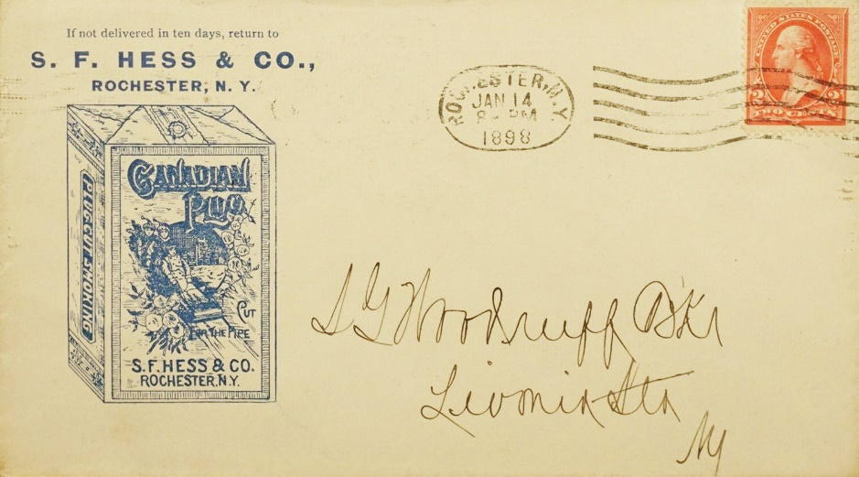
S. F. Hess and Company
Another major tobacco manufacturer in Rochester.

Slide 25
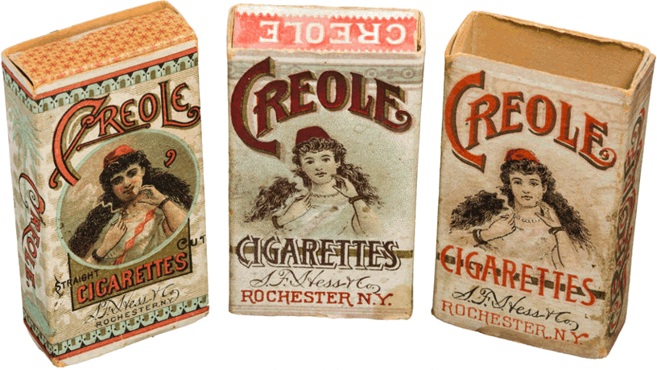
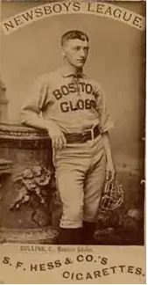
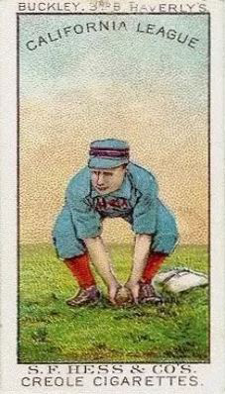
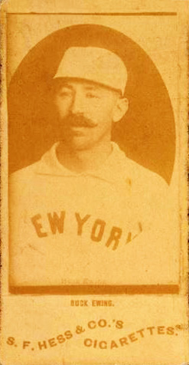
S. F. Hess & Company of the Premium Tobacco Works began in 1838. In 1880 Rochester produced 8.6 million cigars and 91.5 million cigarettes. Hess invented an improved tobacco bailer to assist in his company’s productivity that brought his workforce to over 300 employees by that time, mostly women and girls per industry norms. Hess sold their trademark “Seal Skin” cigars ($3.75 per box of 50) and several cigarette brands. The company was sold to the American Tobacco Company in 1890, but continued producing through 1905.
Interesting fact: Hess was among the first cigarette companies in the US to insert printed advertising stiffeners to prevent packages from crushing. Their 3 1888 card series showed Newsboys, California and Big League players.

Slide 26
Selden Motor Vehicle Company
Did Henry Ford really invent the automobile?

Slide 27
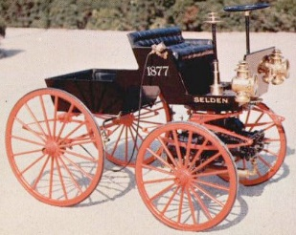
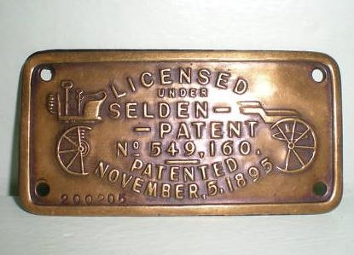
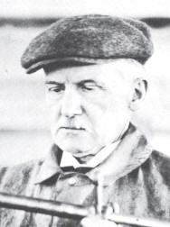
Rochester lawyer turned inventor George Baldwin Selden designed a “road locomotive” to be powered by a gasoline engine in 1877. His patent took 18 years before approval. The Electric Vehicle Company of Hartford paid Selden $10,000 for the patent rights and a royalty for every gas powered car they produced. Selden started his own auto firm in 1906 selling 850 cars by 1908. Henry Ford fought the patent for years in the court, eventually winning in 1911. Selden eventually converted to manufacturing trucks until he sold the business in 1930.
Interesting fact: Cars produced by Cadillac, Packard, Buick, Peerless and others around the turn of the century had labels proving they took license under the patent. Henry Ford refused, claiming his 1893 auto was the first of its kind.

Slide 28
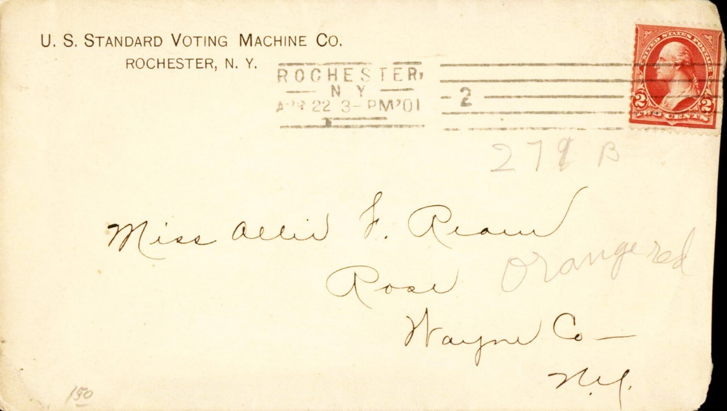
US Standard Voting Machine Company
It all started in Rochester.

Slide 29
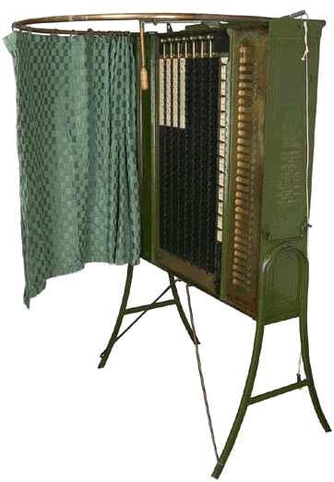
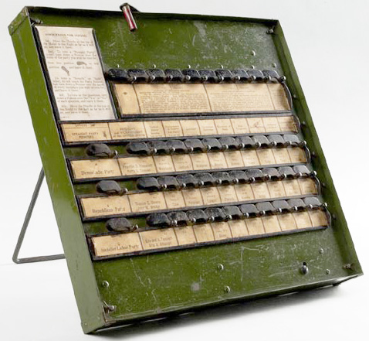
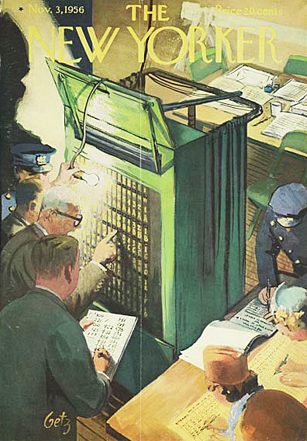
The gear and lever voting machine was patented by inventor Jacob H. Myers in 1889 and first manufactured by the Standard Voting Machine Company with improvements by Alfred J. Gillespie in 1895. The concept was simple: pull the handle that draws the curtain closed; turn a lever over the candidate of choice exposing a red X; pull the handle back and the vote registers while resetting the lever and opening the curtain. Counts appear in the rear of the machine. By 1930 every US major city used them. Rochester did until 2010.
Interesting fact: State and local municipalities found investing in these machines to be cost effective and time saving, especially once women received the right to vote and potentially doubling voter turnout.

Slide 30

William W. Osgoodby
Legal/court stenographer.

Slide 31



William W. Osgoodby’s obituary lauded him as a veteran shorthand expert and world’s most experienced court stenographer. The Rochester native born in 1834 began studying shorthand at age 14 and by 21 was a newspaper reporter. He left for Michigan in 1856 where he eventually reported on state House affairs and studied the law, passing the New York Bar on his return in 1859. From 1862-1913 he was the state’s Supreme Court stenographer. Over time he developed a new form of phonetic shorthand that became used worldwide.
Interesting fact: William Osgoodby was the first Rochesterian to own a typewriter.

Slide 32
I hope you’ve enjoyed this brief look at the Rochester that once was.
Covers displayed come from my digital collection of more than 800 Rochester advertising covers documented over many years, part of a larger project mapping the city through the businesses once there.
All of the information used in this presentation was found on the Internet from a variety of sources. I especially want to point interested viewers to two invaluable historical resources:
The digital collection of the Rochester Public Library https://roccitylibrary.org/digital-collections/
The Rochester historical books of Donovan Shilling, especially “Made in Rochester” - preview select pages here: https://books.google.com/books?id=rCauCAAAQBAJ&printsec=frontcover#v=onepage&q&f=false

