Slide 1

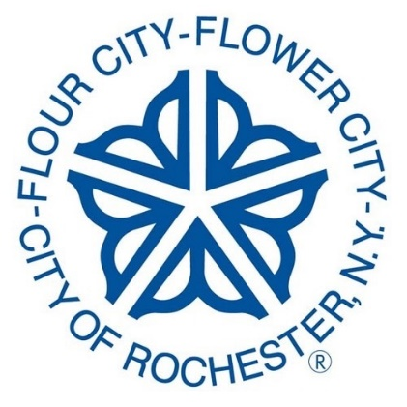
Rochester’s Landmark Buildings
(and their stories) by Tom Fortunato A presentation for the Rochester Philatelic Association, 2020

Slide 2

The City of Rochester, NY has a rich architectural history seen through its buildings of today and images of the past.
Iconic companies and wealthy businessmen often built skyscrapers downtown that took their name, including Kodak, Xerox and Bausch & Lomb. The buildings are still here while their original occupants are gone. Here are seven classic structures still on the city skyline you may not be so familiar with. Next time you drive by you’ll know more about them.
This brief presentation uses advertising covers, postcards and photos to make the reader aware of what was and still is in the Flower City. Enjoy! Let’s start out with an easy quiz…

Slide 3
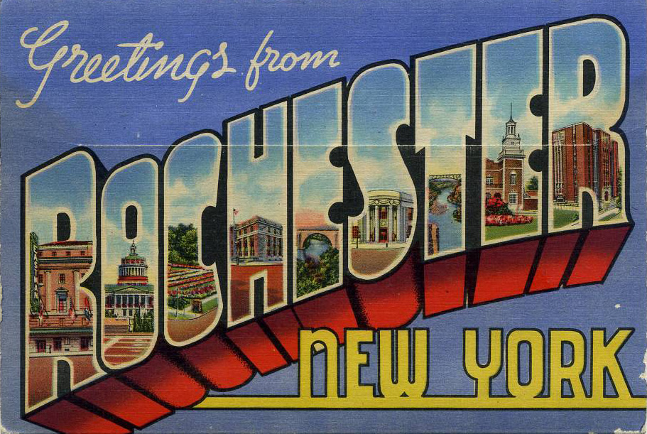
How many of these Rochester sites can you identify from 1937?
Look at Answers each appear letter on the and next identify slide. the They are landmark all still shown. around!

Slide 4
How did you do?
R Eastman S Cumberland
Theater Post Office
O U of R T Driving Park
Library Bridge
C Highland E Charlotte
Park Bath House
H Public R Auditorium
Library Theater
E Veteran’s
Memorial
Bridge

Slide 5
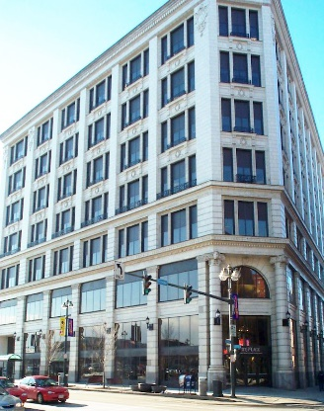
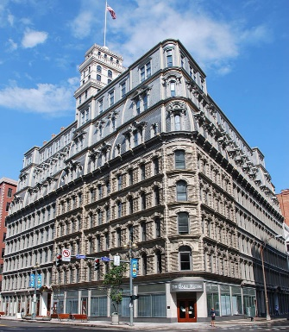
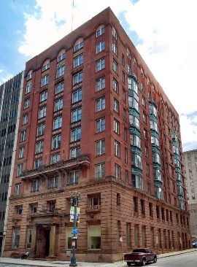
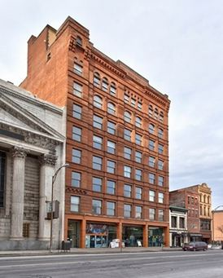
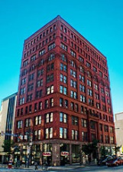
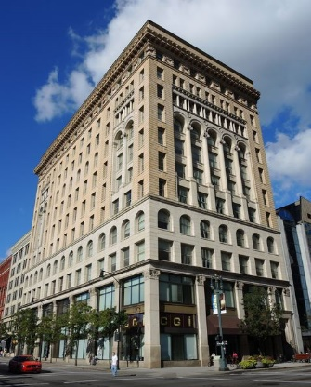
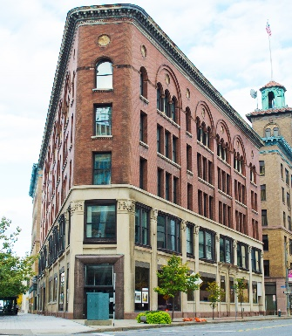
Buildings in this presentation include:
West Main St Area
• Duffy-Powers Building
• Powers Building/Hotel
• German Insurance Company Building
• Ellwanger and Barry Building
East Main St Area
• Wilder Building
• Granite Building
• Sibley Triangle Building
These classic buildings are all in central downtown, most around the “Four Corners” intersection of Main and State streets.
100 Acre Plot Tour ← Look for web links like this throughout the presentation to learn more about the buildings.

Slide 6
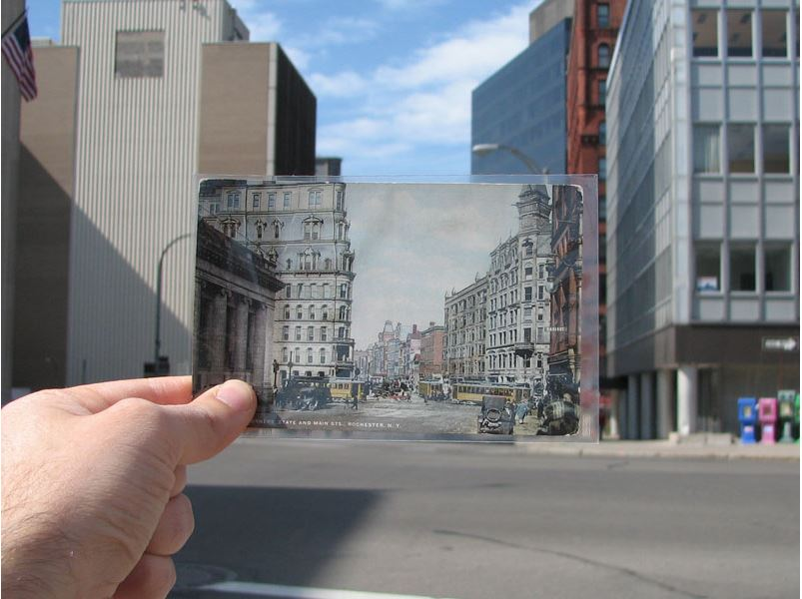
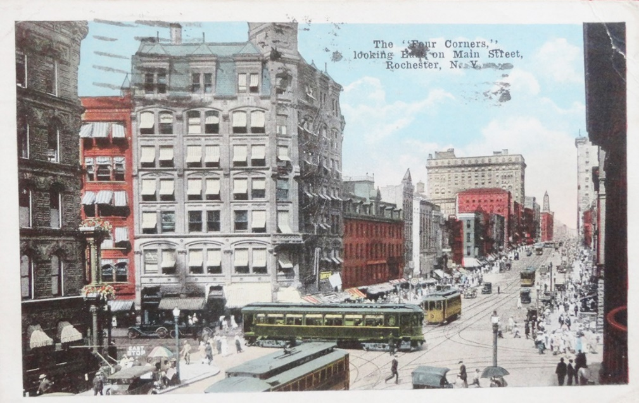
Four Corners, looking north toward State Street, then and now.
It’s not too hard to imagine yourself walking the Rochester streets in the early 1900’s.
Looking east down Main Street.
from "Rochester Subway"

Slide 7
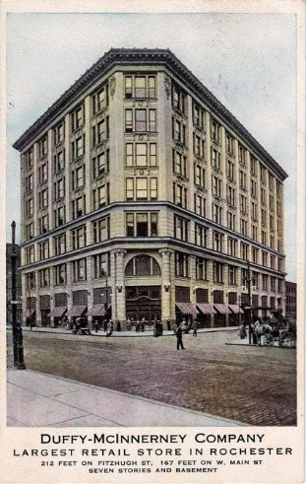
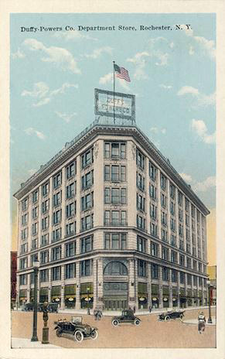
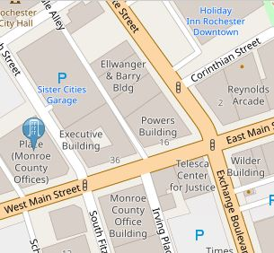
First stop on West
Main Street is the
Duffy-Powers Co.
Building, formerly
Duffy-McInnerney, finished in 1904.
Emporis Duffy-Powers Building, 50 West Main St

Slide 8
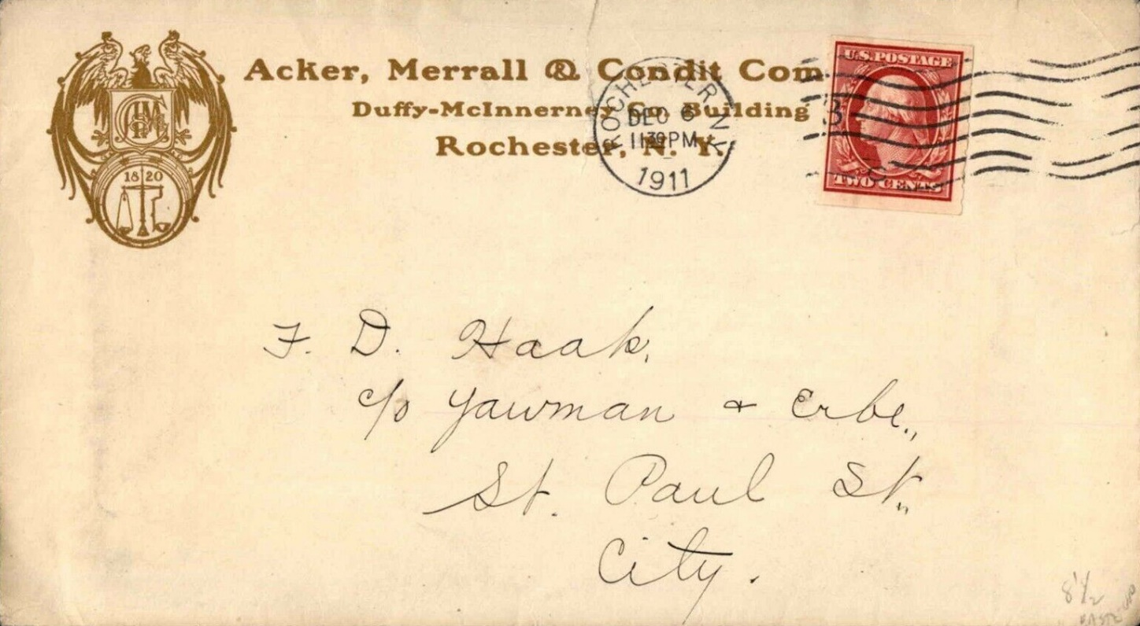
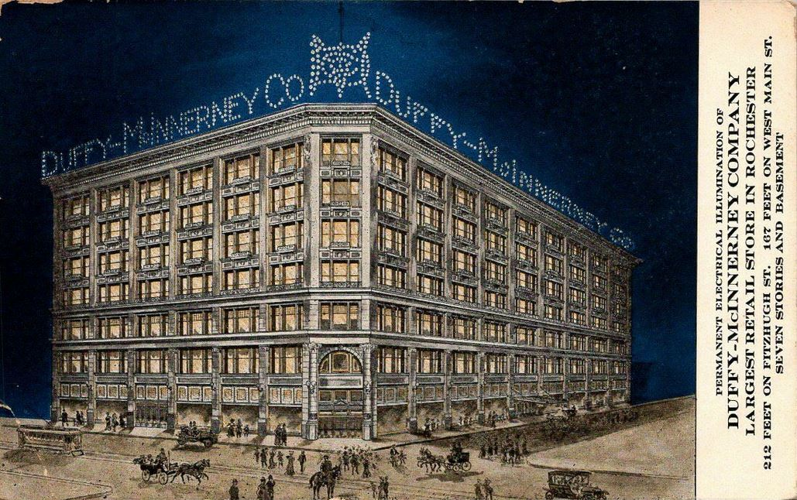
Businessmen James Duffy and Thomas Henry McInnerney built the 7 story structure to house their department store, the second largest in the state. The top 7th floor 800-seat restaurant was a unique attraction to the original department store versus rival Sibley’s. It was also the first Rochester building to be electrified, using Edison light bulbs.
Building Story Duffy-Powers Building, 50 West Main St

Slide 9
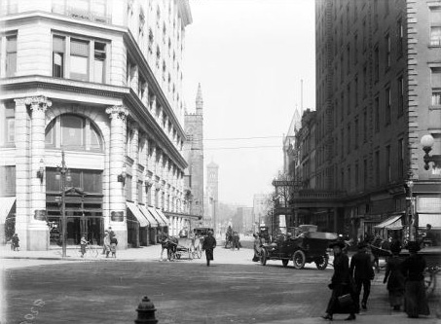
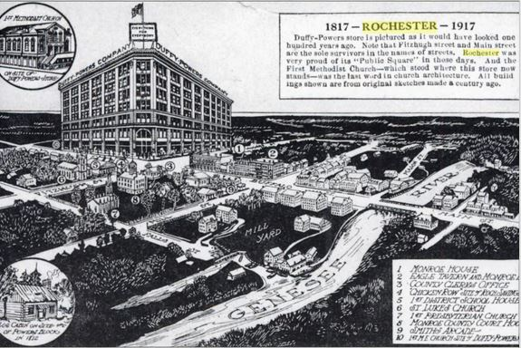
On July 17, 1911 the building and business converted to the Duffy-Powers Company, with Walter Powers buying out McInnerney. It was the first department store that clerks cashed out customers who picked out their own merchandise rather than having clerks bring items to the customer.
The Store that Came Back Duffy-Powers Building, 50 West Main St

Slide 10
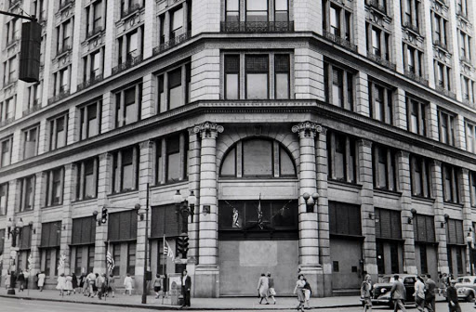
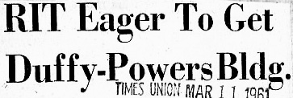
The Duffy-Powers Company went out of business in 1932 during the Great Depression.
The building remained vacant until 1940 when Kodak bought it to work on a secret project for the Navy creating radio proximity fuses that helped to improve bombing shell accuracy. During the 1960s
Rochester Institute of
Technology used it as part of its campus.
Duffy Biography Duffy-Powers Building, 50 West Main St

Slide 11
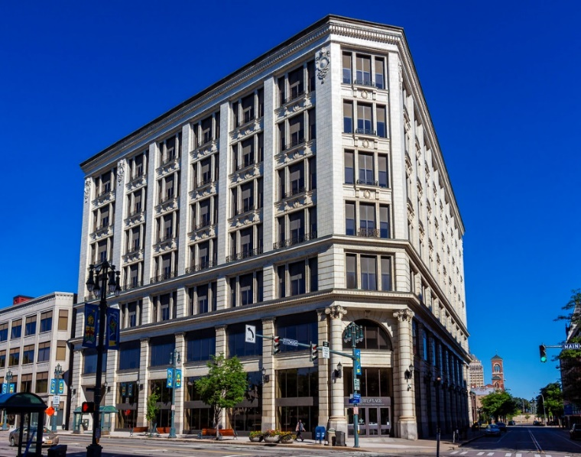
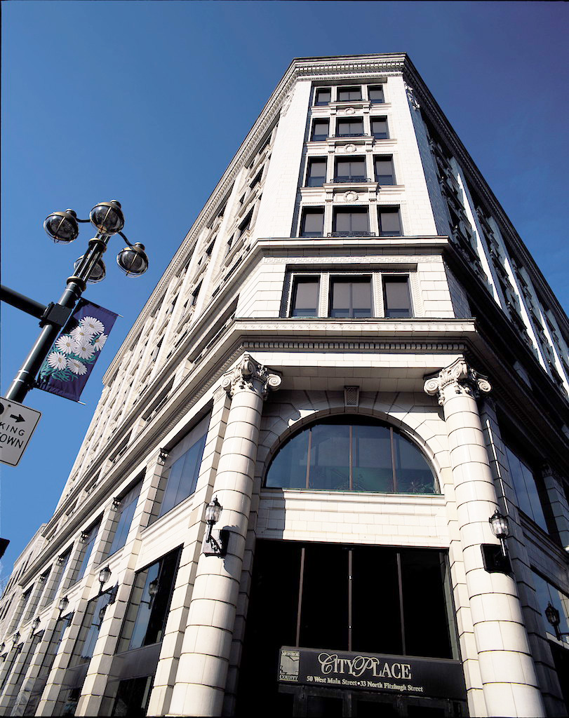
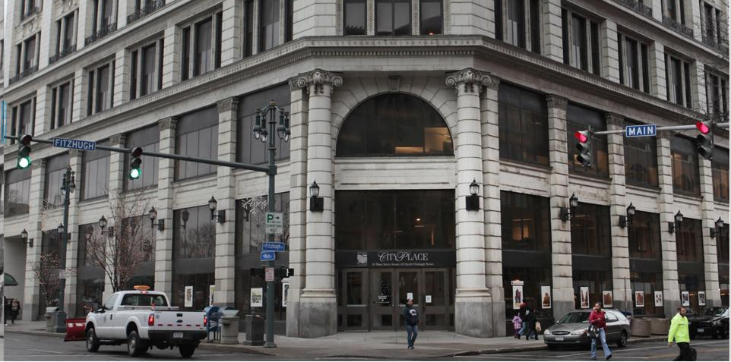
It’s now named
City Place and mostly occupied by Monroe County department offices.
County Purchase Duffy-Powers Building, 50 West Main St

Slide 12
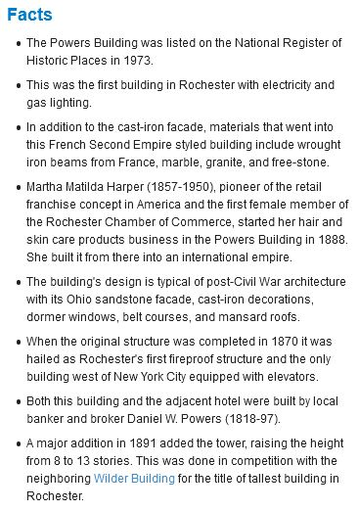
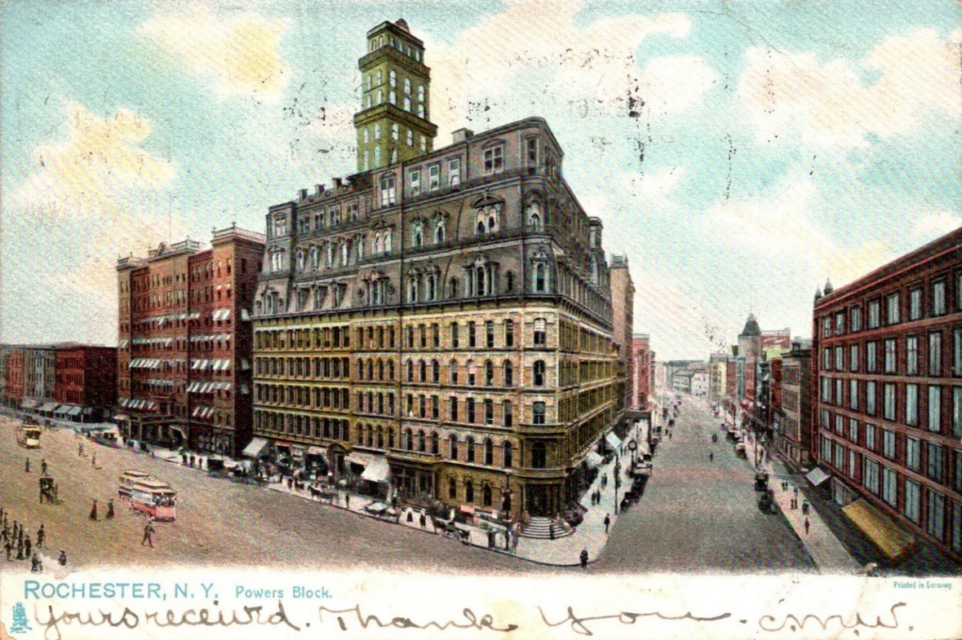
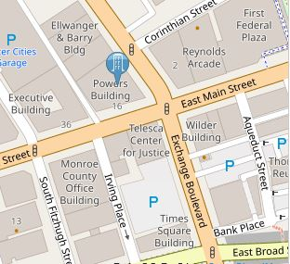
First known as the Powers Block, then the
Powers Building, the anchor of Rochester’s
Four Corners is probably the most historic of any property in the city. The facts at the left detail just a few fascinating tidbits.
Emporis Powers Building, 16 West Main St/Powers Hotel, 36 West Main St

Slide 13
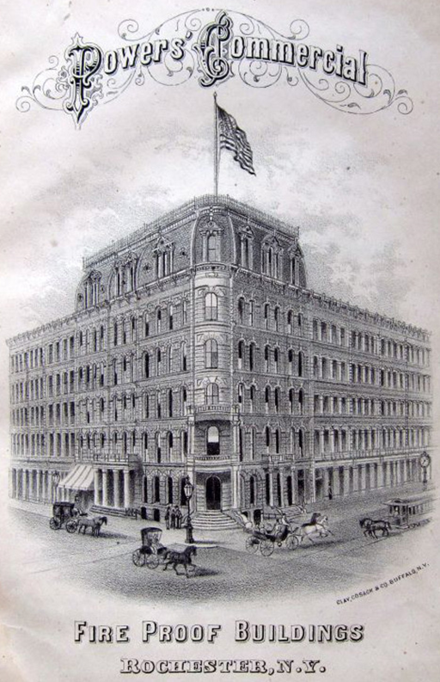
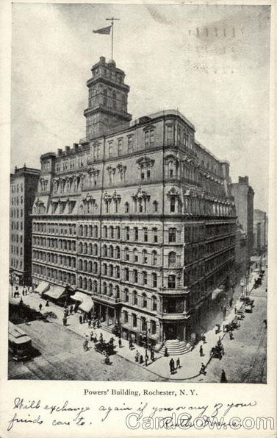
This was another design by architect
Andrew Jackson
Warner, completed in 1869 with additions made through 1888 by owner Daniel
Powers including a triple roof and an observation tower to make it the city’s tallest building.
Sentinel of the Four Corners Powers Building, 16 West Main St/Powers Hotel, 36 West Main St

Slide 14
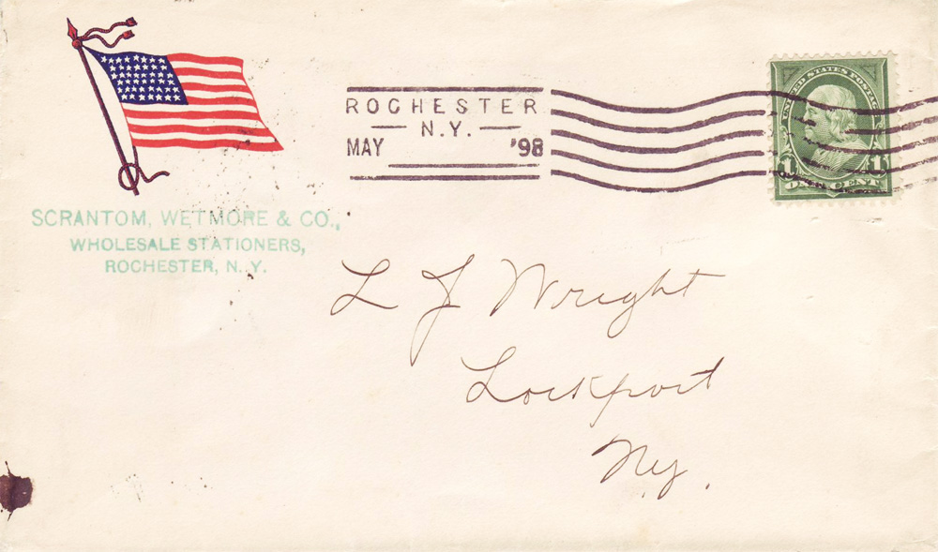
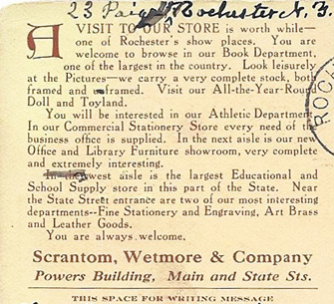
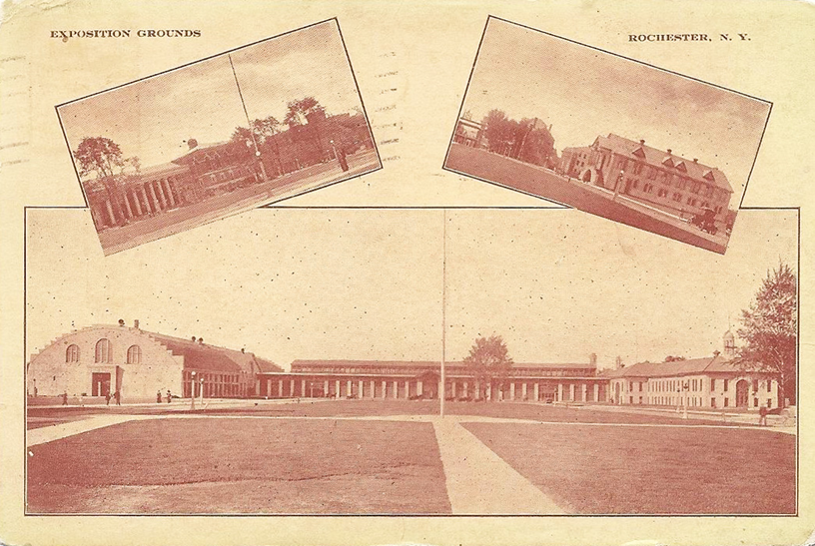
Per the Powers Building web site, “The building was the first in upstate New York to have a passenger elevator (then called a vertical railroad), gas illumination and marble floors. In 1861 it became the first commercial structure in Rochester to have electricity, utilizing its own power generating boilers.” Stationer company Scrantom’s was its
1st level floor tenant for years.
Text from a 1911 post card given away at the Rochester Exposition Grounds.
Powers Building.com Powers Building, 16 West Main St/Powers Hotel, 36 West Main St

Slide 15
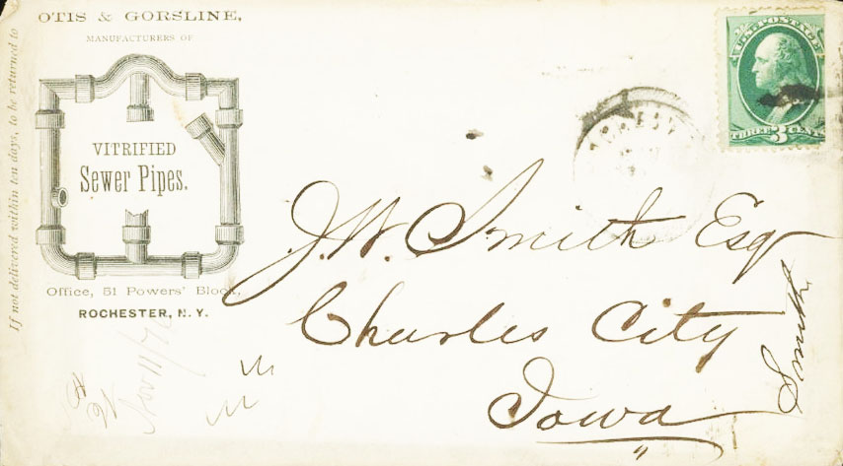
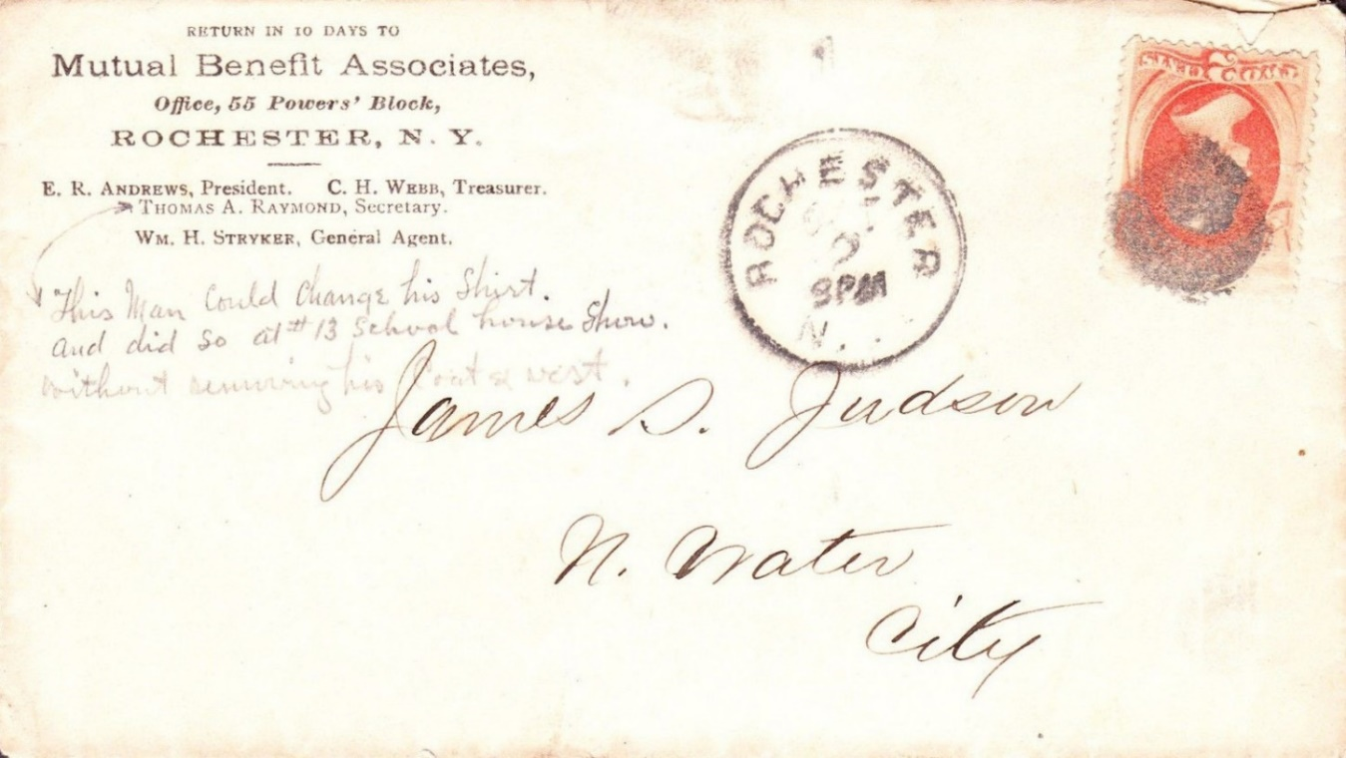
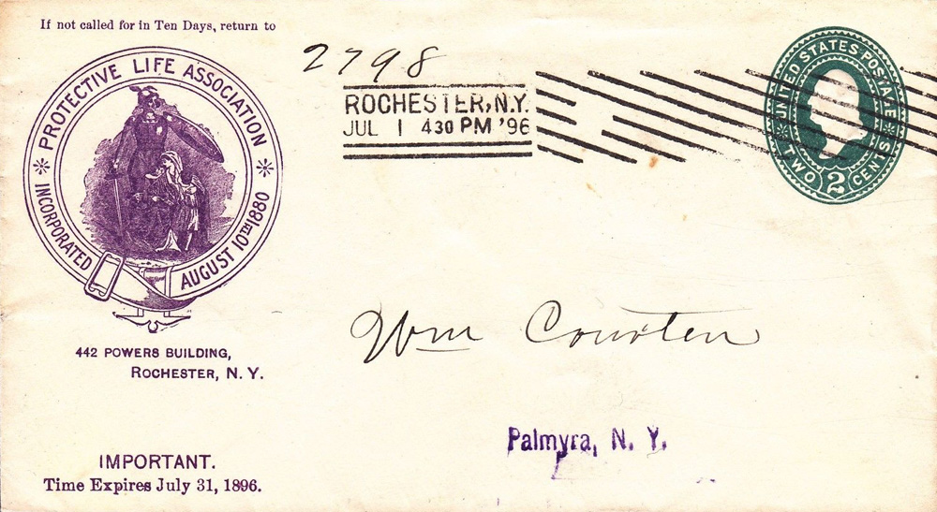
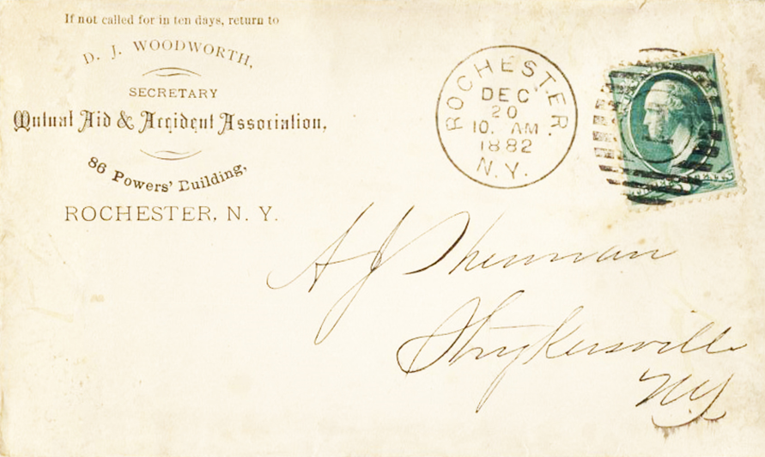
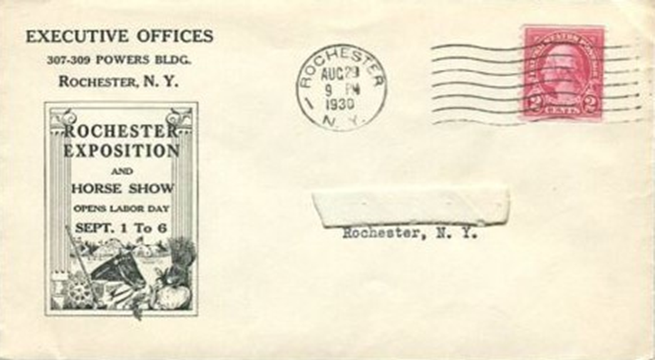
More tenants.
Yelp! Building Reviews Powers Building, 16 West Main St/Powers Hotel, 36 West Main St

Slide 16
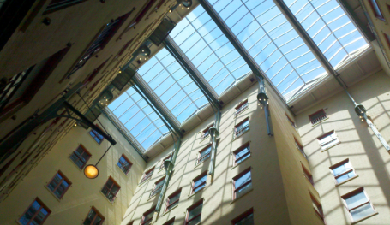
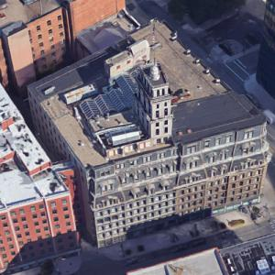
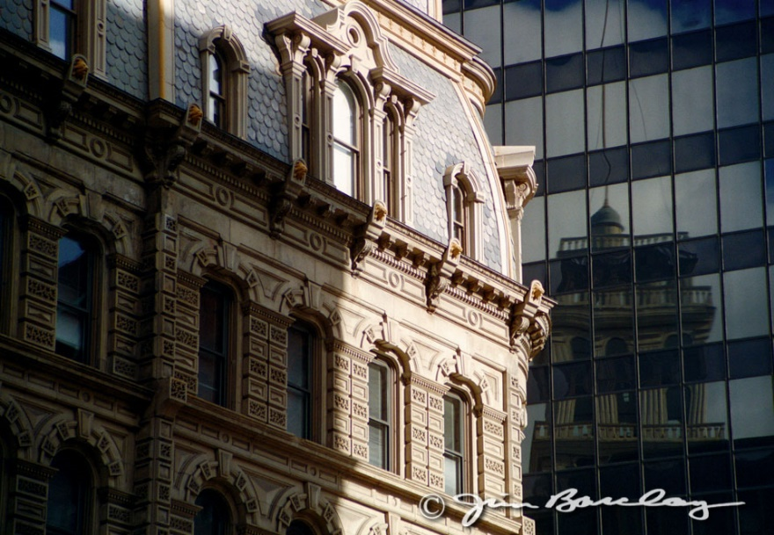
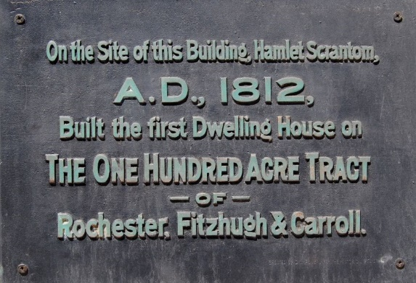
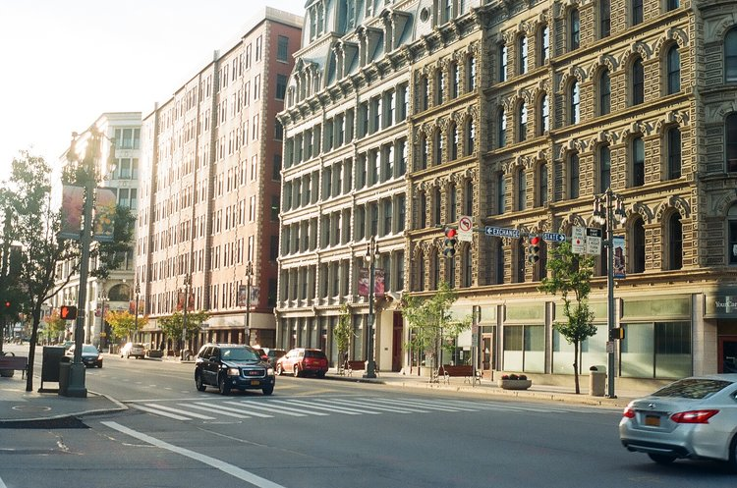
The Power
Building and environs today.
WayMarking Page Powers Building, 16 West Main St/Powers Hotel, 36 West Main St

Slide 17
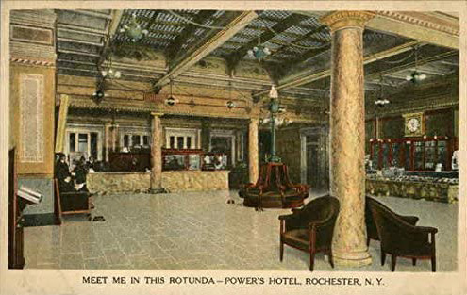
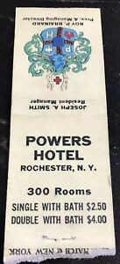
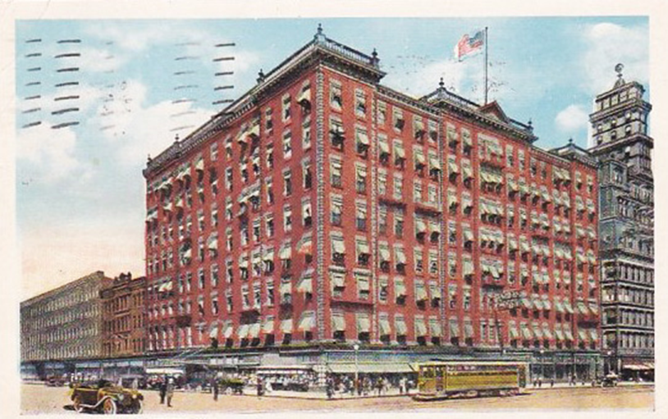
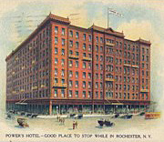
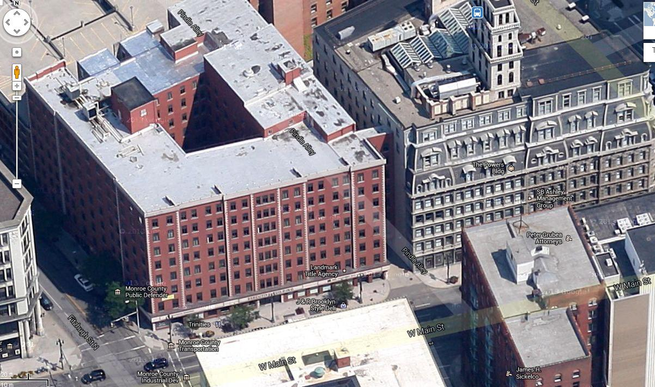
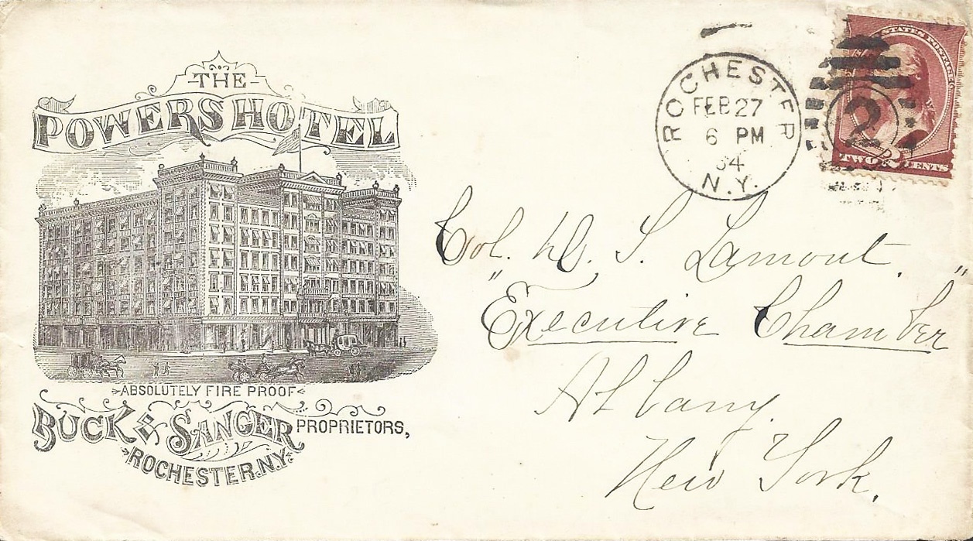
The Powers Hotel was next door, now known as the Executive Building.
Powers Hotel History Powers Building, 16 West Main St/Powers Hotel, 36 West Main St

Slide 18
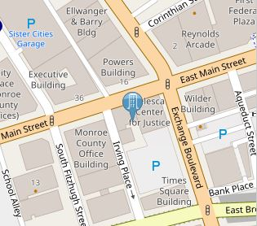
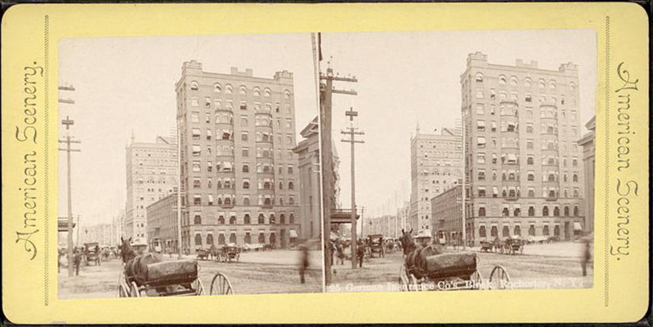
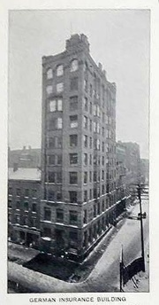
Commonly called the German Insurance Building, this 10 story edifice of red brick with Italianate/
Romanesque styling was finished in 1888. Like the Ellwanger and Barry Building, Andrew Jackson
Warner was its architect. But the building under- went a major reconstruction in 1904, doubling its size and shifting its façade formerly overlooking an empty lot on Irving Place (as seen here on both photos) 90 degrees to face Main
Street instead.
Emporis German Insurance Company Building, 19 West Main St

Slide 19


Here’s how the building looked after its make-over. Note the two columns at the doorway entrance, a new addition to the design by the second builders, A. Friederich
& Sons, which by the way was constructing the Rochester Trust &
Safe Deposit Co. next door at the same time as seen on the left of both postcards here.
Building History Rochester German Insurance Building, 19 West Main St

Slide 20


The German Insurance Company set up offices in major US cities across the country. Rochester’s firm was founded by a number of successful German-born Rochester businessmen. It was incorporated in 1872, specializing in insuring livestock and buildings. The company was absorbed by the German-American Insurance Company in May,
1911.
History and Commerce of Rochester 1894 German Insurance Company Building, 19 West Main St

Slide 21




The 10 story building had many occupants over the years.
Industries of Rochester 1888 German Insurance Company Building, 19 West Main St

Slide 22


A dizzying number of banks occupied parts of the German Insurance Company Building in the early teens due to mergers and acquisitions. The German American Bank, the Flour City National Bank and the Commercial Bank all called 19 Main St West home for a brief time, until they merged into the National Bank of Rochester, which then became headquarters of the
Lincoln National Bank.
World War I soldiers walk by the building in this photo, c. 1918.
Note the bank’s signage in the upper left above the column.
Rochester Bank Currencies German Insurance Company Building, 19 West Main St

Slide 23





In 1925 the Genesee Valley Union Trust Company, another bank, moved into the building and that is the name now over the door.
German Insurance Company Building, 19 West Main St

Slide 24


The Ellwanger and Barry Building was completed in 1888 as an 8 story steel building with a brick and masonry façade in the Romanesque revival style. Its interior was describes as, “resplendent in silver bronze which blends artistically with the yellow and blue tiled floors and the bright walls with their imitation brick penciling in bright red lines.” Andrew
Jackson Warner was its architect.
Emporis Ellwanger and Barry Building, 39 State St

Slide 25

It was built by its namesake business, the Ellwanger and Barry Nursery Company, the international horticulture company.
George Ellwanger was a horticulturist native of Wurttemberg, Germany, who started up the Rochester business in 1840 with Belfast, Ireland native Patrick Barry. Besides their large land holdings on Mt Hope Ave., the company expanded into real estate and home developments in later years, amassing a fortune as the city boomed in the latter half of the 1800’s.
U of R Company Paper Collection Ellwanger and Barry Building, 39 State St

Slide 26




The firm’s best subdivision was the 19.63 acre Highland Park, later donated to the City in
1887 and described by them as, “the finest and healthiest part of the city.”
Highland Park Conservatory Ellwanger and Barry Building, 39 State St

Slide 27



Philatelists will note one of the building’s tenant was the Covert Stamp Company, owned by Paul Wild, 1916 Rochester Philatelic
Association president and treasurer from 1919-1940. Per the covers below he had at least two different office locations there.
Ellwanger and Barry Building, 39 State St

Slide 28




Renovated in 1985, the original yellow and blue tiled floors, if still there, were replaced.
Buckingham Property offering Ellwanger and Barry Building, 39 State St

Slide 29



The Wilder Building had a prime spot at
1 East Main Street when completed in 1887.
It was designed by architects Warner &
Brockett and at 11 stories is considered
Rochester’s first skyscraper.
Emporis Wilder Building, 1 East Main St

Slide 30



Early tenants.
Wikipedia Listing Wilder Building, 1 East Main St

Slide 31



And a few more.
Falcon Watch 2011 Wilder Building, 1 East Main St

Slide 32





The Wilder Building today.
Wilder Offices Wilder Building, 1 East Main St

Slide 33



Finished in 1894 and designed by J. Foster
Warner, the 12 story Granite Building was covered in brick and masonry. Granite was used extensively inside and out, hence its name, including its massive four story front columns. It was touted as being fully fireproof, an innovation at the time, housing the Sibley, Lindsay and Curr department store.
Emporis Granite Building, 130 East Main St

Slide 34




While the lower levels were dedicated to Sibley’s, upper floors were leased to other Rochester businesses, including that of the building’s architect whose office was on the top floor.
ROC Roots Granite Building, 130 East Main St

Slide 35


1.5 acres The building was put burnt over to the test when a
40 hours, fire at the Rochester
8 buildings, Dry Goods Company
3 houses started at 5 AM on incinerated February 26, 1904 destroying several blocks of Main St. It left the shell intact but incinerated the contents. Sibley’s built at a new locale down the street.
The Fire Granite Building, 130 East Main St

Slide 36




The structure was quickly rebuilt.
Granite Building, 130 East Main St

Slide 37




A latter assortment of insurance companies with offices at the Granite Building.
Granite Building, 130 East Main St

Slide 38





The Granite Building today, recently sold to CGI.
Main Street Reborn Granite Building, 130 East Main St

Slide 39


The Sibley Triangle Building, completed in
1897, was a flatiron design of 5 stories covered in Indiana limestone on the lower 2 floors with red brick above, designed by J.
Foster Warner. Hiram Watson Sibley had it built to honor his father, Hiram Sibley.
Emporis Sibley Triangle Building, 20 East Ave

Slide 40




Its eye-catching shape still turns heads to this day. Controversy remains about its address--
Is it 20 East Avenue or 335 East Main Street?
Recent tenants included the NYS Health Dept.
D&C Article Sibley Triangle Building, 20 East Ave

Slide 41

OK, it’s Quiz Time!
Match each building with its correct map number.
1 Duffy-Powers Building 2 Powers Building/Hotel 3 German Insurance Company Building
4 Ellwanger and Barry Building 5 Wilder Building 6 Granite Building 7 Sibley Triangle Building

Slide 42
How well did you do?
1 Duffy-Powers Building 2 Powers Building/Hotel 3 German Insurance Company Building
4 Ellwanger and Barry Building 5 Wilder Building 6 Granite Building 7 Sibley Triangle Building
5 7 4 3
2 6 1

Slide 43
Many thanks for watching!

