Slide 1
Hiking Peru
And
Its Stamps and coins
Steve Eisinger
November 2017

Slide 2
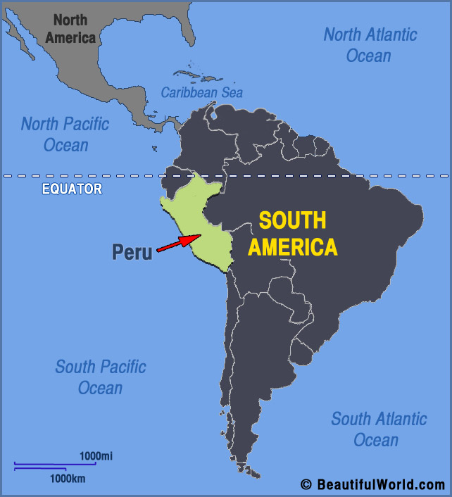
Peru
Pop 31 million
Large country
Two languages and two
cultures : (Spanish and
Quechua)
Bio- and Geo-diverse
Democracy
Developing economy

Slide 3
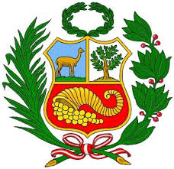
Cities
and
Towns

Slide 4
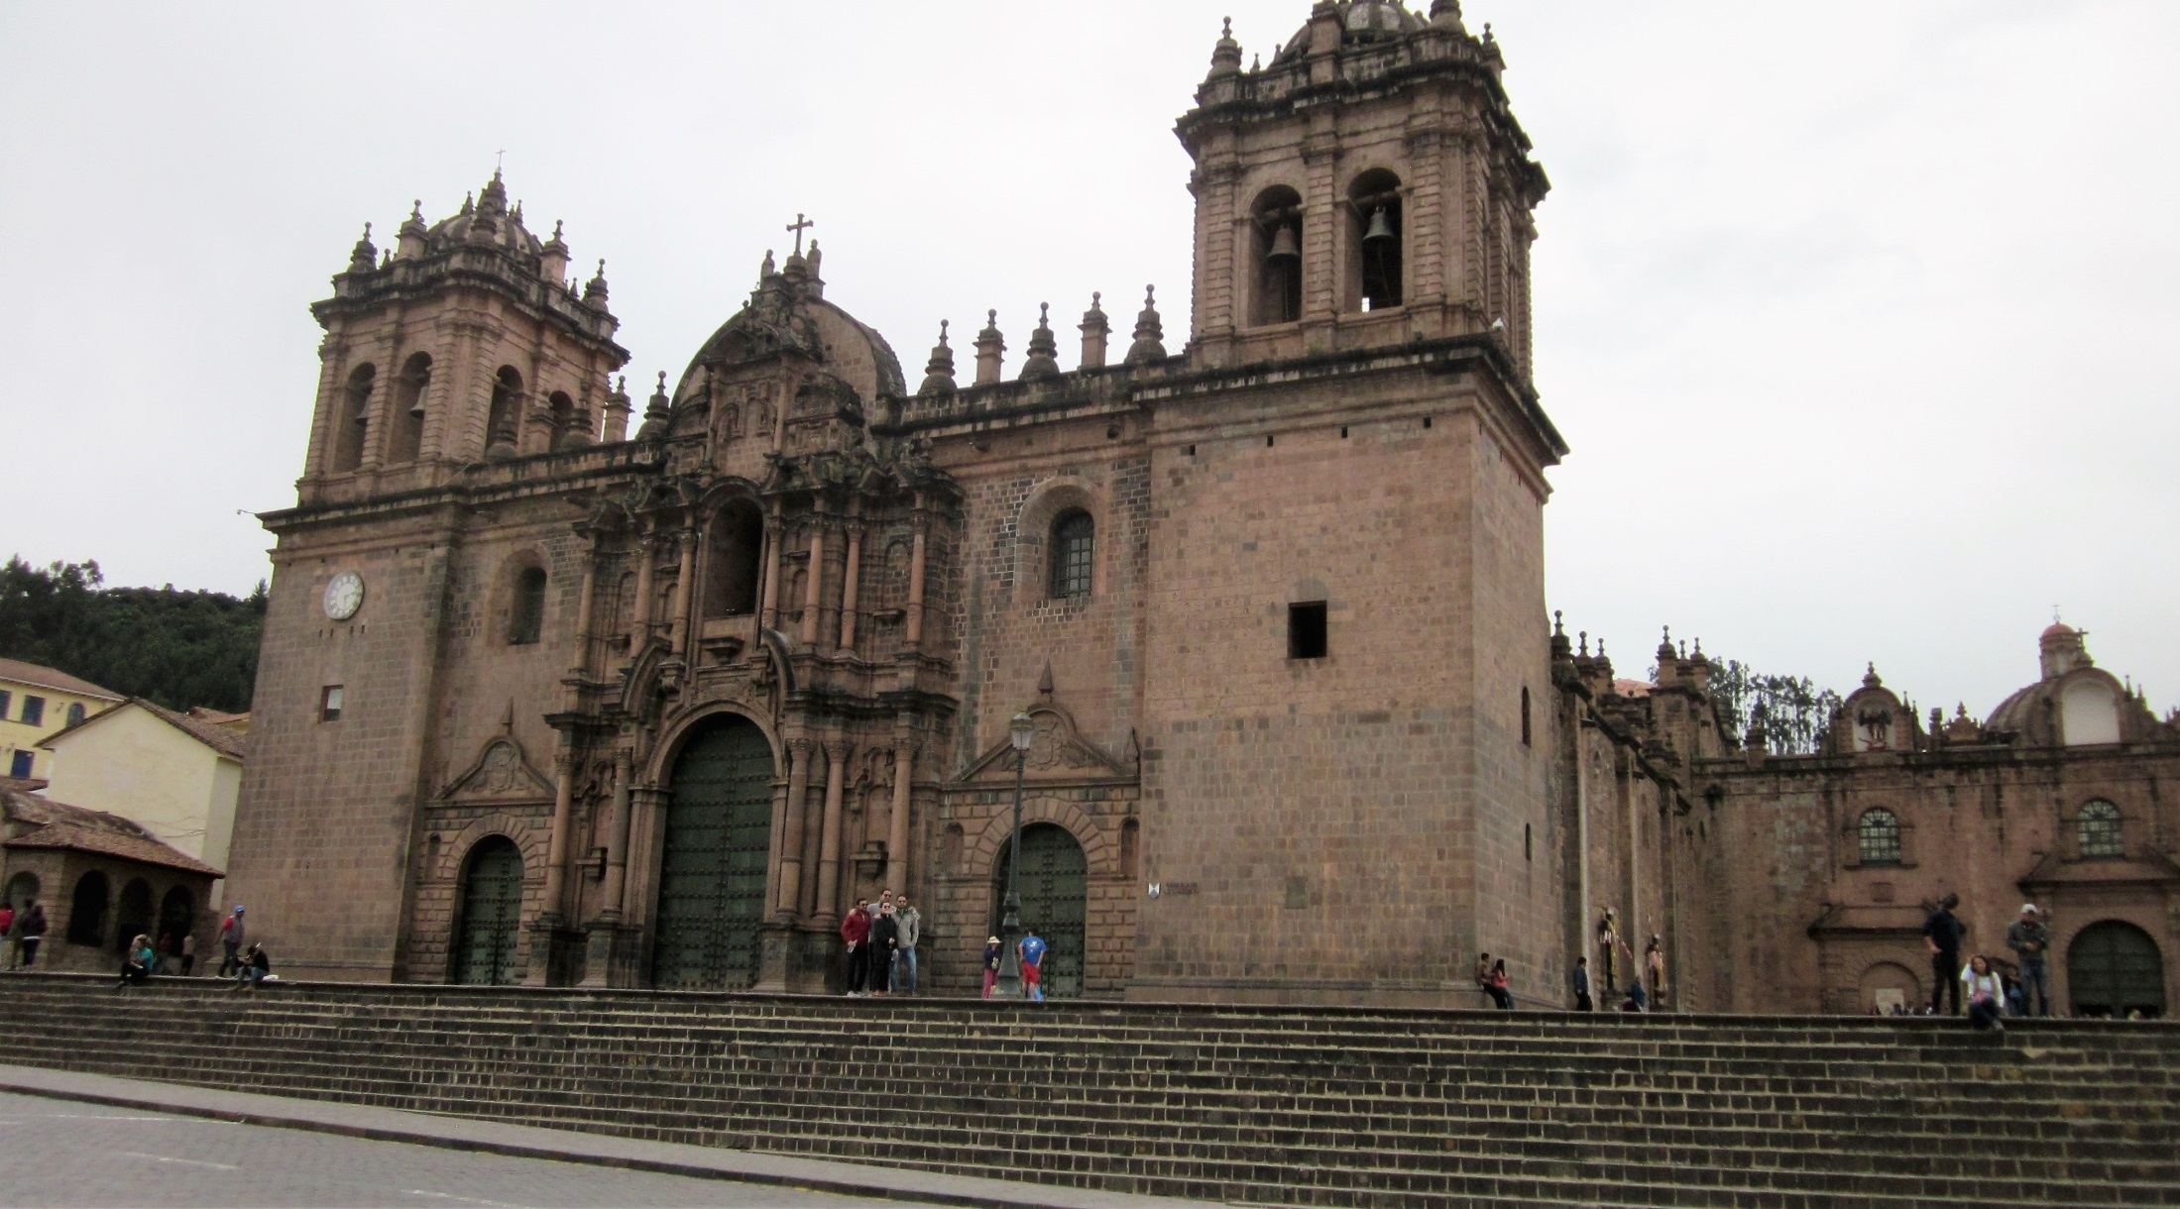
Magnificent Cathedral in Cusco Square

Slide 5
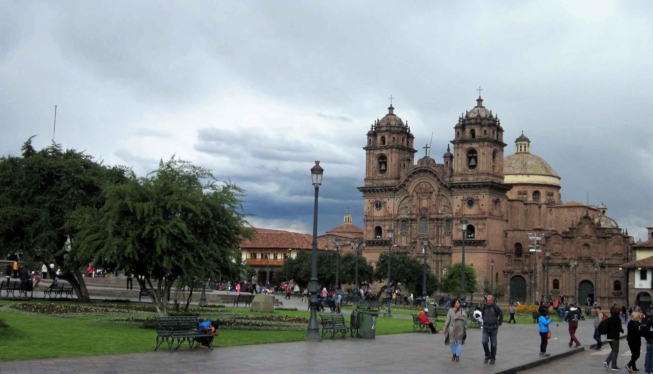
Cusco Square again—note: it is another cathedral

Slide 6
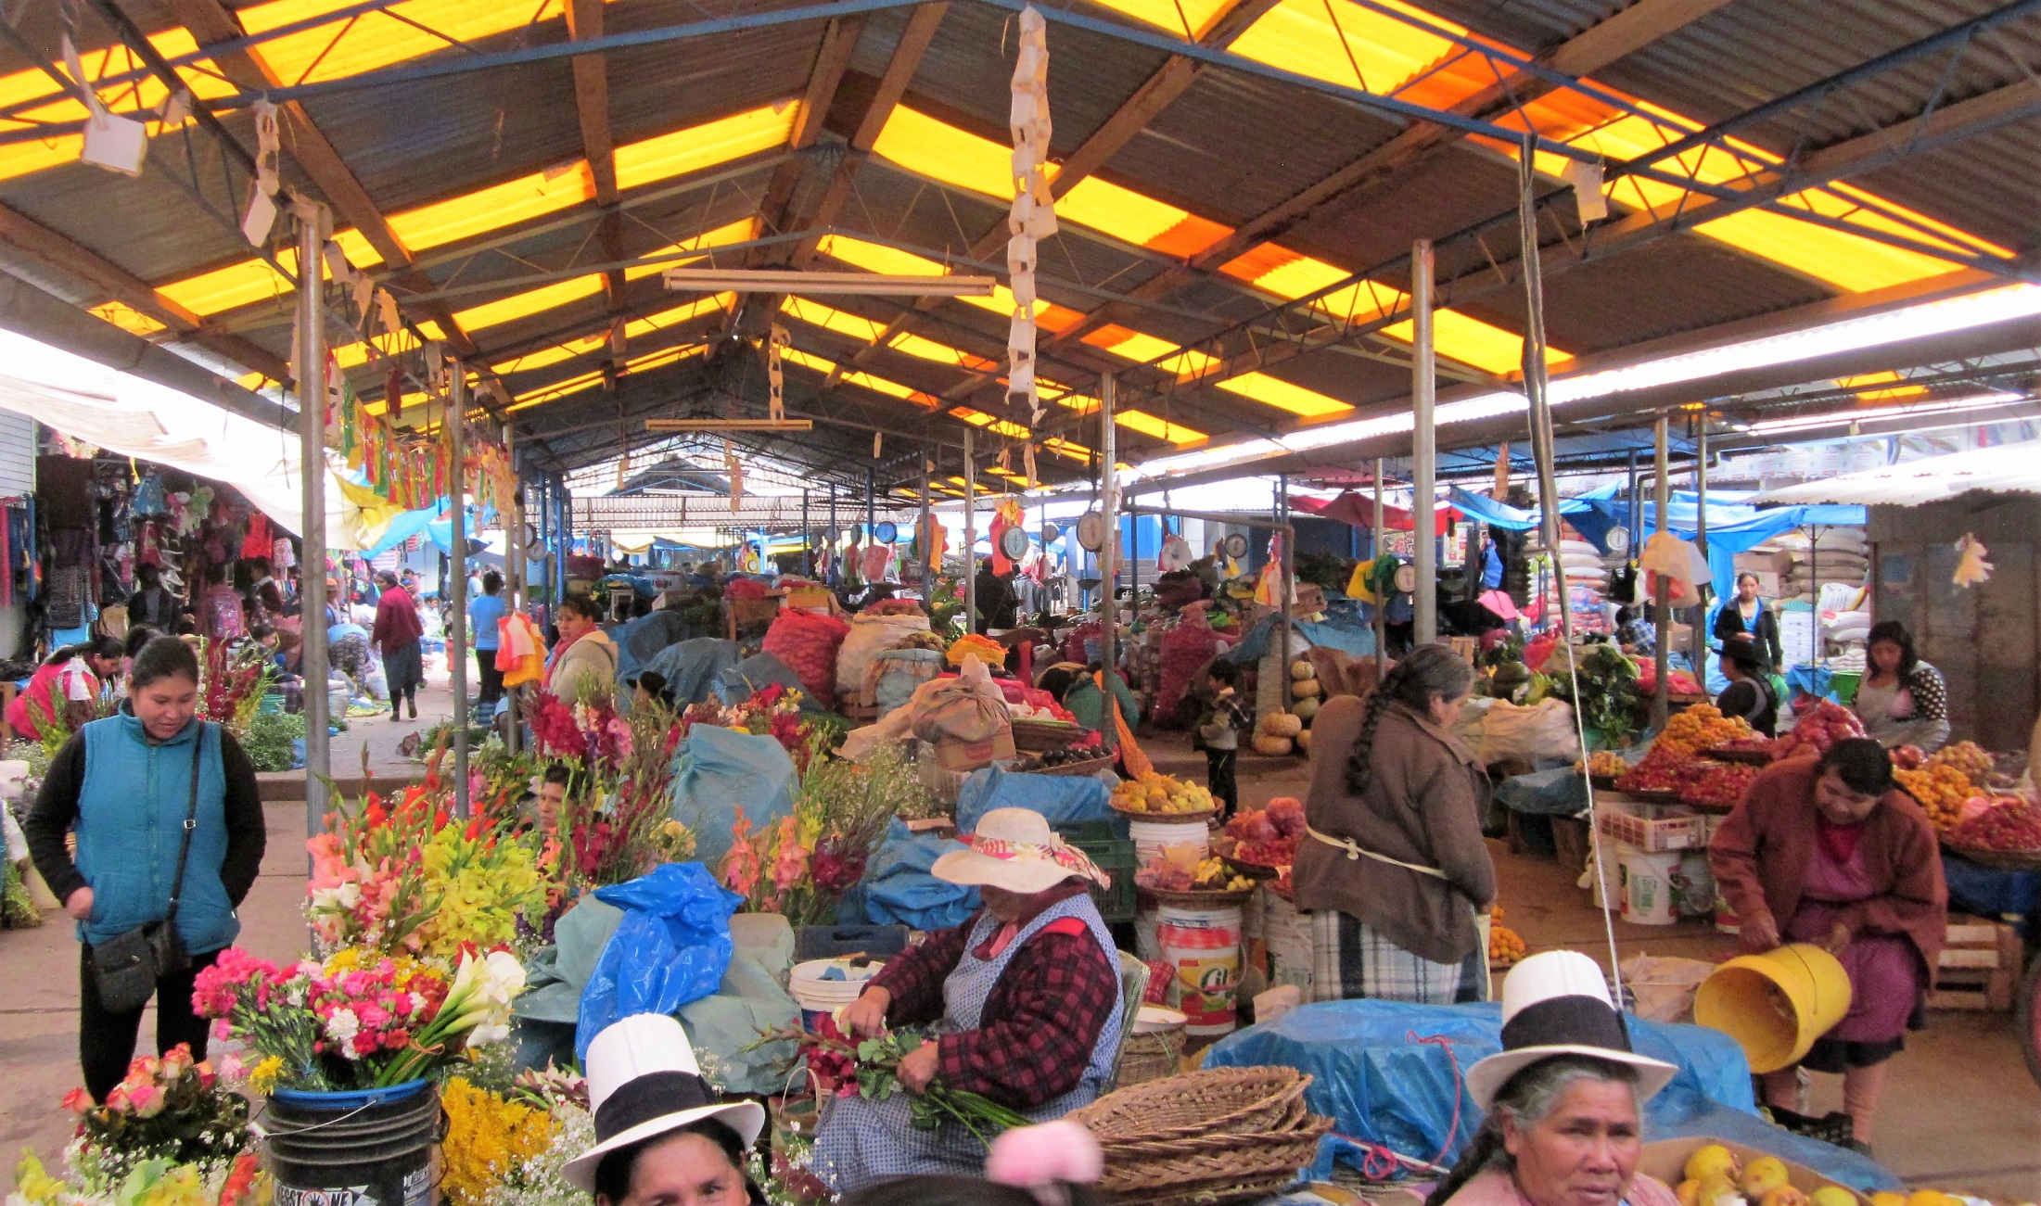
Great indoor small town market scene—
not for the tourists

Slide 7
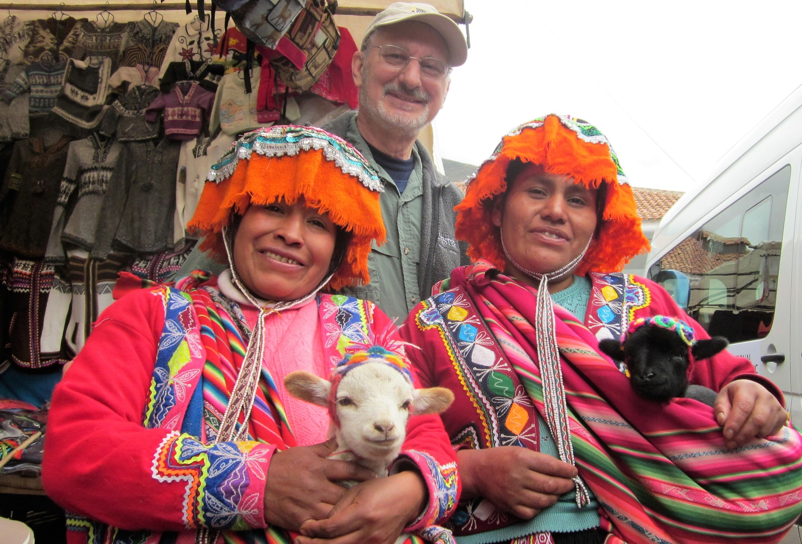
Check out the
Baby Llamas in
The slings

Slide 8
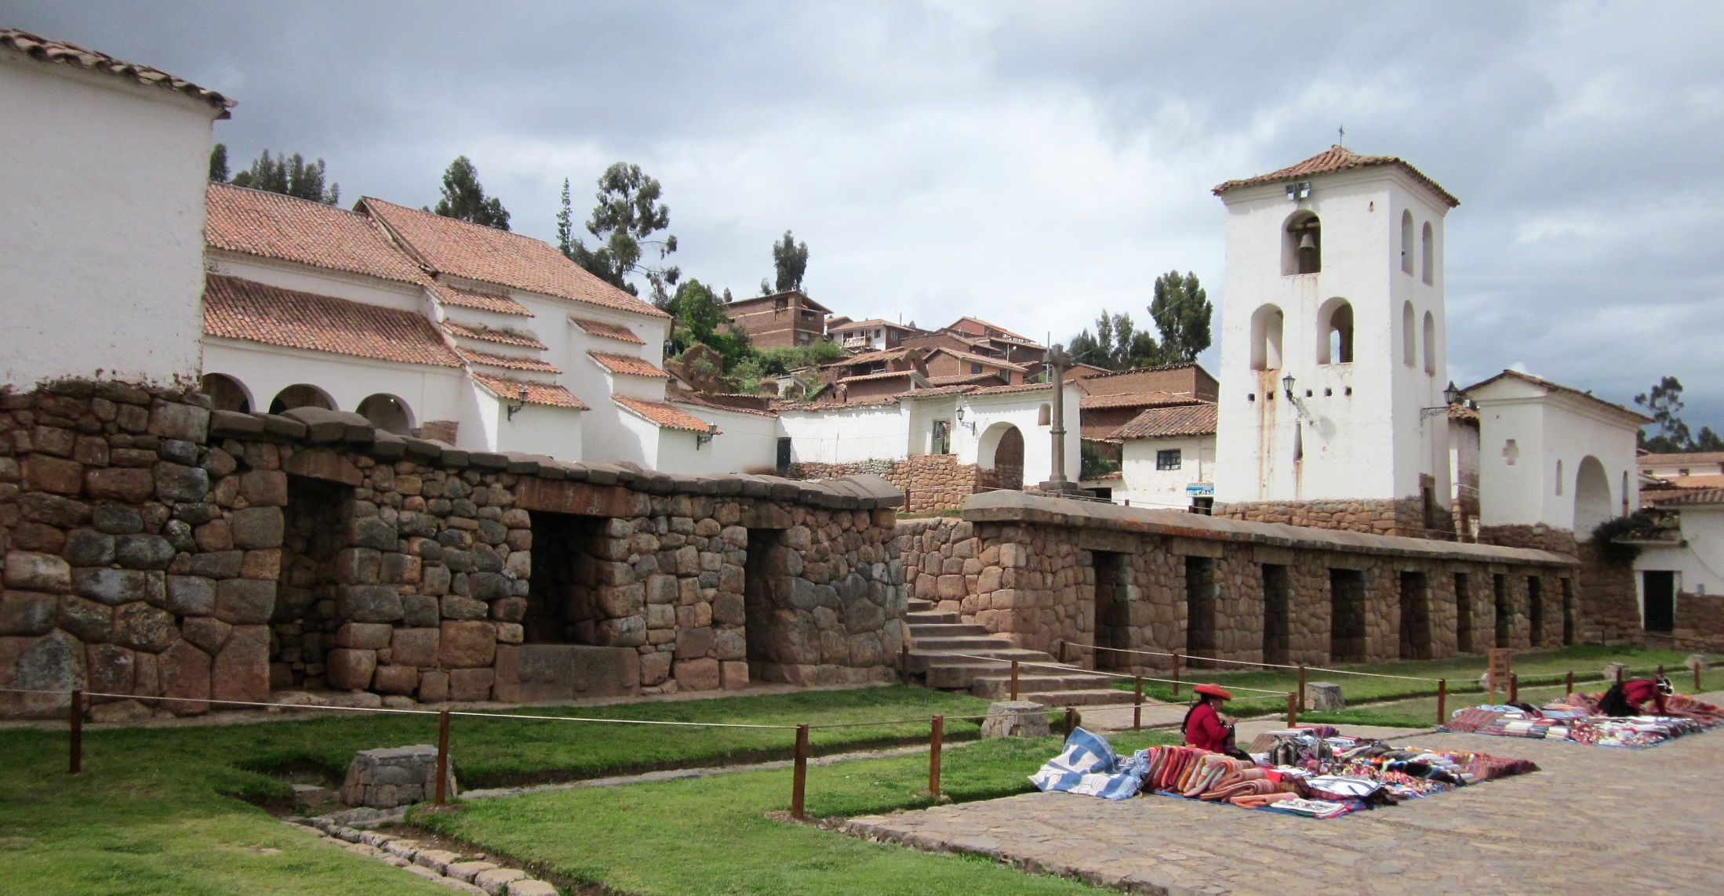
Church built on Inca ruins

Slide 9
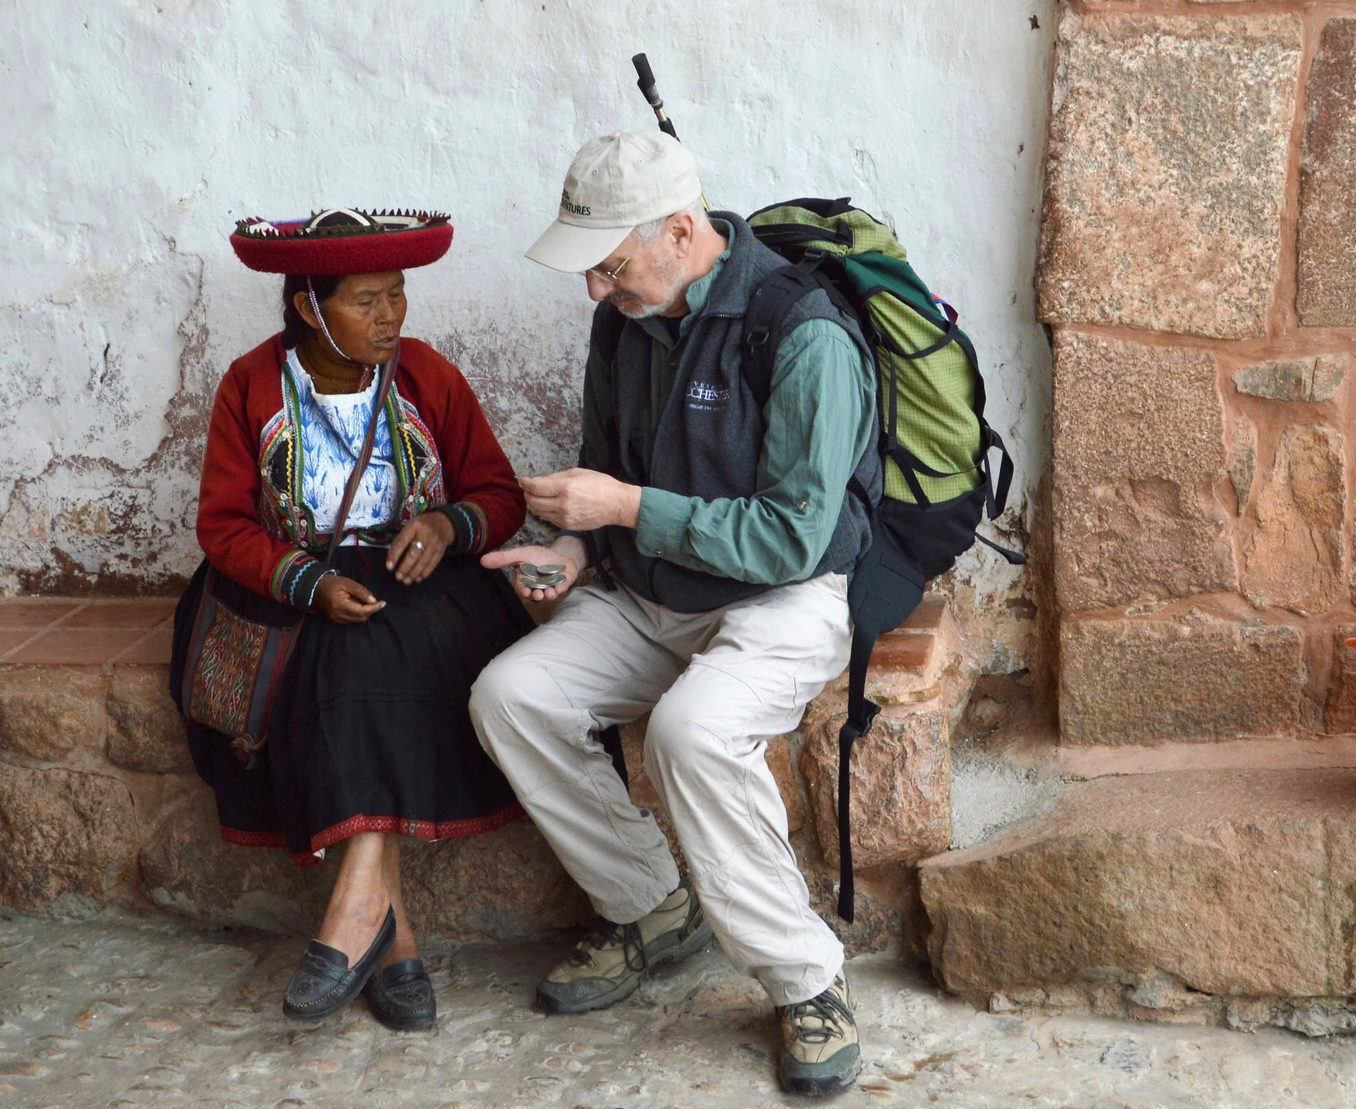
Buying Coins

Slide 10
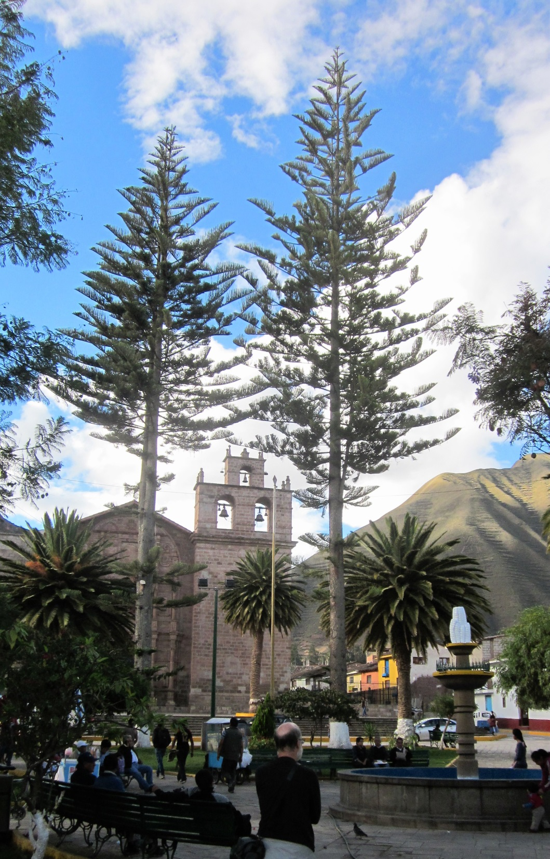
Small village
central square

Slide 11
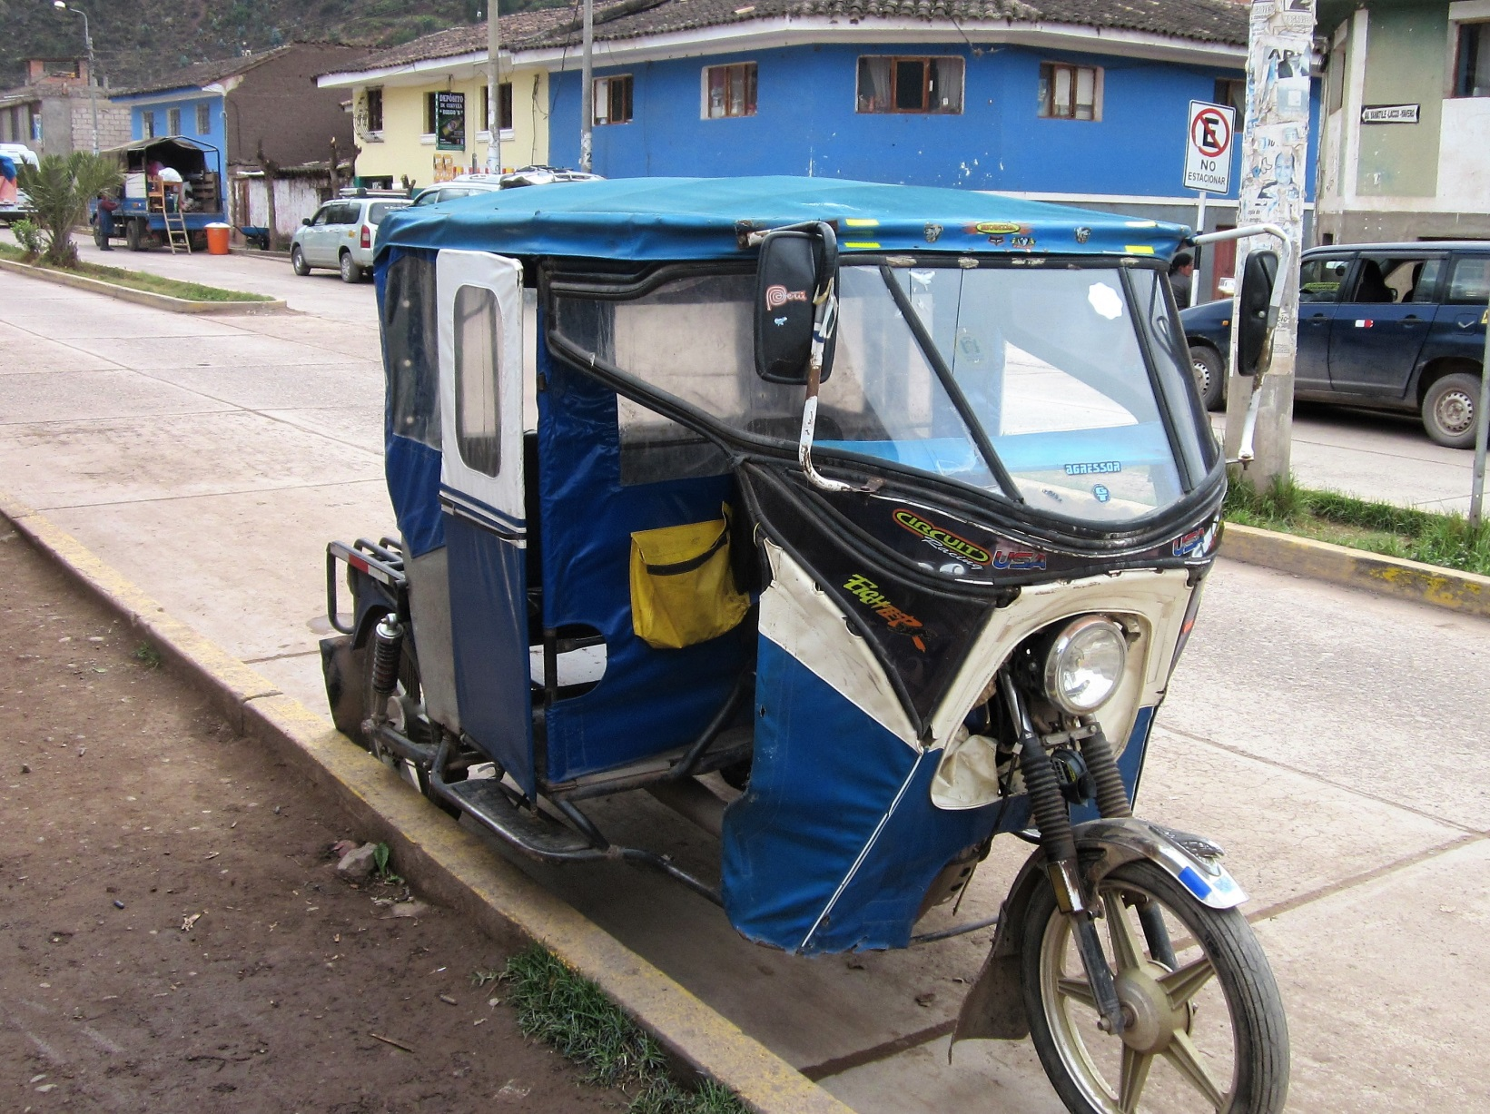
Little tricycle
taxis seen
All over

Slide 12
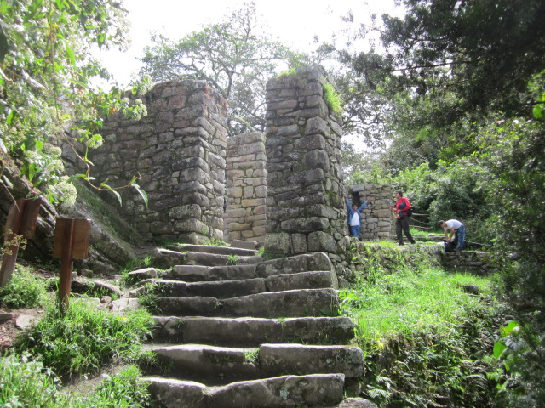
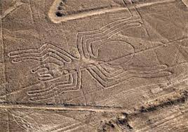
Inca Ruins

Slide 13
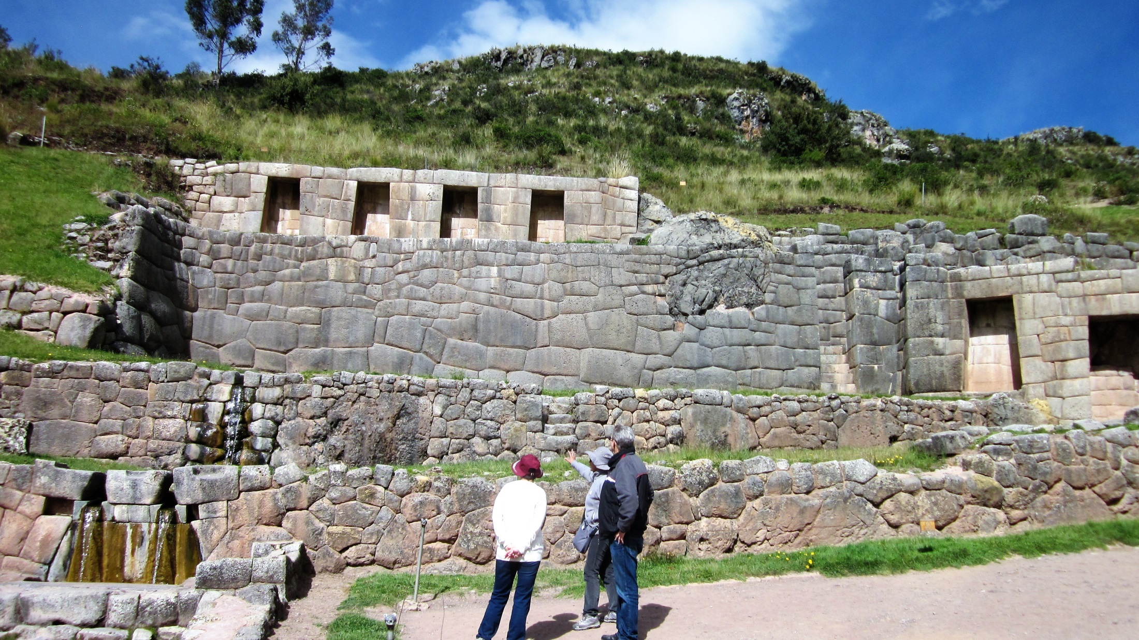
Inca Ruins and Spring Outside of Cusco

Slide 14
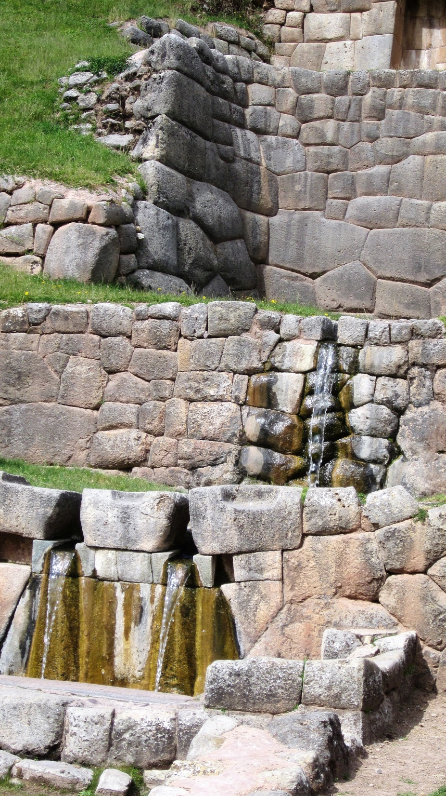
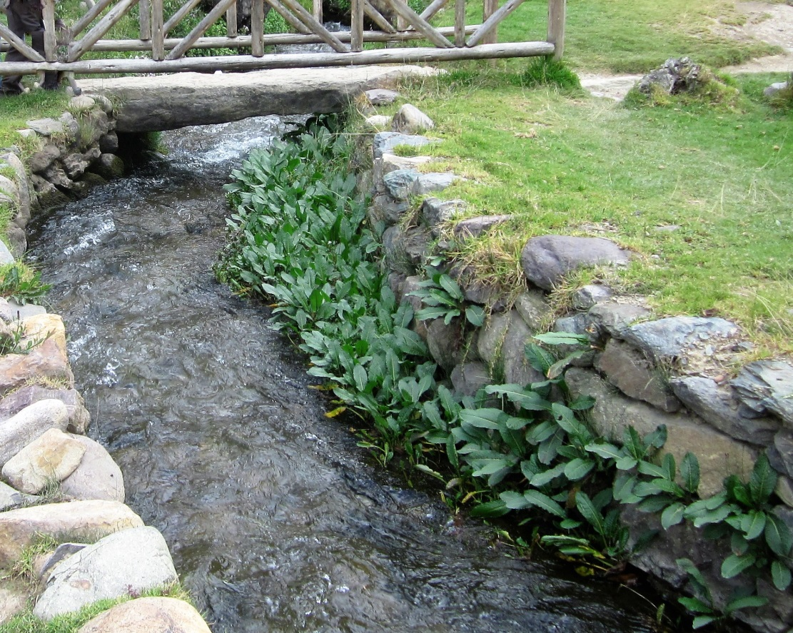
The Incas
revered water
and were masters
at using it

Slide 15
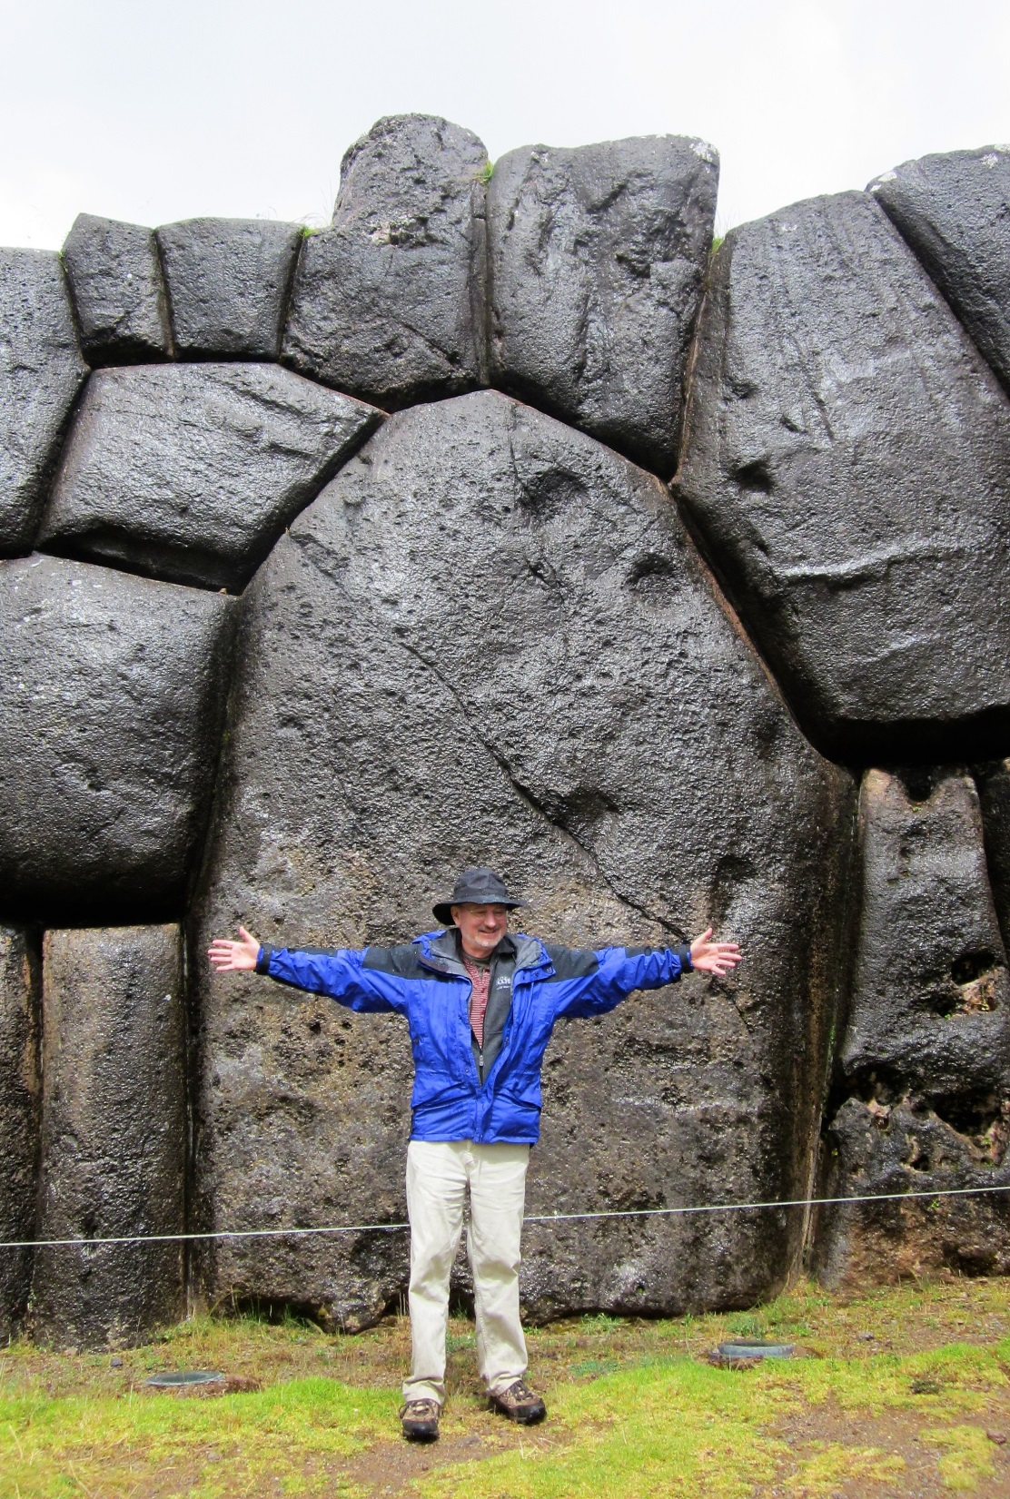
Big rocks at
Sacsayhuaman
Ruins near Cuzco

Slide 16
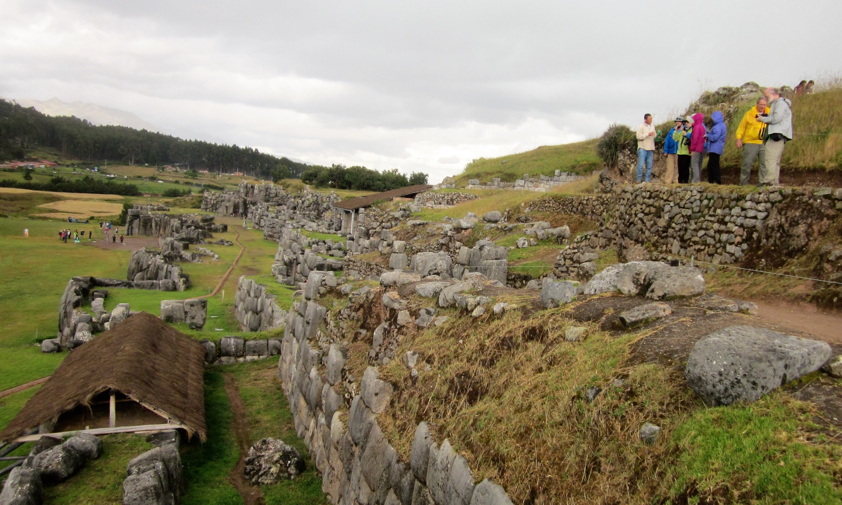
Standing on the fortress walls

Slide 17
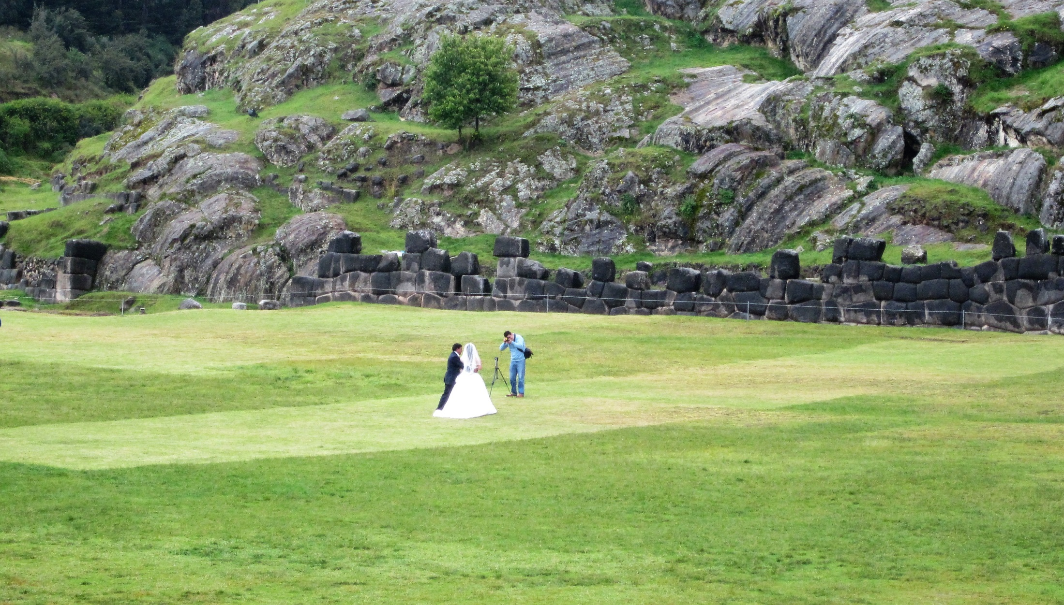
The plain where the wedding party is standing is filled-in land
where a deep valley once existed. Rocks were quarried on the
other side and dragged across the plain to the fortress behind us.

Slide 18
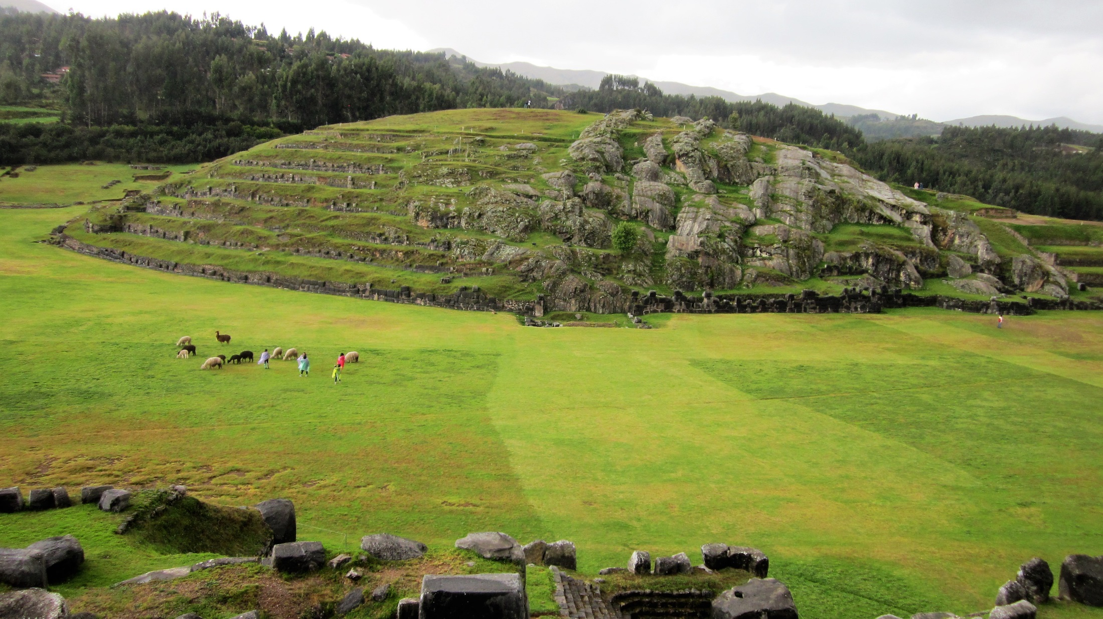

Slide 19
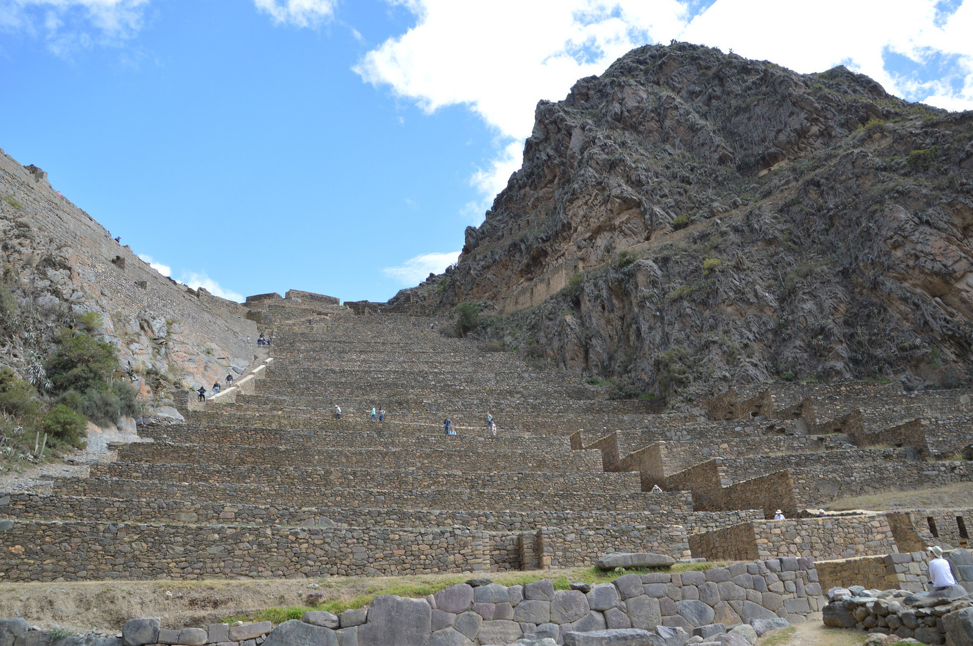
Ollantaytambo

Slide 20
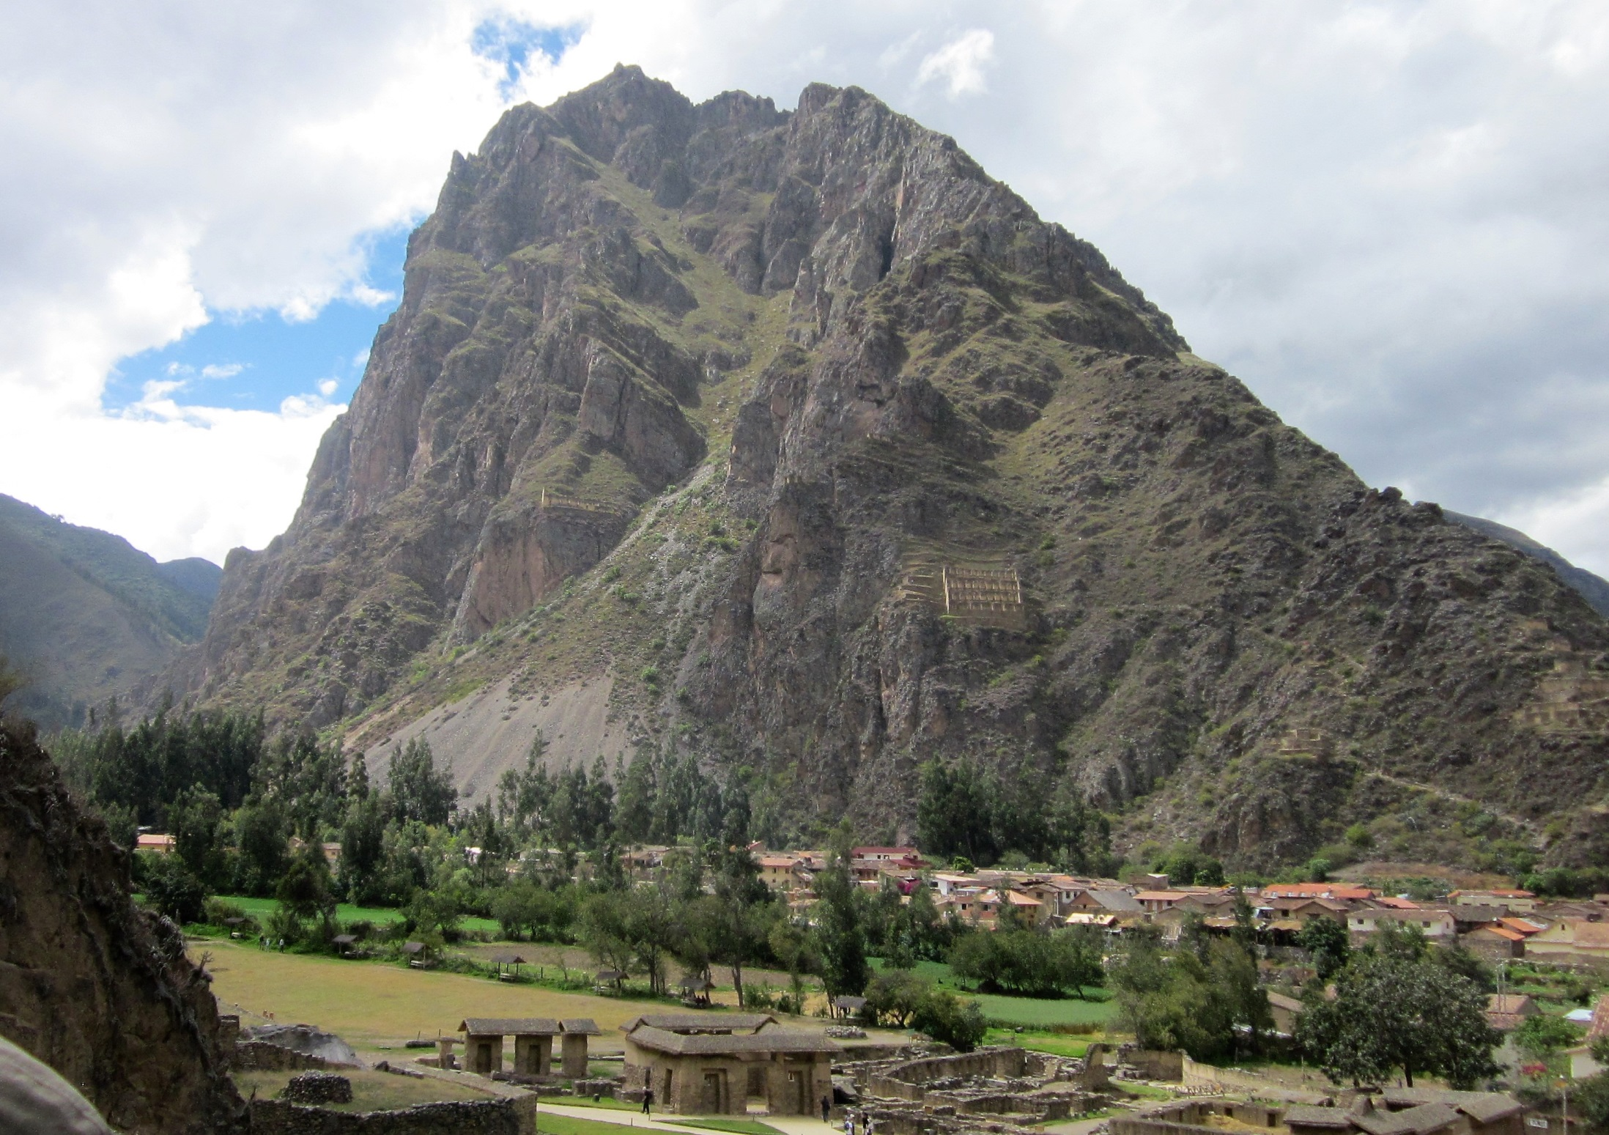
Inca grain storage
facility up on
the mountain
Where would you
store corn?

Slide 21
On the Trail

Slide 22
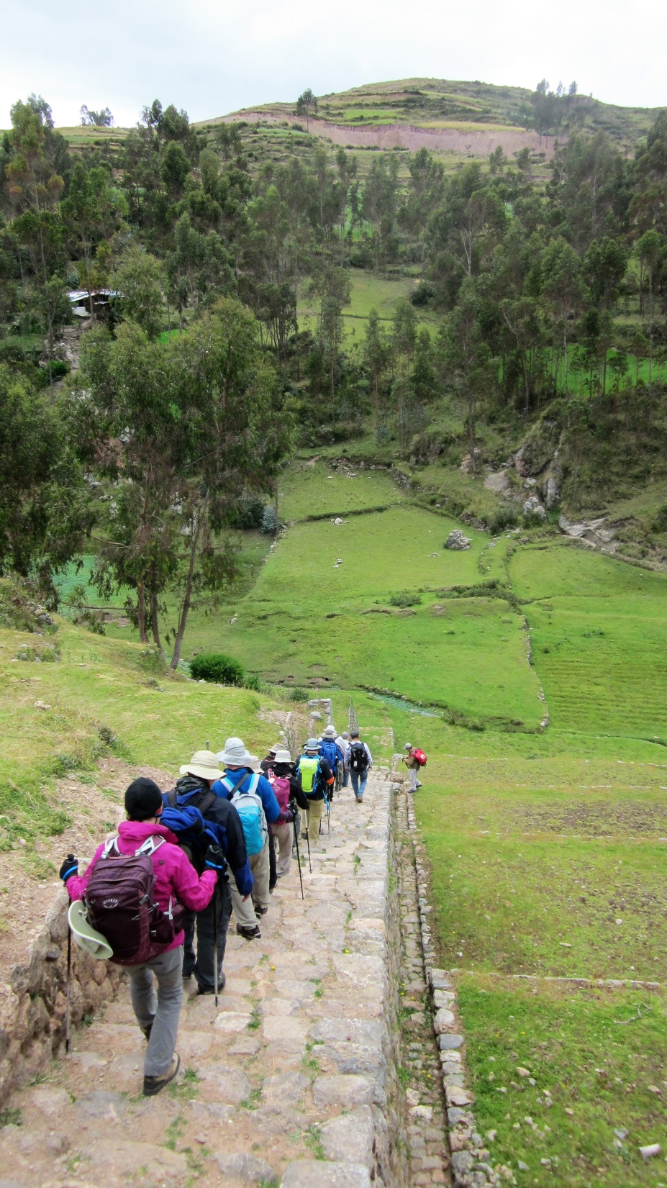
Starting down the
trail, built by the
Incas.– we are at
13,000 feet

Slide 23
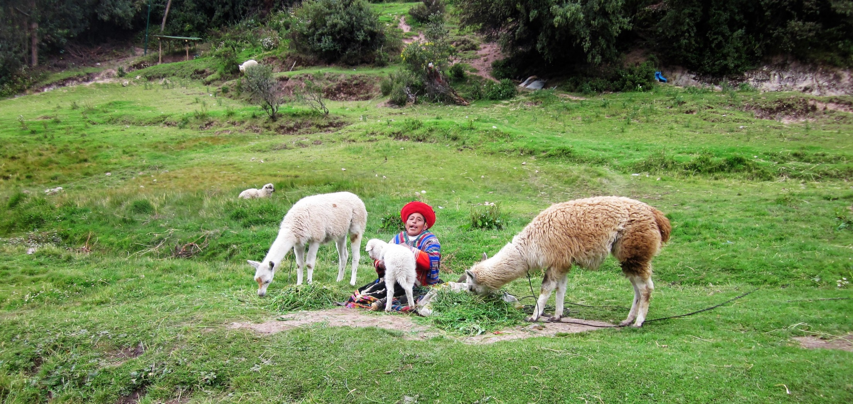

Slide 24
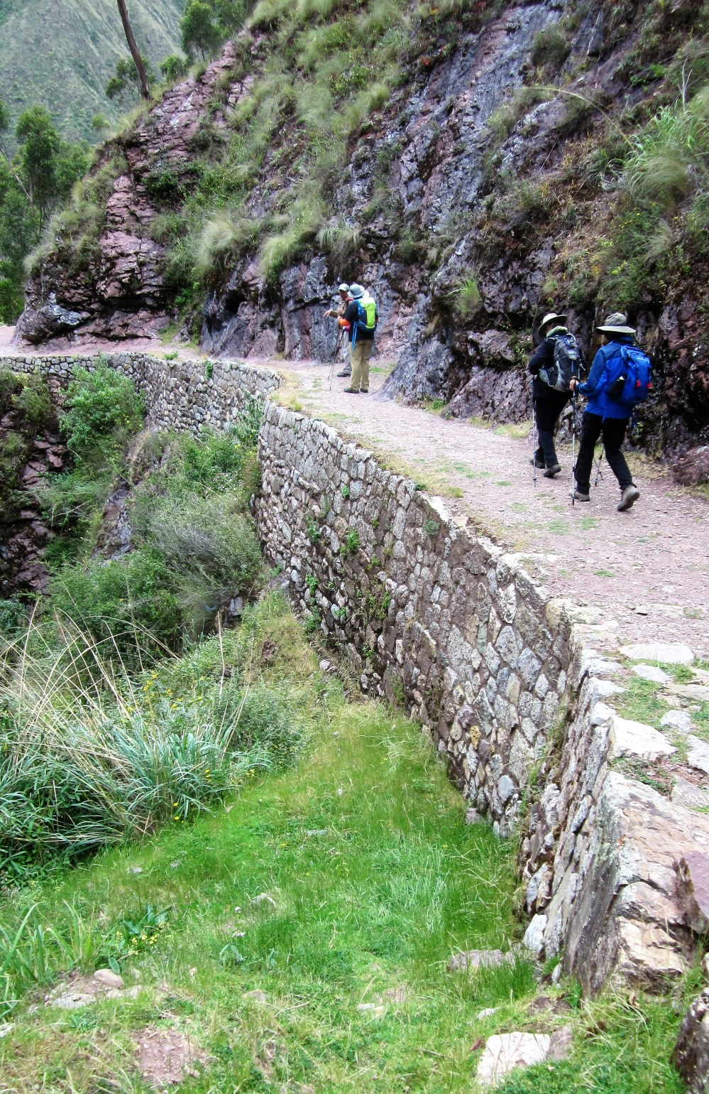
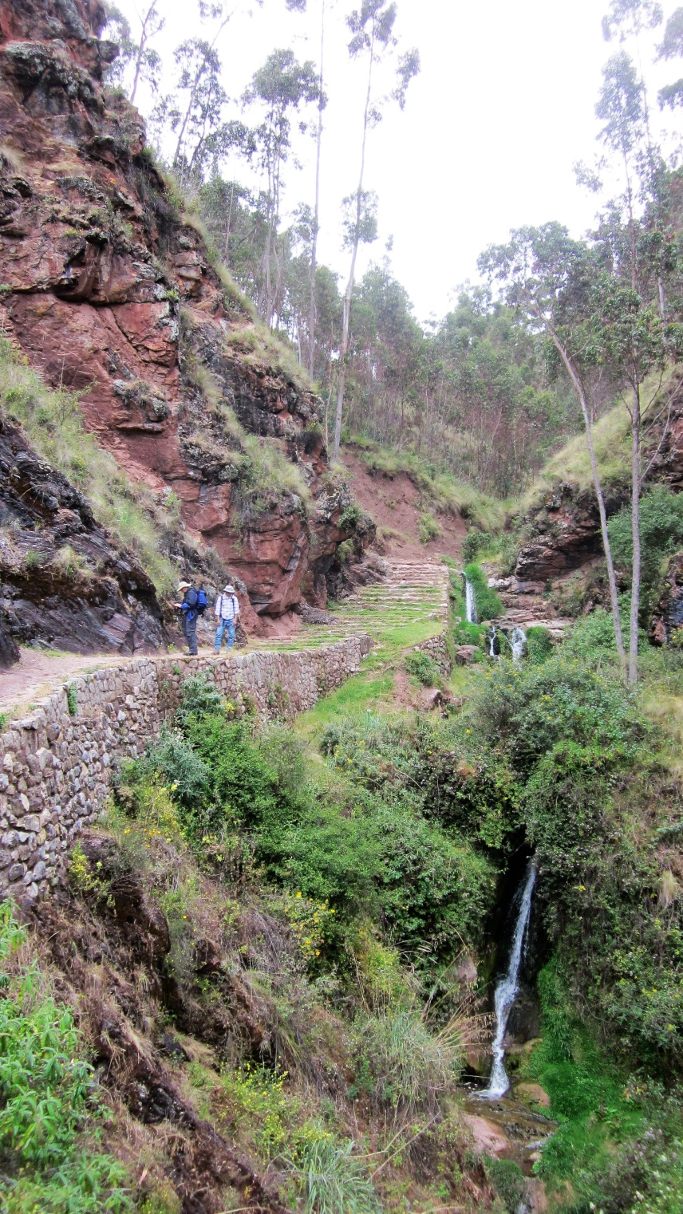

Slide 25
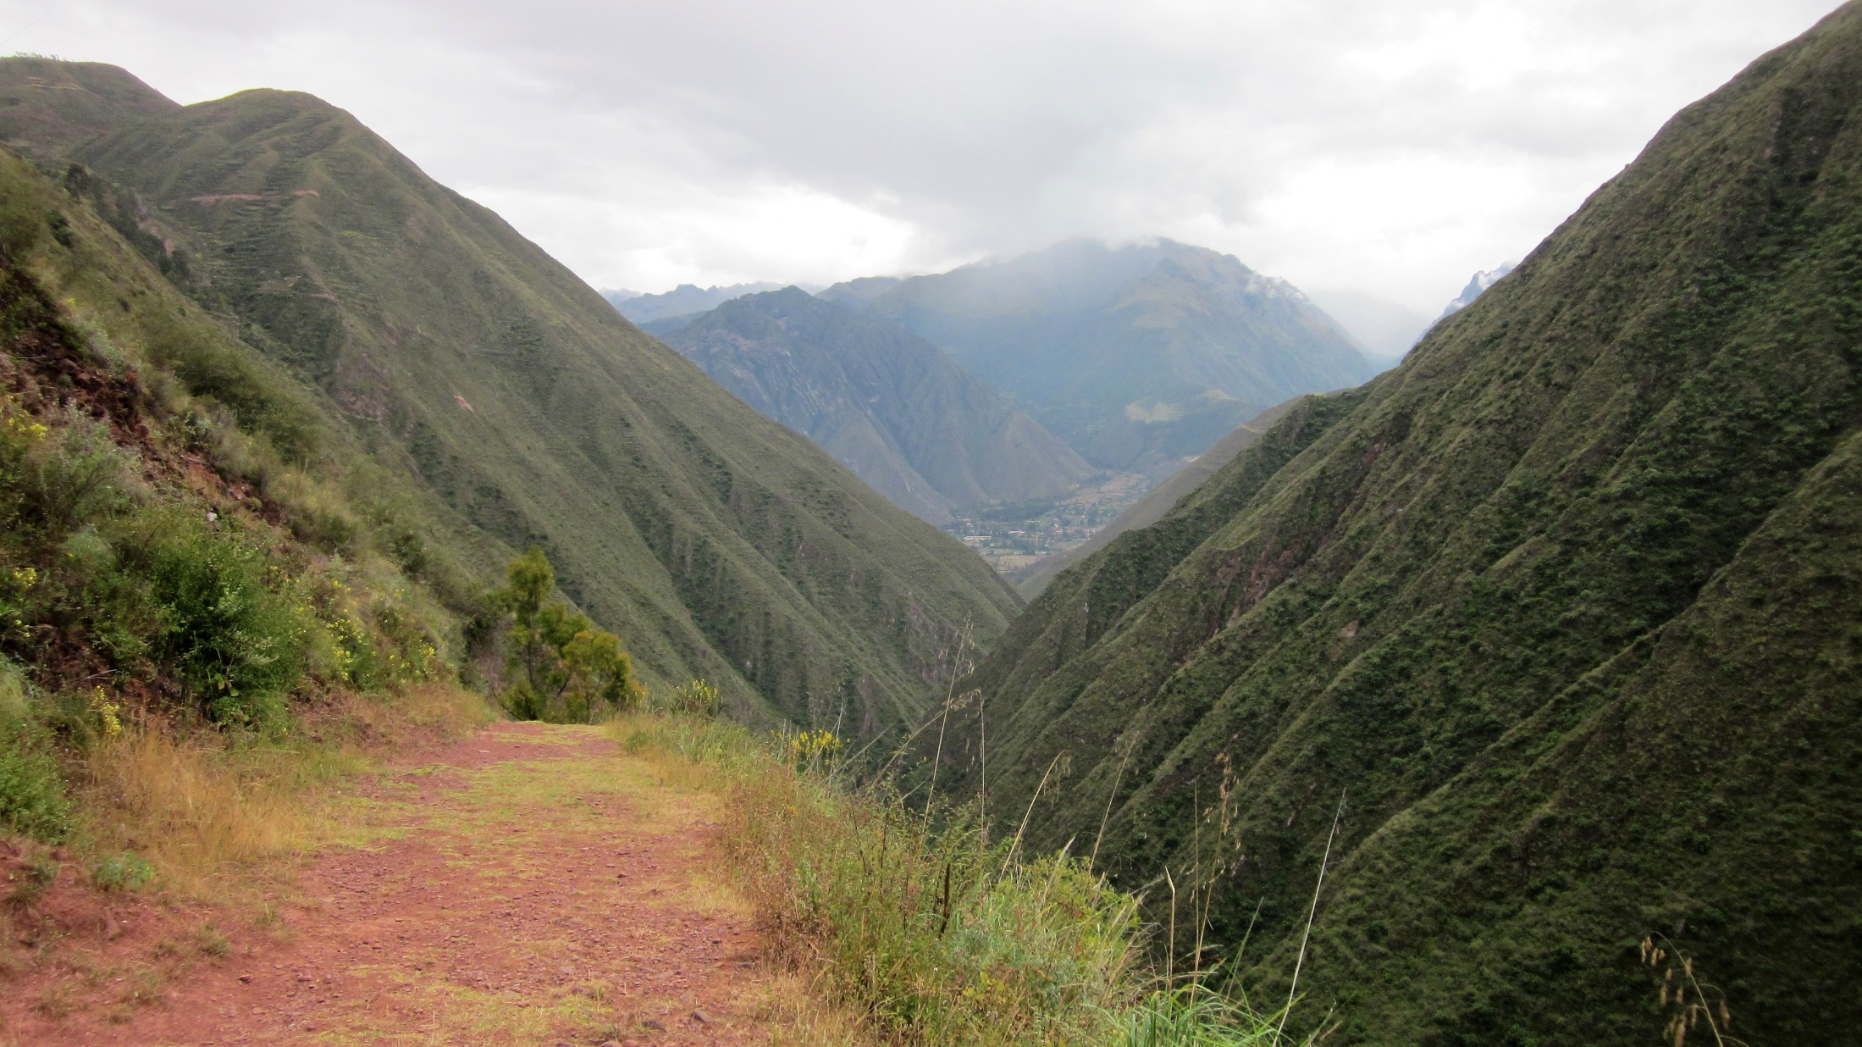

Slide 26
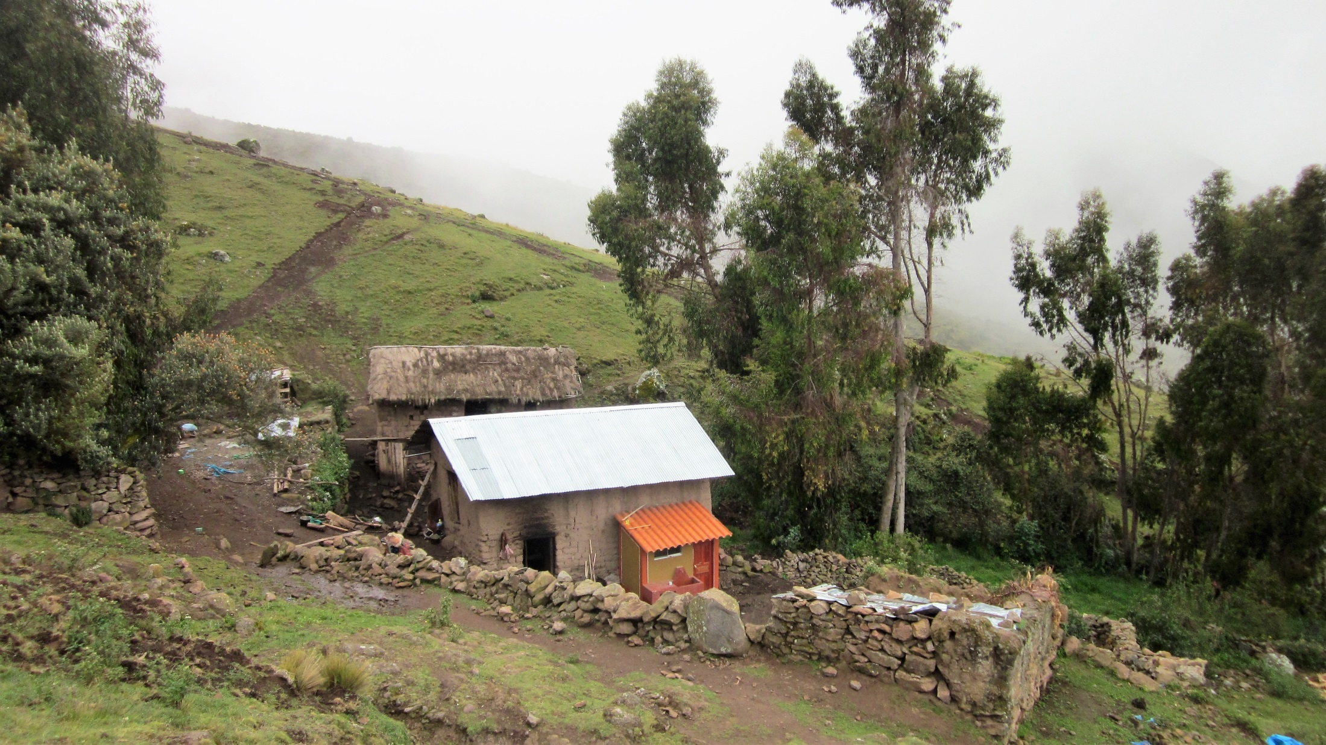
Farmstead high in the Andes; Quechua spoken here

Slide 27
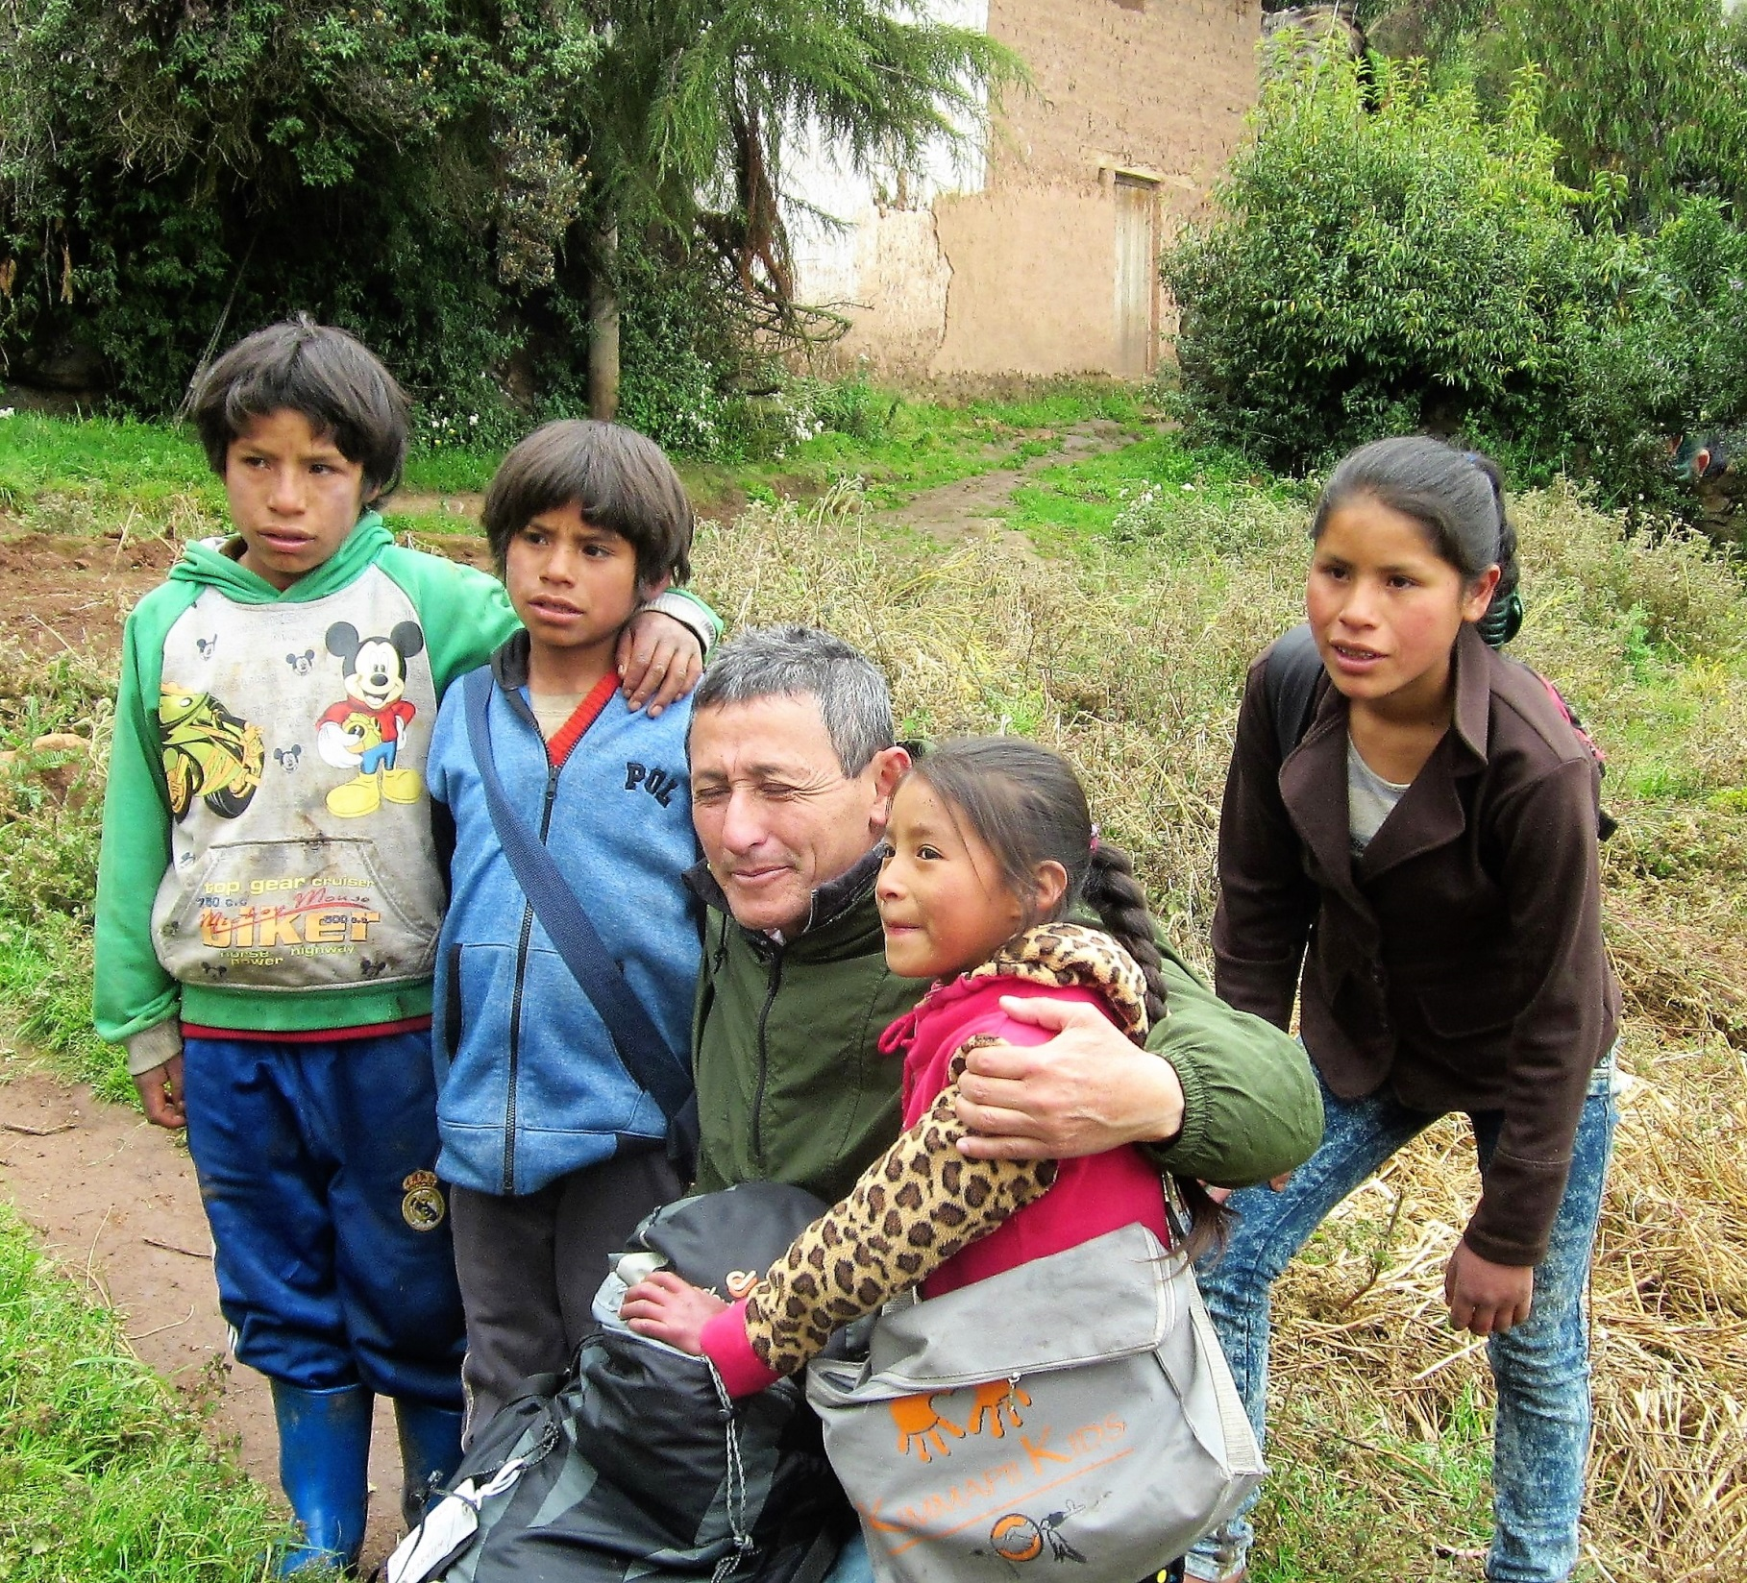
Our
excellent
head
Guide,
Manolo

Slide 28
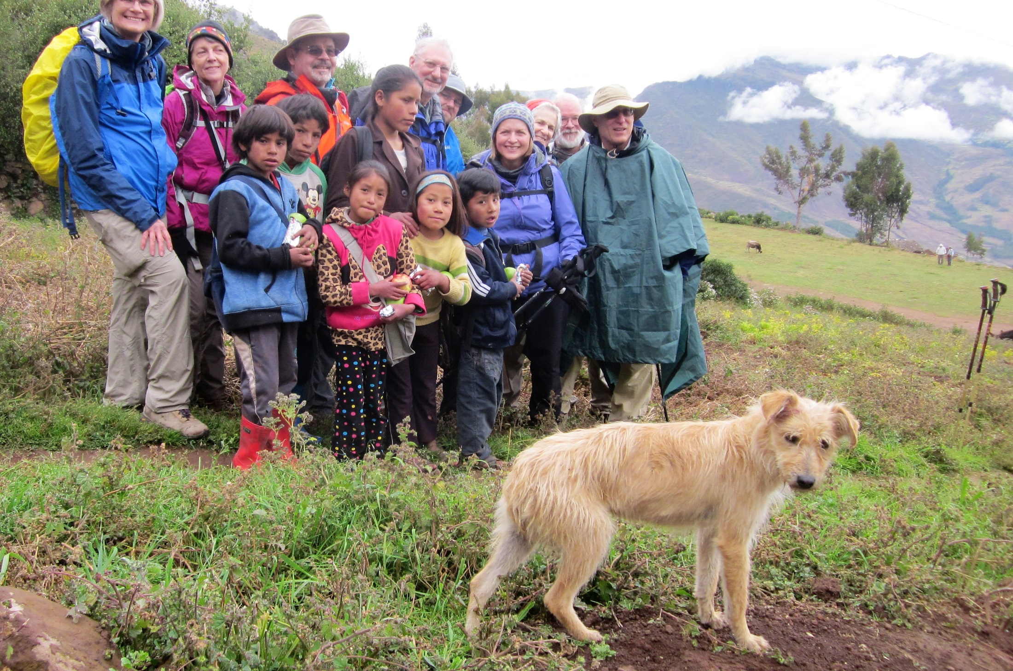
Dog

Slide 29
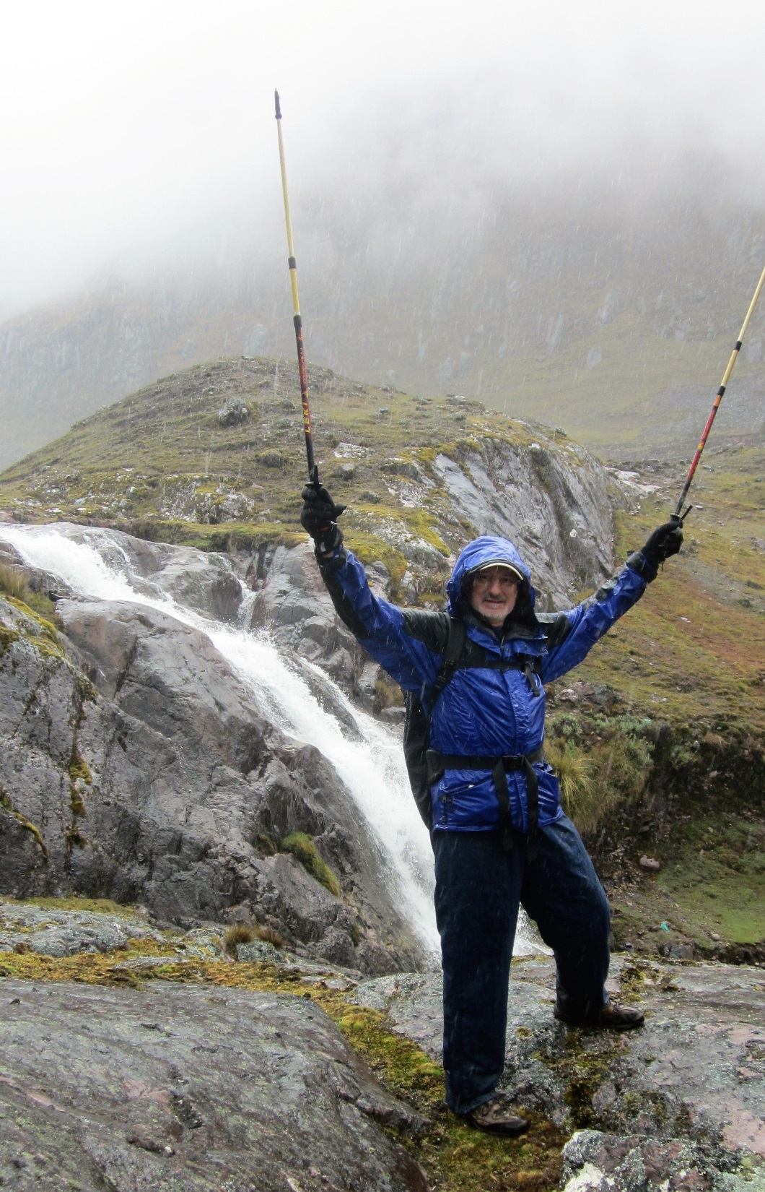
High up—
near 14,000
feet; check out
weather

Slide 30
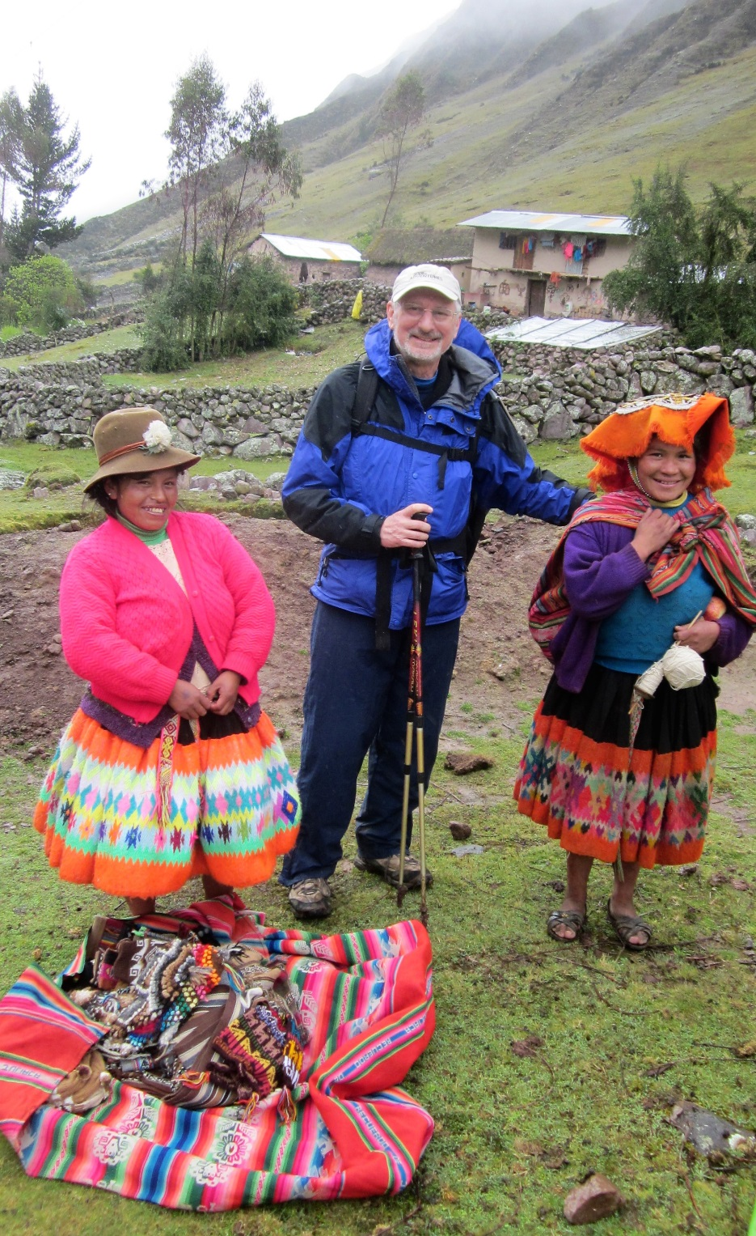
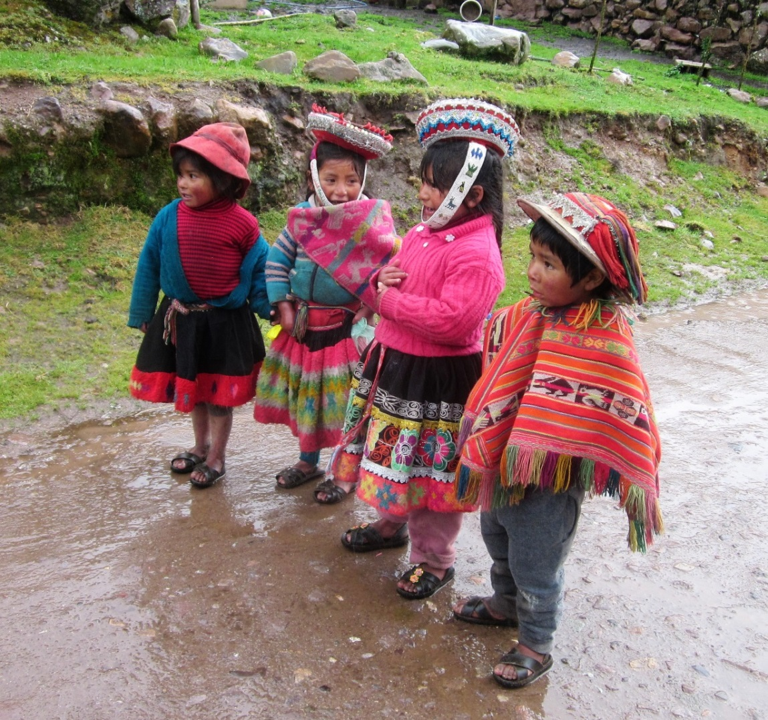

Slide 31
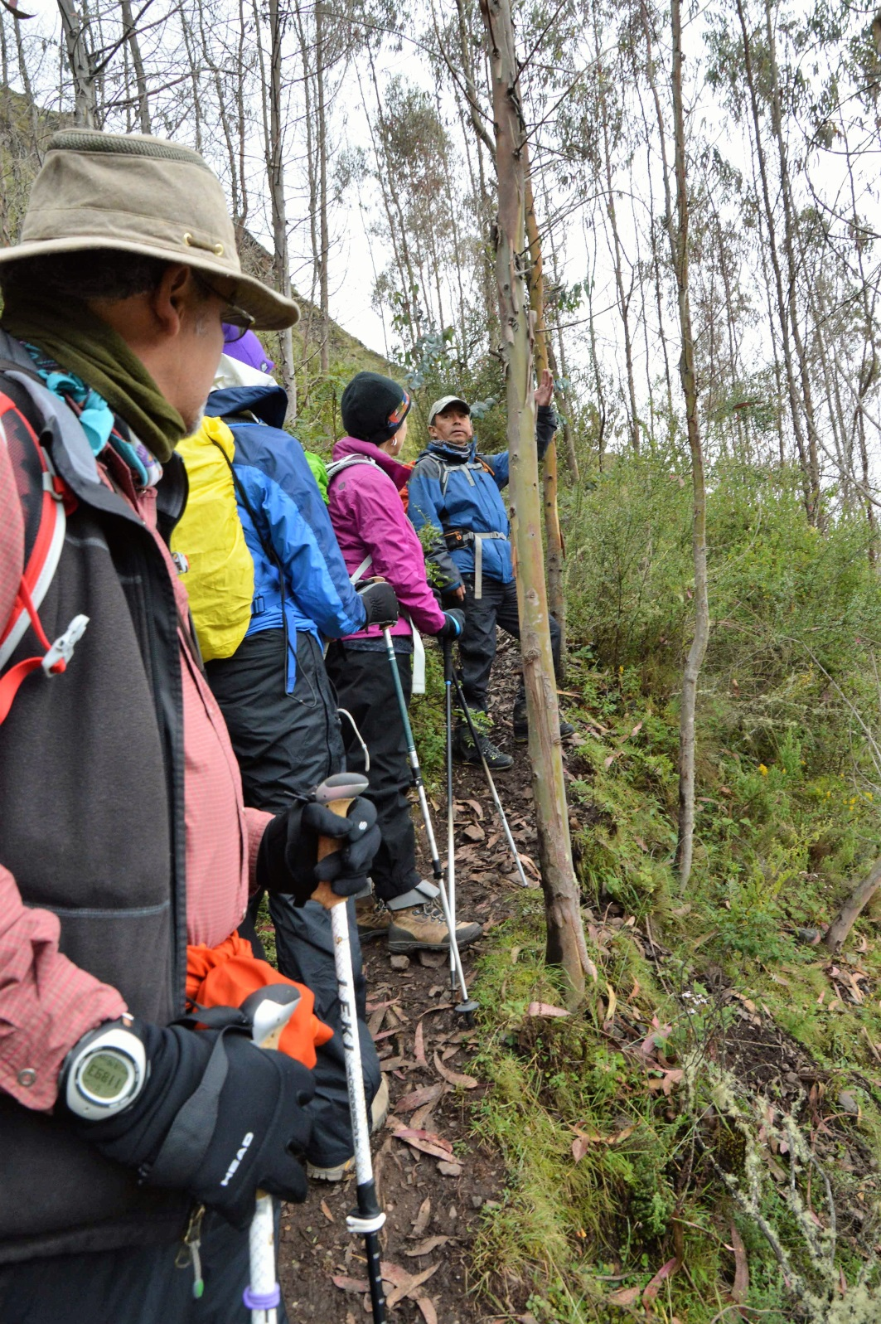

Slide 32
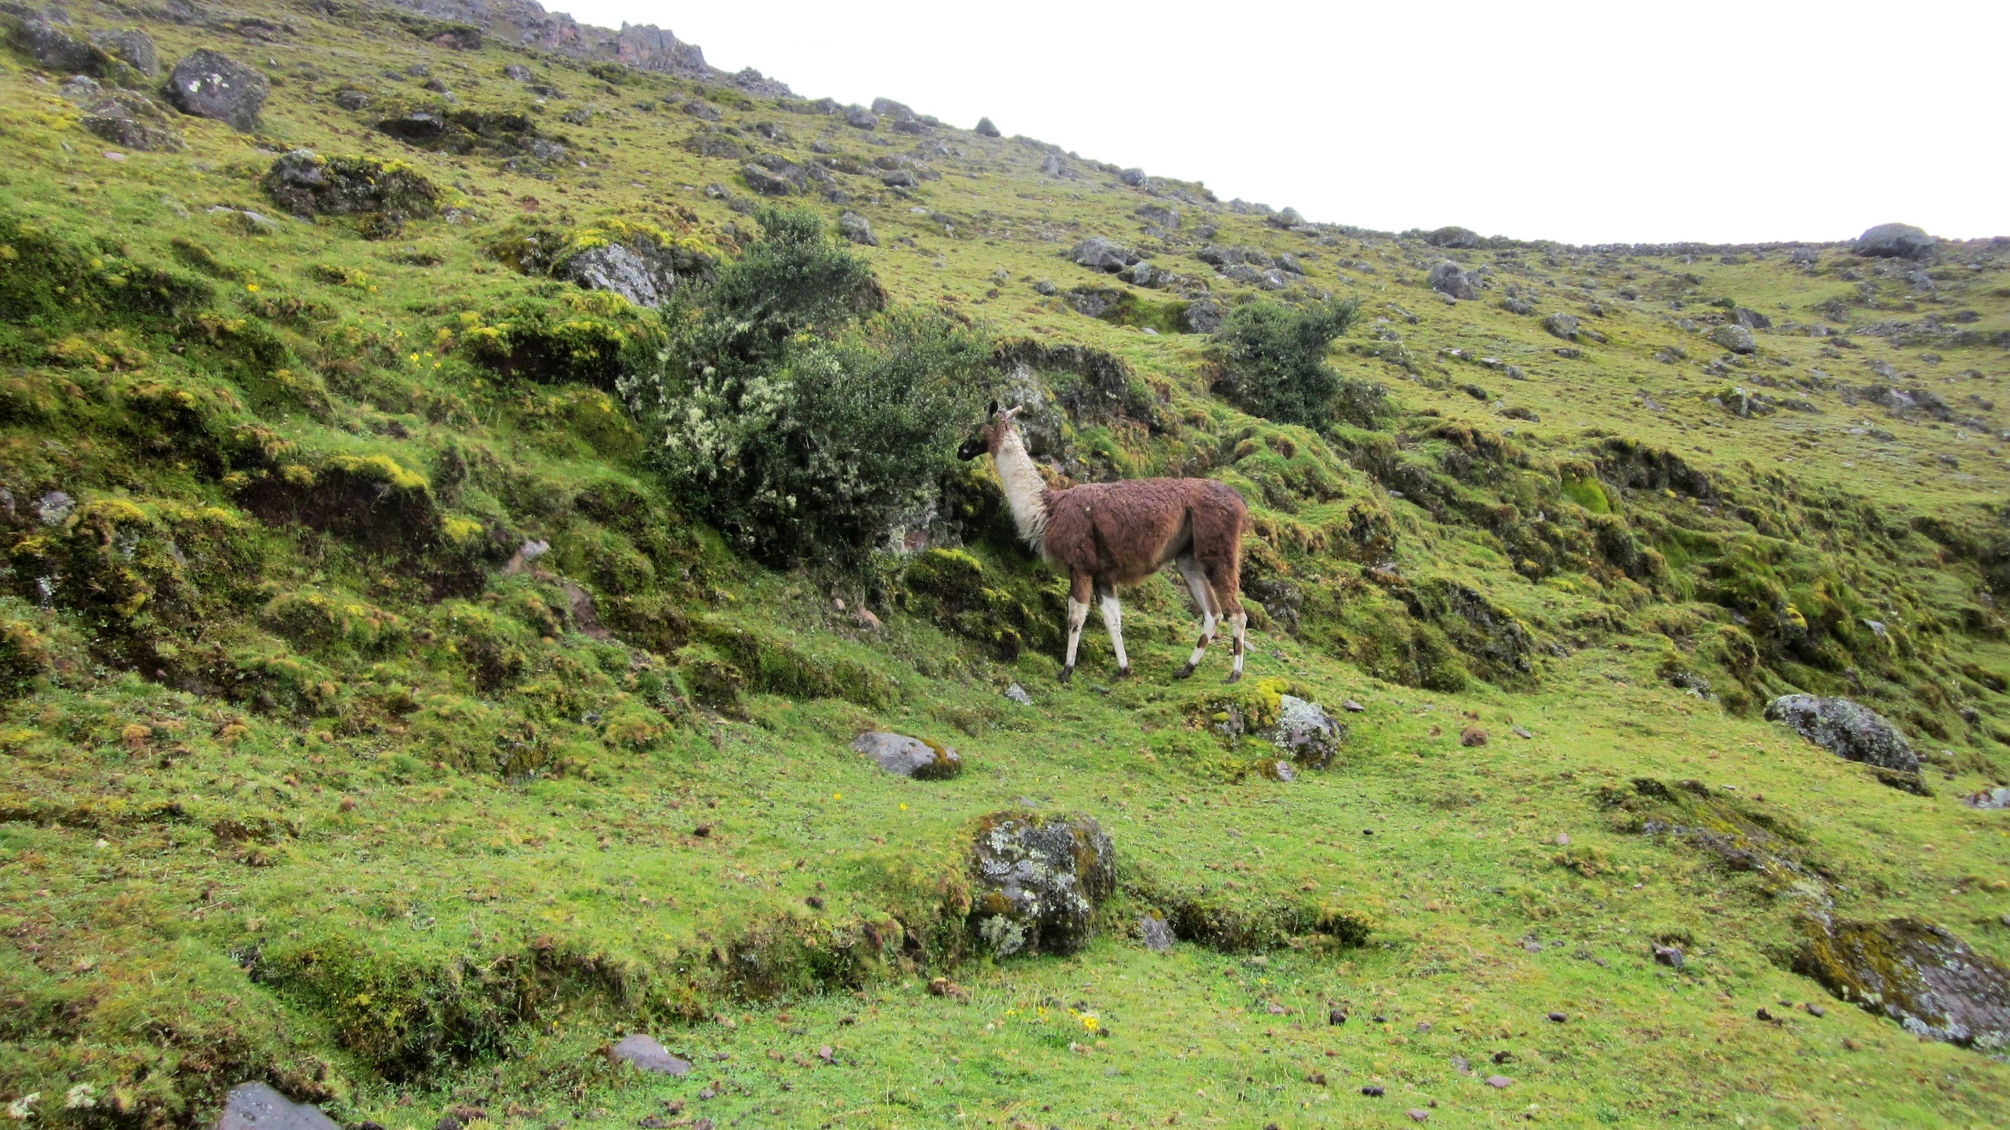
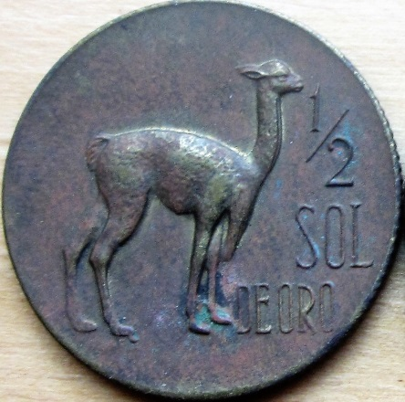
The llama– National Mascot, seen everywhere
in the mountains

Slide 33
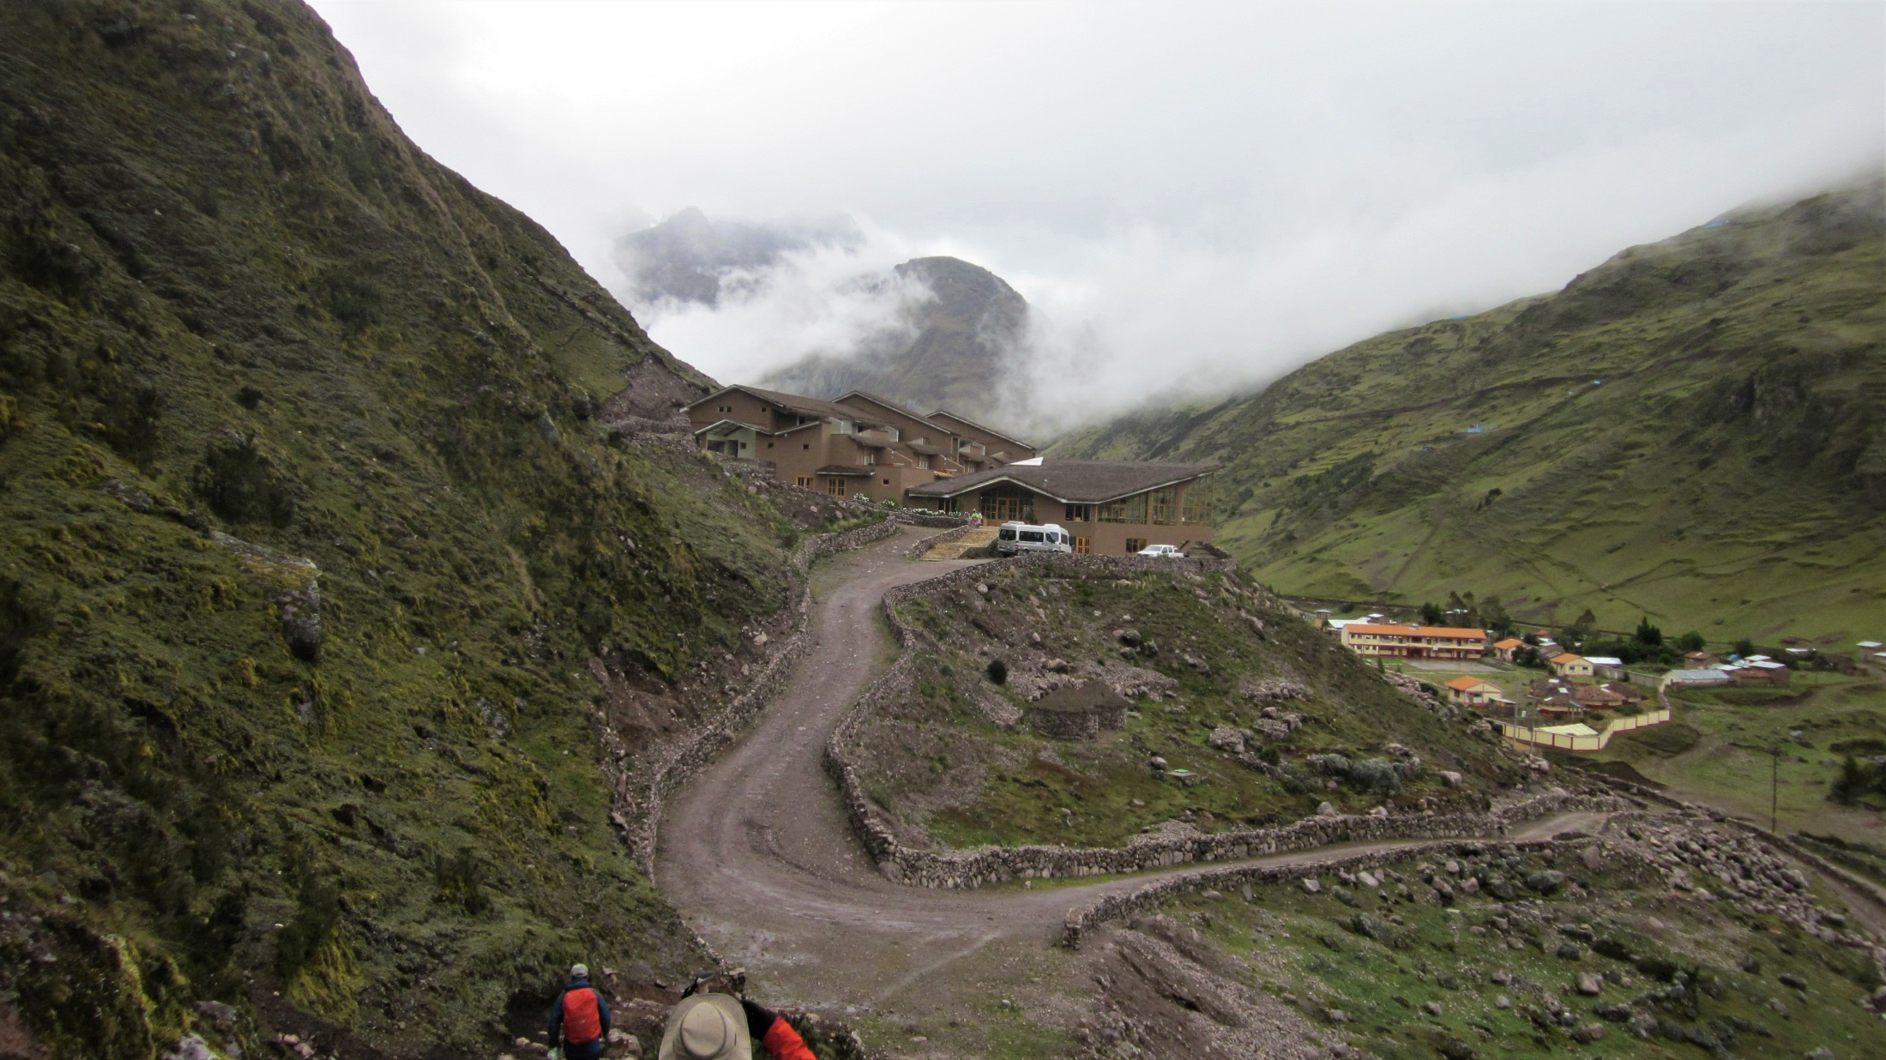
Our lodge coming into view after a long, high,
Wet hike. Note the uphill approach at 13,000 feet!

Slide 34
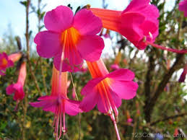
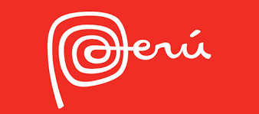
On the Road

Slide 35
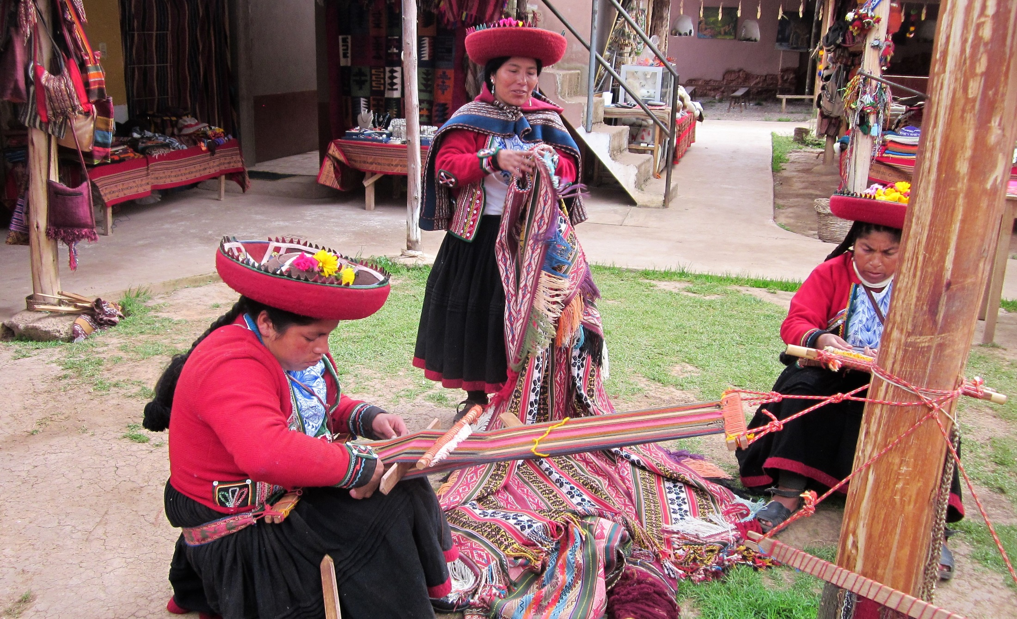
Traditional weaving demonstration

Slide 36
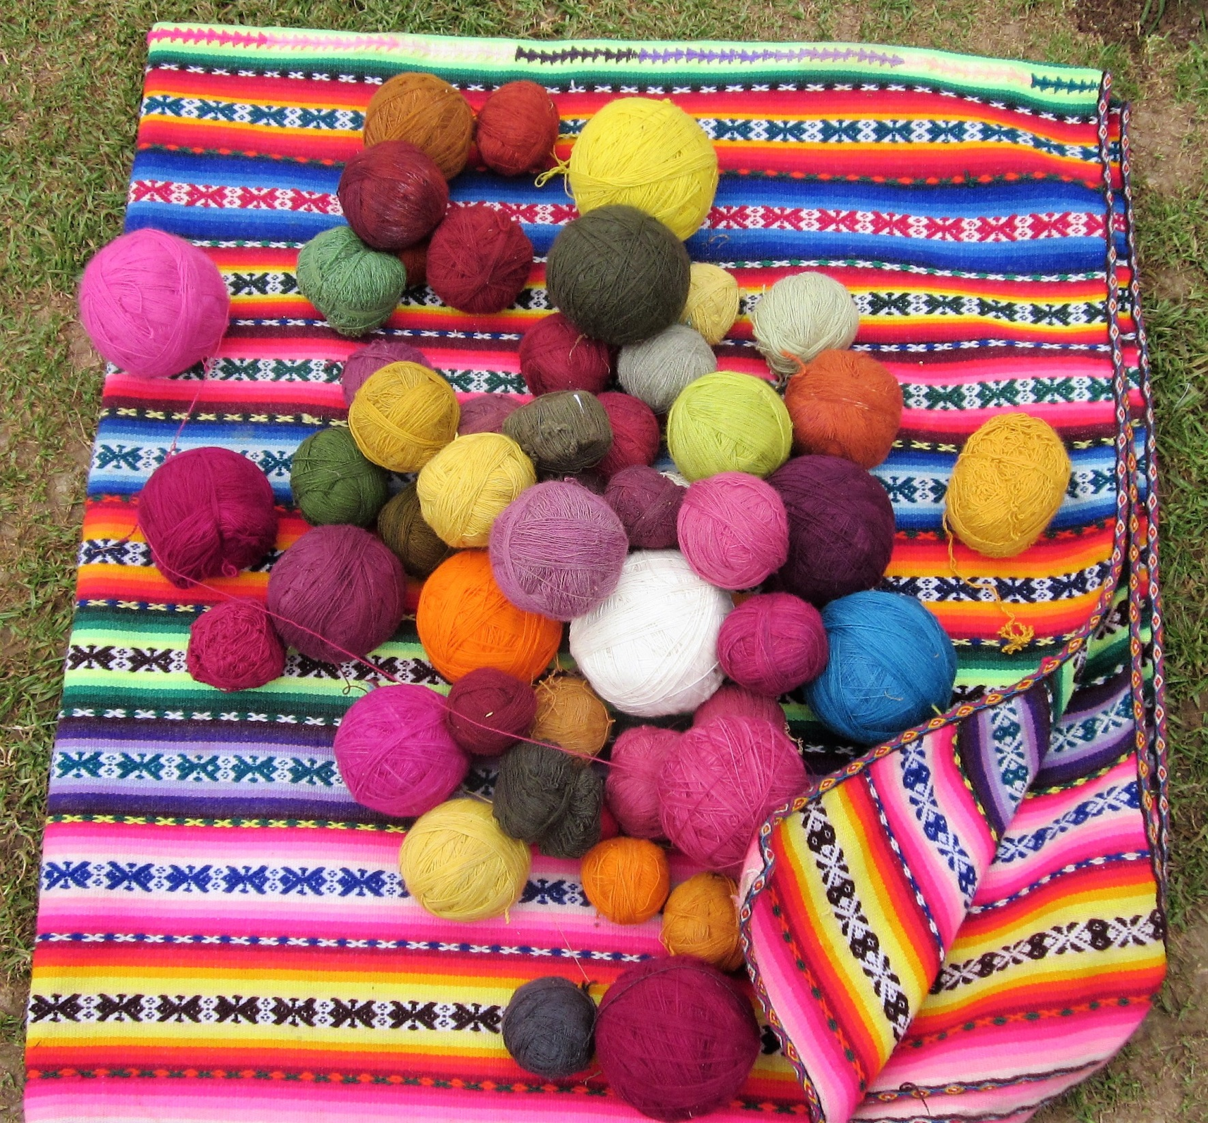

Slide 37
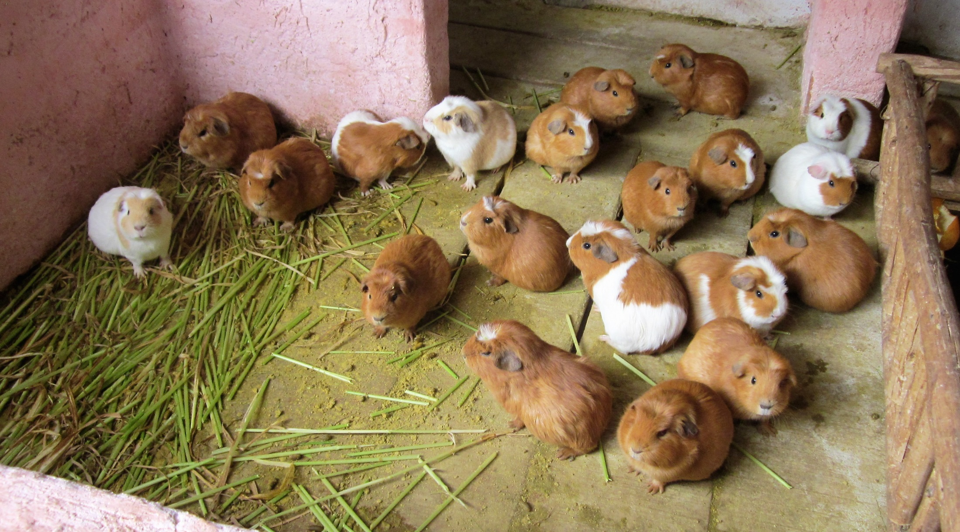
Guinea pigs—dinner

Slide 38
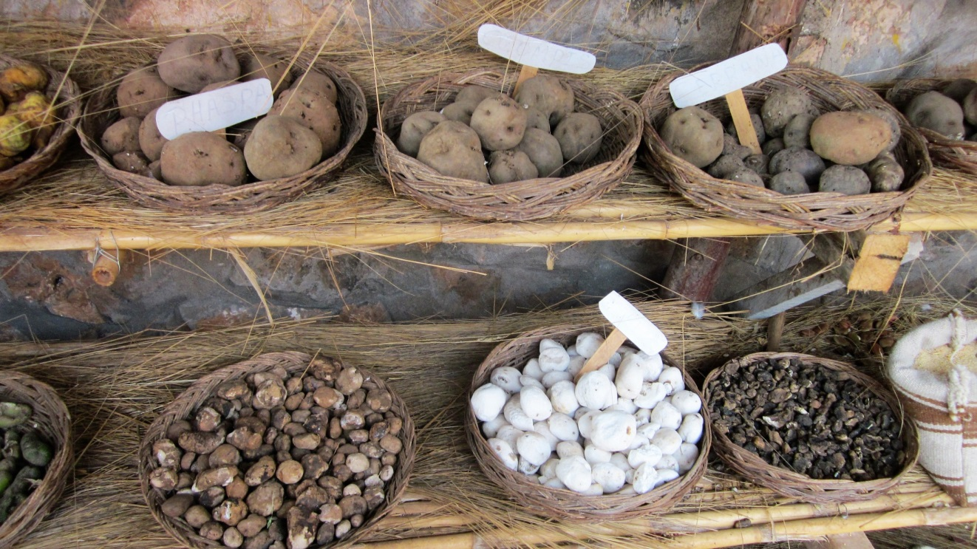
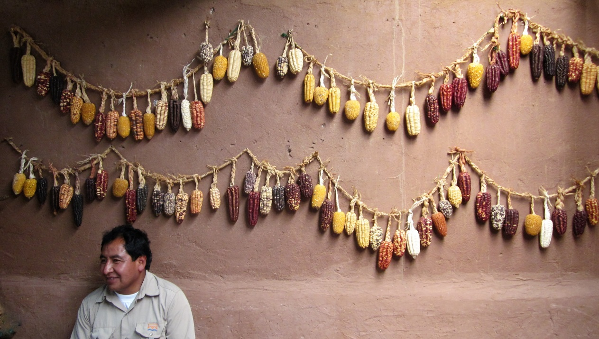
Peru boasts 3,500
varieties of potato
Corn too
One of our
Drivers,
Roberto

Slide 39
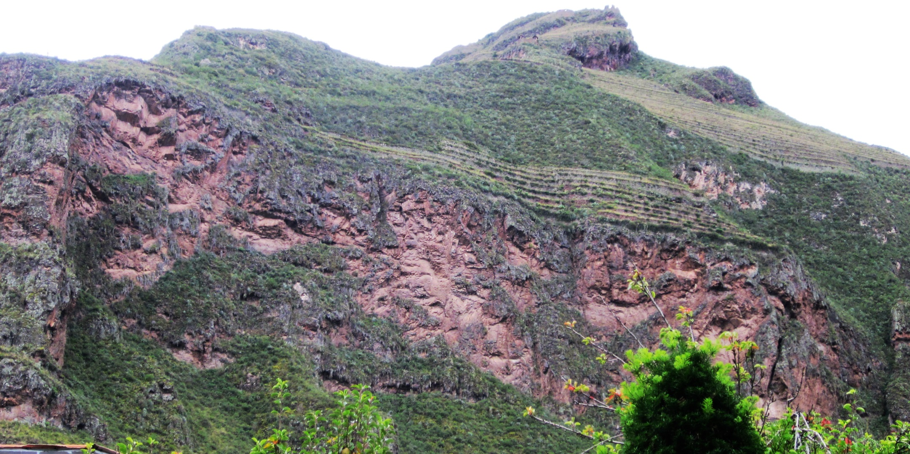
Inca agricultural terraces high
above the valley

Slide 40
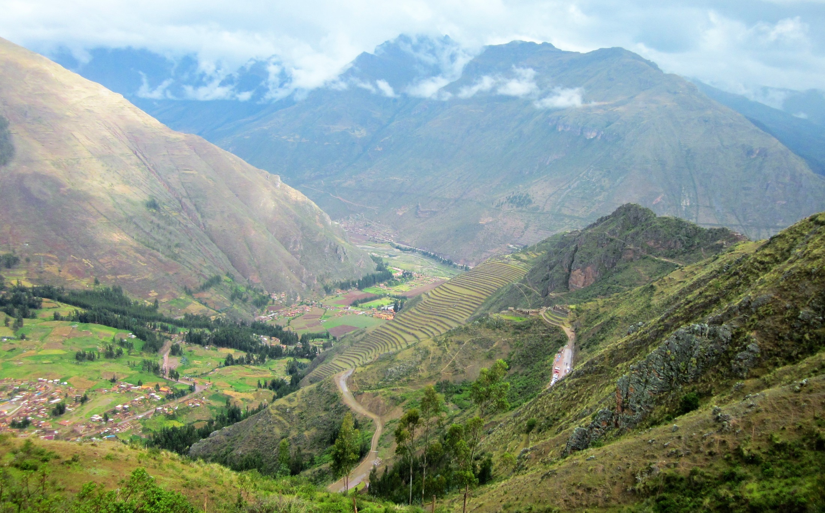
Famous Inca terracing

Slide 41
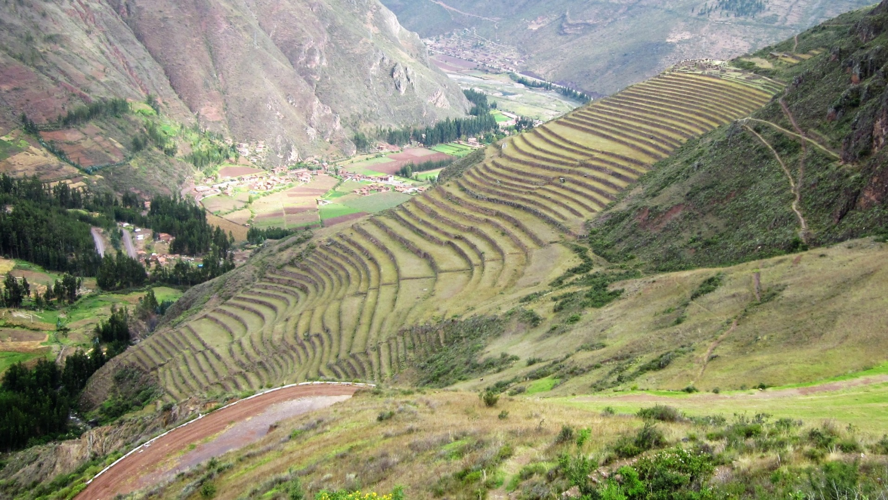
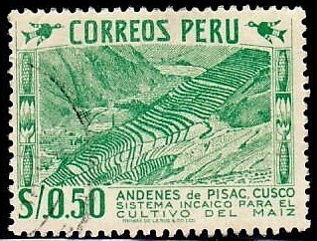

Slide 42
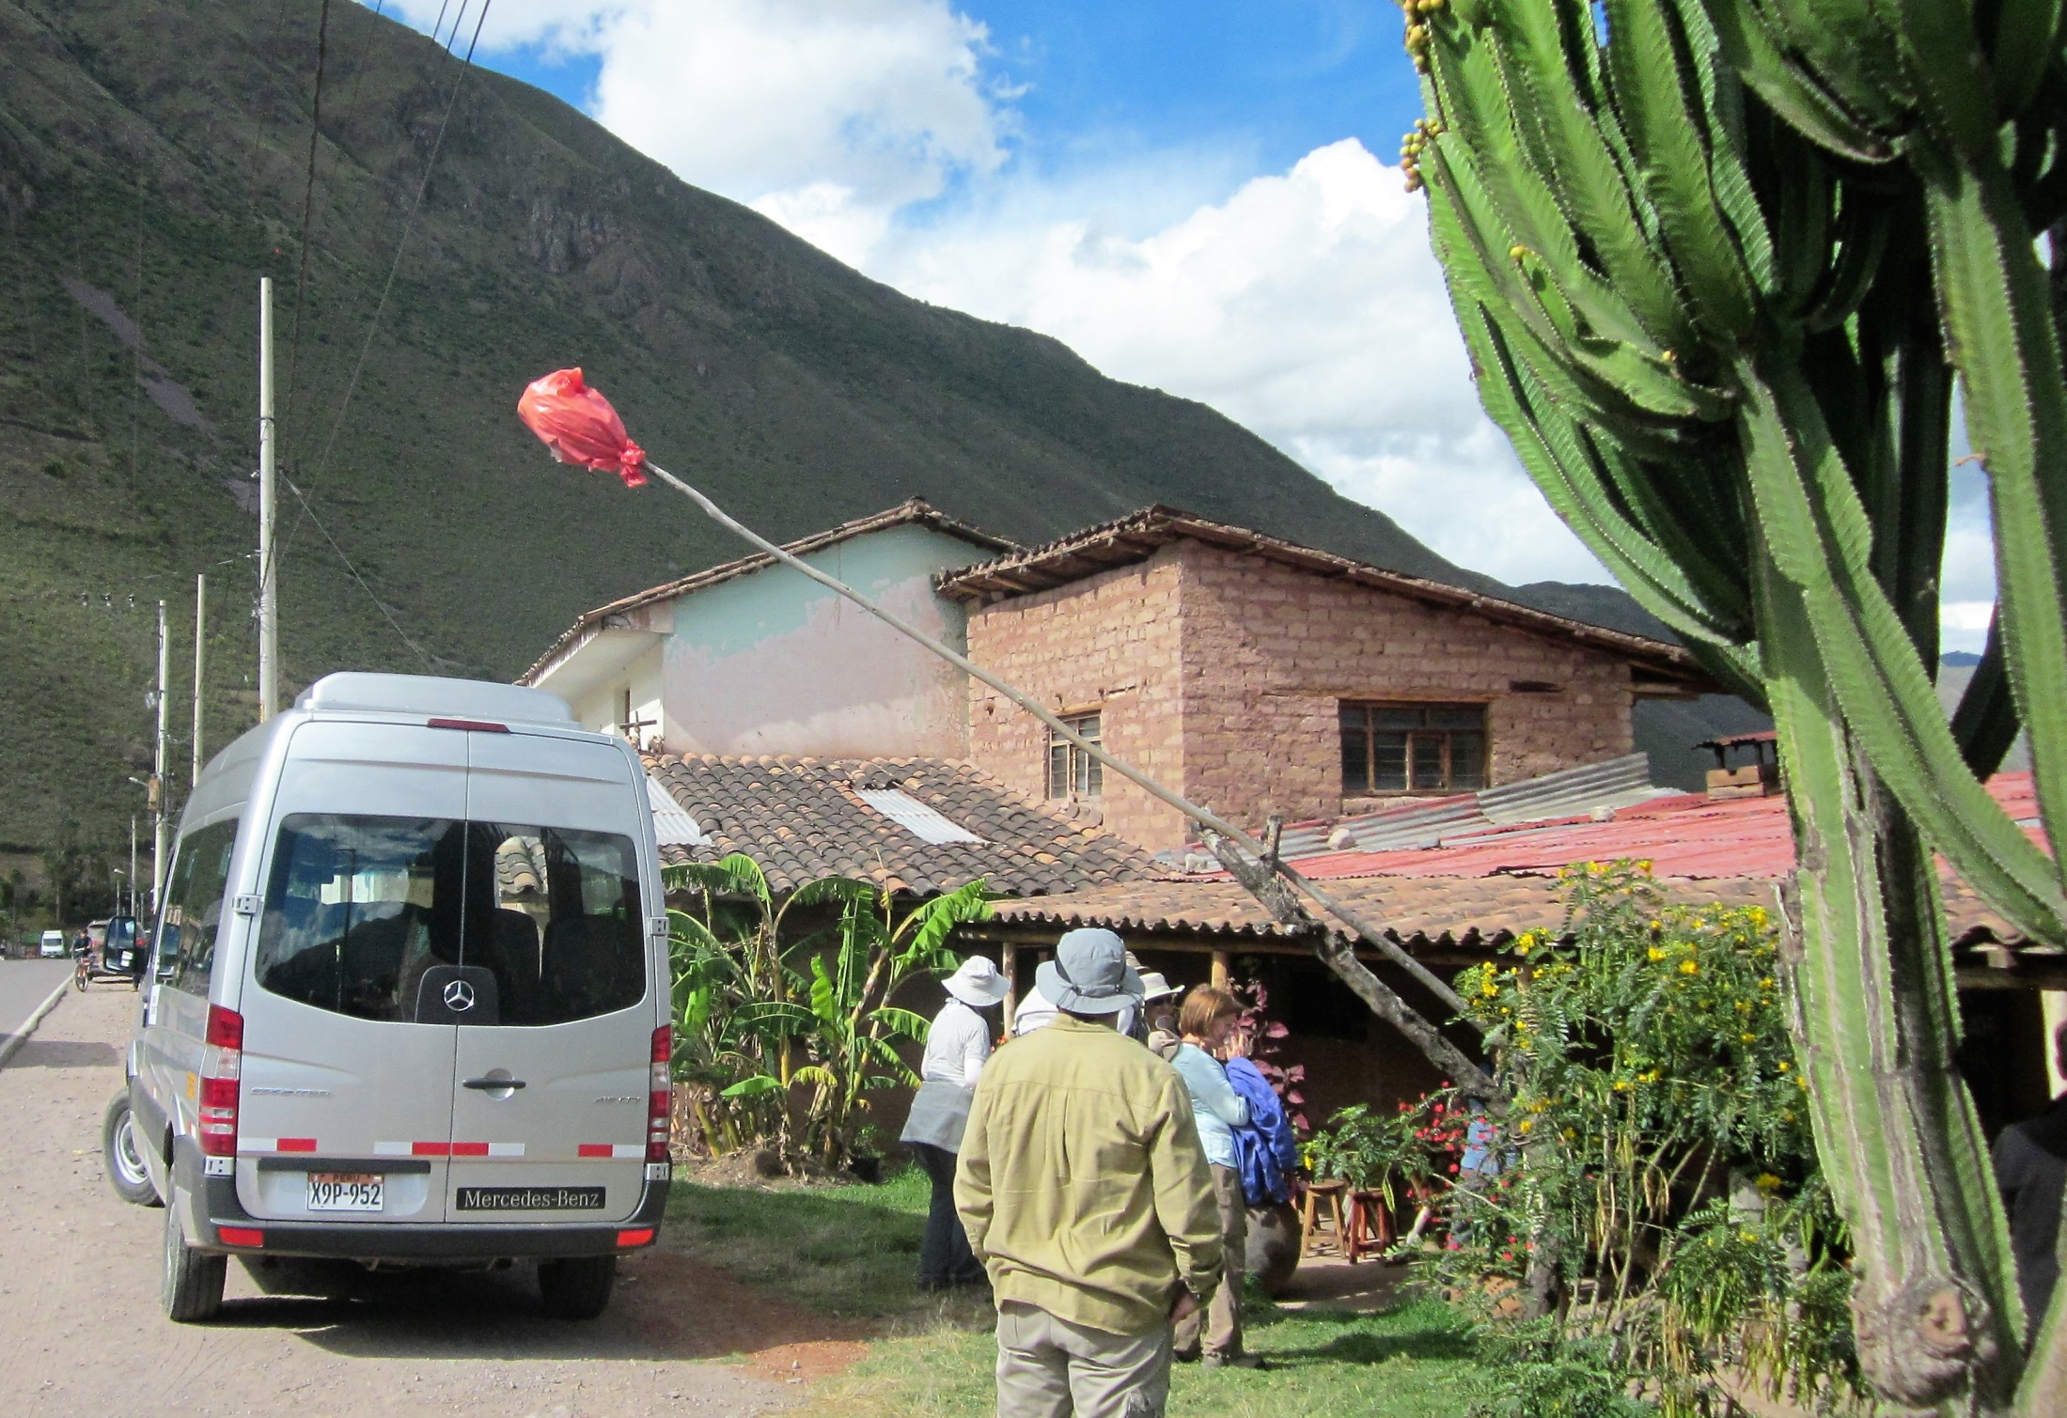
Red plastic flag means—a
roadside bar

Slide 43
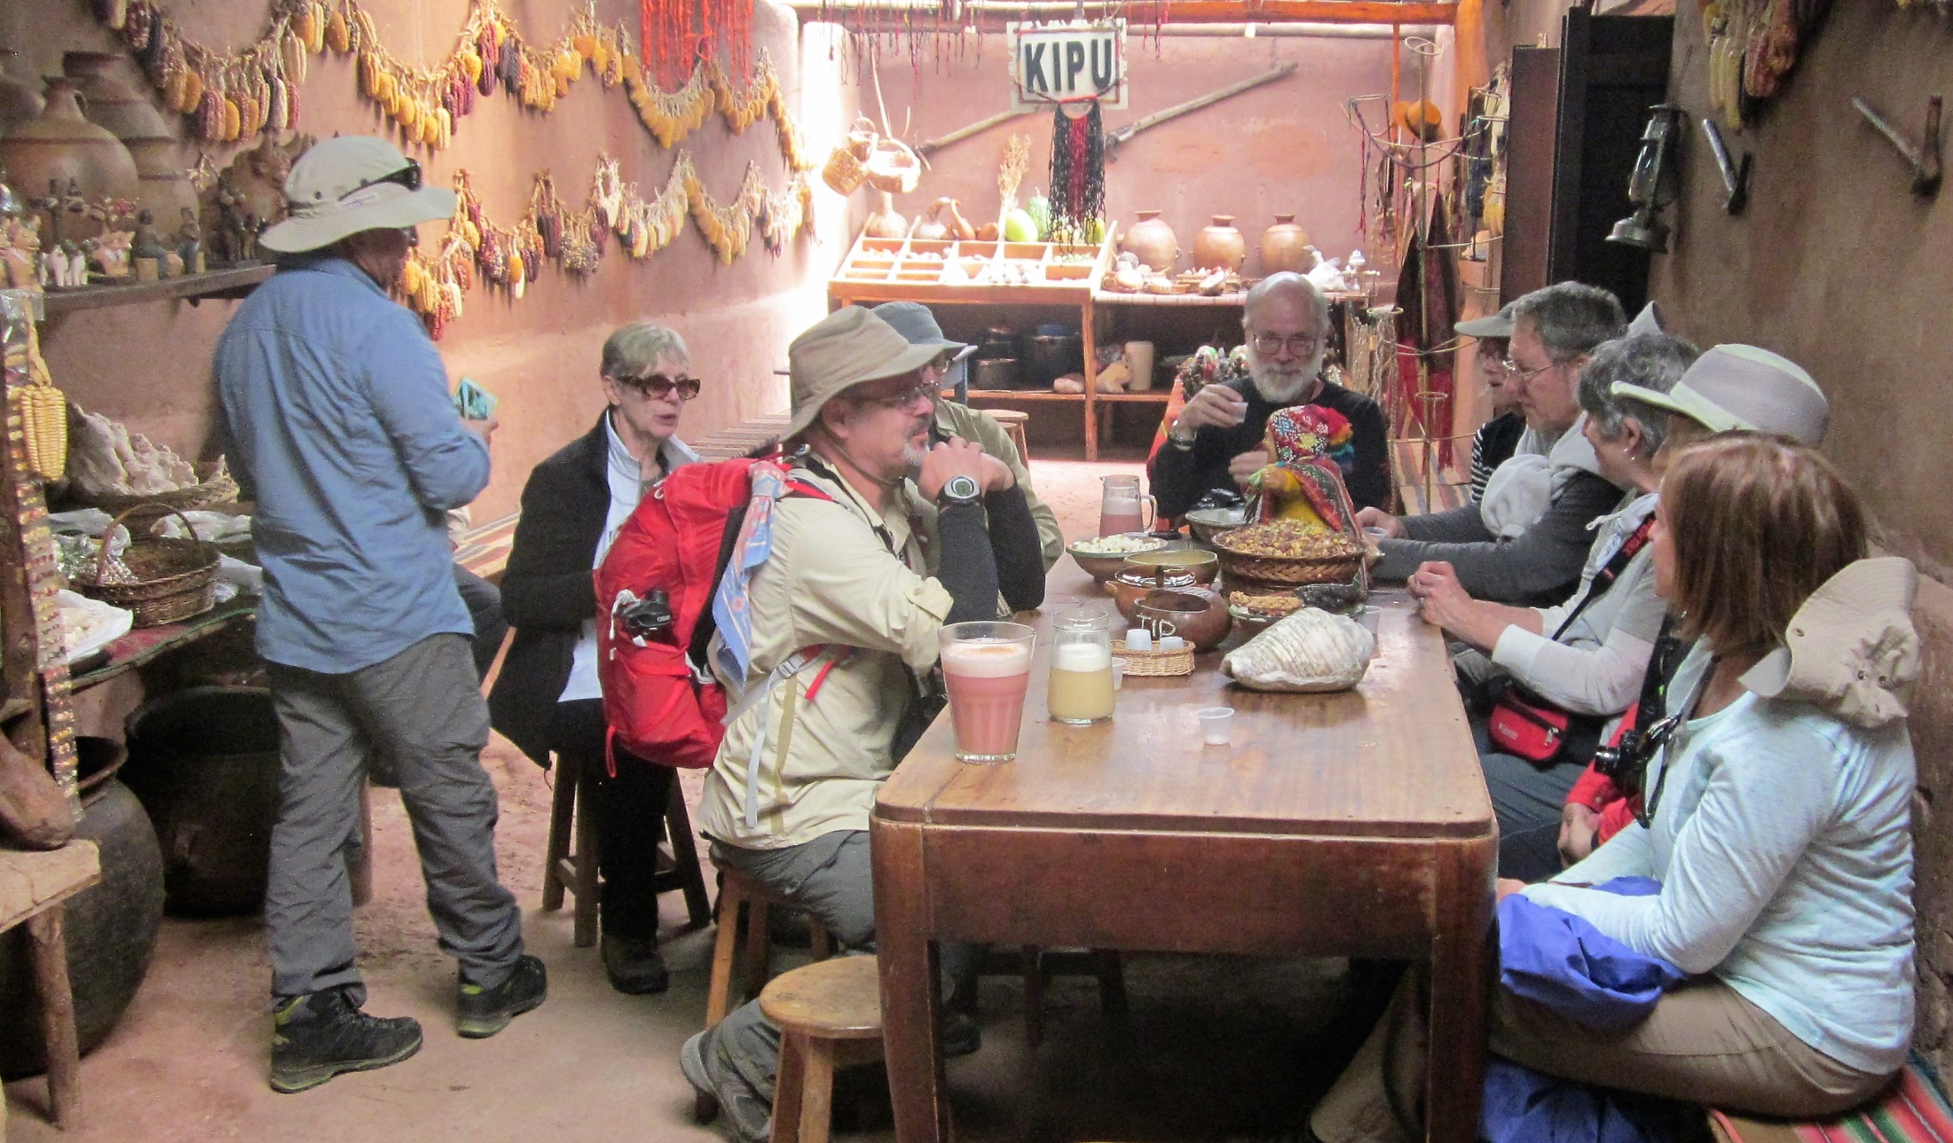
Drinking home-made corn beer—pretty good

Slide 44
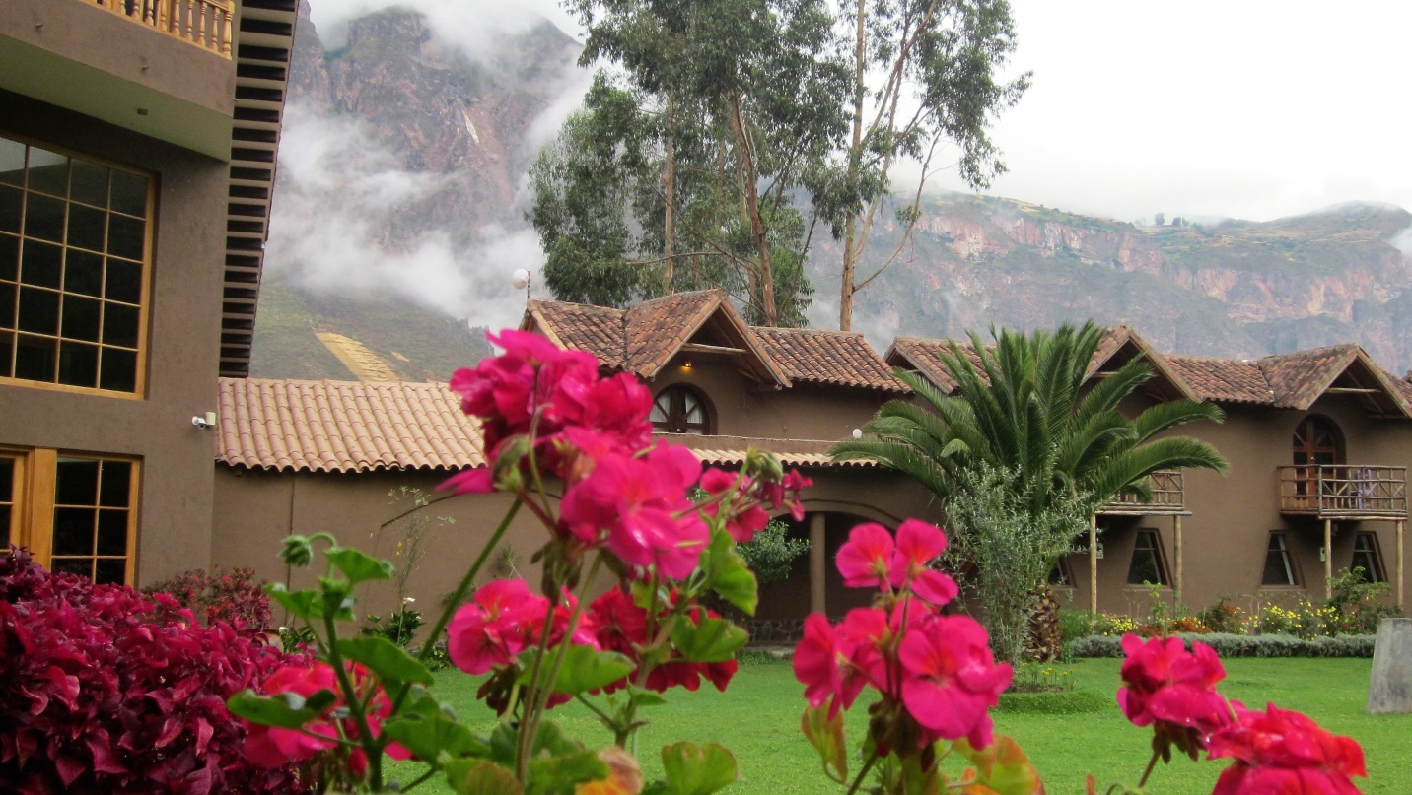
Lunch Stops

Slide 45
Museum in the Sacred Valley of the Incas

Slide 46
Some of the best dioramas I have ever seen

Slide 51
Many cultures are represented here before the Incas

Slide 55
Lodging

Slide 56
Elegant lobby of our first hotel

Slide 57
First Mountain Lodge, owned by National Geographic

Slide 59
Second Five Star
hotel lobby—
Urubamba

Slide 61
Aguas Calientes and
Machu Picchu

Slide 62
Great rail trip to
Machu Picchu

Slide 63
Aguas Calientes Heliport
Personal
Guide to the
Tea Plantation

Slide 64
Not so crowded
On hike to the
Sun Gate
They let in 4,000 tourists
a day to Machu Picchu

Slide 65
Machu Picchu—
my photo and
Stamp
Taken from trail
to Sun Gate

Slide 66
Teddy, superb assistant guide

Slide 67
Trail to the
Inca Bridge
Control
Gate
Inca draw-
bridge
Perilous
trail

Slide 68
View from Inca Bridge Trail; it’s 3000 feet down

Slide 69
Storm coming in over Machu Picchu

Slide 70
World Heritage Site

Slide 71
Road from Aguas Calientes
to Machu Picchu, and pics of
bus ride down from the
shotgun seat

Slide 72
Coins, Stamps,
and Gold

Slide 73
Ancient
artifacts
and
gold that I brought
back from Peru

Slide 74
Weight 27.07 gms; 0.8960
Fineness; ASW 0.7797 toz;
Obverse: Ferdinand in Draped
Laureate Bust; Reverse:
Crowned Arms and Pillars
Peru as Spanish Colony—
1816 8 Reales minted in
Lima

Slide 75
Peru One Sol depicting National Arms and Seated
Liberty; .900 fine; ASW 0.7234 troy ounces. Catalog
Value $11 and up.

Slide 76
Honoring an Indigenous Leader
Who Lead Rebellion
Against the
Spaniards

Slide 77
Llama or
Vicuna
Radiant Sun or
Radiant Flower

Slide 78
Modern
Coinage

Slide 79
Coins of Peru

Slide 80
Typical Peruvian Stamps
Inca themes
Industry and Agriculture
Heroes and Dignitaries
Monuments
Buildings

Slide 81
Selected Peruvian
Stamps

Slide 82
The End

