Slide 1
RIT
Plate Identification of
Great Britain Penny Red
by Deep Computer Scanning
By Larry Rausch

Slide 2
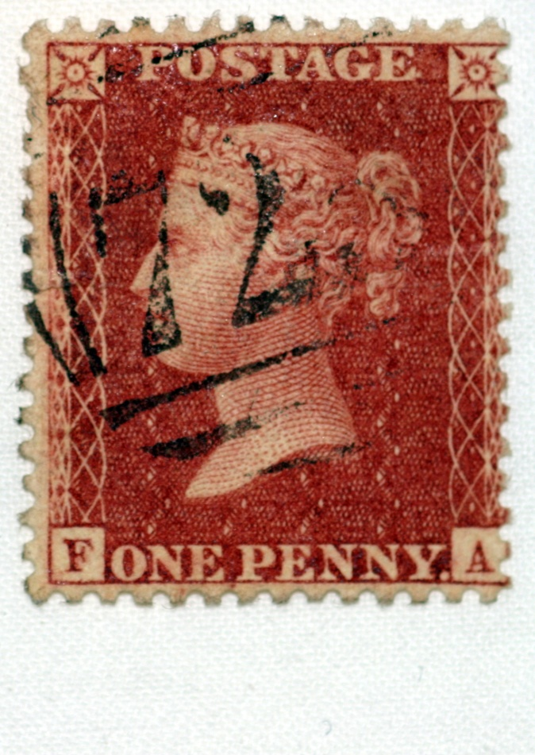
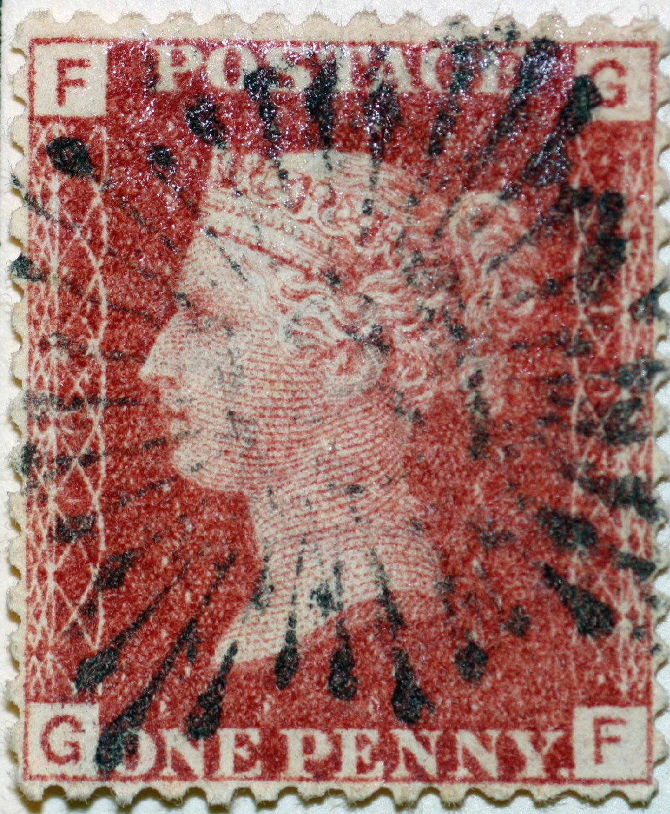
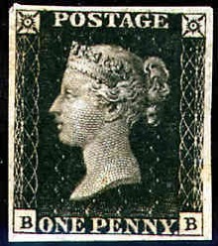
Penny Black 1840
Penny Red(star) 1841
Penny Red 4 corner 1864-1880
Notes:
1st Black doesn’t show postmark well only used 10 months
2nd red star stamp could be cut in half
3rd four corner for forgery but never seen one

Slide 3
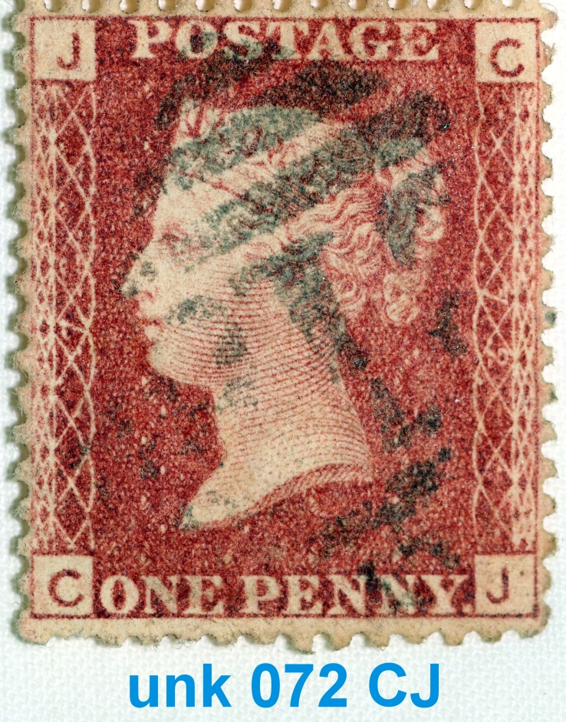
1d Four Corner Red
1864 to 1880
Notes:
Designation is GF on bottom
Alternate letters top and bottom

Slide 4
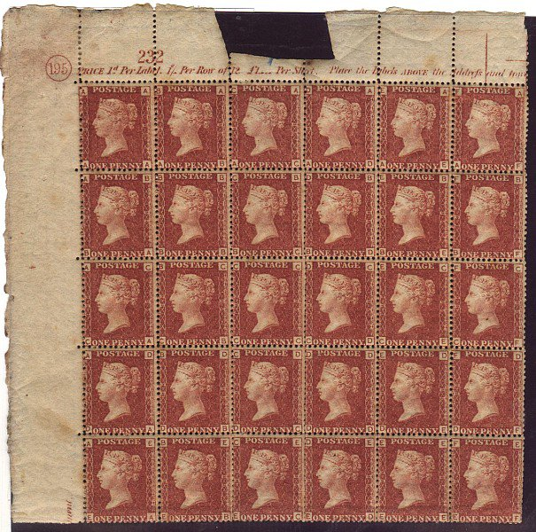
12 Columns A to L
Plate Number 195
20 Rows A to T
Notes:
Total 12 x 20 = 240
12 penny per shilling
20 shillings per pound
1 pound = 240 pennies or 240 pence

Slide 5
12 Column A to L
20 Rows A to T
12 x 20 = 240 Different stamps per sheet
151 Different plate numbers
240 x 151 = 36240 different stamps

Slide 6
30,000 Digital Images provided

Slide 7
Research Goal
Identify Plate Number

Slide 8
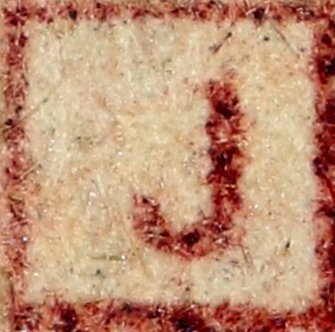
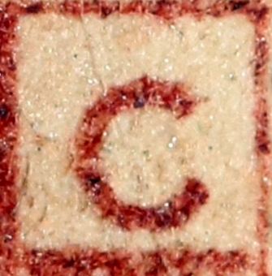
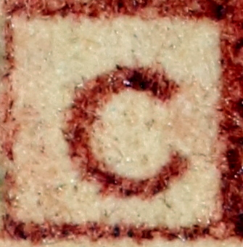
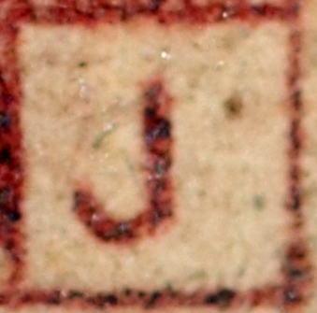

Slide 9
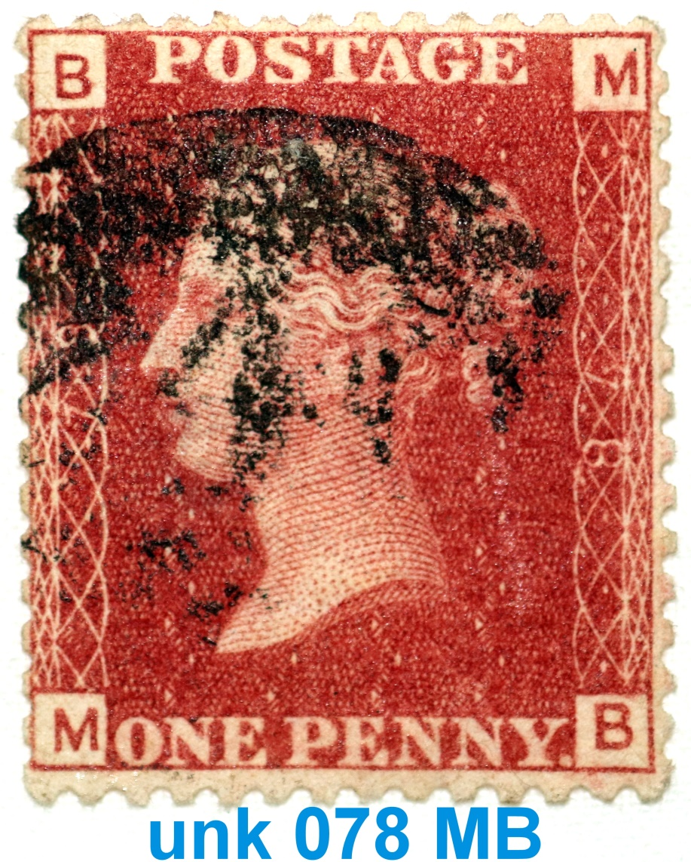
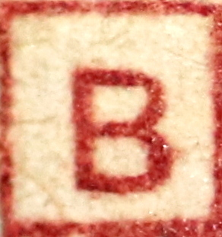
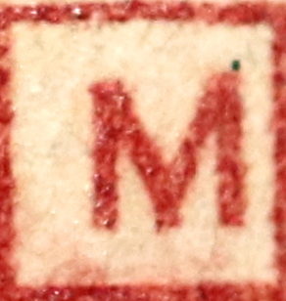
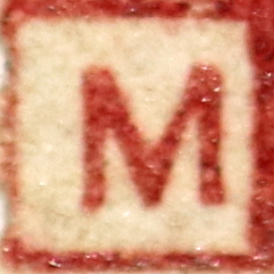
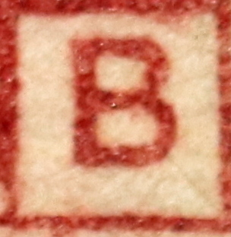
Location of corner letters
can identify plate number

Slide 10
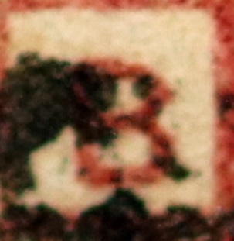
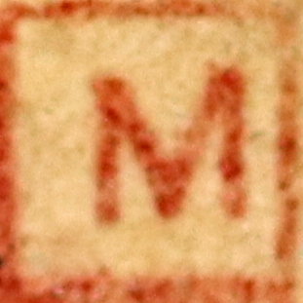
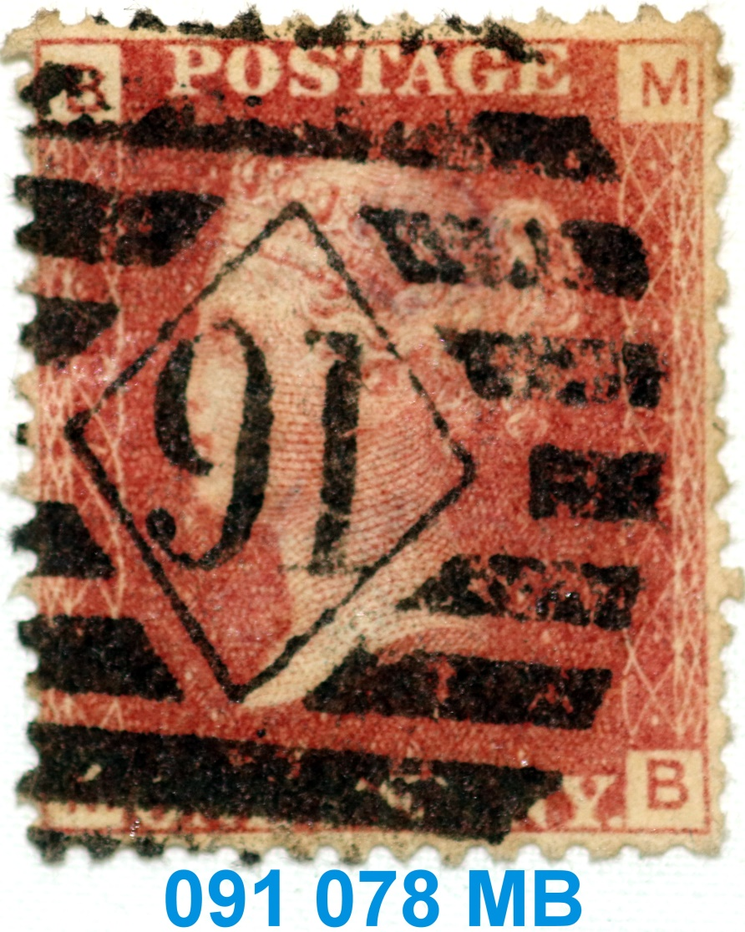
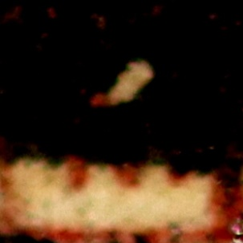
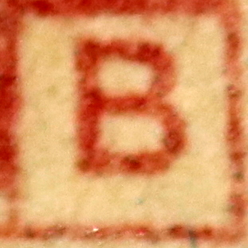
Location of corner letters
can identify plate number
Reference 078 MB

Slide 12
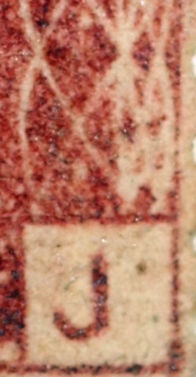
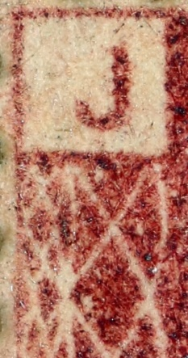
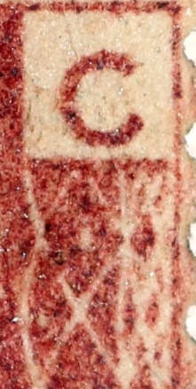
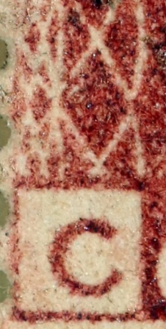
Three Scanning Areas
Resolution: 224x224 each

Slide 13
Testing
30,000 Plate ID digital photos
21,000 Scanned
9,000 tested against scans
Result First Test
151 Plates: 88.9 % Accuracy
8001 out of 9000

