Slide 1
A PASSION AND COLLECTION
SPANNING 70 YEARS
BY
REINHARD DANGER
Developed May 2024

Slide 2
The year was 1953.
I was 7 years old.
I received my first Stamp and rest is History….
*Encouraged by History Teacher, Mr. Poulsen, in Denmark, because he knew I loved history and geography.
*My first Stamp was a Danish Stamp with King Frederik IX.

Slide 3
Why Do I Enjoy Stamp Collecting?
*I love to research different Countries, see what is on the Stamp and what the Stamp is telling me.
*My first Stamp had the face of a King on it, so I researched who he was, why he was King, what about his family etc.
*Another example, while I was still living in Denmark, my first Stamp from another Country, was American. It was an airmail 15 cent Stamp, with a plane on it. I researched the plane, named a C28.
*I learned the year it was used and where it came from etc.
*What did I do with my first Stamps? I GLUED them into a notebook!! Remember, I was only 7!

Slide 4
Which Stamps do I Collect?
*In the beginning I collected anything I could, but focused on Denmark.
*Then I moved to German Stamps because they were easily accessible.
*Then moved to collecting Scandinavian Countries.
*When I lived in Switzerland, I collected Stamps from there.
*When I came to the US, of course I wanted to get those Stamps.
*Before Countries actually became Countries, I collected Colonies.
*Now, even today, I collect from any Country.

Slide 5
How do I Choose?
*There is no way I could collect all Stamps from all Countries.
*When I find a Stamp interesting, by the way it looks, colors, the way it is designed and what is on it, I will begin to research it.
*Then I will keep it in my collection to study it further.

Slide 6
Where do I find Stamps for my Collection?
*I visit Antique Stores to check out post card collections and Stamp collections.
*If I find a Stamp of interest, on a postcard, I will remove it and add it to my collection.
*When I travel, I will visit the local Post Offices.
*I have been gifted collections.
* Being a member of the Rochester Philatelic Association, there are always opportunities to share, trade or purchase Stamps that interest me.

Slide 7
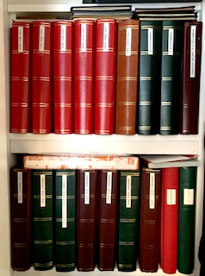
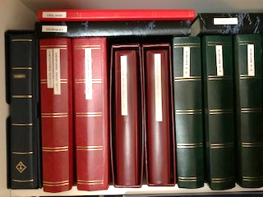
Welcome to My Inventory…

Slide 8
UNITED STATES OF AMERICA
6 Stock Albums, 64 pages each
  Dating from 1861 through and including 2020
  Organized by Catalog
  Including Hawaii, Panama Canal, Puerto Rico and Philippines
Small Stock Album, 24 pages
  Assorted First Day Covers
  Envelopes and Cards
Special Albums
  Kennedy Memorial Album
  American Commemorative Album 1893 – 1965
  First Day Album Covers 1979 – 1981
  Assorted First Day Album Covers 1945 - 2016

Slide 9
UNITED NATIONS
Special Album
  1951 – 1965
  Organized by Catalog
Large First Day Album
  1959 – 1971
  Organized by Catalog

Slide 10
CANADA
1 Stock Album, 64 pages
  Including Saint Pierre et Miquelon
  Organized by Catalog

Slide 11
AMERICAS
3 Stock Albums, 64 pages each
  Countries in alphabetical order
  United Nations Stamps
6 Brazil Annual Stamp Albums
  1981 – 1985
2 Very Large Nicaraguan Stamp Albums
  1890 – 1976 all hinged
  Organized by Catalog

Slide 12
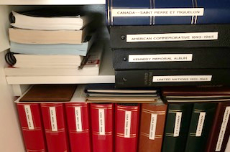
DENMARK
  3 Stock Albums, 64 pages each
    1860 - 2020
  Including 30 years of annual Christmas Stamp sheets
  Organized by Catalog
10 Small First Day Cover Albums
  1979 – 1995
1 Large Album, 24 pages
  Greenland
  Iceland
  Danish Virgins Islands
  Faroe Islands
  Organized by Catalog

Slide 13
GERMANY
  7 Stock Albums, 64 pages each
  1849 – 2020
  Including:
    East Germany (2)
    Berlin
    Colonies
    Old German States
1 Stock Album Danzig, 16 pages
    1920 - 1939
    Organized by Catalog

Slide 14

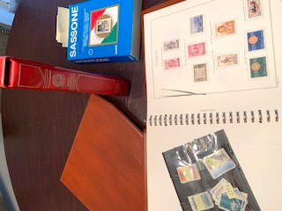
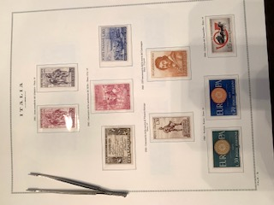
ITALY
3 Stock Albums, 64 pages each
  Including Old Italy, Colonies
  1850 – 2020
  Many years complete
  Organized by Catalog
2 Preprinted Hingeless Albums Republic Italiana
  From 1955 – 1995 Complete
  New individual and never hinged Stamps

Slide 15
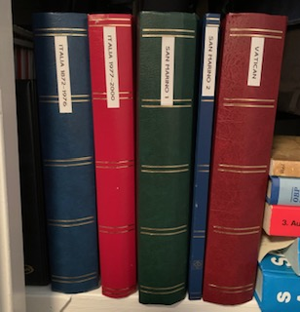
Vatican / San Marino
Vatican
  1 Stock Album, 64 pages
  1930’s – 2020 assorted
  Complete 1959 -2000
  Organized by Catalog
San Marino
  1 Stock Album, 64 pages
  1 Stock Album, 24 pages
  1920’s – 2020 assorted
  Complete sets from 1947 – 2020
  Organized by Catalog

Slide 16
EUROPEAN COUNTRIES
4 Stock Albums, 64 pages each
  1800’s – 2020
  Alphabetical order, A – U and France
  Organized by Catalog

Slide 17
ADDITIONAL EUROPEAN COUNTRY ALBUMS
AUSTRIA
  1 Stock Album, 24 pages
  1800’s – 2020 assorted
NORWAY
  1 Stock Album, 36 pages
  1800’s – 2020 assorted
  Organized by Catalog

Slide 18
ADDITIONAL EUROPEAN COUNTRY ALBUMS
FINLAND
  1 Stock Album, 24 pages
  1917 – 2020 assorted
  Organized by Catalog
SWEDEN
  1 Stock Album, 48 pages
  1800’s – 2020 assorted
  Organized by Catalog

Slide 19
ADDITIONAL EUROPEAN COUNTRY ALBUMS
HUNGARY
  1 Stock Album, 36 pages
  1800’s – 2020 assorted
SWITZERLAND
  1 Special Album, 90 pages
  1862 – 1966
  Organized by Catalog

Slide 20
ADDITIONAL EUROPEAN COUNTRY ALBUMS
UNITED KINDOM
  1 Stock Album, 36 pages
    1800’s – 2020 assorted
    Includes Gibraltar and Guernsey
  1 Stock Album, 30 Pages
    Coronation Issue 1937
    All new, never hinged Stamps
    Queen Elizabeth and King George VI
      All British Colonies (45)
    Newfoundland. King George VI (11)
    Coronation Issue 1937 King George VI. All British Colonies

Slide 21
ADDITIONAL EUROPEAN COUNTRY ALBUMS
UNITED KINDOM
  Coronation Issue Queen Elizabeth II 1953
  All British Colonies (58), 44 Assorted
Peace Issue 1945 -46
  King George VI and Parliament Buildings, London
  All British Colonies (45)
Many assorted Victory Issues 1946
Winston Leonard Spencer Churchill
  1874 – 1965
  All British Colonies (45)
  Many other Colonial Stamps
80th Birthday of HM Queen Elizabeth the Queen Mother
  All British Colonies (30)

Slide 22
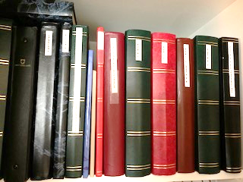
ASIA
JAPAN
  1 Stock Album, 24 pages
  1880’s – 2020
  1 Album postage Stamps of Japan
  Organized by Catalog
SOLOMAN ISLAND
  Special Book, 45 pages
  The Americas Cup in Stamps 1987
  Organized by Catalog

Slide 23
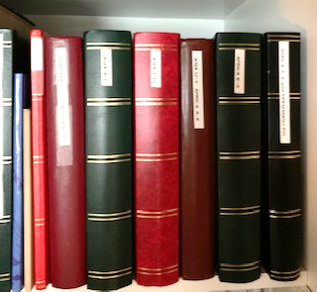
ASIA cont..
ASIAN COUNTRIES
  3 Stock Albums, 64 pages each
  1800’s – 2020
  Alphabetical Order A – Y
AUSTRALIA – SOUTH PACIFIC ISLANDS
  1 Stock Album, 64 pages
  1800’s – 2020 assorted

Slide 24
AFRICA
  2 Stock Albums, 64 pages each
    1880’s – 2020 assorted
    Alphabetical Order A - Y
    Colonies and Countries

Slide 25
NOTES
Stamps Organized by Catalogs
  Italy
  Vatican
  San Marino
  Denmark, Iceland, Faroe Islands, Greenland, Danish Virgin Islands
  Germany
  Scandinavian and Baltic Countries
  USA, Mexico, Canada

Slide 26
IN CLOSING
  *I am no longer collecting Stamps issued after 2020.
  *I am focusing on completing missing sections of my current collection.
  *I always want to continue to learn something new, so if I find something interesting, I will study it and may keep the Stamp or may pass it along.
  *Friends and Family will send me Stamps from many location around the world.
  *During the year I may collect Stamps and put them in a box.
  *It is my winter hobby, I move all items I have collected over the year and take over the dining table to sort.
  *I want to thank my wife, Pamela for supporting me in my passion of collecting and researching.

Slide 27
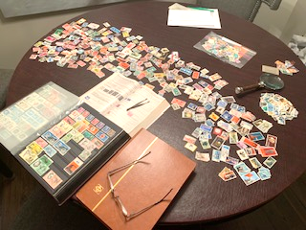
THANK YOU!
QUESTIONS / COMMENTS

