Slide 1
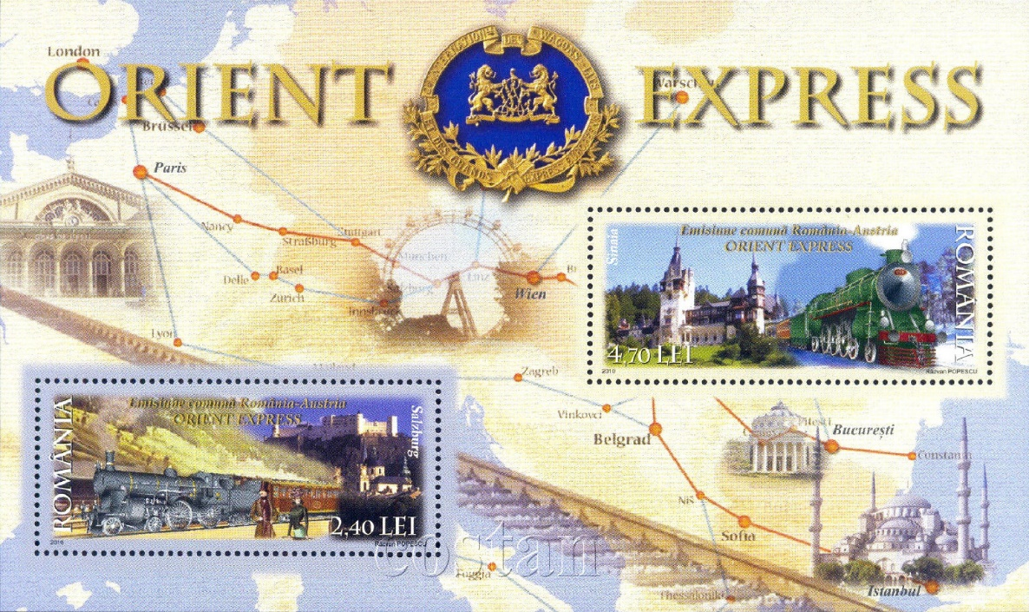
THE
ON STAMPS
by Luis Greiff, Jr.
for the Rochester Philatelic Association, January, 2018

Slide 2
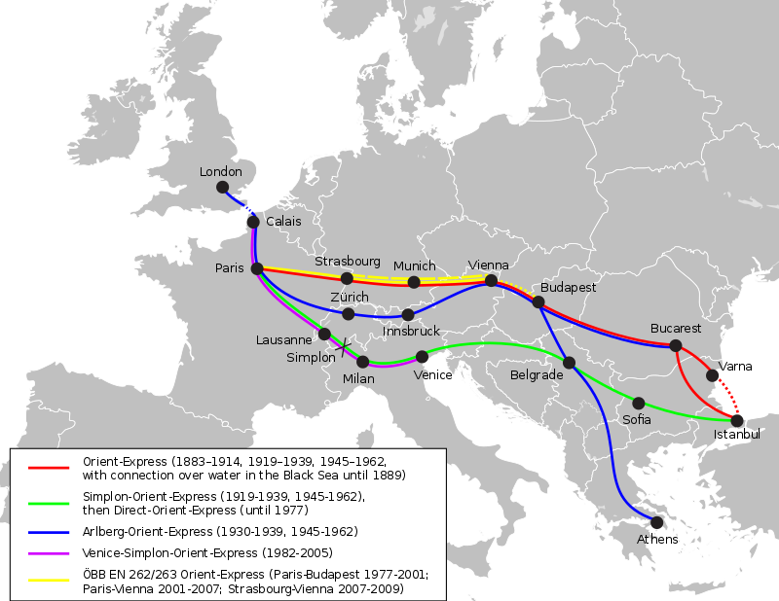
Perhaps the most famous train
in both reality
and fiction, the Orient Express
ran through Europe’s
greatest
cities.

Slide 3
This presentation is just a small sample of the stamps and souvenir sheets depicting the many facets of the Orient Express.
Pages are presented in alphabetical order of the issuing country.

Slide 4
Austria

Slide 5
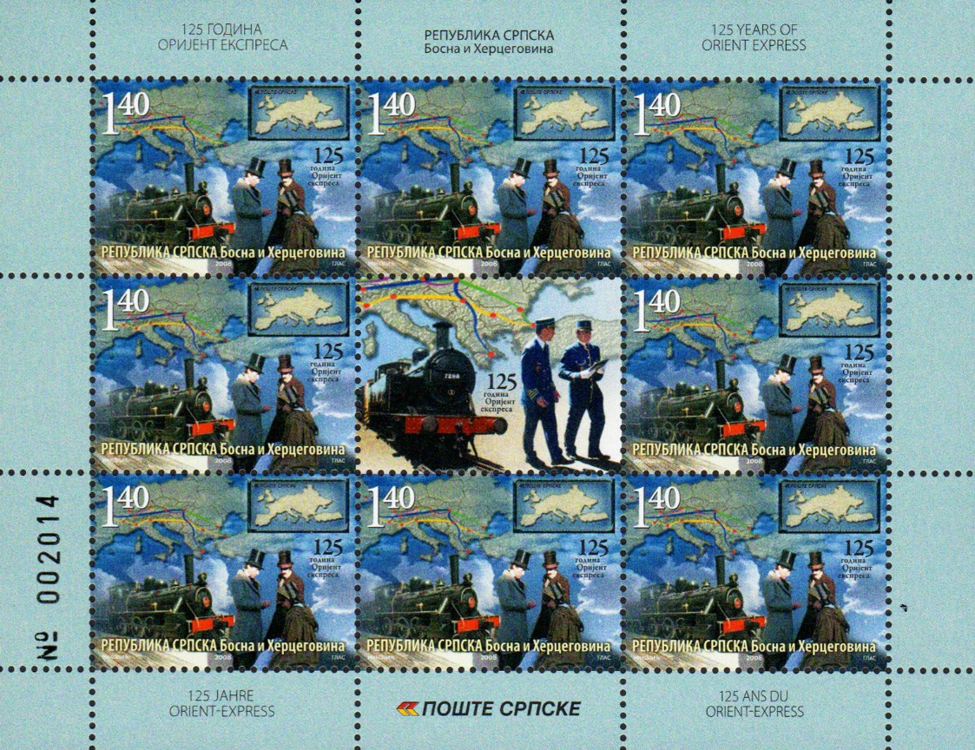
Bosnia & Herzegovina (Serbia Adm.)

Slide 6
Bulgaria

Slide 7
Chad

Slide 8
Congo (Democratic Republic)

Slide 9
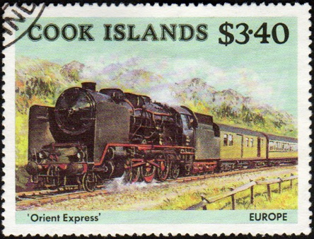
Cook Islands

Slide 10
Cuba

Slide 11
Dominica

Slide 12
France

Slide 13
Great Britain

Slide 14
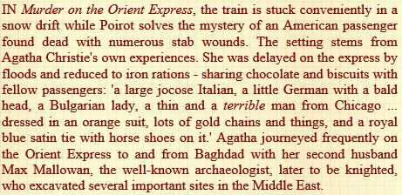
Great Britain

Slide 15
Great Britain

Slide 16
Grenada

Slide 17
Hungary

Slide 18
Ireland

Slide 19
Isle of Man

Slide 20
Lesotho

Slide 21
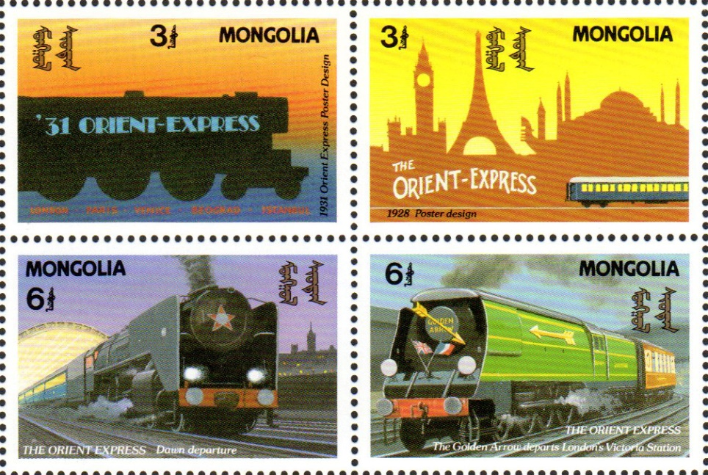
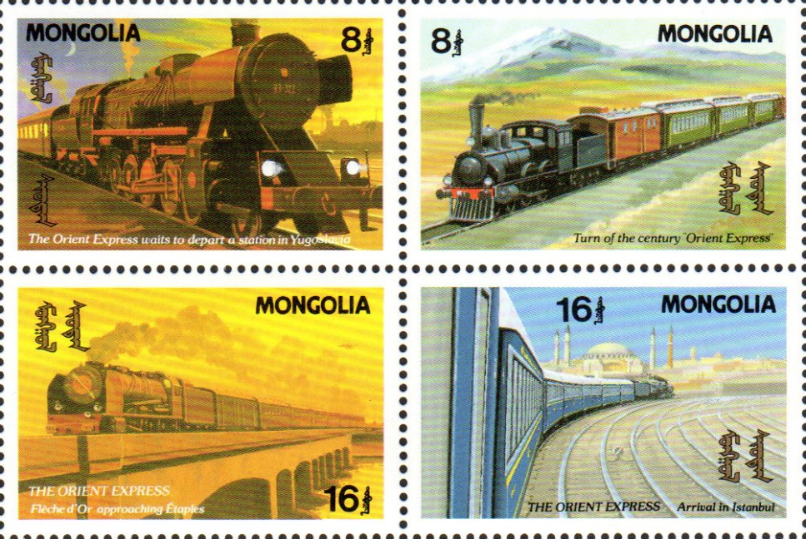
Mongolia

Slide 22
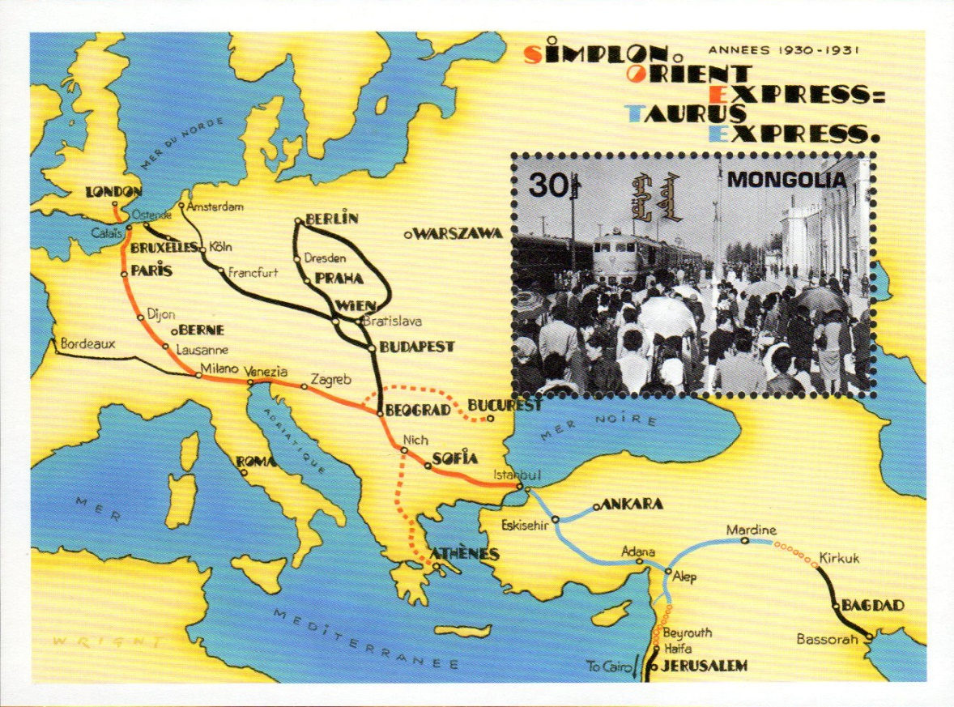
Mongolia

Slide 23
Mongolia

Slide 24
Niger

Slide 25
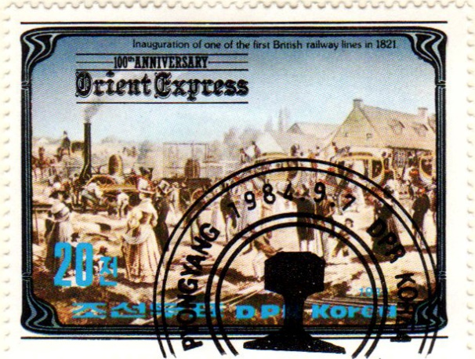
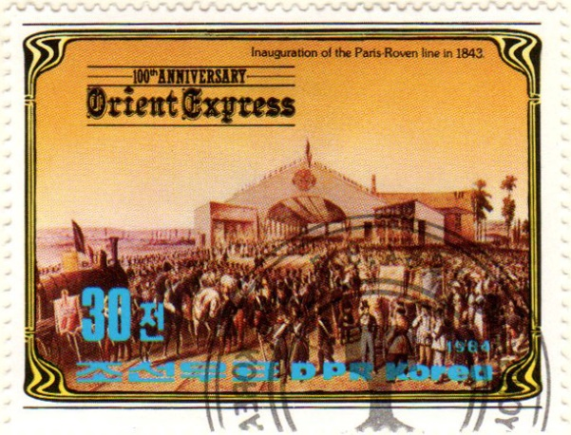
North Korea

Slide 26
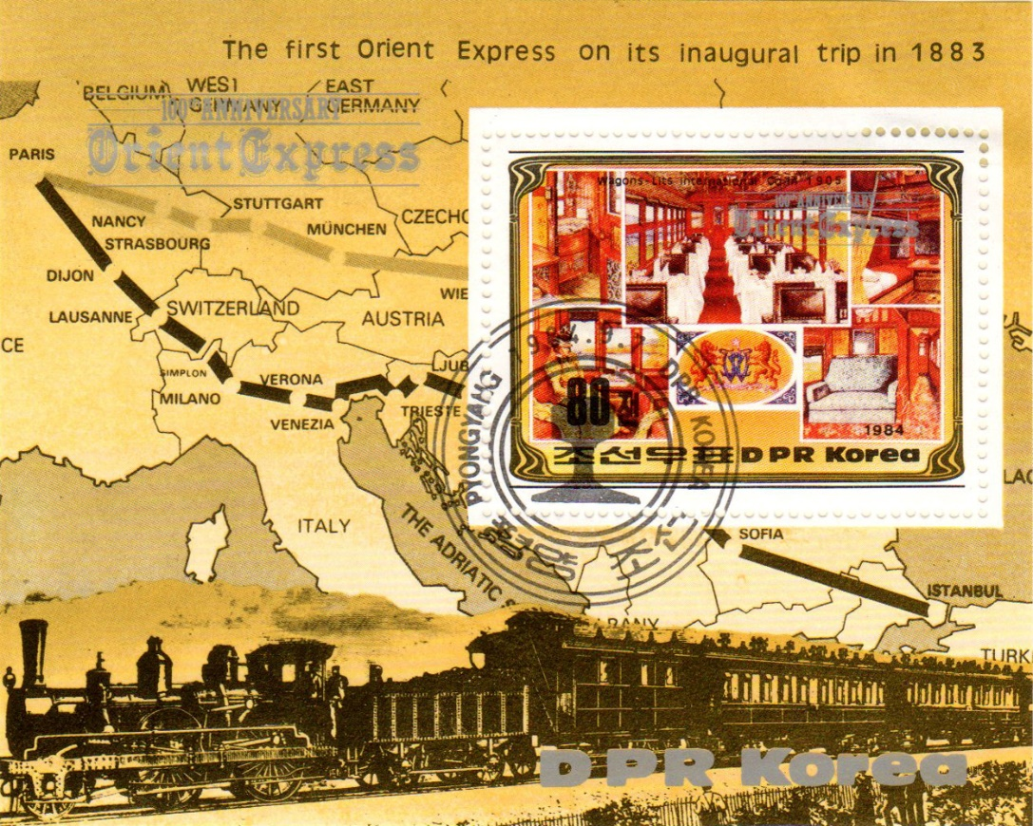
North Korea

Slide 27
Palau

Slide 28
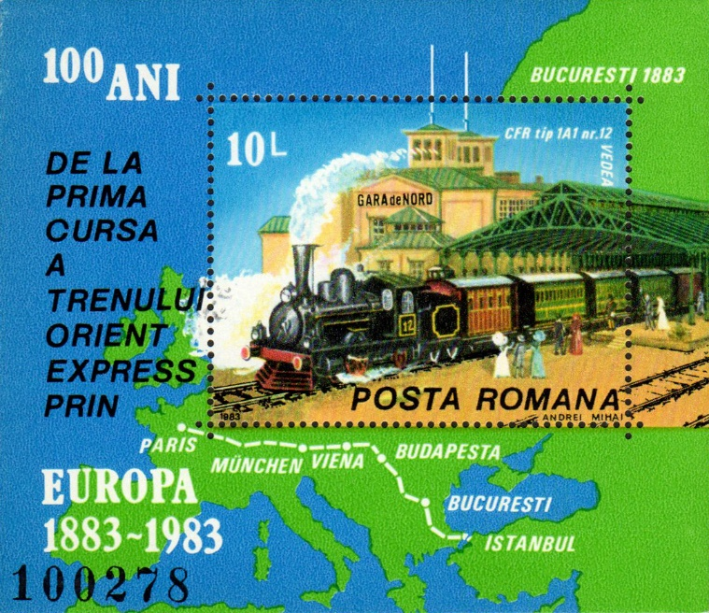
Romania

Slide 29
St. Vincent & the Grenadines

Slide 30
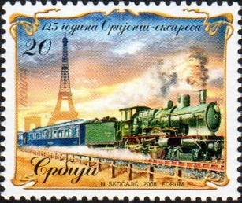
Serbia

Slide 31
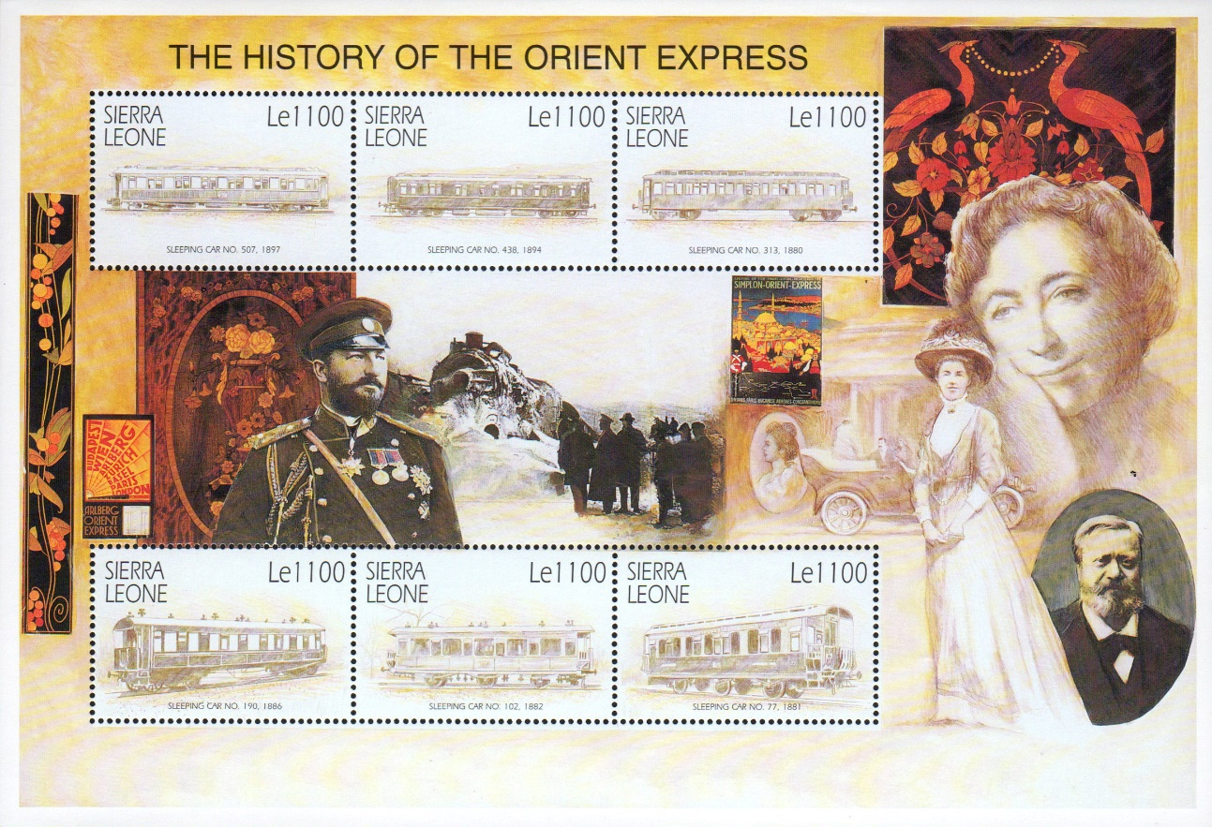
Sierra Leone

Slide 32
Sierra Leone

Slide 33
Sierra Leone

Slide 34
Sierra Leone

Slide 35
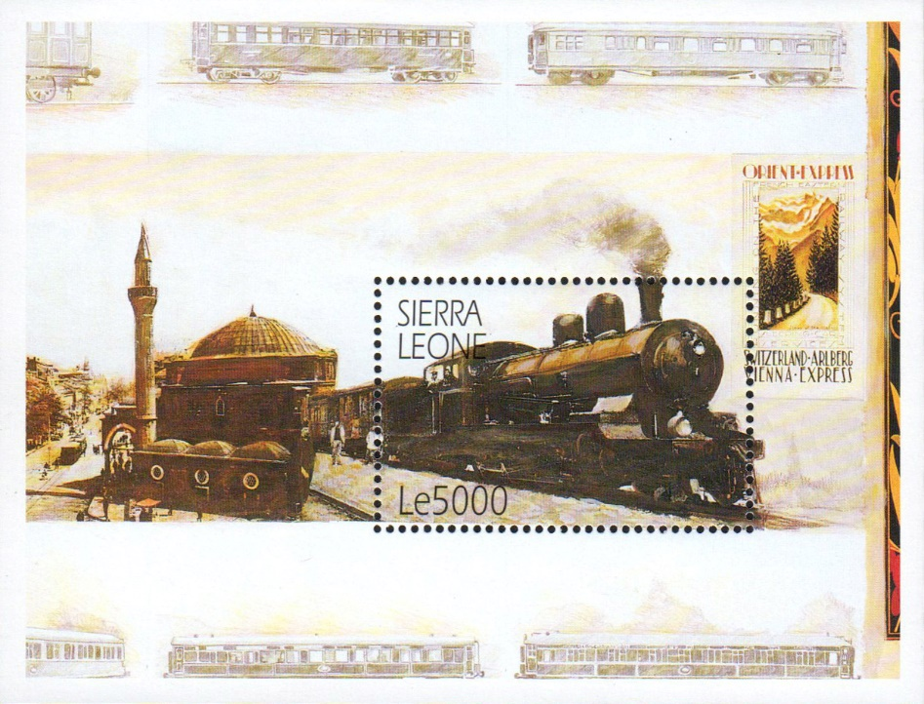
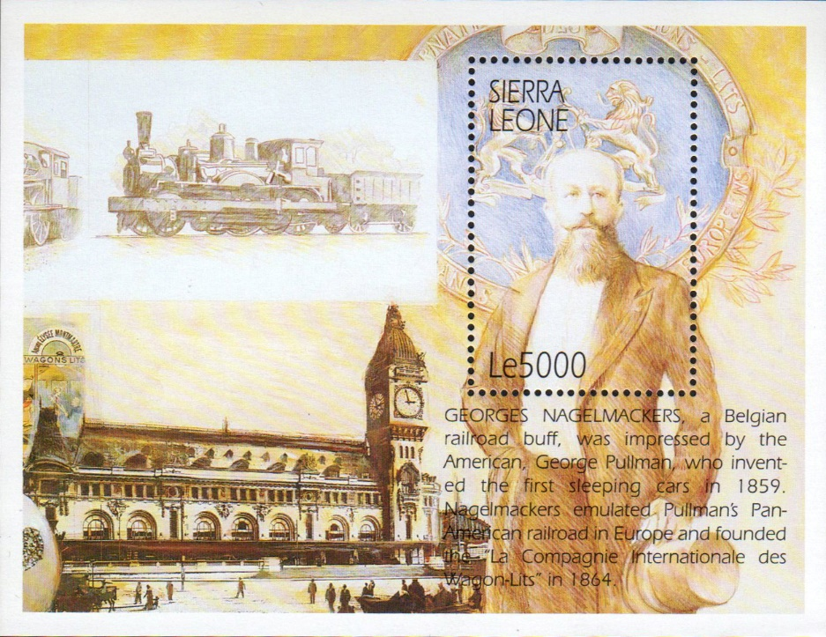
Sierra Leone

Slide 36
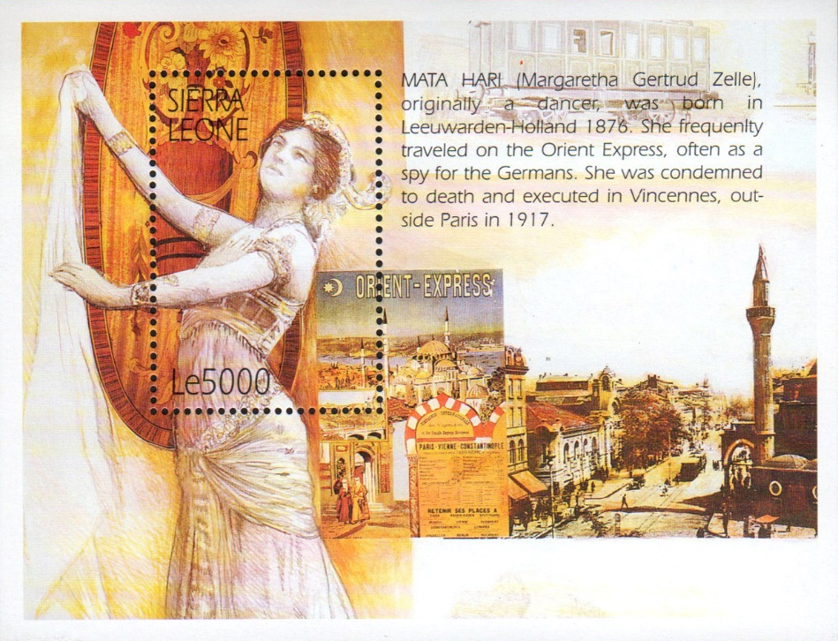
Sierra Leone

Slide 37
Switzerland

Slide 38
Uganda

Slide 39
Uganda

Slide 40
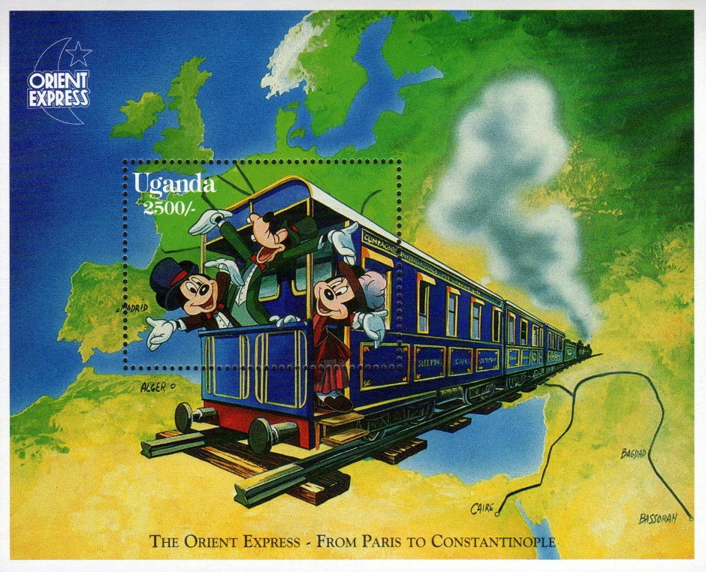
Uganda

Slide 41
Yugoslavia

Slide 42
Yugoslavia

Slide 43
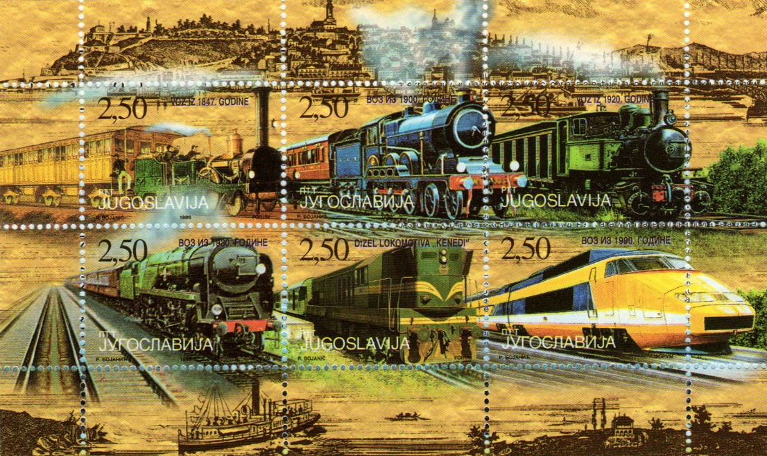
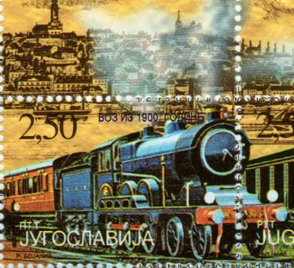
Yugoslavia

Slide 44
Zambia

Slide 45
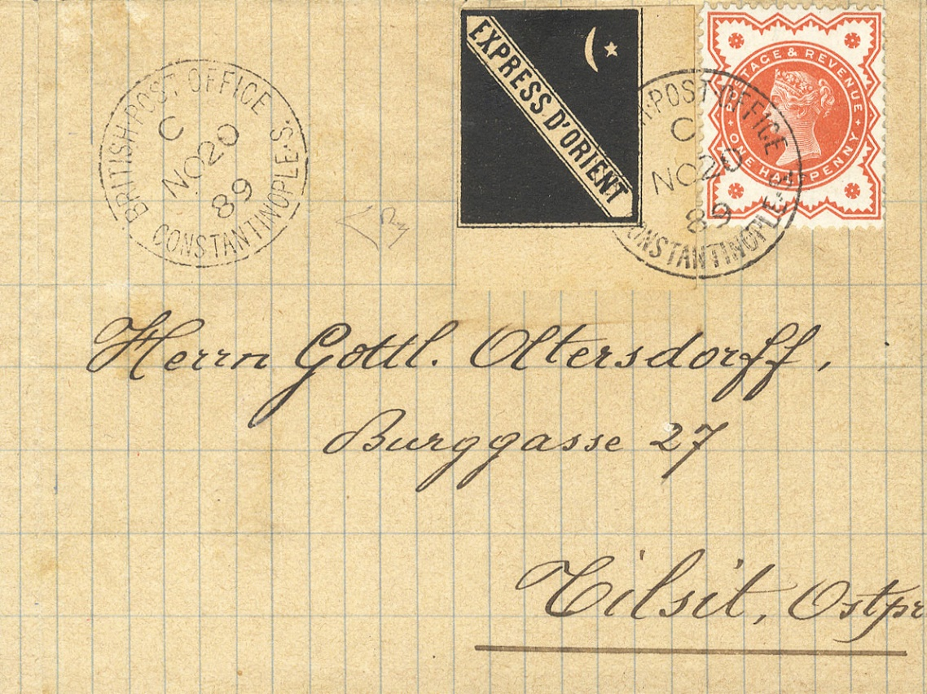
And yes, the Orient Express had its
own stamps!
½ pence postage and additional fee for a
letter sent by the Orient Express, cancelled by
the British Post Office
in Constantinople, Nov.
20, 1889, addressed
to Tilsit (East Prussia)

Slide 46
The End
Design and Layout by
Tom Fortunato

