Slide 1
Confusing, Obscure, Bizarre, and Defunct Countries—Their Coins and Stamps
Steven Eisinger
October 2015

Slide 2
Confusing, Obscure, Bizarre, and Defunct Countries—Their Coins and Stamps
The Problem of the Caucasus

Slide 3
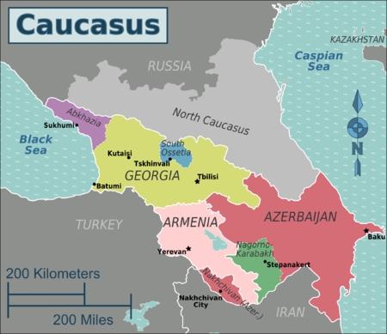

Slide 4
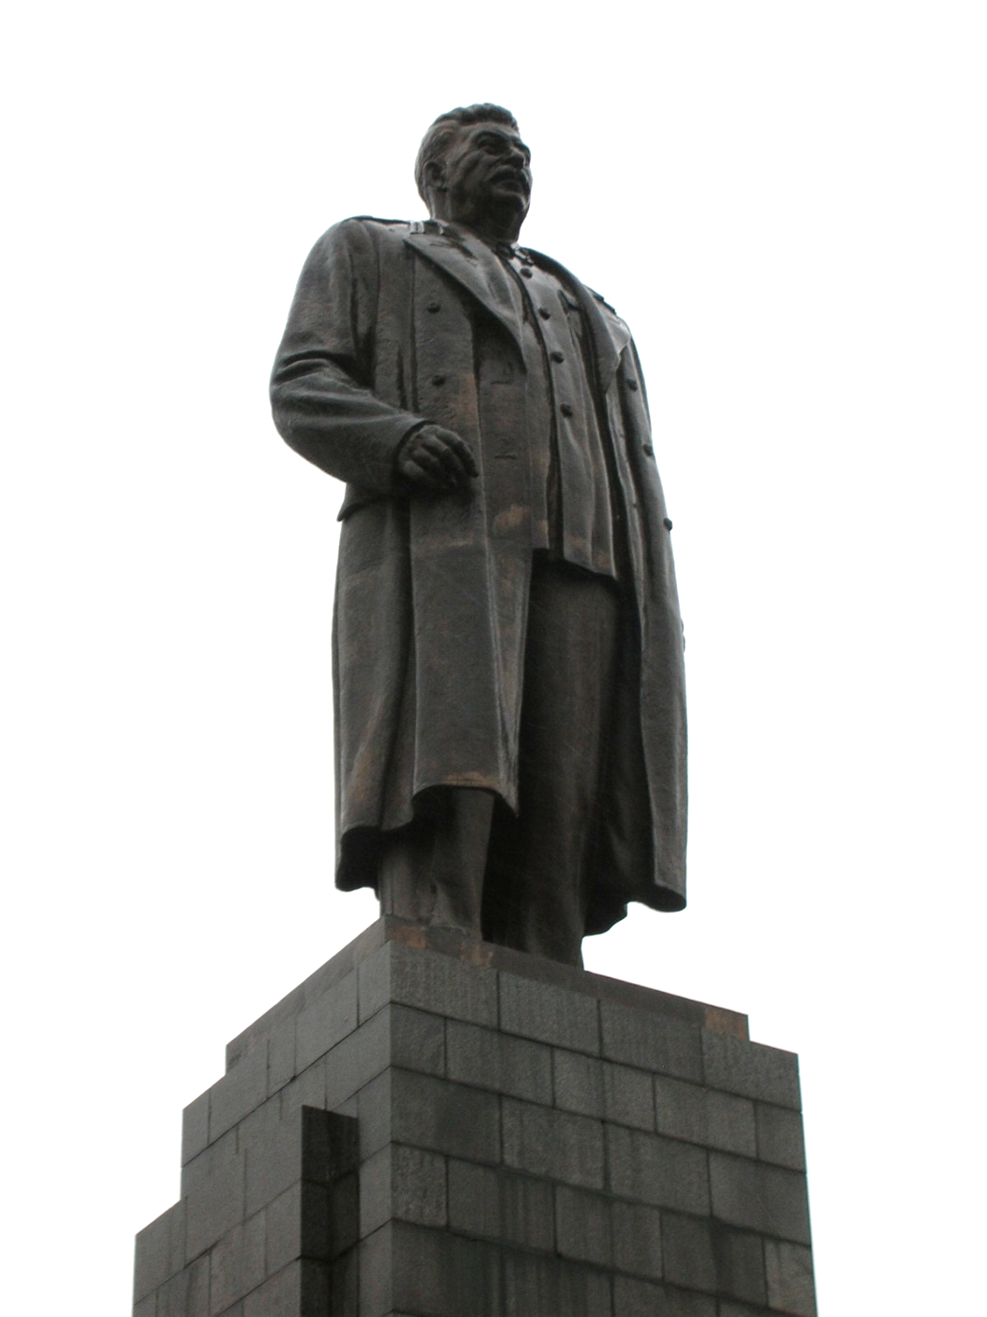
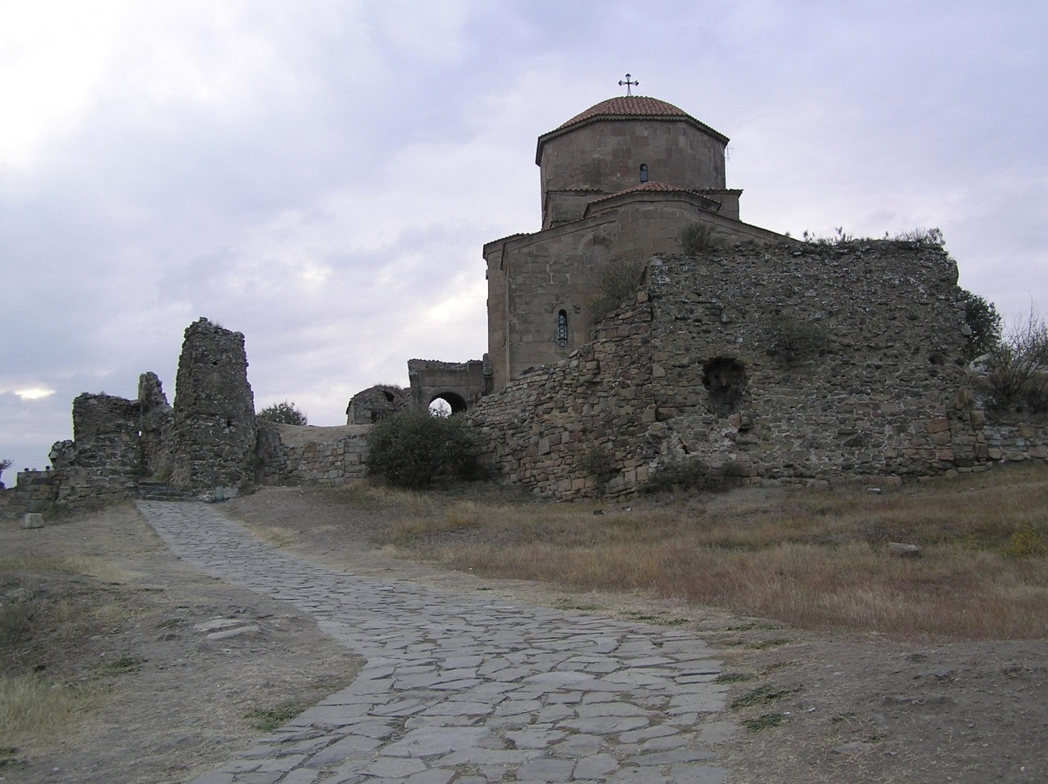
Georgia

Slide 5
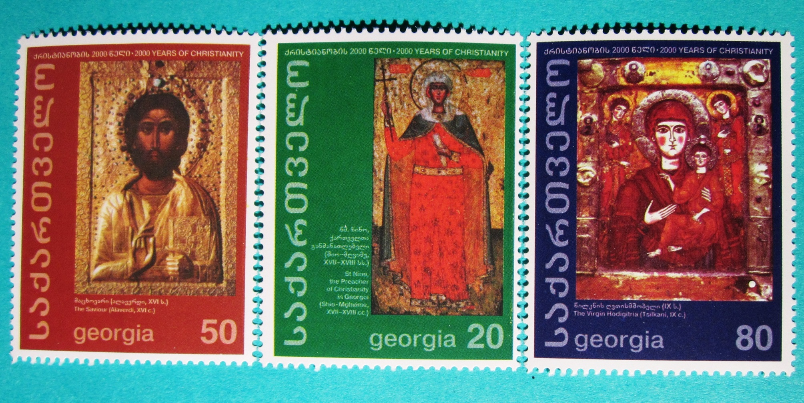
Stamps from Georgia

Slide 6
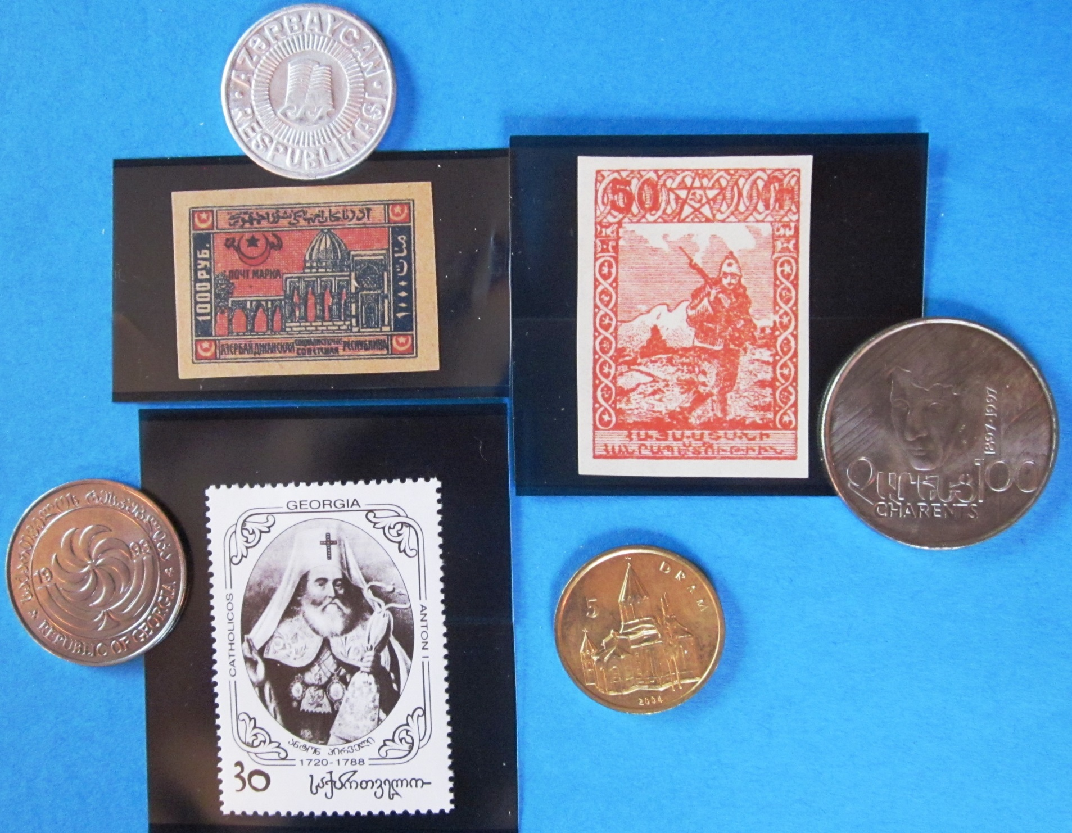
Armenia
Azerbaijan
Nagorno-
Karabakh
Georgia

Slide 7
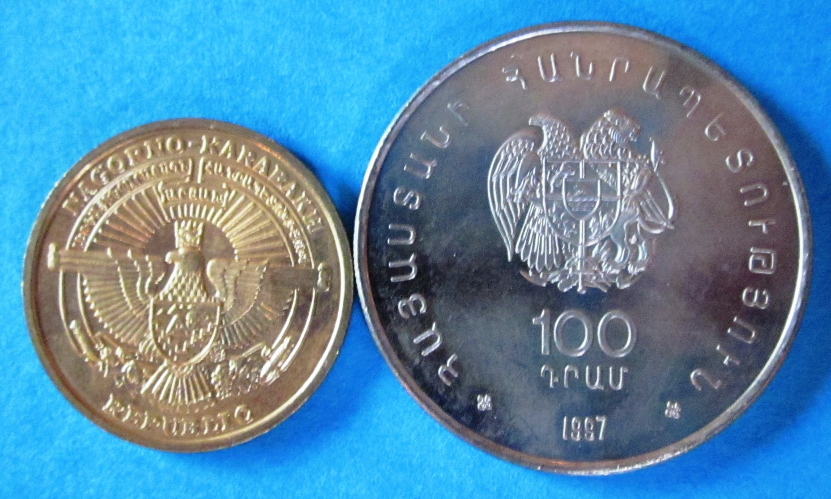
Nagorno
Karabakh
Armenia

Slide 9
Confusing, Obscure, Bizarre, and Defunct Countries—Their Coins and Stamps
The West Africa Problem

Slide 10
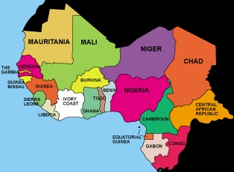
West Africa

Slide 11
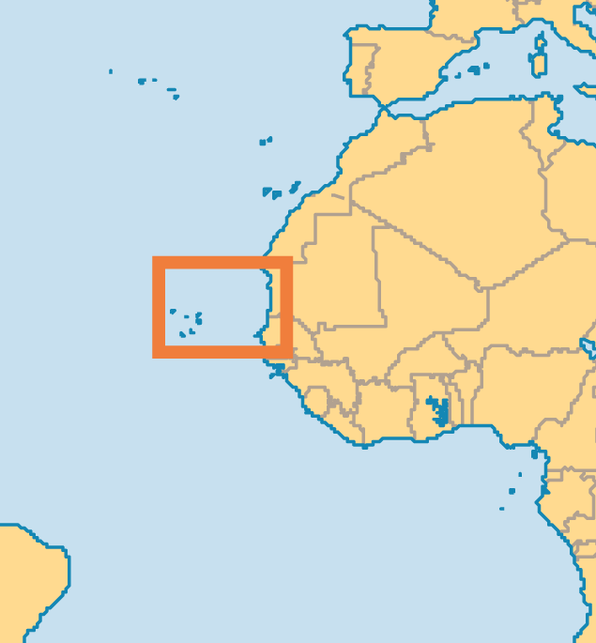
Cape Verde

Slide 12
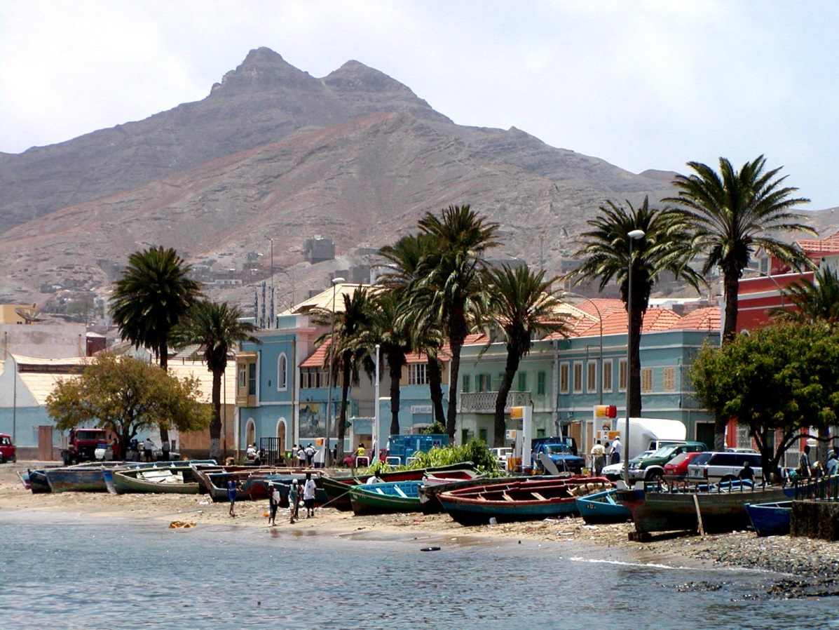
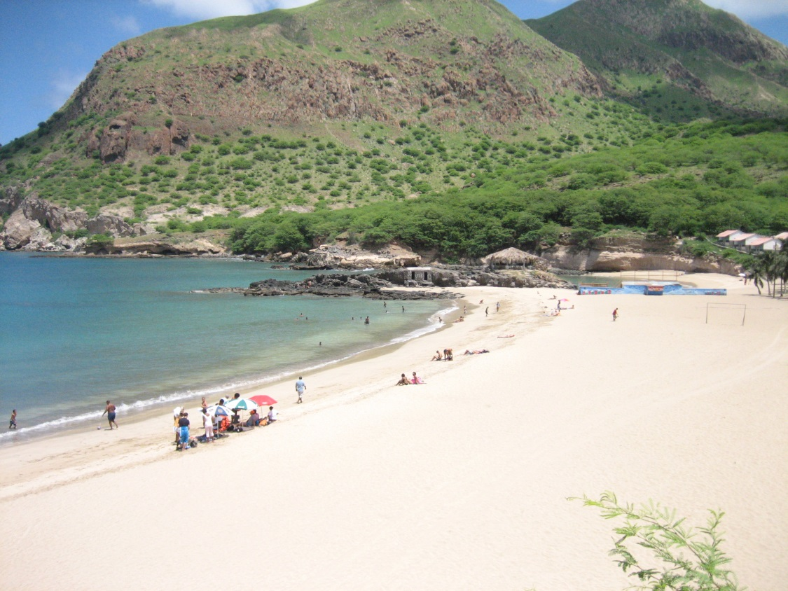
Cape
Verde

Slide 13
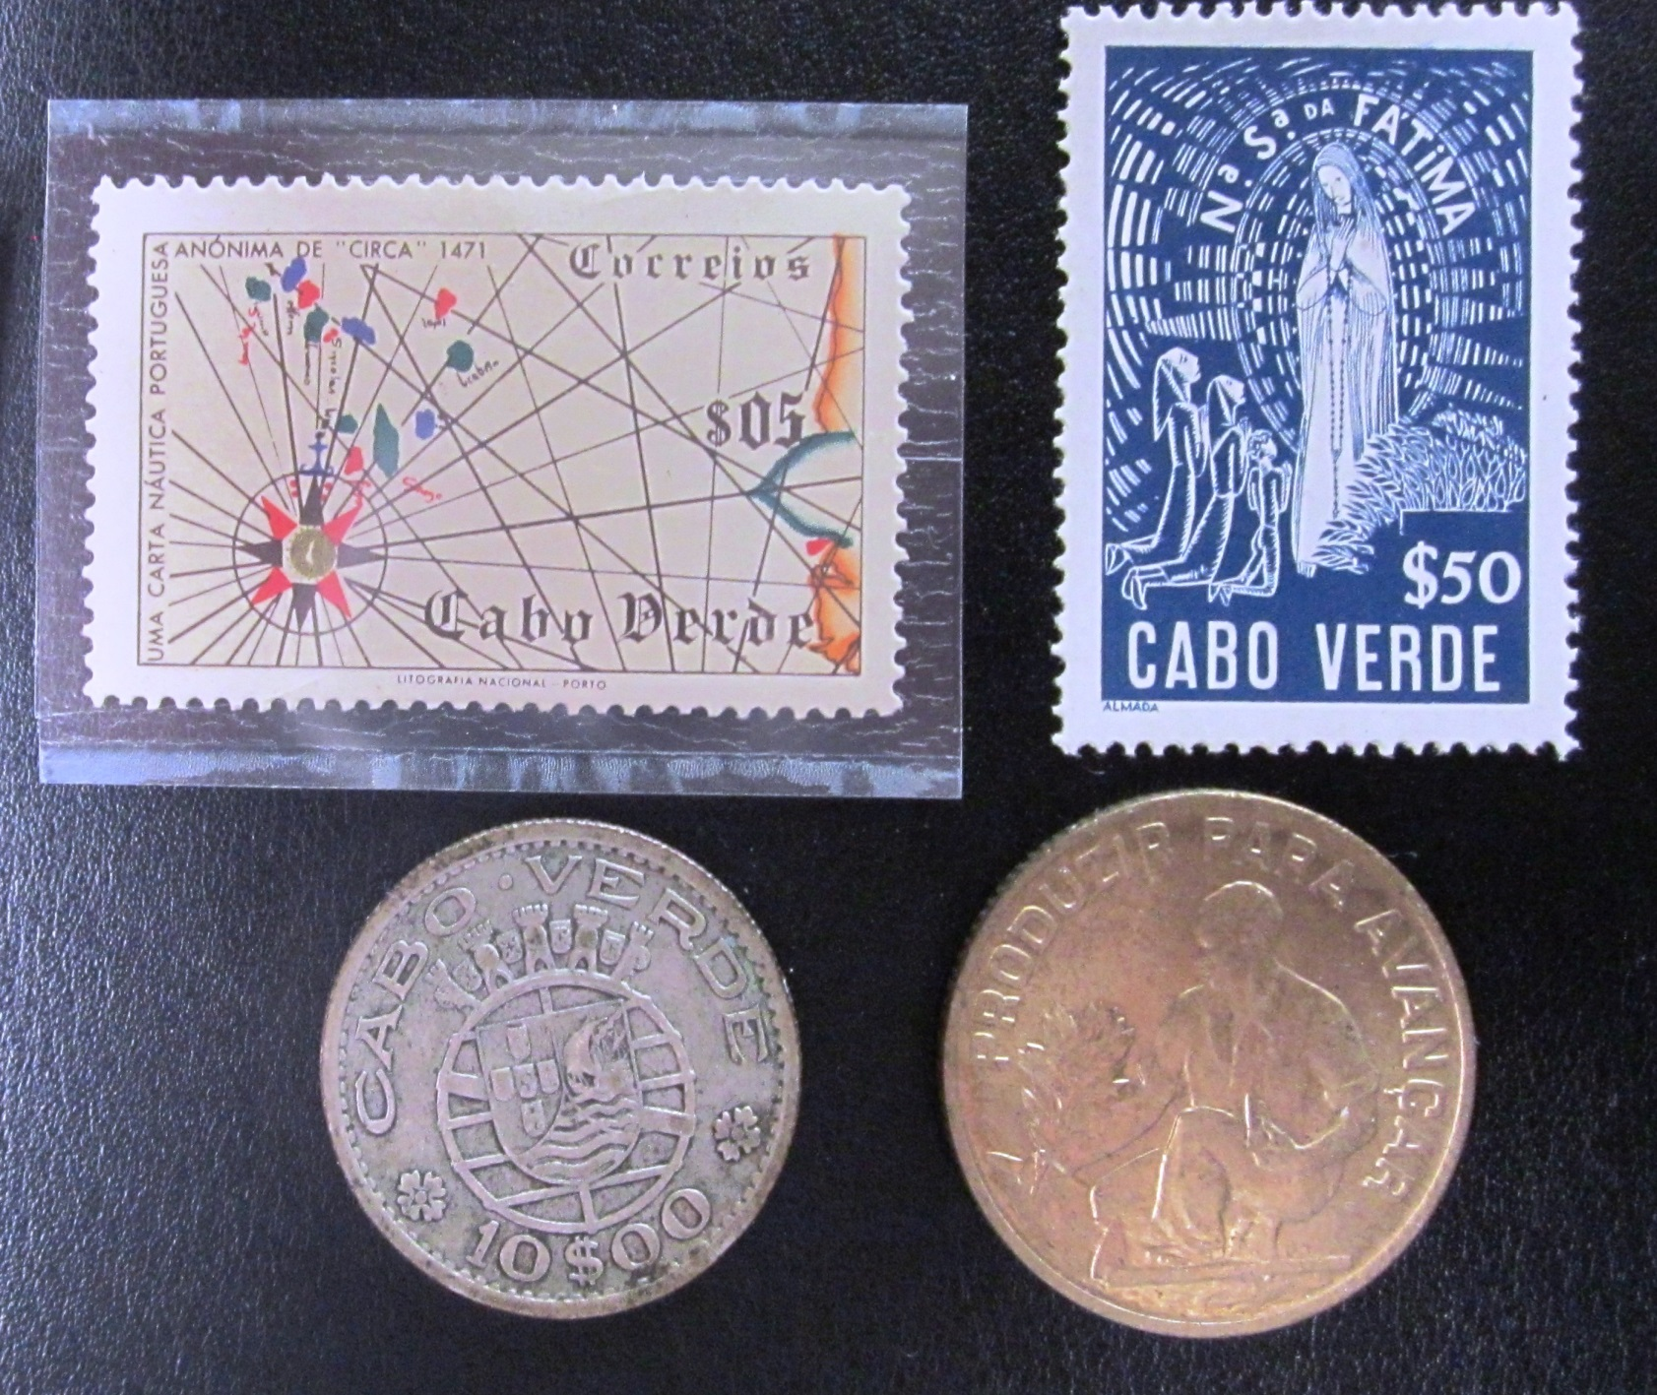
Cape Verde

Slide 14
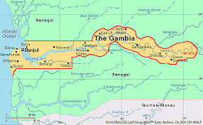
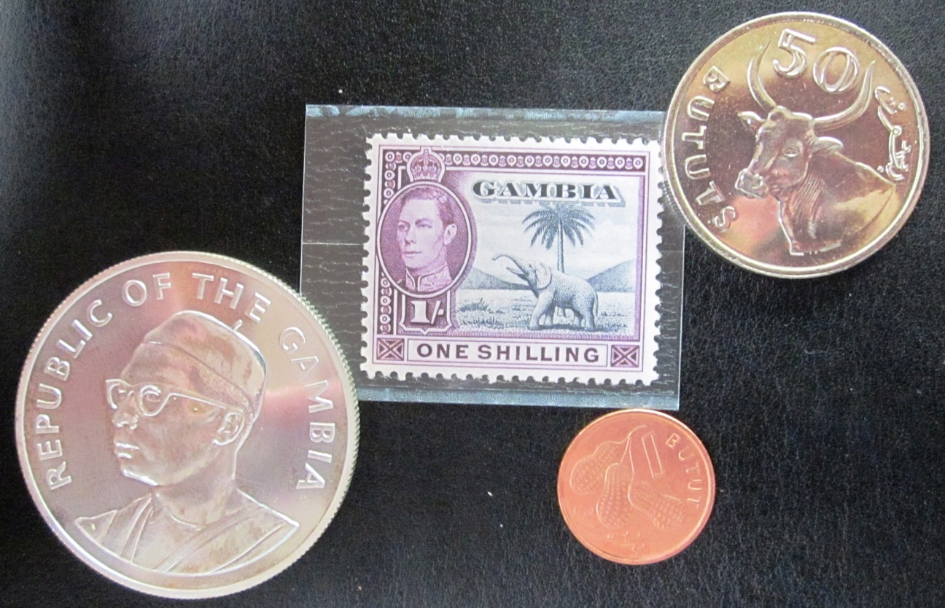
Gambia

Slide 15
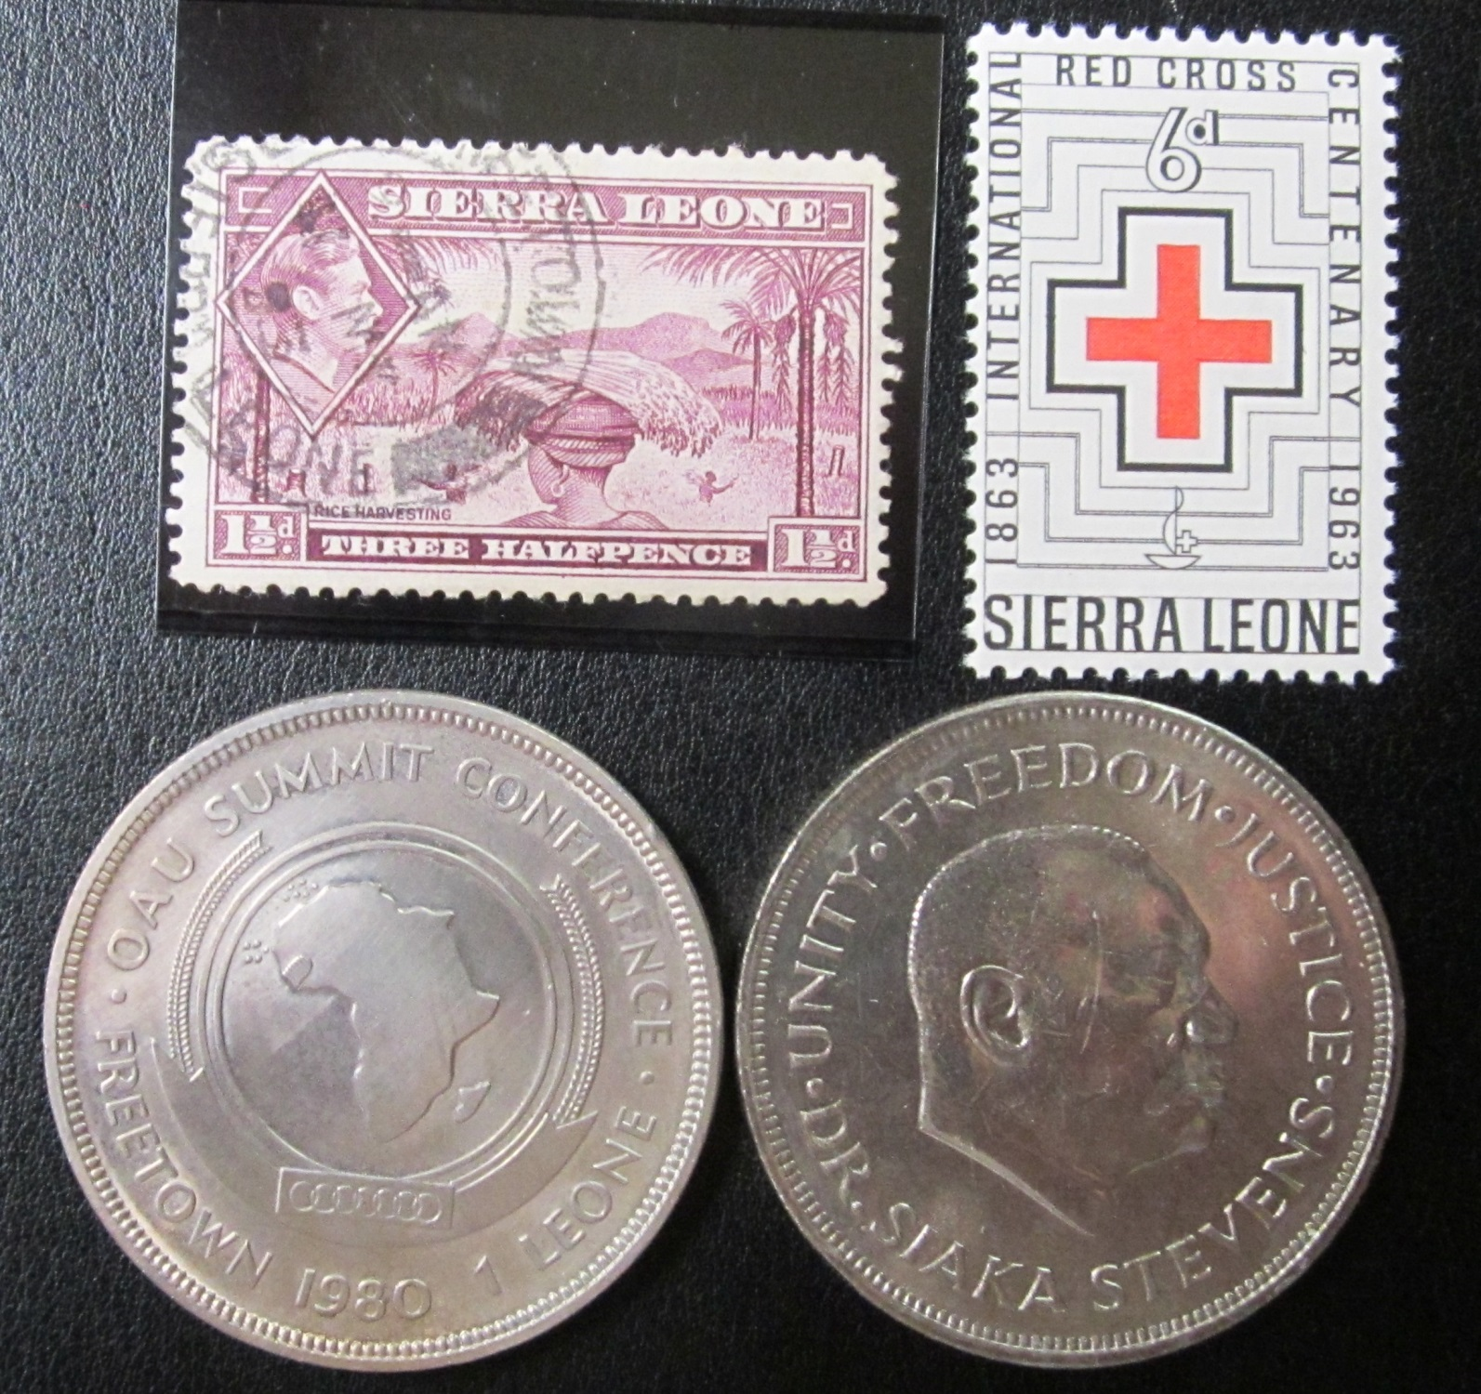
Sierra
Leone

Slide 16
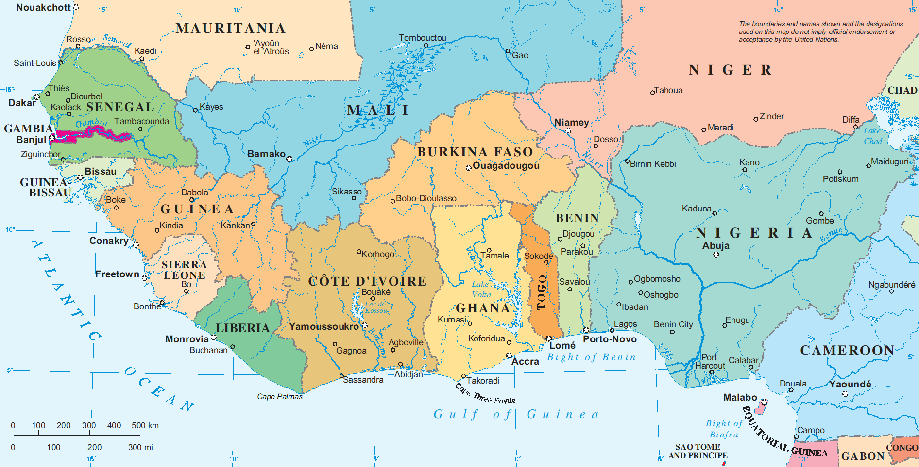
West Africa

Slide 17
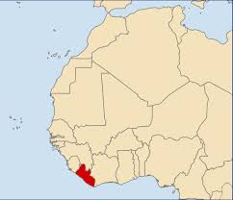
Liberia

Slide 18
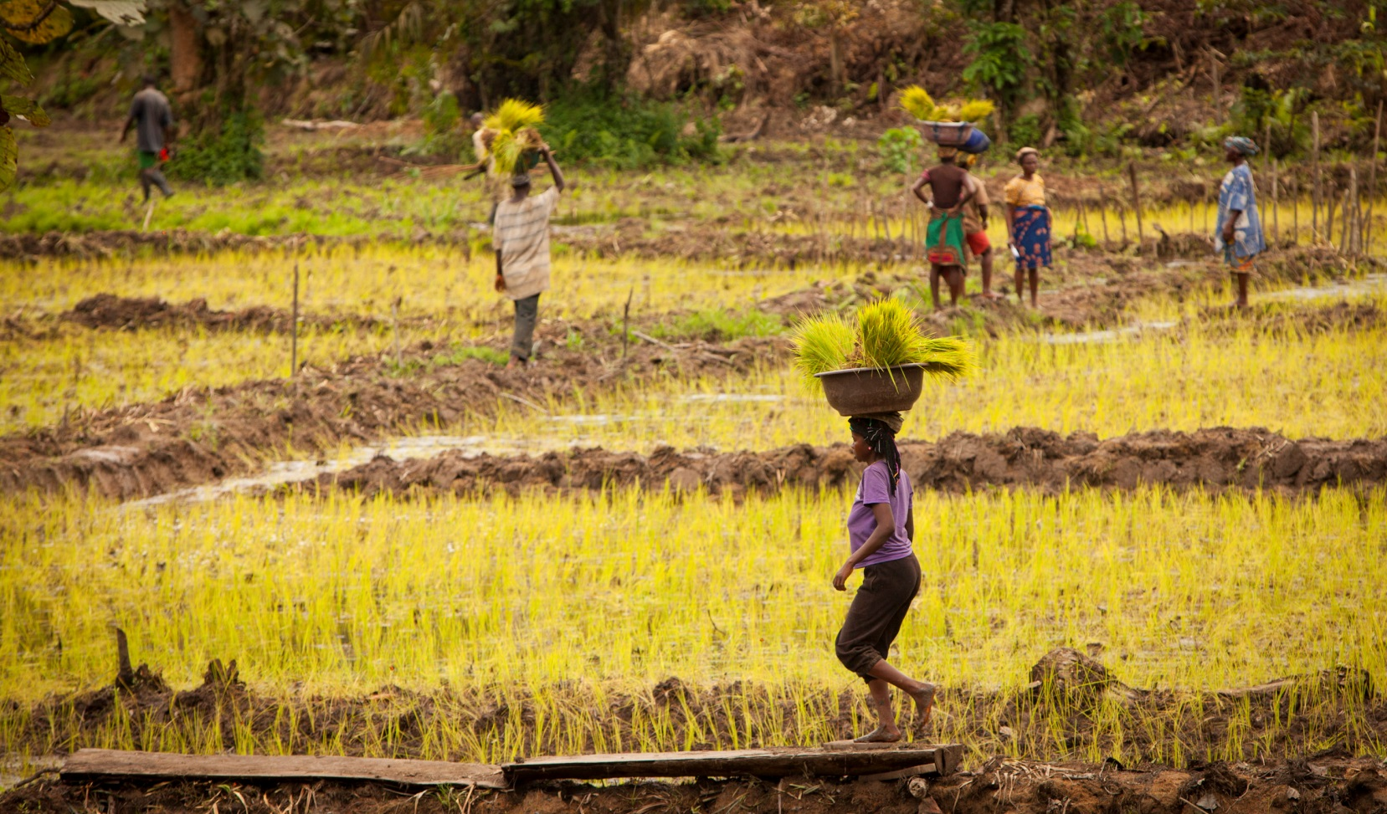
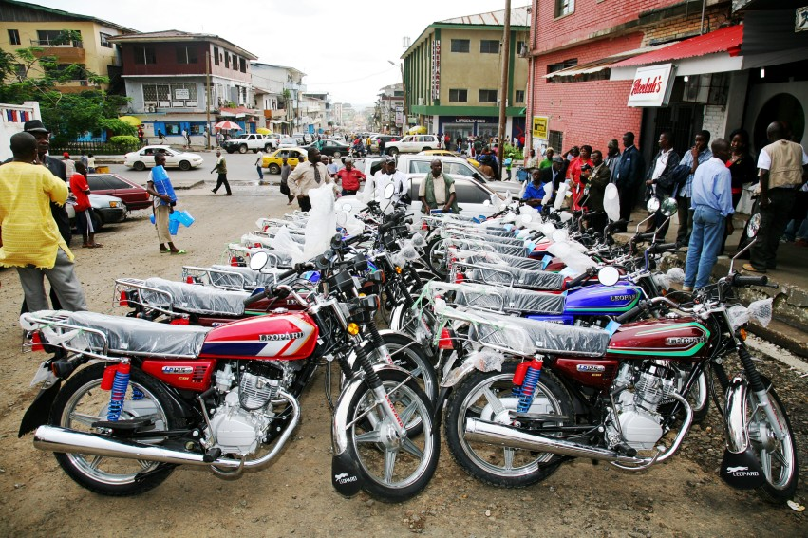
Liberia

Slide 19
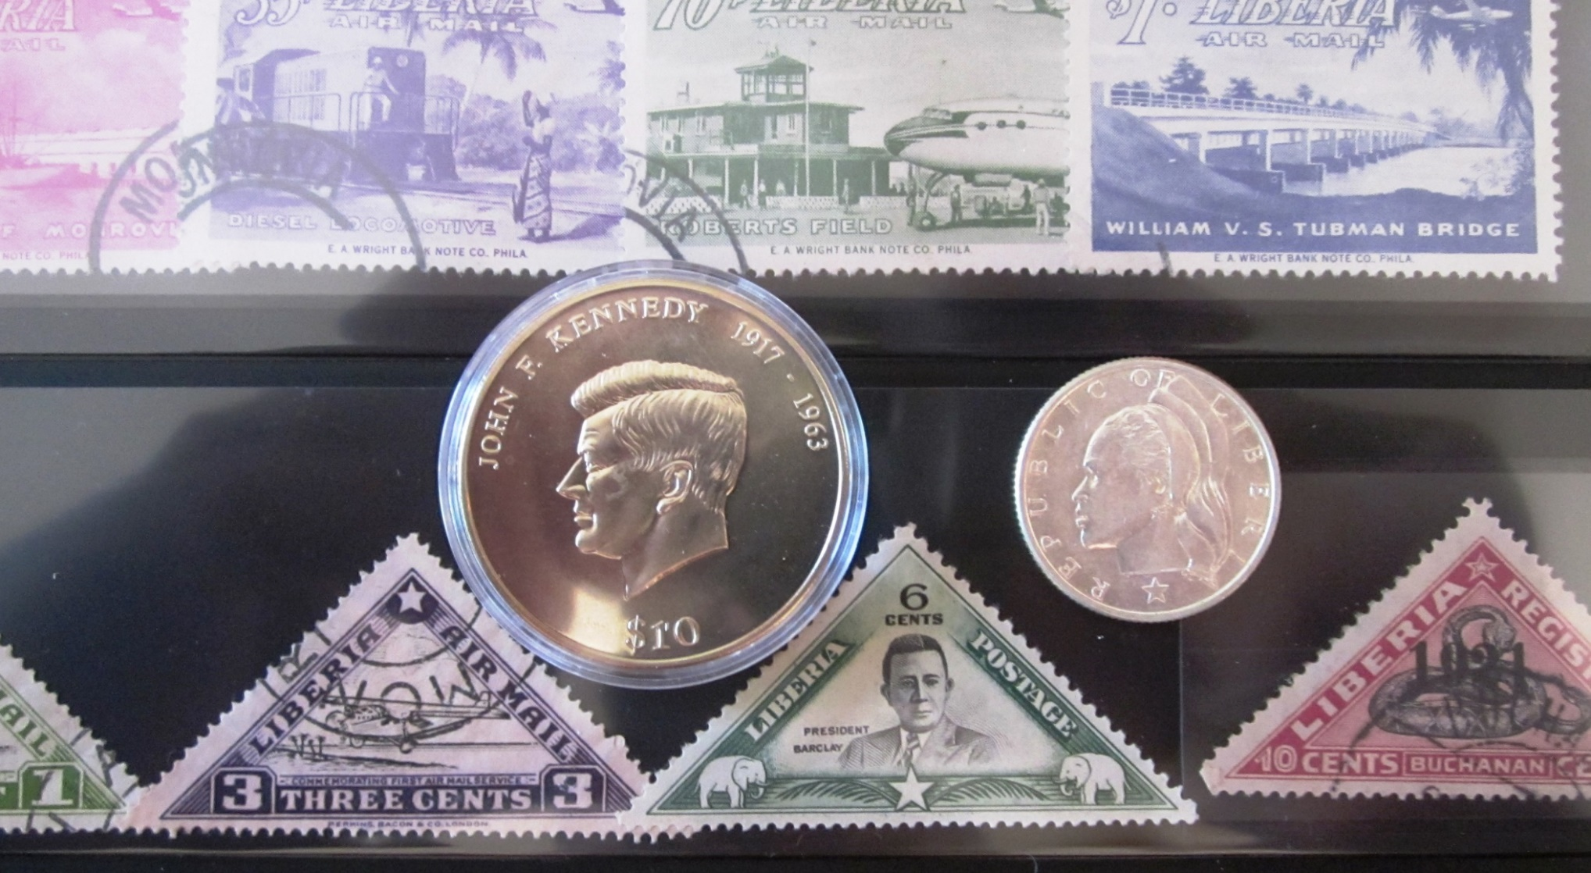
Liberia

Slide 20
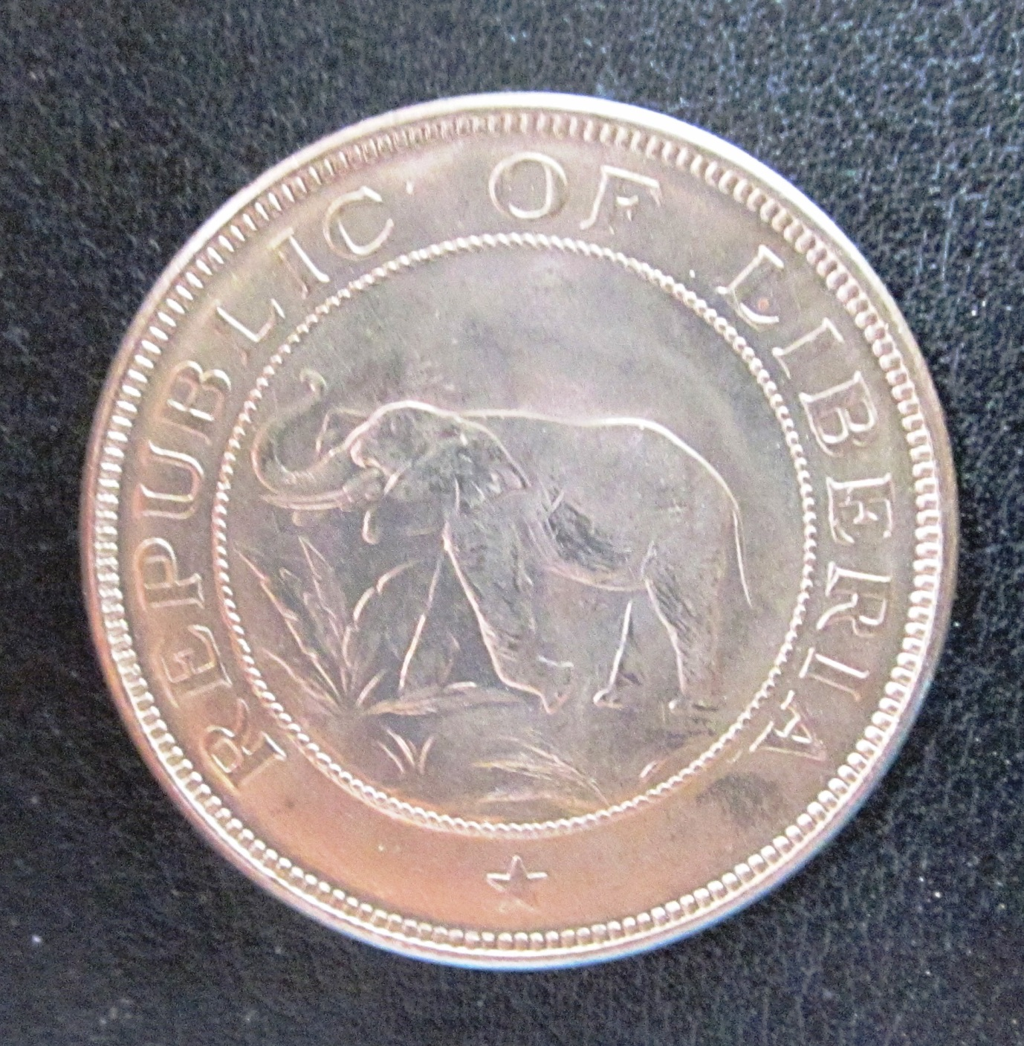
Liberian 1941
Two Cent Piece

Slide 21
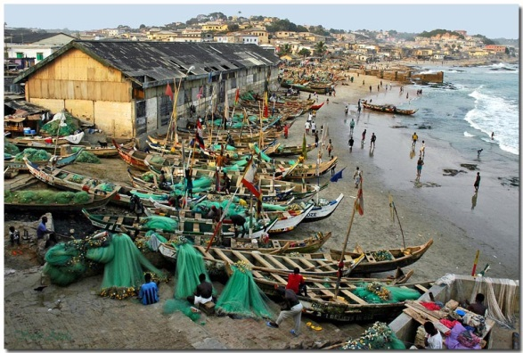
Images of
Ghana

Slide 22
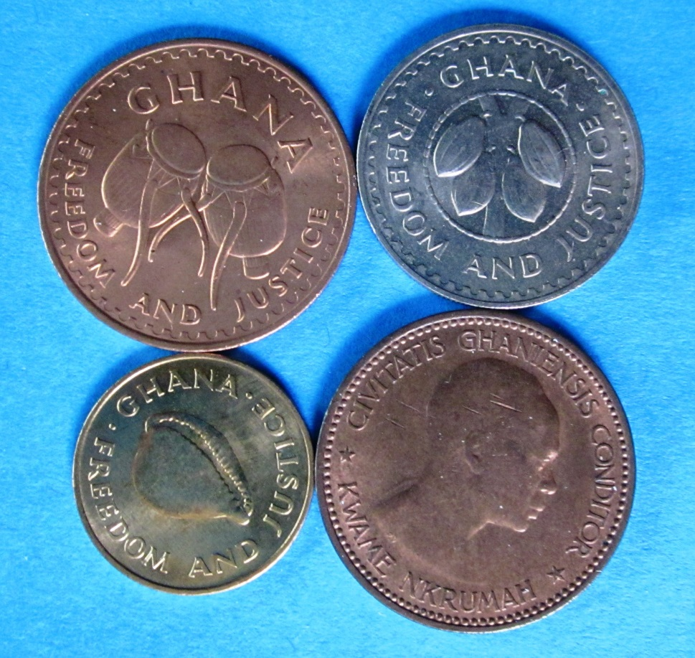
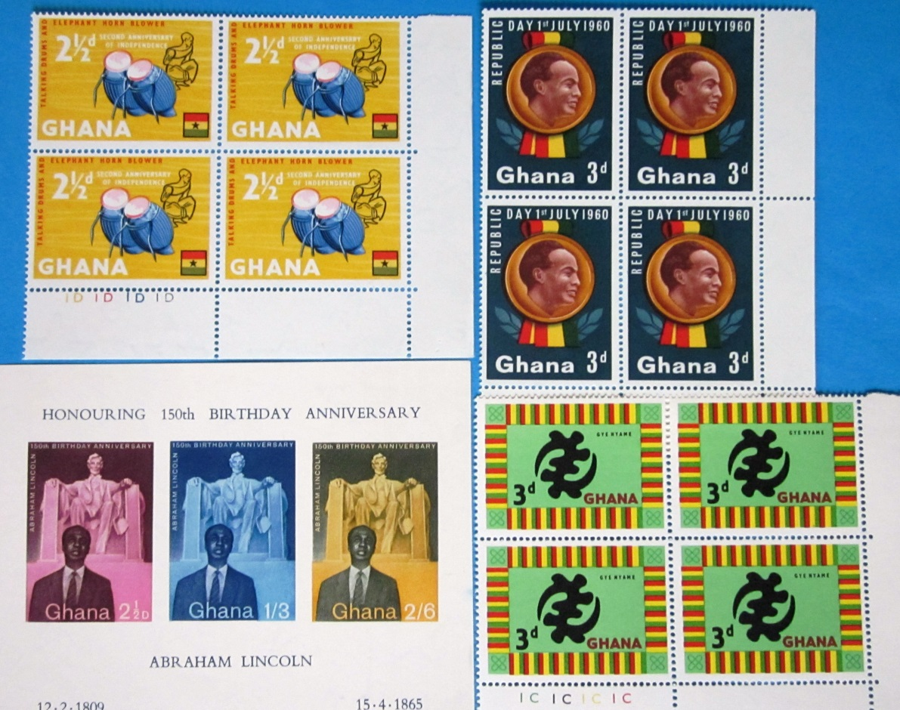
Ghana
Coins and Stamps

Slide 23
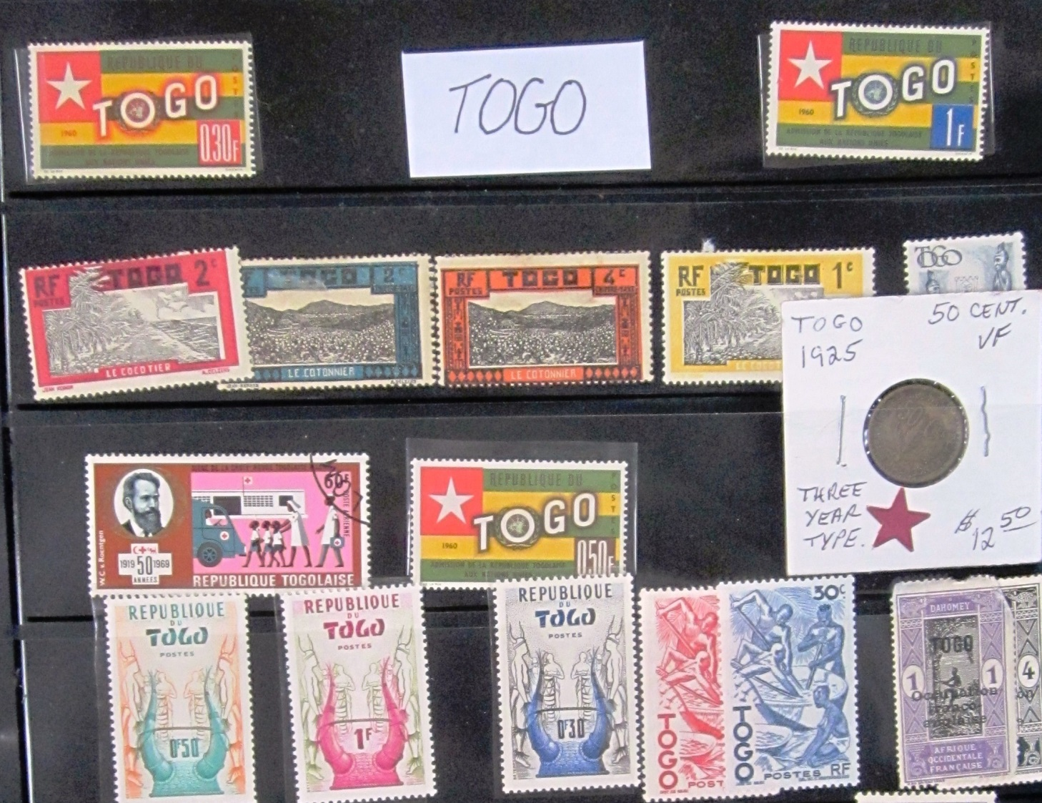
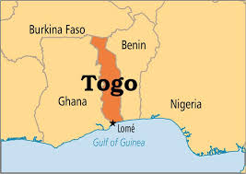

Slide 24
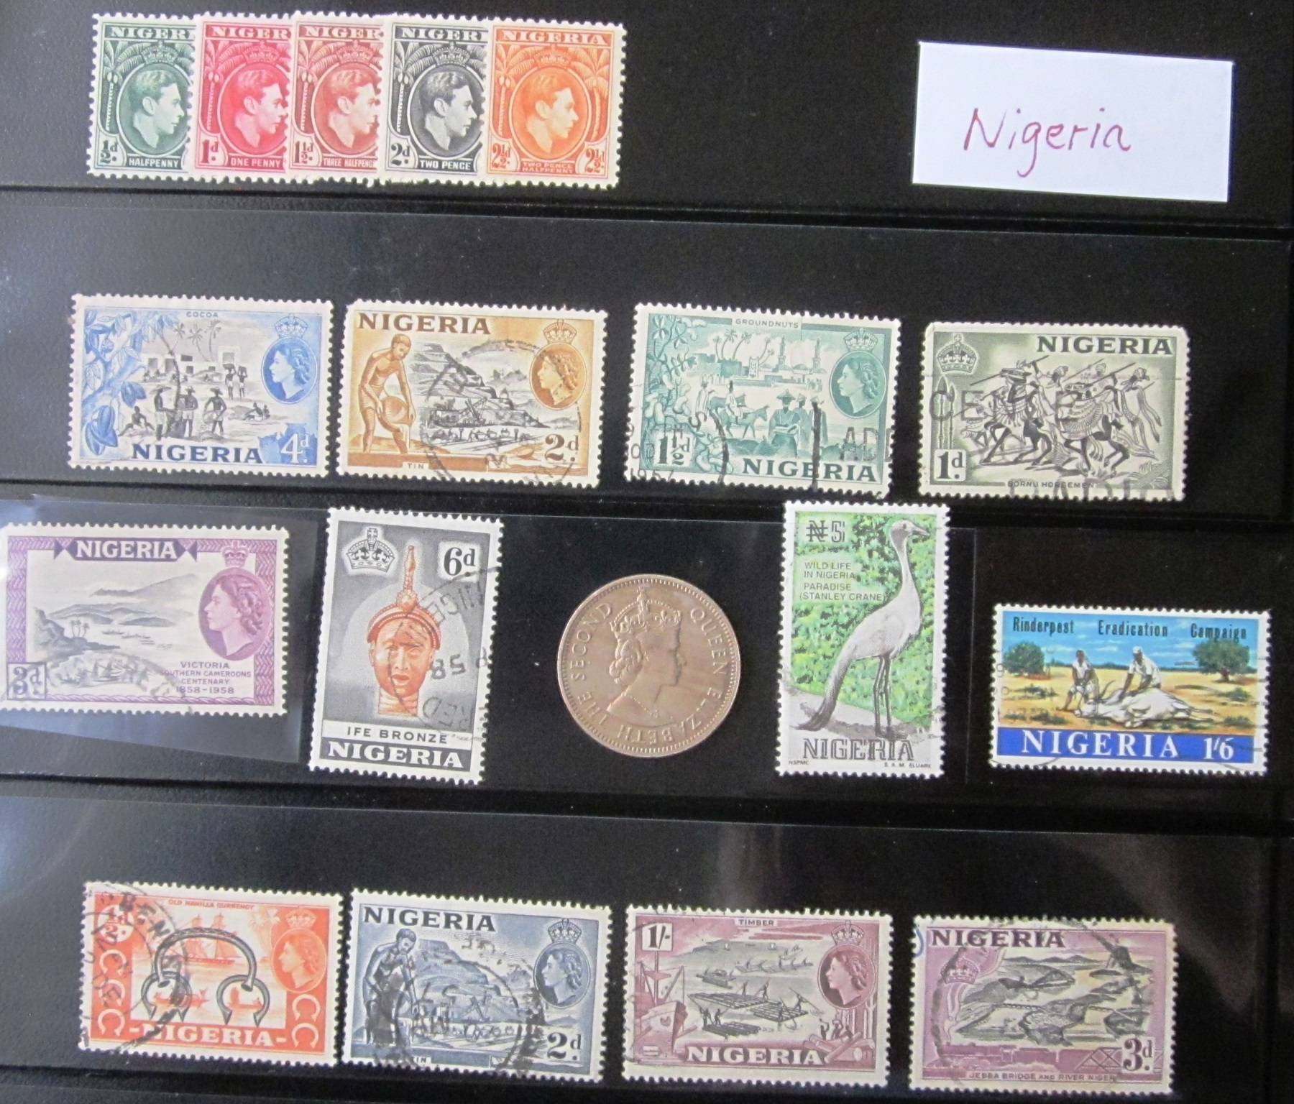

Slide 25
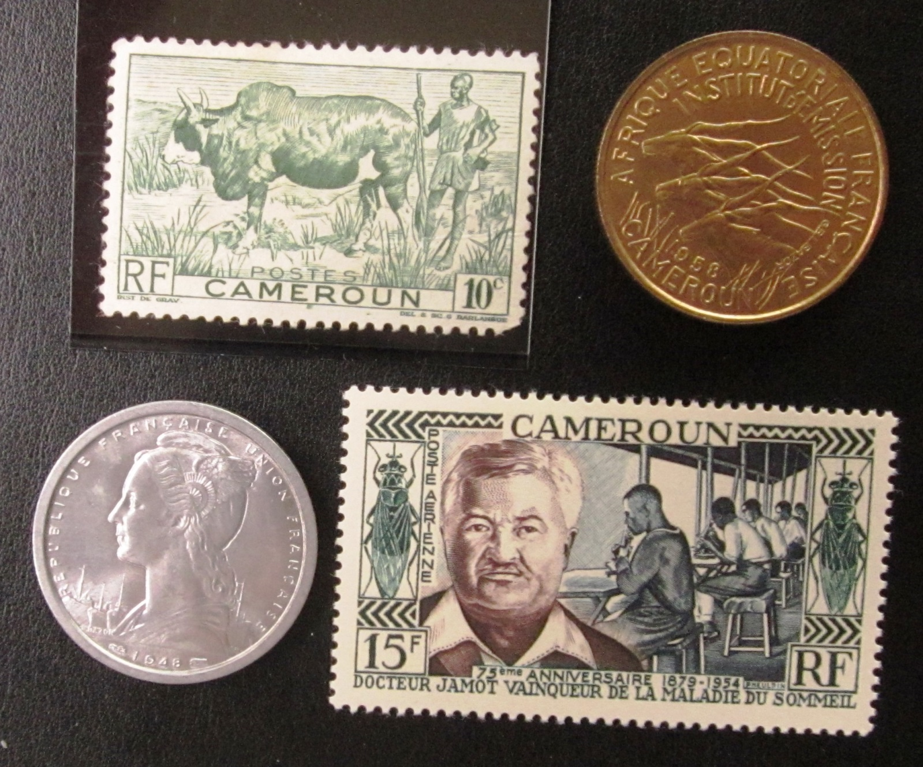
Cameroon

Slide 26
West Africa

Slide 27
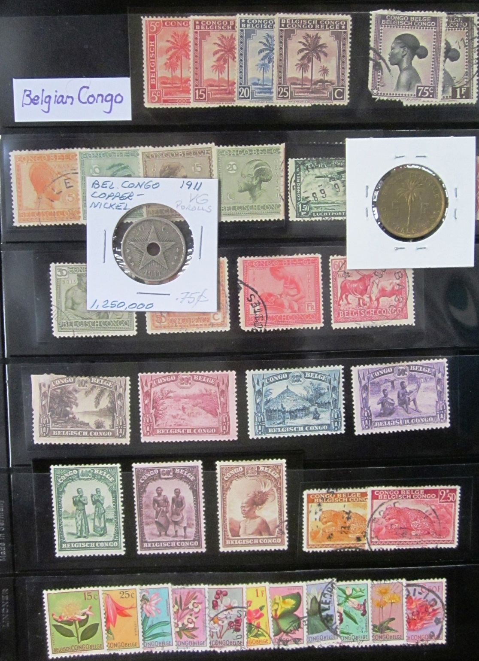
Belgian Congo

Slide 28
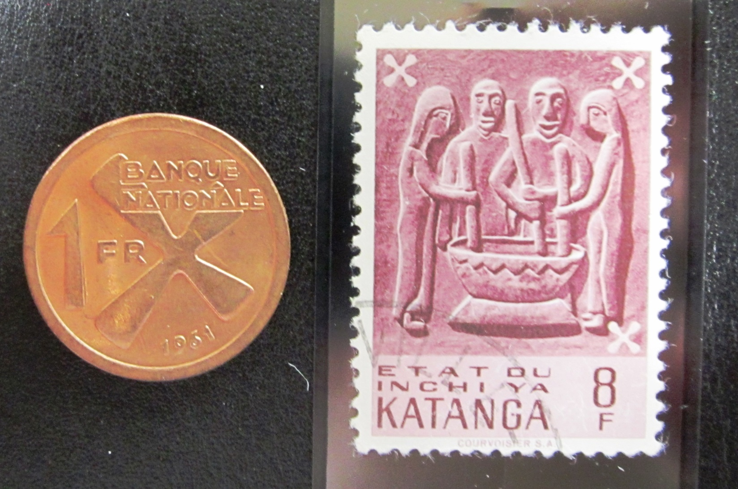
Katanga—Breakaway from 1960-1963. RIP

Slide 29
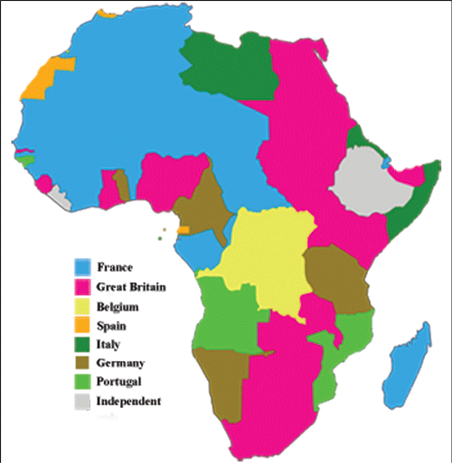
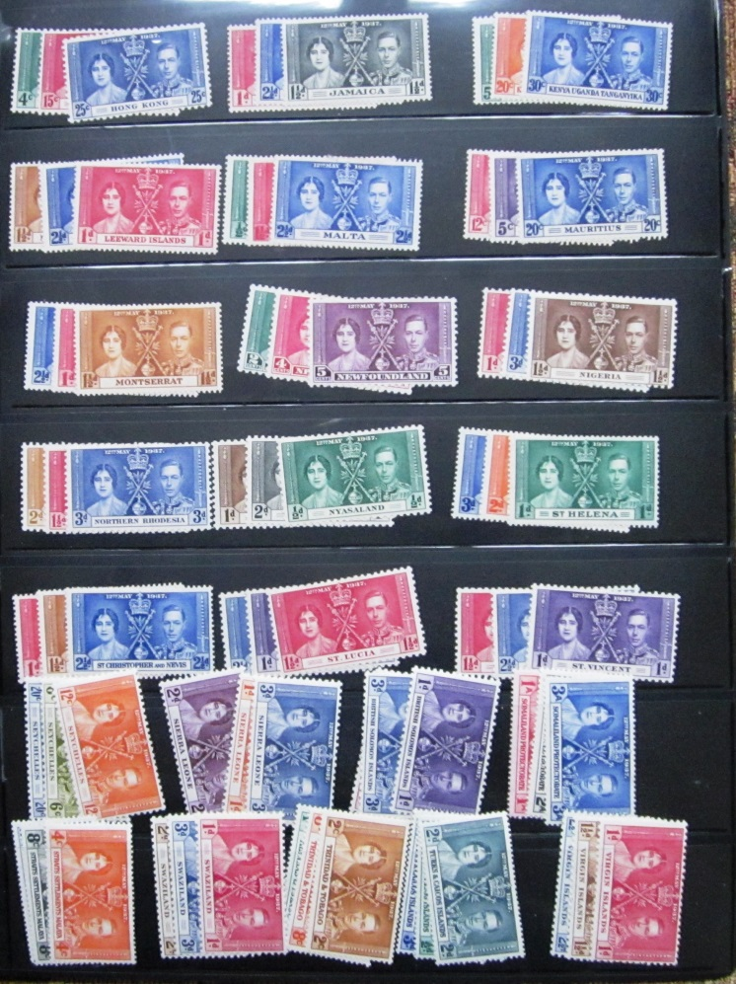
African Colonialism

Slide 30
Confusing, Obscure, Bizarre, and Defunct Countries—Their Coins and Stamps
Guinea and Guiana
(And Papua New Guinea)

Slide 31
AFRICA
French Guinea Guinea
Portuguese Guinea Guinea Bissau
Spanish Guinea;
(Rio Muni; Fernando Po) Equatorial Guinea
SOUTH AMERICA—THE GUIANAS
Spanish Guiana Guayana region in Venezuela
British Guiana Guyana
Dutch Guiana Suriname
French Guiana French Guiana (Overseas Dept.)
Portuguese Guiana Amapa State of Brazil
Papua New Guinea

Slide 32
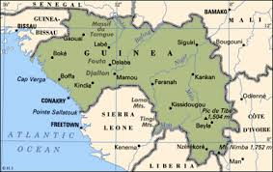
Guinea

Slide 33
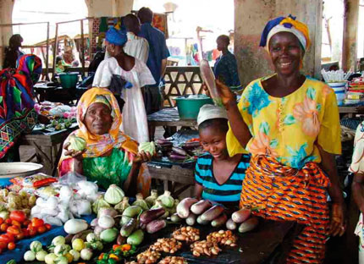
Guinea market scene

Slide 34
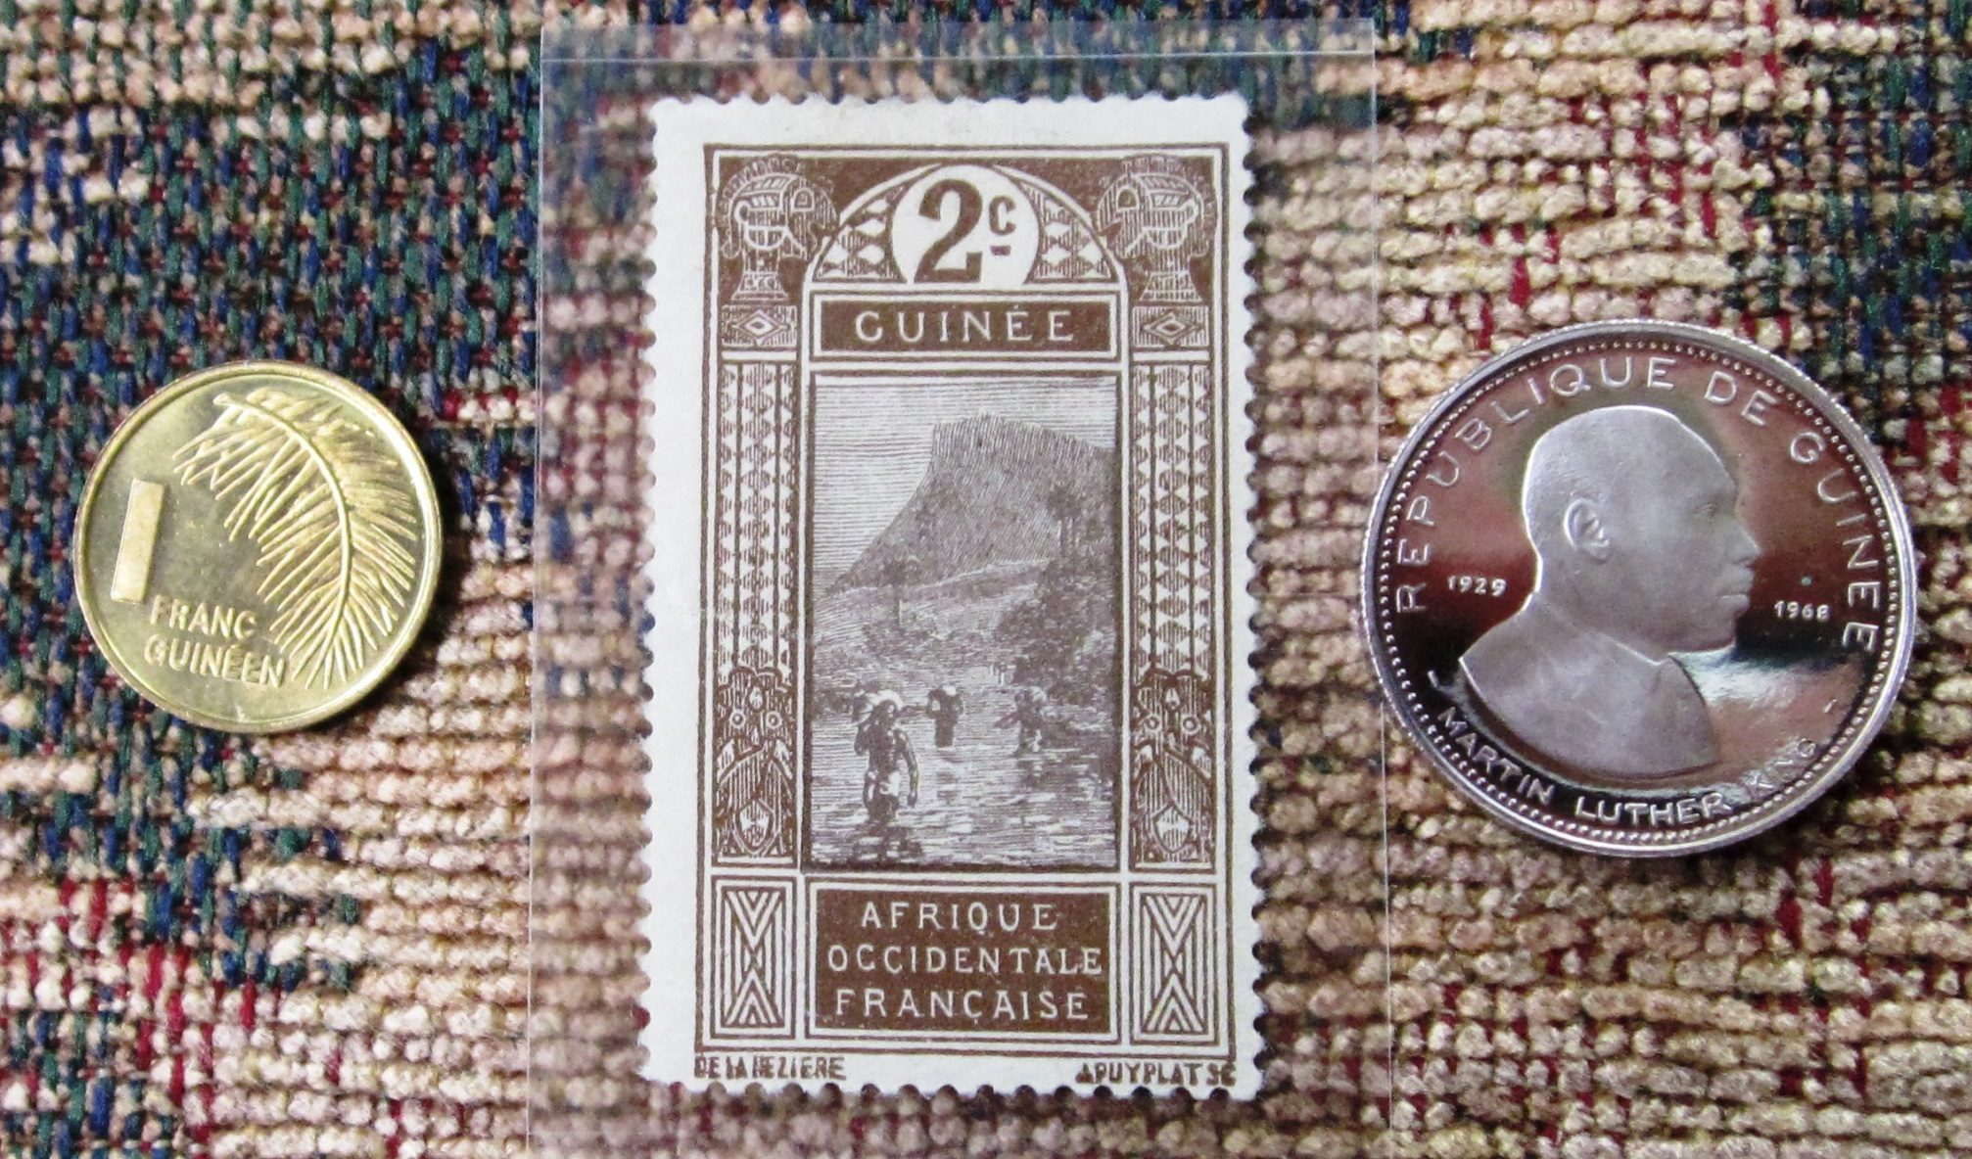
Guinea

Slide 35
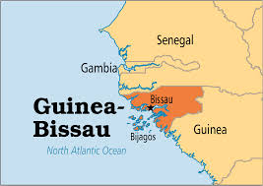
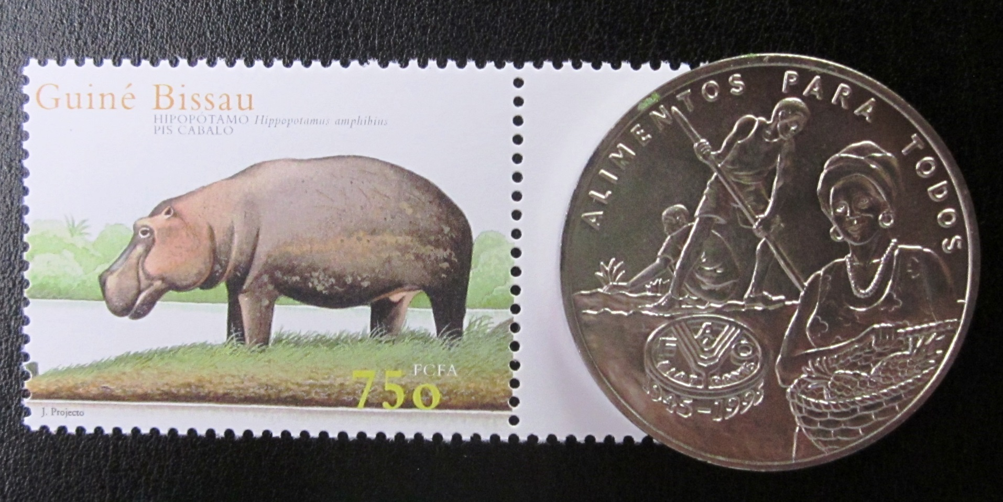

Slide 36
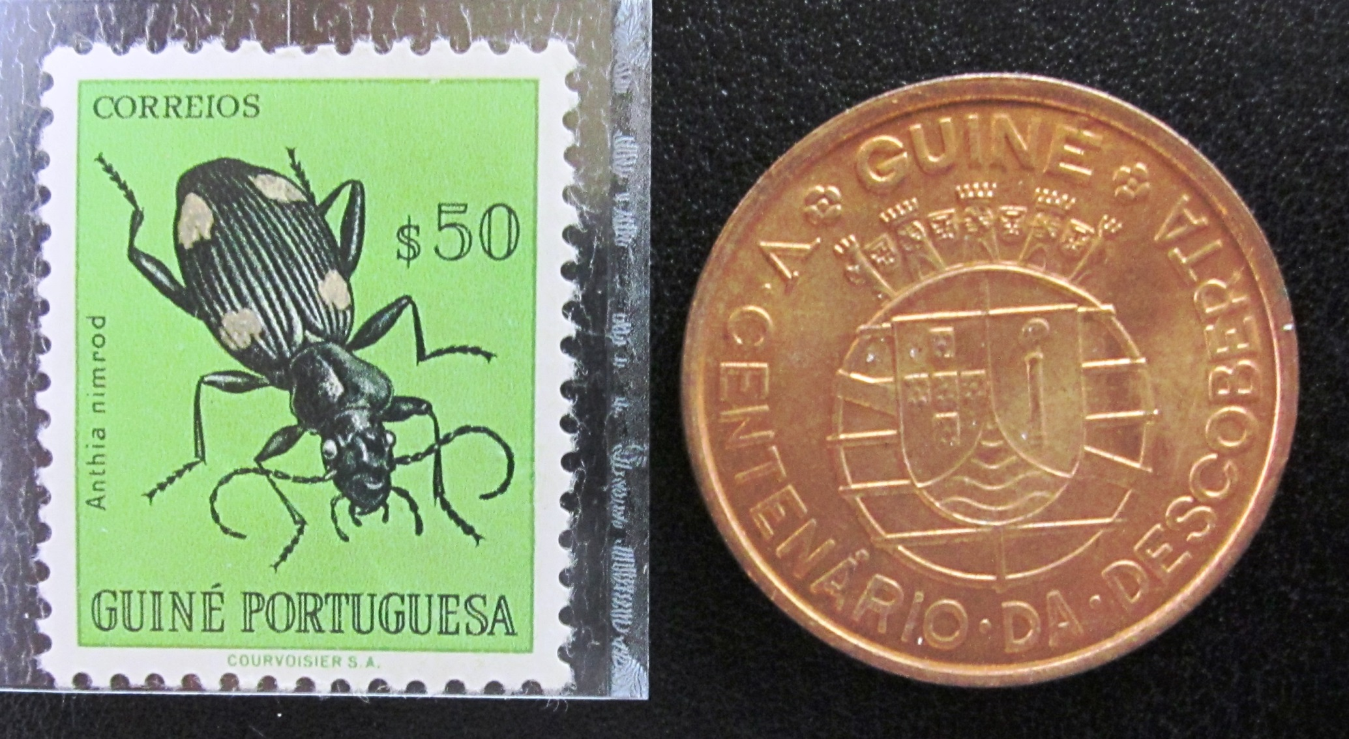
Portuguese Guinea becomes Guinea Bissau

Slide 37
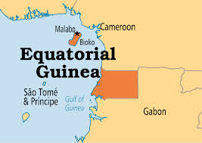
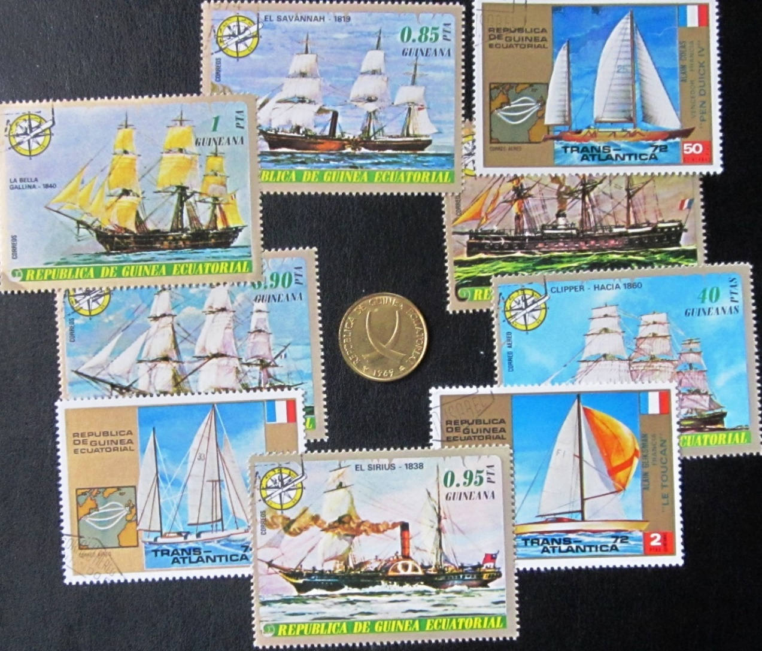

Slide 38
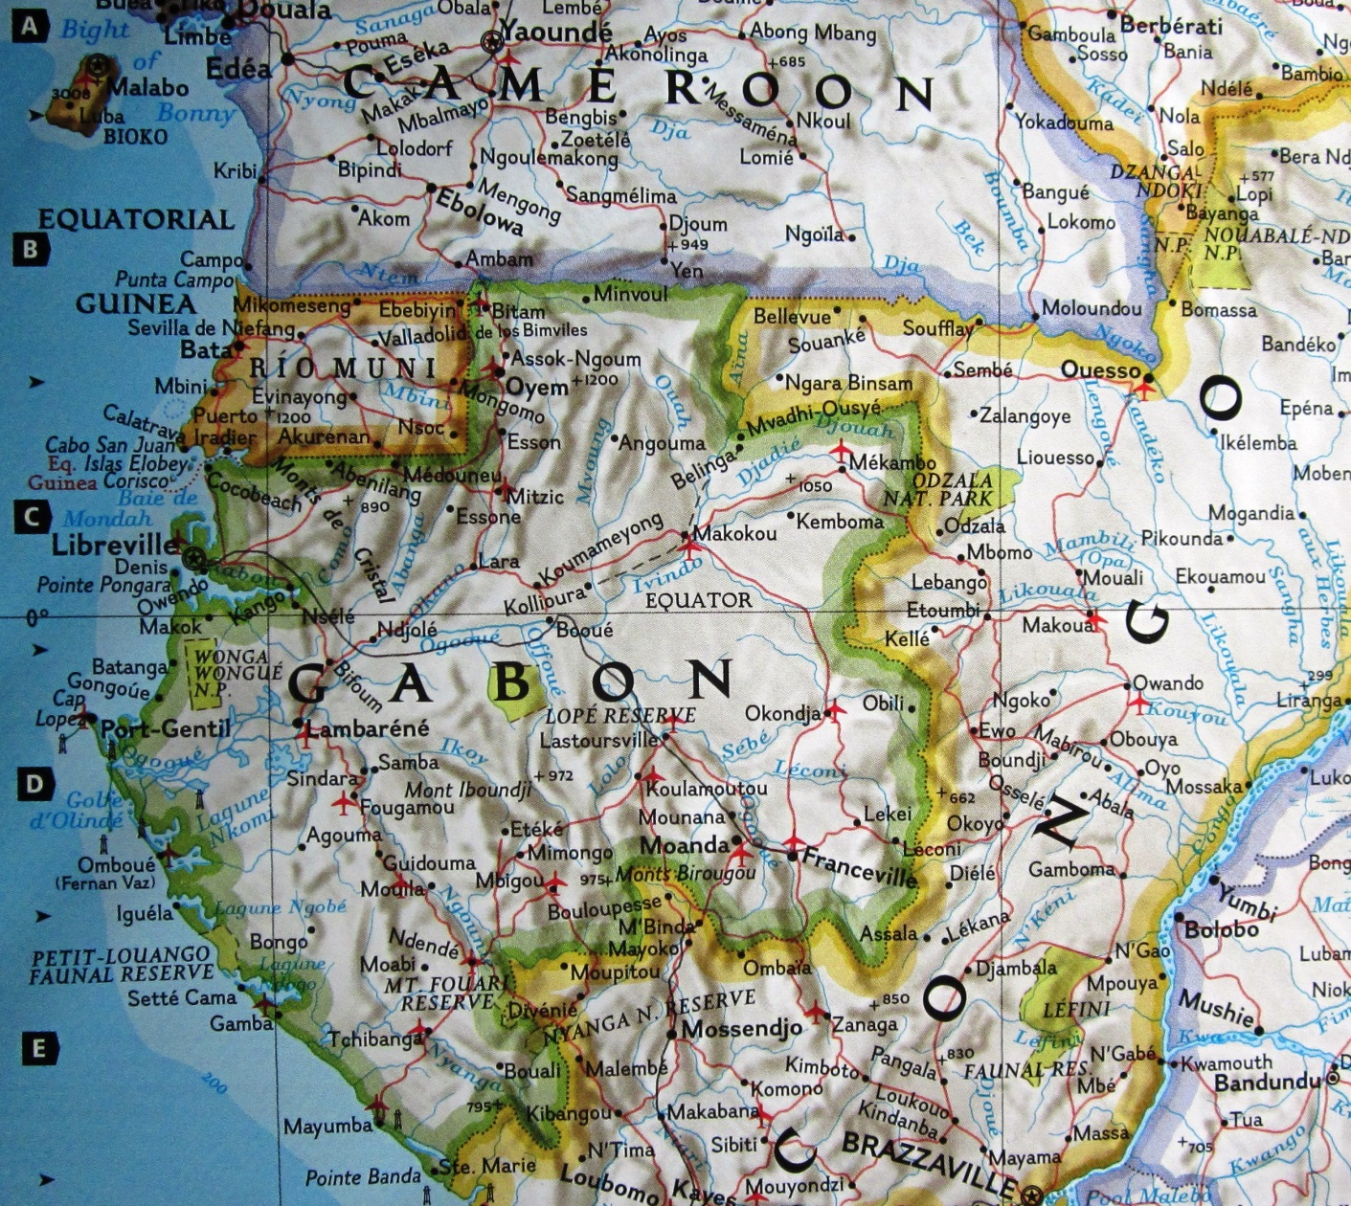
Equator
Equatorial Guinea– close but not on the Equator

Slide 39
AFRICA
French Guinea Guinea
Portuguese Guinea Guinea Bissau
Spanish Guinea;
(Rio Muni; Fernando Po) Equatorial Guinea
SOUTH AMERICA—THE GUIANAS
Spanish Guiana Guayana region in Venezuela
British Guiana Guyana
Dutch Guiana Suriname
French Guiana French Guiana (Overseas Dept.)
Portuguese Guiana Amapa State of Brazil
Papua New Guinea

Slide 40
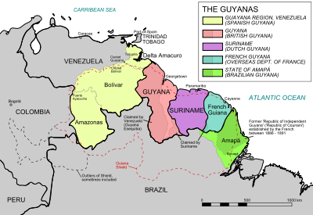

Slide 41
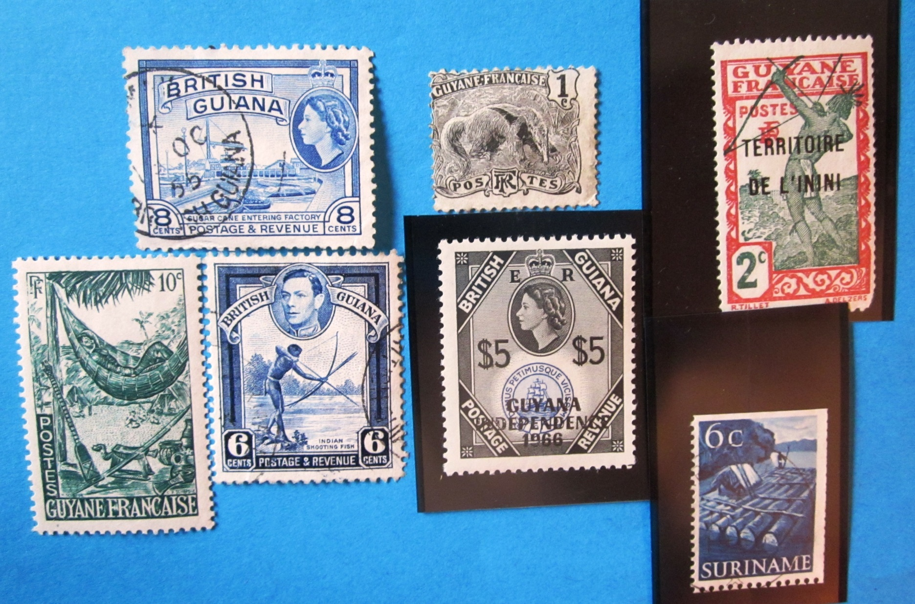
Assorted Guyanese stamps from past and
present countries

Slide 42
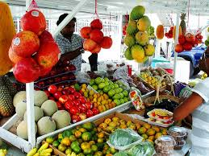

Slide 43
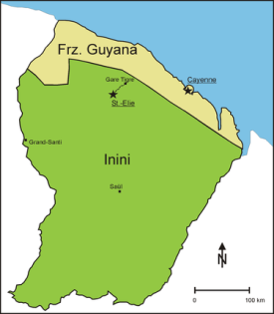
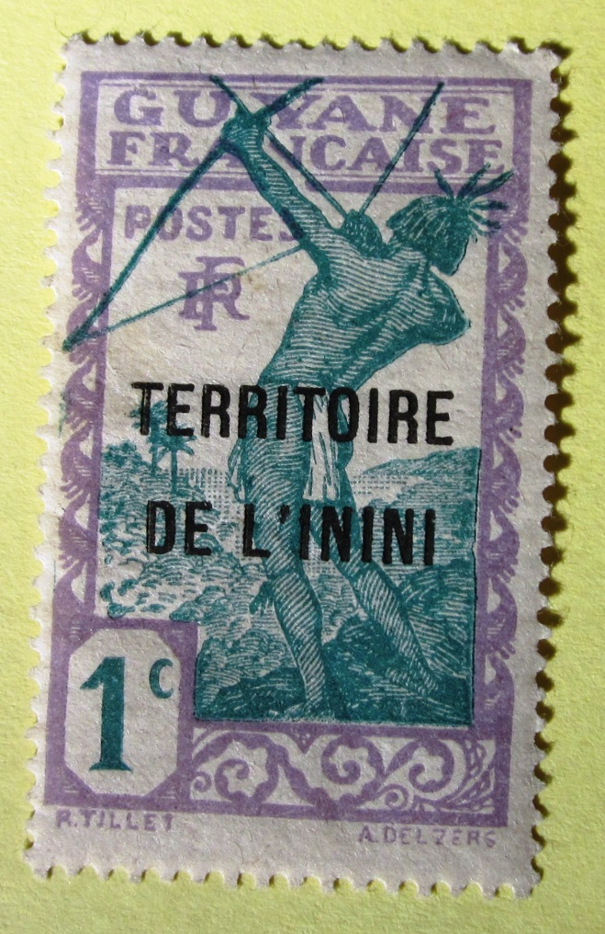
Inini—an inland
division of
French Guyana

Slide 44
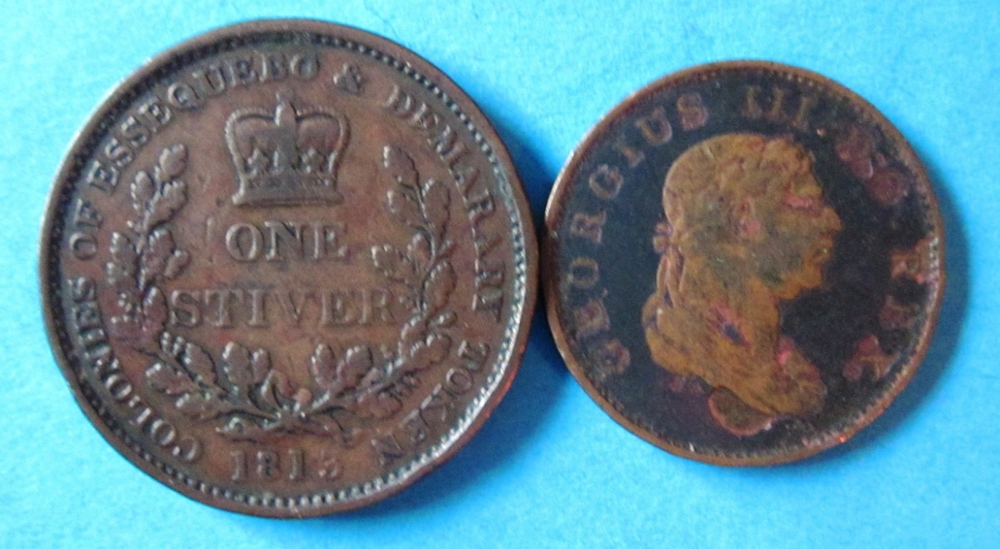
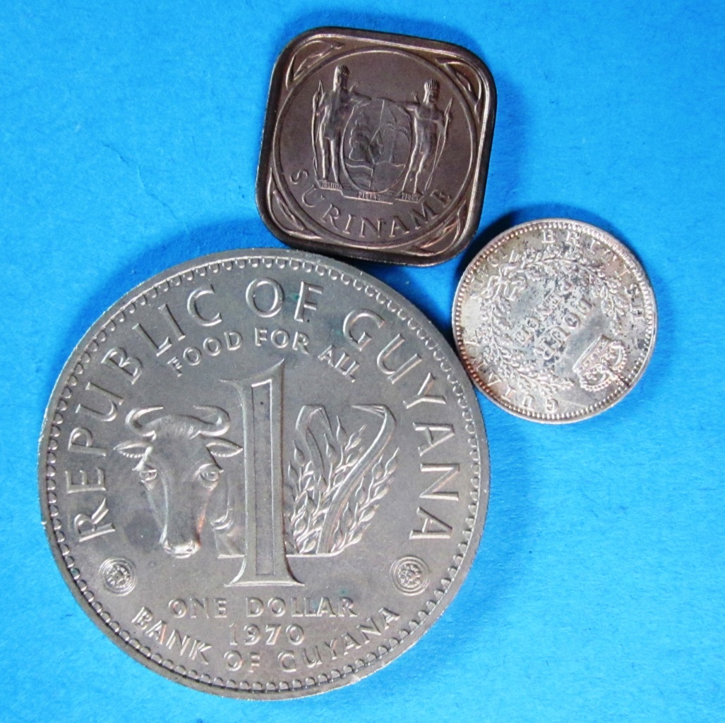
Essequibo and Demarary
Assorted Guyanese
coins from past and
present countries

Slide 46
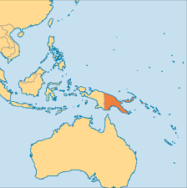
The Island of New
Guinea is divided
into the country of
Papua New Guinea
to the east, and a
part of Indonesia
to the west

Slide 47
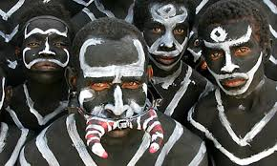
People of Papua
New Guinea

Slide 48
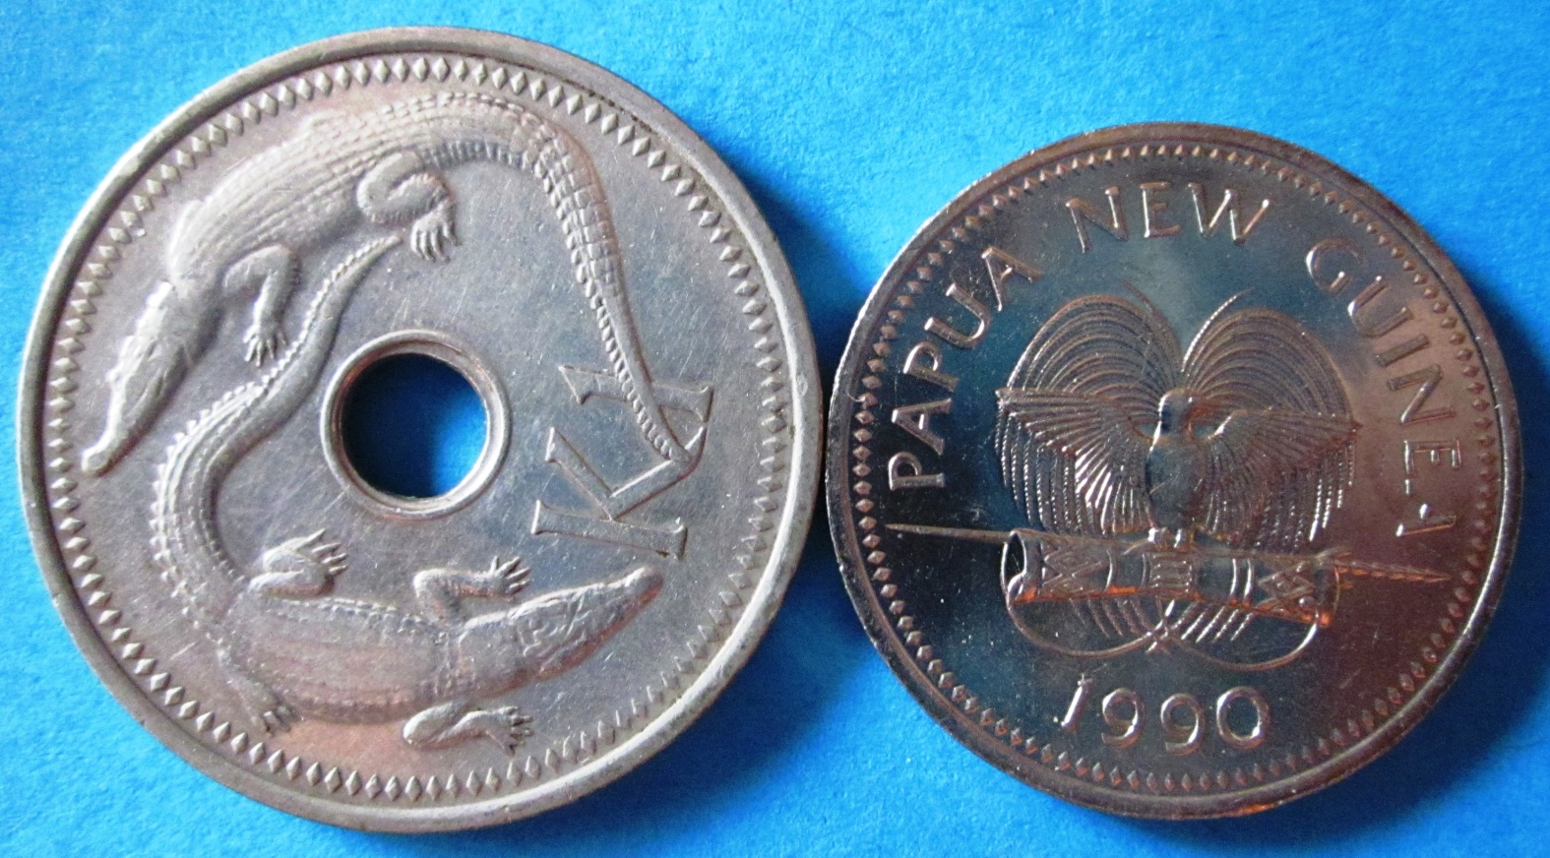

Slide 49
Confusing, Obscure, Bizarre, and Defunct Countries—Their Coins and Stamps
Mauritania, Mauritius, and Martinique

Slide 50
Mauritania

Slide 51
Mauritania

Slide 52
Stamp and Coin of Mauritania

Slide 53
M
A
URITIUS

Slide 54
Mauritius

Slide 55
Mauritius #1 and #2

Slide 56
Martinique

Slide 57
The “Stans”

Slide 58
Uzbekistan Afghanistan Pakistan

Slide 59
President
Niyazov
(deceased)

Slide 60
Kazakhstan Tajikistan

Slide 61
TATARSTAN
KURDISTAN

Slide 62
Great Mosque in Samarkand, Uzbekistan

Slide 63
Uzbekistan borders on the dying Aral Sea

Slide 64
The “Stans”

Slide 65
Confusing, Obscure, Bizarre, and Defunct Countries—Their Coins and Stamps
Tibet Herm Island Saint Pierre et Miquelon
Tannu Tuva Transnistria
KUT Straits Settlements Tunisia
North Ingermanland Italian Socialist Republic

Slide 66
Penang
Dinding
Malacca
Singapore
Labuan
Christmas Island
Cocos Islands
Straits Settlements

Slide 67
Singapore Harbor in the 1940’s

Slide 68
Straits Settlements

Slide 69
Which
Is it?
Country

Slide 70
Tunisia

Slide 71
Typical Tunisian Stamp Design

Slide 72
Tunisian Coins—one weird, one normal

Slide 74
Potala Palace in Lhasa, Tibet

Slide 75
Tibetan Monks in
Debating Exercise
Tibetan Pilgrims Praying
at the Wall of the
Monastery

Slide 76
Me at Base Camp
Everest at Dawn

Slide 77
Tibet
Coins and Stamp

Slide 79
Saint Pierre et
Miquelon

Slide 80
Stamps of Saint Pierre and Miquelon

Slide 81
Herm Island

Slide 82
Herm Island

Slide 83
Herm Island Illegal Stamps

Slide 84
Tannu Tuva

Slide 85
Tannu Tuva–
Fraudulent Stamps

Slide 86
Transnistria--
Frozen
Conflict
Country

Slide 87
Moldova
Transnistria

Slide 88
North
Ingermanland

Slide 89
Italian
Socialist
Republic

Slide 90
Italian Social Republic
(Republic of Salo)

Slide 91
Italian Socialist Republic

Slide 92
Confusing, Obscure, Bizarre, and Defunct Countries—Their Coins and Stamps
Steven Eisinger
October 2015
Much, much more to come– on another day
The End

