Slide 1
Number One and C1
By Steve Eisinger

Slide 2
First Stamps on the Scene
Great Britain 1840
Switzerland Z 1843
Switzerland G 1843
Brazil 1843
Switzerland B 1845
Mauritius 1847
USA 1847
Bermuda 1848
Bavaria 1849
Austria 1850
New South Wales 1850
Prussia 1850
Spain 1850
Switzerland 1850
British Guiana 1850
Latest #1 issued:
South Sudan 2011

Slide 3
Facts and Statistics
617 Stamp-Issuing Countries appear in Scott.
344 of them (or 56%) are defunct.
Total $ Value for #1 in Mint is: $2,816,434
Total $ Value for #1 in Used is: $1,546,386
Total Catalog Value, #1, Mint and Used, is: $4,362,820

Slide 4
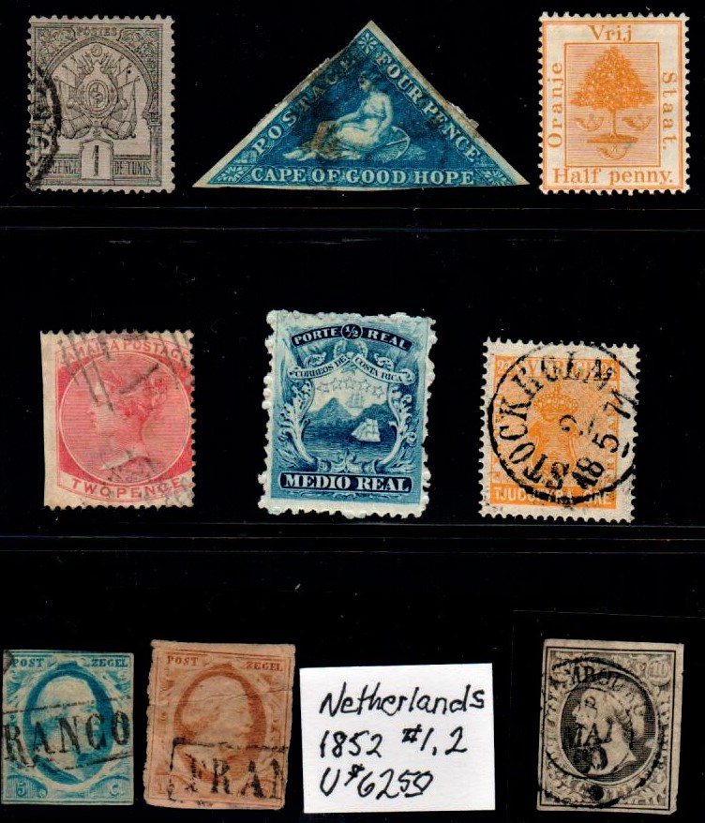
Tunisia 1888
Cape of
Good Hope 1853
Orange River 1868
Jamaica 1860
Costa Rica 1863
Sweden 1858
Netherlands 1852
Luxembourg 1852
Old Stamps

Slide 5
More Interesting Number 1’s: Common Design Types
French Navigation and Commerce Italy Coat of Arms
Portugal Vasco
De Gama
French General Faidherbe Portuguese Crown

Slide 6
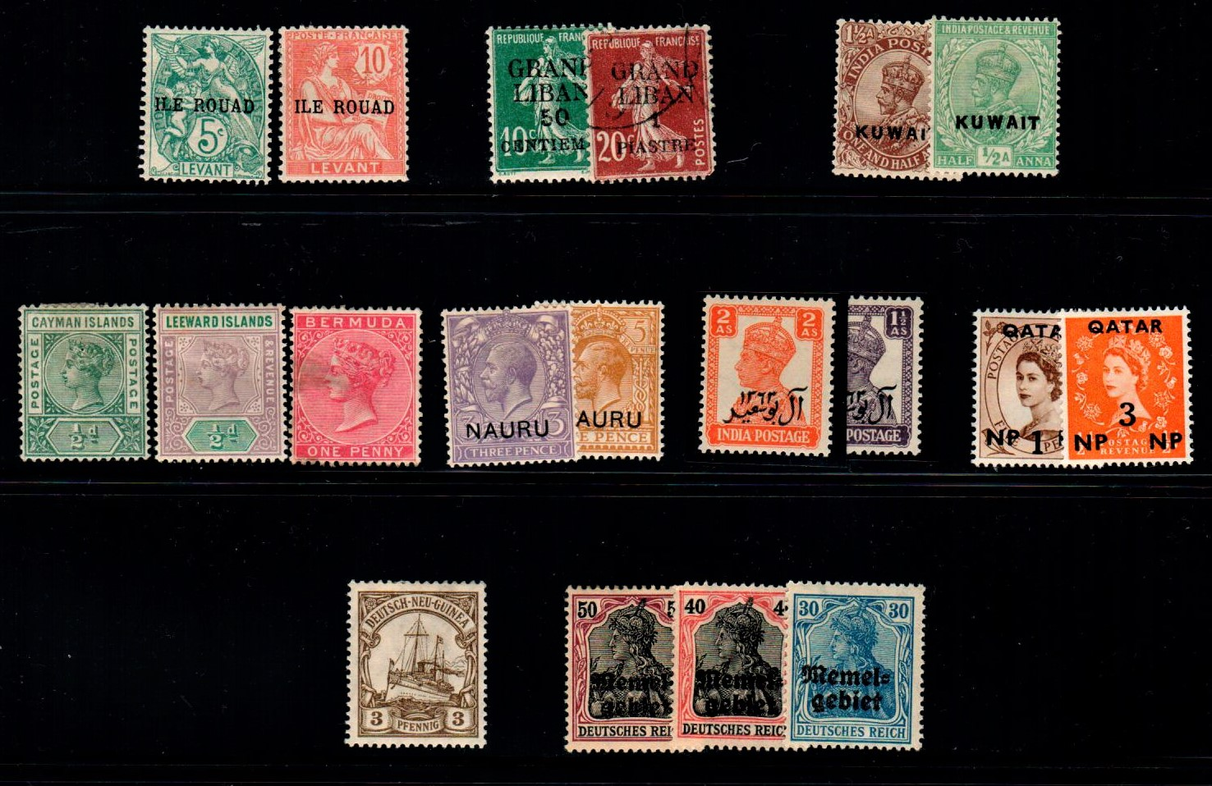
Even More Common Design Types
France France Great Britain
Great Britain
Across
Germany Germany

Slide 7
More Facts and Statistics
Russia has issued the most stamps.
Honduras has issued the most Air Mail Stamps.
Three countries issued only one stamp: Jasdan;
Jahalawar, and Tonk.
St. Lucia and Congo People’s Republic issued
only one Air Mail Stamp.
Great Britain did not issue an Air Mail stamp
until 2003.

Slide 8
Holkar (Indore)
Las Bela Alwar

Slide 9
Ukraine Ghana Central
African
Republic

Slide 10
Venezuela
Guyana State
United Nations
Paraguay

Slide 11
Czechoslovakia
Thailand
Viet Nam

Slide 12
Most Valuable Number One
Country Mint $ Used $ Total $
Mauritius 1,250,000 1,150,000 2,400,000
Hawaii 660,000 250,000 910,000
British Guiana 275,000 -- 275,000
New Zealand 120,000 15,000 135,000
Bermuda -- 135,000 135,000
Switzerland G 60,000 40,000 100,000
Romania 60,000 25,000 85,000
Reunion 39,000 25,000 64,000
Switzerland Z 20,000 17,500 37,500
Zanzibar 25,000 5,500 30,500
Kotah (India) 20,000 8,500 28,500
Malaya Johore 20,000 5,750 25,750

Slide 13
More Valuable Number Ones—
the Second Tier
Country $$
Tuscany 19,750
Poonch (India) 18,000
Sardinia 15,200
Sweden 15,000
Saxony 14,500
Great Britain 11,320
French Congo 11,250
New South
Wales 10,250
Country $$
Italy (#17) 9,860
Uganda 9,500
Fiji 8,750
Sungei Ujong
(Malaya) 7,500
USA 7,150
Charkari (India) 6,500
Schleswig Hol. 5,825
Iceland 4,300

Slide 14
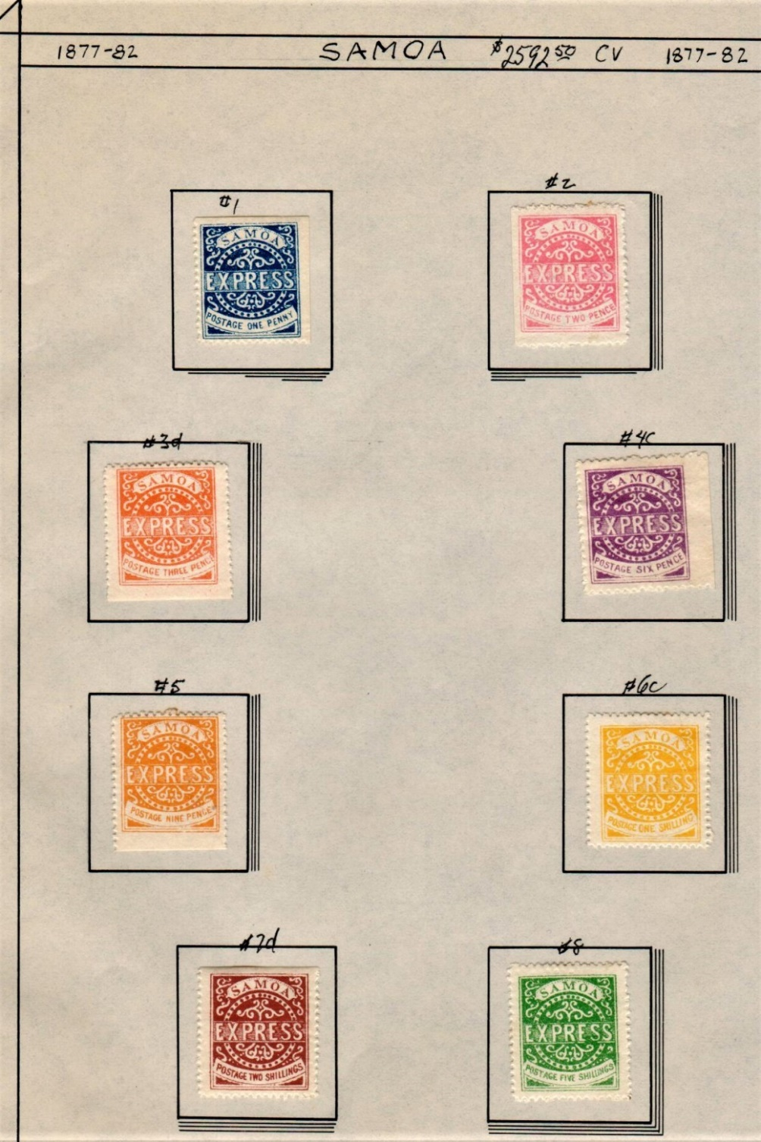
Stamps from Samoa;
Are They Genuine?

Slide 15
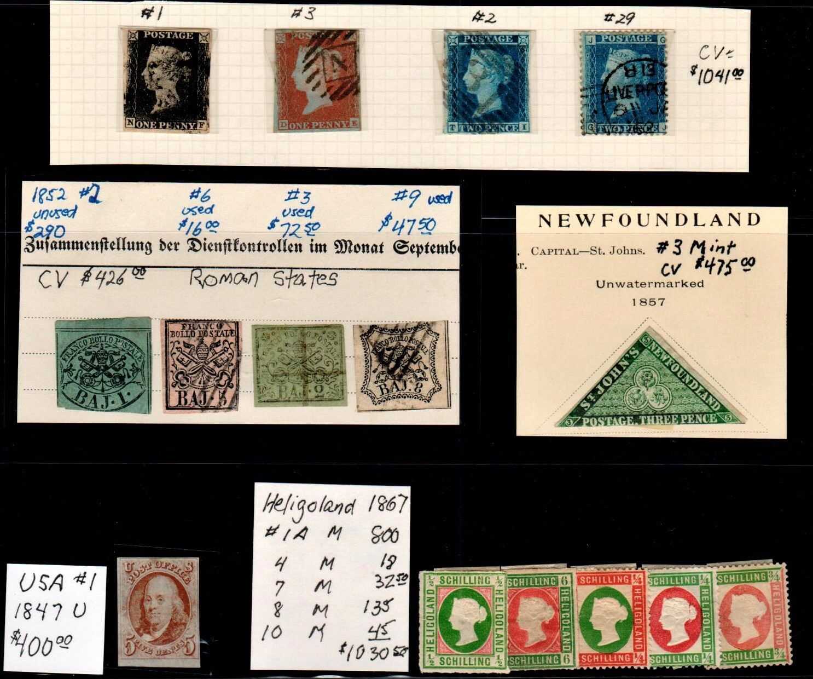
The Top Five for Value
(my collection)

Slide 16
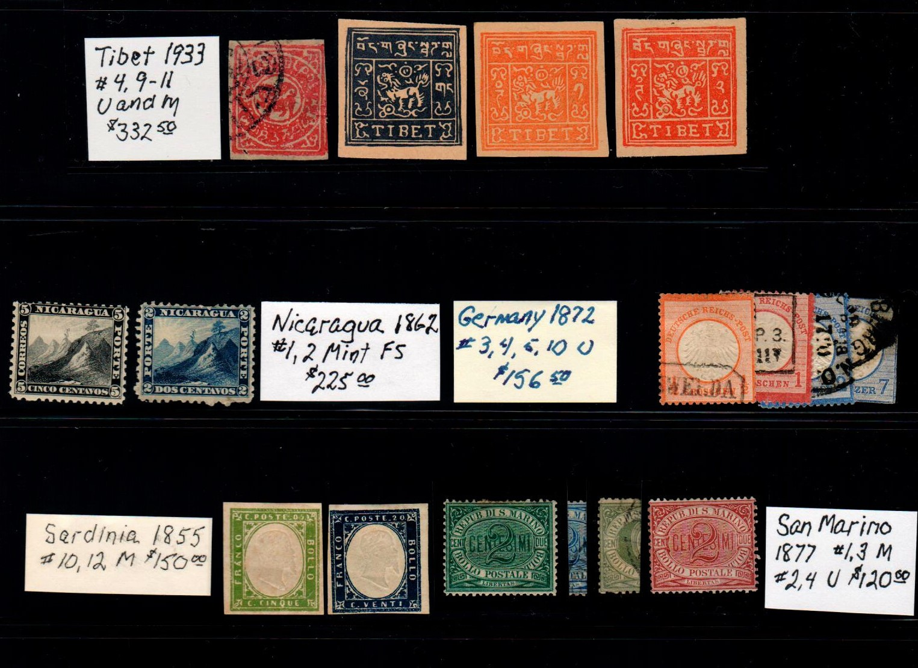
Second
Five
For
Value
(my collection)

Slide 17
First Air Mail Stamps on the Scene
Italy 1917
Hungary 1918
Austria 1918
USA 1918
Mexico 1918
Newfoundland 1919
Columbia 1919
Germany 1919
Japan 1919
Tunisia 1919
Belgian Congo 1920
Czechoslovakia 1920
Danzig 1920
Estonia 1920
Spain 1920
Syria 1920

Slide 18
USA PP8 20 cent Parcel Post Stamp issued
in 1913 is the first stamp anywhere in the
world to depict an airplane.
It catalogs for $120 in Mint and $30 in Used.

Slide 19


Slide 20

Newfoundland #156 (1919) depicting Alcock and Brown
leaving St. John’s for the first non-stop trans-Atlantic
flight.

Slide 21
Facts and Statistics
201 countries issued Air Mail stamps.
Total $ Value for C1 in Mint is: $31,729
  Total $ Value for C1 in Used is: $21,427
  Total Catalog Value, #1 and C1,
  Mint and Used, is: $4,415,976

Slide 22
Most Valuable C1
Country Mint $ Used $
Newfoundland 25,000 16,000
Columbia 3,500 1,700
Switzerland 110 1,250
Reunion 290 250
Liberia 250 275
Chile 400 50 France 200 225
Japan 260 72
Ryukyu 150 60
Syria 160 40
USA 60 30

Slide 23
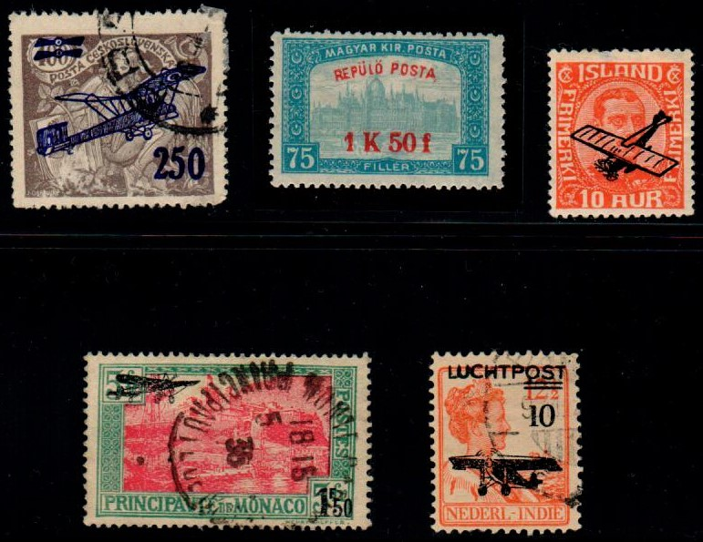
Overprint C1 Stamps
Czechoslovakia Hungary Iceland
Monaco Netherlands Indies

Slide 24
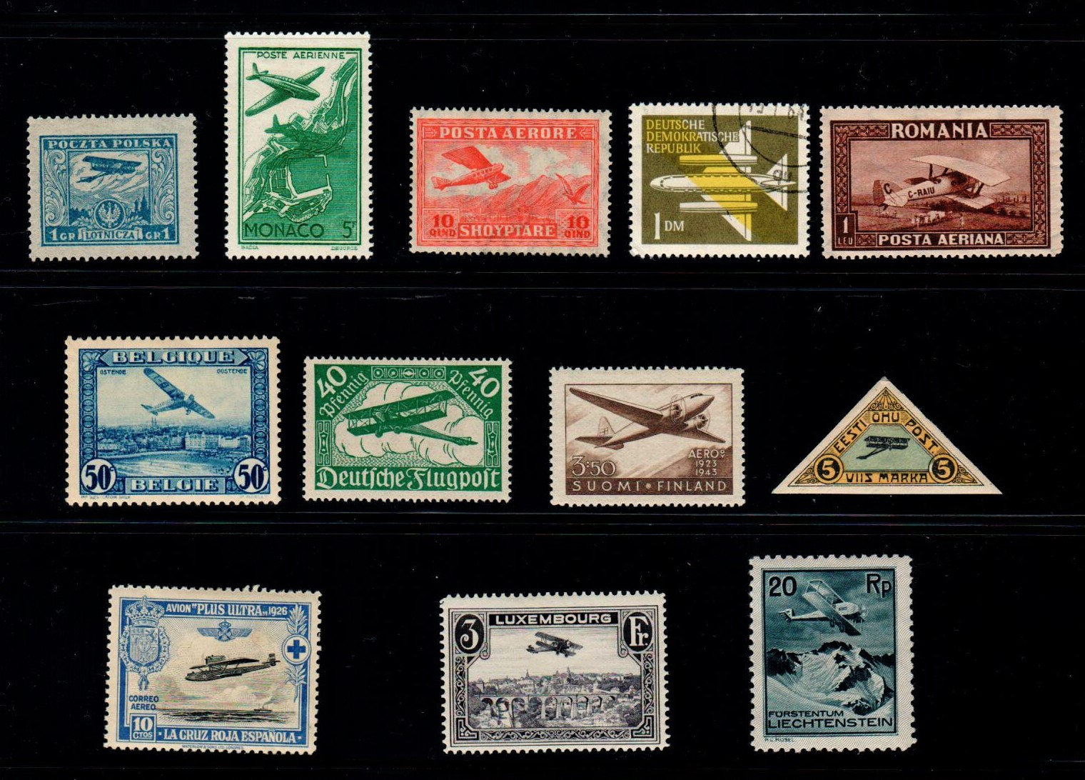
Early Air Mail Stamps of Europe
Monaco
Poland
Albania
DDR
Romania
Belgium
Germany
Finland
Estonia
Liechtenstein
Spain CB1
Luxembourg

Slide 25
Great Early Air Mail Stamps from Africa

Slide 26
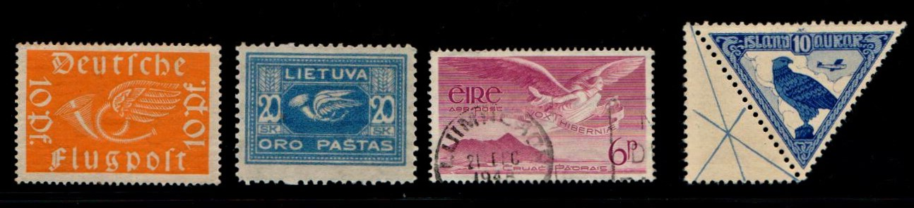
Symbolism and Birds on
Early Air Mail Stamps
Germany Ireland
Lithuania Iceland

Slide 27
Canada Early Air Mail
C1 C2 C3
C4 C5

Slide 28
Number One Air Mail Stamps
Saudi Arabia UAR
Argentina Papua
Bolivia
French
Guiana
From Chad UN (2)
to Rhine:
Common Nicaragua
Design
Canada Mexico
Cuba

Slide 29
Air Mail Common
Designs: French common C1-6 design for
African Colonies

Slide 30
French Common Design for Air Mail in Africa

Slide 31
My Number 1—C1 Collection
In my Number 1—C1 collection are 310 entries
I have 211 items in the #1 column or 34% of the world total. The Catalog Value is: $11.6 K.
I have 97 entries in my C1 collection or 48% of the world total. The Catalog value is $1.6 K
The total Catalog Value of my Number 1-C1 collection is $13.2 K

Slide 32
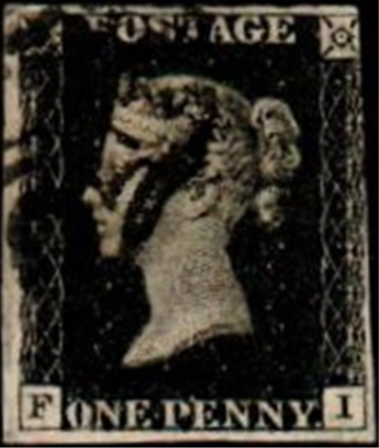
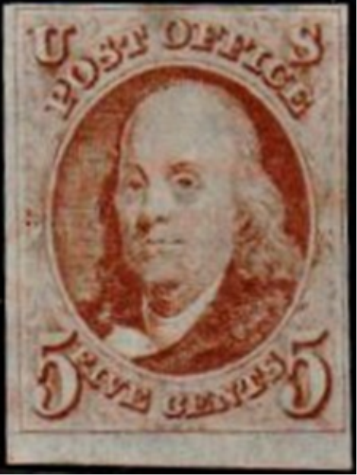
I will buy #1 and C1 stamps.
I sell #1 and C1 stamps.
Show me a stamp or make
me an offer.
The End. Steve Eisinger

