Slide 1
Collections That Never Stop Growing – and on a Budget – or How can a Quarter Stamp Be Impossible to Find? Notes on acquiring mounting values and friends
Collections, Collections

Slide 2
Used United States
Collections, Collections

Slide 3
Perforated Initials - Perfins
United States
Denmark
Great Britain – Machin Heads
Germania
Ceylon
Collections, Collections

Slide 4
US Perfins
Collections, Collections

Slide 5
Denmark Perfins
Collections, Collections

Slide 6
Machin Perfins
Collections, Collections

Slide 7
Germania Perfins
Collections, Collections

Slide 8
Ceylon Perfins
Collections, Collections

Slide 9
Precancels
US Towns and Types
US Overrun Countries
US Champions
US Olympics
US Synoptic
US Alabama General
US 9 Cent Franklins
US 13 Cent Apple Green
Philippine Controls
Canada
Collections, Collections

Slide 10
US Towns and Types
Collections, Collections

Slide 11
US Overrun Countries
Collections, Collections

Slide 12
US Champions
Collections, Collections

Slide 13
US Olympics
Collections, Collections

Slide 14
US Synoptic
Collections, Collections

Slide 15
US General: Alabama
Collections, Collections

Slide 16
US 9 Cent Franklins
Collections, Collections

Slide 17
US 13 Cent Apple Green
Collections, Collections

Slide 18
US Philippine Controls
Collections, Collections

Slide 19
Canada
Collections, Collections

Slide 20
Other Collections…
Haiti
Argentina Official Initials
Swiss Franchise
Dear Doctor
Plate Numbers – Classic
Plate Numbers- Christmas
Flag Cancels
Chicago Ovals
Belgium Railway Stations
20th Century Dates
Collections, Collections

Slide 21
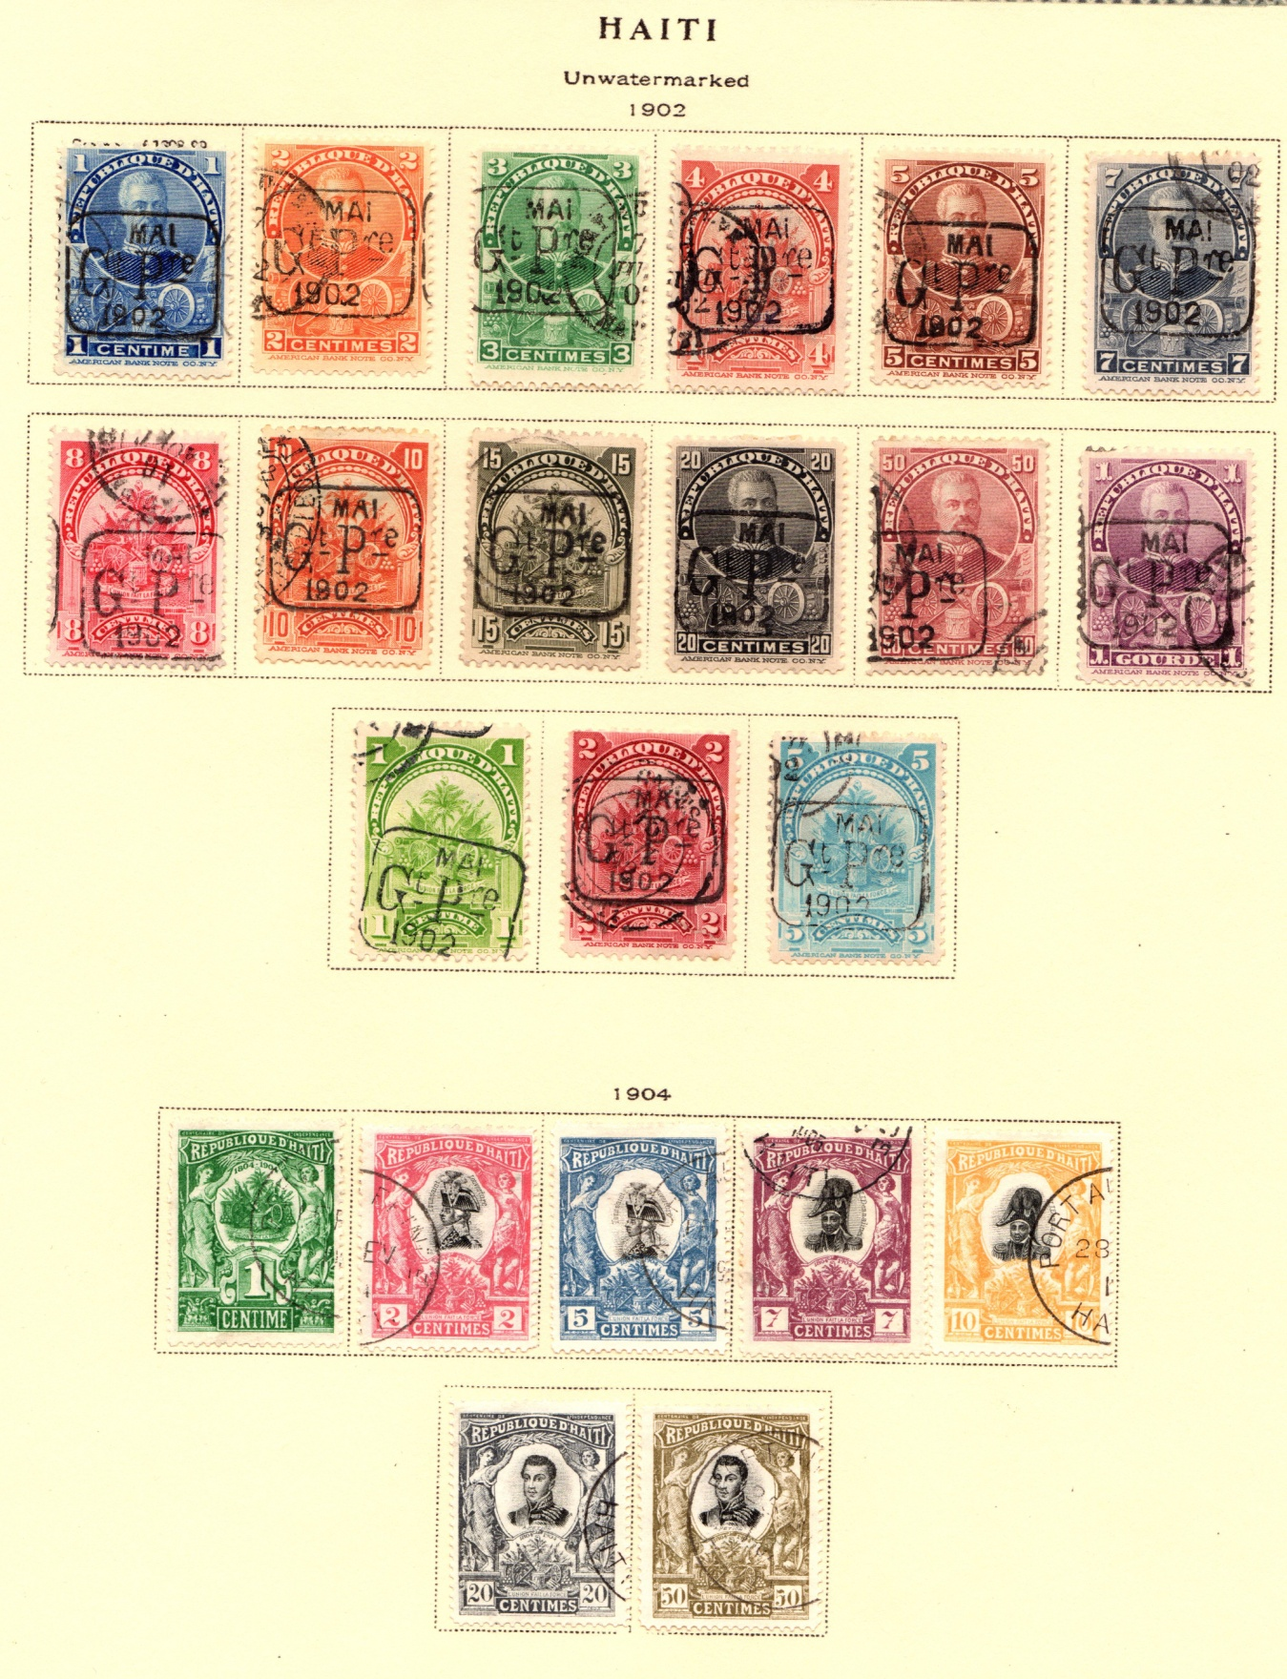
Haiti
Collections, Collections

Slide 22
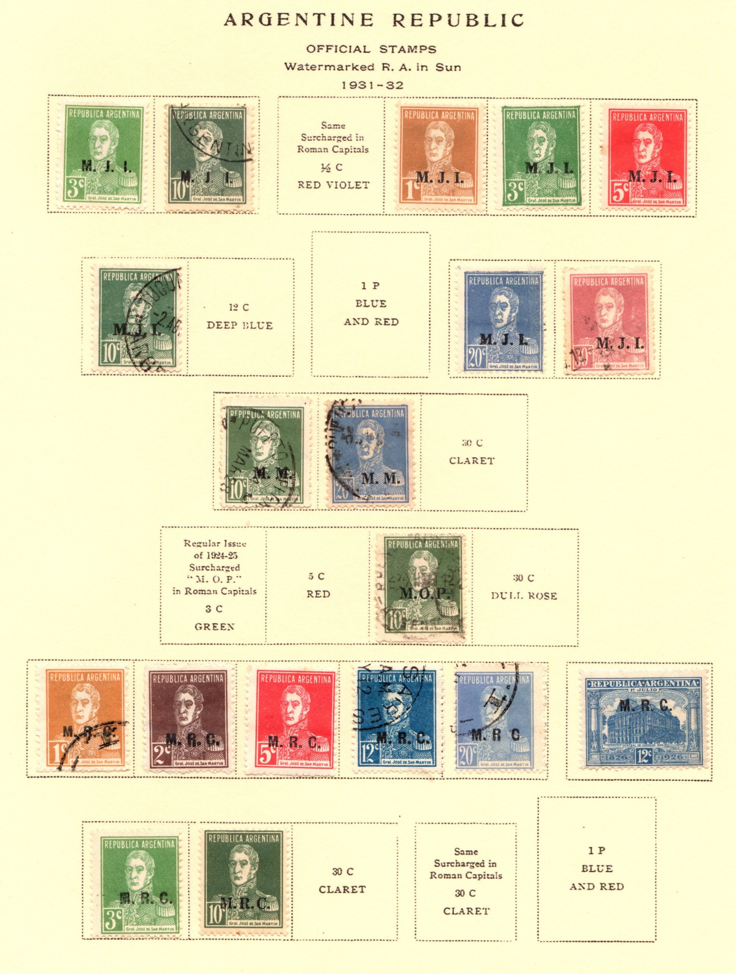
Argentina Official Initials
Collections, Collections

Slide 23
Swiss Franchise
Collections, Collections

Slide 24
Dear Doctor
Collections, Collections

Slide 25
Dear Doctor
Collections, Collections

Slide 26
Plate Numbers - Classic
Collections, Collections

Slide 27
Plate Numbers Christmas
Collections, Collections

Slide 28
Flag Cancels
Collections, Collections

Slide 29
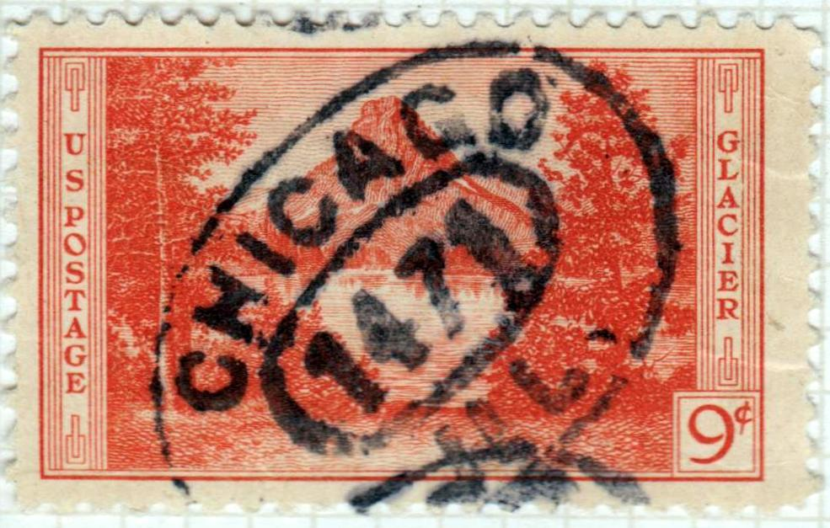
Chicago Ovals
Collections, Collections

Slide 30
Belgium Railway Stations
Collections, Collections

Slide 31
20th Century Dates
Collections, Collections

Slide 32
Thanks for Watching !!!!!!!!!!!!!!!!!!!!!!!!!!!!!!!
Collections, Collections

Slide 33
What is it?

