Slide 1
My Family
Stamp Album

Slide 2
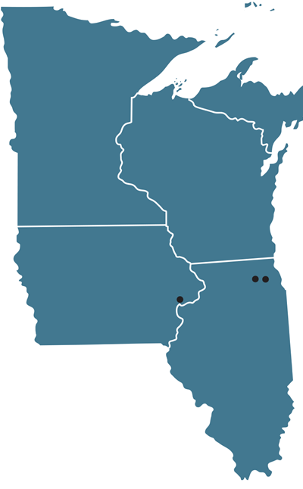
Minnesota
Raymond
Wisconsin
180
Storm Lake
Iowa
Illinois

Slide 3
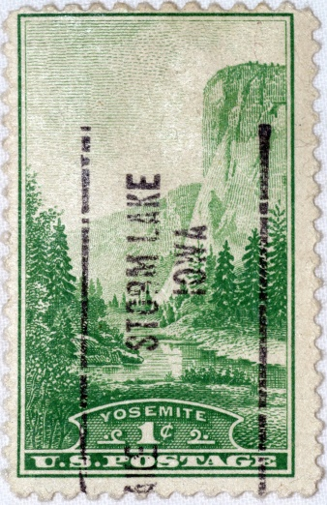
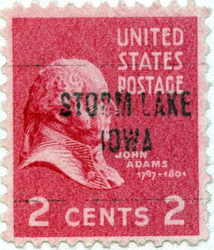
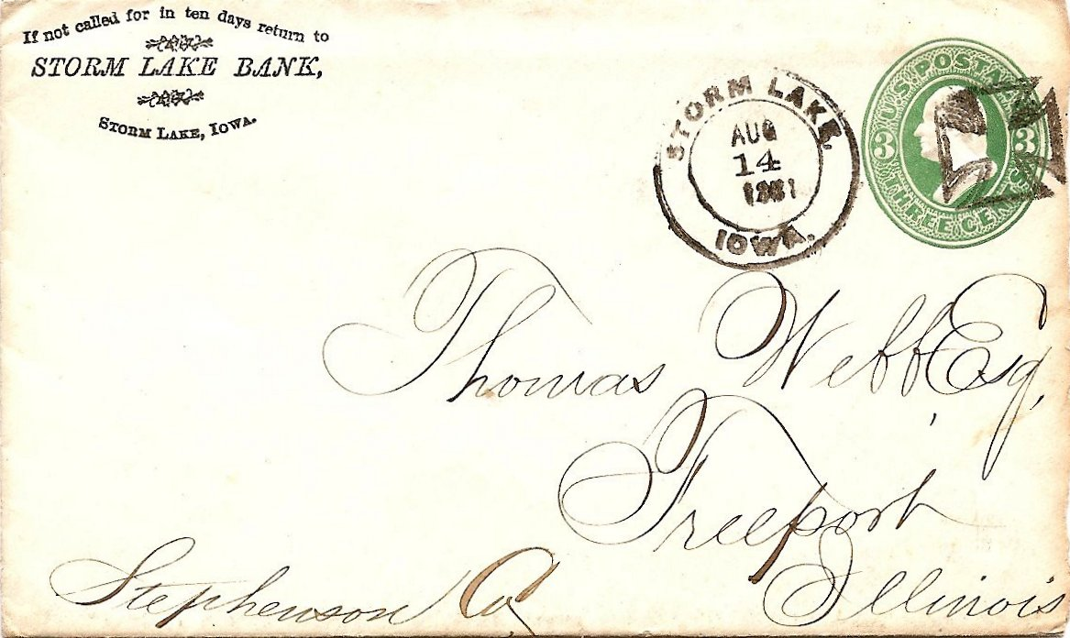
Storm Lake, Iowa
Aug. 14, 1881

Slide 4
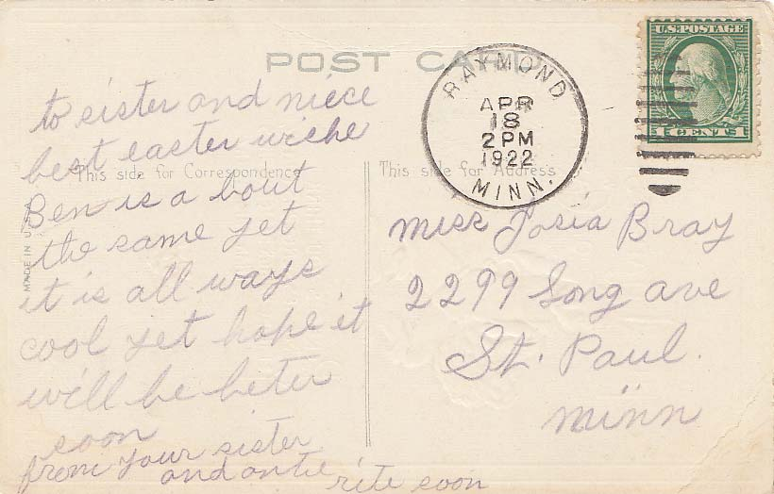
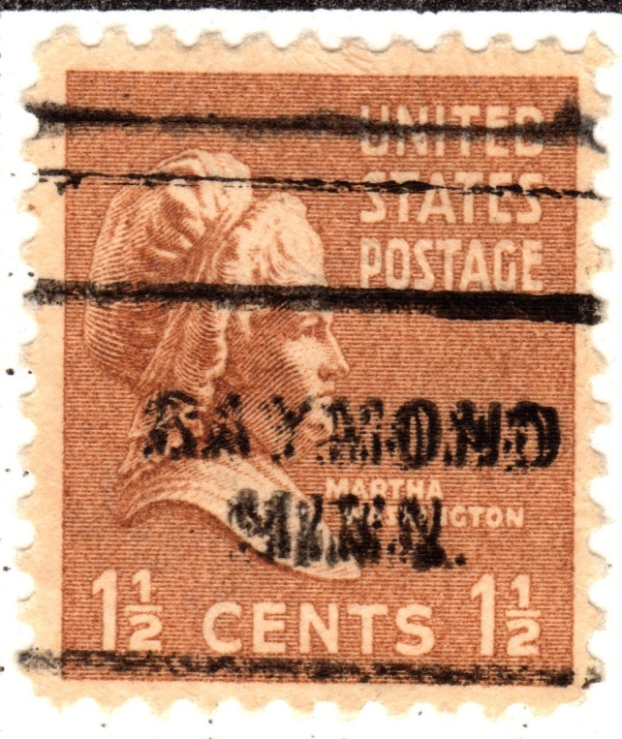
Raymond, Minnesota
Apr. 18, 1922

Slide 5
Minnesota
Glenwood
60
Wisconsin
Raymond
Storm Lake
Iowa
Illinois

Slide 6
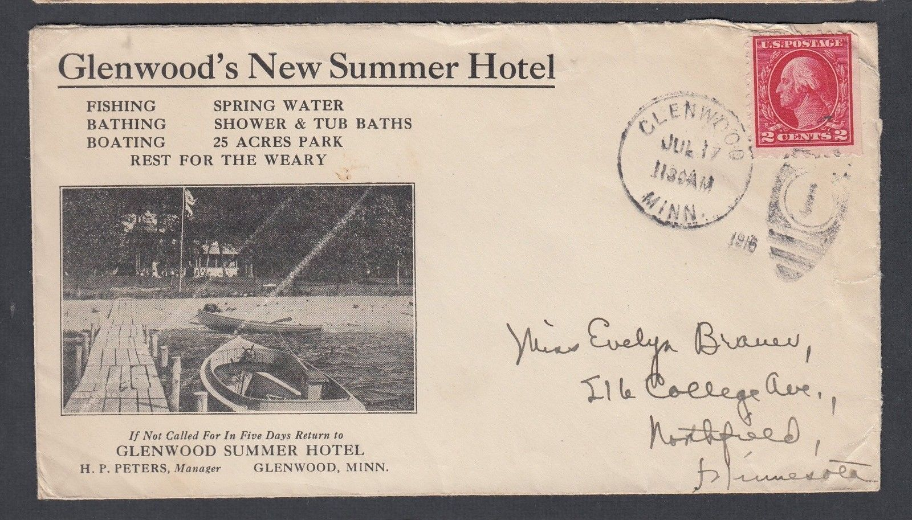
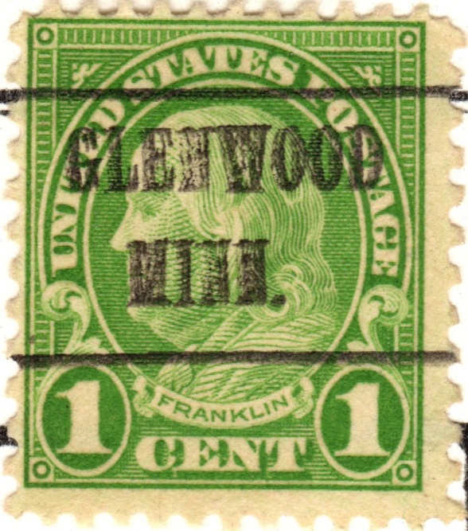
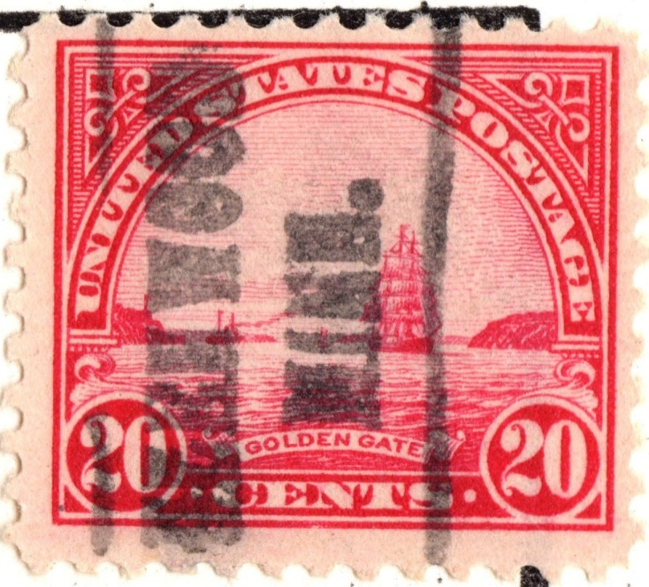
Glenwood, Minnesota
July 17, 1916

Slide 7
Minnesota
Glenwood
Wisconsin
Raymond
225
Storm Lake
Cherokee
Iowa
Illinois

Slide 8
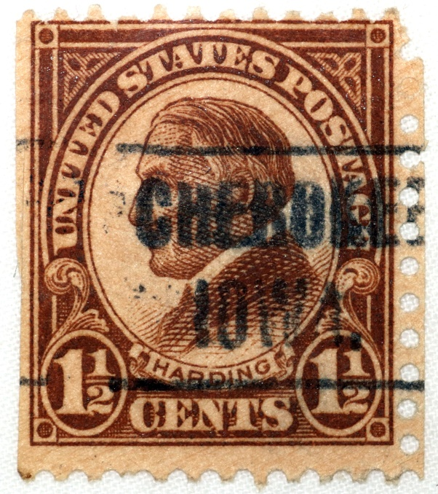
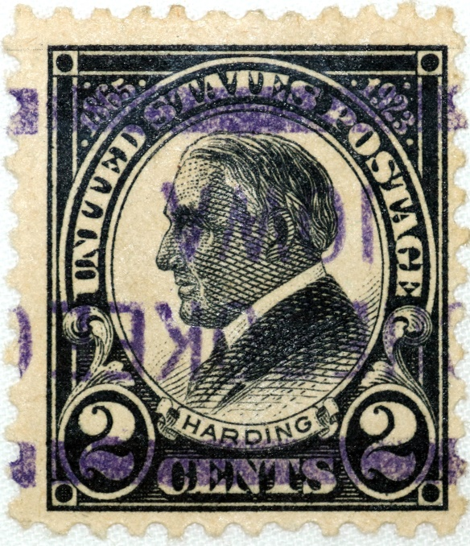
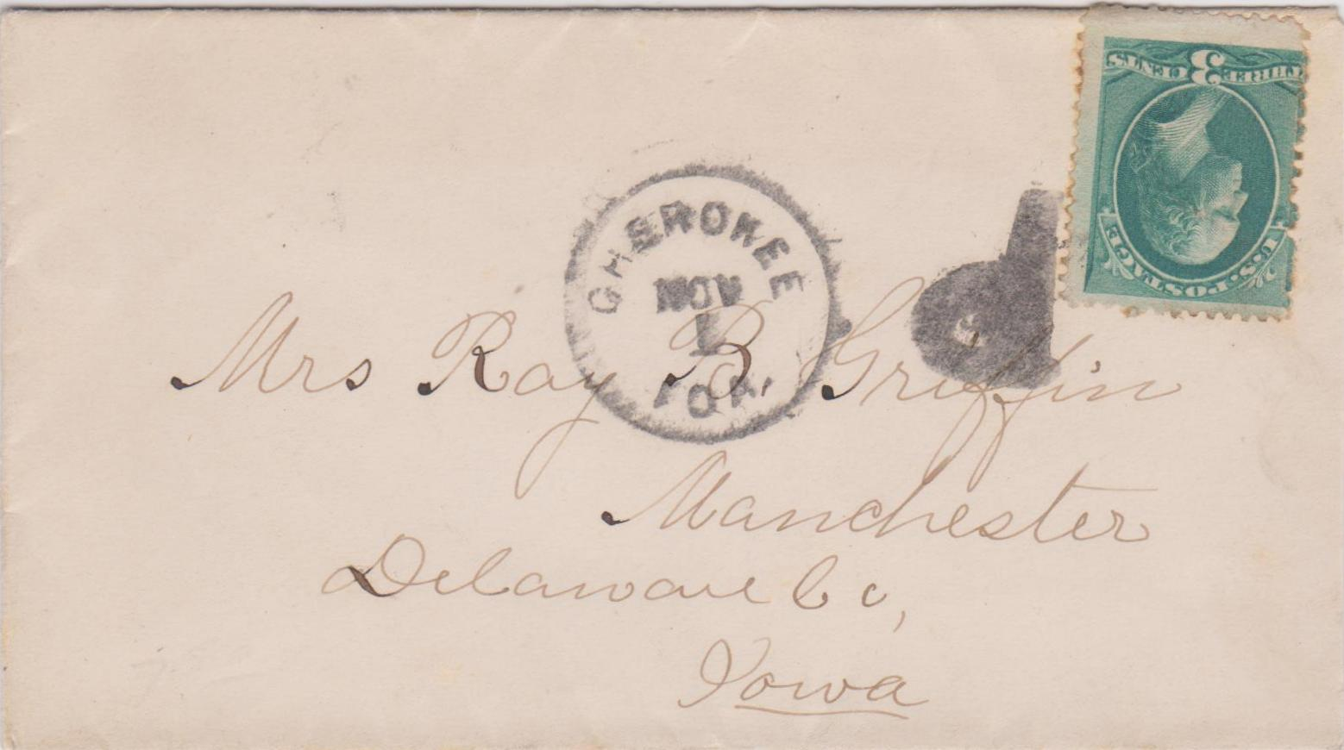
Cherokee, Iowa
Nov. 1

Slide 9
Minnesota
Park Rapids
325
Glenwood
Wisconsin
Raymond
Storm Lake
Cherokee
Iowa
Illinois

Slide 10
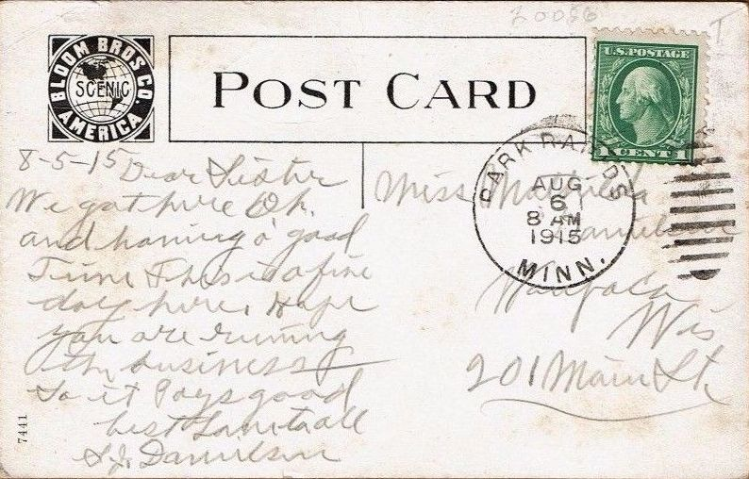
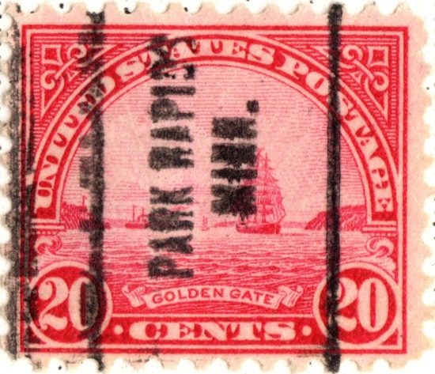
Park Rapids, Minnesota
Aug. 6, 1915

Slide 11
Minnesota
Park Rapids
60
Eagle Bend
Glenwood
Wisconsin
Raymond
Storm Lake
Cherokee
Iowa
Illinois

Slide 12
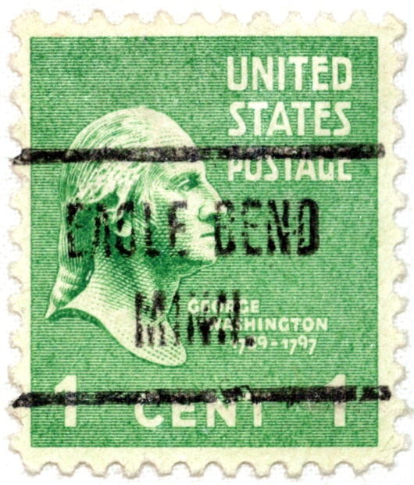
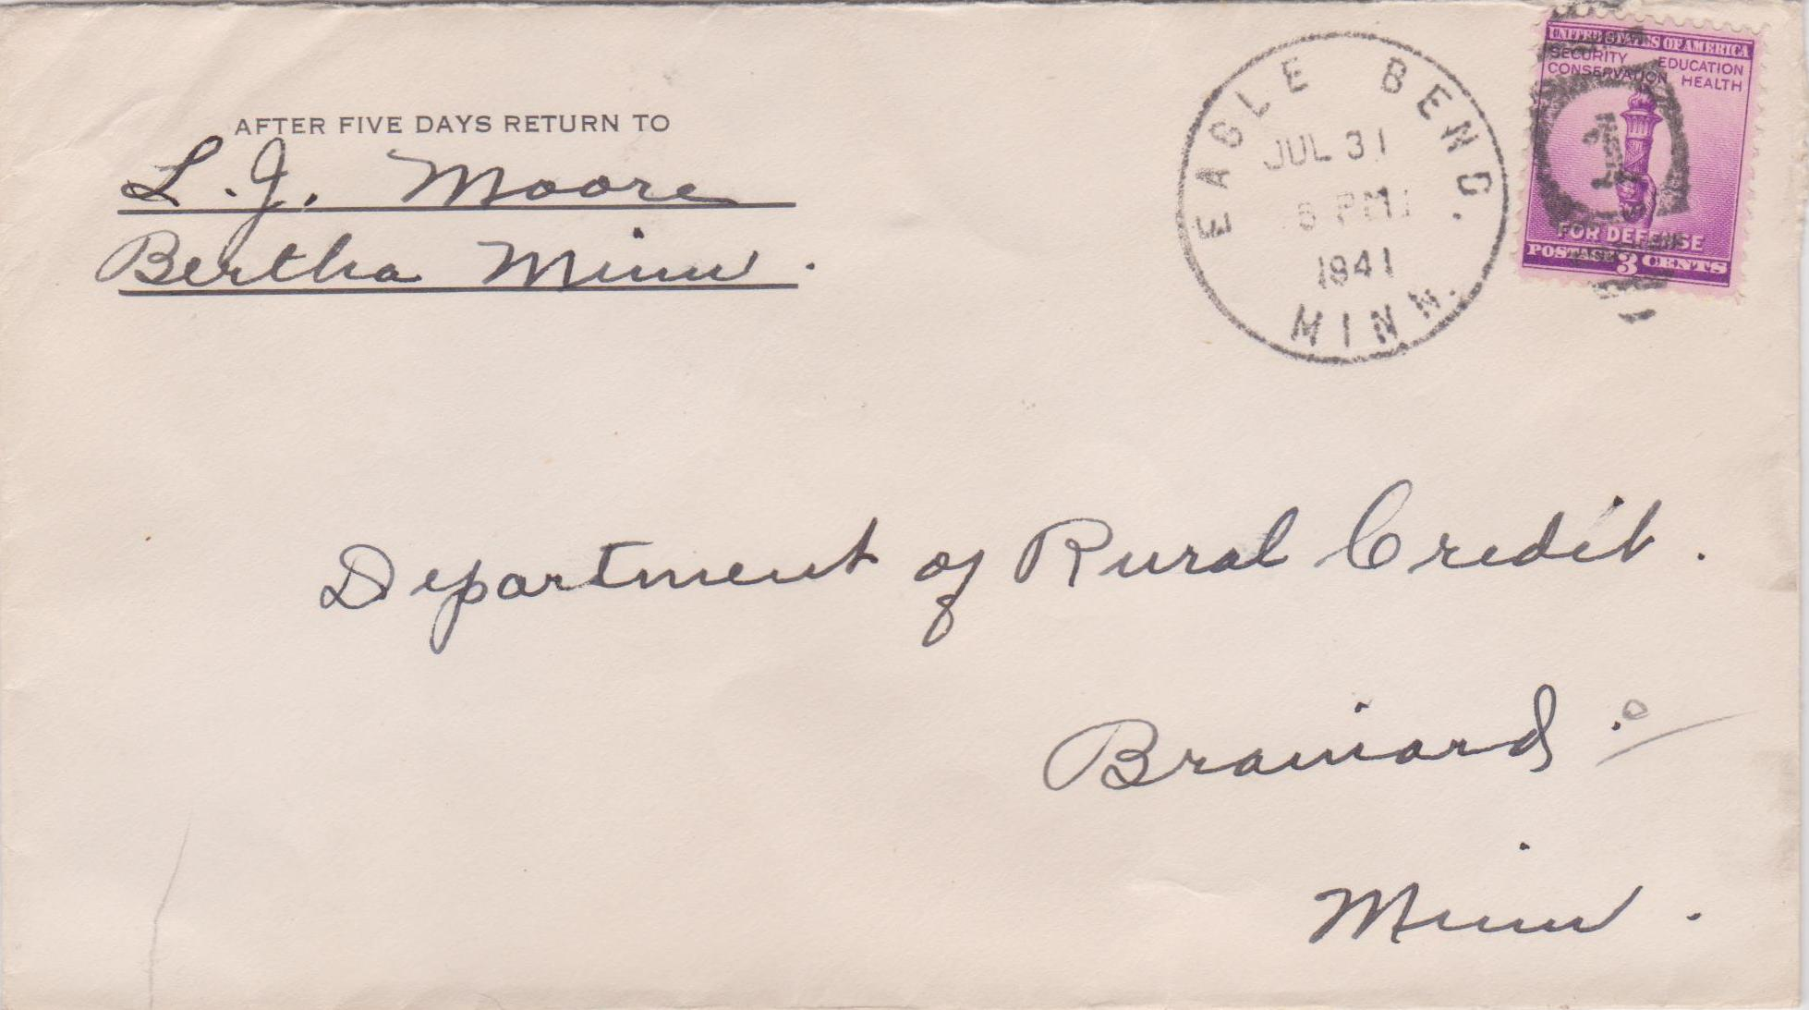
Eagle Bend, Minnesota
July 31, 1941

Slide 13
Minnesota
Park Rapids
Eagle Bend
Wisconsin
Glenwood
Raymond
550
Storm Lake
Cherokee
Sterling
Iowa
Illinois

Slide 14
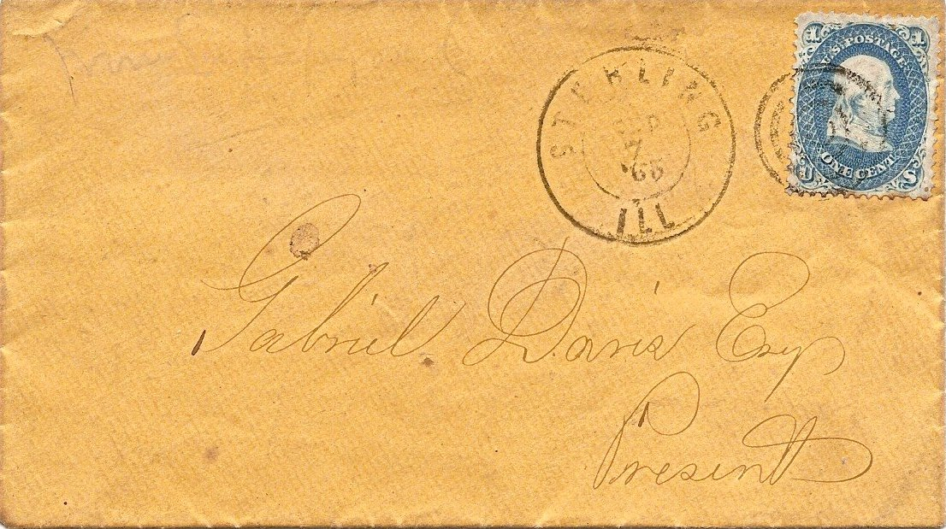
Sterling, Illinois
Sept. 7, 1865

Slide 15
Minnesota
Park Rapids
Eagle Bend
Wisconsin
Glenwood
Raymond
Storm Lake
Milwaukee
160
Cherokee
Sterling
Iowa
Illinois

Slide 16
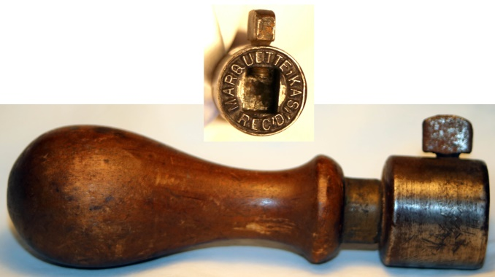
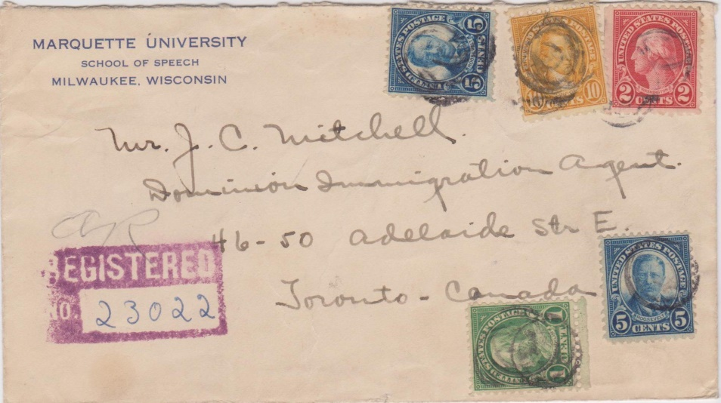
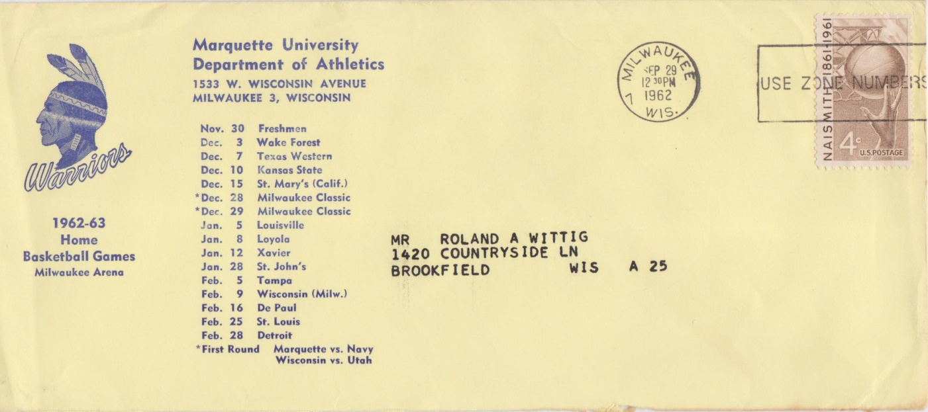
Milwaukee, Wisconsin
1927 Registered
1962-63 Basketball Schedule

Slide 17
Minnesota
Park Rapids
Eagle Bend
Wisconsin
Glenwood
Raymond
Milwaukee
710
Storm Lake
Webster
NY
Cherokee
Sterling
Iowa
Illinois

Slide 18
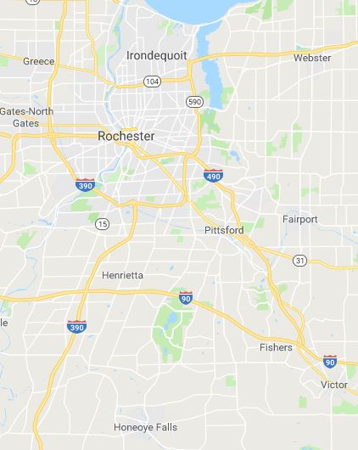
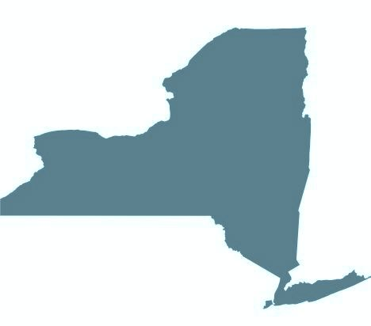
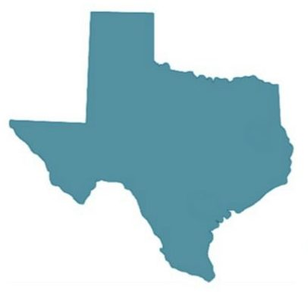
Webster
Henrietta
Rush
New York
Rochester
Fly Creek
Binghamton
Dallas
Texas
Dallas Tx

Slide 19
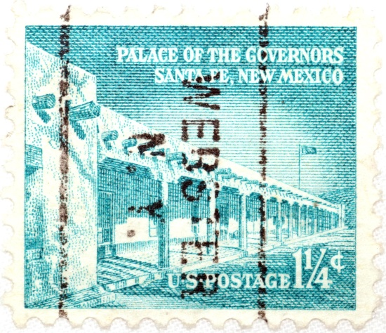
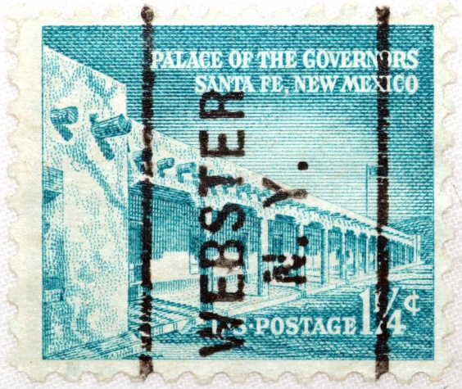
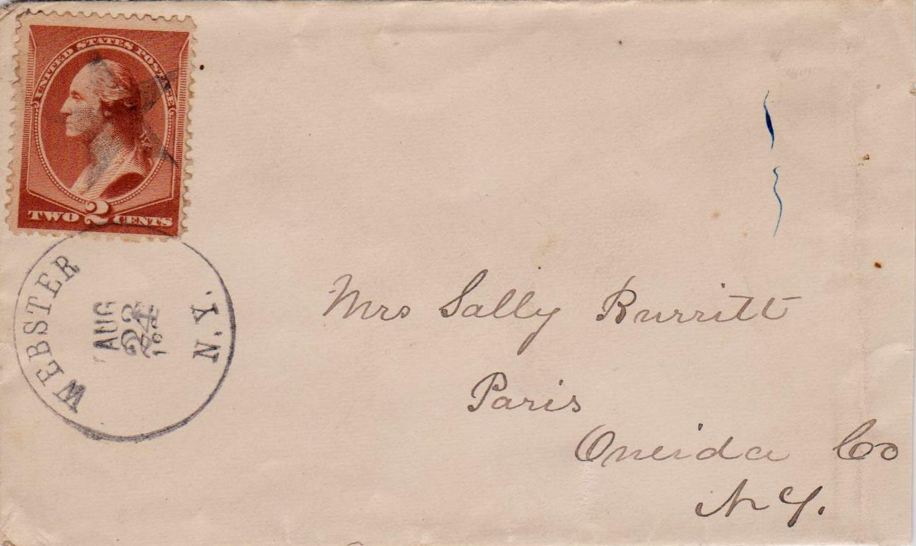
Webster, New York
Aug 23-24

Slide 20
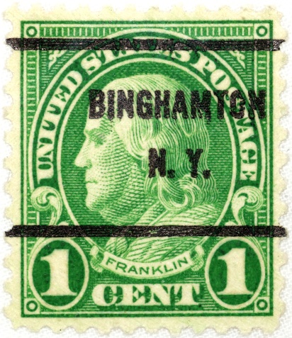
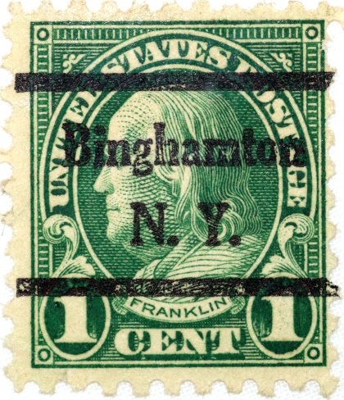
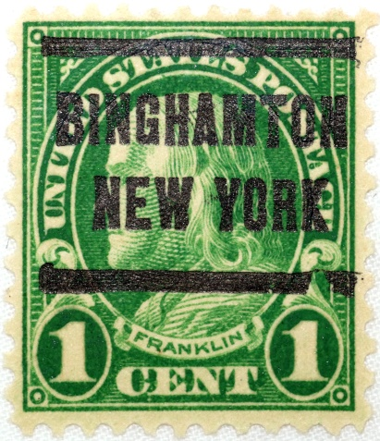
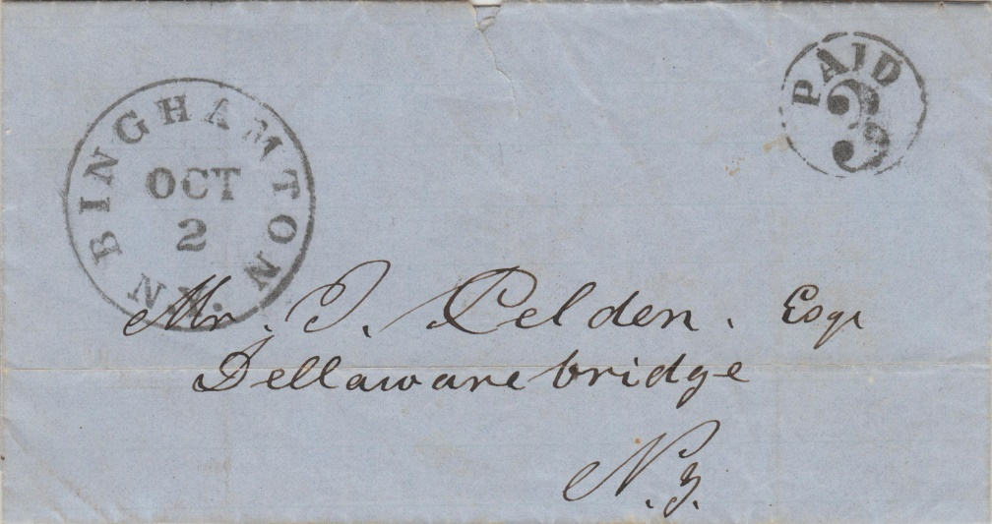
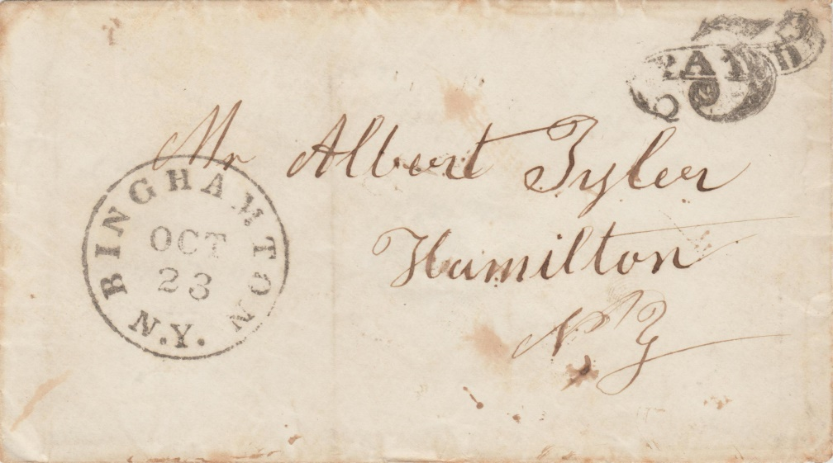
Binghamton, New York
Oct 2
1850’s
Oct 23
1850’s

Slide 21
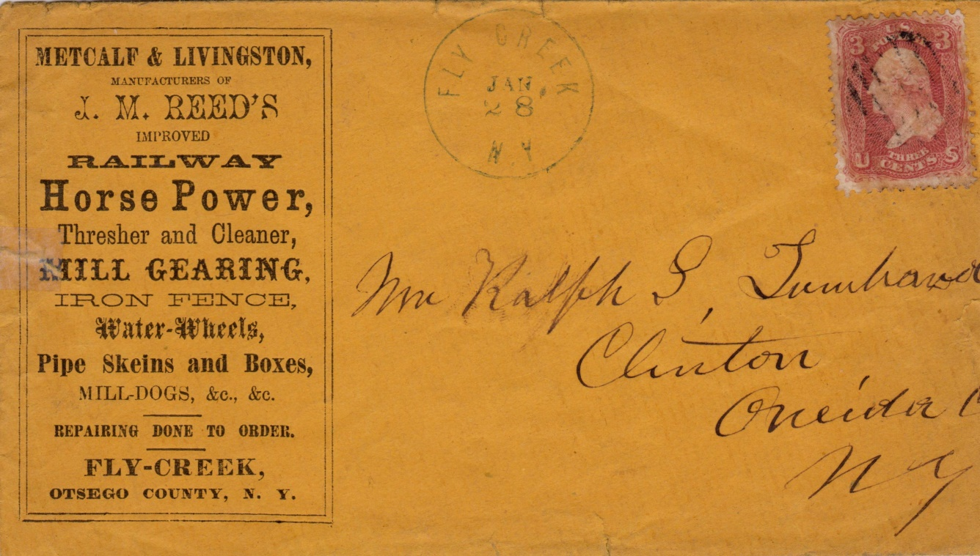
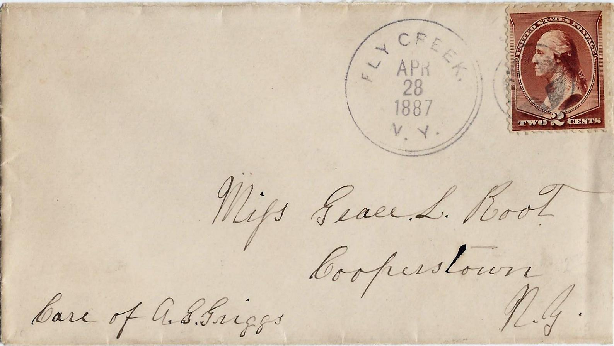
Fly Creek, New York
Jan. 28, 1860’s
Apr. 28, 1887

Slide 22
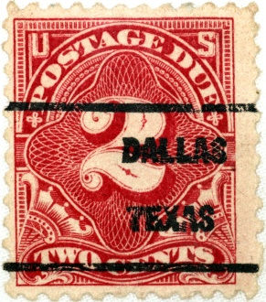
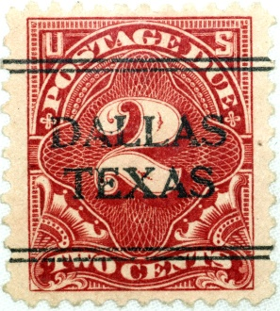
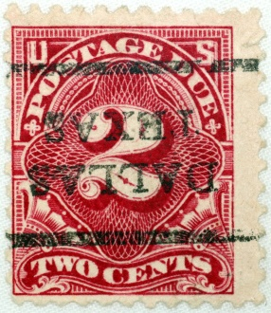
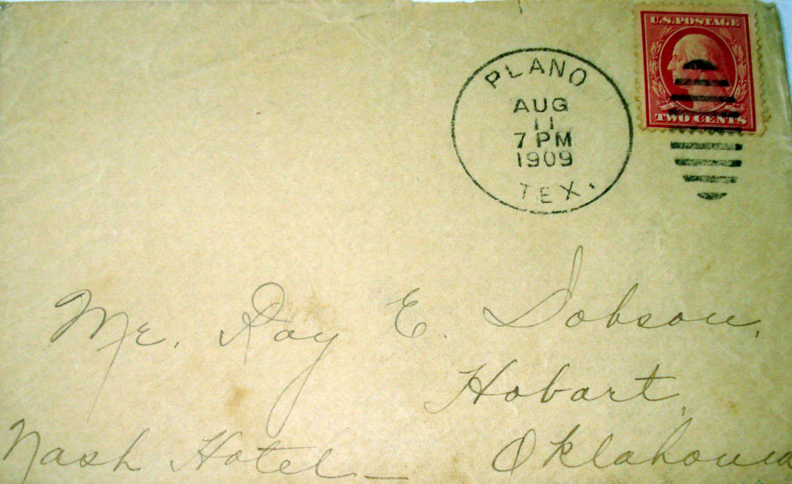
Dallas (Plano), Texas
Aug. 11, 1909

Slide 23
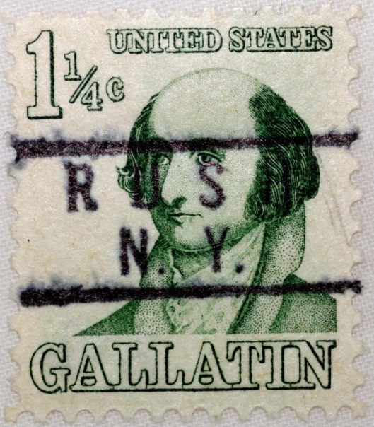
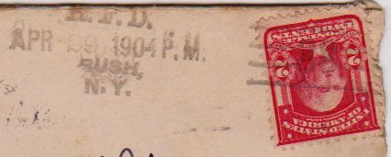
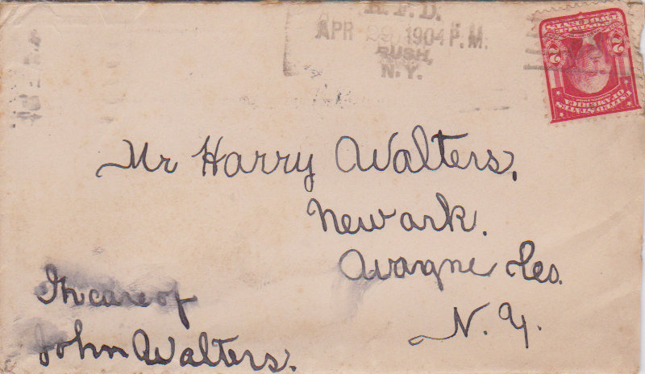
Rush, New York
Apr. 29, 1904

Slide 24
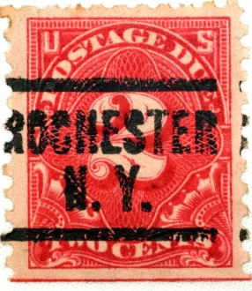
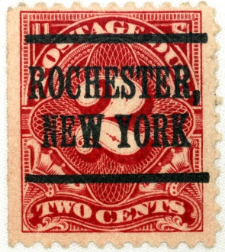
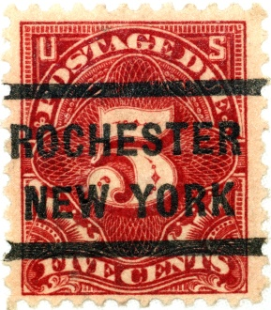
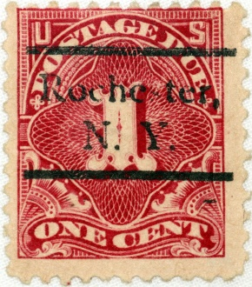
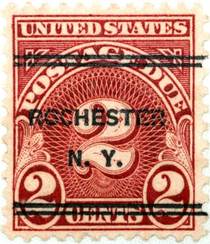
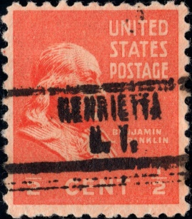
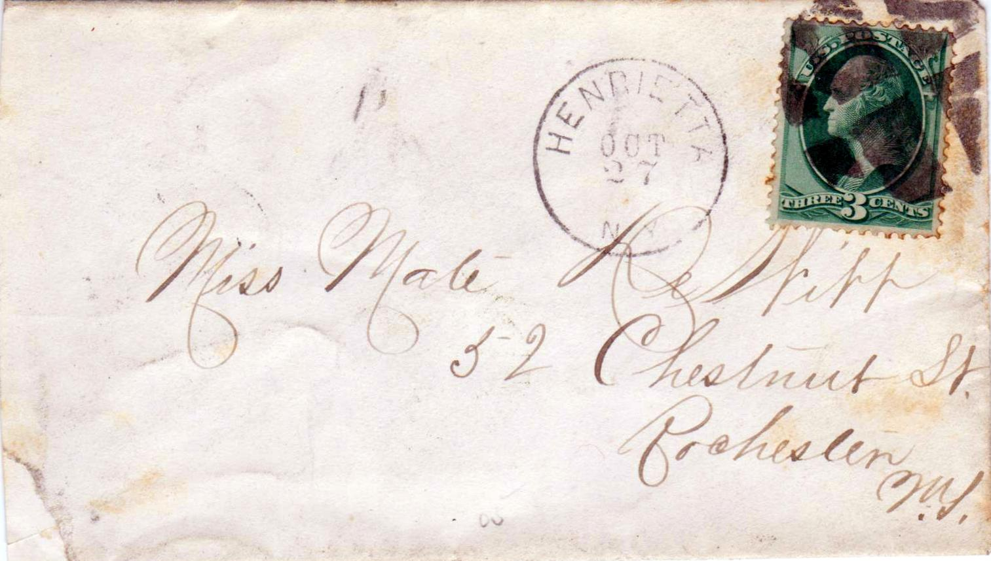
Henrietta, New York
Oct. 27

