Slide 1
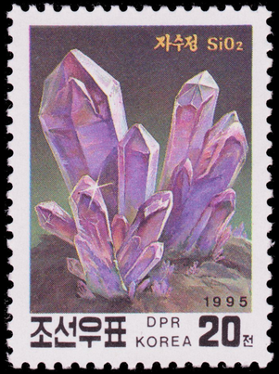
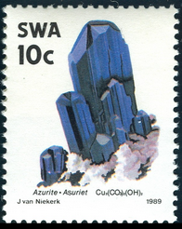
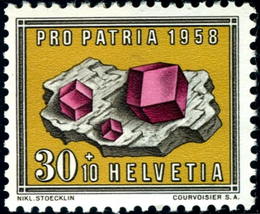
Minerals on Stamps
Fred Haynes
Sept. 23, 2021

Slide 2
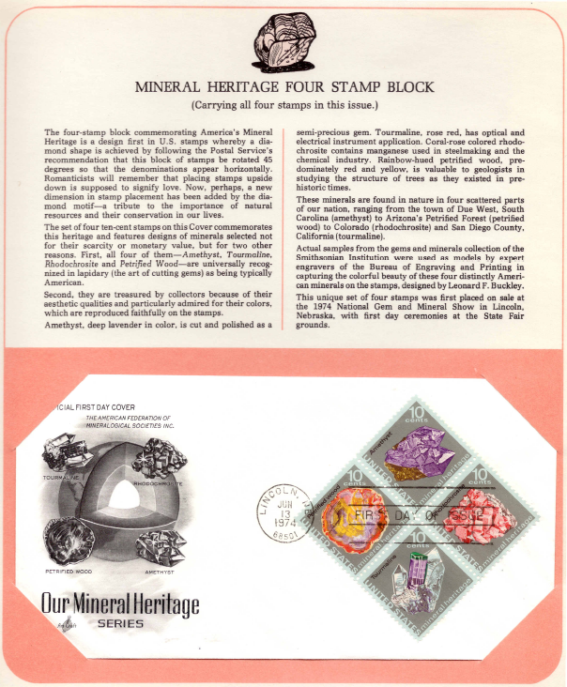
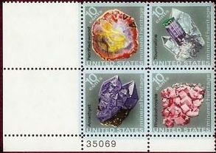
Scott # 1538-1541, June 13, 1974
Petrified Wood – Arizona Petrified Forest
Tourmaline- San Diego County, CA
Rhodochrosite – Sweet Home Mine, Colorado
Amethyst – Due West, SC
All are Smithsonian samples designed by Leonard Buckley. First Day cover issued in Lincoln, NB at the 1974 National Gem and Mineral Show.

Slide 3
The Postage Stamp Tourmaline
Pen and ink drawing of “The Postage Stamp Tourmaline” by W. Wilson
Tourmaline Queen Mine,
San Diego, CA
From T. Praszkier,
Minerals Magazine #5, 2012
One of the few specimens from a famous 1913 pocket that was not processed for gems. The 7 centimeter tourmaline offset by two equally attractive terminated quartz crystals found a permanent location on a US postage stamp and could be had for 10 cents in 1973.

Slide 4
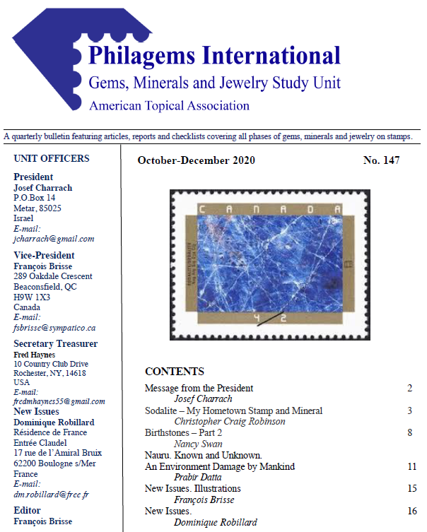
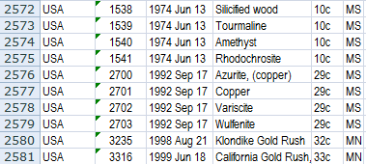
GMJSU Checklist (sortable)
The GMJSU checklist includes over 2700 entries. Just over 1500 are identifed as MS (mineral specimens) or GS (gemstones). The rest include mining stamps, some geology, and a few fossils, jewelry/ artifacts, and other related topics. This list seems fairly complete for minerals, but is not inclusive for other items.
UNFORTUNATELY THE LAST UPDATE WAS IN 2011 !!

Slide 5
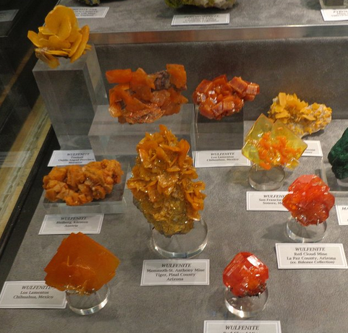
PbMoO₄ is
LOVE
Red Cloud Mine

Slide 6
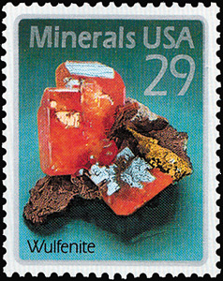
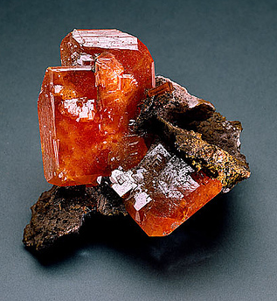
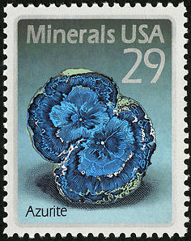
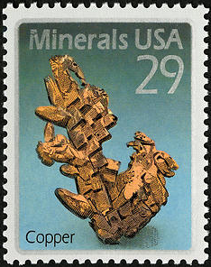
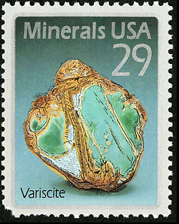
PbMoO₄ is LOVE
Four mineral stamps designed by Leonard Buckley from specimens in the Baird Auditorium of the Smithsonian Museum of Natural History. Printed by offset/intaglio process and issued in panes of 40. Issued Sept. 17, 1992 for domestic postage.
THE ACTUAL SPECIMEN
Americans mined wulfenite and silver at the Red Cloud Mine in Arizona from the 1860’s until 1890, and then sporadically until 1941. Red Cloud wulfenites are among the best in the world because of their deep orange-red colors and their unusual size and perfection.

Slide 7
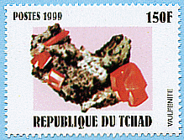
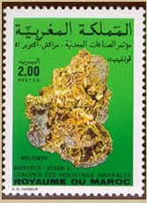
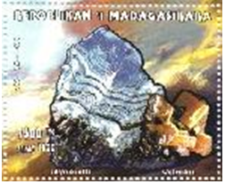
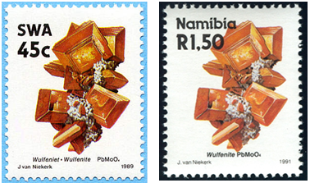
PbMoO₄ is LOVE

Slide 8
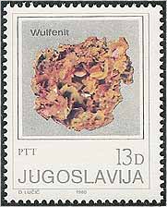
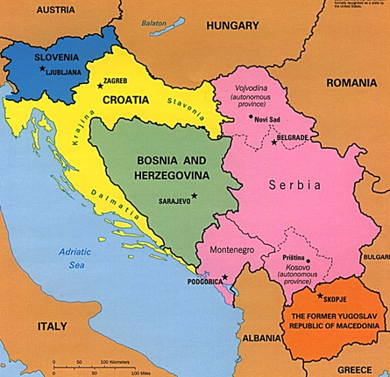
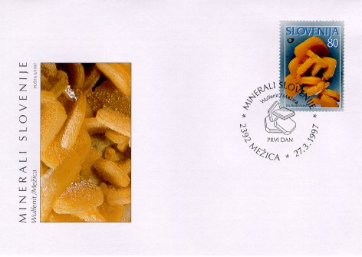
PbMoO₄ is LOVE
Yugoslavia Scott # 1501, part of set of 4, issued Sept. 10, 1980
Mezica in Slovenia – World-Famous Wulfenite Locality
by Dalibor Valebil – Nat’l Mus., Prague, Czech Republic
At the lead and zinc deposit between Mezica and Crna in Slovenia lead was mined from the 17th century until 1994. Since the 19th century zinc was processed in addition to lead. As a secondary ore, wulfenite was mined for its molybedenum.
Extracted from Mineral Magazine 2005, v. 13 #2 pg. 105-112
1991-pres
1941-1945, 1991-pres
1879-1917, 1993-pres
1866-1918, 2003-pres
1874-1913, 2003-pres.
2008-pres
1991-pres
FDC of Scott #286, March 27, 1997
Yugoslavia 1918-2003

Slide 9
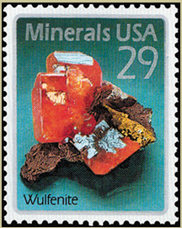
PbMoO₄ is LOVE
Red Cloud Mine
collected March, 1981
Geronimo Mine
collected March, 1981

Slide 10
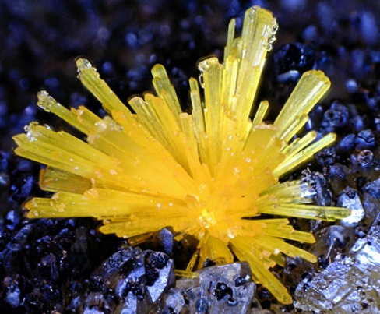
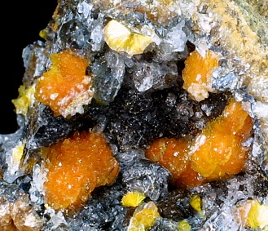
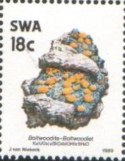
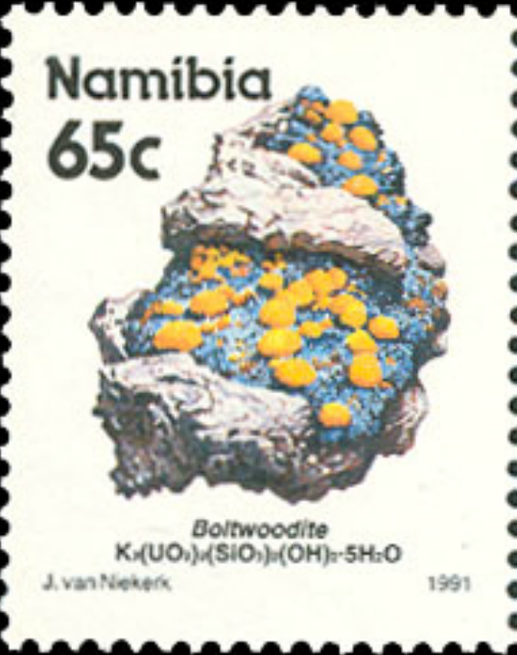
Stamp Error
BOLTWOODITE
BOLTWOODITE
Scott #631, issued 11/16/89
Scott #631A, issued 10/25/90
Scott #685, issued 1/2/92
K(H₃O)(UO₂)(SiO₄)
Incorrect formula
Corrected formula K₂(UO₂)₂(SiO₃)₂(OH)₂·5H₂O

Slide 11
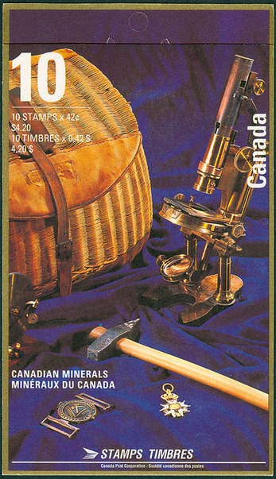
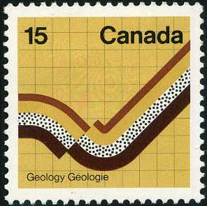
CANADA
Scott #582, Aug. 2, 1972
From a set of 4 commemorating national science conferences, this stamp depicts a normal fault in layered and folder rock, while commemorating the 24th International Geological Congress, held in Montreal
Scott #1436-1440, Sept. 21, 1992

Slide 12
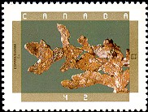
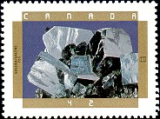
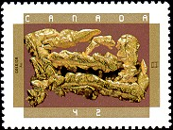
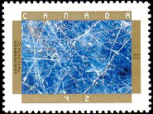
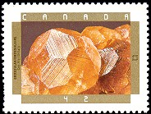
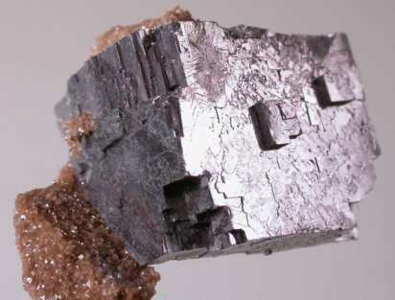
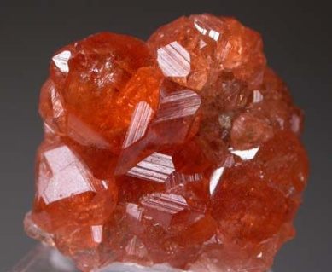
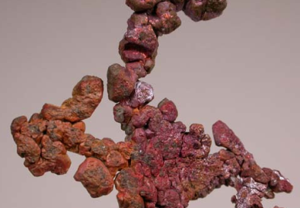
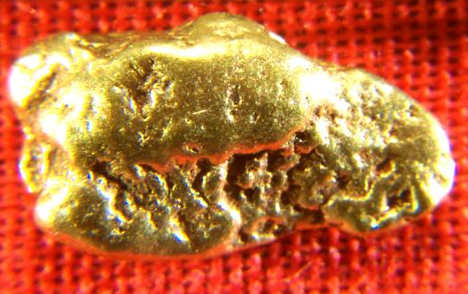
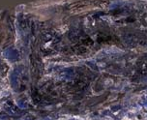
CANADA
Scott #1436-1440, Sept. 21, 1992
Native Copper
Galena
Native Gold
Sodalite (polished)
Garnet (grossular)
Colonial Copper Mine, Cap D’Or, Nova Scotia
Flamboro Quarry, Wentworth, Ontario
Gold, Klondyke District, Yukon
Princess Mine, Hastings Co., Ontario
Jeffrey Mine, Asbestos, Quebec

Slide 14
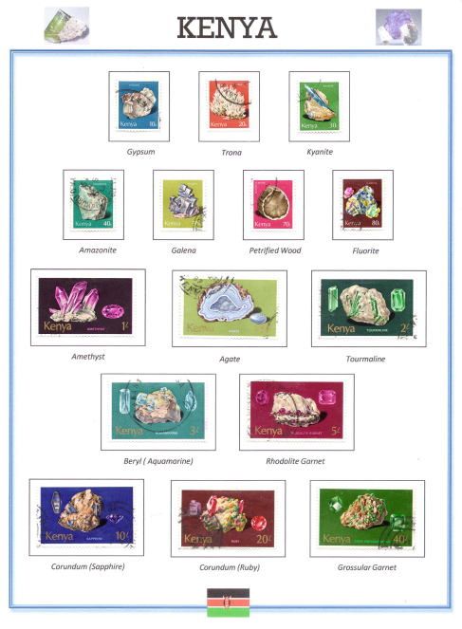
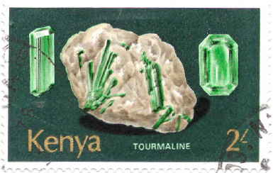
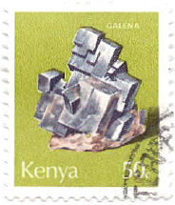
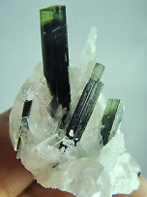
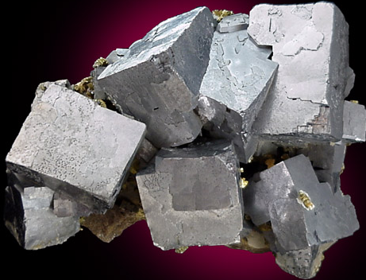
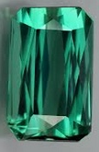
Kenya – Scott # 98-112
December, 1977
Tourmaline (var. Elbaite)
Galena – PbS (cubic)

Slide 15
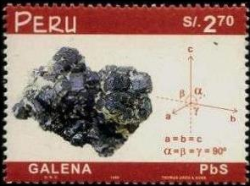
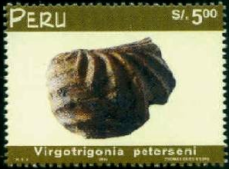
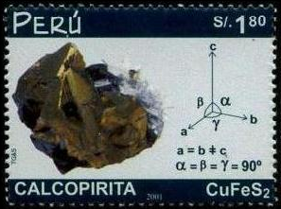
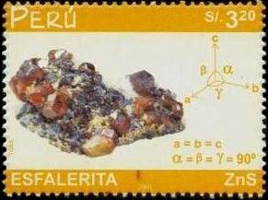
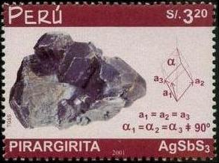
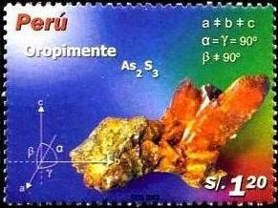
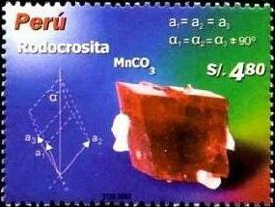
PERU
July 1999
Scott 1230-32
Galena – PbS Scheelite – CaWO₄ Fossil Bivalve
July 2002
Scott 1339-41
Chalcopyrite – CuFeS₂ Sphalerite – ZnS Pyrargyrite – AgSbS₃
Jan. 2004
Scott 1372-73
April 2006 Scott 1514
Orpiment – As₂S3 Rhodochrosite – MnCO₃ Huebnerite – MnWO₄

Slide 16
SPAIN
Scott #2763a-d
Feb., 1994
Cinnabar – HgS Sphalerite – ZnS
Pyrite - FeS2 Galena - PbS
The center labels with the 4 stamps depicts the main floor of the Museo Geominero (Geomineral Museum) in Madrid. The museum is the home for over 8000 mineral specimens in 250 glass cabinets.

Slide 17
ICELAND
A
B
Scott #862, 1998
Stilbite from Teigarhorni (B)
Scott #885, 1999
Calcite from Helgustodum (A)
Some interesting notes about Teigarhorni
Zeolites from here considered world’s best
Now a Historic Preservation Site
Highest recorded temperature in Iceland
was in Teigarhorni on June 22, 1939
30.5°C, 86.9°F
Miner’s in Helgustodum silver mine, 19th century

Slide 18
HONG KONG
Scott #994-997
Sept., 2002
Siltstone
(Ping Chau)
Conglomerate
(Port Island)
The rock outcrop portions of these stamps were applied with a thermographic process, producing a shiny raised surface
Tuff
(Po Pin Chau)
Granite
(Lamma Island)

Slide 19
FLUORITE
France, #2020, 1986
Germany #1106, 1969
South-West Africa,
#627, 1989
Fluorite from Penfield Quarry
Thailand #1348, 1990
Algeria #713, 1983
Fluorite on dolomite, Walworth Quarry

Slide 20
MALACHITE
Zaire #1102, 1983
Dem. Rep. of Congo
Cu₂CO₃(OH)₂
Uganda #649, 1988
Morocco, #648, 1987

Slide 21
October 6, 2006 in New York, NY
Original photos
Physicist Kenneth Libbrecht of Pasadena, CA photographed snowflakes inside a temperature regulated enclosure with a digital camera attached to a high resolution microscope.
The crystals appear blue because Libbrecht illuminated them with a bluish white light. The patterns are stellar dendrites, which form branking arms and hexagaonally sectored plates.
Richard Sheath cut the flakes out digitally in designing the stamps for the post office.
The upper right snowflake was memorialized on film in Fairbanks, Alaska, the lower left in Houghton, Michigan and the other two in northern Ontario.

Slide 22
October 6, 2006 in New York, NY
Original photos
Physicist Kenneth Libbrecht of Pasadena, CA photographed snowflakes inside a temperature regulated enclosure with a digital camera attached to a high resolution microscope.
The crystals appear blue because Libbrecht illuminated them with a bluish white light. The patterns are stellar dendrites, which form branking arms and hexagaonally sectored plates.
Richard Sheath cut the flakes out digitally in designing the stamps for the post office.
The upper right snowflake was memorialized on film in Fairbanks, Alaska, the lower left in Houghton, Michigan and the other two in northern Ontario.
October 1, 2013, presorted postage, sold in rolls of 10,000 coiled stamps

Slide 23
Libbrecht went to Kiruna in northern Sweden to photograph Swedish snowflakes for a series of five 12 kroner stamps issued on November 18, 2010
Not to be outdone, Austria issued stamps depicting 20 of Libbrecht’s creations.

Slide 24
Snowflakes form when water vapor condenses directly into ice.

Slide 25
Maxicards - Liechenstein
Scott #921 (Dec. 4, 1989)
Scepter quartz
Scott #922 (Dec. 4, 1989)
Pyrite nodule
Scott #923 (Dec. 4, 1989)
Calcite rhombs

Slide 26
Maxicards – South Africa
Scott #630-633, 1984
Cr
V
Ti
Mn
Production through 2000 Rank Reserves % in SA

Slide 27
terres australes et antarctiques françaises
Territory of the French Southern and Antarctic Lands
analcime mordenite “mesotype” aragonite
rutile magnetite garnet (almandine)
ilmenite epidote spinel sphene (titanite)

Slide 28
Unusual Minerals on Stamps
Wolframite
(Fe,Mn)WO₄
Scott #1106 (1971)
Ethyrite
Co₃(AsO₄)₂.8H₂O
Scott #1105 (1969)
Wavellite
Al₃(PO₄)₂(OH)₃.5H₂O
not recgonized
Columbite-Tantalite
(Fe,Mn)Nb₂O₆
Scott #599 (1988)
Collected by Fred Haynes
National Limestone Quarry, Mount Pleasant Mills, PA

Slide 29
Unusual Minerals on Stamps
Cordierite
(Fe,Mg)₂Al₃Si₅AlO₁₈
Scott #194 (1994)
Crocoite
PbCrO₄
not recognized
Scolecite
CaAl₂Si₃O₁₀.3H₂O
Scott #863 (1998)
Dioptase
CuSiO₃ .H₂O
Scott #679 (1991)

Slide 30
Gems on Stamps
Emerald Ruby
Blue Sapphire Cat’s Eye
Star Sapphire Ruby
Sapphire Peridot

Slide 31
GEMS from Rhodesia
GEMS from Rhodesia - Zimbabwe
Rhodesia Scott #393-397, Aug. 1978
Beryl Quartz Garnet Quartz Topaz
Morganite Amethyst Pyrope Citrine Blue
Zimbabwe Scott #414-418, April, 1980
In April of 1980 Rhodesia finally achieved de jure sovereignty from the United Kingdom and was renamed Zimbabwe. From 1965-1980 the landlocked country in southern Africa was an unrecognized state after unilaterally declaring itself free of the British Empire.
As a result of the 1980 indepedence, this set of gem stamps was simply re-issued under the new name for the country.

Slide 32
Southern Rhodesia to Rhodesia to Zimbabwe
Angola
Zambia
Tsumeb
ZIMBABWE
Mozambique
Namibia
Botswana
South Africa
Lesotho
Swaziland/Eswatini in 2018

Slide 33
Diamonds and Diamond Mining
Russia
Zimbabwe
Tanzania
South-west Africa
Thailand
Togo
Tanzania
Botswana
Namibia

Slide 34
GOLD
May, 1980
In South Africa
w/ 10 kg Au bar

Slide 35
Thank you

