Slide 1

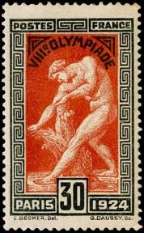

1924 Paris Olympics–
Milo of Croton:
From Design to Use
A traditional approach to the stamp’s “birth” and “life.”
A Presentation for the Rochester Philatelic Association
by Tom Fortunato

Slide 2
Once upon a time in France…
This is the story of the creation of a postage stamp from design through to its printing and uses. It deals with a stamp I’ve been interested in for some time, the 1924 French “Milo of Croton” issue, part of a set commemorating the 1924 Paris Olympic Games. Unlike today’s modern issues, producing a stamp like this one went through a labor-intensive process. The following presentation will take you through various stages of its design, production and use.

Slide 3
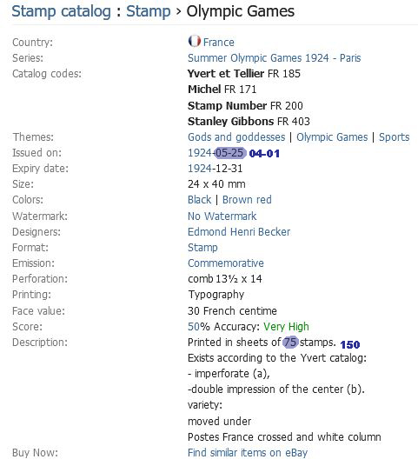
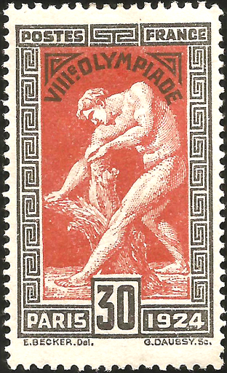
Here’s a peek at data about the stamp we’ll be looking at. It depicts Milo, a famous wrestler born in Croton, southern Italy, in what was then a Greek colony. This six-time ancient Olympiad champ was the ideal persona for a modern Olympic issue.

Slide 4
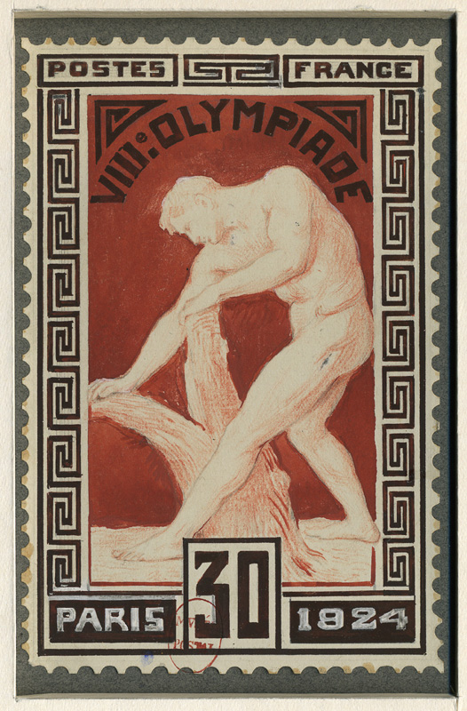
DESIGN
The stamp creation process starts with an artist drafting sketches of design ideas. Often they start out as rough images that eventually progress to large drawings or paintings of what is hoped would be finally accepted. This is the final image designed by Edmond Henri Becker submitted to French postal officials for their approval, modeled after a sculpture by

Slide 5
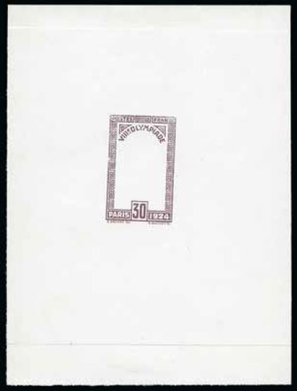
As this stamp uses two colors, both black and brown-red elements needed to be engraved, eventually coming together in the final stage.
Master engraver G. Daussy turned the frame and vignette designs into dies.
Here is a die proof of the frame in violet brown ink and printed on glossy paper.

Slide 6
It was common practice to print examples of die proofs in various trial colors and on different types of paper.
dark blue
red

Slide 7
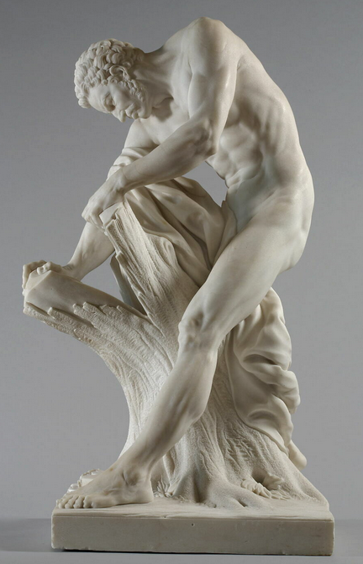
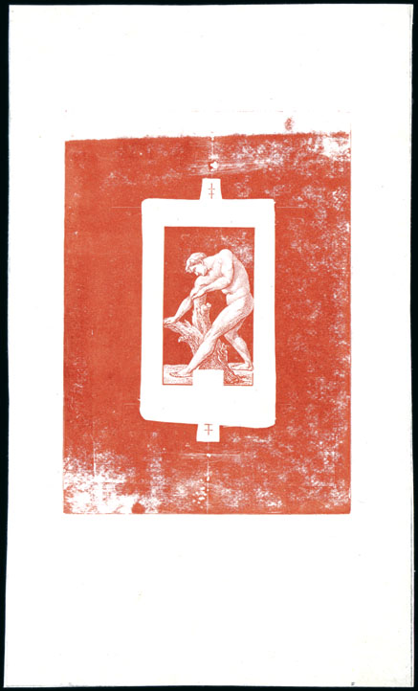
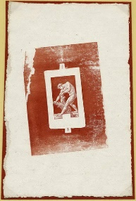
The vignette, modeled after a Louvre marble sculpture of Milo from 1768 by Edme Dumont, underwent several color trials.
blue
red w/printing
block surround
brown w/printing
block surround

Slide 8
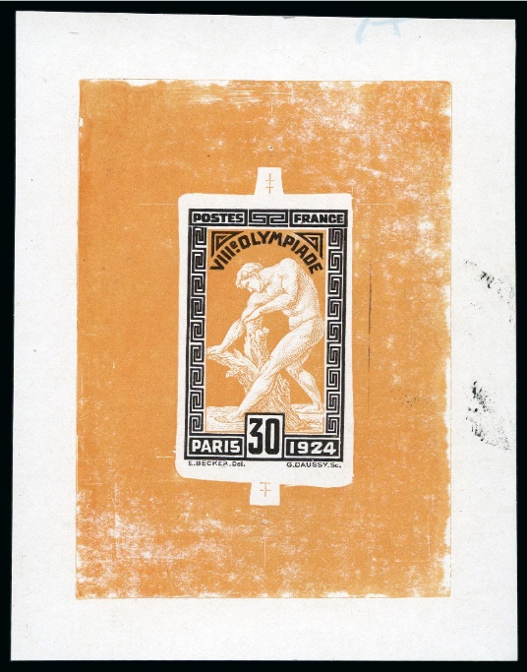
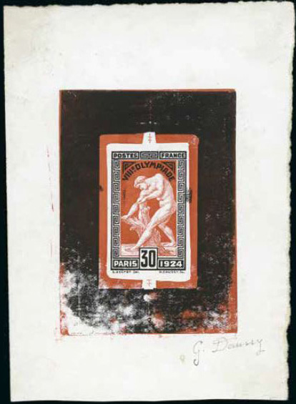
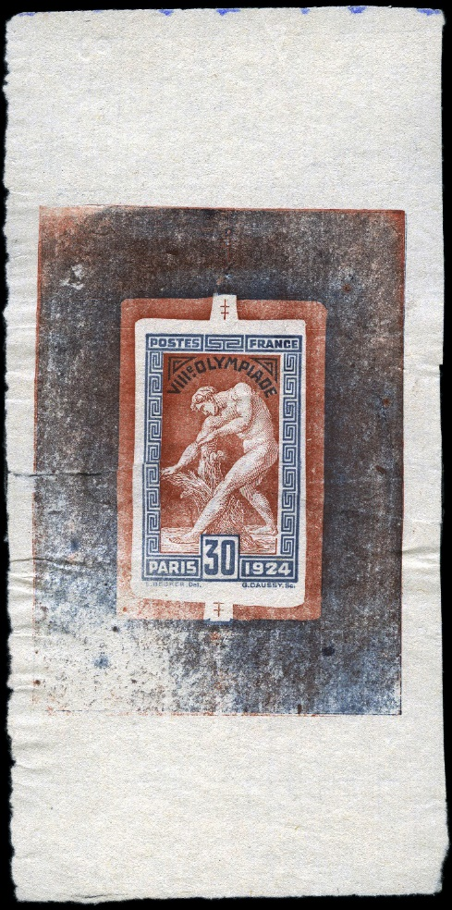
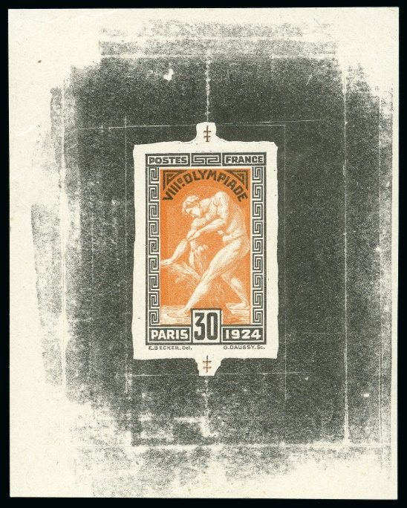
With the final die completed, duo color trial proofs began. Here are a few with printing block surround ink added...
orange-brown and black
dark orange and black
dull red and black (as issued)
red-brown and dark blue

Slide 9
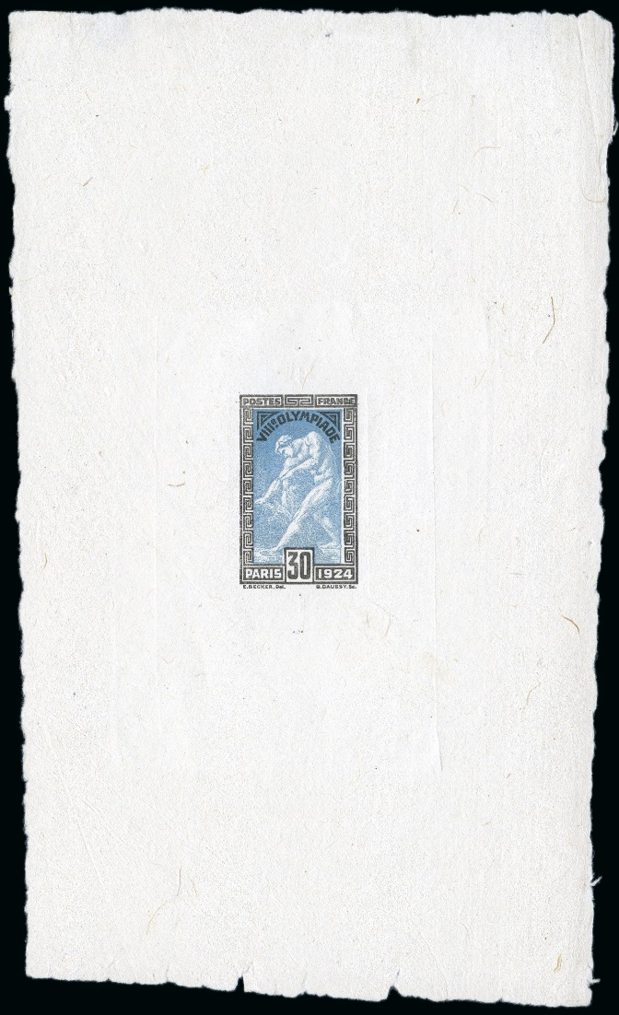
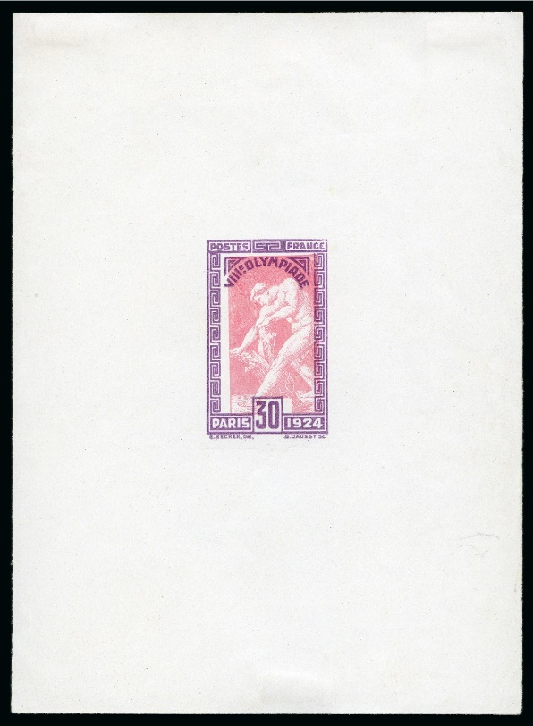
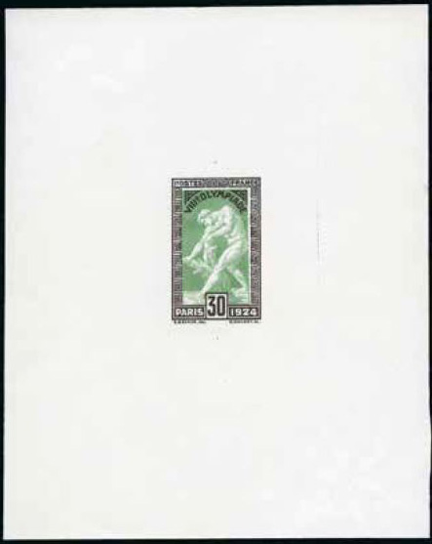
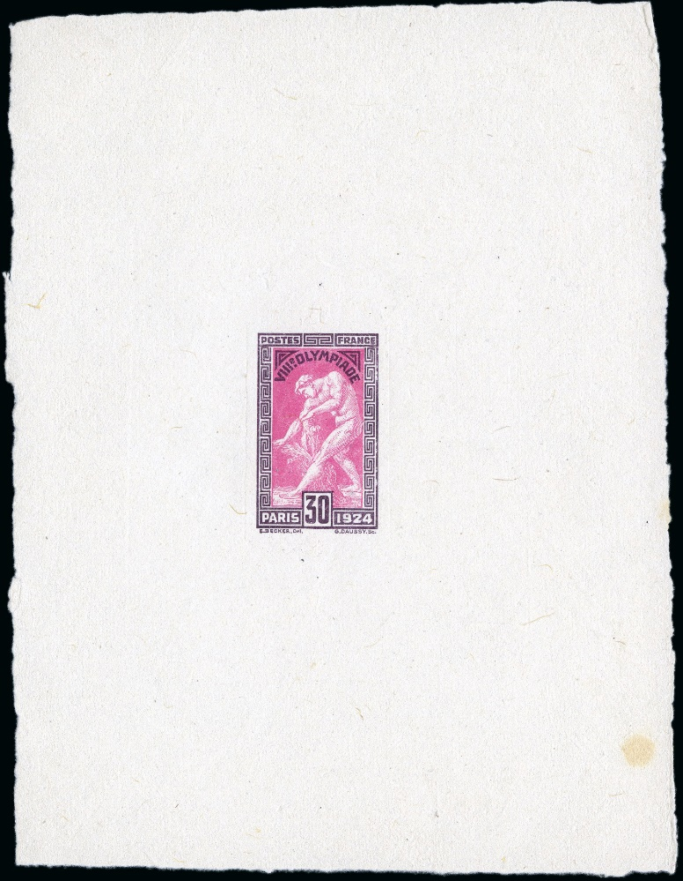
…and here are some without.
grey and red
rose and purple
green and black
bright mauve and dark purple
light blue and black

Slide 10
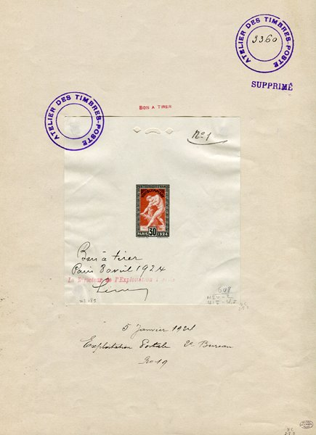
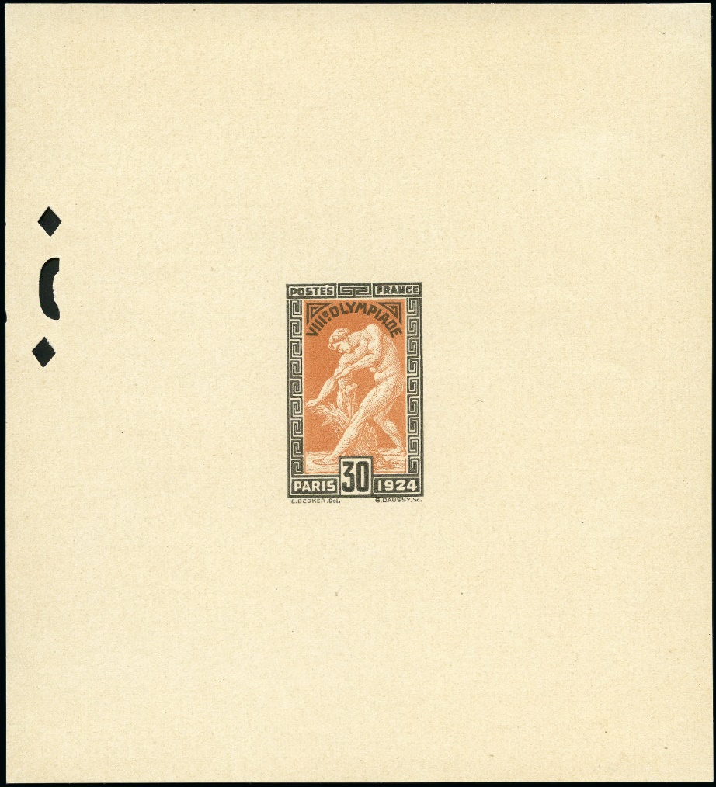
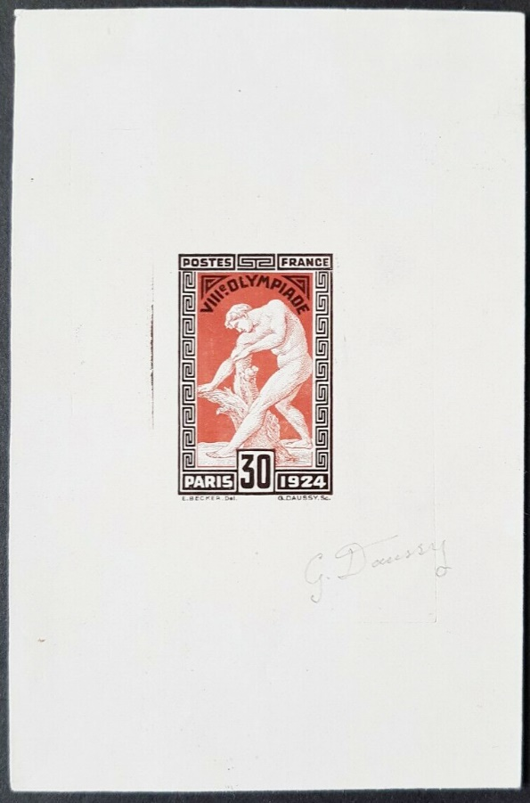
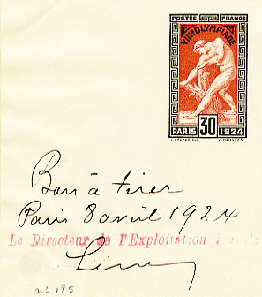
Final proofs in the approved colors.
final proof pull, Jan. 5, approved Jan. 8, 1924 (unique, now at the Lausanne Olympic Museum)
engraver signed
presentation proof with
control holes (1 of 10)

Slide 11
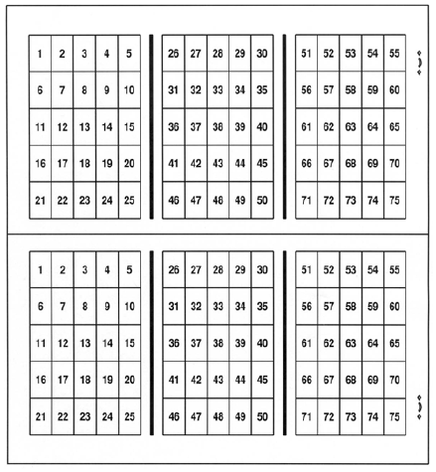
PRODUCTION
The stamps were printed by the French Government Printing Works by typography, the opposite of engraving, where the design is raised in relief above the printing plate that gets inked and under pressure transfers the image to the paper. Each press sheet contained 150 stamps cut in half (2 panes of 75 each) when delivered to post offices per this diagram.

Slide 12
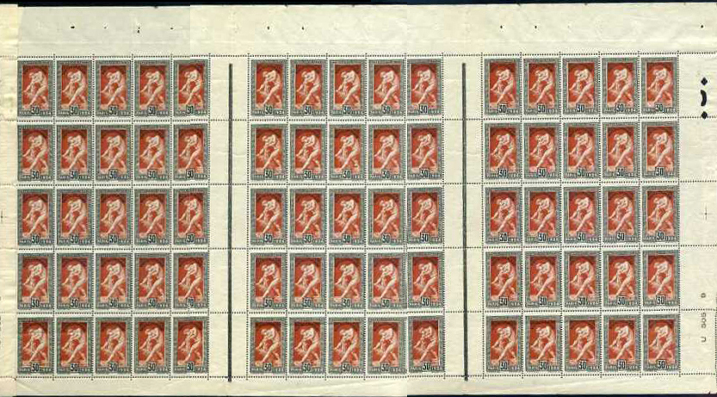
Top pane layout with 2 gutters between blocks of 5x5 stamps.

Slide 13
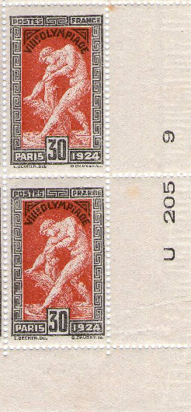
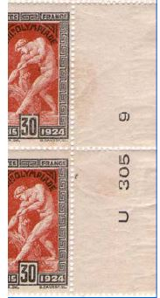
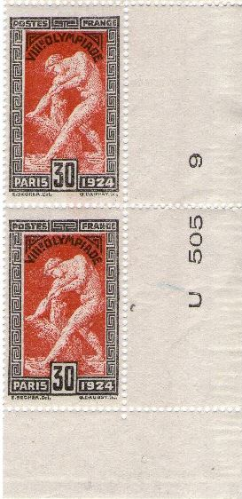
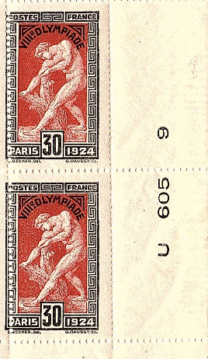
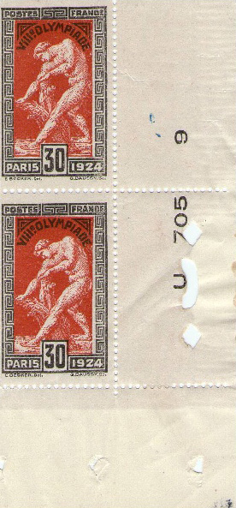
The stamps were printed daily on Press #9 between Friday, May 2 to Thursday, May 8 with the exception of Sunday, May 4 when the facility was closed. Plate inscriptions are dated.
Ú
Ú
Ú
Ú
Ú
thinner yellowish
paper variety

Slide 14
A diamond control mark was placed on every 10th sheet when received and reviewed by the quality control acceptance team.
Ú

Slide 15
The stamp set was issued on April 1, 1924. By law the stamps would only be on sale for four months until July 31, like their 1896 Olympic predecessors intended as a short term fund raiser. They were demonetized on September 30 and the remaining balance destroyed.

Slide 16
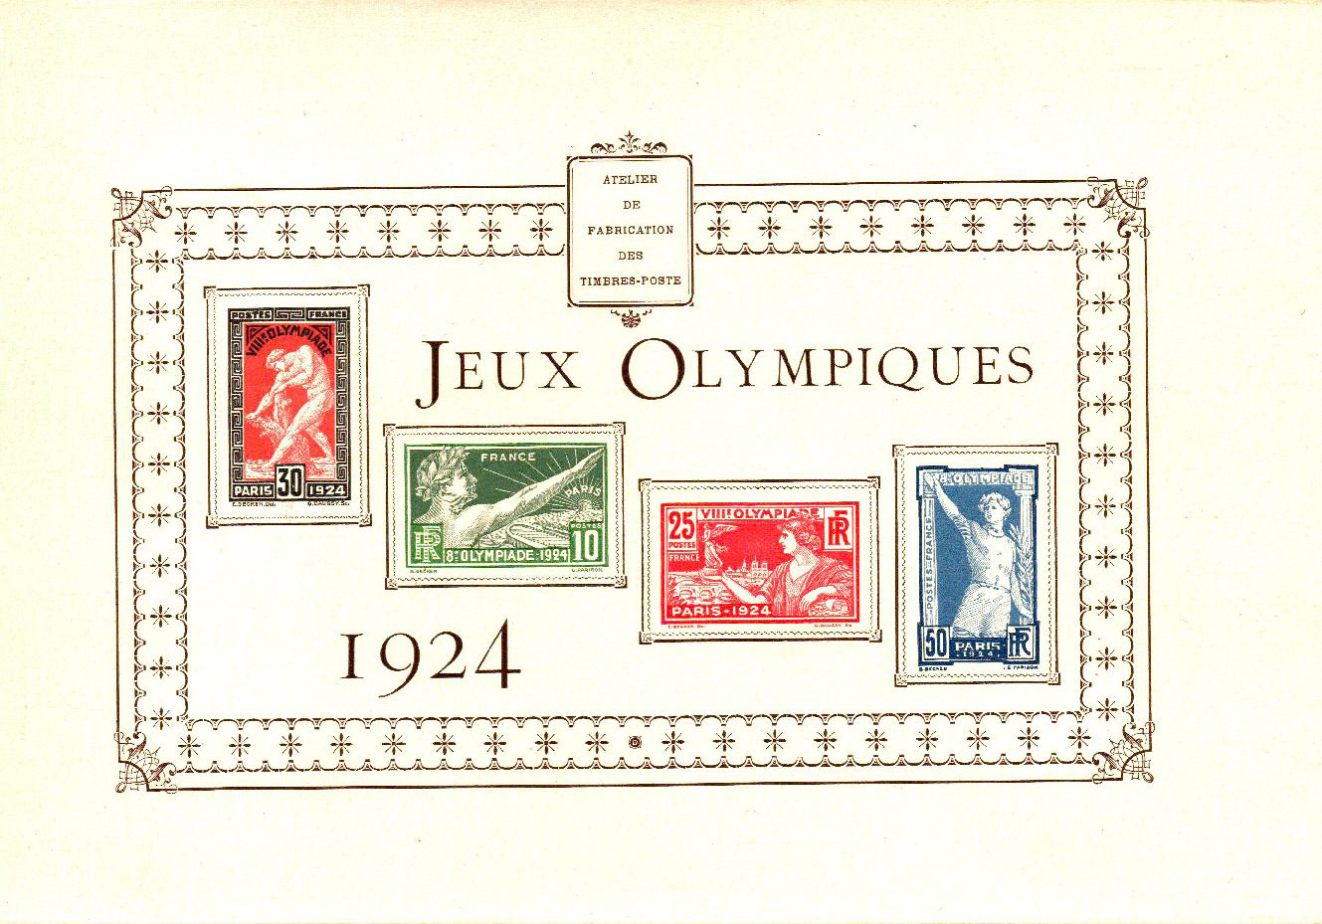
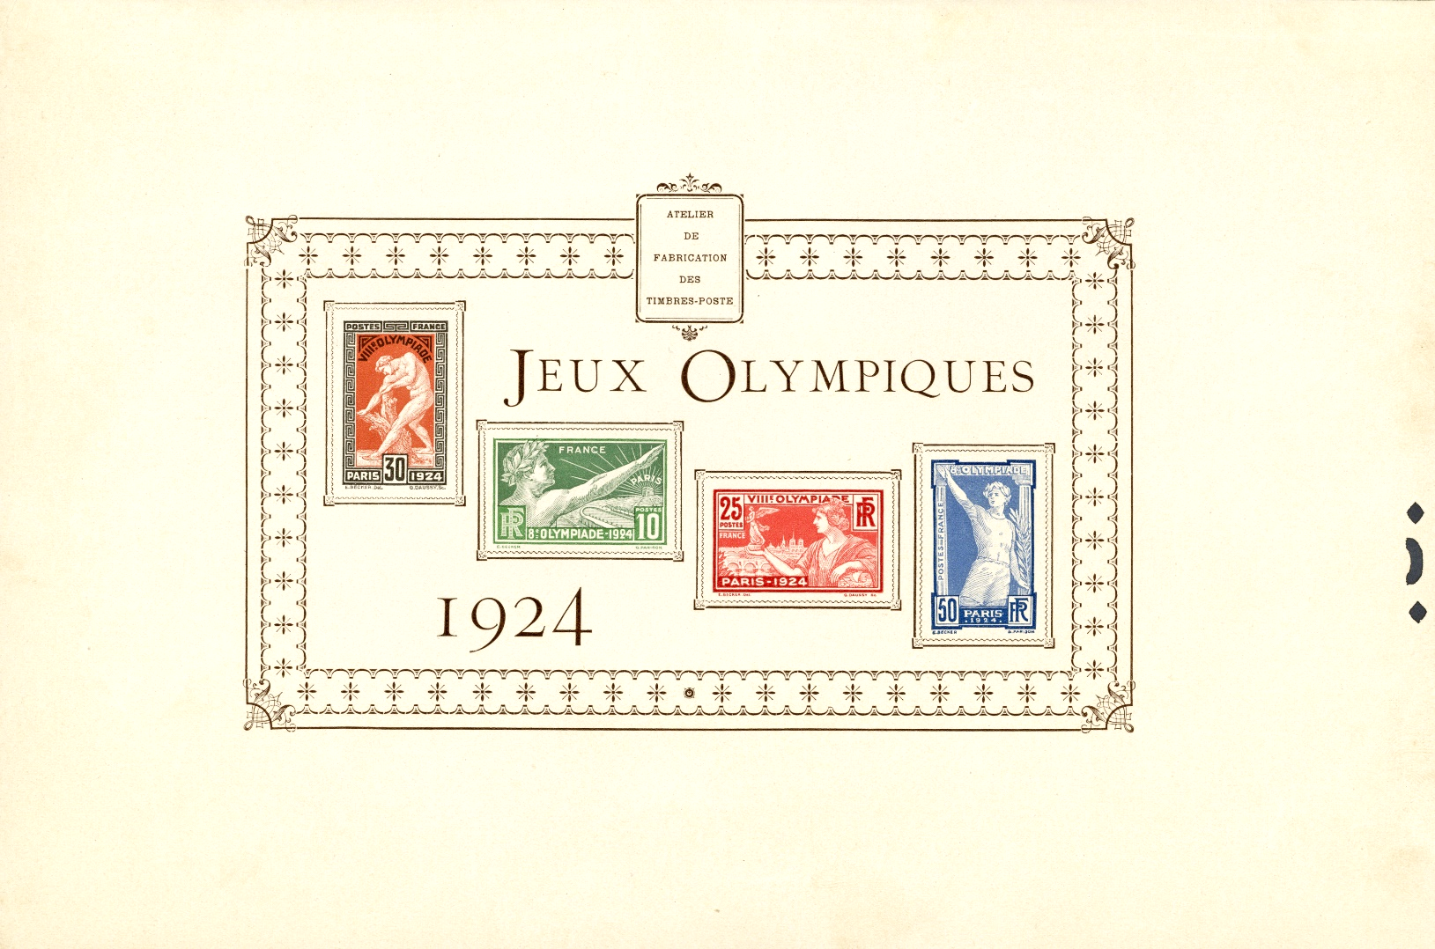
A limited presentation proof sheet was given to government officials and dignitaries on the release of the issue.
between 135-153 produced in 2 varieties- with a control hole and without, the latter distributed at the UPU meeting in Stockholm July and Aug. 1924

Slide 17
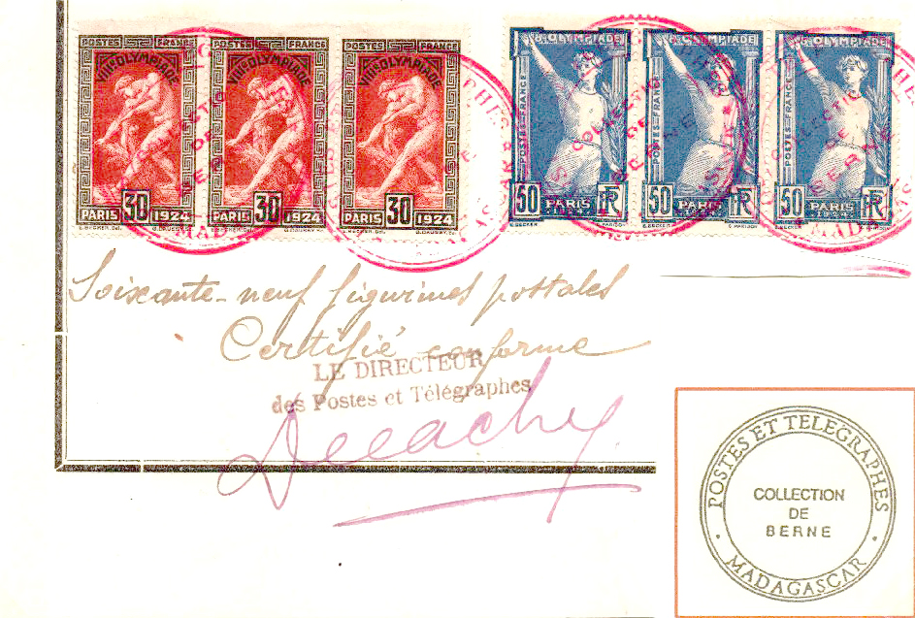
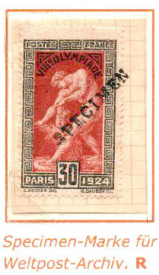
Specimens exist for the stamp.
from the Madagascar post philatelic records

Slide 18
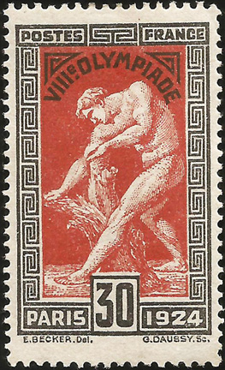
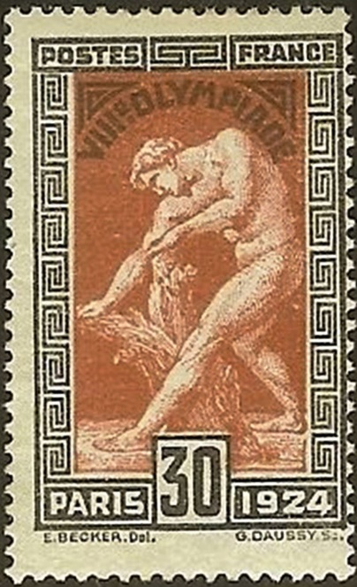
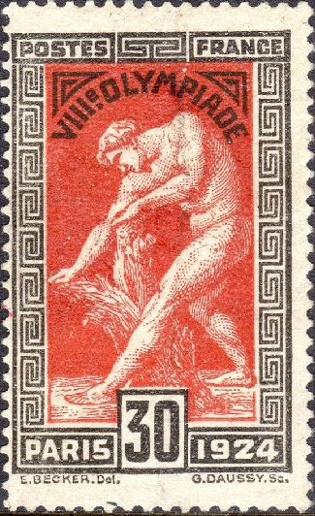
According to the “Catalogue Descriptif des Variétés de
France” (2nd edition, 1949), published by the Office
Philatelique de Paris, there are three shade varieties due to ink mixes used, given these color designations. Reported printed were 25,000 sheets of 150 stamps of all 4 values.
dull red and black
brown red and gray black
light orange red and black

Slide 19
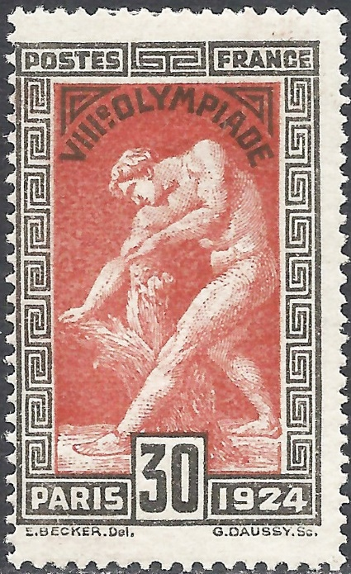
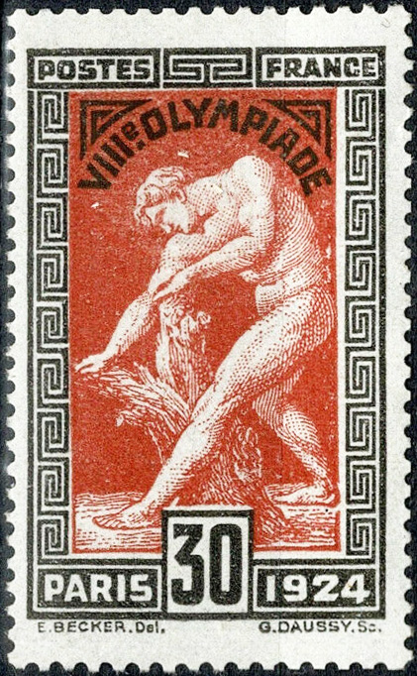
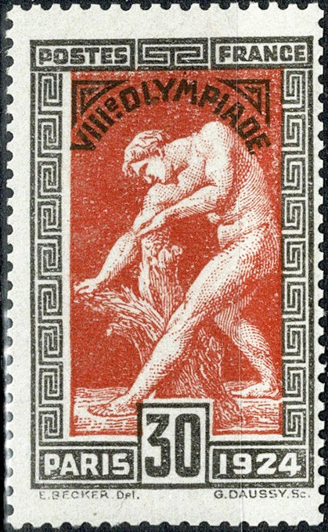
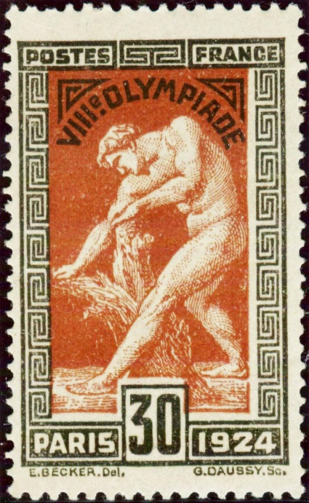
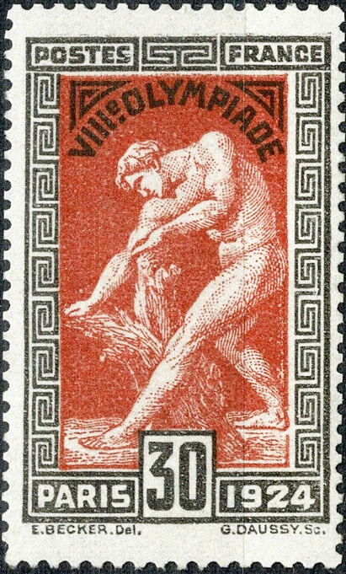
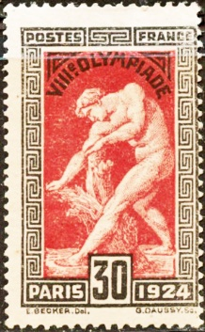
As a bi-colored stamp, the registration of both the frame and vignette was paramount during printing. Not bad, but perfect alignment was not always possible.

Slide 20
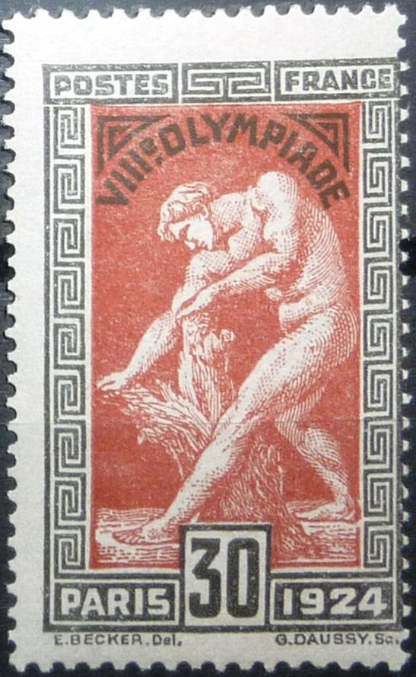
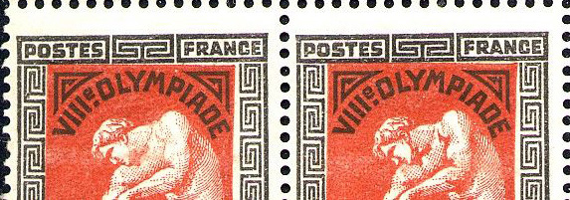
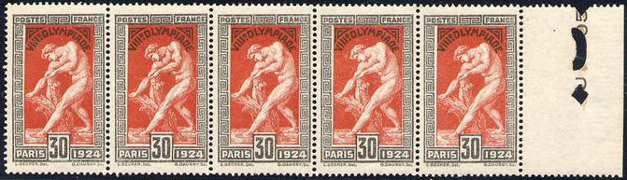
There is only one constant plate flaw known for this issue. The “muscular arm” variety is found on plate position 17.
Ú
Ú
Ú
Ú

Slide 21
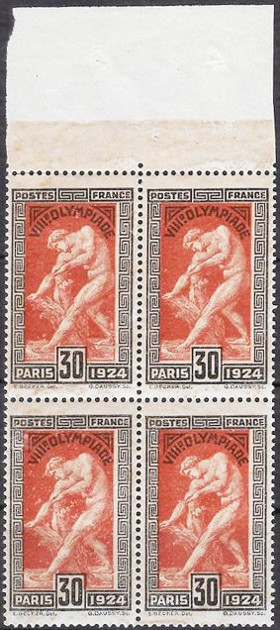
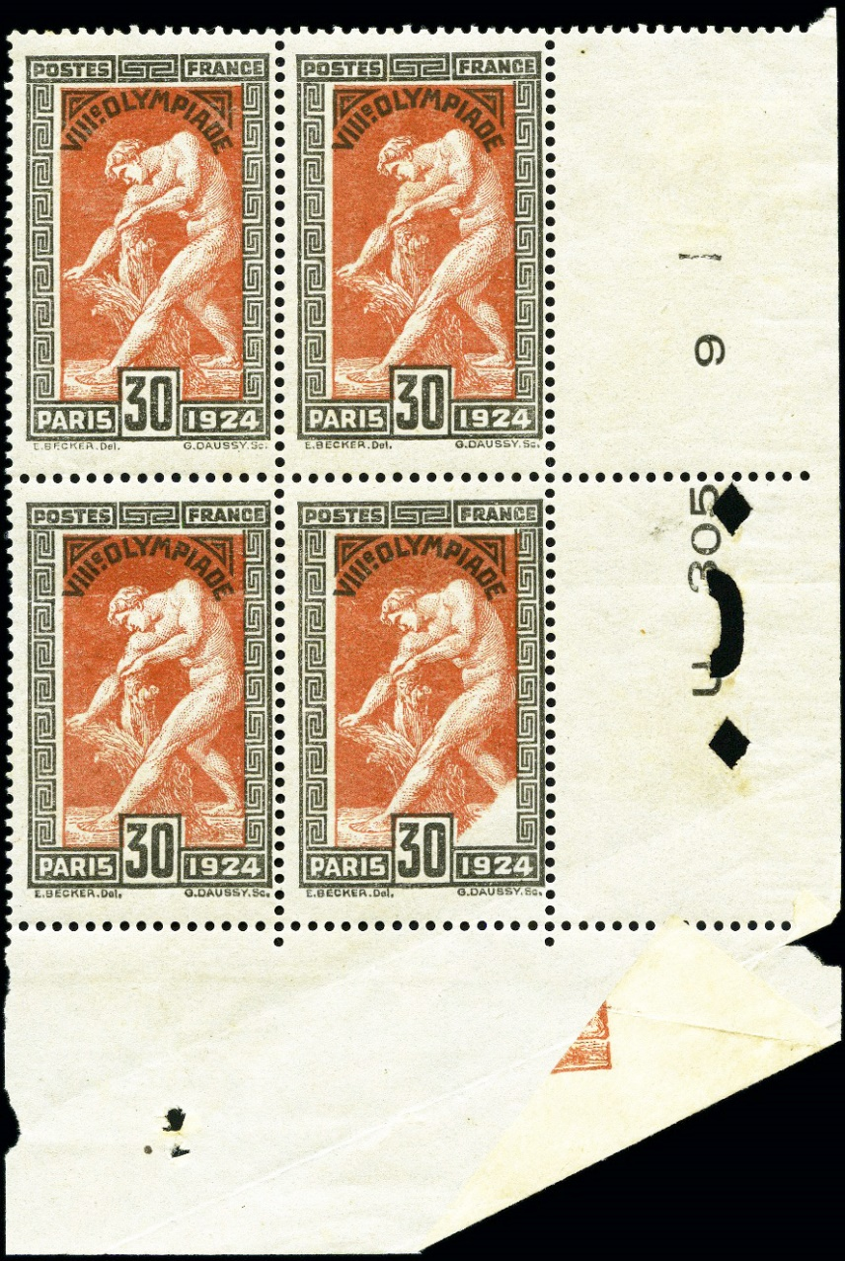
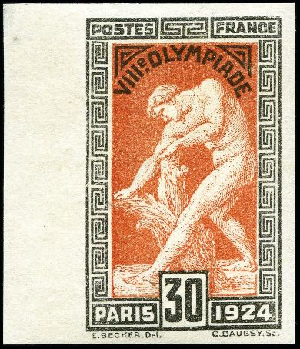
Non-constant varieties are known.
imperforate
printed on the gum side, when one sheet was inserted improperly
Ú
paper fold

Slide 22
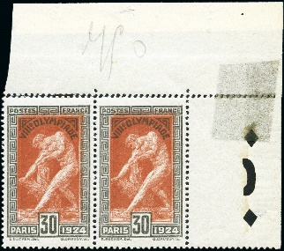


Printing EFOs (errors, freaks and oddities) exist.
vignette set-off, full and partial
known but not shown:
gummed on front and back
frame printed on the gum side
vignette double printed, one of two pairs known

Slide 23
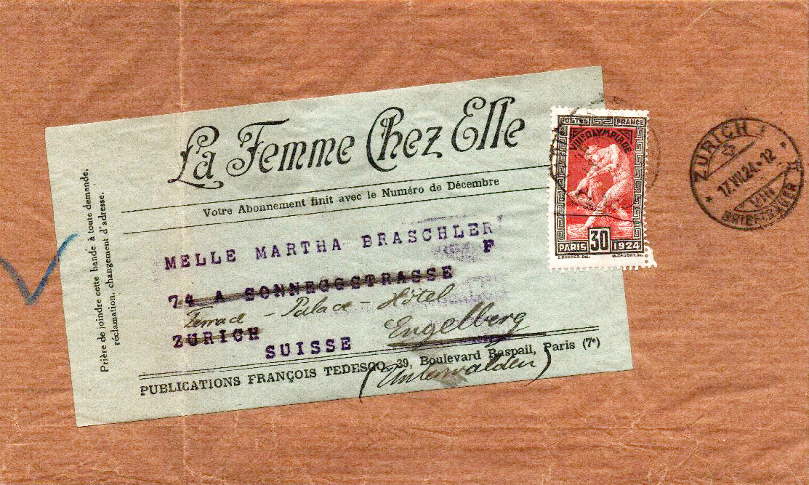
USE
The 30 centime value stamp singularly paid the basic printed matter rate of 50-100 grams to neighboring Switzerland.
newspaper, mailed July 16 from Paris to Zurich
received July 17, readdressed and forwarded
printed letter, mailed June 28 from Paris to Basel with CC perfin

Slide 24
In most cases it was used as a “make-up” stamp to fulfill a specific rate.
domestic registered + insured letter
Total Postage = 1.25 Francs
25 centimes letter rate
60 centimes registration fee
40 centimes insurance fee
(for items valued to 1,000 Francs)
Paid for by
2 x 30 centimes
50 centimes
15 centimes

Slide 25
And another…
international letter
(sent via surface ‘boat’ rate)
Total Postage = 75 centimes
0-15 grams
Paid for by:
30 centimes
45 centimes
to the USA

Slide 26
And another…
military airmail
(letter sent free of postage,
but airmail surcharge required)
Total Postage = 50 centimes
Paid for by:
30 centimes
2 x 10 centimes

Slide 27
Sometimes use of the stamp(s) overpaid a rate.
domestic letter
25 centimes (< 20 g)
overpaid by 5 centimes

Slide 28
And another…
domestic registered letter
85 centimes correct rate
25 centimes letter rate (< 20 g)
60 centimes registration fee
paid for with
3 x 30 centimes
overpaid by 5 centimes

Slide 29
And another.
international postcard
15 centimes correct rate
Paid for with
30 centimes
overpaid by 15 centimes

Slide 30

This set, of course, was issued to promote the VIII Olympiad in Paris from May 4 - July 27 featuring 44 teams, 3,088 athletes and 126 events. The Olympic Village had its own post office, 7 mail boxes and its own hand cancel.
opening day Olympic Village cancel of May 5 on cover to Czechoslovakia

Slide 31
Records show 10,000 30 centime Milo stamps were supplied to the Olympic Village Post Office along with the others from the set.
correct 45 centimes postcard rate to Germany

Slide 32
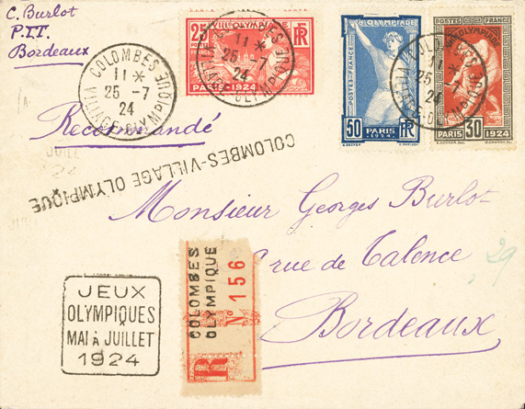
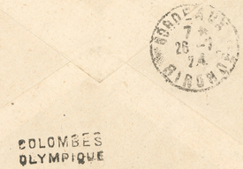
Athletes, trainers and officials took time to write home.
domestic registered letter
Total Postage = 1.05 Francs
45 centimes letter rate
(for 20-50 grams)
60 centimes registration fee
posted July 25, days before the close of the Olympic Village on July 28
reverse

Slide 33


Postcards proved to be popular souvenirs to Olympians and commoners alike, showing Dumont’s 1768 work and Pierre Puget’s earlier marble death sculpture of Milo of 1682.
Ú
Dumont sculpture
Dumont sculpture
Puget sculpture

Slide 34

That’s not quite the end of the story…
French stamps were overprinted for use in Lebanon and Syria, the former Ottoman Empire territory partitioned under mandate of the League of Nations after World War I. So, too, were the four values of the 1924 Olympic issue.

Slide 35
Lebanese stamps were overprinted in two different formats…

Slide 36
… as were those for Syria.

Slide 37


Lebanese overprint varieties abound.
Ú
Ú
Ú
“0” in 1.50 has 2 broken points position 17
thin G in “Grand”
inverted
dot in d of “Gd”
position 8

Slide 38
Syrian varieties also exist.
Ú
Ú
Ú
inverted and doubled
open “R” in Piastre position 4
Inverted and thin “S” in Syrie position 20
thin “S” in Syrie position 9

Slide 39


These stamps can be found on covers, many are philatelic.

Slide 40

But that’s still not the full story, as France also used Milo on the world’s first Olympic postal card, issued April 1, 1924.
138 x 92 mm
and variants

Slide 41






The paper stock used for the postcards was inconsistent in shade and weight, as many types have been documented.

Slide 42

Similar to the stamps, these were produced using two colors, applied separately. Alignment and shade differences abound.
two text/frame and vignette shades

Slide 43





There are also three distinct “star” settings in the upper right.
Ú
Ú
Ú
Ú
5 points closed
6 points closed
6 points open

Slide 44


Before the April 1, 1924 postal rate increase, 30 centimes paid the international postcard rate. After that date the rate increased to 45 centimes, except to Switzerland (20 cent.).
to Germany
to the Netherlands

Slide 45

The French domestic postcard rate after April 1 was 20 centimes, but countrymen happily(?) overpaid the postage.

Slide 46



Epilogue
France printed compound single-color trials in 1925, including the Milo stamp and others doubling each on the sheetlet in various colors.
as produced, but with trimmed margins
Ú
error in lower right Milo tablet
wrong year: 1824, not 1924

Slide 47



These were printed on thin gummed paper. The Milo design is not that of the final as-issued stamp. It lacks the designer and engraver’s name just below the design and the year in the lower right tablet is wrong, 1824 and not 1924.
.
Ú

Slide 48






I hope you enjoyed this presentation created to honor the 100th anniversary of this stamp issue and the remarkable 1924 Paris Olympics.

