Slide 1
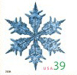
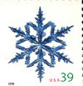
Merry Christmas - -
Stamps
Notes:
US 2006 Christmas stamps & 2015

Slide 2
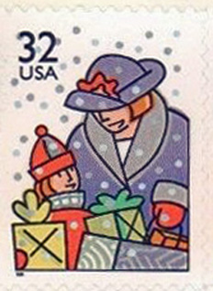
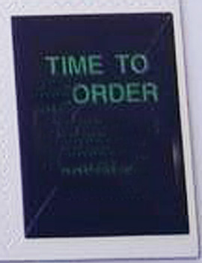
What comes to mind when you hear “Christmas?”
For some, it is Shopping for gifts! Or ordering.
Notes:
US set of four 1996; corner of booklet

Slide 3
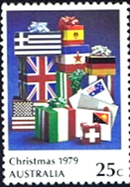
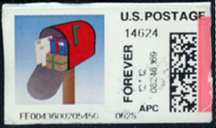
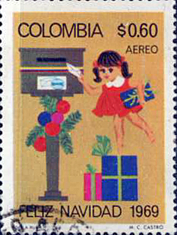
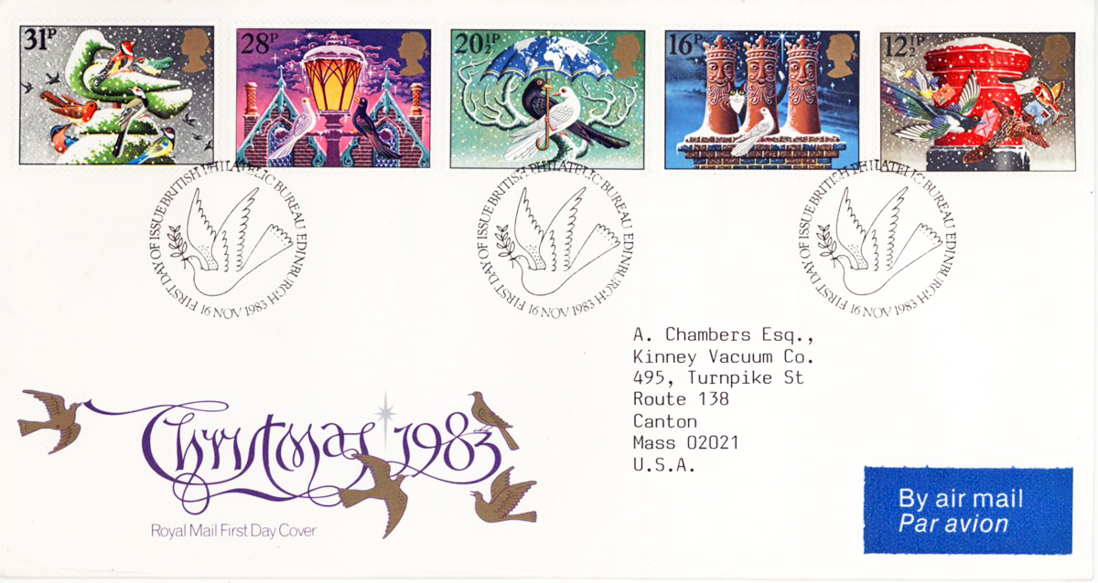
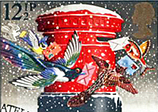
Some gifts need to be mailed, along with the Christmas cards

Slide 4
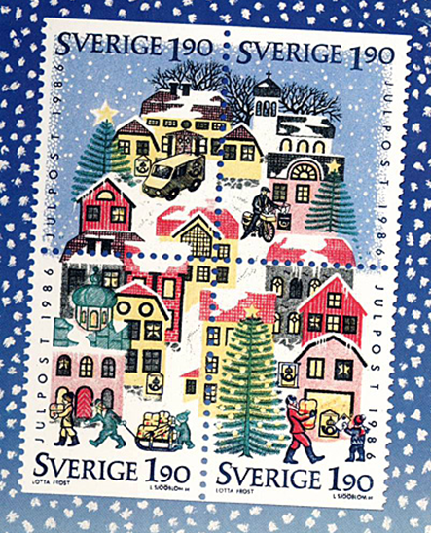
More Mail

Slide 5
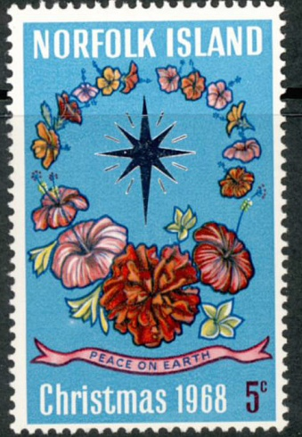
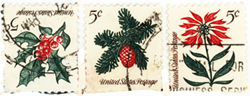
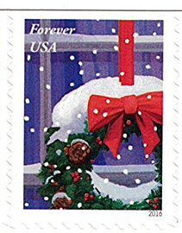
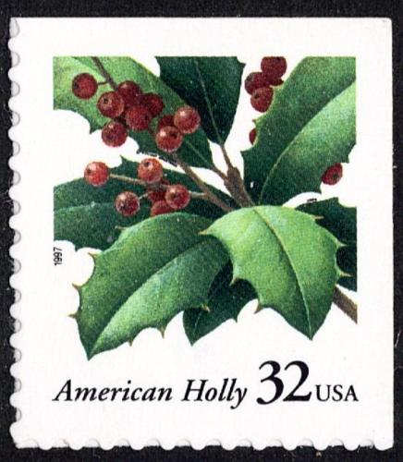
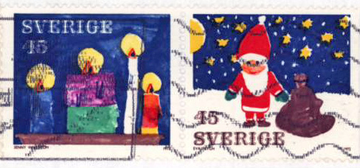
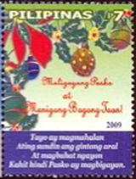
We think of decorating –
Notes:
US wreath 2013,: Holly 2013 , 5c 1964; N.I Hibiscus wreath 1968; Sweden XX;US window 2016; Philippines 2009:Marshall Is. 2009

Slide 6
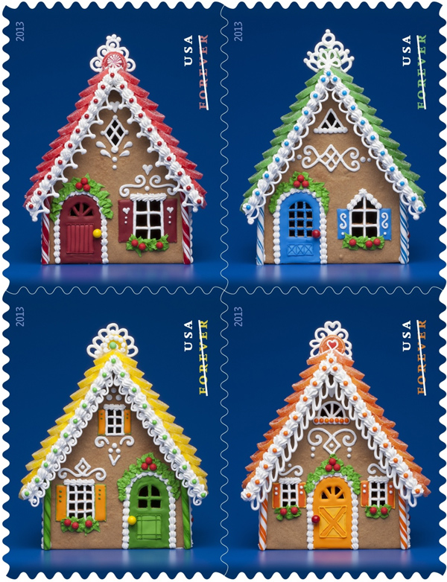
Some folks use lights and lots
of decorations on their houses
If they can’t decorate their houses, - they make cookies!
Lights are often put up arranged in designs.
Notes:
US 2013, Antigua & Barbuda, 2009

Slide 7
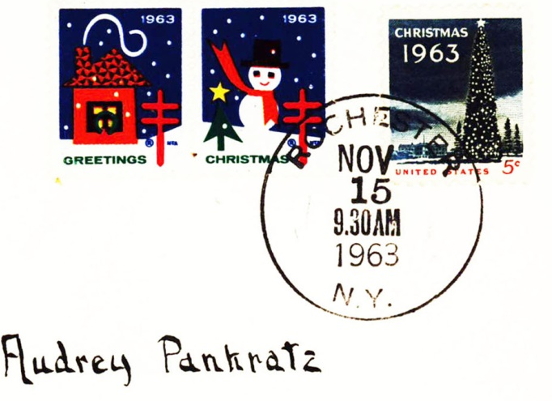
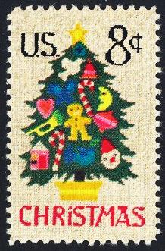
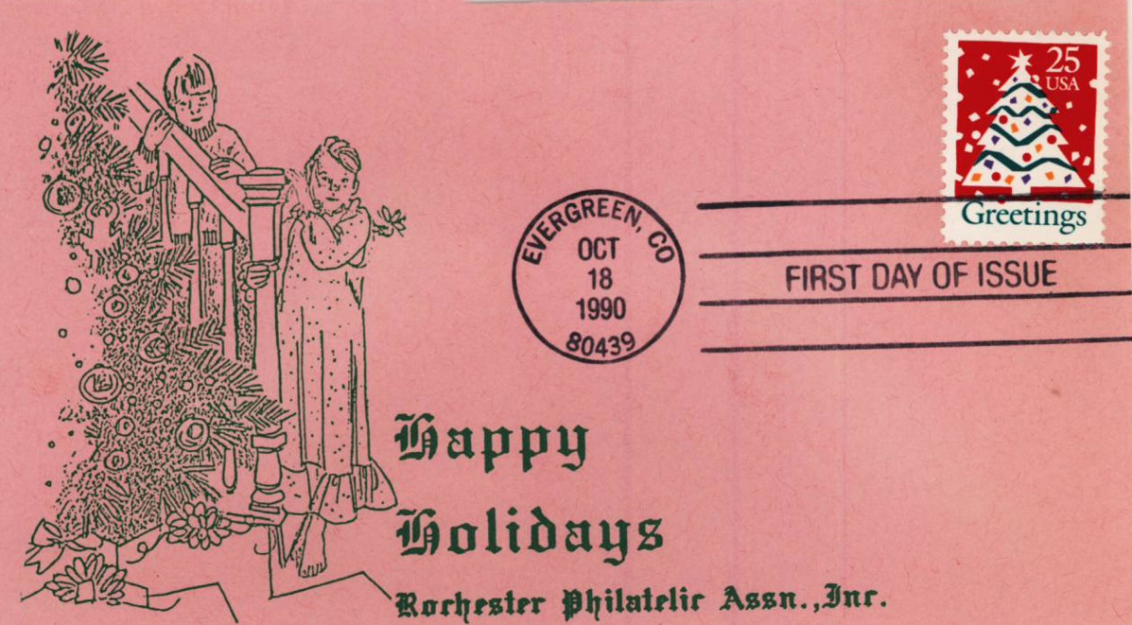
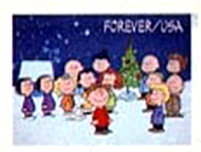
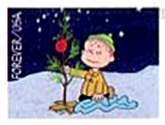
Now to pick out the Christmas tree - -
Notes:
US 1963,1973, 1982, 1990, 2015

Slide 8
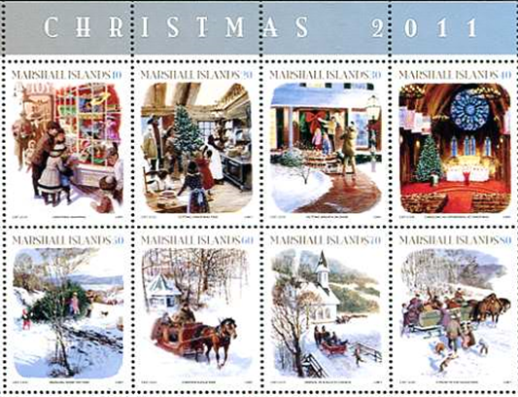
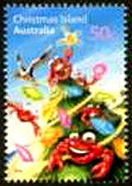
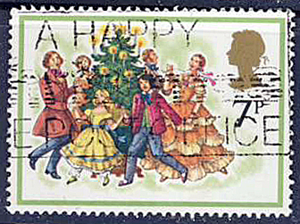
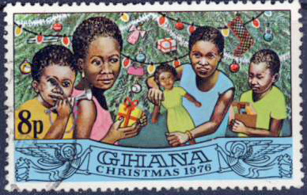
The Tree

Slide 9
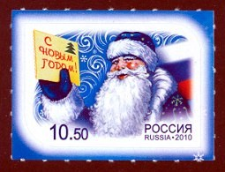
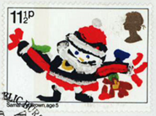
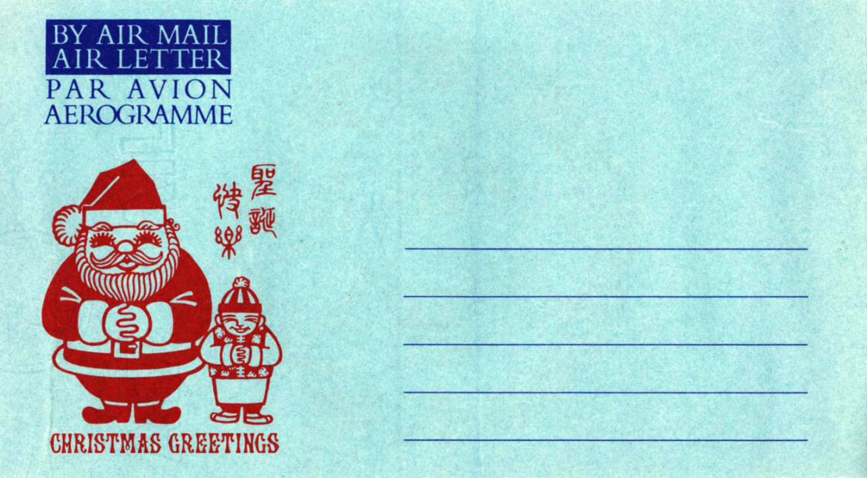
And, of course - -Santa Claus
In some non-traditional appearances
Notes:
Strange and unusual Santas

Slide 10
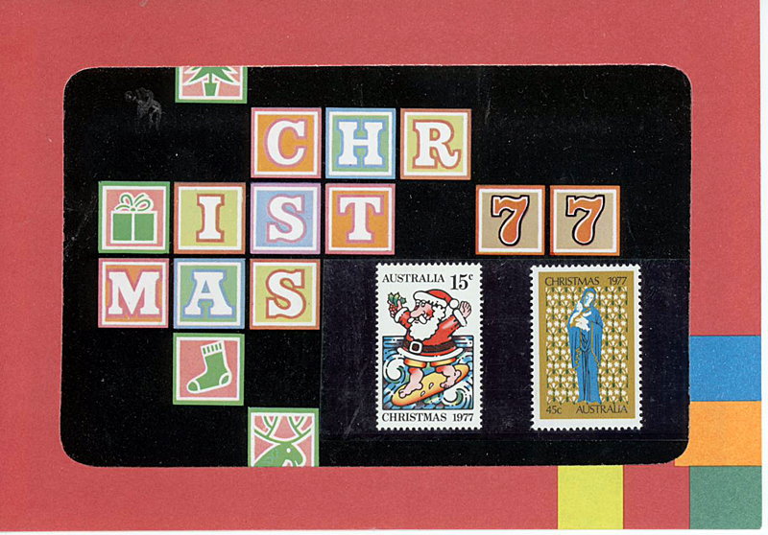
Surfin’ Santa in Australia

Slide 11
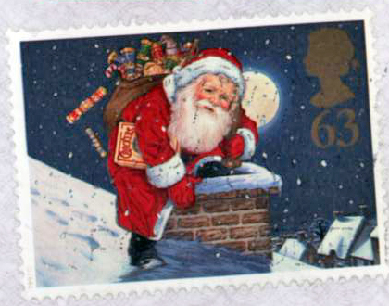
With a Ho, Ho, Ho, a red suit & a white beard

Slide 12
In a sleigh with reindeer (?)
and elves - -

Slide 14
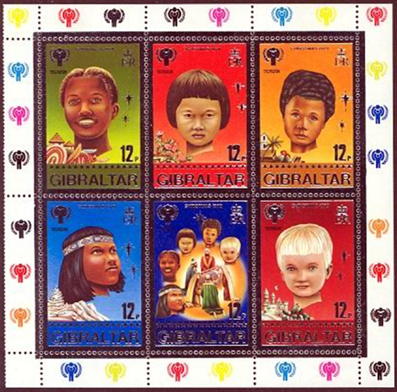
Children – Kids at Christmas – all over the world

Slide 15
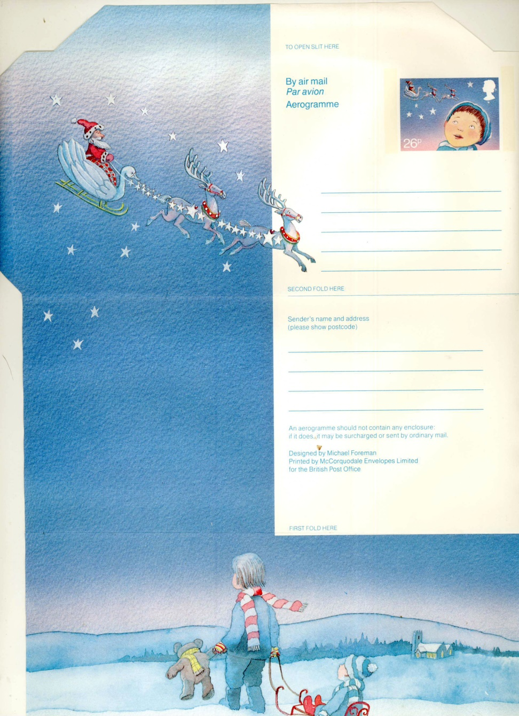
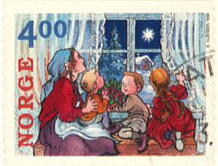
Anticipation

Slide 16
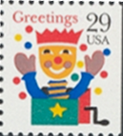
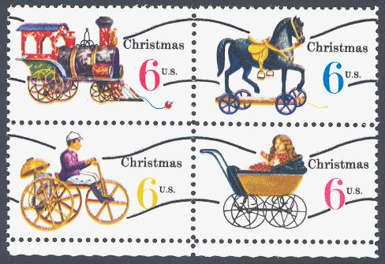
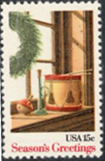
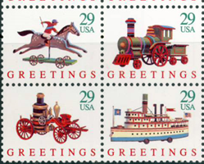
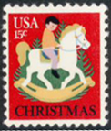
Then the gifts, toys and games

Slide 17
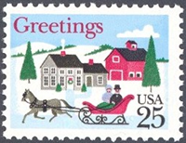
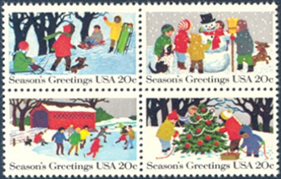
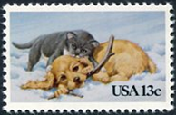
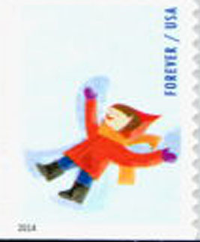
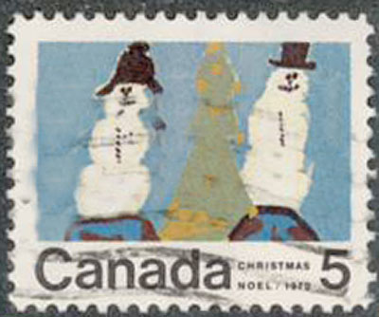
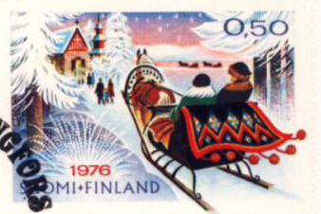
Later, out to play in the Snow!

Slide 18
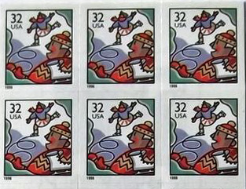
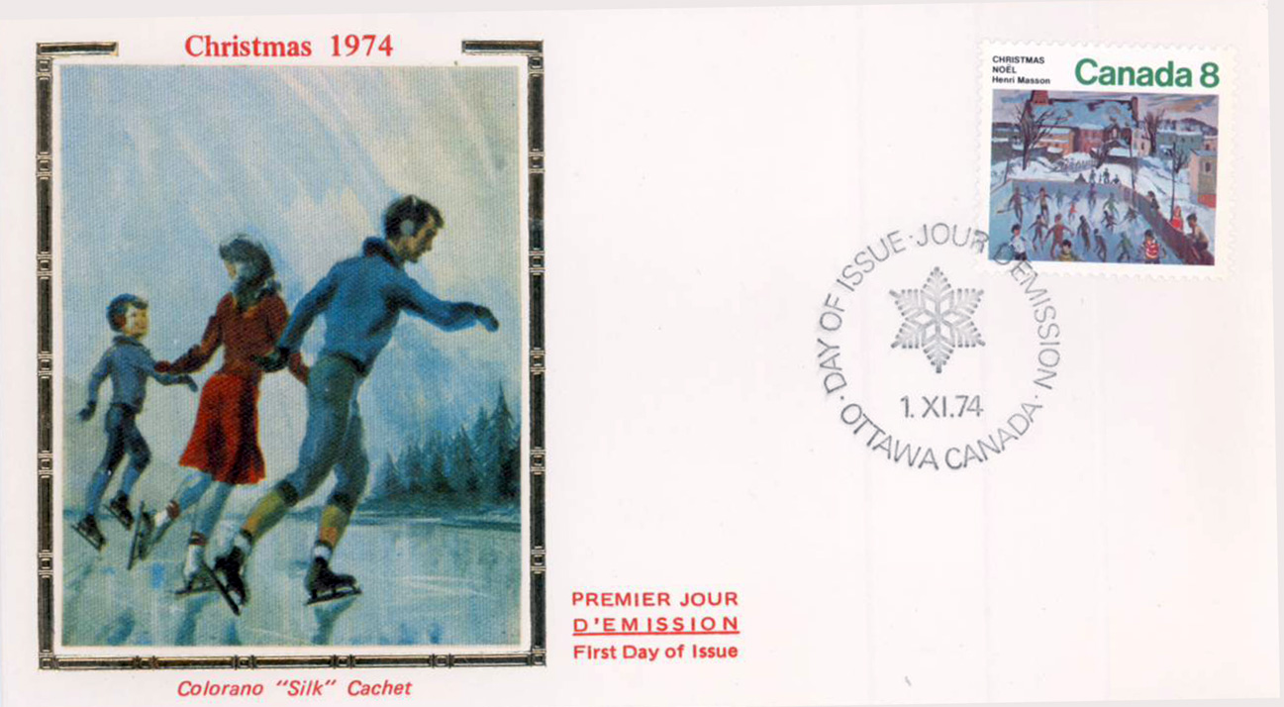
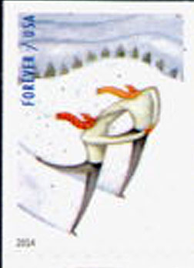
Or skate on frozen ponds

Slide 19
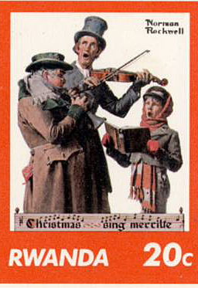
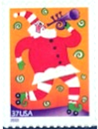
Music at Christmas (non-sacred)

Slide 20
Early Music at Christmas
The Carollers
The “Waits”

Slide 22
Notes:
GB 1973, US 2002

Slide 23
More Music
Notes:
US 2006, GB 1977

Slide 24
Christmas Food

Slide 25
Unusual (to us) at Christmas

Slide 26
Unusual !
Reverse

Slide 27
Unusual

Slide 28
But whatever else Christmas may mean to you, may you have
and

