Slide 1
Medical Stamps
Steve Eisinger
December 12, 2013

Slide 2
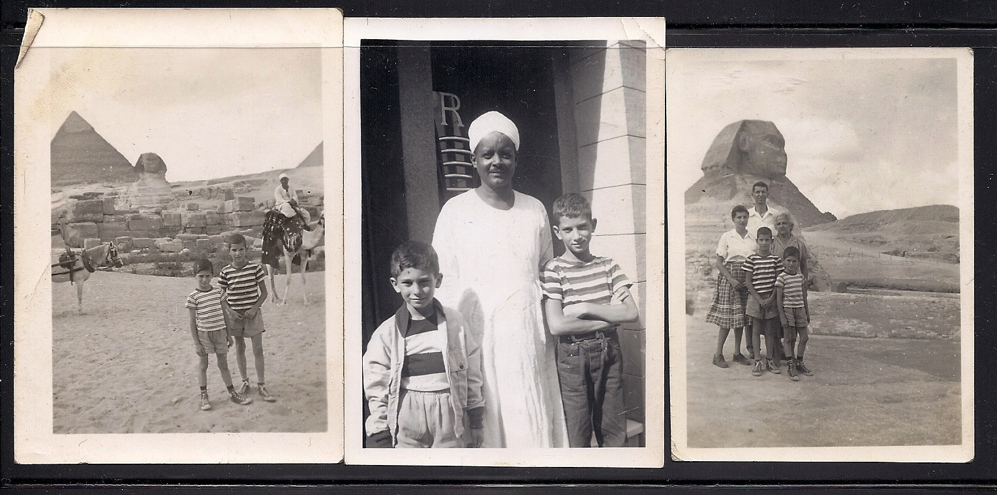
Me and my family in Egypt in 1951, where my
stamp collecting began.

Slide 3

My medical career
begins; graduation
from the University
of Michigan Medical
School, June, 1971

Slide 4
War and Refugees
Missionaries
Great Doctors
Nurses
Doctors at Work
Children
Diseases
Hospitals
Symbolism and Mythology
Red Cross
Red Crescent
Weird

Slide 5
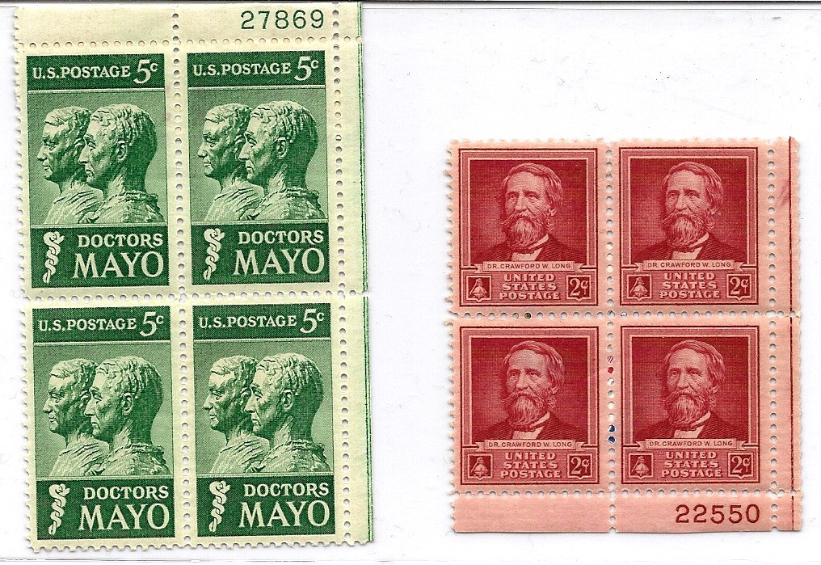
The Mayo brothers advanced surgery
and group practice
Crawford Long developed anesthesia

Slide 6
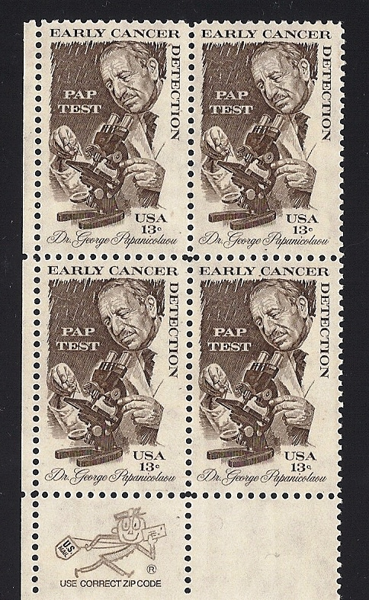
George Papanicolaou
developed the Pap Smear,
a test to detect pre-cancer
of the cervix. He worked
with Herbert Traut, a
gynecologist. A Romanian,
Babes by name, actually
published similar results
a couple of months before
Papanicolaou, but his work
was ignored. We should
call it: the Babes, Papanic-
olaou, Traut Smear.

Slide 7

Walter Reed
He solved the yellow fever mystery
and made the construction of the
Panama Canal possible

Slide 8
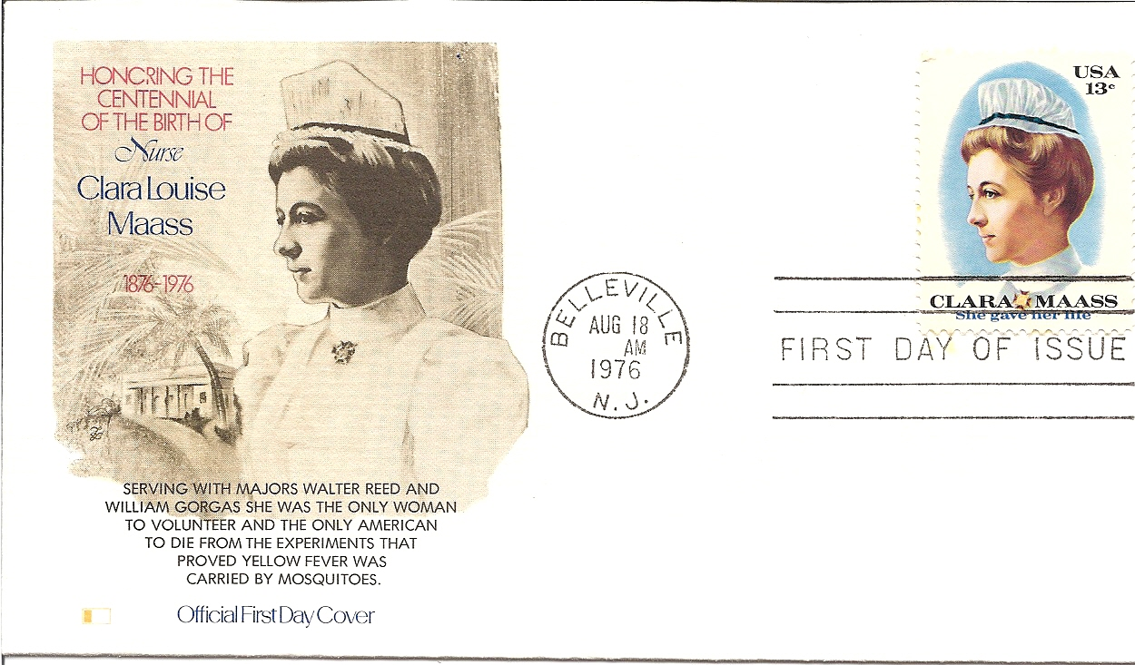

Slide 9
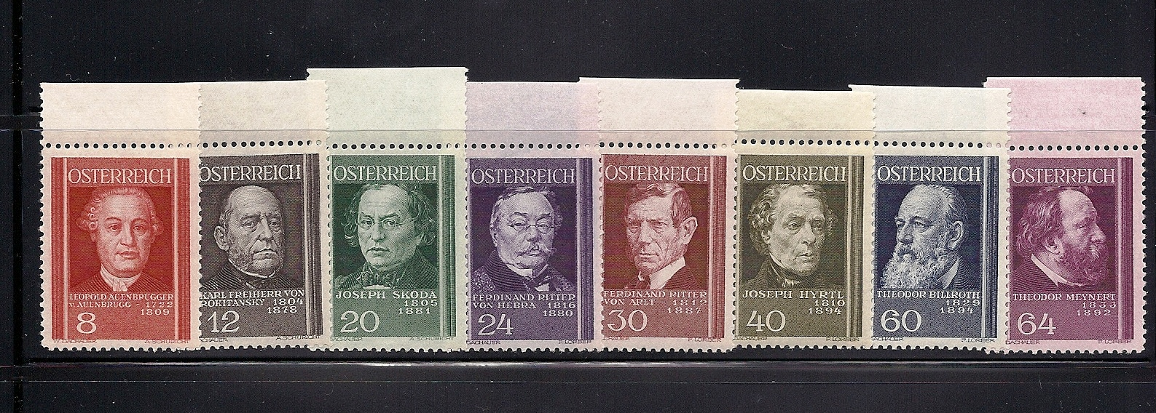
The medical school in Vienna led the world in
medical advances during the middle of the 19th
century

Slide 10
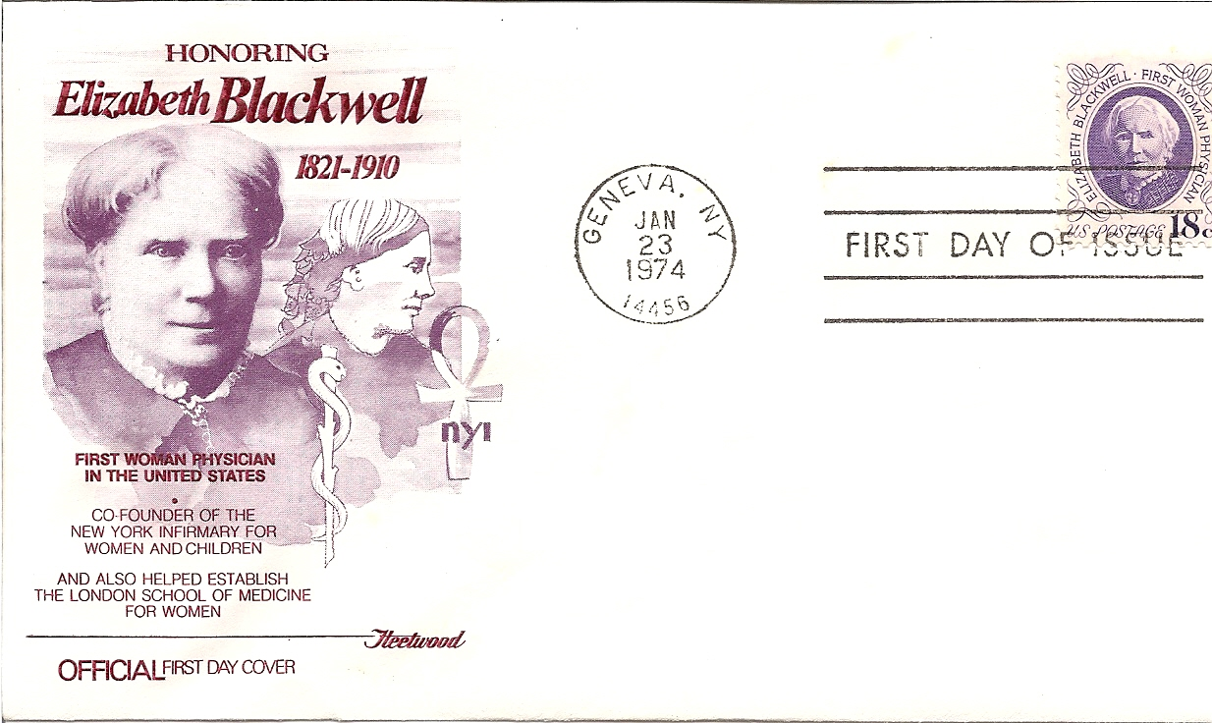

Slide 11
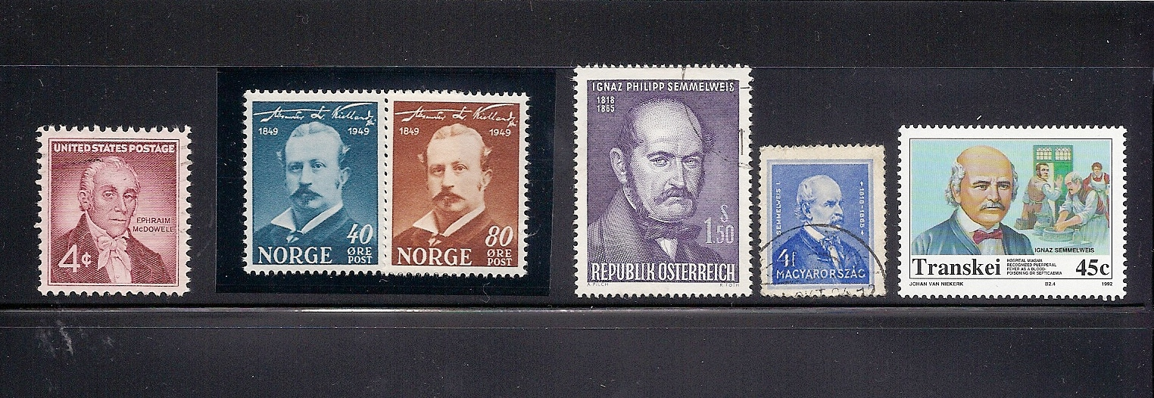
McDowell, Kielland, and Semmelweis
Great Stories in Ob Gyn

Slide 12
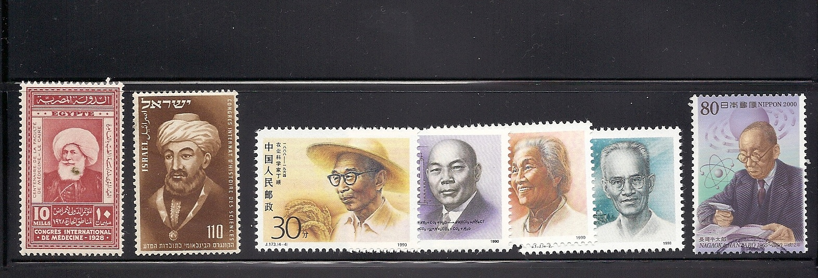
Famous doctors of other cultures

Slide 13
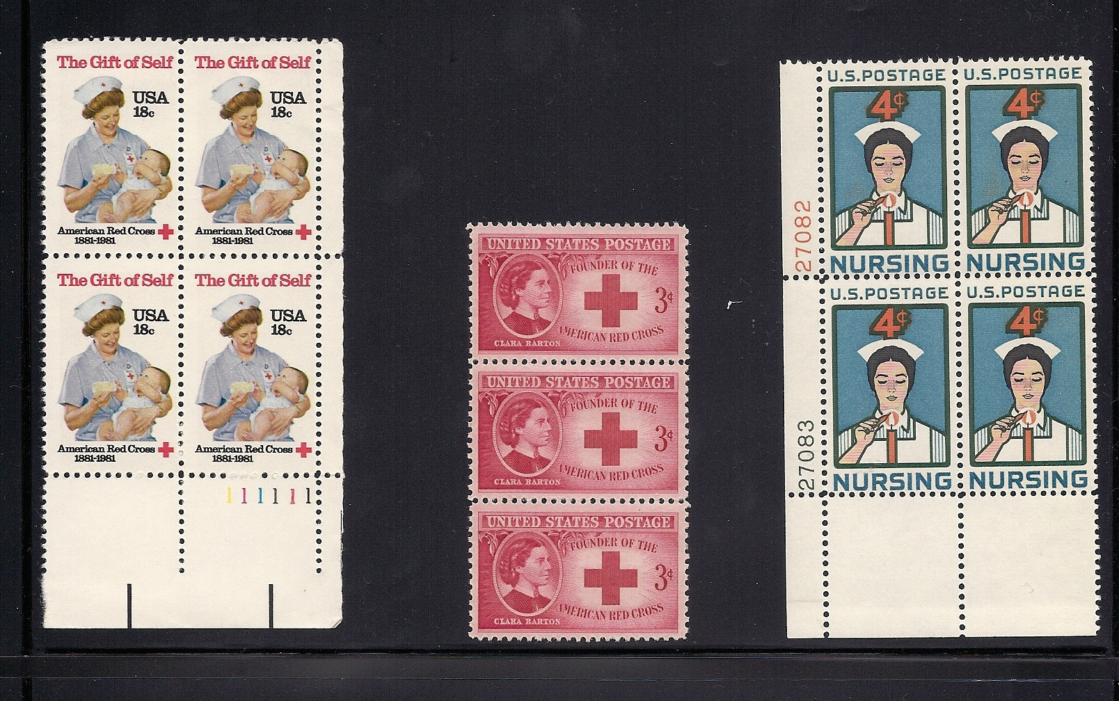
American Nursing Stamps

Slide 14
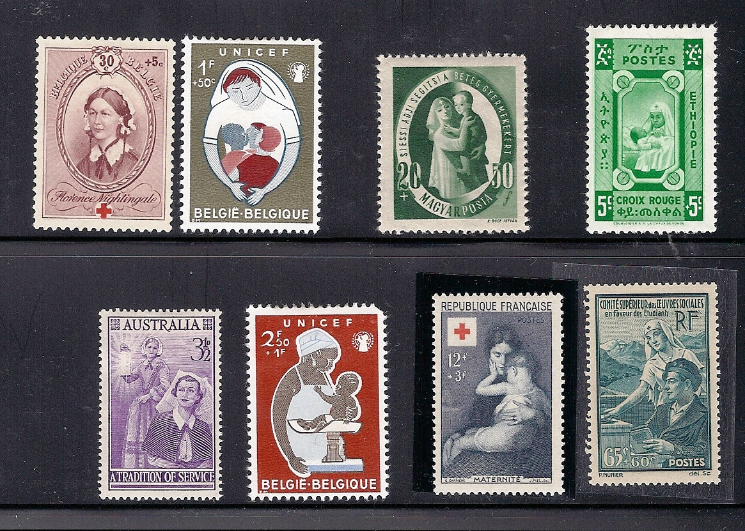
Various foreign
nursing stamps

Slide 15
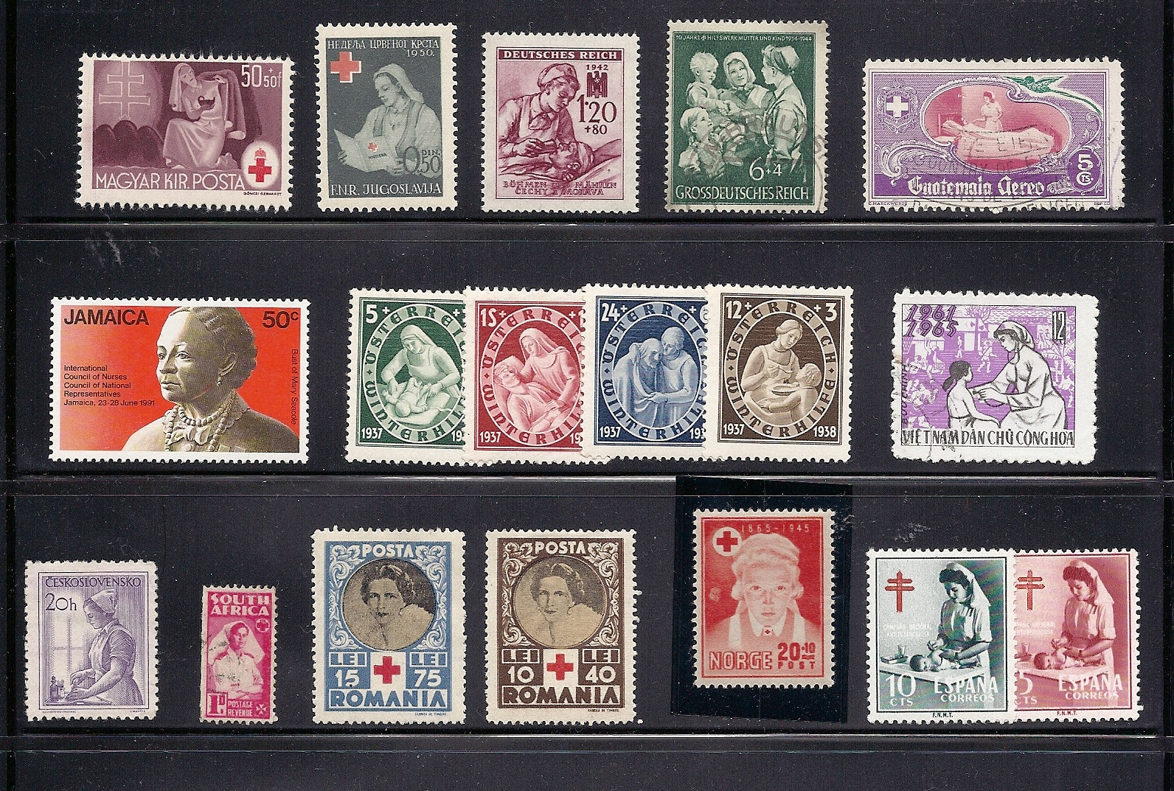
More foreign Nurses

Slide 16
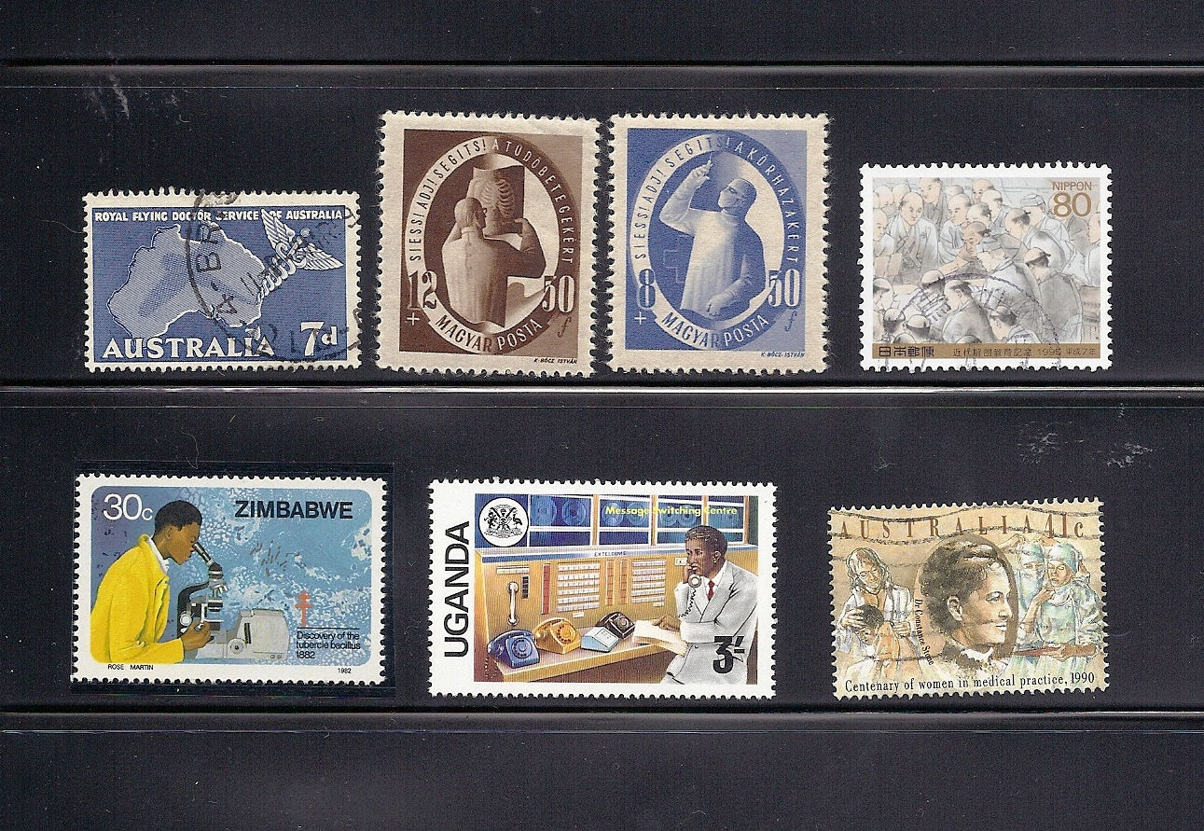
Doctors at work

Slide 17
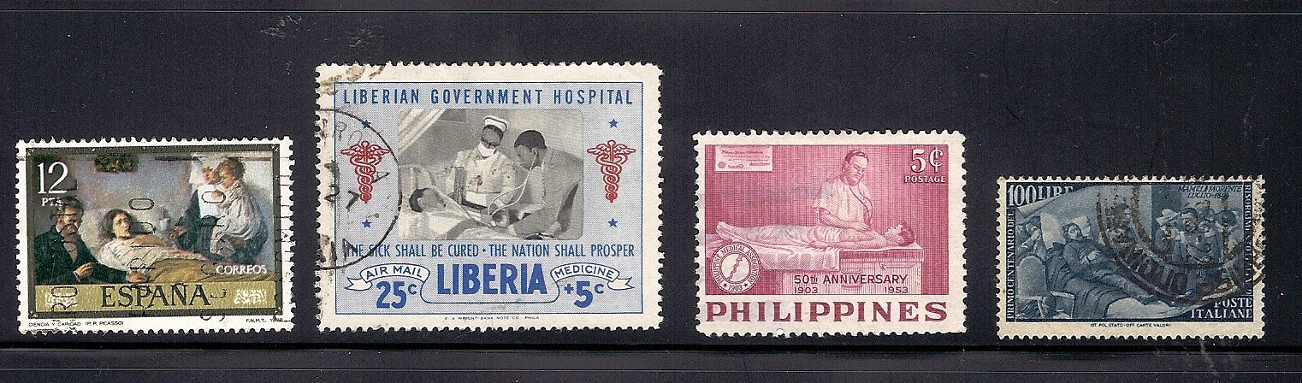
The doctor at the bedside;
Worldwide paradigm

Slide 18
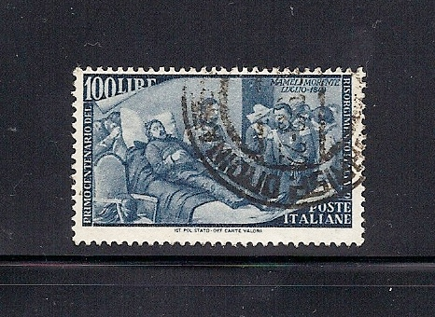
Italy; “Death of Golfredo Mameli” 1948. #506
$27.50 in used (Scott, 2011)

Slide 19
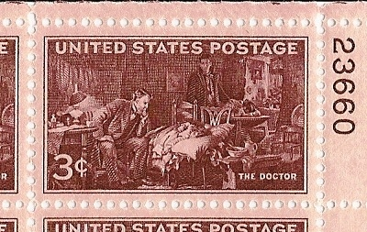
“The Doctor” by Sir Luke Fildes
1947, #949

Slide 20
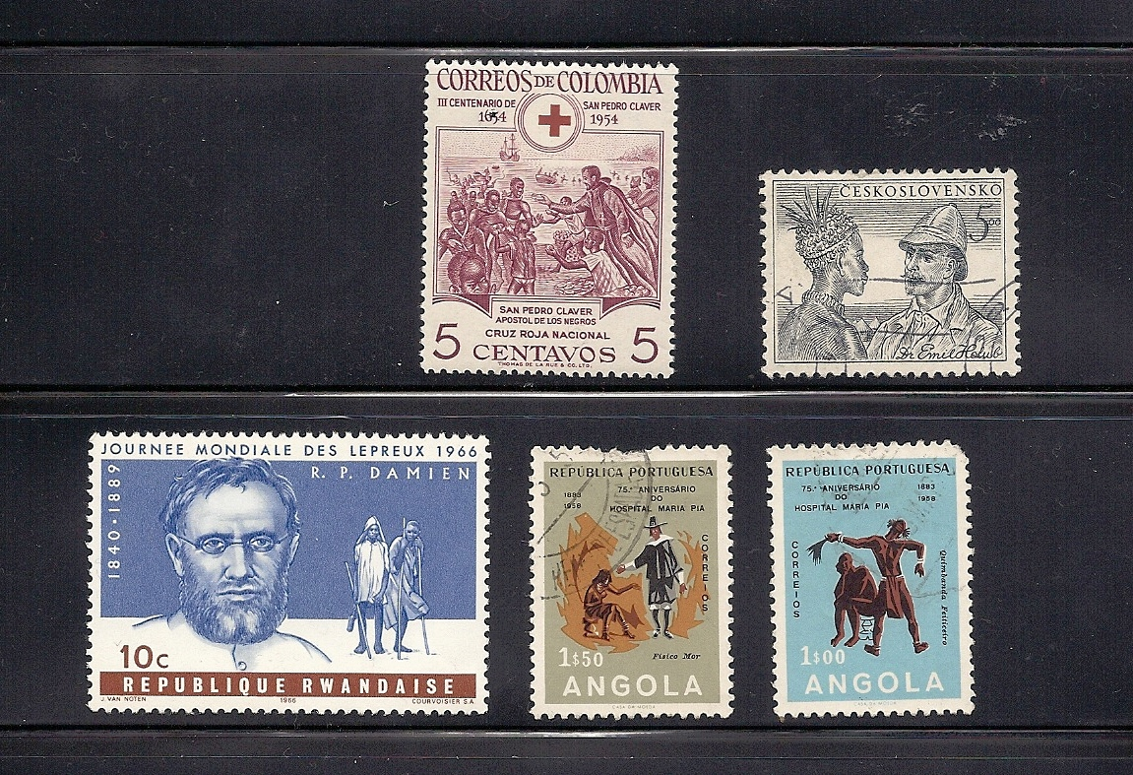
Images of the
Missionary

Slide 21
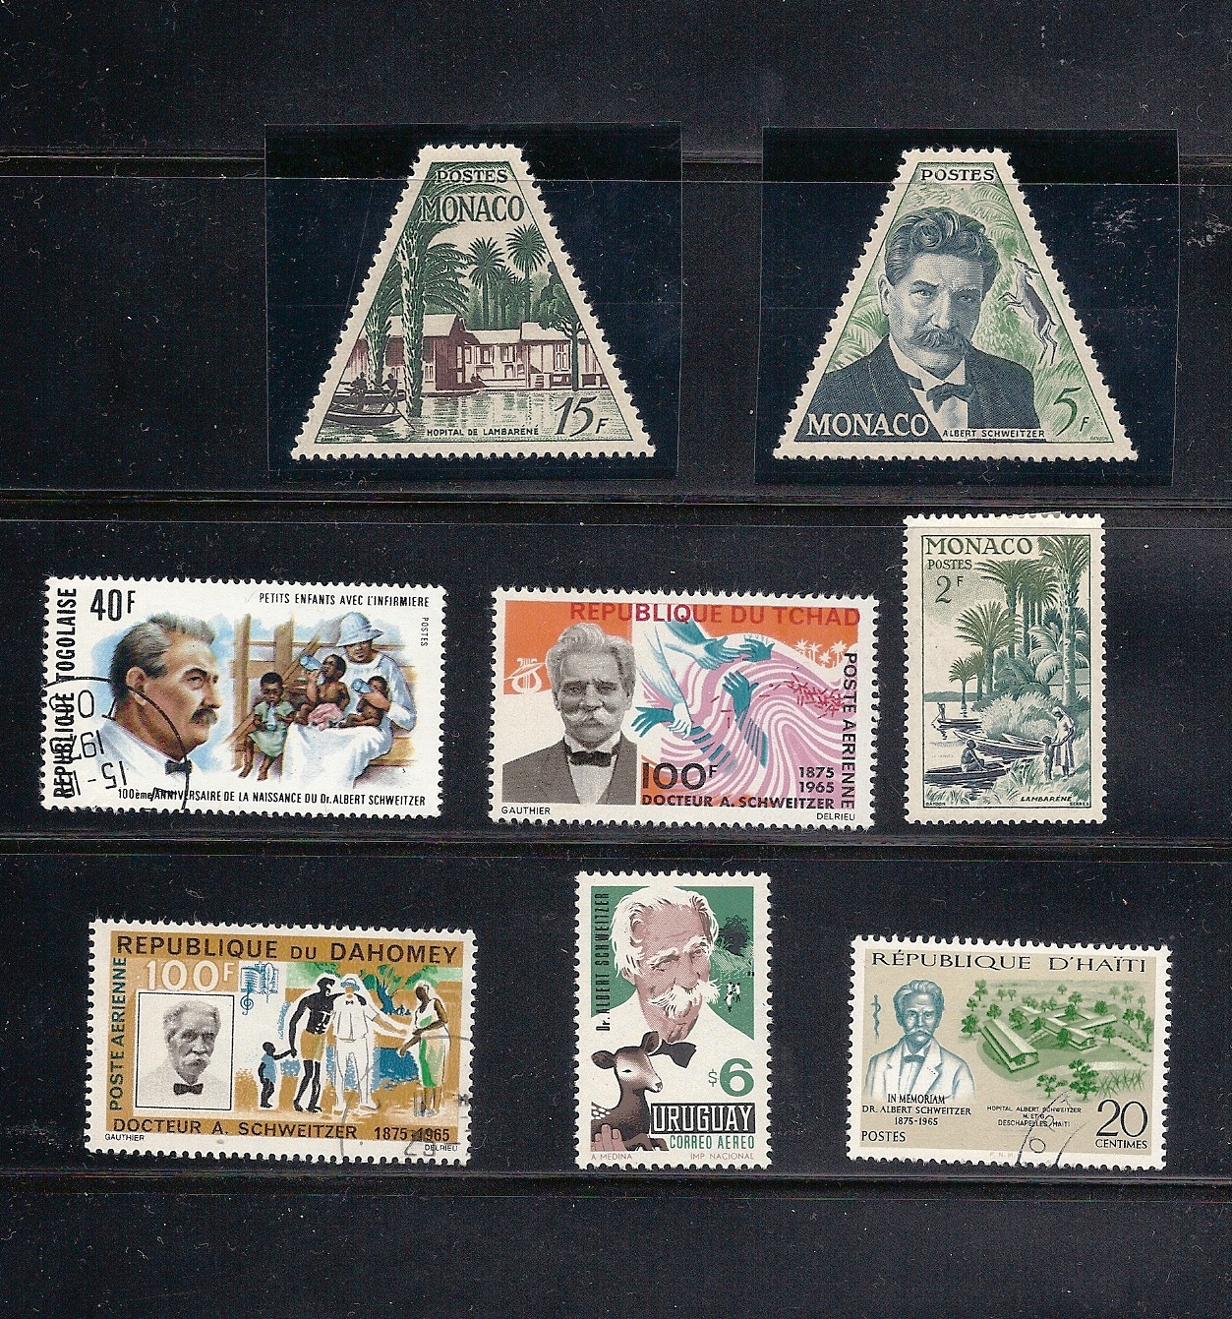
Albert
Schweitzer,
the
ultimate
missionary

Slide 22
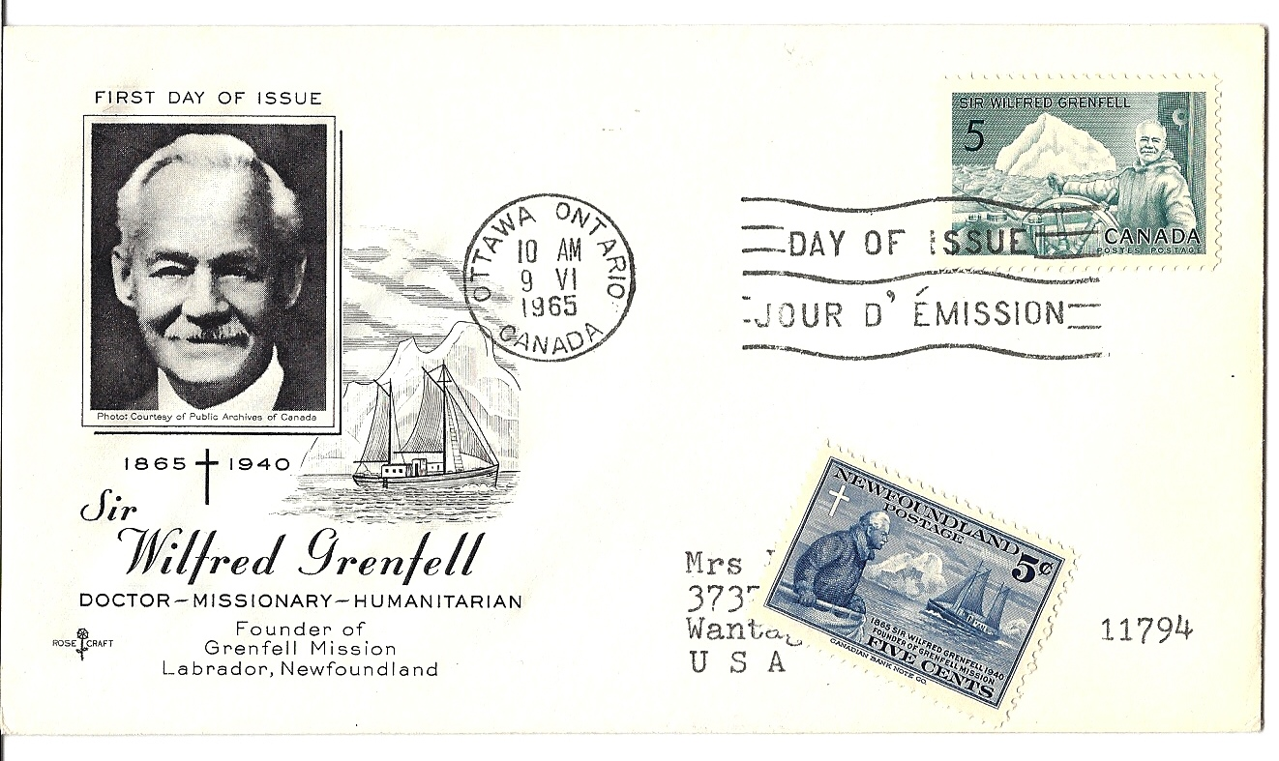
Sir Wilfred Grenfell was the Missionary Extraordinaire of
Newfoundland and Labrador. He is honored by stamps of
Canada and Newfoundland.

Slide 23
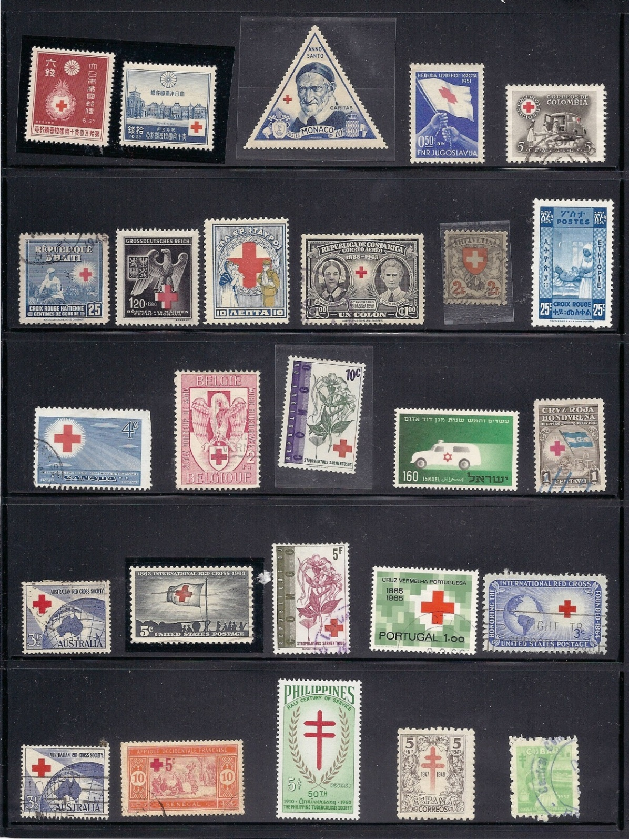
Most countries
across the globe
have accepted
The Red Cross

Slide 24
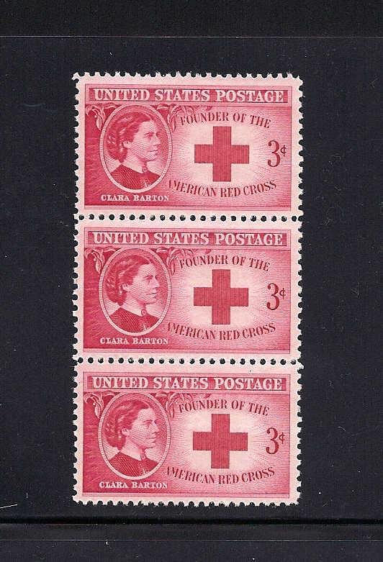
Clara Barton founded
The American Red Cross
in 1881. The first local
Society of the Red Cross
was founded in Dans-
ville, New York, near
Rochester.

Slide 25
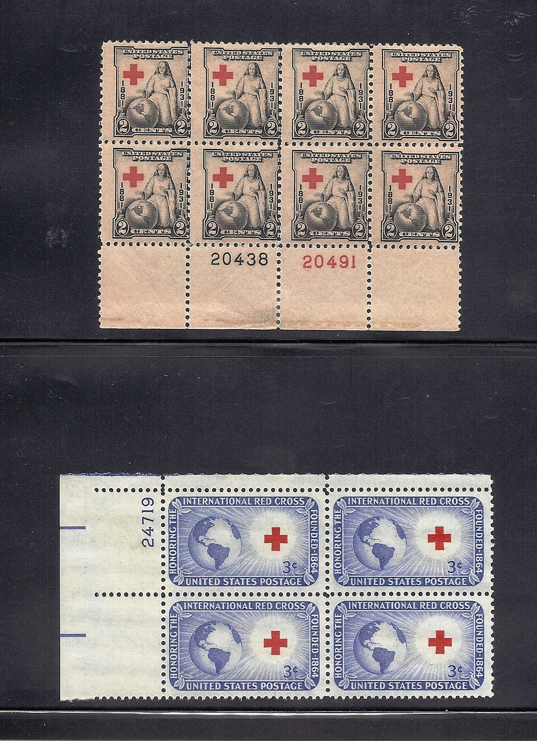
American Red
Cross stamps

Slide 26
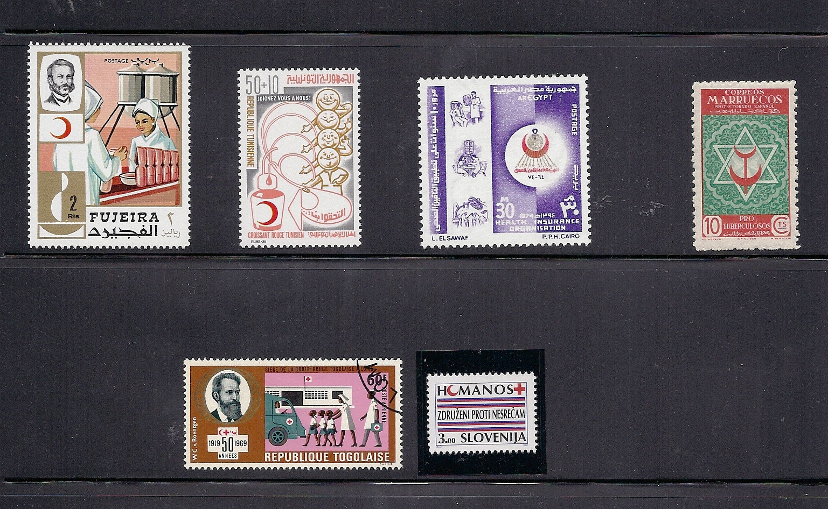
The Red Crescent originated in-
in 1877 and has been accepted by
33 Islamic Islamic countries

Slide 27
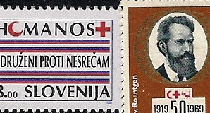
Religious tolerance on stamps

Slide 28
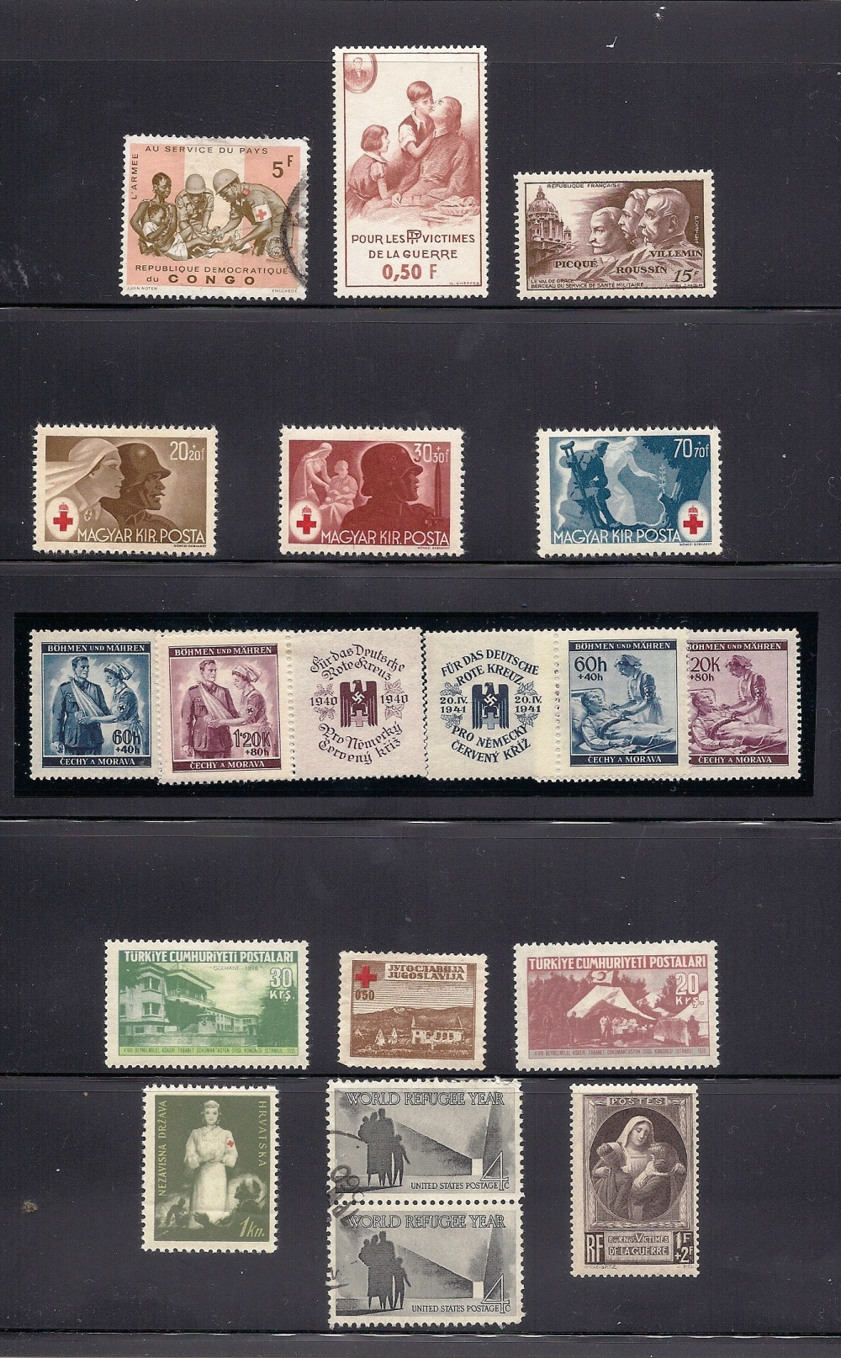
In war, most countries
idealize the victims,
the soldiers, and the
caregivers

Slide 29
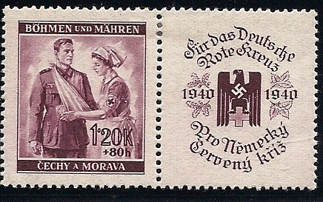
Nazi Sentimentality

Slide 30
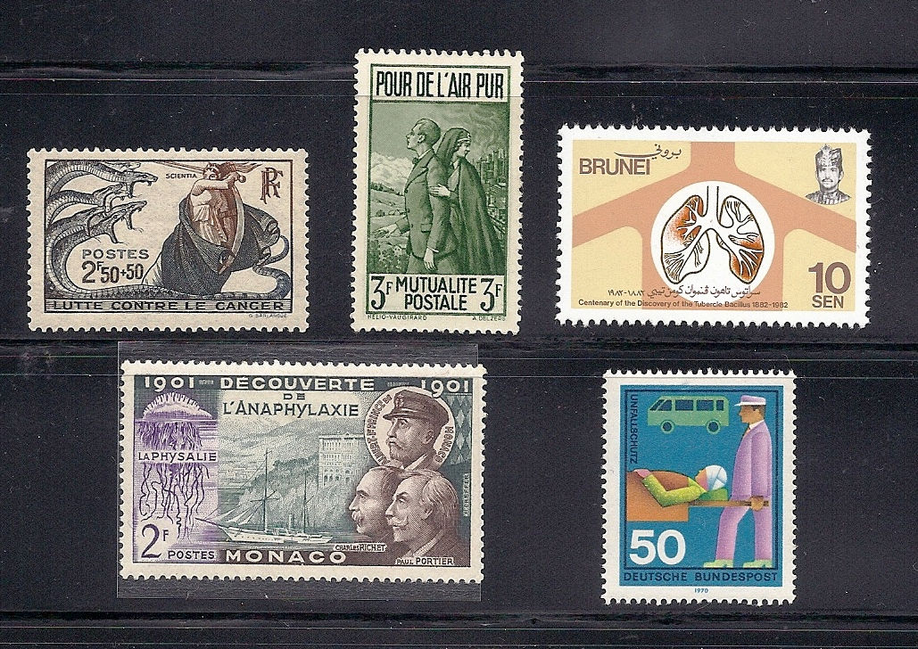
Foreign Weird

Slide 31
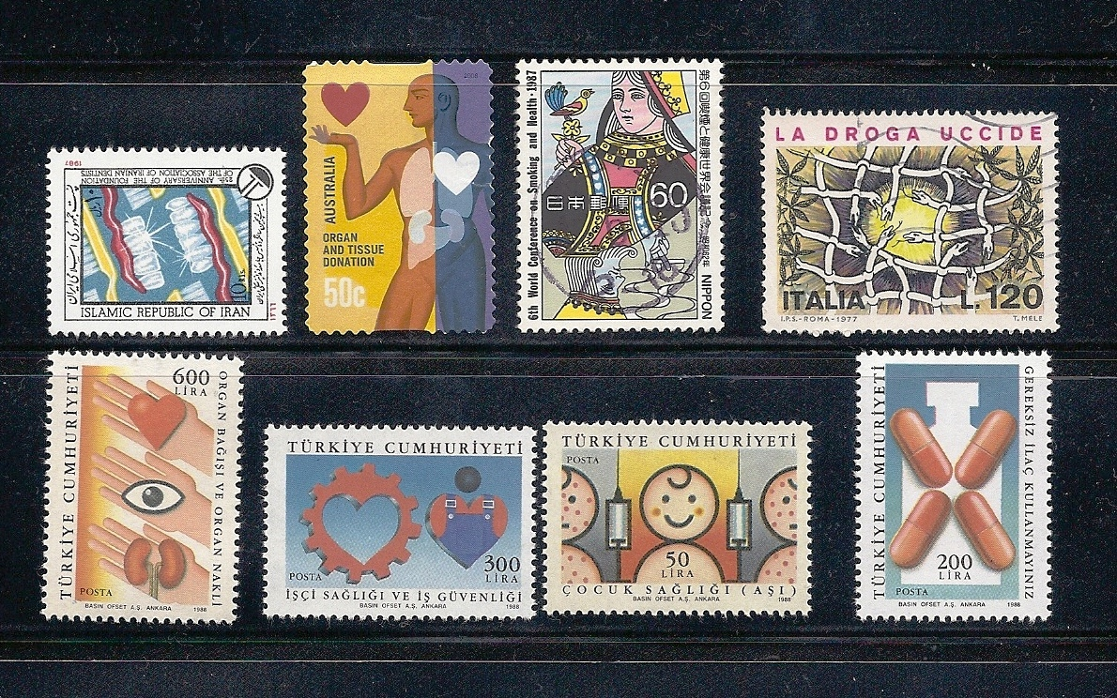
Weird
Foreign

Slide 32
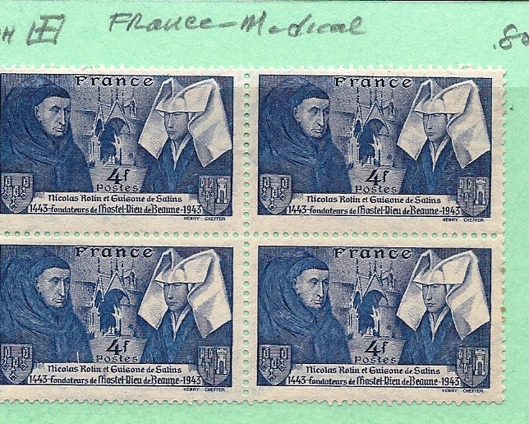
French
Weird

Slide 33
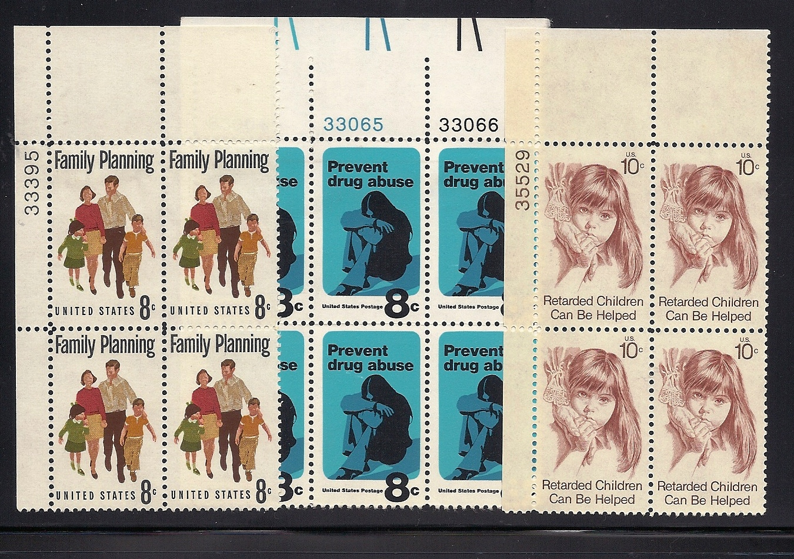
American Weird

Slide 34
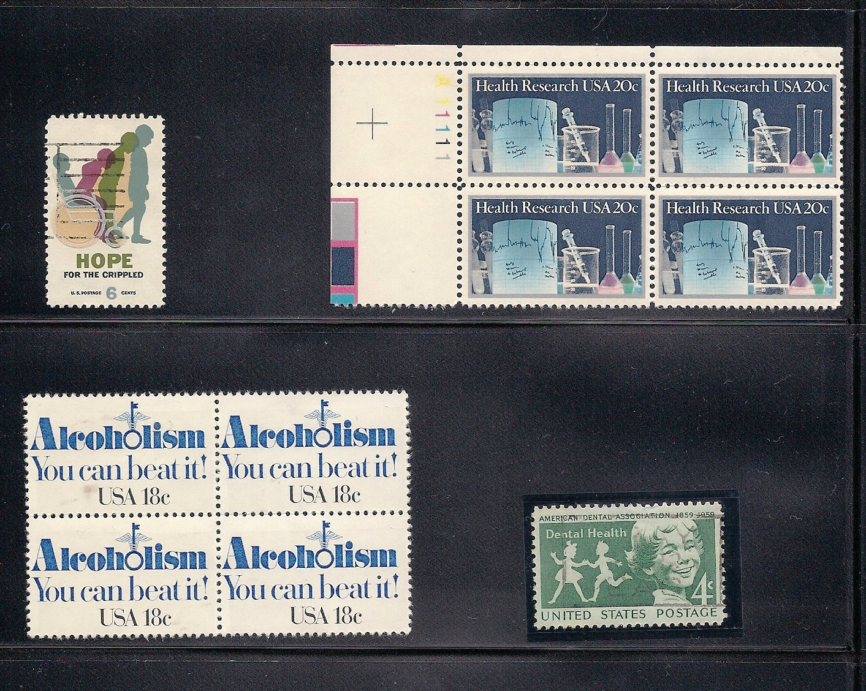
Americnan
Weird

Slide 35

Winner of the Weird Award

Slide 36
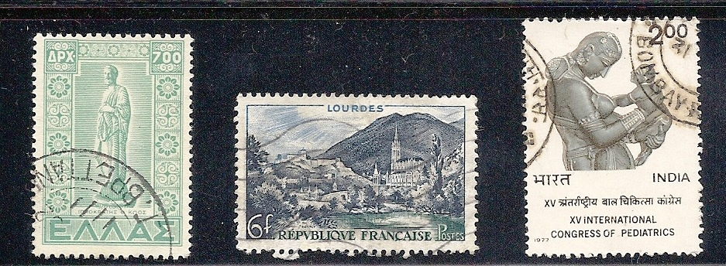
Mythology and Symbolism
on Stamps

Slide 37
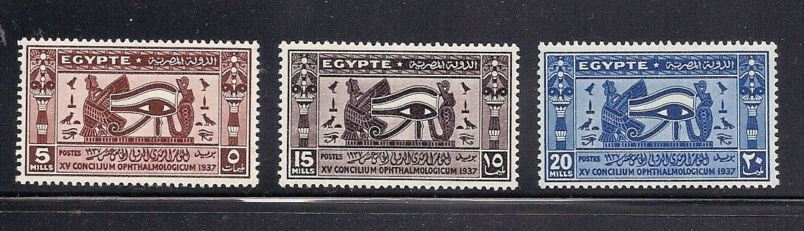
The Eye of
Ra

Slide 38
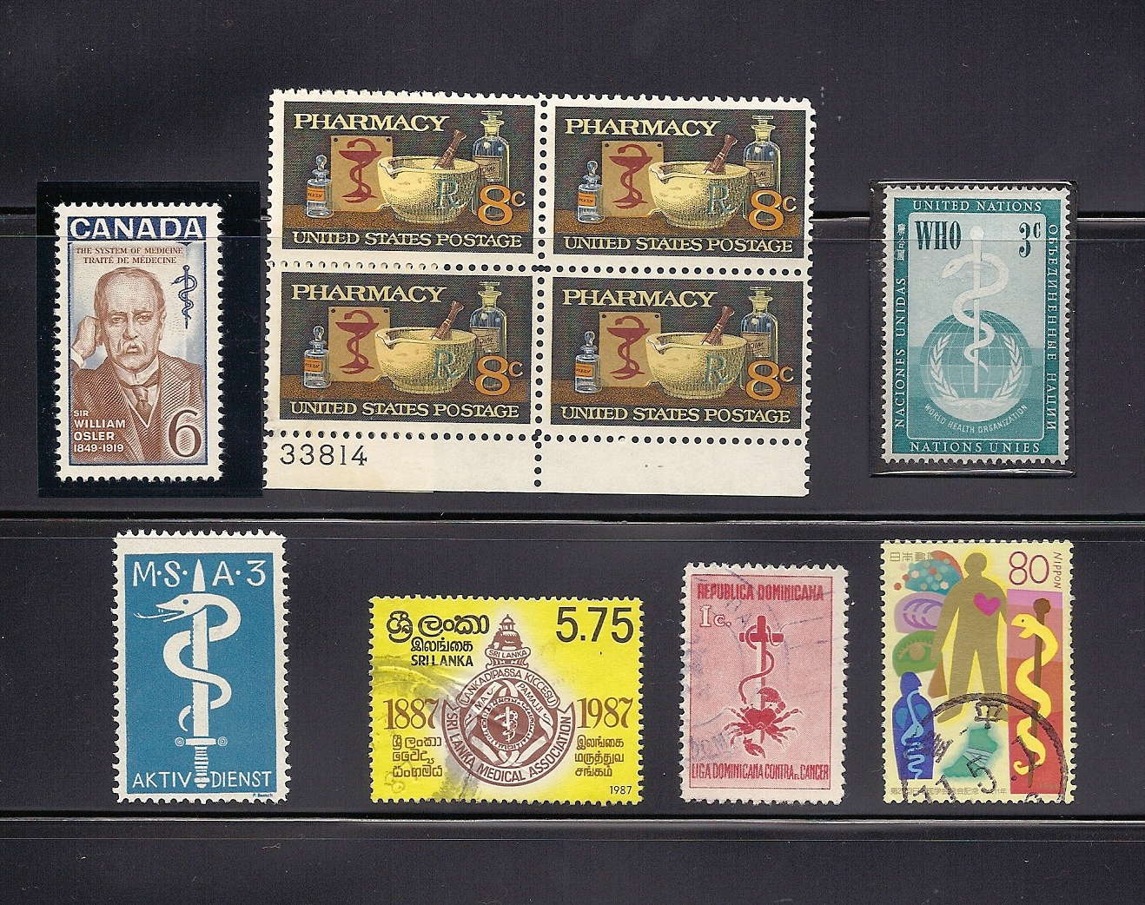
The
Asclepius
on
Stamps

Slide 39
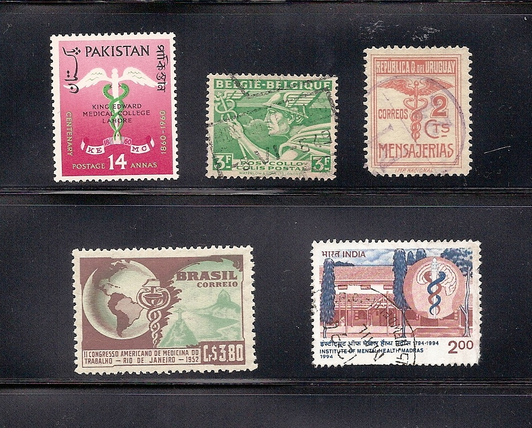
The
Cadeuceus
on
Stamps

Slide 40
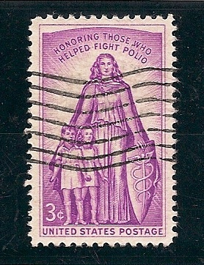
The
Cadeuceus
In
American
Stamps

Slide 41

U. S. Army;
Check out the
Lapel Insignia!

Slide 42
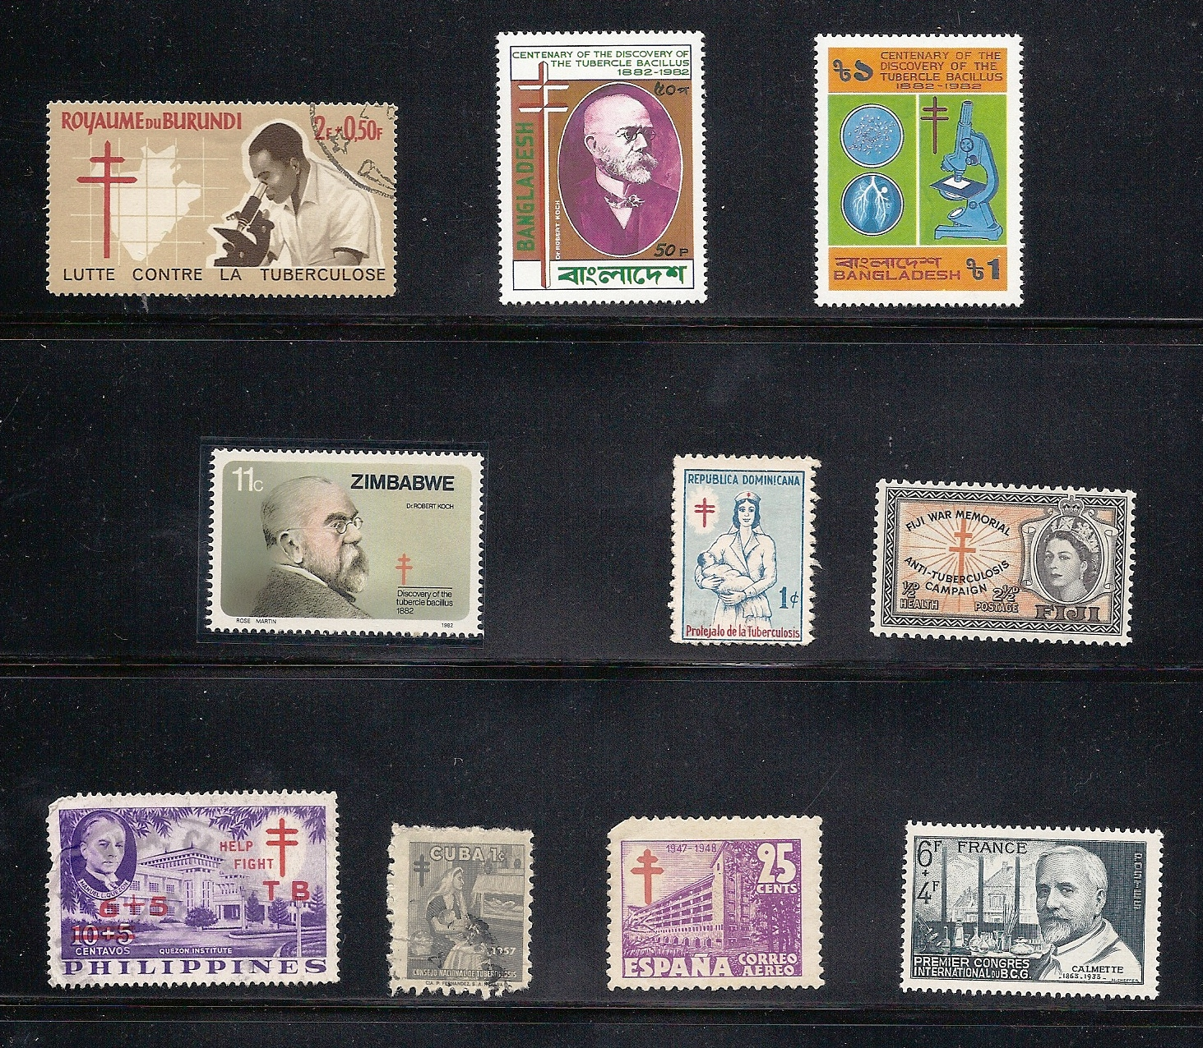
Tuberculosis
and the
Lorraine
Cross

Slide 43
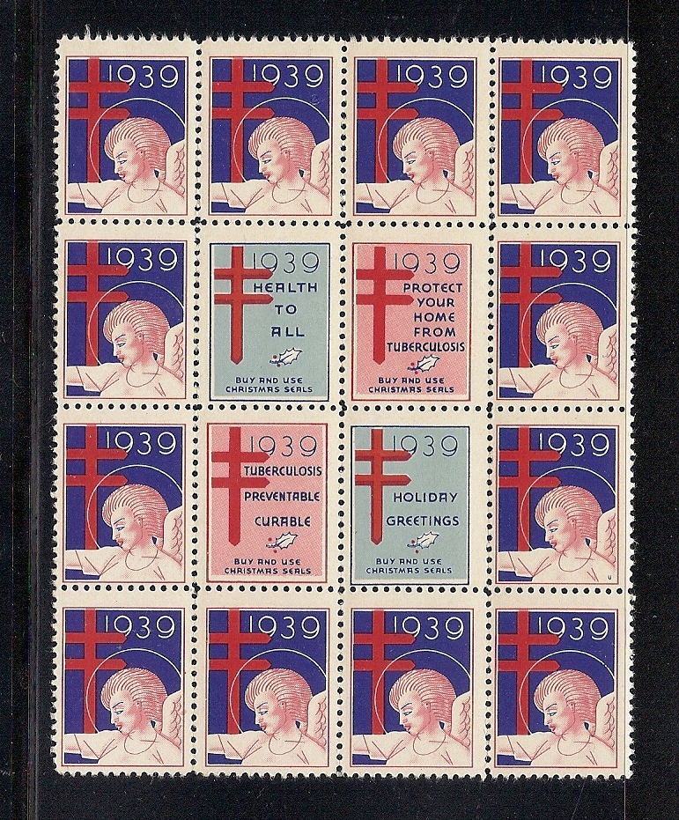
Christmas Seals

Slide 44
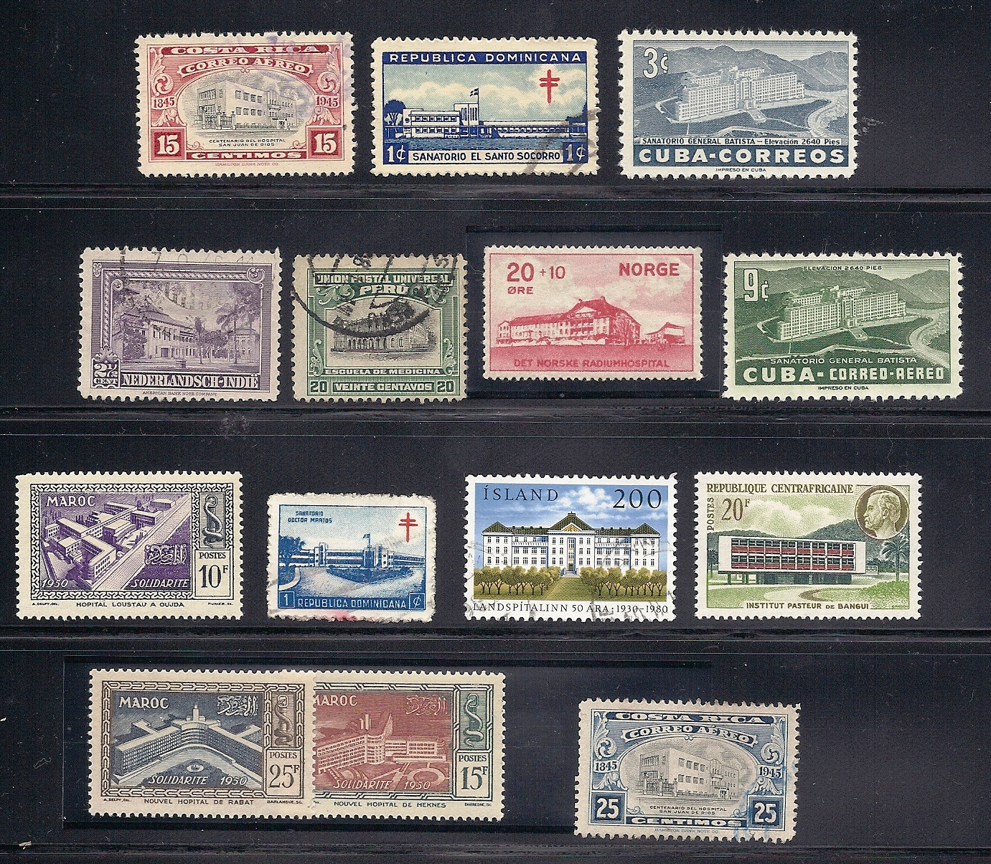
Hospitals
Around the
world

Slide 45
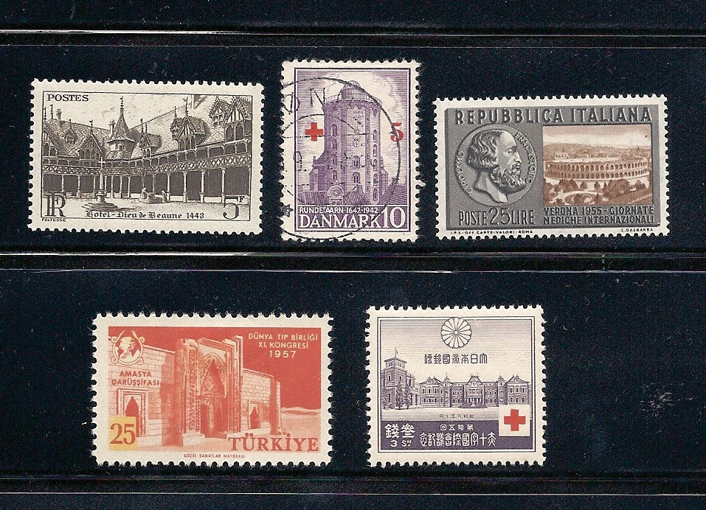
Interesting hospitals worldwide

Slide 46
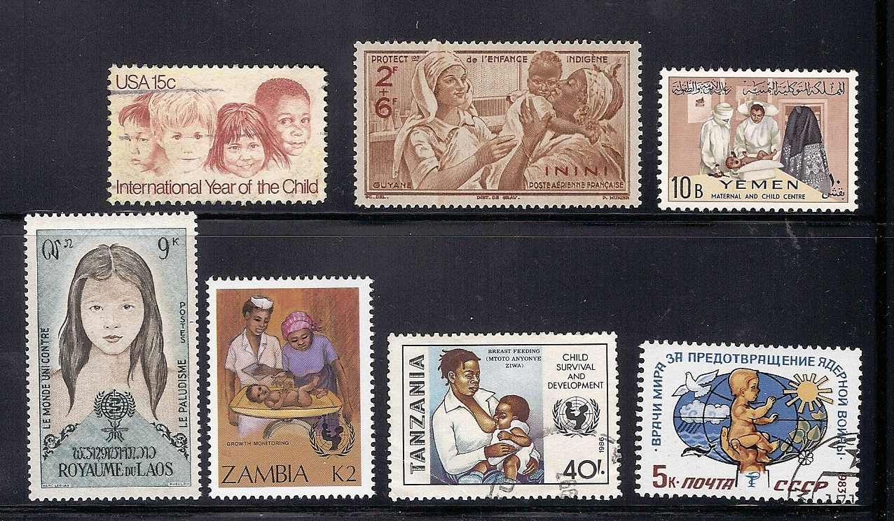
Children

Slide 47
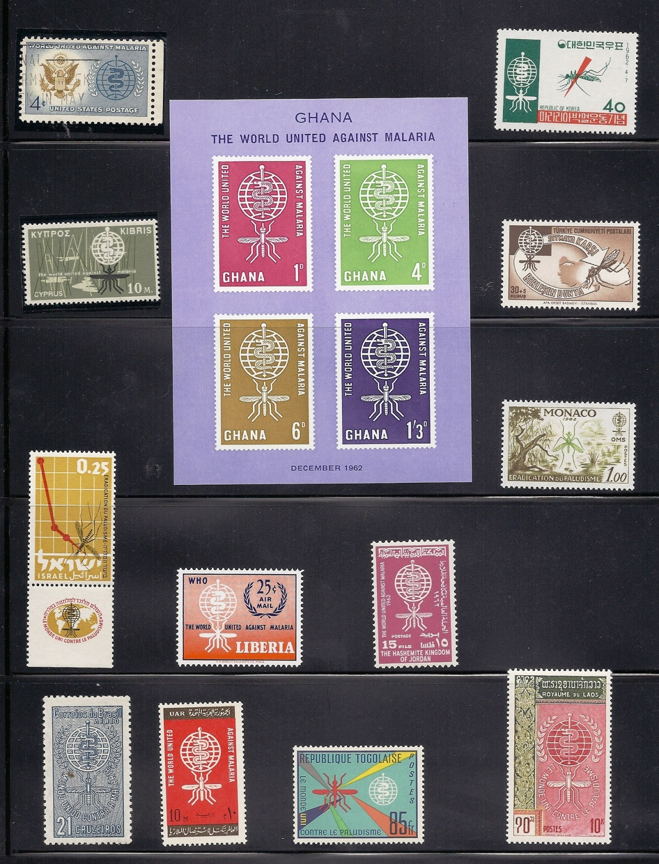
Malaria is the
greatest disease
killer world-
wide

Slide 48
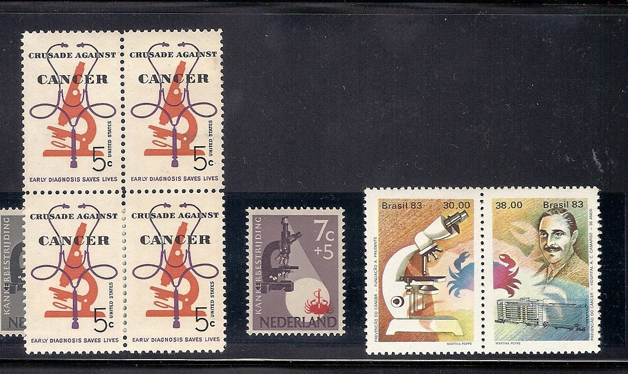
Cancer

Slide 49
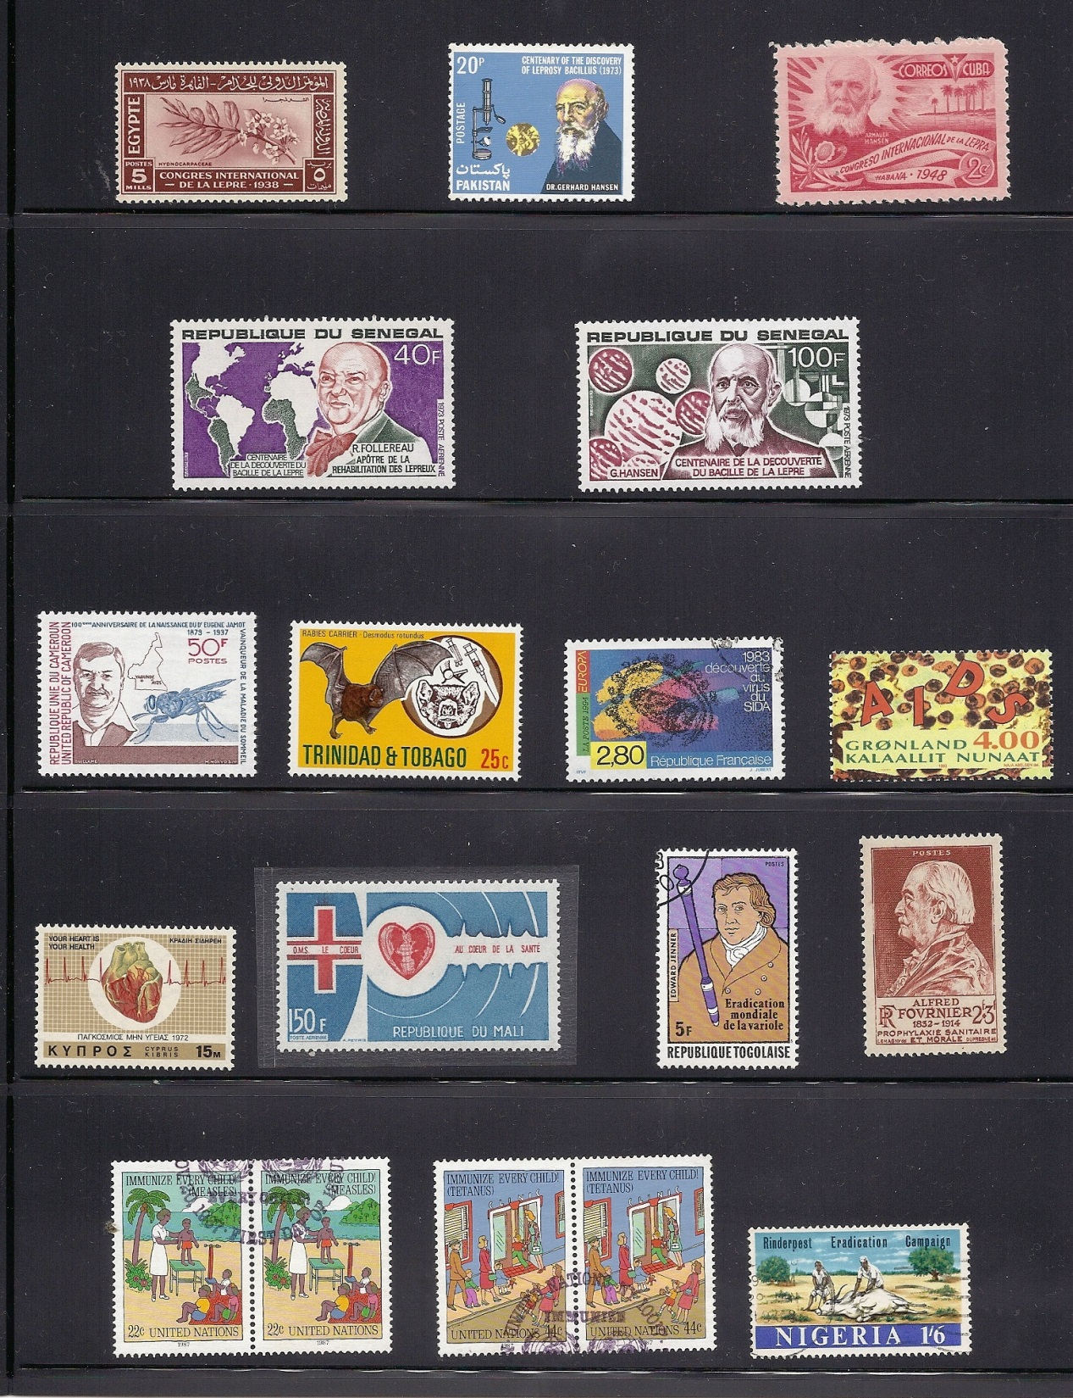
On stamps: leprosy,
sleeping sickness,
rabies, AIDS, heart
disease, variola, syph-
ilis, measles, tetanus,
and rinderpest.

Slide 50
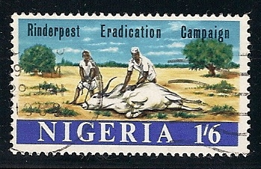
What is Rinderpest? It is an infectious disease
of cattle and other ungulates which wiped out
herds in many countries. It has now been
eradicated world-wide, only the second disease
in history to be fully wiped out.

Slide 51
Medical Stamps
Countries in my Collection
(103)
Algeria (Fr)
Angola
Australia
Austria
Belgian Congo
Belgium
Brazil
Brunei
Burundi
Cameroon
Canada
Newfoundland
Chad
China
China, P.R.
Colombia
Congo
Costa Rica
Croatia
Cuba
Cyprus
Czechoslovakia
Czech Bohemia and Moravia
Dahomey
Danzig
Democratic Republic of Congo
Dominican Republic
Egypt
Ethiopia
Fiji
Finland
France
French Equatorial Africa
French West Africa
Fujiera
Germany
GDR
Germany Third Reich
Ghana
Greece
Greenland
Guatemala
Haiti
Honduras
Hungary
Iceland
India
Inini
Israel
Italy
Jamaica
Japan
Jordan
Korea
Senegal
Slovenia
South Africa
Spain
Spanish Morocco
Sri Lanka
Sweden
Switzerland
Syria
Tanzania
Togo
Transkei
Trinidad and Tobago
Tunisia
Turkey
UAR
Uganda
United Nations
Uruguay
USA
Venezuela
Viet Nam
Yemen
Yugoslavia
Zambia
Zimbabwe
Laos
Liberia
Mali
Martinique
Mexico
Monaco
Morocco
Netherlands
Netherlands Antilles
Netherlands Indies
New Zealand
Nigeria
Norway
Pakistan
Panama
Peru
Philippines
Poland
Portugal
Romania
Russia
Rwanda
Ryukyu

