Slide 1
US Postal History 1847 Issue on Cover
The Catharine McKie Correspondence
From
Troy to South Easton NY, 1847-1851

Slide 2
Collecting Stamps vs. Postal History
Stamps Postal History
Design Y Y
Colors Y Y
Cancels Y Y++
Perfs Y Y
Watermarks Y N
Usages / rates N Y++
Recipients N Y
History – Events Y Y

Slide 3
1847 Issue Cover Census
14900+ Listings
9100+ cover descriptions
8600+ illustrations
Available free online at USPCS.org
Fully searchable – find individual covers or entire correspondences.

Slide 4
1847 Issue Cover Census Challenges
Complete listings
Better images
Year date the covers
Identify the recipient
Identify the sender
Understand their history

Slide 5
1847 Issue Cover Census – Types of Letters
Banking Receipt of drafts from remote cities requesting payment and acknowledging receipt of payment
Professional Letters to local governments, lawyers, clergy and businesses
Personal correspondences Traveling spouses, distant relatives, Valentines & Love Letters

Slide 6
Catharine McKie Correspondence
69 Letters in Census mailed between Nov 1848 and May 1850
Most mailed to Miss Catharine McKie in South Easton, NY
Covers had docket numbers through end of 1849
Docket dates precede mailing date
Docket dates end March 1850
Last cover, dated July 12, 1850 addressed to Mrs. Catharine McKie Thayer

Slide 7
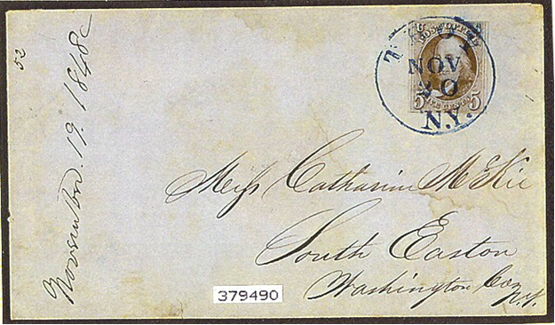
Catharine McKie Correspondence
CDS – Nov 20, 1848 Docket – 52, Nov 19, 1848

Slide 8
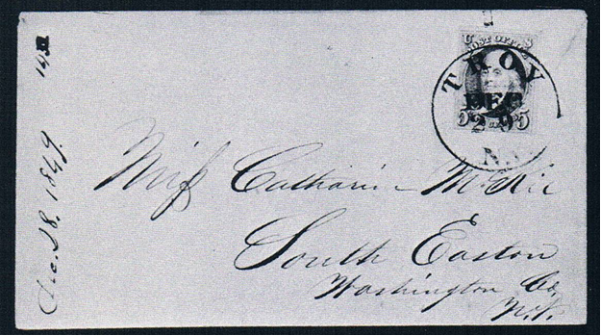
Catharine McKie Correspondence
CDS Dec 29, 1849 Docket – 142, Dec 28, 1849

Slide 9
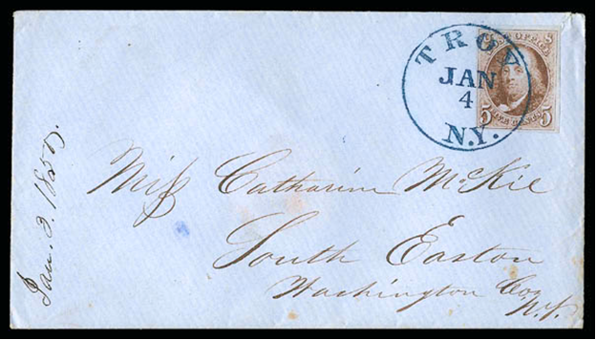
Catharine McKie Correspondence
CDS – Jan 4, 1850 Docket – blank, Jan 3, 1850

Slide 10
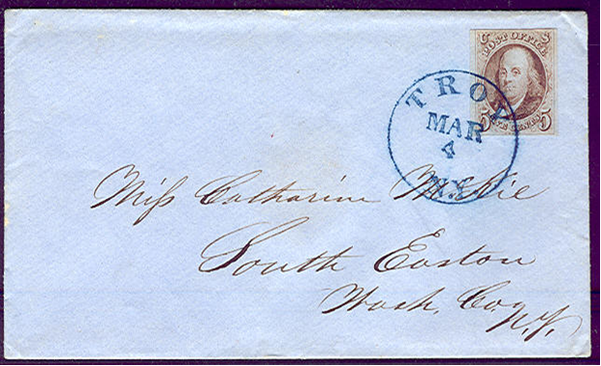
Catharine McKie Correspondence
CDS – March 4, 1850 Docket – None

Slide 11
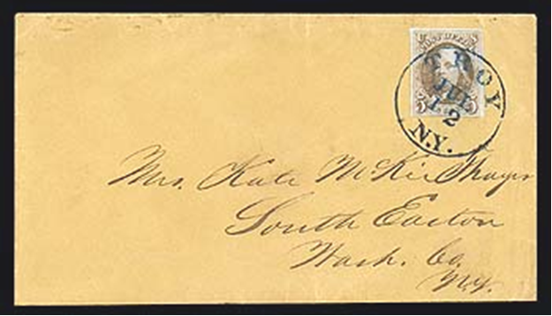
Catharine McKie Correspondence
CDS – Jul 12, 18(50) Docket – None Addressed to Mrs. Kate McKie Thayer

Slide 12
Catharine McKie Correspondence
Conclusions
Large correspondence – 142 + 19 unnumbered = 161 letters min.
1st stamped cover was well after Stamps were available in Troy, NY (first stamped letter from Troy dated Sept 10, 1847)
Thus, something changed in the changed in the correspondents’ relationship around Nov 1848
Any letters missing - 161-51 prior to stamps = 110 covers vs. 69 known
Interestingly, there are no covers from South Easton addressed to Troy.
Catharine McKie married someone named Thayer in April – July 1850

Slide 13
Catharine McKie Correspondence
Thank You & Good Night
Wait a minute. The story is not complete! Is there any more?

Slide 14
More to the Story
The Internet is a wonderful resource.
A few years ago I did a Yahoo search on “Troy McKie Thayer” and got a hit on V. 1844–1850 Letters from Cambridge and Troy, Part One thefamilyletters.com/images/Ch%205.pdf
This was a pdf of Chapter 5 in a book by John Mudge about some old family letters, diaries, and other papers in his possession
Letter excepts told the story of Catharine McKie of Cambridge NY and Francis Thayer of Troy, NY

Slide 15
Catharine McKie’s Story
Catharine was one of 7 children of George and Sophia McKie
She was born in 1827.
She attended school for 9 months (1843-44) at the Troy Conference Academy in Poultney, Vermont, along with her brothers.
Catharine’s family lived in Cambridge NY in Washington County just north of Rensselaer County about 28 miles NE of Troy, NY
South Easton is 13 miles SW of Cambridge and the closest Post Office to the McKie home.

Slide 16
Francis Thayer’s Story
Francis Thayer grew up in Hoosick Falls, NY
He was born in Vermont in 1822
He went to school in 1842 and attended the Troy Conference Academy in Poultney Vt. where he became friends with Catharine’s older brothers.
In 1844 he moved to Troy and started working at a flour mill.
In August 1844 he starting writing to Catharine.

Slide 17
More of Catharine’s Story
Catharine was the youngest child of George and Sophia
She had 6 older brothers
She was only 16 in 1844 when Francis started writing to her
She was probably a typical 16 year old with dreams about romance living with what she considered over-protective parents
Francis’s letters were probably exciting and overwhelming

Slide 18
Francis Thayer’s Letters
Two of Catharine’s brothers worked in Troy and were friends of Francis
They acted as “postmen” delivering some letters between Catharine and Francis, particularly in the early years of the correspondence.
Catharine’s letters were dropped into Francis’ box at the Troy PO, probably requiring a 2 cent drop fee.
Francis’ letters were sent by mail. Catharine may have had the job of picking up the mail every day, and thereby could intercept her letters before her parents could see them
Catharine kept all of Francis’ letters (as girls tend to do)
Francis also kept a draft of all his letters, carefully entered into a diary that still exists.

Slide 19
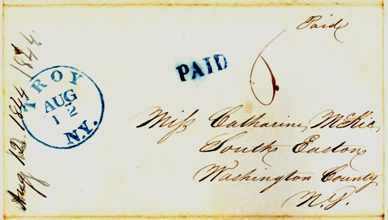
Francis Thayer’s Letters
The docketing may have been added later since the dates are all from internal datelines, not when they were received.
Courtesy of John Mudge
The first letter from Francis was sent stampless to South Easton

Slide 20
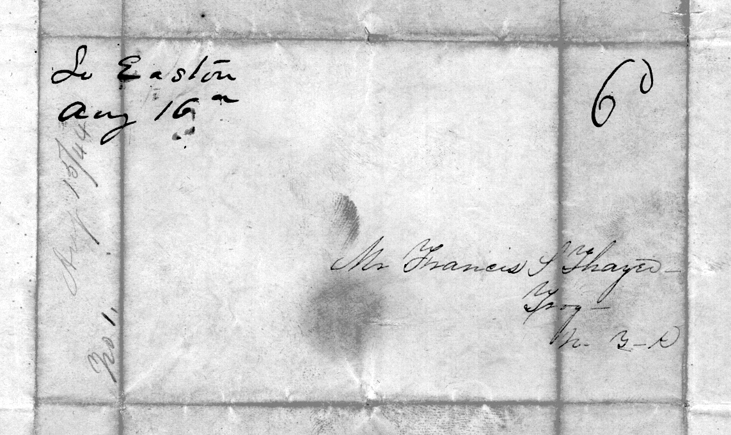
Francis Thayer’s Letters
Catharine’s response was sent stampless, as well
Letters to Francis
were also docketed the date they were written and were numbered.
Courtesy of John Mudge

Slide 21
Francis Thayer’s Letters
The letters started formally
Starting with “Mr. Thayer” on August 15th, she wrote “In reference to a non intimate acquaintance with you, I have not even the shadow of an objection for I have forever considered you one of my most worthy acquaintances, but I cannot approve of the cultivation of that acquaintance with regards to any particular subject.” She told Francis of her desire to keep their correspondence a secret from her mother, as she was in bad health and closed the letter with “Your friend, as ever, Kate.”

Slide 22
Francis Thayer’s Letters
But quickly become more friendly, and then after a few anxious missives from Francis, as he tried to take the long distance relationship to “the next level,” the letters become more intimate.
Eventually the two were professing strong feeling for each other, turning into Love.
Finally, in Feb 1848, Francis wrote “The Letter” to Catharine’s parents, expressing his love for their daughter, and expressing his intentions for them to eventually marry. George wrote back in early March, giving his permission.

Slide 23
Francis Thayer & Catharine McKie
The relationship was not exclusively by mail.
Francis was a frequent visitor to the McKie home since he was a close friend of Catharine’s brothers.
While Francis & Catharine probably spent a few “stolen moments” together and thought they were being discrete, George & Sophia probably had a good idea that the two had grown close together.

Slide 24
Francis Thayer & Catharine McKie
The letters continued to be delivered outside the mail and it wasn’t until Nov 1848 that stamped letters appear.
The reason for the delay is not given in either’s letters.
Perhaps Catharine’s brothers no longer made regular trips to Troy.
Perhaps Francis got a raise and the 5 cent postage was no longer a financial burden

Slide 25
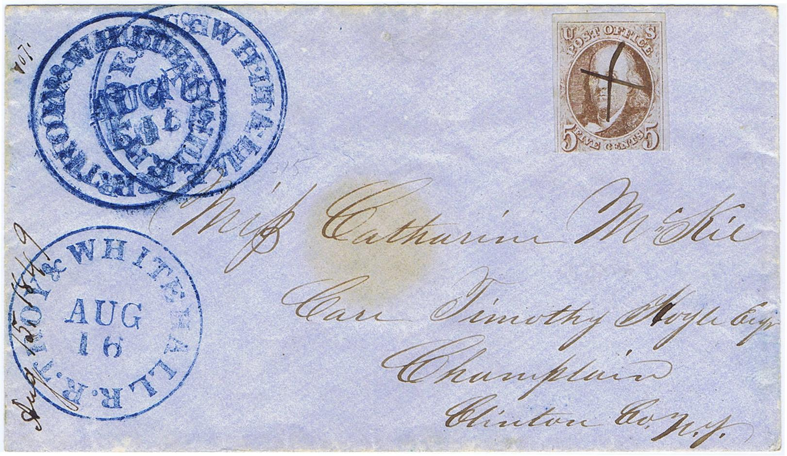
Other Interesting Letters – philatelicly speaking
Sent from the Troy & Whitehall RR – one of 3.
From the collection of Hugh Feldman but recently sold by Schuyler Rumsey
Posted on PhilaMercury.

Slide 26
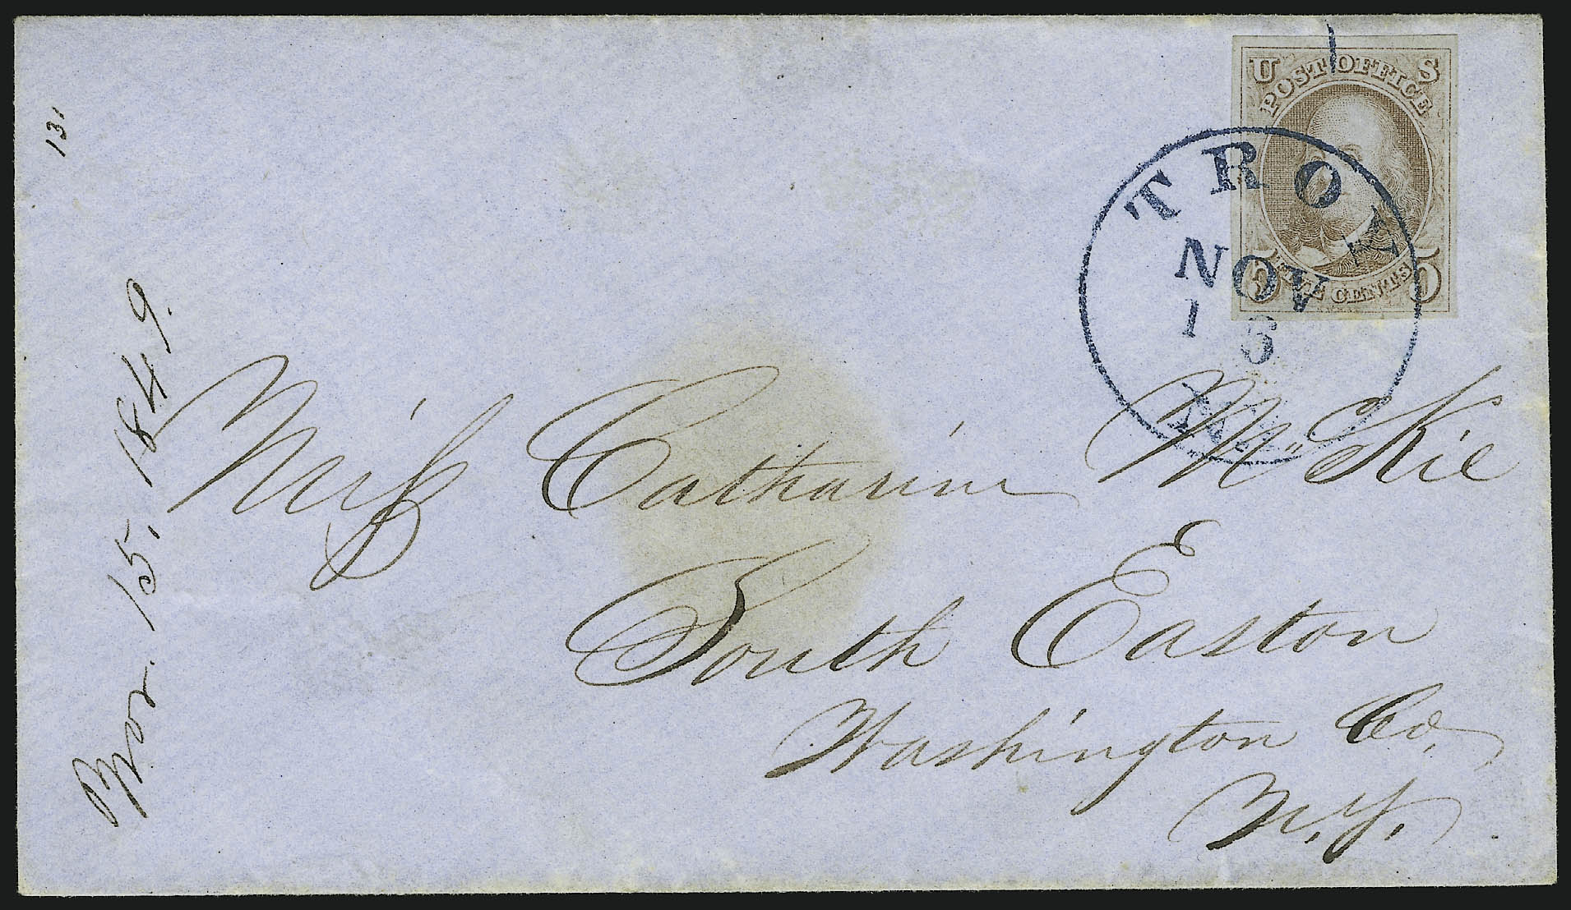
Other Interesting Letters – philatelicly speaking
By Nov. 1849, the letter count jumped by 89.
Docket number 131.

Slide 27
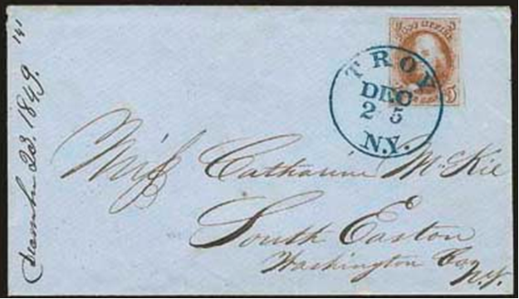
Other Interesting Letters – philatelicly speaking
A Christmas rarity?
Sold in Siegel’s 2000 Rarities of the World, sale 824, lot 63 realized 12,500.
The letter was written two days earlier.

Slide 28
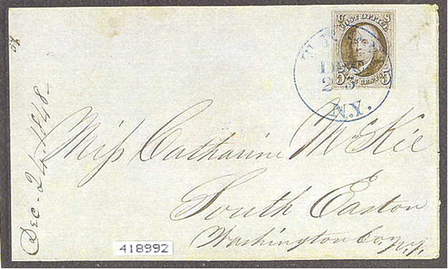
Other Interesting Letters – philatelicly speaking
Docketed Dec 24, 1848 but dated Dec 23 in the CDS.
Trusting Catharine & Francis, the letter must have been mailed on Dec 25.
Bennett sale 277 lot 234 realized only 325
A postal clerk’s mistake?

Slide 29
Francis & Catharine Thayer
Francis & Catharine married on April 30, 1850, allowing us to year date the undocketed letters.
Francis eventually owned the Crystal Palace Flour Mill in Troy
The family eventually moved to Colorado, where Francis died in 1880 and Catharine died in 1901
Francis & Catharine had several children - three died in childhood two lived to become adults; Francis McKie Thayer who married but had no children and Katharine Thayer who married twice, the second time to Henry Wise Hobson, grandson of Henry Alexander Wise, governor of North Carolina during the Civil War.

Slide 30
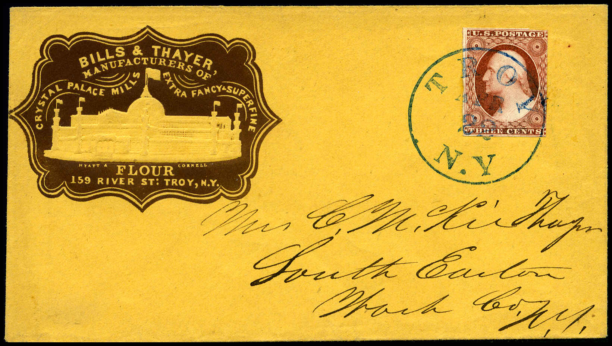
The McKie Correspondence
The letters continued after the 1847 period, when Catharine visited her parents.
Corner advertising cover for Crystal Palace Mills.
Covers were also printed in red, green and blue.

Slide 31
The McKie Correspondence
The stamped letters entered the philatelic market sometime around 1941.
John Mudge believes an uncle of his sold them off.
John still owns the letters, diaries, and stampless covers of many of his ancestors, including Francis & Catharine.
John is missing 101 envelopes from the correspondence, all presumably having 1847 issue stamps.
Sixty nine are currently in the census. Alexander listed 49. Twenty have been found over the past 13 years.
The writing dates of the other 32 are known, waiting to be rediscovered

Slide 32
Catharine McKie Correspondence
Thank You & Good Night
Yes, this is the REAL end, for now.

