Slide 1
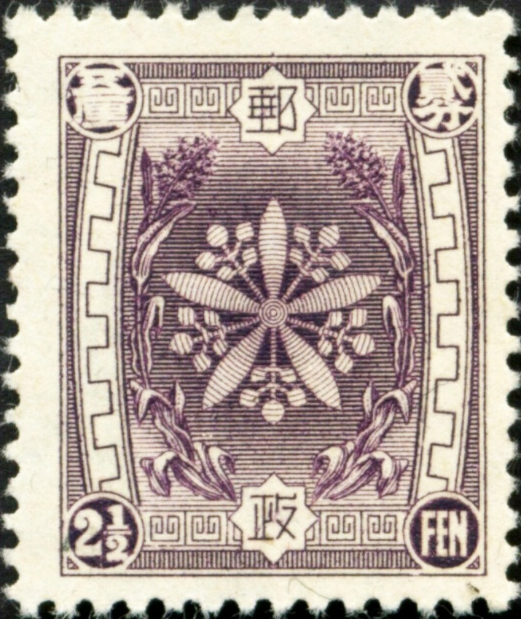
Philately of Manchukuo:
A Personal Perspective
A presentation for the
Rochester Philatelic Association, March 2020
by John Kellas III

Slide 2
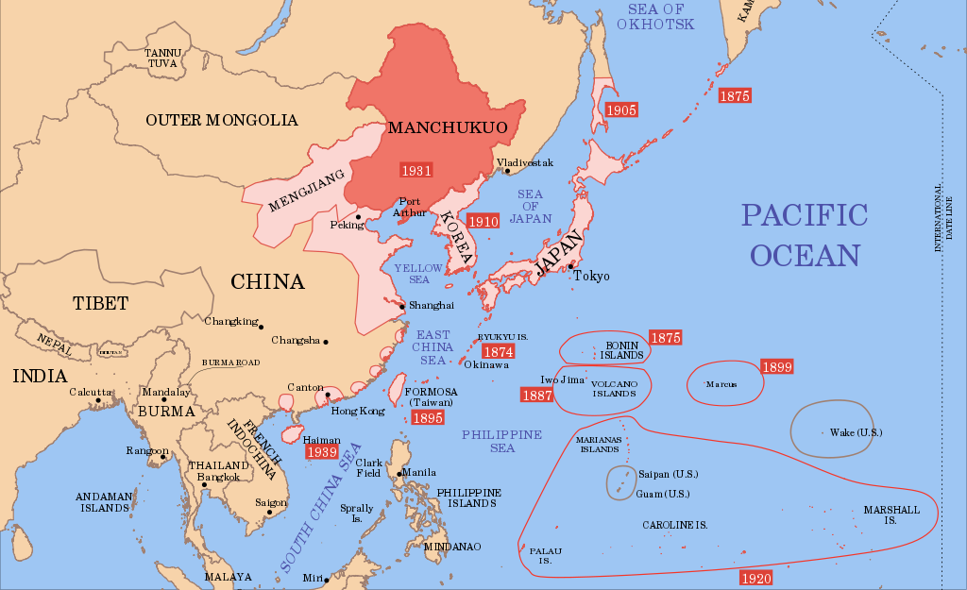
Japanese expansion in the Pacific, 1874-1939.

Slide 3
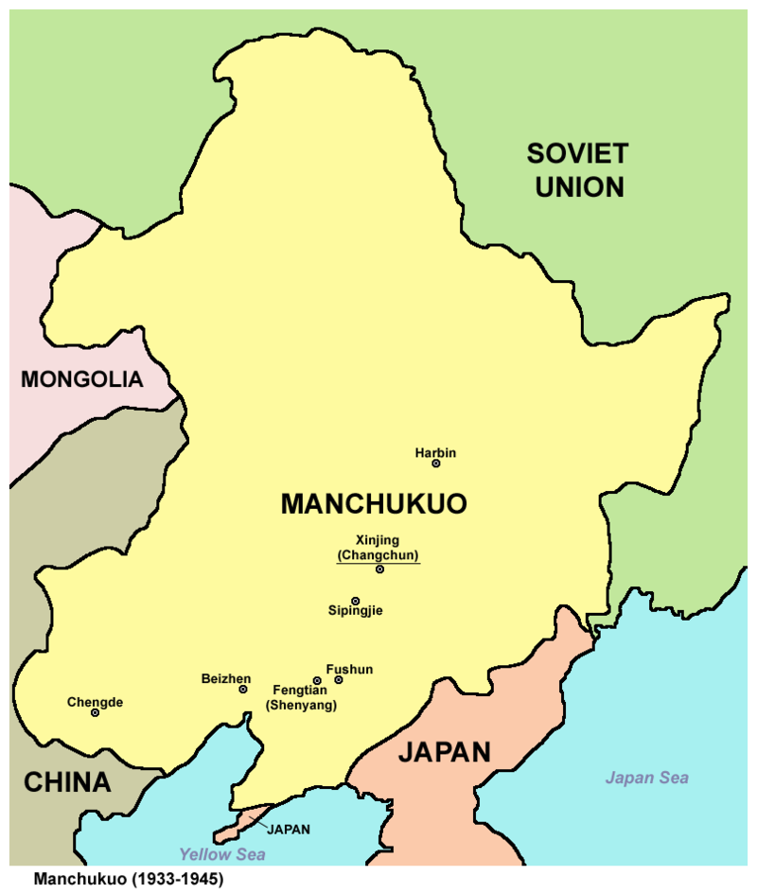
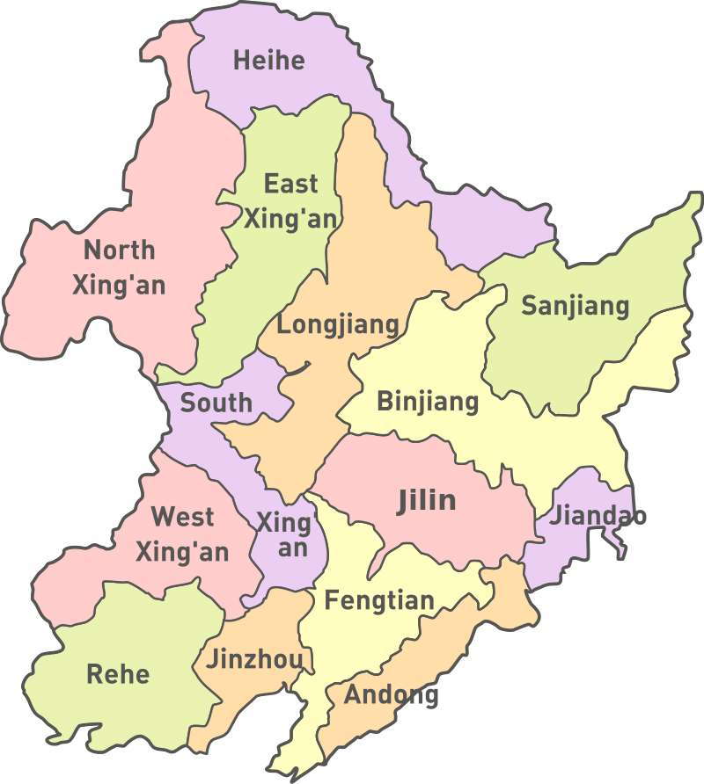
The State of Manchukuo and its regions, 1933-1945.
Harbin

Slide 4
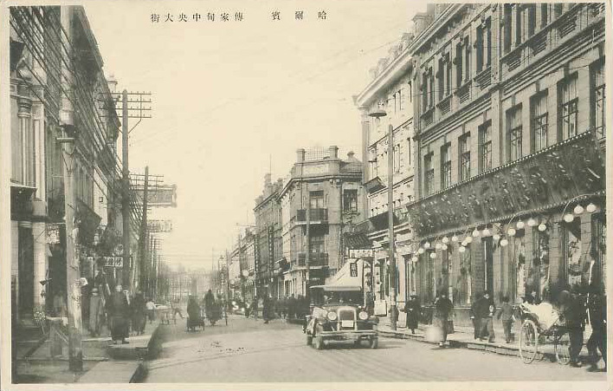
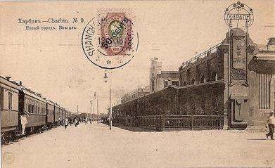
Harbin 哈尔滨 is a major city and provincial capital in northeastern China. It lies on the southern bank of the Songhua River. The city was established in 1898 by a Polish national, Adam Szydłowski, during the construction of the East China Railway. More than 10,000 Poles built and then ran the railway at the turn of the century. Szydłowski eventually became the city’s first president.
Harbin central main street, circa 1930
The city had very strong Russian ties due to its location and trade ties. Wealthy White Russian émigrés flocked there after the Russian Revolution. It was considered China’s fashion capital in the 1920’s, by which time the population was well over 120,000. Sixteen countries established consulates to serve their nationals there. The Japanese invaded Manchuria in 1931, establishing a puppet government throughout the region.
Harbin train station, 1905

Slide 5
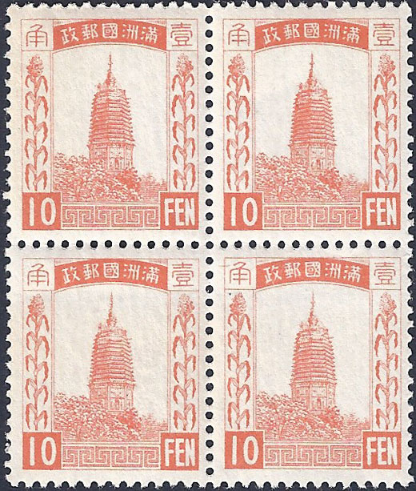
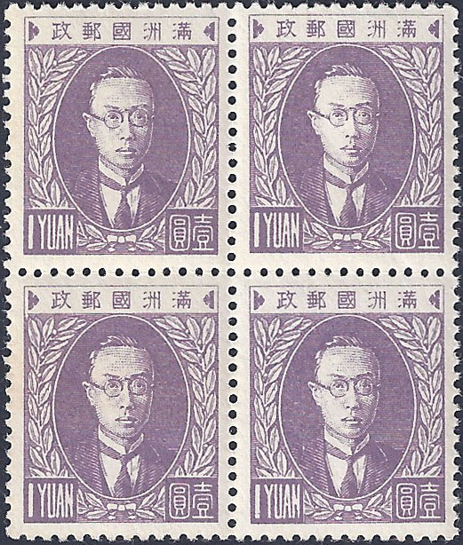
Manchukuo’s first stamp issues, July 26, 1932.
The ½ fen to 10 fen stamps depict the White Pagoda, a 13 story tower carved with images of the Buddha in the city of Liao-yang, 64 km South of Mukden. The pagoda is all that remains of the once important Guan Yu temple. The 13 fen to 1 Yuan values show the Chief Executive of Manchukuo, Puyi.

Slide 6
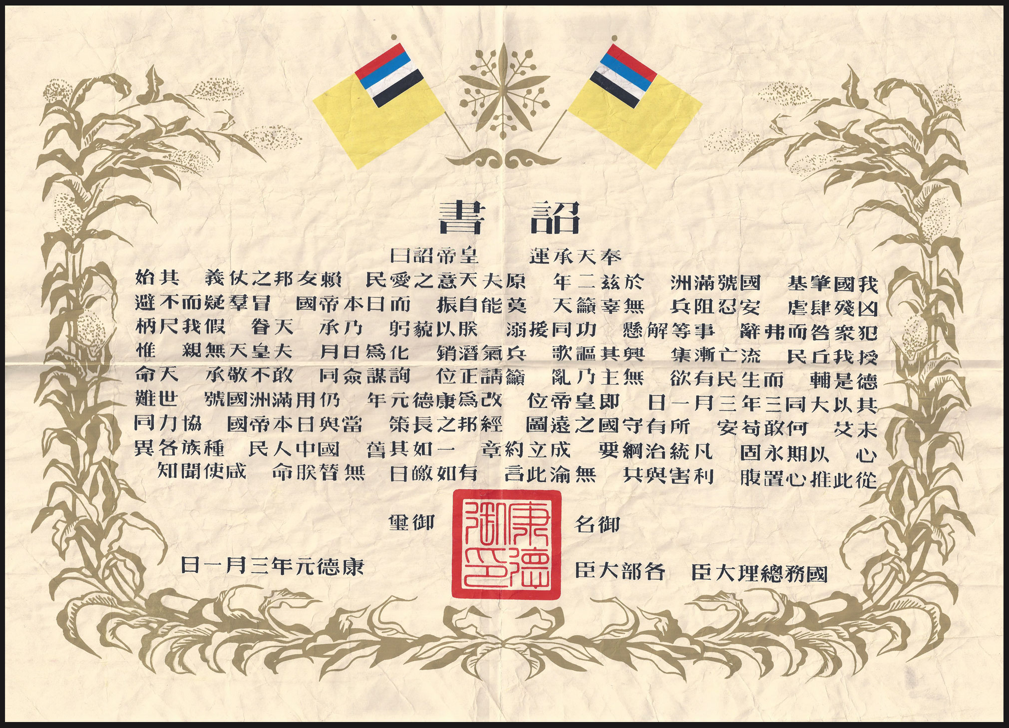
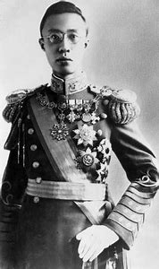
Edict announcing Henry Puyi as Emperor Kāngdé, 3/1/34

Slide 7
Text of the Edict
For the mandate of heaven, the Emperor declares as follows:
Our country’s establishment is done. The name is Manchukuo, effective from the start of next (second) year. The heaven loves our people. Our friendly neighbors trust and protect us. We have seen from earlier that brutality and slaughtering is everywhere. Tolerance and military impotence. We failed heaven. We couldn't stand up. However, The Empire of Japan, despite all suspicions and offensiveness, laid a helping hand. I hereby give a big bow. They made me the ruler, returned me my people, as all exiles now gathering. All waiting will be thriving again, like the Sun and Moon shining. People always say the Emperor does not have relatives. Morality is his closest relative. And people live with a desire. No leader means chaos (no desire). I'm here to take this seat. As if all responsibility tells, I can't refuse to respect (accept). Heaven today ordered that. From Tatung 3rd Year March 1st the new emperor sits on his throne. Change the year code to Kāngdé 1st Year. Keep Manchukuo the name. The world is still full of disasters and hardships. We don't dare to feel safe today. All the defense works. Diplomatic affairs and strategy need to be collaborated with Japan together and united as if we have one heart. To consolidate the relation the terms of the details, agreements and treaties are not changed with Japan. People in our country- despite races and ethnic groups from now on treat each other with highest sincerity. Share hardships and profits. What I have said today is as bright as sun. My Fate is irreplaceable. Everyone has now heard it.
Seal. Name
Kāngdé 1, March 1st Chancellors from all departments, Premier of State Council

Slide 8
The source of much of the material presented here.
A correspondence developed between an American diplomat in Harbin, Manchukuo and a stamp collector from 1936 to 1940.
The stamp collector was John’s relative.

Slide 9
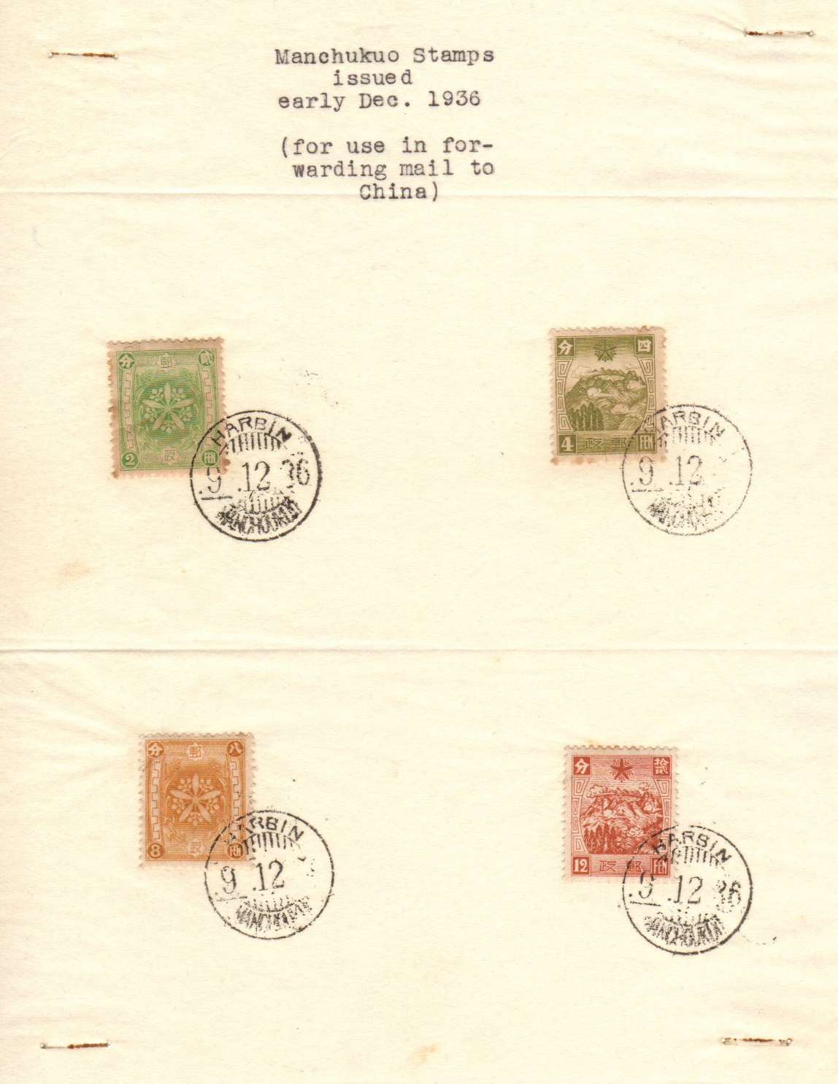
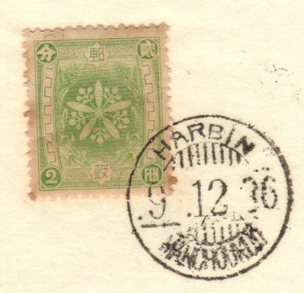
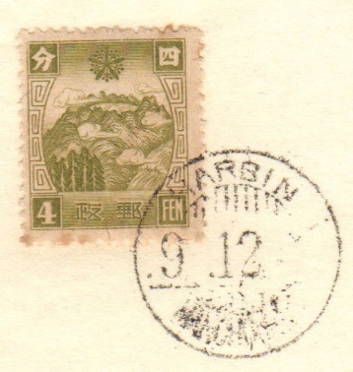
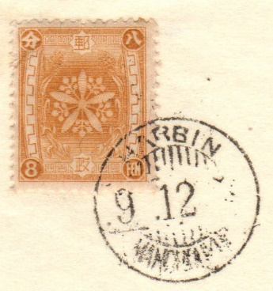
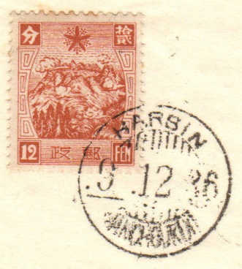
Special China Mail Stamps (Third Issue) 1936- no specific date of issue 2f, 8f depict the Imperial Crest of Manchukuo. 4f, 12f show 長白山 Zhǎngbáishān (Mount Changbai) and the Heavenly Lake, the birthplace of the Manchu dynasty.

Slide 10
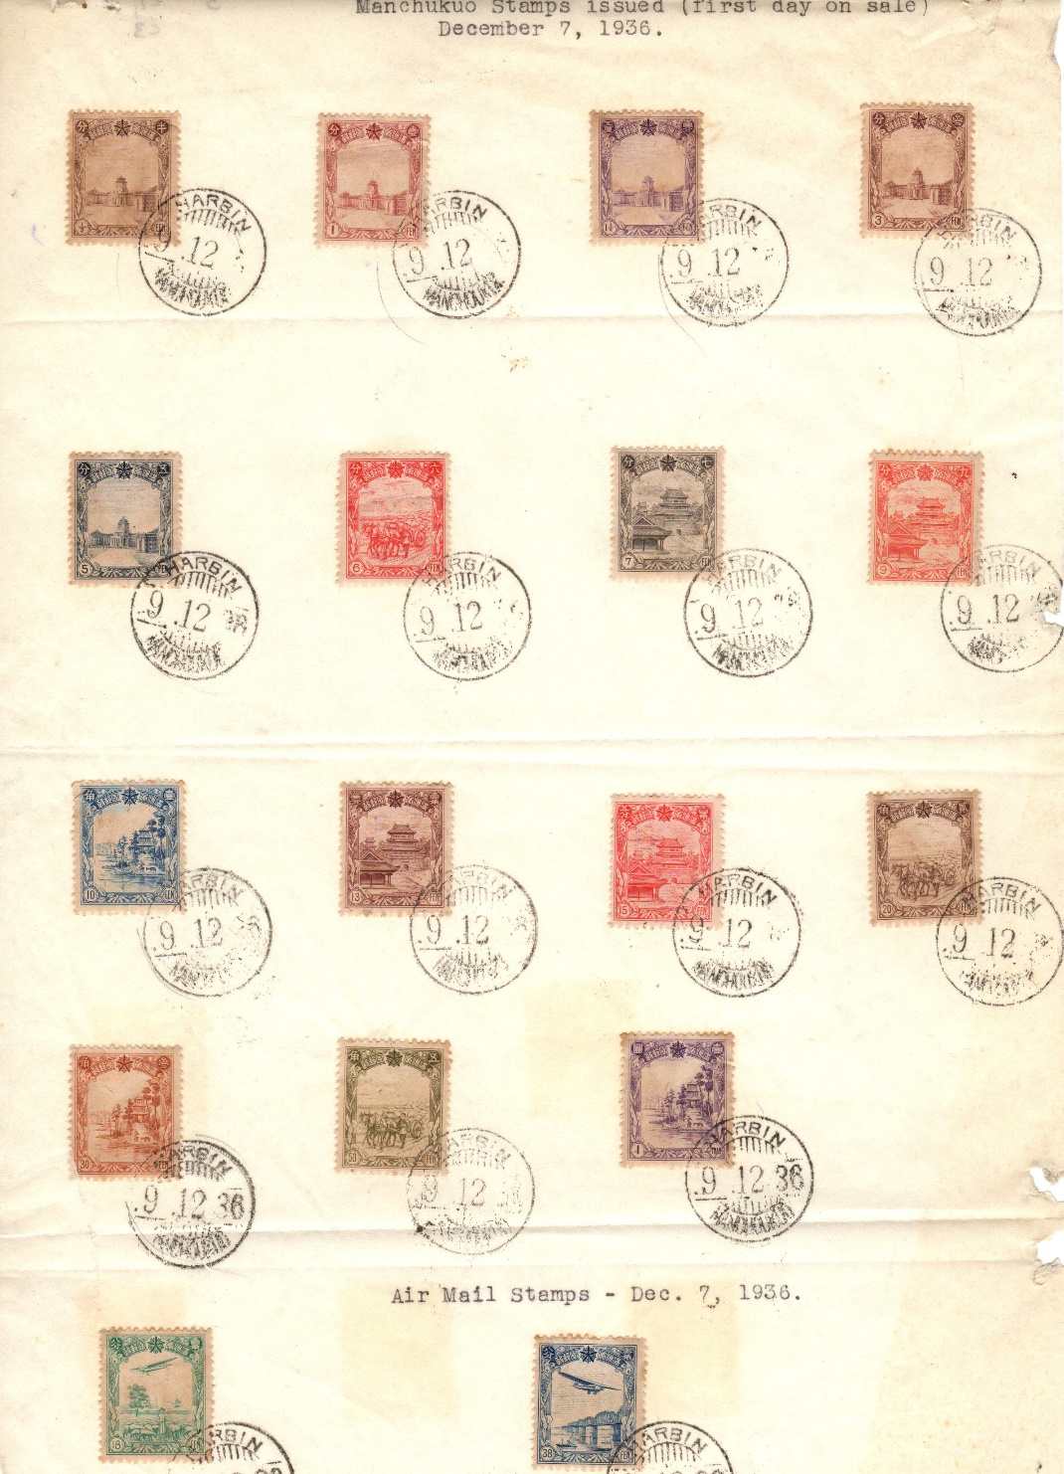
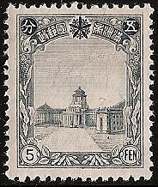
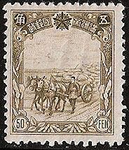
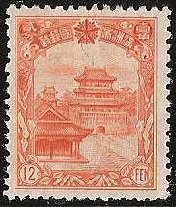
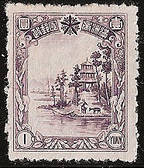
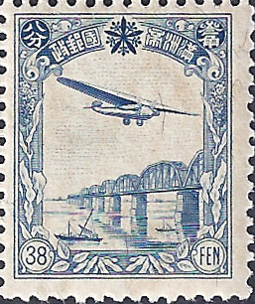
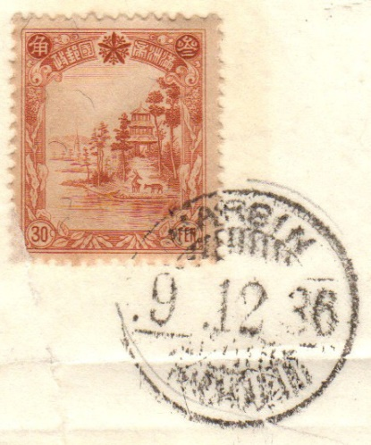
Fourth Regular Issue 12/05/36 ½f ,1f, 1½f, 3f, 5f show the New State Council Building, Hsinking. 2f, 6f, 20f, 50f show Farmers Carting Soya Beans. 4f, 7f, 12f show the Qing Dynasty Peiling Mausoleum at Mukden. 10f, 30f, 1y show the Summer Palace at Chengteh. 38f, 39f show an aircraft flying over the Sungari River railway bridge.

Slide 11
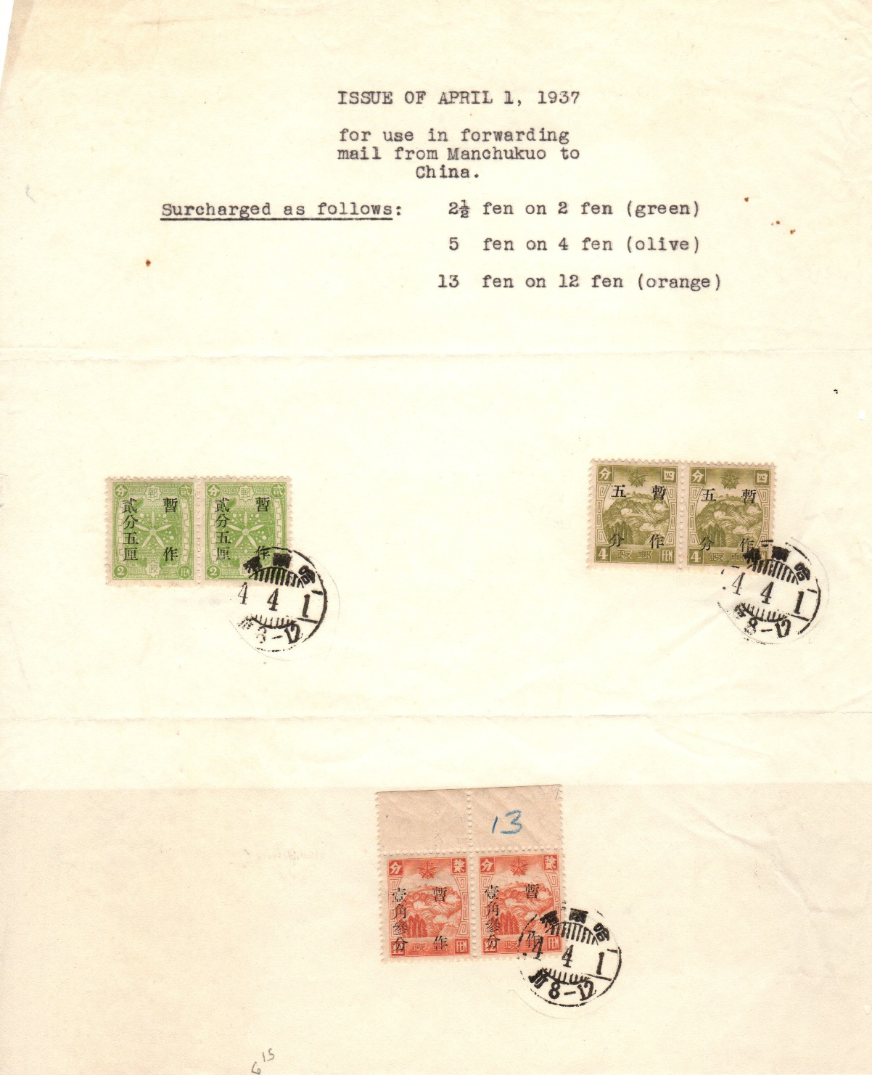
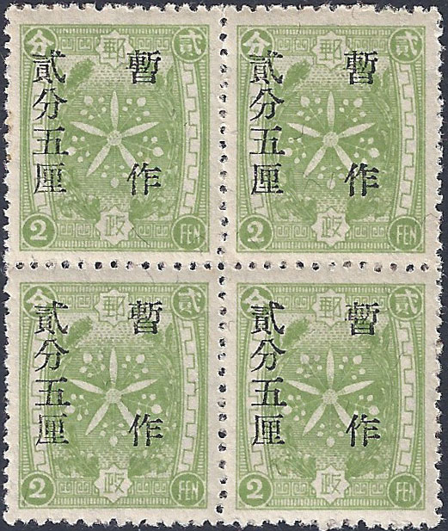
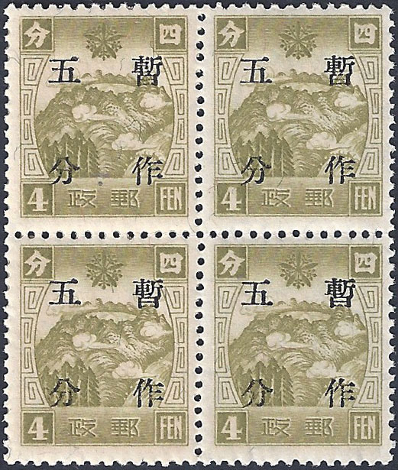
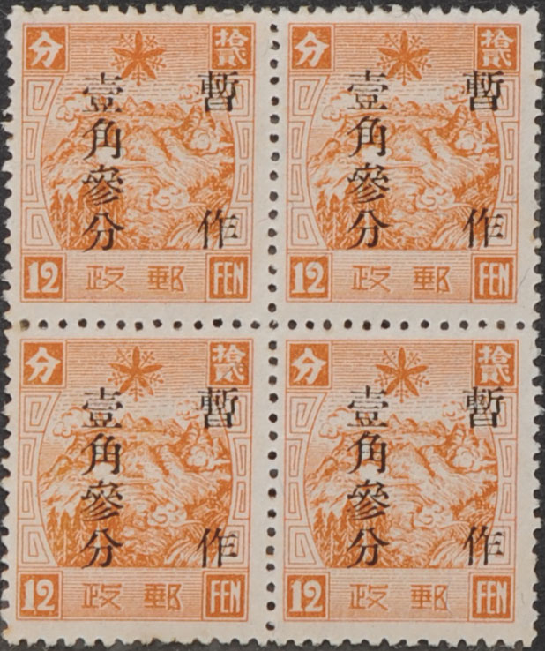
Surcharges to China Mail Issues 04/01/37 The change in postal rates introduced on 1st April 1937 encouraged the authorities to use up all the old stock of China Mail stamps. Later in 1937 the Post Office issued new set of China Mail stamps in keeping with the new pricing. To clear existing stock they overprinted the new April price increase value on the stamps that remained unsold. The overprint by the Manchukuo Postal Administration Office in Hsinking consisted of four or six characters, the vertical spacing of the first batch (and most numerous) was 6.5 mm but was later changed to a narrower 4.5 mm spacing. This made it easier to ensure all characters appeared on each stamp, as there had been registration issues with previous print runs.

Slide 12
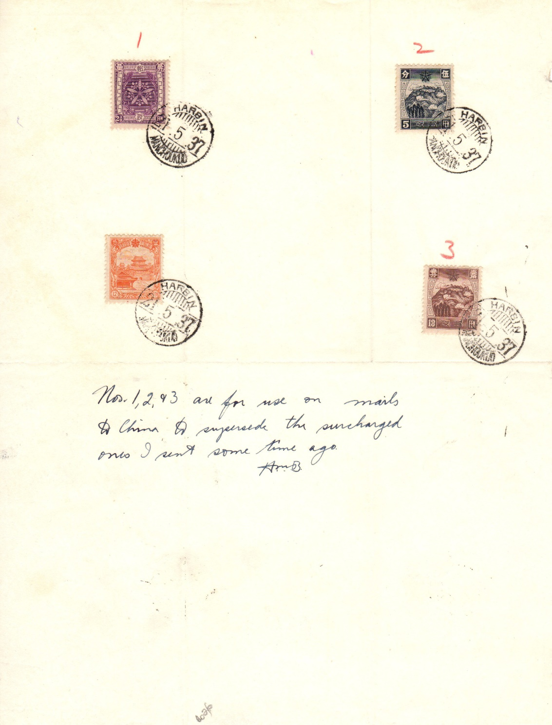
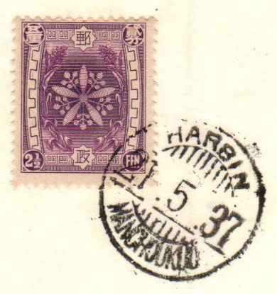
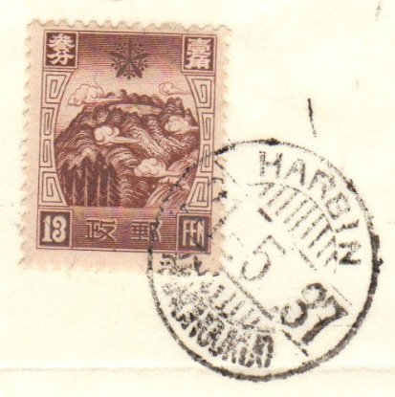
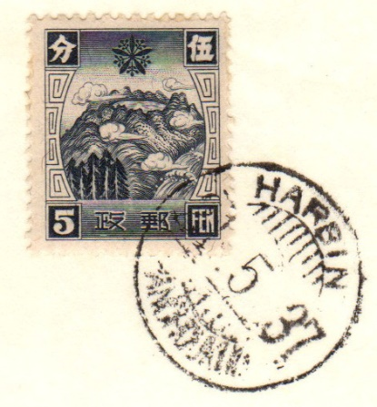
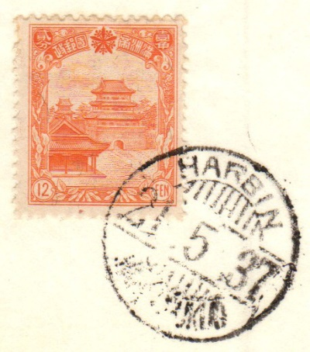
Special China Mail Stamps (Fourth Issue additions) 1937 2½f shows the Imperial Crest of Manchukuo 5f, 13f showing 長白山 Zhǎngbáishān (Mount Changbai) and the Heavenly Lake Although China had accepted the use of stamps bearing the name Manchukuo, it was decided to produce a further issue of China mail stamps in line with the 1st April increases to postal prices. This gave rise to the fourth issue of China Mail stamps with new values.

Slide 13
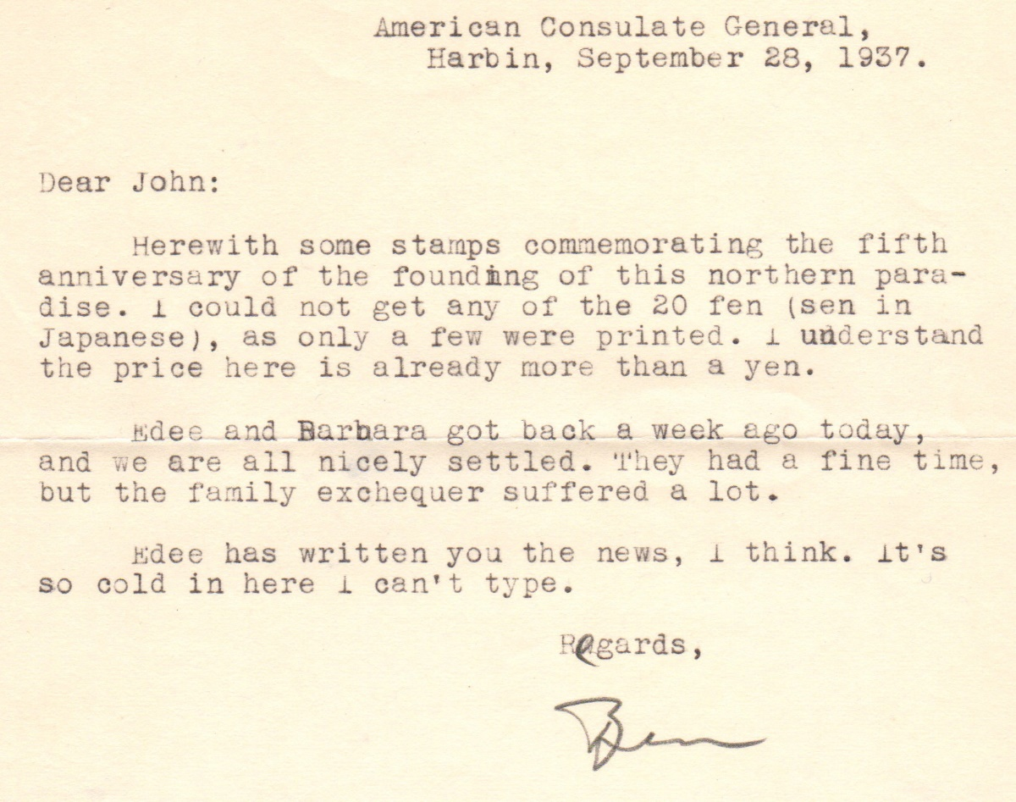

Slide 14
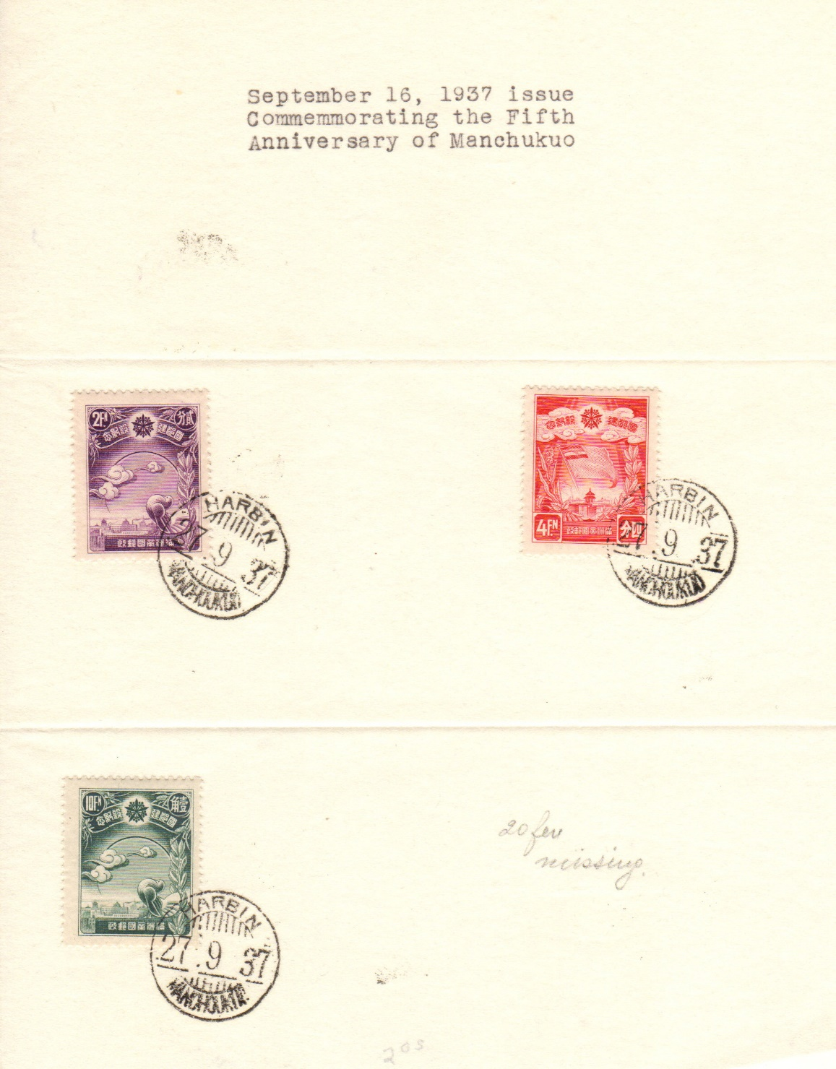
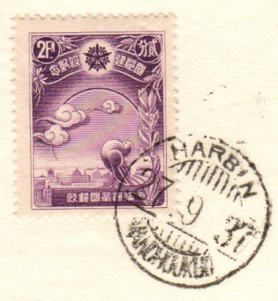
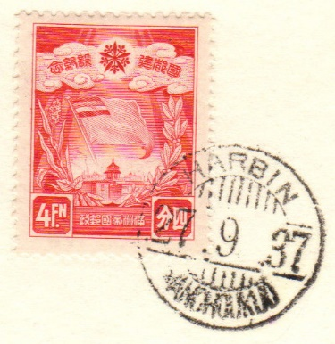
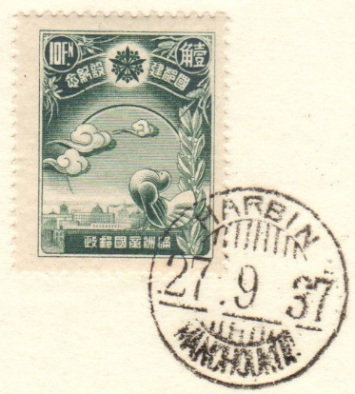
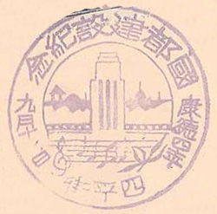
Completion of the Five Year Plan for Re-building of the Capital 09/16/37 2f, 10f shows a pouter pigeon overlooking Hsinking. 4f, 20f features the flag of Manchukuo waving above the new State Council Building (not the Imperial Palace as shown in some catalogues).

Slide 15
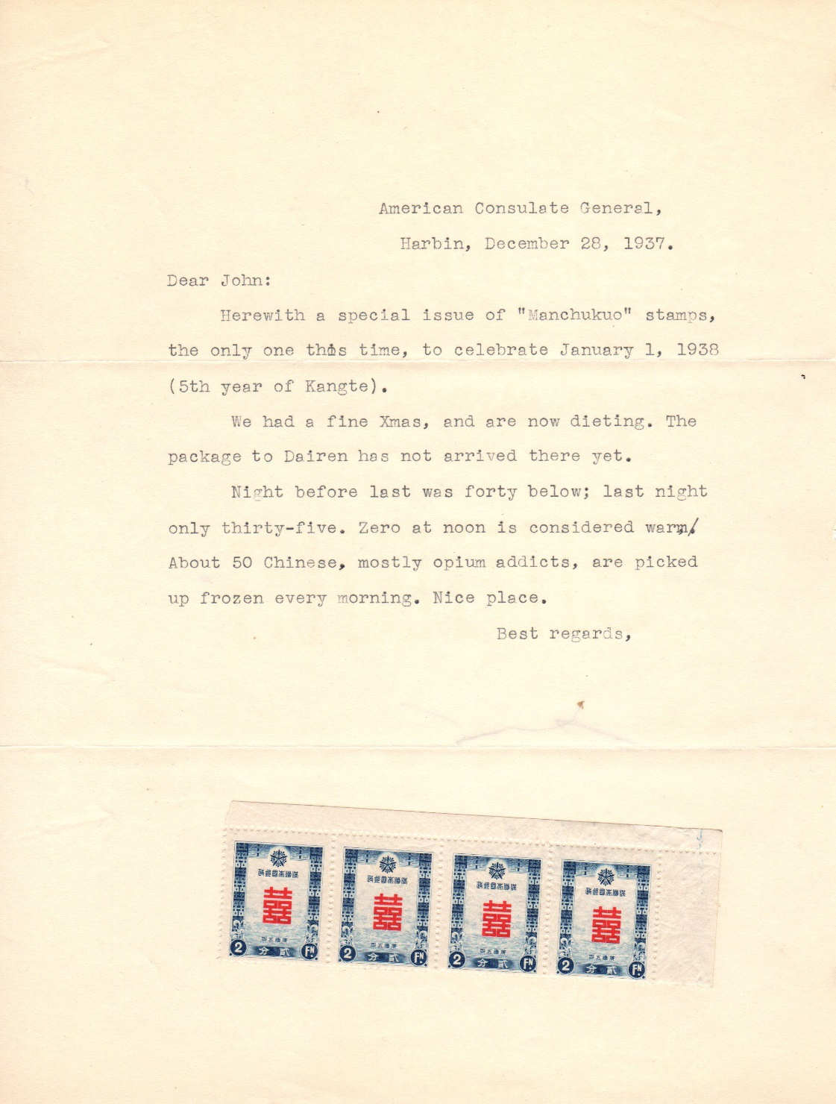
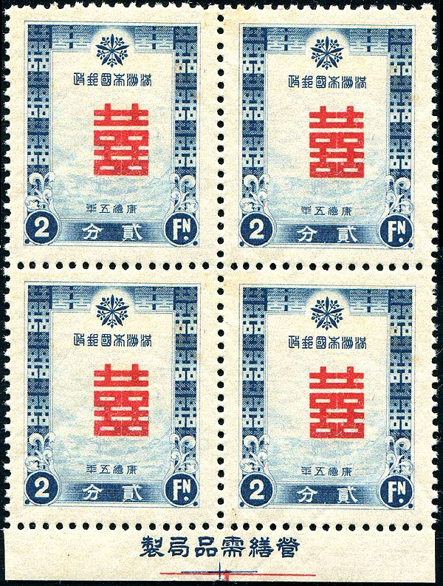
Special Issue for New Years Greetings 12/15/37 A single stamp for use on New Year's greetings cards featuring the character "Hsuan Hsi" Double Happiness. The post office featured a New Year promotion, all letters bearing this stamp could travel for half price between 15th and 30th December 1937, hence the 2f value. The post office ran this offer between 20th and 30th December 1936 and it was so successful that they decided to repeat it, this time with a special stamp.

Slide 16
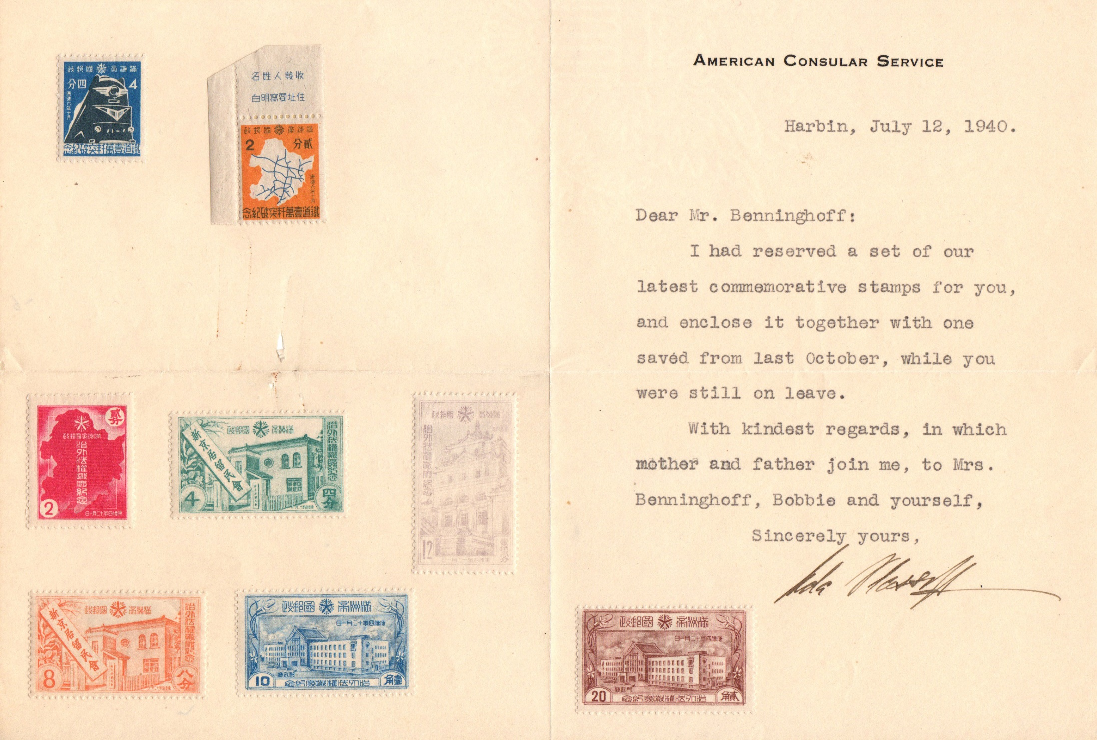
The Completion of 10,000 km of Railways 12/21/39 2f Manchukuo rail network map 4f "The Asia," one of two streamlined express locomotives. The Abolition of Extra Territorial Rights 12/01/37 2f Map of Manchukuo 4f, 8f The Japanese Residents Association Headquarters in Hsinking 10f, 20f The Ministry of Communication Building, Hsinking 12f The Department of Justice Building, Hsinking

Slide 17
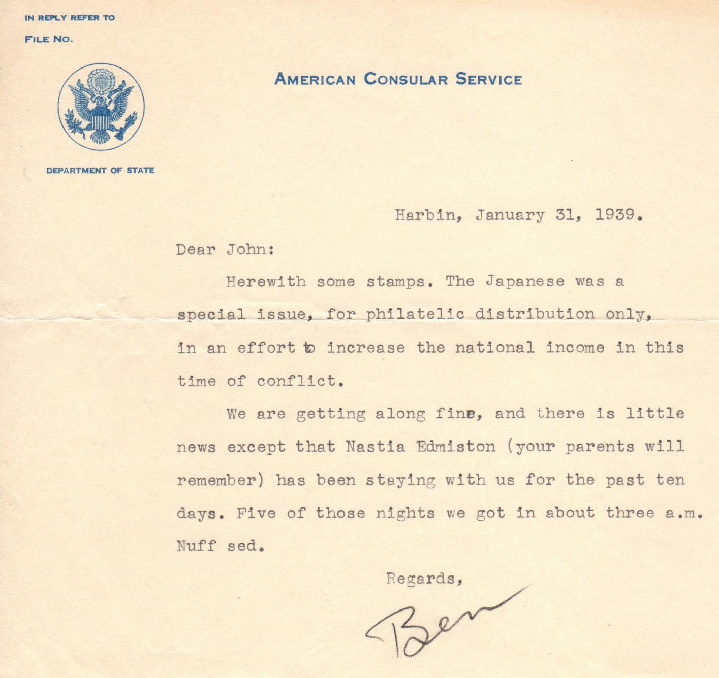
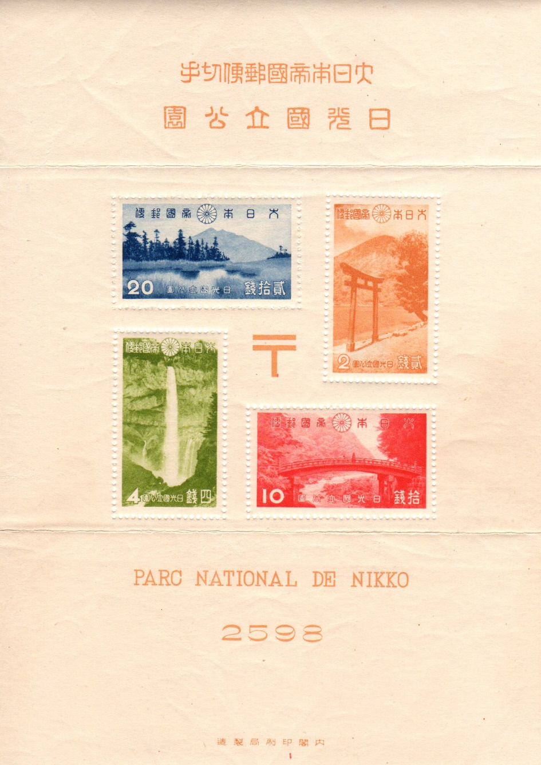
Japan’s first National Parks souvenir sheet, issued 12/25/38, the start of a prolific series. Face value 36 sen, sold for 50 sen.

Slide 18
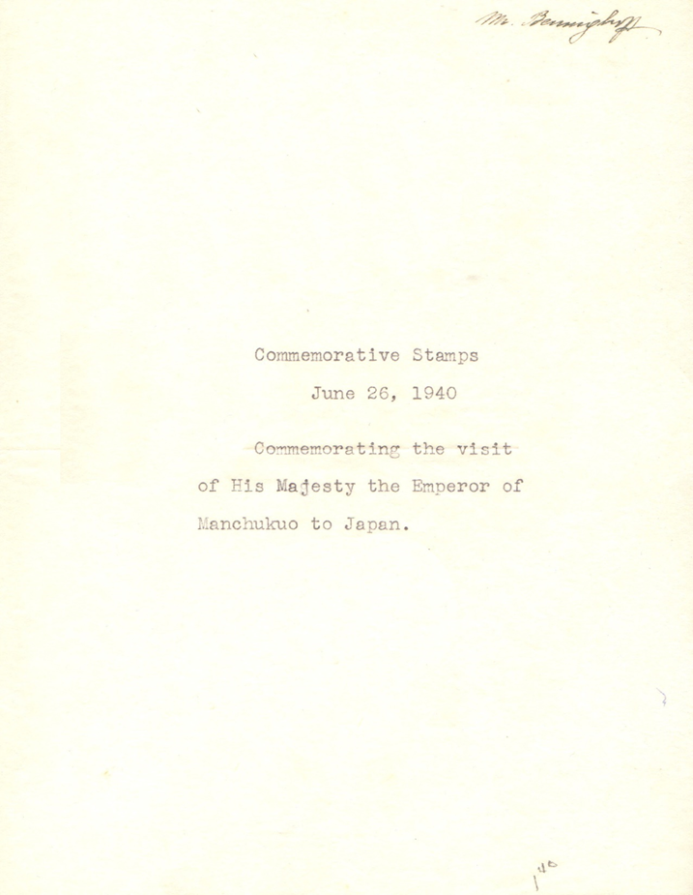
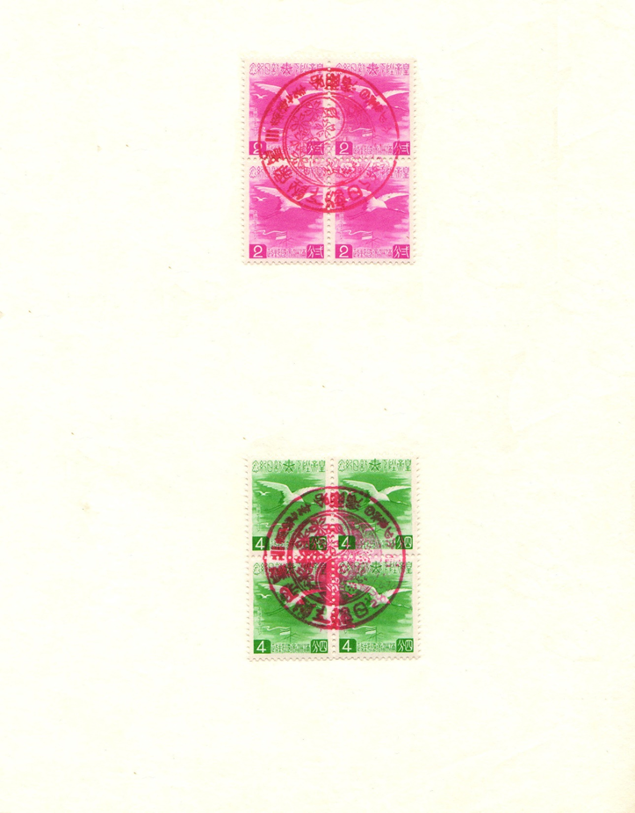
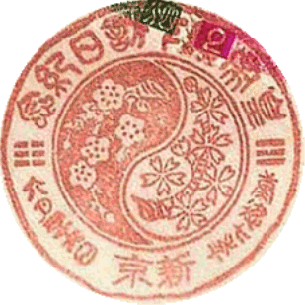
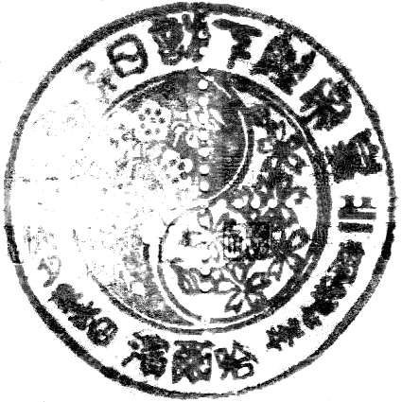
Second Visit of Emperor Kāngdé to Japan 06/26/40 2f, 4f a Manchurian Crane flying above the mast of the cruiser with Chinese and Japanese characters. 新京 Hsinking 哈尔滨 Harbin city city cancel cancel used at right Used June 26-28, 1940 with an interchangeable date in several cities. The cancel text explains that the stamps are to commemorate the second visit of the Emperor Kang-Teh to Japan in both Chinese (top) and Japanese (bottom) characters. The cancel also features the national flowers, apricot and cherry.

Slide 19
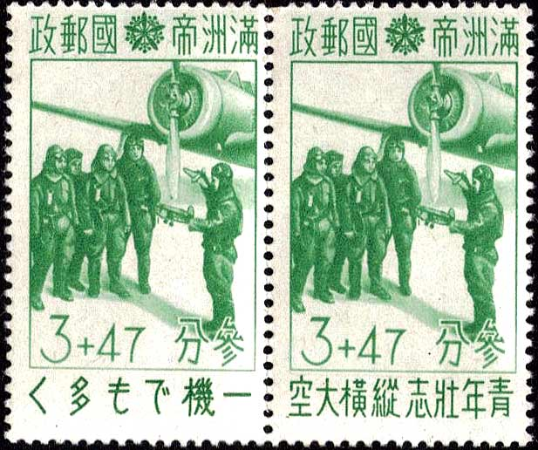
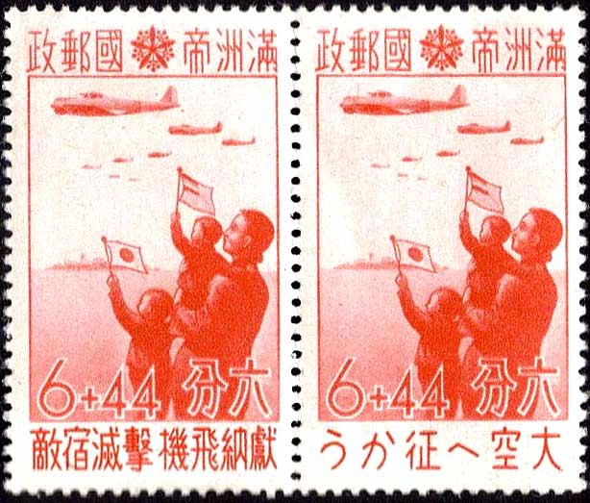
By late 1940 the outbreak of World War II turned the world upside down. Foreign diplomats were recalled from their posts and mostly abandoned the Japanese state.
This unissued 1944 semi-postal duo was in aid of the Patriot Aviation Fund, raising revenue for the armed forces of Japan and Manchukuo. Worded in both Chinese and Japanese the slogan along the bottom reading 3+47f, "The aspiration of the youth is as high and lofty as the airplanes in the sky" with the 6+44f reading, "Donating to (enable) planes to defeat the enemy". A base postal rate increase from 3 to 5 fen and 5 to10 fen caused them not to be released. Overprinting was never considered. Stocks were looted in August, 1945.

Slide 20
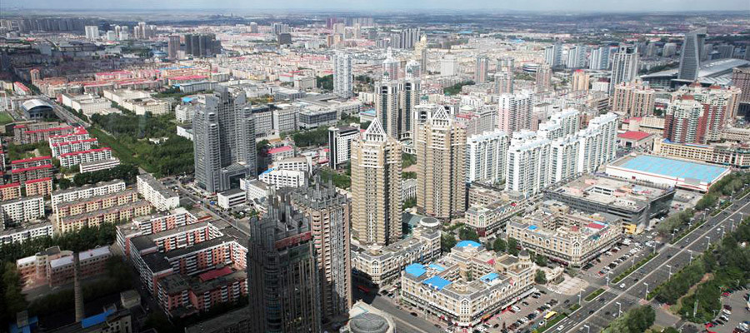
Most of the stamp informational text came from a wonderful Manchukuo philatelic site, www.manchukuostamps.com. It has a wealth of specialty details about stamps, cancels, and much more worthy of your time and attention.
Modern day Harbin, 10.6 million population in 2010, about the size of Chicago.
The End
Scanning and layout by Tom Fortunato.

