Slide 1


JFK on U.S. Covers
A presentation for the
Rochester Philatelic Association
By Luis Greiff, Jr.
(with links to online historical information, news and videos - click each to learn more )
May 25, 2017

Slide 2

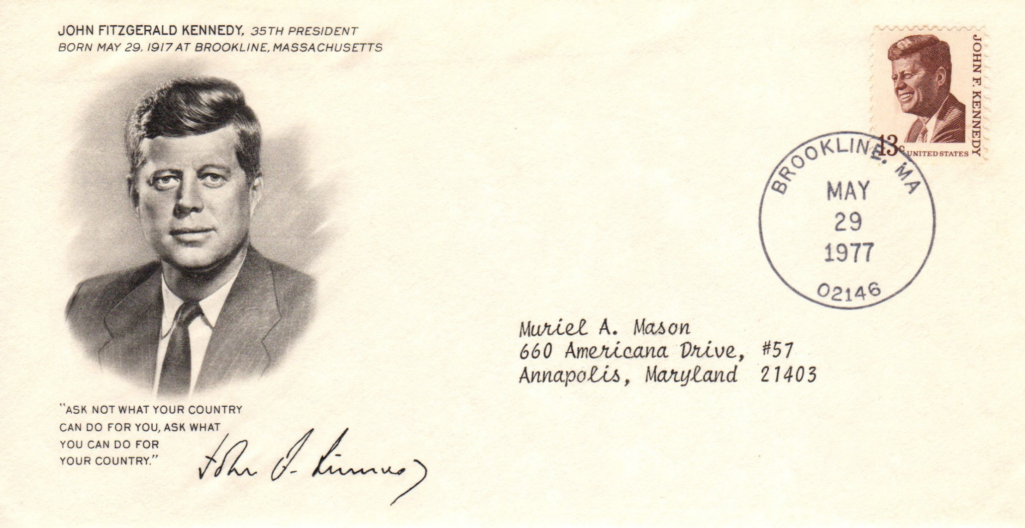
John Fitzgerald Kennedy, born May 29, 1917
May 29, 1977- JFK’s 60th birthday (posthumous)

Slide 3
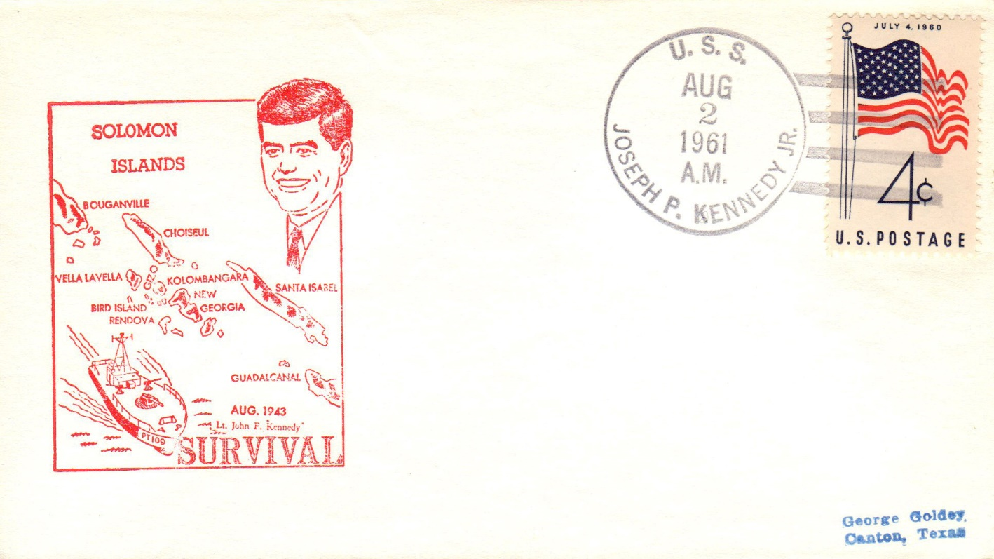

U.S. Navy Reserve Duty, 1941-1945
PT 109 survival in the Soloman Islands, Pacific Ocean, August 1943

Slide 4
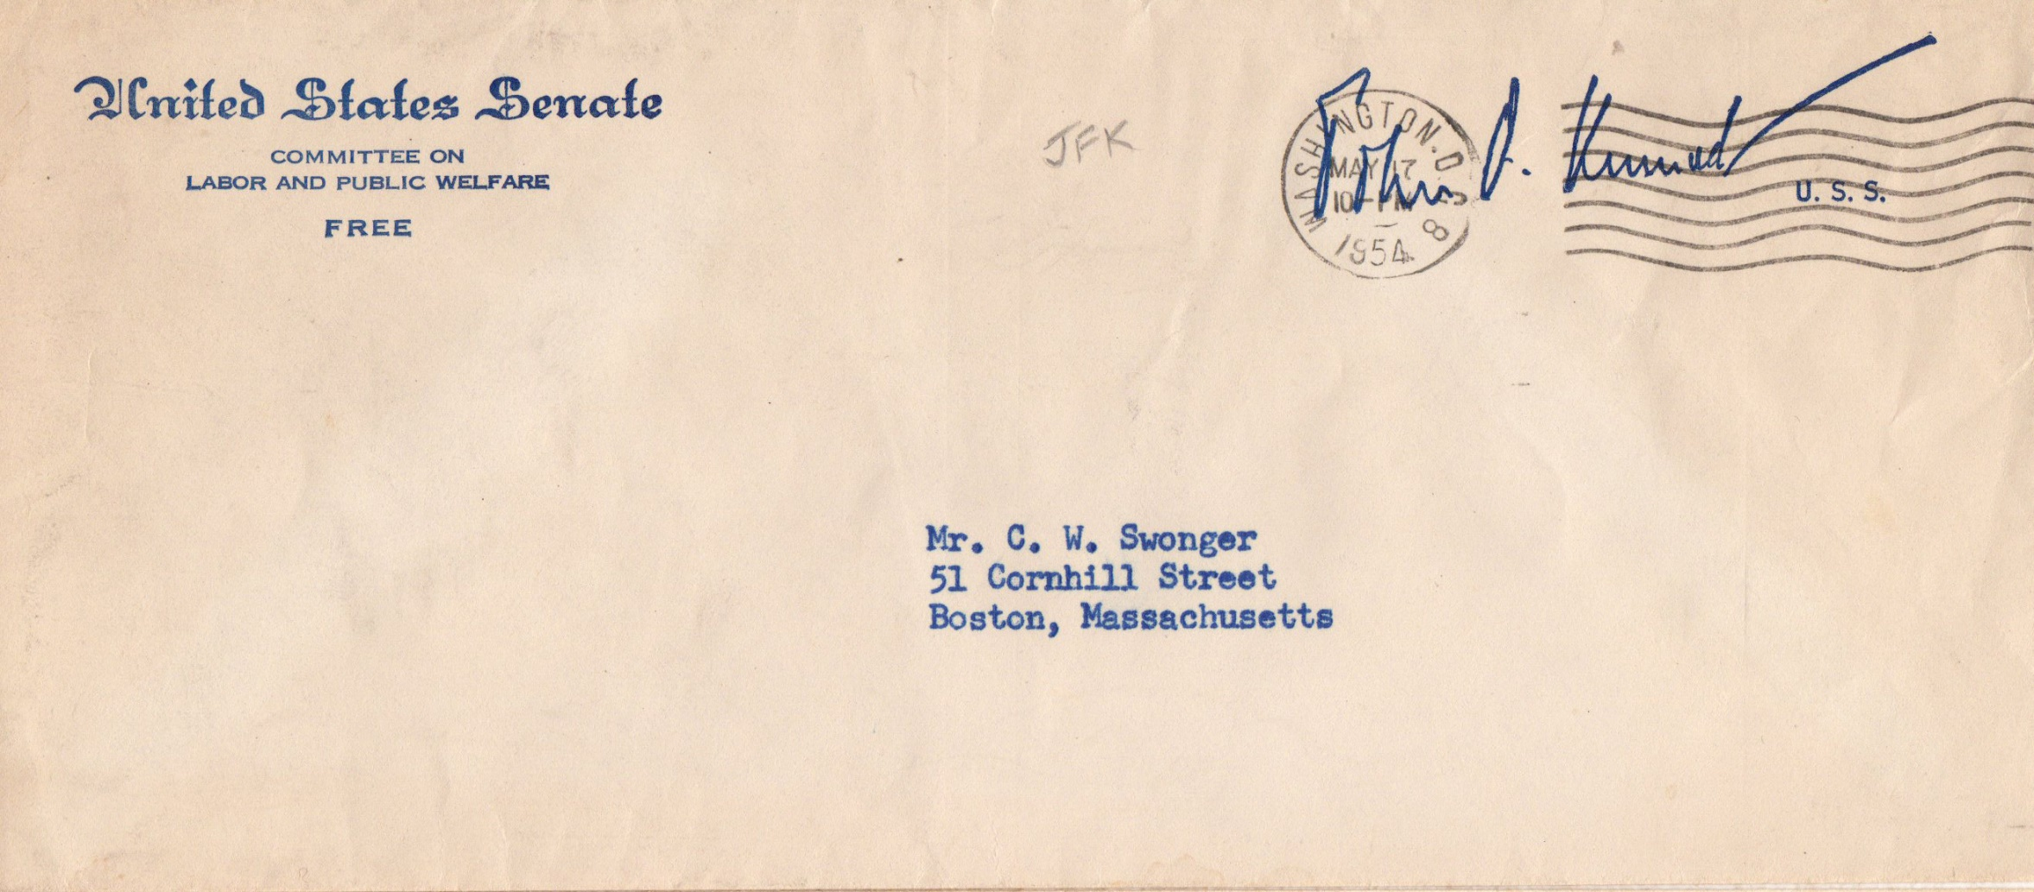
U.S. Senator, 1953-1960
March 17, 1954, Committee of Labor and Public Affairs

Slide 5
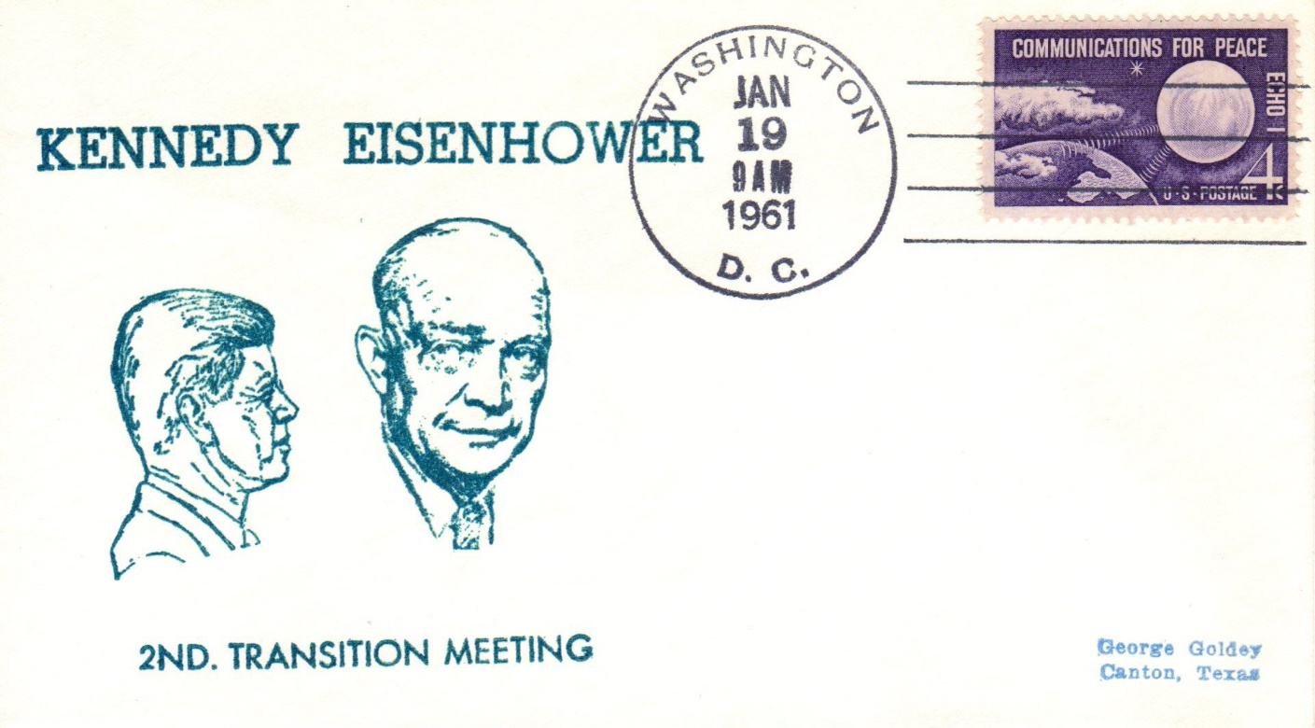
Post-Election Transition
January 19, 1961- day before Inauguration

Slide 6
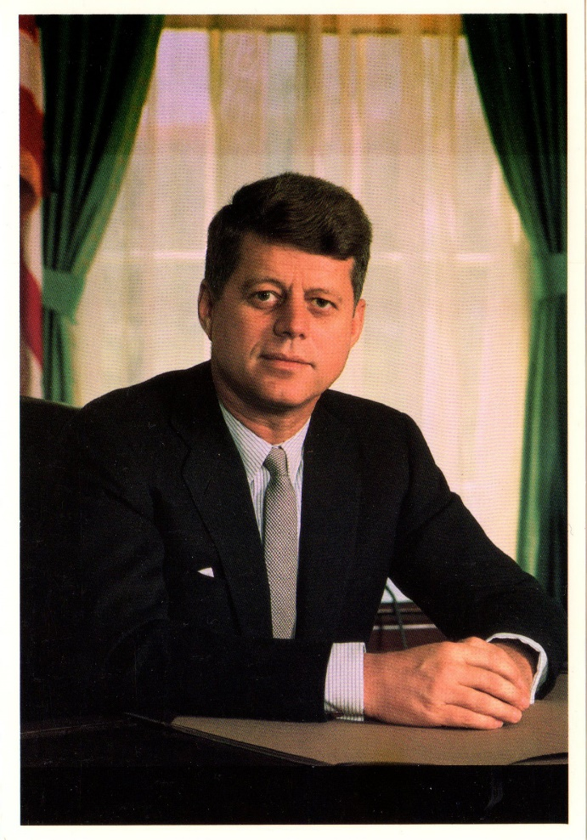
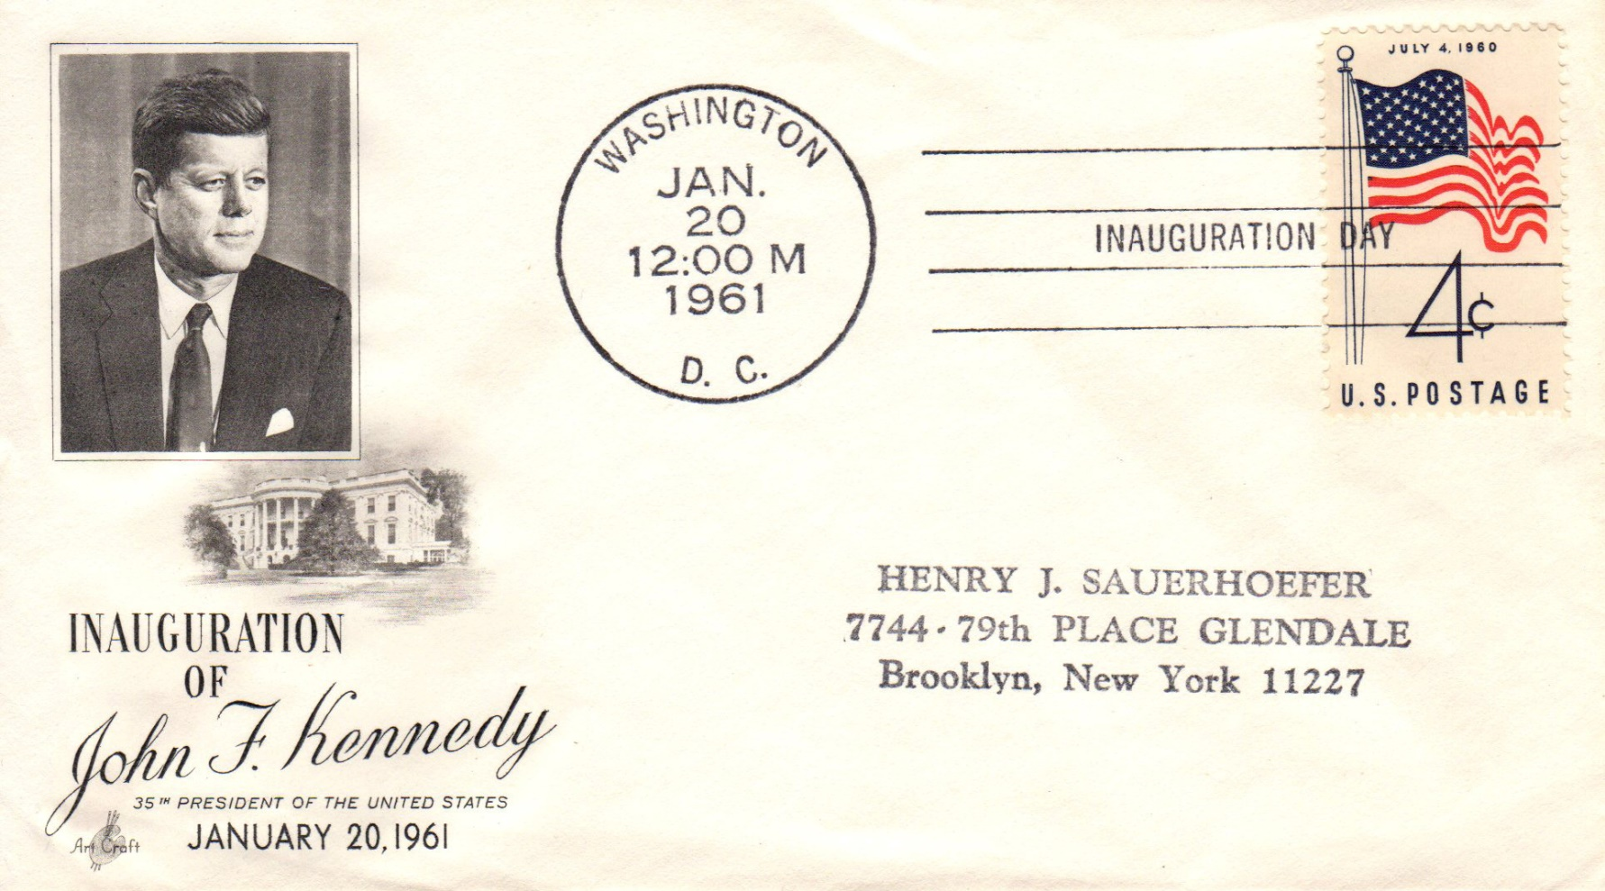
Inauguration, January 20, 1961
ArtCraft cachet
Inaugural cover

Slide 7
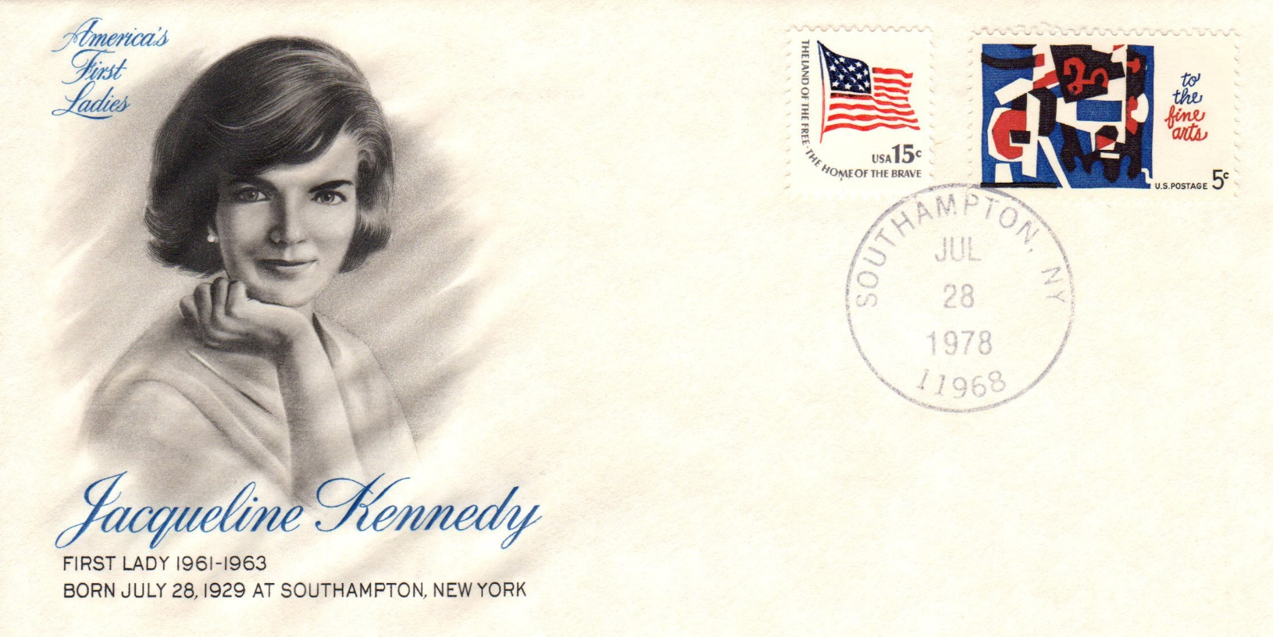
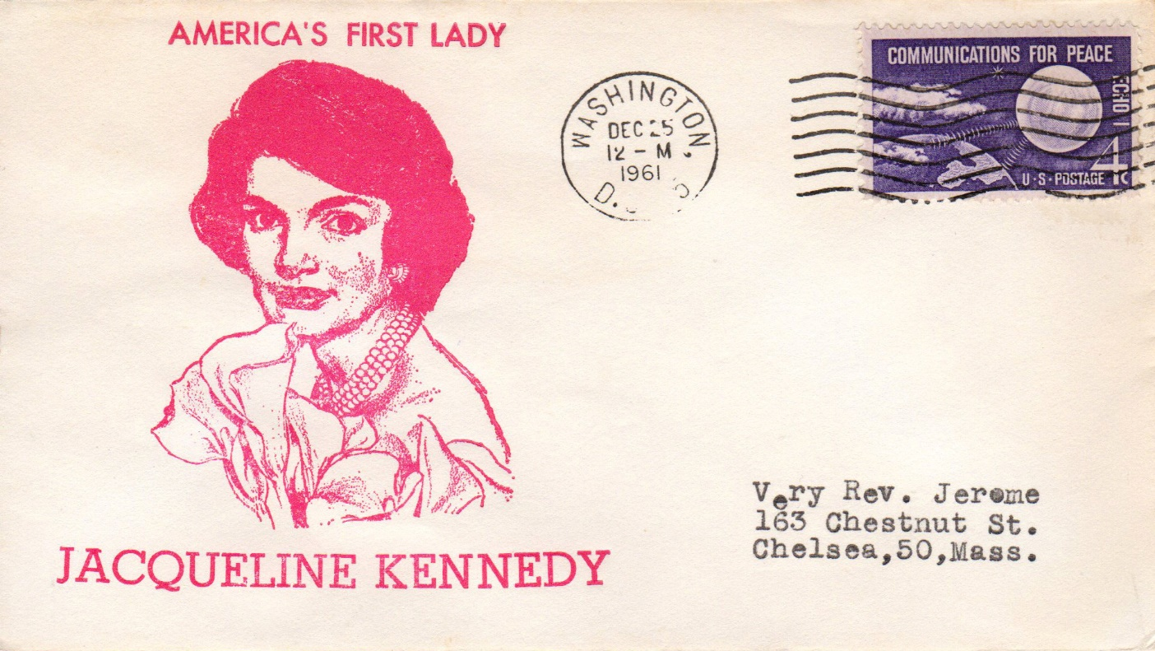
The First Lady, Jacqueline Kennedy
Inaugural cover, Art Craft cachet

Slide 8
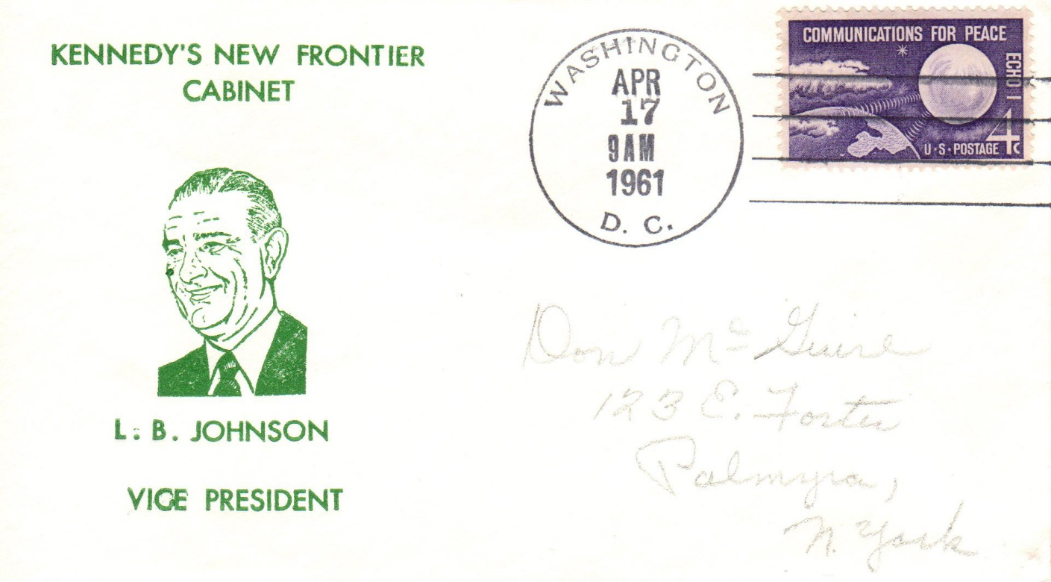
The Vice President – Lyndon B. Johnson

Slide 9
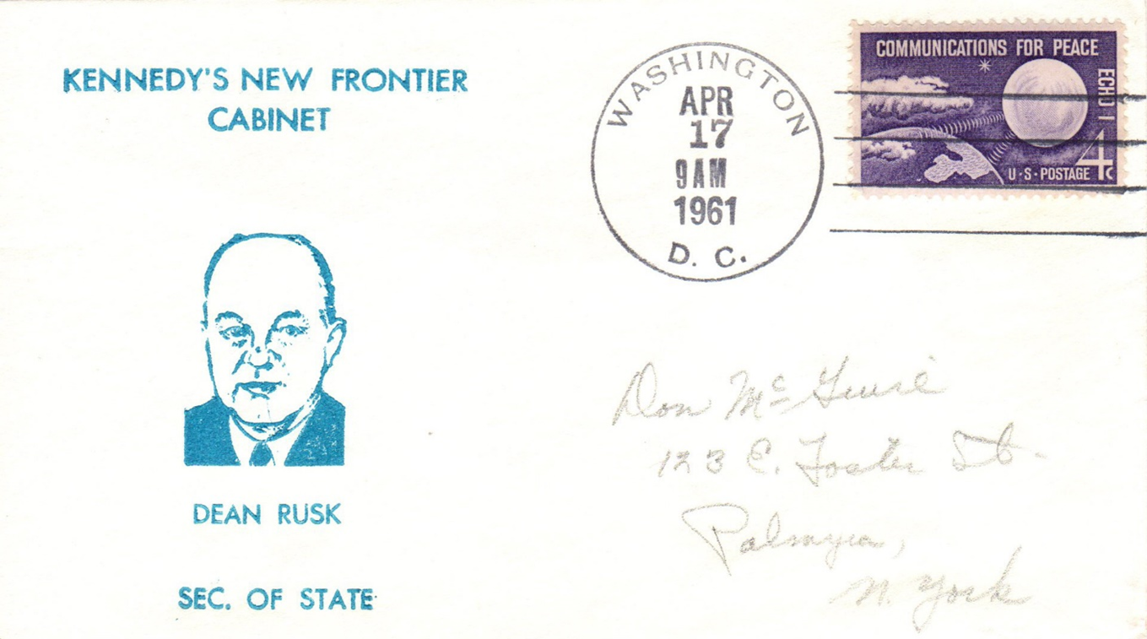
The Cabinet– Secretary of State Dean Rusk

Slide 10
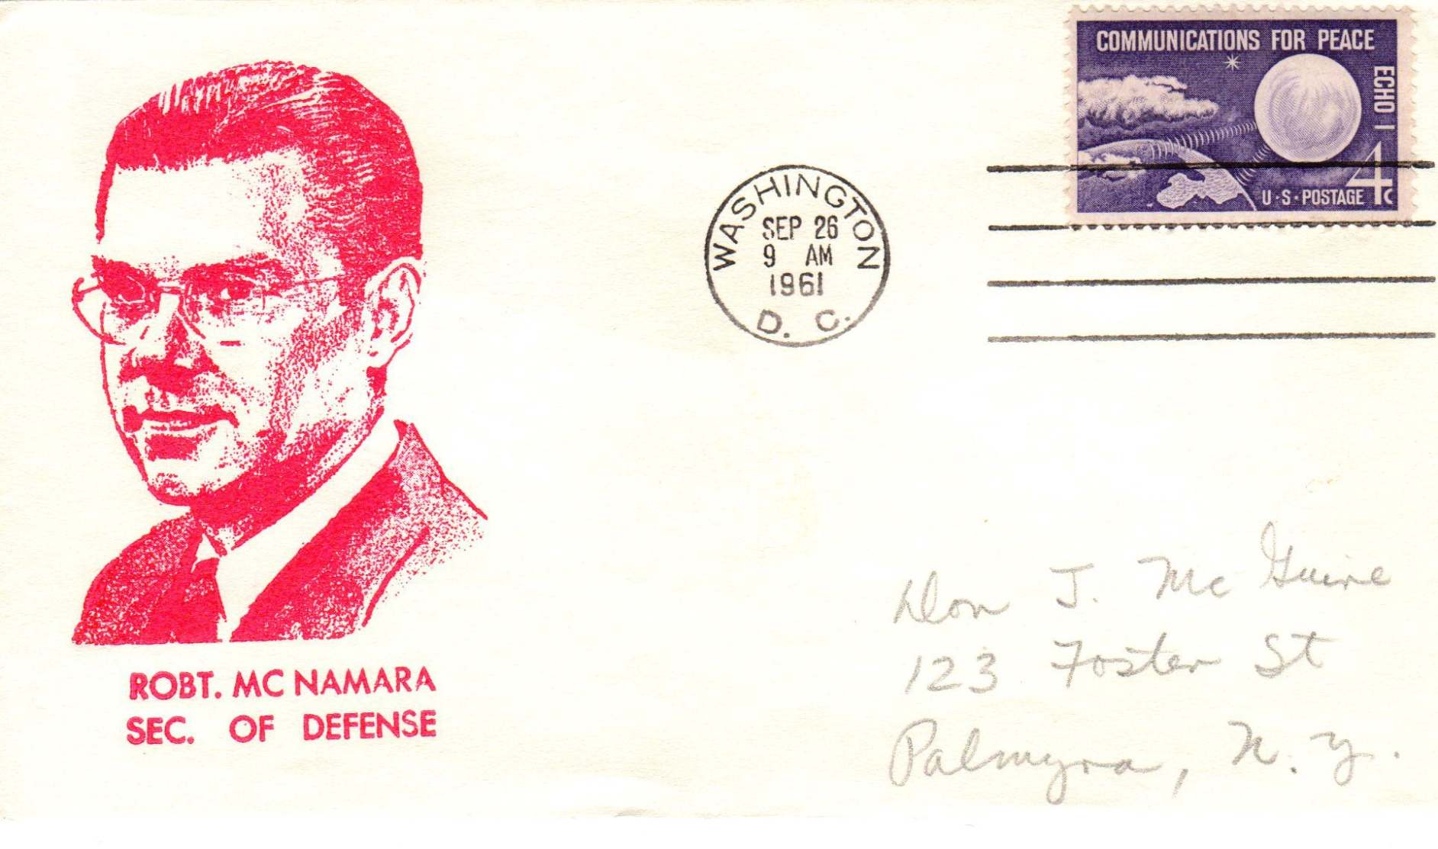
The Cabinet- Secretary of Defense Robert McNamara

Slide 11
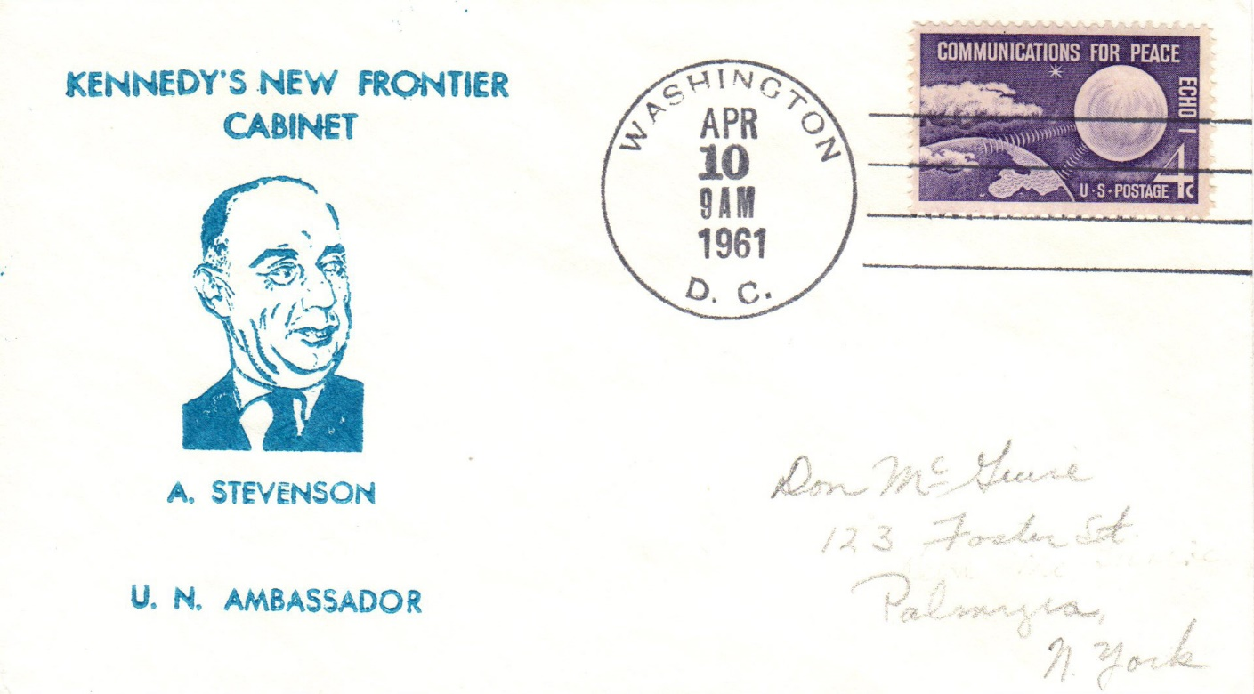
The Cabinet- United Nations Ambassador Adlai Stevenson

Slide 12
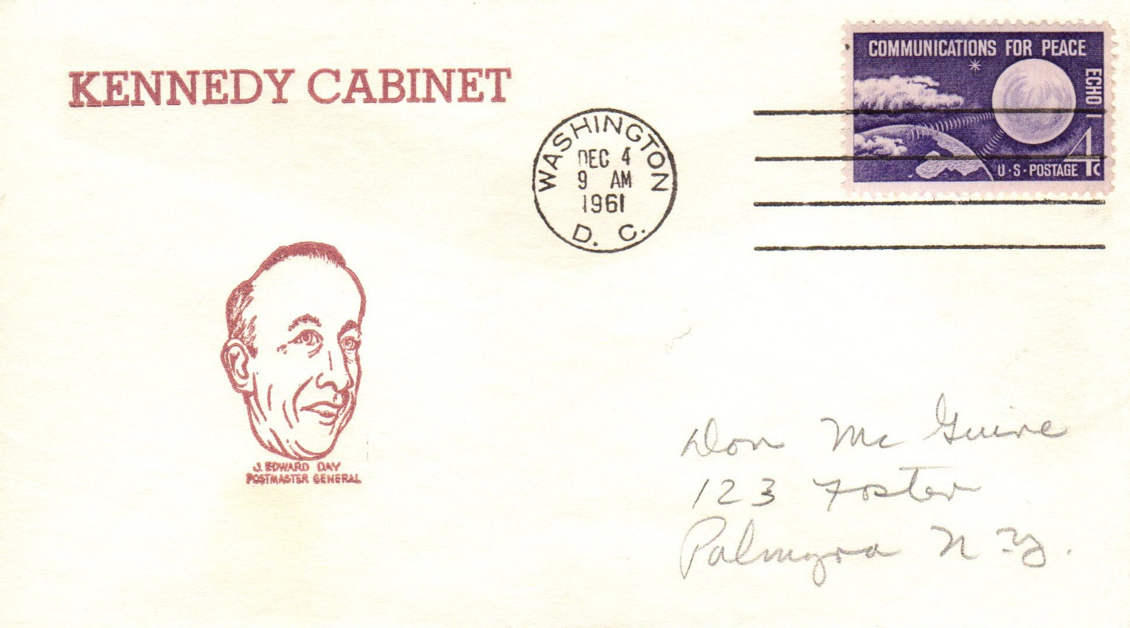
The Cabinet- Postmaster General James Edward Day

Slide 13
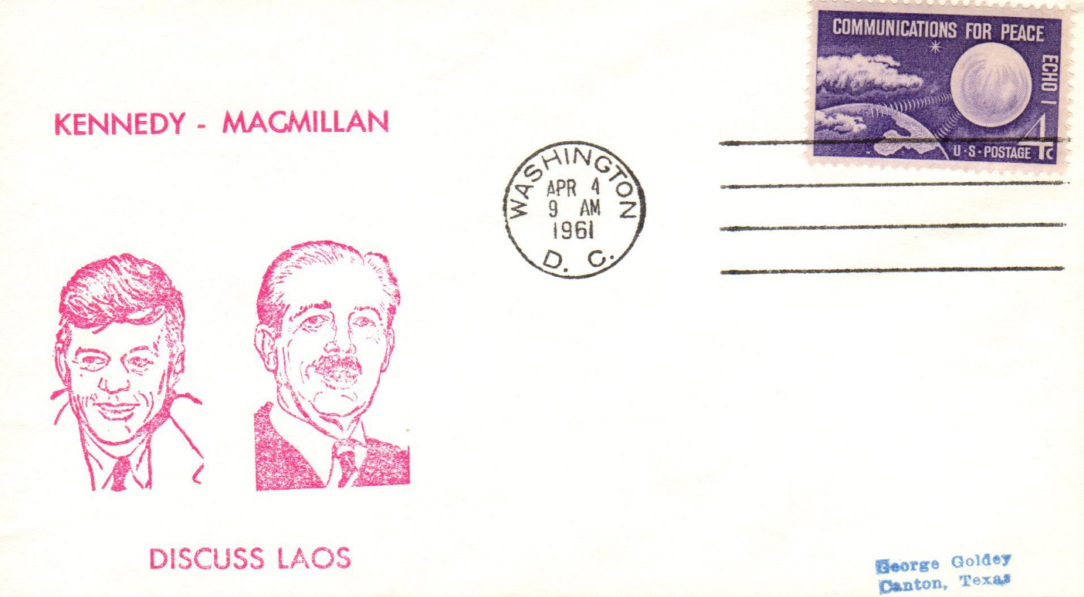
Events in His Presidency, 1961
April 4, 1961- Visit of British Prime Minister Harold MacMillan

Slide 14
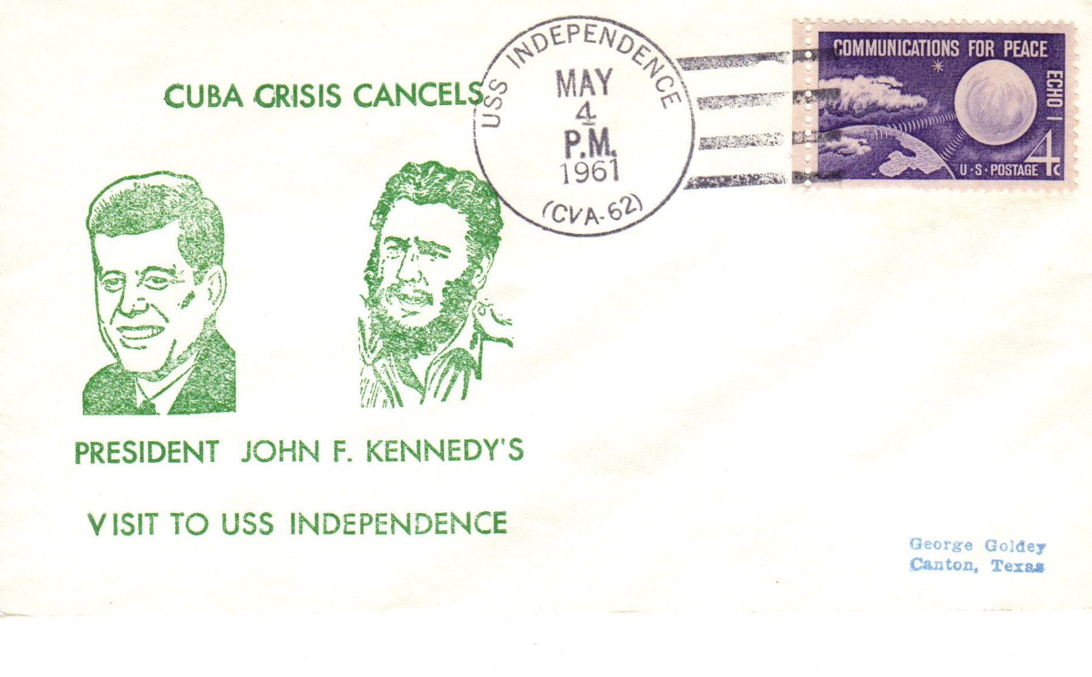
Events in His Presidency, 1961
May 4, 1961- Norfolk-based carrier on Atlantic maneuvers

Slide 15
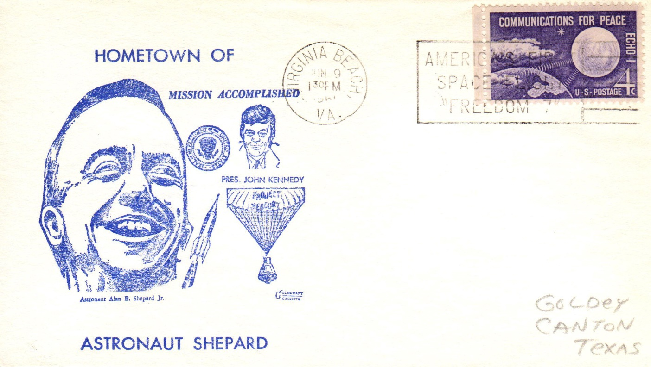
Events in His Presidency, 1961
June 9, 1961- Hometown visit of Alan Shepard, first US astronaut

Slide 16
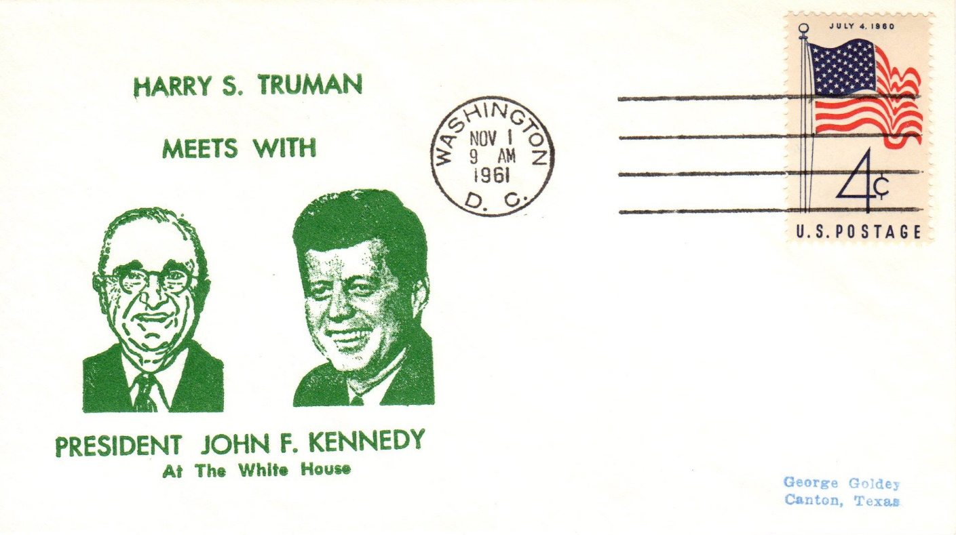
Events in His Presidency, 1961
November 1, 1961- Overnight White House visit of Harry and Bess Truman

Slide 17
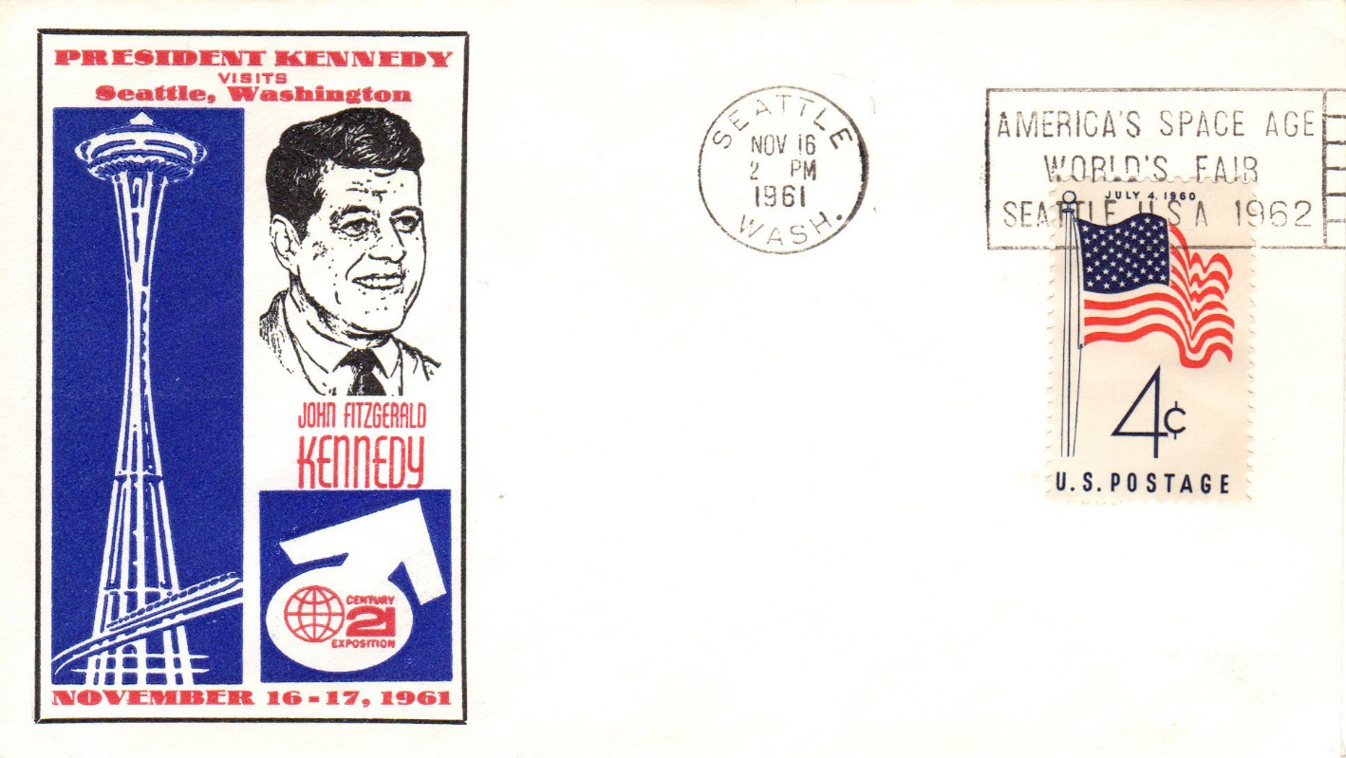
Events in His Presidency, 1961
November 16, 1961- Address at the Univ. of Washington’s centennial

Slide 18
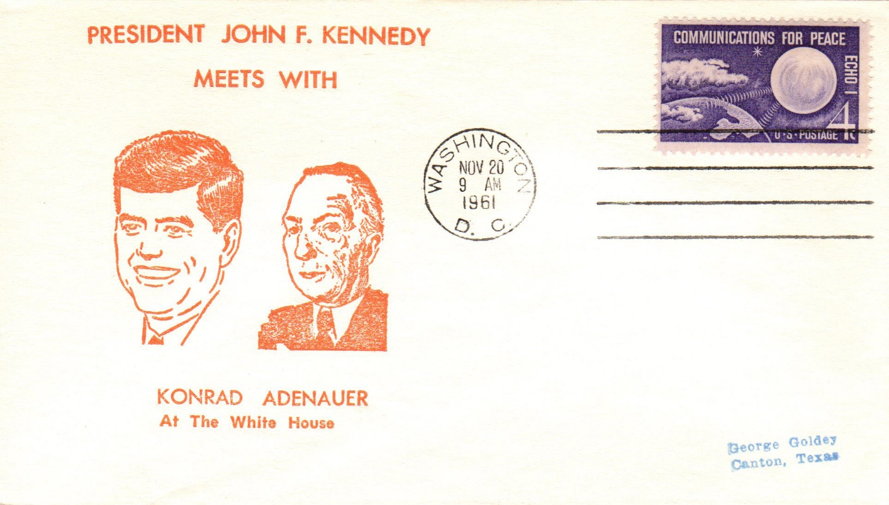
Events in His Presidency, 1961
November 20, 1961- Washington visit of German Chancellor Adenauer

Slide 19
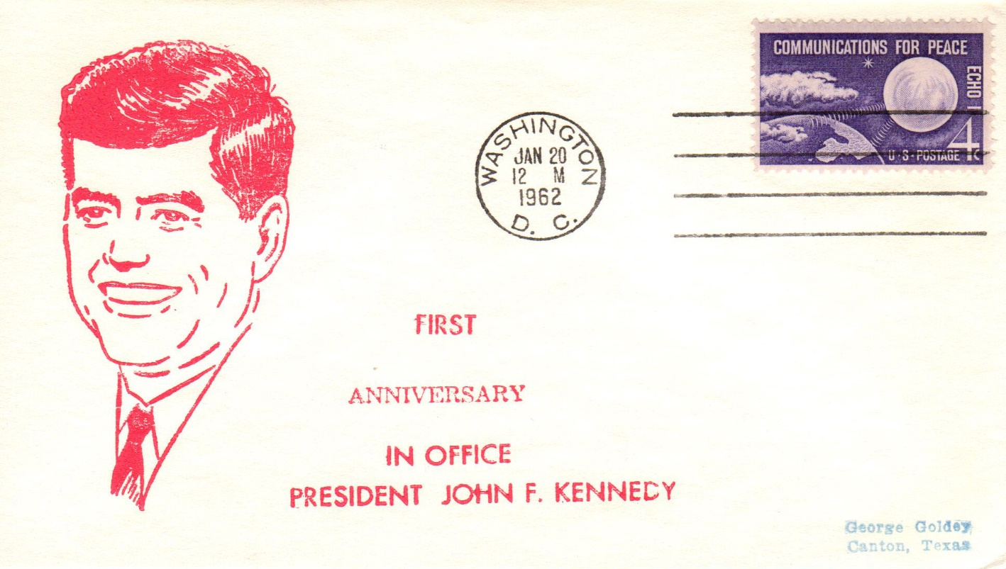
Events in His Presidency, 1962
January 20, 1962- First inaugural anniversary

Slide 20
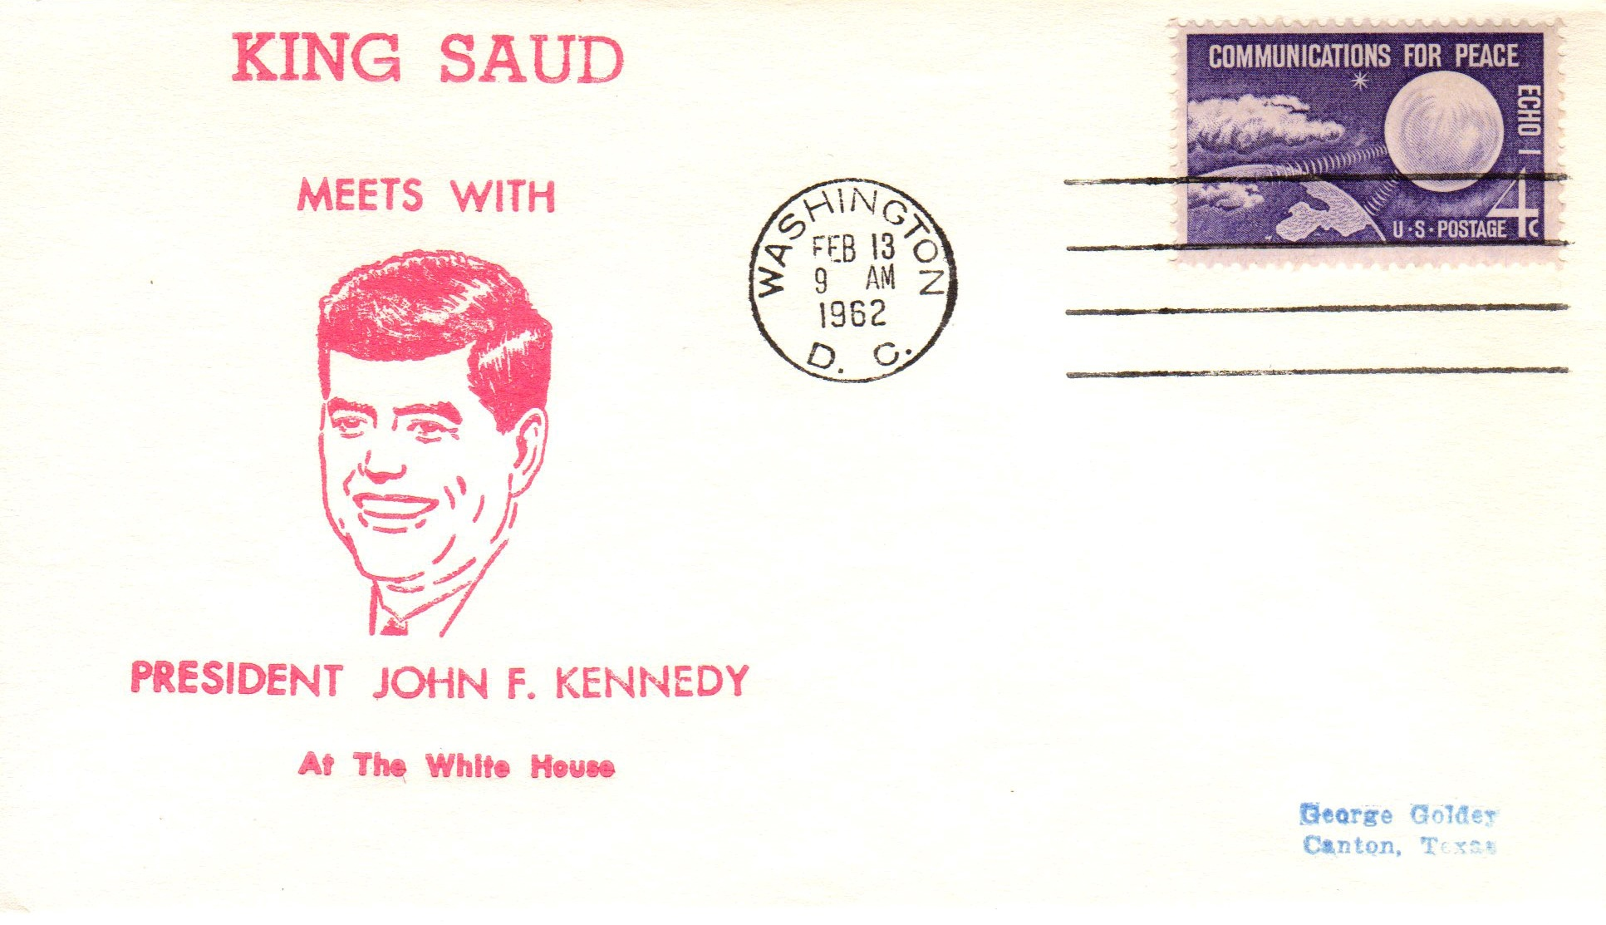
Events in His Presidency, 1962
February 13, 1962- Two day state visit of Saudi Arabian King Saud

Slide 21
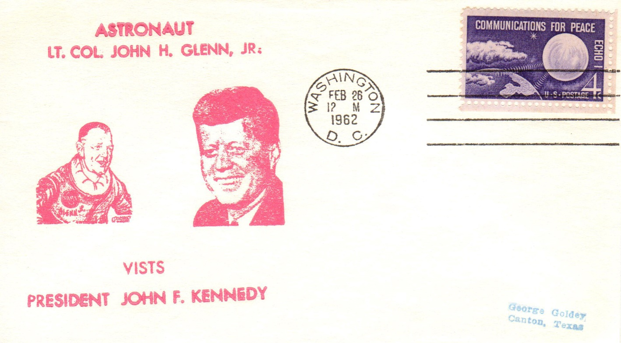
Events in His Presidency, 1962
February 26, 1962- 250,000 greet John Glenn in DC visit and parade

Slide 22
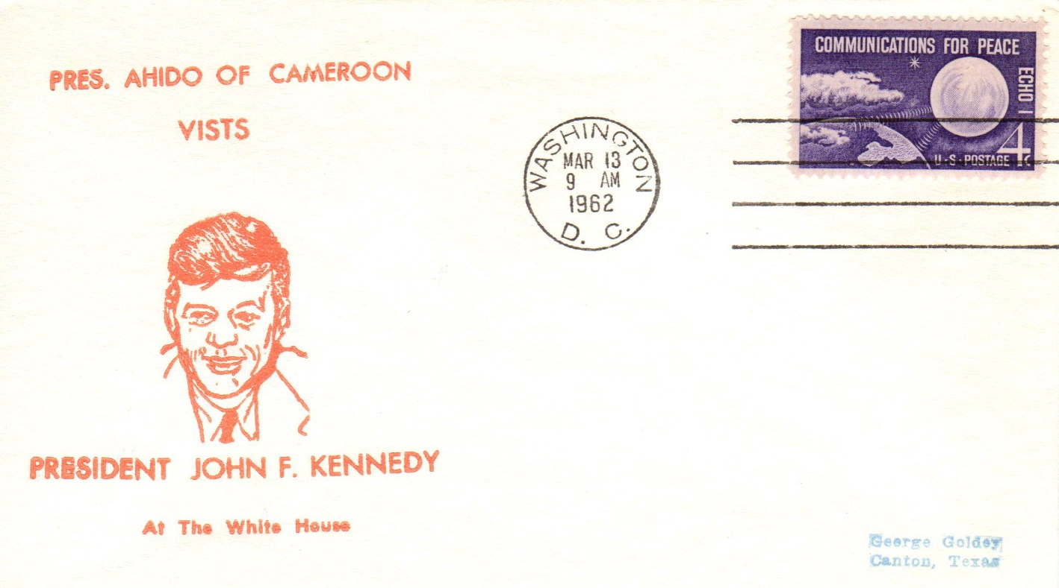
Events in His Presidency, 1962
March 13, 1962- Informal visit of President Ahmadou Ahidjo of Cameroon

Slide 23
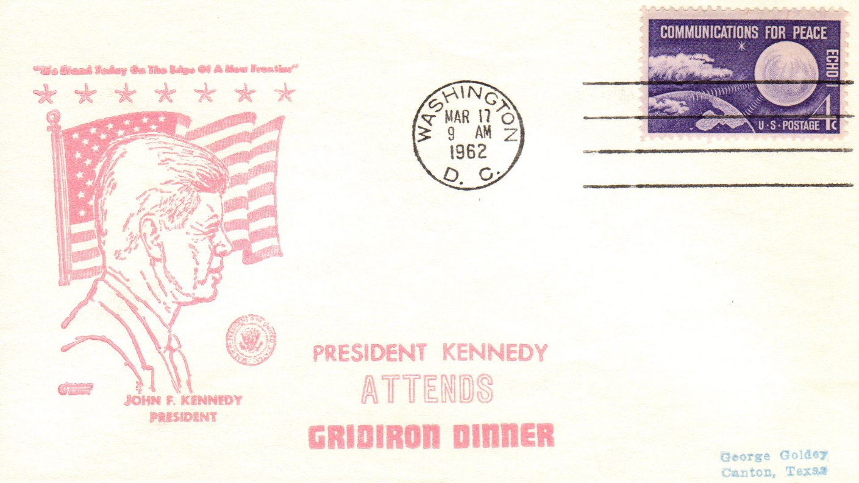
Events in His Presidency, 1962
March 17, 1962- Washington dinner of prominent Americans

Slide 24
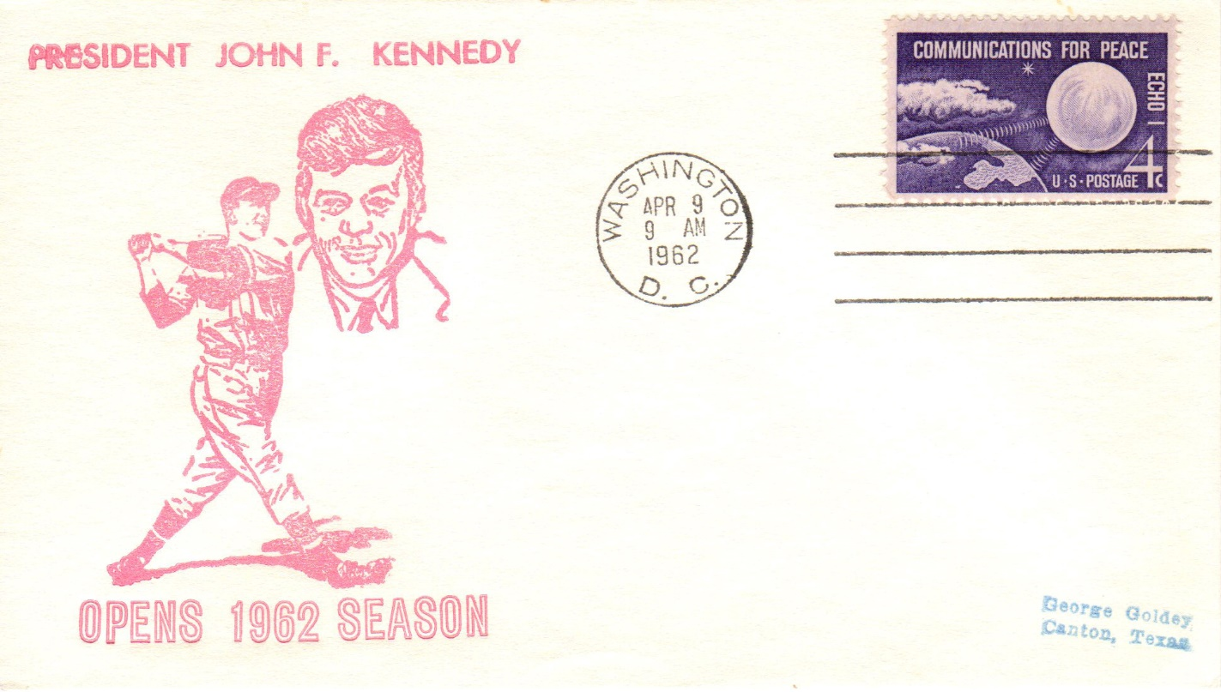
Events in His Presidency, 1962
April 9, 1962- Washington Senators vs. Detroit Tigers

Slide 25
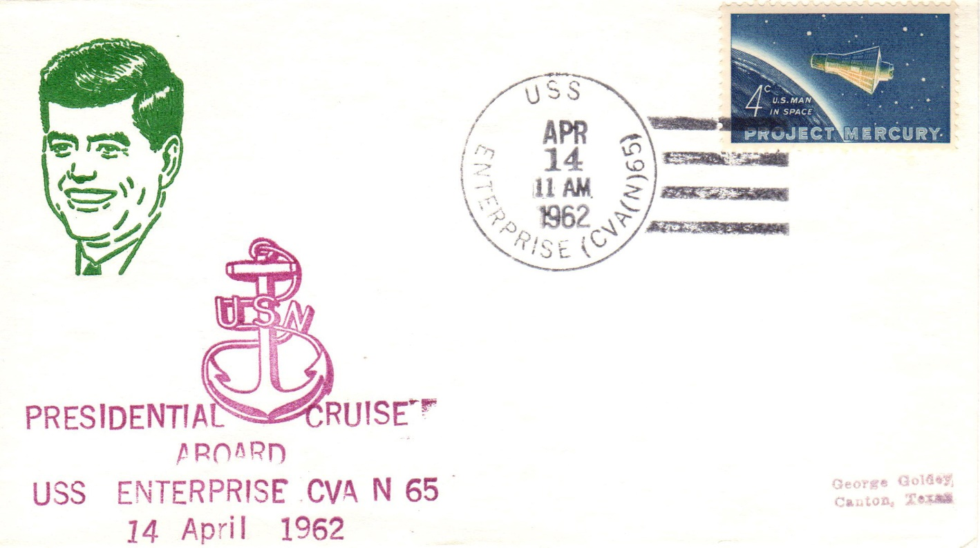
Events in His Presidency, 1962
April 14, 1962- Speech aboard the carrier Enterprise off North Carolina

Slide 26
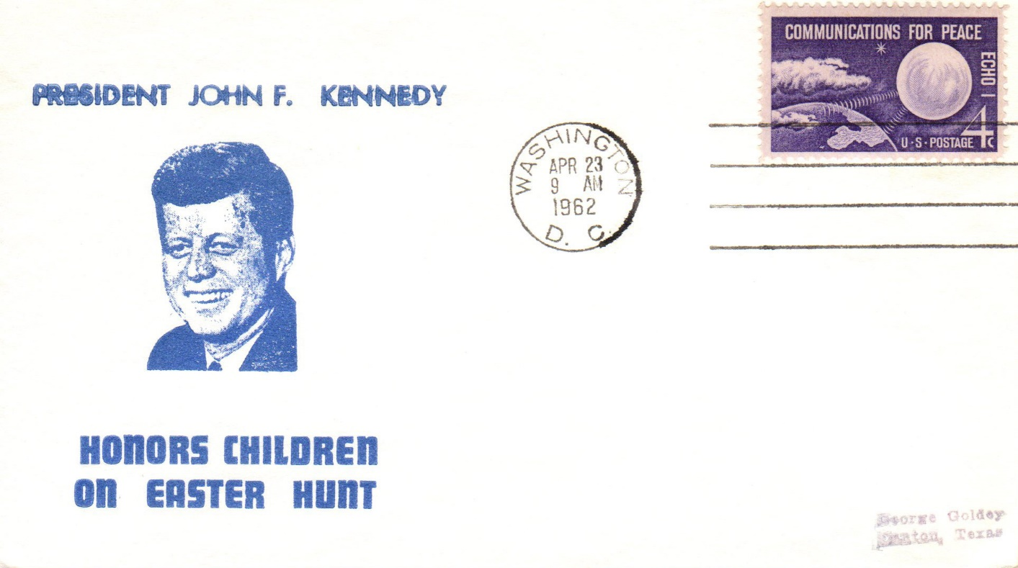
Events in His Presidency, 1962
April 23, 1962- Easter egg roll at the White House

Slide 27
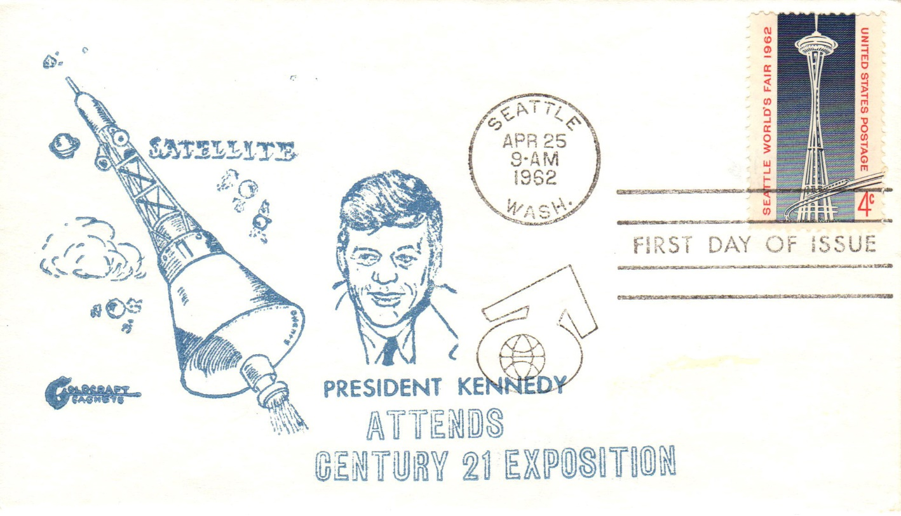
Events in His Presidency, 1962
April 25, 1962- Kennedy never attended the Seattle World’s Fair

Slide 28
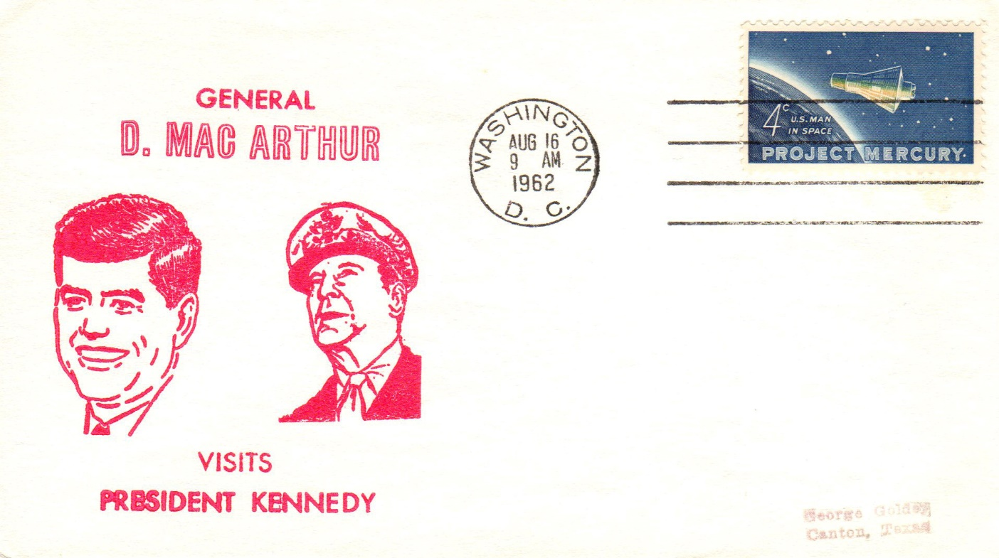
Events in His Presidency, 1962
August 16, 1962- Visit with General Douglas MacArthur

Slide 29
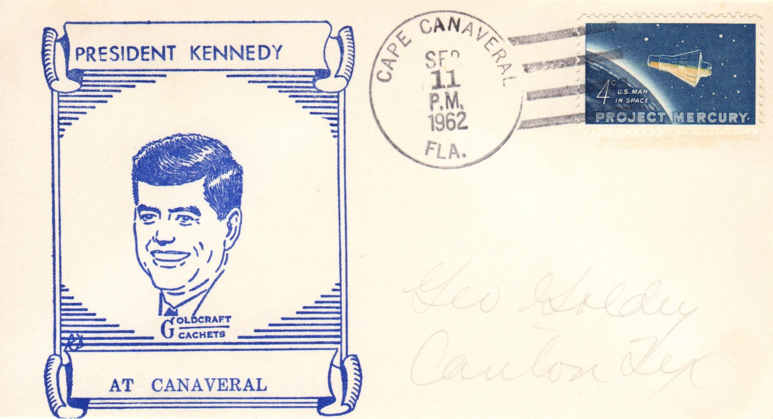
Events in His Presidency, 1962
Goldcraft Cachet
September 11, 1962- Visit to Cape Canaveral, Atlantic Missile Range

Slide 30
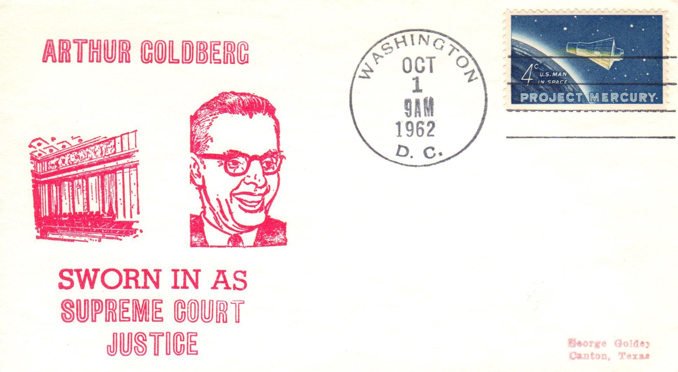
Events in His Presidency, 1962
October 1, 1962- Supreme Court Justice Goldberg sworn in

Slide 31
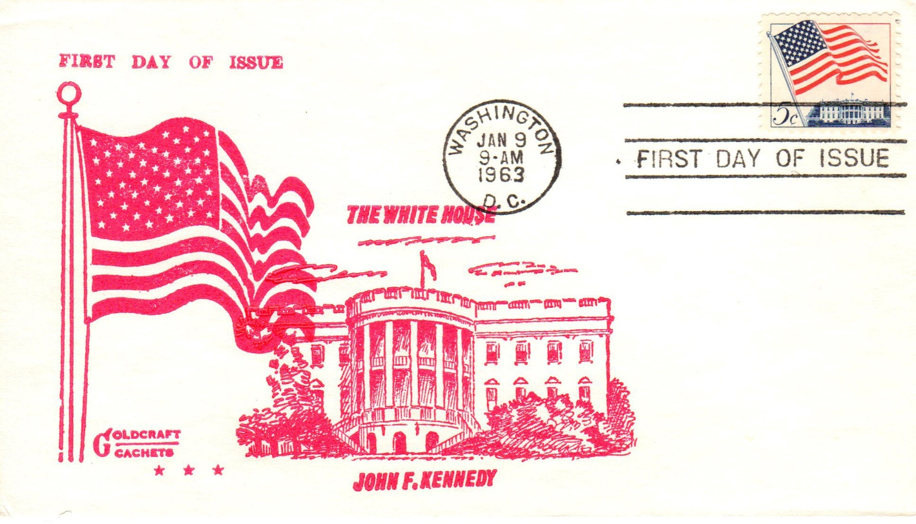
Events in His Presidency, 1963
Goldcraft Cachet
January 9, 1963

Slide 32
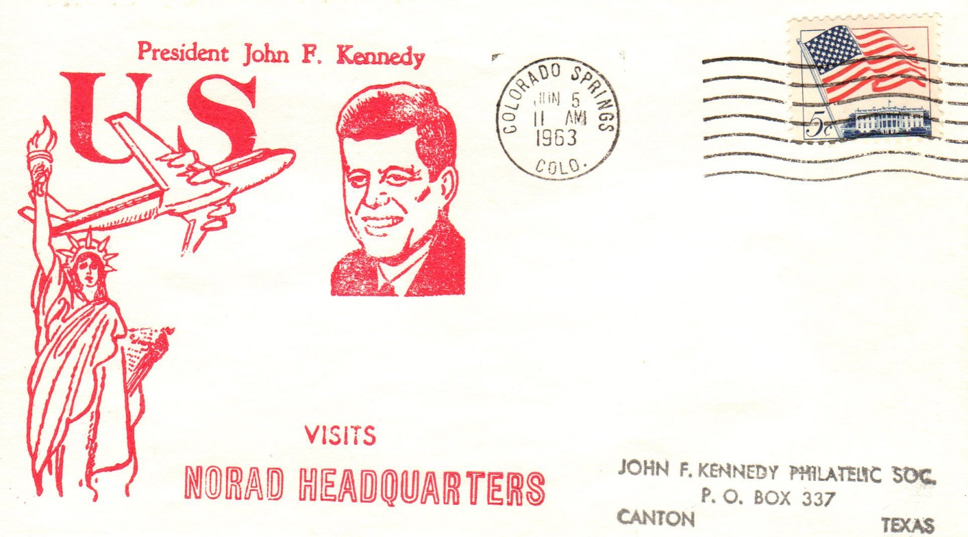
Events in His Presidency, 1963
June 5, 1963- Visit to the Air Force Academy, NORAD headquarters

Slide 33
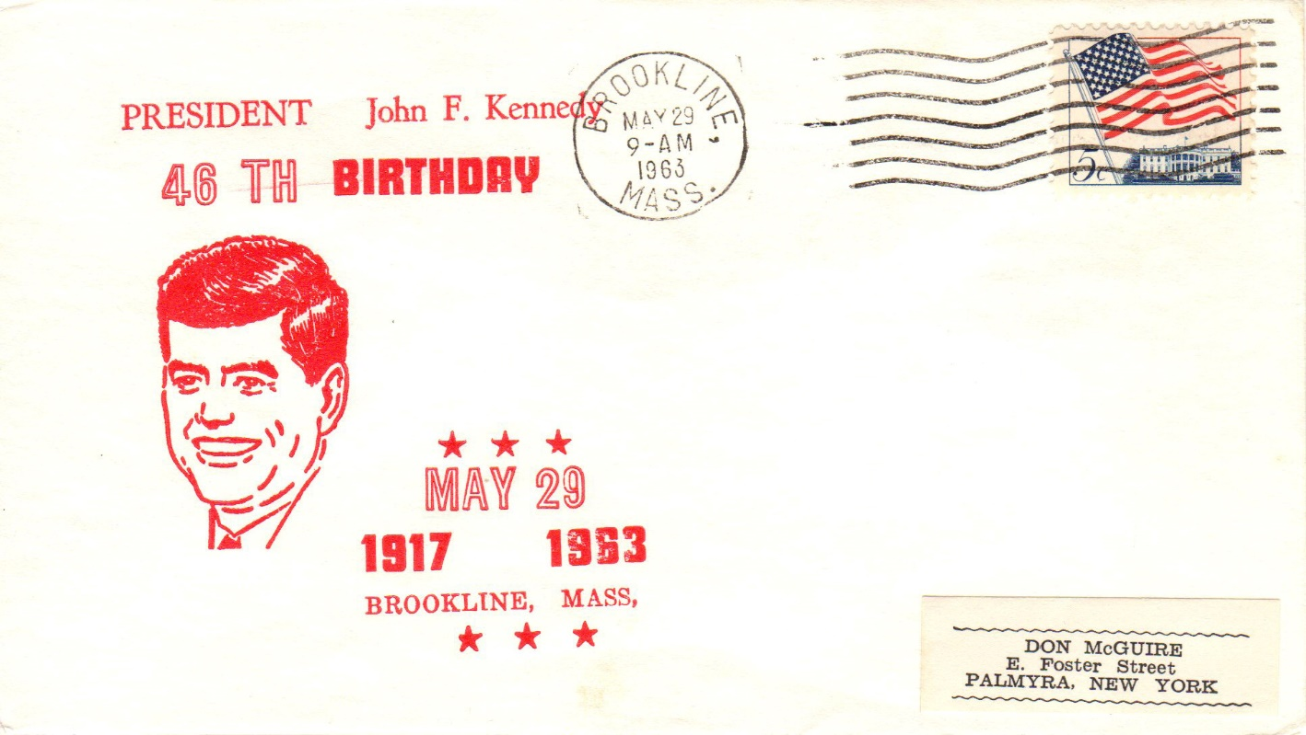
Events in His Presidency, 1963
May 29, 1963- President’s 46th birthday

Slide 34
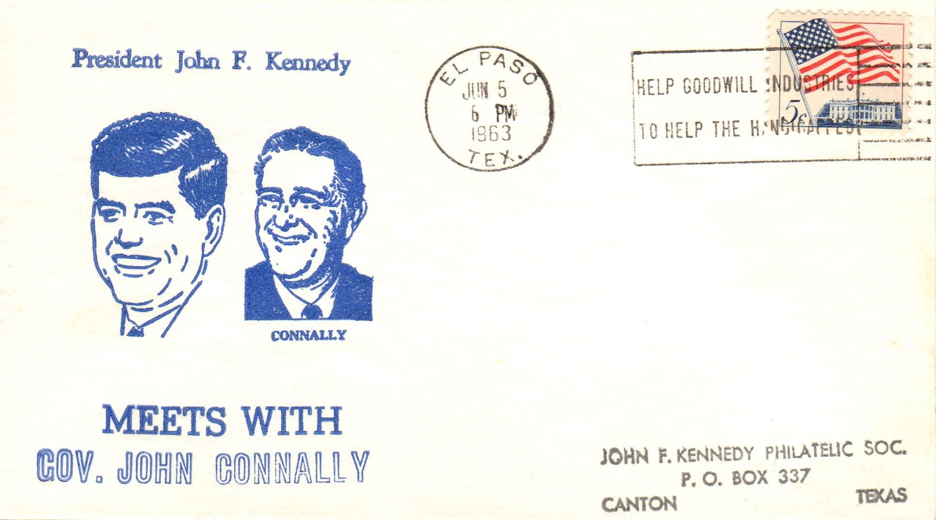
Events in His Presidency, 1963
June 5, 1963- Visit to El Paso, Texas

Slide 35
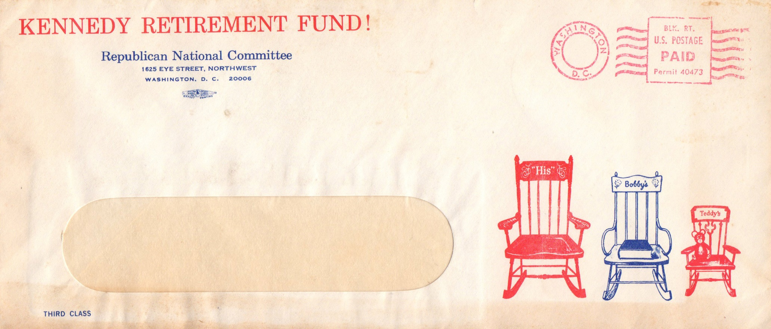
Events in His Presidency, 1963
1963 RNC political cachet, third class mail

Slide 36
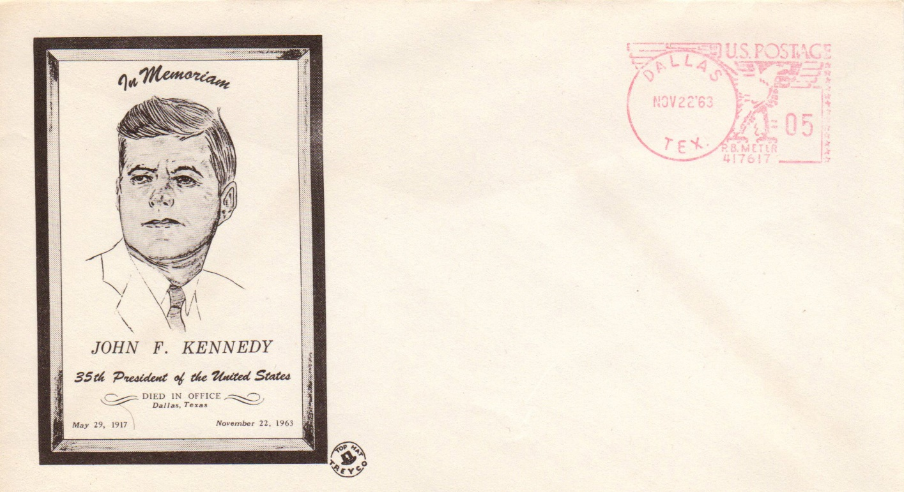
Events in His Presidency, 1963
Treyco “Top Hat” cachet (Mellone #145)
November 22, 1963- Assassination in Dallas, TX

Slide 37
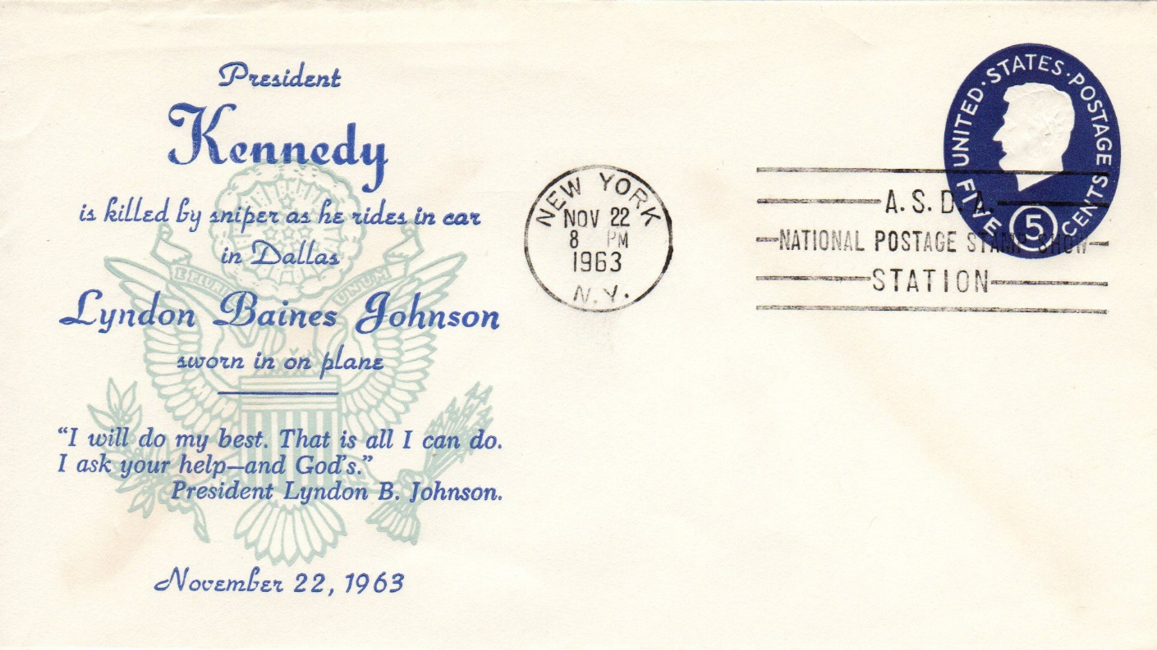
Events in His Presidency, 1963
November 22, 1963- Swearing in of LBJ on Air Force One

Slide 38
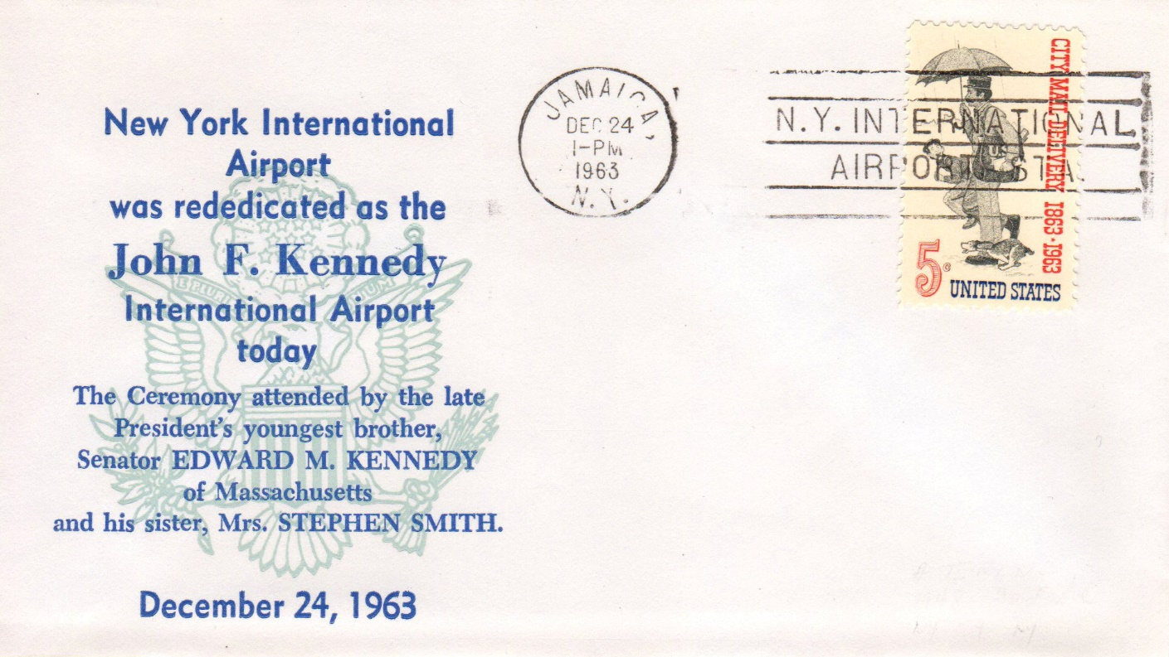
In Memoriam, 1963
December 24, 1963- Rededication of JFK International Airport

Slide 39
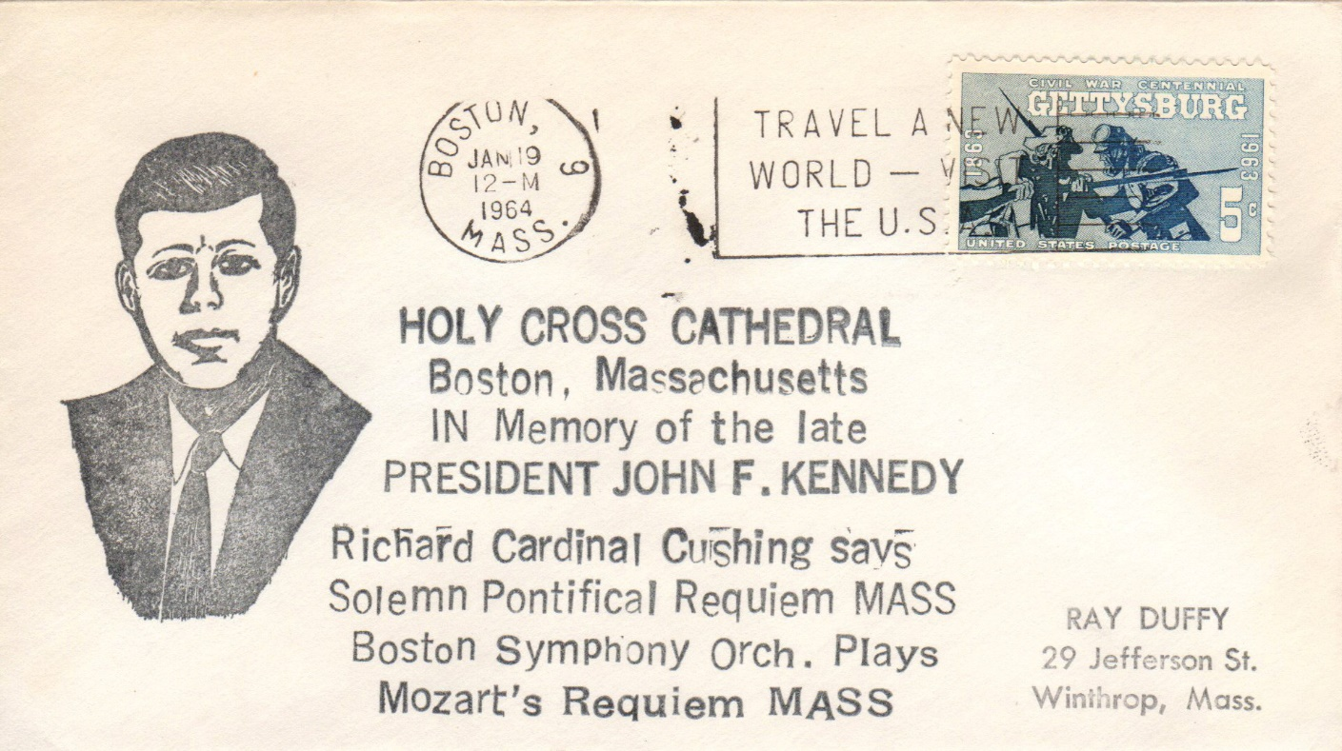
In Memoriam, 1964
January 19, 1964- Requiem Mass in Boston

Slide 40
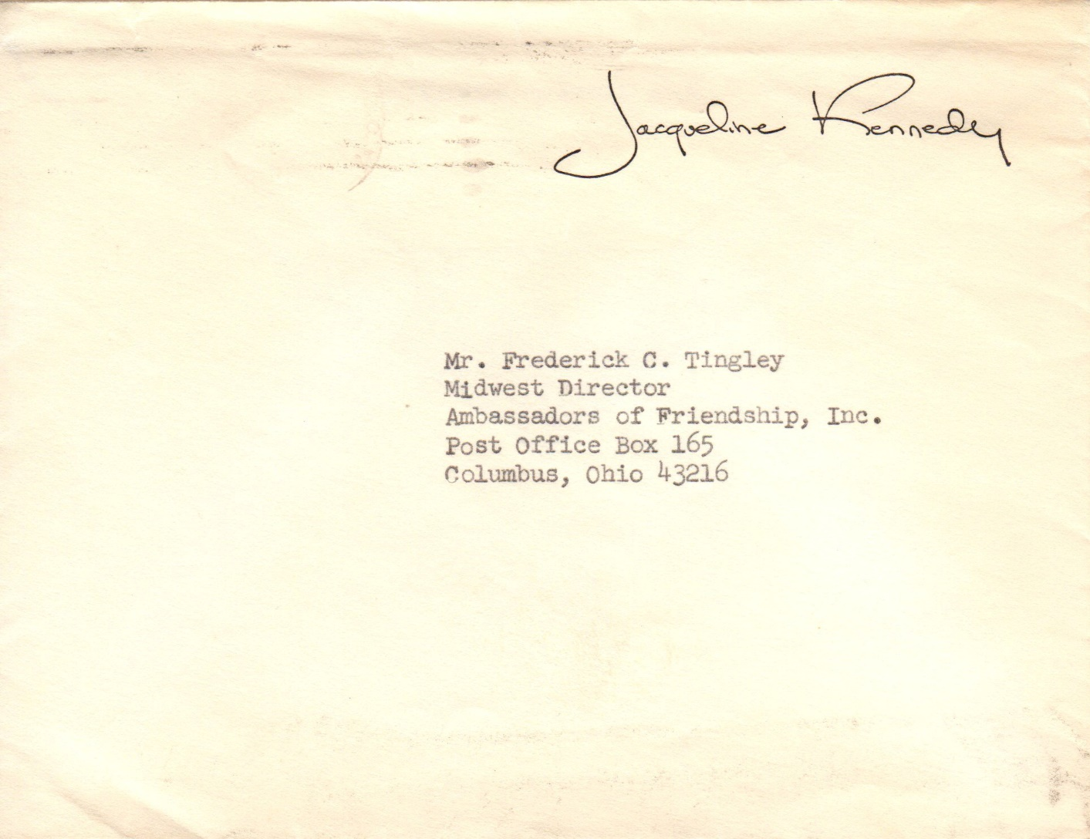
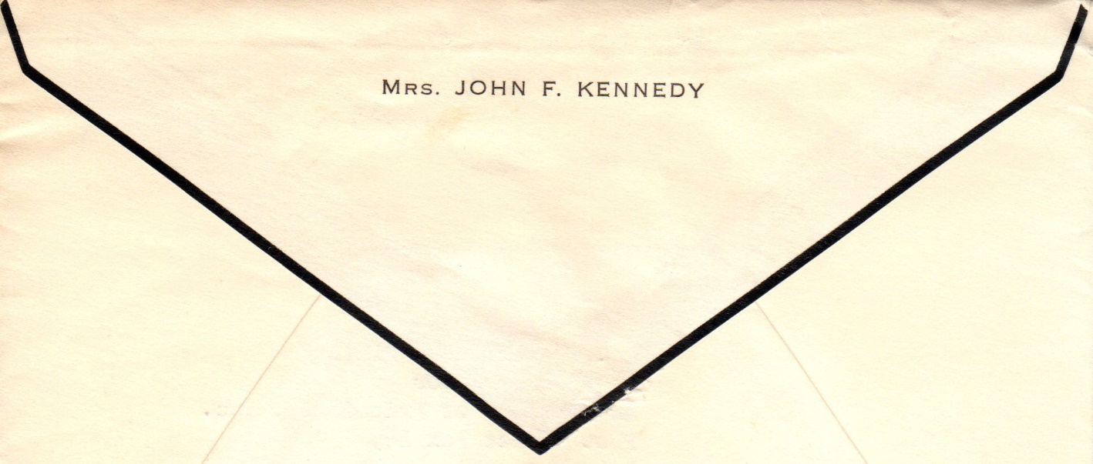
In Memoriam, 1964
Mourning cover sent by the former First Lady

Slide 41
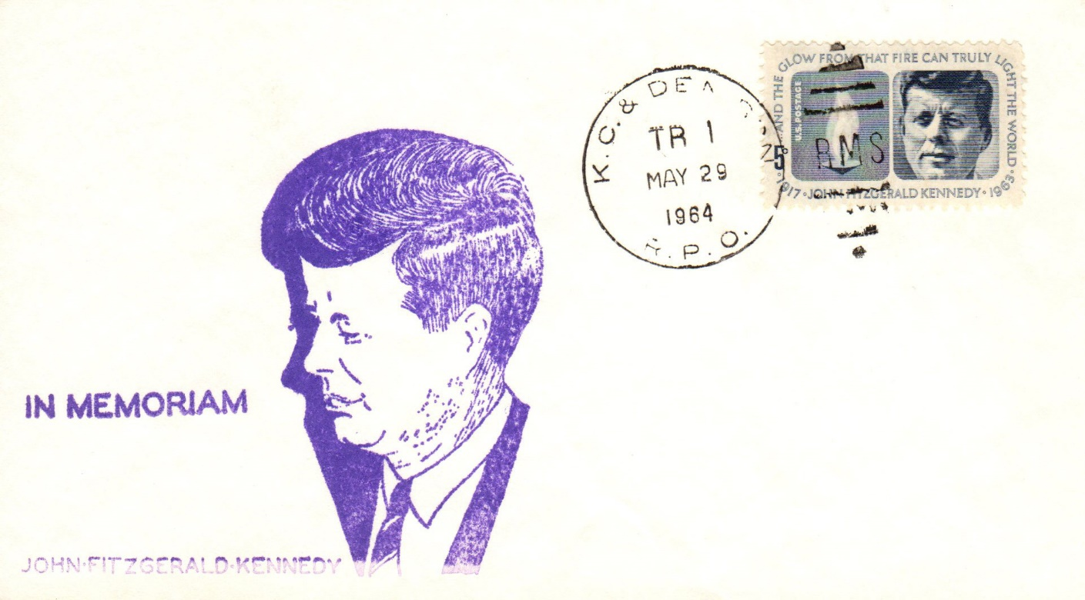
In Memoriam, 1964
May 29, 1964- First day cover

Slide 42
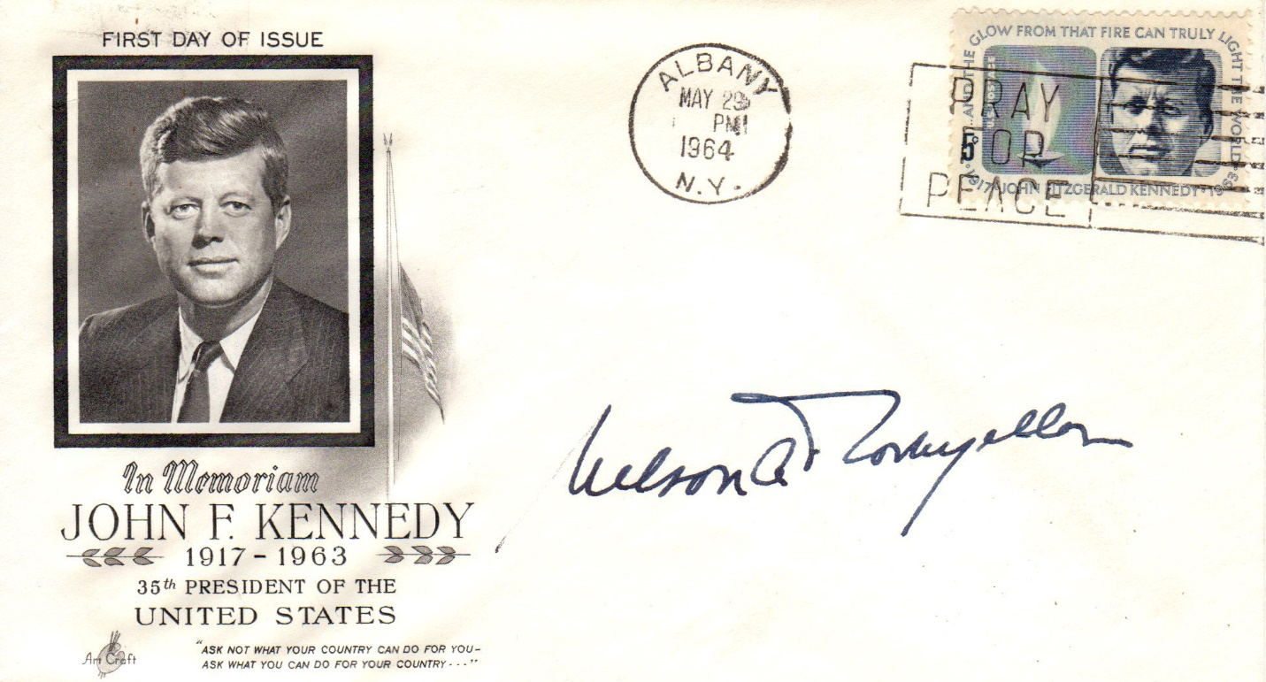
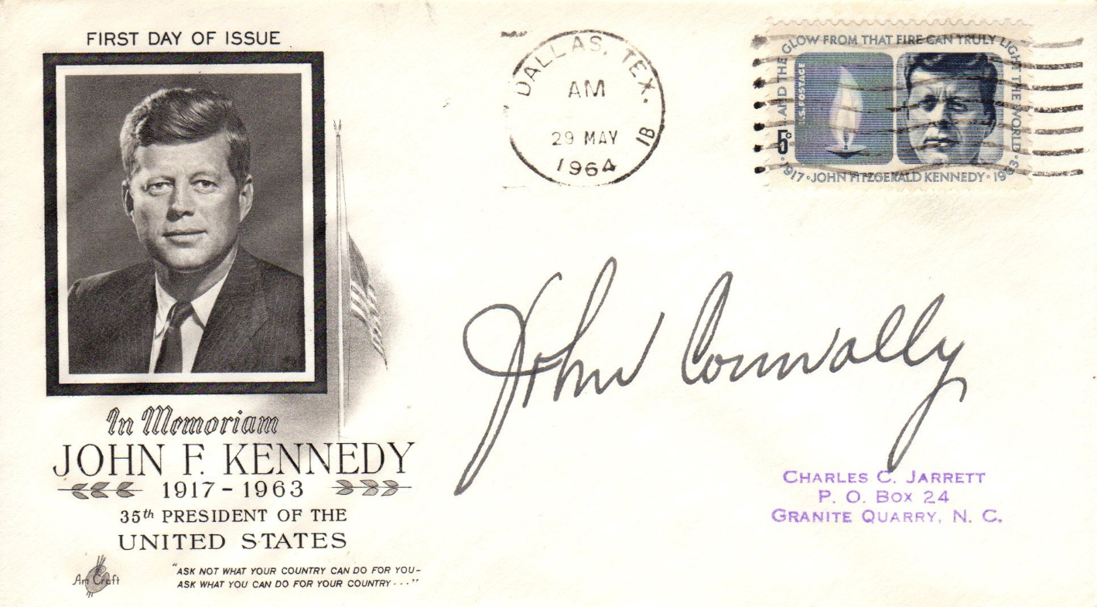
In Memoriam, 1964
ArtCraft cachets
John Connally
Nelson A. Rockefeller
May 29, 1964- ArtCraft first days with respective Governor autographs

Slide 43
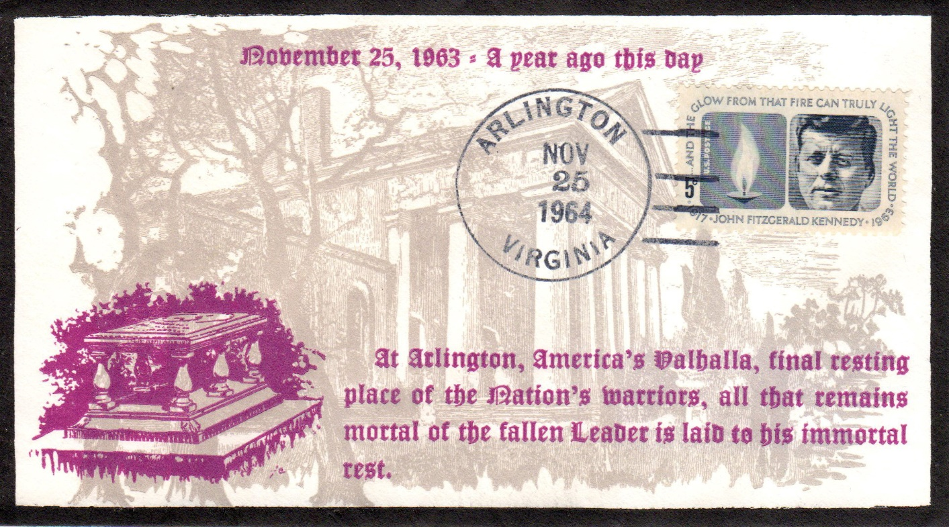
In Memoriam, 1964
November 25, 1964- One year anniversary of internment

Slide 44
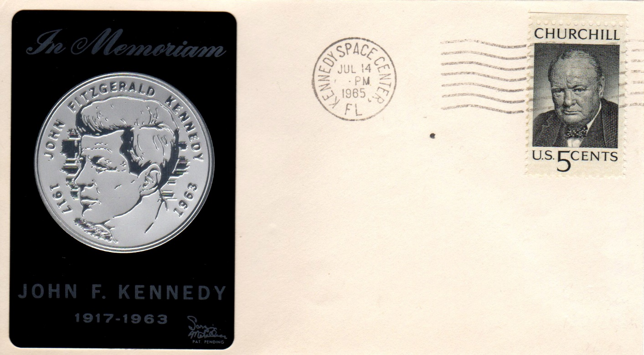
In Memoriam, 1965
Clyde Sarzin cachet (Mellone # 53)
July 14, 1965- Space probe Mariner 4 makes its closest approach to Mars

Slide 45
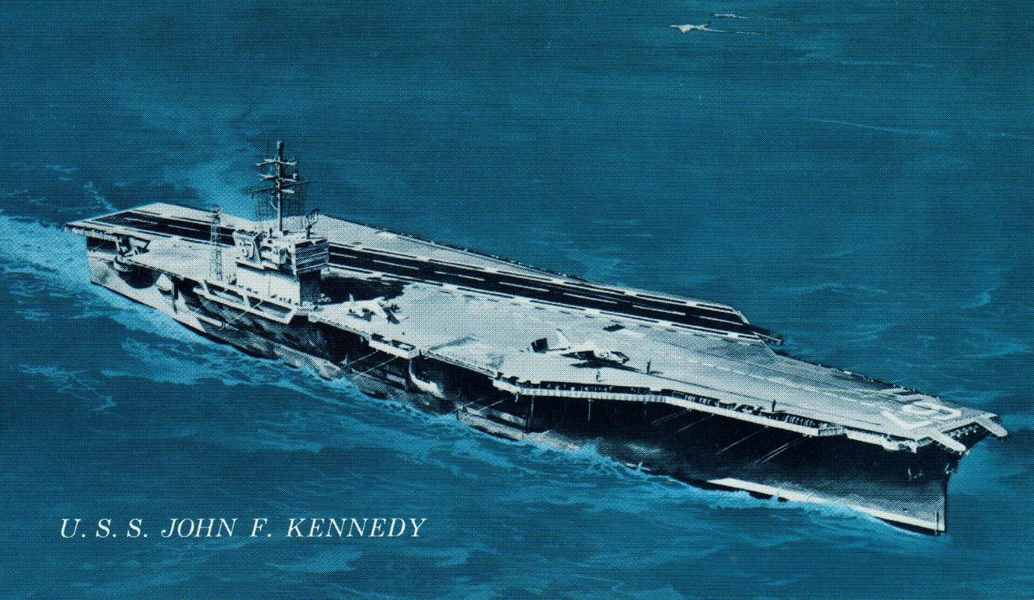
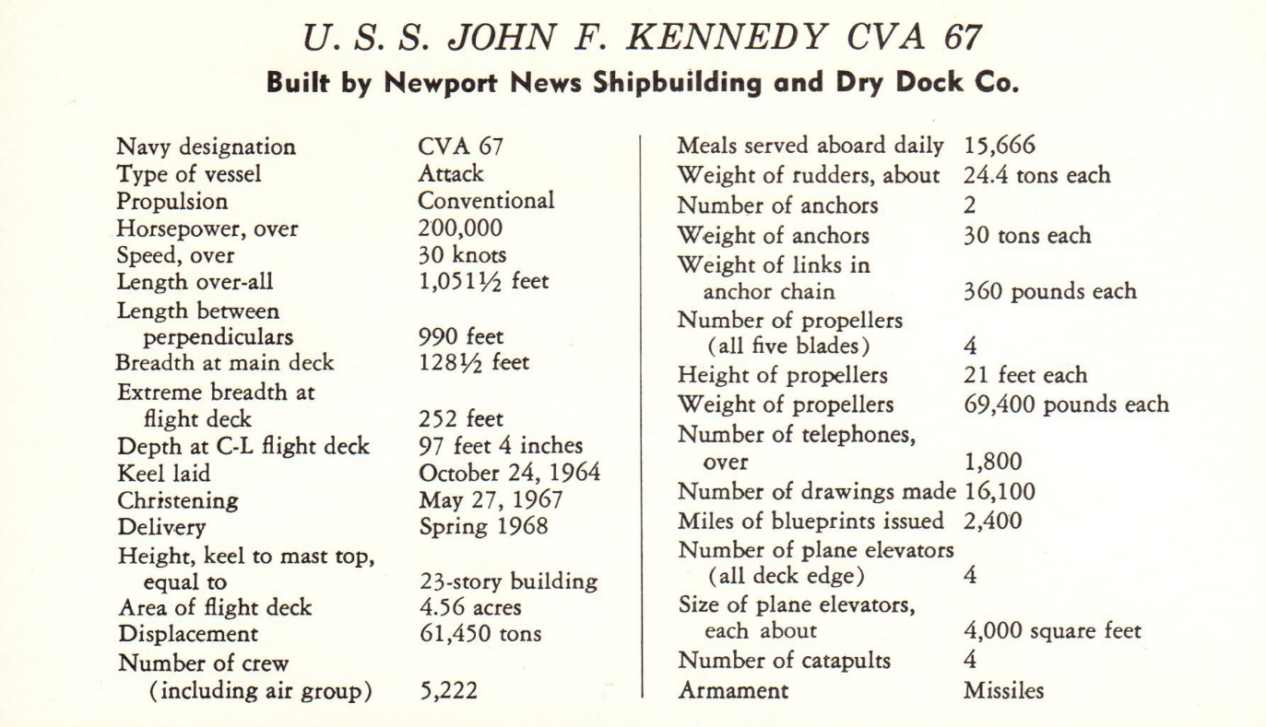
In Memoriam, 1967
Christening of the Carrier U.S.S. John F. Kennedy

Slide 46
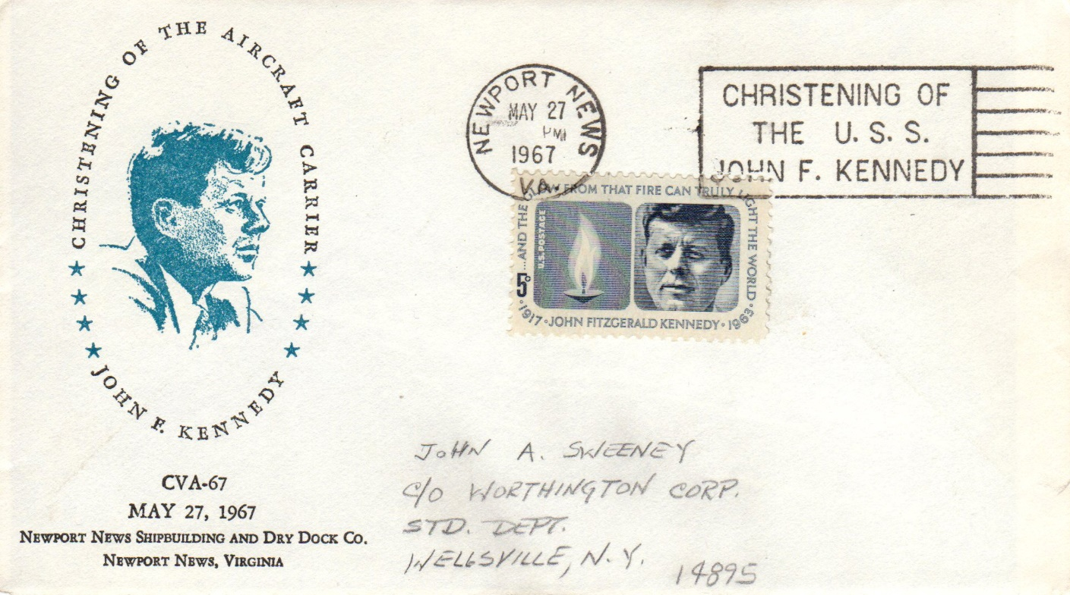
In Memoriam, 1967
May 27, 1967- Christening cover

Slide 47

In Memoriam, 1969
July 16, 1969- Launch of Apollo 11, Buzz Aldrin autograph

Slide 48

In Memoriam, 1979
October 20, 1979- JFK Library Dedication, Boston, MA

Slide 49
In Memoriam, 2015
July 16, 2015- PNC cover, first day of coin’s release

Slide 50
In Memoriam, 2017
February 20, 2016- 100th birth anniversary stamp sheet and FDC

Slide 51


Noteworthy Online Resources
https://www.jfklibrary.org/
http://www.presidency.ucsb.edu/john_f_kennedy.php
http://www.stampboards.com/viewtopic.php?f=17&t=41842
Layout, design and research by Tom Fortunato

