Slide 1
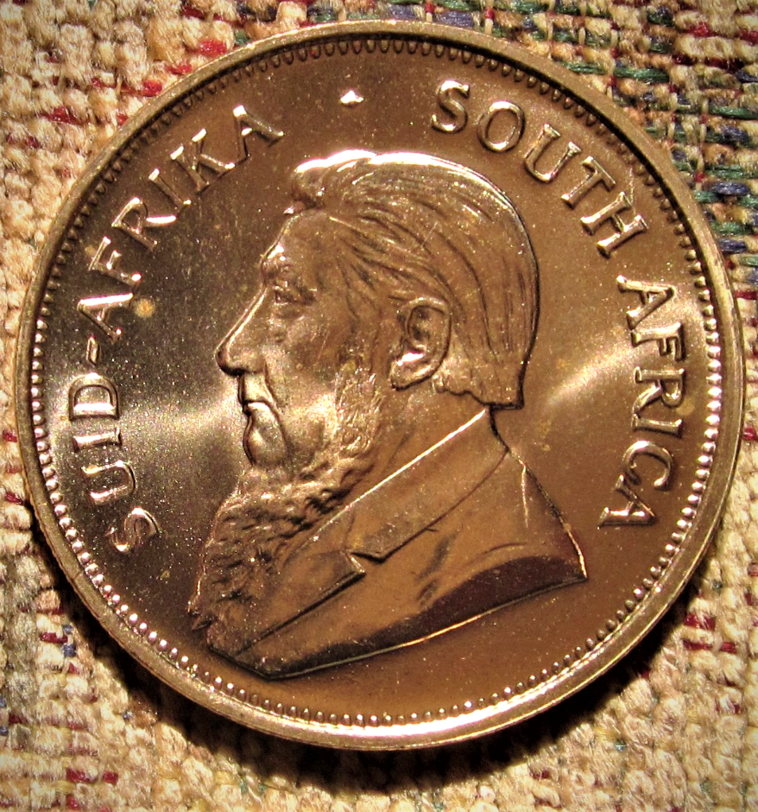
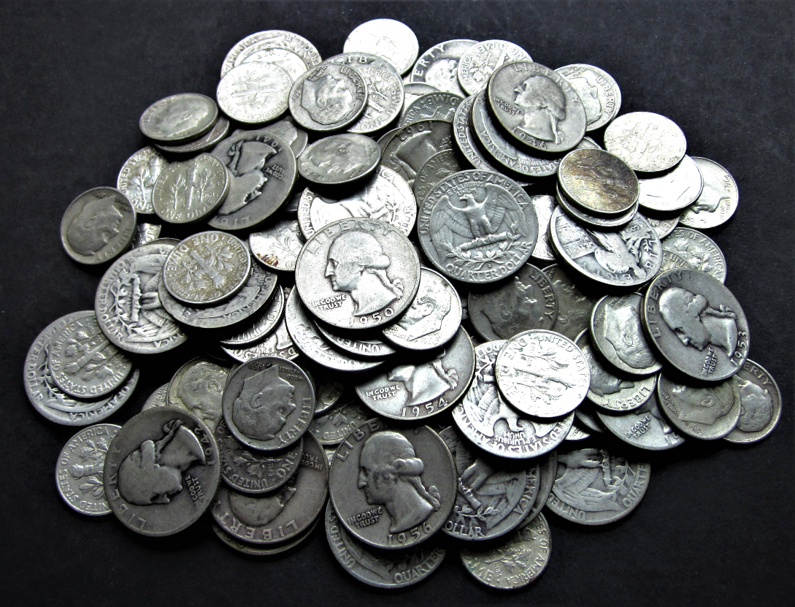
Investing in Gold
And Silver:
A Contrarian Point of View
Steve Eisinger, MD

Slide 2
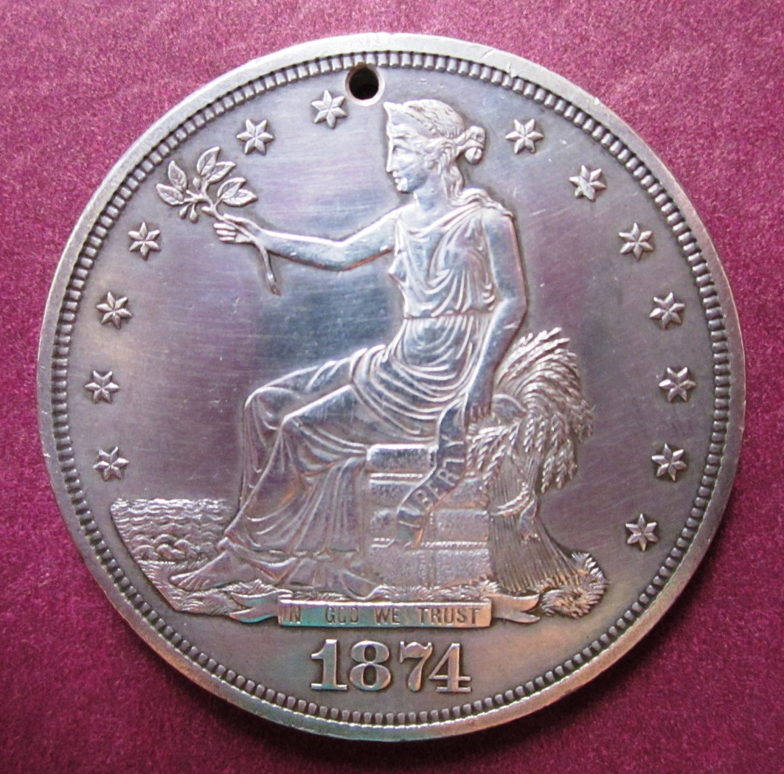
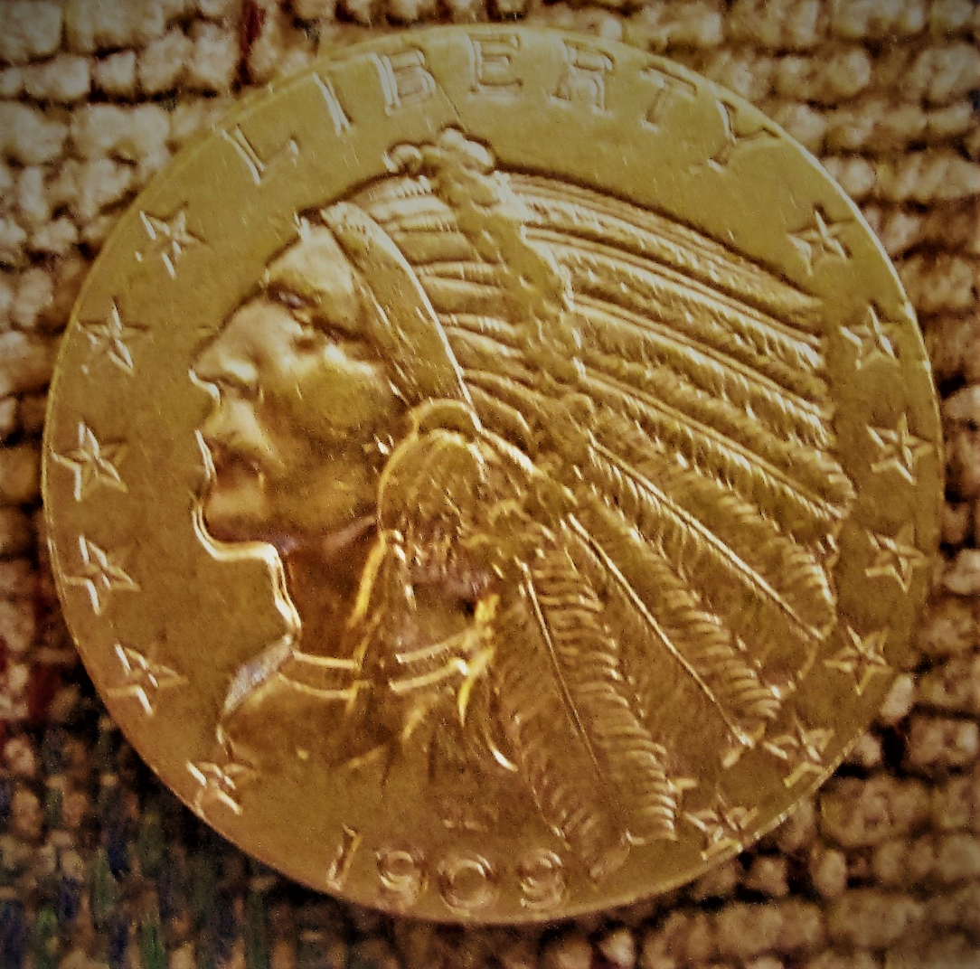
I Introduction and
History

Slide 3
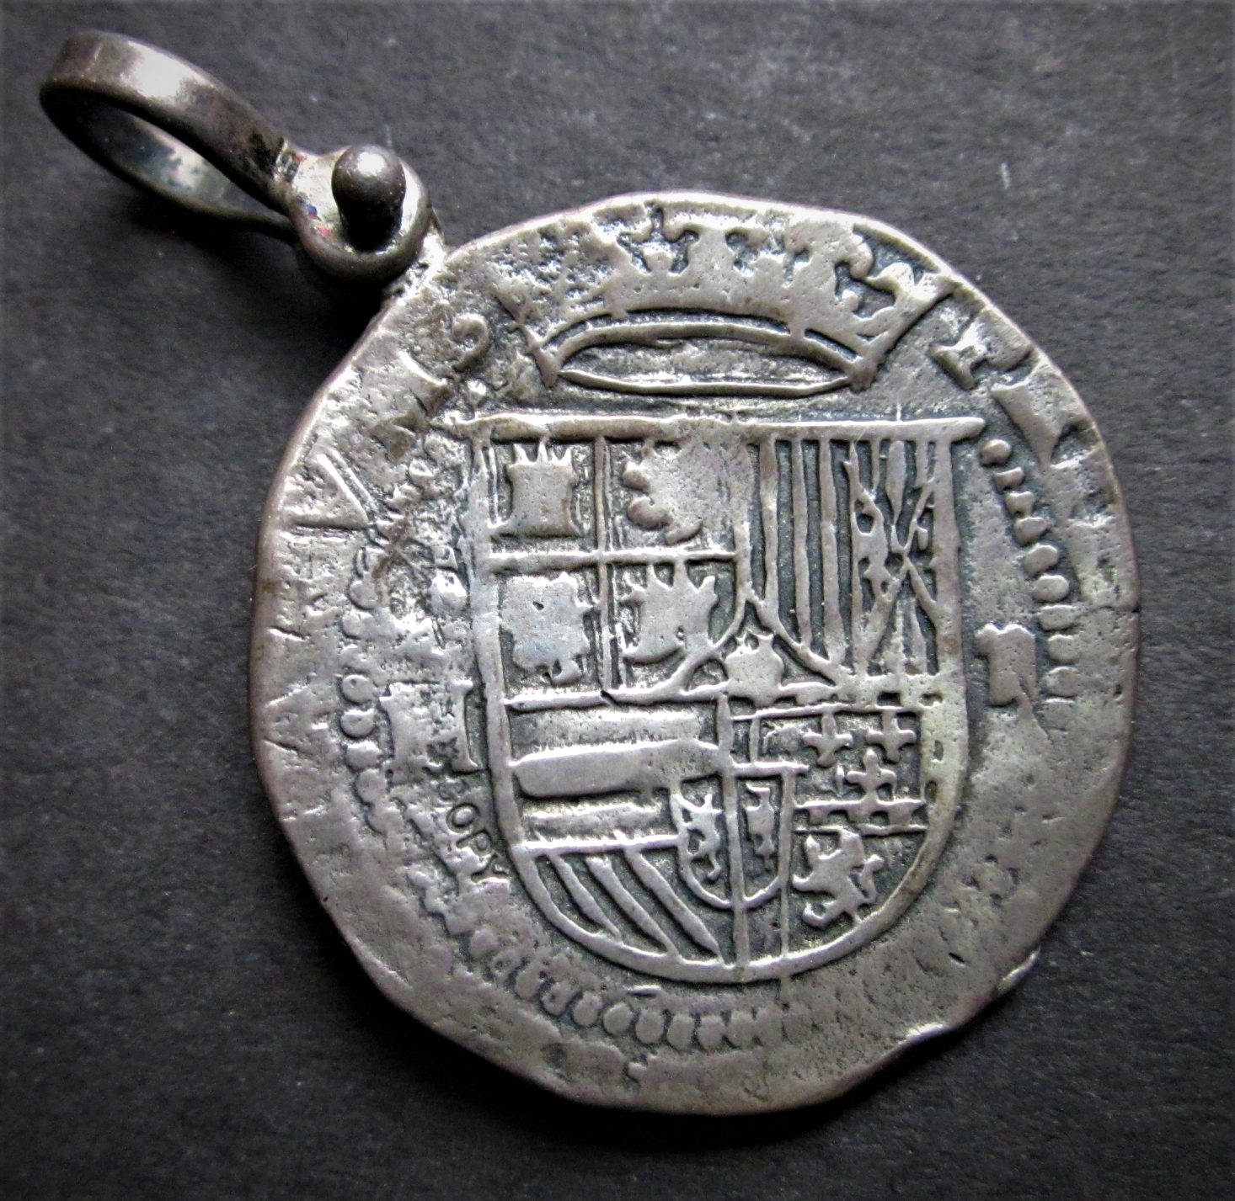
This replica coin was made
From an ingot of silver recovered
from the sunken treasure galleon
De Atocha.
The silver was mined at Potosi
(now in Bolivia) by Native
American slaves in the early
1600’s, and was on its way to Spain
when the ship went down in a
hurricane off the Florida Keys.

Slide 4
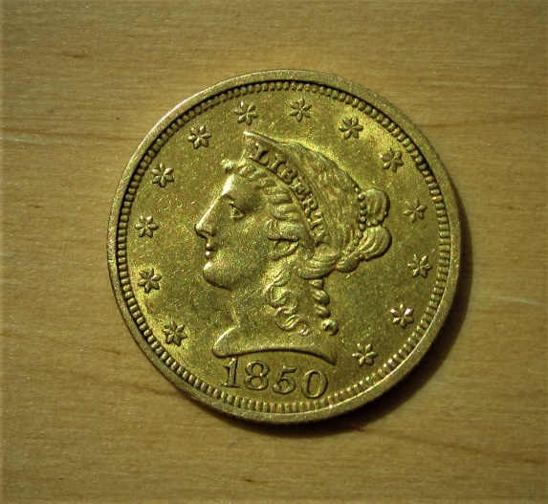
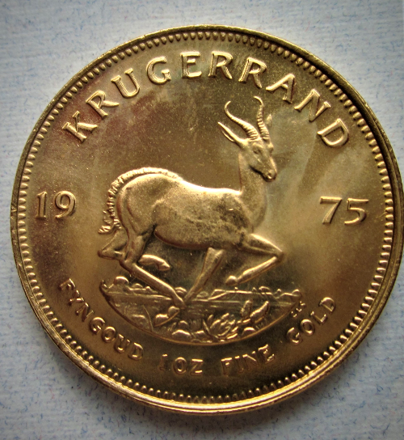
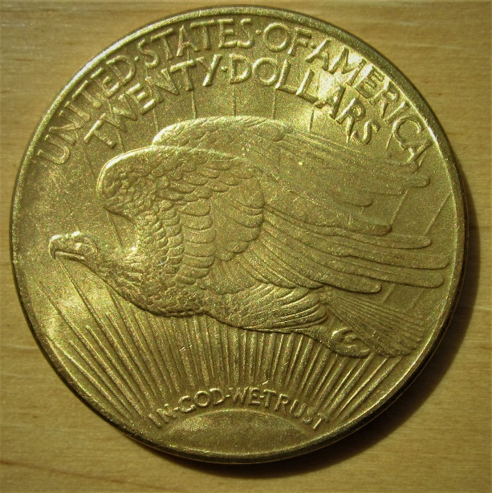
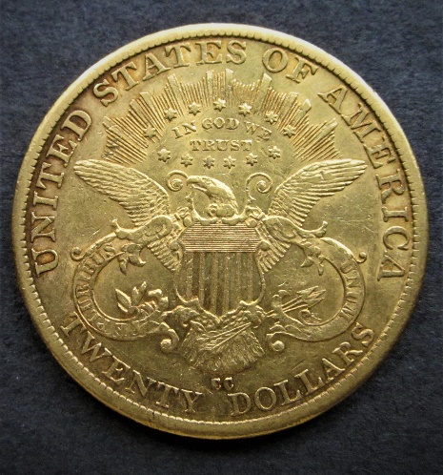
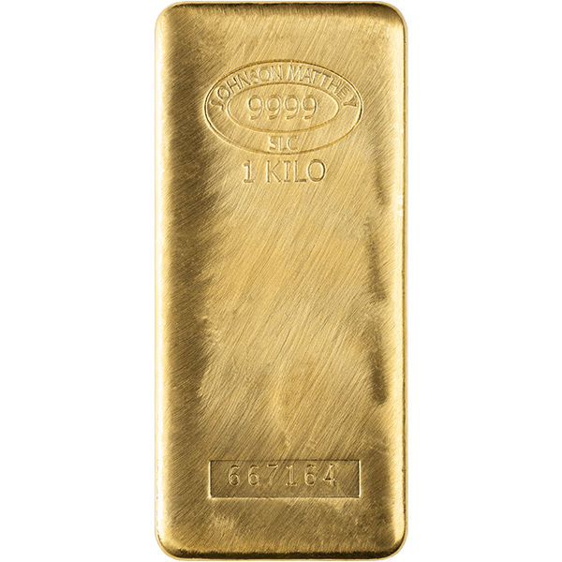
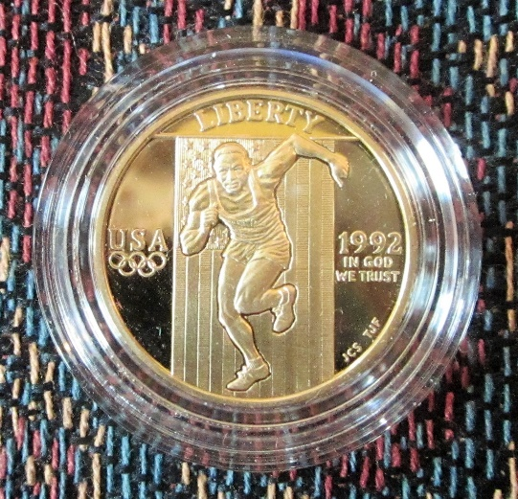
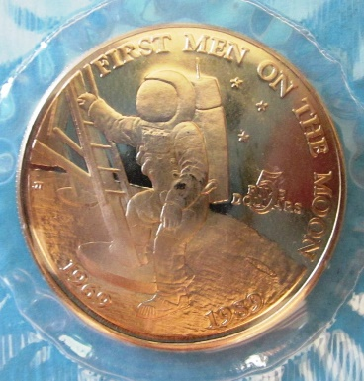
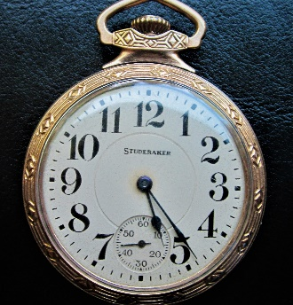
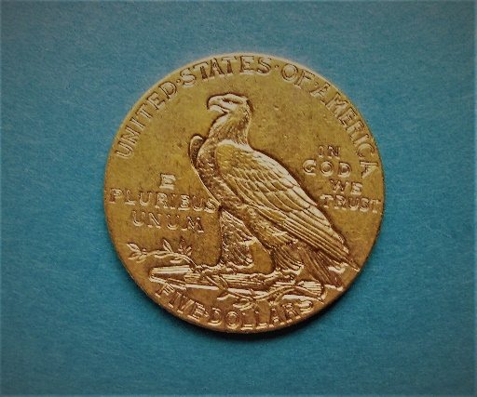
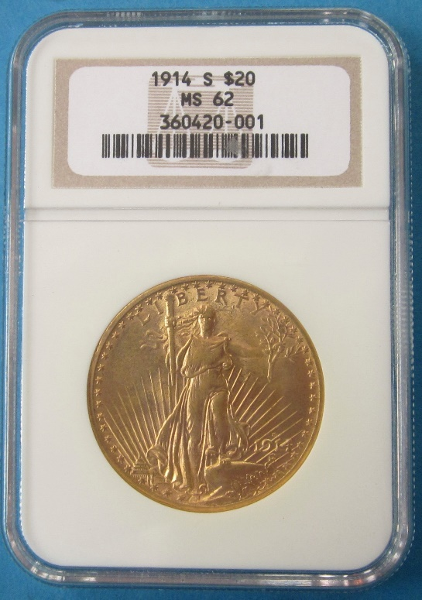
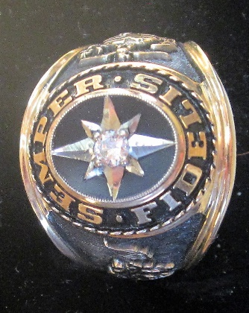
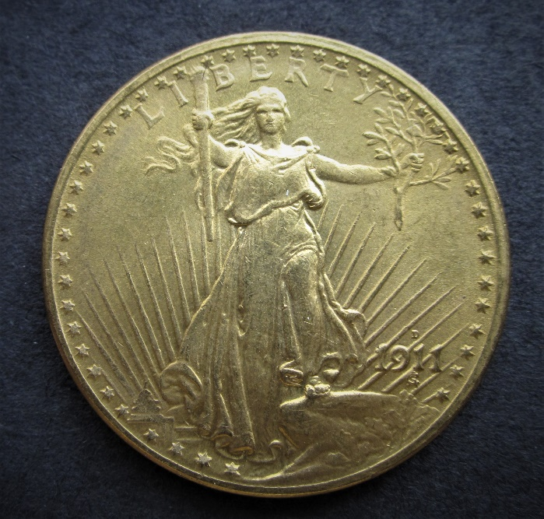
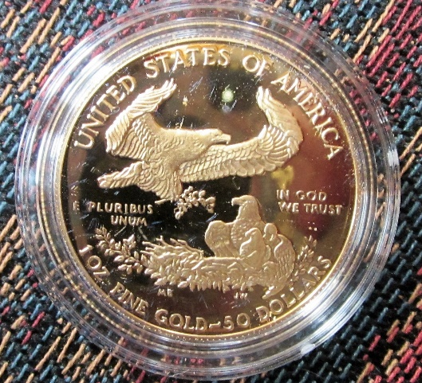
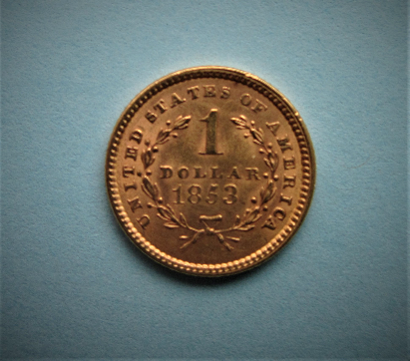
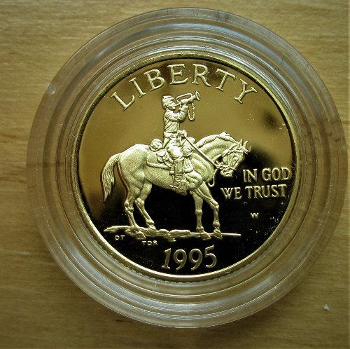

Slide 5
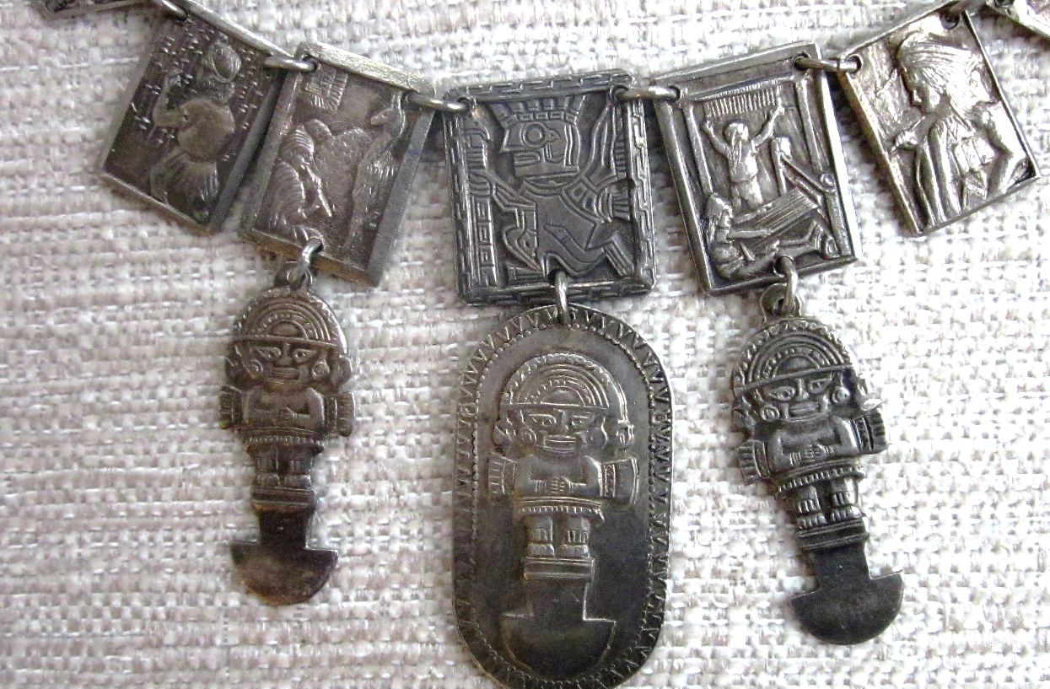
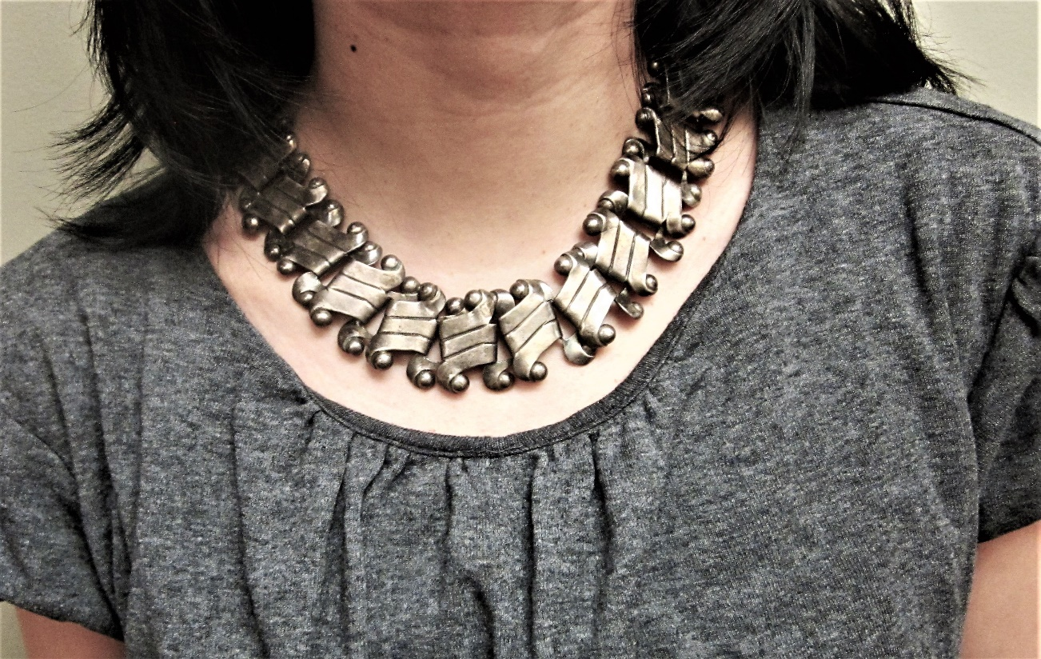
Spratling Mexican Sterling Silver Jewelry

Slide 6
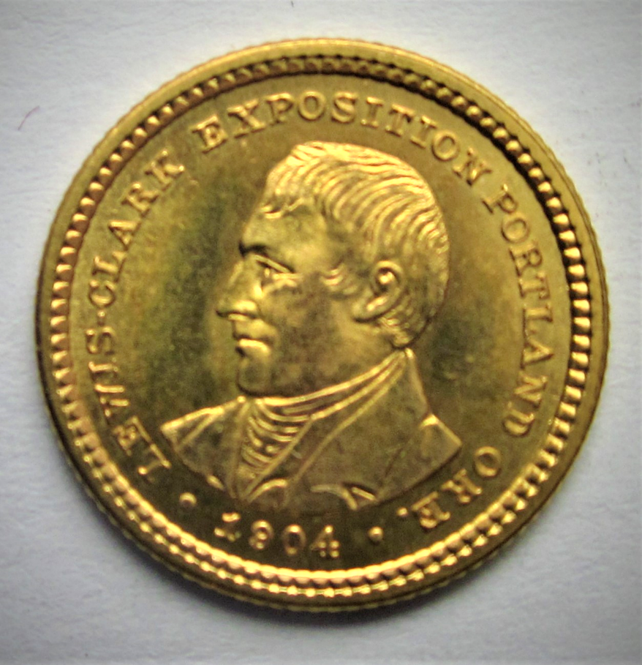
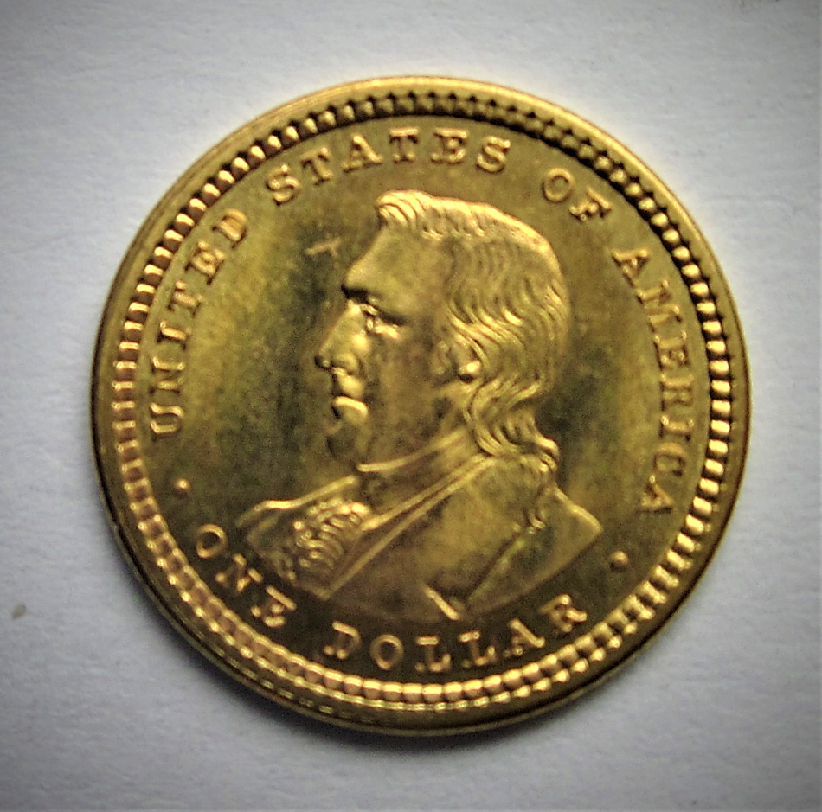
II Returns from Gold and Silver

Slide 7
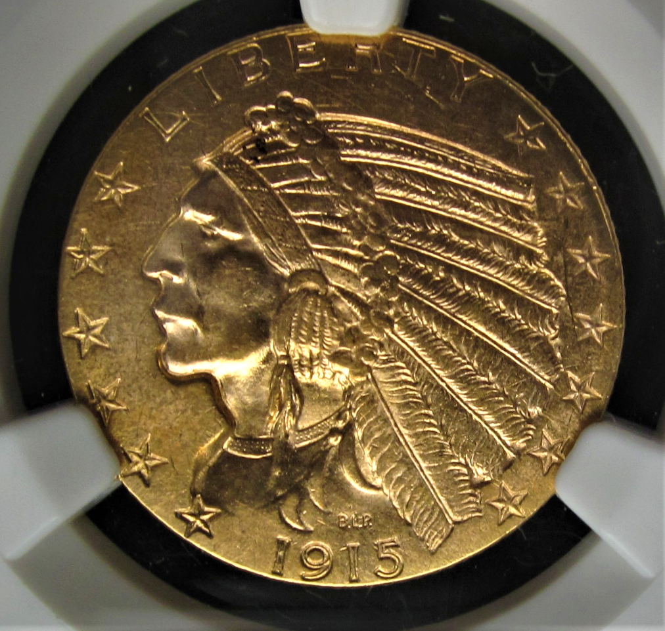
Twenty-Year Price History for Gold
Kitco

Slide 8
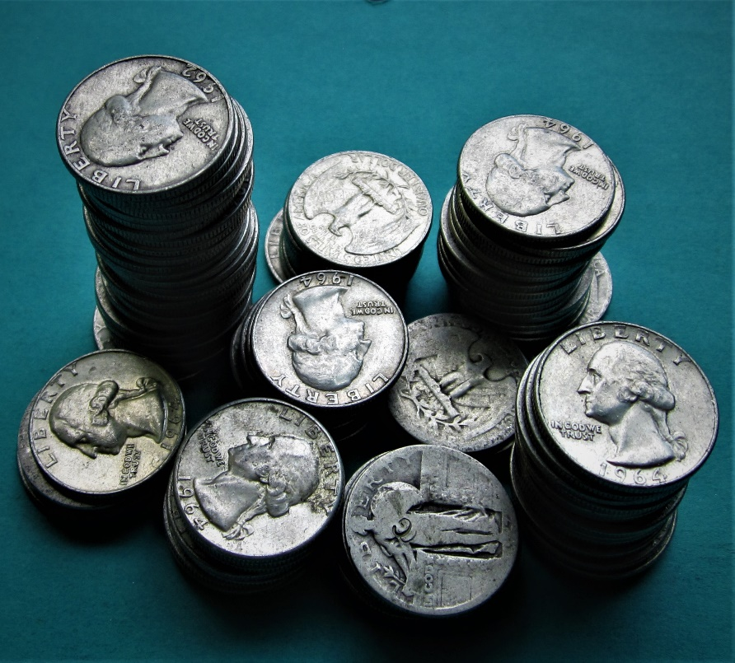
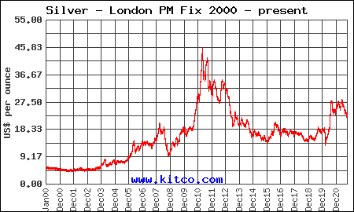
Twenty-Year Price History for Silver
Kitco

Slide 9
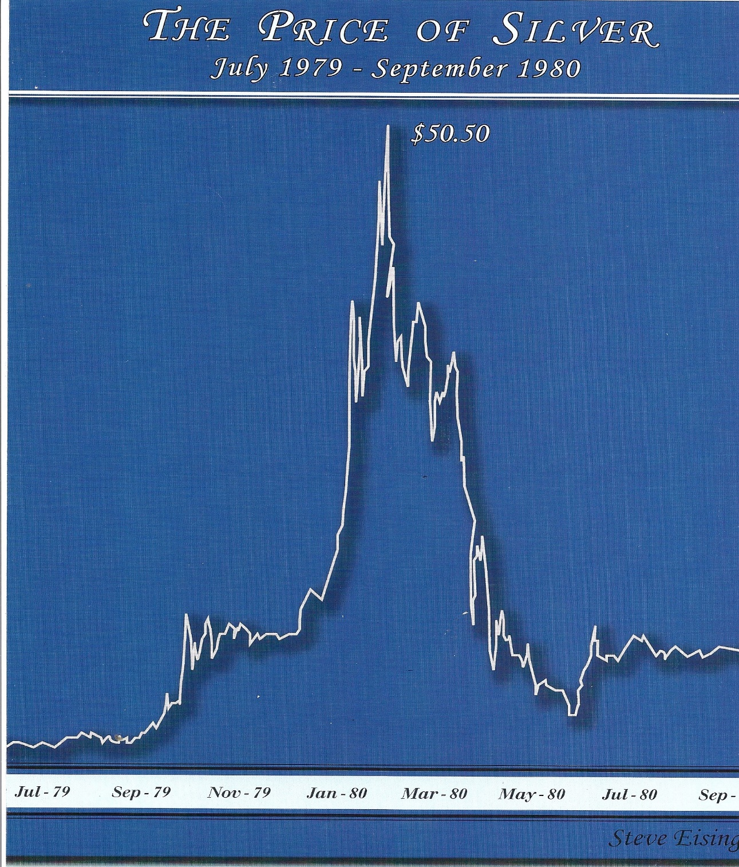
The silver price spike during the
Great Silver Caper of 1979-
1980, during which the Hunt
Brothers attempted to corner
the world silver market.
They failed.
Silver has never since then
approached the January ’80
high of $50.

Slide 10
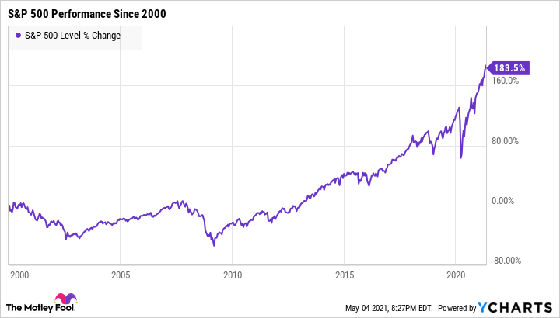
20-Year Stock Market Performance

Slide 11
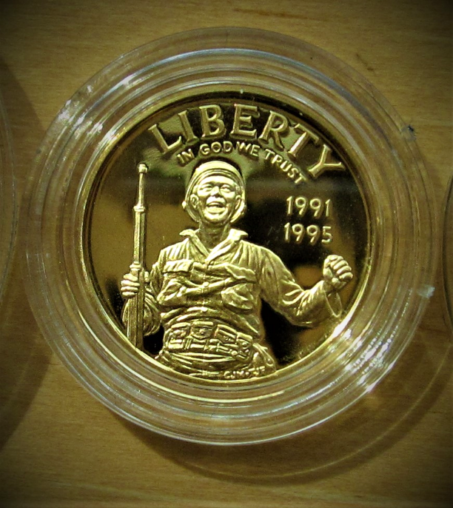
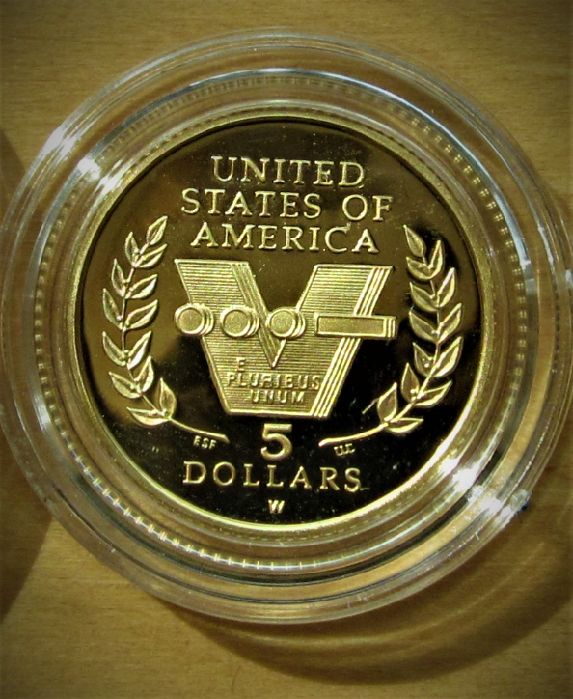
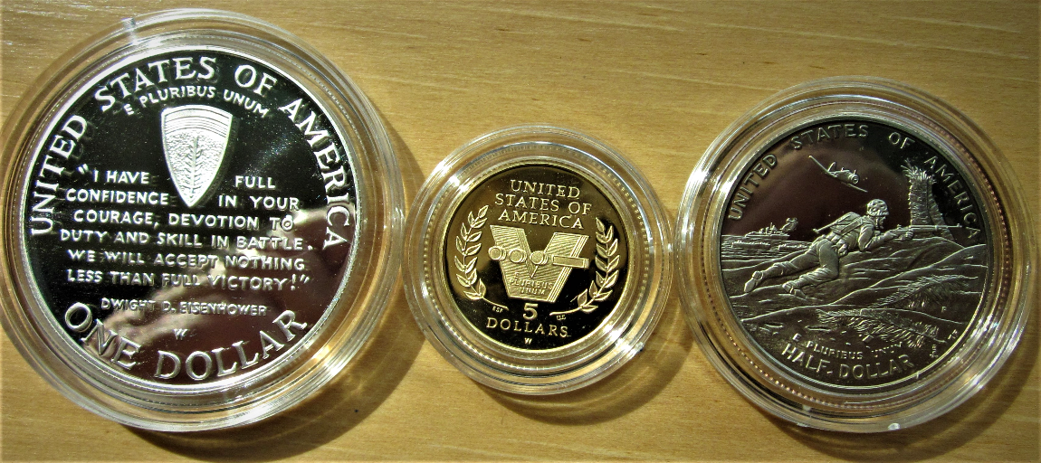
III Fundamentals

Slide 12
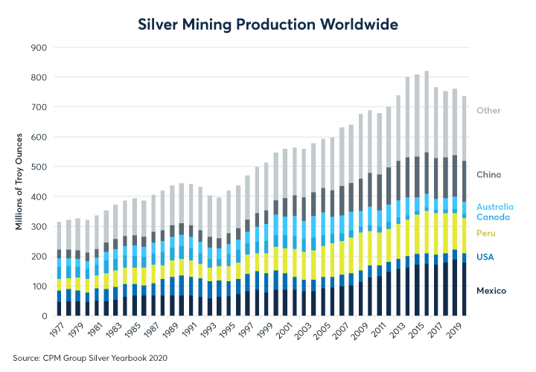

Slide 13
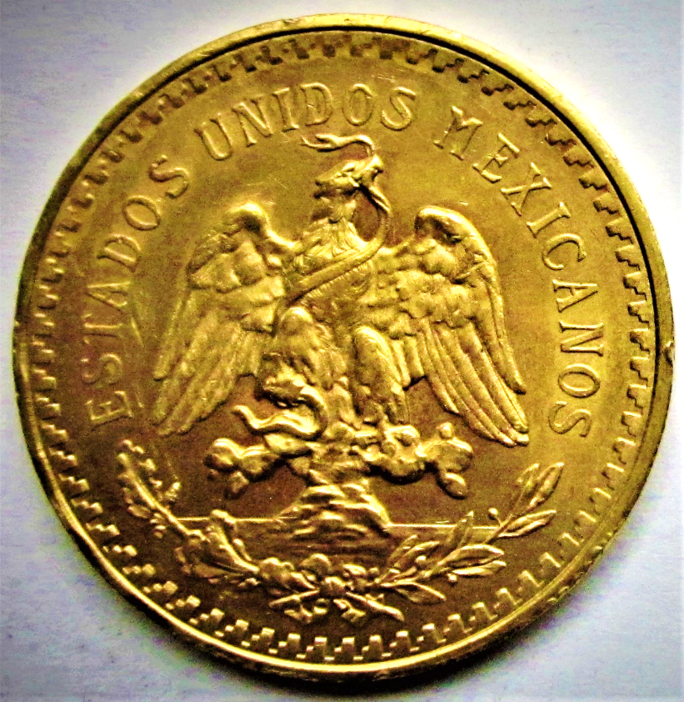
2018 Rank | Country | Gold production (tonnes) | Reserves (tonnes)
1 | China | 404 | 2,000
2 | Australia | 319 | 9,800
3 | Russia | 297 | 5,300
4 | United States | 222 | 3,000
5 | Canada | 189 | 2,200
6 | Peru | 158 | 2,600
7 | Indonesia | 137 | 2,500
8 | Ghana | 130 | 1,000
9 | South Africa | 130 | 6,000
10 | Mexico | 115 | 1,400
11 | Brazil | 97 | 2,400
12 | Uzbekistan | 92 | 1,800
13 | Sudan | 77 | 1,550
14 | Papua New Guinea | 69 | 1,300
15 | Kazakhstan | 68 | 1,000
 | Rest of the world | 1,001 | 12,000
 | World total | 3,503 | 54,000
Gold Production
By Country-2018

Slide 15
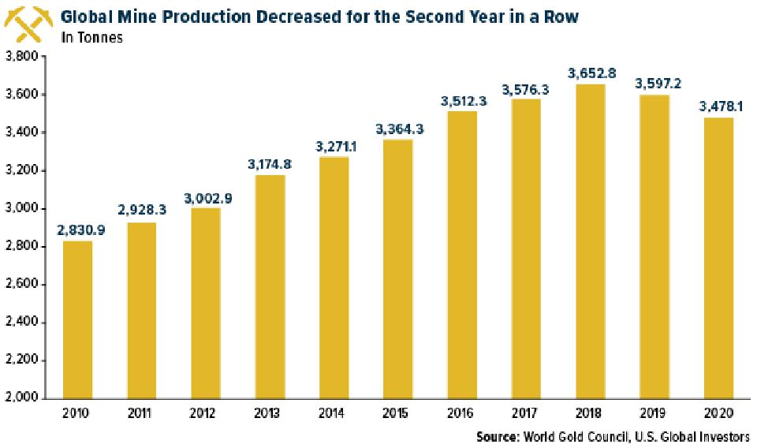
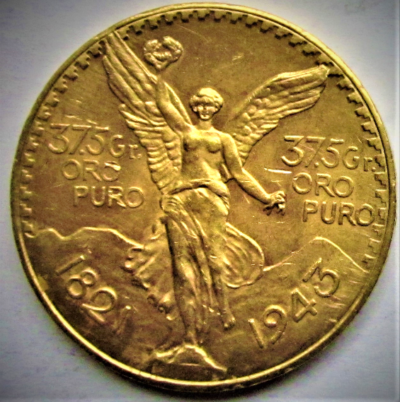

Slide 16
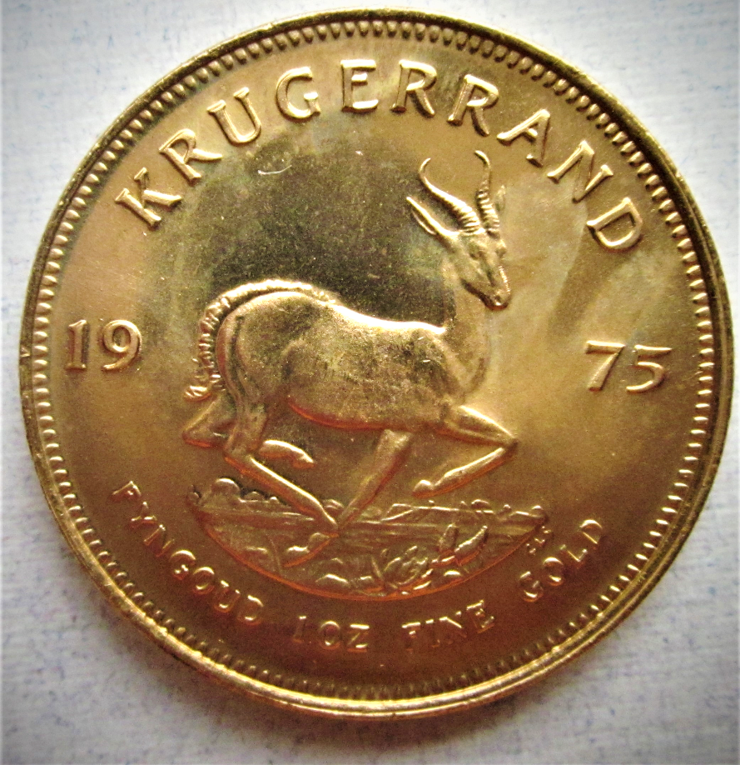
Peak Gold for South Africa

Slide 17
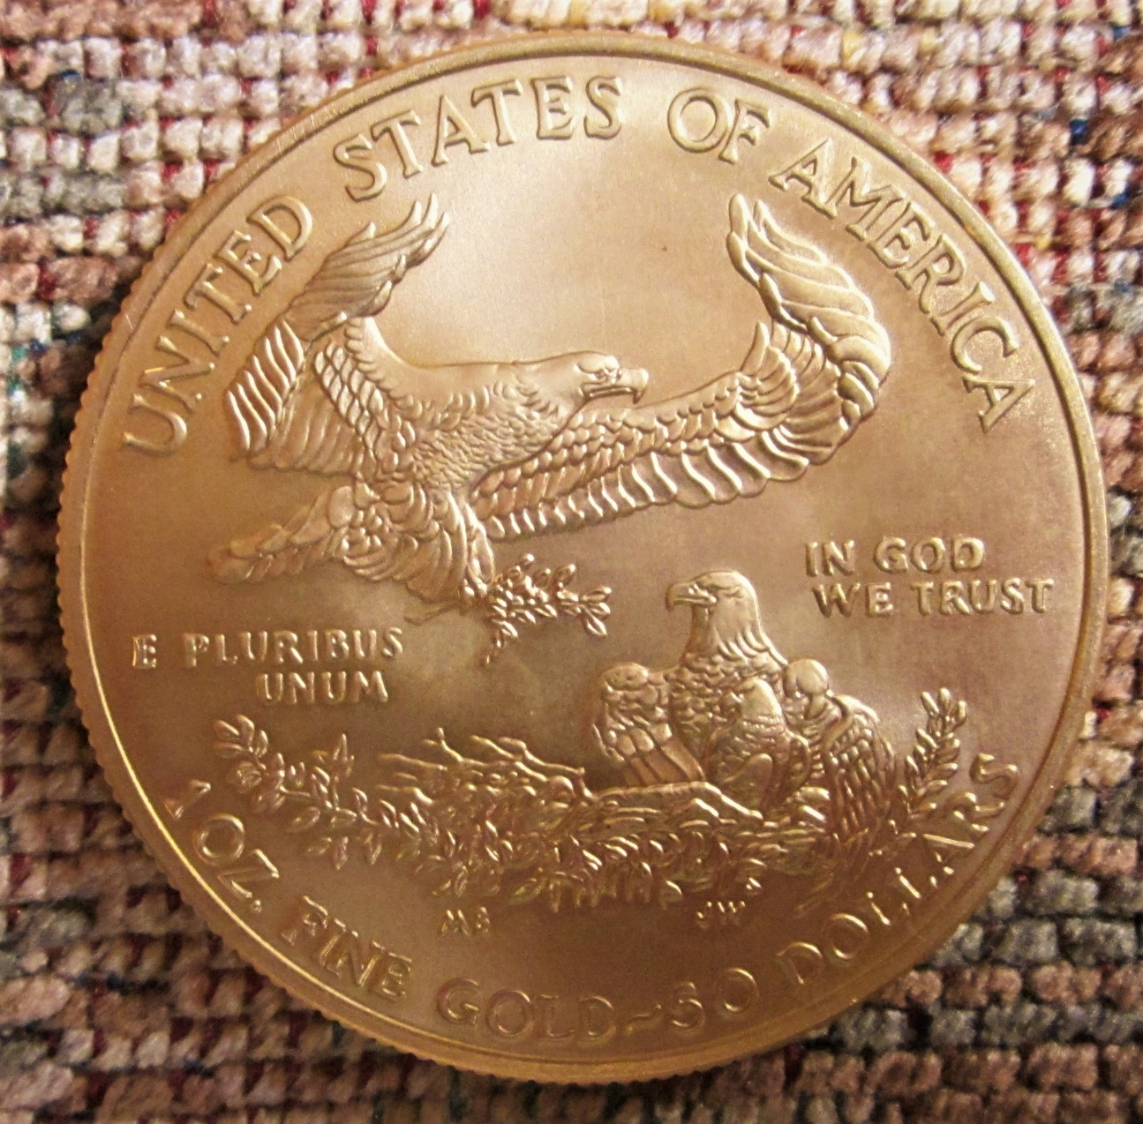
IV Politics, Religion,
Environmentalism,
and Ethics

Slide 18
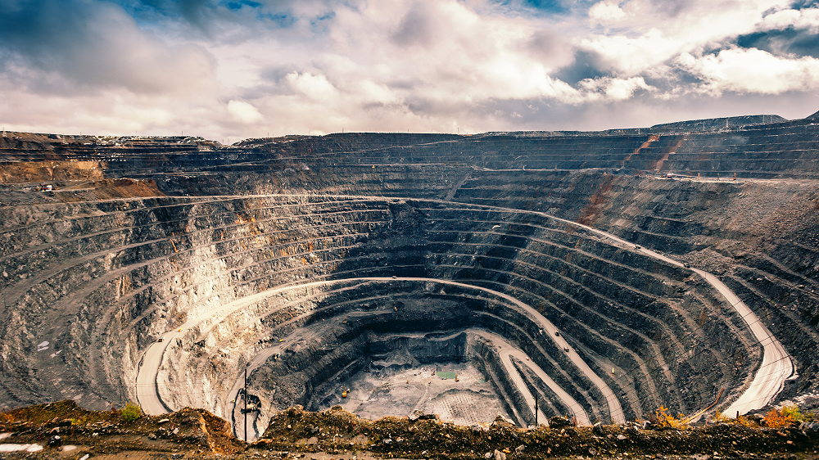
Gold Pit Mining in Russia

Slide 19
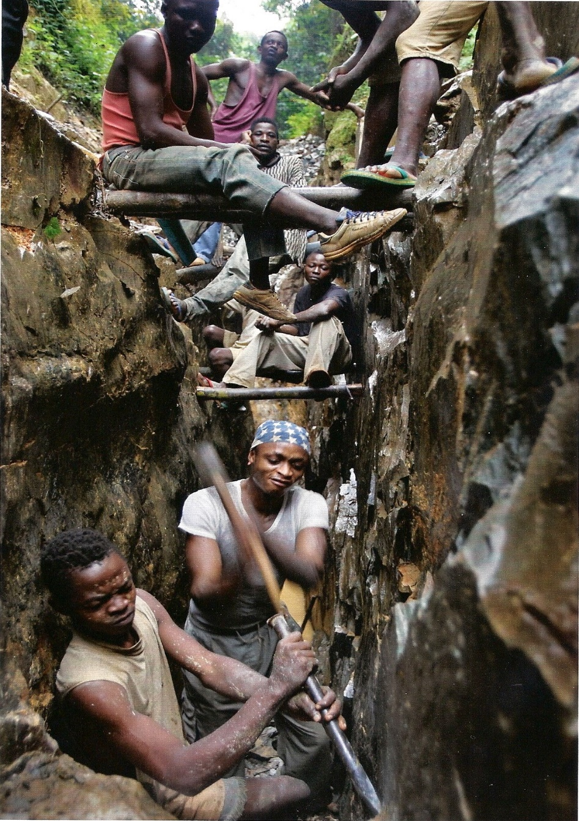
Artisanal Mining
Dangerous
Exploitative of local pop-
ulace
Crime-ridden; terrorist assoc-
iations (“blood gold”)
Environmentally destructive
Child labor often used
Destroys indigenous cultures

Slide 20
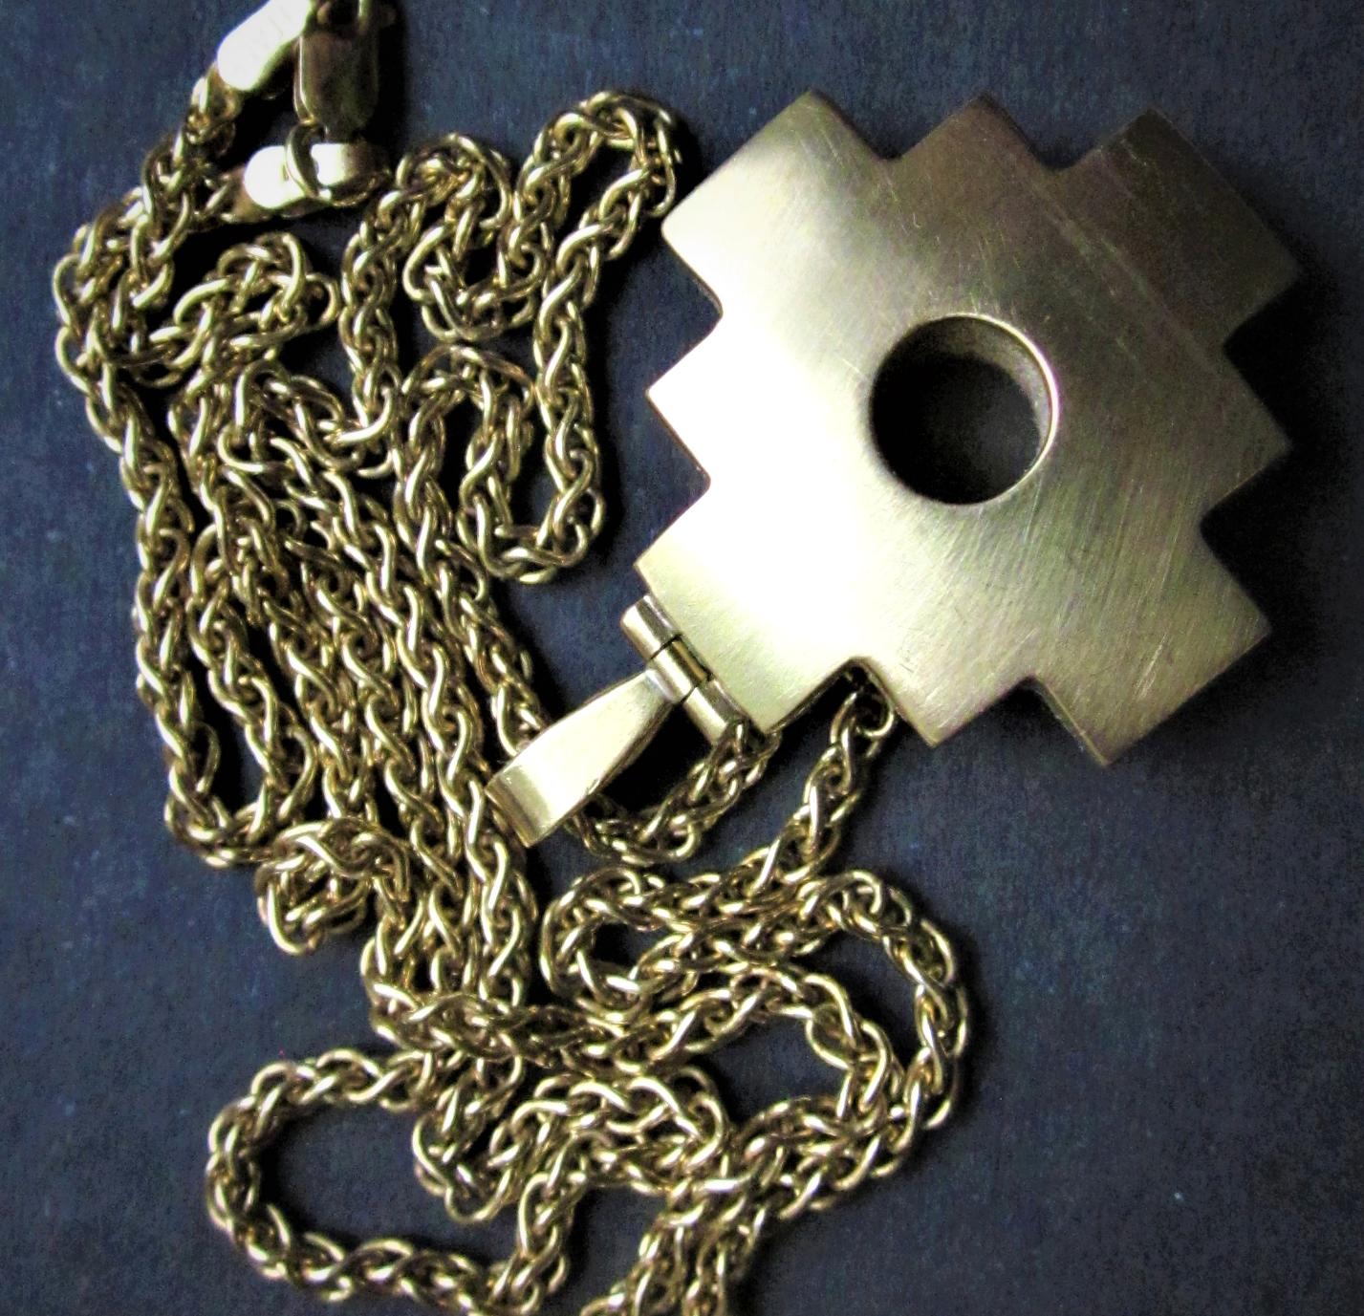
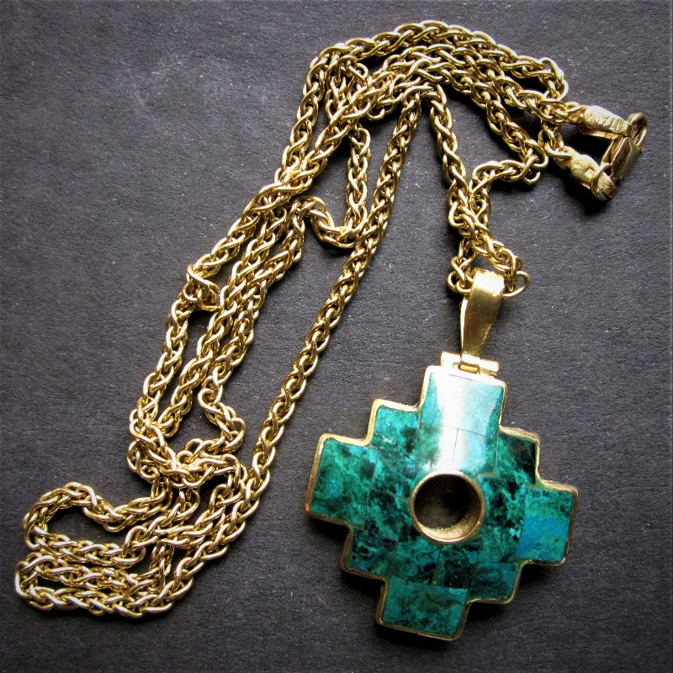
The gold for this piece of
Inca Jewelry was probably
mined by artisanal miners
in the jungles of the Amazon.

Slide 21
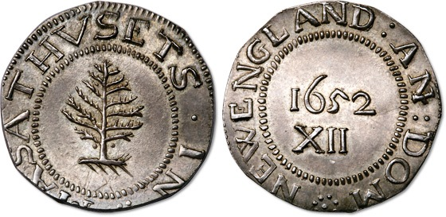
V Strategies and
Methods

Slide 22
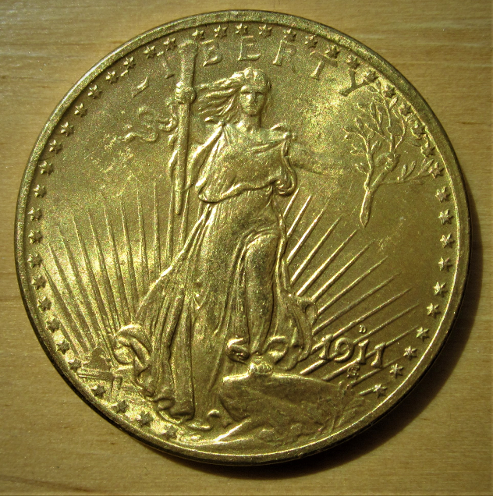
Quotes from ETF Prospectus
“The investment objective of the Trust is for the
shares to reflect the performance of the price
of gold bullion.”
2. “The shares trade on the NYSE and…provide indirect access to the gold bullion market. The shares may be bought and sold on the NYSE Arca like any other exchange-listed securities.”

Slide 23
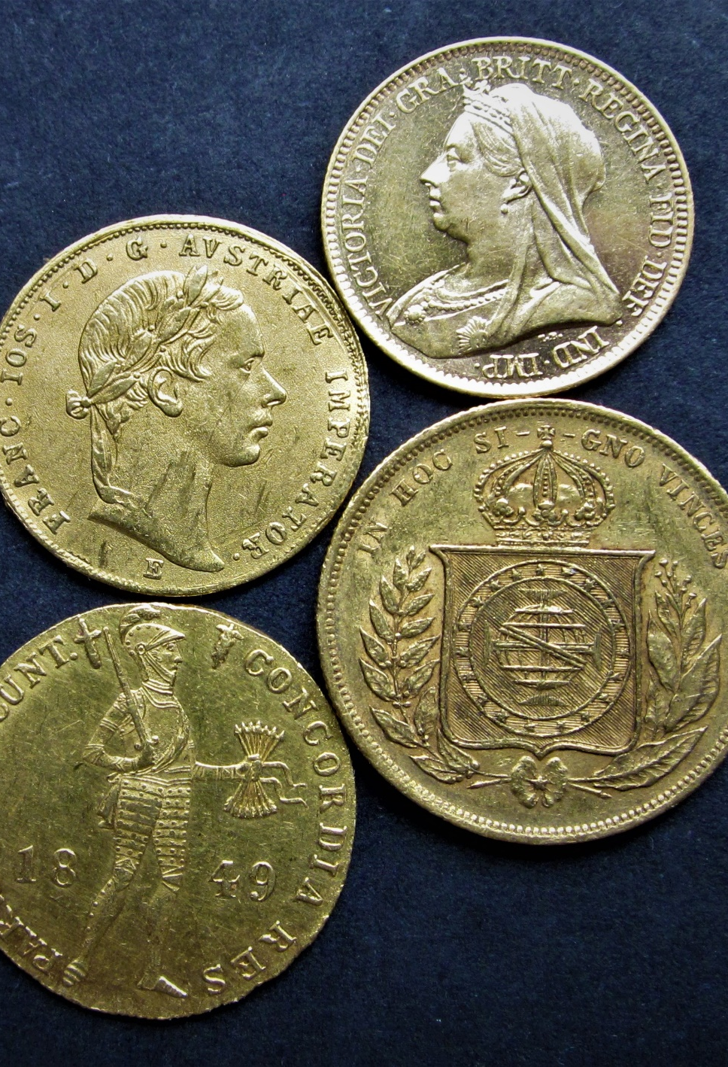
“The value of the shares relates directly to the value of the gold held by the Trust.”

Slide 24
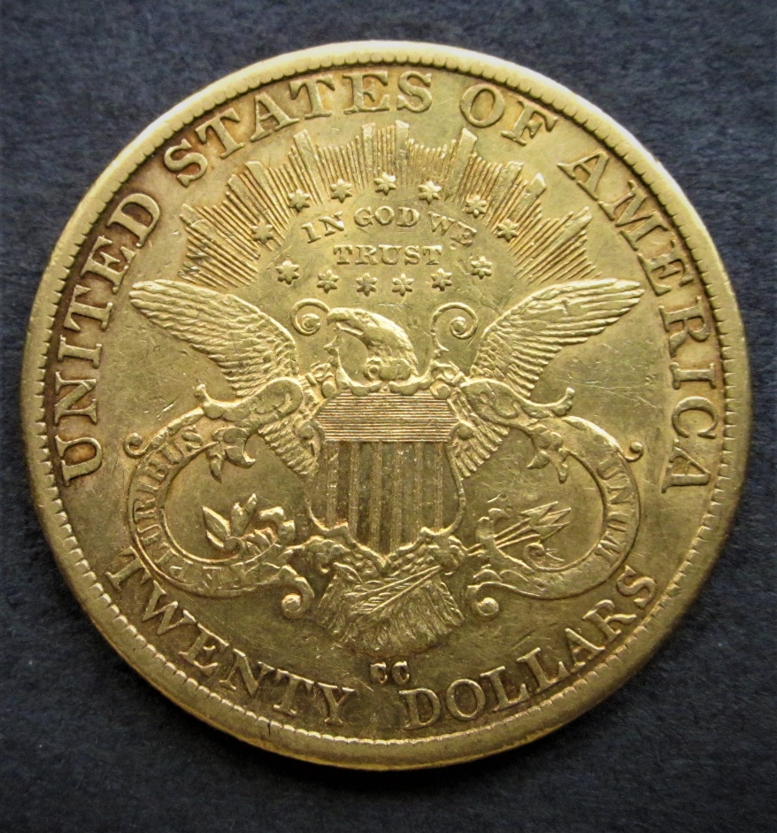
“On June 30, 2020, the Custodian held 37,902,740.8
ounces of gold…”
“…gold held in the Trust’s allocated account is the
property of the Trust and is not traded, leased, or
loaned under any circumstances.”

Slide 25
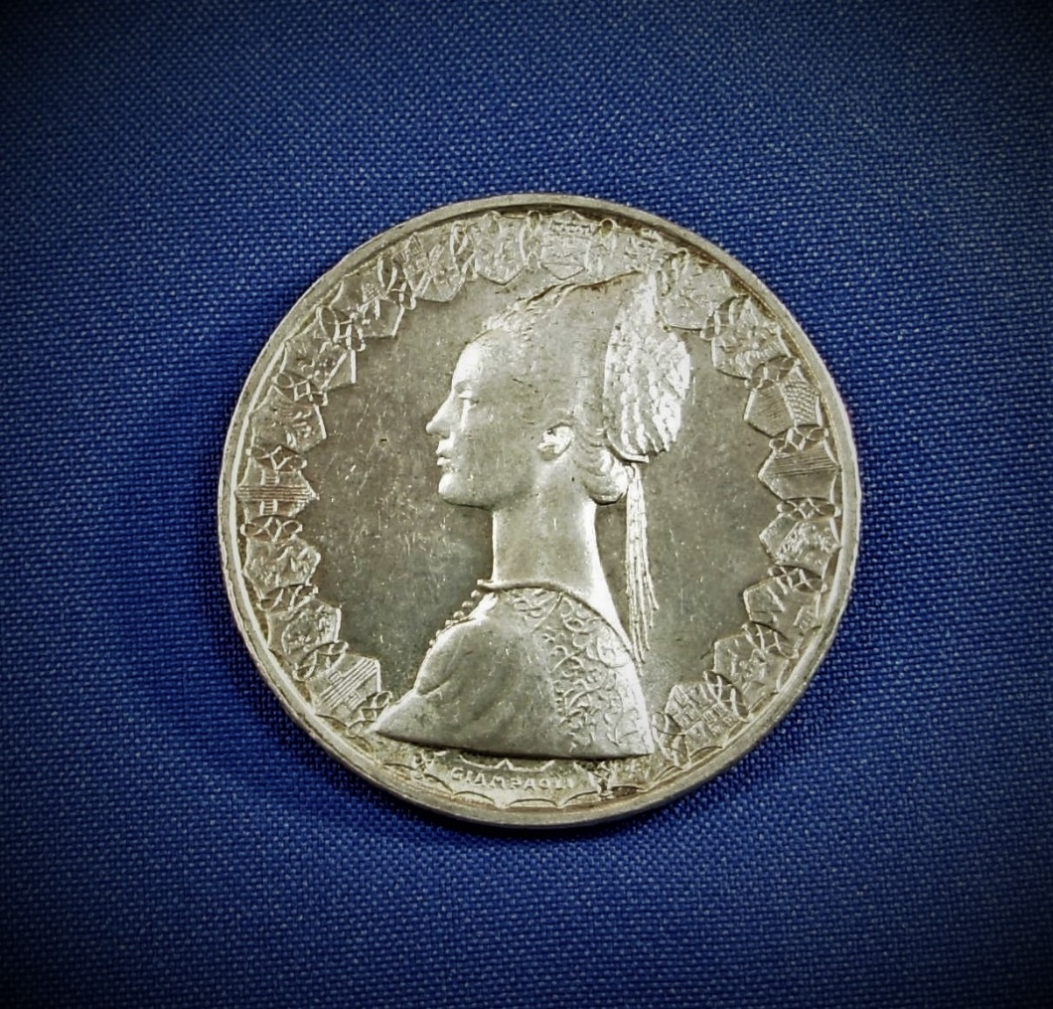
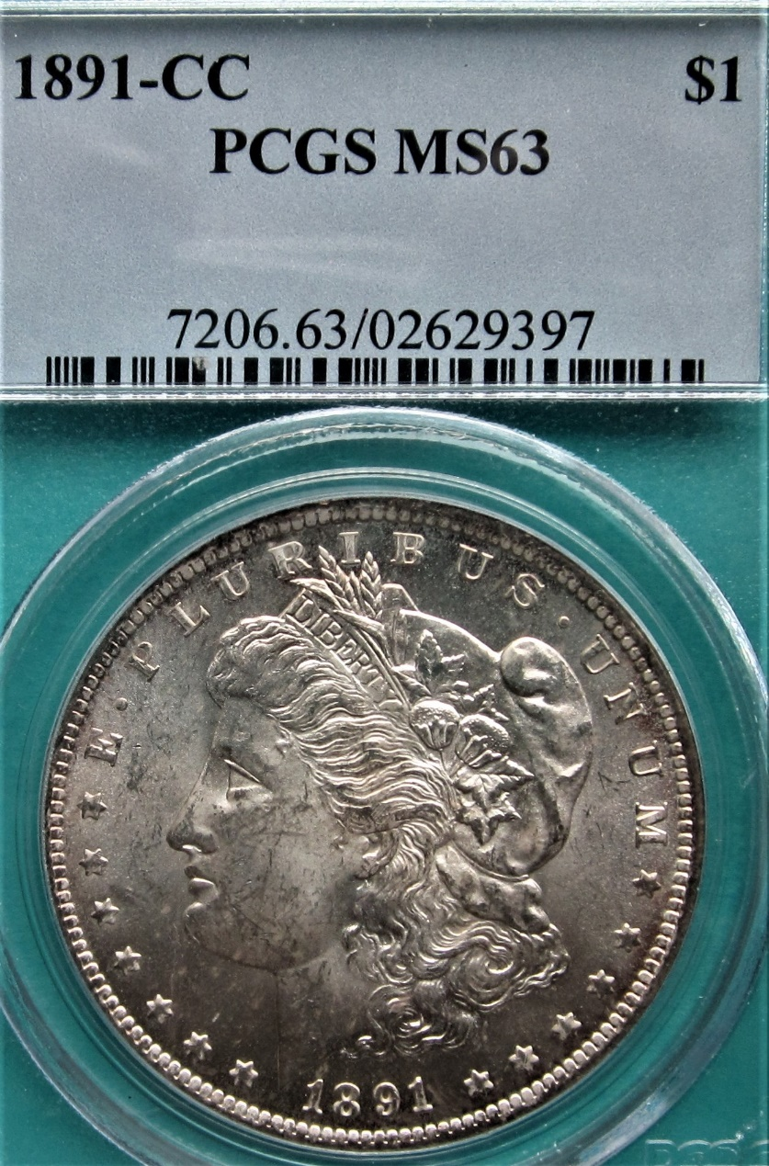
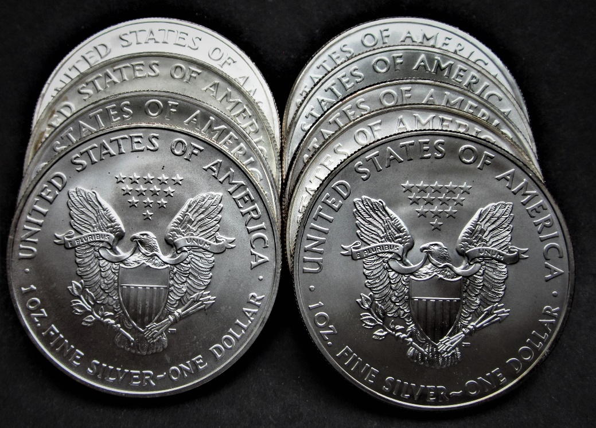
Silver Coins—Bullion and Numismatic

Slide 26
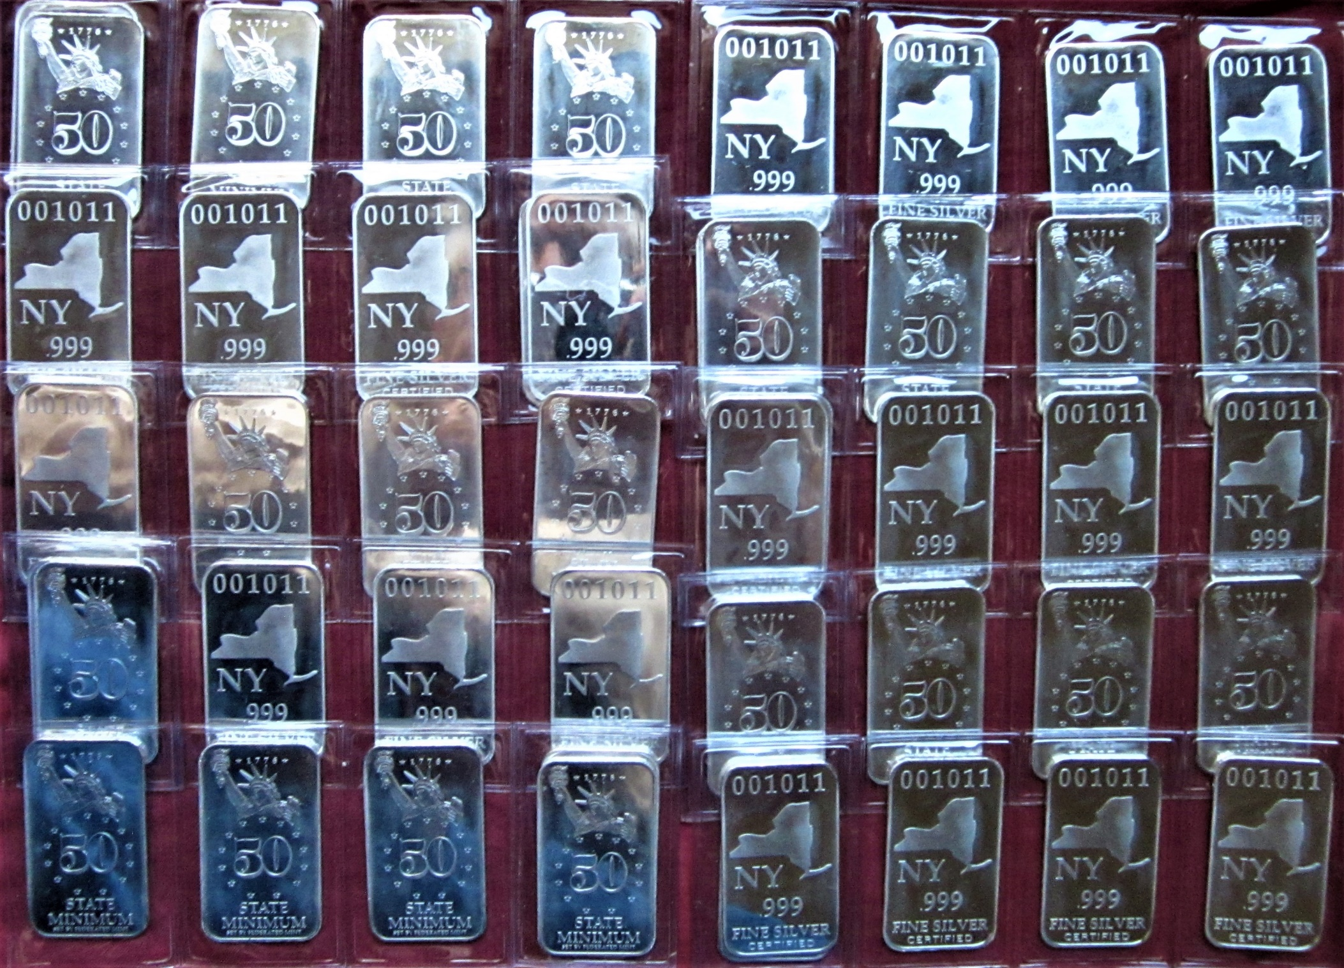
Silver
Bars

Slide 27
Safes
Advantages
Convenient
Ready access
Protection against
fire and theft
No monthly fee
Disadvantages
Expensive
Can fail
Can be forced
Hard to move
You may forget
the combination

Slide 28
VI Risks and
Disadvantages

Slide 29
Risks of investing in gold and silver
Black Swan Event—lack of access to holdings
Counterfeit coins
Transactional costs
Theft or loss
Gold and silver are passive investments;
no interest, no dividends, no income
Price decline
Fake Gold Coin

Slide 30
Silver is very bulky and heavy This two-gallon cooking pot contains 3,900 silver quarters, or $975 face value. The actual silver weight is 705 troy ounces, and the value at spot is about $17,210. The pot and its contents weigh 55 pounds.

Slide 31
VII Rewards and
Advantages

Slide 32
VIII Conclusions
High risks and benefits
Modest past success—Price goes up and down
Gaudy predictions of sky-rocketing price have not occurred
Hold a variety of metals and denominations
Buy and hold for insurance and inheritance
Numismatic holdings have done well and have other benefits and pleasures

Slide 33
The End

